Slide 1
Advanced Cryptography CS 655
Homework 2 Due Thursday @ 11:59PM on Gradescope
Project Proposals due Tonight
Week 7:
Constructing Depth-Robust Graphs
Sustained Space Complexity
Bandwidth Hard-Functions
Spring 2023

Slide 2
Course Project Proposal
Due Tonight by e-mail (jblocki@purdue.edu)
Project Proposal: 2 Pages
Briefly the problem you plan to work on
Briefly summarize prior work on the problem and how your project is different
Identify several related papers that you plan to read as part of the project
Briefly describe your plan to attack the problem

Slide 3
A Few Project Ideas
Pick a cryptographic scheme and try to find a tighter concrete security proof under idealized assumptions
Example: Tighter security analysis for Password Authenticated Key Exchange (PAKE) protocols such as CPACE in the generic group+random oracle model?
Pick a cryptographic scheme/protocol and analyze the security with respect pre-processing attacks or provide a memory-tight reduction
Example: Memory-Tight Reduction for RSA-FDH under the One-More-RSA-Inversion problem?
Example: Security of PAKE protocols against pre-processing attacks?
Example: Security of AES-GCM vs pre-processing attacks?
Pebbling Reduction for Salted iMHFs vs. Preprocessing Attackers
Pebbling Reduction for Argon2 Round Function (in ideal permutation model)

Slide 4
A Few Project Ideas
Implement a Cryptographic Protocol/Attack
Example: Implement Argon2 with different instantiations of round function
Example: Implement partitioning oracle attack on AES-GCM.
Many other possibilities! Make sure your proposal is realistic.
It is ok to try something and fail i.e., a final project report documenting your unsuccessful attempts to solve a problem is acceptable as long as the attempts are clearly described

Slide 5
Recap: iMHFs
Graph Pebbling Reduction [AS15]: Complexity of iMHF $f_{G,H}$ is fully captured by pebbling cost of DAG G.
Informal Theorem [AS15]: Any algorithm A evaluating $f_{G,H}$ in the parallel random oracle model has $CMC(A)≈λ×CC(G)$ where $H(x)∈{\left\{0,1\right\}}^{λ}$
Proof Sketch: Use execution trace from A to extract a legal pebbling of G such that for all rounds i we have $\left|P_{i}\right|≈\left|σ_{i}\right|/λ$
#pebbles at time i
#bits in A’s memory at time i

Slide 6
Recap: Depth Robustness
Definition: A DAG G=(V,E) is (e,d)-reducible if there exists $S⊆V$
s.t. $\left|S\right|≤e$ and depth(G-S) $≤d.$
Otherwise, we say that G is (e,d)-depth robust.
Example: (1,2)-reducible
1
2
3
4
5

Slide 7
Recap: Depth Robustness
Definition: A DAG G=(V,E) is (e,d)-reducible if there exists $S⊆V$
s.t. $\left|S\right|≤e$ and depth(G-S) $≤d.$
Otherwise, we say that G is (e,d)-depth robust.
Example: (1,2)-reducible
1
2
3
4
5

Slide 8
Recap: Depth-Robustness is Sufficient! [ABP17]
$Key Theorem:$Let G=(V,E) be (e,d)-depth robust then $CC$(G)$≥ed$.
Implications: There exists a constant indegree graph G with
$$CC\left(G\right)≥Ω\left(\frac{n^{2}}{\log{n}}\right).$$
[AB16]: We cannot do better (in an asymptotic sense)
$$\operatorname{CC}\left(G\right)=O\left(\frac{n^{2}\log{\log{n}}}{\log{n}}\right).$$

Slide 9
DRSample
$$B_{3}$$
$$B_{2}$$
$$B_{1}$$
…
…
…
1
2
i-8
i-5
i-4
i-3
i-2
i-1
i
n
Indegree: $δ=2$
Key Modification to Argon2i: New distribution for r(i)
Buckets:$B_{1}, …,B_{\log{i}}$
$$B_{j}=\left[i−2^{j},i−2^{j−1}−1\right]$$

Slide 10
DR-Sample: Meta-Graph
$$m=O\left(\log{n}\right)$$
…
…
…
$$G$$
1
2
n
$$m$$
2m
$$G_{m}$$
Each meta-node u corresponds to m nodes $u_{1},…,u_{m}$ .
Let $F_{u}=\left\{u_{1},…,u_{m/3}\right\}$ and $L_{u}=\left\{u_{m−\frac{m}{3}+1},…,u_{m}\right\}$ denote the first (resp. last third) of these nodes
$G_{m}$ has edge (u,v) if and only if G has some edge (x,y) with $x∈L_{u}$ and $y∈L_{u}$

Slide 11
Recap: DRSample Analysis
Let G be the DRSample graph. Define Meta-Graph $G_{m}$ with $m=Ω\left(\log{N}\right)$ and $N^{′}=Ω\left(\frac{N}{m}\right)$
Last Class: We assumed that $G_{m}$ was a $δ−$local expander and proved that any $δ−$local expander with $N^{′}=Ω\left(\frac{N}{m}\right)$ nodes is $\left(Ω\left(N′\right),Ω\left(N′\right)\right)$ depth-robust
Meta-Graph $G_{m}$ is $\left(Ω\left(\frac{N}{m}\right),Ω\left(\frac{N}{m}\right)\right)−$depth-robust with $m=Ω\left(\log{N}\right)$
DRSample G is $\left(Ω\left(\frac{N}{m}\right),Ω\left(N\right)\right)−$depth-robust
TODO: Prove that $G_{m}$ is a $δ−$local expander * (*almost)

Slide 12
$δ−$bipartite expander
$$\left|A\right|=\left|B\right|=n$$
B
A

Slide 13
$δ−$bipartite expander
$$\left|A\right|=\left|B\right|=n$$
B
$$≥δn$$
A
$$\text{X}⊆A$$

Slide 14
$δ−$bipartite expander
$$\text{Y}⊆B$$
$$<δn$$
$$\left|A\right|=\left|B\right|=n$$
$$\text{Y}⊆B$$
(unreachable from $\text{X}$)
B
$$≥δn$$
A
$$\text{X}⊆A$$

Slide 15
$\left(δ \right)$-local expander around v
We have $\left(δ\right)−local exapnsion$ if for every $r$
…
…
…
…
1
2
v-2r+1
v-r
v-r-1
v
n
$$Contains Bipartite Expander Graph$$
…
…
…
…
1
2
v
v+r-1
v+r
v+2r-1
n

Slide 16
Not $δ−$bipartite expander?
$$\text{Y}⊆B$$
$$\left|A\right|=\left|B\right|=r$$
Let A,B be a set of 2r consecutive nodes in meta-graph.
If not $δ−$bipartite then there exists $\text{Y}⊆B$ and $\text{X}⊆A$
$with size|\text{Y}\text{|}\text{=}δr \text{and} |\text{X}\text{|=}δr$ such that none of the edges from any meta-node in Y hit any node in X
$$δr$$
B
$$δr$$
A
$$\text{X}⊆A$$

Slide 17
Not $δ−$bipartite expander?
$$\text{Y}⊆B$$
Fix some subsets $|\text{Y}\text{|}\text{=}δr$ and $|\text{X}\text{|=}δr$
Each individual edge from $\text{Y}$ hits X with probability
$$≈\frac{δ}{3\log{n}}$$
There are $\frac{m}{3}×δr$ edges
(all picked independently)
$$δr$$
B
$$δr$$
A
$$\text{X}⊆A$$

Slide 18
Not $δ−$bipartite expander?
$$\text{Y}⊆B$$
Each individual edge from $\text{Y}$ hits X with probability $≈\frac{δ}{3\log{n}}$
There are $\frac{m}{3}×δr$ edges (independent)
$\operatorname{Pr}\left[Y Misses X\right]≤{\left(1−\frac{δ}{3\log{n}}\right)}^{\frac{m}{3}×δr}$
$≤e^{−rδ^{2}(\frac{m}{9\log{N}})}$
$$δr$$
B
$$δr$$
A
$$\text{X}⊆A$$

Slide 19
Not $δ−$bipartite expander?
$$\text{Y}⊆B$$
Union Bound:
$$\operatorname{Pr}\left[∃X,Y s.t.Y Misses X\right]≤e^{−rδ^{2}\left(\frac{m}{9\log{N}}\right)}{\left({r \atop δr }\right)}^{2}$$
$$≤\exp\left(z\right)$$
With
$$δr$$
B
$$δr$$
A
$$\text{X}⊆A$$
$$z=−rδ^{2}\left(\frac{m}{9\log{N}}\right)+2δr\ln\left(\frac{1}{δ}\right)+2r\ln\left(\frac{1}{1−δ}\right)$$

Slide 20
Not $δ−$bipartite expander?
Union Bound:
$$\operatorname{Pr}\left[∃X,Y s.t.Y Misses X\right]$$
$$≤\exp\left(z\right)$$
$≤\exp\left(−2r\right)$
Pick $m≥(18δ^{−1}ln\left(\frac{1}{δ}\right)+18δ^{−2}(1+\ln\left(\frac{1}{1−δ}\right)))\log{N}$
$$\text{Y}⊆B$$
$$δr$$
B
A
$$δr$$
$$\text{X}⊆A$$
$$z=−rδ^{2}\left(\frac{m}{9\log{N}}\right)+2δr\ln\left(\frac{1}{δ}\right)+2r\ln\left(\frac{1}{1−δ}\right)$$

Slide 21
Second Union Bound?
Fixing any A=[u,…,u+r-1] and B=[u+r,…,u+2r-1] we say that A,B are connected with bipartite expander with probability at least $1−\exp\left(−2r\right)$
Ideal: Want to show that $G_{m} is a δ−$local expander i.e.., this holds for all u and all r
Union bound over all meta-nodes u and all r?
We can union bound over all $r≥\log{N}$ and all u since
$$\sum_{u}{\sum_{r≥\log{N}}{\exp\left(−2r\right)}≤}N\sum_{r≥\log{N}}{\exp\left(−2r\right)}≪\frac{2}{N}$$

Slide 22
Second Union Bound?
Fix: Let $B_{u}$be the event that for some $r<\log{N}$ we do not have an expander between A=[u,…,u+r-1] and B=[u+r,…,u+2r-1]
Key Idea: Use concentration bounds to argue that $\sum_{u}{B_{u}}≤εN$ with high probability (for some suitably small $ε$)
For at least $N−εN$ meta-nodes u we do have local expansion around u.
This is sufficient to argue that meta-graph is depth-robust.

Slide 23
Second Union Bound?
Fix: Let $B_{u}$be the event that for some $r<\log{N}$ we do not have an expander between A=[u,…,u+r-1] and B=[u+r,…,u+2r-1]
Key Idea: Use concentration bounds to argue that $\sum_{u}{B_{u}}≤εN$ with high probability (for some suitably small $ε$)
Problem? $B_{u}$ and $B_{u+1}$ are not independent!
But, $B_{u}$ and $B_{v}$ are independent if $u−v≥log N$
Solution: Partition random variables into $log N$ buckets such that random variables in each bucket are independent. Apply concentration bounds to each bucket.

Slide 24
Sustained Space Complexity
Joël Alwen (IST Austria/Wickr)
Jeremiah Blocki (Purdue)
Krzysztof Pietrzak (IST Austria)

Slide 25
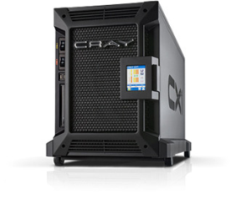
Motivation: Password Storage
jblocki, 123456
Username
jblocki
Salt
89d978034a3f6
Hash
85e23cfe0021f584e3db87aa72630a9a2345c062
SHA1(12345689d978034a3f6)=85e23cfe0021f584e3db87aa72630a9a2345c062
+
Notes:
As a motivating example consider an adversary who breaks into an authentication server and steals a users crptographic hash value. The adversary can execute an offline attack against the password by comparing the hash value with the hashes of likely password guesses. The adversary is limited only by the resources that he is willing to invest cracking the passwords.

Slide 26
Offline Attacks: A Common Problem
Password breaches at major companies have affected millions billions of user accounts.
Notes:
Unfortunately, offline dictionary attacks are quite common. Password breaches at major companies have affected millions of users.

Slide 27
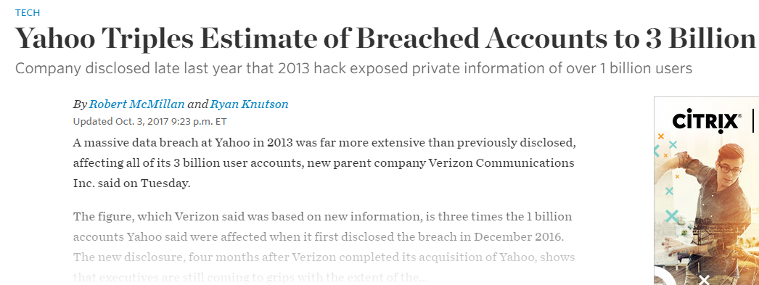
Offline Attacks: A Common Problem
Password breaches at major companies have affected millions billions of user accounts.
Notes:
Unfortunately, offline dictionary attacks are quite common. Password breaches at major companies have affected millions of users.

Slide 28
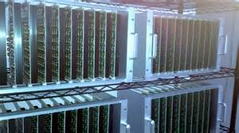
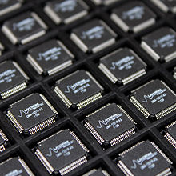
Goal: Moderately Expensive Hash Function
Fast on PC and
Expensive on ASIC?
Notes:
This motivates the need for moderately hard functions. The basic idea is to build a password hash function that is moderately expensive to compute to limit the number of guesses that an adversary would be willing to try. An honest server only needs to compute the function once during a typical authentication session. However, the adversary potentially has an advantage in this game. While the honest server must typically evaluate the function on standard hardware, the adversary could use potentially reduce the cost per password guess by developing customized hardware (GPUs, FPGAs, ASICs) to evaluate the password hash function. Thus, we want to ensure that the cost to evaluate this function is equitable across platforms.

Slide 29
(2013-2015)
https://password-hashing.net/

Slide 30
We recommend that you use Argon2…
(2013-2015)
https://password-hashing.net/

Slide 31
We recommend that you use Argon2…
There are two main versions of Argon2, Argon2i and Argon2d. Argon2i is the safest against side-channel attacks
(2013-2015)
https://password-hashing.net/

Slide 32
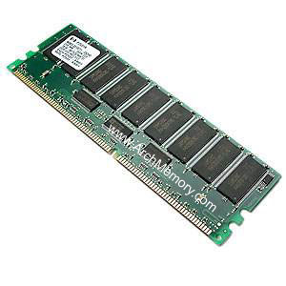
Memory Hard Function (MHF)
Intuition: computation costs dominated by memory costs
vs.
Goal: force attacker to lock up large amounts of memory for duration of computation
→Expensive even on customized hardware
Notes:
In this work we study a special type of memory hard function called data-independent memory hard functions. As the name suggests the memory access pattern will not depend on the input making the functions resistant to side-channel attacks.

Slide 33
Memory Hard Function (MHF)
Intuition: computation costs dominated by memory costs
vs.
Notes:
In this work we study a special type of memory hard function called data-independent memory hard functions. As the name suggests the memory access pattern will not depend on the input making the functions resistant to side-channel attacks.

Slide 34
Memory Hard Function (MHF)
Intuition: computation costs dominated by memory costs
vs.
Notes:
In this work we study a special type of memory hard function called data-independent memory hard functions. As the name suggests the memory access pattern will not depend on the input making the functions resistant to side-channel attacks.

Slide 35
Memory Hard Function (MHF)
Intuition: computation costs dominated by memory costs
vs.
Data Independent Memory Hard Function (iMHF)
Memory access pattern should not depend on input
Notes:
In this work we study a special type of memory hard function called data-independent memory hard functions. As the name suggests the memory access pattern will not depend on the input making the functions resistant to side-channel attacks.

Slide 36
Memory Hard Function (MHF)
Intuition: computation costs dominated by memory costs
vs.
Data Independent Memory Hard Function (iMHF)
Memory access pattern should not depend on input
Notes:
In this work we study a special type of memory hard function called data-independent memory hard functions. As the name suggests the memory access pattern will not depend on the input making the functions resistant to side-channel attacks.

Slide 37
Data-Independent Memory Hard Function (iMHF)
iMHF f_{G,H} defined by
H:$\left\{0,1\right\}2k→\left\{0,1\right\}k$ (Random Oracle)
DAG G (encodes data-dependencies)
Maximum indegree: $δ=O\left(1\right)$
Input: pwd, salt
2
4
1
Output: f_{G,H} (pwd,salt)= L₄
1
3
$$L1=H(pwd,salt)$$
$$L3=H(L2,L1)$$

Slide 38
Evaluating an iMHF (pebbling)
2
4
Output: L₄
Input:
1
1
pwd, salt
3
$$L1=H(pwd,salt)$$
$$L3=H(L2,L1)$$
Pebbling Rules : $\vec{P}$=P₁,…,P_{t}$⊂V$ s.t.
P_{i+1}$⊂\text{P}\text{i}∪\left\{x∈V | parents\left(x\right)⊂\text{P}\text{i}\text{+1}\right\}$(need dependent values)
n$∈$P_{t} (must finish and output L_{n})
Notes:
We will describe our algorithms for evaluating an iMHF using the language of graph pebbling. Placing a pebble on a node corresponds to computing the corresponding label, and keeping a pebble on the graph corresponds to storing that label in memory. Of course we can only compute a label if we have all of the dependent labels. Thus, in a legal pebbling we cannot place a pebble on a node until we have pebbles on the parents of that node. If the adversary is parallel then we are allowed to place multiple pebbles on the graph in each round. We can remove pebbles from the graph at any point in time.

Slide 39
Evaluating an iMHF (pebbling)
4
5
3
4
5
1
3
1
2

Slide 40
Evaluating an iMHF (pebbling)
1
2
3
4
5
P₁ = {1} (data value L₁ stored in memory)

Slide 41
Pebbling Example
1
2
3
4
5
P₁ = {1}
P₂ = {1,2} (data values L₁ and L₂ stored in memory)

Slide 42
Pebbling Example
1
2
3
4
5
P₁ = {1}
P₂ = {1,2}
P₃ = {3}

Slide 43
Pebbling Example
1
2
3
4
5
P₁ = {1}
P₂ = {1,2}
P₃ = {3}
P₄ = {3,4}

Slide 44
Pebbling Example
1
2
3
4
5
P₁ = {1}
P₂ = {1,2}
P₃ = {3}
P₄ = {3,4}
P₅ = {5}

Slide 45
Measuring Cost: Attempt 1
Space $×$Time (ST)-Complexity
$$ST\left(G\right)=\min_{\vec{P}}\left(t_{\vec{P}}×\max_{i≤t_{\vec{P}}}\left|P_{i}\right|\right)$$
Rich Theory
Space-time tradeoffs
But not appropriate for password hashing
ST Cost
m
space
time
t

Slide 46
Amortization and Parallelism
Problem: for parallel computation ST-complexity can scale badly in the number of evaluations of a function.
[AS15] $∃$function f_{n} (consisting of n RO calls) such that: $ST\left(f^{×\sqrt{n}}\right)=O(ST\left(f\right))$
S₃
ST₁ = S₁ × T₁ ≈ S₃ × T₃ = ST₃
S₁
space
cost of computing
f once
cost of computing
f three times
time
T₁
T₃

Slide 47
Measuring Pebbling Costs [AS15]
$$CC\left(G\right)=\min_{\vec{P}}{\sum_{i=1}^{t_{\vec{P}}}{\left|P_{i}\right|}}$$
Approximates Amortized Area x Time Complexity of iMHF
Memory Used at Step i
Cumulative Memory Cost
space
iterations

Slide 48
Measuring Pebbling Costs [AS15]
$$CC\left(G\right)=\min_{\vec{P}}{\sum_{i=1}^{t_{\vec{P}}}{\left|P_{i}\right|}}$$
[AS15] $\text{Costs}$scale linearly with #password guesses
$$CC\left(G,…,G\right)=m×CC(G)$$
Memory Used at Step i
$m$ times

Slide 49
Pebbling Example: Cumulative Cost
1
2
3
4
5
$$CC\left(G\right)≤\sum_{i=1}^{5}{\left|P_{i}\right|}$$
$$= 1+2+1+2+1$$
$= 7$
P₁ = {1}
P₂ = {1,2}
P₃ = {3}
P₄ = {3,4}
P₅ = {5}

Slide 50
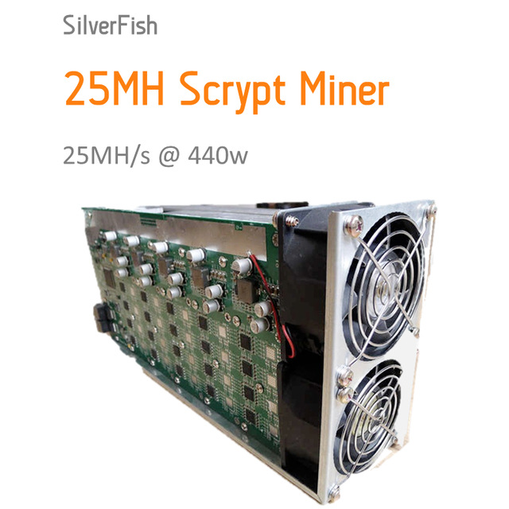
Lessons from SCRYPT
SCRYPT [Per09]
CON: Data-Dependent→ Side-Channel Concerns
PRO: Proven to have high CC [ACPRT17]
CC(SCRYPT) = $Ω\left(n^{2}\right)$
Contrast: any iMHF has CC at most $O\left(\frac{n^{2}\log{\log{n}}}{\log{n}}\right)$
Maximally Memory Hard → Egalitarian?

Slide 51
What Happened?
CC(SCRYPT) = $Ω\left(n^{2}\right)$ the function can be computed with low memory
Each strategy below is easily feasible
Evaluate with $O\left(n\right)$ memory in $O\left(n\right)$ time
Evaluate with $O\left(\sqrt{n}\right)$memory in $O\left(n\sqrt{n}\right)$ time
Evaluate with $O\left(1\right)$memory in $O\left(n^{2}\right)$ time
SCRYPT ASIC miners opt for low memory + high computation options
Goal: Ensure that low memory options are infeasible

Slide 52
Sustained Space
Using memory is more costly than doing computation (at least for ASICs).
Idea: Only charge for computational steps where a lot of memory is being used.
Definition: s-Sustained Space
“Time spent above memory threshold s”
FACT:
$$CC>st$$
s-Sustained Space
Intuition: trade-offs are free.
space
s
time

Slide 53
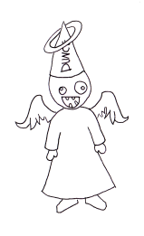
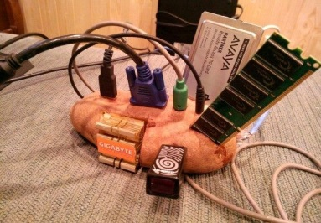
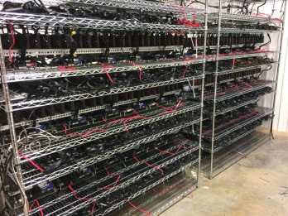
Wanted: A Moderately Hard Function
Desiderata:
Cost for honest & adversary roughly same:
Honest Computational Model
Sequential Computation
Single Evaluation
Cost measured in ST Complexity
Adversarial Model
Parallel Computation
Amortization across many evaluations
Cost measured in s-SS
(for some large s)

Slide 54
Main Theorem
For any n∊ℕ we give a function f_{n} and prove that in the parallel Random Oracle Model (PROM):
Bonus: f_{n} is an iMHF.
E runs in constant time and has data-independent memory access pattern
Honest
Sequential Algorithm E
Time(E(f_{n})) = n
ST(E(f_{n})) = n²
Adversarial
∀ parallel algs. A
s-SS(A(f_{n})) = Ω(n) per eval.
for s = Ω(n/log(n))

Slide 55
The Parallel Black Pebbling Game
Parallel Black Pebbling Game: Same as Black Pebbling, except can touch many pebbles per iteration.
s-SS analogue: Count number of steps when at least s pebbles on graph.
Goal: Place a pebble on the sink.
Rule 1: A node can be pebbled only if all parents contain a pebble.
Rule 2: A pebble can always be removed.
Want G with…
Size(G) = n
In-degree(G) = 2
$\frac{n}{log⁡(n)}$ -SS(G) = Ω(n)
G
s-SS Complexity
1-SS = 3
2-SS = 1

Slide 56
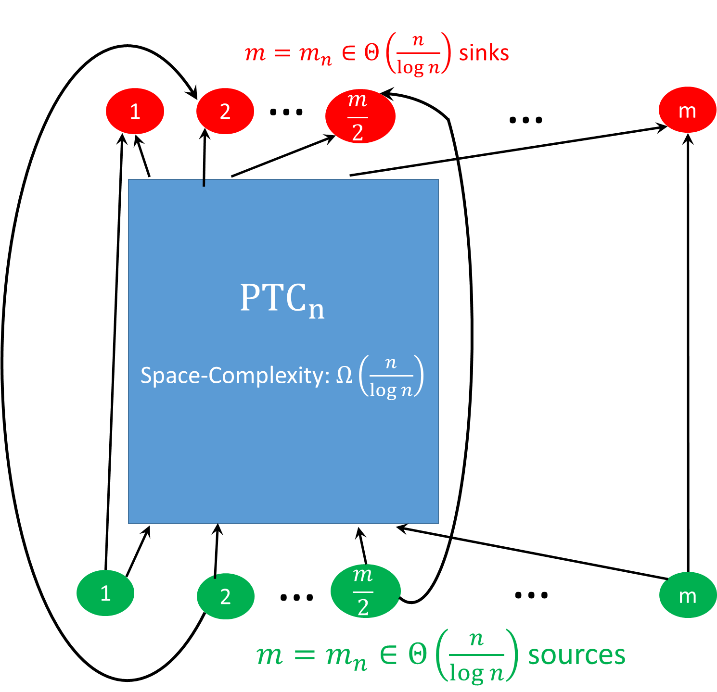
Technical Ingredient #1 [PTC77]
[PTC77] Built a constant indegree DAG G with n nodes and proves that any sequential pebbling has at least one step in which there are at least $Ω\left(n/\log{n}\right)$ pebbles on the graph.
[Hopcroft77] Any constant indegree graph DAG G can be pebbled with space at most $O\left(n/\log{n}\right)$

Slide 57
Technical Ingredient #1 [PTC77]
[PTC77] Built a constant indegree DAG G space complexity $Ω\left(n/\log{n}\right)$
Recursive Construction
PTC_{2n} contains 2 internal copies of PTC_{n}
Stronger Lemma used for Induction!
For any sequential pebbling $P_{1},…,P_{t}$
We can find an interval $\left[i,j\right]⊆[t]$ such that both
$\left|P_{k}\right|≥c_{1}m$ for each $k∈\left[i,j\right]$
At least $c_{2}m$ source nodes are (re)pebbled during the interval

Slide 58
Technical Ingredient #1 [PTC77]
[PTC77] Built a constant indegree DAG G space complexity $Ω\left(n/\log{n}\right)$
Recursive Construction
PTC_{2n} contains 2 internal copies of PTC_{n}
Stronger Lemma used for Induction!
For any parallel (sequential) pebbling $P_{t},…,P_{t}$
Can find an interval $\left[i,j\right]⊆[t]$ such that
$\left|P_{k}\right|≥c_{1}n/\log{n}$ for each $k∈\left[i,j\right]$ (lots of pebbles on the graph)
At least $c_{2}n/\log{n}$ source nodes are (re)pebbled during the interval
Implication ($s=c_{1}n/\log{n}$): s-SS(P) $≥j+1−i$
Sequential Pebbling: $j+1−i≥c_{2}n/\log{n}$ (by (2) above)
Parallel Pebbling: Could (re)pebble all $c_{2}n/\log{n}$ in one step!

Slide 59
Depth Robustness [ABP17]
Definition: A DAG G=(V,E) is (e,d)-depth-robust for all $S⊆V$
s.t. $\left|S\right|≤e$ we have $depth\left(G−S\right)>d.$
Otherwise, we say that G is (e,d)-reducible.
Example: (e=2,d=2)-reducible
1
2
3
4
5
6

Slide 60
Block Depth Robustness [ABP17]
Definition: A DAG G=(V,E) is (e,d)-depth-robust for all $S⊆V$
s.t. $\left|S\right|≤e$ we have $depth\left(G−S\right)>d.$
Otherwise, we say that G is (e,d)-reducible.
Example: (e=2,d=2)-reducible
1
2
3
4
5
6

Slide 61
Technical Ingredient #2
Definition: A DAG $G_{n}^{ε}$ is $ε$-extremely depth robust if it is (e,d)-depth-robust for all $e+d≤\left(1−ε\right)n$.
[EGS75] n node G with log(n) in-degree and (Ω(n), Ω(n))-depth-robust
Problem: Constants too small e.g., $e={10}^{−4}n$ and $d={10}^{−2}n$
Problem: in-degree too high.
[MMV13] $ε$-extremely depth robust DAG $G_{n}^{ε}$ with log²(n) in-degree and (e,d)-DR for any e+d < n(1-ε).
Problem: in-degree too high.

Slide 62
Technical Ingredient #2
Definition: A DAG $G_{n}^{ε}$ is $ε$-extremely depth robust if it is (e,d)-depth-robust for all $e+d≤\left(1−ε\right)n$.
[MMV13] $ε$-extremely depth robust DAG $G_{n}^{ε}$ with indegree $O\left(log2{n} \operatorname{polylog}\left(\log{n}\right)\right)$.
Problem: in-degree too high.
[NEW] $ε$-extremely depth robust DAG $D_{n}^{ε}$ with indegree O(log (n))
Construction: similar to [EGS75]
Many technical details to work out (see paper)

Slide 63
Technical Ingredient #2
Definition: A DAG $G_{n}^{ε}$ is $ε$-extremely depth robust if it is (e,d)-depth-robust for all $e+d≤\left(1−ε\right)n$.
[NEW] $ε$-extremely depth robust DAG $D_{n}^{ε}$with indegree O(log (n))
Construction: similar to [EGS75]
Many technical details to work out (see paper)
Useful Observation: Any subgraph of $D_{n}^{ε}[S]$ of size $\left|S\right|>εn$ must contain a path of length $\left|S\right|−εn$
Proof: Otherwise DAG${ D}_{n}^{ε}$ is not $\left(e,d\right)$-depth robust for $d=\left|S\right|−εn$ and $e=\left|V∖S\right|=n−\left|S\right|.$Contradiction, $D_{n}^{ε}$ is $ε$-extremely depth robust and
$$e+d=n−εn≤\left(1−ε\right)n.$$

Slide 64
Technical Ingredient #2
Definition: A DAG $G_{n}^{ε}$ is $ε$-extremely depth robust if it is (e,d)-depth-robust for all $e+d≤\left(1−ε\right)n$.
Lemma: If legal (parallel) pebbling P₁,…,P_{t} of $D_{n}^{ε}$ has at least one pebbling round j with space $s=\left|Pj\right|>2εn$ then there are at least $t=\frac{\left|Pj\right|}{2}−εn$ distinct time rounds k with space $\left|Pk\right|≥\frac{\left|Pj\right|}{2}$
Proof: Let i<j be last round before round j such that $\left|Pi\right|<\frac{\left|Pj\right|}{2}$and let $S=Pj∖Pi$. Any node in S is (re)pebbled during the interval [i,j].
→ (observation) the subgraph $J_{n}^{ε}[S]$ contains a path of length $t≥\frac{\left|Pj\right|}{2}−εn$
→ at least $t$ pebbling rounds to reach configuration $Pj$ from $Pi$

Slide 65
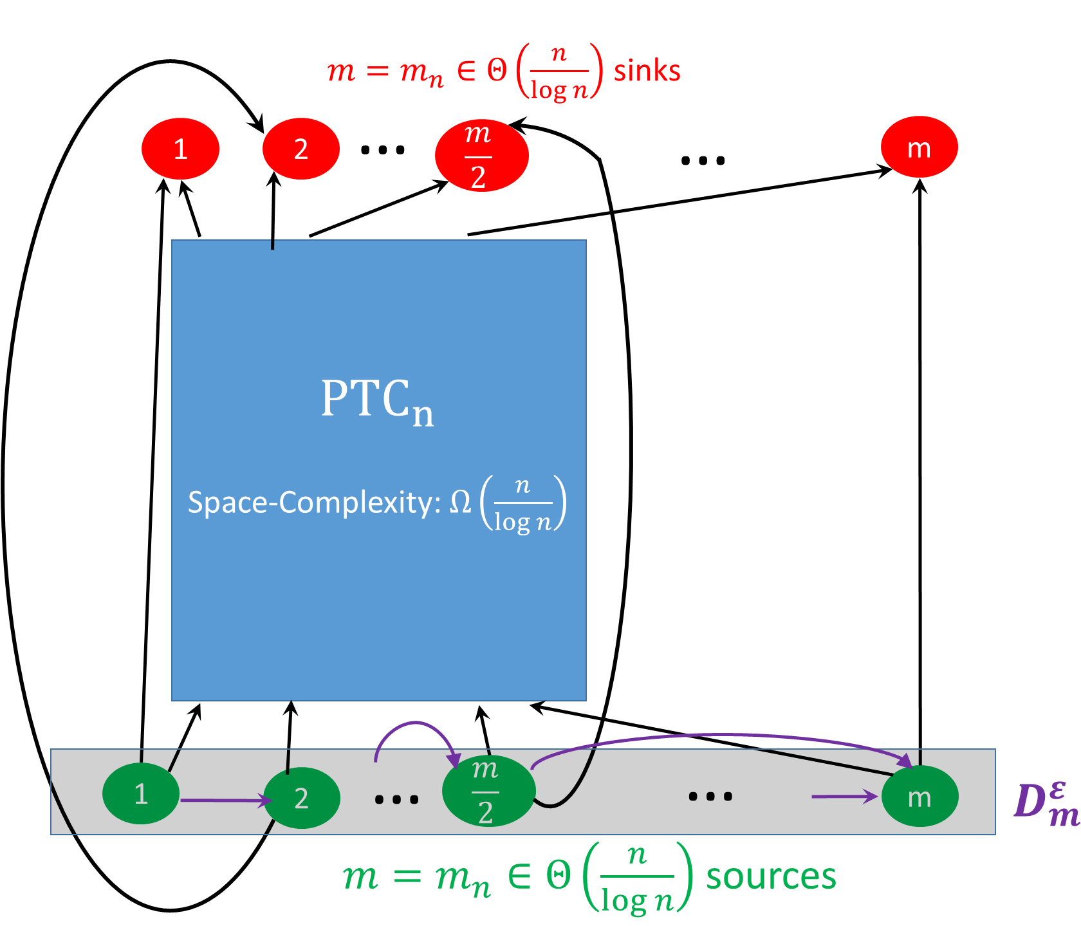
PTC Overlay (Attempt 1)
Lemma [PTC77] In any pebbling of PTC_{n} we can find an interval $\left[i,j\right]⊆[t]$ such that
$\left|P_{k}\right|≥c_{1}n/\log{n}$for each $k∈\left[i,j\right]$ (lots of pebbles on the graph)
At least $c_{2}n/\log{n}$ source nodes are (re)pebbled during the interval
[NEW] Now requires $Ω\left(m\right)$ rounds since $D_{n}^{ε}$ is $ε$-extremely depth robust

Slide 66
PTC Overlay (Attempt 1)
Lemma [PTC77] In any pebbling of PTC_{n} we can find an interval $\left[i,j\right]⊆[t]$ such that
$\left|P_{k}\right|≥c_{1}n/\log{n}$for each $k∈\left[i,j\right]$ (lots of pebbles on the graph)
At least $c_{2}n/\log{n}$ source nodes are (re)pebbled during the interval
[NEW] Overlay requires $Ω\left(m\right)$ rounds since $D_{m}^{ε}$ is $ε$-extremely depth robust
Problems:
Requires $s=Ω\left(n/\log{n}\right)$ pebbles for $t=Ω\left(n/\log{n}\right)$ rounds
I promised $s=Ω\left(n/\log{n}\right)$ pebbles for $t=Ω\left(n\right)$ rounds)
Indegree still too high i.e., $indeg\left(D_{m}^{ε}\right)=O(\log{n})$
I promised constant indegree O(1)

Slide 67
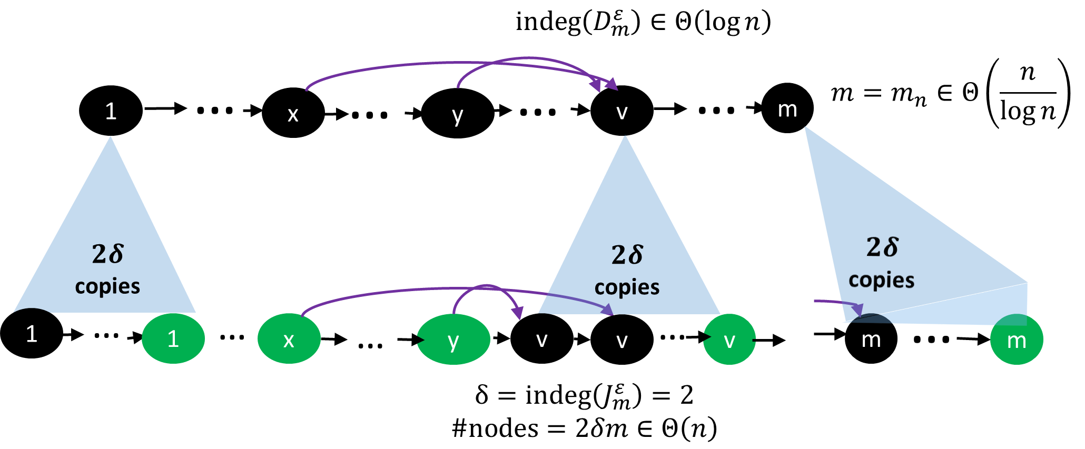
Technical Ingredient #3
Indegree Reduction [ABP17] deals with both problems simultaneously!

Slide 68
Technical Ingredient #3
Indegree Reduction [ABP17] deals with both problems simultaneously!
Lemma [ABP17]: If $D_{m}^{ε}$ is $(e,d)$-depth robust then $J_{m}^{ε}$is $(e,dδ)$-depth robust. Furthermore, $indeg\left(J_{m}^{ε}\right)=2$ and $J_{m}^{ε}$ has $2dm=O(n)$ nodes.

Slide 69
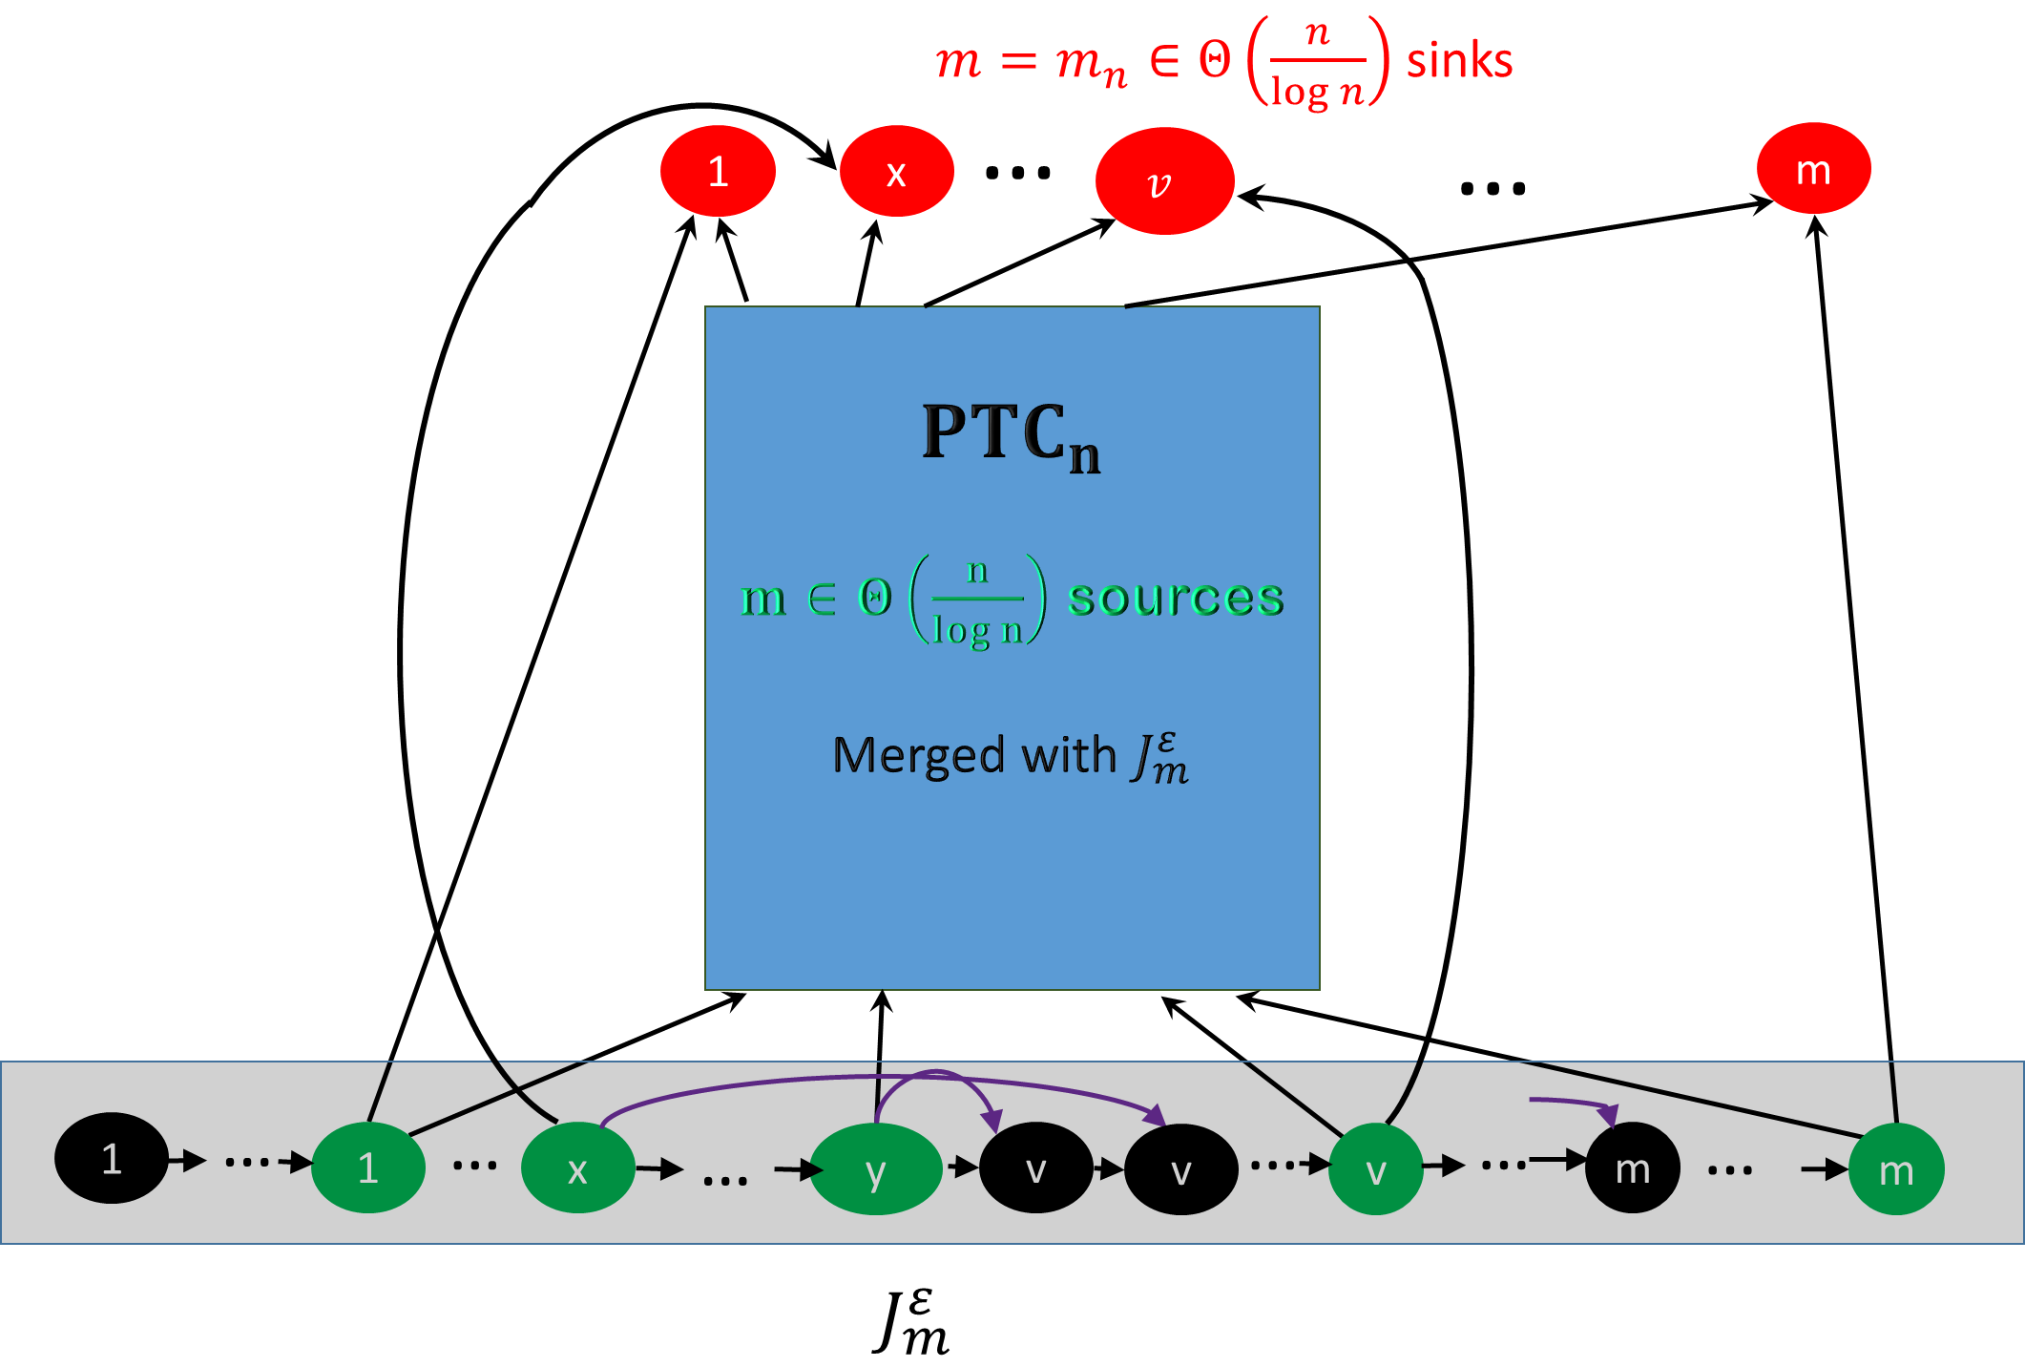
The Final Construction
Theorem: Any (parallel) pebbling requires
$s=Ω\left(n/\log{n}\right)$ pebbles for $t=Ω\left(n\right)$ rounds
Technical Details in paper

Slide 70
Consequences of new Depth-Robust Graphs
Logic: “Parallel Black-White Pebbling”
Application: CNF formulas with very memory costly refutation resolution proofs.
MHFS: Applications: Optimal CC for any graph of size n even though only O(log(n)) in-degree
$CC\left(D_{m}^{ε}\right)≥\frac{\left(1−η\right)n2}{2}$
Exact Constants!
Complete DAG: $CC\left(K_{n}^{}\right)≤\frac{n2}{2}$ (prior result is almost optimal!)
Coding Theory: better locally detectable error detection codes [BGGZ19]
Improved Proof-of-Sequential work (temporarily. See “Simple Proofs of Sequential Work” for construction without depth-robust graphs).

Slide 71
A Few Open Questions
Practical Construction of iMHF with high sustained space complexity?
Analyze/improve constant factors in bounds
Computer Aided Analysis?
Stronger Results for dMHFs? Hybrid Modes like Argon2id?
Find constant indegree DAG with parallel space-time complexity ${ST}^{||}\left(G\right)=Ω\left(n2\right)$ or show that no such DAG exists
Note: [AB16] pebbling shows that $CC\left(G\right)=O\left(\frac{n^{2}\log{\log{n}}}{\log{n}}\right)$, but the pebbling attack P still has ${ST}^{||}(P)=Ω\left(n2\right)$

Slide 72
A Few Open Questions
Practical Construction of iMHF with high sustained space complexity?
See upcoming crypto 2019 paper
Data-Independent Memory Hard Functions: New Attacks and Stronger Constructions (with Ben Harsha and Siteng Kang and Seunghoon Lee and Lu Xing and Samson Zhou).
Theorem: Any pebbling of (practical) DAG G either has
Cumulative Cost $ω\left(n^{2}\right)$, or
At least $s=Ω\left(n/\log{n}\right)$ pebbles for $t=Ω\left(n\right)$ rounds

Slide 73
Announcements & Reminders
Homework 2 Due Tonight (2/23/2023)
Midterm Next Week
Informal Poll: Take Home vs. In-Class
Course Presentation (Signup Sheet will be Announced Soon)

Slide 74
Bandwidth Hard Functions: Reductions and Lower Bounds
Jeremiah Blocki (Purdue)
Ling Ren (MIT)
Samson Zhou (Purdue)

Slide 75
Offline Attacks
jblocki, 123456
Username
jblocki
Salt
89d978034a3f6
Hash
85e23cfe0021f584e3db87aa72630a9a2345c062
HASH(12345689d978034a3f6)=85e23cfe0021f584e3db87aa72630a9a2345c062
+
Notes:
Suppose that I register for an account at playstation.com

Slide 76
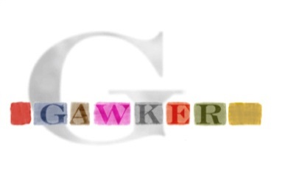
Offline Attacks: A Common Problem
Password breaches at major companies have affected millions billions of user accounts.
Notes:
Unfortunately, such breaches are increasingly commonplace and have affected billions of user accounts. Shown below is an incomplete list of major breaches and I apologize if I forgot to include your competitor.

Slide 77
Key Stretching
Hash Function | Cost: C
H
$H^{τ}$ | …
Hash Iteration
Memory Hard Functions
PBKDF2

Slide 78
Offline Attacks: A Common Problem
Password breaches at major companies have affected millions billions of user accounts.
PKKDF2-SHA256
PBKDF2-SHA256
($τ={10}^{5}$ iterations)
NIST 2017 Guidelines:$τ>{10}^{4}$
Notes:
Unfortunately, offline dictionary attacks are quite common. Password breaches at major companies have affected millions of users.

Slide 79
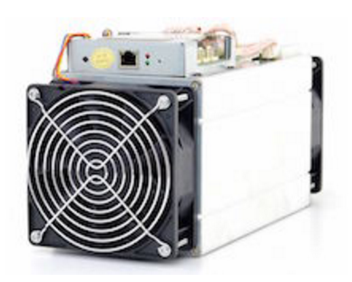
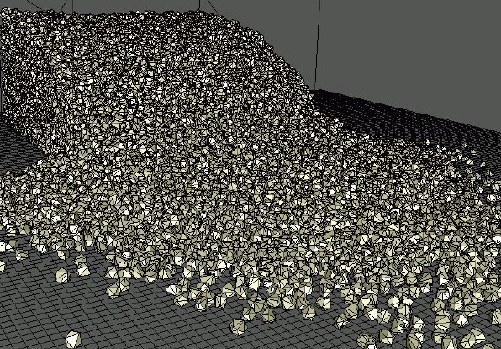
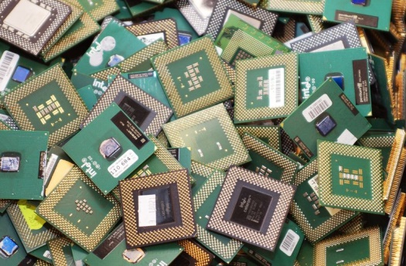
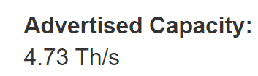
What is the ASIC Advantage?
>200,000x faster than
$$ per eval(): capital + electricity
# of lifetime eval()
Notes:
Bitcoin
CPU = 0.1 MH / J
ASIC = 4GH / J

Slide 80
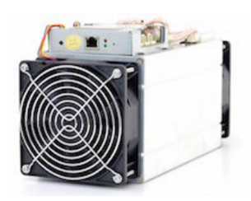
What is the ASIC Advantage?
$$ per eval(): amortized capital + electricity
Notes:
Scrypt
CPU: 40 KH/s, @ 80W, = 0.5 KH/J
ASIC 110 MH/s @ 1100W, = 100 KH/J

Slide 81
Reducing ASIC Advantage
Memory-hard functions [Percival’09 (scrypt)]:
“A natural way to reduce the advantage provided by an attacker’s ability to construct highly parallel circuits is to increase the size of the circuit.”
Size of the circuit:
dominated by memory
Reasonable approximation of amortized capital costs
81

Slide 82
Memory Hard Function (MHF)
Intuition: computation costs dominated by memory costs
vs.
Goal: force attacker to lock up large amounts of memory for duration of computation
→Expensive even on customized hardware
Notes:
In this work we study a special type of memory hard function called data-independent memory hard functions. As the name suggests the memory access pattern will not depend on the input making the functions resistant to side-channel attacks.

Slide 83
Lot’s of Work on Memory Hard Functions
[Percival’09 (scrypt)]
Password Hashing Competition
Argon2 (winner), Catena, Lyra2, yescrypt…
Data-Independent (iMHF) vs Data-Dependent (dMHF)
iMHF: harder to construct, but resistant to side-channel attacks like cache-timing
[Boneh et al.’ 16 (Balloon Hash)]
[Alwen & Serbinenko’ 15]
Definitional issue with ST-complexity (amortization of costs)
Cumulative Memory Complexity (stronger requirement to address amortization)
[Alwen & Blocki’ 16, 17]
Argon2i, Balloon Hash and other iMHFs have low cumulative memory complexity

Slide 84
Lot’s of Work on Memory Hard Functions
[Alwen & Blocki’ 16, 17]
Argon2i, Balloon Hash and other data-independent memory hard functions have low cumulative memory complexity (cmc)
[ABP17]
Theoretical construction of iMHFs with asymptotically optimal cumulative memory complexity
[ABH17]
First practical construction of iMHFs with asymptotically optimal cumulative memory complexity
[ABP18] Sustained Space Complexity

Slide 85
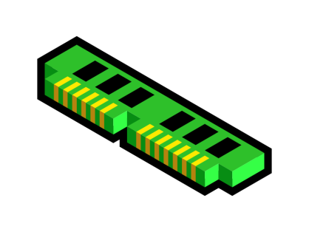
Reducing ASIC Advantage
(memory-hard)
(bandwidth-hard)
$$ per eval(): amortized capital + electricity

Slide 86
How to Define Bandwidth Hardness?
86

Slide 87
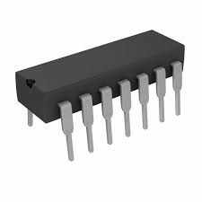
Energy Cost
Graph labeling, compute H:$\left\{0,1\right\}2w→\left\{0,1\right\}w$ in a DAG
Give the adversary a cache
Energy Cost
$$ecost\left(f_{G,H},mw\right)= C_{b}×\frac{\left(\#bits transfered to/from cache\right)}{w}+C_{r}×\left(\#evals H\right)$$
Bit in cache
H()

Slide 88
Evaluating an iMHF (red-blue pebbling)
2
N=4
Output: L_{N}
Input:
1
1
pwd, salt
3
$$L1=H(pwd,salt)$$
$$L3=H(L2,L1)$$
Pebbling: $\vec{P}$=(B₁,R₁)…, (B_{t},R_{t}) where
Set of labels stored in memory at round i: B_{i}
Set of labels stored in cache at round i: R_{i} (Cache-Size: $\left|\text{R}\text{i}\right|≤m$)
Goal: place red pebble on last node (N) in in G
Notes:
We will describe our algorithms for evaluating an iMHF using the language of graph pebbling. Placing a pebble on a node corresponds to computing the corresponding label, and keeping a pebble on the graph corresponds to storing that label in memory. Of course we can only compute a label if we have all of the dependent labels. Thus, in a legal pebbling we cannot place a pebble on a node until we have pebbles on the parents of that node. If the adversary is parallel then we are allowed to place multiple pebbles on the graph in each round. We can remove pebbles from the graph at any point in time.

Slide 89
Evaluating an iMHF (red-blue pebbling)
Pebbling: $\vec{P}=\left(B_{0}=∅,R_{0}=∅\right),\left(B_{1},R_{1}\right),…,\left(B_{t},R_{t}\right)$
B_{i} set of labels stored in memory at time i
R_{i} set of labels stored in cache at time i. (Cache-Size: $\left|\text{R}\text{i}\right|≤m$)
Legal Pebbling Moves between Rounds:
[Blue Move] Change the color of a pebble (cache-miss: store/load value from memory)
[Red Move] Place new red pebble on node v if $parents\left(v\right)⊂\text{R}\text{i}$
[Discard Pebble] May discard pebble(s) at any time.
Notes:
We will describe our algorithms for evaluating an iMHF using the language of graph pebbling. Placing a pebble on a node corresponds to computing the corresponding label, and keeping a pebble on the graph corresponds to storing that label in memory. Of course we can only compute a label if we have all of the dependent labels. Thus, in a legal pebbling we cannot place a pebble on a node until we have pebbles on the parents of that node. If the adversary is parallel then we are allowed to place multiple pebbles on the graph in each round. We can remove pebbles from the graph at any point in time.

Slide 90
Red-Blue Pebbling Cost [RD17]
$$rbpeb\left(P\right)= C_{b}×\left(\#Blue Moves in P\right)+C_{r}×\left(\#Red Moves in P\right)$$
$$rbpeb\left(G,m\right)=\min_{P∈ℛℬ (G,m)}{rbpeb\left(P\right)}$$
Set of all legal red-blue pebblings of DAG G
with cache-size m.
Notes:
Red moves are much cheaper for the attacker. Because the attacker has different costs for red/blue moves then the honest party an attacker might choose to select a different pebbling strategy.

Slide 91
Red-Blue Pebbling Cost Inequity [RD17]
Honest Party (CPU):
$$rbpeb\left(P\right)= C_{b}×\left(\#Blue Moves in P\right)+C_{r}×\left(\#Red Moves in P\right)$$
Attacker (ASIC):
$$rbpeb′\left(P′\right)=C_{b}^{′}×\left(\#Blue Moves in P′\right)+{ C}_{r}^{′} ×\left(\#Red Moves in P′\right)$$
Attacker gets to play with potentially advantageous constants
$$\text{1}\text{nJ}≈C_{b}^{′}≈ C_{b}≈C_{r}≈{10}^{−3}×{ C}_{r}^{′}$$
$≈1pJ ({ C}_{r}^{′}≪C_{r}$)
Notes:
Red moves are much cheaper for the attacker. Because the attacker has different costs for red/blue moves then the honest party an attacker might choose to select a different pebbling strategy.

Slide 92
Red-Blue Pebbling Cost Inequity [RD17]
Honest Party (CPU):
$$rbpeb\left(P\right)= C_{b}×\left(\#Blue Moves in P\right)+C_{r}×\left(\#Red Moves in P\right)$$
Attacker (ASIC):
$$rbpeb′\left(P′\right)=C_{b}^{′}×\left(\#Blue Moves in P′\right)+{ C}_{r}^{′} ×\left(\#Red Moves in P′\right)$$
Attacker gets to play with potentially advantageous constants
${ C}_{r}^{′}≪C_{r}$ $C_{b}^{′}=Θ\left(C_{b}\right)$
How can I make sure that the function is energy intensive for the attacker as well?
Notes:
Red moves are much cheaper for the attacker. Because the attacker has different costs for red/blue moves then the honest party an attacker might choose to select a different pebbling strategy.

Slide 93
A Natural Approach
[Abadi et al.’05]
[Dwork et al.’03]
An iMHF f_{G,H} is memory-bound if:
Computable with at most B cache misses (resp. blue moves)
Not computable with < cB cache misses (resp. blue moves) even using a cache of size M
(definition for dMHFs is similar, but does not involve pebbling)
Problem: Hard to construct; must rule out all space-time tradeoffs
Theorem[Hopcroft’77]: If G has constant indegree then there is a black pebbling which never requires more than S = O(N/log(N)) pebbles.
Corollary: If M= O(N/log(N)) we need 0 blue-moves

Slide 94
Bandwidth-hard functions [RD17]
Observation: computation is not free (even for attacker)!
Allows for slight relaxation of goal
Definition: An iMHF f_{G,H} is bandwidth hard against attacker with cache-size m if
$$\frac{rbpeb\left(G,m\right)}{rbpeb′\left(G,m\right)}=Θ\left(1\right)$$
Sufficient Condition: $rbpeb\left(G,m\right)=Ω\left(N×C_{b}\right)$
Best Red-Blue Pebbling for Honest Party
Best Red-Blue Pebbling for ASIC attacker

Slide 95
Prior State of Affairs (Bandwidth-Hardness)
Prior Results [RD17]:
Proved that DAGs for several key iMHFs satisfy
$$rbpeb\left(G,m\right)=Ω\left(N×C_{b}\right) (1)$$
Catena-BRG
Balloon Hash
Proved that dMHF scrypt is bandwidth-hard *
*vs restricted class of attackers
Key Open Questions:
Pebbling Reduction? Is it true that any algorithm A computing f_{G,H} in the random oracle model can be described as a red-blue pebbling strategy?
(Thm: [AS15] holds for black pebblings)
Does equation (1) hold for
Argon2i? (PHC Winner)
DRSample? (Maximal CMC [ABH17])
aATSample? (Maximal CMC [ABH17])

Slide 96
Pebbling Reduction [BRZ18]
Pebbling Reduction: Any algorithm A computing $f_{G,H}$ in the random oracle model can be described as a red-blue pebbling strategy with comparable cost.
$$ecost\left(f_{G,H},m×w\right)≥Ω\left(rbpeb\left(G,8m\right)\right)$$
Argon2i: $ecost\left(G, \tilde{O}\left(N^{2/3}\right)\right)=Ω\left(N×C_{b}\right)$
DRSample: $ecost\left(G, O\left(N^{1−ε}\right)\right)=Ω\left(N×C_{b}\right)$
aATSample: $ecost\left(G,\tilde{O}\left(N\right)\right)=Ω\left(N×C_{b}\right)$
Arguably a reasonable upper bound on cache-size
Typical $N=2^{20}$ (1KB Blocks) = (1GB RAM)
$N=2^{40/3}$ (1KB Blocks) = (10MB cache)
Tolerates Larger Cache-Size

Slide 97
Additional Results [BRZ18]
Computational Complexity: NP-Hard to find $ecost\left(G\right).$
(Open Question: Approximate $ecost\left(G\right)$?)
Tight Relationship between parallel and sequential pebblings:
$${rbpeb\left(G,2m\right)≤rbpeb}^{∥}\left(G, m\right)$$
(this relationship does not hold for black pebblings!)
Generic Connection Between Memory Hardness and Bandwidth Hardness: Any MHF f(.) with high cumulative memory complexity must have reasonably high energy cost.

Slide 98
Additional Results [BRZ18]
Generic Connection Between Memory Hardness and Bandwidth Hardness: Any MHF f(.) with high cumulative memory complexity must have reasonably high energy cost.
$$ecost\left(f, mw\right) ≥Ω\left(\min_{t}\left(t{ C}_{r}+C_{b}\left(\frac{cmc\left(f\right)}{tw}−m\right)\right)\right)$$
Theorem [ABPRT17]: $cmc\left(scrypt\right)=Ω\left(N^{2}\right)$
Corollary: $ecost\left(scrypt\right)=Ω\left(N\sqrt{C_{r}×C_{b}}\right)$
(first unconditional lower bound on energy cost of scrypt)

Slide 99
Bonus: More Contributions
$$ecost\left(f, mw\right) ≥Ω\left(\min_{t}\left(t{ C}_{r}+C_{b}\left(\frac{cmc\left(f\right)}{tw}−m\right)\right)\right)$$
Theorem [ABPRT17]: $cmc\left(scrypt\right)=Ω\left(N^{2}\right)$
Corollary: $ecost\left(scrypt\right)=Ω\left(N\sqrt{C_{r}×C_{b}}\right)$
(first unconditional lower bound on energy cost of scrypt)
Comparison: [RD17] lower bound is slightly stronger $Ω\left(N×C_{b}\right)$ for restricted adversary class.
Recent: Unconditional proof that $ecost\left(scrypt\right)=Ω\left(N×C_{b}\right)$

Slide 100
Pebbling Reduction
Goal: Compute $f_{G,H}$
minimize
$$ecost\left(f_{G,H},mw\right)$$
Goal: Pebble G
minimize
$rbpeb\left(G,m\right)$
H()
2
N=4
1
1
3

Slide 101
Pebbling Reduction
Goal: Compute $f_{G,H}$
minimize
$$ecost\left(f_{G,H},mw\right)$$
Goal: Pebble G
minimize
$rbpeb\left(G,m\right)$
H()
2
N=4
1
1
Easy Direction
3

Slide 102
Pebbling Reduction
Goal: Compute $f_{G,H}$
minimize
$$ecost\left(f_{G,H},mw\right)$$
Goal: Pebble G
minimize
$rbpeb\left(G,O(m)\right)$
H()
2
N=4
1
1
Extractor Argument
(can’t compress
labels from RO)
3

Slide 103
Pebbling Reduction
Goal: Pebble G
minimize
$rbpeb\left(G,O(m)\right)$
Prior pebbling reduction implies that total number of pebbles on graph (red or blue) is proportional to overall state size (cache+RAM)
Challenge: Ex-post facto pebbling only gives us black pebbling P₁,…,P_{t}.
Which pebbles should we color blue/red in each round?
We cannot directly see what labels are transferred to/from cache (the labels might be stored in encrypted form!)
Recall: In ex-post facto pebbling P_{i} denotes labels that appear “out of the blue” in our simulation i.e., the next time these labels appear will be as the input to a random oracle query.

Slide 104
Pebbling Reduction
Goal: Pebble G
minimize
$rbpeb\left(G,O(m)\right)$
Prior pebbling reduction implies that total number of pebbles on graph (red or blue) is proportional to overall state size (cache+RAM)
Challenge: Ex-post facto pebbling only gives us black pebbling P₁,…,P_{t}.
Recall: In ex-post facto pebbling P_{i} denotes labels that appear “out of the blue” in our simulation i.e., the next time these labels appear will be as the input to a random oracle query.
Intuition: We expect that at least |P_{i}|-m of the labels in P_{i} will have to be transferred from cache in the future at cost (|P_{i}|-m)$C_{b}$.

Slide 105
Pebbling Reduction
Goal: Pebble G
minimize
$rbpeb\left(G,O(m)\right)$
Challenge: Ex-post facto pebbling only gives us black pebbling P₁,…,P_{t}.
Recall: In ex-post facto pebbling P_{i} denotes labels that appear “out of the blue” in our simulation i.e., the next time these labels appear will be as the input to a random oracle query.
Intuition: We expect that at least |P_{i}|-m of the labels in P_{i} will have to be transferred from cache in the future incurring cost (|P_{i}|-m)$C_{b}$.
Suppose Not: If fewer than (|P_{i}|-m)$C_{b}/2$ bits are transferred to/from cache after round i then extractor hint would include
Cache State at round i (mw) bits
Bits transferered between cache/memory ((|P_{i}|-m)$C_{b}/2$ bits)
Additional information to extract labels ($≪$(|P_{i}|-m)$C_{b}/2$ bits)
➔ Contradiction! We would extract a random |P_{i}|w-bit string with a much shorter hint

Slide 106
Pebbling Reduction Challenges
Extractor:
Goal: output (x_{i},H(x_{i})) for as many points x_{i} as possible (without actually querying H(x_{i}))
Given a hint h, initial state etc…
Simulates PROM attacker A with initial state $\left(ξ_{0},σ_{0}\right)$ encoding contents of cache and memory.
Theorem[DKW11]: If probability extractor successfully output k points is $p>2^{−y}$ then
$$\left|h\right|≥kw−y$$
Challenge: A might stores labels in encrypted form
Monitor A’s queries to H(.)
Queries contain decrypted labels
[AS15] Can infer what labels were stored in memory somewhere and extract legal black pebbling
Monitor bits transferred to/from cache?
Might be encrypted ☹

Slide 107
Pebbling Reduction
Key Definition: QueryFirst(t₁,t₂)
Data-labels $Lv$ that appear “out of the blue” as input to RO query before output during rounds [t₁, t₂]
Dependent on execution trace of attacker.
Partition time into intervals [t₁, t₂], [1+t₂, t₃]… s.t
4m > |QueryFirst(t_{i},t_{i+1})| > 3m
Claim 1: Attacker must transfer at least mw bits to/from cache during each interval [1+t_{i},t_{i+1}]
Claim 2: Can find legal red-blue pebbling in which
The number of blue moves during each interval [1+t_{i},t_{i+1}] is at most 4m
We never use more than 8m red pebbles.

Slide 108
Pebbling Reduction
Claim 1: Attacker must transfer at least mw bits to/from cache during each interval [1+t_{i},t_{i+1}]
Proof Sketch: Suppose not then we could use an extractor to extract 3m labels with a hint of size
$$(\left|h\right|−2mw)≪3mw$$
The odds of this happening are negligible!
Extractor Hint:
State $σ_{{1+t}_{i}}$ of PROM attacker cache A at time 1+t_{i}
ignore memory $\left(ξ_{{1+t}_{i}} \right)$
At most mw bits
List of messages passed to/from cache during interval [1+t_{i},t_{i+1}]
At most mw bits
List of labels in QueryFirst(t_{i},t_{i+1}) to extract (plus information to recognize relevant queries)
$O\left(m \left(\log{(n+q)}\right)\right)≪mw$

Slide 109
Extractor for Pebbling Reduction
Given state of cache $σ_{{1+t}_{i}}$ and list of messages passed to/from memory we can simulate the attacker.
When the attacker submits the i^{th} random oracle query
Check hint to see the i^{th} query x is of interest
Otherwise forward query to random oracle and forward the response to the attacker
Label appears “out of the blue”
Making the query “ruins” label $Lv$ we want to extract
$Lv=H(v,L_{v−1},L_{r(V)})$
How to identify such a query?
Rely on hint.
How to continue simulation without making the RO query?
$Lv$ previously appeared out of the blue.
Thus, extractor can simply send the response $Lv$

Slide 110
Bandwidth Hardness of Candidate iMHFs
Key Pebbling Lemma: Lower bounds $rbpeb\left(G,m,T,B,R\right)$ cost to pebble target nodes $T$ $⊆[N]$ starting from configuration with
Blue Pebbles on $B ⊆[N]\backslash T$
Red Pebbles on $R⊆[N]\backslash T$
Let $B′ ⊆B$ be blue moves that are eventually converted to red pebbles.
$$rbpeb\left(G,m,T,B,R\right)≥C_{b}\left|B′\right|$$
$$rbpeb\left(G,m,T,B,R\right)≥C_{r}\left|{ancestors}_{G−R∪B′}\left(T\right)\right|$$
Intuition: If there is a path from v to T which avoids the set $R∪B′$ then node v must be pebbled at some point at cost $C_{r}$.

Slide 111
Bandwidth Hardness of Candidate iMHFs
Key Lemma (central to all proofs)
Lower bounds $rbpeb\left(G,m,T,B,R\right)$ cost to pebble target nodes $T$ $⊆[N]$ starting from configuration with
Blue Pebbles on $B ⊆[N]\backslash T$
Red Pebbles on $R⊆[N]\backslash T$
Let $B′ ⊆B$ be blue moves that are eventually converted to red pebbles.
Lemma: $∀T,B,R⊆[N]\backslash T$
$$rbpeb\left(G,m,T,B,R\right)≥\min_{B′ ⊆B}\left(C_{r}\left|{ancestors}_{G−R∪B′}\left(T\right)\right|+C_{b}\left|B′\right|\right)$$

Slide 112
Bandwidth Hardness of Candidate iMHFs
Lemma: $∀T,B,R⊆[N]\backslash T$
$$rbpeb\left(G,m,T,B,R\right)≥\min_{B′ ⊆B}\left(C_{r}\left|{ancestors}_{G−R∪B′}\left(T\right)\right|+C_{b}\left|B′\right|\right)$$
Partition the nodes $[N]\backslash \left[\frac{N}{2}\right]$ into $Ω\left(\frac{N}{m}\right)$ intervals $T_{1},T_{2},…,$ each containing $Ω\left(m\right)$ nodes.
$$rbpeb\left(G,m \right)≥\sum_{i≥1}{\min_{\begin{aligned}B,R⊆[N]\backslash T_{i} \\ s.t. \left|R\right|≤m\end{aligned}}}\left(rbpeb\left(G,m,T_{i},B,R\right)\right)$$
$$T_{1}$$
$$T_{2}$$
$$T_{3}$$
$$…$$
$$1$$
$$B$$
$$\left|R\right|≤m$$
$$N$$
$$\frac{N}{2}$$
$Ω\left(m\right)$ nodes

Slide 113
Bandwidth Hardness of Candidate iMHFs
Lemma: $∀T,B,R⊆[N]\backslash T$
$$rbpeb\left(G,m,T,B,R\right)≥\min_{B′ ⊆B}\left(C_{r}\left|{ancestors}_{G−R∪B′}\left(T\right)\right|+C_{b}\left|B′\right|\right)$$
Partition the nodes $[N]\backslash \left[\frac{N}{2}\right]$ into $Ω\left(\frac{N}{m}\right)$ intervals $T_{1},T_{2},…,$ each containing $Ω\left(m\right)$ nodes.
$$rbpeb\left(G,m \right)≥\sum_{i≥1}{\min_{\begin{aligned}B,R⊆[N]\backslash T_{i} \\ s.t. \left|R\right|≤m\end{aligned}}}\left(rbpeb\left(G,m,T_{i},B,R\right)\right)$$
$$≥\sum_{i≥1}{\min_{\begin{aligned}B,R⊆[N]\backslash T_{i} \\ s.t. \left|R\right|≤m\end{aligned}}}\left(\min_{B′ ⊆B}\left(C_{r}\left|{ancestors}_{G−R∪B′}\left(T_{i}\right)\right|+C_{b}\left|B′\right|\right)\right)$$
We lower bound this quantity for three iMHF candidates Argon2i, DRSample and aATSample

Slide 114
Bandwidth Hardness of Candidate iMHFs
Theorem: $[N]\backslash \left[\frac{N}{2}\right]$ into $Ω\left(\frac{N}{m}\right)$ intervals $T_{1},T_{2},…,$ each containing $Ω\left(m\right)$ nodes then $rbpeb\left(G,m \right)≥$
$$\sum_{i≥1}{\min_{\begin{aligned}B,R⊆[N]\backslash T_{i} \\ s.t. \left|R\right|≤m\end{aligned}}}\left(\min_{B′ ⊆B}\left(C_{r}\left|{ancestors}_{G−R∪B′}\left(T_{i}\right)\right|+C_{b}\left|B′\right|\right)\right)$$
Argon2i if $m=O\left(N^{\frac{2}{3}−ε}\right)$ then for each interval $T_{i}$ of $Ω\left(m\right)$ nodes we have
$$\min_{\begin{aligned}B,R⊆[N]\backslash T_{i} \\ s.t. \left|R\right|≤m\end{aligned}}\left(\min_{B′ ⊆B}\left(C_{r}\left|{ancestors}_{G−R∪B′}\left(T\right)\right|+C_{b}\left|B′\right|\right)\right)=Ω\left(min\left\{N C_{r},N^{\frac{2}{3}}C_{b}\right\}\right)$$

Slide 115
Bandwidth Hardness of Candidate iMHFs
Theorem: $[N]\backslash \left[\frac{N}{2}\right]$ into $Ω\left(\frac{N}{m}\right)$ intervals $T_{1},T_{2},…,$ each containing $Ω\left(m\right)$ nodes then $rbpeb\left(G,m \right)≥$
$$\sum_{i≥1}{\min_{\begin{aligned}B,R⊆[N]\backslash T_{i} \\ s.t. \left|R\right|≤m\end{aligned}}}\left(\min_{B′ ⊆B}\left(C_{r}\left|{ancestors}_{G−R∪B′}\left(T\right)\right|+C_{b}\left|B′\right|\right)\right)$$
Argon2i if $m=O\left(N^{\frac{2}{3}−ε}\right)$ then for each interval $T_{i}$ of $Ω\left(m\right)$ nodes we have
$$\min_{\begin{aligned}B,R⊆[N]\backslash T_{i} \\ s.t. \left|R\right|≤m\end{aligned}}\left(\min_{B′ ⊆B}\left(C_{r}\left|{ancestors}_{G−R∪B′}\left(T\right)\right|+C_{b}\left|B′\right|\right)\right)=Ω\left(min\left\{N C_{r},N^{\frac{2}{3}}C_{b}\right\}\right)$$
Amortized: $Ω\left(1\right)$ blue moves per node in interval (best possible)

Slide 116
Bandwidth Hardness of Candidate iMHFs
Theorem: $[N]\backslash \left[\frac{N}{2}\right]$ into $Ω\left(\frac{N}{m}\right)$ intervals $T_{1},T_{2},…,$ each containing $Ω\left(m\right)$ nodes then $rbpeb\left(G,m \right)≥$
$$\sum_{i≥1}{\min_{\begin{aligned}B,R⊆[N]\backslash T_{i} \\ s.t. \left|R\right|≤m\end{aligned}}}\left(\min_{B′ ⊆B}\left(C_{r}\left|{ancestors}_{G−R∪B′}\left(T\right)\right|+C_{b}\left|B′\right|\right)\right)$$
Argon2i if $m=O\left(N^{\frac{2}{3}−ε}\right)$ then for each interval $T_{i}$ of $Ω\left(m\right)$ nodes we have
$$\min_{\begin{aligned}B,R⊆[N]\backslash T_{i} \\ s.t. \left|R\right|≤m\end{aligned}}\left(\min_{B′ ⊆B}\left(C_{r}\left|{ancestors}_{G−R∪B′}\left(T_{i}\right)\right|+C_{b}\left|B′\right|\right)\right)=Ω\left(min\left\{N C_{r},N^{\frac{2}{3}}C_{b}\right\}\right)$$
Amortized: $Ω\left(N^{\frac{1}{3}}\right)$ red moves per node in interval (expensive even if $C_{r}≪ C_{b}$

Slide 117
Bandwidth Hardness of Candidate iMHFs
Argon2i
$$\min_{\begin{aligned}B,R⊆[N]\backslash T_{i} \\ s.t. \left|R\right|≤m\end{aligned}}\left(\min_{B′ ⊆B}\left(C_{r}\left|{ancestors}_{G−R∪B′}\left(T_{i}\right)\right|+C_{b}\left|B′\right|\right)\right)=Ω\left(min\left\{N C_{r},N^{\frac{2}{3}}C_{b}\right\}\right)$$
We must pay this cost $Ω\left(\frac{N}{m}\right)$ times for each interval $T_{i}$
$$rbpeb\left(G,N^{\frac{2}{3}−ε}\right)=Ω\left(min\left\{N^{\frac{4}{3}}C_{r},NC_{b}\right\}\right)$$

Slide 118
Bandwidth Hardness of Candidate iMHFs
Lemma: $∀T,B,R⊆[N]\backslash T$
$$rbpeb\left(G,m,T,B,R\right)≥\min_{B′ ⊆B}\left(C_{r}\left|{ancestors}_{G−R∪B′}\left(T\right)\right|+C_{b}\left|B′\right|\right)$$
DRSample: For any constant $ρ<1$ if $m=O\left(N^{ρ}\right)$
$$\min_{\begin{aligned}B,R⊆[N]\backslash T_{i} \\ s.t. \left|R\right|≤m\end{aligned}}\left(\min_{B′ ⊆B}\left(C_{r}\left|{ancestors}_{G−R∪B′}\left(T_{i}\right)\right|+C_{b}\left|B′\right|\right)\right)=Ω\left(min\left\{N^{\frac{1}{2}+\frac{ρ}{2}}C_{r},N^{ρ}C_{b}\right\}\right)$$

Slide 119
Bandwidth Hardness of Candidate iMHFs
Amortized ($ρ=0.8)$: $Ω\left(N^{0.1}\right)$ red moves per node in interval (expensive even if $C_{r}≪ C_{b}$
Lemma: $∀T,B,R⊆[N]\backslash T$
$$rbpeb\left(G,m,T,B,R\right)≥\min_{B′ ⊆B}\left(C_{r}\left|{ancestors}_{G−R∪B′}\left(T\right)\right|+C_{b}\left|B′\right|\right)$$
DRSample: For any constant $ρ<1$ if$m=O\left(N^{ρ}\right)$
$$\min_{\begin{aligned}B,R⊆[N]\backslash T_{i} \\ s.t. \left|R\right|≤m\end{aligned}}\left(\min_{B′ ⊆B}\left(C_{r}\left|{ancestors}_{G−R∪B′}\left(T_{i}\right)\right|+C_{b}\left|B′\right|\right)\right)=Ω\left(min\left\{N^{\frac{1}{2}+\frac{ρ}{2}}C_{r},N^{ρ}C_{b}\right\}\right)$$

Slide 120
Bandwidth Hardness of Candidate iMHFs
Amortized: $Ω\left(1\right)$ blue moves per node in interval (best possible)
Lemma: $∀T,B,R⊆[N]\backslash T$
$$rbpeb\left(G,m,T,B,R\right)≥\min_{B′ ⊆B}\left(C_{r}\left|{ancestors}_{G−R∪B′}\left(T\right)\right|+C_{b}\left|B′\right|\right)$$
DRSample: For any constant $ρ<1$ if$m=O\left(N^{ρ}\right)$
$$\min_{\begin{aligned}B,R⊆[N]\backslash T_{i} \\ s.t. \left|R\right|≤m\end{aligned}}\left(\min_{B′ ⊆B}\left(C_{r}\left|{ancestors}_{G−R∪B′}\left(T_{i}\right)\right|+C_{b}\left|B′\right|\right)\right)=Ω\left(min\left\{N^{\frac{1}{2}+\frac{ρ}{2}}C_{r},N^{ρ}C_{b}\right\}\right)$$

Slide 121
Bandwidth Hardness of Candidate iMHFs
DRSample: For any constant $ρ<1$ if$m=O\left(N^{ρ}\right)$
$$\min_{\begin{aligned}B,R⊆[N]\backslash T_{i} \\ s.t. \left|R\right|≤m\end{aligned}}\left(\min_{B′ ⊆B}\left(C_{r}\left|{ancestors}_{G−R∪B′}\left(T_{i}\right)\right|+C_{b}\left|B′\right|\right)\right) =Ω\left(min\left\{N^{\frac{1}{2}+\frac{ρ}{2}}C_{r},N^{ρ}C_{b}\right\}\right)$$
If $m=O\left(N^{ρ}\right)$ must pay this cost $Ω\left(\frac{N}{N^{ρ}}\right)$ times
$$rbpeb\left(G,N^{ρ}\right)=Ω\left(min\left\{N^{\frac{3}{2}−\frac{ρ}{2}}C_{r},NC_{b}\right\}\right)$$

Slide 122
Comparison between Argon2i and DRSample
Argon2i is maximally bandwidth hard if attacker’s cache size is $m=o\left(N^{2/3}\right)$ ☺
Arguably a reasonable assumption in practice
Argon2i is not maximally memory hard ☹
But it does beat out other entrants in the Password Hashing Competition ☺
DRSample is both maximally memory hard and maximally bandwidth hard ☺
Even if attackers cache size is $m=O\left(N^{1−ε}\right)$
aATSample is also maximally memory hard and maximally bandwidth hard ☺
Even if attackers cache size is $m=O\left(\frac{N}{\log{N}}\right)$

Slide 123
Scrypt is maximally memory-hard
Joël Alwen
Binyi Chen
Krzysztof Pietrzak
Leonid Reyzin
Stefano Tessaro
IST Austria
UCSB
IST Austria
Boston U.
UCSB
(work done at IST Austria)

Slide 124
[Percival 2009]: scrypt
s₀
x₀
x₁
x₂
x₃
x₄
x₅
x₆
…
x_{n}
s₁
s₂
s₃
s₄
s₅
s₆
…
s_{n}
H: {0,1}* → {0,1}^{w} random oracle
Input: x₀
Data-Dependent Memory Access
➔ Pebbling Attacks Don’t apply
Repeat n times: x_{i}=H(x_{i-1})
s₀=x_{n}
Repeat n times: s_{i}=H(s_{i-1}⊕x_{j}) for j = s_{i-1} mod n
Output: s_{n}

Slide 125
scrypt in the wild
Used in several cryptocurrencies, most notably Litecoin (a top-4 cryptocurrency by market cap)
Idea behind password-hashing winner Argon2d
Attempts to standardize within IETF (RFC 7914)

Slide 126
Memory-Hard Functions
Goal: Find moderately hard F for which special-purpose hardware, parallelism, and amortization do not help.
Proposal [Percival 2009]: make a function that needs a lot of memory
(memory is always general, unlike computation)
Make sure parallelism cannot help
(force evaluation to cost the same)
Complexity measure: memory × time

Slide 127
How do we analyze hardness?
Model of computation:
At each step i, adversary A:
- Performs arbitrary computation
- Produces some number of queries to random oracle H
- Receives responses (all computed in parallel)
a
b
Step 1.
H
H
c
d
d
x
z
t
Step 2.
H
H
H
H
e
y
w
u
u
Step 3.
H
v

Slide 128
How do we analyze hardness?
Model of computation:
At each step i, adversary A:
- Performs arbitrary computation
- Produces some number of queries to random oracle H
- Receives responses (all computed in parallel)
Time = number of steps until output is produced
Cost = memory × time
Honest evaluator
Attacker
- general-purpose hardware
+ special-purpose hardware
- sequential
+ parallel
- infrequent evals
+ amortize over many evals

Slide 129
How do we analyze hardness?
Model of computation:
At each step i, adversary A:
- Performs arbitrary computation
- Produces some number of queries to random oracle H
- Receives responses (all computed in parallel)
Time = number of steps until output is produced
Cost = memory × time
memory
time

Slide 130
Problem with cost measure
To compute two instances, a smart adversary won’t do this!
memory
time

Slide 131
Problem with cost measure
Offset multiple computations by a little to keep cost low!
memory
time

Slide 132
Problem with cost measure
Offset multiple computations by a little to keep cost low!
[Alwen-Serbinenko 2015]: there exists a function (consisting of n RO calls) for which you do can this √n times without changing (memory × time) by much
Better measure: sum of memory used over time
memory
time

Slide 133
Problem with cost measure
Offset multiple computations by a little to keep cost low!
Better measure: sum of memory used over time
memory
time

Slide 134
Better Cost Measure
Model of computation:
At each step i, adversary A:
- Performs arbitrary computation
- Produces some number of queries to random oracle H
- Receives responses (all computed in parallel)
Time = number of steps until output is produced
Cost = Σ_{i} (memory used at step i)
“cumulative complexity”
cc(F) = cc(best algorithm that computes F)
memory
time

Slide 135
Better Cost Measure
Model of computation:
At each step i, adversary A:
- Performs arbitrary computation
- Produces some number of queries to random oracle H
- Receives responses (all computed in parallel)
Time = number of steps until output is produced
Cost = Σ_{i} (memory used at step i)
“cumulative complexity”
cc(F) = cc(best algorithm that computes F)
Note: RO model means H is chosen after A and input are fixed.
(we measure cc in expectation over H.)
Goal: find F of high cc given that sequential time is n

Slide 136
What’s the best we can hope for?
H: {0,1}* → {0,1}^{w} random oracle
x₀
x₁
x₂
x₃
x₄
x₅
x₆
…
x_{n}
s₁
s₂
s₃
s₄
s₅
s₆
…
s_{n}
Upper bound on cc(scrypt):
The naïve algorithm stores every x_{i} value.
Time: 2n. Memory: ≤n. Total: ≤2n² (in w-bit units).
Note: any function that has an n-step sequential algorithm has cc ≤ n²/2 (because memory ≤ time)
No function so far has been proven to have cc of n²
(several candidates were proposed during password-hashing competition 2013-15; some have been broken)

Slide 137
Data-Independent Memory Hard Functions
Observation: any function whose memory access pattern is independent of the input can be represented as a fixed graph
Sequential algorithm of time n ⇒ n nodes
Term: iMHF (Data-independent Memory Hard Function)
[Alwen-Blocki 16]: for any iMHF, cc ≤ n² log log n/ log n
scrypt is a very simple dMHF
Q: can scrypt beat this iMHF bound?

Slide 138
Our Result
H: {0,1}* → {0,1}^{w} random oracle
x₀
x₁
x₂
x₃
x₄
x₅
x₆
…
x_{n}
s₁
s₂
s₃
s₄
s₅
s₆
…
s_{n}
Theorem: in the parallel RO model, cc(scrypt) = Ω (n²)
The first ever construction works!

Slide 139
Talk Outline
Memory-hard functions for password hashing
Design of scrypt
How to measure cost: cumulative complexity (cc)
Main Result: cc(scrypt) is highest possible n² in parallel RO model
Before proving: can we simplify scrypt?

Slide 140
An input-independent graph
x₀
x₁
x₂
x₃
x₄
x₅
x₆
…
x_{n}
s₁
s₂
s₃
s₄
s₅
s₆
…
s_{n}
Choose any sequence j₁…j_{n} to build the graph ahead of time
Input: x₀
Repeat n times: x_{i}=H(x_{i-1})
s₀=x_{n}
j = j_{i}
Repeat n times: s_{i}=H(s_{i-1}⊕x_{j}) for j = s_{i-1} mod n
Output: s_{n}
Claim [Alwen-Serbinenko’15]: cc ≤ n^{1.5}

Slide 141
n^{1.5} pebbling of the input-independent version
Algorithm: make forward progress every step
On the top line: keep every k-th node, forget all others

Slide 142
n^{1.5} pebbling of the input-independent version
Algorithm: make forward progress every step
On the top line: keep every k-th node, forget all others
On the bottom line: start preparing for a given node, so as to be ready for it just-in-time (start ≤ k steps beforehand)

Slide 143
n^{1.5} pebbling of the input-independent version
imagine we are preparing for this example node
Algorithm: make forward progress every step
On the top line: keep every k-th node, forget all others
On the bottom line: start preparing for a given node, so as to be ready for it just-in-time (start ≤ k steps beforehand)

Slide 144
n^{1.5} pebbling of the input-independent version
Algorithm: make forward progress every step
On the top line: keep every k-th node, forget all others
On the bottom line: start preparing for a given node, so as to be ready for it just-in-time (start ≤ k steps beforehand)

Slide 145
n^{1.5} pebbling of the input-independent version
Algorithm: make forward progress every step
On the top line: keep every k-th node, forget all others
On the bottom line: start preparing for a given node, so as to be ready for it just-in-time (start ≤ k steps beforehand)

Slide 146
n^{1.5} pebbling of the input-independent version
Algorithm: make forward progress every step
On the top line: keep every k-th node, forget all others
On the bottom line: start preparing for a given node, so as to be ready for it just-in-time (start ≤ k steps beforehand)

Slide 147
n^{1.5} pebbling of the input-independent version
Algorithm: make forward progress every step
On the top line: keep every k-th node, forget all others
On the bottom line: start preparing for a given node, so as to be ready for it just-in-time (start ≤ k steps beforehand)
Total cost: 2n time × (n/k + k ). Set k = n^{0.5}.

Slide 148
Generalization
Observation: any function whose memory access pattern is independent of the input can be represented as a fixed graph
Sequential algorithm of time n ⇒ n nodes
Term: iMHF (Data-independent Memory Hard Function)
[Alwen-Blocki 16]: for any iMHF, cc ≤ n² / log n
scrypt is a very simple dMHF
(Data-dependent Memory Hard Function)

Slide 149
Talk Outline
Memory-hard functions for password hashing
Design of scrypt
How to measure cost: cumulative complexity (cc)
scrypt: very simple dMHF (and iMHF won’t work)
Main Result: cc(scrypt) is the highest possible: n² in parallel RO model
Next: proof in two parts
1. memory vs. time to answer one random challenge
2. cumulative complexity of n challenges

Slide 150
How quickly can you play this game?
x₀
x_{n}
You have x₀ and whatever storage you want
I give you uniform challenge c from 1 to n
You return x_{c}
If you store nothing but x₀: n/2 H-queries per challenge

Slide 151
How quickly can you play this game?
x₀
x_{n}
You have x₀ and whatever storage you want
I give you uniform challenge c from 1 to n
You return x_{c}
If you store nothing but x₀: n/2 H-queries per challenge
If you store p hash values: n/(2p) H-queries per challenge
If you store something other than hash values?

Slide 152
How can it help to store something else?

Slide 153
How can it help to store something else?
…
A1
A
…
A2
x₀
_{n}
…
B1
B
…
B2

Slide 154
How can it help to store something else?
…
A1
A
x₁
x₂
…
A2
x₀
_{n}
…
B1
B
…
B2

Slide 155
How can it help to store something else?
…
A1
A
x₁
x₂
…
A2
x₀
_{n}
…
B1
B
x₃
x₄
…
B2
You have x₀ plus w bits (“one label”) of arbitrary storage
I give you uniform challenge c from 1 to 4
You return x_{c}
What should you store?
If A, then for bottom row sequential cost is 2n

Slide 156
How can it help to store something else?
…
A1
A
x₁
x₂
…
A2
x₀
_{n}
…
B1
B
x₃
x₄
…
B2
You have x₀ plus w bits (“one label”) of arbitrary storage
I give you uniform challenge c from 1 to 4
You return x_{c}
What should you store?
If A, then for bottom row sequential cost is 2n

Slide 157
How can it help to store something else?
…
A1
A
x₁
x₂
…
A2
x₀
_{n}
…
B1
B
x₃
x₄
…
B2
You have x₀ plus w bits (“one label”) of arbitrary storage
I give you uniform challenge c from 1 to 4
You return x_{c}
What should you store?
If A, then for bottom row sequential cost is 2n, top row 4n

Slide 158
How can it help to store something else?
…
A1
A
x₁
x₂
…
A2
x₀
_{n}
…
B1
B
x₃
x₄
…
B2
You have x₀ plus w bits (“one label”) of arbitrary storage
I give you uniform challenge c from 1 to 4
You return x_{c}
What should you store?
If A, then for bottom row sequential cost is 2n, top row 4n

Slide 159
How can it help to store something else?
…
A1
A
x₁
x₂
…
A2
x₀
_{n}
…
B1
B
x₃
x₄
…
B2
You have x₀ plus w bits (“one label”) of arbitrary storage
I give you uniform challenge c from 1 to 4
You return x_{c}
What should you store?
If A or B, then average sequential cost is 3n

Slide 160
How can it help to store something else?
…
A1
A
x₁
x₂
…
A2
x₀
_{n}
…
B1
B
x₃
x₄
…
B2
You have x₀ plus w bits (“one label”) of arbitrary storage
I give you uniform challenge c from 1 to 4
You return x_{c}
[Alwen Chen Kamath Kolmogorov Pietrzak Tessaro ‘16]
What should you store?
If A or B, then average sequential cost is 3n
If A⊕B, then sequential cost is 2n

Slide 161
There are even crazier examples!
Possible to design graph with 5 special nodes A, B, C, D, E, such that its pays to store XORs of their halves
A = A_{L}A_{R} B = B_{L}B_{R} C = C_{L}C_{R} D = D_{L}D_{R} E = E_{L}E_{R}
E_{R}
A_{R}
B_{L}
Can get B from A and C
A_{L}
B_{R}
Can get any label from its neighbors
E_{L}
C_{L}
D_{R}
D_{L}
C_{R}
Store 2.5 values: A_{R}⊕B_{L} B_{R}⊕C_{L} C_{R}⊕D_{L} D_{R}⊕E_{L} E_{R}⊕A_{L}

Slide 162
Result for the scrypt one-shot game
x₀
x_{n}
You have x₀ and whatever storage you want
I give you uniform challenge i from 1 to n
You return x_{i}
Prior result 1: if you store p labels, expected time ≥n/(2p)
Prior result 2 [Alwen Chen Kamath Kolmogorov Pietrzak Tessaro ‘16]: same if you store “entangled” labels (such as XOR or more general linear functions)
but not portions of labels, XORs of portions, etc.
Our result: same for arbitrary storage of pw bits! (where w is label length = output length of H)

Slide 163
Claim: time ≥n/(2p) if storage pw
x₀
x_{n}
Basic idea of the argument (inspired by [Alwen-Serbinenko]):
if A is too fast, then we can extract many labels from A’s storage w/o querying H
but can’t extract more than p labels b/c RO not compressible

Slide 164
Extracting labels from A’s memory
x₀
x_{n}
Imagine: run A on every possible challenge and record queries
…
c=23
c=24
c=25
c=26
…
x₅
x₁₄
x₅
x₁₄
x₂₁
x₁₂
x₃₀
x₅
x₆
x₁₅
x₆
x₁₅
x₂₂
x₁₃
x₃₁
x₆
x₆
x₁₅
x₆
x₁₅
x₁₃
x₂₆
x₇
x₁₆
x₇
x₁₆
x₁₄
x₂₂
x₂₂
x₇
x₂₃
x₂₃
x₈
x₂₃
x₂₄
x₂₄
x₂₅

Slide 165
Extracting labels from A’s memory
x₀
x_{n}
Mark blue any label whose earliest appearance is not from H
…
c=23
c=24
c=25
c=26
…
x₅
x₁₄
x₅
x₁₄
x₂₁
x₁₂
x₃₀
x₅
x₆
x₁₅
x₆
x₁₅
x₂₂
x₁₃
x₃₁
x₆
x₆
x₁₅
x₆
x₁₅
x₁₃
x₂₆
x₇
x₁₆
x₇
x₁₆
x₁₄
x₂₂
x₂₂
x₇
x₂₃
x₂₃
x₈
x₂₃
x₂₄
x₂₄
x₂₅

Slide 166
Extracting labels from A’s memory
x₀
x_{n}
Mark blue any label whose earliest appearance is not from H
…
c=23
c=24
c=25
c=26
…
x₅
x₁₄
x₅
x₁₄
x₂₁
x₁₂
x₃₀
x₅
x₆
x₁₅
x₆
x₁₅
x₂₂
x₁₃
x₃₁
x₆
x₆
x₁₅
x₆
x₁₅
x₁₃
x₂₆
x₇
x₁₆
x₇
x₁₆
x₁₄
x₂₂
x₂₂
x₇
x₂₃
x₂₃
x₈
x₂₃
x₂₄
x₂₄
x₂₅

Slide 167
Extracting labels from A’s memory
x₀
x_{n}
Mark blue any label whose earliest appearance is not from H
…
c=23
c=24
c=25
c=26
…
x₅
x₁₄
x₅
x₁₄
x₂₁
x₁₂
x₃₀
x₅
x₆
x₁₅
x₆
x₁₅
x₂₂
x₁₃
x₃₁
x₆
x₆
x₁₅
x₆
x₁₅
x₁₃
x₂₆
x₇
x₁₆
x₇
x₁₆
x₁₄
Lemma 1: all blue labels can be extracted from memory of A without querying H
Proof: Make a predictor for H that runs A in parallel on all challenges, one step at a time, predicting blue values by querying H only when needed

Slide 168
Extracting labels from A’s memory
x₀
x_{n}
Mark blue any label whose earliest appearance is not from H
…
c=23
c=24
c=25
c=26
…
x₅
x₁₄
x₅
x₁₄
x₂₁
x₁₂
x₃₀
x₅
x₆
x₁₅
x₆
x₁₅
x₂₂
x₁₃
x₃₁
x₆
x₆
x₁₅
x₆
x₁₅
x₁₃
x₂₆
x₇
x₁₆
x₇
x₁₆
x₁₄
Lemma 1: all blue labels can be extracted from memory of A without querying H (so |blue set| ≤ |memory|/w)

Slide 169
Extracting labels from A’s memory
x₀
x_{n}
Mark blue any label whose earliest appearance is not from H
…
c=23
c=24
c=25
c=26
…
x₅
x₁₄
x₅
x₁₄
x₂₁
x₁₂
x₃₀
x₅
x₆
x₁₅
x₆
x₁₅
x₂₂
x₁₃
x₃₁
x₆
x₆
x₁₅
x₆
x₁₅
x₁₃
x₂₆
x₇
x₁₆
x₇
x₁₆
x₁₄
Lemma 1: all blue labels can be extracted from memory of A without querying H (so |blue set| ≤ pw/w)

Slide 170
Extracting labels from A’s memory
x₀
x_{n}
Mark blue any label whose earliest appearance is not from H
…
c=23
c=24
c=25
c=26
…
x₅
x₁₄
x₅
x₁₄
x₂₁
x₁₂
x₃₀
x₅
x₆
x₁₅
x₆
x₁₅
x₂₂
x₁₃
x₃₁
x₆
x₆
x₁₅
x₆
x₁₅
x₁₃
x₂₆
x₇
x₁₆
x₇
x₁₆
x₁₄
Lemma 1: all blue labels can be extracted from memory of A without querying H (so |blue set| ≤ p)

Slide 171
memory pw ⇒ time ≥ n/(2p)
x₀
x_{n}
Mark blue any label whose earliest appearance is not from H
…
c=23
c=24
c=25
c=26
…
x₅
x₁₄
x₅
x₁₄
x₂₁
x₁₂
x₃₀
x₅
x₆
x₁₅
x₆
x₁₅
x₂₂
x₁₃
x₃₁
x₆
x₆
x₁₅
x₆
x₁₅
x₁₃
x₂₆
x₇
x₁₆
x₇
x₁₆
x₁₄
Lemma 1: all blue labels can be extracted from memory of A without querying H (so |blue set| ≤ p)
Lemma 2: Time to answer c ≥ distance from nearest blue
Proof: induction

Slide 172
memory pw ⇒ time ≥ n/(2p)
x₀
x_{n}
Mark blue any label whose earliest appearance is not from H
…
c=23
c=24
c=25
c=26
…
x₅
x₁₄
x₅
x₁₄
x₂₁
x₁₂
x₃₀
x₅
x₆
x₁₅
x₆
x₁₅
x₂₂
x₁₃
x₃₁
x₆
x₆
x₁₅
x₆
x₁₅
x₁₃
x₂₆
x₇
x₁₆
x₇
x₁₆
x₁₄
Lemma 1: all blue labels can be extracted from memory of A without querying H (so |blue set| ≤ p)
Lemma 2: Time to answer c ≥ distance from nearest blue
Conclusion: storage pw ⇒ time ≥ n/(2p)

Slide 173
Talk Outline
Memory-hard functions for password hashing
Design of scrypt
How to measure cost: cumulative complexity (cc)
scrypt: very simple dMHF (and iMHF won’t work)
Main Result: cc(scrypt) is highest possible n² in parallel RO model
Proof in two parts
1. memory vs. time to answer one random challenge
2. cumulative complexity of n challenges

Slide 174
How to go from this…
H: {0,1}* → {0,1}^{w} random oracle
x₀
x₁
x₂
x₃
x₄
x₅
x₆
…
x_{n}
nw
1
Single random challenge: memory ≥
•
2
time

Slide 175
… to cc(n challenges)
H: {0,1}* → {0,1}^{w} random oracle
x₀
x₁
x₂
x₃
x₄
x₅
x₆
…
x_{n}
s₁
s₂
s₃
s₄
s₅
s₆
…
s_{n}
nw
1
Single random challenge: memory ≥
•
2
time
Know only that orange is inversely proportional to red
memory
Prior work [Alwen Chen Kamath Kolmogorov Pietrzak Tessaro ‘16]: “potential” argument to get  (n² / log²n)
t_{i} to compute s_{i}
time

Slide 176
… to cc(n challenges)
H: {0,1}* → {0,1}^{w} random oracle
x₀
x₁
x₂
x₃
x₄
x₅
x₆
…
x_{n}
s₁
s₂
s₃
s₄
s₅
s₆
…
s_{n}
nw
1
Single random challenge: memory ≥
•
2
time
Idea: apply bound k steps before s_{i-1} is known: purple is inversely proportional to red+k
Know only that orange is inversely proportional to red
memory
k
t_{i-1} to compute s_{i-1}
t_{i} to compute s_{i}
time

Slide 177
… to cc(n challenges)
H: {0,1}* → {0,1}^{w} random oracle
x₀
x₁
x₂
x₃
x₄
x₅
x₆
…
x_{n}
s₁
s₂
s₃
s₄
s₅
s₆
…
s_{n}
nw
1
Single random challenge: memory ≥
•
2
time
Know only that orange is inversely proportional to red
memory
t_{i-1} to compute s_{i-1}
t_{i} to compute s_{i}
time

Slide 178
… to cc(n challenges)
H: {0,1}* → {0,1}^{w} random oracle
x₀
x₁
x₂
x₃
x₄
x₅
x₆
…
x_{n}
s₁
s₂
s₃
s₄
s₅
s₆
…
s_{n}
nw
1
Single random challenge: memory ≥
•
2
time
Know only that orange is inversely proportional to red
memory
t_{i-1} to compute s_{i-1}
t_{i} to compute s_{i}
time

Slide 179
… to cc(n challenges)
Adding up memory used during previous challenge:
nw
1
1
1
)
nw
(
…
+
+
+
≥ (ln (t_{i}+t_{i-1}) – ln t_{i})
2
t_{i}
t_{i}+1
t_{i} + t_{i-1}
2
nw
1
Single random challenge: memory ≥
•
2
time
Know only that orange is inversely proportional to red
memory
t_{i-1} to compute s_{i-1}
t_{i} to compute s_{i}
time

Slide 180
… to cc(n challenges)
Adding up memory used during previous challenge:
nw
1
1
1
)
nw
(
…
+
+
+
≥ (ln (t_{i}+t_{i-1}) – ln t_{i})
2
t_{i}
t_{i}+1
t_{i} + t_{i-1}
2
Adding up over all challenges i from 1 to n:
½nw ( ln (t₁+t₂) – ln t₂ + ln (t₂+t₃) – ln t₃+ … + ln (t_{n-1}+ t_{n}) – ln t_{n})
≥ ½nw (n ln 2)
≥ Ω(n²w)
memory
time

Slide 181
Talk Outline
Memory-hard functions for password hashing
Design of scrypt
How to measure cost: cumulative complexity (cc)
scrypt: very simple dMHF (and iMHF won’t work)
Main Result: cc(scrypt) is highest possible n² in parallel RO model
Proof in two parts
1. memory vs. time to answer one random challenge
2. cumulative complexity of n challenges

Slide 182
Thanks for Listening

