Slide 1
Advanced Cryptography
CS 655
Week 4:
Generic Group Model/Ideal Permutation
Pre-Computation Attacks
Bit-Fixing Model/Auxiliary Input
Compression Arguments
Spring 2023

Slide 2
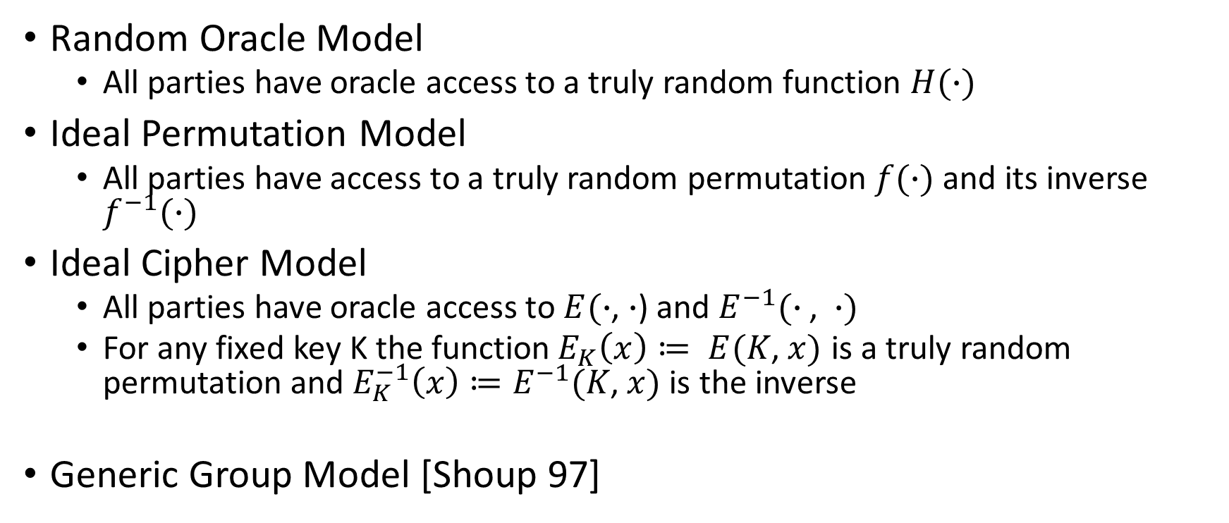
Idealized Models of Computation
Random Oracle Model
  All parties have oracle access to a truly random function $H(∙)$
Ideal Permutation Model
  All parties have access to a truly random permutation $f(∙)$ and its inverse $f^{−1}(∙)$
Ideal Cipher Model
  All parties have oracle access to $E(∙$, $∙$) and $E^{−1}(∙\text{,} ∙)$
  For any fixed key K the function$E_{K}\left(x\right)≔ E(K\text{,} x)$ is a truly random permutation and $E_{K}^{−1}\left(x\right)≔E^{−1}(K\text{,} x)$ is the inverse
Generic Group Model [Shoup 97]

Slide 3
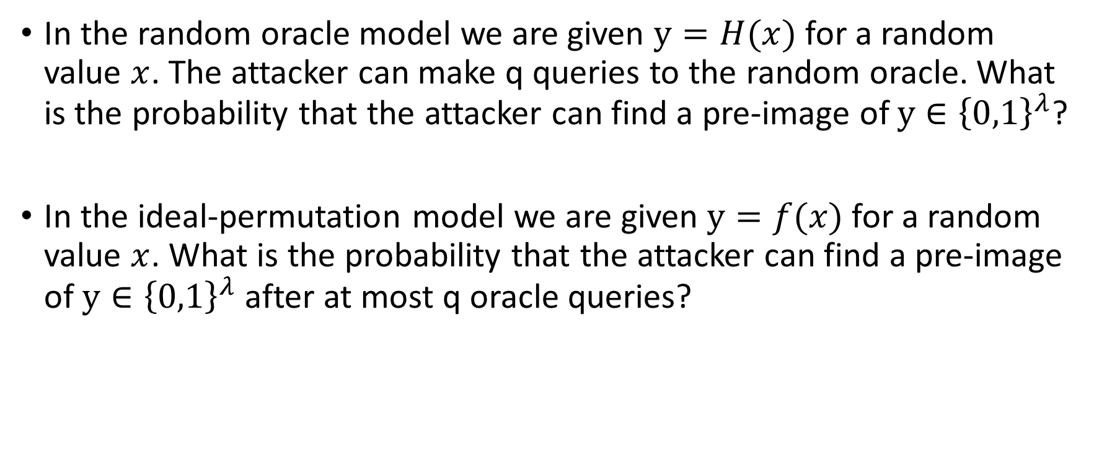
Warm-Up
In the random oracle model we are given $y=H(x)$ for a random value $x$. The attacker can make q queries to the random oracle. What is the probability that the attacker can find a pre-image of $y∈{\left\{0,1\right\}}^{λ}$?
In the ideal-permutation model we are given $y=f(x)$ for a random value $x$. What is the probability that the attacker can find a pre-image of $y∈{\left\{0,1\right\}}^{λ}$ after at most q oracle queries?

Slide 4
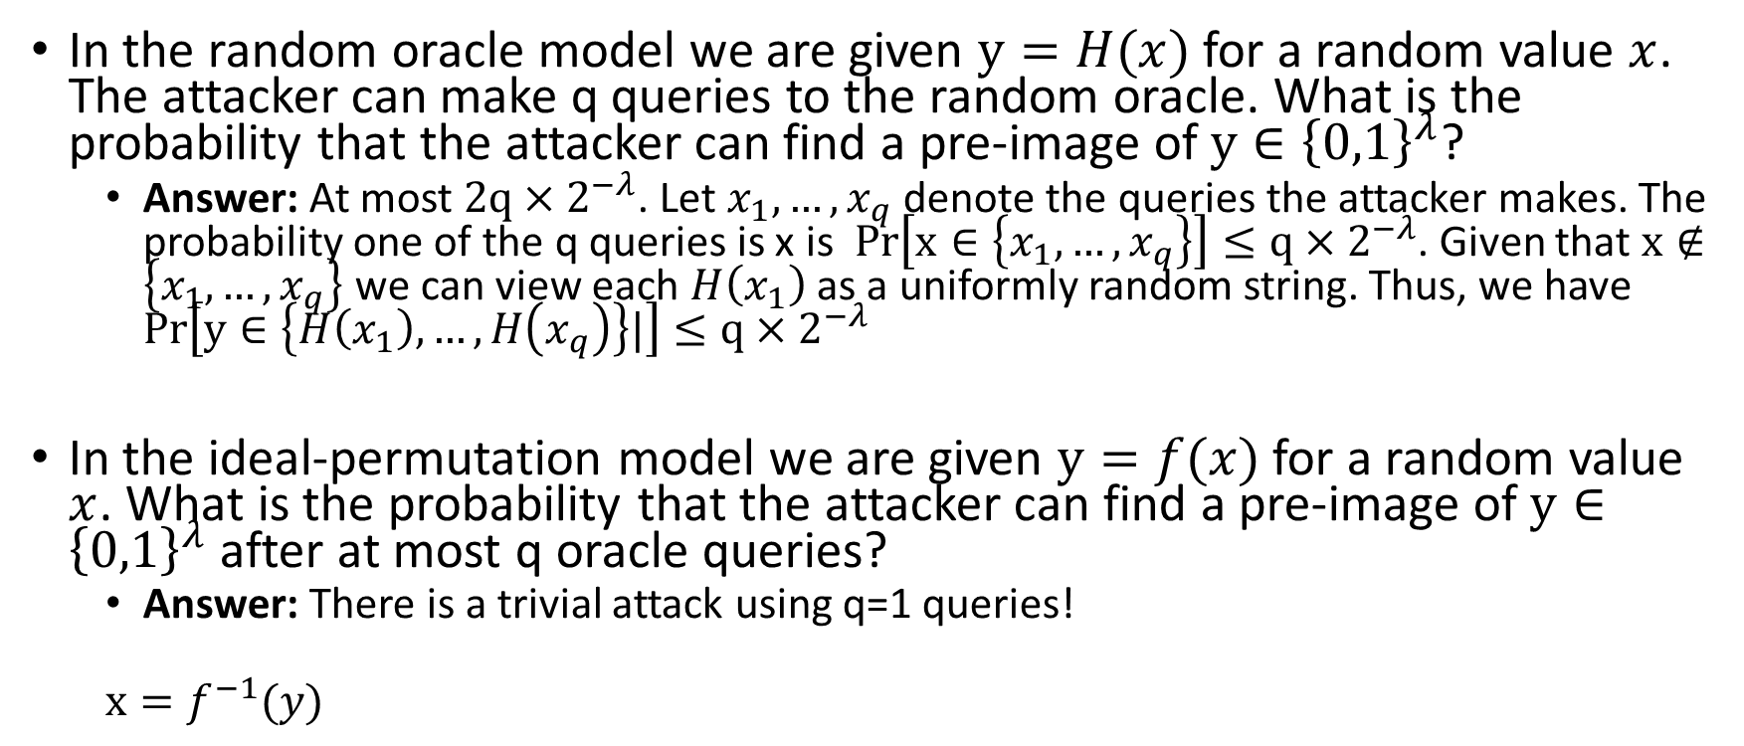
Warm-Up
In the random oracle model we are given $y=H(x)$ for a random value $x$. The attacker can make q queries to the random oracle. What is the probability that the attacker can find a pre-image of $y∈{\left\{0,1\right\}}^{λ}$?
  Answer: At most $2q×2^{−λ}$. Let $x_{1},…,x_{q}$ denote the queries the attacker makes. The probability one of the q queries is x is $Pr\left[x∈\left\{x_{1},…,x_{q}\right\}\right]≤q×2^{−λ}$. Given that $x∉\left\{x_{1},…,x_{q}\right\}$ we can view each $H\left(x_{1}\right)$ as a uniformly random string. Thus, we have $Pr\left[y∈\left\{H\left(x_{1}\right),…,H\left(x_{q}\right)\right\}|\right]≤q×2^{−λ}$
In the ideal-permutation model we are given $y=f(x)$ for a random value $x$. What is the probability that the attacker can find a pre-image of $y∈{\left\{0,1\right\}}^{λ}$ after at most q oracle queries?
  Answer: There is a trivial attack using q=1 queries!
  $x=f^{−1}(y)$

Slide 5

Warm-Up: Part 2
In the Ideal-Cipher Model we are given $\left(m,E_{K}\left(m\right)\right)$ where $K∈{\left\{0,1\right\}}^{λ}$ is random. The attacker may make q queries to the ideal cipher. What is the probability that the attacker can find $K$?

Slide 6
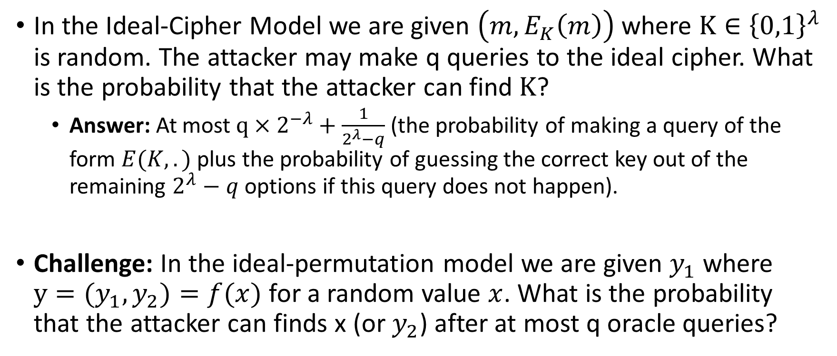
Warm-Up: Part 2
In the Ideal-Cipher Model we are given $\left(m,E_{K}\left(m\right)\right)$ where $K∈{\left\{0,1\right\}}^{λ}$ is random. The attacker may make q queries to the ideal cipher. What is the probability that the attacker can find $K$?
  Answer: At most $q×2^{−λ}+\frac{1}{2^{λ}−q}$(the probability of making a query of the form $E(K,.)$ plus the probability of guessing the correct key out of the remaining $2^{λ}−q$ options if this query does not happen).
Challenge: In the ideal-permutation model we are given $y_{1}$ where $y=(y_{1},y_{2})=f(x)$ for a random value $x$. What is the probability that the attacker can finds x (or $y_{2}$) after at most q oracle queries?

Slide 7
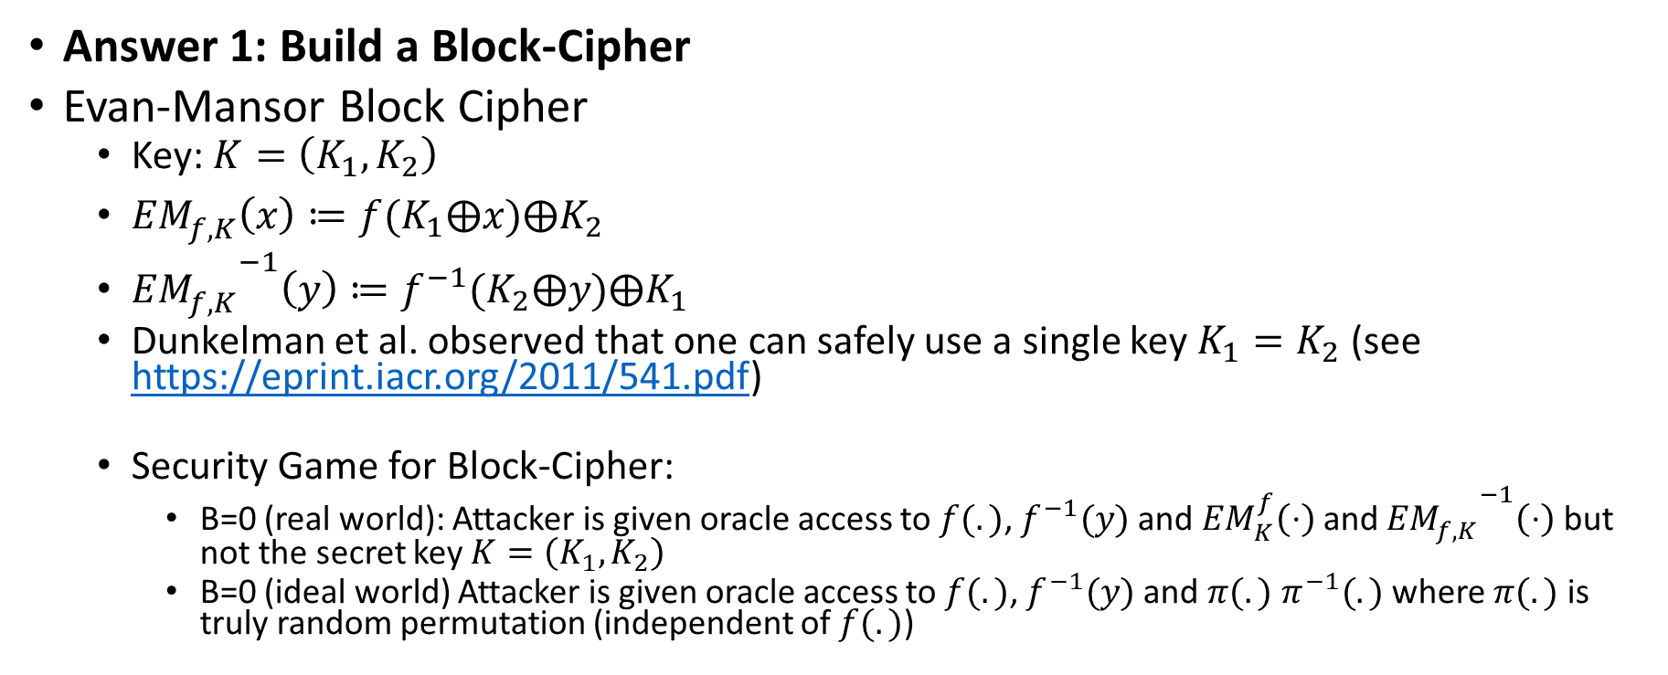
What Can We Do with Ideal Permutation?
Answer 1: Build a Block-Cipher
Evan-Mansor Block Cipher
  Key: $K=\left(K_{1},K_{2}\right)$
  ${EM}_{f,K}^{}\left(x\right)≔f(K_{1}⨁x)⨁K_{2}$
  ${{EM}_{f,K}^{}}^{−1}\left(y\right)≔f^{−1}(K_{2}⨁y)⨁K_{1}$
  Dunkelman et al. observed that one can safely use a single key $K_{1}=K_{2}$ (see https://eprint.iacr.org/2011/541.pdf)
  Security Game for Block-Cipher:
    B=0 (real world): Attacker is given oracle access to $f(.)$, $f^{−1}(y)$ and ${EM}_{K}^{f}\left(⋅\right)$ and ${{EM}_{f,K}^{}}^{−1}\left(⋅\right)$ but not the secret key $K=\left(K_{1},K_{2}\right)$
    B=0 (ideal world) Attacker is given oracle access to $f(.)$, $f^{−1}(y)$ and $π(.)$ $π^{−1}(.)$ where $π(.)$ is truly random permutation (independent of $f(.)$)

Slide 8
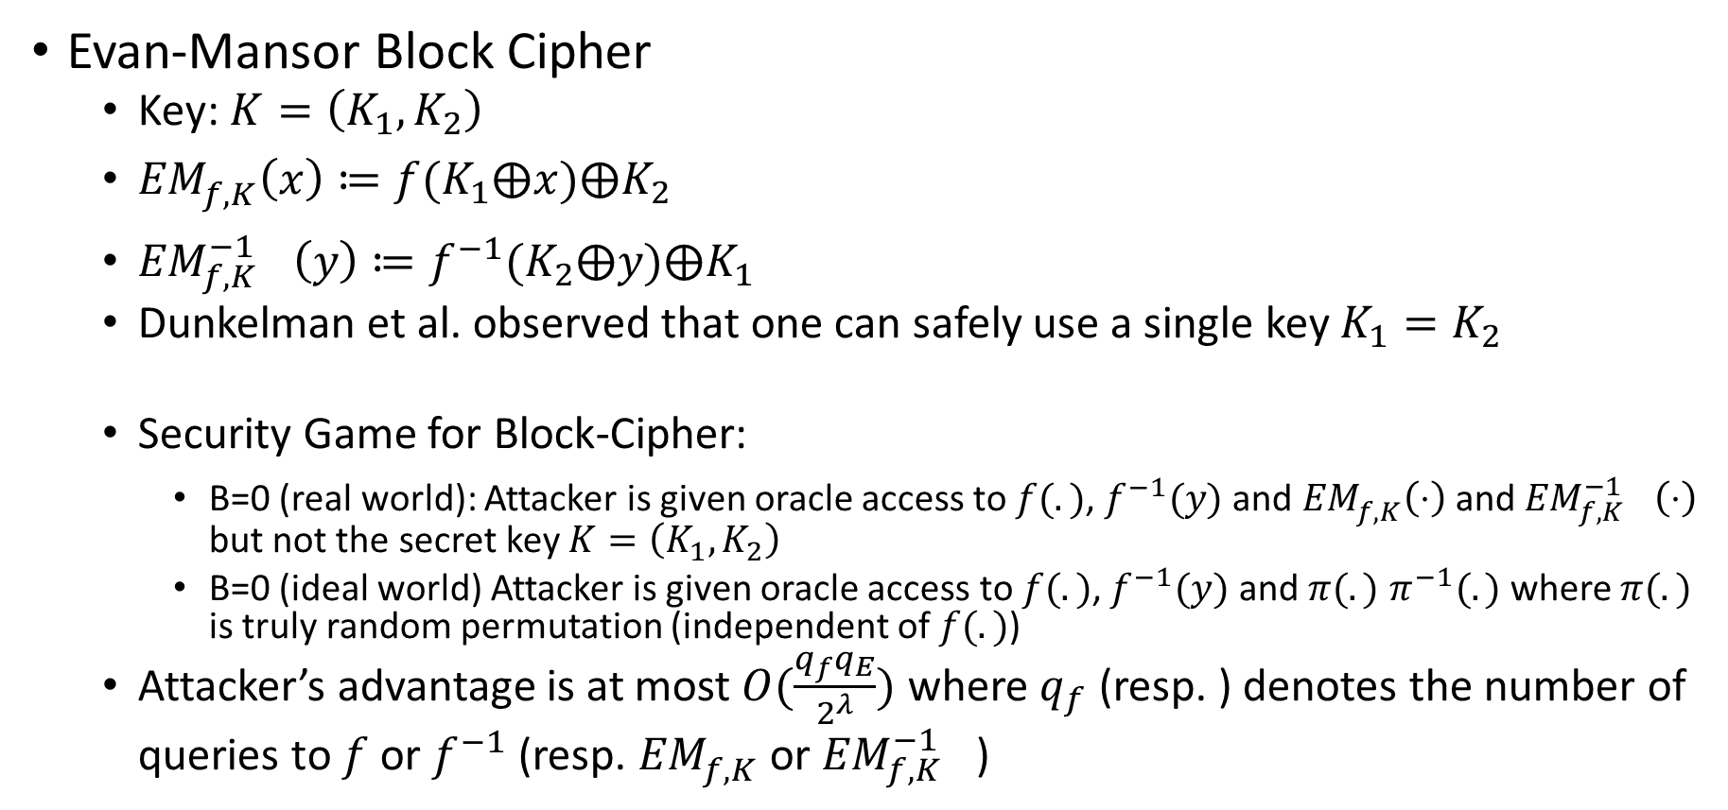
What Can We Do with Ideal Permutation?
Evan-Mansor Block Cipher
  Key: $K=\left(K_{1},K_{2}\right)$
  ${EM}_{f,K}^{}\left(x\right)≔f(K_{1}⨁x)⨁K_{2}$
  ${{EM}_{f,K}^{−1}}^{}\left(y\right)≔f^{−1}(K_{2}⨁y)⨁K_{1}$
  Dunkelman et al. observed that one can safely use a single key $K_{1}=K_{2}$
  Security Game for Block-Cipher:
    B=0 (real world): Attacker is given oracle access to $f(.)$, $f^{−1}(y)$ and ${EM}_{f,K}^{}\left(⋅\right)$ and ${{EM}_{f,K}^{−1}}^{}\left(⋅\right)$ but not the secret key $K=\left(K_{1},K_{2}\right)$
    B=0 (ideal world) Attacker is given oracle access to $f(.)$, $f^{−1}(y)$ and $π(.)$ $π^{−1}(.)$ where $π(.)$ is truly random permutation (independent of $f(.)$)
  Attacker’s advantage is at most $O(\frac{q_{f}q_{E}}{2^{λ}})$ where $q_{f}$ (resp. ) denotes the number of queries to $f$ or $f^{−1}$ (resp. ${EM}_{f,K}^{}$ or ${{EM}_{f,K}^{−1}}^{}$)

Slide 9
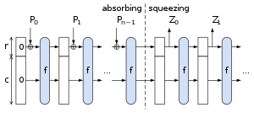


What Can We Do with Ideal Permutation?
Answer 2: Build a Collision-Resistant Hash Function
  Sponge Construction: SHA3
  Input: $P=(P_{0},P_{1},…,P_{n−1})$ viewed as r-bit blocks e.g.,
  Input “absorbed” in multiple rounds
  Output squeezed out in subsequent rounds
  Keccak (SHA3): |r|+|c|=1600-bit state
  $c∈\{256,512,…\}$

Slide 10
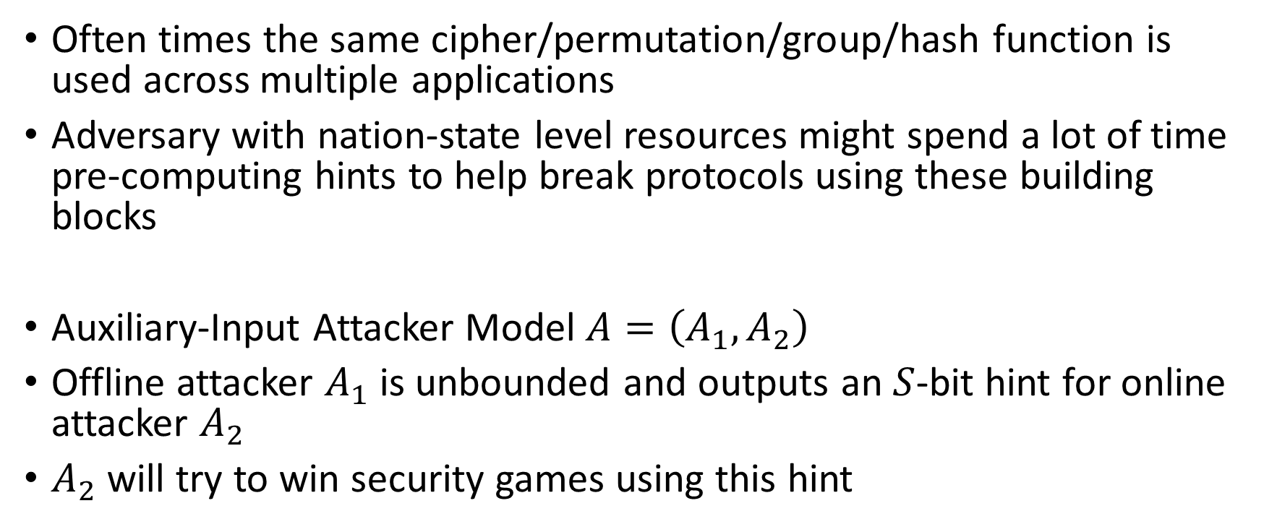
Pre-Processing Attacks
Often times the same cipher/permutation/group/hash function is used across multiple applications
Adversary with nation-state level resources might spend a lot of time pre-computing hints to help break protocols using these building blocks
Auxiliary-Input Attacker Model $A=\left(A_{1},A_{2}\right)$
Offline attacker $A_{1}$ is unbounded and outputs an $S$-bit hint for online attacker $A_{2}$
$A_{2}$ will try to win security games using this hint

Slide 11
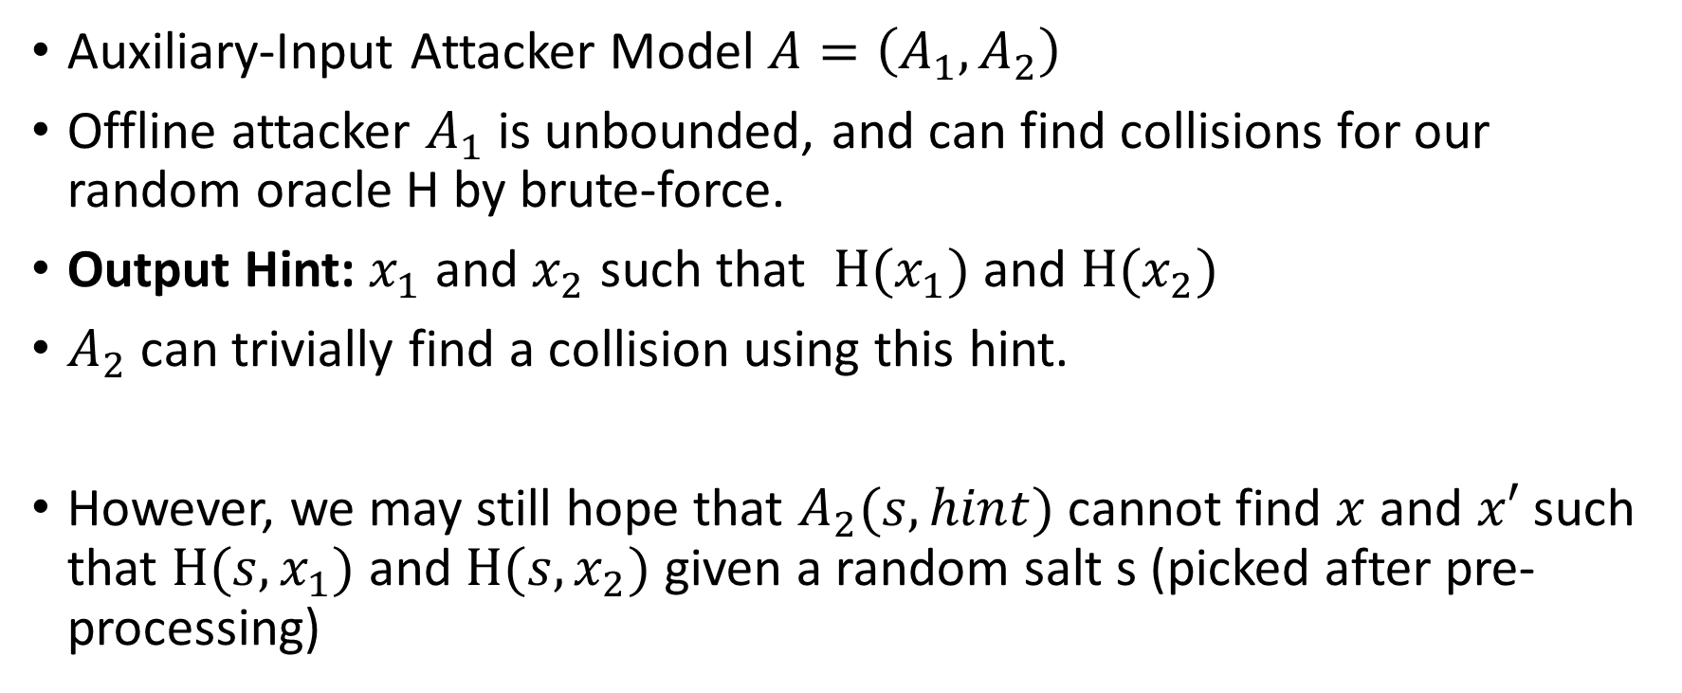
Pre-Processing Attacks: Trivial Example
Auxiliary-Input Attacker Model $A=\left(A_{1},A_{2}\right)$
Offline attacker $A_{1}$ is unbounded, and can find collisions for our random oracle H by brute-force.
Output Hint: $x_{1}$ and $x_{2}$ such that $H(x_{1})$ and $H(x_{2})$
$A_{2}$ can trivially find a collision using this hint.
However, we may still hope that $A_{2}(s,hint)$ cannot find $x$ and $x′$ such that $H(s,x_{1})$ and $H(s,x_{2})$ given a random salt s (picked after pre-processing)

Slide 12
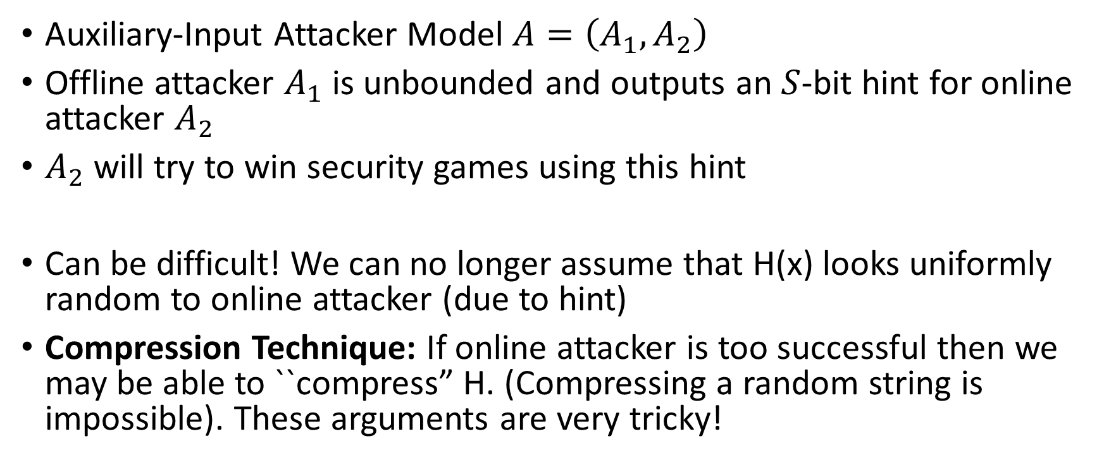
Pre-Processing Lower Bounds
Auxiliary-Input Attacker Model $A=\left(A_{1},A_{2}\right)$
Offline attacker $A_{1}$ is unbounded and outputs an $S$-bit hint for online attacker $A_{2}$
$A_{2}$ will try to win security games using this hint
Can be difficult! We can no longer assume that H(x) looks uniformly random to online attacker (due to hint)
Compression Technique: If online attacker is too successful then we may be able to ``compress” H. (Compressing a random string is impossible). These arguments are very tricky!

Slide 13
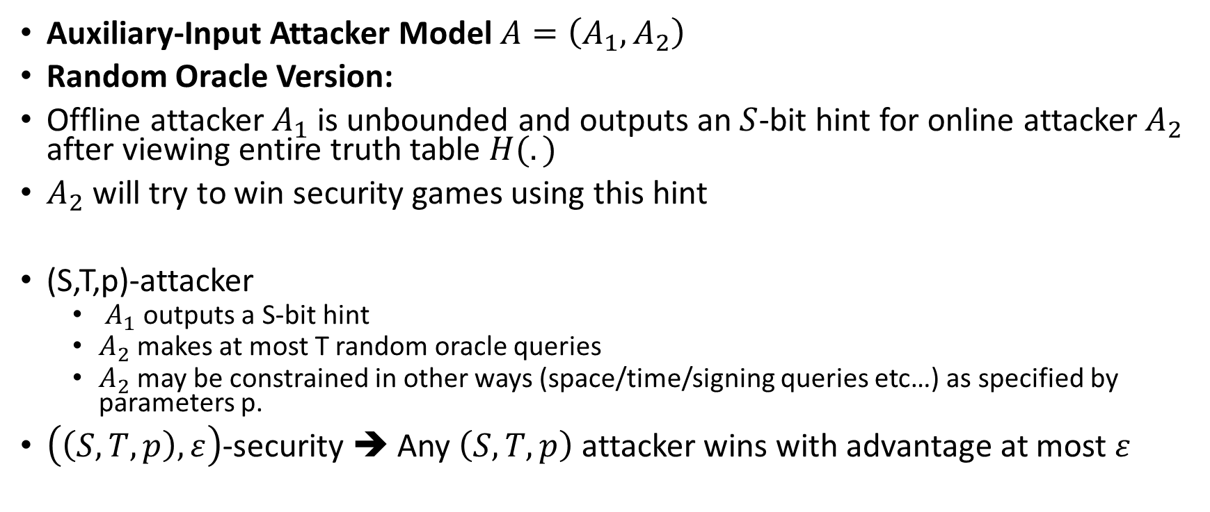
Auxiliary-Input Attacker Model
Auxiliary-Input Attacker Model $A=\left(A_{1},A_{2}\right)$
Random Oracle Version:
Offline attacker $A_{1}$ is unbounded and outputs an $S$-bit hint for online attacker $A_{2}$ after viewing entire truth table $H(.)$
$A_{2}$ will try to win security games using this hint
(S,T,p)-attacker
  $A_{1}$ outputs a S-bit hint
  $A_{2}$ makes at most T random oracle queries
  $A_{2}$ may be constrained in other ways (space/time/signing queries etc…) as specified by parameters p.
$\left(\left(S,T,p\right),ε\right)$-security ➔ Any $\left(S,T,p\right)$ attacker wins with advantage at most $ε$

Slide 14

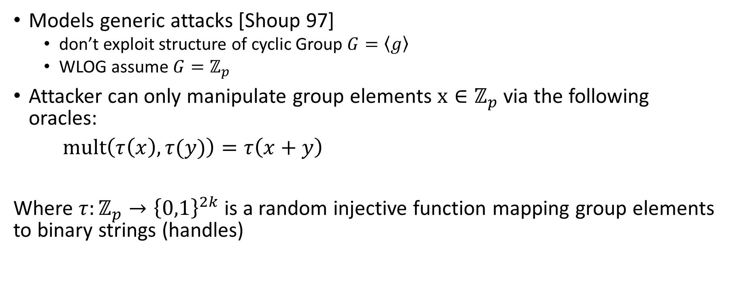

Generic Group Model (GGM)
Models generic attacks [Shoup 97]
  don’t exploit structure of cyclic Group $G=\left\langle g\right\rangle$
  WLOG assume $G=ℤ_{p}$
Attacker can only manipulate group elements $x∈ℤ_{p}$ via the following oracles:
$\operatorname{mult}\left(τ\left(x\right),τ(y)\right)=τ\left(x+y\right)$
Where $τ:ℤ_{p}→{\left\{0,1\right\}}^{2k}$ is a random injective function mapping group elements to binary strings (handles)
Input: handles for group elements $x,y∈ℤ_{p}$
Output: handles for group element $x+y∈ℤ_{p}$

Slide 15
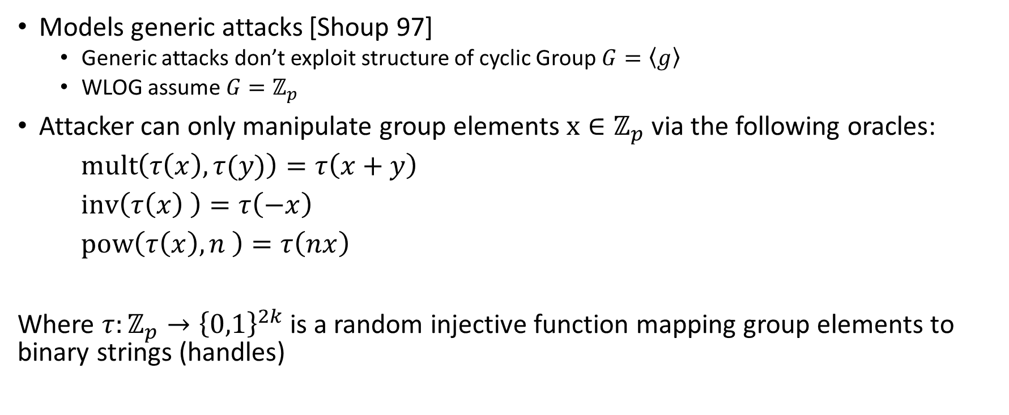
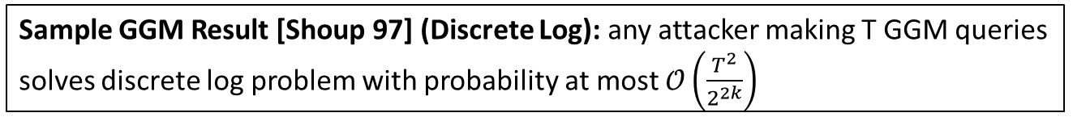
Generic Group Model (GGM)
Models generic attacks [Shoup 97]
  Generic attacks don’t exploit structure of cyclic Group $G=\left\langle g\right\rangle$
  WLOG assume $G=ℤ_{p}$
Attacker can only manipulate group elements $x∈ℤ_{p}$ via the following oracles:
$\operatorname{mult}\left(τ\left(x\right),τ(y)\right)=τ\left(x+y\right)$
$\operatorname{inv}\left(τ\left(x\right) \right)=τ\left(−x\right)$
$\operatorname{pow}\left(τ\left(x\right),n \right)=τ\left(nx\right)$
Where $τ:ℤ_{p}→{\left\{0,1\right\}}^{2k}$ is a random injective function mapping group elements to binary strings (handles)
Output: handle for group element $(nx mod p)∈ℤ_{p}$
Input: handle for group elements $x∈ℤ_{p}$ and integer n
Sample GGM Result [Shoup 97] (Discrete Log): any attacker making T GGM queries solves discrete log problem with probability at most $𝒪\left(\frac{T^{2}}{2^{2k}}\right)$

Slide 16
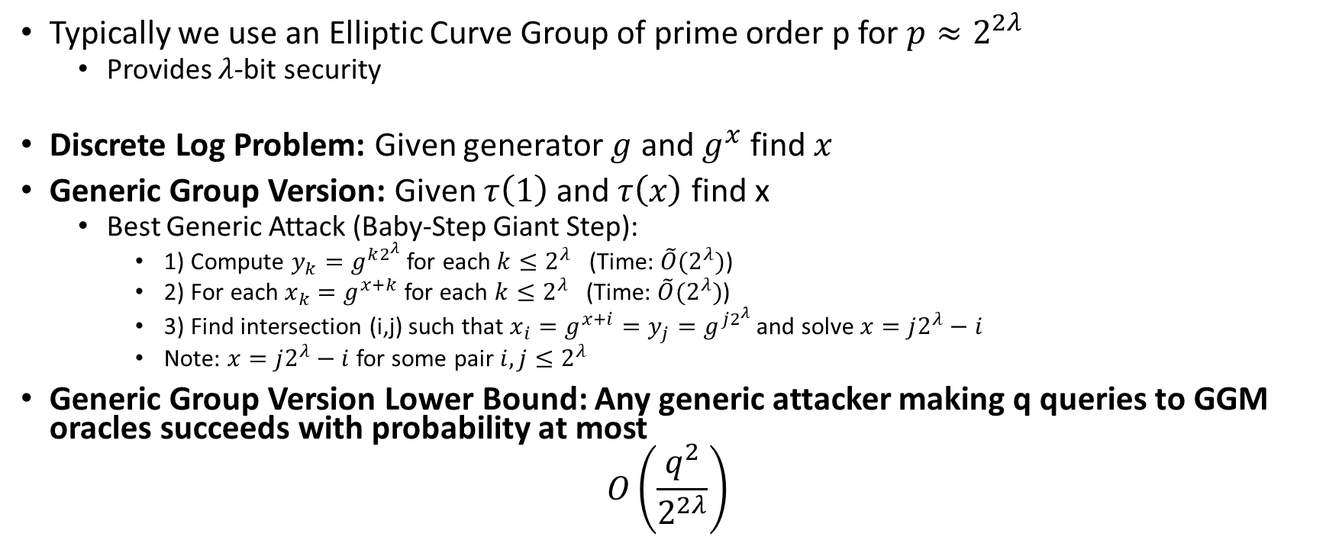
Generic Group Model
Typically we use an Elliptic Curve Group of prime order p for $p≈2^{2λ}$
  Provides $λ$-bit security
Discrete Log Problem: Given generator $g$ and $g^{x}$ find $x$
Generic Group Version: Given $τ\left(1\right)$ and $τ\left(x\right)$ find x
  Best Generic Attack (Baby-Step Giant Step):
    1) Compute $y_{k}=g^{k2^{λ}}$ for each $k≤2^{λ}$ (Time: $\tilde{O}(2^{λ})$)
    2) For each $x_{k}=g^{x+k}$ for each $k≤2^{λ}$ (Time: $\tilde{O}(2^{λ})$)
    3) Find intersection (i,j) such that $x_{i}=g^{x+i}=y_{j}=g^{j2^{λ}}$ and solve $x=j2^{λ}−i$
    Note: $x=j2^{λ}−i$ for some pair $i,j≤2^{λ}$
Generic Group Version Lower Bound: Any generic attacker making q queries to GGM oracles succeeds with probability at most
$$O\left(\frac{q^{2}}{2^{2λ}}\right)$$

Slide 17
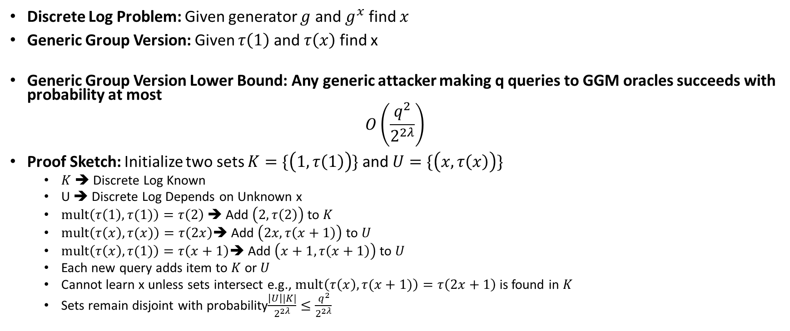
Generic Group Lower Bound
Discrete Log Problem: Given generator $g$ and $g^{x}$ find $x$
Generic Group Version: Given $τ\left(1\right)$ and $τ\left(x\right)$ find x
Generic Group Version Lower Bound: Any generic attacker making q queries to GGM oracles succeeds with probability at most
$$O\left(\frac{q^{2}}{2^{2λ}}\right)$$
Proof Sketch: Initialize two sets $K=\{\left(1,τ\left(1\right)\right)\}$ and $U=\{\left(x,τ\left(x\right)\right)\}$
  $K$ ➔ Discrete Log Known
  U ➔ Discrete Log Depends on Unknown x
  $\operatorname{mult}\left(τ\left(1\right),τ(1)\right)=τ\left(2\right)$ ➔ Add $\left(2,τ\left(2\right)\right)$ to $K$
  $\operatorname{mult}\left(τ\left(x\right),τ(x)\right)=τ\left(2x\right)$➔ Add $\left(2x,τ\left(x+1\right)\right)$ to $U$
  $\operatorname{mult}\left(τ\left(x\right),τ(1)\right)=τ\left(x+1\right)$➔ Add $\left(x+1,τ\left(x+1\right)\right)$ to $U$
  Each new query adds item to $K$ or $U$
  Cannot learn x unless sets intersect e.g., $\operatorname{mult}\left(τ\left(x\right),τ(x+1)\right)=τ\left(2x+1\right)$is found in $K$
  Sets remain disjoint with probability$\frac{\left|U\right||K|}{2^{2λ}}≤\frac{q^{2}}{2^{2λ}}$

Slide 18
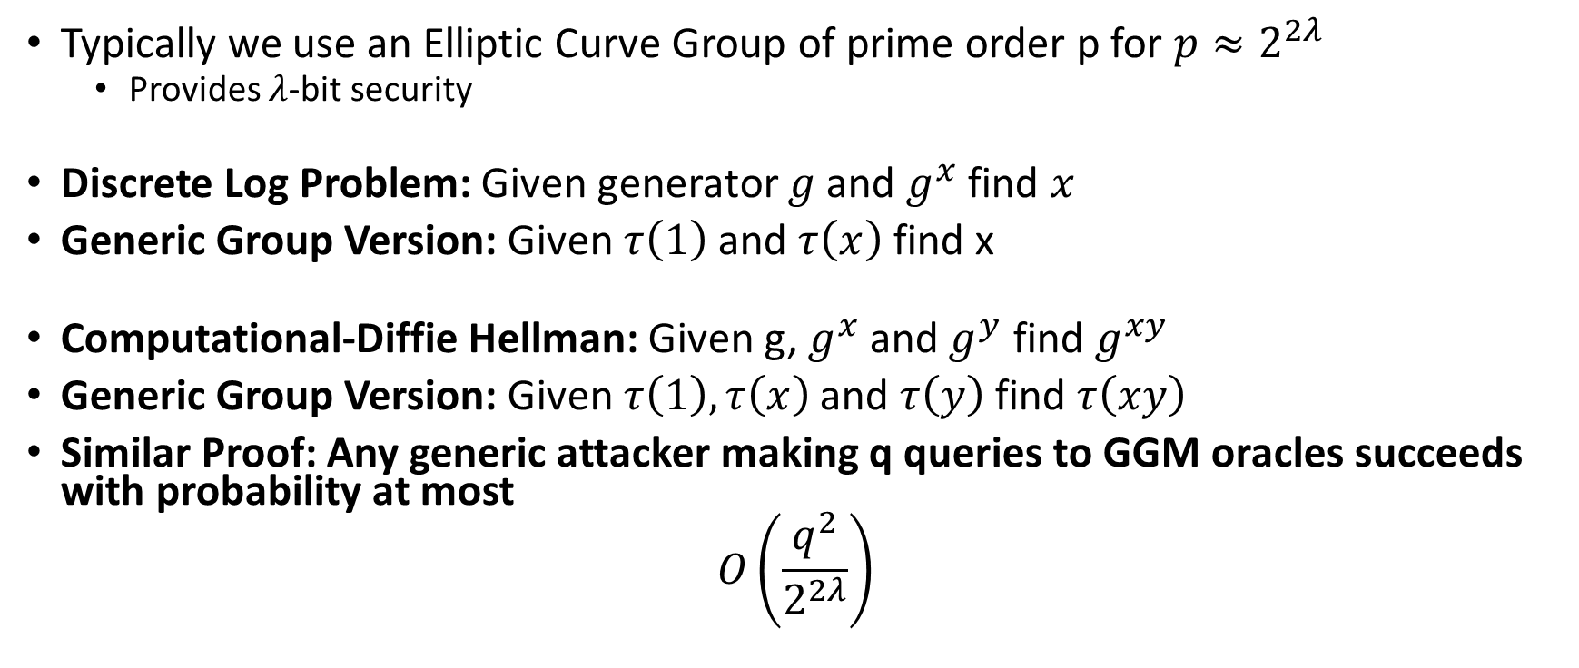
Generic Group Model
Typically we use an Elliptic Curve Group of prime order p for $p≈2^{2λ}$
  Provides $λ$-bit security
Discrete Log Problem: Given generator $g$ and $g^{x}$ find $x$
Generic Group Version: Given $τ\left(1\right)$ and $τ\left(x\right)$ find x
Computational-Diffie Hellman: Given g, $g^{x}$ and $g^{y}$ find $g^{xy}$
Generic Group Version: Given $τ\left(1\right), τ\left(x\right)$ and $τ\left(y\right)$ find $τ\left(xy\right)$
Similar Proof: Any generic attacker making q queries to GGM oracles succeeds with probability at most
$$O\left(\frac{q^{2}}{2^{2λ}}\right)$$

Slide 19
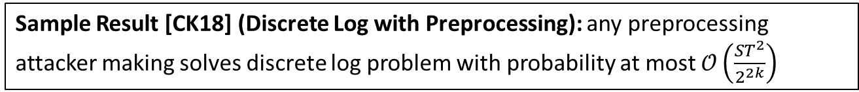
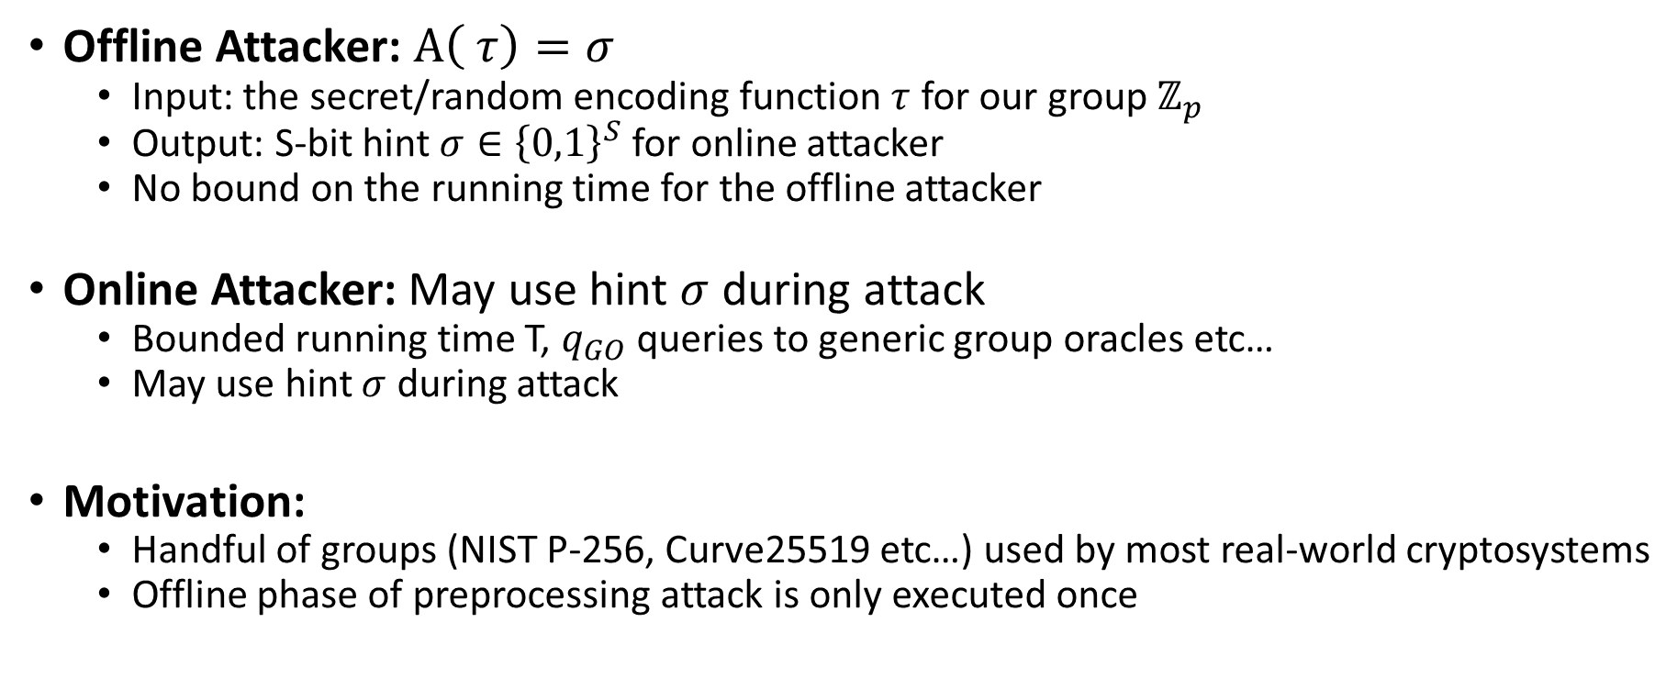
Generic Group Model with Preprocessing
Offline Attacker: $A\left( τ\right)=σ$
  Input: the secret/random encoding function $τ$ for our group $ℤ_{p}$
  Output: S-bit hint $σ∈{\left\{0,1\right\}}^{S}$ for online attacker
  No bound on the running time for the offline attacker
Online Attacker: May use hint $σ$ during attack
  Bounded running time T, $q_{GO}$ queries to generic group oracles etc…
  May use hint $σ$ during attack
Motivation:
  Handful of groups (NIST P-256, Curve25519 etc…) used by most real-world cryptosystems
  Offline phase of preprocessing attack is only executed once
Sample Result [CK18] (Discrete Log with Preprocessing): any preprocessing attacker making solves discrete log problem with probability at most $𝒪\left(\frac{ST^{2}}{2^{2k}}\right)$

Slide 20
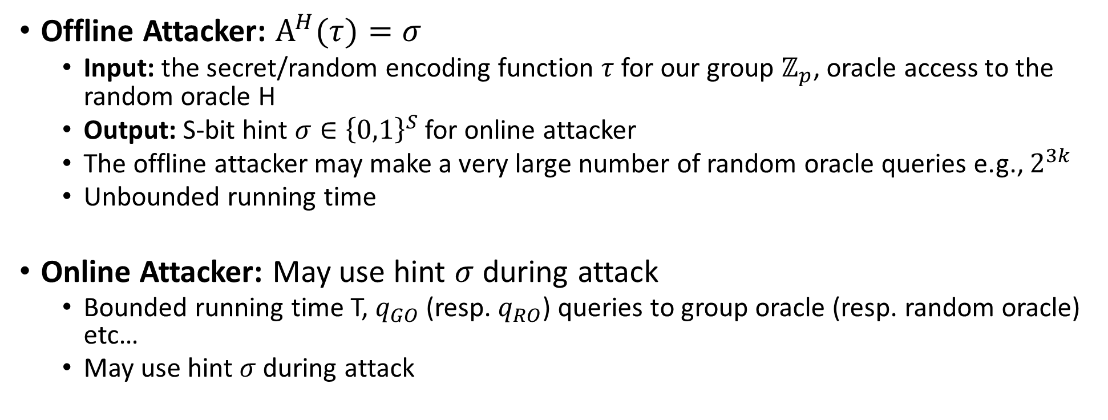
GGM + ROM with Preprocessing
Offline Attacker: $A^{H}(τ)=σ$
  Input: the secret/random encoding function $τ$ for our group $ℤ_{p}$, oracle access to the random oracle H
  Output: S-bit hint $σ∈{\left\{0,1\right\}}^{S}$ for online attacker
  The offline attacker may make a very large number of random oracle queries e.g., $2^{3k}$
  Unbounded running time
Online Attacker: May use hint $σ$ during attack
  Bounded running time T, $q_{GO}$ (resp. $q_{RO}$) queries to group oracle (resp. random oracle) etc…
  May use hint $σ$ during attack

Slide 21
The Discrete Logarithm Problem with Preprocessing
Henry Corrigan-Gibbs and Dmitry Kogan
Stanford University
Eurocrypt – 1 May 2018
Tel Aviv, Israel

Slide 22

DH key
exchange
Pairings
Signatures
(DSA and Schnorr)
DDH
Discrete log

Slide 23

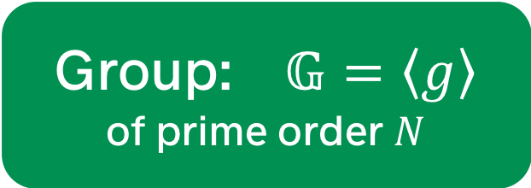

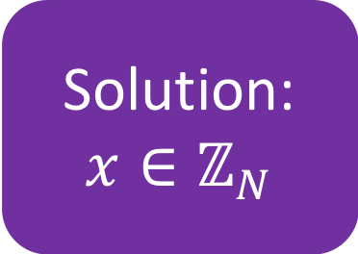

The discrete-log problem
Group: $𝔾=\left\langle g\right\rangle$
of prime order $N$
Solution: $x∈ℤ_{N}$
Instance: $g^{x}∈𝔾$
Adversary $𝒜$
Why do we believe this
problem is hard?

Slide 24
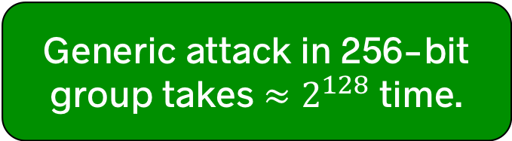

Generic lower bounds give us confidence
Theorem. [Shoup’97] Every generic discrete-log algorithm that
operates in a group of prime order $N$ and
succeeds with probability at least $½$
must run in time $Ω(N^{1/2})$.
Generic attack in 256-bit group takes $≈2^{128}$ time.
Best attacks on standard EC groups are generic

Slide 25
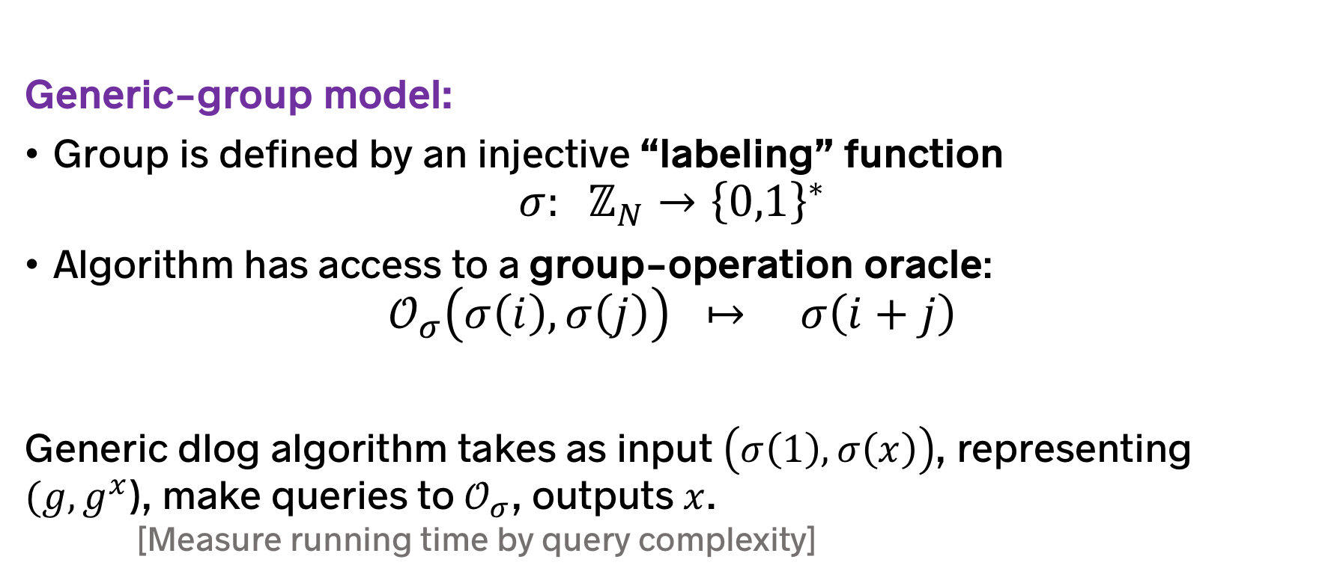
Generic algorithms can only make
“black-box” use of the group operation
Generic-group model:
Group is defined by an injective “labeling” function
$σ: ℤ_{N}→{\left\{0,1\right\}}^{∗}$
Algorithm has access to a group-operation oracle:
$𝒪_{σ}\left(σ\left(i\right), σ\left(j\right)\right) ↦ σ\left(i+j\right)$
Generic dlog algorithm takes as input $\left(σ\left(1\right), σ\left(x\right)\right)$, representing $(g, g^{x}$), make queries to $𝒪_{σ}$, outputs $x$.
[Measure running time by query complexity]
Very useful way to understand hardness
[BB04,B05,M05,D06,
B08,Y15,…]
[Nechaev’94], [Shoup’97], [Maurer’05]

Slide 26

Existing generic lower bounds do not account for preprocessing
Premise of generic-group model: the adversary knows nothing about the structure of the group $𝔾$ in advance
In reality: the adversary knows a lot about $𝔾$!
  $𝔾$ is one of a small number of groups: NIST P-256, Curve25519, …
A realistic adversary can perform $𝔾$-specific preprocessing!
Existing generic-group lower bounds say nothing about preprocessing attacks! [H80, Yao90, FN91, …]

Slide 27


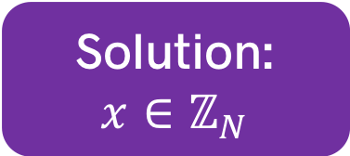



Preprocessing phase
Group: $𝔾=\left\langle g\right\rangle$
Advice: ${st}_{𝔾}$
$$𝒜_{0}$$
Both algorithms
are generic!
Both algorithms
are generic!
Online phase
Instance: $g^{x}∈𝔾$
Solution:
$$x∈ℤ_{N}$$
$$𝒜_{1}$$
Initiated by Hellman (1980) in context of OWFs

Slide 28




Preprocessing time $P$
Preprocessing phase
Group: $𝔾=\left\langle g\right\rangle$
Advice: ${st}_{𝔾}$
$$𝒜_{0}$$
Advice size $S$
Online phase
Online time $T$
Instance: $g^{x}∈𝔾$
Solution:
$$x∈ℤ_{N}$$
$$𝒜_{1}$$
Success prob. $ε$
Initiated by Hellman (1980) in context of OWFs

Slide 29
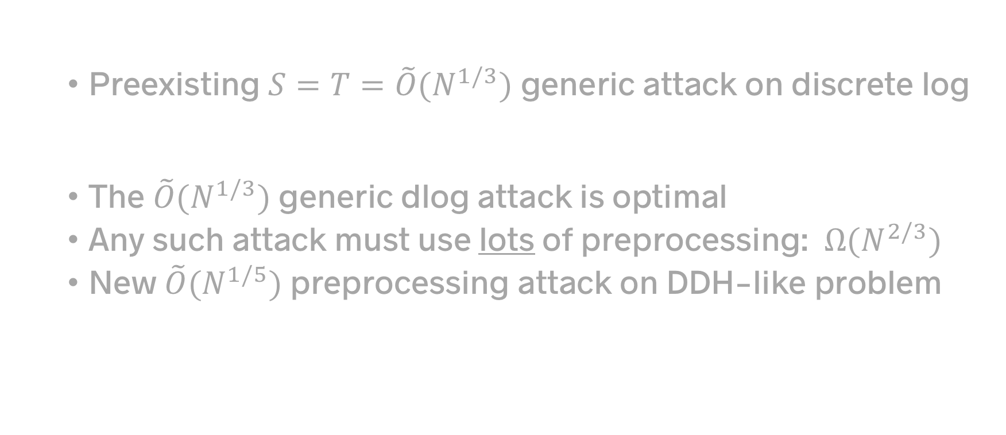
Rest of this talk
Background: Preprocessing attacks are relevant
  Preexisting $S=T=\tilde{O}(N^{1/3})$ generic attack on discrete log
Our results: Preprocessing lower-bounds and attacks
  The $\tilde{O}(N^{1/3})$ generic dlog attack is optimal
  Any such attack must use lots of preprocessing: $Ω(N^{2/3})$
  New $\tilde{O}(N^{1/5})$preprocessing attack on DDH-like problem
Open questions

Slide 30
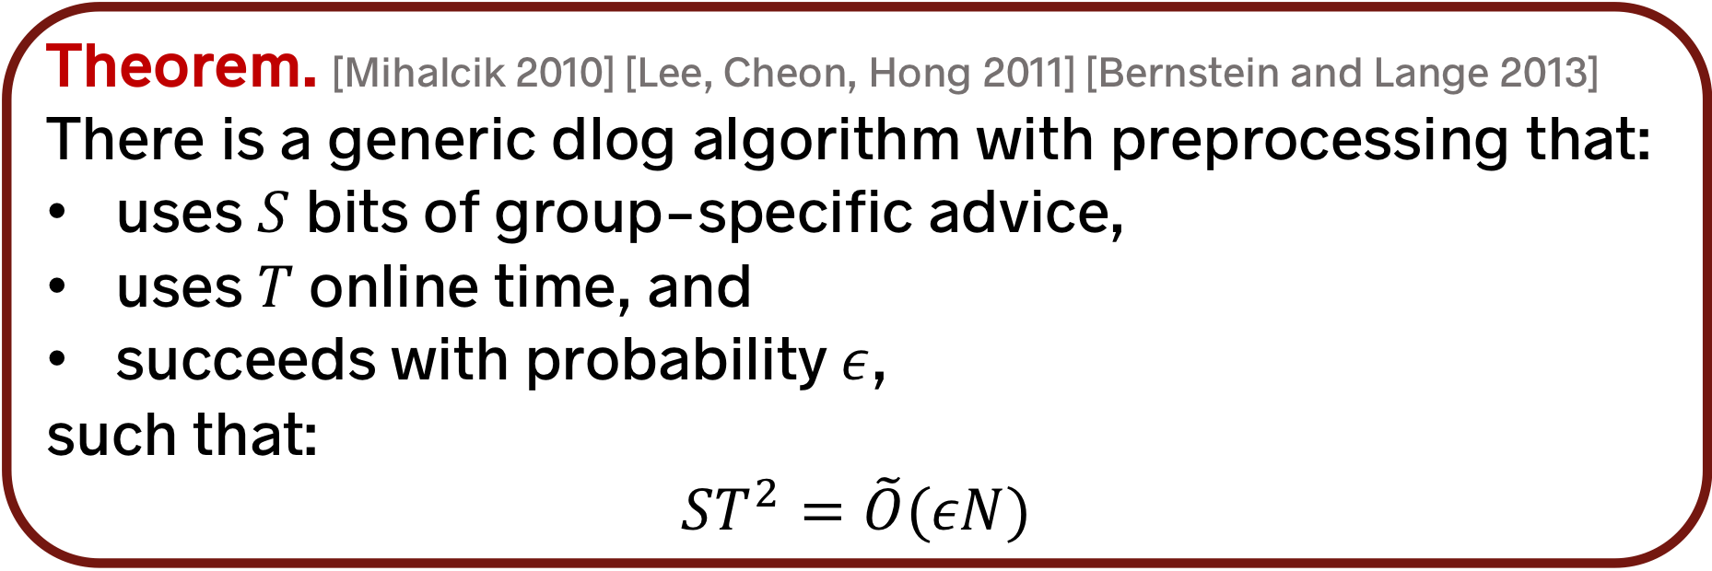
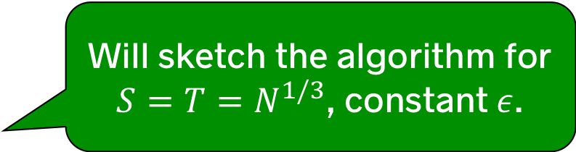
A preexisting result…
Theorem. [Mihalcik 2010] [Lee, Cheon, Hong 2011] [Bernstein and Lange 2013]
There is a generic dlog algorithm with preprocessing that:
uses $S$ bits of group-specific advice,
uses $T$ online time, and
succeeds with probability $ε$,
such that:
$$ST^{2}=\tilde{O}(εN)$$
Will sketch the algorithm for
$S=T=N^{1/3}$, constant $ε$.
…. building on prior work on
multiple-discrete-log algorithms
[ESST99,KS01,HMCD04,BL12]
Notes:
Escott, Sager, Selkirk, Tsapakidis (CryptoBytes) – Reusing DPs
Kuhn and Struik - Multiple Dlog
Hitchcock, Montague, Carter, Dawson (2004) – Implications of using fixed curves
Lee, Cheon, Hong (2011) - Dlog for IBE

Slide 31

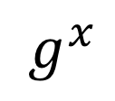


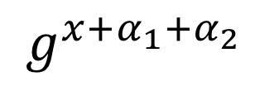
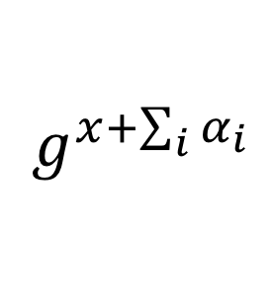


Preliminaries
Define a pseudo-random walk on $𝔾$:
$g^{x}↦g^{x+α}$ where $α=\text{Hash}\left(g^{x}\right)$
is a random function
$g^{x}$
$g^{x+α_{1}}$
$g^{x+α_{1}+α_{2}}$
…
$g^{x+\sum_{i}{α_{i}}}$
${=g}^{y}$
…
$$x$$
$y$
If you know the dlog of the endpoint of a walk,
you know the dlog of the starting point!
[M10, LCH11, BL13]

Slide 32
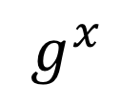



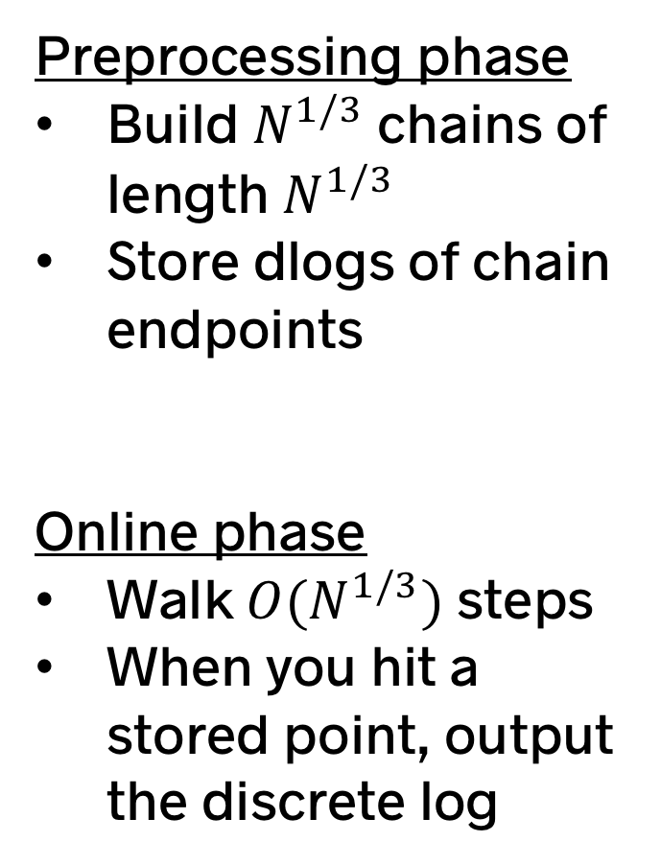


Preprocessing phase
Build $N^{1/3}$ chains of length $N^{1/3}$
Store dlogs of chain endpoints
Online phase
Walk $O(N^{1/3})$ steps
When you hit a stored point, output the discrete log
Length: $N^{1/3}$
Advice: $\tilde{O}(N^{1/3})$ bits
$N^{1/3}$ chains
…
…
$g^{x}$
Time: $\tilde{O}(N^{1/3})$ steps
Preprocessing time: $\tilde{Ω}(N^{2/3})$
Advice string
[M10, LCH11, BL13]

Slide 33

Generic discrete log
Without preprocessing: $Ω\left(N^{1/2}\right)$ $2^{128}$ time
With preprocessing: $\tilde{O}(N^{1/3})$ $2^{86}$ time
Related preprocessing attacks break:
Multiple discrete log problem [This paper]
One-round Even-Mansour cipher [FJM14]
Merkle-Damgård hash with random IV [CDGS17]
256-bit ECDL
Is this dlog attack
the best possible?!
“

Slide 34
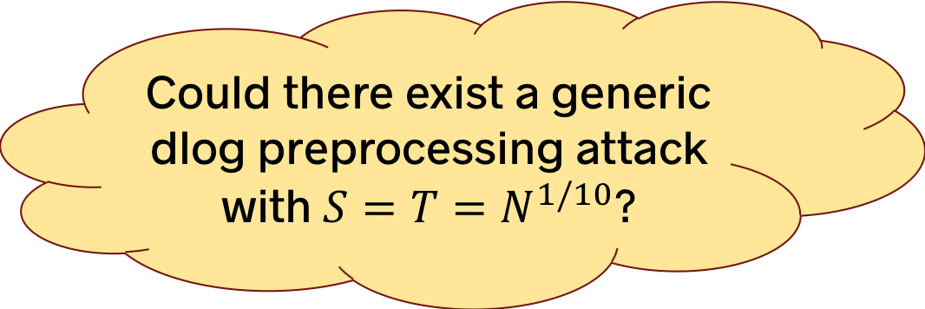
DH key
exchange
Pairings
Signatures
(DSA and Schnorr)
DDH
Discrete log
Could there exist a generic dlog preprocessing attack with $S=T=N^{1/10}$?
Preprocessing attacks might make us worry about 256-bit EC groups

Slide 36
This talk
Background: Preprocessing attacks are relevant
  Preexisting $S=T=\tilde{O}(N^{1/3})$ generic attack on discrete log
Our results: Preprocessing lower-bounds and attacks
  The $\tilde{O}(N^{1/3})$ generic dlog attack is optimal
  Any such attack must use lots of preprocessing: $Ω(N^{2/3})$
  New $\tilde{O}(N^{1/5})$preprocessing attack on DDH-like problem
Open questions

Slide 37
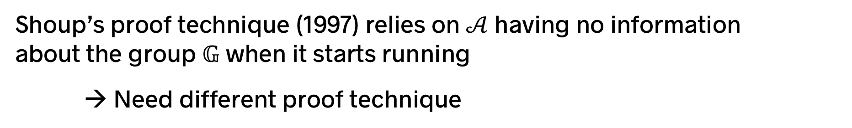
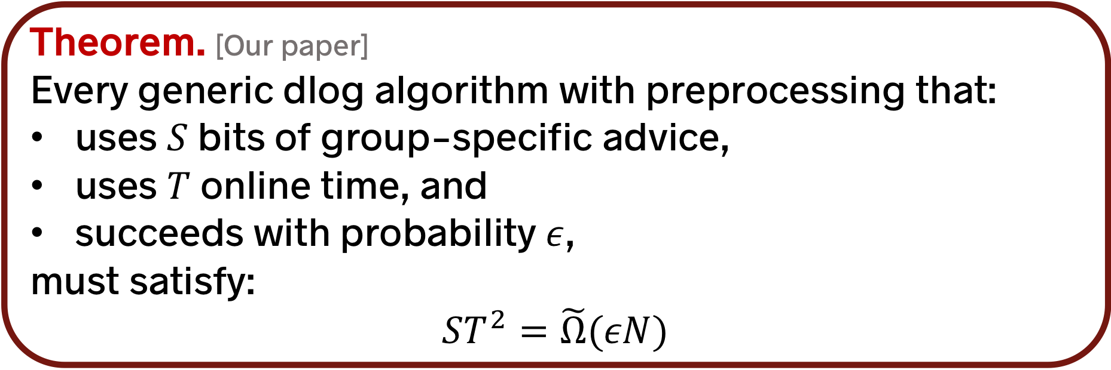
Theorem. [Our paper]
Every generic dlog algorithm with preprocessing that:
uses $S$ bits of group-specific advice,
uses $T$ online time, and
succeeds with probability $ε$,
must satisfy:
$$ST^{2}=\tilde{Ω}(εN)$$
This bound is tight for the full range of parameters
(up to log factors)
Shoup’s proof technique (1997) relies on $𝒜$having no information
about the group $𝔾$ when it starts running
→ Need different proof technique

Slide 38

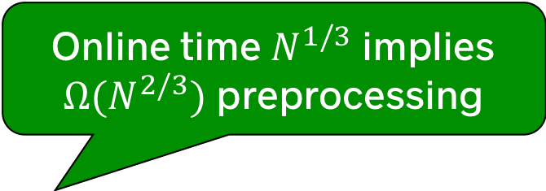
Theorem. [Our paper]
Every generic dlog algorithm with preprocessing that:
uses $S$ bits of group-specific advice,
uses $T$ online time, and
succeeds with probability $ε$,
must satisfy:
$$ST^{2}=\tilde{Ω}(εN)$$
Online time $N^{1/3}$ implies $Ω(N^{2/3})$ preprocessing
Theorem. [Our paper]
Furthermore, the preprocessing time $P$ must satisfy
$$PT+T^{2}=Ω(εN)$$

Slide 39
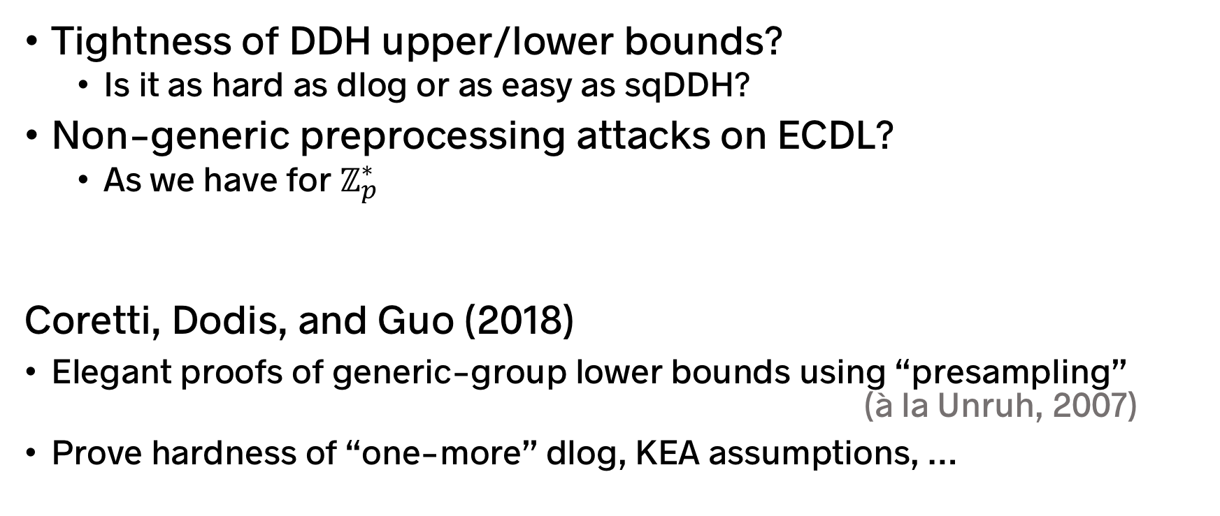
Open questions and recent progress
Tightness of DDH upper/lower bounds?
  Is it as hard as dlog or as easy as sqDDH?
Non-generic preprocessing attacks on ECDL?
  As we have for $ℤ_{p}^{∗}$
Coretti, Dodis, and Guo (2018)
Elegant proofs of generic-group lower bounds using “presampling”
(à la Unruh, 2007)
Prove hardness of “one-more” dlog, KEA assumptions, …

Slide 40
Auxiliary-Input Attacker Model
Auxiliary-Input Attacker Model $A=\left(A_{1},A_{2}\right)$
Random Oracle Version:
Offline attacker $A_{1}$ is unbounded and outputs an $S$-bit hint for online attacker $A_{2}$ after viewing entire truth table $H(.)$
$A_{2}$ will try to win security games using this hint
(S,T,p)-attacker
  $A_{1}$ outputs a S-bit hint
  $A_{2}$ makes at most T random oracle queries
  $A_{2}$ may be constrained in other ways (space/time/signing queries etc…) as specified by parameters p.
$\left(\left(S,T,p\right),ε\right)$-security ➔ Any $\left(S,T,p\right)$ attacker wins with advantage at most $ε$

Slide 41
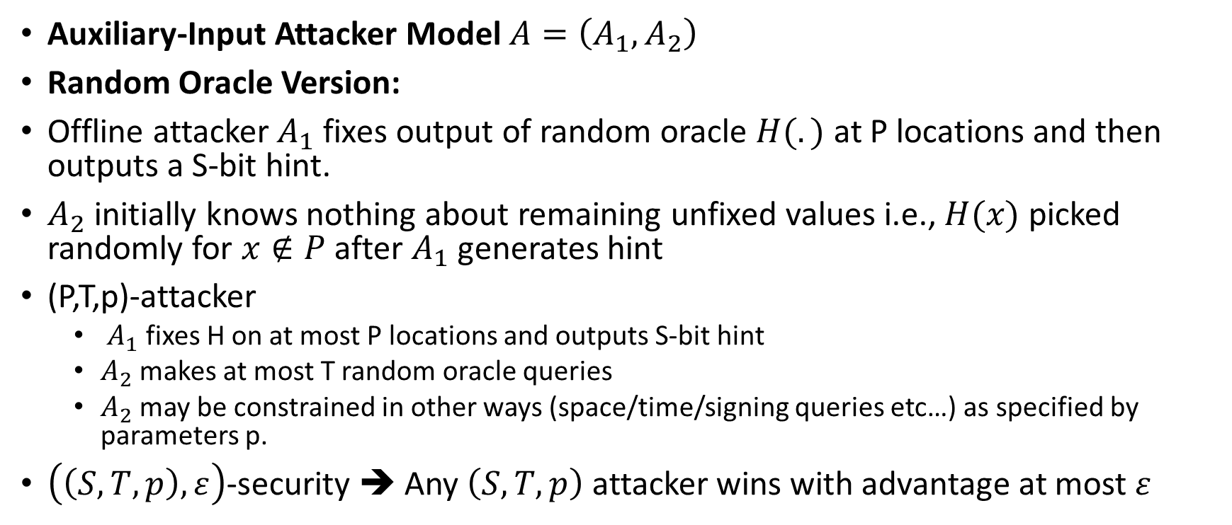
Bit-Fixing Model for Pre-Processing Attacks
Auxiliary-Input Attacker Model $A=\left(A_{1},A_{2}\right)$
Random Oracle Version:
Offline attacker $A_{1}$ fixes output of random oracle $H(.)$ at P locations and then outputs a S-bit hint.
$A_{2}$ initially knows nothing about remaining unfixed values i.e., $H(x)$ picked randomly for $x∉P$ after $A_{1}$ generates hint
(P,T,p)-attacker
  $A_{1}$ fixes H on at most P locations and outputs S-bit hint
  $A_{2}$ makes at most T random oracle queries
  $A_{2}$ may be constrained in other ways (space/time/signing queries etc…) as specified by parameters p.
$\left(\left(S,T,p\right),ε\right)$-security ➔ Any $\left(S,T,p\right)$ attacker wins with advantage at most $ε$

Slide 42
Bit-Fixing Model (Unruh)
Pro: Much easier to prove lower bounds in Bit-Fixing Model
Con: Bit-Fixing model is not a compelling model for pre-processing attacks
Usage: Lower bound in bit-fixing model ➔ Lower bound in Auxilliary-Input Model
This approach yields tight lower-bounds in the Auxilliary-Input Model for some applications ☺
Other applications require a different approach (e.g., compression)

Slide 45
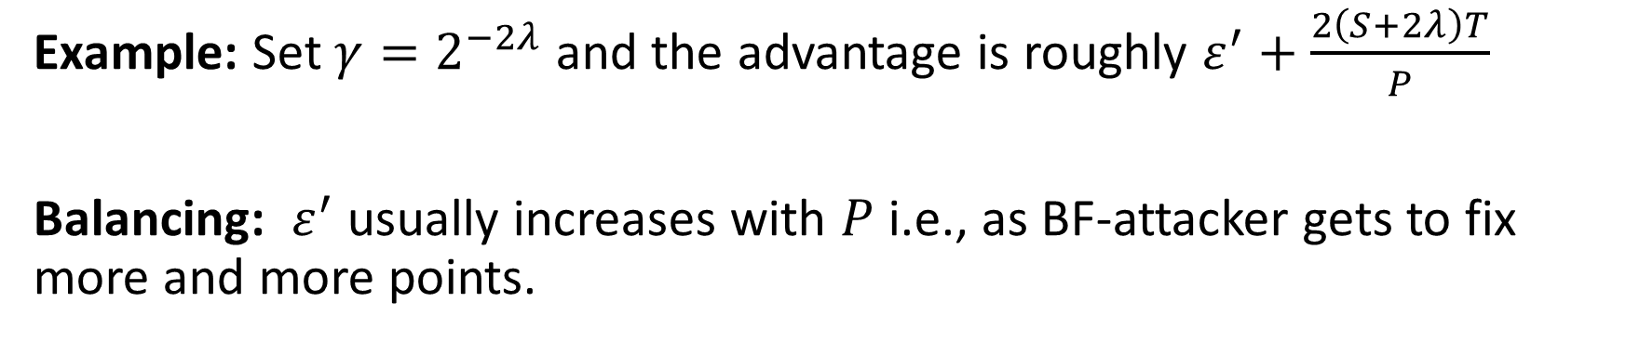
Relationship: BF-RO and AI-RO
Example: Set $γ=2^{−2λ}$ and the advantage is roughly $ε^{′}+\frac{2\left(S+2λ\right)T}{P}$
Balancing: $ε^{′}$ usually increases with $P$ i.e., as BF-attacker gets to fix more and more points.

Slide 46
Relationship: BF-RO and AI-RO

Slide 47
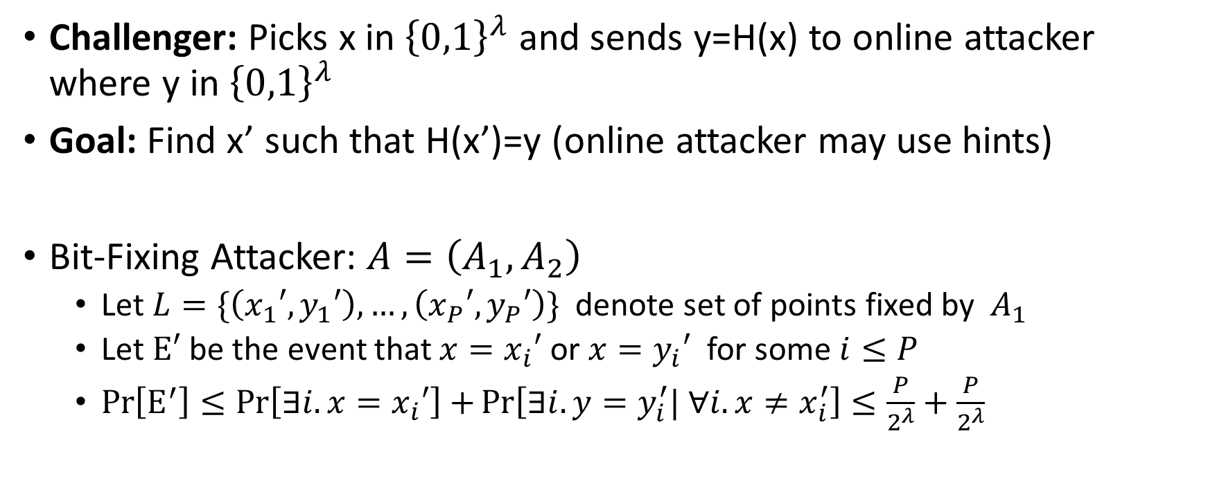
Application: Function-Inversion
Challenger: Picks x in ${\left\{0,1\right\}}^{λ}$ and sends y=H(x) to online attacker where y in ${\left\{0,1\right\}}^{λ}$
Goal: Find x’ such that H(x’)=y (online attacker may use hints)
Bit-Fixing Attacker: $A=\left(A_{1},A_{2}\right)$
  Let $L=\{\left(x_{1}′,y_{1}′\right),…,\left(x_{P}′,y_{P}′\right)\}$ denote set of points fixed by $A_{1}$
  Let $Ε′$ be the event that ${x=x}_{i}′$ or ${x=y}_{i}′$ for some $i≤P$
  $\operatorname{Pr}\left[Ε^{′}\right]≤\operatorname{Pr}\left[∃i. {x=x}_{i}′\right]+\operatorname{Pr}\left[∃i. {y=y}_{i}^{′}| ∀i.{x≠x}_{i}^{′}\right]≤\frac{P}{2^{λ}}+\frac{P}{2^{λ}}$
x is random
$y_{i}^{′}$ = H($x_{i}^{′}$) is uniformly random if not previously fixed i.e., ${x≠x}_{i}^{′}$ for all i

Slide 48
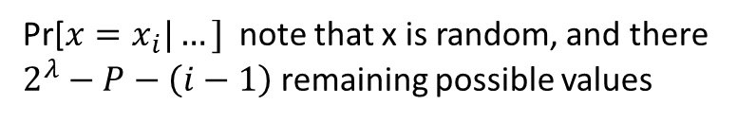
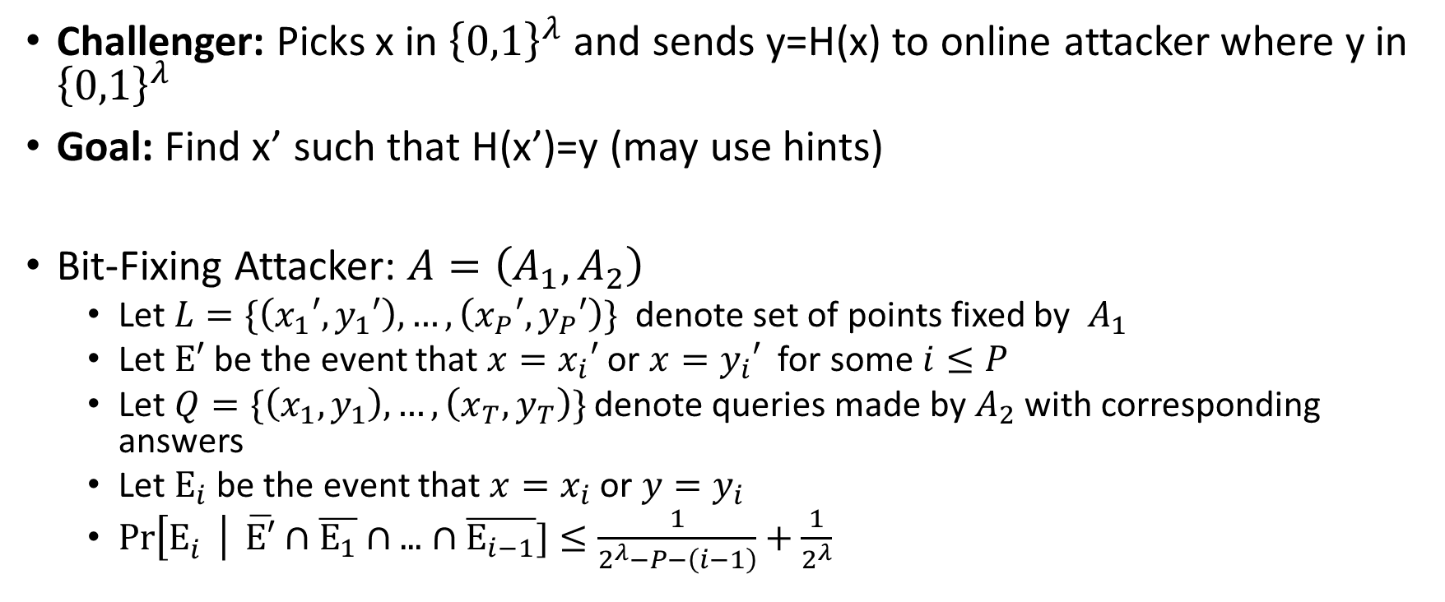


Application: Function-Inversion
Challenger: Picks x in ${\left\{0,1\right\}}^{λ}$ and sends y=H(x) to online attacker where y in ${\left\{0,1\right\}}^{λ}$
Goal: Find x’ such that H(x’)=y (may use hints)
Bit-Fixing Attacker: $A=\left(A_{1},A_{2}\right)$
  Let $L=\{\left(x_{1}′,y_{1}′\right),…,\left(x_{P}′,y_{P}′\right)\}$ denote set of points fixed by $A_{1}$
  Let $Ε′$ be the event that ${x=x}_{i}′$ or ${x=y}_{i}′$ for some $i≤P$
  Let $Q=\{\left(x_{1},y_{1}\right),…,\left(x_{T},y_{T}\right)\}$ denote queries made by $A_{2}$ with corresponding answers
  Let $Ε_{i}$ be the event that ${x=x}_{i}$ or ${y=y}_{i}$
  $\operatorname{Pr}\left[Ε_{i}^{}\right| \overline{Ε′}∩$ $\overline{Ε_{1}}∩\text{...}∩\overline{Ε_{i−1}}]≤\frac{1}{2^{λ}−P−\left(i−1\right)}+\frac{1}{2^{λ}}$
Pr[${y=y}_{i}|…]$note that
$y_{i}^{}$ = H($x_{i}^{}$) is uniformly random if not previously fixed i.e., if $x_{i}^{}≠x$, $x_{i}^{}$ not in $L$ and ${x_{i}^{}≠x}_{j}^{}$ for all j<i,
Pr[${x=x}_{i}|…]$ note that x is random, and there
$2^{λ}−P−\left(i−1\right)$ remaining possible values

Slide 49


Application: Function-Inversion
Challenger: Picks x in ${\left\{0,1\right\}}^{λ}$ and sends y=H(x) to online attacker where y in ${\left\{0,1\right\}}^{λ}$
Goal: Find x’ such that H(x’)=y (may use hints)
Bit-Fixing Attacker: $A=\left(A_{1},A_{2}\right)$
  Attacker wins with probability at most
  $$\operatorname{Pr}\left[Ε^{′}\right]+\sum_{i≤q}{\operatorname{Pr}\left[Ε_{i}^{}\right| \overline{Ε′}∩ \overline{Ε_{1}}∩\text{...}∩\overline{Ε_{i−1}}]}≤\frac{2P+q}{2^{λ}}+\frac{q}{2^{λ}−P−q}≤\frac{2P+3q}{2^{λ}}$$
Assume $P+q≤2^{λ−1}$

Slide 50

Application: Function-Inversion
Bit-Fixing Attacker: $A=\left(A_{1},A_{2}\right)$
  Attacker wins with probability at most
  $$\operatorname{Pr}\left[Ε^{′}\right]+\sum_{i≤q}{\operatorname{Pr}\left[Ε_{i}^{′}\right| \overline{Ε′}∩ \overline{Ε_{1}}∩\text{...}∩\overline{Ε_{i−1}}]}≤\frac{2P+q}{2^{λ}}+\frac{q}{2^{λ}−P−q}$$
  Set $P≥6\left(S+2λ\right)T$ ➔ Auxilliary-Input Attacker wins with Probability at most
  $$2\left(\frac{6\left(S+2λ\right)T+T}{2^{λ}}+\frac{6\left(S+2λ\right)T}{2^{λ}−6\left(S+2λ\right)T−T}\right)+2^{−2λ}=O\left(\frac{ST+λT}{2^{λ}}\right)$$

Slide 51

Review: Bit-Fixing vs Auxiliary Input
Auxiliary-Input: (S,T,p)-attacker
  $A_{1}$ outputs a S-bit hint based on the entire description of ideal-object
  $A_{2}$ makes at most T oracle queries
  $A_{2}$ may be constrained in other ways (space/time/signing queries etc…) as specified by parameters p.
Bit-Fixing: (P,S,T,p)-attacker
  $A_{1}$ fixes at most P input/output pairs and outputs a S-bit hint. The remaining ideal object is picked randomly subject to this restriction.
  $A_{2}$ makes at most T oracle queries
  $A_{2}$ may be constrained in other ways (space/time/signing queries etc…) as specified by parameters p.

Slide 52
Bit-Fixing Model (Unruh)
Pro: Much easier to prove lower bounds in Bit-Fixing Model
Con: Bit-Fixing model is not a compelling model for pre-processing attacks
Usage: Lower bound in bit-fixing model ➔ Lower bound in Auxiliary-Input Model
This approach yields tight lower-bounds in the Auxiliary-Input Model for some applications ☺
Other applications require a different approach (e.g., compression)

Slide 53
Relationship Bit-Fixing and Auxilliary Input

Slide 54


Generic Group Lower Bound
Discrete Log Problem: Given generator $g$ and $g^{x}$ find $x$
Generic Group Version: Given $τ\left(1\right)$ and $τ\left(x\right)$ find x
Generic Group Version Lower Bound: Any generic attacker making q queries to GGM oracles succeeds with probability at most
$$O\left(\frac{q^{2}}{2^{2λ}}\right)$$
Proof Sketch: Initialize two sets $K=\{\left(1,τ\left(1\right)\right)\}$ and $U=\{\left(x,τ\left(x\right)\right)\}$
  $K$ ➔ Discrete Log Known
  U ➔ Discrete Log Depends on Unknown x
  $\operatorname{mult}\left(τ\left(1\right),τ(1)\right)=τ\left(2\right)$ ➔ Add $\left(2,τ\left(2\right)\right)$ to $K$
  $\operatorname{mult}\left(τ\left(x\right),τ(x)\right)=τ\left(2x\right)$➔ Add $\left(2x,τ\left(2x\right)\right)$ to $U$
  $\operatorname{mult}\left(τ\left(x\right),τ(1)\right)=τ\left(x+1\right)$➔ Add $\left(x+1,τ\left(x+1\right)\right)$ to $U$
  Each new query adds item to $K$ or $U$
  Cannot learn x unless sets intersect e.g., $\operatorname{mult}\left(τ\left(x\right),τ(x+1)\right)=τ\left(2x+1\right)$is found in $K$
  Sets remain disjoint with probability$≈\frac{\left|U\right||K|}{2^{2λ}}≤\frac{q^{2}}{2^{2λ}}$
  Technical Note: If attacker queries $\operatorname{mult}\left(κ,.\right)$ for fresh $κ$ which is not in $K$ or $U$ then can add $\left(τ^{−1}\left(κ\right),κ\right)$ to K
Generic Group of prime order $p≈2^{2λ}$:

Slide 55


Generic Group Lower Bound with Bit-Fixing
Generic Group Version Lower Bound: Any Bit-Fixing attacker making q queries to GGM oracles (online) and fixing at most P points succeeds with probability at most
$$O\left(\frac{q^{2}+qP}{2^{2λ}}\right)$$
Proof Sketch: Let $L=\left\{\left(x_{1},y_{1}\right),…,\left(x_{P},y_{P}\right)\right\}$ denote the fixed points where attacker fixed${τ\left(x_{i}\right)=y}_{i}$
Initialize two sets $K=\left\{\left(1,τ\left(1\right)\right)\right\}∪L$ and $U=\{\left(x,τ\left(x\right)\right)\}$
  $K$ ➔ Discrete Log Known
  U ➔ Discrete Log Depends on Unknown x
  Each new query adds item to $K$ or $U$
  Cannot learn x unless sets intersect
  Sets remain disjoint with probability$≈\frac{\left|U\right||K|}{2^{2λ}}≤\frac{q^{2}}{2^{2λ}}$

Slide 56


Generic Group Lower Bound with Preprocessing Attacker
Generic Group Version Lower Bound: Any auxiliary-input attacker making q queries to GGM oracles (online) and with a S bit hint points succeeds with probability at most
$$O\left(\frac{q^{2}+q^{2}(S+λ)}{2^{2λ}}\right)$$
Proof Sketch: Set $P=O\left(\left(S+2λ\right)q\right)$ for our bit-fixing attacker A bit-fixing attacker succeeds with probability at most
$$ε=O\left(\frac{q^{2}+q^{2}(S+λ)}{2^{2λ}}\right)$$
It follows that the AI-attacker succeeds with probability at most $2ε+2^{−2λ}=O\left(\frac{q^{2}+q^{2}(S+λ)}{2^{2λ}}\right)$

Slide 57

Block-Ciphers with Leakage
Ideal Cipher Model
  All parties have oracle access to $E(∙$, $∙$) and $E^{−1}(∙\text{,} ∙)$
  For any fixed key K the function$E_{K}\left(x\right)≔ E(K\text{,} x)$ is a truly random permutation and $E_{K}^{−1}\left(x\right)≔E^{−1}(K\text{,} x)$ is the inverse
Question: Can we still safely use the block-cipher after S-bit leakage?

Slide 58

Block-Ciphers with Leakage
Question: Can we still safely use the block-cipher after S-bit leakage?
Leakage Security Game:
  Offline Attacker $A_{1}$outputs S-bit hint
  Online Attacker has to predict secret bit b
  Real World (b=0): Online attacker may query $E(∙$, $∙$) , $E^{−1}(∙\text{,} ∙)$, $E(K$, $∙$) and $E^{−1}(K\text{,} ∙)$, where K is a random key picked by the challenger
  Ideal World (b=1): Online attacker may query $E(∙$, $∙$) , $E^{−1}(∙\text{,} ∙)$, $f(∙$) and $f^{−1}(∙)$ where $f$ is a truly random permutation (independent of block-cipher + hint).
  Online Attacker may make T queries to $E(∙$, $∙$) or $E^{−1}(∙\text{,} ∙)$ and q queries to $E(K$, $∙$) or $E^{−1}(K\text{,} ∙)$ when b=0 (resp. $f(∙$) or $f^{−1}(∙)$ when b=1)

Slide 59

Block-Ciphers with Leakage
Leakage Security Game:
  Offline Attacker $A_{1}$outputs S-bit hint
  Online Attacker has to predict secret bit b
  Real World (b=0): Online attacker may query $E(∙$, $∙$) , $E^{−1}(∙\text{,} ∙)$, $E(K,∙)$ and $E^{−1}(K\text{,} ∙)$, where K is a random key picked by the challenger
  Ideal World (b=1): Online attacker may query $E(∙$, $∙$) , $E^{−1}(∙\text{,} ∙)$, $f(∙)$ and $f^{−1}(∙)$ where $f$ is a truly random permutation (independent of block-cipher + hint).
Analysis (Bit Fixing Attacker): Let
$$L=\left\{K^{′}: ∃x s.t. E\left(K,x\right) was fixed by A_{1}\right\}$$
and observe that $\operatorname{Pr}\left[K∈L\right]≤{|L|2}^{−λ}$.

Slide 60



Block-Ciphers with Leakage
Analysis (Bit Fixing Attacker): Let
$$L=\left\{K′: ∃x s.t. E\left(K′,x\right) was fixed by A_{1}\right\}$$
$$\operatorname{Pr}\left[K∈L\right]≤{\left|L\right|2}^{−λ}≤{P2}^{−λ}$$
Let $B_{i}^{}$ denote event that $K=K_{i}$ where $K_{i}$ is the key used in the ith query to $E\left(.,.\right)$ or $E^{−1}(∙\text{,} ∙)$
$$\operatorname{Pr}\left[B_{i}^{}\right| \overline{L}∩ \overline{B_{1}}∩\text{...}∩\overline{B_{i−1}}]≤\frac{1}{2^{λ}−\left|P\right|−i}≤\frac{2}{2^{λ}}$$
$2^{λ}−\left|P\right|−i$ possible keys remain
WLOG assume $\left|P\right|+T≤2^{λ−1}$
(otherwise upper bound on success rate of bit-fixing attacker becomes 1 holds trivially)

Slide 61

Block-Ciphers with Leakage
Analysis (Bit Fixing Attacker): Let
$$L=\left\{K^{′}: ∃x s.t. E\left(K′,x\right) was fixed by A_{1}\right\}$$
$$\operatorname{Pr}\left[K∈L\right]≤{\left|L\right|2}^{−λ}≤{P2}^{−λ}$$
Let $B_{i}^{}$ denote event that $K=K_{i}$ where $K_{i}$ is the key used in the ith query to $E\left(.,.\right)$ or $E^{−1}(∙\text{,} ∙)$
If the attacker does not query K or fix an input for K then the attacker cannot distinguish between b=0 or b=1 since $E(K$, $∙$) is a random permutation. Advantage is upper bounded by
$$\operatorname{Pr}\left[L\right]+\sum_{i≤T}{\operatorname{Pr}\left[B_{i}^{}\right| \overline{L}∩ \overline{B_{1}}∩\text{...}∩\overline{B_{i−1}}]}≤\frac{P}{2^{λ}}+\frac{2T}{2^{λ}}=\frac{P+2T}{2^{λ}}$$

Slide 62


Block-Ciphers with Leakage
Analysis (Pre-Processing Attacker):
Advantage of pre-processing is upper bounded by
$$O\left(\frac{P+T}{2^{λ}}+\frac{\left(S+λ\right)(T+q)}{P}\right)$$
Set $P=\sqrt{\left(S+λ\right)T2^{λ}}$ ➔ $O\left(\frac{T}{2^{λ}}+\sqrt{\frac{\left(S+λ\right)(T+q)}{2^{λ}}}\right)$
$T_{comb}=T+1$ combined # of queries to ideal object

Slide 63

Block-Ciphers with Leakage
Thm (Informal): an ideal cipher is $\left(\left(S,T,q\right),ε\right)$-secure against preprocessing attacks in the auxiliary-input model with
$$ε=O\left(\frac{T}{2^{λ}}+\sqrt{\frac{\left(S+λ\right)(T+q)}{2^{λ}}}\right)$$
Best Attack: $ε=Ω\left(\frac{T}{2^{λ}}+\sqrt{\frac{S}{2^{λ}}}\right)$
Open Question: Better attack or tighter lower-bound?
Note: Lower-bound likely requires different techniques (e.g., compression?)

Slide 64

Sponge-Construction
Input: $m=(m_{1},…,m_{ℓ})$ with $m_{i}∈{\left\{0,1\right\}}^{r}$
$s_{0}= s_{0}^{(1)}\left\|s_{0}^{(2)}\right.$ where ${s_{0}^{(1)}=0}^{r}$ and $s_{0}^{(2)}=0^{c}$ and
For $i=1,…,ℓ;$ set $s_{i}=s_{i}^{(1)}\left\|s_{i}^{(2)}\right.=π\left(\left(s_{i−1}^{(1)}⨁m_{i}\right)\left\|s_{i−1}^{(2)}\right.\right)$
Output: $s_{ℓ}^{(1)}$
Collision-Game: Attacker $A_{1}$outputs s-bit hint based on ideal permutation $π$. $A_{2}$ tries to find collision for sponge construction.

Slide 65


Sponge-Construction: ${Sponge}_{π}(.)$
Input: $m=(m_{1},…,m_{ℓ})$ with $m_{i}∈{\left\{0,1\right\}}^{r}$
$s_{0}= s_{0}^{(1)}\left\|s_{0}^{(2)}\right.$ where ${s_{0}^{(1)}=0}^{r}$ and $s_{0}^{(2)}=0^{c}$ and
For $i=1,…,ℓ;$ set $s_{i}=s_{i}^{(1)}\left\|s_{i}^{(2)}\right.=π\left(\left(s_{i−1}^{(1)}⨁m_{i}\right)\left\|s_{i−1}^{(2)}\right.\right)$
Output: ${Sponge}_{π}\left(m_{1},…,m_{ℓ}\right):=s_{ℓ}^{(1)}$
Pre-processing Attack: Find $m_{1}$ and $m_{2}$ such that $π\left(\left(m_{1}\right)\left\|0^{c}\right.\right)$ and $π\left(\left(m_{2}\right)\left\|0^{c}\right.\right)$ match on first r-bits. $A_{1}$ outputs hint $m_{1}$ and $m_{2}$.

Slide 66


Salted Sponge-Construction: ${Sponge}_{π,IV}(.)$
Input: $m=(m_{1},…,m_{ℓ})$ with $m_{i}∈{\left\{0,1\right\}}^{r}$
$s_{0}= s_{0}^{(1)}\left\|s_{0}^{(2)}\right.$ where ${s_{0}^{(1)}=0}^{r}$ and $s_{0}^{(2)}=IV∈{\left\{0,1\right\}}^{c}$ (random salt) For $i=1,…,ℓ;$ set $s_{i}=s_{i}^{(1)}\left\|s_{i}^{(2)}\right.=π\left(\left(s_{i−1}^{(1)}⨁m_{i}\right)\left\|s_{i−1}^{(2)}\right.\right)$
Output: $s_{ℓ}^{(1)}$
Question: Is the salted sponge-construction secure against pre-processing attacks?
Parameters: Attacker gets S-bit hint, q queries to $π$ or $π^{−1}$ and outputs a collision of length at most $ℓ$.
First Step: Analyze a bit-fixing attacker who can fix P input/outputs for $π$

Slide 67

Salted Sponge-Construction
Input: $m=(m_{1},…,m_{ℓ})$ with $m_{i}∈{\left\{0,1\right\}}^{r}$
$s_{0}= s_{0}^{(1)}\left\|s_{0}^{(2)}\right.$ where ${s_{0}^{(1)}=0}^{r}$ and $s_{0}^{(2)}=IV∈{\left\{0,1\right\}}^{c}$ (random salt)
For $i=1,…,ℓ;$ set $s_{i}=s_{i}^{(1)}\left\|s_{i}^{(2)}\right.=π\left(\left(s_{i−1}^{(1)}⨁m_{i}\right)\left\|s_{i−1}^{(2)}\right.\right)$
Output: $s_{ℓ}^{(1)}$
First Step: Analyze a bit-fixing attacker who can fix P input/outputs for $π$
At the cost of $2ℓ$ additional queries to $π$ we can assume (WLOG) that the attacker who outputs $m$ and $m′$ has queried $π$ at all points needed to evaluate ${Sponge}_{π}\left(m\right)$ and ${Sponge}_{π}\left(m′\right)$ since $m$ and $m′$ are at most $ℓ$-blocks long

Slide 68



Analysis Tool 1: Permutation Graph
Permutation Graph: $G_{π}$
Nodes:$V={\left\{0,1\right\}}^{c+r}$
Directed Edges: $(s,t=π\left(s\right))$
  Each node has indegree 1 and outdegree 1
  Label Edges with first $r$ bits of output $t^{(1)}\left\|t^{(2)}\right.=π\left(s\right)$
Special Start node: $s_{0}=0^{r}\left\|IV\right.$
A sponge-input $m=(m_{1},…,m_{ℓ})$ with $m_{i}∈{\left\{0,1\right\}}^{r}$ defines a path in the above graph $s_{0},s_{1},…,s_{ℓ}$ with $s_{i}=π\left(\left(s_{i−1}^{(1)}⨁m_{i}\right)\left\|s_{i−1}^{(2)}\right.\right)$
s
$$t^{(1)}$$
$$π\left(s\right)$$

Slide 69

Analysis Tool 1: Permutation Graph
Permutation Graph: $G_{π}$
Nodes:$V={\left\{0,1\right\}}^{c+r}$
Directed Edges: $(s,t=π\left(s\right))$
  Each node has indegree 1 and outdegree 1
  Label Edges with first $r$ bits of output $t^{(1)}\left\|t^{(2)}\right.=π\left(s\right)$
Call a node s prefixed if $A_{1}$ fixed the value of $π\left(s\right)$
Attacker is only aware of some of the edges e.g., after making q queries to $π$ attacker is only aware at most P+q directed edges.
Let $G_{π,0}$ denote initial known graph (using only edges defined by P prefixed points)
Let $G_{π,i}$ denote known graph after i queries to $π$ or $π^{−1}$
s
$$t^{(1)}$$
$$π\left(s\right)$$

Slide 70

Analysis Tool 1: Permutation Graph
Permutation Graph: $G_{π}$
Nodes:$V={\left\{0,1\right\}}^{c+r}$
Directed Edges: $(s,t=π\left(s\right))$
  Each node has indegree 1 and outdegree 1
  Label Edges with first $r$ bits of output $t^{(1)}\left\|t^{(2)}\right.=π\left(s\right)$
Let $G_{π,0}$ denote initial known graph (using only edges defined by P prefixed points)
Let $G_{π,i}$ denote known graph after i queries to $π$ or $π^{−1}$
Special Start node: $s^{∗}=0^{r}\left\|IV\right.$
Collision $⟺$for some label $t^{(1)}∈{\left\{0,1\right\}}^{r}$are two distinct paths from start node $s^{∗}$ both ending an edge labeled $t^{(1)}$ in $G_{π,q}$
s
$$t^{(1)}$$
$$π\left(s\right)$$

Slide 71




Analysis Tool 2: Super-Node Graph
$$s^{(2)}$$
$$(s^{\left(1\right)},t^{\left(1\right)})$$
$$t^{(2)}$$
Permutation Super Graph
Nodes: $V^{′}={\left\{0,1\right\}}^{c}$
Directed Edges: $(s^{\left(2\right)},t^{\left(2\right)})∈E′$ iff there exists strings $s^{\left(1\right)},t^{\left(1\right)}∈{\left\{0,1\right\}}^{r}$ such that $t^{(1)}\left\|t^{(2)}\right.=π\left(s^{(1)}\left\|s^{(2)}\right.\right)$
Label edges with $(s^{\left(1\right)},t^{\left(1\right)})$
Starting Super-node: $IV∈{\left\{0,1\right\}}^{c}$
Let $G_{0}$ denote the initial super-graph (defined using P fixed points)
Let $G_{i}$ denote the super-graph after i queries to $π$ or $π^{−1}$
Call a super-node $s^{\left(2\right)}∈{\left\{0,1\right\}}^{c}$ ``pre-fixed” if there exists $s^{\left(1\right)}∈{\left\{0,1\right\}}^{r}$ such that $s=s^{(1)}\left\|s^{(2)}\right.$ was pre-fixed

Slide 72

Analysis Tool 2: Super-Node Graph
$$s^{(2)}$$
$$(s^{\left(1\right)},t^{\left(1\right)})$$
$$t^{(2)}$$
Permutation Super Graph
Starting Super-node: $IV∈{\left\{0,1\right\}}^{c}$
Let $G_{0}$ denote the initial super-graph (defined using P fixed points)
Let $G_{i}$ denote the super-graph after i queries to $π$ or $π^{−1}$
Call a super-node $s^{\left(2\right)}∈{\left\{0,1\right\}}^{c}$ ``pre-fixed” if there exists $s^{\left(1\right)}∈{\left\{0,1\right\}}^{r}$ such that $s=s^{(1)}\left\|s^{(2)}\right.$ was pre-fixed
Let $B_{i}$ denote the event that either
  (1) $G_{i}$ contains a path from starting node IV to some pre-fixed
  (2) $G_{i}$ contains two distinct paths from starting node IV to $x$ for some supernode $x∈{\left\{0,1\right\}}^{c}$
$$\operatorname{Pr}\left[B_{0}\right]=Pr⁡[IV prefixed]≤\frac{P}{2^{c}}$$

Slide 73

Analysis Tool 2: Super-Node Graph
$$s^{(2)}$$
$$(s^{\left(1\right)},t^{\left(1\right)})$$
$$t^{(2)}$$
Permutation Super Graph
Let $B_{i}$ denote the event that either
  (1) $G_{i}$ contains a path from starting node IV to some pre-fixed
  (2) $G_{i}$ contains two distinct paths from starting node IV to $x$ for some supernode $x∈{\left\{0,1\right\}}^{c}$
If $B_{T+2ℓ}$ does not occur then every supernode has one incoming edge and the value $t^{\left(1\right)}∈{\left\{0,1\right\}}^{r}$ (potential hash output) is uniform.
$$\operatorname{Pr}\left[COLLISION| \overline{B_{T+2ℓ}}\right]≤\left({T+2ℓ \atop 2}\right)2^{−r}$$

Slide 74

Probability of Bad Event (Forward Query)
Let $B_{i}$ denote the event that either
  (1) $G_{i}$ contains a path from starting node IV to some pre-fixed
  (2) $G_{i}$ contains two distinct paths from starting node IV to $x$ for some supernode $x∈{\left\{0,1\right\}}^{c}$
Suppose that no bad event has occurred after the first i-1 queries to $π$ or $π^{−1}$ and that the ith query is of the form
$$π\left(t^{(1)}\left\|t^{(2)}\right.\right)=y^{(1)}\left\|y^{(2)}\right.$$
Adds edge from supernode $t^{(2)}$ to $y^{(2)}$.
Bad if there was already a path to $y^{(2)}$ or if $y^{(2)}$ was fixed.
At most $(i+P)2^{r}$ bad outputs for $π\left(t^{(1)}\left\|t^{(2)}\right.\right)$ out of $2^{r+c}−\left(i−1+P\right)$ possibilities

Slide 75


Probability of Bad Event (Forward Query)
Let $B_{i}$ denote the event that either
  (1) $G_{i}$ contains a path from starting node IV to some pre-fixed
  (2) $G_{i}$ contains two distinct paths from starting node IV to $x$ for some supernode $x∈{\left\{0,1\right\}}^{c}$
Suppose that no bad event has occurred after the first i-1 queries to $π$ or $π^{−1}$ and that the ith query is of the form
$$π\left(t^{(1)}\left\|t^{(2)}\right.\right)=y^{(1)}\left\|y^{(2)}\right.$$
Adds edge from supernode $t^{(2)}$ to $y^{(2)}$. Bad if there was already a path to $y^{(2)}$ or if $y^{(2)}$ was fixed.
$$\operatorname{Pr}\left[B_{i}^{}\right| \overline{B_{1}}∩\text{...}∩\overline{B_{i−1}}]≤\frac{\left(i+P\right)2^{r}}{2^{c+r}−\left(i−1+P\right)}≤\frac{i+P}{2^{c−1}}$$
WLOG assume $P+T+2ℓ≤2^{c+r−1}$

Slide 76

Probability of Bad Event (Inverse Query)
Let $B_{i}$ denote the event that either
  (1) $G_{i}$ contains a path from starting node IV to some pre-fixed
  (2) $G_{i}$ contains two distinct paths from starting node IV to $x$ for some supernode $x∈{\left\{0,1\right\}}^{c}$
Suppose that no bad event has occurred after the first i-1 queries to $π$ or $π^{−1}$ and that the ith query is of the form
$$π^{−1}\left(y^{(1)}\left\|y^{(2)}\right.\right)=t^{(1)}\left\|t^{(2)}\right.$$
Adds edge from supernode $t^{(2)}$ to $y^{(2)}$.
Potentially bad if there was already a path from IV to $y^{(2)}$.
At most $i2^{r}$ bad outputs form $π^{−1}\left(y^{(1)}\left\|y^{(2)}\right.\right)$ out of $2^{r+c}−\left(i−1+P\right)$ possibilities

Slide 77

Probability of Bad Event (Inverse Query)
Let $B_{i}$ denote the event that either
  (1) $G_{i}$ contains a path from starting node IV to some pre-fixed
  (2) $G_{i}$ contains two distinct paths from starting node IV to $x$ for some supernode $x∈{\left\{0,1\right\}}^{c}$
Suppose that no bad event has occurred after the first i-1 queries to $π$ or $π^{−1}$ and that the ith query is of the form
$$π^{−1}\left(y^{(1)}\left\|y^{(2)}\right.\right)=t^{(1)}\left\|t^{(2)}\right.$$
$$\operatorname{Pr}\left[B_{i}^{}\right| \overline{B_{1}}∩\text{...}∩\overline{B_{i−1}}]≤\frac{i2^{r}}{2^{c+r}−\left(i−1+P\right)}≤\frac{i}{2^{c−1}}≤\frac{i+P}{2^{c−1}}$$
WLOG assume $P+T+2ℓ≤2^{c+r−1}$

Slide 78

Probability of Bad Event (Total)
Let $B_{i}$ denote the event that either
  (1) $G_{i}$ contains a path from starting node IV to some pre-fixed
  (2) $G_{i}$ contains two distinct paths from starting node IV to $x$ for some supernode $x∈{\left\{0,1\right\}}^{c}$
After all $T+2ℓ$ queries we have
$$\operatorname{Pr}\left[B_{T+2ℓ}^{}\right]≤\operatorname{Pr}\left[B_{0}^{}\right]+\sum_{i=1}^{T+2ℓ}{\operatorname{Pr}\left[B_{i}^{}\right| \overline{B_{1}}∩\text{...}∩\overline{B_{i−1}}]}$$
$$≤\frac{P}{2^{c}}+\sum_{i=1}^{T+2ℓ}{\frac{i+P}{2^{c−1}}}≤\frac{{(T+2ℓ)}^{2}+TP+2ℓP+P}{2^{c−1}}$$

Slide 79

Probability of Collision (Bit-Fixing)
$$\operatorname{Pr}\left[COLLISION| \overline{B_{T+2ℓ}}\right]≤\left({T+2ℓ \atop 2}\right)2^{−r}$$
$$\operatorname{Pr}\left[B_{T+2ℓ}^{}\right]≤\frac{{(T+2ℓ)}^{2}+TP+2ℓP+P}{2^{c−1}}$$
$$\operatorname{Pr}\left[COLLISION\right]≤\left({T+2ℓ \atop 2}\right)2^{−r}+\frac{{(T+2ℓ)}^{2}+TP+2ℓP+P}{2^{c−1}}$$

Slide 80

Probability of Collision: Auxilliary-Input
Bit-Fixing(P): $\operatorname{Pr}\left[COLLISION\right]≤\left({T+2ℓ \atop 2}\right)2^{−r}+\frac{{(T+ℓ)}^{2}+TP+2ℓP+P}{2^{c−1}}$
Set $P=6(S+c+r)(T+2ℓ)$ to apply main theorem
Thm (Informal): Salted-Sponge is $(\left(S,T,ℓ\right),ε)$-secure in the auxiliary-input model with
$$ε≤{O\left(\frac{{\left(T+ℓ\right)}^{2} }{2^{r−1}}+\frac{{\left(T+ℓ\right)}^{2}(S+c+r) }{2^{c−1}}\right)}$$

Slide 82
Course Project Ideas: Analyze different construction vs pre-processing attackers (easier) or tighten existing bounds (likely harder).

Slide 83
Reminder: Link Between BF-RO and AI-RO
So far we have used this result (or similar results for Ideal-Ciphers, Permutations etc…) as a black-box.
How is this result proved?

Slide 84

Leaky vs Dense Sources
Idea 1: Leaky Source (auxiliary-input) can be replaced by convex combination of $(P,1−δ$)-dense sources.
Idea 2: Hard to distinguish between $(P,1−δ$)-dense source and P-bit-fixing source after T queries

