Slide 1
Advanced Cryptography
CS 655
Week 3:
Memory-Tight Reductions
RSA-FDH
Memory-Tightness
Spring 2023

Slide 2



Memory-Tight Reductions
Benedikt Auerbach¹ David Cash² Manuel Fersch¹
Eike Kiltz¹
¹ Horst Görtz Institute for IT Security, Ruhr University Bochum, Germany
² Rutgers University, New Jersey, USA
Crypto 2017, Santa Barbara August 21, 2017

Slide 3
Tightness and Memory-Tightness

Slide 4
Cryptographic Reductions and Tightness
Problem P
Reduction A_{P} Adversary A_{S}
Reduction is tight if Time(A_{P}) ≈ Time(A_{S}) and Succ(A_{P}) ≈ Succ(A_{S})

Slide 5

Relevance of Tightness for Concrete Security
Time
big
unbroken
broken
small
Succ
big small
Time-success trade-off plot for algorithms solving problem P
4 / 23

Slide 6

Relevance of Tightness for Concrete Security
Time
big
unbroken
broken
small
A_{S}
Succ
big small
Time-success trade-off plot for algorithms solving problem P
4 / 23

Slide 7

Relevance of Tightness for Concrete Security
Time
A_{P}
big
∆Time
broken
unbroken
small
AS ∆Succ
Succ
big
small
Non-tight reduction
∆_{Succ} = Succ(A_{S})/Succ(A_{P}) » 1 or ∆_{Time} = Time(A_{P})/Time(A_{S}) » 1
4 / 23

Slide 8
Relevance of Tightness for Concrete Security
Time
big
unbroken
A_{S}/A_{P}
broken
small
Succ
big
small
Tight reduction
Succ(A_{P}) ≈ Succ(A_{S}) Time(A_{P}) ≈ Time(A_{S})
4 / 23

Slide 9
What about memory?
Resources of adversary
Running time
Success probability
Memory consumption

Slide 10
Contributions
Raise awareness for memory usage in reductions
Propose tools for achieving memory-tightness
Concrete application: memory-tight reduction for RSA-FDH
Impossibility of memory-tight reductions for certain problems

Slide 11
Time-Memory Trade-offs

Slide 12
Time-Memory Trade-offs
Some problems are harder with less memory
  in particular many lattice / coding problems
Needs to be taken into account in reductions
Concrete example: Learning Parity with Noise (LPN)

Slide 13
Adding Memory-Consumption
Time
big
small
Succ
big
small
9 / 23

Slide 14
Adding Memory-Consumption
Time
big
small
Succ
small
big
small
big
Mem
9 / 23

Slide 15
Adding Memory-Consumption
Time
big
small
Succ
small
big
small
big
Mem
For simplicity: consider algorithms with constant success probability
9 / 23

Slide 16

Example: Time-Memory Trade-off for LPN
Time
broken unbroken
big
small
Mem
small big
Algorithm 1: Gauss algorithm for dimension λ
Mem = poly(λ), Time ≈ 2^{λ}
10 / 23

Slide 17


Example: Time-Memory Trade-off for LPN
Time
big
broken
unbroken
small
Mem
small big
Algorithm 2: BKW algorithm for dimension λ
_{Mem ≈ 2}λ/ log λ_{, Time ≈ 2}λ/ log λ
10 / 23

Slide 18


Example: Time-Memory Trade-off for LPN
Time
big
broken
unbroken
small
Mem
small big
Time-memory trade-off plot for LPN
10 / 23

Slide 19

Example: Time-Memory Trade-off for LPN
Time
big
broken unbroken
small
Mem
small big
Time-memory trade-off plot for LPN [EKM, 11:00 Lotte Lehman Hall]
10 / 23

Slide 20

Memory-Tight Reductions
Time
big
A_{S}
broken unbroken
small
Mem
small
big
11 / 23

Slide 21

Memory-Tight Reductions
Time
big
A_{P}
A_{S}
∆Mem
broken unbroken
small
Mem
small big
(Time-)Tight but not memory-tight reduction
11 / 23

Slide 22
Memory-Tight Reductions
Time
big
A_{S}/A_{P}
broken unbroken
small
Mem
small big
(Time-)Tight and memory-tight reduction
Time(A_{P}) ≈ Time(A_{S}), Mem(A_{P}) ≈ Mem(A_{S})
11 / 23

Slide 23


Memory-Sensitive Problems
Time
Time
A_{P}
A_{P}
A_{S}
A_{S}
Mem
Mem
Memory-sensitive:
LPN
Shortest Vector Problem
3 collision resistance
DLP in finite fields
Factoring
Not memory-sensitive:
Collision resistance
Preimage resistance
DLP over elliptic curves
Might change in future

Slide 24
Typical Non-Memory-Tight Reductions

Slide 25
Example 1: Random Oracle Simulation
P
A_{P}
A_{S}
 | If H(x₁) = ⊥: H(x₁) ← $ | X_{1________} H(x₁)___
 |  | ..
 |  | .
 | If H(x_{q} ) = ⊥: H(x_{q} ) ← $ | x_{q} H(x_{q} )
Worst case: Mem(A_{P}) ≈ Time(A_{S}), while Mem(A_{S}) small

Slide 26
Example 2: Unforgeability of Signatures
P
A_{P}
A_{S}
M ← M ∪{m₁} | m₁ σ₁ .. . m_{q_____} σ_{q_-________} (m∗,σ∗)__
σ₁ ← Sign(m₁)
M ← M ∪{m_{q} }
σ_{q} ← Sign(m_{q} )
?
m∗ ∈ M
Worst case: Mem(A_{P}) ≈ Time(A_{S}), while Mem(A_{S}) small

Slide 27
Recap
Currently memory often ignored in reductions
Many existing reductions not memory-tight
  Worst case Mem(AP) ≈ Time(AS ) while Mem(AS ) small
Particularly problematic for memory-sensitive problems

Slide 28
Achieving Memory-Tightness

Slide 29
Example 1: Random Oracle Simulation
P
A_{P}
A_{S}
 | If H(x₁) = ⊥: H(x₁) ← $ | x₁ H(x₁)
 | If H(x_{q} ) = ⊥: H(x_{q} ) ← $ | x_{q} H(x_{q} )
RO simulation via lazy sampling
18 / 23

Slide 30
Example 1: Random Oracle Simulation
P
A_{P}
A_{S}
K ← $
x₁
PRF_{K} (x₁)
.
x_{q}
PRF_{K} (x_{q} )
Memory efficient RO simulation [Bernstein 2011]
18 / 23

Slide 31
Example 2: Unforgeability of Signatures
P
A_{P}
A_{S}
M ← M ∪{m₁} | m₁ σ₁ .. . m_{q} σ_{q} (m∗ , σ∗)
σ₁ ← Sign(m₁)
M ← M ∪{m_{q} }
σ_{q} ← Sign(m_{q} )
?
m∗ ∈ M
Usual simulation of unforgeability game
19 / 23

Slide 32
Example 2: Unforgeability of Signatures
P
A_{P}
A_{S}
σ₁ ← Sign(m₁) σ_{q} ← Sign(m_{q} ) Store m∗ Rewind A_{S}
 | m₁ σ₁ .. . m_{q_______}σ_{q} (m∗ , σ∗)
Memory-efficient simulation of unforgeability game
19 / 23

Slide 33
Example 2: Unforgeability of Signatures
P
A_{P}
A_{S}
σ₁ ← Sign(m₁) m =? m∗ 1 σ_{q} ← Sign(m_{q} ) m =? m∗ q
 | m₁ σ₁ .. . m_{q} σq (m∗ , σ∗)
Memory-efficient simulation of unforgeability game
19 / 23

Slide 34
Example 2: Unforgeability of Signatures
P
A_{P}
A_{S}
σ₁ ← Sign(m₁) m =? m∗ 1 σ_{q} ← Sign(m_{q} ) m =? m∗ q
 | m₁ σ₁ .. . m_{q} σq (m∗ , σ∗)
Important: Coins of A_{P} and A_{S} have to be stored memory-efficiently
19 / 23

Slide 35
Lower Bounds

Slide 36
Unforgeability and Multi-Unforgeability
GForge
A
win ← 0 | pk
 | m₁ σ₁ .. . m_{q} σ_{q} (m∗ , σ∗)
M ← M ∪ {m₁}
σ₁ ← Sign(m₁)
M ← M ∪ {m_{q} }
σ_{q} ← Sign(m_{q} )
If m∗ ∈/ M and
Ver(m∗ , σ∗) = 1
win ← 1
win
21 / 23

Slide 37
Unforgeability and Multi-Unforgeability
GmForge
A
win ← 0
pk
m₁
σ₁
M ← M ∪ {m₁}
σ₁ ← Sign(m₁)
..
If m∗ ∈/ M and
.
∗ ∗
1
(m₁ , σ₁ )
Ver(m∗ , σ∗) = 1
1 1
win ← 1
M ← M ∪ {m_{q} }
σ_{q} ← Sign(m_{q} )
..
.
m_{q}
σ_{q}
If m∗ ∈/ M and
k
(m∗ , σ∗)
Ver(m∗ , σ∗) = 1
win
k k
win ← 1
k k
21 / 23

Slide 38
Unforgeability and Multi-Unforgeability
GmForge
A
win ← 0
pk
m₁
σ₁
M ← M ∪ {m₁}
σ₁ ← Sign(m₁)
..
If m∗ ∈/ M and
.
∗ ∗
1
(m₁ , σ₁ )
Ver(m∗ , σ∗) = 1
1 1
win ← 1
M ← M ∪ {m_{q} }
σ_{q} ← Sign(m_{q} )
..
.
m_{q}
σ_{q}
If m∗ ∈/ M and
k
(m∗ , σ∗)
win Ver(m∗ , σ∗) = 1
k k
k k
win ← 1
Tight but not memory-tight reduction (store queries)
21 / 23

Slide 39
Unforgeability and Multi-Unforgeability
GmForge
A
win ← 0
pk
m₁
σ₁
M ← M ∪ {m₁}
σ₁ ← Sign(m₁)
..
If m∗ ∈/ M and
.
∗ ∗
1
(m₁ , σ₁ )
Ver(m∗ , σ∗) = 1
1 1
win ← 1
M ← M ∪ {m_{q} }
σ_{q} ← Sign(m_{q} )
..
.
m_{q}
σ_{q}
If m∗ ∈/ M and
k
(m∗ , σ∗)
win Ver(m∗ , σ∗) = 1
k k
k k
win ← 1
Memory-tight reduction with lower success probability (guess forgery)
21 / 23

Slide 40
Unforgeability and Multi-Unforgeability
GmForge
A
win ← 0
pk
m₁
σ₁
M ← M ∪ {m₁}
σ₁ ← Sign(m₁)
..
If m∗ ∈/ M and
.
∗ ∗
1
(m₁ , σ₁ )
Ver(m∗ , σ∗) = 1
1 1
win ← 1
M ← M ∪ {m_{q} }
σ_{q} ← Sign(m_{q} )
..
.
m_{q}
σ_{q}
If m∗ ∈/ M and
k
(m∗ , σ∗)
win Ver(m∗ , σ∗) = 1
k k
k k
win ← 1
Memory-tight reduction with higher running time (rewind adversary)
21 / 23

Slide 41
Unforgeability and Multi-Unforgeability
Reductions from mForge to Forge (for q adversarial queries)
 |  | Time | Succ | Mem
store | queries | 1 | 1 | q
guess forgery |  | 1 | 1/q | 1
rewind adversary |  | q | 1 | 1
21 / 23

Slide 42
Lower Bounds
Theorem
A certain class of black box reductions from mForge to Forge can not be simultaneously tight and memory-tight.
Proof uses techniques from streaming algorithms
Similar results for multi-collision to collision resistance
22 / 23

Slide 43
Lower Bounds
Theorem
A certain class of black box reductions from mForge to Forge can not be simultaneously tight and memory-tight.
Streaming algorithm A
x₁
x₂
x₃
. . .
x_{q}
22 / 23

Slide 44
Conclusions and Future Work
Memory usage is ignored but affects security.
Many reductions are easily fixed...
... but some seem inherently loose, including some widely used implicitly.
Future work:
Give memory-tight reductions for some constructions (e.g. Hashed ElGamal).
Prove lower bounds in less restrictive models.
ia.cr/2017/675
23 / 23

Slide 45


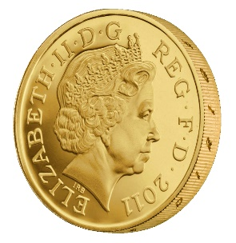




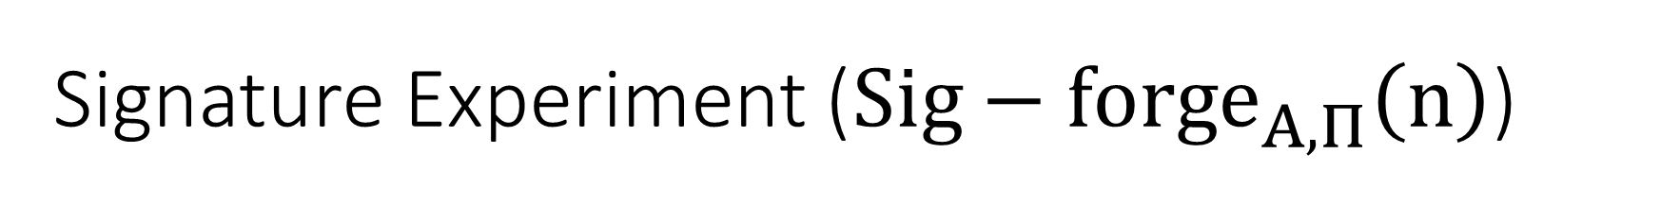

Signature Experiment (${Sig−forge}_{A,Π}^{}\left(n\right)$)
Public Key: pk
m₁
$$σ_{1}={Sign}_{sk}\left(m_{1}^{}\right)$$
m₂
…
$$σ_{2}={Sign}_{sk}\left(m_{2}^{}\right)$$
$$σ ,m∉𝔔=\left\{m_{1},m_{2}…\right\}$$
${Sig−forge}_{A,Π}^{}\left(n\right)=\operatorname{Vrfypk}{(m,σ)}$
(pk,sk) = Gen(.)
$$∀PPT A ∃μ (negligible) s.t$$
$$Pr\left[{Sig−forge}_{A,Π}^{}\left(n\right)=1\right]≤μ(n)$$

Slide 46

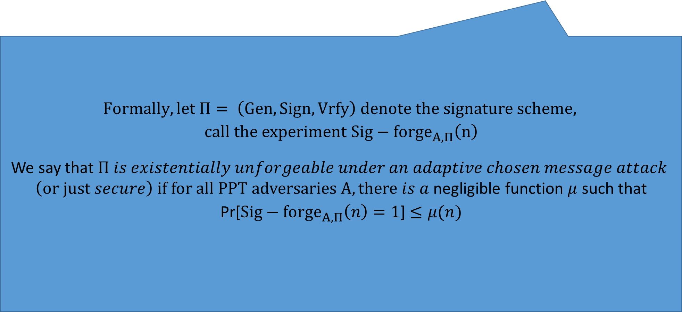

Signature Experiment (${Sig−forge}_{A,Π}^{}\left(n\right)$)
Public Key: pk
$$Formally, let Π= \left(Gen,Sign,Vrfy\right) denote the signature scheme,$$
$$call the experiment {Sig−forge}_{A,Π}^{}\left(n\right)$$
We say that $Π is existentially unforgeable under an adaptive chosen message attack$
$\left(or just secure\right) if for all PPT adversaries A, there is a$negligible function $μ$ such that
Pr[${Sig−forge}_{A,Π}^{}\left(n\right)=1$] $≤μ(n)$
m₁
$$σ_{1}={Sign}_{sk}\left(m_{1}^{}\right)$$
m₂
…
$$σ_{2}={Sign}_{sk}\left(m_{2}^{}\right)$$
$$σ ,m∉\left\{m_{1},m_{2}…\right\}$$
${Sig−forge}_{A,Π}^{}\left(n\right)=\operatorname{Vrfypk}{(m,σ)}$
Random bit b
(pk,sk) = Gen(.)
$$∀PPT A ∃μ (negligible) s.t$$
$$Pr\left[{Sig−forge}_{A,Π}^{}\left(n\right)=1\right]≤μ(n)$$

Slide 47
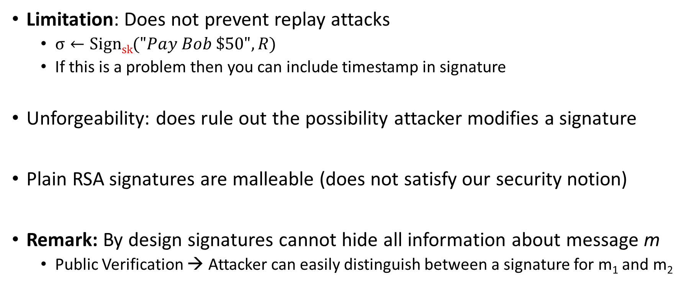
Existential Unforgeability
Limitation: Does not prevent replay attacks
  $σ←Signsk{("Pay Bob \$50", R)}$
  If this is a problem then you can include timestamp in signature
Unforgeability: does rule out the possibility attacker modifies a signature
Plain RSA signatures are malleable (does not satisfy our security notion)
Remark: By design signatures cannot hide all information about message m
  Public Verification → Attacker can easily distinguish between a signature for m₁ and m₂

Slide 48
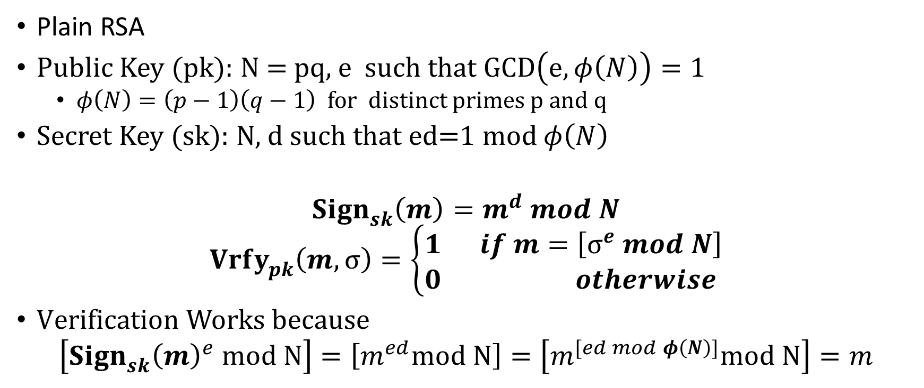
Plain RSA Signatures
Plain RSA
Public Key (pk): N = pq, e such that $GCD\left(e,φ\left(N\right)\right)=1$
  $φ\left(N\right)=\left(p−1\right)\left(q−1\right)$ for distinct primes p and q
Secret Key (sk): N, d such that ed=1 mod $φ\left(N\right)$
$${Sign}_{sk}^{}\left(m\right)=m^{d} mod N$$
$${Vrfy}_{pk}^{}\left(m,σ\right)=\left\{\begin{aligned}1 if m=\left[σ^{e} mod N\right] \\ 0 otherwise \end{aligned}\right.$$
$Verification Works because$
$$\left[{{Sign}_{sk}^{}\left(m\right)}^{e} mod N\right]=\left[m^{ed}mod N\right]=\left[m^{[ed mod φ\left(N\right)]}mod N\right]=m$$

Slide 49
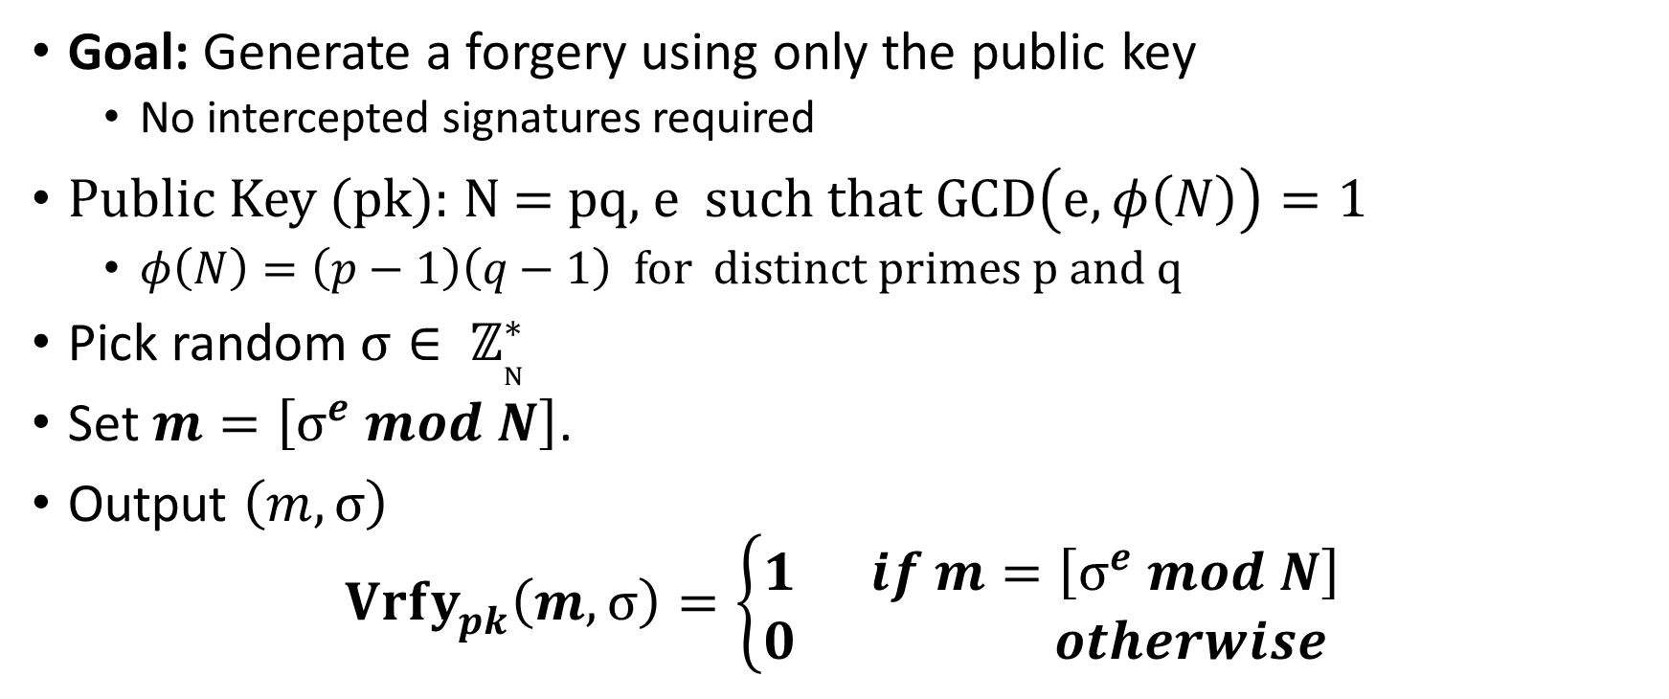
No Message Attack
Goal: Generate a forgery using only the public key
  No intercepted signatures required
Public Key (pk): N = pq, e such that $GCD\left(e,φ\left(N\right)\right)=1$
  $φ\left(N\right)=\left(p−1\right)\left(q−1\right)$ for distinct primes p and q
Pick random$σ∈ ℤ_{N}^{∗}$
Set $m=\left[σ^{e} mod N\right]$.
Output $\left(m,σ\right)$
$${Vrfy}_{pk}^{}\left(m,σ\right)=\left\{\begin{aligned}1 if m=\left[σ^{e} mod N\right] \\ 0 otherwise \end{aligned}\right.$$

Slide 50
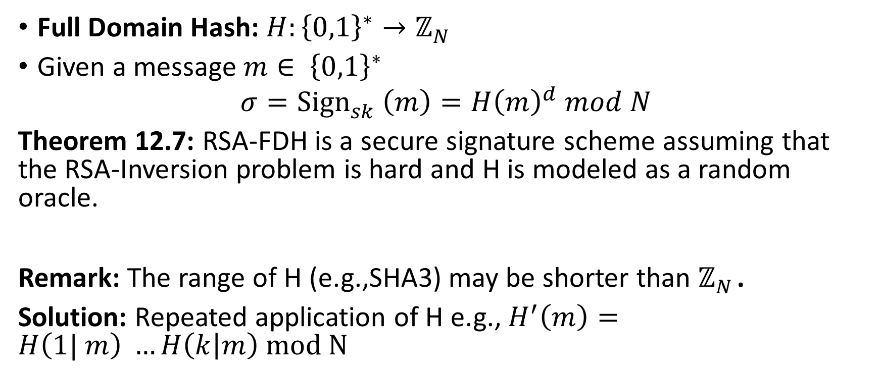
RSA-FDH
Full Domain Hash: $H:{\left\{0,1\right\}}^{∗}→ℤ_{N}^{}$
Given a message $m∈ {\left\{0,1\right\}}^{∗}$
$$σ={Sign}_{sk}^{}\left(m\right)=H{\left(m\right)}^{d} mod N$$
Theorem 12.7: RSA-FDH is a secure signature scheme assuming that the RSA-Inversion problem is hard and H is modeled as a random oracle.
Remark: The range of H (e.g.,SHA3) may be shorter than $ℤ_{N}^{}$.
Solution: Repeated application of H e.g., $H^{′}\left(m\right)=H\left(1| m\right) …H\left(k | m\right) mod N$

Slide 51
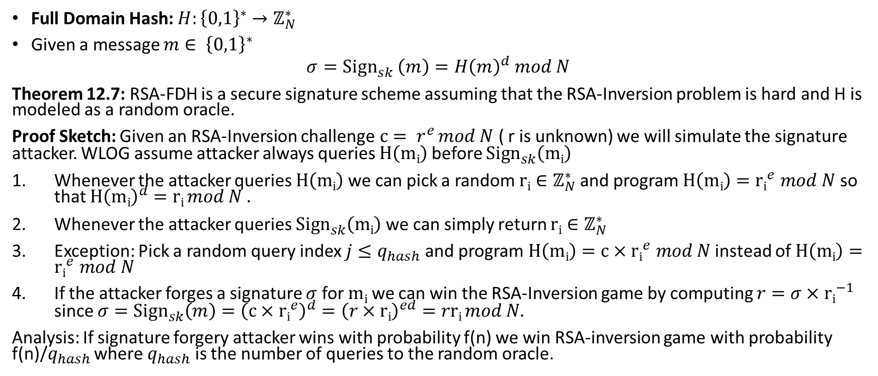
RSA-FDH
Full Domain Hash: $H:{\left\{0,1\right\}}^{∗}→ℤ_{N}^{∗}$
Given a message $m∈ {\left\{0,1\right\}}^{∗}$
$$σ={Sign}_{sk}^{}\left(m\right)=H{\left(m\right)}^{d} mod N$$
Theorem 12.7: RSA-FDH is a secure signature scheme assuming that the RSA-Inversion problem is hard and H is modeled as a random oracle.
Proof Sketch: Given an RSA-Inversion challenge$c= r^{e}$ $mod N$ ( r is unknown) we will simulate the signature attacker. WLOG assume attacker always queries $H\left(mi\right)$ before ${Sign}_{sk}^{}\left(mi\right)$
Whenever the attacker queries $H\left(mi\right)$ we can pick a random ${ri∈ℤ}_{N}^{∗}$ and program $H\left(mi\right)={ri}^{e} mod N$ so that ${H\left(mi\right)}^{d}=ri mod N .$
Whenever the attacker queries ${Sign}_{sk}^{}\left(mi\right)$ we can simply return ${ri∈ℤ}_{N}^{∗}$
Exception: Pick a random query index $j≤q_{hash}$ and program $H\left(mi\right)=c×{ri}^{e} mod N$ instead of $H\left(mi\right)={ri}^{e} mod N$
If the attacker forges a signature $σ$ for $mi$ we can win the RSA-Inversion game by computing $r=σ×{ri}^{−1}$ since ${σ=Sign}_{sk}^{}\left(m\right)={\left(c×{ri}^{e}\right)}^{d}={\left(r×ri\right)}^{ed}=rri mod N.$
Analysis: If signature forgery attacker wins with probability f(n) we win RSA-inversion game with probability f(n)/$q_{hash}$ where $q_{hash}$ is the number of queries to the random oracle.

Slide 52
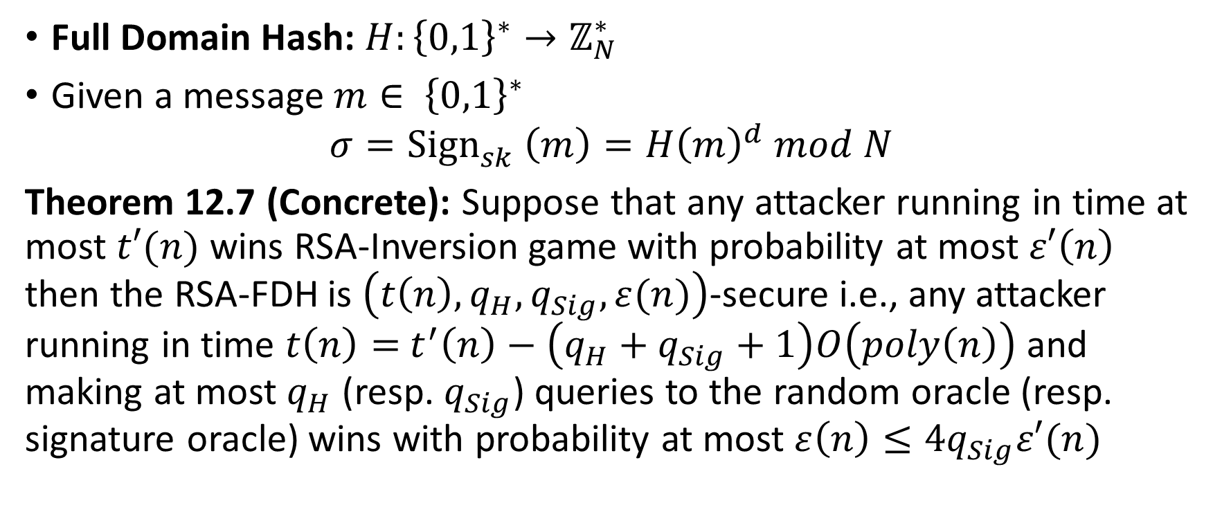
RSA-FDH
Full Domain Hash: $H:{\left\{0,1\right\}}^{∗}→ℤ_{N}^{∗}$
Given a message $m∈ {\left\{0,1\right\}}^{∗}$
$$σ={Sign}_{sk}^{}\left(m\right)=H{\left(m\right)}^{d} mod N$$
Theorem 12.7 (Concrete): Suppose that any attacker running in time at most $t′(n)$ wins RSA-Inversion game with probability at most $ε′\left(n\right)$ then the RSA-FDH is $\left(t\left(n\right), q_{H},q_{Sig},ε(n)\right)$-secure i.e., any attacker running in time $t\left(n\right)=$ $t^{′}\left(n\right)−\left(q_{H}+q_{Sig}+1\right)O\left(poly\left(n\right)\right)$ and making at most $q_{H}$ (resp. $q_{Sig}$) queries to the random oracle (resp. signature oracle) wins with probability at most $ε\left(n\right)≤4q_{Sig}ε′(n)$

Slide 53
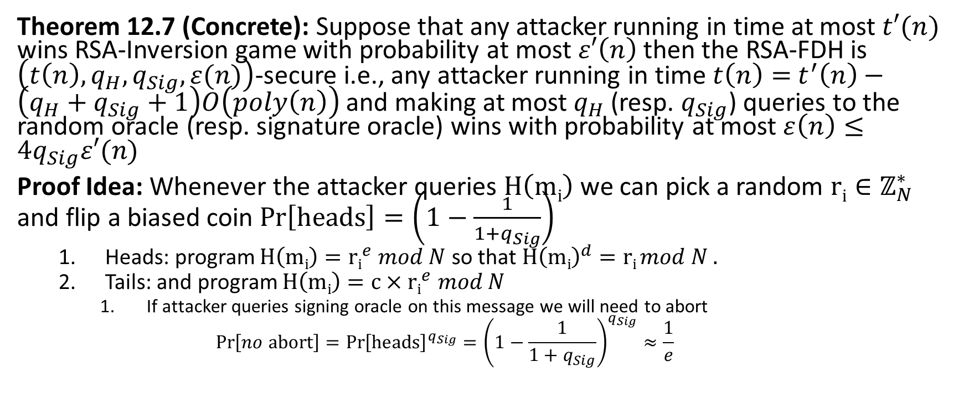
RSA-FDH
Theorem 12.7 (Concrete): Suppose that any attacker running in time at most $t′(n)$ wins RSA-Inversion game with probability at most $ε′\left(n\right)$ then the RSA-FDH is $\left(t\left(n\right), q_{H},q_{Sig},ε(n)\right)$-secure i.e., any attacker running in time $t\left(n\right)=$ $t^{′}\left(n\right)−\left(q_{H}+q_{Sig}+1\right)O\left(poly\left(n\right)\right)$ and making at most $q_{H}$ (resp. $q_{Sig}$) queries to the random oracle (resp. signature oracle) wins with probability at most $ε\left(n\right)≤4q_{Sig}ε′(n)$
Proof Idea: Whenever the attacker queries $H\left(mi\right)$ we can pick a random ${ri∈ℤ}_{N}^{∗}$ and flip a biased coin $Pr\left[heads\right]=\left(1−\frac{1}{1+q_{Sig}}\right)$
  Heads: program $H\left(mi\right)={ri}^{e} mod N$ so that ${H\left(mi\right)}^{d}=ri mod N .$
  Tails: and program $H\left(mi\right)=c×{ri}^{e} mod N$
    If attacker queries signing oracle on this message we will need to abort
    $$Pr\left[no abort\right]={Pr\left[heads\right]}^{q_{Sig}}={\left(1−\frac{1}{1+q_{Sig}}\right)}^{q_{Sig}}≈\frac{1}{e}$$

Slide 54
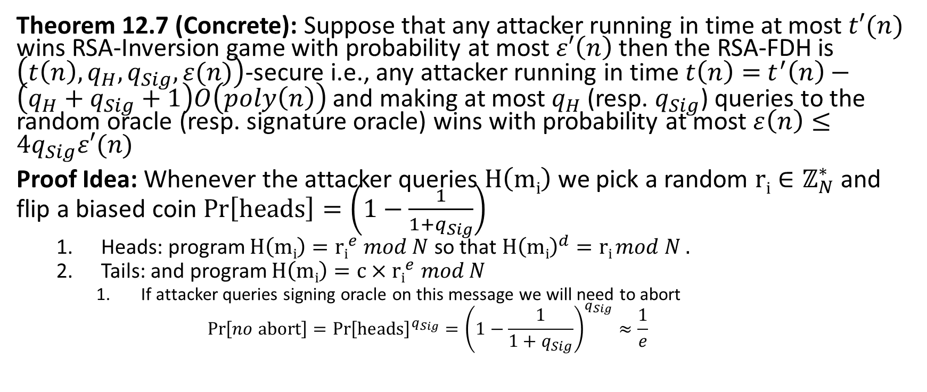
RSA-FDH
Theorem 12.7 (Concrete): Suppose that any attacker running in time at most $t′(n)$ wins RSA-Inversion game with probability at most $ε′\left(n\right)$ then the RSA-FDH is $\left(t\left(n\right), q_{H},q_{Sig},ε(n)\right)$-secure i.e., any attacker running in time $t\left(n\right)=$ $t^{′}\left(n\right)−\left(q_{H}+q_{Sig}+1\right)O\left(poly\left(n\right)\right)$ and making at most $q_{H}$ (resp. $q_{Sig}$) queries to the random oracle (resp. signature oracle) wins with probability at most $ε\left(n\right)≤4q_{Sig}ε′(n)$
Proof Idea: Whenever the attacker queries $H\left(mi\right)$ we pick a random ${ri∈ℤ}_{N}^{∗}$ and flip a biased coin $Pr\left[heads\right]=\left(1−\frac{1}{1+q_{Sig}}\right)$
  Heads: program $H\left(mi\right)={ri}^{e} mod N$ so that ${H\left(mi\right)}^{d}=ri mod N .$
  Tails: and program $H\left(mi\right)=c×{ri}^{e} mod N$
    If attacker queries signing oracle on this message we will need to abort
    $$Pr\left[no abort\right]={Pr\left[heads\right]}^{q_{Sig}}={\left(1−\frac{1}{1+q_{Sig}}\right)}^{q_{Sig}}≈\frac{1}{e}$$

Slide 55
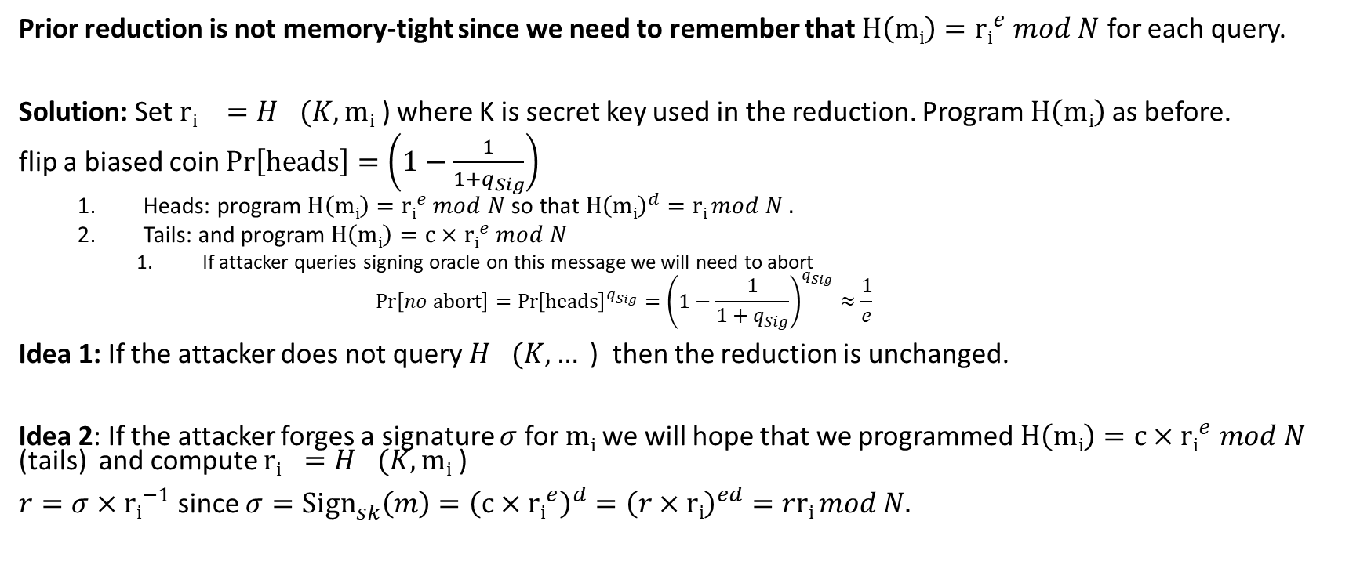
Reducing Memory Usage in Reduction
Prior reduction is not memory-tight since we need to remember that $H\left(mi\right)={ri}^{e} mod N$ for each query.
Solution: Set ${ri}^{}=H_{}(K,mi \text{) }$where K is secret key used in the reduction. Program $H\left(mi\right)$ as before.
flip a biased coin $Pr\left[heads\right]=\left(1−\frac{1}{1+q_{Sig}}\right)$
  Heads: program $H\left(mi\right)={ri}^{e} mod N$ so that ${H\left(mi\right)}^{d}=ri mod N .$
  Tails: and program $H\left(mi\right)=c×{ri}^{e} mod N$
    If attacker queries signing oracle on this message we will need to abort
    $$Pr\left[no abort\right]={Pr\left[heads\right]}^{q_{Sig}}={\left(1−\frac{1}{1+q_{Sig}}\right)}^{q_{Sig}}≈\frac{1}{e}$$
Idea 1: If the attacker does not query $H_{}(K,…\text{ ) }$ then the reduction is unchanged.
Idea 2: If the attacker forges a signature $σ$ for $mi$ we will hope that we programmed $H\left(mi\right)=c×{ri}^{e} mod N$ (tails) and compute ${ri}^{}=H_{}(K,mi\text{ ) }$
$r=σ×{ri}^{−1}$ since ${σ=Sign}_{sk}^{}\left(m\right)={\left(c×{ri}^{e}\right)}^{d}={\left(r×ri\right)}^{ed}=rri mod N.$

Slide 56




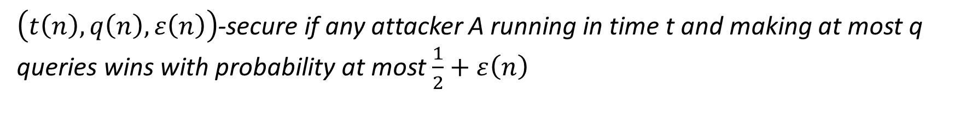
CPA-Security Game (Single Message Version)
m₀,m₁
$$\left\langle r,F_{k}\left(r\right)⨁m_{b}\right\rangle$$
m₂
$$\left\langle r_{2},F_{k}\left(r_{2}\right)⨁m_{2}\right\rangle$$
m₃
$$\left\langle r_{3},F_{k}\left(r_{3}\right)⨁m_{3}\right\rangle$$
…
b’
Random bit b
$$K←Gen\left(1^{n}\right)$$
$\left(t\left(n\right),q\left(n\right),ε\left(n\right)\right)$-secure if any attacker A running in time t and making at most q queries wins with probability at most $\frac{1}{2}+ε\left(n\right)$

Slide 57

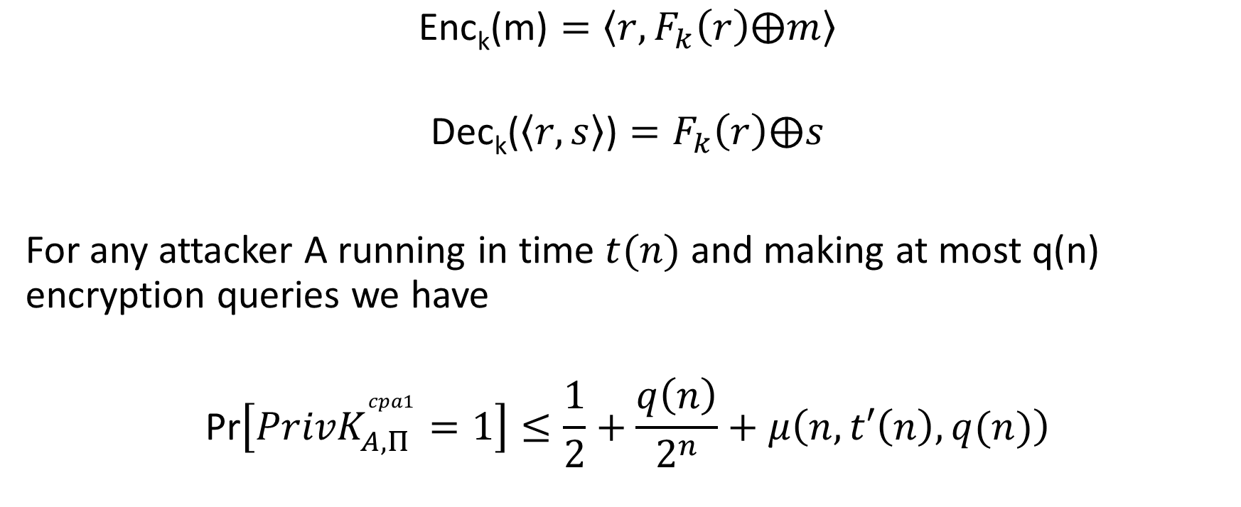
Recall: Week 1 Reduction
$$\text{Enc}\text{k}\text{(}\text{m}\text{)}=\left\langle r,F_{k}\left(r\right)⨁m\right\rangle$$
$$\text{Dec}\text{k}\text{(}\left\langle r,s\right\rangle \text{)}=F_{k}\left(r\right)⨁s$$
For any attacker A running in time $t(n)$ and making at most q(n) encryption queries we have
$$\text{Pr}\left[{PrivK}_{A,Π }^{cpa1}=1\right]≤\frac{1}{2}+\frac{q\left(n\right)}{2^{n}}+μ\left(n,t′\left(n\right),q(n)\right)$$
PRF Security
$$t′\left(n\right)≈t(n)$$
Probability of Nonce
Collision with initial challenge

Slide 58


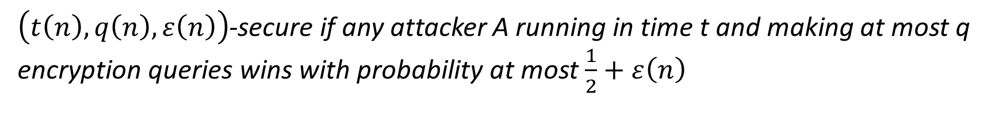





CPA-Security Game (Left-Right)
$$m_{0}^{1},m_{1}^{1}$$
$$\left\langle r,F_{k}\left(r\right)⨁m_{b}^{1}\right\rangle$$
$$m_{0}^{2},m_{1}^{2}$$
$$\left\langle r_{2},F_{k}\left(r_{2}\right)⨁m_{b}^{2}\right\rangle$$
$$m_{0}^{3},m_{1}^{3}$$
$$\left\langle r_{3},F_{k}\left(r_{3}\right)⨁m_{b}^{3}\right\rangle$$
…
b’
Random bit b
$$K←Gen\left(1^{n}\right)$$
$\left(t\left(n\right),q\left(n\right),ε\left(n\right)\right)$-secure if any attacker A running in time t and making at most q encryption queries wins with probability at most $\frac{1}{2}+ε\left(n\right)$

Slide 59

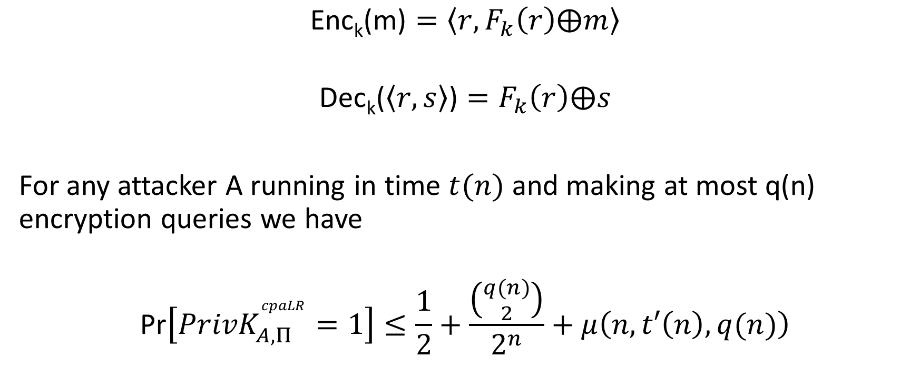
Example: Left-Right Security
$$\text{Enc}\text{k}\text{(}\text{m}\text{)}=\left\langle r,F_{k}\left(r\right)⨁m\right\rangle$$
$$\text{Dec}\text{k}\text{(}\left\langle r,s\right\rangle \text{)}=F_{k}\left(r\right)⨁s$$
For any attacker A running in time $t(n)$ and making at most q(n) encryption queries we have
$$\text{Pr}\left[{PrivK}_{A,Π }^{cpaLR}=1\right]≤\frac{1}{2}+\frac{\left({q(n) \atop 2}\right)}{2^{n}}+μ\left(n,t′\left(n\right),q(n)\right)$$
$$t′\left(n\right)≈t(n)$$
PRF Security
Probability there exists a nonce collision

Slide 60
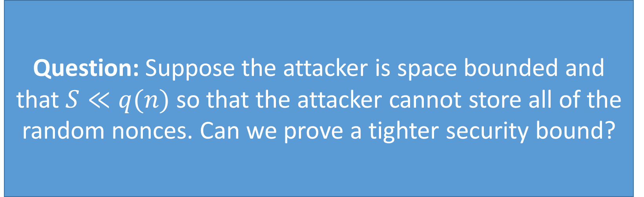
Example: Left-Right Security
Question: Suppose the attacker is space bounded and that $S≪q(n)$ so that the attacker cannot store all of the random nonces. Can we prove a tighter security bound?
$$\text{Enc}\text{k}\text{(}\text{m}\text{)}=\left\langle r,F_{k}\left(r\right)⨁m\right\rangle$$
$$\text{Dec}\text{k}\text{(}\left\langle r,s\right\rangle \text{)}=F_{k}\left(r\right)⨁s$$
For any attacker A running in time $t(n)$ and making at most q(n) encryption queries we have
$$\text{Pr}\left[{PrivK}_{A,Π }^{cpaLR}=1\right]≤\frac{1}{2}+\frac{\left({q(n) \atop 2}\right)}{2^{n}}+μ\left(n,t′\left(n\right),q(n)\right)$$
$$t′\left(n\right)≈t(n)$$
PRF Security
Probability there exists a nonce collision

Slide 61
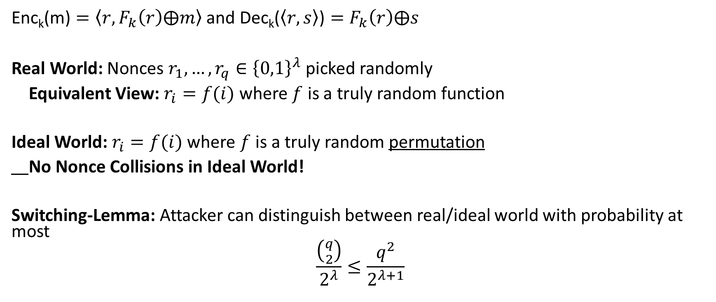
Switching-Lemma: Application 1
$\text{Enc}\text{k}\text{(}\text{m}\text{)}=\left\langle r,F_{k}\left(r\right)⨁m\right\rangle$ and $\text{Dec}\text{k}\text{(}\left\langle r,s\right\rangle \text{)}=F_{k}\left(r\right)⨁s$
Real World: Nonces $r_{1},…,r_{q}∈{\left\{0,1\right\}}^{λ}$ picked randomly
Equivalent View: $r_{i}=f(i)$ where $f$ is a truly random function
Ideal World: $r_{i}=f(i)$ where $f$ is a truly random permutation
No Nonce Collisions in Ideal World!
Switching-Lemma: Attacker can distinguish between real/ideal world with probability at most
$$\frac{\left({q \atop 2}\right)}{2^{λ}}≤\frac{q^{2}}{2^{λ+1}}$$

Slide 62
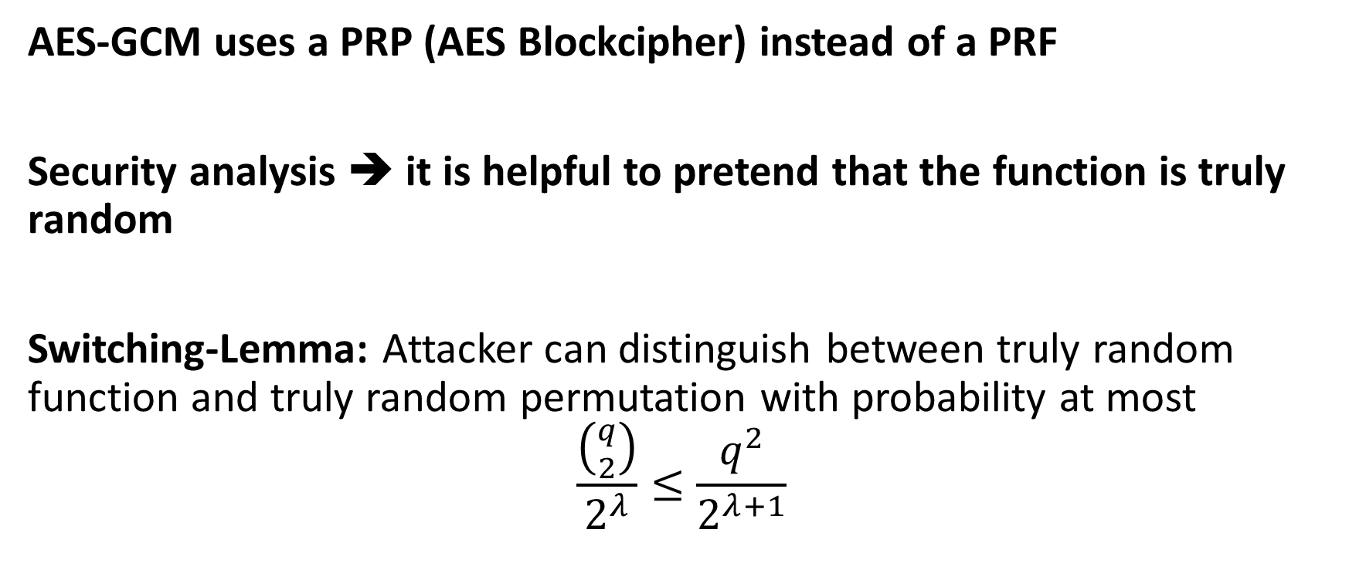
Switching-Lemma: Application 2
AES-GCM uses a PRP (AES Blockcipher) instead of a PRF
Security analysis ➔ it is helpful to pretend that the function is truly random
Switching-Lemma: Attacker can distinguish between truly random function and truly random permutation with probability at most
$$\frac{\left({q \atop 2}\right)}{2^{λ}}≤\frac{q^{2}}{2^{λ+1}}$$

Slide 63

On the Streaming Indistinguishability of a Random Permutation and a Random Function
Itai Dinur
Ben-Gurion University
Eurocrypt 2020
1

Slide 64
“Switching Lemma”
for Random Permutation\Function
Classical problem: adversary A tries to distinguish a random permutation P:[N]->[N] from random function F:[N]->[N] with Q queries
“Switching Lemma”: A has advantage bounded by O(Q²/N)
  | Pr[A^{P(}⋅⁾ = 1] – Pr[A^{F(}⋅⁾ = 1] | ∊ O(Q²/N)
Widely used to establish concrete security of cryptosystems
up to birthday bound of Q = 𝑁
  E.g., modes of operation (counter-mode)
oracle
q_{i}
x_{i} = P(q_{i}) or F(q_{i})
2
A

Slide 65





“Switching Lemma”
for Random Permutation\Function
“Switching Lemma”: A has advantage bounded by O(Q²/N)
  | Pr[A^{P(}⋅⁾ = 1] – Pr[A^{F(}⋅⁾ = 1] | ∊ O(Q²/N)
Matching algorithm: store the Q query outputs and look for
collision (F(q_{i})= F(q_{j}) for q_{i} ≠q_{j})
3

Slide 66





Memory-Restricted Adversaries
Algorithm requires memory ≈Q bits
What about memory-restricted adversaries?
Use cycle detection algorithm to obtain optimal O(Q²/N) advantage with ≈log(N) memory
Requires adaptive queries to primitive
What if adversary with S memory bits only given stream of Q elements produced by random function\permutation?
Considered by Jaeger and Tessaro at EUROCRYPT 2019 [JT’19]
oracle
x_{i} = P(i) or F(i)
S
A

Slide 67
Streaming Switching Lemma [JT’19]
“Streaming switching lemma“ [JT’19]: adversary with S bits of memory with (1-pass) access to stream of Q elements from random permutation\function has distinguishing
advantage of at most 𝑄 ⋅ 𝑆/𝑁
Application: better security bounds against memory- restricted adversaries for some modes of operation

Slide 68
Streaming Switching Lemma [JT’19]
Application: better security bounds against memory- restricted adversaries for some modes of operation
AES-based counter-mode:
m_{i} encrypted to (r_{i} , c_{i} = AES_{K}(r_{i}) ⊕ m_{i} ) for uniform r_{i}
Eavesdropping adversary sees stream (r₁ , c₁ ), (r₂ , c₂ ),...
Replace AES by random P + apply streaming switching lemma (several times):
show (r₁ , c₁ ), (r₂ , c₂ ),... Indistinguishable from
(r₁, α₁ ) , (r₂ , α₂ ),... for uniform α_{i}

Slide 69
Streaming Switching Lemma
“Streaming switching lemma“ [JT’19]: adversary with S bits of memory with access to stream of Q elements from random permutation\function has distinguishing
advantage of at most 𝑄 ⋅ 𝑆/𝑁
Application: if 𝑆 is limited, counter-mode secure beyond birthday bound
Limitations of [JS’19]:
1) Proof based on unproven combinatorial conjecture
2) Bound 𝑄 ⋅ 𝑆/𝑁 not tight when 𝑄 ⋅ 𝑆 ≪ 𝑁
  E.g., when 𝑆 = 𝑄, bound is 𝑄²/𝑁, but (original) switching lemma gives 𝑄²/𝑁

Slide 70








New Streaming Switching Lemma
In this work: overcome limitations
New streaming switching lemma bound 𝑂(log 𝑄 ⋅ 𝑄 ⋅ 𝑆/𝑁)
Tight (up to poly-log factors):
  Algorithm: store first S elements and look for collision with 𝑄
elements
  Advantage: ≈ 𝑄 ⋅ 𝑆/𝑁
Note: when 𝑆 = 𝑄, we get (original) switching lemma
S

Slide 72
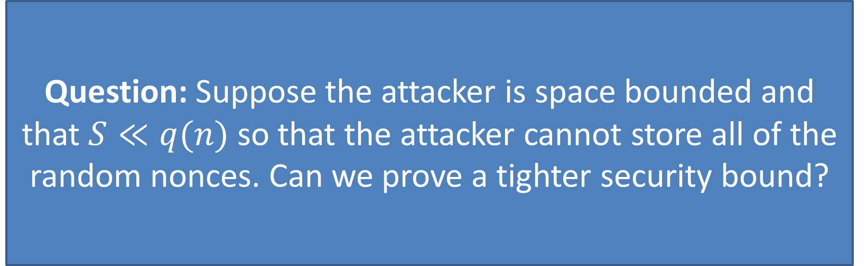
Question: Suppose the attacker is space bounded and that $S≪q(n)$ so that the attacker cannot store all of the random nonces. Can we prove a tighter security bound?

Slide 74
CC → Streaming
Main idea: reduce from communication complexity (CC) problem (with strong lower bounds) to streaming
General reduction framework from one-way CC problem:
  Alice, Bob solve CC problem given access to streaming algorithm:
  View concatenated inputs as stream
  Alice simulates streaming algorithm on her input, passes state to Bob which continues simulation, outputs result
Alice S bits Bob
stream
74

Slide 75
CC → Streaming
Streaming algorithm with memory S gives one-way communication protocol with communication cost S (and same advantage)
Lower bound on cost of communication protocol →
lower bound on memory of streaming algorithm
Alice S bits Bob
stream
75

Slide 76
Set-Disjointness and Unique-Disjointness Problem
Alice (resp. Bob) are given lists a and b encoded as incidence vectors
Alice and Bob want to compute DISJ(a,b) where
DISJ(a,b) = 0 if a[i] = b[i]=1 for some index i;
DISJ(a,b) = 1 otherwise
Solution 1: Alice sends a to Bob who computes DISJ(a,b)
Goal: Minimize communication
Unique-Disjointness Variant (UDISJ): promise that a and b intersect in at most one location

Slide 77
Unique-Disjointness: Communication Complexity
Unique-Disjointness Variant (UDISJ): promise that a and b intersect in at most one location
It is not possible to do much better than the trivial protocol (Alice sends Bob her entire input a)

Slide 78
Unique-Disjointness: Communication Complexity
Unique-Disjointness Variant (UDISJ): promise that a and b intersect in at most one location
It is not possible to do much better than the trivial protocol (Alice sends Bob her entire input a)

Slide 79
Reduction Attempt for Random Permutation\Function
Attempt: CC problem – each player gets Q/2 elements, chosen using rand permutation\function
Useless: CC problem is easy
  E.g., if Q > 𝑁, players can trivially distinguish between permutation\function with no communication
  Each player has unlimited resources and can detect a collision locally
Alice
Bob
x₁,…,x_{Q/2}
^{x}Q/2+1^{,…,x}Q

Slide 80
Reduction Attempt for Random Permutation\Function
General restriction: in hard CC problem joint distributions
for Alice and Bob’s inputs should have identical marginals
  Alice and Bob should have same local view
Impossible when considering rand permutation\function distributions
Solution: use hybrid argument
  Consider intermediate hybrid distributions between random permutation and random function
  Prove indistinguishability of neighboring hybrid distributions by
reduction from CC

Slide 81
Hybrid Argument
Attempt: define Q hybrids games
  Game i: 𝑥₁, … 𝒙_{𝑸−𝒊}, 𝑥_{𝑄−𝑖+1}, … , 𝑥_{𝑄}
or 𝑥₁, … 𝑥_{𝑄−𝑖−1}, 𝒙_{𝑸−𝒊}, … , 𝑥_{𝑄}
w\o replacement w replacement
w\o replacement
w replacement
(Standard) hybrid argument far from tight
  (Distinguishing advantage) x (num of hybrids) too large

Slide 82
Improved Hybrid Argument
Main idea: break dependency between halves
Denote 1st sequence by 𝑥₁, 𝑥₂, … , 𝑥_{𝑄/2}, 𝑦₁, 𝑦₂, … , 𝑦_{𝑄/2}
1st distribution: elements chosen using (same) permutation
1st intermediate hybrid: 𝑥₁, 𝑥₂, … , 𝑥_{𝑄/2} and 𝑦₁, 𝑦₂, … , 𝑦_{𝑄/2}
chosen using independent permutations
Reduction from (one-way) CC:
Alice gets 1st half of sequence, Bob gets 2nd half (decide if they obtain same or independent permutations)
  Marginals are identical

Slide 84
Permutation Dependence
(one way) CC problem - permutation dependence (PDEP):
Alice and Bob decide if their inputs were drawn using same
or independent permutations
PDEP to streaming reduction:
Alice
S bits
Bob
𝑥₁, … , 𝑥_{𝑄/2}
𝑦₁, … , 𝑦_{𝑄/2}
𝑥₁, … , 𝑥_{𝑄/2} 𝑦₁, … , 𝑦_{𝑄/2}
stream

Slide 85
UDISJ-> PDEP
Communication cost \ advantage tradeoff for PDEP?
Reduction from (unique) disjointness (UDISJ)
  Each player receives a set of size n (domain size O(n)), need to decide if sets intersect or disjoint
Theorem (informal)[BM’13, GW’14]: if Alice and Bob communicate c bits for DISJ (UDISJ) in the worst case, their
max advantage is O(c/n)
  Even when given access to public randomness
Alice
Bob
𝑎₁, … , 𝑎_{𝑛}
𝑏₁, … , 𝑏_{𝑛}
18

Slide 86
UDISJ-> PDEP
Alice
Bob
Public randomness
𝑎₁, … , 𝑎_{𝑁/𝑄}
b₁, … , b_{𝑁/𝑄}
Alice
Bob
𝑥¹, … , 𝑥¹
1 𝑄/2
𝑦¹, … , 𝑦¹
1 𝑄/2
Theorem (informal): there is a public coin local reduction that converts a UDISJ instance of size n=N/Q to a PDEP instance of size Q
  Shorter inputs harder from PDEP, but easier for UDISJ
Overall: UDISJ -> PDEP-> streaming
bounds max advantage for hybrid game by
O(c/n) = 𝑂(𝑆/(𝑁/𝑄)) = 𝑂(𝑄 ⋅ 𝑆/𝑁)

Slide 87
The Full Hybrid Argument
Once dependency between 2 halves broken:
  Continue recursively (tree structure)
2’nd level: 2 games of distinguishing stream distributions on Q/2 elements
Final distribution: Q elements divided into Q independent permutations == random function
Max advantage for each level: 𝑂(𝑄 ⋅ 𝑆/𝑁)
Total max advantage: 𝑂(log 𝑄 ⋅ 𝑄 ⋅ 𝑆/𝑁)
game 1
game 2
game 3
game 4
game 5
game 6
game 7

Slide 88
Conclusions
New streaming switching lemma bound 𝑂(log 𝑄 ⋅ 𝑄 ⋅ 𝑆/𝑁)
Tight up to poly-log factors
Reduction from CC to streaming uses unconventional
hybrid argument
Standard streaming problems defined in worst case setting
  Gives freedom to choose hard distributions for CC problem
In our (cryptographic) setting streams distributions fixed
  Hybrid argument reduction applicable to more problems?
Extension: multi-pass streaming switching lemma
  Streaming alg allowed multiple passes over data

Slide 89
Thanks for your attention!

Slide 90
The Memory-Tightness of Authenticated Encryption
Ashrujit Ghoshal
Joseph Jaeger
Stefano Tessaro
University of Washington
CRYPTO 2020

Slide 91
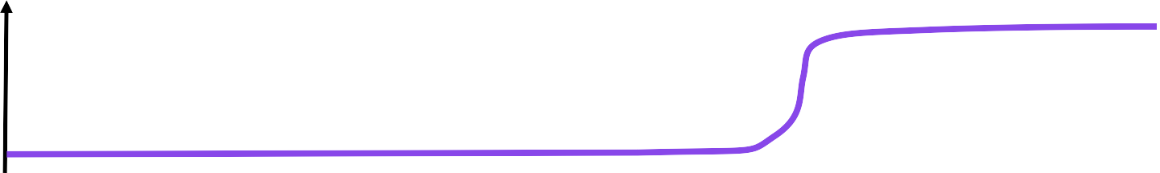

Concrete security theorems: 𝐀𝐝𝐯 resources ≤ 𝜖
1
𝐀𝐝𝐯
0
resources
Traditionally: time 𝑡, data complexity/queries 𝑞
𝐀𝐝𝐯 𝑡, 𝑞 ≤ 𝜖
𝐀𝐝𝐯 𝑡, 𝑞, 𝑆 ≤ 𝜖
This work: time 𝑡, data complexity/queries 𝑞, memory 𝑆

Slide 92



Prior work
Focus: confidentiality
Focus: public-key
crypto
Time-memory tradeoffs for symmetric encryption [TT18, JT19, Dinur20, SS20]
Memory-tight reductions
[ACFK17, WMHT18, GT20,
Bhattacharya20]
This work: Time-memory tradeoffs for (nonce-based)
authenticated encryption (AE)
Positive results
Tl;dr:
Negative results

Slide 93
Nonce-based encryption
NE=(NE.Kg, NE.Enc, NE.Dec)
NE.Kg
Security holds only if encryption under distinct nonces
𝐾
𝐾
NE.Enc 𝐶
𝐾
𝑁
𝑀
𝑁
𝐶
NE.Dec
𝑀/⊥
Long line of work on concrete security of nonce-based AE
[BR00, RBBK01, R02, RS06 …]
Can we extend them to consider memory?

Slide 94

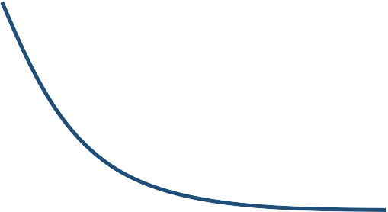

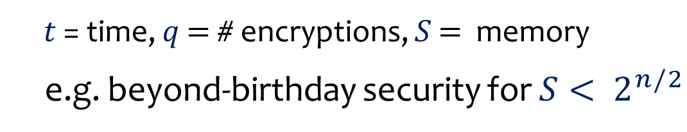
Example: NE.Enc(𝐾, 𝑁, 𝑀) = E₀ 𝑁 ⊕ 𝑀
E = 𝑛-bit block cipher
indr = indistinguishability from random ciphertexts
Theorem. [JT19 + Dinur20]
indr
𝑆 ⋅ 𝑞 log 𝑞
prp
Adv_{NE}
𝑡, 𝑞, 𝑆 ≤
$$2n$$
+ Adv_{E}
𝑡, 𝑞, 𝑆
𝑡 = time, 𝑞 = # encryptions, 𝑆 = memory
e.g. beyond-birthday security for 𝑆 < $2^{n/2}$
𝑆
insecure
secure
Goal: similar results for AE security? (like GCM [MV04])
𝑞

Slide 95
Target: combined AE security notion (confidentiality + integrity)
Usual proof approach: INDR + CTXT ⇒ AE
indistinguishability from random ciphertexts
ciphertext integrity
ae indr ctxt
Theorem. Adv_{NE} 𝑡, 𝑞 ≤ Adv_{NE} 𝑡, 𝑞 + Adv_{NE} 𝑡, 𝑞
Theorem. Adv^{ae} 𝑡, 𝑞, 𝑆₁
≤ Adv
indr NE
𝑡, 𝑞, S₂
+ Adv
ctxt NE
𝑡, 𝑞, 𝑆₃
#
NE
Wanted: memory-tight reduction [ACFK17] 𝑆₁ = 𝑆₂ = 𝑆₃
Unclear! Known reduction is not memory-tight!

Slide 96



NE=(NE.Kg, NE.Enc, NE.Dec)
ae
Adv_{NE} 𝑡, 𝑞, 𝑆 ?
$
𝐾 ← NE.Kg
Proc. ENC₁(𝑁, 𝑀)
𝐶 ← NE.Enc(𝐾, 𝑁, 𝑀)
Return 𝐶
Proc. ENC₁(𝑁, 𝑀)
𝐶 ← NE.Enc(𝐾, 𝑁,𝑀) L 𝑁, 𝐶 ← 𝑀
Return 𝐶
Proc. ENC₀(𝑁, 𝑀)
𝐶 ←
L 𝑁, 𝐶 ← 𝑀
Return 𝐶
Proc. DEC₁(𝑁, 𝐶)
Return NE.Dec(𝐾, 𝑁, 𝐶)
Proc. DEC₀(𝑁, 𝐶)
Return L | 𝑁, 𝐶
Proc. DEC₀(𝑁, 𝐶)
Return L | 𝑁, 𝐶
$
𝐾 ←NE.Kg
ctxt
indr
Adv_{NE} (𝑡, 𝑞, 𝑆) 👍
Adv_{NE} 𝑡, 𝑞, 𝑆 + 𝑂(𝑞) 👎

Slide 97
Proc. ENC₁(𝑁, 𝑀)
𝐶 ← NE.Enc(𝐾, 𝑁, 𝑀)
Return 𝐶
Proc. ENC₁(𝑁, 𝑀)
𝐶 ← NE.Enc(𝐾, 𝑁, 𝑀)
Return 𝐶
L 𝑁, 𝐶 ← 𝑀
L[N,C] ← M
Proc. DEC₀(𝑁, 𝐶)
Return L | 𝑁, 𝐶
Requires memory proportional to # of queries!
indr security
Proc. DEC₀(𝑁, 𝐶)
Return L | 𝑁, 𝐶
Proc. ENC₀(𝑁, 𝑀)
𝐶 ←
Return 𝐶
Proc. ENC₀(𝑁, 𝑀)
𝐶 ←
Return 𝐶
L 𝑁, 𝐶 ← 𝑀
L[N,C] ← M

Slide 98
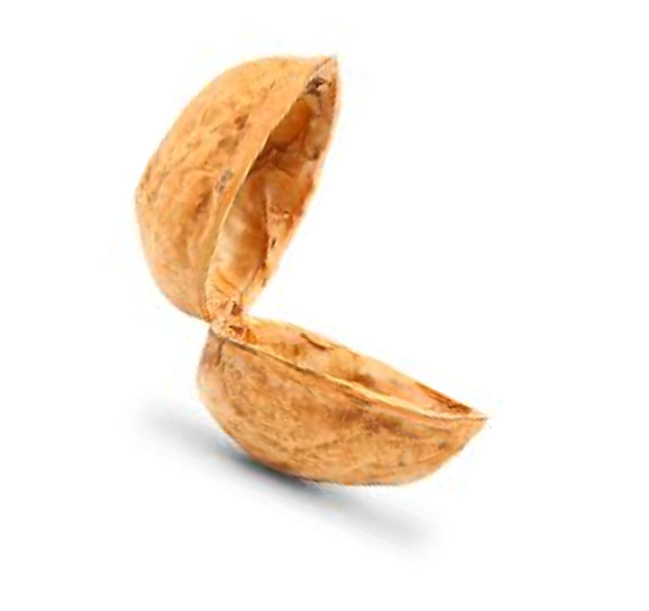


Our results, in a nutshell
1. Memory-tight reduction and time-memory trade- offs in the channel setting
Typical usage within protocols like TLS
New technique: memory-adaptive reduction
2. Impossibility result for general memory-tight reduction INDR + CTXT ⇒ AE!

Slide 99
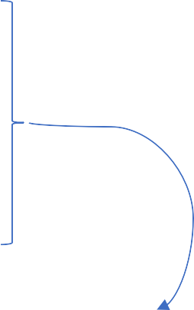
Channel setting: motivation
AE often used to establish a secure communication channel, as in TLS
implicit nonces = counter
ENC 𝐾, 0, 𝑀₀ , ENC 𝐾, 1, 𝑀₁ , ⋯
receiver aborts upon the first decryption failure
in-order delivery
Channel setting captures this

Slide 100
The channel setting
CH=(CH.Sg, CH.S, CH.R)
_{𝜎}s
_{𝜎}r
 | CH.Sg
𝑀
𝐶
𝐶′
𝑀′/⊥
CH.S
CH.R
_{𝜎}s
_{𝜎}r

Slide 101
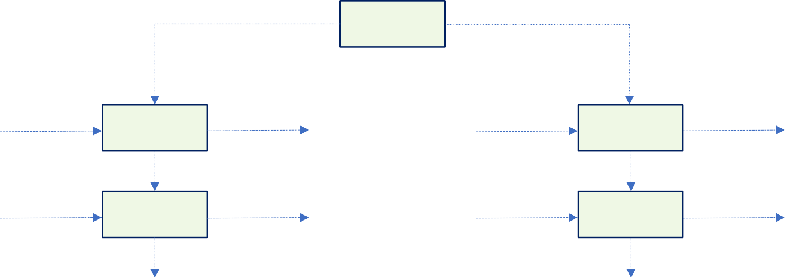
The channel setting: correctness
CH=(CH.Sg, CH.S, CH.R)
_{𝜎}s
_{𝜎}r
CH.Sg
𝑀₁
𝐶₁
𝐶₁
𝑀₁
CH.S
_{𝜎}s
CH.S
_{𝜎}s
CH.R
_{𝜎}r
CH.R
_{𝜎}r
𝑀₂
𝐶₂
𝐶₂
𝑀₂
𝑀₃
𝐶₃
𝐶₃
𝑀₃
CH.S
CH.R
_{𝜎}s
_{𝜎}r

Slide 102
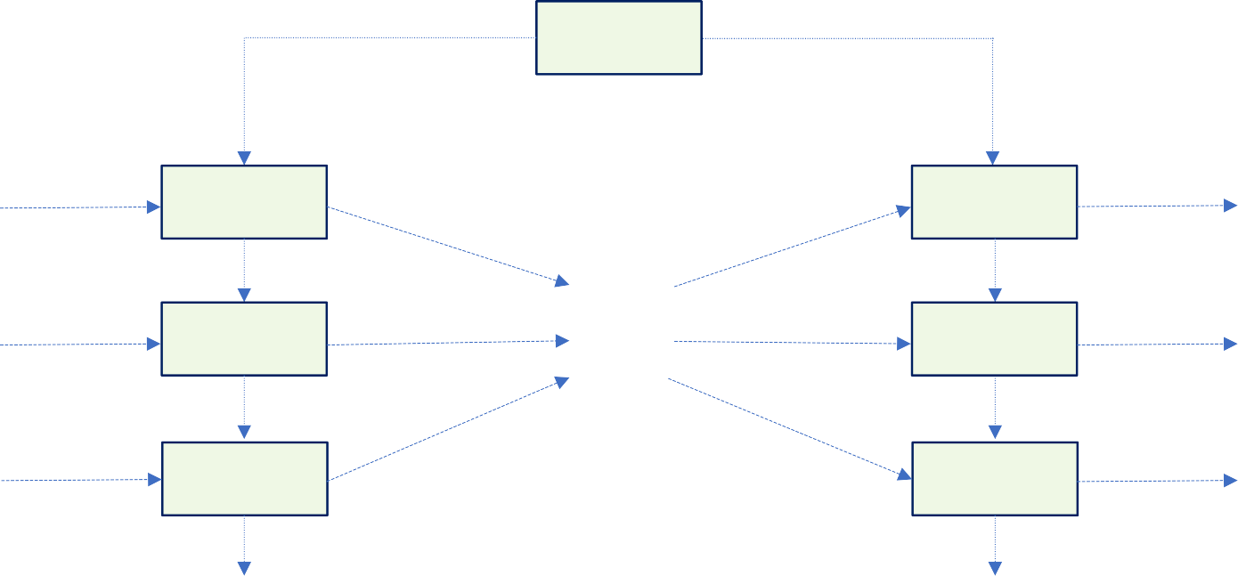

The channel setting: security
CH=(CH.Sg, CH.S, CH.R)
_{𝜎}s
_{𝜎}r
CH.Sg
𝑀₁
𝐶₁
𝑀₁
CH.S
_{𝜎}s
CH.S
_{𝜎}s
CH.S
_{𝜎}s
𝐶₁
CH.R
_{𝜎}r
CH.R
_{𝜎}r
CH.R
_{𝜎}r
𝑀₂
𝐶₂
𝐶₂
⊥
𝐶₃
𝑀₃
𝐶₃
⊥

Slide 103
AE security for channels
CH=(CH.Sg, CH.S, CH.R)
sync ← true
Proc. ENC₁(𝑀)
(𝜎^{s}, 𝐶) ← CH.S(𝜎^{s}, 𝑀)
Return 𝐶
Proc. ENC₀(𝑀)
𝐶 ← Enqueue(𝑀,𝐶)
Return 𝐶
Proc. DEC₁(𝐶)
(𝜎^{r}, 𝑀) ← CH.R(𝜎^{r}, 𝐶)
Return 𝑀
Adv_{NE}
ch−ae
𝑡, 𝑞, 𝑆
Proc. DEC₀(𝐶)
(𝑀$, 𝐶$) ← Dequeue()
If sync then
If 𝐶 = 𝐶$ then return 𝑀′ sync ← false
Return ⊥
$
(𝜎^{s}, 𝜎^{r}) ← CH.Sg

Slide 104
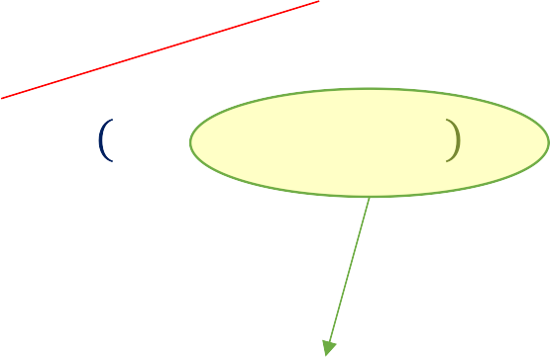


Main theorem
indistinguishability from random ciphertexts for channels
ae security for channels
ciphertext integrity for channels
Theorem. [this work] ∀ 𝜆 ∈ ℕ
ch-ae ch-ctxt
Ch-indr
1
𝑡, 𝑞, 3𝑆 + 𝑂(log 𝑞 + 𝜆) +
₂ 𝜆
Adv_{CH} ≤ Adv_{CH}
𝑡, 𝑞, 𝑆
𝑡, 𝑞, 𝑆
+ 2 ⋅ Adv_{CH}
Memory-tight!
New technique: Memory-adaptive reduction

Slide 105
ENC₀
ENC₁
ENC₁
DEC₁
DEC₀
DEC₀
easy
next up!
ch-ctxt
ch-indr
1
Adv_{CH}
(𝑡, 𝑞, 𝑆)
2 ⋅ Adv_{CH}
𝑡, 𝑞, 3𝑆 + 𝑂 log 𝑞
+ 𝜆 +
₂)

Slide 106
Issue: size of queue grows with the number of queries
$
𝑏 ← {0,1}
ENC_{b}(𝑀₁), ENC_{b} 𝑀₂
𝐶₁, 𝐶₂, 𝐶₃
DEC₀ 𝐶₁
𝑀₁
, ENC_{b} 𝑀₃
(𝑀₁, 𝐶₁)
(𝑀₂, 𝐶₂)
(𝑀₃, 𝐶₃)
Queue

Slide 107

Key idea: bounding queue size does not change behavior
What if we only store 2 pairs in the queue?
Hope: Space bounded attacker won’t notice.
$
𝑏 ← {0,1}
ENC_{b}(𝑀₁), ENC_{b} 𝑀₂ , ENC_{b} 𝑀₃
𝐶₁, 𝐶₂, 𝐶₃
DEC₀ 𝐶₁ , DEC₀ 𝐶₂ , DEC₀(𝐶₃)
𝑀₁, 𝑀₂, ⊥
(𝑀₁, 𝐶₁)
(𝑀₂, 𝐶₂)
Adversary had to remember 𝐶₁, 𝐶₂, 𝐶₃ to cause this! Bound queue size to Δ = 2𝑆 + log 𝑞 + 𝜆 bits
Queue

Slide 108
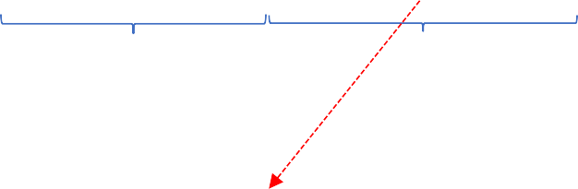

Information-theoretic game
𝐿, Δ ∈ ℕ, Δ ≤ 𝐿
$
𝑅 ← 0,1 ,
𝐴₁
𝑖
Δ
𝑖 ≤ 𝐿 − Δ
𝜎 ≤ 𝑆
(𝑖, 𝜎)
?
𝐴₂
=
Δ
Lemma. If Δ = 2𝑆 + 𝑂 log 𝐿 + 𝜆 then
$$Pr[\left(A_{1},A_{2}\right) wins]≤\frac{1}{2^{λ}}$$

Slide 109
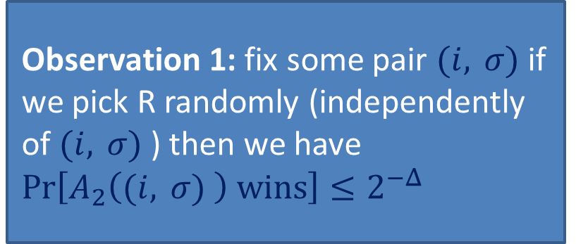
Information-theoretic game
𝐿, Δ ∈ ℕ, Δ ≤ 𝐿
$
𝑅 ← 0,1 ,
𝐴₁
𝑖
Δ
𝑖 ≤ 𝐿 − Δ
𝜎 ≤ 𝑆
(𝑖, 𝜎)
?
𝐴₂
=
Δ
Observation 1: fix some pair $\text{(}\text{i}\text{, } \text{σ}\text{)}$if we pick R randomly (independently of $\text{(}\text{i}\text{, } \text{σ}\text{)}$) then we have
$Pr\left[A_{2}\left(\text{(}\text{i}\text{, } \text{σ}\text{)} \right) wins\right]≤2^{−Δ}$
Lemma. If Δ = 2𝑆 + 𝑂 log 𝐿 + 𝜆 then
$$Pr[\left(A_{1},A_{2}\right) wins]≤\frac{1}{2^{λ}}$$

Slide 110
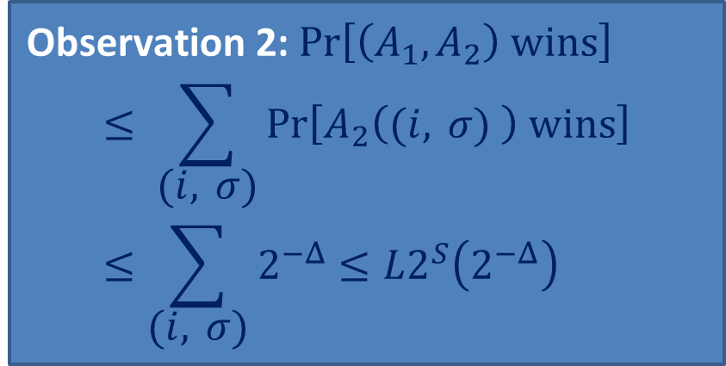
Information-theoretic game
𝐿, Δ ∈ ℕ, Δ ≤ 𝐿
$
𝑅 ← 0,1 ,
𝐴₁
𝑖
Δ
𝑖 ≤ 𝐿 − Δ
𝜎 ≤ 𝑆
(𝑖, 𝜎)
?
𝐴₂
=
Observation 2: $Pr\left[\left(A_{1},A_{2}\right) wins\right]$
$$≤ \sum_{\text{(}\text{i}\text{, } \text{σ}\text{)}}{Pr\left[A_{2}\left(\text{(}\text{i}\text{, } \text{σ}\text{)} \right) wins\right]}≤\sum_{\text{(}\text{i}\text{, } \text{σ}\text{)}}{2^{−Δ}}≤L2^{S}\left(2^{−Δ}\right)$$
Δ
Lemma. If Δ = 2𝑆 + 𝑂 log 𝐿 + 𝜆 then
$$Pr[\left(A_{1},A_{2}\right) wins]≤\frac{1}{2^{λ}}$$

Slide 111
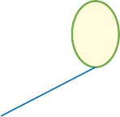
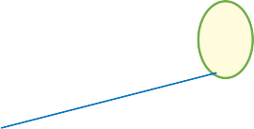
one of the most widely deployed encryption schemes
Application to GCM
CAU [BT16] : an abstraction of GCM
encryption scheme from block cipher 𝐸 and hash function 𝐻
𝑛-bit block cipher
AXU
Theorem. [this work]
ch]ae
prp
𝑆𝑞 log 𝑞
Adv_{NCH}
𝑡, 𝑞, 𝑆
≤ 4 ⋅ Adv_{E}
𝑡, 𝑂 𝑞 , 𝑂(𝑆) + 𝑂
₂𝜆
channel induced by CAU

Slide 112
Our results, in a nutshell
1. Memory-tight reduction and time-memory trade- offs in the channel setting
Typical usage within protocols like TLS
New technique: memory-adaptive reduction
2. Impossibility result for general memory-tight reduction INDR + CTXT ⇒ AE!

Slide 113
Negative result for the general setting
Impossibility result for proving INDR+CTXT⇒AE in a memory-tight way for nonce-based encryption schemes
  Similar spirit as prior work [ACFK17,WMHT18,GT20]
Also rules out memory-adaptive reductions (like the one for channels)
Evidence that some restriction necessary for memory- tight reduction

Slide 114
Our result
inefficient
Theorem. [this work] ∀ INDR+CTXT-secure NE ∃ AE
adversary 𝐴∗ making 𝑞 queries, using memory 𝑂(log 𝑞) s.t.
ae
1) Adv_{NE} 𝐴∗ ≈ 1
2) ∀ “efficient” black-box reductions 𝑅 using additional
memory 𝑆 = 𝑜 𝑞
then
indr
Adv_{NE} 𝑅[𝐴∗]
= negl
3) ∀ “efficient” black-box reductions 𝑅′
ctxt
Adv_{NE} 𝑅′[𝐴∗]
= negl

Slide 115
Our result
Theorem. [this work] ∀ INDR+CTXT-secure NE ∃ AE
adversary 𝐴∗ making 𝑞 queries, using memory 𝑂(log 𝑞) s.t.
ae
1) Adv_{NE} 𝐴∗ ≈ 1
2) ∀ “efficient” restricted black-box reductions 𝑅 using
additional memory 𝑆 = 𝑜 𝑞
then
indr
Adv_{NE} 𝑅[𝐴∗]
= negl
3) ∀ “efficient” restricted black-box reductions 𝑅′
ctxt
Adv_{NE} 𝑅′[𝐴∗]
= negl

Slide 116
Restricted black-box reduction
1. faithful
ENC'(𝑁, 𝑀)
𝐶
⋮
_{𝐴}∗
𝑅
ENC`
ENC'(𝑁, 𝑀)
𝐶
nonce-respecting 𝐴∗ ⇒ nonce-respecting 𝑅
straightline or fully-rewinding

Slide 117
The adversary 𝐴∗: basic idea
• In round 𝑖 = 1, ⋯ , 𝑟
• Encrypt random 𝑀₍, 𝑀₎, ⋯ , 𝑀* ← 0,1 ^{ℓ}
𝐶, ← ENC'( 𝑖, 𝑗 , 𝑀,)
• Sample 𝑗∗ ← [𝑢]
𝑀 ← DEC'( 𝑖, 𝑗∗ , 𝐶,∗ )
If 𝑀,∗ ≠ 𝑀 then ABORT
$
Intuition: reduction w/ memory
𝑘 ⋅ ℓ bits succeeds in each
$
round w/ probability ≤ .
*
All rounds succeed ⟹ Inefficiently break the scheme

Slide 118
Conclusions
Memory-sensitive bounds for the AE security of channels
Time-memory tradeoffs for the AE security of a TLS like channel instantiated with GCM
New technique: Memory-adaptive reductions
Impossibility for full AE security
Evidence that restricting AE security to specific settings is inherent for memory-tight reductions

Slide 119
Open problems
Memory-sensitive bounds for other practical examples of channels?
More applications of memory-adaptive reductions?

