Slide 1
Advanced Cryptography
CS 655
Week 2:
Authenticated Encryption with Associated Data
Concrete (Multi-User) Security Analysis of AES-GCM
Partitioning Oracle Attacks
AES-GCM-SIV
Spring 2023

Slide 2
Authenticated Encryption with Associated Data
AE.KeyGen: Generates random key K
AE.Enc(K,N,M,H)
  Inputs: Key: K, Nonce: N, Message: M, Header: H (associated data)
  Output: ciphertext C
AE.Dec(K,C,H)
  Inputs: Key: K, Ciphertext: C, Header: H (associated data)
  Output: message m (or “Invalid Ciphertext”)

Slide 3
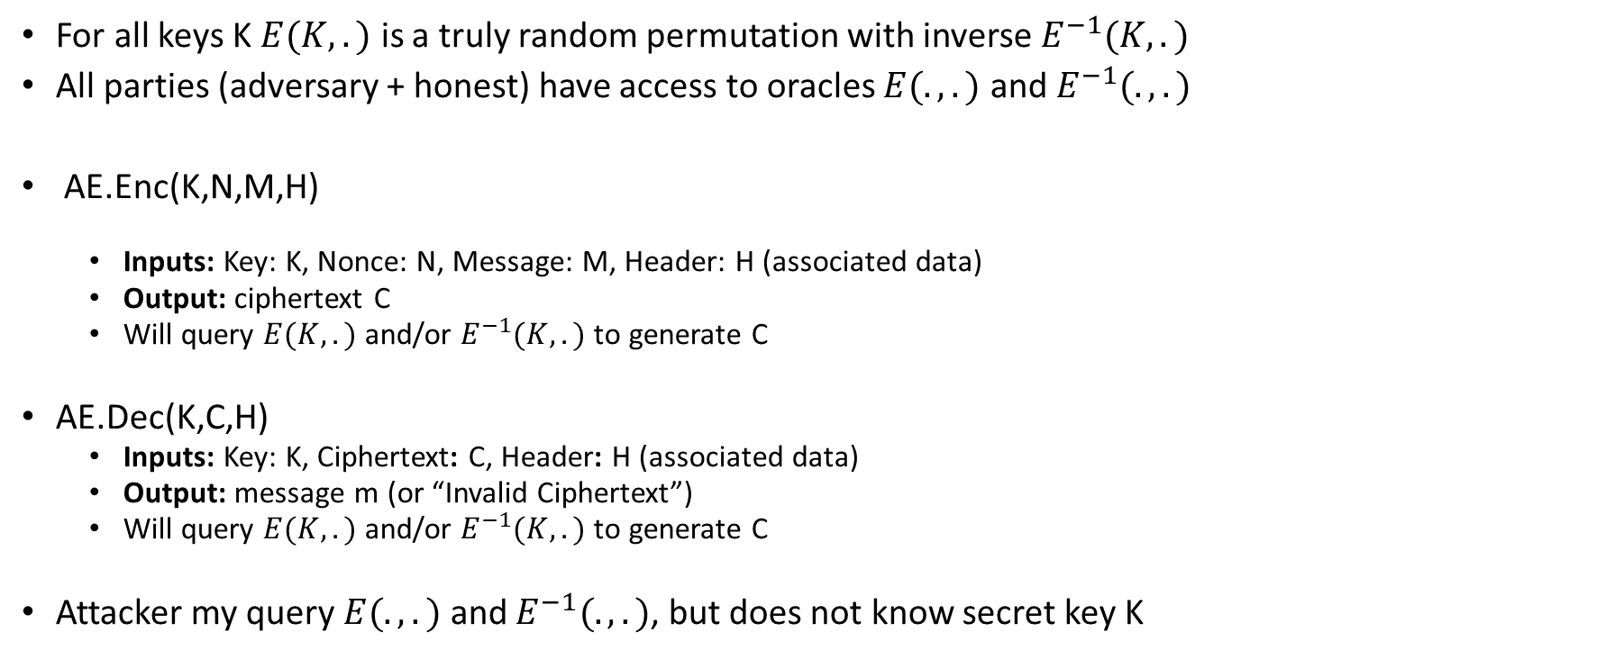
Ideal Cipher Model
For all keys K $E(K,.)$ is a truly random permutation with inverse $E^{−1}(K,.)$
All parties (adversary + honest) have access to oracles $E(.,.)$ and $E^{−1}(.,.)$
AE.Enc(K,N,M,H)
  Inputs: Key: K, Nonce: N, Message: M, Header: H (associated data)
  Output: ciphertext C
  Will query $E(K,.)$ and/or $E^{−1}(K,.)$ to generate C
AE.Dec(K,C,H)
  Inputs: Key: K, Ciphertext: C, Header: H (associated data)
  Output: message m (or “Invalid Ciphertext”)
  Will query $E(K,.)$ and/or $E^{−1}(K,.)$ to generate C
Attacker my query $E(.,.)$ and $E^{−1}(.,.)$, but does not know secret key K

Slide 4
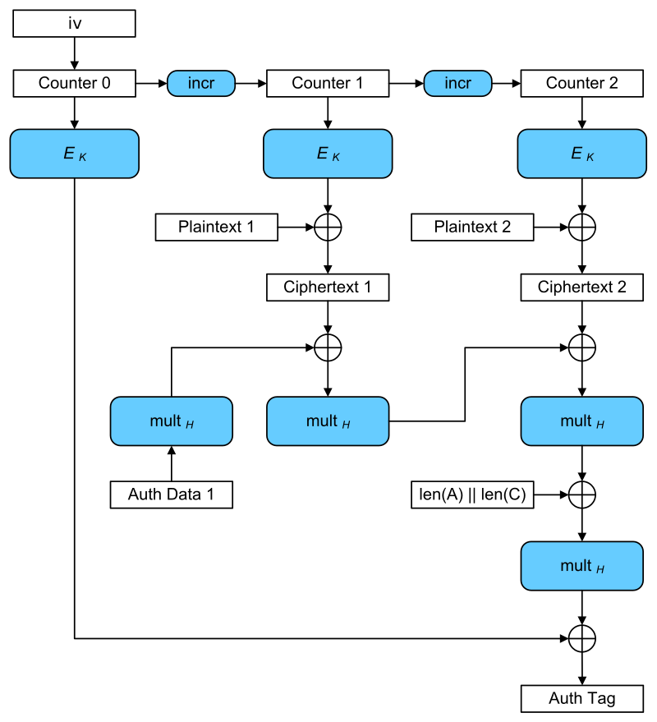
Galois Counter Mode (GCM)
Input: plaintexts 1 & 2
AES-GCM
Security Guarantee: Authentication Encryption with Associated Data
  Message can be arbitrarily long
  Length of message and authentication data is authenticated to avoid truncation attacks etc…
  Public Associated Data is Authenticated
    Source IP
    Destination IP
    Why can’t these values be encrypted?
Outputs: iv, ciphertexts 1 & 2, authentication tag

Slide 5
GCM: Nonce Collision
AES-GCM
Suppose that message m₁ is b₁ blocks long and message m₂ is b₂ block long.
Suppose that we pick nonces N₁ and N₂
How should we define nonce collision?
What is the probability of this event?

Slide 6
GCM: Nonce Collision
AES-GCM
Suppose that message m₁ is b₁ blocks long and message m₂ is b₂ block long.
Suppose that we pick nonces N₁ and N₂
How should we define nonce collision?
  If interval [N₁,N₁+b₁] intersects with [N₂, N₂+b₂] then there could be problems. Why?

Slide 7
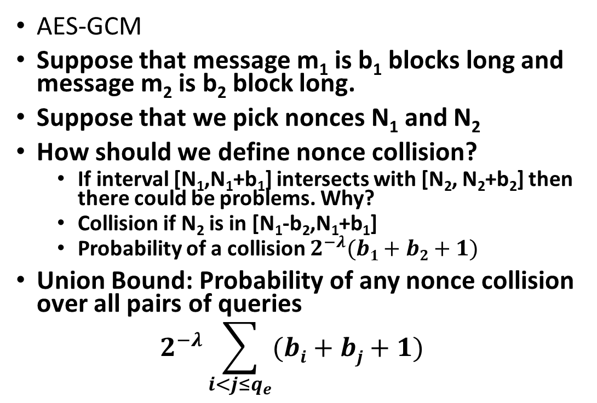
GCM: Nonce Collision
AES-GCM
Suppose that message m₁ is b₁ blocks long and message m₂ is b₂ block long.
Suppose that we pick nonces N₁ and N₂
How should we define nonce collision?
  If interval [N₁,N₁+b₁] intersects with [N₂, N₂+b₂] then there could be problems. Why?
  Collision if N₂ is in [N₁-b₂,N₁+b₁]
  Probability of a collision $2^{−λ}(b1+b2+1)$
Union Bound: Probability of any nonce collision over all pairs of queries
$$2^{−λ}\sum_{i<j≤q_{e}}{(bi+bj+1) }$$

Slide 8
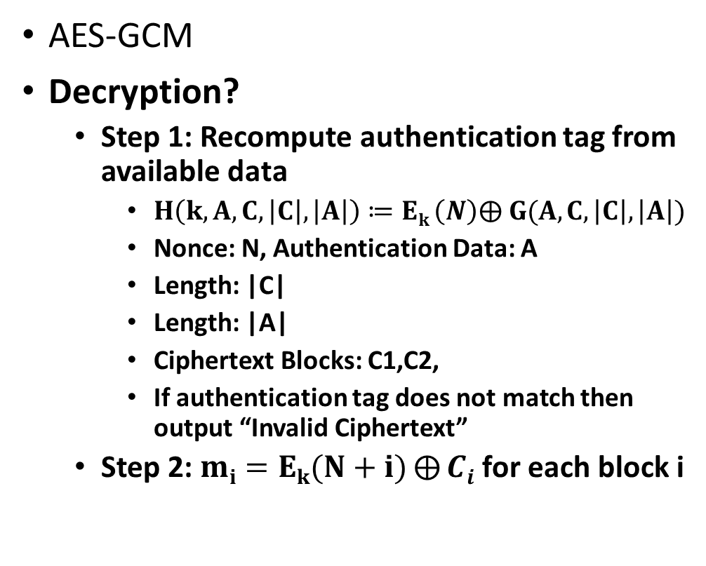
Galois Counter Mode (GCM)
AES-GCM
Decryption?
  Step 1: Recompute authentication tag from available data
    $H\left(k, A,C, \left|C\right|,\left|A\right|\right)≔Ek \left(N\right)⨁ G(A,C, \left|C\right|,\left|A\right|)$
    Nonce: N, Authentication Data: A
    Length: |C|
    Length: |A|
    Ciphertext Blocks: C1,C2,
    If authentication tag does not match then output “Invalid Ciphertext”
  Step 2: $mi=Ek(N+i)⨁{Ci}$ for each block i

Slide 9
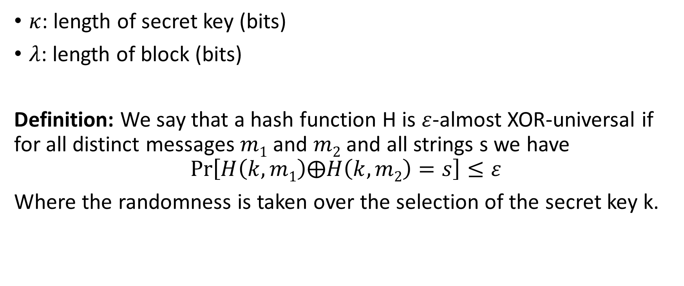
Parameters and Definitions
$κ$: length of secret key (bits)
$λ$: length of block (bits)
Definition: We say that a hash function H is $ε$-almost XOR-universal if for all distinct messages $m1$ and $m2$ and all strings s we have
$$\operatorname{Pr}\left[H\left(k,m1\right)⨁H\left(k,m2\right)=s\right]≤ε$$
Where the randomness is taken over the selection of the secret key k.

Slide 10
AES-GCM: Nonces
Option 1: Random N
  Advantage: Stateless + simple to implement,
  Disadvantage: It is possible for a nonce to collide (typical solution: generate fresh keys after 2³² messages to keep probability of a nonce collision small)
Option 2: Both parties increment N after each message
  Advantage: Avoids nonce collisions ☺
  Disadvantage:
    Requires keeping track of current value.
    Implementation Challenges. What if packets are dropped?
    Security issue if implementation is buggy or if counter is accidently reset (e.g., radiation)

Slide 11
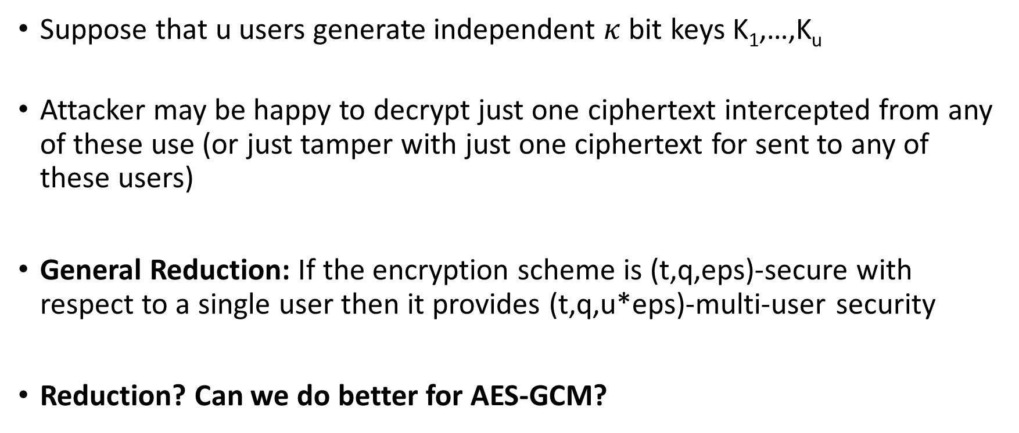
Multi-User Security
Suppose that u users generate independent $κ$bit keys K₁,…,K_{u}
Attacker may be happy to decrypt just one ciphertext intercepted from any of these use (or just tamper with just one ciphertext for sent to any of these users)
General Reduction: If the encryption scheme is (t,q,eps)-secure with respect to a single user then it provides (t,q,u*eps)-multi-user security
Reduction? Can we do better for AES-GCM?

Slide 12
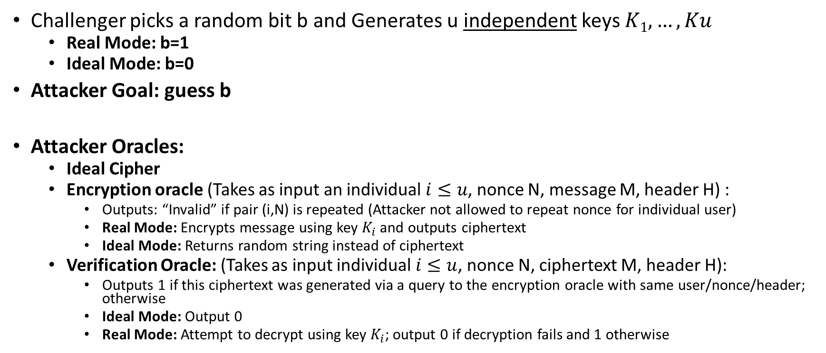
Multi-User Security Game for AEAD
Challenger picks a random bit b and Generates u independent keys $K1,…,Ku$
  Real Mode: b=1
  Ideal Mode: b=0
Attacker Goal: guess b
Attacker Oracles:
  Ideal Cipher
  Encryption oracle (Takes as input an individual $i≤u$, nonce N, message M, header H) :
    Outputs: “Invalid” if pair (i,N) is repeated (Attacker not allowed to repeat nonce for individual user)
    Real Mode: Encrypts message using key $K_{i}$ and outputs ciphertext
    Ideal Mode: Returns random string instead of ciphertext
  Verification Oracle: (Takes as input individual $i≤u$, nonce N, ciphertext M, header H):
    Outputs 1 if this ciphertext was generated via a query to the encryption oracle with same user/nonce/header; otherwise
    Ideal Mode: Output 0
    Real Mode: Attempt to decrypt using key $K_{i}$; output 0 if decryption fails and 1 otherwise
Source: Bellare, Tackmann, Multi-User Security of Authenticated Encryption: AES-GCM in TLS 1.3

Slide 13
Multi-User Security Game
Oracles
Source: Bellare, Tackmann, Multi-User Security of Authenticated Encryption: AES-GCM in TLS 1.3

Slide 14
Though Question: Which parameters do we expect to be large in practice? qe, qv or p?

Slide 15
P: may be very large (can compute E(.,.) offline)
qe, qv require cooperation from a party who knows secret key

Slide 16
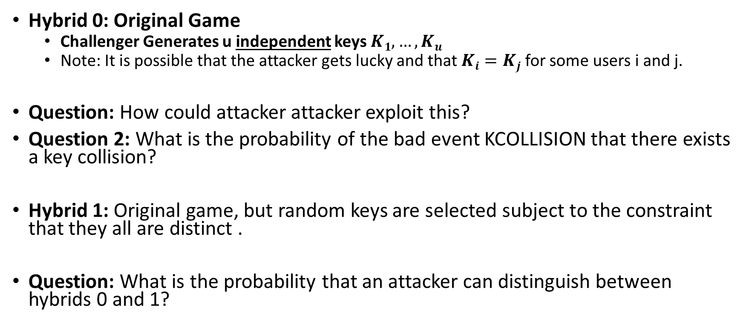
Hybrid Argument: Slowly Make Real/Ideal Oracles Identical
Hybrid 0: Original Game
  Challenger Generates u independent keys $K1,…,Ku$
  Note: It is possible that the attacker gets lucky and that $Ki=Kj$ for some users i and j.
Question: How could attacker attacker exploit this?
Question 2: What is the probability of the bad event KCOLLISION that there exists a key collision?
Hybrid 1: Original game, but random keys are selected subject to the constraint that they all are distinct .
Question: What is the probability that an attacker can distinguish between hybrids 0 and 1?

Slide 17
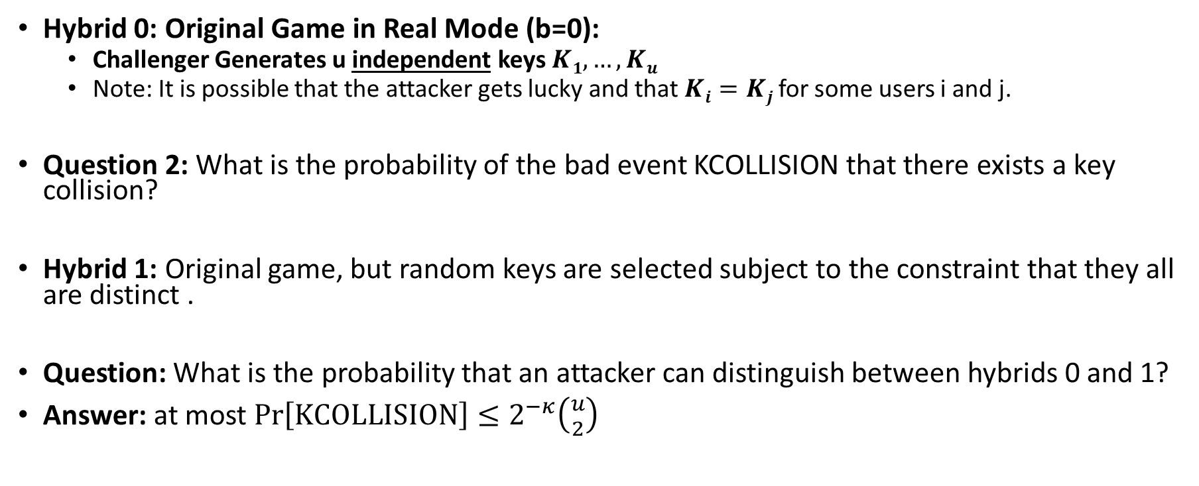
Hybrid Argument: Slowly Make Real/Ideal Oracles Identical
Hybrid 0: Original Game in Real Mode (b=0):
  Challenger Generates u independent keys $K1,…,Ku$
  Note: It is possible that the attacker gets lucky and that $Ki=Kj$ for some users i and j.
Question 2: What is the probability of the bad event KCOLLISION that there exists a key collision?
Hybrid 1: Original game, but random keys are selected subject to the constraint that they all are distinct .
Question: What is the probability that an attacker can distinguish between hybrids 0 and 1?
Answer: at most $\operatorname{Pr}\left[KCOLLISION\right]≤2^{−κ}\left({u \atop 2}\right)$

Slide 19
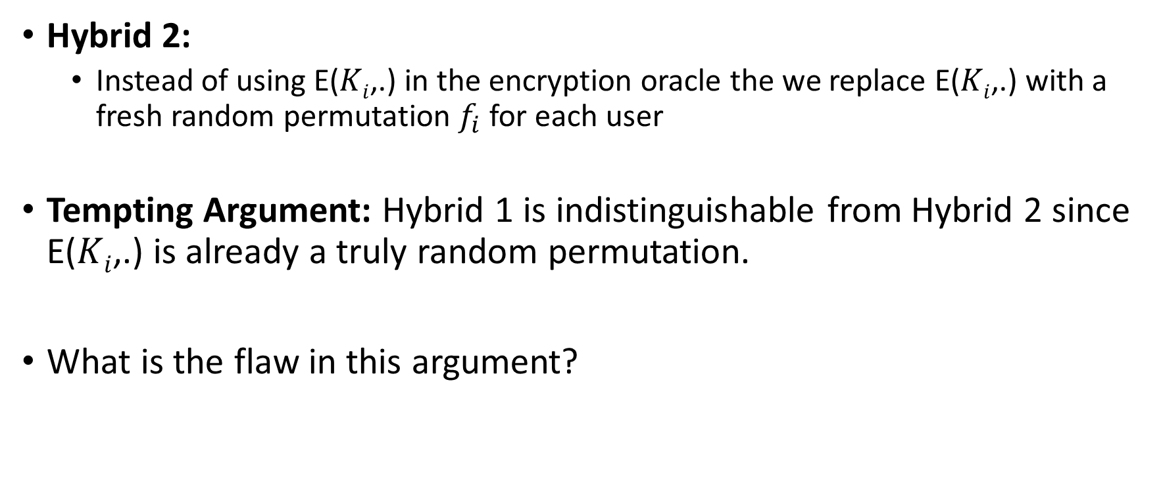
Hybrid Argument: Slowly Make Real/Ideal Oracles Identical
Hybrid 2:
  Instead of using E($Ki$,.) in the encryption oracle the we replace E($Ki$,.) with a fresh random permutation $f_{i}$ for each user
Tempting Argument: Hybrid 1 is indistinguishable from Hybrid 2 since E($Ki$,.) is already a truly random permutation.
What is the flaw in this argument?

Slide 20
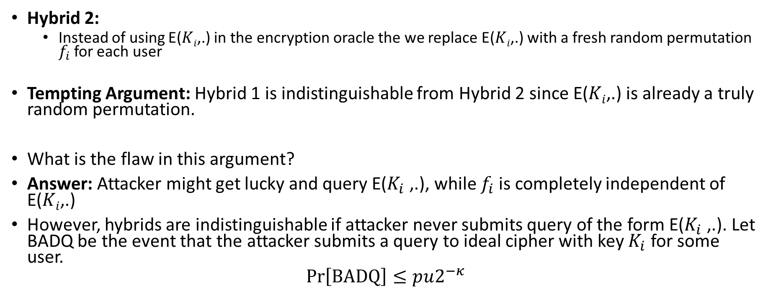
Hybrid Argument: Slowly Make Real/Ideal Oracles Identical
Hybrid 2:
  Instead of using E($Ki$,.) in the encryption oracle the we replace E($Ki$,.) with a fresh random permutation $f_{i}$ for each user
Tempting Argument: Hybrid 1 is indistinguishable from Hybrid 2 since E($Ki$,.) is already a truly random permutation.
What is the flaw in this argument?
Answer: Attacker might get lucky and query E($K_{i}$ ,.), while $f_{i}$ is completely independent of E($Ki$,.)
However, hybrids are indistinguishable if attacker never submits query of the form E($K_{i}$ ,.). Let BADQ be the event that the attacker submits a query to ideal cipher with key $K_{i}$ for some user.
$$\operatorname{Pr}\left[BADQ\right]≤pu2^{−κ}$$

Slide 22
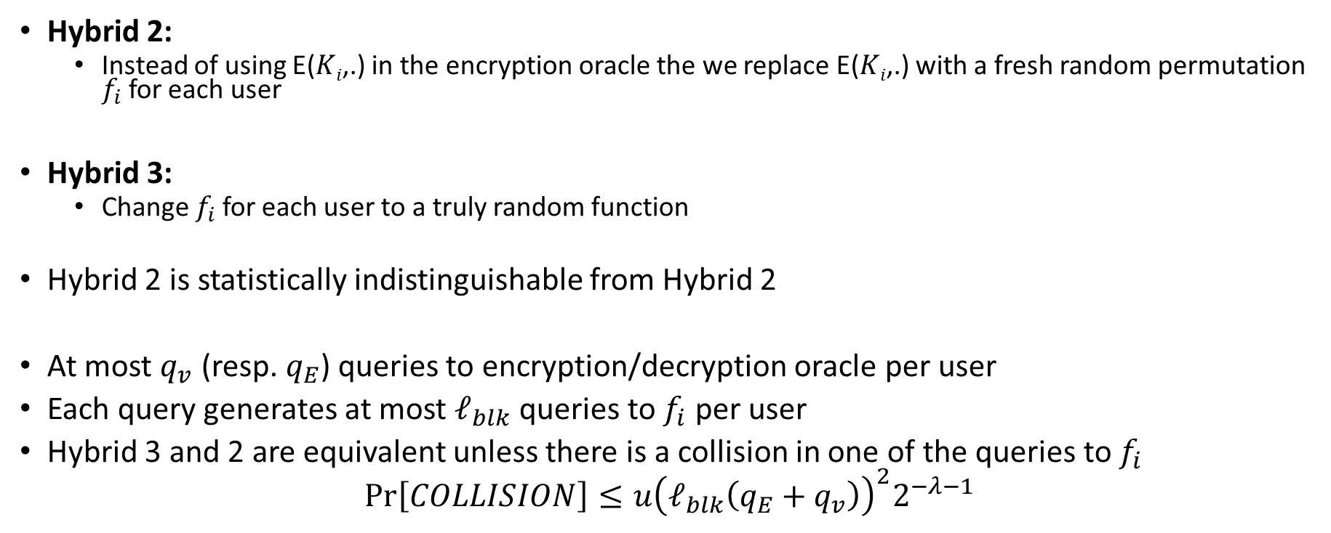
Hybrid Argument: Slowly Make Real/Ideal Oracles Identical
Hybrid 2:
  Instead of using E($Ki$,.) in the encryption oracle the we replace E($Ki$,.) with a fresh random permutation $f_{i}$ for each user
Hybrid 3:
  Change $f_{i}$ for each user to a truly random function
Hybrid 2 is statistically indistinguishable from Hybrid 2
At most $q_{v}$ (resp. $q_{E}$) queries to encryption/decryption oracle per user
Each query generates at most $ℓ_{blk}$queries to $f_{i}$ per user
Hybrid 3 and 2 are equivalent unless there is a collision in one of the queries to $f_{i}$
$$\operatorname{Pr}\left[COLLISION\right]≤u{\left(ℓ_{blk}\left({q_{E}+q}_{v}\right)\right)}^{2}2^{−λ−1}$$

Slide 24
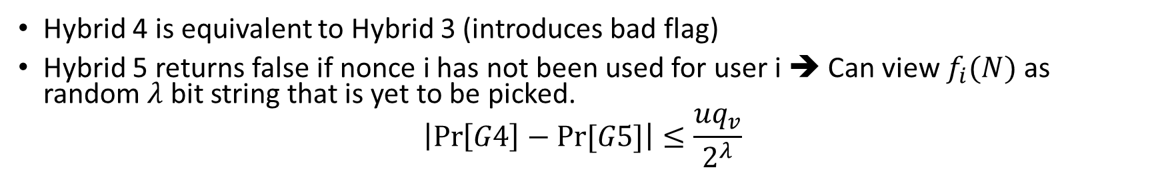
Hybrid 4 is equivalent to Hybrid 3 (introduces bad flag)
Hybrid 5 returns false if nonce i has not been used for user i ➔ Can view $f_{i}(N)$ as random $λ$ bit string that is yet to be picked.
$$\left|\operatorname{Pr}\left[G4\right]−Pr⁡[G5]\right|≤\frac{uq_{v}}{2^{λ}}$$

Slide 27
What is Probability Attacker wins in Hybrid 7
What is the probability attacker wins in Hybrid 7?
Exactly ½
Why? In hybrid 7 of all oracles is identical when b=0 and b=1.

Slide 28
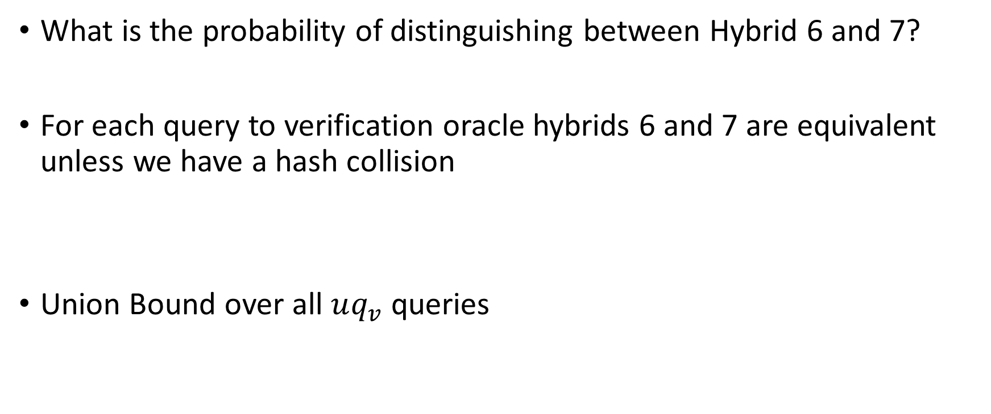
Question:
What is the probability of distinguishing between Hybrid 6 and 7?
For each query to verification oracle hybrids 6 and 7 are equivalent unless we have a hash collision
Union Bound over all $uq_{v}$ queries

Slide 31
Multi-User Security Game for AEAD
Challenger picks a random bit b and Generates u independent keys $K1,…,Ku$
  Real Mode: b=1
  Ideal Mode: b=0
Attacker Goal: guess b
Attacker Oracles:
  Ideal Cipher
  Encryption oracle (Takes as input an individual $i≤u$, nonce N, message M, header H) :
    Outputs: “Invalid” if pair (i,N) is repeated (Attacker not allowed to repeat nonce for individual user)
    Real Mode: Encrypts message using key $K_{i}$ and outputs ciphertext
    Ideal Mode: Returns random string instead of ciphertext
  Verification Oracle: (Takes as input individual $i≤u$, nonce N, ciphertext M, header H):
    Outputs 1 if this ciphertext was generated via a query to the encryption oracle with same user/nonce/header; otherwise
    Ideal Mode: Output 0
    Real Mode: Attempt to decrypt using key $K_{i}$; output 0 if decryption fails and 1 otherwise
Source: Bellare, Tackmann, Multi-User Security of Authenticated Encryption: AES-GCM in TLS 1.3

Slide 32
Reminder: Last Class

Slide 33
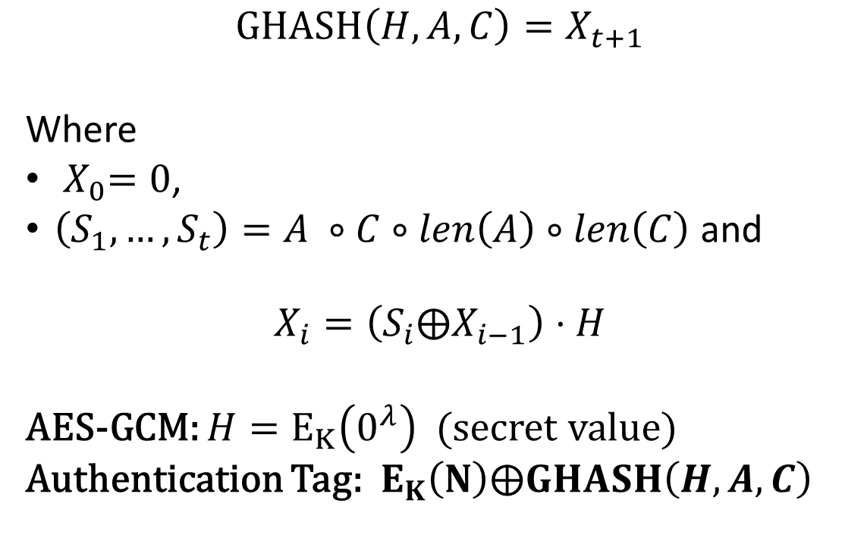

GHASH in AES-GCM
$$GHASH\left(H,A,C\right)=X_{t+1}$$
Where
${ X}_{0}=0$,
$\left(S_{1},…,S_{t}\right)=A ∘C∘len\left(A\right)∘len\left(C\right)$ and
$$X_{i}=\left(S_{i}⨁X_{i−1}\right)⋅H$$
AES-GCM: $H=E_{K}\left(0^{λ}\right)$ (secret value)
Authentication Tag: $E_{K}\left(N\right)⨁GHASH\left(H,A,C\right)$
$$GHASH\left(H,A,C\right)$$

Slide 34
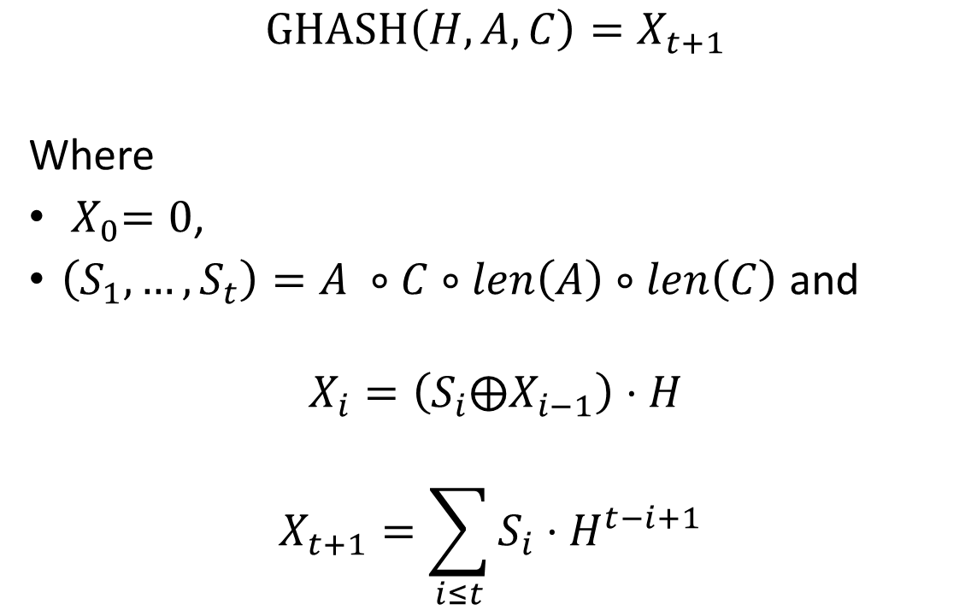
GHASH in AES-GCM
$$GHASH\left(H,A,C\right)=X_{t+1}$$
Where
${ X}_{0}=0$,
$\left(S_{1},…,S_{t}\right)=A ∘C∘len\left(A\right)∘len\left(C\right)$ and
$$X_{i}=\left(S_{i}⨁X_{i−1}\right)⋅H$$
$$X_{t+1}=\sum_{i≤t}{S_{i}⋅H^{t−i+1} }$$
$$GHASH\left(H,A,C\right)$$

Slide 35
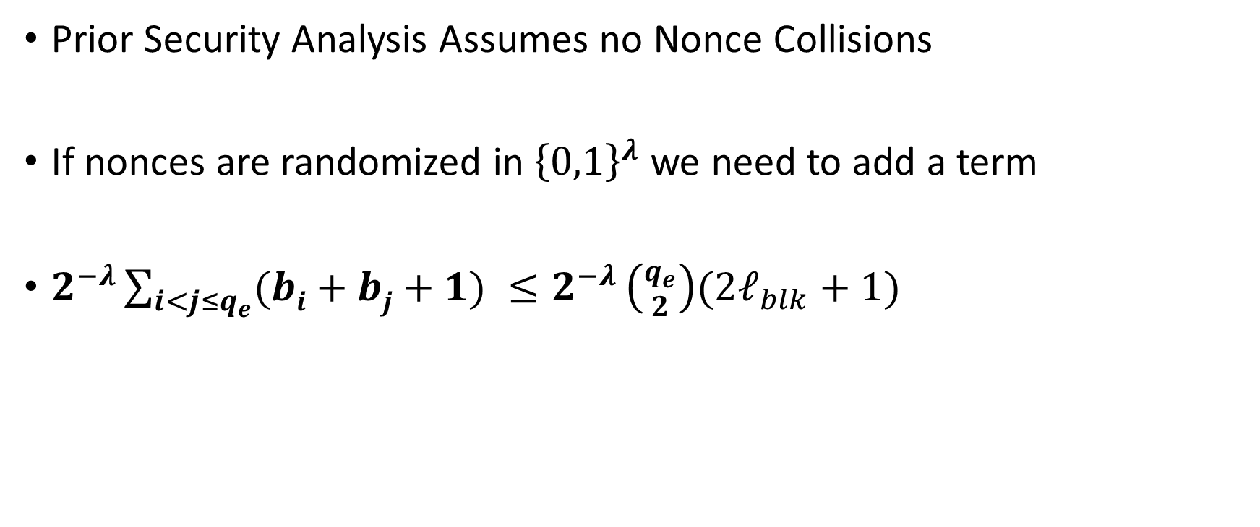
Back to the Nonces
Prior Security Analysis Assumes no Nonce Collisions
If nonces are randomized in ${\left\{0,1\right\}}^{λ}$ we need to add a term
$2^{−λ}\sum_{i<j≤q_{e}}{(bi+bj+1) ≤2^{−λ}}\left({q_{e} \atop 2}\right)(2ℓ_{blk}+1)$

Slide 36
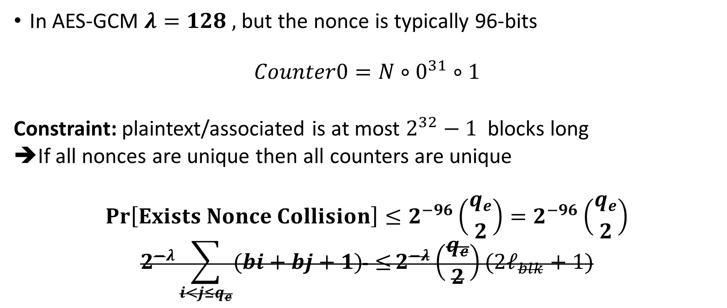
Back to the Nonces: AES GCM
In AES-GCM $λ=128 ,$but the nonce is typically 96-bits
$$Counter0=N∘0^{31}∘1$$
Constraint: plaintext/associated is at most $2^{32}−1$ blocks long
➔If all nonces are unique then all counters are unique
$$Pr\left[Exists Nonce Collision\right]≤2^{−96}\left({q_{e} \atop 2}\right)=2^{−96}\left({q_{e} \atop 2}\right)$$
$$2^{−λ}\sum_{i<j≤q_{e}}{(bi+bj+1) ≤}2^{−λ}\left({q_{e} \atop 2}\right)(2ℓ_{blk}+1)$$

Slide 37
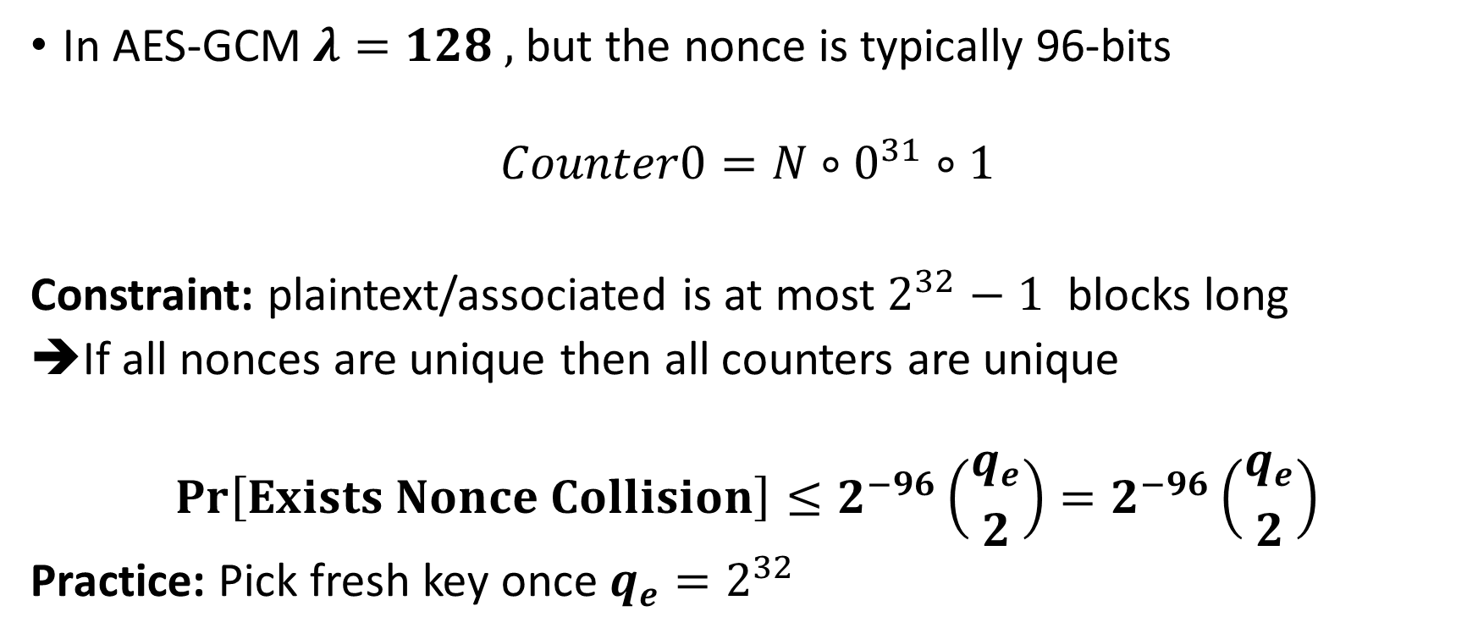
Back to the Nonces: AES GCM
In AES-GCM $λ=128 ,$but the nonce is typically 96-bits
$$Counter0=N∘0^{31}∘1$$
Constraint: plaintext/associated is at most $2^{32}−1$ blocks long
➔If all nonces are unique then all counters are unique
$$Pr\left[Exists Nonce Collision\right]≤2^{−96}\left({q_{e} \atop 2}\right)=2^{−96}\left({q_{e} \atop 2}\right)$$
Practice: Pick fresh key once $q_{e}=2^{32}$

Slide 38
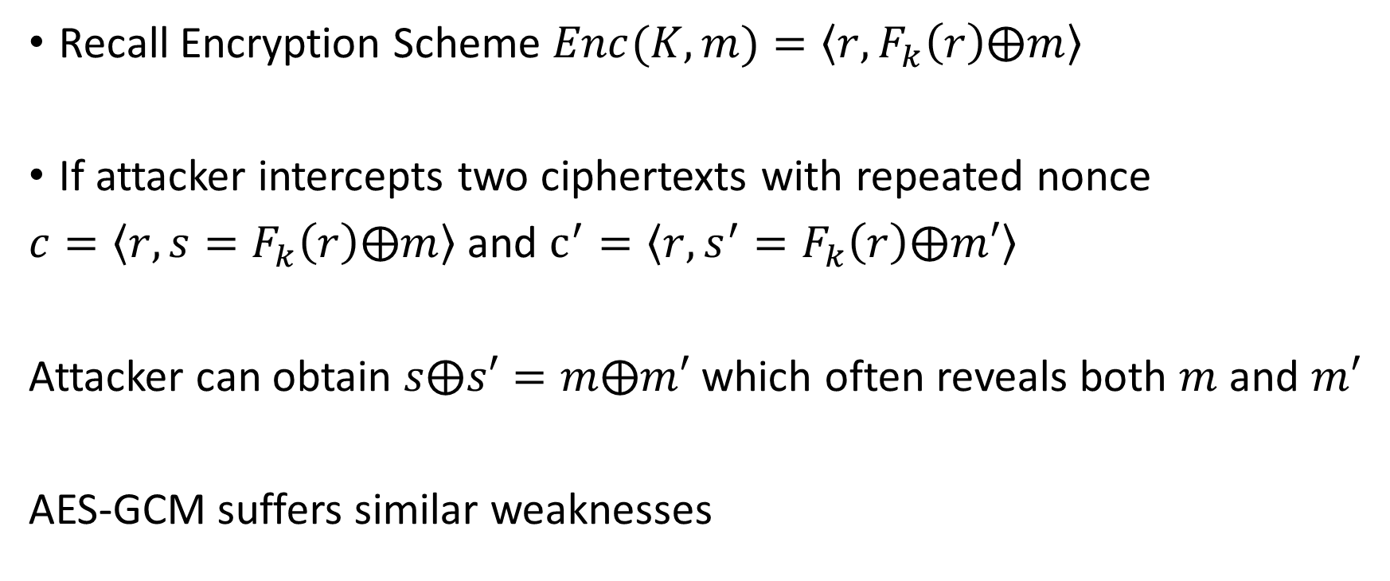
Nonce-Misuse Resistance
Recall Encryption Scheme $Enc(K,m)=\left\langle r,F_{k}\left(r\right)⨁m\right\rangle$
If attacker intercepts two ciphertexts with repeated nonce
$c=\left\langle r,s=F_{k}\left(r\right)⨁m\right\rangle$ and $c^{′}=\left\langle r,s^{′}=F_{k}\left(r\right)⨁m′\right\rangle$
Attacker can obtain $s⨁s′=m⨁m′$ which often reveals both $m$ and $m′$
AES-GCM suffers similar weaknesses

Slide 39
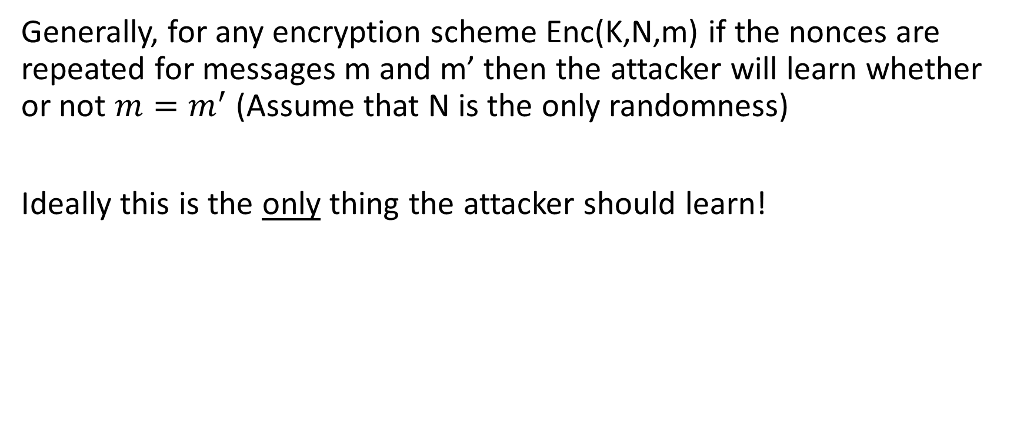
Nonce-Misuse Resistance
Generally, for any encryption scheme Enc(K,N,m) if the nonces are repeated for messages m and m’ then the attacker will learn whether or not $m=m^{′}$(Assume that N is the only randomness)
Ideally this is the only thing the attacker should learn!

Slide 40
Attacker is allowed to repeat nonce N for same user i as long as the message M (or authentication headers A) are different.

Slide 41
Attacker is allowed to repeat nonce N for same user i as long as the message M (or authentication headers A) are different.

Slide 42
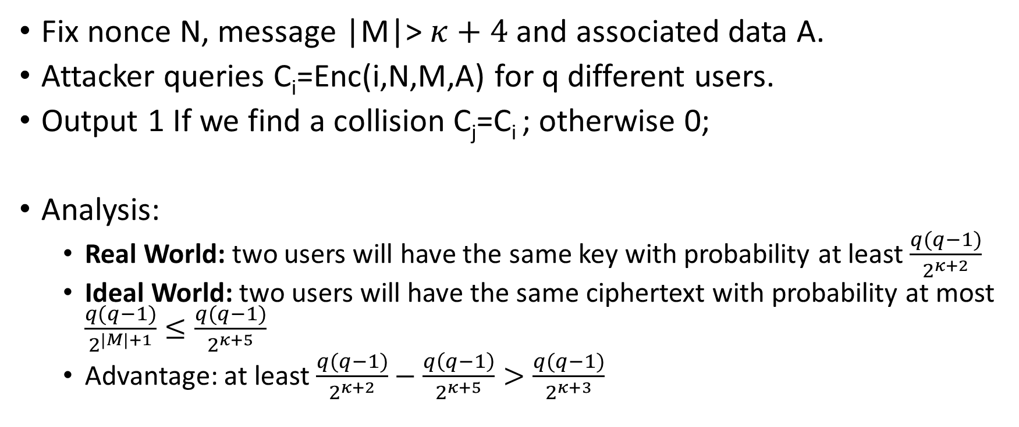
Generic Attack
Fix nonce N, message |M|> $κ+4$ and associated data A.
Attacker queries C_{i}=Enc(i,N,M,A) for q different users.
Output 1 If we find a collision C_{j}=C_{i} ; otherwise 0;
Analysis:
  Real World: two users will have the same key with probability at least $\frac{q(q−1)}{2^{κ+2}}$
  Ideal World: two users will have the same ciphertext with probability at most $\frac{q(q−1)}{2^{|M|+1}}≤\frac{q(q−1)}{2^{κ+5}}$
  Advantage: at least $\frac{q(q−1)}{2^{κ+2}}−\frac{q\left(q−1\right)}{2^{κ+5}}>\frac{q(q−1)}{2^{κ+3}}$

Slide 43
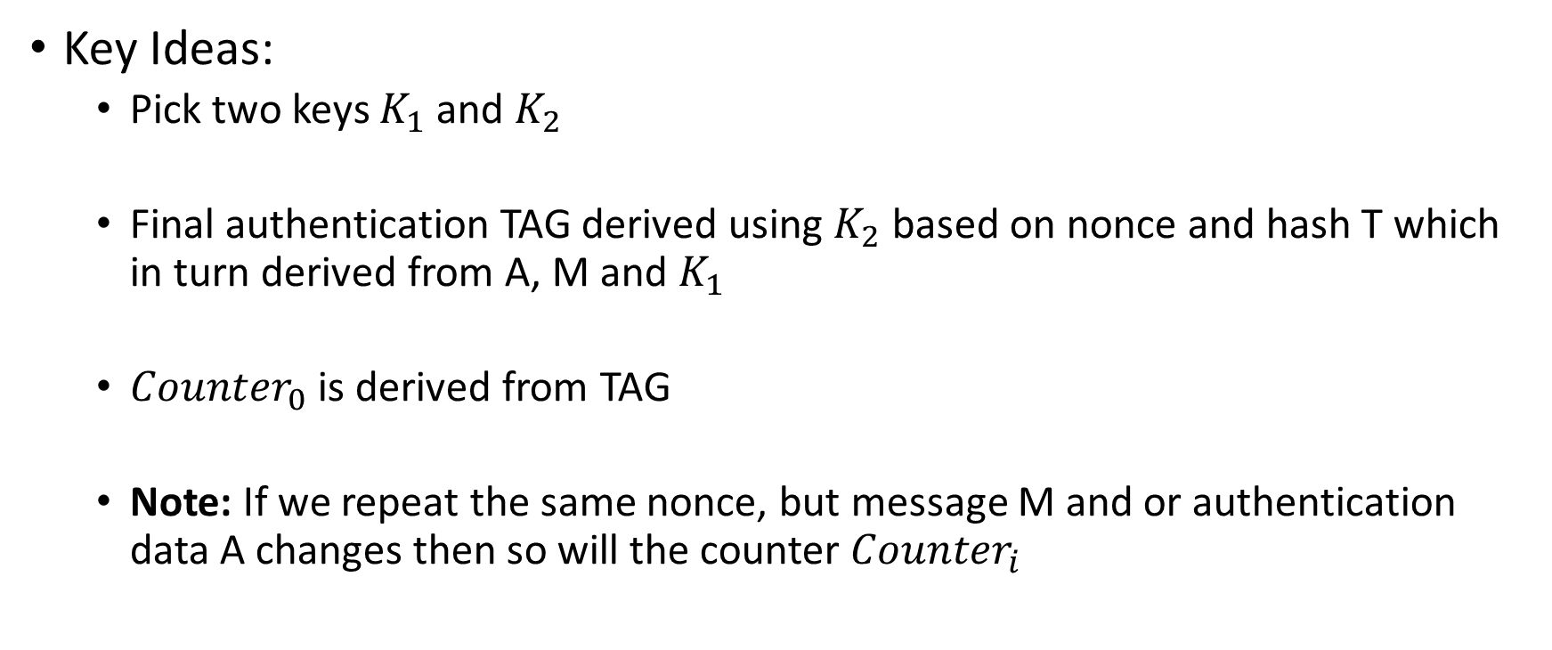
AES-GCM-SIV
Key Ideas:
  Pick two keys $K_{1}$ and $K_{2}$
  Final authentication TAG derived using $K_{2}$ based on nonce and hash T which in turn derived from A, M and $K_{1}$
  ${Counter}_{0}$ is derived from TAG
  Note: If we repeat the same nonce, but message M and or authentication data A changes then so will the counter ${Counter}_{i}$

Slide 45
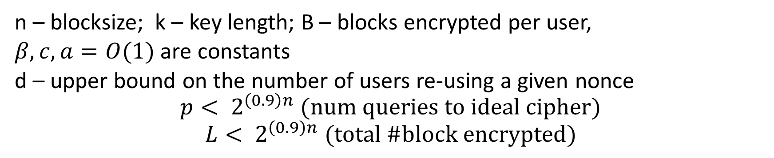
Security Bounds
n – blocksize; k – key length; B – blocks encrypted per user,
$β,c,a=O(1)$ are constants
d – upper bound on the number of users re-using a given nonce
$$p< 2^{\left(0.9\right)n} (num queries to ideal cipher)$$
$$L< 2^{\left(0.9\right)n} (total \#block encrypted)$$
Revisiting AES-GCM-SIV: Multi-user Security, Faster Key Derivation and Better Bounds [BHT18]

Slide 46
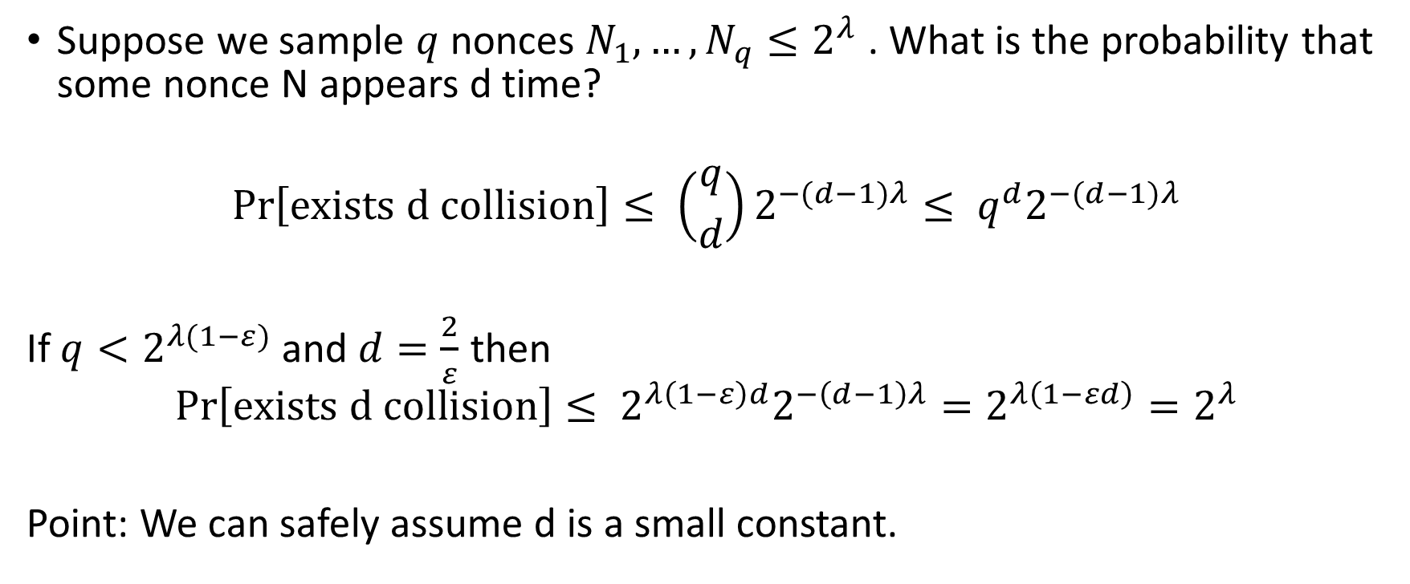
Nonce Multi-Collisions (d)
Suppose we sample $q$ nonces $N_{1},…,N_{q}≤2^{λ}$ . What is the probability that some nonce N appears d time?
$$\operatorname{Pr}\left[exists d collision\right]≤ \left({q \atop d}\right)2^{−(d−1)λ}≤ q^{d}2^{−(d−1)λ}$$
If $q<2^{λ(1−ε)}$ and $d=\frac{2}{ε}$ then
$$\operatorname{Pr}\left[exists d collision\right]≤ 2^{λ\left(1−ε\right)d}2^{−\left(d−1\right)λ}=2^{λ\left(1−εd\right)}=2^{λ}$$
Point: We can safely assume d is a small constant.

Slide 47
Partitioning Oracle Attacks
Julia Len
Paul Grubbs
Thomas Ristenpart
Cornell Tech
USENIX Security 2021
1

Slide 48
Authenticated Encryption
For simplicity, we ignore associated data in this presentation
Nonce N Plaintext M
C ← AEAD.Enc(
, N, M)

Slide 49

Authenticated Encryption
For simplicity, we ignore associated data in this presentation
Nonce N Plaintext M
C ← AEAD.Enc(
N || C
, N, M)
?
M ← AEAD.Dec(
, N, C)

Slide 50
Authenticated Encryption
For simplicity, we ignore associated data in this presentation
Nonce N Plaintext M
C ← AEAD.Enc(
N || C
, N, M)
?
M ← AEAD.Dec(
, N, C)
Popular
AES-GCM
XSalsa20/Poly1305
ChaCha20/Poly1305
AES-GCM-SIV
Easy to use
Efficient
Standardized
Widely supported
Secure
Proven CCA-secure
Confidentiality
Integrity

Slide 51
Authenticated Encryption
For simplicity, we ignore associated data in this presentation
Nonce N Plaintext M
C ← AEAD.Enc(
N || C
, N, M)
?
M ← AEAD.Dec(
, N, C)
Popular Easy to use Secure
But don’t target robustness, also called committing AEAD, as a security goal
[ABN TCC’10], [FLPQ PKC’13] for PKE, [FOR FSE’17] for AEAD
AES-GCM
XSalsa20/Poly1305
ChaCha20/Poly1305
AES-GCM-SIV
Efficient
Standardized
Widely supported
Proven CCA-secure
Confidentiality
Integrity

Slide 52
(Non-) Committing AEAD
For simplicity, we ignore associated data in this presentation
Nonce N’ Ciphertext C’
M ← AEAD.Dec(
M* ← AEAD.Dec(
, N’, C’)
, N’, C’)

Slide 53
(Non-) Committing AEAD
For simplicity, we ignore associated data in this presentation
?
Nonce N’
Ciphertext C’
M ← AEAD.Dec(
M* ← AEAD.Dec(
, N’, C’)
, N’, C’)

Slide 54
(Non-) Committing AEAD
For simplicity, we ignore associated data in this presentation
?
Nonce N’ Ciphertext C’
N’ || C’
M ← AEAD.Dec(
, N’, C’)
M ← AEAD.Dec(
M* ← AEAD.Dec(
, N’, C’)
, N’, C’)

Slide 55
(Non-) Committing AEAD
For simplicity, we ignore associated data in this presentation
?
Nonce N’ Ciphertext C’
N’ || C’
M ← AEAD.Dec(
, N’, C’)
M ← AEAD.Dec(
M* ← AEAD.Dec(
, N’, C’)
, N’, C’)
No guarantee the sender actually knows the exact key the recipient will use to decrypt!
Not considered an essential security goal, except in moderation settings [GLR CRYPTO’17], [DGRW CRYPTO’18]

Slide 56
password1 password2 password3 password4 password5 password6 password7 password8
Password dictionary D
password5

Slide 57
Brute-force Dictionary Attack
N || C₁
C₁ ← AEAD.Enc(“password1”, N, M)
password1 password2 password3 password4 password5 password6 password7 password8
Decryption error
Password dictionary D
N || C₂
C₂ ← AEAD.Enc(“password2”, N, M)
Decryption error
N || C₃
C₃ ← AEAD.Enc(“password3”, N, M)
Decryption error
password5
N || C₄
C₄ ← AEAD.Enc(“password4”, N, M)
Decryption error
N || C₅
C₅ ← AEAD.Enc(“password5”, N, M)
Decryption success!

Slide 58
Partitioning Oracle Attack
A high level overview of our attack
password1 password2 password3 password4 password5 password6 password7 password8
Password dictionary D
password5
password1 password2 password3 password4
password5 password6 password7 password8

Slide 59

Partitioning Oracle Attack
A high level overview of our attack
password1 password2 password3 password4 password5 password6 password7 password8
Password dictionary D
password5
password1 password2 password3 password4
password5 password6 password7 password8
Nonce N
[Ciphertext C
splitting
ciphertext k = 4

Slide 60
Partitioning Oracle Attack
A high level overview of our attack
password1 password2 password3 password4 password5 password6 password7 password8
Password dictionary D
N || C
⏊ ← AEAD.Dec(“password5”, N, C)
password5
password1 password2 password3 password4
password5 password6 password7 password8
Nonce N
[Ciphertext C
splitting
ciphertext k = 4

Slide 61
Partitioning Oracle Attack
A high level overview of our attack
password1 password2 password3 password4 password5 password6 password7 password8
Password dictionary D
N || C
⏊ ← AEAD.Dec(“password5”, N, C)
password5
password1 password2 password3 password4
password5 password6 password7 password8
Nonce N
Decryption error
[Ciphertext C
splitting
ciphertext k = 4

Slide 62
Partitioning Oracle Attack
A high level overview of our attack
password1 password2 password3 password4 password5 password6 password7 password8
Password dictionary D
N || C
⏊ ← AEAD.Dec(“password5”, N, C)
password5
password1 password2 password3 password4
password5 password6 password7 password8
Nonce N
Decryption error
[Ciphertext C
splitting
ciphertext k = 4

Slide 63
Partitioning Oracle Attack
D
k = 1
D₁
k = 1
D₂
k = 1
D₃
…
k = 1
Brute-force dictionary attack
Requires 𝒪(|D|) queries to learn the password
17

Slide 64
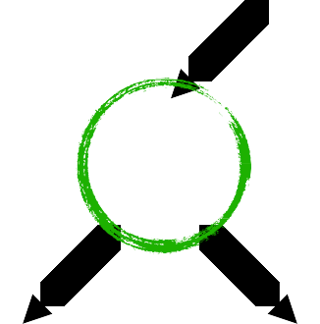
Partitioning Oracle Attack
D
k = 1
D
k = |D| / 2
D_{0 ✕}D₁
D₁
k = 1
k = |D| / 4
D_{2 ✕}D₃
k = |D| / 8 k = |D| / 16
D
k = 1
✕D₄ D₅
2
D₃
…
✕D₆ D₇
k = 1
k = |D| / 32
…
Requires 𝒪(log |D|) queries to learn the password
Brute-force dictionary attack
Requires 𝒪(|D|) queries to learn
the password
Exponential speedup over brute-force
dictionary attack!
18

Slide 65

Partitioning Oracle Attack
D
k = 1
D
k = |D| / 2
D
k = 5000
D_{0 ✕}D₁
✕D₀ D₁
k = |D| / 4
k = 5000
D₁
k = 1
D_{2 ✕}D₃
✕D₂ D₃
k = |D| / 8 k = |D| / 16
k = 5000
D₂
k = 1
✕D₄ D₅
✕D₄ D₅
k = 5000
✕D₆ D₇
✕D₆ D₇
D₃
…
k = 1
k = 5000
k = |D| / 32
D_{8 ✕}D₉
…
Requires 𝒪(log |D|) queries to learn the password
k = 2500
…
Brute-force dictionary attack
|D| is large so a more realistic case is k = 5000
Requires 𝒪(|D|) queries to learn the password
Exponential speedup over brute-force dictionary attack!
This still offers a good speedup over brute-force
19

Slide 66
Partitioning oracle attacks rely on:
1. Building splitting ciphertexts that can decrypt under k > 1 different keys
2. Access to a partitioning oracle

Slide 67
Partitioning oracle attacks rely on:
Building splitting ciphertexts that can decrypt under k > 1 different keys
Key Multi-collision Attacks
[GLR CRYPTO’17] first showed an attack against AES-GCM for k = 2
Access to a partitioning oracle

Slide 68
Computing Key Multi-Collisions: AES-GCM
Encrypt
-
then
-
MAC
Counter mode encryption of AES
GHASH:
polynomial MAC
Run time: 𝒪(k²)
K₁ K₂ K₃
Ciphertext that decrypts under all k keys
Attack algorithm
…
Kk-1
K_{k}
Length: k 16-byte blocks

Slide 69

Computing Key Multi-Collisions: AES-GCM
Encrypt
-
then
-
MAC
Counter mode encryption of AES
GHASH:
polynomial MAC
Run time: 𝒪(k²)
Reduces finding
ciphertext to solving set of linear equations
K₁ K₂ K₃
Ciphertext that decrypts under all k keys
Attack algorithm
…
Kk-1
K_{k}
Length: k 16-byte blocks

Slide 70

GHASH in AES-GCM
$$GHASH\left(H,A,C\right)=X_{t+1}$$
Where
$$T=X_{t+1}=\sum_{i≤t}{C_{i}⋅H^{t−i+1} }$$
$$GHASH\left(H,A,C\right)$$

Slide 71
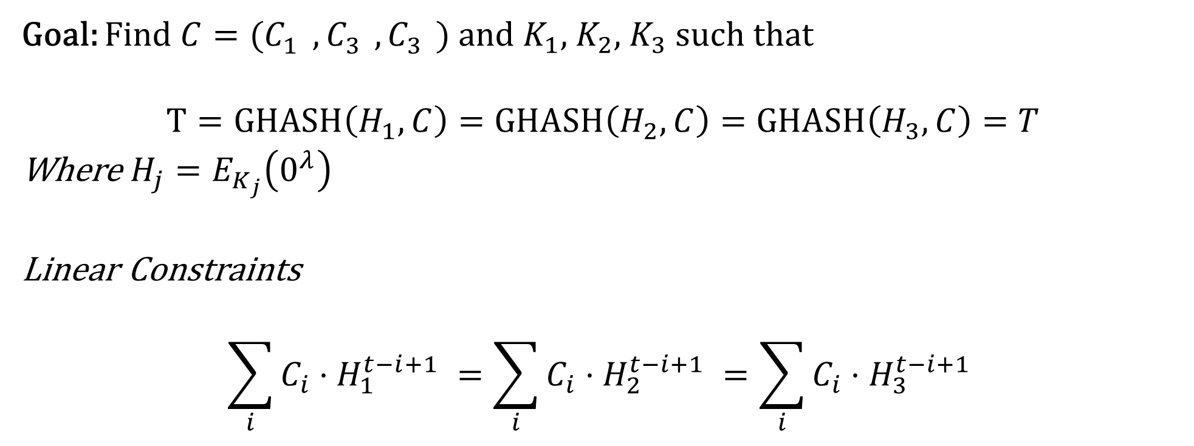
Multi-Collision
Goal: Find $C=(C_{1}^{},C_{3}^{},C_{3}^{})$ and $K_{1},$ $K_{2}$, $K_{3}$ such that
$$T=GHASH\left(H_{1},C\right)=GHASH\left(H_{2}, C\right)=GHASH\left(H_{3}, C\right)=T$$
Where $H_{j}=E_{K_{j}}\left(0^{λ}\right)$
Linear Constraints
$$\sum_{i}{C_{i}⋅H_{1}^{t−i+1} }=\sum_{i}{C_{i}⋅H_{2}^{t−i+1} }=\sum_{i}{C_{i}⋅H_{3}^{t−i+1} }$$

Slide 72
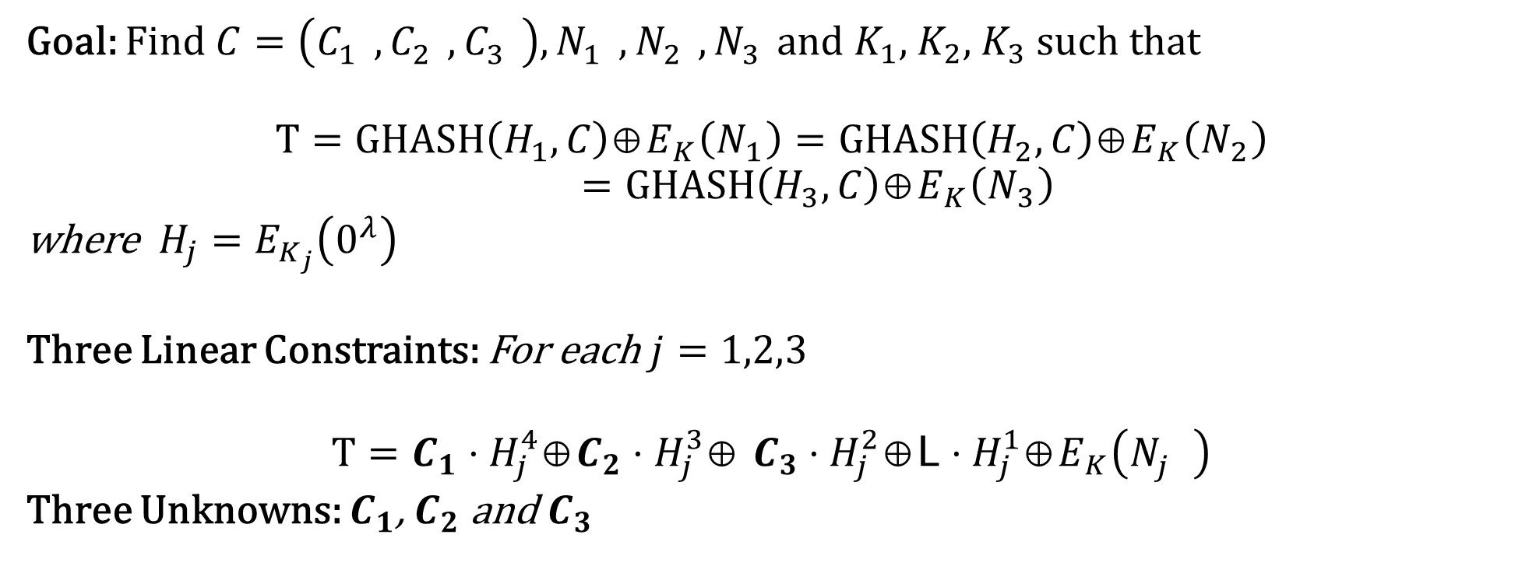
Multi-Collision
Goal: Find $C=\left(C_{1}^{},C_{2}^{},C_{3}^{}\right),N_{1}^{},N_{2}^{},N_{3}^{}$and $K_{1},$ $K_{2}$, $K_{3}$ such that
$$T=GHASH\left(H_{1},C\right)\text{⊕}E_{K}\left(N_{1}\right)=GHASH\left(H_{2}, C\right)\text{⊕}E_{K}\left(N_{2}\right)$$
$$=GHASH\left(H_{3}, C\right)\text{⊕}E_{K}\left(N_{3}\right)$$
where $H_{j}=E_{K_{j}}\left(0^{λ}\right)$
Three Linear Constraints: For each $j=1,2,3$
$$T=C_{1}⋅H_{j}^{4}\text{⊕}C_{2}⋅H_{j}^{3}\text{⊕} C_{3}⋅H_{j}^{2}\text{⊕}\text{L}⋅H_{j}^{1}\text{⊕}E_{K}\left(N_{j}^{}\right)$$
Three Unknowns: $C_{1}$, $C_{2}$ and $C_{3}$

Slide 73
Computing Key Multi-Collisions: AES-GCM
Input: Goal:
Let nonce N, authentication tag T, and keys K₁, K₂, K₃ be arbitrary Compute ciphertext C that decrypts under all 3 keys
Pre-compute: H_{i} = AES_{Ki}(0¹²⁸), P_{i} = AES_{Ki}(N || 0³¹1), L = |C|
⊕ P₁ = T
H₁・C₁ ⊕ H₁ ・C₂ ⊕ H₁ ・C₃ ⊕ H₁・L
4 3 2
⊕ P₂ = T
H₂ ・C₁ ⊕ H₂ ・C₂ ⊕ H₂ ・C₃ ⊕ H₂・L
4 3 2
⊕ P₃ = T
H₃ ・C₁ ⊕ H₃ ・C₂ ⊕ H₃ ・C₃ ⊕ H₃・L
4 3 2

Slide 74

Computing Key Multi-Collisions: AES-GCM
Input: Goal:
Let nonce N, authentication tag T, and keys K₁, K₂, K₃ be arbitrary Compute ciphertext C that decrypts under all 3 keys
Pre-compute: H_{i} = AES_{Ki}(0¹²⁸), P_{i} = AES_{Ki}(N || 0³¹1), L = |C|
(T ⊕ H₁・L (T ⊕ H₂・L (T ⊕ H₃・L
H₁ | 1
H₂ | 1
H₃ | 1
⊕ P₁)・H₁
-2
H₁ C₁
2
[
] [ ]
H₂
C₂
=
2
[
⊕ P₂)・H₂
-2
]
H₃
2
C₃
⊕ P₃)・H₃
-2
Vandermonde matrix: we can use polynomial interpolation!

Slide 75

Computing Key Multi-Collisions: AES-GCM
Implemented Multi-Collide-GCM using SageMath and Magma computational algebra system
Timing experiments performed on desktop with Intel Core i9 processor and 128 GB RAM, running Linux x86-64
k Time (s) Size (B) 2 0.18 48
We make a ciphertext that decrypts under > 4000 keys in < 30 seconds!
2¹⁰ 6.6 | 16,400
2¹² 29 | 65,552
2¹⁶ 1,820 | 1,048,592

Slide 76
Computing Key Multi-Collisions: AES-GCM
Implemented Multi-Collide-GCM using SageMath and Magma computational algebra system
Timing experiments performed on desktop with Intel Core i9 processor and 128 GB RAM, running Linux x86-64
k Time (s) Size (B) 2 0.18 48
There exists an algorithm that does polynomial
interpolation in 𝒪(k log²k)
using FFTs, so it’s possible to create multi-collisions much faster [BM ’74]
We make a ciphertext that decrypts under > 4000 keys in < 30 seconds!
2¹⁰ 6.6 | 16,400
2¹² 29 | 65,552
2¹⁶ 1,820 | 1,048,592

Slide 77
Computing Key Multi-Collisions
XSalsa20/Poly1305
Also vulnerable to key multi-collision attacks!
⇒
ChaCha20/Poly1305
Attacks are more complex and less scalable than those for AES-GCM
}
AES-GCM-SIV

Slide 78
Partitioning oracle attacks rely on:
Building splitting ciphertexts that can decrypt under k > 1 different keys
Key Multi-collision Attacks
[GLR CRYPTO’17] first showed an attack against AES-GCM for k = 2
Access to a partitioning oracle

Slide 79
Partitioning oracle attacks rely on:
Building splitting ciphertexts that can decrypt under k > 1 different keys
Key Multi-collision Attacks
[GLR CRYPTO’17] first showed an attack against AES-GCM for k = 2
Access to a partitioning oracle
Where do partitioning oracles arise?

Slide 80
Partitioning Oracles
Schemes we looked at in depth
Shadowsocks proxy servers for UDP
•
•
Popular Internet censorship evasion tool
Partitioning oracle attacks enable an attacker to efficiently recover a password from a Shadowsocks server

Slide 81
Partitioning Oracles
Schemes we looked at in depth
Shadowsocks proxy servers for UDP
•
•
Popular Internet censorship evasion tool
Partitioning oracle attacks enable an attacker to efficiently recover a password from a Shadowsocks server
Early implementations of the OPAQUE asymmetric PAKE protocol
•
•
Selected by the IETF CFRG for standardization
Many early implementations went against protocol specification to use a non- committing AEAD scheme
These schemes are vulnerable to partitioning oracle attacks
•

Slide 82
Partitioning Oracles
Schemes we looked at in depth
Shadowsocks proxy servers for UDP
Possible partitioning oracles
Hybrid encryption: Hybrid Public-Key Encryption (HPKE)
Age file encryption tool
Kerberos drafts (not adopted)
JavaScript Object Signing and Encryption (JOSE)
Anonymity systems: use partitioning oracles to learn which public key a recipient is using from a set of public keys
•
•
Popular Internet censorship evasion tool
Partitioning oracle attacks enable an attacker to efficiently recover a password from a Shadowsocks server
Early implementations of the OPAQUE asymmetric PAKE protocol
•
•
Selected by the IETF CFRG for standardization
Many early implementations went against protocol specification to use a non- committing AEAD scheme
These schemes are vulnerable to partitioning oracle attacks
•

Slide 83
What do we do?
Our paper is the latest in a growing body of evidence that non-committing AEAD can lead to vulnerabilities*
So which committing AEAD scheme do we use?
  None currently standardized!
We need a committing AEAD standard, and it should be the default choice for AEAD
* After we published our results, [ADGKLS ’20] also discussed the importance of committing AEAD

Slide 84
Conclusion
Contact: jlen@cs.cornell.edu
Full version: https://eprint.iacr.org/2020/1491.pdf
Described partitioning oracle attacks, which exploit non-committing AEAD to recover secrets
Widely-used AEAD schemes, such as AES-GCM, XSalsa20/Poly1305, ChaCha20/Poly1305, and AES-GCM-SIV, are not committing
Partitioning oracle attacks can be used to recover passwords from Shadowsocks proxy servers and incorrect implementations of OPAQUE
Recommendation: Design and standardize committing AEAD for deployment
Thank you to my co-authors and Hugo Krawczyk, Mihir Bellare, Scott Fluhrer, David McGrew, Kenny Patterson, Chris Wood, Steven Bellovin, and Samuel Neves!

Slide 85
References
[ABN TCC’10] Michel Abdalla, Mihir Bellare, Gregory Neven. Robust Encryption. TCC, 2010.
[FLPQ PKC’13] Pooya Farshim, Benoît Libert, Kenneth Paterson, Elizabeth Quaglia. Robust encryption, revisited. PKC, 2013.
[FOR FSE’17] Pooya Farshim, Claudio Orlandi, Răzvan Roşie. Security of symmetric primitives under incorrect usage of keys. FSE, 2017. [GLR CRYPTO’17] Paul Grubbs, Jiahui Lu, Thomas Ristenpart. Message franking via committing authenticated encryption. CRYPTO, 2017. [DGRW CRYPTO’18] Yevgeniy Dodis, Paul Grubbs, Thomas Ristenpart, Joanne Woodage. Fast message franking: From invisible
salamanders to encryptment. CRYPTO, 2018.
[BM ’74] A. Borodin and R. Moenck. Fast modular transforms. Journal of Computer and System Sciences, 1974.
[ADGKLS ’20] Ange Albertini, Thai Duong, Shay Gueron, Stefan Kölbl, Atul Luykx, Sophie Schmieg. How to abuse and fix authenticated encryption without key commitment. ePrint 2020/1456.

Slide 86
AES-GCM SIV

