Slide 1
Advanced Cryptography
CS 655
Week 15:
Quantum Random Oracle Model
Oblivious RAM
Homework 4 Released
Course Presentations: Next Week (Schedule Announced Soon)
Spring 2023

Slide 2
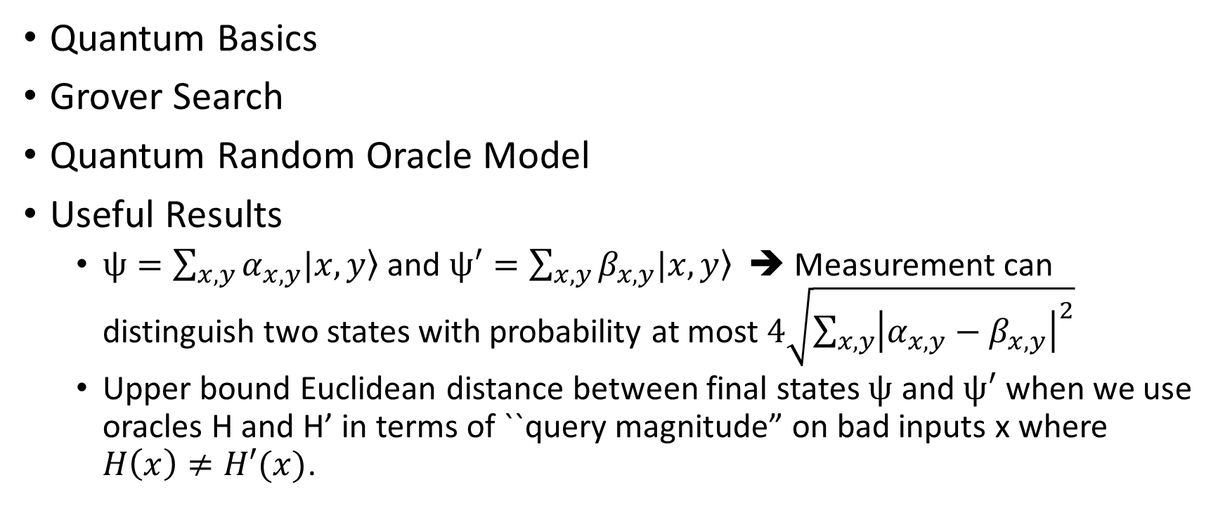
Recap
Quantum Basics
Grover Search
Quantum Random Oracle Model
Useful Results
  $ψ=\sum_{x,y}{α_{x,y}|x,\left.y\right\rangle }$ and $ψ′=\sum_{x,y}{β_{x,y}|x,\left.y\right\rangle }$ ➔ Measurement can distinguish two states with probability at most $4\sqrt{\sum_{x,y}{{\left|α_{x,y}−β_{x,y}\right|}^{2}}}$
  Upper bound Euclidean distance between final states $ψ$ and $ψ′$ when we use oracles H and H’ in terms of ``query magnitude” on bad inputs x where $H\left(x\right)≠H′(x)$.

Slide 3

State in QROM
Output Register
Typically we write
$$|ψ〉=\sum_{x,y,z}{α_{x,y,z}|x,\left.y,z\right\rangle }$$
$$RO|ψ〉 =\sum_{x,y,z}{α_{x,y,z}|x,RO\left(X\right)⊕\left.y,z\right\rangle }$$
Auxilliary State (not associated with current RO query)
Input Register

Slide 4
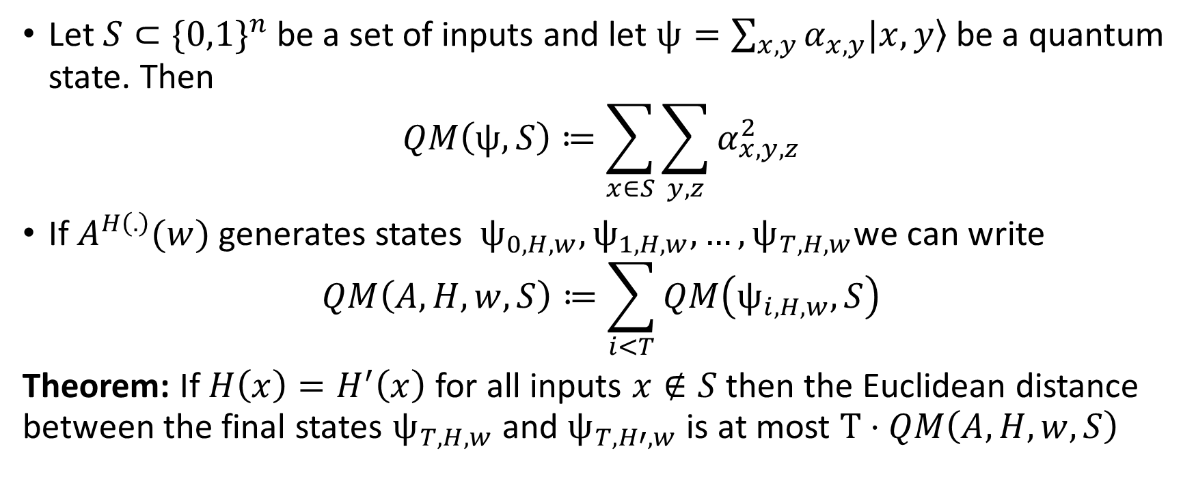
Query Magnitude
Let $S⊂\{0,1\}^{n}$ be a set of inputs and let $ψ=\sum_{x,y}{α_{x,y}|x,\left.y\right\rangle }$ be a quantum state. Then
$$QM\left(ψ,S\right)≔\sum_{x∈S}{\sum_{y,z}{α_{x,y,z}^{2}}}$$
If $A^{H\left(.\right)}(w)$ generates states $ψ_{0,H,w},ψ_{1,H,w},…,ψ_{T,H,w}$we can write
$$QM\left(A,H,w,S\right)≔\sum_{i<T}{QM\left(ψ_{i,H,w},S\right)}$$
Theorem: If $H\left(x\right)=H^{′}\left(x\right)$ for all inputs $x∉S$ then the Euclidean distance between the final states $ψ_{T,H,w}$ and $ψ_{T,H′,w}$ is at most $T⋅QM\left(A,H,w,S\right)$

Slide 5
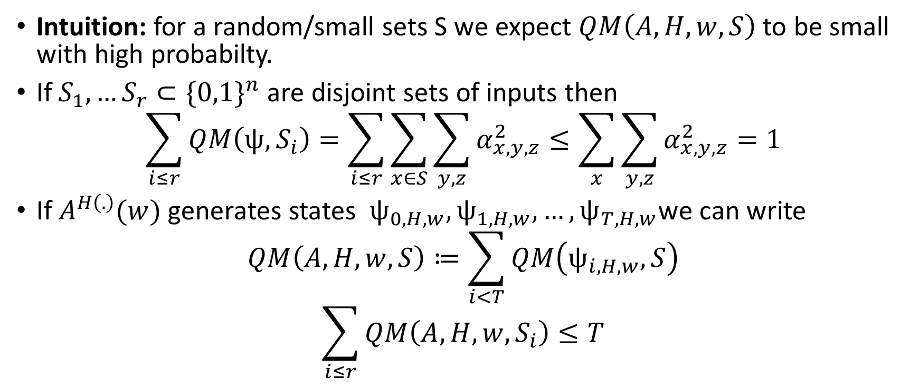
Homework Hint
Intuition: for a random/small sets S we expect $QM\left(A,H,w,S\right)$ to be small with high probabilty.
If $S_{1},…S_{r}⊂\{0,1\}^{n}$ are disjoint sets of inputs then
$$\sum_{i≤r}{QM\left(ψ,S_{i}\right)}=\sum_{i≤r}{\sum_{x∈S}{\sum_{y,z}{α_{x,y,z}^{2}}}}≤\sum_{x}{\sum_{y,z}{α_{x,y,z}^{2}}}=1$$
If $A^{H\left(.\right)}(w)$ generates states $ψ_{0,H,w},ψ_{1,H,w},…,ψ_{T,H,w}$we can write
$$QM\left(A,H,w,S\right)≔\sum_{i<T}{QM\left(ψ_{i,H,w},S\right)}$$
$$\sum_{i≤r}{QM\left(A,H,w,S_{i}\right)}≤T$$

Slide 6
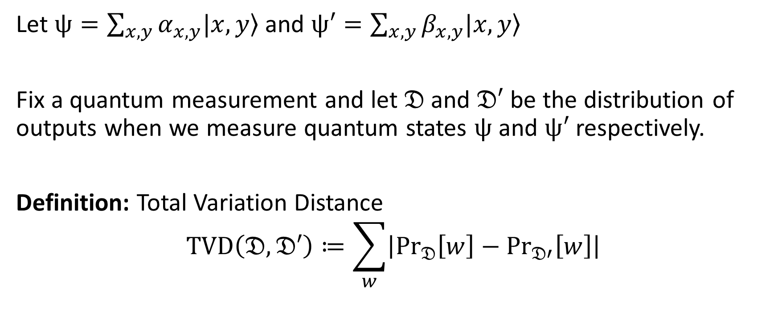
Quantum Computing: Useful Theorem
Let $ψ=\sum_{x,y}{α_{x,y}|x,\left.y\right\rangle }$ and $ψ′=\sum_{x,y}{β_{x,y}|x,\left.y\right\rangle }$
Fix a quantum measurement and let $𝔇$ and $𝔇′$ be the distribution of outputs when we measure quantum states $ψ$ and $ψ′$ respectively.
Definition: Total Variation Distance
$$TVD\left(𝔇,𝔇′\right)≔\sum_{w}{\left|{Pr}_{𝔇}\left[w\right]−{Pr}_{𝔇′}\left[w\right]\right|}$$

Slide 7
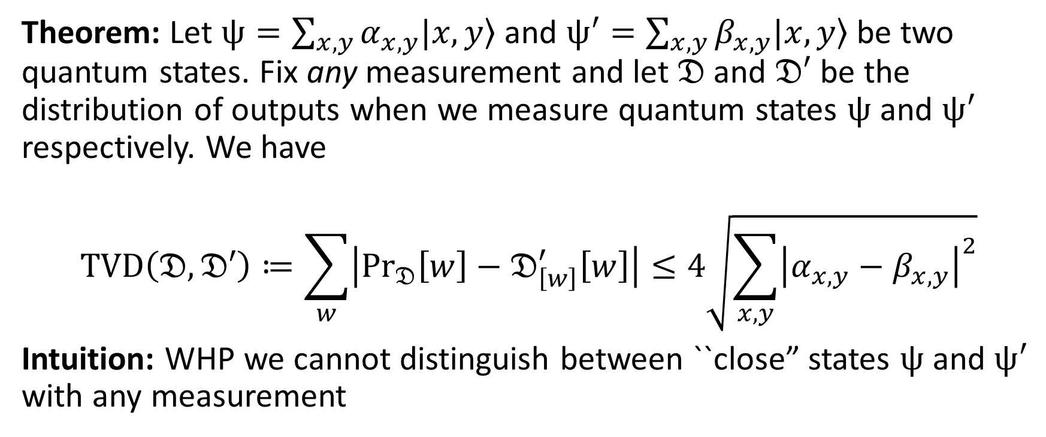
Quantum Computing: Useful Theorem
Theorem: Let $ψ=\sum_{x,y}{α_{x,y}|x,\left.y\right\rangle }$ and $ψ′=\sum_{x,y}{β_{x,y}|x,\left.y\right\rangle }$ be two quantum states. Fix any measurement and let $𝔇$ and $𝔇′$ be the distribution of outputs when we measure quantum states $ψ$ and $ψ′$ respectively. We have
$$TVD\left(𝔇,𝔇′\right)≔\sum_{w}{\left|{Pr}_{𝔇}\left[w\right]−𝔇_{\left[w\right]}^{′}\left[w\right]\right|}≤4\sqrt{\sum_{x,y}{{\left|α_{x,y}−β_{x,y}\right|}^{2}}}$$
Intuition: WHP we cannot distinguish between ``close” states $ψ$ and $ψ′$ with any measurement

Slide 8

Phase Oracle vs Standard Oracle
Output Register
Typically we write
$$|ψ〉=\sum_{x,y,z}{α_{x,y,z}|x,\left.y,z\right\rangle }$$
$$StO|ψ〉 =\sum_{x,y,z}{α_{x,y,z}|x,RO\left(x\right)⊕\left.y,z\right\rangle }$$
$$PhO|ψ〉 =\sum_{x,y,z}{α_{x,y,z}{\left(−1\right)}^{y⋅RO(x)}|x, \left.y,z\right\rangle }$$
Auxilliary State (not associated with current RO query)
Input Register
Phase Oracle

Slide 9

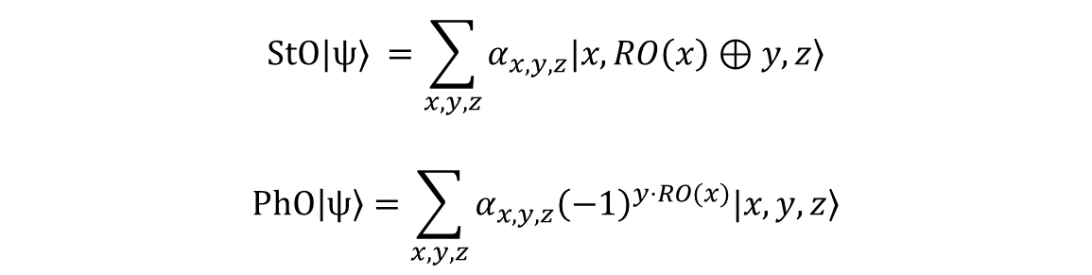
Equivalence: Phase/Standard Oracle
Let $Had_{out}=I^{⨂n }H^{⨂n }I^{⨂|z| }$be a unitary transformation which applies the Hadamard transform to response registers (y) and identity transform elsewhere. Then
$$Had_{out}PhO(Had_{out}|ψ〉)=StO|ψ〉 =\sum_{x,y,z}{α_{x,y,z}|x,RO\left(x\right)⊕\left.y,z\right\rangle }$$
$$StO|ψ〉 =\sum_{x,y,z}{α_{x,y,z}|x,RO\left(x\right)⊕\left.y,z\right\rangle }$$
$$PhO|ψ〉=\sum_{x,y,z}{α_{x,y,z}{\left(−1\right)}^{y⋅RO(x)}|x, \left.y,z\right\rangle }$$

Slide 10
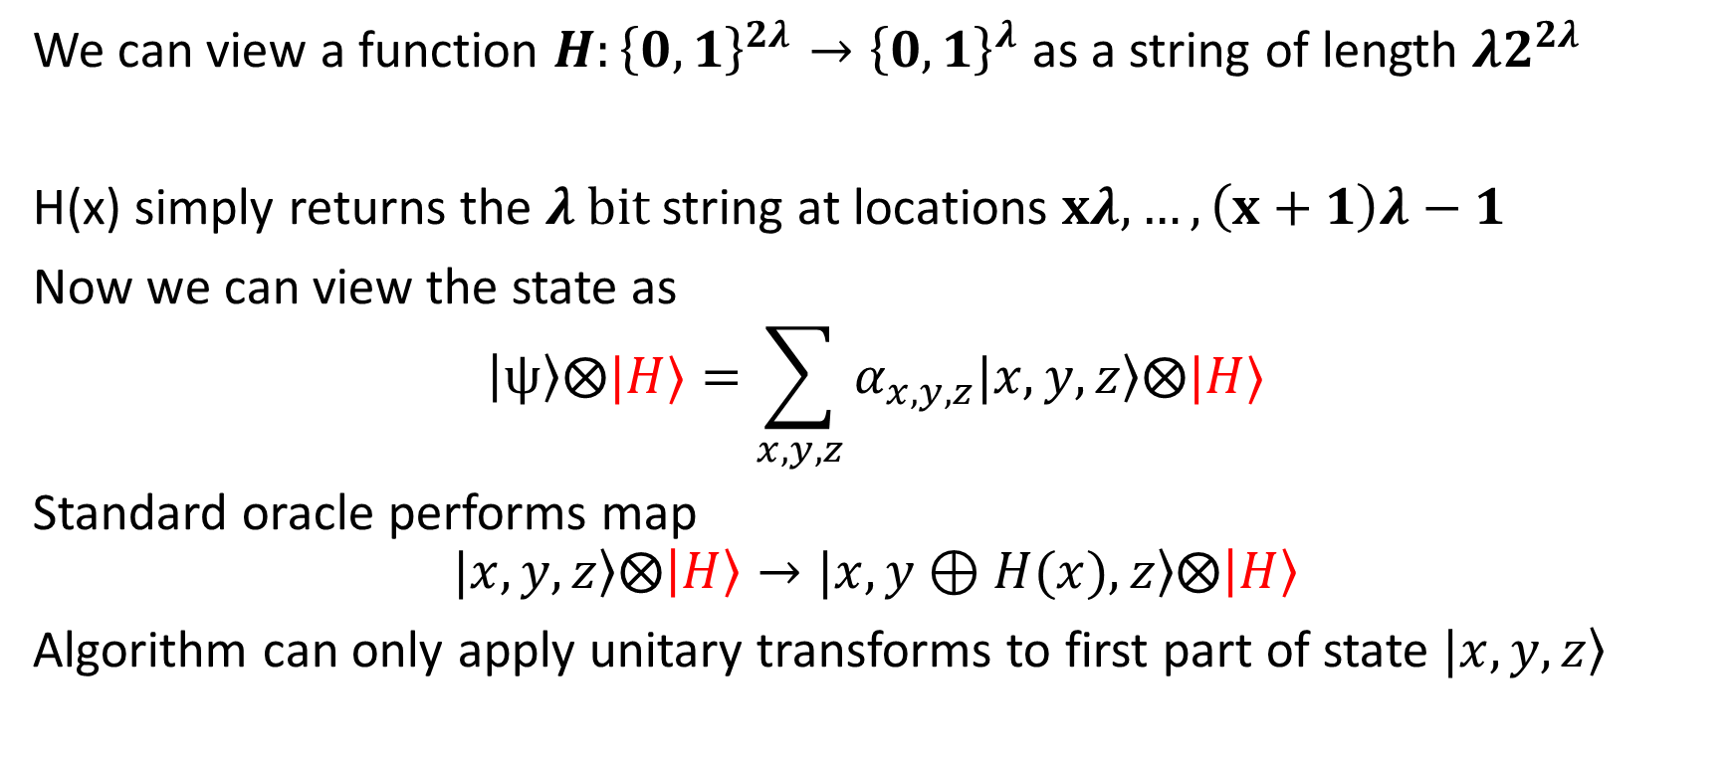
Views of the Quantum Random Oracle
We can view a function $H:{\left\{0,1\right\}}^{2λ}→{\left\{0,1\right\}}^{λ}$ as a string of length $λ2^{2λ}$
H(x) simply returns the $λ bit$ string at locations $xλ,…,\left(x+1\right)λ−1$
Now we can view the state as
$$|ψ〉⨂|H〉=\sum_{x,y,z}{α_{x,y,z}|x,\left.y,z\right\rangle ⨂|H〉}$$
Standard oracle performs map
$$|x,\left.y,z\right\rangle ⨂|H〉→|x,\left.y⊕H(x),z\right\rangle ⨂|H〉$$
Algorithm can only apply unitary transforms to first part of state $|x,\left.y,z\right\rangle$

Slide 11
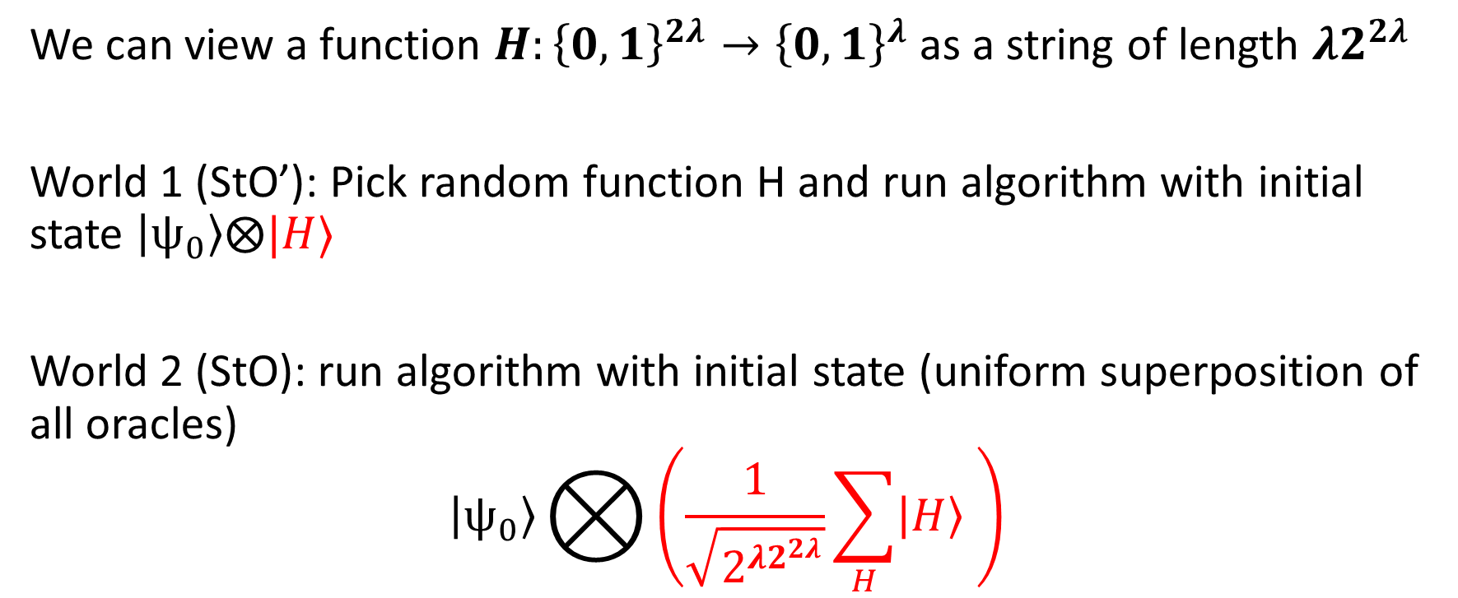
Views of the Quantum Random Oracle
We can view a function $H:{\left\{0,1\right\}}^{2λ}→{\left\{0,1\right\}}^{λ}$ as a string of length $λ2^{2λ}$
World 1 (StO’): Pick random function H and run algorithm with initial state $|ψ_{0}〉⨂|H〉$
World 2 (StO): run algorithm with initial state (uniform superposition of all oracles)
$$|ψ_{0}〉⨂{\left(\frac{1}{\sqrt{2^{λ2^{2λ}}}}\sum_{H}{|H〉 }\right)}$$

Slide 12
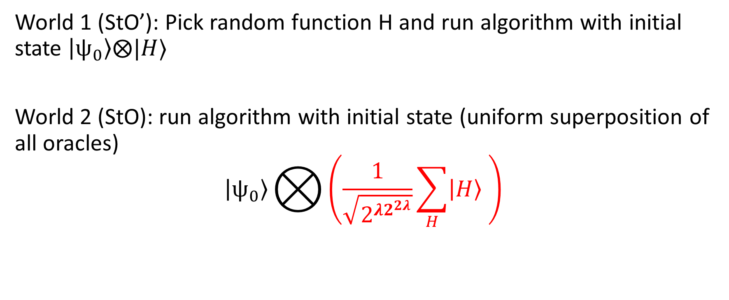
Views of the Quantum Random Oracle
World 1 (StO’): Pick random function H and run algorithm with initial state $|ψ_{0}〉⨂|H〉$
World 2 (StO): run algorithm with initial state (uniform superposition of all oracles)
$$|ψ_{0}〉⨂{\left(\frac{1}{\sqrt{2^{λ2^{2λ}}}}\sum_{H}{|H〉 }\right)}$$

Slide 13
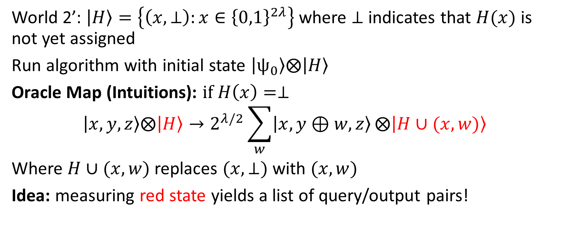
Another View
World 2’: $|H〉=\left\{\left(x,⊥\right):x∈{\left\{0,1\right\}}^{2λ}\right\}$ where $⊥$ indicates that $H(x)$ is not yet assigned
Run algorithm with initial state $|ψ_{0}〉⨂|H〉$
Oracle Map (Intuitions): $if H\left(x\right)=⊥$
$$|x,y,z〉⨂|H〉→2^{λ/2}\sum_{w}{|x,y⊕w,z〉}⨂|H∪(x,w)〉$$
Where $H∪(x,w)$ replaces $(x,⊥)$ with $(x,w)$
Idea: measuring red state yields a list of query/output pairs!
Notes:
Question: What if $H\left(x\right)≠⊥$? How do we make sure oracle is

Slide 14
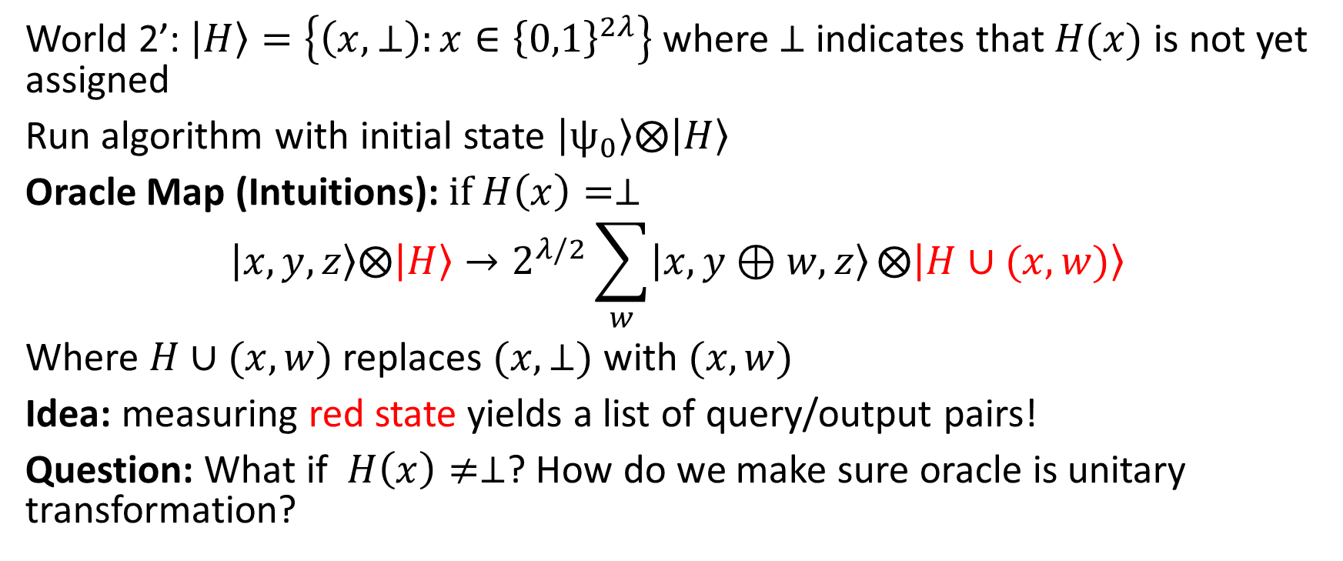
Not Quite that Simple…
World 2’: $|H〉=\left\{\left(x,⊥\right):x∈{\left\{0,1\right\}}^{2λ}\right\}$ where $⊥$ indicates that $H(x)$ is not yet assigned
Run algorithm with initial state $|ψ_{0}〉⨂|H〉$
Oracle Map (Intuitions): $if H\left(x\right)=⊥$
$$|x,y,z〉⨂|H〉→2^{λ/2}\sum_{w}{|x,y⊕w,z〉}⨂|H∪(x,w)〉$$
Where $H∪(x,w)$ replaces $(x,⊥)$ with $(x,w)$
Idea: measuring red state yields a list of query/output pairs!
Question: What if $H\left(x\right)≠⊥$? How do we make sure oracle is unitary transformation?

Slide 15
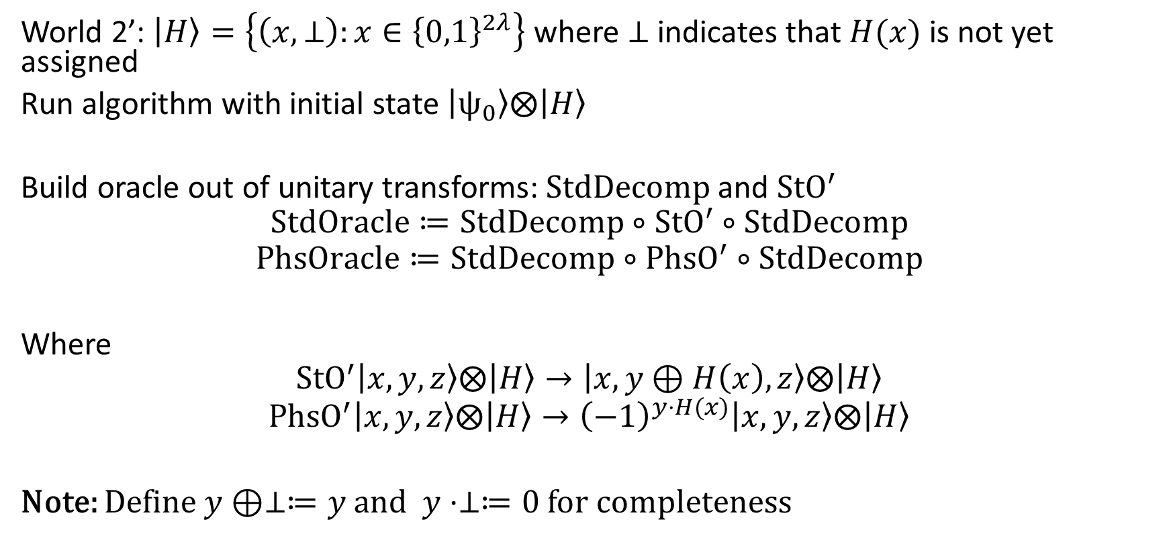
Towards Unitary Transform
World 2’: $|H〉=\left\{\left(x,⊥\right):x∈{\left\{0,1\right\}}^{2λ}\right\}$ where $⊥$ indicates that $H(x)$ is not yet assigned
Run algorithm with initial state $|ψ_{0}〉⨂|H〉$
Build oracle out of unitary transforms:$StdDecomp$and ${StO}^{′}$
$$StdOracle≔StdDecomp∘{StO}^{′}∘StdDecomp$$
$$PhsOracle≔StdDecomp∘{PhsO}^{′}∘StdDecomp$$
Where
$${StO}^{′}|x,y,z〉⨂|H〉→|x,y⊕H\left(x\right),z〉⨂|H〉$$
$${PhsO}^{′}|x,y,z〉⨂|H〉→{\left(−1\right)}^{y⋅H(x)}|x,y,z〉⨂|H〉$$
Note: Define $y⊕⊥≔y$ and $y⋅⊥≔0$ for completeness

Slide 16
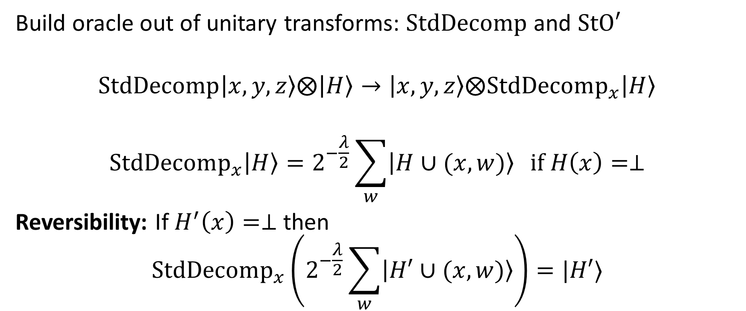
Towards Unitary Transform
Build oracle out of unitary transforms: $StdDecomp$ and $StO′$
$$StdDecomp|x,y,z〉⨂|H〉→|x,y,z〉⨂StdDecomp_{x}|H〉$$
$$StdDecomp_{x}|H〉=2^{−\frac{λ}{2}}\sum_{w}{|H∪(x,w)〉} if H\left(x\right)=⊥$$
Reversibility: If $H^{′}\left(x\right)=⊥$ then
$$StdDecomp_{x}\left(2^{−\frac{λ}{2}}\sum_{w}{|H′∪(x,w)〉}\right)=|H′〉$$

Slide 17
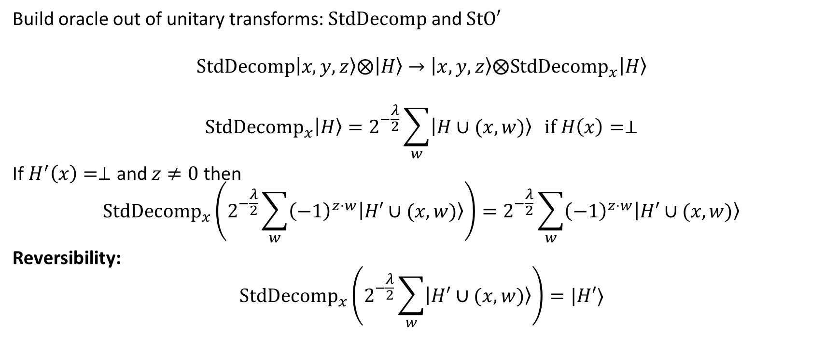
Towards Unitary Transform
Build oracle out of unitary transforms: $StdDecomp$ and $StO′$
$$StdDecomp|x,y,z〉⨂|H〉→|x,y,z〉⨂StdDecomp_{x}|H〉$$
$$StdDecomp_{x}|H〉=2^{−\frac{λ}{2}}\sum_{w}{|H∪(x,w)〉} if H\left(x\right)=⊥$$
If $H^{′}\left(x\right)=⊥$ and $z≠0$ then
$$StdDecomp_{x}\left(2^{−\frac{λ}{2}}\sum_{w}{{\left(−1\right)}^{z⋅w}|H′∪(x,w)〉}\right)=2^{−\frac{λ}{2}}\sum_{w}{{\left(−1\right)}^{z⋅w}|H′∪(x,w)〉}$$
Reversibility:
$$StdDecomp_{x}\left(2^{−\frac{λ}{2}}\sum_{w}{|H′∪(x,w)〉}\right)=|H′〉$$
State is untouched
All pairs of the form (x,w) are removed

Slide 18
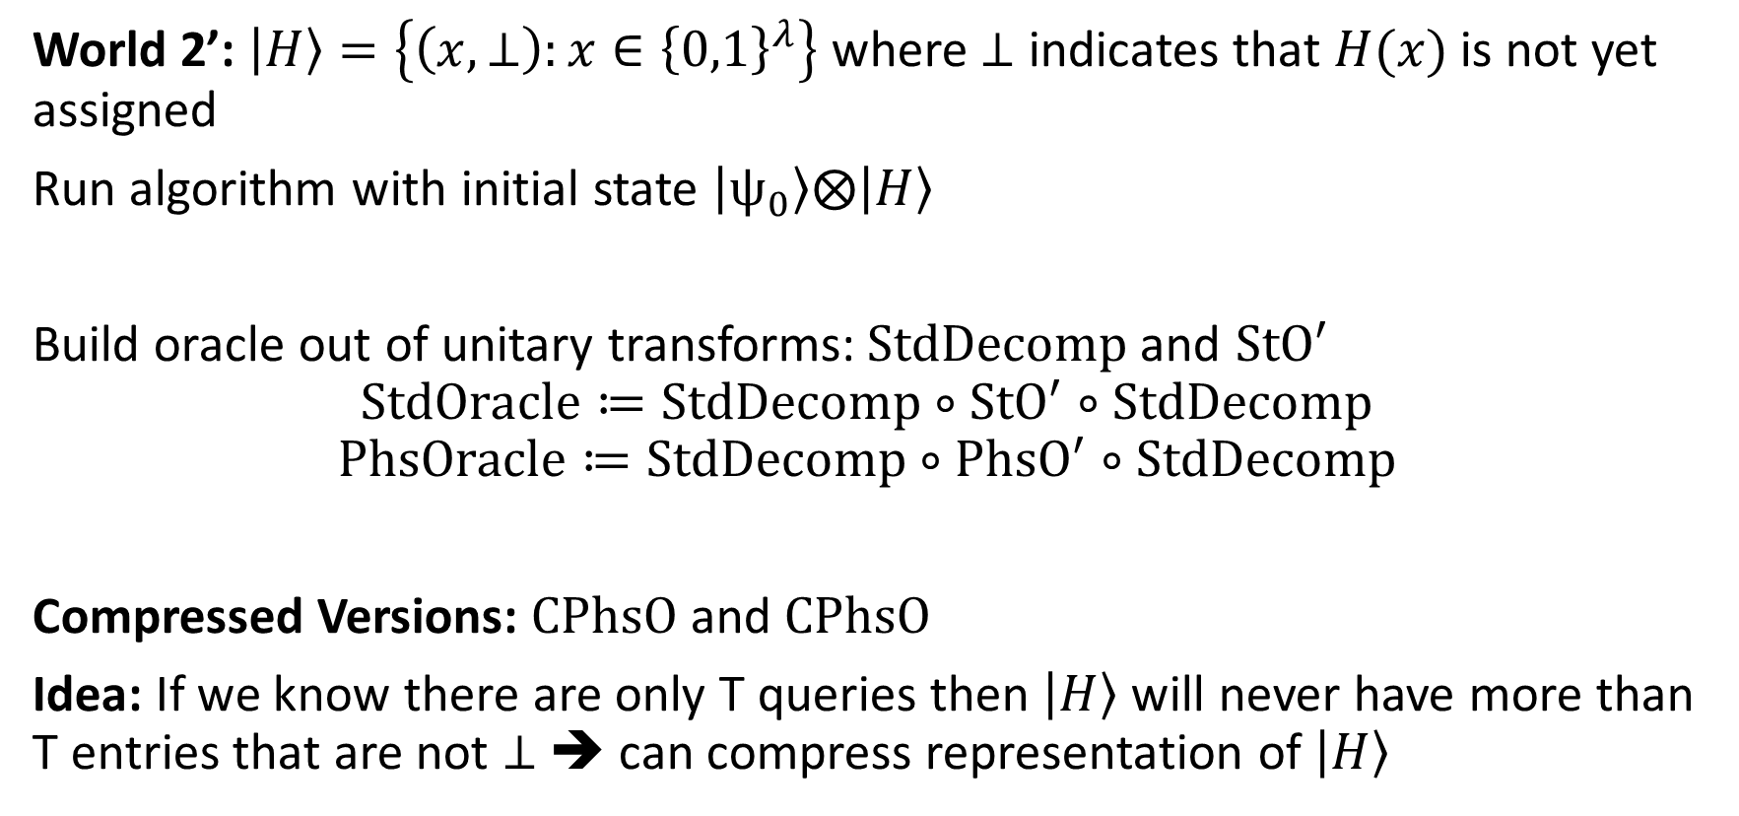
Compressed Oracles
World 2’: $|H〉=\left\{\left(x,⊥\right):x∈{\left\{0,1\right\}}^{λ}\right\}$ where $⊥$ indicates that $H(x)$ is not yet assigned
Run algorithm with initial state $|ψ_{0}〉⨂|H〉$
Build oracle out of unitary transforms:$StdDecomp$and ${StO}^{′}$
$$StdOracle≔StdDecomp∘{StO}^{′}∘StdDecomp$$
$$PhsOracle≔StdDecomp∘{PhsO}^{′}∘StdDecomp$$
Compressed Versions: $CPhsO$ and $CPhsO$
Idea: If we know there are only T queries then $|H〉$ will never have more than T entries that are not $⊥$ ➔ can compress representation of $|H〉$

Slide 19

Compressed Oracles
Compressed Versions: $CPhsO$ and $CPhsO$
Idea: If we know there are only T queries then $|H〉$ will never have more than T entries that are not $⊥$ ➔ can compress representation of $|H〉$

Slide 20
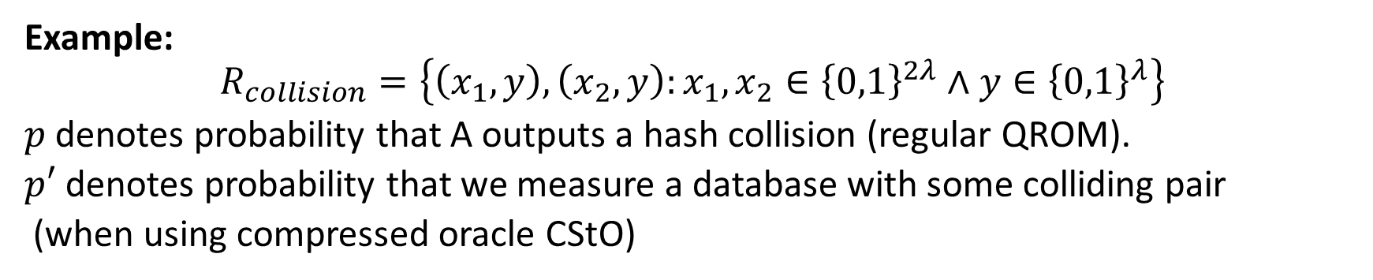
A Helpful Lemma
Example:
$$R_{collision}=\left\{\left(x_{1},y\right),\left(x_{2},y\right):x_{1},x_{2}∈{\left\{0,1\right\}}^{2λ}∧y∈{\left\{0,1\right\}}^{λ}\right\}$$
$p$ denotes probability that A outputs a hash collision (regular QROM).
$p′$ denotes probability that we measure a database with some colliding pair
(when using compressed oracle CStO)

Slide 21
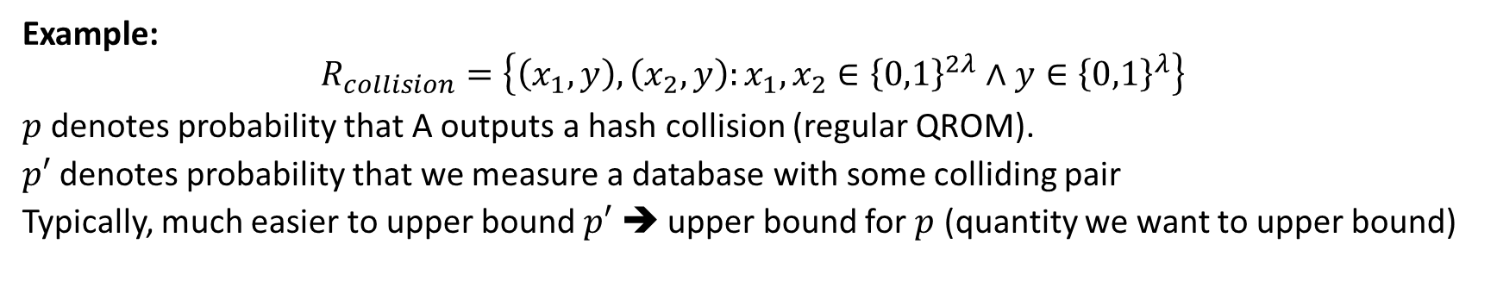
A Helpful Lemma
Example:
$$R_{collision}=\left\{\left(x_{1},y\right),\left(x_{2},y\right):x_{1},x_{2}∈{\left\{0,1\right\}}^{2λ}∧y∈{\left\{0,1\right\}}^{λ}\right\}$$
$p$ denotes probability that A outputs a hash collision (regular QROM).
$p′$ denotes probability that we measure a database with some colliding pair
Typically, much easier to upper bound $p′$ ➔ upper bound for $p$ (quantity we want to upper bound)

Slide 22
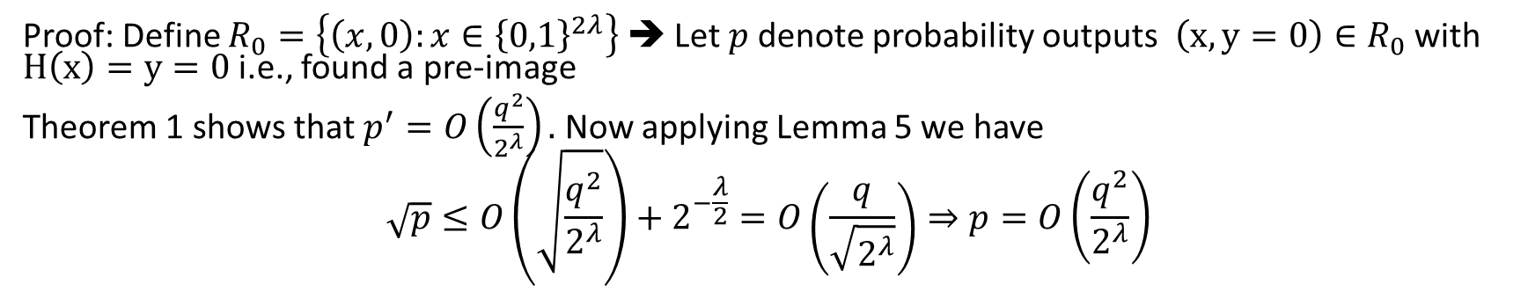
Grover Search Revisited
Proof: Define $R_{0}=\left\{\left(x,0\right):x∈{\left\{0,1\right\}}^{2λ}\right\}$ ➔ Let $p$denote probability outputs $\left(x,y=0\right)∈R_{0}$ with $H\left(x\right)=y=0$ i.e., found a pre-image
Theorem 1 shows that $p^{′}=O\left(\frac{q^{2}}{2^{λ}}\right).$ Now applying Lemma 5 we have
$$\sqrt{p}≤O\left(\sqrt{\frac{q^{2}}{2^{λ}}}\right)+2^{−\frac{λ}{2}}=O\left(\frac{q}{\sqrt{2^{λ}}}\right)⇒p=O\left(\frac{q^{2}}{2^{λ}}\right)$$

Slide 23
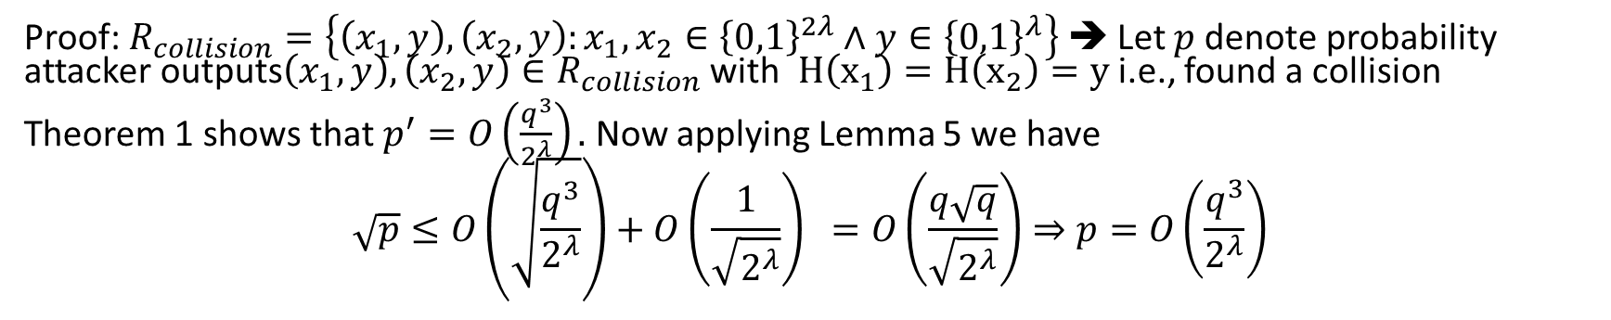
Hash Collisions
Proof: $R_{collision}=\left\{\left(x_{1},y\right),\left(x_{2},y\right):x_{1},x_{2}∈{\left\{0,1\right\}}^{2λ}∧y∈{\left\{0,1\right\}}^{λ}\right\}$ ➔ Let $p$denote probability attacker outputs$\left(x_{1},y\right),\left(x_{2},y\right)∈R_{collision}$ with $H\left(x_{1}\right)=H\left(x_{2}\right)=y$ i.e., found a collision
Theorem 1 shows that $p^{′}=O\left(\frac{q^{3}}{2^{λ}}\right).$ Now applying Lemma 5 we have
$$\sqrt{p}≤O\left(\sqrt{\frac{q^{3}}{2^{λ}}}\right)+O\left(\frac{1}{\sqrt{2^{λ}}}\right) =O\left(\frac{q\sqrt{q}}{\sqrt{2^{λ}}}\right)⇒p=O\left(\frac{q^{3}}{2^{λ}}\right)$$

Slide 24
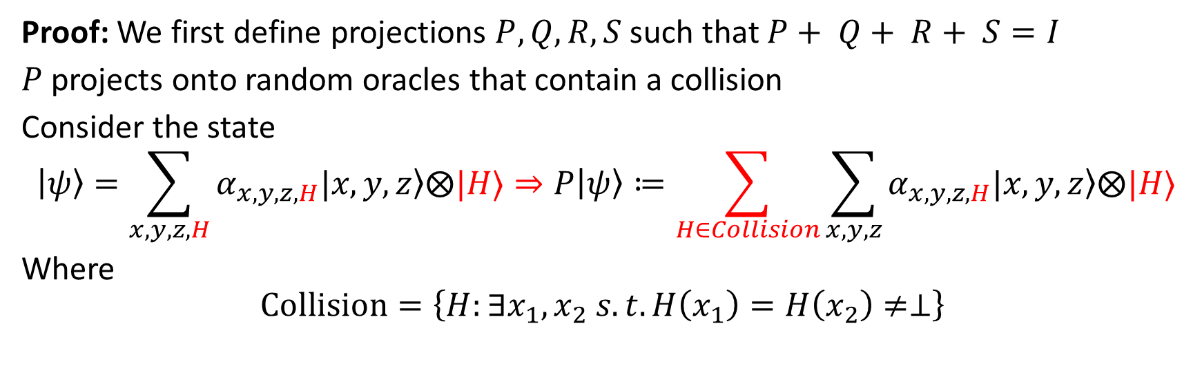
Proof of Theorem 2
Proof: We first define projections $P, Q, R, S$ such that $P+ Q+ R+ S=I$
$P$ projects onto random oracles that contain a collision
Consider the state
$$|ψ〉=\sum_{x,y,z,H}{α_{x,y,z,H}|x,\left.y,z\right\rangle ⨂|H〉}⇒P|ψ〉≔\sum_{H∈Collision}{\sum_{x,y,z}{α_{x,y,z,H}|x,\left.y,z\right\rangle ⨂|H〉}}$$
Where
$$Collision=\left\{H:∃x_{1},x_{2} s.t. H\left(x_{1}\right)=H\left(x_{2}\right)≠⊥\right\}$$

Slide 25
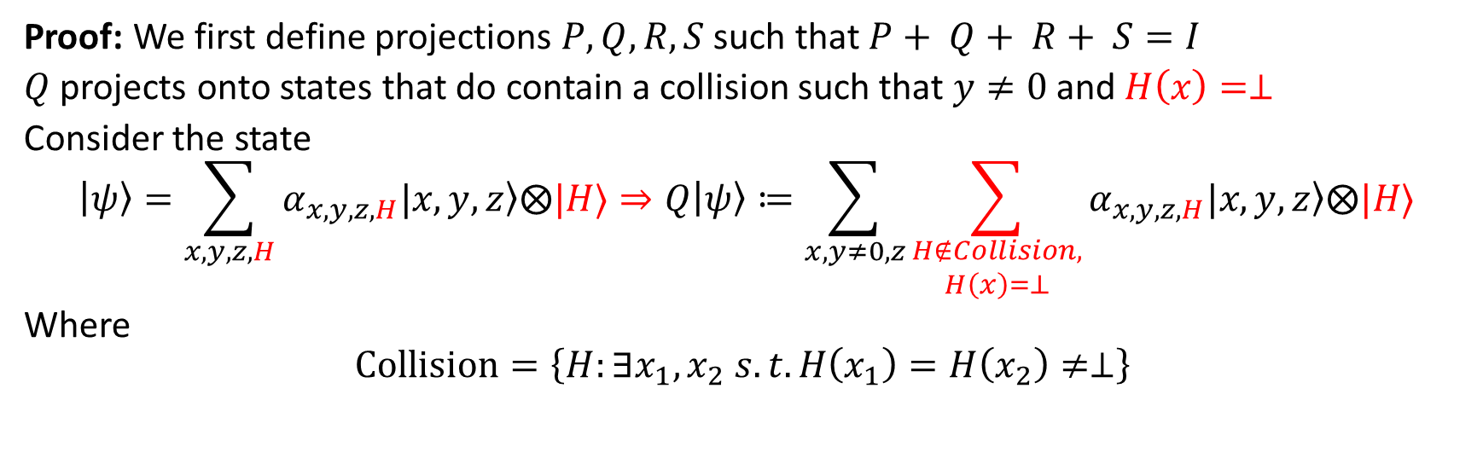
Proof of Theorem 2
Proof: We first define projections $P, Q, R, S$ such that $P+ Q+ R+ S=I$
$Q$ projects onto states that do contain a collision such that $y≠0$ and $H\left(x\right)=⊥$
Consider the state
$$|ψ〉=\sum_{x,y,z,H}{α_{x,y,z,H}|x,\left.y,z\right\rangle ⨂|H〉}⇒Q|ψ〉≔\sum_{x,y≠0,z}{\sum_{\begin{aligned}H∉Collision, \\ H\left(x\right)=⊥\end{aligned}}{α_{x,y,z,H}|x,\left.y,z\right\rangle ⨂|H〉}}$$
Where
$$Collision=\left\{H:∃x_{1},x_{2} s.t. H\left(x_{1}\right)=H\left(x_{2}\right)≠⊥\right\}$$

Slide 26
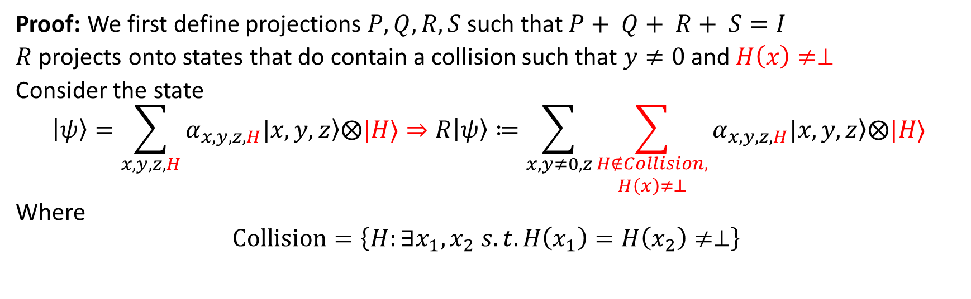
Proof of Theorem 2
Proof: We first define projections $P, Q, R, S$ such that $P+ Q+ R+ S=I$
$R$ projects onto states that do contain a collision such that $y≠0$ and $H\left(x\right)≠⊥$
Consider the state
$$|ψ〉=\sum_{x,y,z,H}{α_{x,y,z,H}|x,\left.y,z\right\rangle ⨂|H〉}⇒R|ψ〉≔\sum_{x,y≠0,z}{\sum_{\begin{aligned}H∉Collision, \\ H\left(x\right)≠⊥\end{aligned}}{α_{x,y,z,H}|x,\left.y,z\right\rangle ⨂|H〉}}$$
Where
$$Collision=\left\{H:∃x_{1},x_{2} s.t. H\left(x_{1}\right)=H\left(x_{2}\right)≠⊥\right\}$$

Slide 27
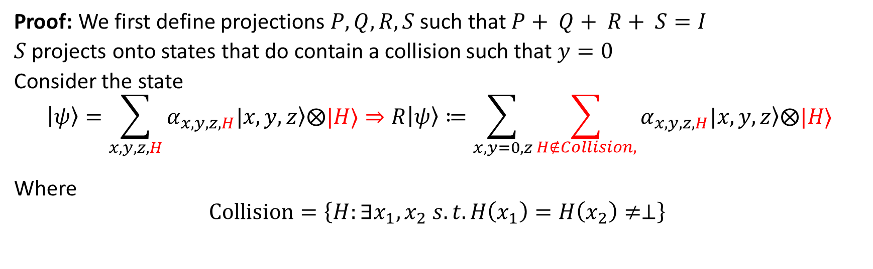
Proof of Theorem 2
Proof: We first define projections $P, Q, R, S$ such that $P+ Q+ R+ S=I$
$S$ projects onto states that do contain a collision such that $y=0$
Consider the state
$$|ψ〉=\sum_{x,y,z,H}{α_{x,y,z,H}|x,\left.y,z\right\rangle ⨂|H〉}⇒R|ψ〉≔\sum_{x,y=0,z}{\sum_{\begin{aligned}H∉Collision, \\ \end{aligned}}{α_{x,y,z,H}|x,\left.y,z\right\rangle ⨂|H〉}}$$
Where
$$Collision=\left\{H:∃x_{1},x_{2} s.t. H\left(x_{1}\right)=H\left(x_{2}\right)≠⊥\right\}$$

Slide 28
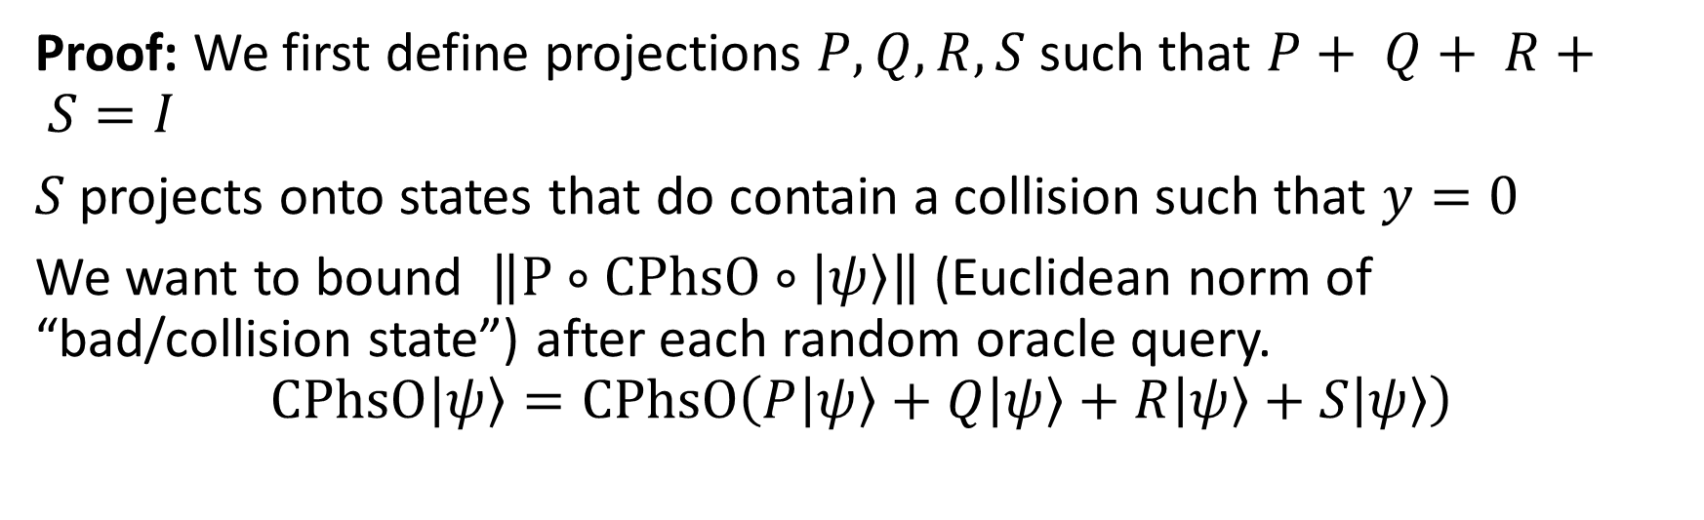
Proof of Theorem 2
Proof: We first define projections $P, Q, R, S$ such that $P+ Q+ R+ S=I$
$S$ projects onto states that do contain a collision such that $y=0$
We want to bound $\left\|P∘CPhsO∘|ψ〉\right\|$ (Euclidean norm of “bad/collision state”) after each random oracle query.
$$CPhsO|ψ〉=CPhsO\left(P|ψ〉+Q|ψ〉+R|ψ〉+S|ψ〉\right)$$

Slide 29
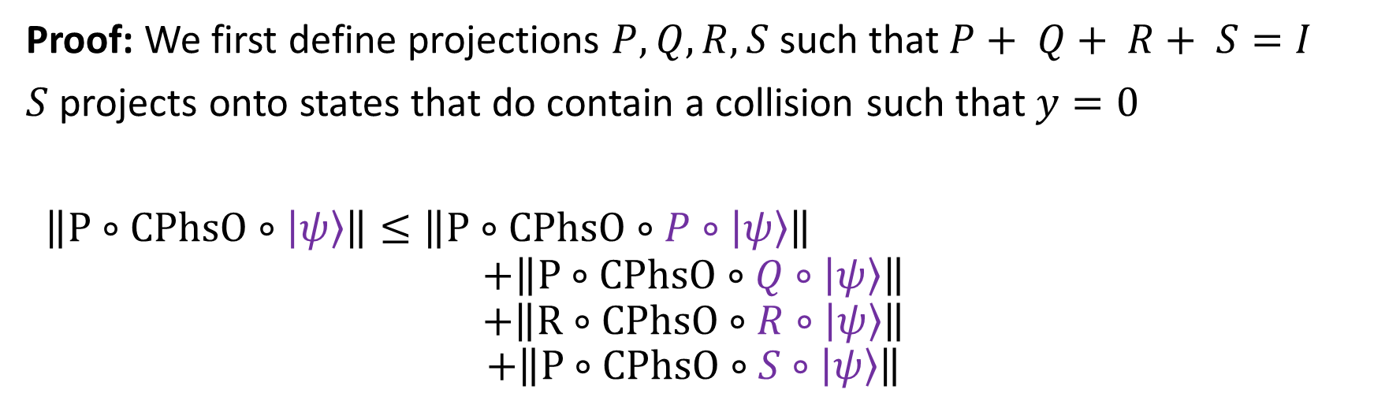
Proof of Theorem 2
Proof: We first define projections $P, Q, R, S$ such that $P+ Q+ R+ S=I$
$S$ projects onto states that do contain a collision such that $y=0$
$\left\|P∘CPhsO∘|ψ〉\right\|≤\left\|P∘CPhsO∘P∘|ψ〉\right\|$
$$+\left\|P∘CPhsO∘Q∘|ψ〉\right\|$$
$$+\left\|R∘CPhsO∘R∘|ψ〉\right\|$$
$$+\left\|P∘CPhsO∘S∘|ψ〉\right\|$$

Slide 30
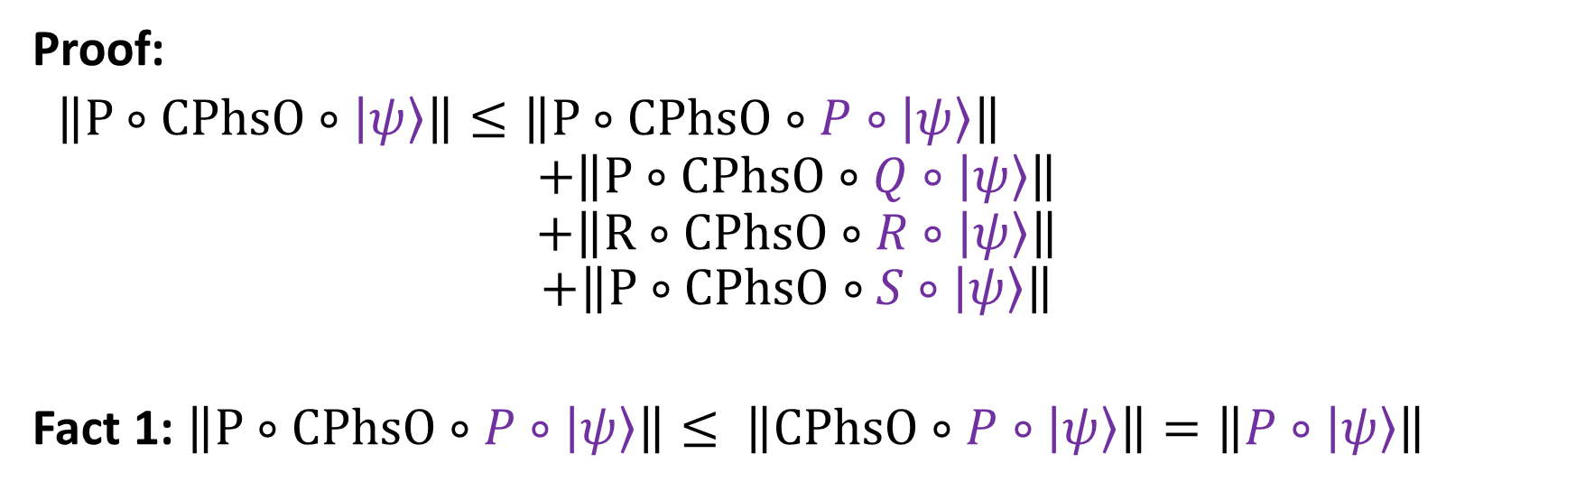
Proof of Theorem 2
Proof:
$\left\|P∘CPhsO∘|ψ〉\right\|≤\left\|P∘CPhsO∘P∘|ψ〉\right\|$
$$+\left\|P∘CPhsO∘Q∘|ψ〉\right\|$$
$$+\left\|R∘CPhsO∘R∘|ψ〉\right\|$$
$$+\left\|P∘CPhsO∘S∘|ψ〉\right\|$$
Fact 1: $\left\|P∘CPhsO∘P∘|ψ〉\right\|≤ \left\|CPhsO∘P∘|ψ〉\right\|=\left\|P∘|ψ〉\right\|$
Old Projection before RO query
Projection can only decrease norm
CPhsO is unitary ➔ preserves norms

Slide 31
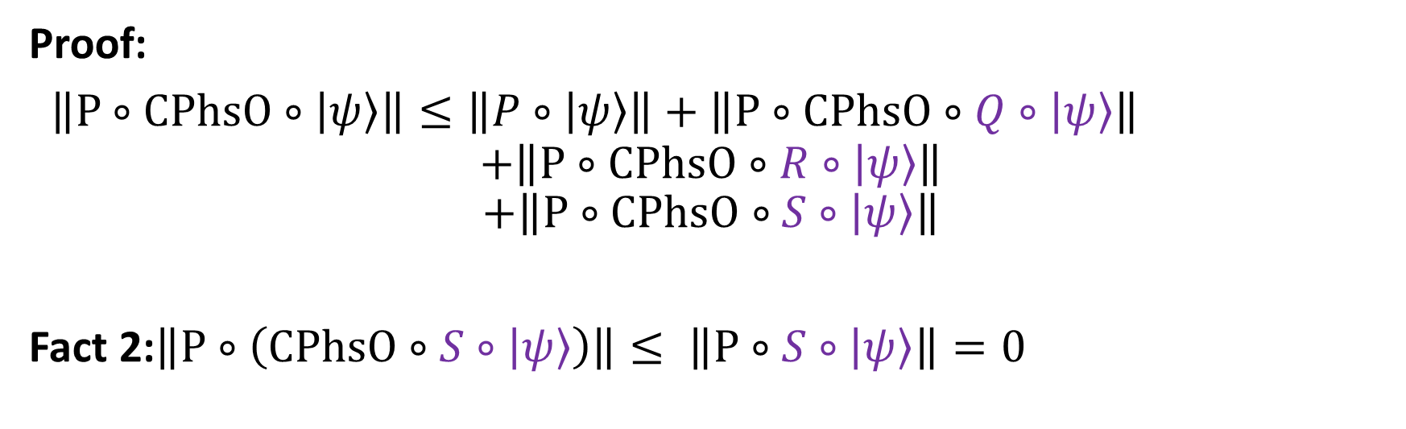
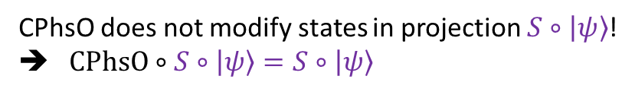
Proof of Theorem 2
Proof:
$\left\|P∘CPhsO∘|ψ〉\right\|≤\left\|P∘|ψ〉\right\|+\left\|P∘CPhsO∘Q∘|ψ〉\right\|$
$$+\left\|P∘CPhsO∘R∘|ψ〉\right\|$$
$$+\left\|P∘CPhsO∘S∘|ψ〉\right\|$$
Fact 2:$\left\|P∘\left(CPhsO∘S∘|ψ〉\right)\right\|≤ \left\|P∘S∘|ψ〉\right\|=0$
CPhsO does not modify states in projection $S∘|ψ〉$!
➔ $CPhsO∘S∘|ψ〉=S∘|ψ〉$
States in projection S do no have collision!

Slide 32
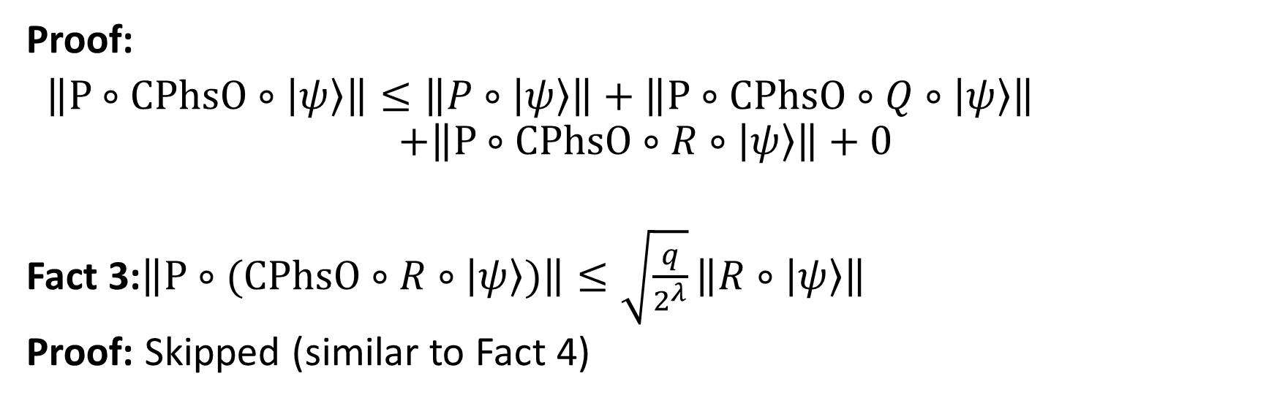
Proof of Theorem 2
Proof:
$\left\|P∘CPhsO∘|ψ〉\right\|≤\left\|P∘|ψ〉\right\|+\left\|P∘CPhsO∘Q∘|ψ〉\right\|$
$$+\left\|P∘CPhsO∘R∘|ψ〉\right\|+0$$
Fact 3:$\left\|P∘(CPhsO∘R∘|ψ〉)\right\|≤\sqrt{\frac{q}{2^{λ}}}\left\|R∘|ψ〉\right\|$
Proof: Skipped (similar to Fact 4)

Slide 33
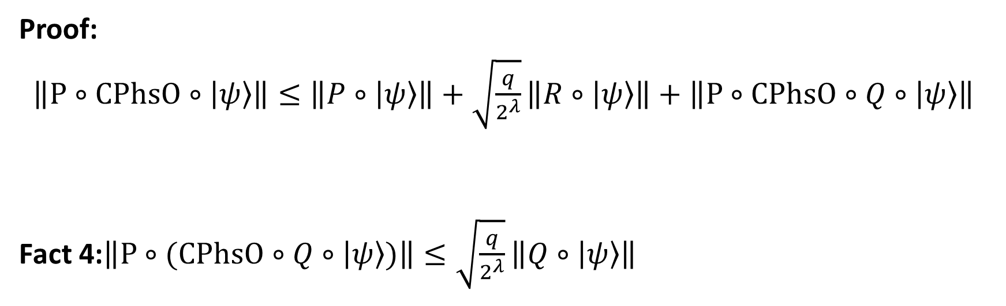
Proof of Theorem 2
Proof:
$\left\|P∘CPhsO∘|ψ〉\right\|≤\left\|P∘|ψ〉\right\|+\sqrt{\frac{q}{2^{λ}}}\left\|R∘|ψ〉\right\|+\left\|P∘CPhsO∘Q∘|ψ〉\right\|$
Fact 4:$\left\|P∘(CPhsO∘Q∘|ψ〉)\right\|≤\sqrt{\frac{q}{2^{λ}}}\left\|Q∘|ψ〉\right\|$

Slide 34
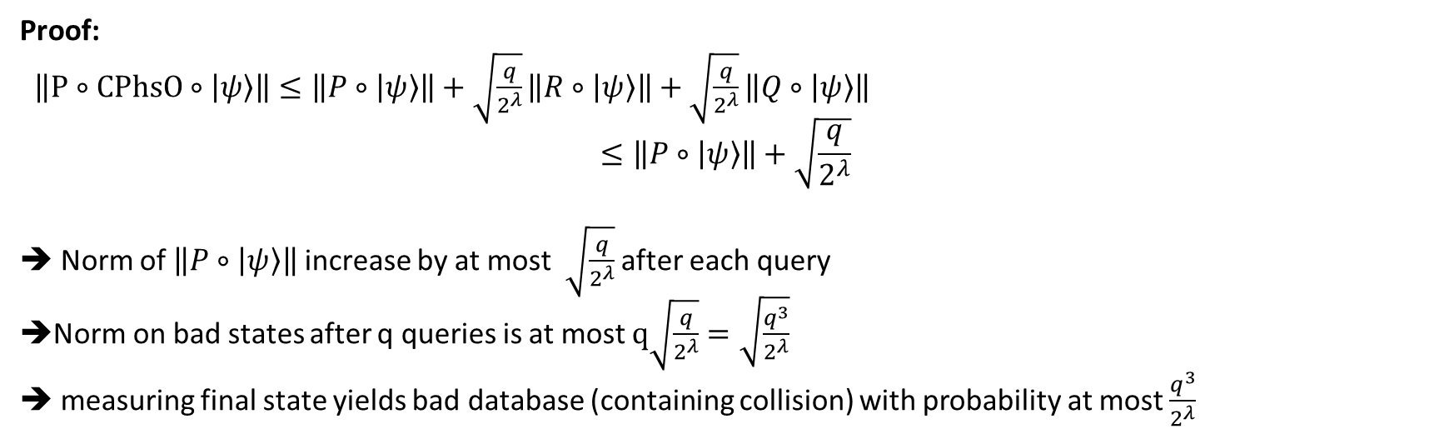
Proof of Theorem 2
Proof:
$\left\|P∘CPhsO∘|ψ〉\right\|≤\left\|P∘|ψ〉\right\|+\sqrt{\frac{q}{2^{λ}}}\left\|R∘|ψ〉\right\|+\sqrt{\frac{q}{2^{λ}}}\left\|Q∘|ψ〉\right\|$
$$≤\left\|P∘|ψ〉\right\|+\sqrt{\frac{q}{2^{λ}}}$$
➔ Norm of $\left\|P∘|ψ〉\right\|$ increase by at most $\sqrt{\frac{q}{2^{λ}}}$ after each query
Norm on bad states after q queries is at most $q\sqrt{\frac{q}{2^{λ}}}=\sqrt{\frac{q^{3}}{2^{λ}}}$
measuring final state yields bad database (containing collision) with probability at most $\frac{q^{3}}{2^{λ}}$

Slide 35
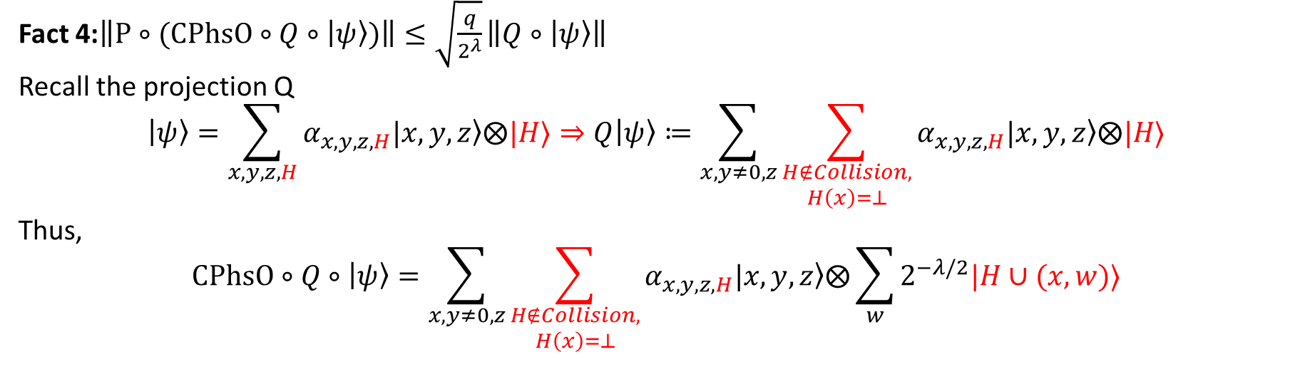
Proof of Theorem 2
Fact 4:$\left\|P∘(CPhsO∘Q∘|ψ〉)\right\|≤\sqrt{\frac{q}{2^{λ}}}\left\|Q∘|ψ〉\right\|$
Recall the projection Q
$$|ψ〉=\sum_{x,y,z,H}{α_{x,y,z,H}|x,\left.y,z\right\rangle ⨂|H〉}⇒Q|ψ〉≔\sum_{x,y≠0,z}{\sum_{\begin{aligned}H∉Collision, \\ H\left(x\right)=⊥\end{aligned}}{α_{x,y,z,H}|x,\left.y,z\right\rangle ⨂|H〉}}$$
Thus,
$$CPhsO∘Q∘|ψ〉=\sum_{x,y≠0,z}{\sum_{\begin{aligned}H∉Collision, \\ H\left(x\right)=⊥\end{aligned}}{α_{x,y,z,H}|x,\left.y,z\right\rangle ⨂\sum_{w}{2^{−λ/2}|H∪(x,w)〉}}}$$

Slide 36
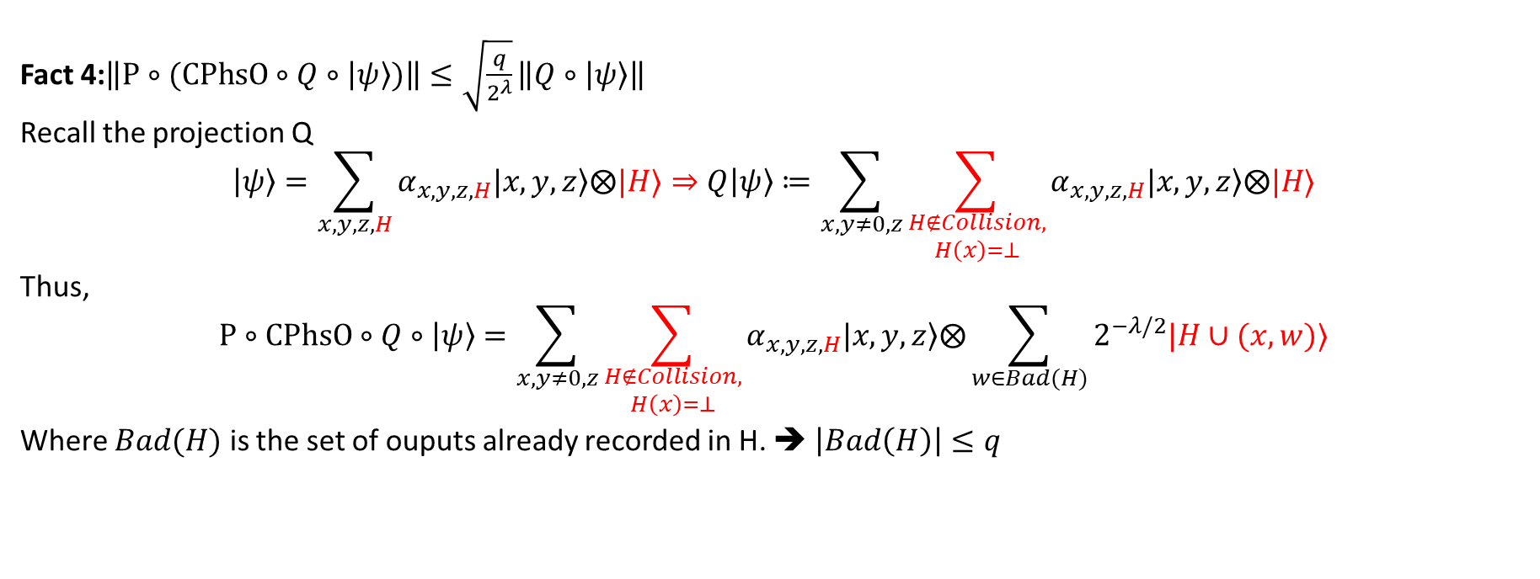
Proof of Theorem 2
Fact 4:$\left\|P∘(CPhsO∘Q∘|ψ〉)\right\|≤\sqrt{\frac{q}{2^{λ}}}\left\|Q∘|ψ〉\right\|$
Recall the projection Q
$$|ψ〉=\sum_{x,y,z,H}{α_{x,y,z,H}|x,\left.y,z\right\rangle ⨂|H〉}⇒Q|ψ〉≔\sum_{x,y≠0,z}{\sum_{\begin{aligned}H∉Collision, \\ H\left(x\right)=⊥\end{aligned}}{α_{x,y,z,H}|x,\left.y,z\right\rangle ⨂|H〉}}$$
Thus,
$$P∘CPhsO∘Q∘|ψ〉=\sum_{x,y≠0,z}{\sum_{\begin{aligned}H∉Collision, \\ H\left(x\right)=⊥\end{aligned}}{α_{x,y,z,H}|x,\left.y,z\right\rangle ⨂\sum_{w∈Bad(H)}{2^{−λ/2}|H∪(x,w)〉}}}$$
Where $Bad(H)$ is the set of ouputs already recorded in H. ➔ $\left|Bad\left(H\right)\right|≤q$

Slide 37
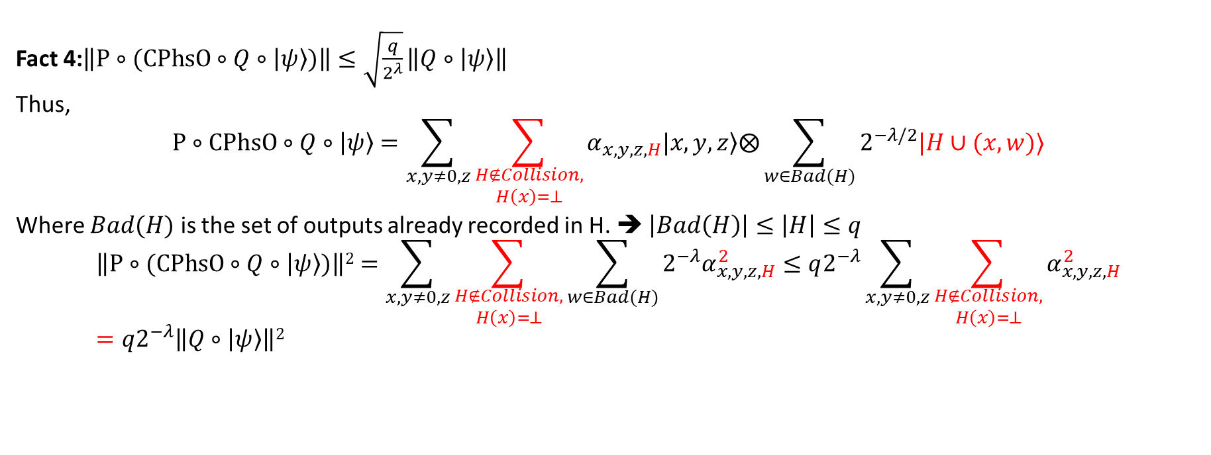
Proof of Theorem 2
Fact 4:$\left\|P∘(CPhsO∘Q∘|ψ〉)\right\|≤\sqrt{\frac{q}{2^{λ}}}\left\|Q∘|ψ〉\right\|$
Thus,
$$P∘CPhsO∘Q∘|ψ〉=\sum_{x,y≠0,z}{\sum_{\begin{aligned}H∉Collision, \\ H\left(x\right)=⊥\end{aligned}}{α_{x,y,z,H}|x,\left.y,z\right\rangle ⨂\sum_{w∈Bad(H)}{2^{−λ/2}|H∪(x,w)〉}}}$$
Where $Bad(H)$ is the set of outputs already recorded in H. ➔ $\left|Bad\left(H\right)\right|≤\left|H\right|≤q$
$$\left\|P∘(CPhsO∘Q∘|ψ〉)\right\|2=\sum_{x,y≠0,z}{\sum_{\begin{aligned}H∉Collision, \\ H\left(x\right)=⊥\end{aligned}}{\sum_{w∈Bad(H)}{2^{−λ}α_{x,y,z,H}^{2}}}}≤q2^{−λ}\sum_{x,y≠0,z}{\sum_{\begin{aligned}H∉Collision, \\ H\left(x\right)=⊥\end{aligned}}{α_{x,y,z,H}^{2}}}=q2^{−λ}\left\|Q∘|ψ〉\right\|2$$

Slide 38
Course Evaluation
I would appreciate if you take the time to fill out your course evaluation.
What did you like about the course? What could be improved? Let me know!
Your feedback is anonymous and will not impact grades.

Slide 39
Final Project Presentation (Next Week)
Tuesday, April 25th | Thursday, April 27th
Albert Yu (3:00-3:18 PM) | Blake and Xiuyu (3:00-3:28 PM)
Nicolas Harrell (3:18-3:36 PM) | Adithya and Jacob (3:28-3:56 PM)
Hongoa Wang (3:36-3:54 PM) | Jimmy Hwang (3:56-4:14 PM)
Zhongtang Luo (3:54-4:12 PM)
Individuals: 14 minute presentation + 3 minute Q&A + 1 minute transition
Groups: 24 minute presentation + 3 minute Q&A + 1 minute transition
It is expected that both team members will give part of the presentation
You may choose how to divide the presentation
E-mail slides to Hassan at least one hour before class on the day of your presentation (CC me)
Format: PDF/PPT

Slide 40
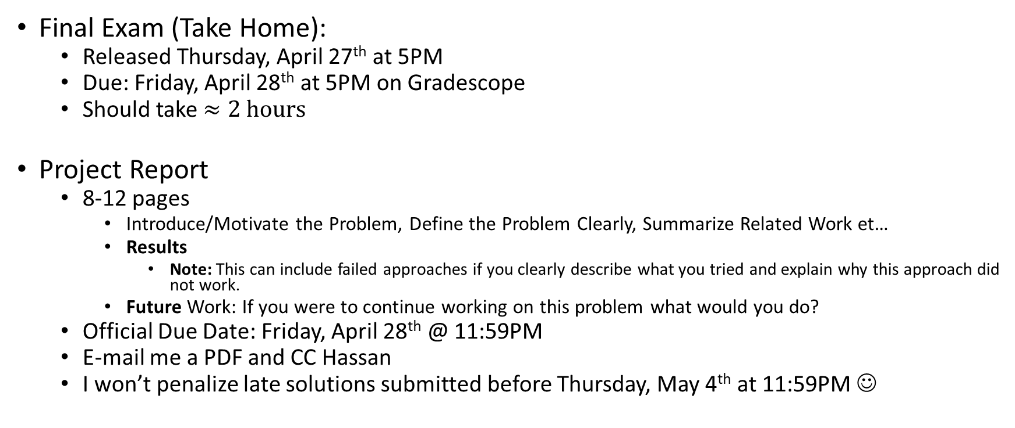
Final Exam and Project Report
Final Exam (Take Home):
  Released Thursday, April 27th at 5PM
  Due: Friday, April 28th at 5PM on Gradescope
  Should take $≈2 hours$
Project Report
  8-12 pages
    Introduce/Motivate the Problem, Define the Problem Clearly, Summarize Related Work et…
    Results
      Note: This can include failed approaches if you clearly describe what you tried and explain why this approach did not work.
    Future Work: If you were to continue working on this problem what would you do?
  Official Due Date: Friday, April 28th @ 11:59PM
  E-mail me a PDF and CC Hassan
  I won’t penalize late solutions submitted before Thursday, May 4th at 11:59PM ☺

Slide 41
Side Channel: Memory Access Pattern
Program 1: secret value x
if (x < 5)
z = A[0]
A[1] = z*z
else
z = A[100]
A[101] = z*z
Suppose Attacker Learns Memory Access pattern was (100, 101).
What can attacker conclude?

Slide 42
Side Channel: Memory Access Pattern
When could attacker learn memory access pattern?
Scenario 1: User is storing (encrypted) array on an untrusted server
Scenario 2: Program 1 (trusted) is running on the same machine as program 2 (untrusted)
Operating System ensures that program 2 cannot access program 1’s memory. What is the problem?

Slide 43
Side Channel: Memory Access Pattern
When could attacker learn memory access pattern?
Scenario 2: Program 1 (trusted) is running on the same machine as program 2 (untrusted)
Operating System ensures that program 2 cannot access program 1’s memory. What is the problem?
Executing P1
RAM
Cache
A[0] | A[1] | … | A[100] | A[101] | Y | …
B[0] | B[1] | … | B[100] | B[101] | Z
Load A[100]
CPU

Slide 44
Side Channel: Memory Access Pattern
When could attacker learn memory access pattern?
Scenario 2: Program 1 (trusted) is running on the same machine as program 2 (untrusted)
Operating System ensures that program 2 cannot access program 1’s memory. What is the problem?
Executing P1
RAM
Cache
A[0] | A[1] | … | A[100] | A[101] | Y | …
B[0] | B[1] | … | B[100] | B[101] | Z
A[100]
B[100]
Load A[100]
CPU

Slide 45
Side Channel: Memory Access Pattern
When could attacker learn memory access pattern?
Scenario 2: Program 1 (trusted) is running on the same machine as program 2 (untrusted)
Operating System ensures that program 2 cannot access program 1’s memory. What is the problem?
Executing P1
RAM
Cache
A[0] | A[1] | … | A[100] | A[101] | Y | …
B[0] | B[1] | … | B[100] | B[101] | Z
A[100]
B[100]
Load A[101]
CPU

Slide 46
Side Channel: Memory Access Pattern
When could attacker learn memory access pattern?
Scenario 2: Program 1 (trusted) is running on the same machine as program 2 (untrusted)
Operating System ensures that program 2 cannot access program 1’s memory. What is the problem?
Executing P1
RAM
Cache
A[0] | A[1] | … | A[100] | A[101] | Y | …
B[0] | B[1] | … | B[100] | B[101] | Z
 |  |  | … | …
 |  |  | … | …
A[100] | A[101]
B[100] | B[101]
… | …
… | …
Load A[101]
CPU
Load A[101]

Slide 47
Side Channel: Memory Access Pattern
When could attacker learn memory access pattern?
Scenario 2: Program 1 (trusted) is running on the same machine as program 2 (untrusted)
Operating System ensures that program 2 cannot access program 1’s memory. What is the problem?
Executing P2
RAM
Cache
A[0] | A[1] | … | A[100] | A[101] | Y | …
B[0] | B[1] | … | B[100] | B[101] | Z
 |  |  | … | …
 |  |  | … | …
A[100] | A[101]
B[100] | B[101]
… | …
… | …
Load B[100]
CPU
In-Cache Already ➔
Quick response

Slide 48
Side Channel: Memory Access Pattern
When could attacker learn memory access pattern?
Scenario 2: Program 1 (trusted) is running on the same machine as program 2 (untrusted)
Operating System ensures that program 2 cannot access program 1’s memory. What is the problem?
Executing P2
RAM
Cache
A[0] | A[1] | … | A[100] | A[101] | Y | …
B[0] | B[1] | … | B[100] | B[101] | Z
 |  |  | … | …
 |  |  | … | …
A[100] | A[101]
B[100] | B[101]
… | …
… | …
Load B[1]
CPU
Not in Cache ➔
Slow response

Slide 49
ORAM
Slides: Adapted from TCC 2022 Test of Time Talk
“A Walk in the ORAM Forest: About oblivious RAMs and something about trees” (Jesper Buus Nielsen)

Slide 50


Definition: ORAM = Oblivious Array
An ORAM implements an array of N
words of log(N) bits
Operations on array: operations
Operations on server memory: probes
• o = o1, o2, …, on
  oi ∊ { (read, p), (write, p, v) }
A(oi) = list of server positions probed
• A(o) = (A(o1), A(o2), …, A(on))
• Oblivious: |o¹|=|o²| ⇒ ∆(A(o¹),A(o²)) ≤ ε
  Perfect: ε=0
  Statistical: ε=negl.
  Computational: |∆|=poly
Online: Simulate one operation at a time
Offline: Gets o up front and can plan
Amortised overhead: limn |A(o)|/|o|
Worst-case overhead: maxi |A(oi)|
x
(write, 8, 1) (write, 8, )
(read, 7) (read, 7) (V7 = 42) (V7 = )
(write, p, V)
42
Server Memory
Oh!
Array
(read, p)
Client Memory
Constant size today
Client side
Server side

Slide 51
Genesis
ToT
ToT
ToT
Oded Goldreich: Towards a Theory of Software Protection and Simulation by Oblivious RAMs. STOC 1987
  “We show how to implement n fetch instructions to a [RAM] memory of size m by making less than n·m^{ε} actual accesses, for every fixed ε>0.”
Rafail Ostrovsky: An Efficient Software Protection Scheme. CRYPTO 1989
  Poly-logarithmic overhead
Oded Goldreich, Rafail Ostrovsky: Software Protection and Simulation on Oblivious RAMs. J. ACM 43(3). 1996
  Logarithmic lower bound in balls-in-bins model
¹ The rest is footnotes

Slide 52
Trivial ORAM
Memory
Probe entire memory on each operation
(write, p, v)
Perfect
Overhead = N
Memory
Memory
Array
Memory
(read, p)
Client side
Server side

Slide 53
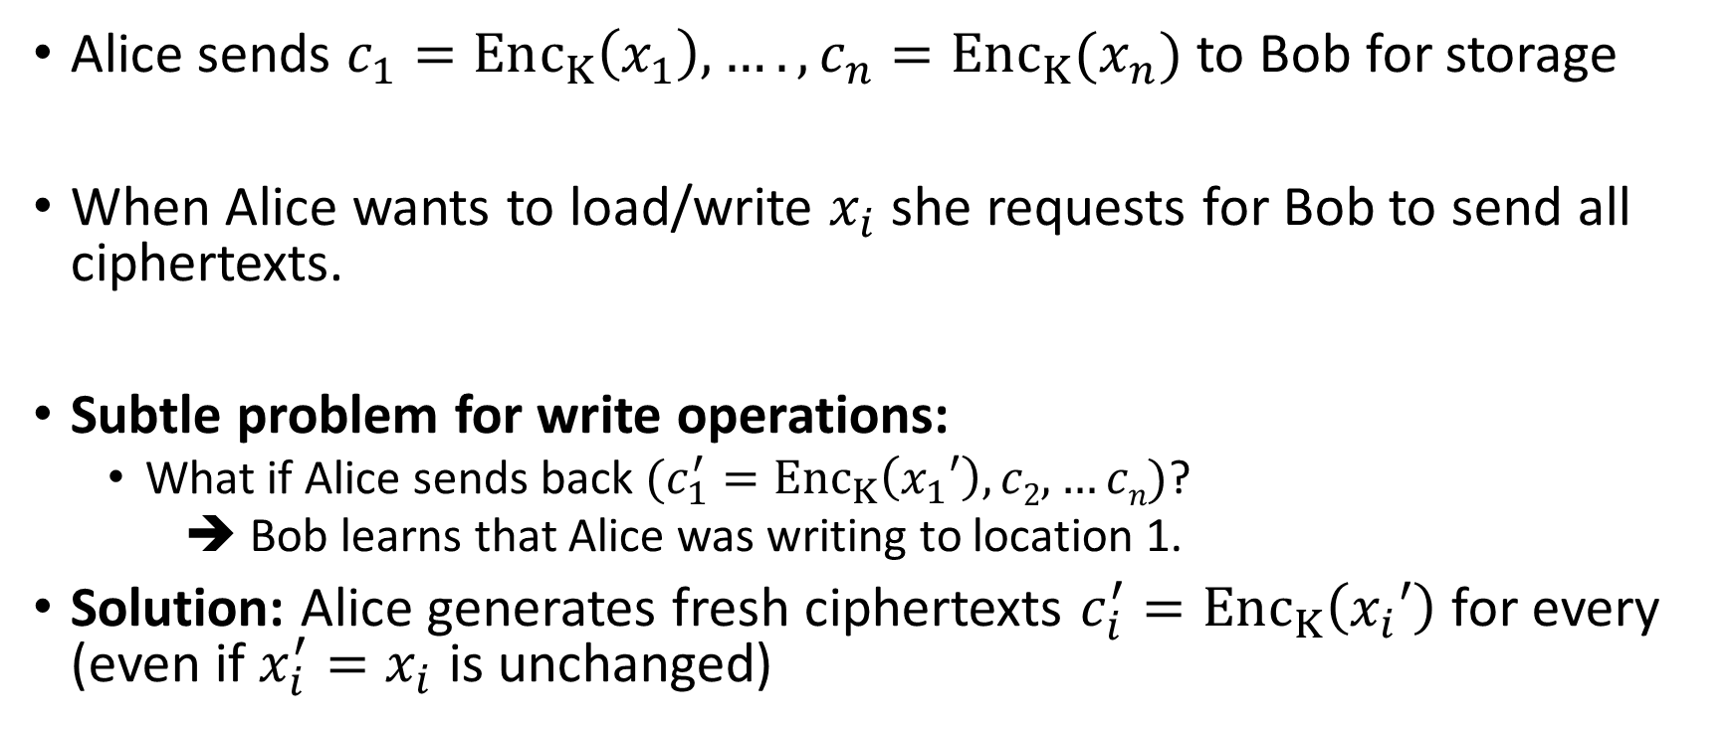
Trivial ORAM
Alice sends $c_{1}=Enc_{K}\left(x_{1}\right),….,c_{n}=Enc_{K}(x_{n})$ to Bob for storage
When Alice wants to load/write $x_{i}$ she requests for Bob to send all ciphertexts.
Subtle problem for write operations:
  What if Alice sends back $(c_{1}^{′}=Enc_{K}\left(x_{1}′\right),c2,…cn)$?
  ➔ Bob learns that Alice was writing to location 1.
Solution: Alice generates fresh ciphertexts $c_{i}^{′}=Enc_{K}\left(x_{i}′\right)$ for every (even if $x_{i}^{′}=x_{i}$ is unchanged)

Slide 54
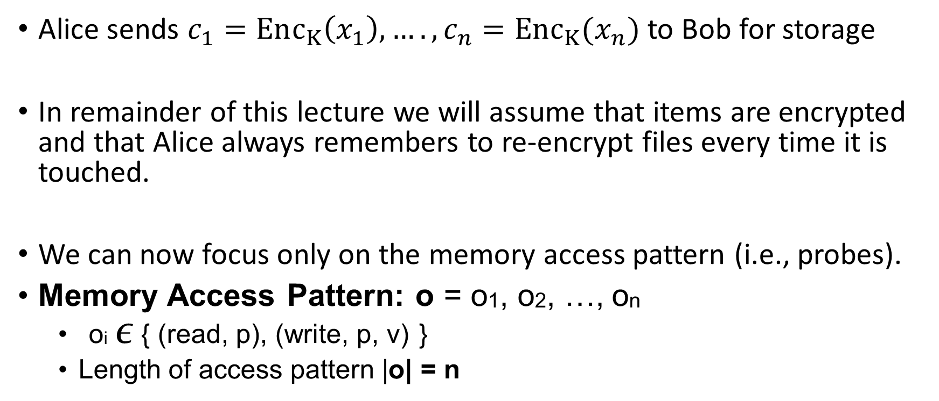
Trivial ORAM
Alice sends $c_{1}=Enc_{K}\left(x_{1}\right),….,c_{n}=Enc_{K}(x_{n})$ to Bob for storage
In remainder of this lecture we will assume that items are encrypted and that Alice always remembers to re-encrypt files every time it is touched.
We can now focus only on the memory access pattern (i.e., probes).
Memory Access Pattern: o = o1, o2, …, on
  oi ∊ { (read, p), (write, p, v) }
  Length of access pattern |o| = n

Slide 55
Trivial ORAM
Memory Access Pattern: o = o1, o2, …, on
  oi ∊ { (read, p), (write, p, v) }
  Length of access pattern |o| = n
A(o) memory access pattern (probes) induced by ORAM compiler
  Note: A(o) is a random variable
Trivial ORAM:
  A(oi)=(1,…,n)
  A(o) = (A(o1),…, A(on)) = ((1,…,n),…, (1,…,n))

Slide 56
Definition: ORAM = Oblivious Array
An ORAM implements an array of N
words of log(N) bits
Operations on array: operations
Operations on server memory: probes
• o = o1, o2, …, on
  oi ∊ { (read, p), (write, p, v) }
A(oi) = list of server positions probed
• A(o) = (A(o1), A(o2), …, A(on))
• Oblivious: |o¹|=|o²| ⇒ ∆(A(o¹),A(o²)) ≤ ε
  Perfect: ε=0
  Statistical: ε=negl.
  Computational: |∆|=poly
Online: Simulate one operation at a time
Offline: Gets o up front and can plan
Amortised overhead: limn |A(o)|/|o|
Worst-case overhead: maxi |A(oi)|
x
(write, 8, 1) (write, 8, )
(read, 7) (read, 7) (V7 = 42) (V7 = )
(write, p, V)
42
Server Memory
Oh!
Array
(read, p)
Client Memory
Constant size today
Client side
Server side

Slide 57
ORAM Security/Limitation
Memory Access Pattern: o = o1, o2, …, on
  oi ∊ { (read, p), (write, p, v) }
  Length of access pattern |o| = n
Security Guarantee: For any two access patterns |o¹|=|o²| of the same length an attacker cannot distinguish between A(o¹) and A(o²)
  Identical Distributions/Statistically Close/Computationally Indistinguishable
Limitation: If |o¹|>|o²| there are no guarantees.
  Can append |o²| with dummy operations
  Must append to maximum running time
  Efficiency bottleneck.

Slide 58
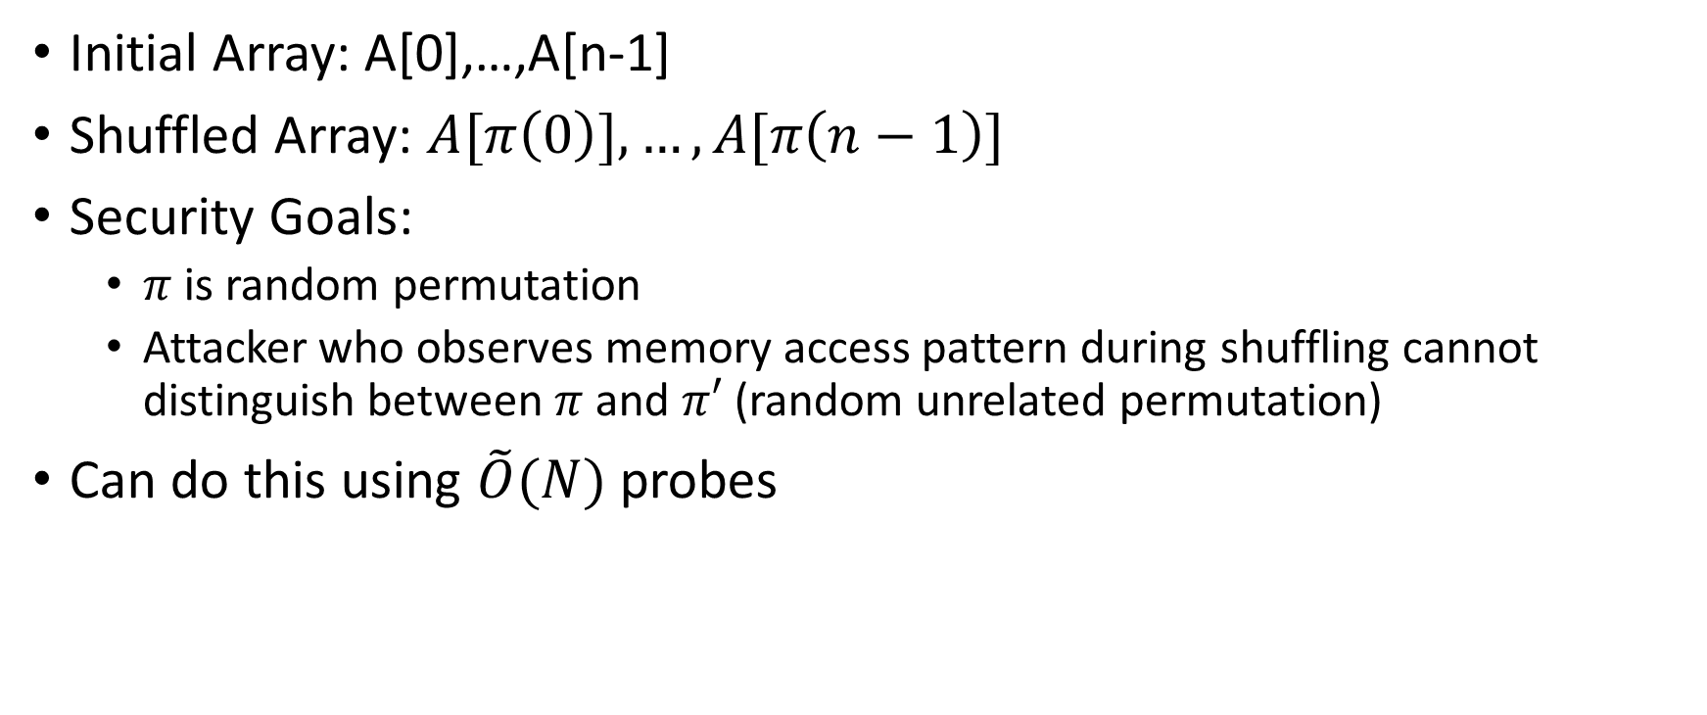
Oblivious Shuffling
Initial Array: A[0],…,A[n-1]
Shuffled Array: $A[π\left(0\right)],…, A[π\left(n−1\right)]$
Security Goals:
  $π$ is random permutation
  Attacker who observes memory access pattern during shuffling cannot distinguish between $π$ and $π′$ (random unrelated permutation)
Can do this using $\tilde{O}(N)$ probes

Slide 59
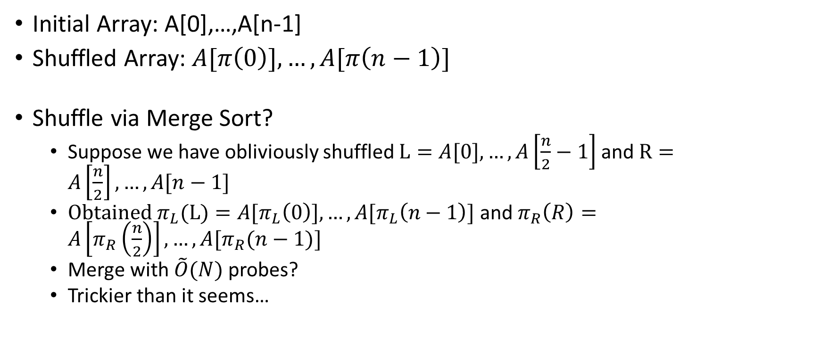
Oblivious Shuffling
Initial Array: A[0],…,A[n-1]
Shuffled Array: $A[π\left(0\right)],…, A[π\left(n−1\right)]$
Shuffle via Merge Sort?
  Suppose we have obliviously shuffled $L=A[0],…, A\left[\frac{n}{2}−1\right]$ and $R=A\left[\frac{n}{2}\right],…, A[n−1]$
  Obtained $π_{L}(L)=A[π_{L}\left(0\right)],…, A[π_{L}\left(n−1\right)]$ and $π_{R}\left(R\right)=A\left[π_{R}\left(\frac{n}{2}\right)\right],…, A[π_{R}(n−1)]$
  Merge with $\tilde{O}(N)$ probes?
  Trickier than it seems…

Slide 60
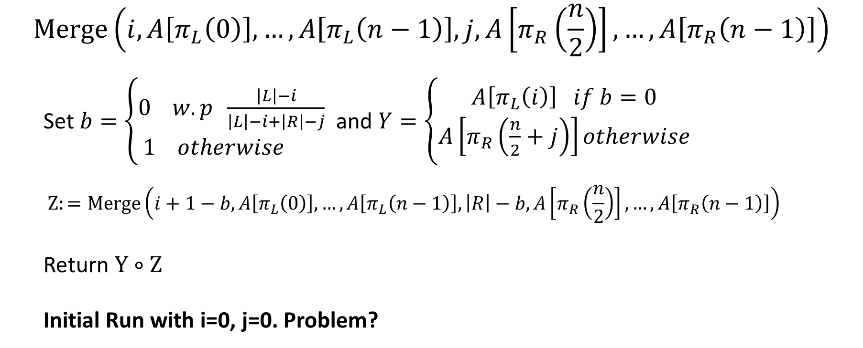
Oblivious Merge (Attempt 1)
$$Merge\left(i,A\left[π_{L}\left(0\right)\right],…, A\left[π_{L}\left(n−1\right)\right],j,A\left[π_{R}\left(\frac{n}{2}\right)\right],…, A\left[π_{R}\left(n−1\right)\right]\right)$$
  Set $b=\left\{\begin{aligned}0 w.p \frac{\left|L\right|−i}{\left|L\right|−i+\left|R\right|−j} \\ 1 otherwise \end{aligned}\right.$ and $Y=\left\{\begin{aligned}A\left[π_{L}\left(i\right)\right] if b=0 \\ A\left[π_{R}\left(\frac{n}{2}+j\right)\right]otherwise\end{aligned}\right.$
  $$Z:=Merge\left(i+1−b,A\left[π_{L}\left(0\right)\right],…, A\left[π_{L}\left(n−1\right)\right],\left|R\right|−b,A\left[π_{R}\left(\frac{n}{2}\right)\right],…, A\left[π_{R}\left(n−1\right)\right]\right)$$
  Return $Y∘Z$
  Initial Run with i=0, j=0. Problem?

Slide 61
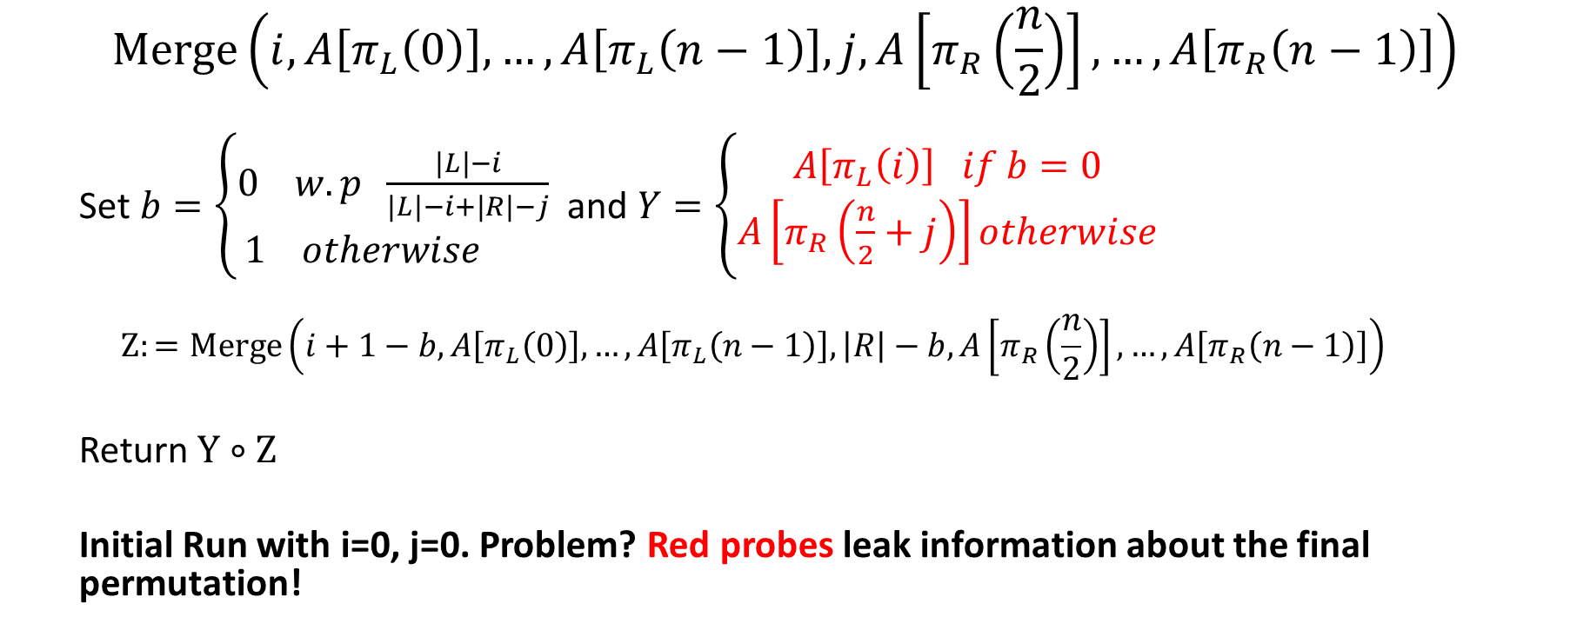
Oblivious Merge (Attempt 1)
$$Merge\left(i,A\left[π_{L}\left(0\right)\right],…, A\left[π_{L}\left(n−1\right)\right],j,A\left[π_{R}\left(\frac{n}{2}\right)\right],…, A\left[π_{R}\left(n−1\right)\right]\right)$$
  Set $b=\left\{\begin{aligned}0 w.p \frac{\left|L\right|−i}{\left|L\right|−i+\left|R\right|−j} \\ 1 otherwise \end{aligned}\right.$ and $Y=\left\{\begin{aligned}A\left[π_{L}\left(i\right)\right] if b=0 \\ A\left[π_{R}\left(\frac{n}{2}+j\right)\right]otherwise\end{aligned}\right.$
  $$Z:=Merge\left(i+1−b,A\left[π_{L}\left(0\right)\right],…, A\left[π_{L}\left(n−1\right)\right],\left|R\right|−b,A\left[π_{R}\left(\frac{n}{2}\right)\right],…, A\left[π_{R}\left(n−1\right)\right]\right)$$
  Return $Y∘Z$
  Initial Run with i=0, j=0. Problem? Red probes leak information about the final permutation!

Slide 70
March 2010: Information Theoretic Solutions
Ivan Damgård, Sigurd Meldgaard, Jesper Buus Nielsen: Perfectly Secure Oblivious RAM without Random Oracles. TCC 2011
  Posted on IACR ePrint on 2 March 2010
AOH: log(N)³
Perfect security
Also:
  Method for ORAM in MPC
  N log(N) lower bound on amount of randomness ORAM must store
Milkós Ajtai. Oblivious RAMs without cryptographic assumptions. STOC 2010
  Posted on ECCC on 6 March 2010
  STOC had deadline November 5 2009
Poly-logarithmic overhead, constant in exponent not explicitly given
Statistical error for t operations: t^{-log(t)}

Slide 71

2011: Worst-Case Poly-Log OH
Elaine Shi, T.-H. Hubert Chan, Emil Stefanov, Mingfei Li: Oblivious RAM with O((log N)³) Worst-Case Cost. ASIACRYPT 2011
  Worst case log(N)³
  Amortised overhead log(N)² when using DMN’11 as a tool: ORAM on small internal buckets
  Statistical
Michael T. Goodrich, Michael Mitzenmacher, Olga Ohrimenko, Roberto Tamassia: Oblivious RAM simulation with efficient worst- case access overhead. CCSW 2011
  Worst case N^{1/2}log(N)²
  Worst case log(N)² with large client memory.
  Computational
Eyal Kushilevitz, Steve Lu, Rafail Ostrovsky: On the (in)security of hash-based oblivious RAM and a new balancing scheme. SODA 2012
  IACR ePrint August 2011
  Worst case log(N)² / log(log(N))
  Computational
The last two paper uses “deamortisation”:
  Have two hash maps on each level
  Shuffle one while using the other and swap when the shuffling is done

Slide 72
2011-2013: Path ORAM
• Elaine Shi, T.-H. Hubert Chan, Emil Stefanov, Mingfei Li: Oblivious RAM with O((log N)³) Worst-Case Cost. ASIACRYPT 2011
• Worst case overhead log(N)³
• Emil Stefanov, Marten van Dijk, Elaine Shi, Christopher W. Fletcher, Ling Ren, Xiangyao Yu, Srinivas Devadas: Path ORAM: an extremely simple oblivious RAM protocol. CCS 2013
• Worst case overhead log(N)²
• PathORAM Idea:
• Fix the tree (do not shuffle the levels as Ajtai and DMN’11)
• Store Vp on path to uniformly random leaf Lp
• Use smaller ORAM L with size N’ = N/2 and word size w = 2 log(N)
• For all p’ = p div 2 store (L2p+0, L2p+1) in L[p]

Slide 75
2016-2018: What About that Lower Bound?!
Elette Boyle, Moni Naor: Is There an Oblivious RAM Lower Bound? ITCS 2016
Points out the following about the Goldreich-Ostrovsky lower bound:
  It only applies to “balls-in-bins” algorithms, i.e., algorithms where the ORAM may only shuffle stored values around and not apply any sophisticated encoding of the data
  It only applies to computationally unbounded adversaries
  But it applies even to off-line algorithms and improving it will involve switching to considering on-line or proving unconditional lower bounds of circuits for sorting
Kasper Green Larsen, Jesper Buus Nielsen: Yes, There is an Oblivious RAM Lower Bound! CRYPTO 2018
  Applies to all types of on-line algorithms
  Applies also to computationally bounded adversaries

Slide 76

2016-2018: What About that Lower Bound?!
Kasper Green Larsen, Jesper Buus Nielsen: Yes, There is an Oblivious RAM Lower Bound! CRYPTO 2018
  Applies to all types of on-line algorithms
  Applies also to computationally bounded adversaries
Mihai Patrascu, Erik D. Demaine: Logarithmic Lower Bounds in the Cell-Probe Model. SIAM J. Comput. 35(4) 2006
  Introduced the “Information transfer” technique
  On-line algorithms turns time into location by putting events on a time-line
  Reasoning about how information moves around in space is much, much easier than reasoning about computational complexity
  Put a binary tree on top to reason about how information is moved
LN’18: The “Information transfer” technique normally does not apply to array maintenance but when combined with obliviousness suddenly it does

Slide 77





PanORAMa
• E. Stefanov, M. van Dijk, E. Shi, C. Fletcher, L. Ren, X. Yu, and S. Devadas. Path ORAM: An Extremely Simple Oblivious RAM Protocol. In CCS ’13. 2013.
• Sarvar Patel, Giuseppe Persiano, Mariana Raykova, Kevin Yeo: PanORAMa: Oblivious RAM with Logarithmic Overhead. FOCS 2018
• Sarvar Patel, Giuseppe Persiano, Mariana Raykova, Kevin Yeo: PanORAMa: Oblivious RAM with Logarithmic Overhead. FOCS 2018
Efficient, Oblivious Data Structures for MPC. Marcel Keller and Peter Scholl. ASIACRYPT (2) 2014:.
• Efficient, Oblivious Data Structures for MPC. Marcel Keller and Peter Scholl. ASIACRYPT (2) 2014:.
• MPC AS WE PROPOSED IT
• F
MPC as we proposed in
• Ddd
After the Cuckoo: Lookup is log(N)
Amortised OH is log(N)² because of having to shuﬄe the levels
Sarvar Patel, Giuseppe Persiano, Mariana Raykova, Kevin Yeo: PanORAMa: Oblivious RAM with Logarithmic Overhead. FOCS 2018
Amortised Overhead: log(N) log(log (N))
No need to shuffle merged levels:
The remaining, untouched elements are already randomly permuted!
Extract the untouched elements
One can do this in O(N log(log(N))) Sorting small buckets of size O(log(N))
Randomly merge the permuted untouched elements
Only has to add O(N) randomness but suffers log(log(N)) to do it obliviously

Slide 78









OptORAMa
• E. Stefanov, M. van Dijk, E. Shi, C. Fletcher, L. Ren, X. Yu, and S. Devadas. Path ORAM: An Extremely Simple Oblivious RAM Protocol. In CCS ’13. 2013.
• Sarvar Patel, Giuseppe Persiano, Mariana Raykova, Kevin Yeo: PanORAMa: Oblivious RAM with Logarithmic Overhead. FOCS 2018
• Sarvar Patel, Giuseppe Persiano, Mariana Raykova, Kevin Yeo: PanORAMa: Oblivious RAM with Logarithmic Overhead. FOCS 2018
Efficient, Oblivious Data Structures for MPC. Marcel Keller and Peter Scholl. ASIACRYPT (2) 2014:.
• Efficient, Oblivious Data Structures for MPC. Marcel Keller and Peter Scholl. ASIACRYPT (2) 2014:.
• MPC AS WE PROPOSED IT
• F
MPC as we proposed in
• Ddd
Gilad Asharov, Ilan Komargodski, Wei-Kai Lin, Kartik Nayak, Enoch Peserico, Elaine Shi:
OptORAMa: Optimal Oblivious RAM. EUROCRYPT 2020 Amortised Overhead: O(log N)
Has O(N) oblivious, deterministic tight compaction algorithm!
Tight compactions: Sort elements marked 0 or 1 such that all marked 0 appear first Circumvents 0-1 lower bound by doing non-comparison operations
Extract the unused elements using tight compaction
Merge-shuffle: Just a “reverse tight compaction” which is O(N) Paper is 73 pages so I must have simplified somewhere :-)

Slide 79


















All at Once!?!?!
Perfect, worst-case, OH = log(N) ?
  Michael A. Raskin, Mark Simkin: Perfectly Secure Oblivious RAM with Sublinear Bandwidth Overhead. ASIACRYPT 2019
  Worst case OH = √ N
Computational, worst-case, OH = log(N) ?
  Gilad Asharov, Ilan Komargodski, Wei-Kai Lin, Elaine Shi: Oblivious RAM with Worst-Case Logarithmic Overhead. CRYPTO 2021
  New deamortisation technique compatible with merge-shuffle and compaction
Perfect, amortised, OH = log(N) ?
  T.-H. Hubert Chan, Elaine Shi, Wei-Kai Lin, Kartik Nayak: Perfectly Oblivious (Parallel) RAM Revisited, and Improved Constructions. ITC 2021
  AOH = O(log(N)³/log(log(N)))
Perfect, worst-case, OH = log(N) ?
♫♫♫
I’m still standing after all this time..
♫♫♫
Statistical, worst-case, OH = log(N)
  Path ORAM for word-size log(N)²

Slide 80


















ORAMs with Special Properties
ORAMs good for MPC
  Marcel Keller, Peter Scholl: Efficient, Oblivious Data Structures for MPC. ASIACRYPT 2014
Xiao Wang, T.-H. Hubert Chan, Elaine Shi: Circuit ORAM: On Tightness of the Goldreich-Ostrovsky Lower Bound. CCS 2015
Parallel ORAM
  Elette Boyle, Kai-Min Chung, Rafael Pass: Oblivious Parallel RAM and Applications. TCC 2016
Round Complexity
David Cash, Andrew Drucker, Alexander Hoover: A Lower Bound for One-Round Oblivious RAM. TCC 2020
√N Overhead
Oh a √ again!?
Random-index ORAM
  Shai Halevi, Eyal Kushilevitz: Random-Index Oblivious RAM. TCC Yesterday.
  This one is One-Round…
• …

Slide 81

















Other Oblivious Data Structures
Xiao Shaun Wang, Kartik Nayak, Chang Liu, T.-H. Hubert Chan, Elaine Shi, Emil Stefanov, Yan Huang: Oblivious Data Structures. CCS 2014
Riko Jacob, Kasper Green Larsen, Jesper Buus Nielsen: Lower Bounds for Oblivious Data Structures. SODA 2019
  Ω(log N) lower bounds for oblivious stacks, queues, deques, priority queues and search trees
Giuseppe Persiano, Kevin Yeo: Lower Bounds for Differentially Private RAMs. EUROCRYPT 2019
  Constant DP security of a single operation implies Ω(log N) OH
  Information transfer does not work here, introduces chronogram technique to ORAM
    Fredman, M., Saks, M.: The cell probe complexity of dynamic data structures. STOC 1989
Kasper Green Larsen, Mark Simkin, Kevin Yeo: Lower Bounds for Multi-server Oblivious RAMs. TCC 2020
  K servers of which the adversary can see the access pattern to only one
  If better than approx 1/K security then OH Ω(log N)
Zahra Jafargholi, Kasper Green Larsen, Mark Simkin: Optimal Oblivious Priority Queues. SODA 2021
  OH = 10 log(N)
Ilan Komargodski, Elaine Shi: Differentially Oblivious Turing Machines. ITCS 2021
  OH O(log log N)
Differentially private stack can be done with OH O(log log N).
$

Slide 83

Thanks for Listening

Slide 84










How to Record Quantum Queries
and Applications to Quantum Indifferentiability
Mark Zhandry
Princeton University & NTT Research

Slide 85





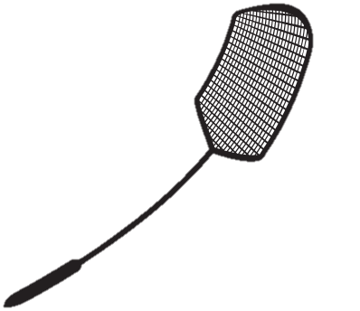













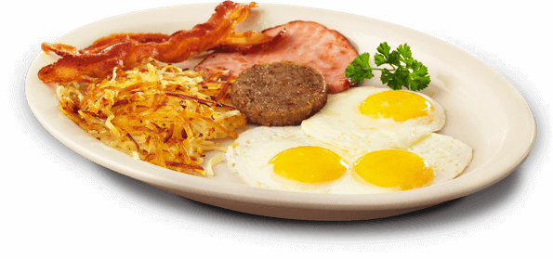



















































This talk
xy
∑α_{x}ω_{N}

Slide 86
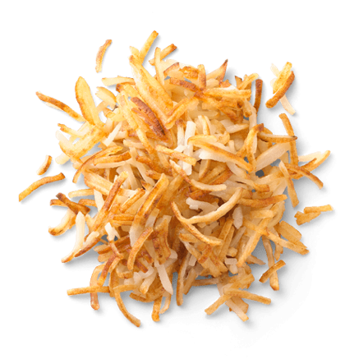




The (Classical) Random Oracle Model (ROM)
[Bellare-Rogaway’93]
hash function
Cryptosystem

Slide 87



The (Classical) Random Oracle Model (ROM)
[Bellare-Rogaway’93]
H
Cryptosystem

Slide 88











Typical ROM Proof: On-the-fly Simulation
Input Output
x₁ y₁
Query(x, D):
If (x,y)∈D: Return(y,D)
Else:
y ß$ Y
D’ = D+(x,y)
Return(y,D’)
H
x
y
2
2
x₃ y₃
x₄ y₄

Slide 89
Typical ROM Proof: On-the-fly Simulation
Allows us to:
Know the inputs adversary cares about ✓
Know the corresponding outputs
✓
(Adaptively) program the outputs ✓
Easy analysis of bad events (e.g. collisions) ✓

Slide 90





The Quantum Random Oracle Model (QROM)
[Boneh-Dagdelen-Fischlin-Lehmann-Schaffner-Z’11]
H
Now standard in post-quantum crypto

Slide 91








Problem with Classical Proofs in QROM
Input Output
x₁ y₁
How do we record the x values?
x₂ y₂
x₃ y₃
x₄ y₄

Slide 92


Problem with Classical Proofs in QROM
Observer Effect:
Learning anything about quantum system disturbs it
H
answers obliviously, so no disturbance
Reduction must answer obliviously, too?

Slide 93

Typical QROM Proof
H
H
H fixed once and for all at beginning

Slide 94
Limitations
Allows us to:
Know the inputs adversary cares about?
Know the corresponding outputs?
(Adaptively) program the outputs?
Easy analysis of bad events (e.g. collisions)?

Slide 95
Limitations
Allows us to:
Know the inputs adversary cares about? ✘
Know the corresponding outputs?
✘
(Adaptively) program the outputs?
✓/✘
Easy analysis of bad events (e.g. collisions)?✘

Slide 96
Limitations
Good News: Numerous positive results (30+ papers)
Bad News: Still some major holdouts
Indifferentiable domain extension
Fiat-Shamir
Luby-Rackoff
ROM è ICM

Slide 97
Example: Domain Extension for Random Oracles
Q: Does Merkle-Damgård preserve random oracle-ness?
x₁ x₂ x₃
x₄
MD_{h}
IV
h
h
h
h

Slide 98


Example: Domain Extension for Random Oracles
A: Yes(ish) [Coron-Dodis-Malinaud-Puniya’05]
How? Indifferentiability [Maurer-Renner-Holenstein’04]
Real World Ideal World
H
MD
h
≈
Sim
Thm [Ristenpart-Shacham-Shrimpton’11]: Indifferentiability ⇒ as good as RO for “single stage games”

Slide 99


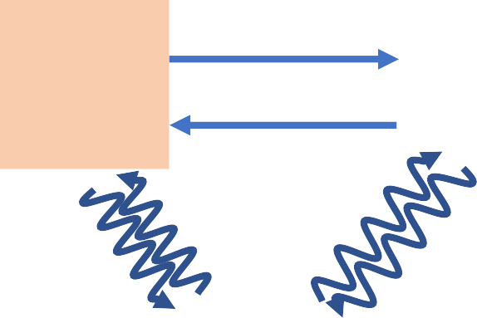

Quantum Indifferentiability?
Concurrently considered by [Carstens-Ebrahimi-Tabia-Unruh’18]
Real World
Ideal World
H
h
MD
Sim

Slide 100

Quantum Indifferentiability?
_{A}E_{r}as_{e}y Th_{w}m:_{e}
Stateless simulation for domain extension is impossible,_{t}cl_{o}ass_{a}ica_{s}ll_{t}y o?r quantumly
[Carstens-Ebrahimi-Tabia-Unruh’18]:
Proof idea: Compr_{C}e_{o}s_{n}s_{je}t_{c}r_{tu}u_{r}t_{e}h_{ye}t_{s}able of random H

Slide 101
This Work:
On-the-fly simulation of quantum random oracles
(aka Compressed Oracles)

Slide 102


Step 1: Quantum-ify (aka Purify)
Quantum-ifying (aka purifying) random oracle:
+ now single quantum system
H
H
Reminiscent of old impossibilities for unconditional quantum protocols [Lo’97,Lo-Chau’97,Mayers’97,Nayak’99]

Slide 103



Step 1: Superposition of Oracles
Initial oracle state: H
H
Query(x, y, H): y = y⊕H(x)
Oracle’s state
Adversary’s query

Slide 104












Step 2: Look at Fourier Domain
H
Ĥ

Slide 105






Step 2: Look at Fourier Domain
Initial oracle state: Z(x) = 0
Query(x, y, Ĥ): Ĥ = Ĥ⊕P_{x,y}
Ĥ
y if x=x’ 0 else
P_{x,y}(x’) =
 | A
Proof:
Fourier Transform
A
-T

Slide 106






Step 3: Compress
Observation:
After q queries, Ĥ is non-zero on at most q points
Ĥ
^D

Slide 107

Step 3: Compress
Initial oracle state: {} Query(x, y, D^):
(1) If ∄(x,y’)∈^D: ^D = D^ +(x,0)
^D
(2) Replace (x,y’)∈^D
with (x,y’⊕y)
(3) If (x,0)∈^D: remove it

Slide 108








Step 4: Revert back to Primal Domain
D
^D

Slide 109






Step 4: Revert back to Primal Domain
Input Output
x₁ y₁
Roughly analogous to classical on-the- fly simulation
D
x₂ y₂
x₃ y₃
x₄ y₄
Points adversary cares about
≈Corresponding outputs

Slide 110
Compressed Oracles
Allows us to:
Know the inputs adversary cares about? ✓
Know the corresponding outputs?
✓
(Adaptively) program the outputs? ✘
Fixed by [Don-Fehr-Majenz-Schaffner’19,Liu-Z’19], later this session!
Easy analysis of bad events (e.g. collisions)?✓

Slide 111

So, what happened?
Recall…
Observer Effect:
Learning anything about quantum system disturbs it
H
learns about through queries
H
gets disturbed
Compressed oracles decode such disturbance

Slide 112
Caveats
Outputs in database ≠0 in Fourier domain
y values aren’t exactly query outputs
Examining x,y values perturbs state
Still must be careful about how we use them
But, still good enough for many applications…

Slide 113
Applications In This Work
Quantum Indiff. of Merkle-Damgård
Easily re-prove quantum lower bounds: Ω(N^{1/2}) queries needed for Grover search Ω(N^{1/3}) queries needed for collision finding Ω(N^{1/(k+1)}) queries needed for k-SUM
CCA-security of plain Fujisaki-Okamoto

Slide 114

Further Applications
[Alagic-Majenz-Russell-Song’18]:
Quantum-secure signature separation [Liu-Z’19a]: Tight bounds
for multi-collision problem
[Liu-Z’19b]: Fiat-Shamir
( [Don-Fehr-Majenz-Schaffner’19]: direct proof )
[Czajkowski-Majenz-Schaffner-Zur’19]:
Indifferentiability of Sponge
[Hosoyamada-Iwata’19]:
[Chiesa-Manohar-Spooner’19]: zk-SNARKs
4-round Luby-Rackoff
[Bindel-Hamburg-Hülsing-Persichetti’19]: Tighter CCA security proofs

Slide 115







Lessons Learned
Always purify your oracles!

