Slide 1
Advanced Cryptography
CS 655
Week 14:
Quantum Random Oracle Model
Homework 3: Due tonight at 11:59PM
Spring 2023

Slide 2
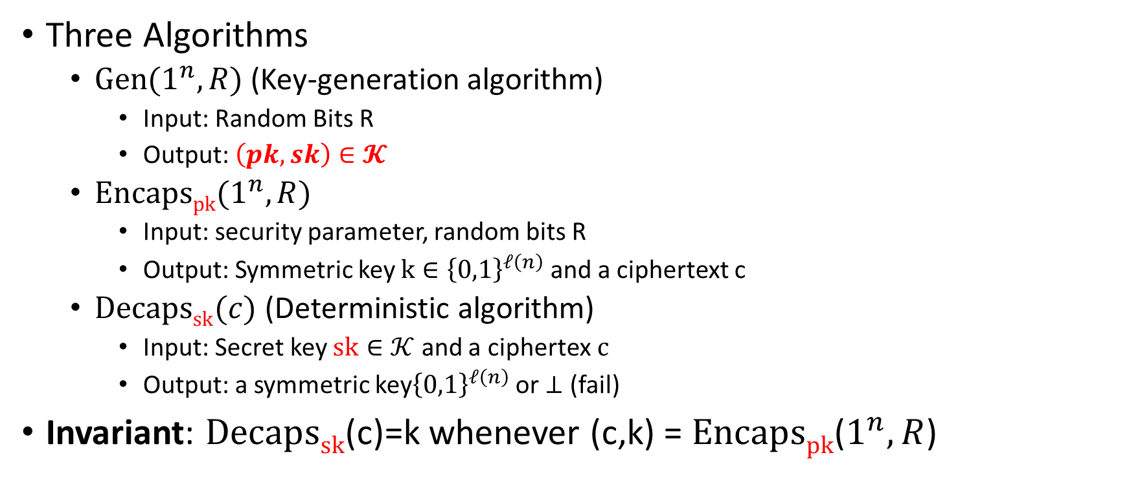
Key Encapsulation Mechanism (KEM)
Three Algorithms
  $\operatorname{Gen}{(1^{n},R)}$ (Key-generation algorithm)
    Input: Random Bits R
    Output: $\left(pk,sk\right)∈𝓚$
  $\operatorname{Encapspk}{(1^{n},R)}$
    Input: security parameter, random bits R
    Output: Symmetric key $k∈{\left\{0,1\right\}}^{ℓ\left(n\right)}$ and a ciphertext c
  $\operatorname{Decapssk}{(c)}$ (Deterministic algorithm)
    Input: Secret key $sk∈𝒦$ and a ciphertex$c$
    Output: a symmetric key${\left\{0,1\right\}}^{ℓ\left(n\right)}$ or $⊥$ (fail)
Invariant: $Decapssk$(c)=k whenever (c,k) = $Encapspk$($1^{n},R$)

Slide 3
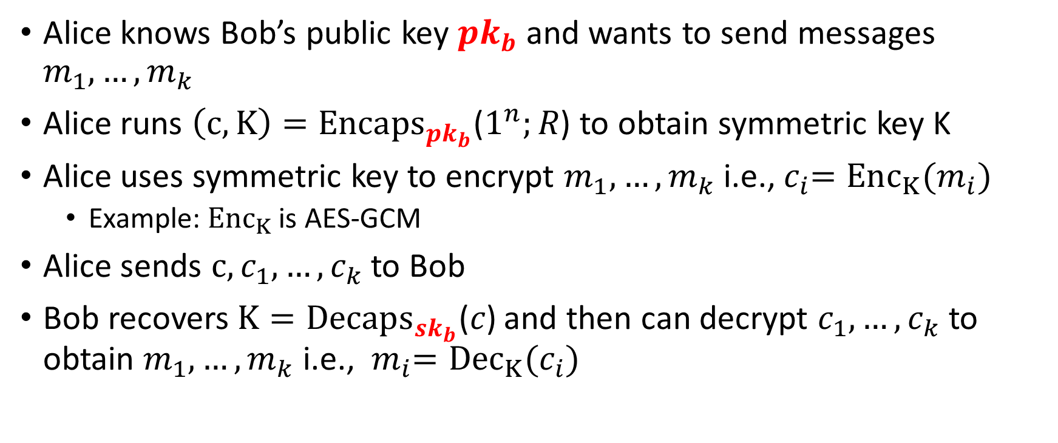
Application: KEM
Alice knows Bob’s public key ${pk}_{b}$ and wants to send messages $m_{1},…,m_{k}$
Alice runs $\left(c,K\right)={Encaps}_{{pk}_{b}}\text{(}1^{n};R\text{)}$ to obtain symmetric key K
Alice uses symmetric key to encrypt $m_{1},…,m_{k}$ i.e.,${ c}_{i}={Enc}_{K}(m_{i})$
  Example: ${Enc}_{K}$ is AES-GCM
Alice sends $c,c_{1},…,c_{k}$ to Bob
Bob recovers $K={Decaps}_{{sk}_{b}}\text{(}c\text{)}$ and then can decrypt $c_{1},…,c_{k}$ to obtain $m_{1},…,m_{k}$ i.e., ${ m}_{i}={Dec}_{K}(c_{i})$

Slide 4


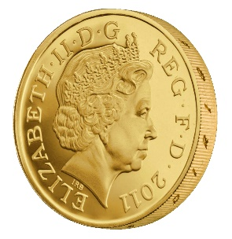








KEM CCA-Security (${KEM}_{A,Π}^{cca}\left(n\right)$)
$$\left(pk,c,kb\right)$$
…
$$c_{1}≠c$$
$${Decaps}_{sk}\left(c_{1}\right)$$
$$c_{2}≠c$$
$$∀PPT A ∃μ (negligible) s.t$$
$$Pr\left[{KEM}_{A,Π}^{cca}=1\right]≤\frac{1}{2}+μ(n)$$
$${Decaps}_{sk}\left(c_{2}\right)$$
b’
…
Random bit b
(pk,sk) = Gen(.)
$$\left(c,k0\right)={Encaps}_{pk}\left(.\right)$$
$$k1 ⟵{\left\{0,1\right\}}^{n}$$

Slide 5
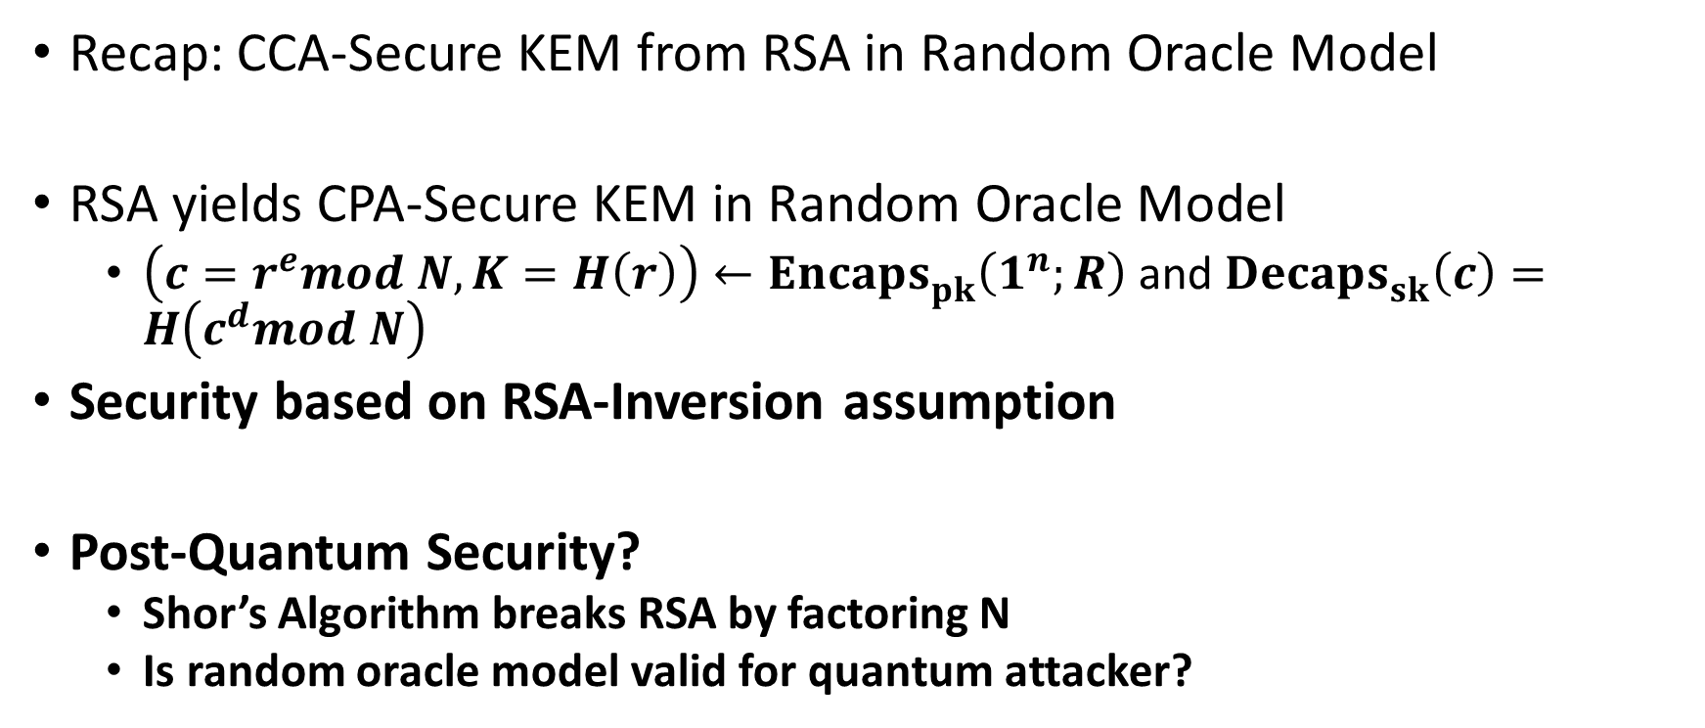
KEM from RSA
Recap: CCA-Secure KEM from RSA in Random Oracle Model
RSA yields CPA-Secure KEM in Random Oracle Model
  $\left(c=r^{e}mod N,K=H\left(r\right)\right)←{Encaps}_{pk}^{}\left(1^{n};R\right)$ and ${Decaps}_{sk}^{}\left(c\right)=H\left(c^{d}mod N\right)$
Security based on RSA-Inversion assumption
Post-Quantum Security?
  Shor’s Algorithm breaks RSA by factoring N
  Is random oracle model valid for quantum attacker?

Slide 6
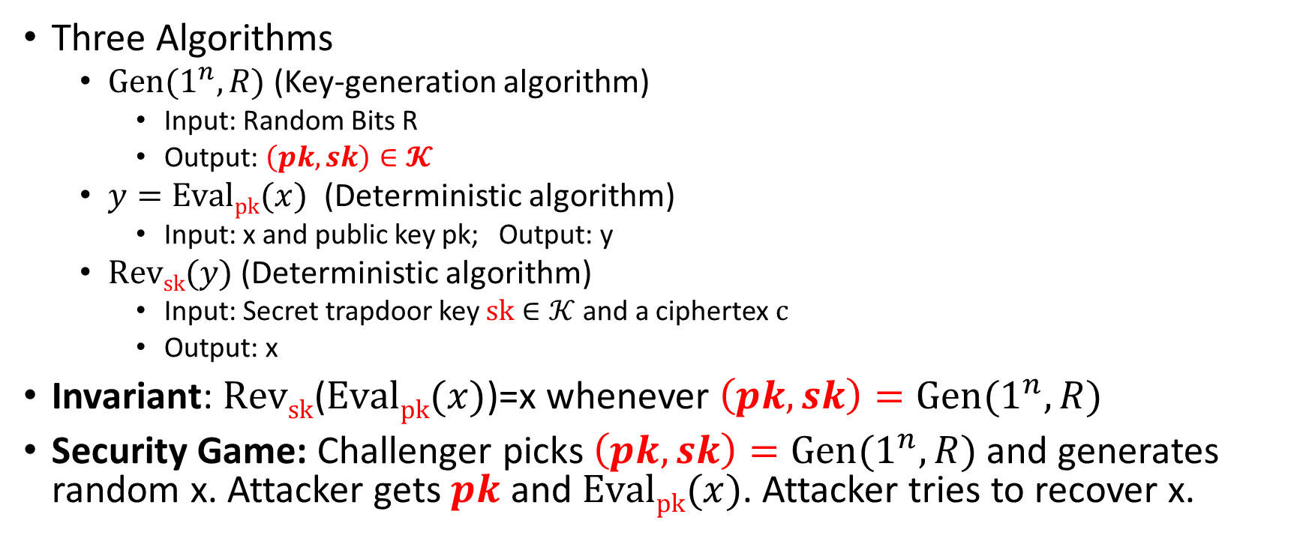
Trapdoor Permutation
Three Algorithms
  $\operatorname{Gen}{(1^{n},R)}$ (Key-generation algorithm)
    Input: Random Bits R
    Output: $\left(pk,sk\right)∈𝓚$
  $y=\operatorname{Evalpk}{(x)}$ (Deterministic algorithm)
    Input: x and public key pk; Output: y
  $\operatorname{Revsk}{(y)}$ (Deterministic algorithm)
    Input: Secret trapdoor key $sk∈𝒦$ and a ciphertex$c$
    Output: x
Invariant: $Revsk$($\operatorname{Evalpk}{(x)}$)=x whenever $\left(pk,sk\right)=\operatorname{Gen}{(1^{n},R)}$
Security Game: Challenger picks $\left(pk,sk\right)=\operatorname{Gen}{(1^{n},R)}$ and generates random x. Attacker gets $pk$ and $\operatorname{Evalpk}{(x)}$. Attacker tries to recover x.

Slide 7
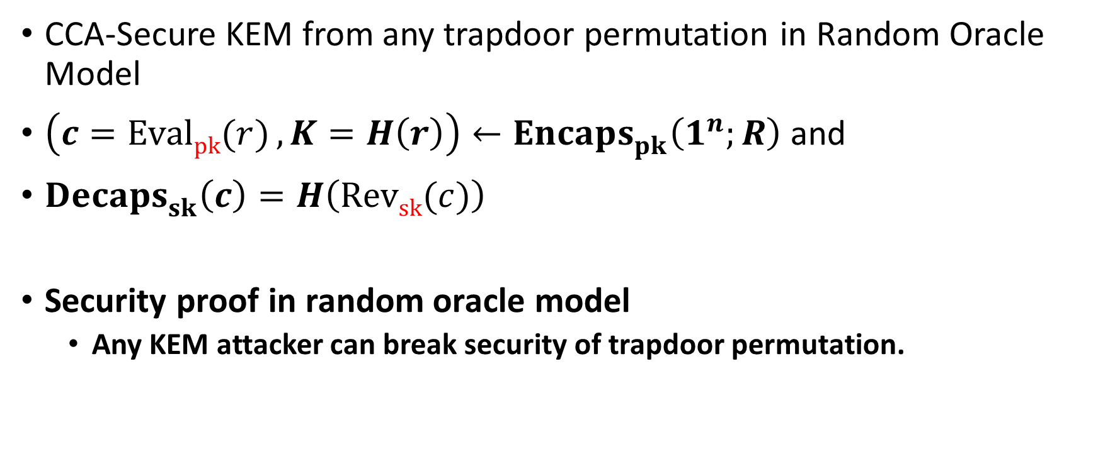
KEM from Trapdoor Permutation
CCA-Secure KEM from any trapdoor permutation in Random Oracle Model
$\left(c=\operatorname{Evalpk}{(r)},K=H\left(r\right)\right)←{Encaps}_{pk}^{}\left(1^{n};R\right)$ and
${Decaps}_{sk}^{}\left(c\right)=H\left(\operatorname{Revsk}{(c)}\right)$
Security proof in random oracle model
  Any KEM attacker can break security of trapdoor permutation.

Slide 8
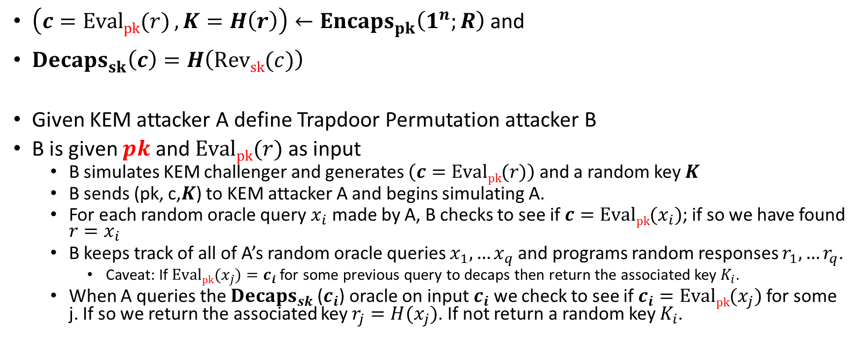
KEM Security Reduction
$\left(c=\operatorname{Evalpk}{(r)},K=H\left(r\right)\right)←{Encaps}_{pk}^{}\left(1^{n};R\right)$ and
${Decaps}_{sk}^{}\left(c\right)=H\left(\operatorname{Revsk}{(c)}\right)$
Given KEM attacker A define Trapdoor Permutation attacker B
B is given $pk$ and $\operatorname{Evalpk}{(r)}$ as input
  B simulates KEM challenger and generates $\left(c=\operatorname{Evalpk}{(r)}\right)$and a random key $K$
  B sends (pk, c,$K$) to KEM attacker A and begins simulating A.
  For each random oracle query $x_{i}$ made by A, B checks to see if $c=\operatorname{Evalpk}{(x_{i})}$; if so we have found $r=x_{i}$
  B keeps track of all of A’s random oracle queries $x_{1},…x_{q}$ and programs random responses $r_{1},…r_{q}$.
    Caveat: If $\operatorname{Evalpk}{(x_{j})}=c_{i}$ for some previous query to decaps then return the associated key $K_{i}$.
  When A queries the ${Decaps}_{sk}$($c_{i}$) oracle on input $c_{i}$ we check to see if $c_{i}=\operatorname{Evalpk}{(x_{j})}$ for some j. If so we return the associated key $r_{j}=H(x_{j})$. If not return a random key $K_{i}$.

Slide 9
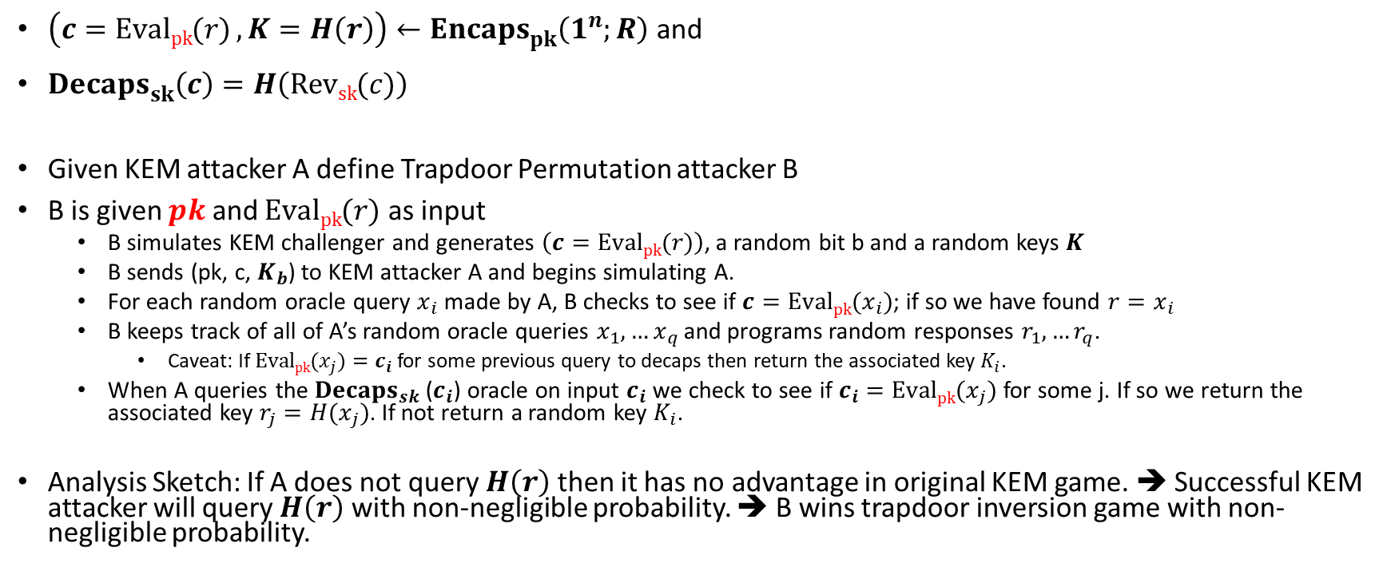
KEM Security Reduction
$\left(c=\operatorname{Evalpk}{(r)},K=H\left(r\right)\right)←{Encaps}_{pk}^{}\left(1^{n};R\right)$ and
${Decaps}_{sk}^{}\left(c\right)=H\left(\operatorname{Revsk}{(c)}\right)$
Given KEM attacker A define Trapdoor Permutation attacker B
B is given $pk$ and $\operatorname{Evalpk}{(r)}$ as input
  B simulates KEM challenger and generates $\left(c=\operatorname{Evalpk}{(r)}\right)$, a random bit b and a random keys $K$
  B sends (pk, c, $K_{b}$) to KEM attacker A and begins simulating A.
  For each random oracle query $x_{i}$ made by A, B checks to see if $c=\operatorname{Evalpk}{(x_{i})}$; if so we have found $r=x_{i}$
  B keeps track of all of A’s random oracle queries $x_{1},…x_{q}$ and programs random responses $r_{1},…r_{q}$.
    Caveat: If $\operatorname{Evalpk}{(x_{j})}=c_{i}$ for some previous query to decaps then return the associated key $K_{i}$.
  When A queries the ${Decaps}_{sk}$($c_{i}$) oracle on input $c_{i}$ we check to see if $c_{i}=\operatorname{Evalpk}{(x_{j})}$ for some j. If so we return the associated key $r_{j}=H(x_{j})$. If not return a random key $K_{i}$.
Analysis Sketch: If A does not query $H\left(r\right)$ then it has no advantage in original KEM game. ➔ Successful KEM attacker will query $H\left(r\right)$ with non-negligible probability. ➔ B wins trapdoor inversion game with non-negligible probability.

Slide 10
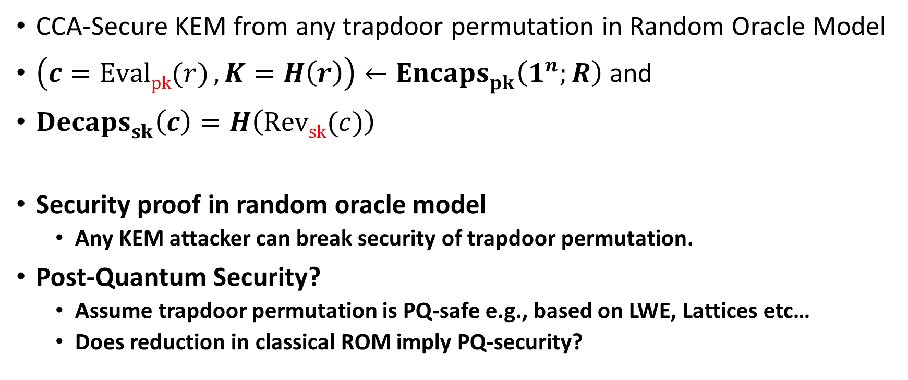
KEM from Trapdoor Permutation
CCA-Secure KEM from any trapdoor permutation in Random Oracle Model
$\left(c=\operatorname{Evalpk}{(r)},K=H\left(r\right)\right)←{Encaps}_{pk}^{}\left(1^{n};R\right)$ and
${Decaps}_{sk}^{}\left(c\right)=H\left(\operatorname{Revsk}{(c)}\right)$
Security proof in random oracle model
  Any KEM attacker can break security of trapdoor permutation.
Post-Quantum Security?
  Assume trapdoor permutation is PQ-safe e.g., based on LWE, Lattices etc…
  Does reduction in classical ROM imply PQ-security?

Slide 11
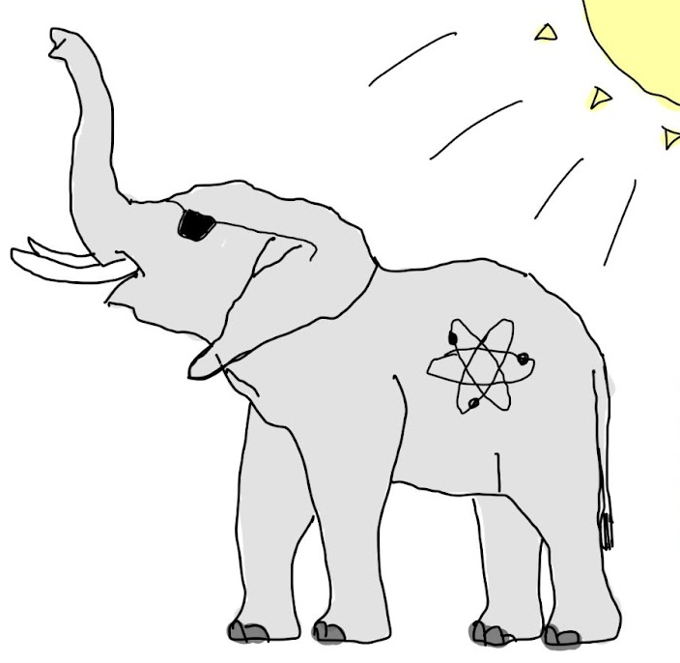
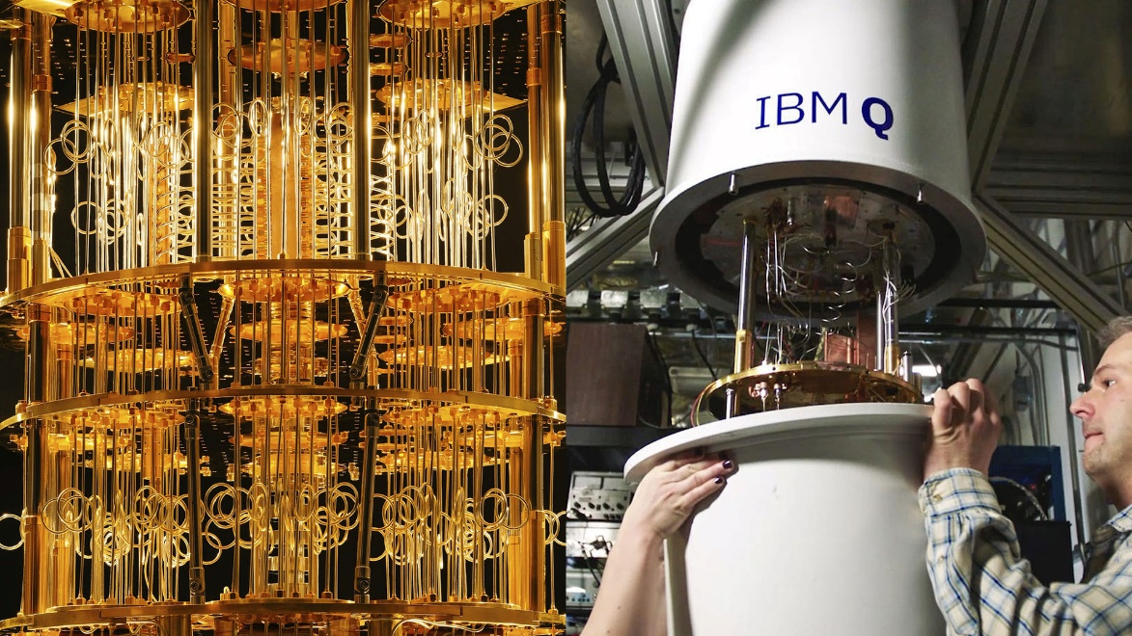

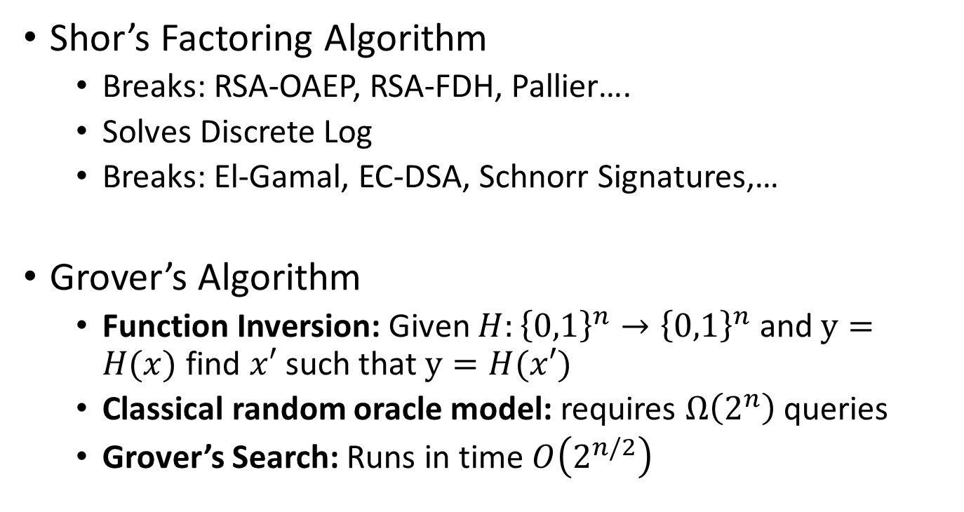
Elephant in the Room?
Shor’s Factoring Algorithm
  Breaks: RSA-OAEP, RSA-FDH, Pallier….
  Solves Discrete Log
  Breaks: El-Gamal, EC-DSA, Schnorr Signatures,…
Grover’s Algorithm
  Function Inversion: Given $H:{\left\{0,1\right\}}^{n}→{\left\{0,1\right\}}^{n}$ and $y=H(x)$ find $x′$ such that $y=H(x′)$
  Classical random oracle model: requires $Ω\left(2^{n}\right)$ queries
  Grover’s Search: Runs in time $O\left(2^{n/2}\right)$

Slide 12
Elephant in the Room?
Shor’s Factoring Algorithm
  Breaks: RSA-OAEP, RSA-FDH, Pallier….
  Solves Discrete Log
  Breaks: El-Gamal, EC-DSA, Schnorr Signatures,…
  Basically, most deployed public key crypto
NIST PQC Competition
  Public Key Encryption (PKE): Crystals-Kyber
    Hardness: Learning With Errors (LWE) (Specifically: Module-LWE)
    Integration in Crypto Libraries: Cloundfare (CIRCL), Amazon (AWS Key Management), IBM
  Digital Signatures: Three Winners
    Crystals-Dilithium
    Falcon (Lattice Based Signatures):
      Hardness: Short Integer Solution (SIS) over NTRU Lattices
    SPHINCS+ (Hash Based Construction)

Slide 13
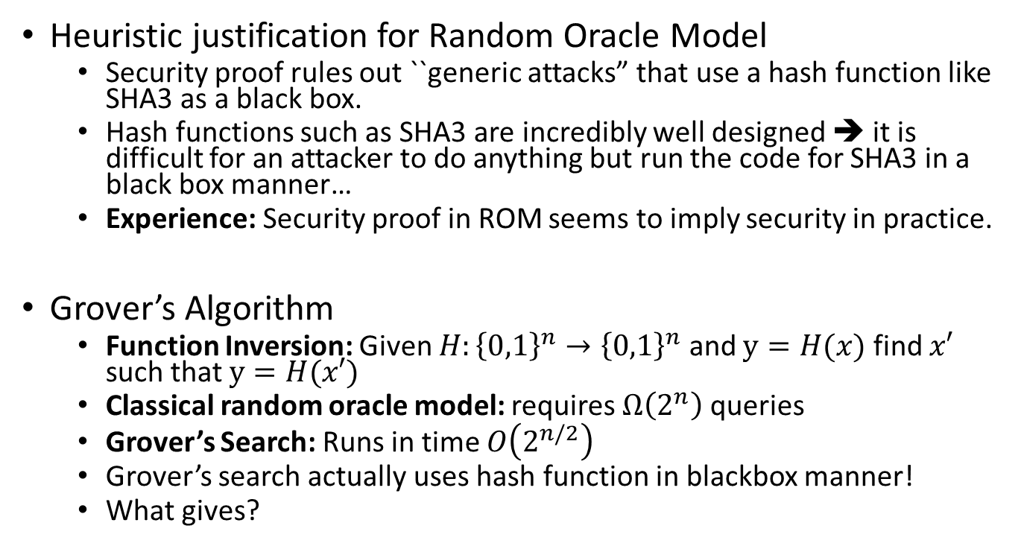
Random Oracle Model?
Heuristic justification for Random Oracle Model
  Security proof rules out ``generic attacks” that use a hash function like SHA3 as a black box.
  Hash functions such as SHA3 are incredibly well designed ➔ it is difficult for an attacker to do anything but run the code for SHA3 in a black box manner…
  Experience: Security proof in ROM seems to imply security in practice.
Grover’s Algorithm
  Function Inversion: Given $H:{\left\{0,1\right\}}^{n}→{\left\{0,1\right\}}^{n}$ and $y=H(x)$ find $x′$ such that $y=H(x′)$
  Classical random oracle model: requires $Ω\left(2^{n}\right)$ queries
  Grover’s Search: Runs in time $O\left(2^{n/2}\right)$
  Grover’s search actually uses hash function in blackbox manner!
  What gives?

Slide 14
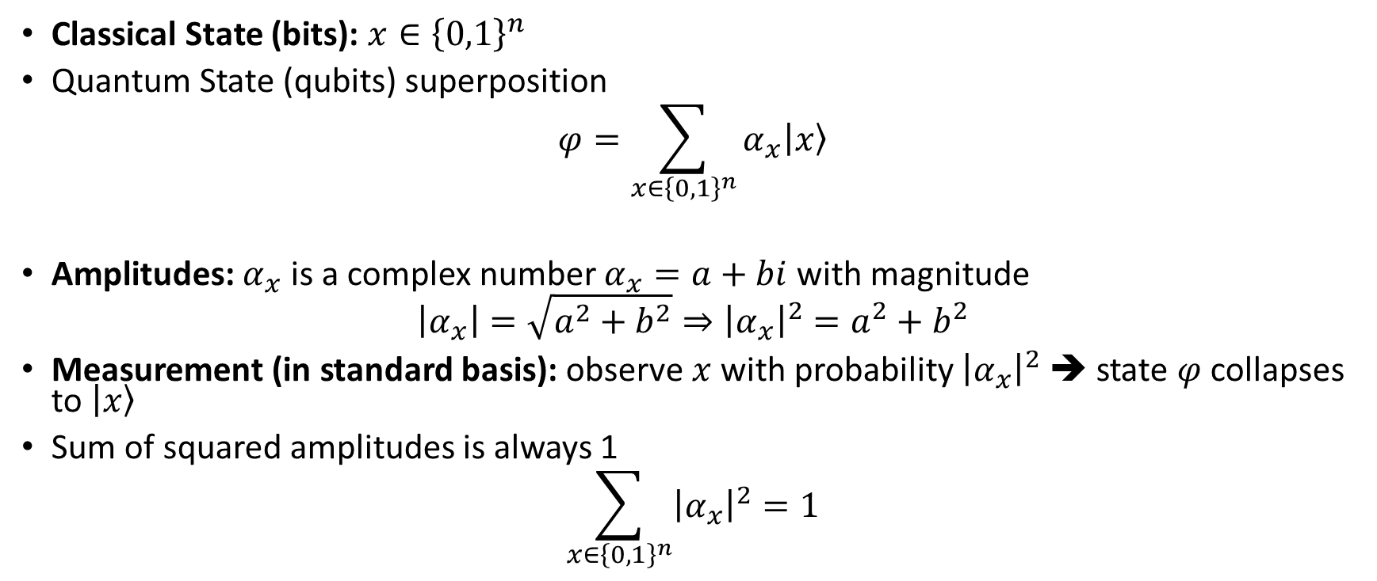
Quantum Computation (Basics)
Classical State (bits): $x∈{\left\{0,1\right\}}^{n}$
Quantum State (qubits) superposition
$$φ=\sum_{x∈{\left\{0,1\right\}}^{n}}{α_{x}\left|\left.x\right\rangle \right.}$$
Amplitudes: $α_{x}$ is a complex number $α_{x}=a+bi$ with magnitude
$$\left|α_{x}\right|=\sqrt{a^{2}+b^{2}}⇒{\left|α_{x}\right|}^{2}=a^{2}+b^{2}$$
Measurement (in standard basis): observe $x$ with probability ${\left|α_{x}\right|}^{2}$ ➔ state $φ$ collapses to $\left|\left.x\right\rangle \right.$
Sum of squared amplitudes is always 1
$$\sum_{x∈{\left\{0,1\right\}}^{n}}{{\left|α_{x}\right|}^{2}}=1$$

Slide 15
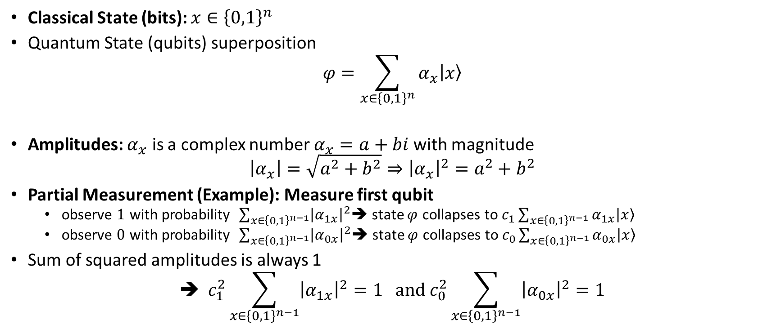
Quantum Computation (Basics)
Classical State (bits): $x∈{\left\{0,1\right\}}^{n}$
Quantum State (qubits) superposition
$$φ=\sum_{x∈{\left\{0,1\right\}}^{n}}{α_{x}\left|\left.x\right\rangle \right.}$$
Amplitudes: $α_{x}$ is a complex number $α_{x}=a+bi$ with magnitude
$$\left|α_{x}\right|=\sqrt{a^{2}+b^{2}}⇒{\left|α_{x}\right|}^{2}=a^{2}+b^{2}$$
Partial Measurement (Example): Measure first qubit
  observe $1$ with probability $\sum_{x∈{\left\{0,1\right\}}^{n−1}}{{\left|α_{1x}\right|}^{2}}$➔ state $φ$ collapses to $c_{1}\sum_{x∈{\left\{0,1\right\}}^{n−1}}{α_{1x}\left|\left.x\right\rangle \right.}$
  observe $0$ with probability $\sum_{x∈{\left\{0,1\right\}}^{n−1}}{{\left|α_{0x}\right|}^{2}}$➔ state $φ$ collapses to $c_{0}\sum_{x∈{\left\{0,1\right\}}^{n−1}}{α_{0x}\left|\left.x\right\rangle \right.}$
Sum of squared amplitudes is always 1
$$\text{➔} c_{1}^{2}\sum_{x∈{\left\{0,1\right\}}^{n−1}}{{\left|α_{1x}\right|}^{2}}=1 and c_{0}^{2}\sum_{x∈{\left\{0,1\right\}}^{n−1}}{{\left|α_{0x}\right|}^{2}}=1$$

Slide 16

Quantum Measurement (Basics)
Quantum (Partial) Measurement: Necessarily alters the quantum state

Slide 17
Quantum Measurement (Basics)
Quantum (Partial) Measurement: Necessarily alters the quantum state
Idea: Replicate the state and measure the copy?
Impossible! No-Cloning Theorem ➔ Impossible to create an independent and identical copy of an arbitrary/unknown quantum state.

Slide 18
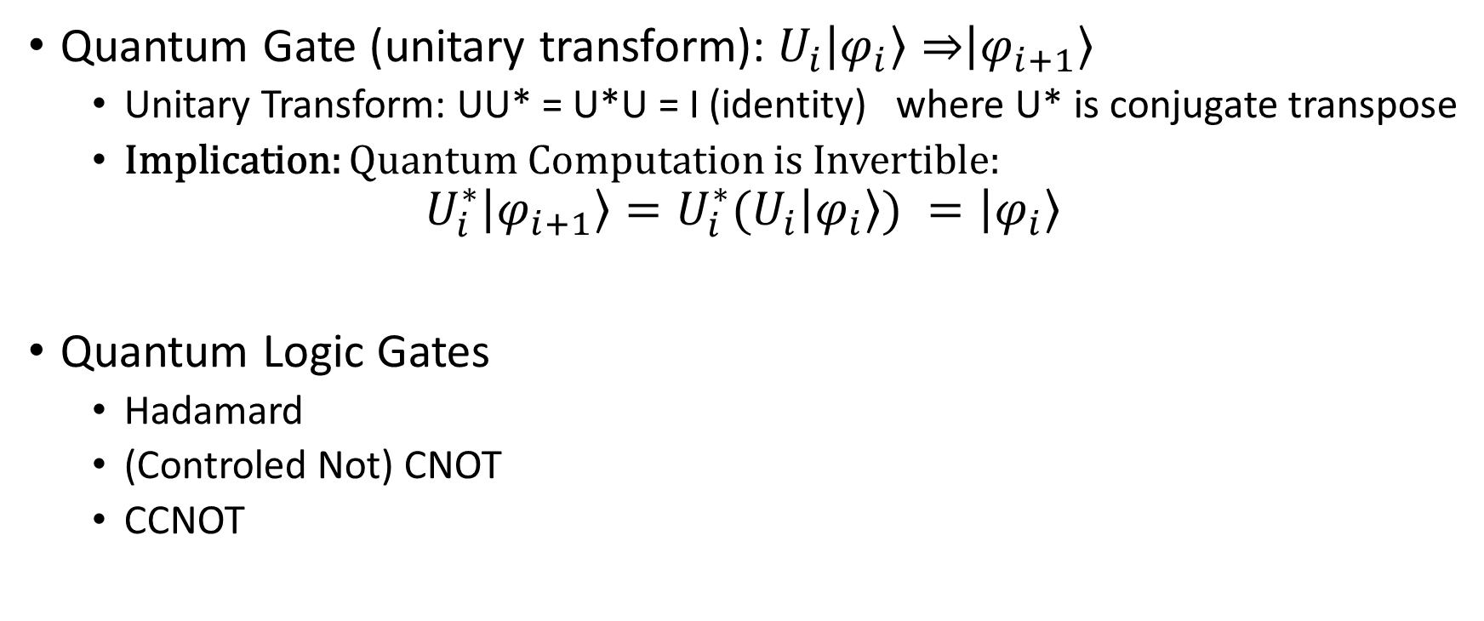
Quantum Computation (Basics)
Quantum Gate (unitary transform): $U_{i}\left|\left.φ_{i}\right\rangle ⇒\right.\left|\left.φ_{i+1}\right\rangle \right.$
  Unitary Transform: UU* = U*U = I (identity) where U* is conjugate transpose
  Implication: Quantum Computation is Invertible:
$$U_{i}^{∗}\left|\left.φ_{i+1}\right\rangle \right.=U_{i}^{∗}(U_{i}\left|\left.φ_{i}\right\rangle ) \right.=\left|\left.φ_{i}\right\rangle \right.$$
Quantum Logic Gates
  Hadamard
  (Controled Not) CNOT
  CCNOT

Slide 19
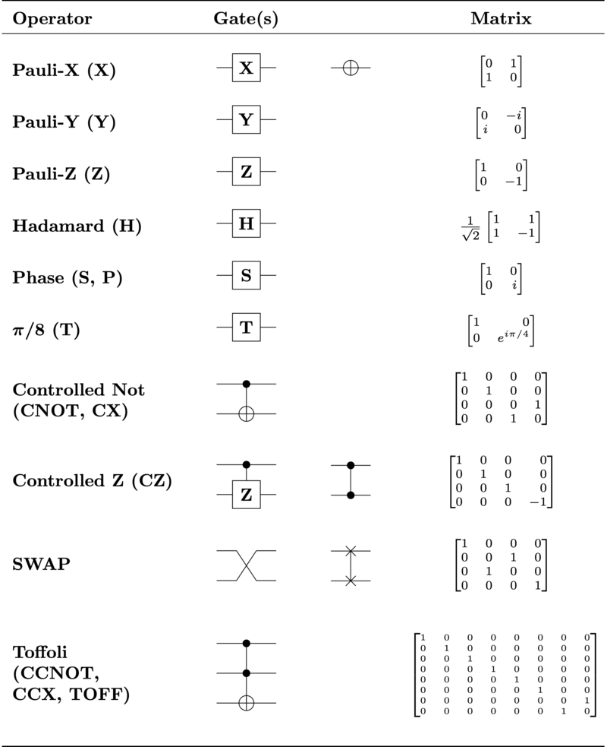

Hadamard (Single Bit)
$$H|\left.0\right\rangle ⇒\frac{1}{\sqrt{2}}|\left.0\right\rangle +\frac{1}{\sqrt{2}}|\left.1\right\rangle$$
$$H|\left.1\right\rangle ⇒\frac{1}{\sqrt{2}}|\left.1\right\rangle −\frac{1}{\sqrt{2}}|\left.1\right\rangle$$

Slide 20
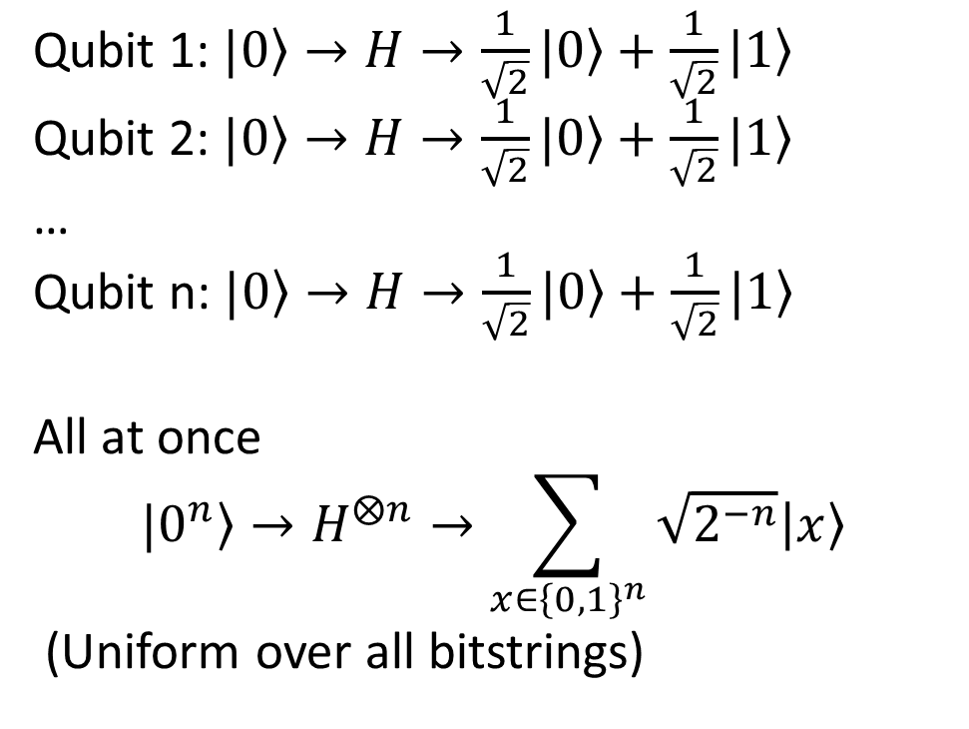
Hadamard (Multiple Bits)
Qubit 1: $|\left.0\right\rangle →H→\frac{1}{\sqrt{2}}|\left.0\right\rangle +\frac{1}{\sqrt{2}}|\left.1\right\rangle$
Qubit 2: $|\left.0\right\rangle →H→\frac{1}{\sqrt{2}}|\left.0\right\rangle +\frac{1}{\sqrt{2}}|\left.1\right\rangle$
…
Qubit n: $|\left.0\right\rangle →H→\frac{1}{\sqrt{2}}|\left.0\right\rangle +\frac{1}{\sqrt{2}}|\left.1\right\rangle$
All at once
$$|\left.0^{n}\right\rangle →H^{⨂n}→\sum_{x∈{\left\{0,1\right\}}^{n}}{\sqrt{2^{−n}}\left|\left.x\right\rangle \right.}$$
(Uniform over all bitstrings)

Slide 21
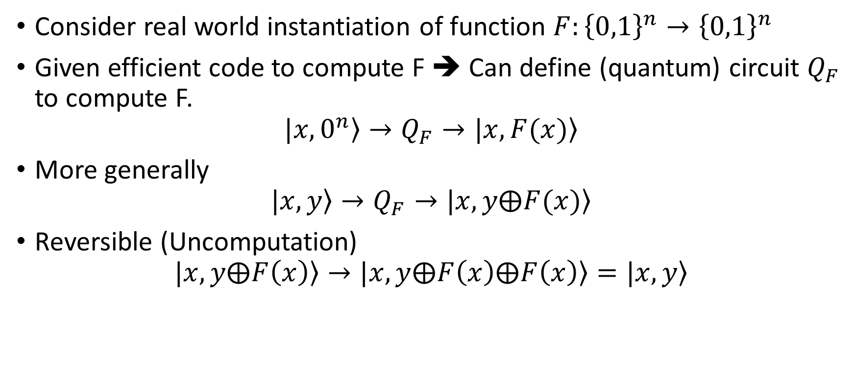
Quantum Oracle
Consider real world instantiation of function $F:{\left\{0,1\right\}}^{n}→{\left\{0,1\right\}}^{n}$
Given efficient code to compute F ➔ Can define (quantum) circuit $Q_{F}$ to compute F.
$$|x,\left.0^{n}\right\rangle →Q_{F}→|x,\left.F(x)\right\rangle$$
More generally
$$|x,\left.y\right\rangle →Q_{F}→|x,\left.y⨁F(x)\right\rangle$$
Reversible (Uncomputation)
$$|x,\left.y⨁F\left(x\right)\right\rangle →|x,\left.y⨁F\left(x\right)⨁F\left(x\right)\right\rangle =|x,\left.y\right\rangle$$

Slide 22
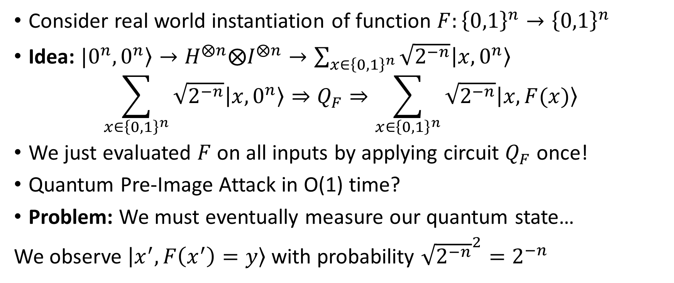
Grover’s Algorithm
Consider real world instantiation of function $F:{\left\{0,1\right\}}^{n}→{\left\{0,1\right\}}^{n}$
Idea: $|0^{n},\left.0^{n}\right\rangle →H^{⨂n}⨂I^{⨂n}→\sum_{x∈{\left\{0,1\right\}}^{n}}{\sqrt{2^{−n}}\left|\left.x,0^{n}\right\rangle \right.}$
$$\sum_{x∈{\left\{0,1\right\}}^{n}}{\sqrt{2^{−n}}\left|\left.x,0^{n}\right\rangle \right.}⇒Q_{F}⇒\sum_{x∈{\left\{0,1\right\}}^{n}}{\sqrt{2^{−n}}\left|\left.x,F(x)\right\rangle \right.}$$
We just evaluated $F$ on all inputs by applying circuit $Q_{F}$ once!
Quantum Pre-Image Attack in O(1) time?
Problem: We must eventually measure our quantum state…
We observe $\left|\left.x^{′},F\left(x^{′}\right)=y\right\rangle \right.$ with probability ${\sqrt{2^{−n}}}^{2}=2^{−n}$

Slide 23
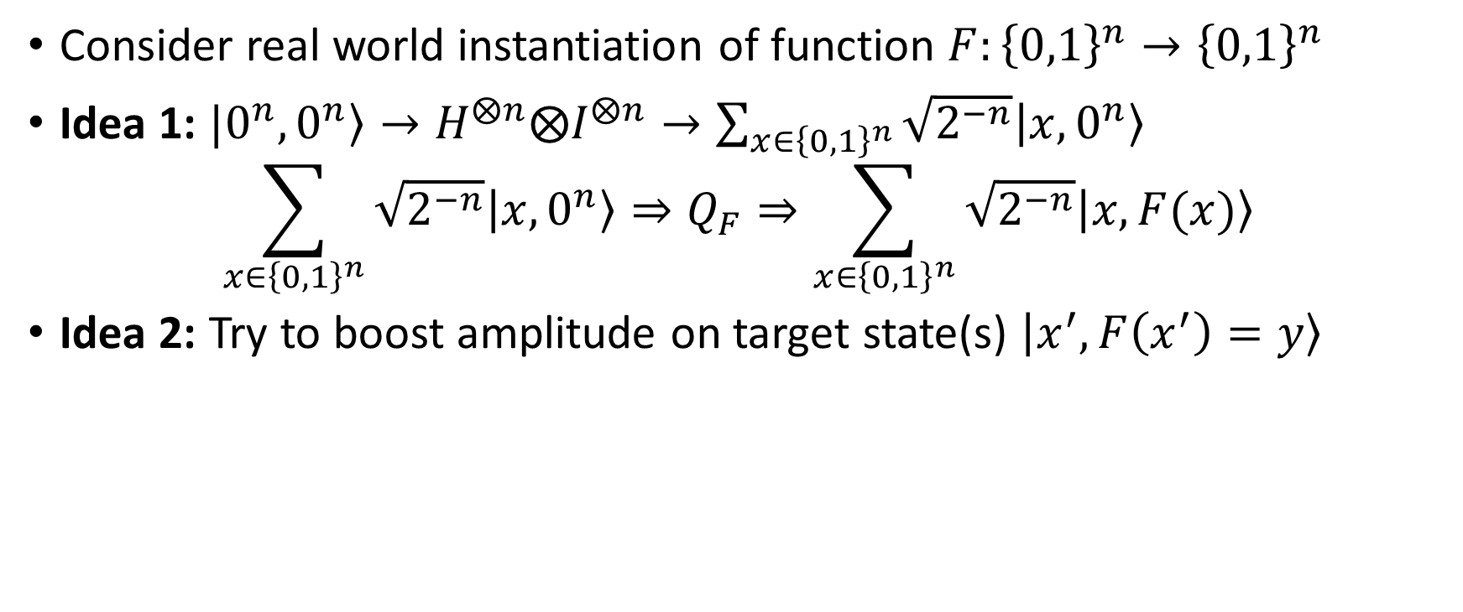
Quantum Oracle
Consider real world instantiation of function $F:{\left\{0,1\right\}}^{n}→{\left\{0,1\right\}}^{n}$
Idea 1: $|0^{n},\left.0^{n}\right\rangle →H^{⨂n}⨂I^{⨂n}→\sum_{x∈{\left\{0,1\right\}}^{n}}{\sqrt{2^{−n}}\left|\left.x,0^{n}\right\rangle \right.}$
$$\sum_{x∈{\left\{0,1\right\}}^{n}}{\sqrt{2^{−n}}\left|\left.x,0^{n}\right\rangle \right.}⇒Q_{F}⇒\sum_{x∈{\left\{0,1\right\}}^{n}}{\sqrt{2^{−n}}\left|\left.x,F(x)\right\rangle \right.}$$
Idea 2: Try to boost amplitude on target state(s) $\left|\left.x^{′},F\left(x^{′}\right)=y\right\rangle \right.$

Slide 24
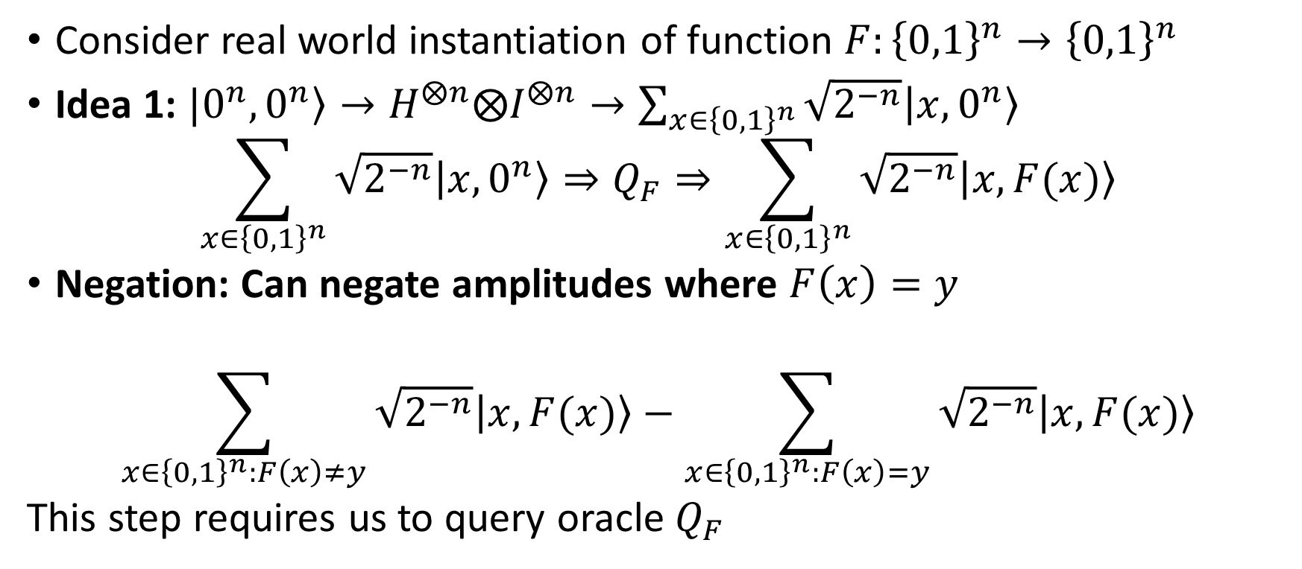
Quantum Oracle
Consider real world instantiation of function $F:{\left\{0,1\right\}}^{n}→{\left\{0,1\right\}}^{n}$
Idea 1: $|0^{n},\left.0^{n}\right\rangle →H^{⨂n}⨂I^{⨂n}→\sum_{x∈{\left\{0,1\right\}}^{n}}{\sqrt{2^{−n}}\left|\left.x,0^{n}\right\rangle \right.}$
$$\sum_{x∈{\left\{0,1\right\}}^{n}}{\sqrt{2^{−n}}\left|\left.x,0^{n}\right\rangle \right.}⇒Q_{F}⇒\sum_{x∈{\left\{0,1\right\}}^{n}}{\sqrt{2^{−n}}\left|\left.x,F(x)\right\rangle \right.}$$
Negation: Can negate amplitudes where $F\left(x\right)=y$
$$\sum_{x∈{\left\{0,1\right\}}^{n}:F\left(x\right)≠y}{\sqrt{2^{−n}}\left|\left.x,F(x)\right\rangle \right.}−\sum_{x∈{\left\{0,1\right\}}^{n}:F\left(x\right)=y}{\sqrt{2^{−n}}\left|\left.x,F(x)\right\rangle \right.}$$
This step requires us to query oracle $Q_{F}$

Slide 25
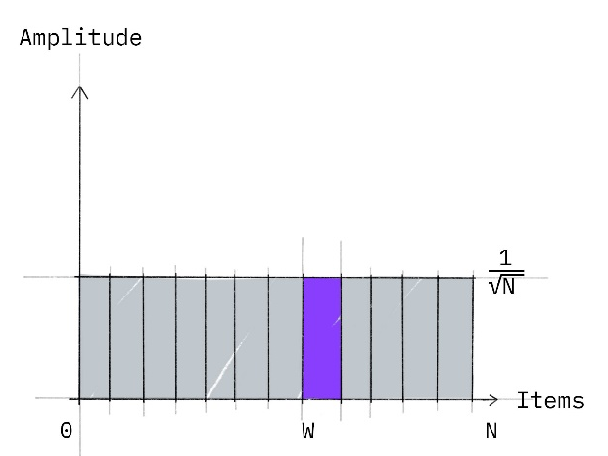
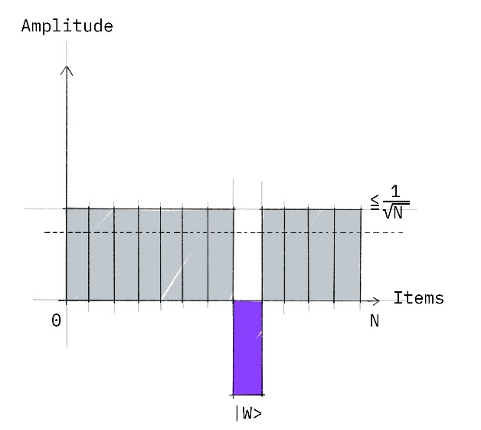
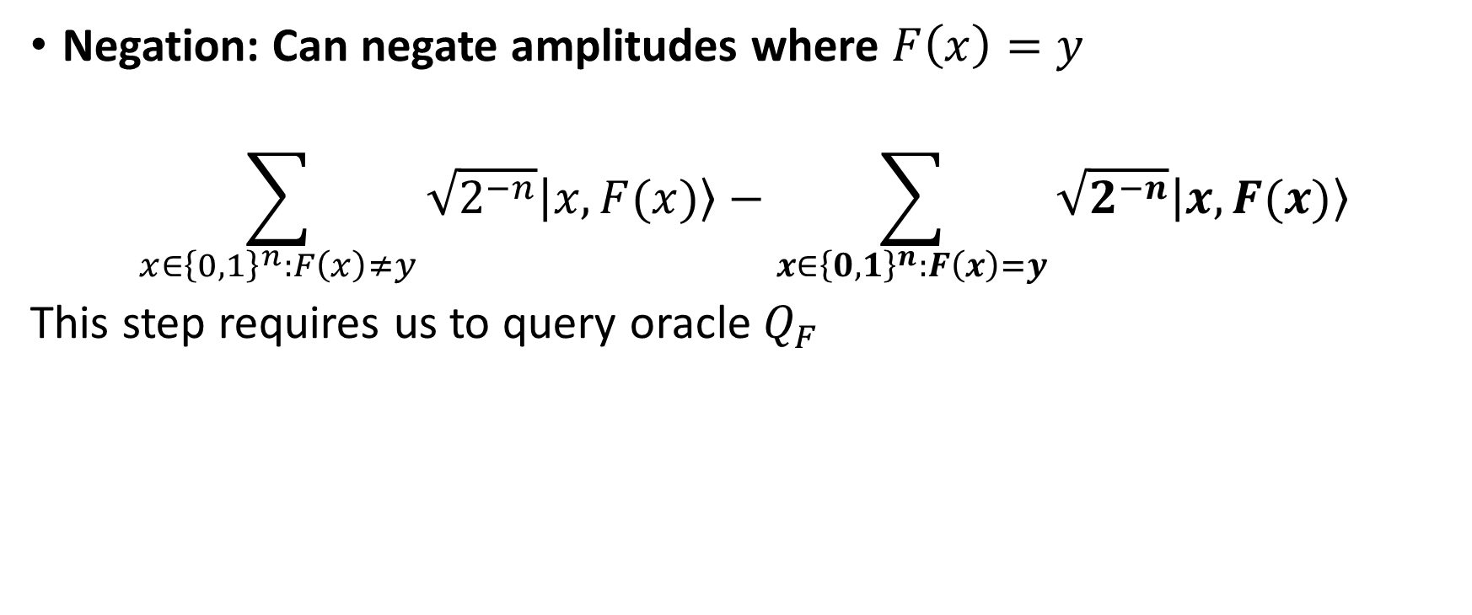

Quantum Oracle
Negation: Can negate amplitudes where $F\left(x\right)=y$
$$\sum_{x∈{\left\{0,1\right\}}^{n}:F\left(x\right)≠y}{\sqrt{2^{−n}}\left|\left.x,F(x)\right\rangle \right.}−\sum_{x∈{\left\{0,1\right\}}^{n}:F\left(x\right)=y}{\sqrt{2^{−n}}\left|\left.x,F(x)\right\rangle \right.}$$
This step requires us to query oracle $Q_{F}$
Reflection
$$⇒Negation⇒$$

Slide 26
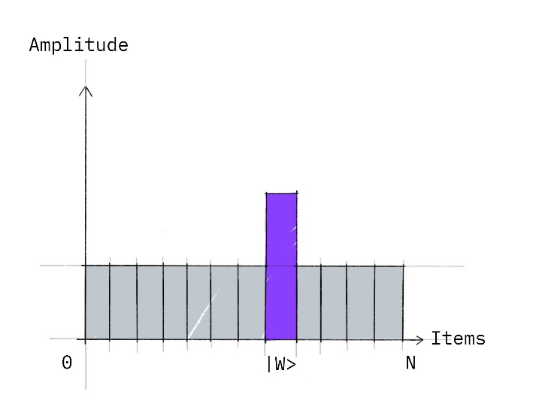



Quantum Oracle
Reflection: Can reflect amplitudes around mean
$$\sum_{x∈{\left\{0,1\right\}}^{n}:F\left(x\right)≠y}{\sqrt{2^{−n}}(1−ε)\left|\left.x,F(x)\right\rangle \right.}+\sum_{x∈{\left\{0,1\right\}}^{n}:F\left(x\right)=y}{(3−ε′)\sqrt{2^{−n}}\left|\left.x,F(x)\right\rangle \right.}$$
Reflection
$$⇒Negation⇒$$
$$⇒Reflection⇒$$

Slide 27
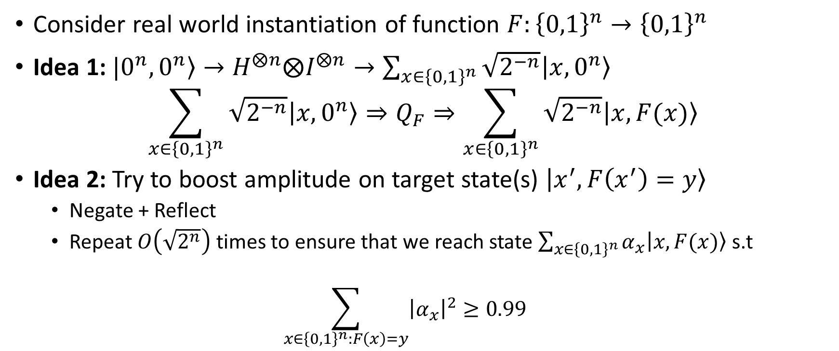
Quantum Oracle
Consider real world instantiation of function $F:{\left\{0,1\right\}}^{n}→{\left\{0,1\right\}}^{n}$
Idea 1: $|0^{n},\left.0^{n}\right\rangle →H^{⨂n}⨂I^{⨂n}→\sum_{x∈{\left\{0,1\right\}}^{n}}{\sqrt{2^{−n}}\left|\left.x,0^{n}\right\rangle \right.}$
$$\sum_{x∈{\left\{0,1\right\}}^{n}}{\sqrt{2^{−n}}\left|\left.x,0^{n}\right\rangle \right.}⇒Q_{F}⇒\sum_{x∈{\left\{0,1\right\}}^{n}}{\sqrt{2^{−n}}\left|\left.x,F(x)\right\rangle \right.}$$
Idea 2: Try to boost amplitude on target state(s) $\left|\left.x^{′},F\left(x^{′}\right)=y\right\rangle \right.$
  Negate + Reflect
  Repeat $O\left(\sqrt{2^{n}}\right)$ times to ensure that we reach state $\sum_{x∈{\left\{0,1\right\}}^{n}}{α_{x}\left|\left.x,F(x)\right\rangle \right.}$s.t
  $$\sum_{x∈{\left\{0,1\right\}}^{n}:F\left(x\right)=y}{{\left|α_{x}\right|}^{2}}≥0.99$$

Slide 28
Quantum Random Oracle Model
Motivation: Any real world hash function can be computed efficiently by a quantum circuit ➔ we can use Grover’s algorithm.
Grover’s algorithm uses hash function as random blackbox, but somehow the classical Random Oracle model does not capture power of generic quantum attacker.
Goal: Generic analysis tools to analyze the power of a quantum attacker who uses hash function as a blackbox?

Slide 29


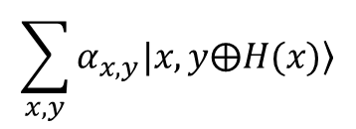
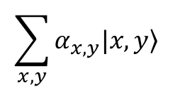


ROM vs qROM [BDF⁺11]
<Classical ROM>
<Quantum ROM>
$$x$$
C
$$\sum_{x,y}{α_{x,y}|x,\left.y\right\rangle }$$
$$H(x)$$
$$\sum_{x,y}{α_{x,y}|x,\left.y⨁H(x)\right\rangle }$$
⁸ 19
8/19

Slide 30
ROM vs qROM [BDF⁺11]
<Classical ROM>
<Quantum ROM>
$$x$$
C
$$\sum_{x,y}{α_{x,y}|x,\left.y\right\rangle }$$
$$H(x)$$
$$\sum_{x,y}{α_{x,y}|x,\left.y⨁H(x)\right\rangle }$$
Security proofs are much more challenging in the qROM
0 Programmability & Extractability (ROM: ✔, qROM: ✘)
0 Recording quantum queries?
⁸ 19
8/19

Slide 31
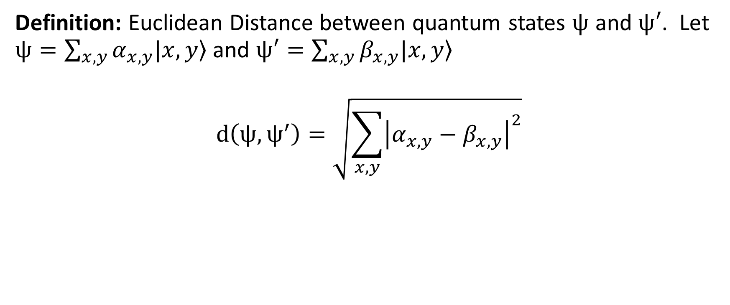
Quantum Computing: Useful Theorem
Definition: Euclidean Distance between quantum states $ψ$ and $ψ′$. Let $ψ=\sum_{x,y}{α_{x,y}|x,\left.y\right\rangle }$ and $ψ′=\sum_{x,y}{β_{x,y}|x,\left.y\right\rangle }$
$$d\left(ψ,ψ^{′}\right)=\sqrt{\sum_{x,y}{{\left|α_{x,y}−β_{x,y}\right|}^{2}}}$$

Slide 32
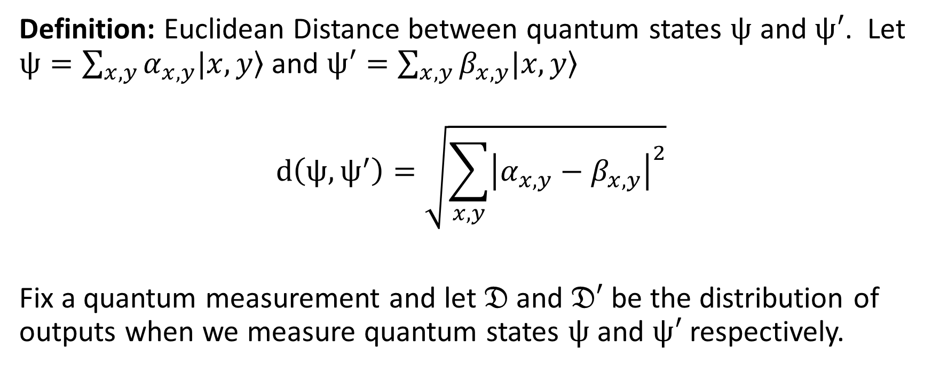
Quantum Computing: Useful Theorem
Definition: Euclidean Distance between quantum states $ψ$ and $ψ′$. Let $ψ=\sum_{x,y}{α_{x,y}|x,\left.y\right\rangle }$ and $ψ′=\sum_{x,y}{β_{x,y}|x,\left.y\right\rangle }$
$$d\left(ψ,ψ^{′}\right)=\sqrt{\sum_{x,y}{{\left|α_{x,y}−β_{x,y}\right|}^{2}}}$$
Fix a quantum measurement and let $𝔇$ and $𝔇′$ be the distribution of outputs when we measure quantum states $ψ$ and $ψ′$ respectively.

Slide 33
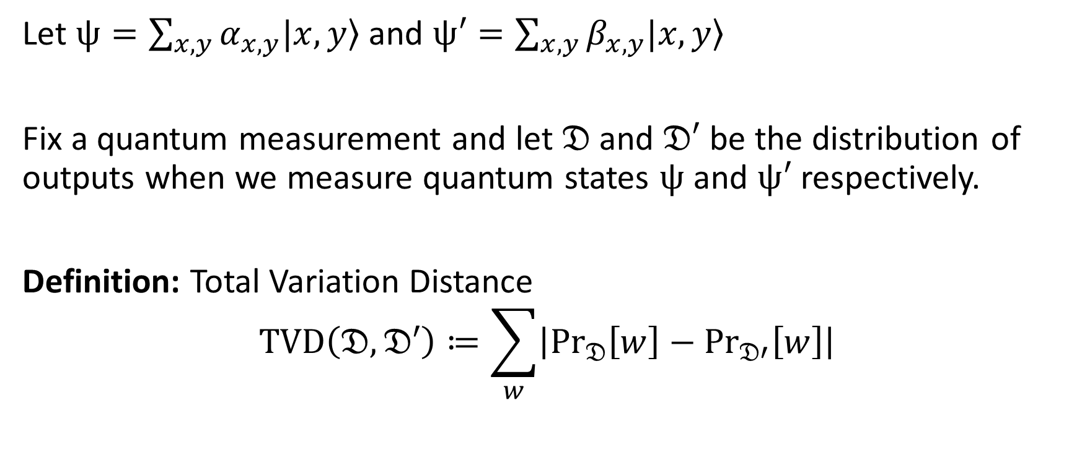
Quantum Computing: Useful Theorem
Let $ψ=\sum_{x,y}{α_{x,y}|x,\left.y\right\rangle }$ and $ψ′=\sum_{x,y}{β_{x,y}|x,\left.y\right\rangle }$
Fix a quantum measurement and let $𝔇$ and $𝔇′$ be the distribution of outputs when we measure quantum states $ψ$ and $ψ′$ respectively.
Definition: Total Variation Distance
$$TVD\left(𝔇,𝔇′\right)≔\sum_{w}{\left|{Pr}_{𝔇}\left[w\right]−{Pr}_{𝔇′}\left[w\right]\right|}$$

Slide 34
Quantum Computing: Useful Theorem
Let $ψ=\sum_{x,y}{α_{x,y}|x,\left.y\right\rangle }$ and $ψ′=\sum_{x,y}{β_{x,y}|x,\left.y\right\rangle }$
Fix a quantum measurement and let $𝔇$ and $𝔇′$ be the distribution of outputs when we measure quantum states $ψ$ and $ψ′$ respectively.
Definition: Total Variation Distance
$$TVD\left(𝔇,𝔇′\right)≔\sum_{w}{\left|{Pr}_{𝔇}\left[w\right]−{Pr}_{𝔇′}\left[w\right]\right|}$$

Slide 35
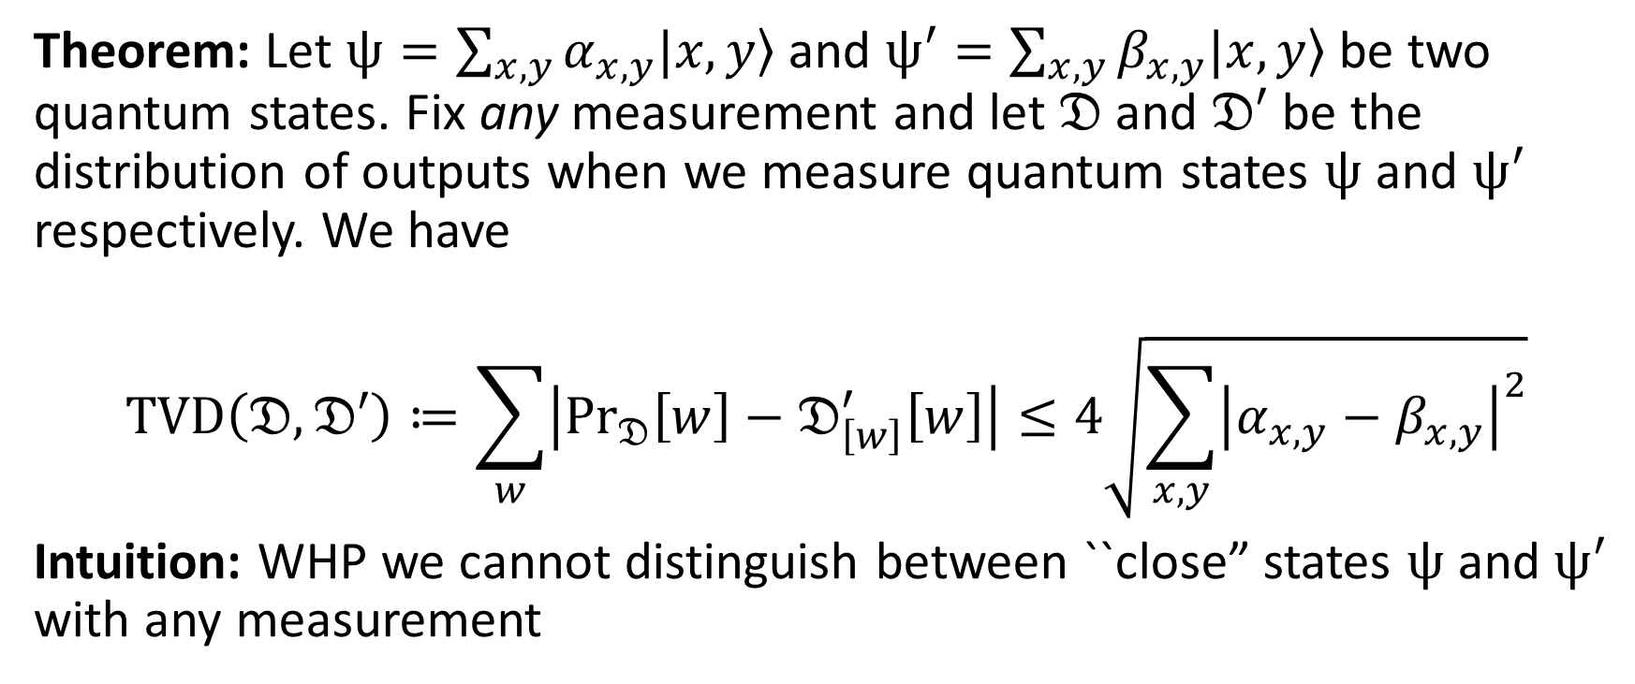
Quantum Computing: Useful Theorem
Theorem: Let $ψ=\sum_{x,y}{α_{x,y}|x,\left.y\right\rangle }$ and $ψ′=\sum_{x,y}{β_{x,y}|x,\left.y\right\rangle }$ be two quantum states. Fix any measurement and let $𝔇$ and $𝔇′$ be the distribution of outputs when we measure quantum states $ψ$ and $ψ′$ respectively. We have
$$TVD\left(𝔇,𝔇′\right)≔\sum_{w}{\left|{Pr}_{𝔇}\left[w\right]−𝔇_{\left[w\right]}^{′}\left[w\right]\right|}≤4\sqrt{\sum_{x,y}{{\left|α_{x,y}−β_{x,y}\right|}^{2}}}$$
Intuition: WHP we cannot distinguish between ``close” states $ψ$ and $ψ′$ with any measurement

Slide 36
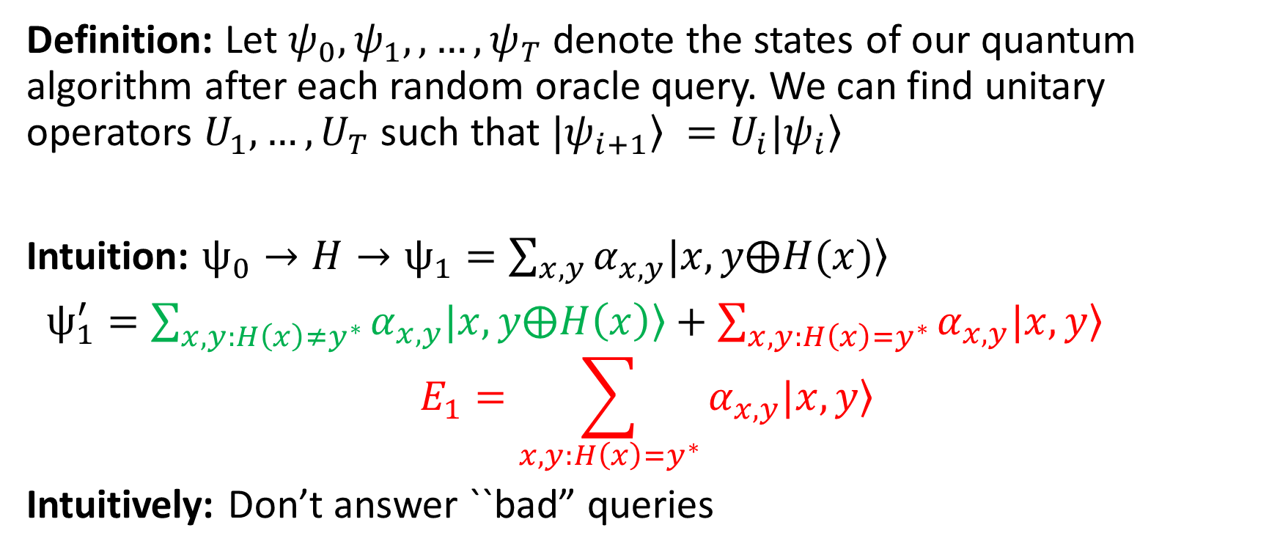
Quantum Computing: Useful Theorem (2)
Definition: Let $ψ_{0}, ψ_{1},,…,ψ_{T}$ denote the states of our quantum algorithm after each random oracle query. We can find unitary operators $U_{1},…,U_{T}$ such that $|\left.ψ_{i+1}\right\rangle =U_{i}|\left.ψ_{i}\right\rangle$
Intuition: $ψ_{0}→H→ψ_{1}=\sum_{x,y}{α_{x,y}|x,\left.y⨁H(x)\right\rangle }$
$ψ_{1}^{′}=\sum_{x,y:H\left(x\right)≠y^{∗}}{α_{x,y}|x,\left.y⨁H\left(x\right)\right\rangle }+\sum_{x,y:H\left(x\right)=y^{∗}}{α_{x,y}|x,\left.y\right\rangle }$
$$E_{1}=\sum_{x,y:H\left(x\right)=y^{∗}}{α_{x,y}|x,\left.y\right\rangle }$$
Intuitively: Don’t answer ``bad” queries

Slide 37
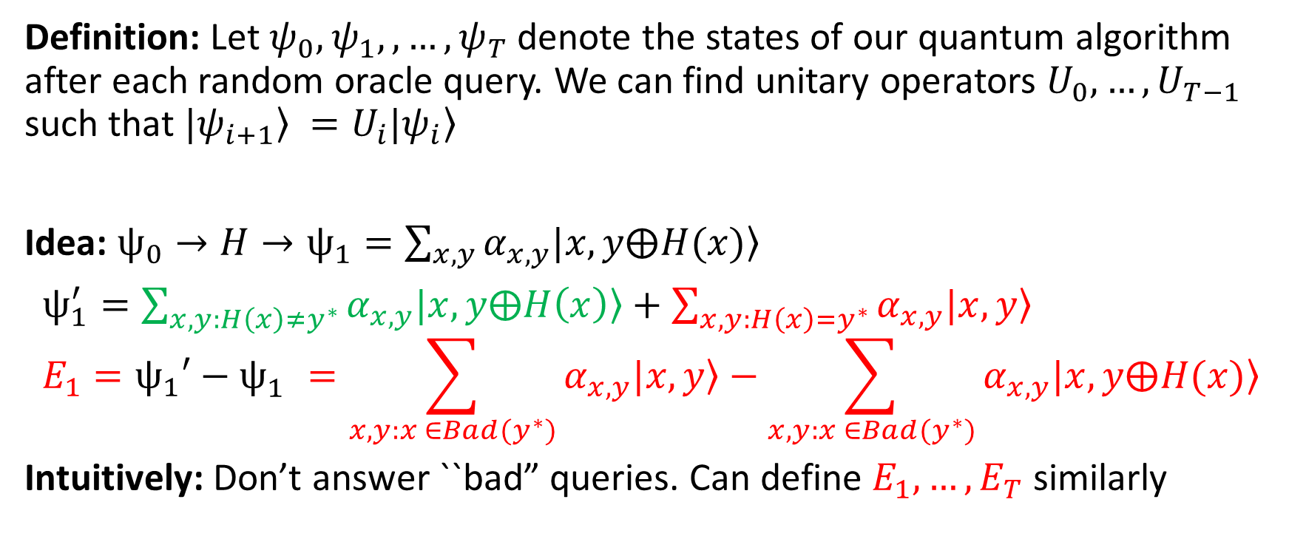
Quantum Computing: Useful Theorem (2)
Definition: Let $ψ_{0}, ψ_{1},,…,ψ_{T}$ denote the states of our quantum algorithm after each random oracle query. We can find unitary operators $U_{0},…,U_{T−1}$ such that $|\left.ψ_{i+1}\right\rangle =U_{i}|\left.ψ_{i}\right\rangle$
Idea: $ψ_{0}→H→ψ_{1}=\sum_{x,y}{α_{x,y}|x,\left.y⨁H(x)\right\rangle }$
$ψ_{1}^{′}=\sum_{x,y:H\left(x\right)≠y^{∗}}{α_{x,y}|x,\left.y⨁H\left(x\right)\right\rangle }+\sum_{x,y:H\left(x\right)=y^{∗}}{α_{x,y}|x,\left.y\right\rangle }$
$$E_{1}=ψ_{1}′−ψ_{1}^{}=\sum_{x,y:x ∈Bad(y^{∗})}{α_{x,y}|x,\left.y\right\rangle }−\sum_{x,y:x ∈Bad(y^{∗})}{α_{x,y}|x,\left.y⨁H(x)\right\rangle }$$
Intuitively: Don’t answer ``bad” queries. Can define $E_{1},…,E_{T}$ similarly

Slide 38
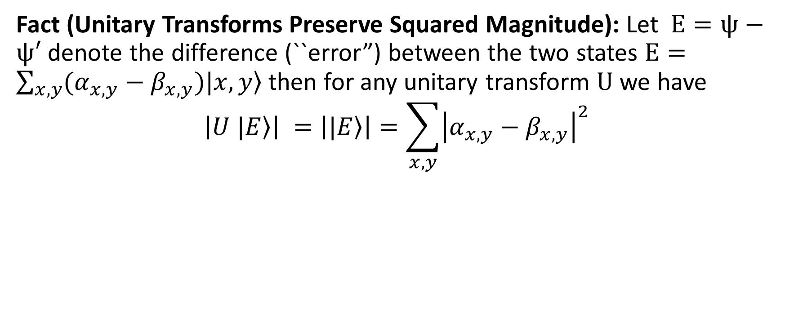
Quantum Computing: Useful Theorem (2)
Fact (Unitary Transforms Preserve Squared Magnitude): Let $E=ψ−ψ′$ denote the difference (``error”) between the two states $E=\sum_{x,y}{(α_{x,y}−β_{x,y})|x,\left.y\right\rangle }$ then for any unitary transform $U$ we have
$$\left|U \left.|E\right\rangle \right| =\left|\left.|E\right\rangle \right|=\sum_{x,y}{{\left|α_{x,y}−β_{x,y}\right|}^{2}}$$

Slide 39
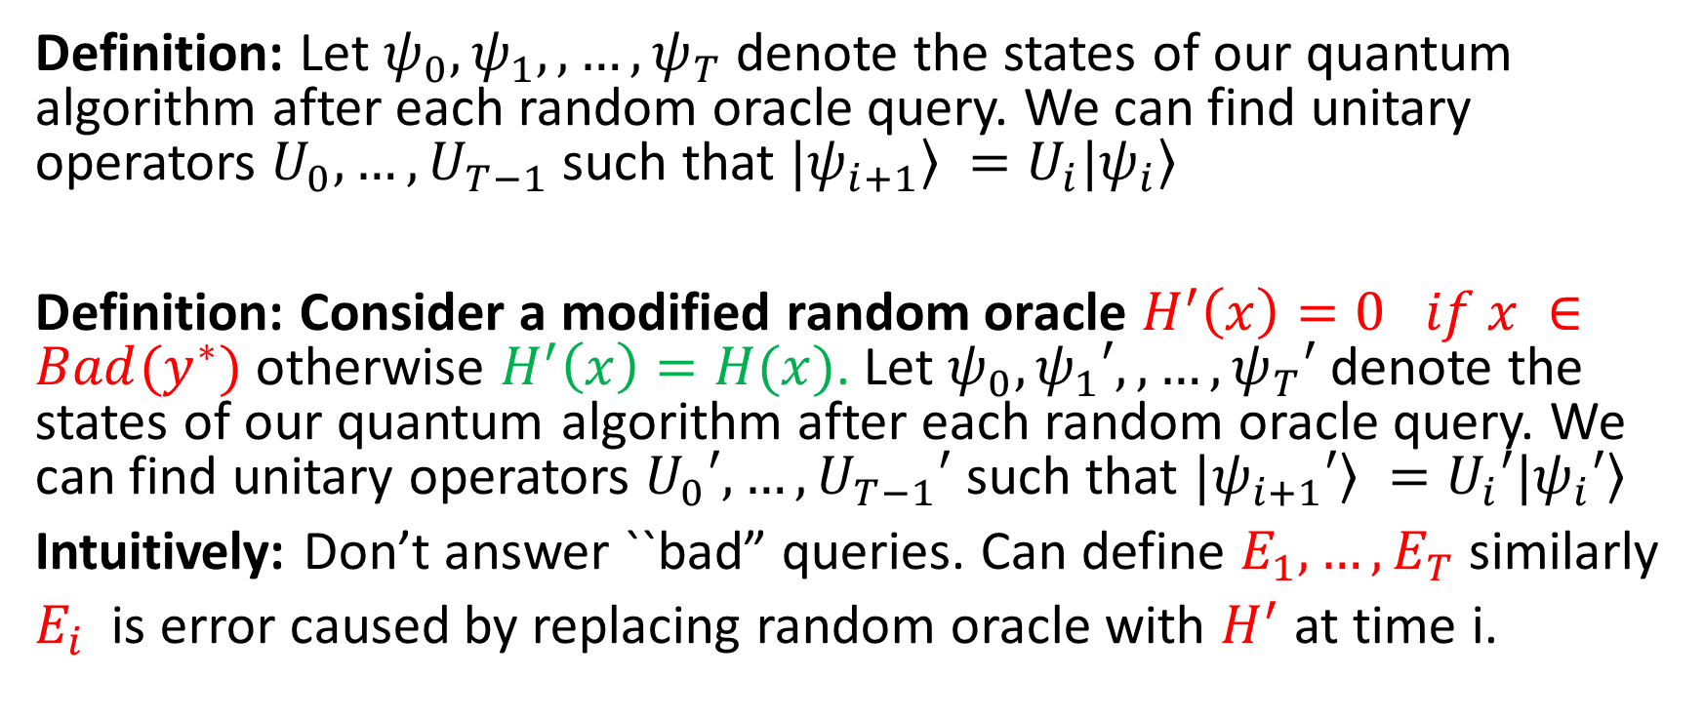
Quantum Computing: Useful Theorem (2)
Definition: Let $ψ_{0}, ψ_{1},,…,ψ_{T}$ denote the states of our quantum algorithm after each random oracle query. We can find unitary operators $U_{0},…,U_{T−1}$ such that $|\left.ψ_{i+1}\right\rangle =U_{i}|\left.ψ_{i}\right\rangle$
Definition: Consider a modified random oracle $H^{′}\left(x\right)=0 if x ∈Bad(y^{∗})$ otherwise $H^{′}\left(x\right)=H(x)$. Let $ψ_{0}, ψ_{1}′,,…,ψ_{T}′$ denote the states of our quantum algorithm after each random oracle query. We can find unitary operators $U_{0}′,…,U_{T−1}′$ such that $|\left.ψ_{i+1}′\right\rangle =U_{i}′|\left.ψ_{i}′\right\rangle$
Intuitively: Don’t answer ``bad” queries. Can define $E_{1},…,E_{T}$ similarly
$E_{i}$ is error caused by replacing random oracle with $H^{′}$ at time i.

Slide 40
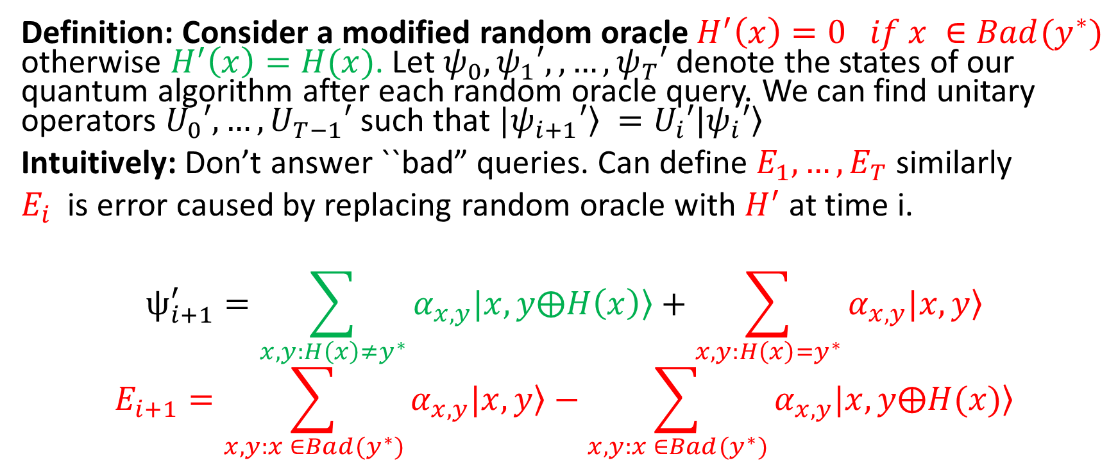
Quantum Computing: Useful Theorem (2)
Definition: Consider a modified random oracle $H^{′}\left(x\right)=0 if x ∈Bad(y^{∗})$ otherwise $H^{′}\left(x\right)=H(x)$. Let $ψ_{0}, ψ_{1}′,,…,ψ_{T}′$ denote the states of our quantum algorithm after each random oracle query. We can find unitary operators $U_{0}′,…,U_{T−1}′$ such that $|\left.ψ_{i+1}′\right\rangle =U_{i}′|\left.ψ_{i}′\right\rangle$
Intuitively: Don’t answer ``bad” queries. Can define $E_{1},…,E_{T}$ similarly
$E_{i}$ is error caused by replacing random oracle with $H^{′}$ at time i.
$$ψ_{i+1}^{′}=\sum_{x,y:H\left(x\right)≠y^{∗}}{α_{x,y}|x,\left.y⨁H\left(x\right)\right\rangle }+\sum_{x,y:H\left(x\right)=y^{∗}}{α_{x,y}|x,\left.y\right\rangle }$$
$$E_{i+1}=\sum_{x,y:x ∈Bad(y^{∗})}{α_{x,y}|x,\left.y\right\rangle }−\sum_{x,y:x ∈Bad(y^{∗})}{α_{x,y}|x,\left.y⨁H(x)\right\rangle }$$

Slide 41
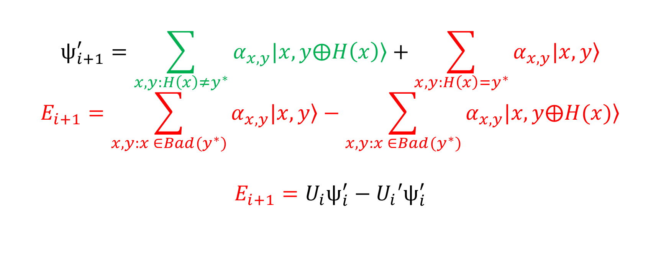
Quantum Computing: Useful Theorem (2)
$$ψ_{i+1}^{′}=\sum_{x,y:H\left(x\right)≠y^{∗}}{α_{x,y}|x,\left.y⨁H\left(x\right)\right\rangle }+\sum_{x,y:H\left(x\right)=y^{∗}}{α_{x,y}|x,\left.y\right\rangle }$$
$$E_{i+1}=\sum_{x,y:x ∈Bad(y^{∗})}{α_{x,y}|x,\left.y\right\rangle }−\sum_{x,y:x ∈Bad(y^{∗})}{α_{x,y}|x,\left.y⨁H(x)\right\rangle }$$
$$E_{i+1}=U_{i}ψ_{i}^{′}−U_{i}′ψ_{i}^{′}$$
Applied H
Applied H’

Slide 42
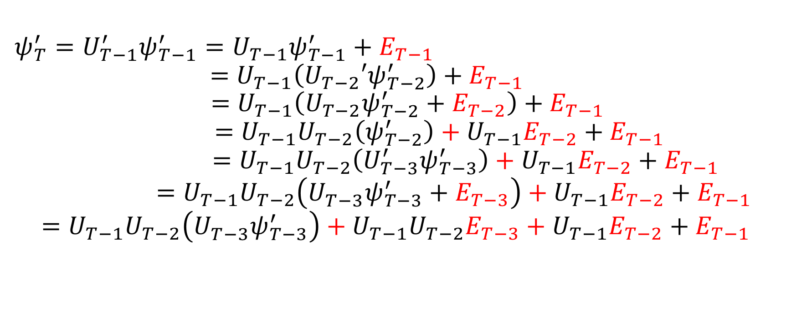
Quantum Computing: Useful Theorem (2)
$$ψ_{T}^{′}=U_{T−1}^{′}ψ_{T−1}^{′}=U_{T−1}ψ_{T−1}^{′}+E_{T−1}$$
$$=U_{T−1}\left({U_{T−2}′ψ}_{T−2}^{′}\right)+E_{T−1}$$
$$=U_{T−1}\left({U_{T−2}ψ}_{T−2}^{′}+E_{T−2}\right)+E_{T−1}$$
$$=U_{T−1}U_{T−2}\left(ψ_{T−2}^{′}\right)+U_{T−1}E_{T−2}+E_{T−1}$$
$$=U_{T−1}U_{T−2}\left(U_{T−3}^{′}ψ_{T−3}^{′}\right)+U_{T−1}E_{T−2}+E_{T−1}$$
$$=U_{T−1}U_{T−2}\left(U_{T−3}^{}ψ_{T−3}^{′}+E_{T−3}\right)+U_{T−1}E_{T−2}+E_{T−1}$$
$$=U_{T−1}U_{T−2}\left(U_{T−3}^{}ψ_{T−3}^{′}\right)+U_{T−1}U_{T−2}E_{T−3}+U_{T−1}E_{T−2}+E_{T−1}$$

Slide 43

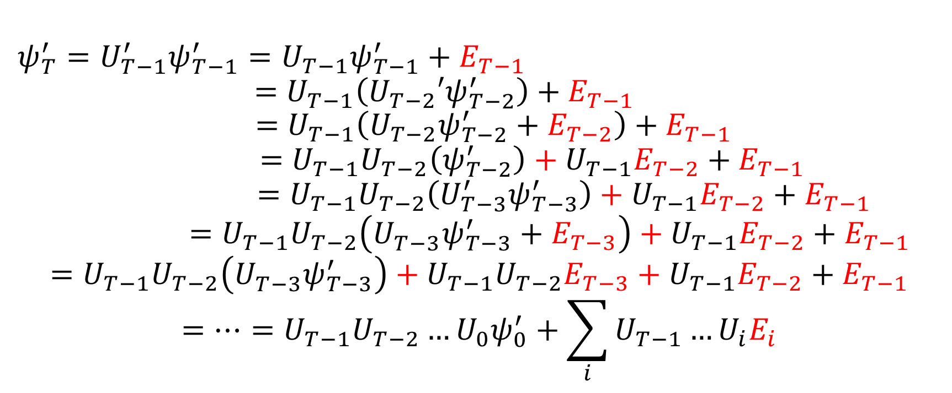
Quantum Computing: Useful Theorem (2)
$$ψ_{T}^{′}=U_{T−1}^{′}ψ_{T−1}^{′}=U_{T−1}ψ_{T−1}^{′}+E_{T−1}$$
$$=U_{T−1}\left({U_{T−2}′ψ}_{T−2}^{′}\right)+E_{T−1}$$
$$=U_{T−1}\left({U_{T−2}ψ}_{T−2}^{′}+E_{T−2}\right)+E_{T−1}$$
$$=U_{T−1}U_{T−2}\left(ψ_{T−2}^{′}\right)+U_{T−1}E_{T−2}+E_{T−1}$$
$$=U_{T−1}U_{T−2}\left(U_{T−3}^{′}ψ_{T−3}^{′}\right)+U_{T−1}E_{T−2}+E_{T−1}$$
$$=U_{T−1}U_{T−2}\left(U_{T−3}^{}ψ_{T−3}^{′}+E_{T−3}\right)+U_{T−1}E_{T−2}+E_{T−1}$$
$$=U_{T−1}U_{T−2}\left(U_{T−3}^{}ψ_{T−3}^{′}\right)+U_{T−1}U_{T−2}E_{T−3}+U_{T−1}E_{T−2}+E_{T−1}$$
$$=…=U_{T−1}U_{T−2}…U_{0}ψ_{0}^{′}+\sum_{i}{U_{T−1}…U_{i}E_{i}}$$
$$ψ_{0}^{′}=ψ_{0}^{}$$

Slide 44
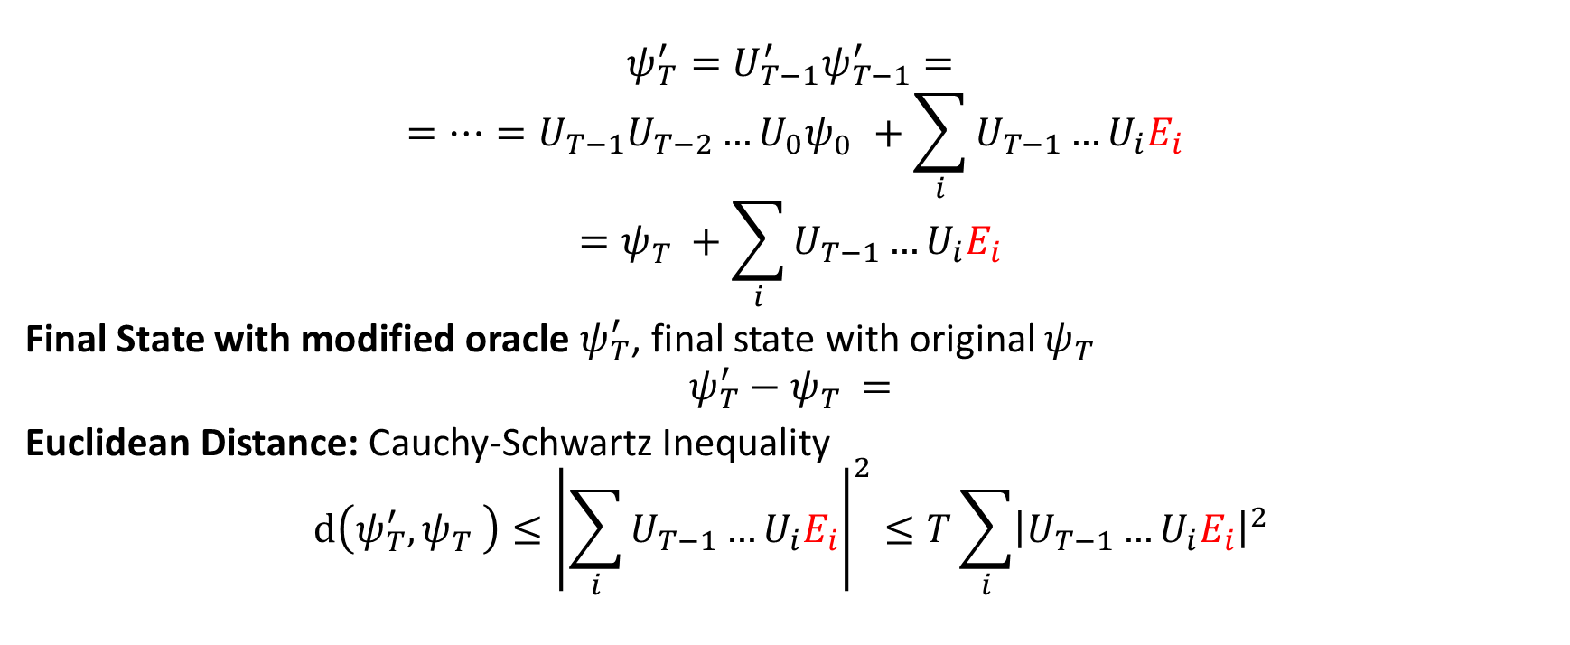
Quantum Computing: Useful Theorem (2)
$$ψ_{T}^{′}=U_{T−1}^{′}ψ_{T−1}^{′}=$$
$$=…=U_{T−1}U_{T−2}…U_{0}ψ_{0}^{}+\sum_{i}{U_{T−1}…U_{i}E_{i}}$$
$$=ψ_{T}^{}+\sum_{i}{U_{T−1}…U_{i}E_{i}}$$
Final State with modified oracle $ψ_{T}^{′}$, final state with original $ψ_{T}^{}$
$$ψ_{T}^{′}−ψ_{T}^{}=$$
Euclidean Distance: Cauchy-Schwartz Inequality
$$d\left(ψ_{T}^{′},ψ_{T}^{}\right)≤{\left|\sum_{i}{U_{T−1}…U_{i}E_{i}}\right|}^{2}≤T\sum_{i}{{\left|U_{T−1}…U_{i}E_{i}\right|}^{2}}$$

Slide 45
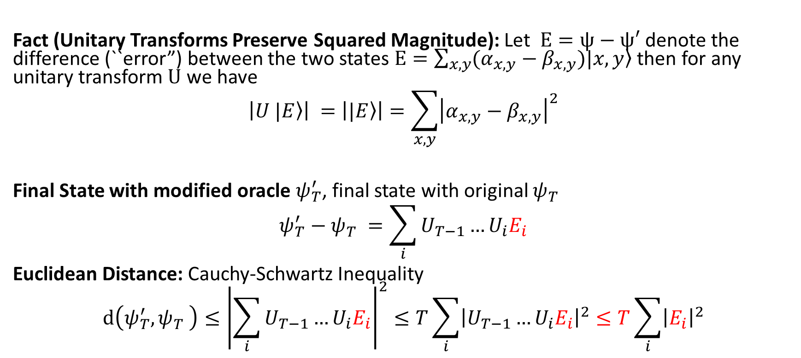
Quantum Computing: Useful Theorem (2)
Fact (Unitary Transforms Preserve Squared Magnitude): Let $E=ψ−ψ′$ denote the difference (``error”) between the two states $E=\sum_{x,y}{(α_{x,y}−β_{x,y})|x,\left.y\right\rangle }$ then for any unitary transform $U$ we have
$$\left|U \left.|E\right\rangle \right| =\left|\left.|E\right\rangle \right|=\sum_{x,y}{{\left|α_{x,y}−β_{x,y}\right|}^{2}}$$
Final State with modified oracle $ψ_{T}^{′}$, final state with original $ψ_{T}^{}$
$$ψ_{T}^{′}−ψ_{T}^{}=\sum_{i}{U_{T−1}…U_{i}E_{i}}$$
Euclidean Distance: Cauchy-Schwartz Inequality
$$d\left(ψ_{T}^{′},ψ_{T}^{}\right)≤{\left|\sum_{i}{U_{T−1}…U_{i}E_{i}}\right|}^{2}≤T\sum_{i}{{\left|U_{T−1}…U_{i}E_{i}\right|}^{2}}≤T\sum_{i}{{\left|E_{i}\right|}^{2}}$$

Slide 46
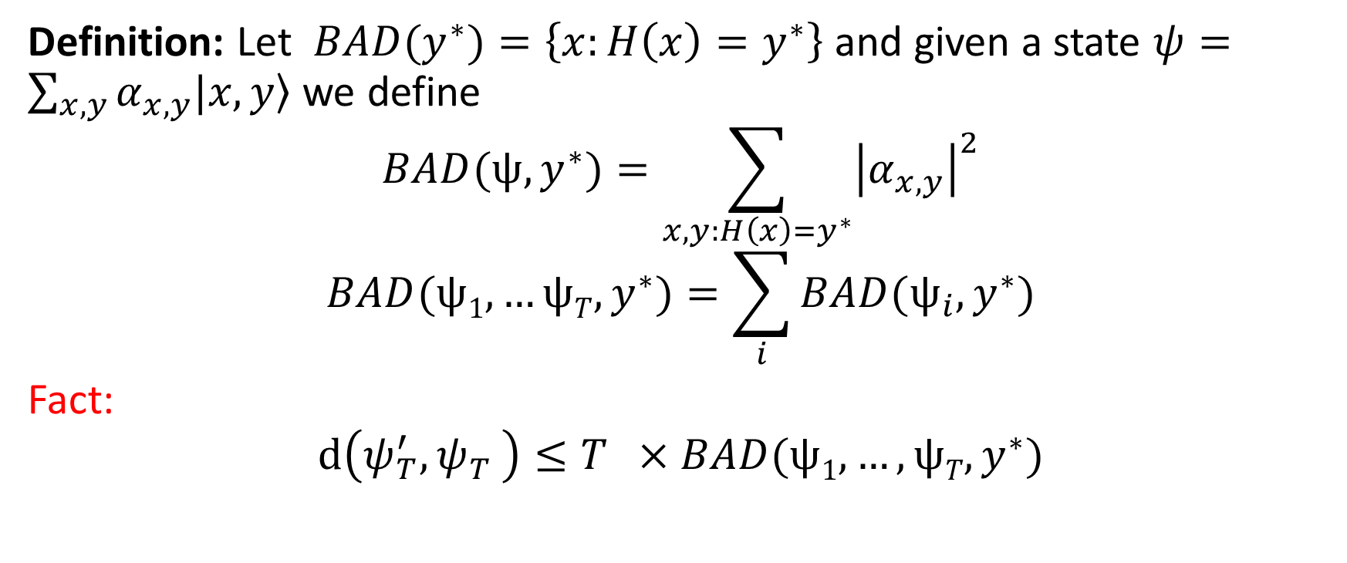
Quantum Computing: Useful Theorem (2)
Definition: Let $BAD(y^{∗})=\left\{x:H\left(x\right)=y^{∗}\right\}$ and given a state $ψ=\sum_{x,y}{α_{x,y}|x,\left.y\right\rangle }$ we define
$$BAD(ψ,y^{∗})=\sum_{x,y:H\left(x\right)=y^{∗}}{{\left|α_{x,y}\right|}^{2}}$$
$$BAD(ψ1,…ψT,y^{∗})=\sum_{i}{BAD(ψ_{i},y^{∗})}$$
Fact:
$$d\left(ψ_{T}^{′},ψ_{T}^{}\right)≤T ×BAD(ψ1,…,ψT,y^{∗})$$

Slide 47
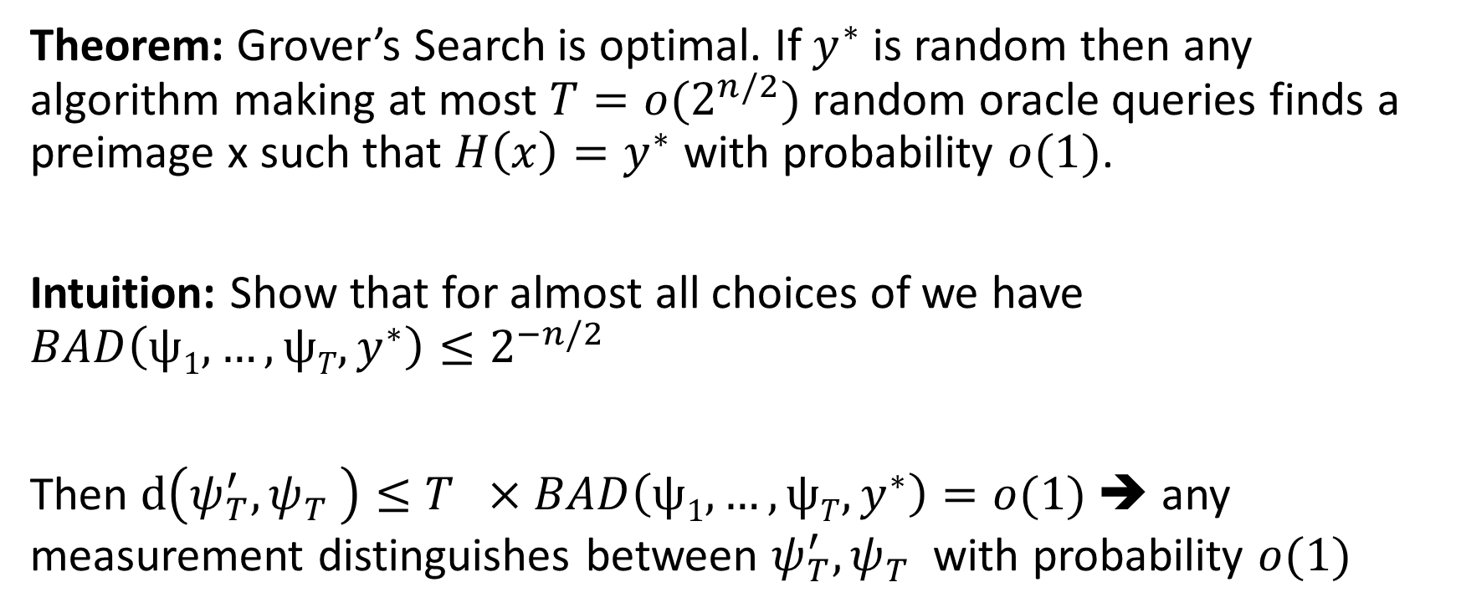
Quantum Computing: Useful Theorem (2)
Theorem: Grover’s Search is optimal. If $y^{∗}$ is random then any algorithm making at most $T=o(2^{n/2})$ random oracle queries finds a preimage x such that $H\left(x\right)=y^{∗}$ with probability $o(1)$.
Intuition: Show that for almost all choices of we have $BAD\left(ψ1,…,ψT,y^{∗}\right)≤2^{−n/2}$
Then $d\left(ψ_{T}^{′},ψ_{T}^{}\right)≤T ×BAD\left(ψ1,…,ψT,y^{∗}\right)=o(1)$ ➔ any measurement distinguishes between $ψ_{T}^{′},ψ_{T}^{}$ with probability $o(1)$

Slide 48

Quantum Computing: Useful Theorem (2)
Theorem: Grover’s Search is optimal. If $y^{∗}$ is random then any algorithm making at most $T=o(2^{n/2})$ random oracle queries finds a preimage x such that $H\left(x\right)=y^{∗}$ with probability $o(1)$.
Intuition: Show that for almost all choices of we have $BAD\left(ψ1,…,ψT,y^{∗}\right)≤2^{−n/2}$
Then $d\left(ψ_{T}^{′},ψ_{T}^{}\right)≤T ×BAD\left(ψ1,…,ψT,y^{∗}\right)=o(1)$ ➔ any measurement distinguishes between $ψ_{T}^{′},ψ_{T}^{}$ with probability $o(1)$
But $ψ_{T}^{′}$ uses random oracle H’ where information about preimages of $y^{∗}$are information theoretically hidden

Slide 50










How to Record Quantum Queries
and Applications to Quantum Indifferentiability
Mark Zhandry
Princeton University & NTT Research

Slide 51







































































This talk
xy
∑α_{x}ω_{N}

Slide 52





The (Classical) Random Oracle Model (ROM)
[Bellare-Rogaway’93]
hash function
Cryptosystem

Slide 53



The (Classical) Random Oracle Model (ROM)
[Bellare-Rogaway’93]
H
Cryptosystem

Slide 54











Typical ROM Proof: On-the-fly Simulation
Input Output
x₁ y₁
Query(x, D):
If (x,y)∈D: Return(y,D)
Else:
y ß$ Y
D’ = D+(x,y)
Return(y,D’)
H
x
y
2
2
x₃ y₃
x₄ y₄

Slide 55
Typical ROM Proof: On-the-fly Simulation
Allows us to:
Know the inputs adversary cares about ✓
Know the corresponding outputs
✓
(Adaptively) program the outputs ✓
Easy analysis of bad events (e.g. collisions) ✓

Slide 56





The Quantum Random Oracle Model (QROM)
[Boneh-Dagdelen-Fischlin-Lehmann-Schaffner-Z’11]
H
Now standard in post-quantum crypto

Slide 57








Problem with Classical Proofs in QROM
Input Output
x₁ y₁
How do we record the x values?
x₂ y₂
x₃ y₃
x₄ y₄

Slide 58


Problem with Classical Proofs in QROM
Observer Effect:
Learning anything about quantum system disturbs it
H
answers obliviously, so no disturbance
Reduction must answer obliviously, too?

Slide 59

Typical QROM Proof
H
H
H fixed once and for all at beginning

Slide 60
Limitations
Allows us to:
Know the inputs adversary cares about?
Know the corresponding outputs?
(Adaptively) program the outputs?
Easy analysis of bad events (e.g. collisions)?

Slide 61
Limitations
Allows us to:
Know the inputs adversary cares about? ✘
Know the corresponding outputs?
✘
(Adaptively) program the outputs?
✓/✘
Easy analysis of bad events (e.g. collisions)?✘

Slide 62
Limitations
Good News: Numerous positive results (30+ papers)
Bad News: Still some major holdouts
Indifferentiable domain extension
Fiat-Shamir
Luby-Rackoff
ROM è ICM

Slide 63
Example: Domain Extension for Random Oracles
Q: Does Merkle-Damgård preserve random oracle-ness?
x₁ x₂ x₃
x₄
MD_{h}
IV
h
h
h
h

Slide 64


Example: Domain Extension for Random Oracles
A: Yes(ish) [Coron-Dodis-Malinaud-Puniya’05]
How? Indifferentiability [Maurer-Renner-Holenstein’04]
Real World Ideal World
H
MD
h
≈
Sim
Thm [Ristenpart-Shacham-Shrimpton’11]: Indifferentiability ⇒ as good as RO for “single stage games”

Slide 65




Quantum Indifferentiability?
Concurrently considered by [Carstens-Ebrahimi-Tabia-Unruh’18]
Real World
Ideal World
H
h
MD
Sim

Slide 66

Quantum Indifferentiability?
_{A}E_{r}as_{e}y Th_{w}m:_{e}
Stateless simulation for domain extension is impossible,_{t}cl_{o}ass_{a}ica_{s}ll_{t}y o?r quantumly
[Carstens-Ebrahimi-Tabia-Unruh’18]:
Proof idea: Compr_{C}e_{o}s_{n}s_{je}t_{c}r_{tu}u_{r}t_{e}h_{ye}t_{s}able of random H

Slide 67
This Work:
On-the-fly simulation of quantum random oracles
(aka Compressed Oracles)

Slide 68


Step 1: Quantum-ify (aka Purify)
Quantum-ifying (aka purifying) random oracle:
+ now single quantum system
H
H
Reminiscent of old impossibilities for unconditional quantum protocols [Lo’97,Lo-Chau’97,Mayers’97,Nayak’99]

Slide 69



Step 1: Superposition of Oracles
Initial oracle state: H
H
Query(x, y, H): y = y⊕H(x)
Oracle’s state
Adversary’s query

Slide 70












Step 2: Look at Fourier Domain
H
Ĥ

Slide 71






Step 2: Look at Fourier Domain
Initial oracle state: Z(x) = 0
Query(x, y, Ĥ): Ĥ = Ĥ⊕P_{x,y}
Ĥ
y if x=x’ 0 else
P_{x,y}(x’) =
 | A
Proof:
Fourier Transform
A
-T

Slide 72






Step 3: Compress
Observation:
After q queries, Ĥ is non-zero on at most q points
Ĥ
^D

Slide 73

Step 3: Compress
Initial oracle state: {} Query(x, y, D^):
(1) If ∄(x,y’)∈^D: ^D = D^ +(x,0)
^D
(2) Replace (x,y’)∈^D
with (x,y’⊕y)
(3) If (x,0)∈^D: remove it

Slide 74








Step 4: Revert back to Primal Domain
D
^D

Slide 75






Step 4: Revert back to Primal Domain
Input Output
x₁ y₁
Roughly analogous to classical on-the- fly simulation
D
x₂ y₂
x₃ y₃
x₄ y₄
Points adversary cares about
≈Corresponding outputs

Slide 76
Compressed Oracles
Allows us to:
Know the inputs adversary cares about? ✓
Know the corresponding outputs?
✓
(Adaptively) program the outputs? ✘
Fixed by [Don-Fehr-Majenz-Schaffner’19,Liu-Z’19], later this session!
Easy analysis of bad events (e.g. collisions)?✓

Slide 77

So, what happened?
Recall…
Observer Effect:
Learning anything about quantum system disturbs it
H
learns about through queries
H
gets disturbed
Compressed oracles decode such disturbance

Slide 78
Caveats
Outputs in database ≠0 in Fourier domain
y values aren’t exactly query outputs
Examining x,y values perturbs state
Still must be careful about how we use them
But, still good enough for many applications…

Slide 79
Applications In This Work
Quantum Indiff. of Merkle-Damgård
Easily re-prove quantum lower bounds: Ω(N^{1/2}) queries needed for Grover search Ω(N^{1/3}) queries needed for collision finding Ω(N^{1/(k+1)}) queries needed for k-SUM
CCA-security of plain Fujisaki-Okamoto

Slide 80

Further Applications
[Alagic-Majenz-Russell-Song’18]:
Quantum-secure signature separation [Liu-Z’19a]: Tight bounds
for multi-collision problem
[Liu-Z’19b]: Fiat-Shamir
( [Don-Fehr-Majenz-Schaffner’19]: direct proof )
[Czajkowski-Majenz-Schaffner-Zur’19]:
Indifferentiability of Sponge
[Hosoyamada-Iwata’19]:
[Chiesa-Manohar-Spooner’19]: zk-SNARKs
4-round Luby-Rackoff
[Bindel-Hamburg-Hülsing-Persichetti’19]: Tighter CCA security proofs

Slide 81







Lessons Learned
Always purify your oracles!

Slide 82

Thanks for Listening

