Slide 1
Advanced Cryptography
CS 655
Week 1:
Course Overview & Policy
Review
Concrete Security Analysis
Spring 2023

Slide 2
Topic 0: Course Overview

Slide 3
Course Resources
Instructor: Jeremiah Blocki
Office Hours: Thursdays from 4:30-6:30PM
TA: Mohammad Hassan Ameri
Office Hours: TBD (Poll)
Course Web Page: Slides, homeworks and schedule https://www.cs.purdue.edu/homes/jblocki/courses/655_Spring23/index.html

Slide 4
Technology
Brightspace
  Syllabus (You are responsible for reading and understanding course policies)
  Grades
Gradescope
  Submit homework assignments
  View Graded Assignments and Exams
Piazza
  Course Discussion Board
  Announcements/Questions
  Preferred method of communication
  https://piazza.com/purdue/spring2023/cs655/home

Slide 5
Grades
Course Project: 30%
Homework: 20%
Midterm Exam: 15%
Final Exam: 25%
Course Presentation: 10%
Collaboration is permitted on homework assignments, but you completely understand your solutions and you must write the solutions entirely in your own words.
No collaboration on exams

Slide 6
Expected Background
Prerequisites: CS555 (or equivalent) and CS 526
We will assume mathematical maturity
  Ability to Write Proofs
  Ability to Understand/Interpret Crypto Definitions
  Security Reductions
  Probability Theory
  Combinatorics
  Counting

Slide 7
Course Topics (Tentative)
The course will review several cutting edge research topics in the field of cryptography.
Cryptography is a big field ➔ There will be many interesting topics that we cannot cover.
Tentative List of Topics: Concrete Security Analysis, Idealized Models, Preprocessing Attacks and Lower Bounds, Proofs of Space, Proofs of Sequential Work, Verifiable Delay Functions, Memory Tight Reductions, Memory Hard Functions, Oblivious RAM, Obfuscation + Applications, Differential Privacy, Functional Secret Sharing, Quantum Random Oracle Model + Compressed Oracles, Differential Privacy, Fully Homomorphic Encryption

Slide 8
Homeworks (20%)
  There will be between 4 to 6 homework assignments. Homeworks must be submitted via Gradescope before the stated deadline.
  You should typeset your assignment (preferably using LaTeX). It is ok to include handdrawn figures in your pdf.
  You are encouraged to collaborate with others, but you must completely understand your solution and you should cite any resources that you use
  Late Policy:
    On Time: No penalty
    < 1 Day Late: 10-point penalty
    < 2 Days Late: 25-point penalty
    > 2 days late: no credit

Slide 9
Course Presentation (10%)
  Pick a recent paper (last 15 years) from a cryptography conference and give a 15 minute presentation in class
    12 minutes for presentation + 3 minutes for questions
  Suggested conferences include CRYPTO, EUROCRYPT, TCC, ASIACRYPT.
  If you would like to pick a crypto paper from another venue (e.g., S&P, CCS) you will need to verify that the focus of the paper is crypto and then request permission from the instructor.

Slide 10
Course Project (30%)
  Project Proposal: 5%
  Progress Report: 5%
  Final Project Report: 10%
  Final Project Presentation: 10%
  We will provide some ideas for projects. You are also welcome to propose your own topics.
    Example: New security analysis of ___ construction
      Example Twists: Tighter Security Analysis in Ideal Model? Memory-Tight Reduction? Security proof in Quantum Random Oracle Model?
    Implementation: pick a recent crypto construction and implement it

Slide 11
Topic 1: Review

Slide 12
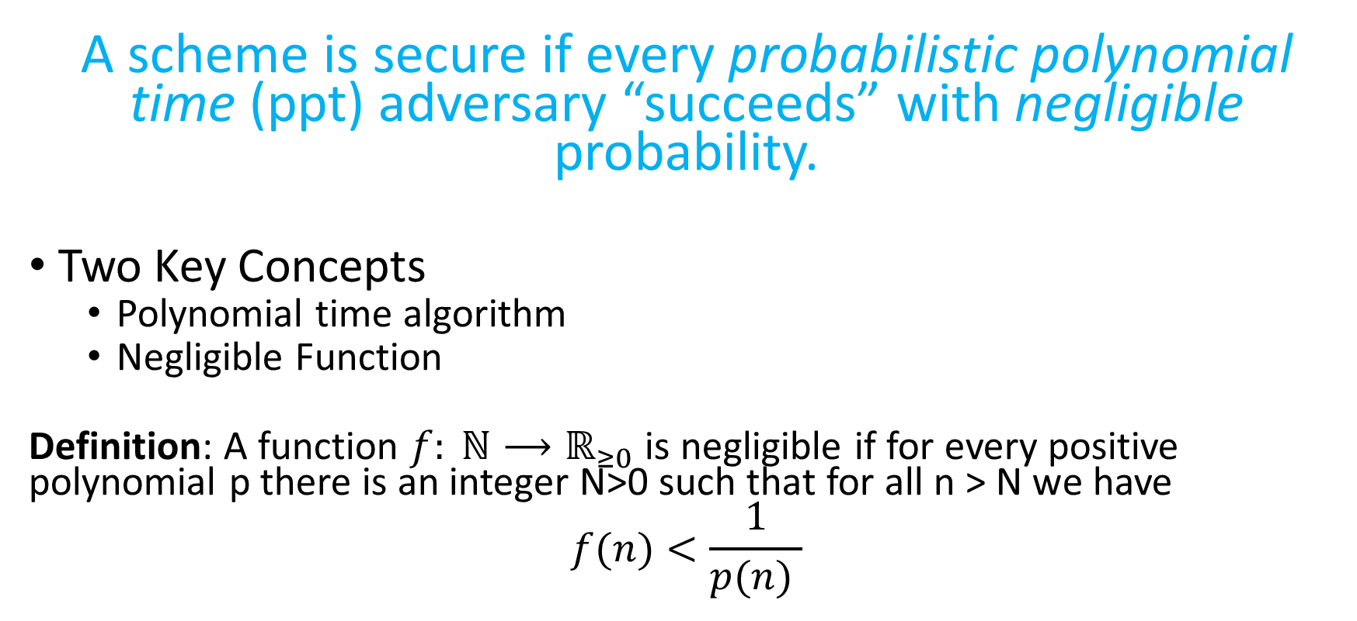
Asymptotic Approach to Security
A scheme is secure if every probabilistic polynomial time (ppt) adversary “succeeds” with negligible probability.
Two Key Concepts
  Polynomial time algorithm
  Negligible Function
Definition: A function $f: ℕ⟶ℝ_{≥0}$ is negligible if for every positive polynomial p there is an integer N>0 such that for all n > N we have
$$f(n)<\frac{1}{p(n) }$$

Slide 13
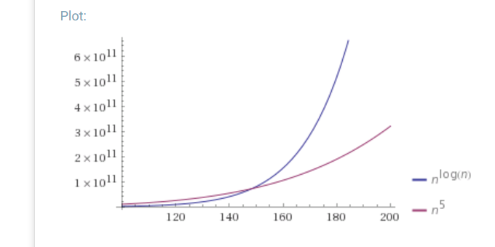

Asymptotic Approach to Security
Definition: A function $f: ℕ⟶ℝ_{≥0}$ is negligible if for every positive polynomial p there is an integer N>0 such that for all n > N we have
$$f(n)<\frac{1}{p(n) }$$
Which functions below are negligible?
${f\left(n\right)=2}^{−n}$
$f\left(n\right)=n^{−5}$
$f\left(n\right)={2^{−1000}1000n}^{1000}$
${f\left(n\right)=2^{100}2}^{−\sqrt{n}}$
${f\left(n\right)=2}^{−\log{n}}$
${f\left(n\right)=n}^{−\log{n}}$

Slide 14
Concrete Security
  “A scheme is (t,ε)-secure if every adversary running for time at most t succeeds in breaking the scheme with probability at most ε”
Example: t = 2⁶⁰ CPU cycles
  9 years on a 4GHz processor
  < 1 minute on fastest supercomputer (in parallel)
Full formal definition needs to specify “break”
Important Metric in Practice
  Caveat 1: difficult to provide/prove such precise statements
  Caveat 2: hardware improves over time

Slide 15
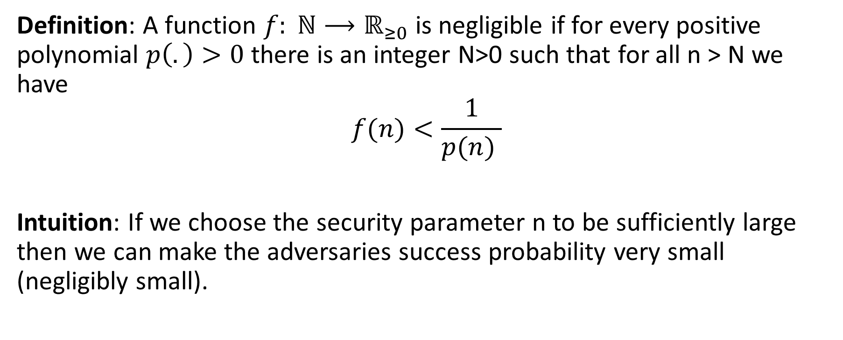
Asymptotic Approach to Security
Definition: A function $f: ℕ⟶ℝ_{≥0}$ is negligible if for every positive polynomial $p\left(.\right)>0$ there is an integer N>0 such that for all n > N we have
$$f(n)<\frac{1}{p(n) }$$
Intuition: If we choose the security parameter n to be sufficiently large then we can make the adversaries success probability very small (negligibly small).

Slide 16
Symmetric Key Building Blocks
Pseudorandom Generator
Pseudorandom Functions
Pseudorandom Permutations + Block Ciphers
Message Authentication Codes
Hash Functions
CPA-Secure Encryption
Authenticated Encryption

Slide 17
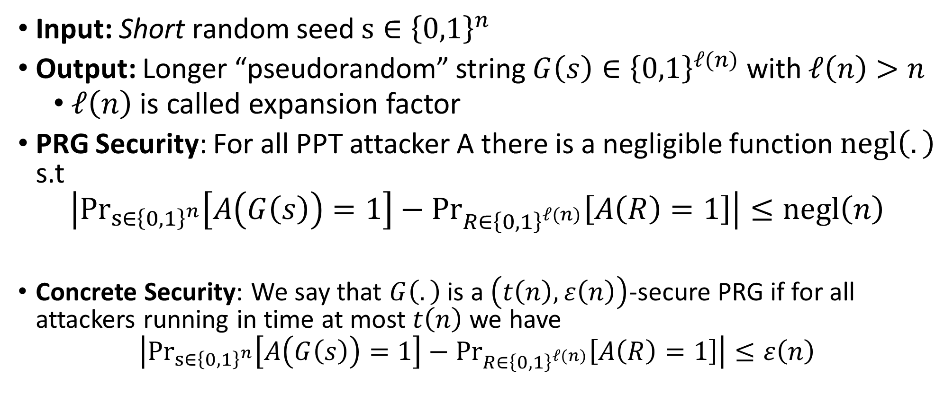
Pseudorandom Generator (PRG) G
Input: Short random seed $s∈{\left\{0,1\right\}}^{n}$
Output: Longer “pseudorandom” string $G\left(s\right)∈{\left\{0,1\right\}}^{ℓ(n)}$ with $ℓ\left(n\right)>n$
  $ℓ\left(n\right)$ is called expansion factor
PRG Security: For all PPT attacker A there is a negligible function $negl\left(.\right)$ s.t
$$\left|{Pr}_{s∈{\left\{0,1\right\}}^{n}}\left[A\left(G\left(s\right)\right)=1\right]−{Pr}_{R∈{\left\{0,1\right\}}^{ℓ(n)}}⁡\left[A\left(R\right)=1\right]\right|≤negl\left(n\right)$$
Concrete Security: We say that $G\left(.\right)$ is a $\left(t\left(n\right),ε\left(n\right)\right)$-secure PRG if for all attackers running in time at most $t\left(n\right)$ we have
$$\left|{Pr}_{s∈{\left\{0,1\right\}}^{n}}\left[A\left(G\left(s\right)\right)=1\right]−{Pr}_{R∈{\left\{0,1\right\}}^{ℓ(n)}}⁡\left[A\left(R\right)=1\right]\right|≤ε\left(n\right)$$

Slide 18
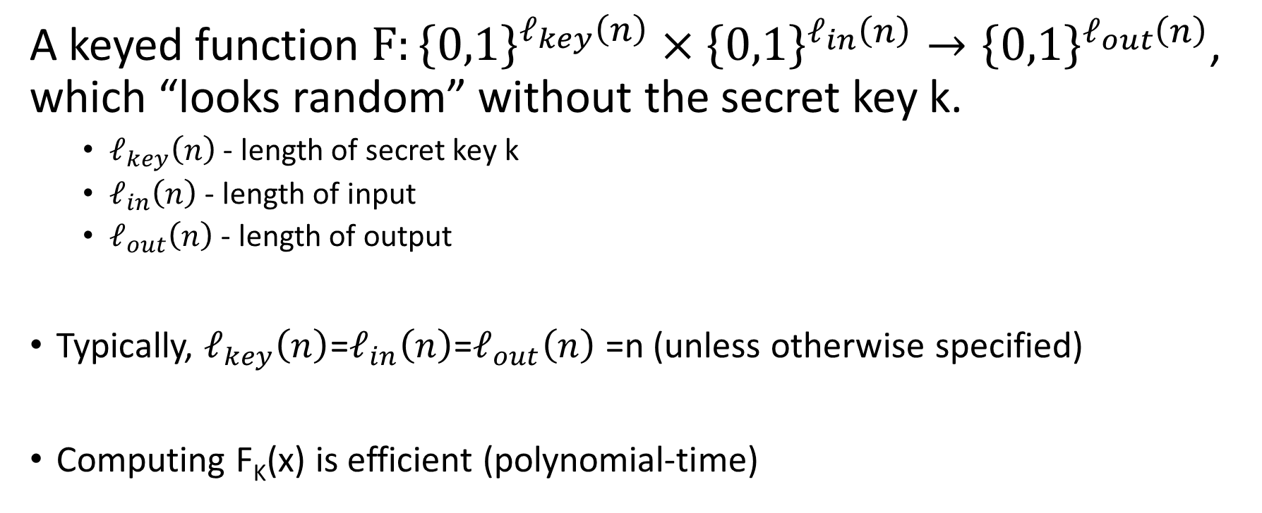
Pseudorandom Function (PRF)
A keyed function $F:{\left\{0,1\right\}}^{ℓ_{key}\left(n\right)}×{\left\{0,1\right\}}^{ℓ_{in}\left(n\right)}→{\left\{0,1\right\}}^{ℓ_{out}\left(n\right)}$, which “looks random” without the secret key k.
  $ℓ_{key}\left(n\right)$ - length of secret key k
  $ℓ_{in}\left(n\right)$ - length of input
  $ℓ_{out}\left(n\right)$ - length of output
Typically, $ℓ_{key}\left(n\right)$=$ℓ_{in}\left(n\right)$=$ℓ_{out}\left(n\right)$ =n (unless otherwise specified)
Computing F_{K}(x) is efficient (polynomial-time)

Slide 19
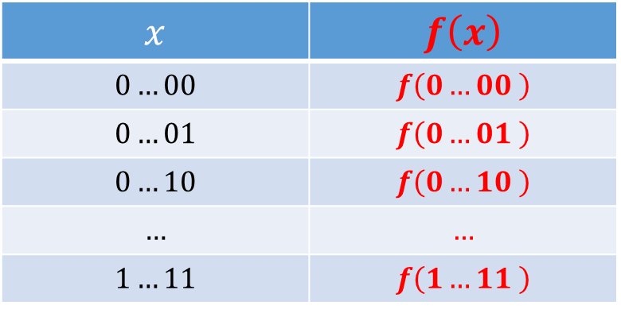
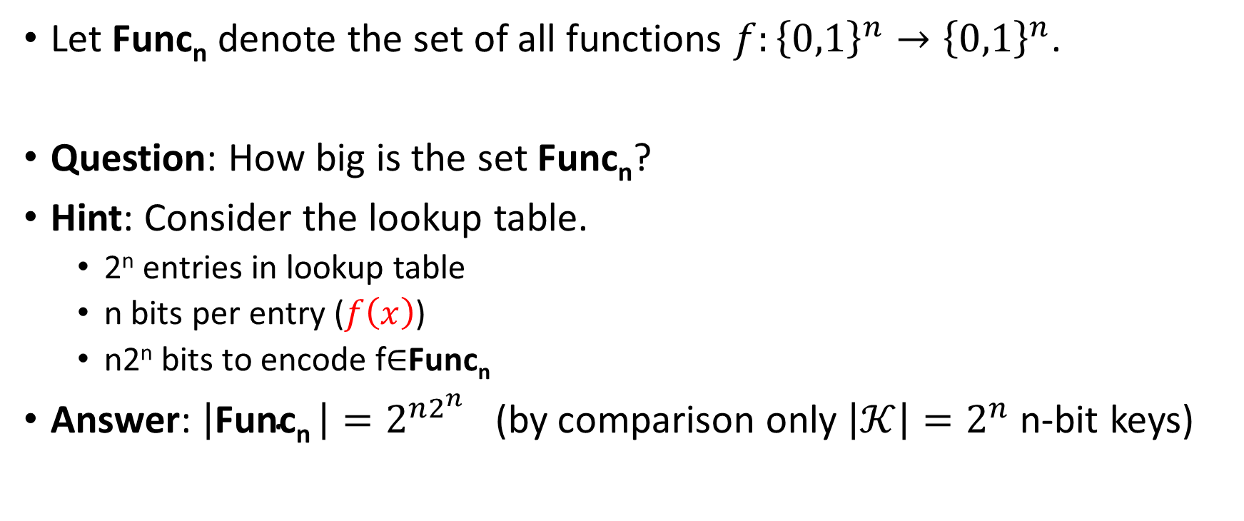

Truly Random Function
Let Func_{n} denote the set of all functions ${f:\left\{0,1\right\}}^{n}→{\left\{0,1\right\}}^{n}$.
Question: How big is the set Func_{n}?
Hint: Consider the lookup table.
  2^{n} entries in lookup table
  n bits per entry ($f\left(x\right)$)
  n2^{n} bits to encode f$∈$Func_{n}
Answer: $\left|\text{Func}\text{n} \right|=2^{n2^{n}}$ (by comparison only $\left|𝒦\right|=2^{n}$ n-bit keys)
$$x$$ | $$f\left(x\right)$$
$$0…00$$ | $$f\left(0…00 \right)$$
$$0…01$$ | $$f\left(0…01 \right)$$
$$0…10$$ | $$f\left(0…10 \right)$$
$$…$$ | $$…$$
$$1…11$$ | $$f\left(1…11 \right)$$
$$2^{n}$$

Slide 20
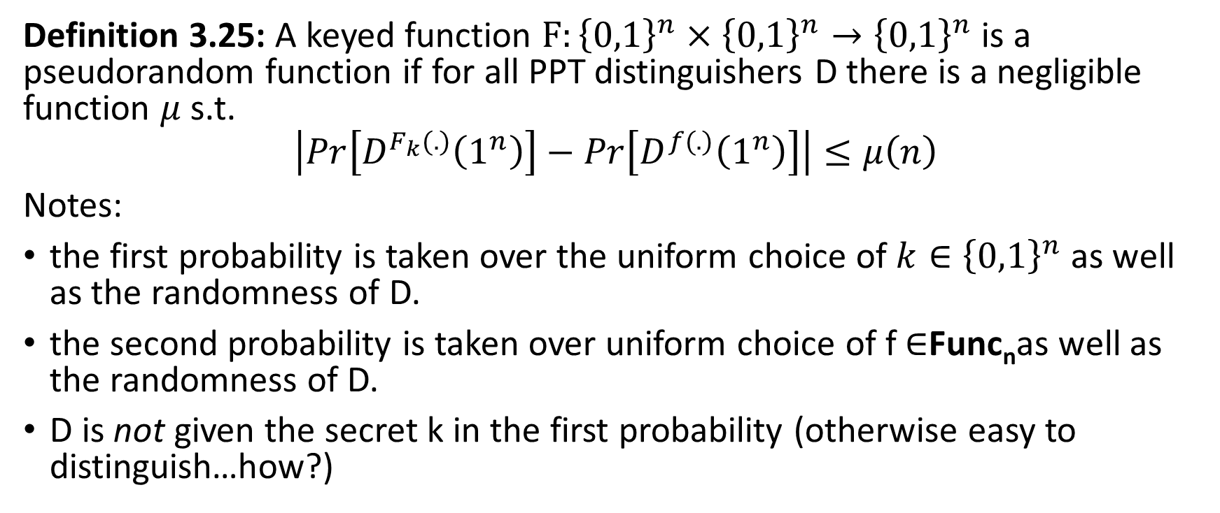
PRF Security
Definition 3.25: A keyed function $F:{\left\{0,1\right\}}^{n}×{\left\{0,1\right\}}^{n}→{\left\{0,1\right\}}^{n}$ is a pseudorandom function if for all PPT distinguishers D there is a negligible function $μ$ s.t.
$$\left|Pr\left[D^{F_{k}(.)}\left(1^{n}\right)\right]−Pr\left[D^{f(.)}\left(1^{n}\right)\right]\right|≤μ\left(n\right)$$
Notes:
the first probability is taken over the uniform choice of ${k∈\left\{0,1\right\}}^{n}$ as well as the randomness of D.
the second probability is taken over uniform choice of f $∈$Func_{n}as well as the randomness of D.
D is not given the secret k in the first probability (otherwise easy to distinguish…how?)

Slide 21
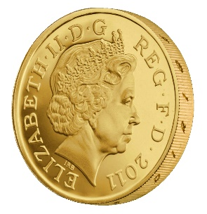
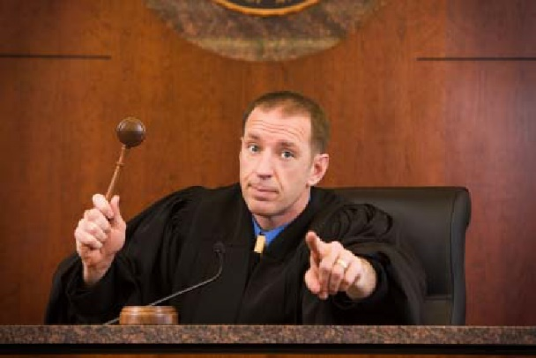


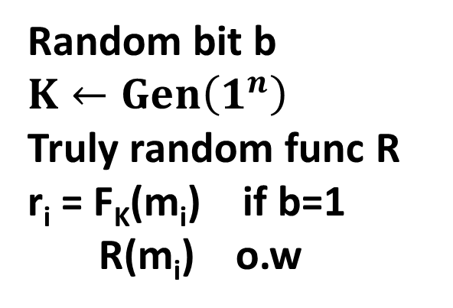
PRF-Security as a Game
m₁
r₁
m₂
r₂
m₃
r₃
…
$$∀PPT A ∃μ (negligible) s.t$$
$$Pr\left[A Guesses b^{′}=b\right]≤\frac{1}{2}+μ(n)$$
b’
Random bit b
$K←Gen\left(1^{n}\right)$
Truly random func R
r_{i} = F_{K}(m_{i}) if b=1
R(m_{i}) o.w

Slide 22
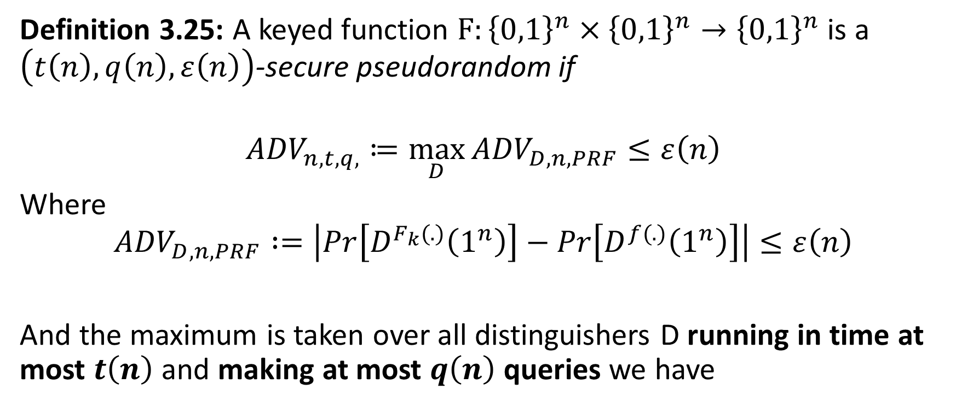
PRF Security Concrete Version
Definition 3.25: A keyed function $F:{\left\{0,1\right\}}^{n}×{\left\{0,1\right\}}^{n}→{\left\{0,1\right\}}^{n}$ is a $\left(t\left(n\right),q\left(n\right),ε\left(n\right)\right)$-secure pseudorandom if
$${ADV}_{n,t,q,}≔\max_{D}{{ADV}_{D,n,PRF}}≤ε\left(n\right)$$
Where
$${ADV}_{D,n,PRF} :=\left|Pr\left[D^{F_{k}(.)}\left(1^{n}\right)\right]−Pr\left[D^{f(.)}\left(1^{n}\right)\right]\right|≤ε\left(n\right)$$
And the maximum is taken over all distinguishers D running in time at most $t\left(n\right)$ and making at most $q\left(n\right)$ queries we have

Slide 23
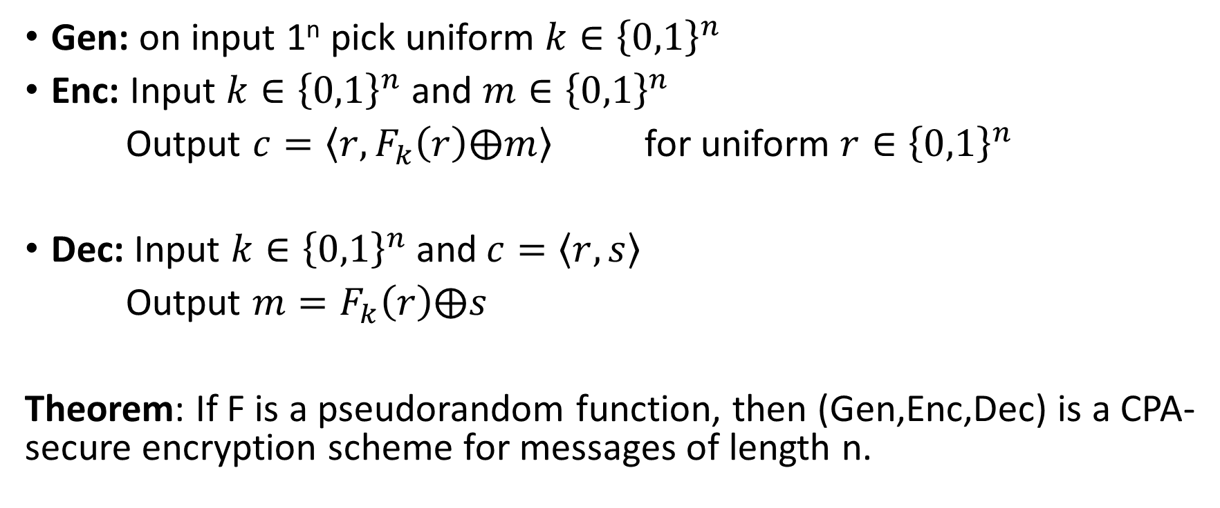
CPA-Secure Encryption
Gen: on input 1^{n} pick uniform ${k∈\left\{0,1\right\}}^{n}$
Enc: Input ${k∈\left\{0,1\right\}}^{n}$ and ${m∈\left\{0,1\right\}}^{n}$
Output $c=\left\langle r,F_{k}\left(r\right)⨁m\right\rangle$ for uniform ${r∈\left\{0,1\right\}}^{n}$
Dec: Input ${k∈\left\{0,1\right\}}^{n}$ and$c=\left\langle r,s\right\rangle$
Output $m=F_{k}\left(r\right)⨁s$
Theorem: If F is a pseudorandom function, then (Gen,Enc,Dec) is a CPA-secure encryption scheme for messages of length n.
How to begin proof?

Slide 24




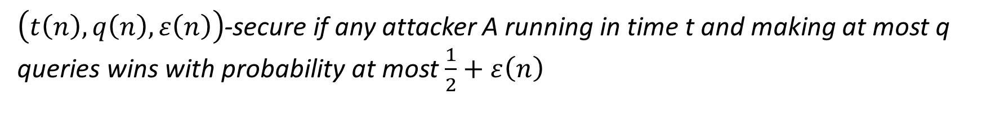
CPA-Security Game (Single Message Version)
m₀,m₁
$$\left\langle r,F_{k}\left(r\right)⨁m_{b}\right\rangle$$
m₂
$$\left\langle r_{2},F_{k}\left(r_{2}\right)⨁m_{2}\right\rangle$$
m₃
$$\left\langle r_{3},F_{k}\left(r_{3}\right)⨁m_{3}\right\rangle$$
…
b’
Random bit b
$$K←Gen\left(1^{n}\right)$$
$\left(t\left(n\right),q\left(n\right),ε\left(n\right)\right)$-secure if any attacker A running in time t and making at most q queries wins with probability at most $\frac{1}{2}+ε\left(n\right)$

Slide 25

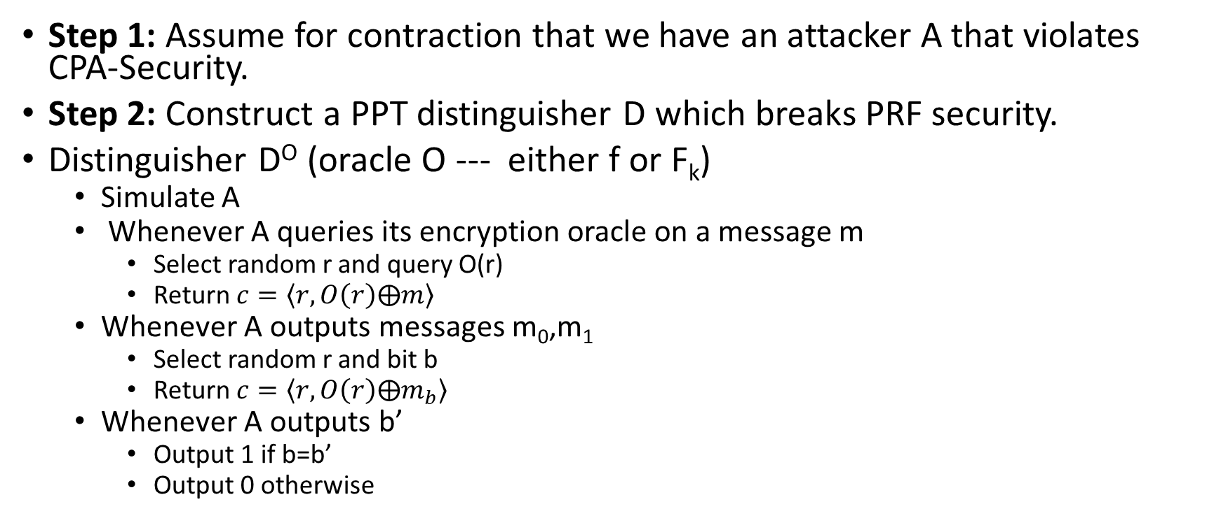
Security Reduction
Step 1: Assume for contraction that we have an attacker A that violates CPA-Security.
Step 2: Construct a PPT distinguisher D which breaks PRF security.
Distinguisher D^{O} (oracle O --- either f or F_{k})
  Simulate A
  Whenever A queries its encryption oracle on a message m
    Select random r and query O(r)
    Return $c=\left\langle r,O\left(r\right)⨁m\right\rangle$
  Whenever A outputs messages m₀,m₁
    Select random r and bit b
    Return $c=\left\langle r,O\left(r\right)⨁m_{b}\right\rangle$
  Whenever A outputs b’
    Output 1 if b=b’
    Output 0 otherwise
Analysis: Suppose that O = f then
$\text{Pr}\left[{\text{D}}^{F_{k}}=1\right]\text{=} \text{Pr}\left[{PrivK}_{A,Π }^{cpa}=1\right]$
Suppose that O = f then
$$\text{Pr}\left[{\text{D}}^{f}=\text{1}\right]\text{=}\text{Pr}\left[{PrivK}_{A,\tilde{Π} }^{cpa}=1\right]$$
where $\tilde{Π}$ denotes the encryption scheme in which F_{k} is replaced by truly random f.

Slide 26
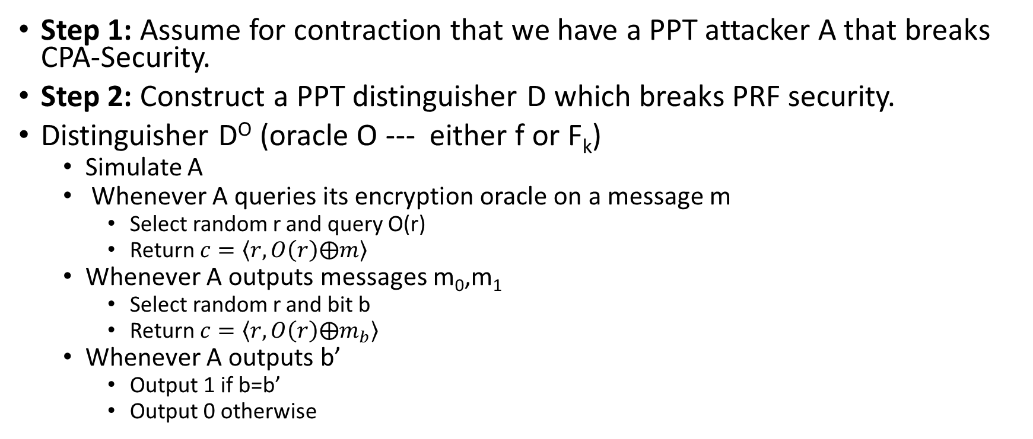

Security Reduction
Step 1: Assume for contraction that we have a PPT attacker A that breaks CPA-Security.
Step 2: Construct a PPT distinguisher D which breaks PRF security.
Distinguisher D^{O} (oracle O --- either f or F_{k})
  Simulate A
  Whenever A queries its encryption oracle on a message m
    Select random r and query O(r)
    Return $c=\left\langle r,O\left(r\right)⨁m\right\rangle$
  Whenever A outputs messages m₀,m₁
    Select random r and bit b
    Return $c=\left\langle r,O\left(r\right)⨁m_{b}\right\rangle$
  Whenever A outputs b’
    Output 1 if b=b’
    Output 0 otherwise
Analysis: By PRF security, we have
$$\left|\text{Pr}\left[{PrivK}_{A,Π }^{cpa}=1\right]−\text{Pr}\left[{PrivK}_{A,\tilde{Π} }^{cpa}=1\right]\right|=\left|\text{Pr}\text{[}{\text{D}}^{F_{k}}=1\text{]}−\text{Pr}\text{[}{\text{D}}^{f}=1\text{]}\right|≤{ADV}_{D,n,PRF}$$
Implies: $\text{Pr}\left[{PrivK}_{A,\tilde{Π} }^{cpa}=1\right]≥\text{Pr}\left[{PrivK}_{A,Π }^{cpa}=1\right]−{ADV}_{D,n,PRF}$

Slide 27
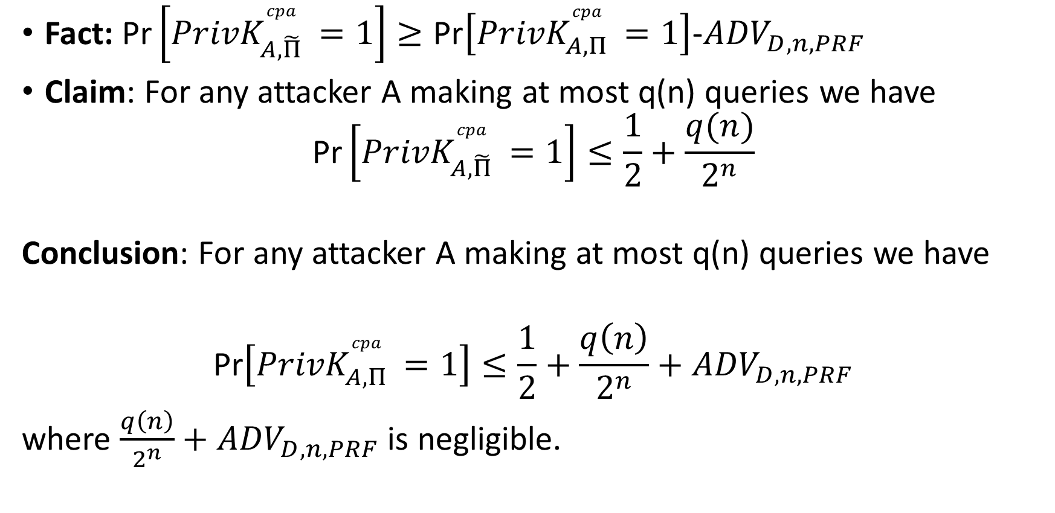
Security Reduction
Fact: $\text{Pr}\left[{PrivK}_{A,\tilde{Π} }^{cpa}=1\right]≥\text{Pr}\left[{PrivK}_{A,Π }^{cpa}=1\right]$-${ADV}_{D,n,PRF}$
Claim: For any attacker A making at most q(n) queries we have
$$\text{Pr}\left[{PrivK}_{A,\tilde{Π} }^{cpa}=1\right]≤\frac{1}{2}+\frac{q(n)}{2^{n}}$$
Conclusion: For any attacker A making at most q(n) queries we have
$$\text{Pr}\left[{PrivK}_{A,Π }^{cpa}=1\right]≤\frac{1}{2}+\frac{q\left(n\right)}{2^{n}}+{ADV}_{D,n,PRF}$$
where $\frac{q\left(n\right)}{2^{n}}+{ADV}_{D,n,PRF}$ is negligible.

Slide 28
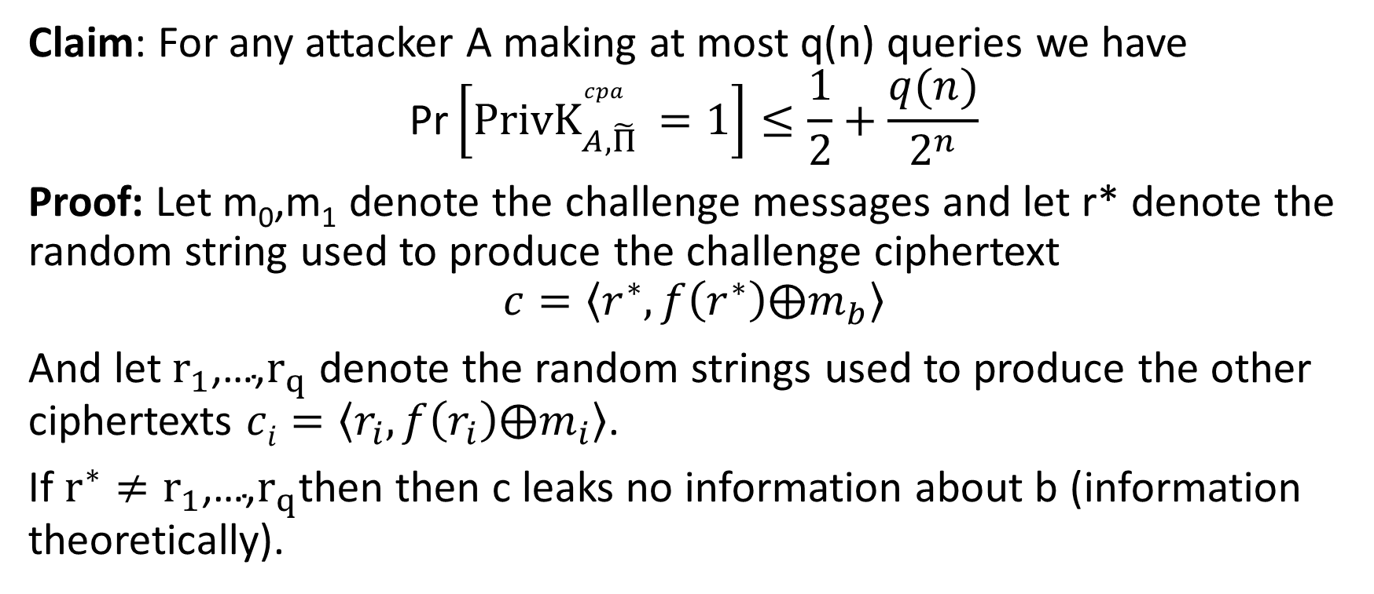
Finishing Up
Claim: For any attacker A making at most q(n) queries we have
$$\text{Pr}\left[{PrivK}_{A,\tilde{Π} }^{cpa}=1\right]≤\frac{1}{2}+\frac{q(n)}{2^{n}}$$
Proof: Let m₀,m₁ denote the challenge messages and let r* denote the random string used to produce the challenge ciphertext
$$c=\left\langle r^{∗},f\left(r^{∗}\right)⨁m_{b}\right\rangle$$
And let $r_{1}\text{,…,}r_{q}$ denote the random strings used to produce the other ciphertexts $ci=\left\langle r_{i},f\left(r_{i}\right)⨁m_{i}\right\rangle$.
If $r^{∗}≠r_{1}\text{,…,}r_{q}$then then c leaks no information about b (information theoretically).

Slide 29
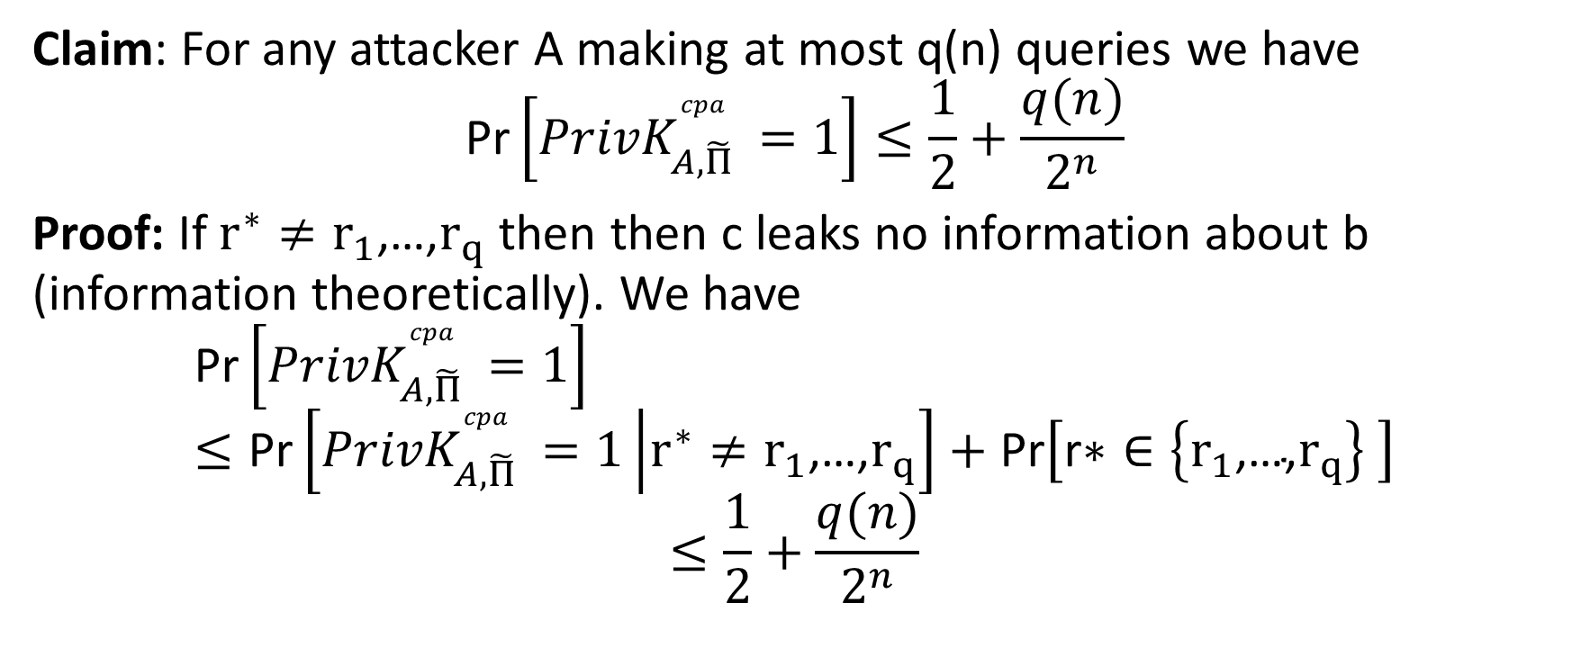
Finishing Up
Claim: For any attacker A making at most q(n) queries we have
$$\text{Pr}\left[{PrivK}_{A,\tilde{Π} }^{cpa}=1\right]≤\frac{1}{2}+\frac{q(n)}{2^{n}}$$
Proof: If $r^{∗}≠r_{1}\text{,…,}r_{q}$ then then c leaks no information about b (information theoretically). We have
$$\text{Pr}\left[{PrivK}_{A,\tilde{Π} }^{cpa}=1\right]≤\text{Pr}\left[{PrivK}_{A,\tilde{Π} }^{cpa}=1\left|r^{∗}≠r_{1}\text{,…,}r_{q}\right.\right]+\text{Pr}\left[\text{r}\text{∗}∈\left\{r_{1}\text{,…,}r_{q}\right\} \right]$$
$$≤\frac{1}{2}+\frac{q(n)}{2^{n}}$$

Slide 30
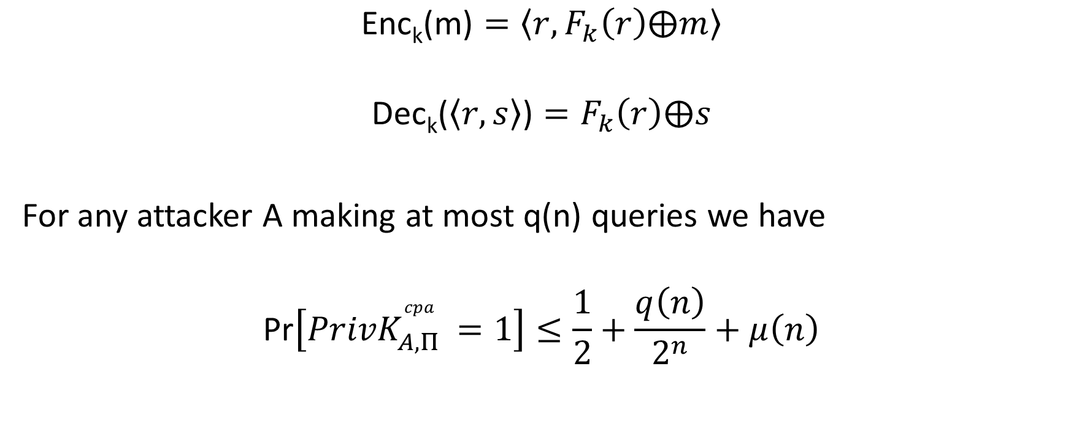
Conclusion
$$\text{Enc}\text{k}\text{(}\text{m}\text{)}=\left\langle r,F_{k}\left(r\right)⨁m\right\rangle$$
$$\text{Dec}\text{k}\text{(}\left\langle r,s\right\rangle \text{)}=F_{k}\left(r\right)⨁s$$
For any attacker A making at most q(n) queries we have
$$\text{Pr}\left[{PrivK}_{A,Π }^{cpa}=1\right]≤\frac{1}{2}+\frac{q\left(n\right)}{2^{n}}+μ\left(n\right)$$
PRF Security
Suggested Exercise: Work out concrete version of security proof

Slide 31
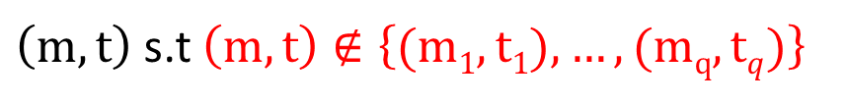



Concrete Version: $\left(t\left(n\right),q\left(n\right),ε(n)\right)$-secure MAC
m₁
t₁ = Mac_{K}(m₁)
m₂
…
t₂ = Mac_{K} (m₂)
m_{q}
t_{q} = Mac_{K}(m_{q})
$\left(m,t\right)$ s.t $\left(m,t\right)∉\left\{(m1,t1),…,(mq,tq)\right\}$
$${Macsforge}_{A,Π}(n)=Vrfyk{(m,t)}$$
K = Gen(.)
$$∀ A with \left(time(A)≤t\left(n\right),queries(A)≤q\left(n\right)\right)$$
$$Pr\left[{Macsforge}_{A,Π}\left(n\right)=1\right]≤ε(n)$$

Slide 32




What Does It Mean to “Secure Information”
Confidentiality (Security/Privacy)
  Only intended recipient can see the communication
Integrity (Authenticity)
  The message was actually sent by the alleged sender
I love you Alice… - Bob
We need to break up -Bob
Alice
Bob

Slide 33
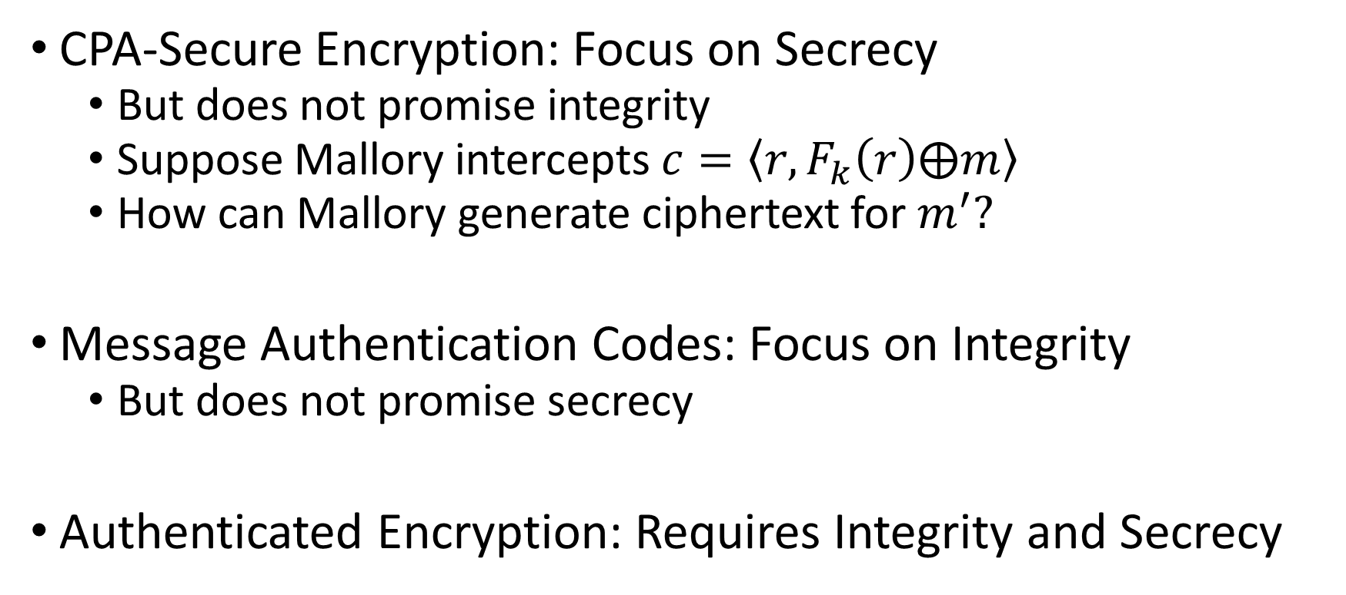
Message Authentication Codes
CPA-Secure Encryption: Focus on Secrecy
  But does not promise integrity
  Suppose Mallory intercepts $c=\left\langle r,F_{k}\left(r\right)⨁m\right\rangle$
  How can Mallory generate ciphertext for $m^{′}?$
Message Authentication Codes: Focus on Integrity
  But does not promise secrecy
Authenticated Encryption: Requires Integrity and Secrecy

Slide 34
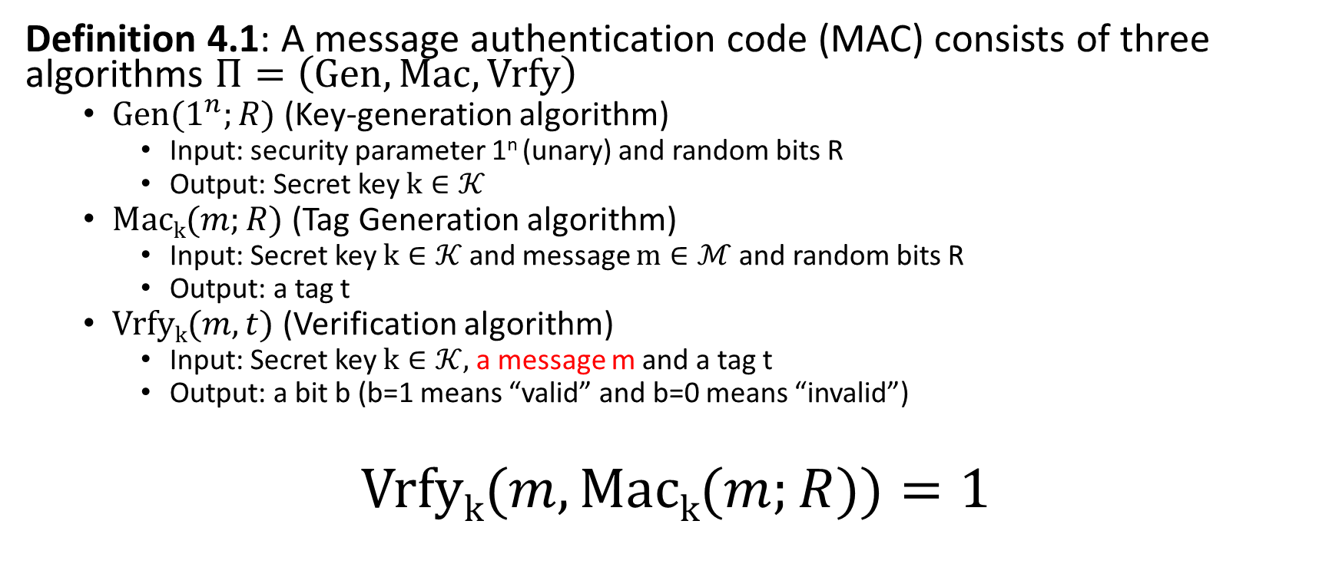
Message Authentication Code Syntax
Definition 4.1: A message authentication code (MAC) consists of three algorithms $Π=\left(Gen, Mac, Vrfy\right)$
  $\operatorname{Gen}{(1^{n};R)}$ (Key-generation algorithm)
    Input: security parameter 1^{n} (unary) and random bits R
    Output: Secret key $k∈𝒦$
  $\operatorname{Mack}{(m;R)}$ (Tag Generation algorithm)
    Input: Secret key $k∈𝒦$ and message $m∈ℳ$ and random bits R
    Output: a tag t
  $\operatorname{Vrfyk}{(m,t)}$ (Verification algorithm)
    Input: Secret key $k∈𝒦,$ a message m and a tag t
    Output: a bit b (b=1 means “valid” and b=0 means “invalid”)
$$\operatorname{Vrfyk}{(m,\operatorname{Mack}{(m;R)})}=1$$
Security Goal (Informal): Attacker should not be able to forge a valid tag t’ for new message m’ that s/he wants to send.

Slide 35
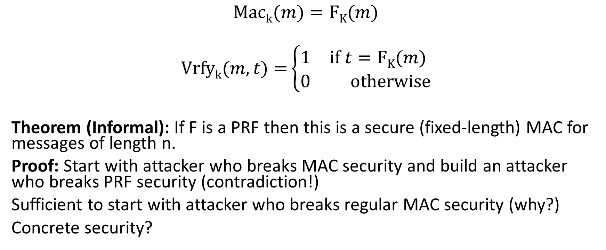
Strong MAC Construction (Fixed Length)
$$\operatorname{Mack}{(m)}=FK(m)$$
$$\operatorname{Vrfyk}{(m,t)}=\left\{\begin{aligned}\begin{matrix}1 & if t=FK(m) \end{matrix} \\ \begin{matrix}0 & otherwise\end{matrix}\end{aligned}\right.$$
Theorem (Informal): If F is a PRF then this is a secure (fixed-length) MAC for messages of length n.
Proof: Start with attacker who breaks MAC security and build an attacker who breaks PRF security (contradiction!)
Sufficient to start with attacker who breaks regular MAC security (why?)
Concrete security?

Slide 36
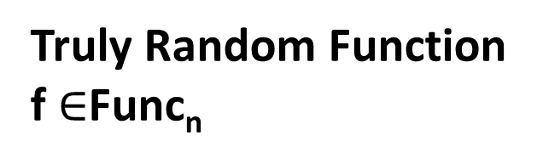


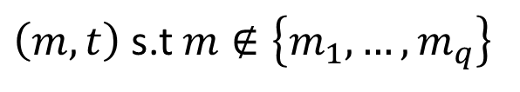
Warmup: Ideal MAC (${Macforge}_{A,\tilde{Π}}(n)$)
m₁
Why? Because f(m) is distributed uniformly
in {0,1}^{n} and we have not queried f(m) so Pr[f(m)=t]=2^{-n}
t₁ = f(m₁)
m₂
…
t₂ = f (m₂)
m_{q}
t_{q} = f(m_{q})
$\left(m,t\right)$ s.t $m∉\left\{m_{1},…,m_{q}\right\}$
Truly Random Function
f $∈$Func_{n}
Claim: $∀A \left(not just PPT\right)$
$$Pr\left[{Macforge}_{A,\tilde{Π}}\left(n\right)=1\right]=Pr\left[f\left(m\right)=t \right]≤2^{−n}$$

Slide 37
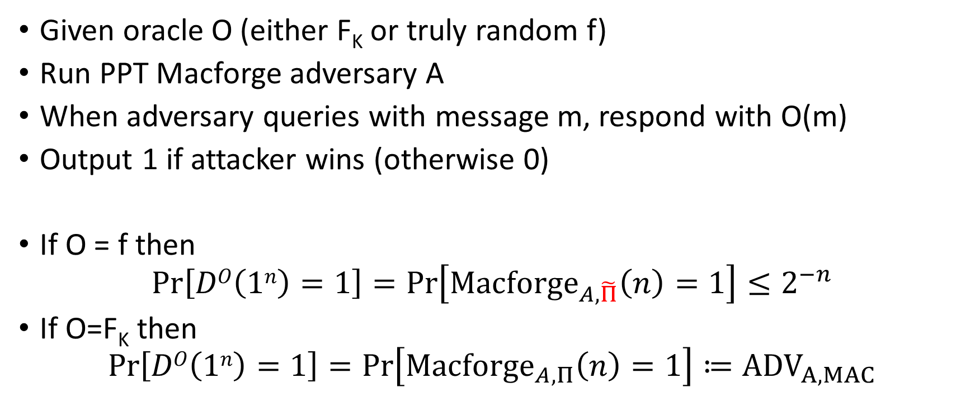
PRF Distinguisher D
Given oracle O (either F_{K} or truly random f)
Run PPT Macforge adversary A
When adversary queries with message m, respond with O(m)
Output 1 if attacker wins (otherwise 0)
If O = f then
$$Pr\left[DO\left(1n\right)=1\right]=Pr\left[{Macforge}_{A,\tilde{Π}}\left(n\right)=1\right]≤2^{−n}$$
If O=F_{K} then
$$Pr\left[DO\left(1n\right)=1\right]=Pr\left[{Macforge}_{A,Π}\left(n\right)=1\right]≔{ADV}_{A,MAC}$$

Slide 38
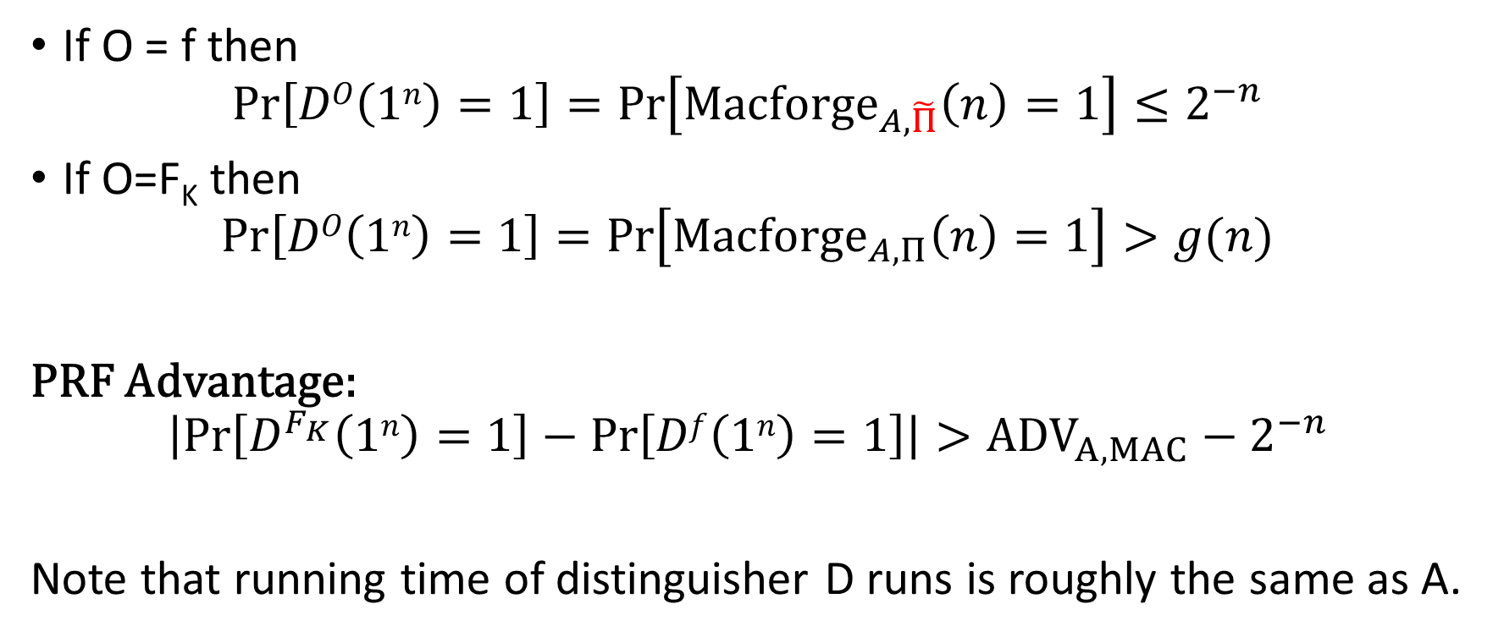
PRF Distinguisher D
If O = f then
$$Pr\left[DO\left(1n\right)=1\right]=Pr\left[{Macforge}_{A,\tilde{Π}}\left(n\right)=1\right]≤2^{−n}$$
If O=F_{K} then
$$Pr\left[DO\left(1n\right)=1\right]=Pr\left[{Macforge}_{A,Π}\left(n\right)=1\right]>g(n)$$
PRF Advantage:
$$\left|Pr\left[D^{F_{K}}\left(1n\right)=1\right]−Pr\left[Df\left(1n\right)=1\right]\right|>{ADV}_{A,MAC}−2^{−n}$$
Note that running time of distinguisher D runs is roughly the same as A.

Slide 39
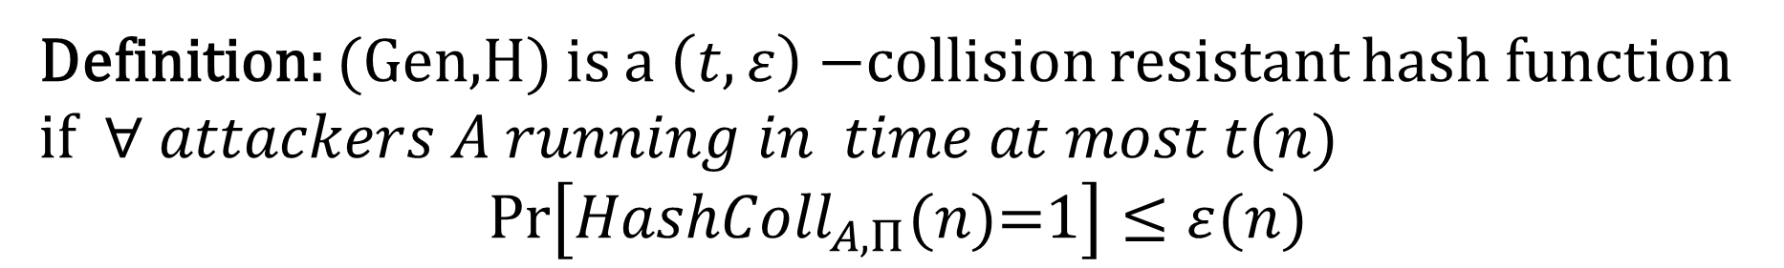

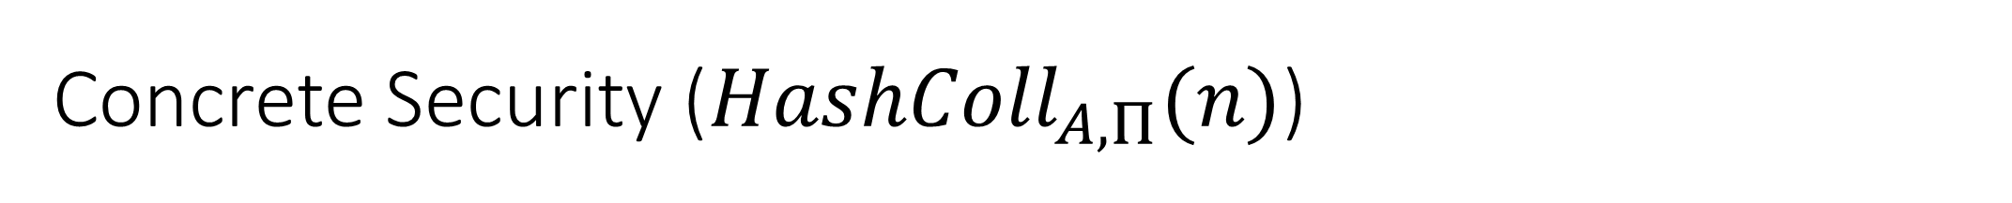
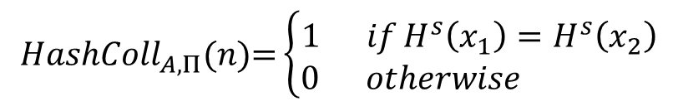
Concrete Security (${HashColl}_{A,Π}(n)$)
s
x₁,x₂
$${HashColl}_{A,Π}(n)\text{=}\left\{\begin{aligned}1 ifH^{s}\left(x_{1}\right)=H^{s}\left(x_{2}\right) \\ 0 otherwise \end{aligned}\right.$$
$$s=Gen{(1n;R)}$$
Definition: (Gen,H) is a $\left(t,ε\right)−$collision resistant hash function if $∀ attackers A running in time at most t(n)$
$$Pr\left[{HashColl}_{A,Π}(n)\text{=}1\right]≤ε(n)$$

Slide 40
Theory vs Practice
Most cryptographic hash functions used in practice are un-keyed
  Examples: MD5, SHA1, SHA2, SHA3, Blake2B
Tricky to formally define collision resistance for keyless hash function
  There is a PPT algorithm to find collisions
  We just usually can’t find this algorithm ☺
  Guarantee for protocol using H
    If we know an explicit efficient algorithm A
    breaking our protocol then there is an efficient
    blackbox reduction transforming A into an efficient
    collision finding algorithm.

Slide 41
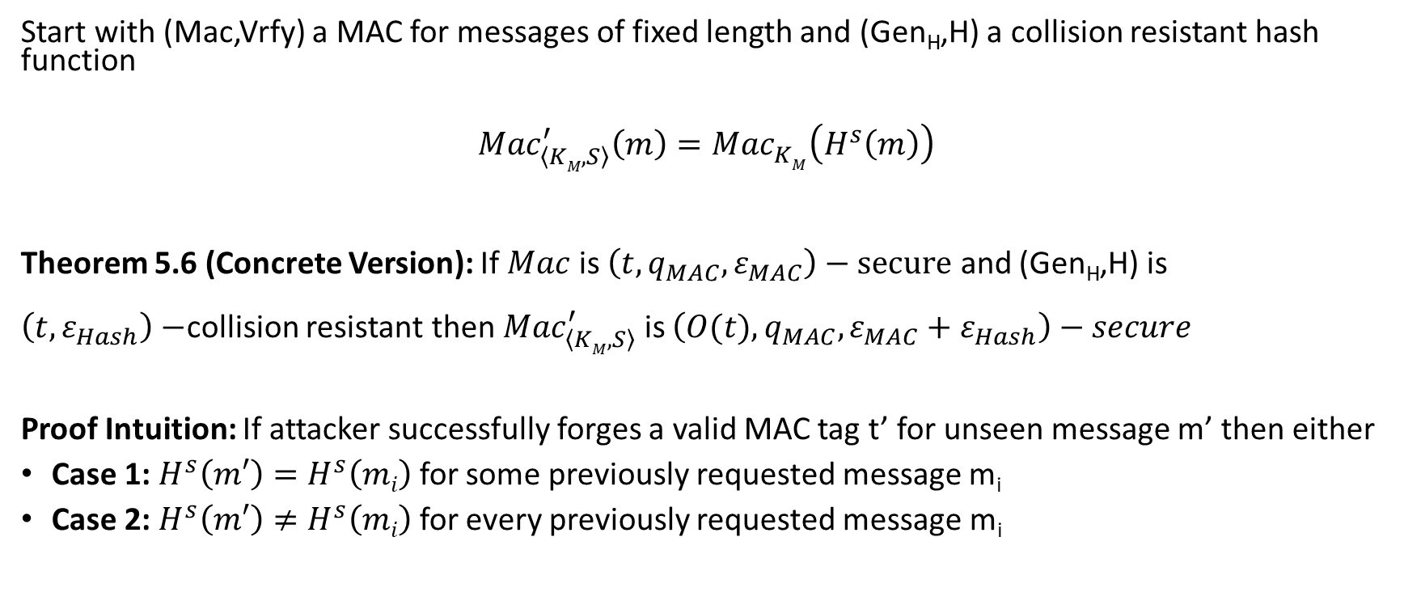
Hash and MAC Construction
Start with (Mac,Vrfy) a MAC for messages of fixed length and (Gen_{H},H) a collision resistant hash function
$${Mac}_{\left\langle KM,S\right\rangle }^{′}\left(m\right)={Mac}_{KM}^{}\left(H^{s}\left(m\right)\right)$$
Theorem 5.6 (Concrete Version): If $Mac$ is $\left(t,q_{MAC},ε_{MAC}\right)−secure$ and (Gen_{H},H) is $\left(t,ε_{Hash}\right)−$collision resistant then ${Mac}_{\left\langle KM,S\right\rangle }^{′}$ is $\left(O(t),q_{MAC},ε_{MAC}+ε_{Hash}\right)−secure$
Proof Intuition: If attacker successfully forges a valid MAC tag t’ for unseen message m’ then either
Case 1: $H^{s}\left(m′\right)=H^{s}\left(mi\right)$ for some previously requested message m_{i}
Case 2: $H^{s}\left(m′\right)≠H^{s}\left(mi\right)$ for every previously requested message m_{i}

Slide 42
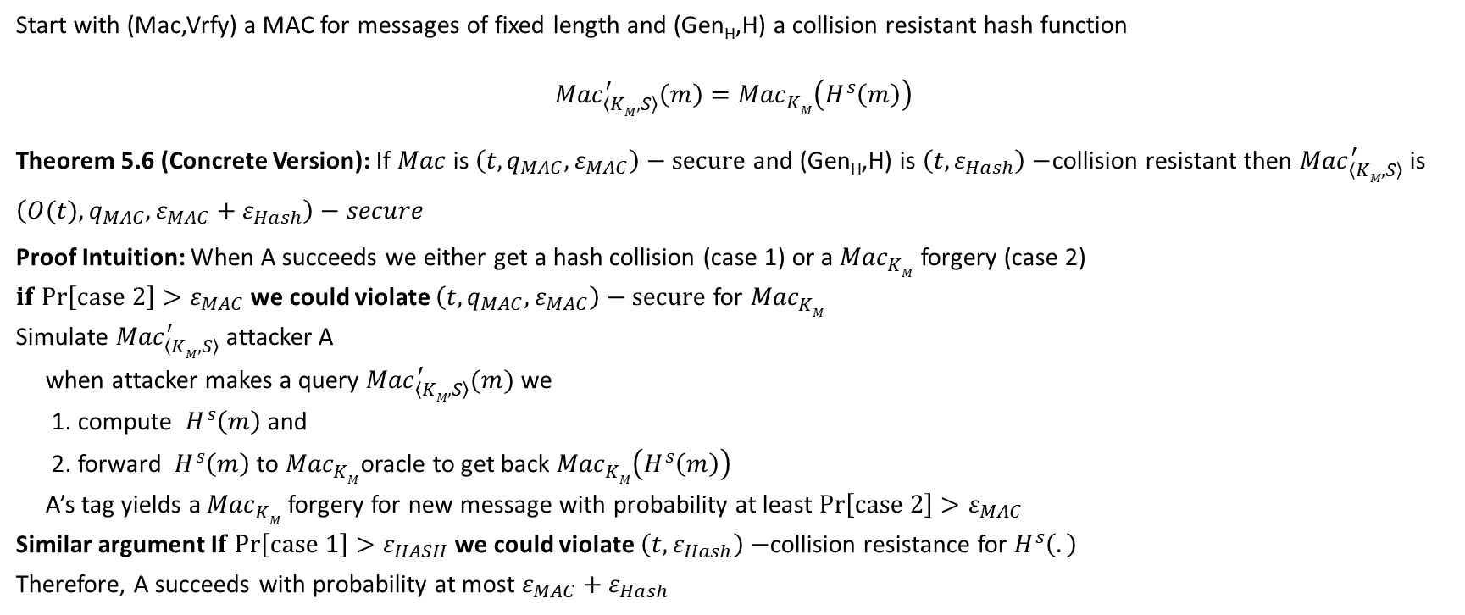
Hash and MAC Construction
Start with (Mac,Vrfy) a MAC for messages of fixed length and (Gen_{H},H) a collision resistant hash function
$${Mac}_{\left\langle KM,S\right\rangle }^{′}\left(m\right)={Mac}_{KM}^{}\left(H^{s}\left(m\right)\right)$$
Theorem 5.6 (Concrete Version): If $Mac$ is $\left(t,q_{MAC},ε_{MAC}\right)−secure$ and (Gen_{H},H) is $\left(t,ε_{Hash}\right)−$collision resistant then ${Mac}_{\left\langle KM,S\right\rangle }^{′}$ is $\left(O(t),q_{MAC},ε_{MAC}+ε_{Hash}\right)−secure$
Proof Intuition: When A succeeds we either get a hash collision (case 1) or a ${Mac}_{KM}^{}$ forgery (case 2)
$if Pr\left[case 2\right]>ε_{MAC}$we could violate $\left(t,q_{MAC},ε_{MAC}\right)−secure$ for ${Mac}_{KM}^{}$
Simulate ${Mac}_{\left\langle KM,S\right\rangle }^{′}$ attacker A
when attacker makes a query ${Mac}_{\left\langle KM,S\right\rangle }^{′}(m)$ we
1. compute $H^{s}\left(m\right)$ and
2. forward $H^{s}\left(m\right)$ to ${Mac}_{KM}^{}$oracle to get back ${Mac}_{KM}^{}\left(H^{s}\left(m\right)\right)$
A’s tag yields a ${Mac}_{KM}^{}$ forgery for new message with probability at least $Pr\left[case 2\right]>ε_{MAC}$
Similar argument I$f Pr\left[case 1\right]>ε_{HASH}$we could violate $\left(t,ε_{Hash}\right)−$collision resistance for $H^{s}\left(.\right)$
Therefore, A succeeds with probability at most $ε_{MAC}+ε_{Hash}$

Slide 43

Authenticated Encryption
Encryption: Hides a message from the attacker
Message Authentication Codes: Prevents attacker from tampering with message

Slide 44
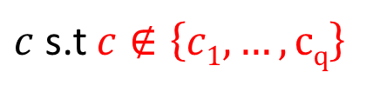

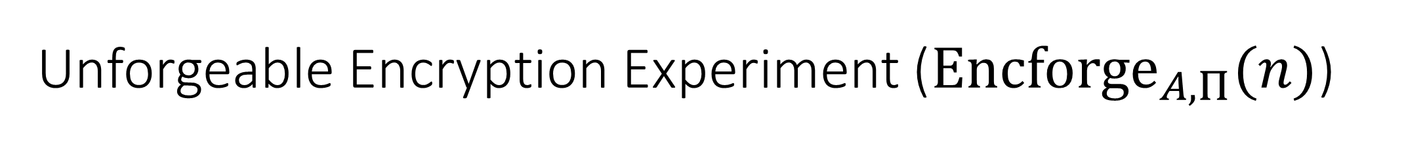
Unforgeable Encryption Experiment (${Encforge}_{A,Π}(n)$)
m₁
c₁ = Enc_{K}(m₁)
m₂
c₂ = Enc_{K} (m₂)
…
m_{q}
c_{q} = Enc_{K}(m_{q})
$c$ s.t $c∉\left\{c1,…,cq\right\}$
$${Encforge}_{A,Π}\left(n\right)=1 if Deck\left(c\right)≠⊥$$
K = Gen(.)
$$∀PPT A ∃μ (negligible) s.t$$
$$Pr\left[{Encforge}_{A,Π}\left(n\right)=1\right]≤μ(n)$$

Slide 45
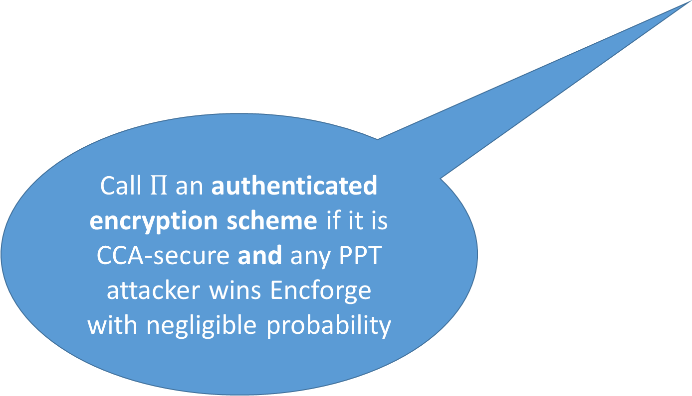
Unforgeable Encryption Experiment (${Encforge}_{A,Π}(n)$)
m₁
c₁ = Enc_{K}(m₁)
m₂
Call $Π$ an authenticated encryption scheme if it is CCA-secure and any PPT attacker wins Encforge with negligible probability
…
c₂ = Enc_{K} (m₂)
Game is very similar to MAC-Forge game
m_{q}
c_{q} = Enc_{K}(m_{q})
$c$ s.t $c∉\left\{c1,…,cq\right\}$
$${Encforge}_{A,Π}\left(n\right)=1 if Deck\left(c\right)≠⊥$$
K = Gen(.)
$$∀PPT A ∃μ (negligible) s.t$$
$$Pr\left[{Encforge}_{A,Π}\left(n\right)=1\right]≤μ(n)$$

Slide 46

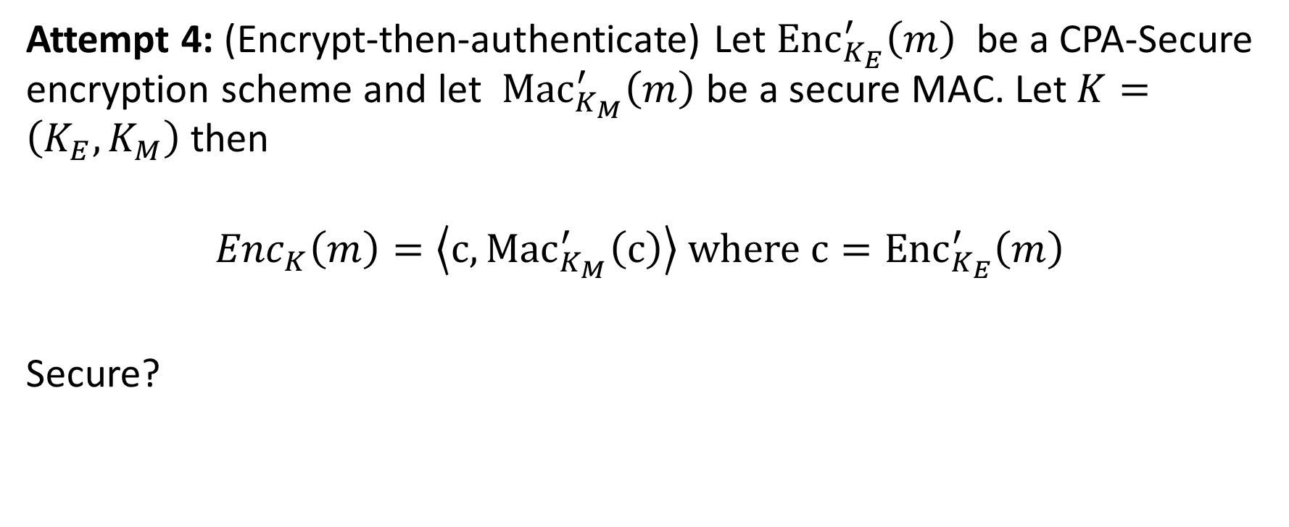
Building Authenticated Encryption
Attempt 4: (Encrypt-then-authenticate) Let ${Enc}_{K_{E}}^{′}\left(m\right)$ be a CPA-Secure encryption scheme and let ${Mac}_{K_{M}}^{′}\left(m\right)$ be a secure MAC. Let $K=\left(K_{E},K_{M}\right)$ then
$${Enc}_{K}\left(m\right)=\left\langle c,{Mac}_{K_{M}}^{′}\left(c\right)\right\rangle where{ c=Enc}_{K_{E}}^{′}\left(m\right)$$
Secure?

Slide 47
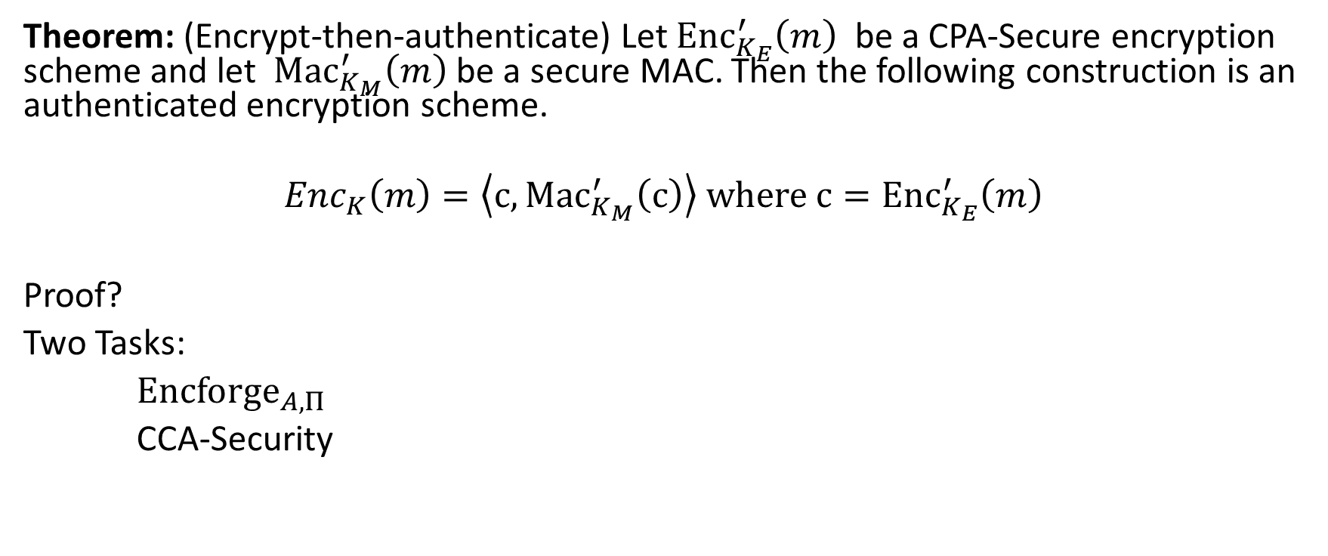
Building Authenticated Encryption
Theorem: (Encrypt-then-authenticate) Let ${Enc}_{K_{E}}^{′}\left(m\right)$ be a CPA-Secure encryption scheme and let ${Mac}_{K_{M}}^{′}\left(m\right)$ be a secure MAC. Then the following construction is an authenticated encryption scheme.
$${Enc}_{K}\left(m\right)=\left\langle c,{Mac}_{K_{M}}^{′}\left(c\right)\right\rangle where{ c=Enc}_{K_{E}}^{′}\left(m\right)$$
Proof?
Two Tasks:
${Encforge}_{A,Π}$
CCA-Security

Slide 48
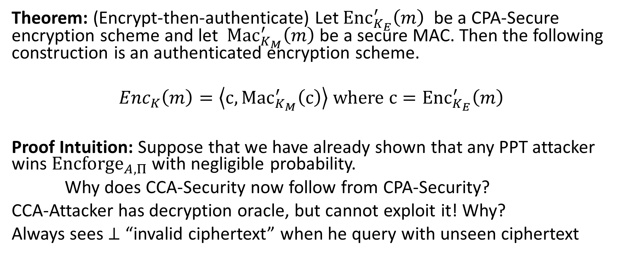
Building Authenticated Encryption
Theorem: (Encrypt-then-authenticate) Let ${Enc}_{K_{E}}^{′}\left(m\right)$ be a CPA-Secure encryption scheme and let ${Mac}_{K_{M}}^{′}\left(m\right)$ be a secure MAC. Then the following construction is an authenticated encryption scheme.
$${Enc}_{K}\left(m\right)=\left\langle c,{Mac}_{K_{M}}^{′}\left(c\right)\right\rangle where{ c=Enc}_{K_{E}}^{′}\left(m\right)$$
Proof Intuition: Suppose that we have already shown that any PPT attacker wins ${Encforge}_{A,Π}$ with negligible probability.
Why does CCA-Security now follow from CPA-Security?
CCA-Attacker has decryption oracle, but cannot exploit it! Why?
Always sees $⊥$ “invalid ciphertext” when he query with unseen ciphertext

Slide 49
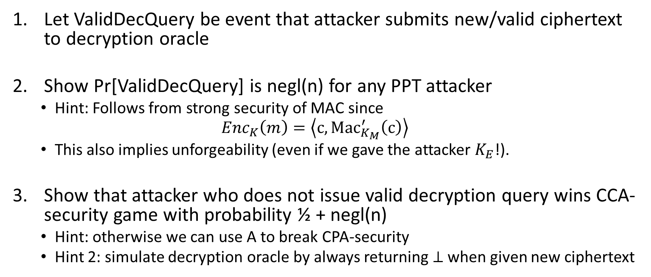
Proof Sketch
Let ValidDecQuery be event that attacker submits new/valid ciphertext to decryption oracle
Show Pr[ValidDecQuery] is negl(n) for any PPT attacker
  Hint: Follows from strong security of MAC since
  $${Enc}_{K}\left(m\right)=\left\langle c,{Mac}_{K_{M}}^{′}\left(c\right)\right\rangle$$
  This also implies unforgeability (even if we gave the attacker $K_{E}$!).
Show that attacker who does not issue valid decryption query wins CCA-security game with probability ½ + negl(n)
  Hint: otherwise we can use A to break CPA-security
  Hint 2: simulate decryption oracle by always returning $⊥$ when given new ciphertext

Slide 50

Pseudorandom Permutation
A keyed function $F:{\left\{0,1\right\}}^{n}×{\left\{0,1\right\}}^{n}→{\left\{0,1\right\}}^{n}$, which is invertible and “looks random” without the secret key k.
Similar to a PRF, but
Computing F_{k}(x) and $F_{k}^{−1}\left(x\right)$ is efficient (polynomial-time)
Definition 3.28: A keyed function $F:{\left\{0,1\right\}}^{n}×{\left\{0,1\right\}}^{n}→{\left\{0,1\right\}}^{n}$ is a strong pseudorandom permutation if for all PPT distinguishers D there is a negligible function $μ$ s.t.
$$\left|Pr\left[D^{F_{k}\left(.\right),F_{k}^{−1}\left(.\right)}\left(1^{n}\right)\right]−Pr\left[D^{f\left(.\right),f^{−1}\left(.\right)}\left(1^{n}\right)\right]\right|≤μ\left(n\right)$$

Slide 51
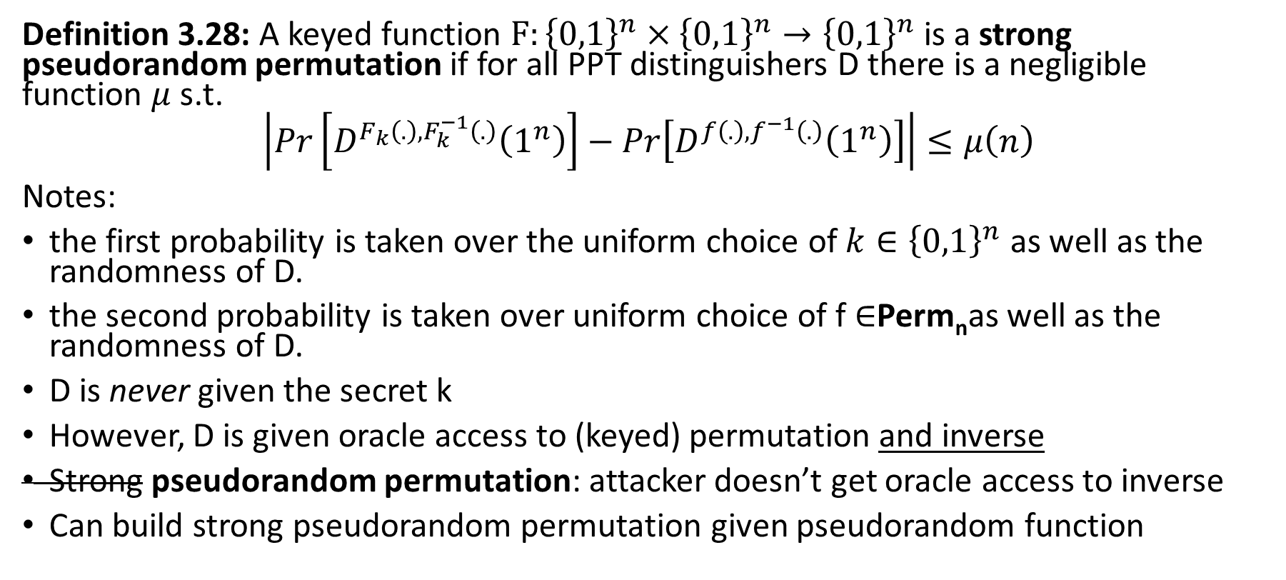
Pseudorandom Permutation
Definition 3.28: A keyed function $F:{\left\{0,1\right\}}^{n}×{\left\{0,1\right\}}^{n}→{\left\{0,1\right\}}^{n}$ is a strong pseudorandom permutation if for all PPT distinguishers D there is a negligible function $μ$ s.t.
$$\left|Pr\left[D^{F_{k}\left(.\right),F_{k}^{−1}\left(.\right)}\left(1^{n}\right)\right]−Pr\left[D^{f\left(.\right),f^{−1}\left(.\right)}\left(1^{n}\right)\right]\right|≤μ\left(n\right)$$
Notes:
the first probability is taken over the uniform choice of ${k∈\left\{0,1\right\}}^{n}$ as well as the randomness of D.
the second probability is taken over uniform choice of f $∈$Perm_{n}as well as the randomness of D.
D is never given the secret k
However, D is given oracle access to (keyed) permutation and inverse
Strong pseudorandom permutation: attacker doesn’t get oracle access to inverse
Can build strong pseudorandom permutation given pseudorandom function

Slide 52
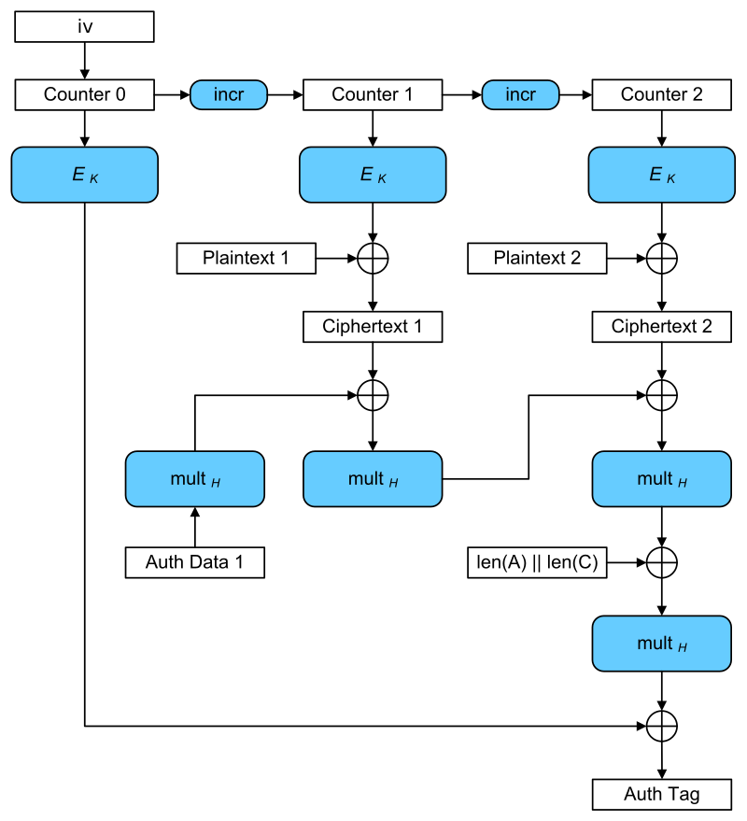
Galois Counter Mode (GCM)
Input: plaintexts 1 & 2
AES-GCM is CCA-secure (> CPA-security)
  Bonus: Authentication Encryption with Associated Data
  Ensure integrity of ciphertext
  Attacker cannot even generate new/valid ciphertext!
  Ensures attacker cannot tamper with associated packet data
    Source IP
    Destination IP
    Why can’t these values be encrypted?
Encryption is largely parallelizable!
Outputs: iv, ciphertexts 1 & 2, authentication tag

Slide 53
Next Week
AES-GCM + AES-GCM-SIV
Multi-User Security
Concrete (Multi-User) Analysis of AES-GCM and AES-GCM-SIV
Papers to Look At:
  The Multi-User Security of Authenticated Encryption: AES-GCM in TLS 1.3 https://eprint.iacr.org/2016/564
  The Security and Performance of the Galois/Counter Mode https://eprint.iacr.org/2004/193.pdf
  AES-GCM-SIV: Specification and Analysis https://eprint.iacr.org/2017/168.pdf
  Revisiting AES-GCM-SIV: Multi-user Security, Faster Key Derivation, and Better Bounds https://homes.cs.washington.edu/~tessaro/papers/BHT17.pdf

Slide 54
Random Oracle Model
Model hash function H as a truly random function
Algorithms can only interact with H as an oracle
  Query: x
  Response: H(x)
If we submit the same query you see the same response
If x has not been queried, then the value of H(x) is uniform
Real World: H instantiated as cryptographic hash function (e.g., SHA3) of fixed length (no Merkle-Damgård)

Slide 55
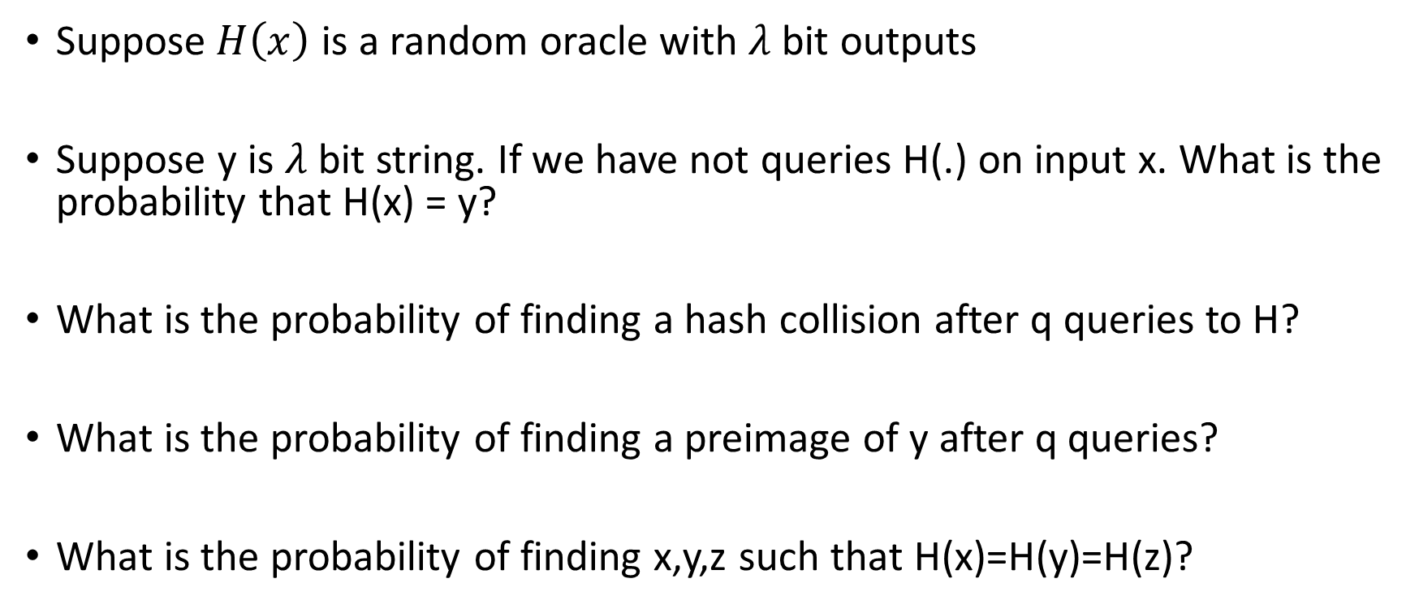
Random Oracle: Warmup Questions
Suppose$H\left(x\right)$ is a random oracle with $λ$ bit outputs
Suppose y is $λ$ bit string. If we have not queries H(.) on input x. What is the probability that H(x) = y?
What is the probability of finding a hash collision after q queries to H?
What is the probability of finding a preimage of y after q queries?
What is the probability of finding x,y,z such that H(x)=H(y)=H(z)?

Slide 56
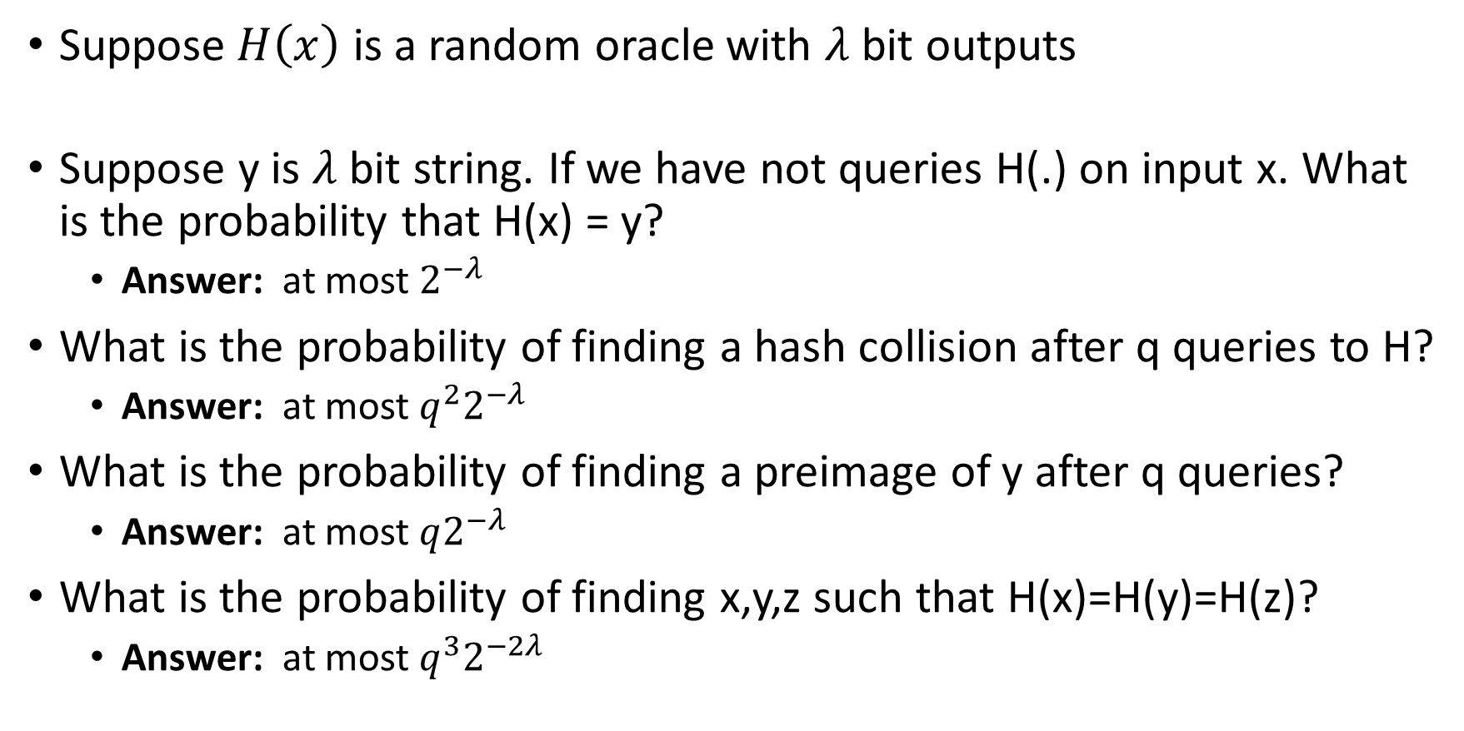
Random Oracle: Warmup Questions
Suppose$H\left(x\right)$ is a random oracle with $λ$ bit outputs
Suppose y is $λ$ bit string. If we have not queries H(.) on input x. What is the probability that H(x) = y?
  Answer: at most $2^{−λ}$
What is the probability of finding a hash collision after q queries to H?
  Answer: at most $q^{2}2^{−λ}$
What is the probability of finding a preimage of y after q queries?
  Answer: at most $q2^{−λ}$
What is the probability of finding x,y,z such that H(x)=H(y)=H(z)?
  Answer: at most $q^{3}2^{−2λ}$

Slide 57

Random Oracle: Harder Questions
Suppose$H\left(x\right)$ is a random oracle with $λ$ bit outputs. Suppose that attacker has space $S≪q$
If attacker has $S=O(1)$ space. What is the probability of finding a hash collision after q queries to H? What is the probability of finding a preimage of y after q queries?
  Answer: Still $Θ(q^{2}2^{−λ})$ (for hash collisions) and $Θ(q2^{−λ})$ (for preimage)
  Hash Collisions in Constant Space? Floyd-Warshall Cycle Detection
What is the probability of finding x,y,z such that H(x)=H(y)=H(z)?
  More complicated!
  Natural attack which achieves advantage $q^{3}2^{−2λ}$ uses $Θ(q)$ space

Slide 58
Random Oracle Model: Pros
It is easier to prove security in Random Oracle Model
Provably secure constructions in random oracle model are often much more efficient (compared to provably secure construction is “standard model”
Sometimes we only know how to design provably secure protocol in random oracle model

Slide 59
Random Oracle Model: Cons
Lack of formal justification
Why should security guarantees translate when we instantiate random oracle with a real cryptographic hash function?
We can construct (contrived) examples of protocols which are
  Secure in random oracle model…
  But broken in the real world

Slide 60
Random Oracle Model: Justification
“A proof of security in the random-oracle model is significantly better than no proof at all.”
Evidence of sound design (any weakness involves the hash function used to instantiate the random oracle)
Empirical Evidence for Security
“there have been no successful real-world attacks on
schemes proven secure in the random oracle model”

Slide 61

Ideal Cipher Model
For each n-bit string K we pick a truly random permutation F_{K}
Public Oracles
  $O\left(K,x\right)=F_{K}(x)$
  $O^{−1}\left(K,y\right)=F_{K}^{−1} (y)$
Real World: Instantiate Ideal Cipher with a modern block cipher like AES
Similar Pros/Cons to Random Oracle Model
  Pro: Powerful evidence of sound design
  Con: No blockcipher is an ideal cipher (even AES)

Slide 62

Hash Functions from Ideal Block Ciphers
Davies-Meyer Construction from block cipher $F_{K}$
$$H\left(K,x\right)=F_{K}\left(x\right)⨁x$$
Theorem: If $F:{\left\{0,1\right\}}^{λ}×{\left\{0,1\right\}}^{λ}→{\left\{0,1\right\}}^{λ}$ is modeled as an ideal block cipher then Davies-Meyer construction is a collision-resistant hash function
(Concrete: Need roughly $q≈2^{λ/2}$ queries to find collision)
Ideal Cipher Model: For each key K model F_{K} as a truly random permutation which may only be accessed in black box manner.
  (Equivalent to Random Oracle Model)

Slide 63

Hash Functions from Block Ciphers
$$H\left(K,x\right)=F_{K}\left(x\right)⨁x$$
Analysis: Suppose we have already made queries to the ideal cipher
Submitted $\left(K_{1},x_{1}\right),…,\left(K_{q},x_{q}\right)$ to $F_{K}$ to get $F_{K_{1}}\left(x_{1}\right),…,F_{K_{q}}\left(x_{q}\right)$
Submitted $\left(K_{q+1},y_{1}\right),…,\left(K_{2q},y_{q}\right)$ to $F_{K}^{−1}\left(.\right)$ to get $x_{q+1}≔F_{K_{q+1}}^{−1}\left(y_{1}\right),…,x_{2q}≔F_{K_{2q}}^{−1}\left(y_{q}\right)$.
$H\left(K_{i},x_{i}\right)$ is known for all $i≤2q$ (but $H\left(K,x\right)$ is unknown at all other input points).
Now suppose we make a new query $\left(K,x\right)∉\left\{\left(K_{1},x_{1}\right),…,\left(K_{2q},x_{2q}\right)\right\}$: $F_{K}\left(x\right)$ sampled uniformly from $2^{λ}−2q$ possible choices.
➔ Collides with $H\left(K_{i},x_{i}\right)$ with probability at most $\frac{1}{2^{λ}−2q}$
➔ Collides with $H\left(K_{q+i},x_{q+i}\right)$ with probability at most $\frac{1}{2^{λ}−2q}$
➔ $H\left(K,x\right)$ Collides with prior query with probability at most $\frac{2q}{2^{λ}−2q}$

Slide 64

Hash Functions from Block Ciphers
$$H\left(K,x\right)=F_{K}\left(x\right)⨁x$$
Analysis:
Fact 1: Query q+1 to ideal cipher yields collision (with prior query) with probability at most $\frac{q}{2^{λ}−q}$
Fact 2: The probability of finding a collision within q queries is at most $\sum_{i≤q}{\frac{i}{2^{λ}−i}≤}\frac{q(q−1)/2}{2^{λ}−q}$

Slide 65

A Broken Attempt
$$H\left(K1,K2,x1,x2\right)=F_{K1}\left(x1\right)⨁F_{K2}\left(x2\right)⨁K1⨁K2$$
Collision Attack: Pick arbitrary keys $K0≠K1$
Step 1: Query $x1≔F_{K0}^{−1}\left(0n\right)$ and $x2≔F_{K0}^{−1}\left(1n\right)$
Step 2: Query $w1≔F_{K1}^{−1}\left(0n\right)$ and $w2≔F_{K1}^{−1}\left(1n\right)$
$$H\left(K0,K0,x1,x2\right)=F_{K0}\left(x1\right)⨁F_{K0}\left(x2\right)⨁K0⨁K0=0n⨁1n$$
$$=F_{K1}\left(w1\right)⨁F_{K1}\left(w2\right)=H\left(K1,K1,w1,w2\right)$$
Exploits the fact that we can query inverse oracle $F_{K}^{−1}$

Slide 66

Pseudorandom Permutation
Definition 3.28: A keyed function $F:{\left\{0,1\right\}}^{n}×{\left\{0,1\right\}}^{n}→{\left\{0,1\right\}}^{n}$ is a strong pseudorandom permutation if for all PPT distinguishers D there is a negligible function $μ$ s.t.
$$\left|Pr\left[D^{F_{k}\left(.\right),F_{k}^{−1}\left(.\right)}\left(1^{n}\right)\right]−Pr\left[D^{f\left(.\right),f^{−1}\left(.\right)}\left(1^{n}\right)\right]\right|≤μ\left(n\right)$$
Notes:
the first probability is taken over the uniform choice of ${k∈\left\{0,1\right\}}^{n}$ as well as the randomness of D.
the second probability is taken over uniform choice of f $∈$Perm_{n}as well as the randomness of D.
D is never given the secret k
However, D is given oracle access to keyed permutation and inverse

Slide 67

PRFs from PRGs
Theorem: Suppose that there is a PRG G with expansion factor $ℓ\left(n\right)=2n.$ Then there is a secure PRF.
Let G(x) = G₀(x)||G₁(x) (first/last n bits of output)
$$F_{K}\left(x_{1},…,x_{n}\right)=G_{x_{n}}\left(…\left(G_{x_{2}}\left(G_{x_{1}}\left(K\right)\right)\right)…\right)$$

Slide 68

PRFs from PRGs
n-bits
n-bits
G(x):= G₀(x) || G₁(x)
Theorem: Suppose that there is a PRG G with expansion factor $ℓ\left(n\right)=2n.$ Then there is a secure PRF.
k
1
0
F_{k}(011)=G₁(G₁(G₀(k)))
G₀(k)
G₁(k)
0
1
1
0
G₀(G₀(k))
G₁(G₀(k))
G₀(G₁(k))
G₁(G₁(k))
1
…
…
0
1
0
1
…
0
1
…
0
…
…
…
…

Slide 69

PRFs from PRGs
Theorem: Suppose that there is a PRG G with expansion factor $ℓ\left(n\right)=2n.$ Then there is a secure PRF.
Proof:
Claim 1: For any t(n) and any PPT attacker A we have
$$\left|Pr\left[A\left(r_{1}∥…∥r_{t(n)}\right)\right]−Pr\left[A\left(G\left(s_{1}\right)∥…∥G\left(s_{t(n)}\right)\right)\right]\right|<negl(n)$$

Slide 70

PRFs from PRGs
Claim 1: For any t(n) and any PPT attacker A we have
$$\left|Pr\left[A\left(r_{1}∥…∥r_{t(n)}\right)\right]−Pr\left[A\left(G\left(s_{1}\right)∥…∥G\left(s_{t(n)}\right)\right)\right]\right|<negl\left(n\right)$$
Proof Sketch (by Triangle Inequality): Fix j
$$Advj=\left|Pr\left[A\left(r_{1}∥…∥r_{j+1}∥G\left(s_{j+2}\right)…∥G\left(s_{t(n)}\right)\right)\right]−Pr\left[A\left(r_{1}∥…∥r_{j}∥G\left(s_{j+1}\right)∥…∥G\left(s_{t(n)}\right)\right)\right]\right|<negl\left(n\right)$$
This difference is negligible by PRG security (just replaced $G\left(s_{j+1}\right) with r_{j+1}).$

Slide 71

PRFs from PRGs
Claim 1: For any t(n) and any PPT attacker A we have
$$\left|Pr\left[A\left(r_{1}∥…∥r_{t(n)}\right)\right]−Pr\left[A\left(G\left(s_{1}\right)∥…∥G\left(s_{t(n)}\right)\right)\right]\right|<negl\left(n\right)$$
Proof Sketch
$$\left|Pr\left[A\left(r_{1}∥…∥r_{t(n)}\right)\right]−Pr\left[A\left(G\left(s_{1}\right)∥…∥G\left(s_{t(n)}\right)\right)\right]\right|$$
$$≤\sum_{j<t\left(n\right)}{Advj}$$
$$≤t\left(n\right)×negl\left(n\right)=negl\left(n\right) (QED)$$

Slide 72

PRFs from PRGs
Claim 1: For any t(n) and any PPT attacker A we have
$$\left|Pr\left[A\left(r_{1}∥…∥r_{t(n)}\right)\right]−Pr\left[A\left(G\left(s_{1}\right)∥…∥G\left(s_{t(n)}\right)\right)\right]\right|<negl\left(n\right)$$
Proof
$$\left|Pr\left[A\left(r_{1}∥…∥r_{t(n)}\right)\right]−Pr\left[A\left(G\left(s_{1}\right)∥…∥G\left(s_{t(n)}\right)\right)\right]\right|$$
$$≤\sum_{j<t(n)}{Advj}$$
$$≤t\left(n\right)×negl\left(n\right)=negl(n)$$

Slide 73

PRFs from PRGs
Claim 1: For any t(n) and any PPT attacker A we have
$$\left|Pr\left[A\left(r_{1}∥…∥r_{t(n)}\right)\right]−Pr\left[A\left(G\left(s_{1}\right)∥…∥G\left(s_{t(n)}\right)\right)\right]\right|<negl\left(n\right)$$
Proof
$$\left|Pr\left[A\left(r_{1}∥…∥r_{t(n)}\right)\right]−Pr\left[A\left(G\left(s_{1}\right)∥…∥G\left(s_{t(n)}\right)\right)\right]\right|$$
$$≤\sum_{j<t(n)}{Advj}$$
$$≤t\left(n\right)×negl\left(n\right)=negl(n)$$
(QED, Claim 1)

Slide 74
Hybrid H₁ and H₂
Original Construction: Hybrid H₁
K
1
0
r₀ = G₀(K)
r₁ = G₁(K)
0
1
1
0
r₀₀=G₀(r0)
r₀₁= G₁(r0)
r₁₀= G₀(r₁)
r₁₀= G₁(r₁)
1
…
…
0
1
0
1
…
0
1
…
0
…
…
…
…
74

Slide 75
Hybrid H₁ and H₂
Modified Construction H₂: Pick r₀ and r₁ randomly instead of r_{i} = G_{i}(K)
____
1
0
r₀
r₁
0
1
1
0
r₀₀=G₀(r0)
r₀₁= G₁(r0)
r₁₀= G₀(r₁)
r₁₀= G₁(r₁)
1
…
…
0
1
0
1
…
0
1
…
0
…
…
…
…
75

Slide 76
Hybrid H₃
Modified Construction H₃: Pick r₀₀ , r₀₁ , r₁₀ and r₁₁ randomly instead of applying PRG
____
1
0
____
____
0
1
1
0
r₀₀
r₀₁
r₁₀
r₁₁
1
…
…
0
1
0
1
…
0
1
…
0
…
…
…
…
76

Slide 77
Hybrid H_{n}
Truly Random Function: All output values r_{x} are picked randomly
____
1
0
____
____
0
1
1
0
____
____
____
____
1
r_{00…0}
…
0
1
0
1
…
0
1
r_{11…1}
0
…
r_{x}
…
…
77

Slide 78
Hybrid H₁
r
1
0
r₀
r₁
0
1
1
0
G₀(r0)
G₁(r0)
G₀(r₁)
G₁(r₁)
1
…
…
0
1
0
1
…
0
1
…
0
…
…
…
…
78

Slide 79

Hybrid H₁ vs H₂
Claim 1: For any t(n) and any PPT attacker A we have
$$\left|Pr\left[A\left(r_{1}∥…∥r_{t(n)}\right)\right]−Pr\left[A\left(G\left(s_{1}\right)∥…∥G\left(s_{t(n)}\right)\right)\right]\right|<negl\left(n\right)$$
Claim 2: Attacker who makes t(n) queries to F_{k} (or f) cannot distinguish H₂ from the real game (except with negligible probability).
Proof Intuition: Follows by Claim 1

Slide 80

Hybrid H_{i} vs H_{i}
Claim 1: For any t(n) and any PPT attacker A we have
$$\left|Pr\left[A\left(r_{1}∥…∥r_{t(n)}\right)\right]−Pr\left[A\left(G\left(s_{1}\right)∥…∥G\left(s_{t(n)}\right)\right)\right]\right|<negl\left(n\right)$$
Claim 3: Attacker who makes t(n) queries to F_{k} (or f) cannot distinguish H_{i} from H_{i -1} the real game (except with negligible probability).
Challenge: Cannot replace 2^{i} pseudorandom values with random strings at level i
$2^{i} negl\left(n\right)$ is not necessarily negligible if $i=\frac{n}{2}$
Key Idea: Only need to replace t(n) values (note: $t\left(n\right)negl\left(n\right)$ is negligible).

Slide 81

Hybrid H_{i}
Red Leaf Nodes: Queried F_{k}(x) (at most t(n) red leaf nodes)
Red Internal Nodes: On path from red leaf node to root
Level i: $≤t(n)$ red nodes
____
1
0
____
____
0
1
1
0
____
____
____
____
1
r_{00…0}
…
0
1
0
1
…
0
1
r_{11…1}
0
…
r_{x}
…
…
81

Slide 82

Hybrid H₁ vs H₂
Claim 1: For any t(n) and any PPT attacker A we have
$$\left|Pr\left[A\left(r_{1}∥…∥r_{t(n)}\right)\right]−Pr\left[A\left(G\left(s_{1}\right)∥…∥G\left(s_{t(n)}\right)\right)\right]\right|<negl\left(n\right)$$
Claim 2: Attacker who makes t(n) oracle queries to our function cannot distinguish H_{i} from H_{i+1} (except with negligible probability).
Proof: Indistinguishability follows by Claim 1
Let x₁,…x_{t} denote the t queries. Let y₁,…,y_{t} denote first i bits of each query.
(H_{i+1} vs H_{i} : replaced $G\left(r_{y_{i}}\right)$ with $r_{y_{i}∥0}∥$ $r_{y_{i}∥1}$)

Slide 83

Hybrid H_{i} vs H_{i}
Claim 1: For any t(n) and any PPT attacker A we have
$$\left|Pr\left[A\left(r_{1}∥…∥r_{t(n)}\right)\right]−Pr\left[A\left(G\left(s_{1}\right)∥…∥G\left(s_{t(n)}\right)\right)\right]\right|<negl\left(n\right)$$
Claim 3: Attacker who makes t(n) queries to F_{k} (or f) cannot distinguish H_{i} from H_{i -1} the real game (except with negligible probability).
Triangle Inequality: Attacker who makes t(n) queries to F_{k} (or f) cannot distinguish H₁ (real construction) from H_{n} (truly random function) except with negligible probability.

