Slide 1
Cryptography CS 555
Week 9:
Number Theory + Public Key Crypto
Readings: Katz and Lindell Chapter 8, B.1, B.2
Spring 2021

Slide 2
Limits of Symmetric Crypto
Key-Exchange Problem:
Obi-Wan and Yoda want to communicate securely
Suppose that
Obi-Wan and Yoda don’t have time to meet privately and generate a shared secret key
Use AES-GCM (requires shared secret key!)
Trusted Intermediary: If Obi-Wan and Yoda both have secret keys with Anakin they can exchange a secret key via the trusted party.

Slide 3
Limits of Symmetric Crypto
Key-Exchange Problem:
Obi-Wan and Yoda want to communicate securely
Suppose that
Obi-Wan and Yoda don’t have time to meet privately and generate a shared secret key
Use AES-GCM (requires shared secret key!)
Trusted Intermediary: If Obi-Wan and Yoda both have secret keys with Anakin (K_{Y,A} and K_{O,A}) they can exchange a secret key via the trusted party.
Obi-Wan picks a key K, computes $c={Enc}_{K_{O,A}}(K)$ and sends $c$ to Anakin with instructions to re-encrypt and forward to Yoda.
Anakin computes $K={Dec}_{K_{O,A}}(c)$ and $c′={Enc}_{K_{Y,A}}(K)$ and forwards to Yoda.
Yoda recovers $K={Dec}_{K_{Y,A}}(c′)$
Anakin also learns the secret key
Remark: Obi-Wan and Yoda both trust Anakin, but would prefer to keep the key private just in case.

Slide 4
Limits of Symmetric Crypto
Key-Exchange Problem:
Obi-Wan and Yoda want to communicate securely
Trusted Intermediary: If Obi-Wan and Yoda both have secret keys with Anakin (K_{Y,A} and K_{O,A}) they can exchange a secret key via the trusted party.
Remark: Obi-Wan and Yoda both trust Anakin, but would prefer to keep the key private just in case.

Slide 5
Limits of Symmetric Crypto
Key-Exchange Problem:
Obi-Wan and Yoda want to communicate securely
Suppose that
Obi-Wan and Yoda don’t have time to meet privately and generate one
Obi-Wan and Yoda share an asymmetric key with Anakin
Can they use Anakin to exchange a secret key?
Remark: Obi-Wan and Yoda both trust Anakin, but would prefer to keep the key private just in case.
Need for Public-Key Crypto
We can solve the key-exchange problem using public-key cryptography.
No solution is known using symmetric key cryptography alone

Slide 6
Symmetric Key Explosion Problem
Suppose we have n people and
each pair of people want to be able
to maintain a secure communication
channel.
How many private keys per person?
Answer: n-1
Key Explosion Problem
n can get very big if you are Google or Amazon!

Slide 7
Public Key Encryption: Basic Terminology
Plaintext/Plaintext Space
A message $m∈ℳ$
Ciphertext $c∈𝒞$
Public/Private Key Pair $\left(pk,sk\right)∈𝓚$

Slide 8
Public Key Encryption Syntax
Three Algorithms
$\operatorname{Gen}{(1^{n},R)}$ (Key-generation algorithm)
Input: Random Bits R
Output: $\left(pk,sk\right)∈𝓚$
$\operatorname{Encpk}{(m)}$ $∈𝒞$ (Encryption algorithm)
$\operatorname{Decsk}{(c)}$ (Decryption algorithm)
Input: Secret key $sk$ and a ciphertex$c$
Output: a plaintext message $m∈ℳ$
Invariant: Dec_{sk}(Enc_{pk}(m))=m
Alice must run key generation algorithm in advance an publishes the public key: pk
Assumption: Adversary only gets to see pk (not sk)

Slide 9
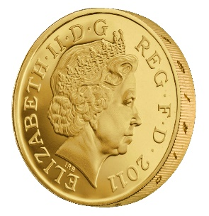
CPA-Security (${PubK}_{A,Π}^{LR−cpa}\left(n\right)$)
Public Key: pk
$$m_{0}^{1},m_{1}^{1}$$
$$c_{1}={Enc}_{pk}\left(m_{b}^{1}\right)$$
$$m_{0}^{2},m_{1}^{2}$$
$$c_{2}={Enc}_{pk}\left(m_{b}^{2}\right)$$
$$m_{0}^{3},m_{1}^{3}$$
$$c_{3}={Enc}_{pk}\left(m_{b}^{3}\right)$$
$$∀PPT A ∃μ (negligible) s.t$$
$$Pr\left[{PubK}_{A,Π}^{LR−cpa}\left(n\right)=1\right]≤\frac{1}{2}+μ(n)$$
…
b’
Random bit b
(pk,sk) = Gen(.)

Slide 10
Public Key Crypto
Fact 1: CPA Security and Eavesdropping Security are Equivalent
Key Insight: The attacker has the public key so he doesn’t gain anything from being able to query the encryption oracle!
Fact 2: Any deterministic encryption scheme is not CPA-Secure
Historically overlooked in many real world public key crypto systems
Fact 3: No Public Key Cryptosystem can achieve Perfect Secrecy!
Exercise 11.1
Hint: Unbounded attacker can keep encrypting the message m using the public key to recover all possible encryptions of m.
Key Question: How do we achieve CPA/CCA-Secure Public Key Encryption?

Slide 11
Number Theory
Key tool behind (most) public key-crypto
RSA, El-Gamal, Diffie-Hellman Key Exchange
Aside: don’t worry we will still use symmetric key crypto
It is more efficient in practice
First step in many public key-crypto protocols is to generate symmetric key
Then communicate using authenticated encryption e.g., AES-GCM

Slide 12
Polynomial Time Factoring Algorithm?
Did we just break RSA?
FindPrimeFactor
Input: N
For i=1,…,N
if N/i is an integer then
Output i
Running time: O(N) steps
Correctness: Always returns a factor

Slide 13
Polynomial Time Factoring Algorithm?
We measure running time of an arithmetic algorithm (multiply, divide, GCD, remainder) in terms of the number of bits necessary to encode the inputs.
How many bits $\left\|N\right\|$ to encode N?
Answer: $\left\|N\right\|$= log₂(N)
FindPrimeFactor
Input: N
For i=1,…,N
if N/i is an integer then
Output i
Running time: O(N) steps
Correctness: Always returns a factor

Slide 14
Polynomial Time Operations on Integers
Polynomial time in $\left\|a\right\|$and $\left\|b\right\|$
Addition
Multiplication
Division with Remainder
Input: a and divisor b
Output: quotient q and remainder r < b such that
$$a=qb+r$$
Convenient Notation: r = a mod b
Note 1: We require that quotient q and remainder r are both integers
Note 2: If remainder is $r=0$ (i.e., $a=qb+0)$ we say that b divides a (Notation: b|a)
Greatest Common Divisor
Example: gcd(9,15) = 3
Extended GCD(a,b)
Output integers X,Y such that
$$Xa+Yb=gcd⁡(a,b)$$

Slide 15
Polynomial Time Operations on Integers
Division with Remainder
Input: a and b
Output: quotient q and remainder r < b such that
$$a=qb+r$$
Greatest Common Divisor
Key Observation: if $a=qb+r$
Then gcd(a,b) = gcd(r, b)=gcd(a mod b, b)
Proof:
Let d = gcd(a,b). Then d divides both a and b. Thus, d also divides r=a-qb.
→d=gcd(a,b) $≤$ gcd(r, b)
Let d’ = gcd(r, b). Then d’ divides both b and r. Thus, d’ also divides a = qb+r.
→gcd(a,b) $≥$ gcd(r, b)=d’
Conclusion: d=d’.

Slide 16
More Polynomial Time Operations on Integers
(Modular Arithmetic) The following operations are polynomial time in $\left\|a\right\|$ and $\left\|b\right\|$ and $\left\|N\right\|.$
Compute [a mod N]
Compute sum [(a+b) mod N], difference [(a-b) mod N] or product [ab mod N]
Determine whether a has an inverse a⁻¹ such that 1=[aa⁻¹ mod N]
Find a⁻¹ if it exists
Compute the exponentiation [a^{b} mod N]

Slide 17
More Polynomial Time Operations on Integers
Remark: Part 3 and 4 use extended GCD algorithm
(Modular Arithmetic) The following operations are polynomial time in in $\left\|a\right\|$ and $\left\|b\right\|$ and $\left\|N\right\|.$
Compute [a mod N]
Compute sum [(a+b) mod N], difference [(a-b) mod N] or product [ab mod N]
Determine whether a has an inverse a⁻¹ such that 1=[aa⁻¹ mod N]
Find a⁻¹ if it exists
Compute the exponentiation [a^{b} mod N]

Slide 18
More Polynomial Time Operations on Integers
(Modular Arithmetic) The following operations are polynomial time in in $\left\|a\right\|$ and $\left\|b\right\|$ and $\left\|N\right\|.$
Compute [a mod N]
Compute sum [(a+b) mod N], difference [(a-b) mod N] or product [ab mod N]
Determine whether a has an inverse a⁻¹ such that 1=[aa⁻¹ mod N]
Find a⁻¹ if it exists
Note: a⁻¹ exists if and only if GCD(a,N) = 1.
Extended Euclidean Algorithm: Finds integers x,y s.t. ax+Ny =GCD(a,N)=1.
Define: a⁻¹ =[x mod N] and observe [aa⁻¹ mod N]=[ax-Ny mod N] = GCD(a,N)=1.
Compute the exponentiation [a^{b} mod N]

Slide 19
More Polynomial Time Operations on Integers
(Modular Arithmetic) The following operations are polynomial time in in $\left\|a\right\|$ and $\left\|b\right\|$ and $\left\|N\right\|.$
Compute the exponentiation [a^{b} mod N]
Attempt 1:
X =1
For i=1,…,b
X = X*a
What is wrong?

Slide 20
More Polynomial Time Operations on Integers
(Modular Arithmetic) The following operations are polynomial time in $\left\|a\right\|$, $\left\|b\right\|$ and $\left\|N\right\|.$
Compute the exponentiation [a^{b} mod N]
Attempt 2:
If (b=0) return 1
X[0]=a;
For i=1,…,log₂(b)+1
X[i] = X[i-1]*X[i-1] // Invariant: X[i] = $a^{2^{i}}$
$$\text{[}\text{a}\text{b} \text{mod} \text{N}\text{]=}a^{\sum_{i}{b[i]}2^{i}}mod N$$
$$=\prod_{i}{{\text{X}\text{[}\text{i}\text{]}}^{\text{b}\text{[}\text{i}\text{]}} }mod N$$
What is wrong?
The number of bits in $a^{2^{\left\|b\right\|+1}}$ is O($2^{\left\|b\right\|+1}$).

Slide 21
More Polynomial Time Operations on Integers
(Modular Arithmetic) The following operations are polynomial time in $\left\|a\right\|$, $\left\|b\right\|$ and $\left\|N\right\|.$
Compute the exponentiation [a^{b} mod N]
Fixed Algorithm:
If (b=0) return 1
X[0]=a;
For i=1,…,log₂(b)+1
X[i] = X[i-1]*X[i-1] mod N // Invariant: X[i] = $a^{2^{i}}$ mod N
$$\text{[}\text{a}\text{b} \text{mod} \text{N}\text{]=}a^{\sum_{i}{b[i]}2^{i}}mod N$$
$$=\prod_{i}{{\text{X}\text{[}\text{i}\text{]}}^{\text{b}\text{[}\text{i}\text{]}}}mod N$$

Slide 22
More Polynomial Time Operations on Integers
(Sampling) Let
$$ℤN= \left\{1,…,N\right\}$$
$$ℤ_{N}^{∗}= \left\{x∈ℤN | \gcd\left(N,x\right)=1\right\}$$
Examples:
$$ℤ_{6}^{∗}=\left\{1,5\right\}$$
$$ℤ_{7}^{∗}=\left\{1,2,3,4,5,6\right\}$$
Notes:
Example:

Slide 23
More Polynomial Time Operations on Integers
(Sampling) Let
$$ℤN= \left\{1,…,N\right\}$$
$$ℤ_{N}^{∗}= \left\{x∈ℤN | \gcd\left(N,x\right)=1\right\}$$
There is a probabilistic polynomial time algorithm (in |N|) to sample from $ℤ_{N}^{∗}$ and $ℤN$
Algorithm to sample from $ℤ_{N}^{∗}$ is allowed to output “fail” with negligible probability in $\left\|N\right\|$.
Conditioned on not failing sample must be uniform.
Notes:
Example:

Slide 24
Useful Facts
Fact: ${x,y∈ℤ}_{N}^{∗}→[xy mod N] {∈ℤ}_{N}^{∗}$ where $ℤ_{N}^{∗}= \left\{x∈ℤN | \gcd\left(N,x\right)=1\right\}$
Example 1: $ℤ_{8}^{∗}=\left\{1,3,5,7\right\}$
$$\left[3×7 mod 8\right]=\left[21 mod 8\right]=[5 mod 8] {∈ℤ}_{N}^{∗}$$
Proof (by contradiction): Let d:=gcd(xy,N)
Suppose d>1 then for some prime p and integer q we have d=pq.
Now p must divide N and xy (by definition) and hence p must divide either x or y.
(WLOG) say p divides x. In this case gcd(x,N)=p > 1, which means ${x∉ℤ}_{N}^{∗}$

Slide 25
More Useful Facts
$${x,y∈ℤ}_{N}^{∗}→[xy mod N] {∈ℤ}_{N}^{∗}$$
Fact 1: Let $φ\left(N\right)=\left|ℤ_{N}^{∗}\right|$ then for any ${x∈ℤ}_{N}^{∗}$ we have
$$\left[x^{φ\left(N\right)}mod N\right]=1$$
Example: $ℤ_{8}^{∗}=\left\{1,3,5,7\right\}$, $φ\left(8\right)=4$
$$\left[3^{4}mod 8\right]=\left[9×9mod 8\right]=1$$
$$\left[5^{4}mod 8\right]=\left[25×25 mod 8\right]=1$$
$$\left[7^{4}mod 8\right]=\left[49×49 mod 8\right]=1$$

Slide 26
More Useful Facts
$${x,y∈ℤ}_{N}^{∗}→[xy mod N] {∈ℤ}_{N}^{∗}$$
Fact 1: Let $φ\left(N\right)=\left|ℤ_{N}^{∗}\right|$ then for any ${x∈ℤ}_{N}^{∗}$ we have $\left[x^{φ\left(N\right)}mod N\right]=1$
Fact 2: Let $φ\left(N\right)=\left|ℤ_{N}^{∗}\right|$ and let $N=\prod_{i=1}^{m}{p_{i}^{e_{i}}}$, where each $p_{i}$ is a distinct prime number and e_{i} > 0 then
$$φ\left(N\right)=\prod_{i=1}^{m}{(p_{i}−1)p_{i}^{e_{i}−1}}=N\prod_{i=1}^{m}{\left(1−\frac{1}{p_{i}}\right)}$$

Slide 27
Recap
Polynomial time algorithms (in bit lengths $\left\|a\right\|$, $\left\|b\right\|$ and $\left\|N\right\|$) to do important stuff
GCD(a,b)
Find inverse a⁻¹ of a such that 1=[aa⁻¹ mod N] (if it exists)
PowerMod: [a^{b} mod N]
Draw uniform sample from $ℤ_{N}^{∗}= \left\{x∈ℤN | \gcd\left(N,x\right)=1\right\}$
Randomized PPT algorithm

Slide 28
More Useful Facts
$${x,y∈ℤ}_{N}^{∗}→[xy mod N] {∈ℤ}_{N}^{∗}$$
Fact 1: Let $φ\left(N\right)=\left|ℤ_{N}^{∗}\right|$ then for any ${x∈ℤ}_{N}^{∗}$ we have
$$\left[x^{φ\left(N\right)}mod N\right]=1$$
Example: $ℤ_{8}^{∗}=\left\{1,3,5,7\right\}$, $φ\left(8\right)=4$
$$\left[3^{4}mod 8\right]=\left[9×9mod 8\right]=1$$
$$\left[5^{4}mod 8\right]=\left[25×25 mod 8\right]=1$$
$$\left[7^{4}mod 8\right]=\left[49×49 mod 8\right]=1$$

Slide 29
More Useful Facts
$${x,y∈ℤ}_{N}^{∗}→[xy mod N] {∈ℤ}_{N}^{∗}$$
Fact 1: Let $φ\left(N\right)=\left|ℤ_{N}^{∗}\right|$ then for any ${x∈ℤ}_{N}^{∗}$ we have $\left[x^{φ\left(N\right)}mod N\right]=1$
Fact 2: Let $φ\left(N\right)=\left|ℤ_{N}^{∗}\right|$ and let $N=\prod_{i=1}^{m}{p_{i}^{e_{i}}}$, where each $p_{i}$ is a distinct prime number and e_{i} > 0 then
$$φ\left(N\right)=\prod_{i=1}^{m}{(p_{i}−1)p_{i}^{e_{i}−1}}=N\prod_{i=1}^{m}{\left(1−\frac{1}{p_{i}}\right)}$$

Slide 30
More Useful Facts
Fact 2: Let $φ\left(N\right)=\left|ℤ_{N}^{∗}\right|$ and let $N=\prod_{i=1}^{m}{p_{i}^{e_{i}}}$, where each $p_{i}$ is a distinct prime number and e_{i} > 0 then
$$φ\left(N\right)=\prod_{i=1}^{m}{(p_{i}−1)p_{i}^{e_{i}−1}}=N\prod_{i=1}^{m}{\left(1−\frac{1}{p_{i}}\right)}$$
Example 0: Let p be a prime so that $ℤ_{p}^{∗}=\left\{1,…,p−1\right\}$
$$φ\left(p\right)=p\left(1−\frac{1}{p}\right)=p−1$$

Slide 31
More Useful Facts
Fact 2: Let $φ\left(N\right)=\left|ℤ_{N}^{∗}\right|$ and let $N=\prod_{i=1}^{m}{p_{i}^{e_{i}}}$, where each $p_{i}$ is a distinct prime number and e_{i} > 0 then
$$φ\left(N\right)=\prod_{i=1}^{m}{(p_{i}−1)p_{i}^{e_{i}−1}}=N\prod_{i=1}^{m}{\left(1−\frac{1}{p_{i}}\right)}$$
Example 1: N = 9 = 3² (m=1, e₁=2)
$$φ\left(9\right)=\prod_{i=1}^{1}{(p_{i}−1)p_{i}^{2−1}}=2×3$$

Slide 32
More Useful Facts
Example 1: N = 9 = 3² (m=1, e₁=2)
$$φ\left(9\right)=\prod_{i=1}^{1}{(p_{i}−1)p_{i}^{2−1}}=2×3$$
Double Check: $ℤ_{9}^{∗}=\left\{1,2,4,5,7,8\right\}$

Slide 33
More Useful Facts
Fact 2: Let $φ\left(N\right)=\left|ℤ_{N}^{∗}\right|$ and let $N=\prod_{i=1}^{m}{p_{i}^{e_{i}}}$, where each $p_{i}$ is a distinct prime number and e_{i} > 0 then
$$φ\left(N\right)=\prod_{i=1}^{m}{(p_{i}−1)p_{i}^{e_{i}−1}}=N\prod_{i=1}^{m}{\left(1−\frac{1}{p_{i}}\right)}$$
Example 2: N = 15 = $5×3$ (m=2, e₁=e₂=1)
$$φ\left(15\right)=\prod_{i=1}^{2}{(p_{i}−1)p_{i}^{1−1}}=\left(5−1\right)\left(3−1\right)=8$$

Slide 34
More Useful Facts
Example 2: N = 15 = $5×3$ (m=2, e₁=e₂=1)
$$φ\left(15\right)=\prod_{i=1}^{2}{(p_{i}−1)p_{i}^{1−1}}=\left(5−1\right)\left(3−1\right)=8$$
Double Check: $ℤ_{15}^{∗}=\left\{1,2,4,7,8,11,13,14\right\}$
I count 8 elements in $ℤ_{15}^{∗}$

Slide 35
More Useful Facts
Fact 2: Let $φ\left(N\right)=\left|ℤ_{N}^{∗}\right|$ and let $N=\prod_{i=1}^{m}{p_{i}^{e_{i}}}$, where each $p_{i}$ is a distinct prime number and e_{i} > 0 then
$$φ\left(N\right)=\prod_{i=1}^{m}{(p_{i}−1)p_{i}^{e_{i}−1}}=N\prod_{i=1}^{m}{\left(1−\frac{1}{p_{i}}\right)}$$
Special Case: N = p$q$ (p and q are distinct primes)
$$φ\left(N\right)=\left(p−1\right)\left(q−1\right)$$

Slide 36
More Useful Facts
Special Case: N = p$q$ (p and q are distinct primes)
$$φ\left(N\right)=\left(p−1\right)\left(q−1\right)$$
Proof Sketch: If ${x∈ℤ}_{N}^{}$ is not divisible by p or q then ${x∈ℤ}_{N}^{∗}$. How many elements are not in $ℤ_{N}^{∗}$ $?$
Multiples of p: p, 2p, 3p,…,pq (q multiples of p)
Multiples of q: q, 2q,…,pq (p multiples of q)
Double Counting? N=pq is in both lists. Any other duplicates?
No! cq = dp → q divides d (since, gcd(p,q)=1) and consequently $d≥q$
Hence, $dp≥pq=N$

Slide 37
More Useful Facts
Special Case: N = p$q$ (p and q are distinct primes)
$$φ\left(N\right)=\left(p−1\right)\left(q−1\right)$$
Proof Sketch: If ${x∈ℤ}_{N}^{}$ is not divisible by p or q then ${x∈ℤ}_{N}^{∗}$. How many elements are not in $ℤ_{N}^{∗}$ $?$
Multiples of p: p, 2p, 3p,…,pq (q multiples of p)
Multiples of q: q, 2q,…,pq (p multiples of q)
Answer: p+q-1 elements are not in $ℤ_{N}^{∗}$
$$φ\left(N\right)=N−\left(p+q−1\right)$$
$$=pq−p−q+1=(p−1)(q−1)$$

Slide 38
Groups
Definition: A (finite) group is a (finite) set $𝔾$with a binary operation $∘$ (over G) for which we have
(Closure:) For all $g,h∈𝔾$ we have $g∘h∈𝔾$
(Identity:) There is an element $e∈𝔾$ such that for all $g∈𝔾$ we have
$$g∘e=g=e∘g$$
(Inverses:) For each element $g∈𝔾$ we can find $h∈𝔾$ such that $g∘h=e=h∘g$. We say that h is the inverse of g.
(Associativity: ) For all $g1,g2,g3∈𝔾$ we have
$$\left(g1∘g2\right)∘g3=g1∘\left(g2∘g3\right)$$
We say that the group is abelian if
(Commutativity:) For all $g,h∈𝔾$ we have $g∘h=$ $h∘g$

Slide 39
Groups
Definition: A (finite) group is a (finite) set $𝔾$with a binary operation $∘$ (over G) for which we have
(Closure:) For all $g,h∈𝔾$ we have $g∘h∈𝔾$
(Identity:) There is an element $e∈𝔾$ such that for all $g∈𝔾$ we have
$$g∘e=g=e∘g$$
(Inverses:) For each element $g∈𝔾$ we can find $h∈𝔾$ such that $g∘h=e=h∘g$. We say that h is the inverse of g.
(Associativity: ) For all $g1,g2,g3∈𝔾$ we have
$$\left(g1∘g2\right)∘g3=g1∘\left(g2∘g3\right)$$
Fact: The identity is unique + inverses must be unique
Proof: If $e$ and $e′$ are both identity then $e=e∘e^{′}=e′$
If $h$ and $h′$ are both inverses of $g$ then $h=h∘e=h∘\left(g∘h^{′}\right)=\left(g∘h\right)∘h^{′}=h′$.
Associativity

Slide 40
Abelian Groups (Examples)
Example 1: $ℤ_{N}^{}$ when $∘$ denotes addition modulo N
Identity: 0, since 0 $∘$x =[0+x mod N] = [x mod N].
Inverse of x? Set x⁻¹=N-x so that [x⁻¹+x mod N] = [N-x+x mod N] = 0.
Example 2: $ℤ_{N}^{∗}$ when $∘$ denotes multiplication modulo N
Identity: 1, since 1$∘$x =[1(x) mod N] = [x mod N].
Inverse of x? Run extended GCD to obtain integers a and b such that
$$ax+bN=\gcd\left(x,N\right)=1$$
Observe that: x⁻¹ = a. Why?

Slide 41
Abelian Groups (Examples)
Example 1: $ℤ_{N}^{}$ when $∘$ denotes addition modulo N
Identity: 0, since 0 $∘$x =[0+x mod N] = [x mod N].
Inverse of x? Set x⁻¹=N-x so that [x⁻¹+x mod N] = [N-x+x mod N] = 0.
Example 2: $ℤ_{N}^{∗}$ when $∘$ denotes multiplication modulo N
Identity: 1, since 1$∘$x =[1(x) mod N] = [x mod N].
Inverse of x? Run extended GCD to obtain integers a and b such that
$$ax+bN=\gcd\left(x,N\right)=1$$
Observe that: x⁻¹ = a, since [ax mod N] = [1-bN mod N] = 1

Slide 42
Groups
Lemma 8.13: Let $𝔾$be a group with a binary operation $∘$ (over G) and let $a,b,c∈𝔾$. If $a∘c=b∘c$ then $a=b$.
Proof Sketch: Apply the unique inverse to $c^{−1}$ both sides.
$a∘c=b∘c$ → $\left(a∘c\right){∘c}^{−1}=\left(b∘c\right){∘c}^{−1}$
→ $a∘ \left(c{∘c}^{−1}\right)=b∘\left(c{∘c}^{−1}\right)$
→ $a∘ \left(e\right)=b∘\left(e\right)$
→ $a=b$
(Remark: it is not to difficult to show that a group has a unique identity and that inverses are unique).

Slide 43
Groups
Lemma 8.13: Let $𝔾$be a group with a binary operation $∘$ (over G) and let $a,b,c∈𝔾$. If $a∘c=b∘c$ then $a=b$.
Proof Sketch: Apply the unique inverse to $c^{−1}$ both sides.
$a∘c=b∘c$ → $\left(a∘c\right){∘c}^{−1}=\left(b∘c\right){∘c}^{−1}$
→ $a∘ \left(c{∘c}^{−1}\right)=b∘\left(c{∘c}^{−1}\right)$
→ $a∘ \left(e\right)=b∘\left(e\right)$
→ $a=b$
(Remark: it is not to difficult to show that a group has a unique identity and that inverses are unique).

Slide 44
Group Exponentiation
Definition: Let $𝔾$be a group with a binary operation $∘$ (over G) let m be a positive integer and let $g∈𝔾$ be a group element then we define
$$gm≔g∘…∘g$$
Theorem: Let $𝔾$be finite group with size $m=\left|𝔾\right|$ and let $g∈𝔾$ be a group element then $gm$=1 (where 1 denotes the unique identity of $𝔾$).
m times

Slide 45
Group Exponentiation
Theorem 8.14: Let $𝔾$be finite group with size $m=\left|𝔾\right|$ and let $g∈𝔾$ be a group element then $gm$=1 (where 1 denotes the unique identity of $𝔾$).
Proof: (for abelian group) Let $𝔾=\left\{g_{1},…,g_{m}\right\}$ then we claim
$$g_{1}∘…∘g_{m}=\left(g∘g_{1}\right)∘…∘\left(g∘g_{m}\right)$$
Why? If $\left(g_{i}∘g\right)=\left(g_{j}∘g\right)$ then ${g_{j}=g}_{i}$ (by Lemma 8.13)

Slide 46
Group Exponentiation
Theorem 8.14: Let $𝔾$be finite group with size $m=\left|𝔾\right|$ and let $g∈𝔾$ be a group element then $gm$=1 (where 1 denotes the unique identity of $𝔾$).
Proof: (for abelian group) Let $𝔾=\left\{g_{1},…,g_{m}\right\}$ then we claim
$$g_{1}∘…∘g_{m}=\left(g∘g_{1}\right)∘…∘\left(g∘g_{m}\right)$$
Because $𝔾$ is abelian we can re-arrange terms
$$1∘\left(g_{1}∘…∘g_{m}\right)=\left(gm\right)∘\left(g_{1}∘…∘g_{m}\right)$$
By Lemma 8.13 we have $1=gm$. QED

Slide 47
Group Exponentiation
Theorem 8.14: Let $𝔾$be finite group with size $m=\left|𝔾\right|$ and let $g∈𝔾$ be a group element then $gm$=1 (where 1 denotes the unique identity of $𝔾$).
Corollary 8.15: Let $𝔾$be finite group with size $m=\left|𝔾\right|>1$ and let $g∈𝔾$ be a group element then for any integer x we have $gx=g^{[x mod m]}$.
Proof: $gx=g^{qm+[x mod m]}=1×g^{[x mod m]},$ where q is unique integer such that x=qm+ $[x mod m]$

Slide 48
Group Exponentiation
Special Case: $ℤ_{N}^{∗}$ is a group of size $φ\left(N\right)$ so we have now proved
Corollary 8.22: For any ${g∈ℤ}_{N}^{∗}$ and integer x we have
$$\left[g^{x}mod N\right]=\left[g^{[x mod φ\left(N\right)]}mod N\right]$$

Slide 49
Chinese Remainder Theorem
Theorem: Let N = pq (where gcd(p,q)=1) be given and let ${f:ℤ}_{N}^{}→ℤp×ℤq$ be defined as follows
$$f\left(x\right)=\left([x mod p],[x mod q]\right)$$
then
f is a bijective mapping (invertible)
f and its inverse $f^{−1}:ℤp×ℤq→ℤ_{N}^{}$ can be computed efficiently
$f\left(x+y\right)=f\left(x\right)+f\left(y\right)=\left([x+y mod p],[x+y mod q]\right)$
The restriction of f to $ℤ_{N}^{∗}$ yields a bijective mapping to $ℤ_{p}^{∗}×ℤ_{q}^{∗}$
For inputs ${x,y∈ℤ}_{N}^{∗}$ we have $f\left(x\right)f\left(y\right)=f\left(xy\right)$

Slide 50
Chinese Remainder Theorem
Application of CRT: Faster computation modulo N=pq.
Example: Compute [11⁵³ mod 15]
f(11)=([-1 mod 3],[1 mod 5])
f(11⁵³) =([(-1)⁵³ mod 3],[1⁵³ mod 5])= (-1,1)
$f^{−1}$(-1,1)=11
Thus, 11=[11⁵³ mod 15]

Slide 51
CS 555: Week 10: Topic 1 Finding Prime Numbers, RSA

Slide 52
Recap
Number Theory Basics
Polynomial Time Operations on Integers
Addition/Subtraction/Multiplication/Division
Exponentiation Modulo N
GCD
Find Modular Inverse of${ x∈ℤ}_{N}^{∗}$
$φ\left(N\right)=\left|ℤ_{N}^{∗}\right|$
Special Case: $φ\left(pq\right)=\left(p−1\right)\left(q−1\right)$ for distinct primes p and q
Key Property: For each ${g∈ℤ}_{N}^{∗}$ and integer $x∈ℕ$ we have
$$\left[g^{x}mod N\right]=\left[g^{[x mod φ\left(N\right)]}mod N\right]$$

Slide 53
RSA Key-Generation
KeyGeneration(1^{n})
Step 1: Pick two random n-bit primes p and q
Step 2: Let N=pq, $φ\left(N\right)=(p−1)(q−1)$
Step 3: …
Question: How do we accomplish step one?

Slide 54
Bertrand’s Postulate
Theorem 8.32. For any n > 1 the fraction of n-bit integers that are prime is at least $1/{3n}$.
GenerateRandomPrime(1^{n})
For i=1 to 3n²:
p’← {0,1}^{n-1}
p← $1\left\|p′\right.$
if isPrime(p) then
return p
return fail
Can we do this in polynomial time?

Slide 55
Bertrand’s Postulate
Theorem 8.32. For any n > 1 the fraction of n-bit integers that are prime is at least $1/{3n}$.
GenerateRandomPrime(1^{n})
For i=1 to 3n²:
p’← {0,1}^{n-1}
p← $1\left\|p′\right.$
if isPrime(p) then
return p
return fail
Assume for now that we can run isPrime(p). What are the odds that the algorithm fails?
On each iteration the probability that p is not a prime is $\left(1−\frac{1}{3n}\right)$
We fail if we pick a non-prime in all 3n² iterations. The probability of failure is at most
$${\left(1−\frac{1}{3n}\right)}^{3n^{2}}={\left({\left(1−\frac{1}{3n}\right)}^{3n}\right)}^{n}≤e^{−n}$$

Slide 56
isPrime(p): Miller-Rabin Test
We can check for primality of p in polynomial time in $\left\|p\right\|$.
Theory: Deterministic algorithm to test for primality.
See breakthrough paper “Primes is in P”
Practice: Miller-Rabin Test (randomized algorithm)
Guarantee 1: If p is prime then the test outputs YES
Guarantee 2: If p is not prime then the test outputs NO except with negligible probability.
https://www.cse.iitk.ac.in/users/manindra/algebra/primality_v6.pdf

Slide 57
The “Almost” Miller-Rabin Test
Input: Integer N and parameter 1^{t}
Output: “prime” or “composite”
for i=1 to t:
a ← {1,…,N-1}
if $a^{N−1} ≠1 mod N$ then return “composite”
Return “prime”
Claim: If N is prime then algorithm always outputs “prime”
Proof: For any $a∈\text{\{1,…,}\text{N}\text{−1\}}$ we have $a^{N−1}=a^{φ\left(N\right)}=1 mod N$

Slide 58
The “Almost” Miller-Rabin Test
Need a bit of extra work to handle Carmichael numbers (see textbook).
Input: Integer N and parameter 1^{t}
Output: “prime” or “composite”
for i=1 to t:
a ← {1,…,N-1}
if $a^{N−1} ≠1 mod N$ then return “composite”
Return “prime”
Fact: If N is composite and not a Carmichael number then the algorithm outputs “composite” with probability
$$1−2^{−t}$$

Slide 59
Miller-Rabin Primality Test
Input: Integer N and parameter 1^{t}
Output: “prime” or “composite”
If Even(N) or PerfectPower(N) return “composite”
Else find $u$ (odd) and $r≥1$ s.t. $N−1=2^{r}u$
for j=1 to t:
if $a^{u}≠±1 mod N$ and $a^{2^{i}u}≠−1 mod N$ for all $1≤ i≤ r−1$
return “composite”
Return “prime”

Slide 60
Miller-Rabin Primality Test
Lemma: If p is prime and
$x^{2}=1 mod p$ then
$$x=±1 mod p$$
Input: Integer N and parameter 1^{t}
Output: “prime” or “composite”
If Even(N) or PerfectPower(N) return “composite”
Else find $u$ (odd) and $r≥1$ s.t. $N−1=2^{r}u$
for j=1 to t:
if $a^{u}≠±1 mod N$ and $a^{2^{i}u}≠−1 mod N$ for all $1≤ i≤ r−1$
return “composite”
Return “prime”

Slide 61
Miller-Rabin Primality Test
Observe:
$${\left(a^{2^{r−1}u}\right)}^{2}=a^{N−1} mod N$$
$=1 mod N$
Input: Integer N and parameter 1^{t}
Output: “prime” or “composite”
If Even(N) or PerfectPower(N) return “composite”
Else find $u$ (odd) and $r≥1$ s.t. $N−1=2^{r}u$
for j=1 to t:
if $a^{u}≠±1 mod N$ and $a^{2^{i}u}≠−1 mod N$ for all $1≤ i≤ r−1$
return “composite”
Return “prime”
$${\left(a^{2^{i}u}\right)}^{2}−1=\left(a^{2^{i−1}u}−1\right)\left(a^{2^{i−1}u}+1\right)+1$$

Slide 62
Miller-Rabin Primality Test
Observe:
$${\left(a^{2^{r−1}u}\right)}^{2}=a^{N−1} mod N$$
$=1 mod N$
Input: Integer N and parameter 1^{t}
Output: “prime” or “composite”
If Even(N) or PerfectPower(N) return “composite”
Else find $u$ (odd) and $r≥1$ s.t. $N−1=2^{r}u$
for j=1 to t:
if $a^{u}≠±1 mod N$ and $a^{2^{i}u}≠−1 mod N$ for all $1≤ i≤ r−1$
return “composite”
Return “prime”
If N is prime we won’t return composite
$$\left(a^{2^{r}u}\right)−1=\left(a^{2^{r−1}u}−1\right)\left(a^{2^{r−1}u}+1\right)$$
$$=…=\left(a^{2^{r−2}u}−1\right)\left(a^{2^{r−2}u}+1\right)\left(a^{2^{r−1}u}+1\right)$$

Slide 63
Miller-Rabin Primality Test
Observe:
$${\left(a^{2^{r−1}u}\right)}^{2}=a^{N−1} mod N$$
$=1 mod N$
Input: Integer N and parameter 1^{t}
Output: “prime” or “composite”
If Even(N) or PerfectPower(N) return “composite”
Else find $u$ (odd) and $r≥1$ s.t. $N−1=2^{r}u$
for j=1 to t:
if $a^{u}≠±1 mod N$ and $a^{2^{i}u}≠−1 mod N$ for all $1≤ i≤ r−1$
return “composite”
Return “prime”
One of the factors must be 0 (mod N)
If N is prime we won’t return composite
$$0=\left(a^{2^{r}u}\right)−1=…=\left(a^{u}−1\right)\prod_{i=0}^{r−1}{\left(a^{2^{i}u}+1\right)}$$

Slide 64
Back to RSA Key-Generation
KeyGeneration(1^{n})
Step 1: Pick two random n-bit primes p and q
Step 2: Let N=pq, $φ\left(N\right)=(p−1)(q−1)$
Step 3: Pick e > 1 such that gcd(e, $φ\left(N\right)$)=1
Step 4: Set d=[e⁻¹ mod $φ\left(N\right)$] (secret key)
Return: N, e, d
How do we find d?
Answer: Use extended gcd algorithm to find e⁻¹mod $φ\left(N\right)$.

Slide 65
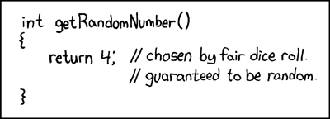
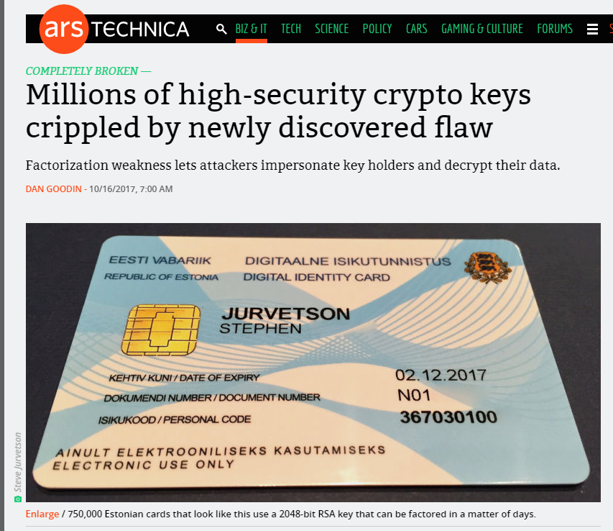
Be Careful Where You Get Your “Random Bits!”
RSA Keys Generated with weak PRG
Implementation Flaw
Unfortunately Commonplace
Resulting Keys are Vulnerable
Sophisticated Attack
Coppersmith’s Method
The Return of Coppersmith's Attack: Practical Factorization of Widely Used RSA Moduli (CCS 2017)

Slide 66
(Plain) RSA Encryption
Public Key: PK=(N,e)
Message $m∈ℤ_{N}^{}$
$$\text{Enc}\text{PK}\text{(}\text{m}\text{)}= \left[m^{e}\operatorname{mod}{N}\right]$$
Remark: Encryption is efficient if we use the power mod algorithm.

Slide 67
(Plain) RSA Decryption
Secret Key: SK=(N,d)
Ciphertext $c∈ℤ_{N}^{}$
$$\text{D}\text{e}\text{c}\text{S}\text{K}\text{(}\text{c}\text{)}= \left[c^{d}\operatorname{mod}{N}\right]$$
Remark 1: Decryption is efficient if we use the power mod algorithm.
Remark 2: Suppose that $m∈ ℤ_{N}^{∗}$ and let c=$\text{Enc}\text{PK}\text{(}\text{m}\text{)}= \left[m^{e}\operatorname{mod}{N}\right]$
$$\text{De}\text{c}\text{SK}\text{(}\text{c}\text{)}= \left[{\left(m^{e}\right)}^{d}\operatorname{mod}{N}\right]= \left[m^{ed}\operatorname{mod}{N}\right]$$
$$= \left[m^{[ed mod φ\left(N\right)]}\operatorname{mod}{N}\right]$$
$$= \left[m1\operatorname{mod}{N}\right]=m$$

Slide 68
RSA Decryption
Secret Key: SK=(N,d)
Ciphertext $c∈ℤ_{N}^{}$
$$\text{D}\text{e}\text{c}\text{S}\text{K}\text{(}\text{c}\text{)}= \left[c^{d}\operatorname{mod}{N}\right]$$
Remark 1: Decryption is efficient if we use the power mod algorithm.
Remark 2: Suppose that $m∈ ℤ_{N}^{∗}$ and let c=$\text{Enc}\text{PK}\text{(}\text{m}\text{)}= \left[m^{e}\operatorname{mod}{N}\right]$ then
$$\text{De}\text{c}\text{SK}\text{(}\text{c}\text{)}= m$$
Remark 3: Even if $m∈ℤ_{N}^{}− ℤ_{N}^{∗}$ and let $c=\text{Enc}\text{PK}\text{(}\text{m}\text{)}= \left[m^{e}\operatorname{mod}{N}\right]$ then
$$\text{De}\text{c}\text{SK}\text{(}\text{c}\text{)}= m$$
Use Chinese Remainder Theorem to show this
$$ed=1+k\left(p−1\right)\left(q−1\right)$$
$$→f\left(c^{d}\right)=\left(\left[m^{ed}\operatorname{mod}{p}\right],\left[m^{ed}\operatorname{mod}{q}\right]\right)=\left(\left[m^{1}\operatorname{mod}{p}\right],\left[m^{1}\operatorname{mod}{q}\right]\right)$$
$$→f^{−1}\left(f\left(c^{d}\right)\right)=f^{−1}\left(\left[m^{1}\operatorname{mod}{p}\right],\left[m^{1}\operatorname{mod}{q}\right]\right)=m$$

Slide 69
Plain RSA (Summary)
Public Key (pk): N = pq, e such that $GCD\left(e,φ\left(N\right)\right)=1$
$φ\left(N\right)=\left(p−1\right)\left(q−1\right)$ for distinct primes p and q
Secret Key (sk): N, d such that ed=1 mod $φ\left(N\right)$
Encrypt(pk=(N,e),m) = $m^{e} mod N$
Decrypt(sk=(N,d),c) = $c^{d} mod N$
$Decryption Works because$
$$\left[c^{d}mod N\right]=\left[m^{ed}mod N\right]=\left[m^{[ed mod φ\left(N\right)]}mod N\right]=\left[m mod N\right]$$

Slide 70
Factoring Assumption
Let GenModulus(1^{n}) be a randomized algorithm that outputs (N=pq,p,q) where p and q are n-bit primes (except with negligible probability negl(n)).
Experiment FACTOR_{A,n}
(N=pq,p,q) ← GenModulus(1^{n})
Attacker A is given N as input
Attacker A outputs p’ > 1 and q’ > 1
Attacker A wins if N=p’q’.

Slide 71
Factoring Assumption
Necessary for security of RSA.
Not known to be sufficient.
Experiment FACTOR_{A,n}
(N=pq,p,q) ← GenModulus(1^{n})
Attacker A is given N as input
Attacker A outputs p’ > 1 and q’ > 1
Attacker A wins ($\text{FACTOR}\text{A}\text{,}\text{n}=1$) if and only if N=p’q’.
$$∀PPT A ∃μ (negligible) s.t Pr\left[\text{FACTOR}\text{A}\text{,}\text{n}=1\right]≤μ(n)$$

Slide 72
RSA-Assumption
RSA-Experiment: RSA-INV_{A,n}
Run KeyGeneration(1^{n}) to obtain (N,e,d)
Pick uniform $y∈ ℤ_{N}^{∗}$
Attacker A is given N, e, y and outputs $x∈ ℤ_{N}^{∗}$
Attacker wins (RSA-INV_{A,n}=1) if $x^{e}=y mod N$
$$∀PPT A ∃μ (negligible) s.t Pr\left[\text{RSA}\text{−}\text{INVA}\text{,}\text{n} =1\right]≤μ(n)$$

Slide 73
RSA-Assumption
RSA-Experiment: RSA-INV_{A,n}
Run KeyGeneration(1^{n}) to obtain (N,e,d)
Pick uniform $y∈ ℤ_{N}^{∗}$
Attacker A is given N, e, y and outputs $x∈ ℤ_{N}^{∗}$
Attacker wins (RSA-INV_{A,n}=1) if $x^{e}=y mod N$
$$∀PPT A ∃μ (negligible) s.t Pr\left[\text{RSA}\text{−}\text{INVA}\text{,}\text{n}=1\right]≤μ(n)$$
Plain RSA Encryption behaves like a one-way function
Attacker cannot invert encryption of random message

Slide 74
Discussion of RSA-Assumption
Plain RSA Encryption behaves like a one-way-function
Decryption key is a “trapdoor” which allows us to invert the OWF
RSA-Assumption ➔ OWFs exist

Slide 75
Recap
Plain RSA
Public Key (pk): N = pq, e such that $GCD\left(e,φ\left(N\right)\right)=1$
$φ\left(N\right)=\left(p−1\right)\left(q−1\right)$ for distinct primes p and q
Secret Key (sk): N, d such that ed=1 mod $φ\left(N\right)$
Encrypt(pk=(N,e),m) = $m^{e} mod N$
Decrypt(sk=(N,d),c) = $c^{d} mod N$
$Decryption Works because$
$$\left[c^{d}mod N\right]=\left[m^{ed}mod N\right]=\left[m^{[ed mod φ\left(N\right)]}mod N\right]=\left[m mod N\right]$$

Slide 76
Mathematica Demo
https://www.cs.purdue.edu/homes/jblocki/courses/555_Spring17/slides/Lecture24Demo.nb
http://develop.wolframcloud.com/app/
Note: Online version of mathematica available at https://sandbox.open.wolframcloud.com (reduced functionality, but can be used to solve homework bonus problems)

Slide 77
(Toy) RSA Implementation in Mathematica
(* Random Seed 123456 is not secure, but it allows us to repeat the experiment *)
SeedRandom[123456]
(* Step 1: Generate primes for an RSA key *)
p = RandomPrime[{10^1000, 10^1050}];
q = RandomPrime[{10^1000, 10^1050}];
NN = p q; (*Symbol N is protected in mathematica *)
phi = (p - 1) (q - 1);
https://www.cs.purdue.edu/homes/jblocki/courses/555_Spring17/slides/Lecture24Demo.nb

Slide 78
(Toy) RSA Implementation in Mathematica
(* Step 1.A: Find e *)
GCD[phi,7]
Output: 7
(* GCD[phi,7] is not 1, so he have to try a different value of e *)
GCD[phi,3]
Output: 1
(* We can set e=3 *)
e=3;
https://www.cs.purdue.edu/homes/jblocki/courses/555_Spring17/slides/Lecture24Demo.nb

Slide 79
(Toy) RSA Implementation in Mathematica
(* Step 1.B find d s.t. ed = 1 mod N by using the extended GCD algorithm *)
(* Mathematica is clever enough to do this automatically *)
Solve[e x == 1, Modulus->phi]
Output:
{{x->36469680590663028301700626132883867272718728905205088...
…………………………………………………………………………………………………………
394069421778610209425624440980084481398131}}
(* We can now set d = x *)
d=364696805…. 8131;

Slide 80
(Toy) RSA Implementation in Mathematica
(* Double Check 1 = [ed mod $φ\left(N\right)]$ *)
Mod [e d, (p-1)(q-1)]
Output: 1
(* Encrypt the message 200, c= m^e mod N *)
m = 200;
PowerMod[m,e,NN]
Output: 8 000 000

Slide 81
(Toy) RSA Implementation in Mathematica
(* Encrypt the message 200, c= m^e mod N *)
m = 200;
PowerMod[m,e,NN]
Output: 8 000 000
(* Hm...That doesn't seem too secure *)
CubeRoot[PowerMod[m,e,NN]]
Output: 200
(* Moral: if $m^{e}<N$then Plain RSA does not hide the message m. *)

Slide 82
RSA Implementation in Mathematica
(* Encrypt a larger message, c= m^e mod N *)
SeedRandom[1234567];
m2= RandomInteger[{10^1500,10^1501}];
c=PowerMod[m2,e,NN]
Output: 405215834903772786……… 388068292685976133
(* Does it Decrypt Properly? *)
PowerMod[c,d, NN]-m2
Output: 0
(* Yes! *)

Slide 83
CS 555: Week 10: Topic 2 Attacks on Plain RSA

Slide 84
(Plain) RSA Discussion
We have not introduced security models like CPA-Security or CCA-security for Public Key Cryptosystems
However, notice that (Plain) RSA Encryption is stateless and deterministic.
→Plain RSA is not secure against chosen-plaintext attacks
As we will see Plain RSA is also highly vulnerable to chosen-ciphertext attacks

Slide 85
(Plain) RSA Discussion
However, notice that (Plain) RSA Encryption is stateless and deterministic.
→Plain RSA is not secure against chosen-plaintext attacks
Remark: In a public key setting the attacker who knows the public key always has access to an encryption oracle
Encrypted messages with low entropy are particularly vulnerable to brute-force attacks
Example: If $m<B$ then attacker can recover $m$ from $c={Enc}_{pk}\left(m\right)$after at most $B$ queries to encryption oracle (using public key)

Slide 86
Chosen Ciphertext Attack on Plain RSA
Attacker intercepts ciphertext $c=\left[m^{e}\operatorname{mod}{N}\right]$
Attacker generates ciphertext c’ for secret message 2m as follows
$\text{c}\text{’}=\left[\left(c2^{e}\right)\operatorname{mod}{N}\right]$
$=\left[\left(m^{e}2^{e}\right)\operatorname{mod}{N}\right]$
$=\left[{\left(2m\right)}^{e}\operatorname{mod}{N}\right]$
Attacker asks for decryption of $\left[c2^{e}\operatorname{mod}{N}\right]$ and receives 2m.
Divide by two to recover message
Above Example: Shows plain RSA is highly vulnerable to ciphertext-tampering attacks

Slide 87
More Weaknesses: Plain RSA with small e
(Small Messages) If m^{e} < N then we can decrypt c = m^{e} mod N directly e.g., m=c^{(1/e)}
(Partially Known Messages) If an attacker knows first 1-(1/e) bits of secret message $m=m_{1}\left\|??\right.$ then he can recover m given
$$Encrypt\left(pk,m\right)=m^{e} mod N$$
Theorem[Coppersmith]: If p(x) is a polynomial of degree e then in polynomial time (in log(N), 2e) we can find all m such that p(m) = 0 mod N and |m|<N^{(1/e)}

Slide 88
More Weaknesses: Plain RSA with small e
Theorem[Coppersmith]: If p(x) is a polynomial of degree e then in polynomial time (in log(N), e) we can find all m such that p(m) = 0 mod N and |m|<N^{(1/e)}
Example: e = 3, $m=m1\left\|m2\right.$ and attacker knows $m1\left(2k bits\right)$ and $c={\left(m1\left\|m2\right.\right)}^{e}mod N$, but not $m2\left(k bits\right)$
$$p\left(x\right)={\left(2^{k}m1+x\right)}^{3}−c$$
Polynomial has a small root mod N at x= $m2$ and coppersmith’s method will find it!
D. Coppersmith (1996). "Finding a Small Root of a Univariate Modular Equation".

Slide 89
More Weaknesses: Plain RSA with small e
Theorem[Coppersmith] (Informal): Can also find small roots of bivariate polynomial $p\left(x_{1},x_{2}\right)$
Similar Approach used to factor weak RSA secret keys N=q₁q₂
Weak PRG → Can guess many of the bits of prime factors
Obtain $\tilde{q_{1}}≈q_{1}$ and $\tilde{q_{2}}≈q_{2}$
Coppersmith Attack: Define polynomial p(.,.) as follows
$$p\left(x_{1},x_{2}\right)=\left(x_{1}+\tilde{q_{1}}\right)\left(x_{2}+\tilde{q_{2}}\right)−N$$
Small Roots of $p\left(x_{1},x_{2}\right)$: $x_{1}=q_{1}−\tilde{q_{1}}$ and $x_{2}=q_{2}−\tilde{q_{2}}$
D. Coppersmith (1996). "Finding a Small Root of a Bivariate Integer Equation; Factoring with high bits known"

Slide 90
The Return of Coppersmith's Attack: Practical Factorization of Widely Used RSA Moduli (CCS 2017)

Slide 91
RSA-Assumption
RSA-Experiment: RSA-INV_{A,n}
Run KeyGeneration(1^{n}) to obtain (N,e,d)
Pick uniform $y∈ ℤ_{N}^{∗}$
Attacker A is given N, e, y and outputs $x∈ ℤ_{N}^{∗}$
Attacker wins (RSA-INV_{A,n}=1) if $x^{e}=y mod N$
$$∀PPT A ∃μ (negligible) s.t Pr\left[\text{RSA}\text{−}\text{INVA}\text{,}\text{n} =1\right]≤μ(n)$$

Slide 92
(Plain) RSA Discussion
However, notice that (Plain) RSA Encryption is stateless and deterministic.
→Plain RSA is not secure against chosen-plaintext attacks
In a public key setting the attacker does have access to an encryption oracle
Encrypted messages with low entropy are vulnerable to a brute-force attack.

Slide 93
Fixes for Plain RSA
Approach 1: RSA-OAEP
Incorporates random nonce r
CCA-Secure (in random oracle model)
Approach 2: Use RSA to exchange symmetric key for Authenticated Encryption scheme (e.g., AES)
Key Encapsulation Mechanism (KEM)
More details in future lectures…stay tuned!
For now we will focus on attacks on Plain RSA

Slide 94
Chinese Remainder Theorem
Theorem: Let N = pq (where gcd(p,q)=1) be given and let ${f:ℤ}_{N}^{}→ℤp×ℤq$ be defined as follows
$$f\left(x\right)=\left([x mod p],[x mod q]\right)$$
then
f is a bijective mapping (invertible)
f and its inverse$f^{−1}:ℤp×ℤq→ℤ_{N}^{}$ can be computed efficiently
$f\left(x+y\right)=f\left(x\right)+f(y)$
The restriction of f to $ℤ_{N}^{∗}$ yields a bijective mapping to $ℤ_{p}^{∗}×ℤ_{q}^{∗}$
For inputs ${x,y∈ℤ}_{N}^{∗}$ we have $f\left(x\right)f\left(y\right)=f\left(xy\right)$

Slide 95
Chinese Remainder Theorem
Application of CRT: Faster computation
Example: Compute [11⁵³ mod 15]
f(11)=([-1 mod 3],[1 mod 5])
f(11⁵³) =([(-1)⁵³ mod 3],[1⁵³ mod 5])= (-1,1)
$f^{−1}$(-1,1)=11
Thus, 11=[11⁵³ mod 15]

Slide 96
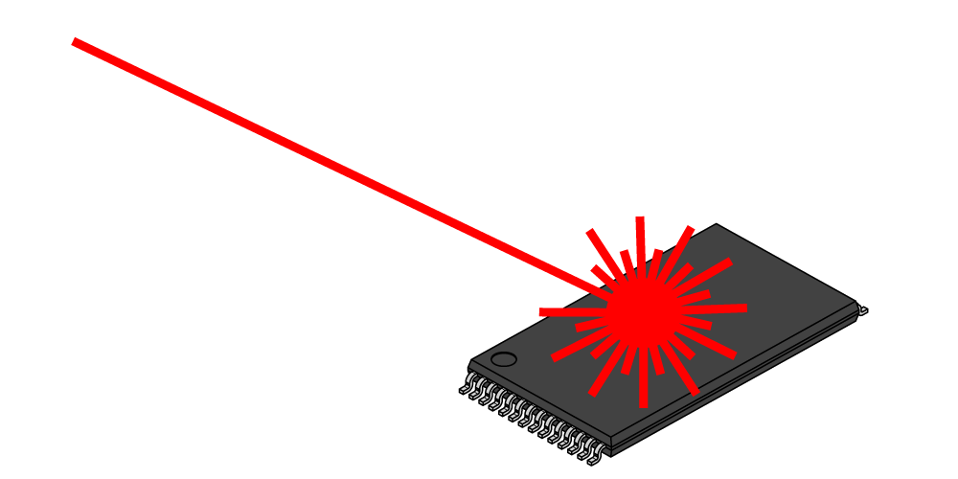
A Side Channel Attack on RSA with CRT
Suppose that decryption is done via Chinese Remainder Theorem for speed.
$${Dec}_{sk}^{}\left(c\right)=c^{d} mod N↔\left(c^{d} mod p,c^{d} mod q\right)$$
Attacker has physical access to smartcard
Can mess up computation of $c^{d} mod p$
Response is $R↔\left(r,c^{d} mod q\right)$
$R−m↔\left(r−m mod p,0 mod q\right)$
GCD(R-m,N)=q

Slide 97
Recovering Encrypted Message faster than Brute-Force
Claim: Let m < 2^{n} be a secret message. For some constant $α=\frac{1}{2}+ε.$ We can recover m in in time ${T=2}^{αn}$ with high probability.
For r=1,…,T
let $xr=\left[cr^{−e}mod N\right]$, where $r^{−e}={\left(r^{−1}\right)}^{e}mod N$
Sort $L={\left\{\left(r,x_{r}\right)\right\}}_{r=1}^{T}$ (by the x_{r} values)
For s=1,…,T
if $\left[s^{e}mod N\right]=x_{r}$ for some r then
return $\left[rs mod N\right]$

Slide 98
Recovering Encrypted Message faster than Brute-Force
For r=1,…,T
let $xr=\left[cr^{−e}mod N\right]$, where $r^{−e}={\left(r^{−1}\right)}^{e}mod N$
Sort $L={\left\{\left(r,x_{r}\right)\right\}}_{r=1}^{T}$ (by the x_{r} values)
For s=1,…,T
if $\left[s^{e}mod N\right]=x_{r}$ for some r then
return $\left[rs mod N\right]$
Analysis: $\left[rs mod N\right]=\left[r\left(s^{e}\right)d mod N\right]=\left[r\left(xr\right)d mod N\right]$
$$=\left[r\left(cr^{−e}\right)d mod N\right]=\left[rr^{−ed}\left(c\right)d mod N\right]$$
$$=\left[rr^{−1}m mod N\right]=m$$

Slide 99
Recovering Encrypted Message faster than Brute-Force
For r=1,…,T
let $xr=\left[cr^{−e}mod N\right]$, where $r^{−e}={\left(r^{−1}\right)}^{e}mod N$
Sort $L={\left\{\left(r,x_{r}\right)\right\}}_{r=1}^{T}$ (by the x_{r} values)
For s=1,…,T
if $\left[s^{e}mod N\right]=x_{r}$ for some r then
return $\left[rs mod N\right]$
Fact: some constant $α=\frac{1}{2}+ε$ setting ${T=2}^{αn}$ with high probability we will find a pair s and x_{r} with $\left[s^{e}mod N\right]=xr$.

Slide 100
Recovering Encrypted Message faster than Brute-Force
Claim: Let m < 2^{n} be a secret message. For some constant $α=\frac{1}{2}+ε.$ We can recover m in in time ${T=2}^{αn}$ with high probability.
Roughly $\sqrt{B}$ steps to find a secret message m < B

Slide 101
CS 555: Week 10: Topic 3 Discrete Log + DDH Assumption

Slide 102
(Recap) Finite Groups
Definition: A (finite) group is a (finite) set $𝔾$with a binary operation $∘$ (over G) for which we have
(Closure:) For all $g,h∈𝔾$ we have $g∘h∈𝔾$
(Identity:) There is an element $e∈𝔾$ such that for all $g∈𝔾$ we have
$$g∘e=g=e∘g$$
(Inverses:) For each element $g∈𝔾$ we can find $h∈𝔾$ such that $g∘h=e$. We say that h is the inverse of g.
(Associativity: ) For all $g1,g2,g3∈𝔾$ we have
$$\left(g1∘g2\right)∘g3=g1∘\left(g2∘g3\right)$$
We say that the group is abelian if
(Commutativity:) For all $g,h∈𝔾$ we have $g∘h=$ $h∘g$

Slide 103
Finite Abelian Groups (Examples)
Example 1: $ℤ_{N}^{}$ when $∘$ denotes addition modulo N
Identity: 0, since 0 $∘$x =[0+x mod N] = [x mod N].
Inverse of x? Set x⁻¹=N-x so that [x⁻¹+x mod N] = [N-x+x mod N] = 0.
Example 2: $ℤ_{N}^{∗}$ when $∘$ denotes multiplication modulo N
Identity: 1, since 1$∘$x =[1(x) mod N] = [x mod N].
Inverse of x? Run extended GCD to obtain integers a and b such that
$$ax+bN=\gcd\left(x,N\right)=1$$
Observe that: x⁻¹ = a. Why?

Slide 104
Cyclic Group
Let $𝔾 be a group with order m=\left|𝔾\right|$with a binary operation $∘$ (over G) and let $g∈𝔾$ be given consider the set
$$\left\langle g\right\rangle =\left\{g0,g1,g2,…\right\}$$
Fact: $\left\langle g\right\rangle$ defines a subgroup of $𝔾.$
Identity: $g0$
Closure: $gi∘gj=g^{i+j}∈\left\langle g\right\rangle$
g is called a “generator” of the subgroup.
Fact: Let $r=\left|\left\langle g\right\rangle \right|$ then $g^{i }=gj$ if and only if $i=j mod r$. Also m is divisible by r.

Slide 105
Finite Abelian Groups (Examples)
Fact: Let p be a prime then $ℤ_{p}^{∗}$ is a cyclic group of order p-1.
Note: Number of generators g s.t. of $\left\langle g\right\rangle =ℤ_{p}^{∗}$ is $φ\left(p−1\right)$
Example (non-generator): p=7, g=2
<2>={1,2,4}
Example (generator): p=7, g=5
<2>={1,5,4,6,2,3}

Slide 106
Discrete Log Experiment DLog_{A,G}(n)
Run G(1^{n}) to obtain a cyclic group $𝔾$ of order q (with $\left\|q\right\|=n$) and a generator g such that $<g>=𝔾$.
Select$h∈𝔾$ uniformly at random.
Attacker A is given $𝔾$, q, g, h and outputs integer x.
Attacker wins (DLog_{A,G}(n)=1) if and only if g^{x}=h.
We say that the discrete log problem is hard relative to generator G if
$$∀PPT A ∃μ (negligible) s.t Pr\left[\text{DLog}\text{A}\text{,}\text{n} =1\right]≤μ(n)$$

Slide 107
Diffie-Hellman Problems
Computational Diffie-Hellman Problem (CDH)
Attacker is given $h1=g^{x_{1}}∈𝔾$ and $h2=g^{x_{2}}∈𝔾.$
Attackers goal is to find${ g}^{x_{1}x_{2}}={\left(h1\right)}^{x_{2}}={\left(h2\right)}^{x_{1}}$
CDH Assumption: For all PPT A there is a negligible function negl upper bounding the probability that A succeeds with probability at most negl(n).
Decisional Diffie-Hellman Problem (DDH)
L$et z0={ g}^{x_{1}x_{2}}$ and let $z1={ g}^{r}$, where x₁,x₂ and r are random
Attacker is given $g^{x_{1}}$, $g^{x_{2}}$ and $zb$ (for a random bit b)
Attackers goal is to guess b
DDH Assumption: For all PPT A there is a negligible function negl such that A succeeds with probability at most ½ + negl(n).

Slide 108
Secure key-agreement with DDH
Alice publishes ${ g}^{xA}$ and Bob publishes ${ g}^{xB}$
Alice and Bob can both compute ${K_{A,B}=g}^{xB xA}$ but to Eve this key is indistinguishable from a random group element (by DDH)
Remark: Protocol is vulnerable to Man-In-The-Middle Attacks if Bob cannot validate ${ g}^{xA}$.

Slide 109
Can we find a cyclic group where DDH holds?
Example 1: $ℤ_{p}^{∗}$ where p is a random n-bit prime.
CDH is believed to be hard
DDH is *not* hard (Exercise 13.15)
Theorem: $Let$p=rq+1 be a random n-bit prime where q is a large $λ$-bit prime then the set of r^{th} residues modulo p is a cyclic subgroup of order q. Then $𝔾_{r}=\left\{[h^{r}mod p] | {h∈ℤ}_{p}^{∗}\right\}$is a cyclic subgroup of $ℤ_{p}^{∗}$ of order q.
Remark 1: DDH is believed to hold for such a group
Remark 2: It is easy to generate uniformly random elements of $𝔾_{r}$
Remark 3: Any element (besides 1) is a generator of $𝔾_{r}$

Slide 110
Can we find a cyclic group where DDH holds?
Theorem: $Let$p=rq+1 be a random n-bit prime where q is a large $λ$-bit prime then the set of rth residues modulo p is a cyclic subgroup of order q. Then $𝔾_{r}=\left\{[h^{r}mod p] | {h∈ℤ}_{p}^{∗}\right\}$is a cyclic subgroup of $ℤ_{p}^{∗}$ of order q.
Closure: $hrgr={\left(hg\right)}^{r}$
Inverse of $hr$ is ${\left(h^{−1}\right)}^{r}∈𝔾_{r}$
Size ${\left(hr\right)}^{x}=h^{[rx mod rq]}={{\left(hr\right)}^{x}=h}^{r[x mod q]}={\left(hr\right)}^{[x mod q]}mod p$
Remark: Two known attacks on Discrete Log Problem for $𝔾_{r}$(Section 9.2).
First runs in time $O\left(\sqrt{q}\right)=O\left(2^{λ/2}\right)$
Second runs in time $2^{O\left(\sqrt[3]{n}{\left(\log{n}\right)}^{2/3}\right)}$

Slide 111
Can we find a cyclic group where DDH holds?
Remark: Two known attacks (Section 9.2).
First runs in time $O\left(\sqrt{q}\right)=O\left(2^{λ/2}\right)$
Second runs in time $2^{O\left(\sqrt[3]{n}{\left(\log{n}\right)}^{2/3}\right)},$where n is bit length of p
Goal: Set $λ$ and n to balance attacks
$$λ=O\left(\sqrt[3]{n}{\left(\log{n}\right)}^{2/3}\right)$$
How to sample p=rq+1?
First sample a random $λ$-bit prime q and
Repeatedly check if rq+1 is prime for a random n- $λ$ bit value r

Slide 112
Can we find a cyclic group where DDH holds?
Elliptic Curves Example: Let p be a prime (p > 3) and let A, B be constants. Consider the equation
$$y2=x3+Ax+B mod p$$
And let
$$E\left(ℤ_{p}^{}\right)=\left\{\left(x,y\right)∈ℤ_{p}^{2} | y2=x3+Ax+B mod p \right\}∪\left\{𝒪\right\}$$
Note: $𝒪$ is defined to be an additive identity $\left(x,y\right)+𝒪=\left(x,y\right)$
W$hat is \left(x1,y1\right)+\left(x2,y2\right)?$

Slide 113
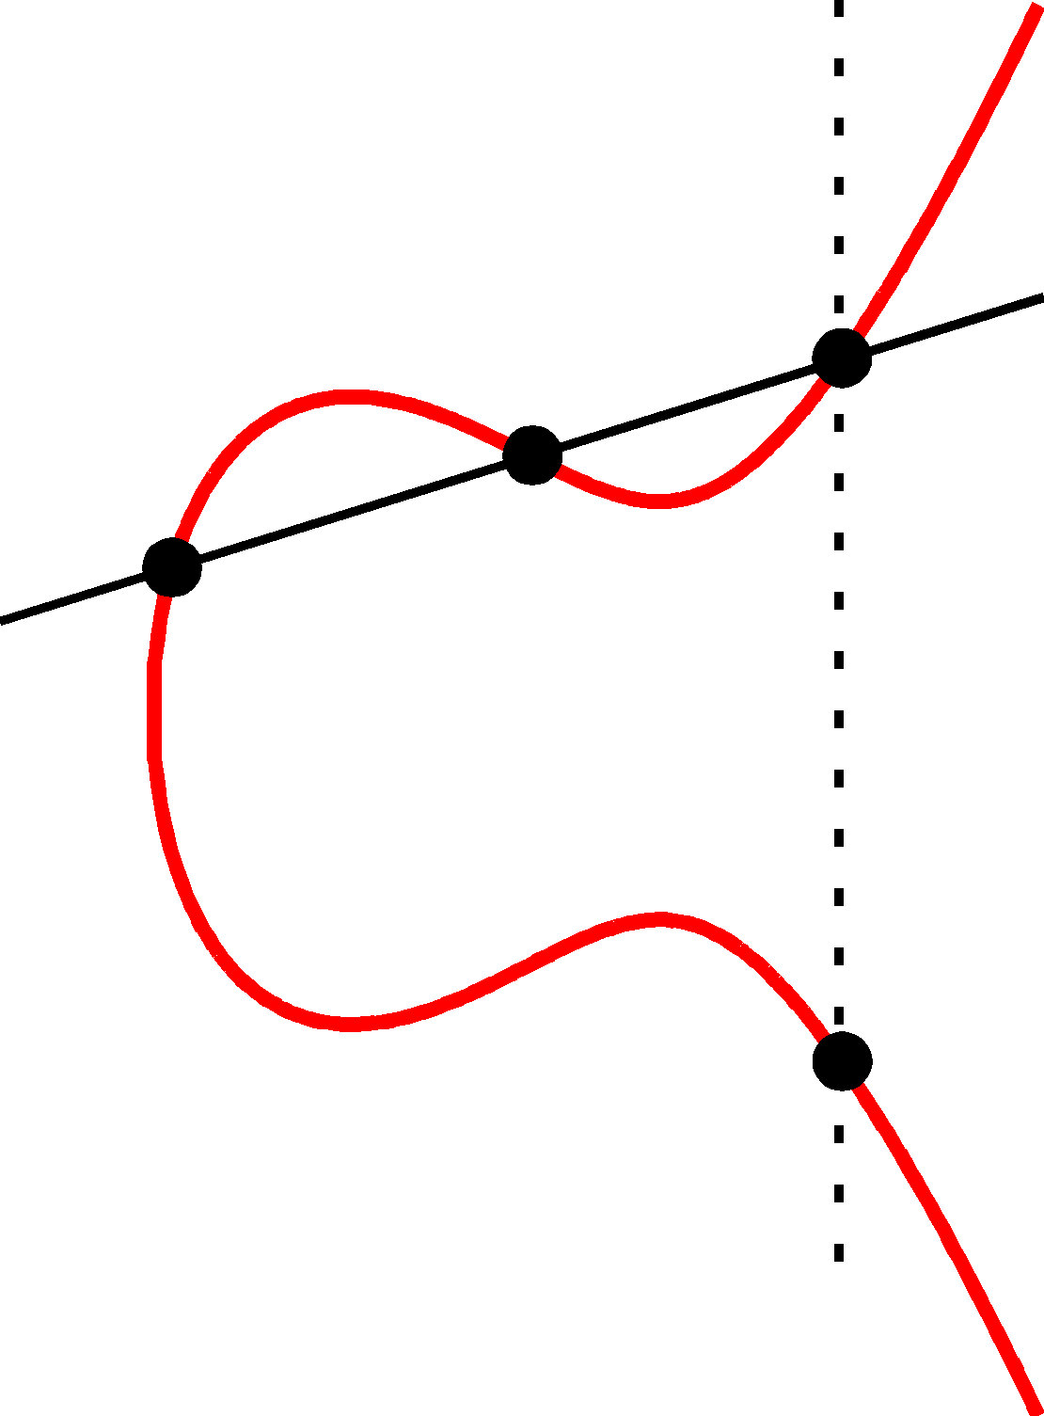
Elliptic Curve Example
$$\left(x2,y2\right)$$
(x₃,y₃)
The line passing through $\left(x1,y1\right)$ and $\left(x2,y2\right)$ has the equation
$$y=m\left(x−x1\right)+y1 mod P$$
Where the slope
$$m=\left[\frac{y1−y2}{x1−x2} mod p\right]$$
$$\left(x1,y1\right)$$
(x₃,-y₃)=$\left(x1,y1\right)+\left(x2,y2\right)$

Slide 114
Elliptic Curve Example
$$\left(x2,y2\right)$$
(x₃,y₃)
$$\left(x1,y1\right)$$
Formally, let
$$m=\left[\frac{y1−y2}{x1−x2} mod p\right]$$
Be the slope. Then the line passing through $\left(x1,y1\right)$ and $\left(x2,y2\right)$ has the equation
$$y=m\left(x−x1\right)+y1 mod P$$
$$\left(m\left(x−x1\right)+y1\right)2=x3+Ax+B mod p$$
(x₃,-y₃)=$\left(x1,y1\right)+\left(x2,y2\right)$
$$x3=[m2−x1−x2 mod p]$$
$$y3=[m\left(x3−x1\right)+y1 mod p]$$

Slide 115
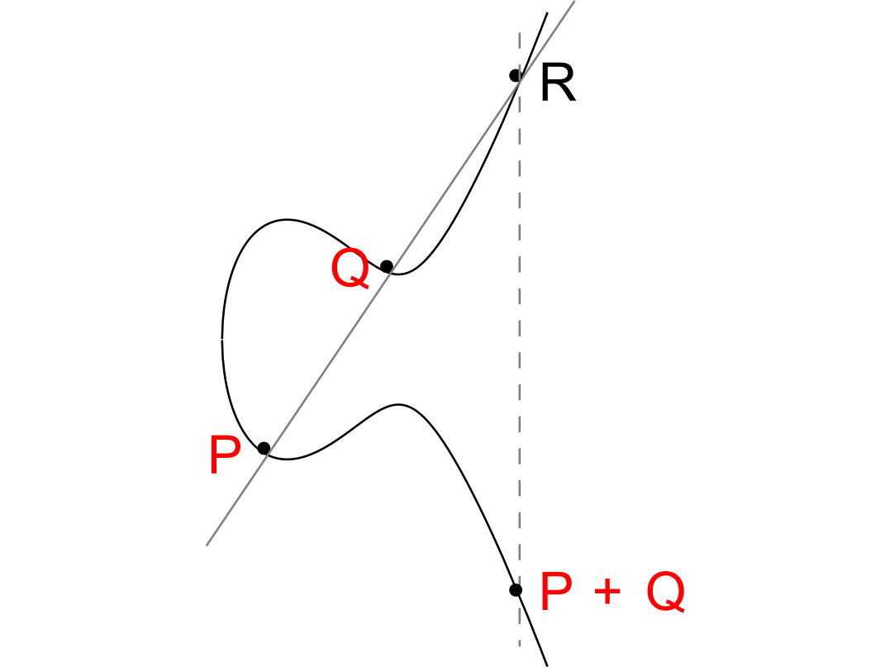

Slide 116
Elliptic Curve Example
No third point R on the elliptic curve.
P+Q = 0
(Inverse)

Slide 117
Can we find a cyclic group where DDH holds?
Elliptic Curves Example: Let p be a prime (p > 3) and let A, B be constants. Consider the equation
$$y2=x3+Ax+B mod p$$
And let
$$E\left(ℤ_{p}^{}\right)=\left\{\left(x,y\right)∈ℤ_{p}^{2} | y2=x3+Ax+B mod p \right\}∪\left\{𝒪\right\}$$
Fact: $E\left(ℤ_{p}^{}\right)$ defines an abelian group
For appropriate curves the DDH assumption is believed to hold
If you make up your own curve there is a good chance it is broken…
NIST has a list of recommendations

