Slide 1
Cryptography CS 555
Week 7:
AES
One Way Functions
Readings: Katz and Lindell Chapter 6.2.5, 6.3, 7.1-7.4
Spring 2021

Slide 2
Recap
Block Ciphers, SPNs, Feistel Networks, DES
Meet in the Middle, 3DES
Building Stream Ciphers
Linear Feedback Shift Registers (+ Attacks)
RC4 (+ Attacks)
Trivium

Slide 3
CS 555: Week 7: Topic 1 Block Ciphers (Continued)

Slide 4
Advanced Encryption Standard (AES)
(1997) US National Institute of Standards and Technology (NIST) announces competition for new block cipher to replace DES
Fifteen algorithms were submitted from all over the world
Analyzed by NIST
Contestants given a chance to break competitors schemes
October, 2000 NIST announces a winner Rijndael
Vincent Rijmen and Joan Daemen
No serious vulnerabilities found in four other finalists
Rijndael was selected for efficiency, hardware performance, flexibility etc…

Slide 5
Advanced Encryption Standard
Block Size: 128 bits (viewed as 4x4 byte array)
Key Size: 128, 192 or 256
Essentially a Substitution Permutation Network
AddRoundKey: Generate 128-bit sub-key from master key XOR with current state
SubBytes: Each byte of state array (16 bytes) is replaced by another byte according a a single S-box (lookup table)
ShiftRows – shift ith row by i bytes
MixColumns – permute the bits in each column

Slide 6
Substitution Permutation Networks
S-box a public “substitution function” (e.g.$S∈\text{Perm}\text{8}$).
S is not part of a secret key, but can be used with one
$$f(x)=S\left(\text{x}⨁k\right)$$
Input to round: x, k (k is subkey for current round)
Key Mixing: Set $x≔x⨁k$
Substitution:$x≔$ $\text{S}\text{1}\left(\text{x}\text{1}\right)∥\text{S}\text{2}\left(\text{x}\text{2}\right)∥…∥\text{S}\text{8}\left(\text{x}\text{8}\right)$
Bit Mixing Permutation: permute the bits of x to obtain the round output
Note: there are only n! possible bit mixing permutations of [n] as opposed to 2^{n}! Permutations of {0,1}^{n}

Slide 7
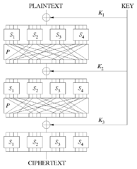
Substitution Permutation Networks
Proposition 6.3: Let F be a keyed function defined by a Substitution Permutation Network. Then for any keys/number of rounds F_{k} is a permutation.
Why? Composing permutations f,g results in another permutation h(x)=g(f(x)).

Slide 8
Advanced Encryption Standard
Key Mixing
Block Size: 128 bits
Key Size: 128, 192 or 256
Essentially a Substitution Permutation Network
AddRoundKey: Generate 128-bit sub-key from master key, XOR with current state array
SubBytes: Each byte of state array (16 bytes) is replaced by another byte according a single S-box (lookup table)
ShiftRows
MixColumns
Bit Mixing Permutation
Substitution

Slide 9
AddRoundKey:
Round Key (16 Bytes)
00001111 | … | … | …
10100011 | … | … | …
11001100 | … | … | …
01111111 | … | … | …
$$⨁$$
State
11110000 | … | … | …
01100010 | … | … | …
00110000 | … | … | …
11111111 | … | … | …
$$=$$
11111111 | … | … | …
11000001 | … | … | …
11111100 | … | … | …
10000000 | … | … | …

Slide 10
AddRoundKey:
Round Key (16 Bytes)
 | … | … | …
10100011 | … | … | …
 | … | … | …
 | … | … | …
State
11111111 | … | … | …
11000001 | … | … | …
11111100 | … | … | …
10000000 | … | … | …
SubBytes (Apply S-box)
S(11111111) | S(…) | S(…) | S(…)
S(11000001) | S(…) | S(…) | S(…)
S(11111100) | S(…) | S(…) | S(…)
S(10000000) | S(…) | S(…) | S(…)

Slide 11
AddRoundKey:
Round Key (16 Bytes)
10100011 | …
 |  | …
 |  |  | …
State
S(11111111) | S(…) | S(…) | S(…)
S(11000001) | S(…) | S(…) | S(…)
S(11111100) | S(…) | S(…) | S(…)
S(10000000) | S(…) | S(…) | S(…)
Shift Rows
S(11111111) | S(…) | S(…) | S(…)
S(…) | S(11000001) | S(…) | S(…)
S(…) | S(…) | S(11111100) | S(…)
S(…) | S(…) | S(…) | S(10000000)

Slide 12
AddRoundKey:
Round Key (16 Bytes)
10100011 | …
 |  | …
 |  |  | …
State
S(11111111)
 | S(11000001) | S(…)
S(…) |  | S(11111100)
 |  | S(…) | S(10000000)
Mix Columns
Invertible (linear) transformation.
Key property: if inputs differ in b>0 bytes then output differs in 5-b bytes (minimum)

Slide 13
AES
We just described one round of the SPN
AES uses
10 rounds (with 128 bit key)
12 rounds (with 192 bit key)
14 rounds (with 256 bit key)

Slide 14
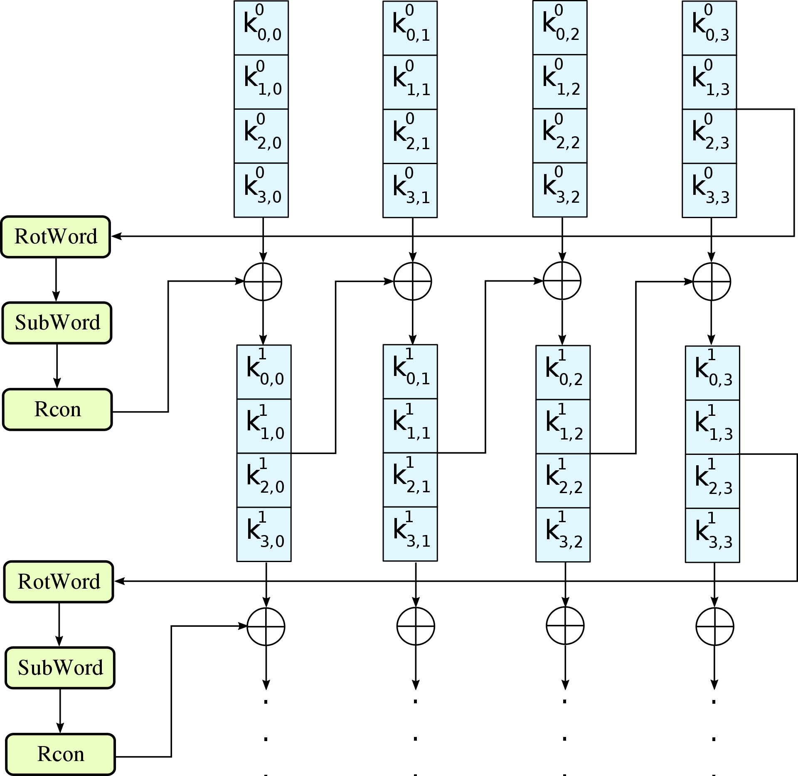
AES-128: Key Schedule

Slide 15
Announcements
Homework 2 Solutions Posted (See Piazza).
Please read through carefully and make sure you understand the solutions to each problem.
Grading in progress
No Class on Tuesday (October Break)
Look for Practice Midterm Next Week

Slide 16
AES Attacks?
Side channel attacks affect a few specific implementations
But, this is not a weakness of AES itself
Timing attack on OpenSSL’s implementation AES encryption (2005, Bernstein)
(2009) Related-Key Attack on 11 round version of AES
Related Key Attack: Attacker convinces Alice to use two related (but unknown) keys
recovers 256-bit key in time 2⁷⁰
But AES is 14 round (with 256 bit key) so the attack doesn’t apply in practice
(2009) Related Key Attack on 192-bit and 256 bit version of AES
recovers 256-bit key in time 2^{99.5}.
(2011) Key Recovery attack on AES-128 in time 2^{126.2}.
Improved to 2^{126.0} for AES-128, 2^{189.9} for AES-192 and 2^{254.3} for AES-256
First public cipher approved by NSA for Top Secret information
SECRET level (AES-128,AES-192 & AES-256), TOP SECRET level (AES-128,AES-192 & AES-256)
Notes:
In April 2005, D.J. Bernstein announced a cache-timing attack that he used to break a custom server that used OpenSSL's AES encryption.^{[20]} The custom server was designed to give out as much timing information as possible (the server reports back the number of machine cycles taken by the encryption operation), and the attack required over 200 million chosen plaintexts.^{[21]}

Slide 17
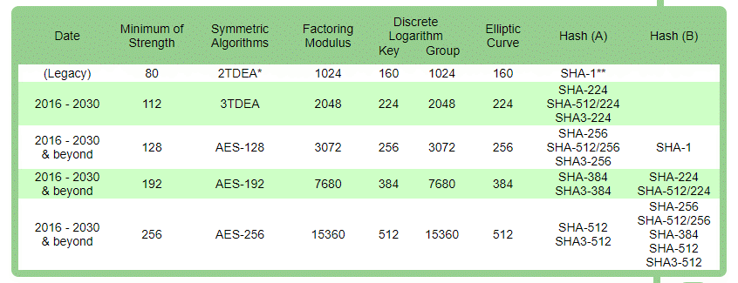
NIST Recommendations
Ok, as CRHF and in Digital Signatures
Ok, to use for HMAC, Key Derivation and as PRG
80 bits-security is no longer acceptable
Recommendations from Other Groups (Including NIST): www.keylength.com

Slide 18
AES-GCM
Note: just because AES is a good block cipher does not mean that all modes of operation that use AES are secure.
ECB Penguin
AES-GCM: authenticated encryption with associated data
Increasing deployment: TLS 1.2, TLS 1.3, QUIC
Hardware support for AES + AES-GCM in many modern processors

Slide 19
Differential Cryptanalysis
Definition: We say that the differential $\left(△_{x},△_{y}\right)$ occurs with probability $p$ in the keyed block cipher $F$ if
$$Pr\left[F_{K}\left(x_{1}\right)⨁F_{K}\left(x_{1}⨁△_{x}\right)=△_{y}\right]≥p$$
Can Lead to Efficient (Round) Key Recovery Attacks
Exploiting Weakness Requires: well over $\frac{1}{p}$ chosen plaintext-ciphertext pairs
Differentials in S-box can lead to (weaker) differentials in SPN.

Slide 20
Linear Cryptanalysis
$$y=F_{K}\left(x\right)$$
Definition: Fixed set of input bits $i_{1},…,i_{in}$ and output bits $i_{1}′,…,i_{out}′$ are said to have $ε$-linear bias if the following holds
$$\left|Pr\left[x_{i_{1}}⨁x_{i_{2}}…⨁x_{i_{in}}⨁y_{i_{1}′}⨁y_{i_{2}′}…⨁y_{i_{out}′}\right]\right|=ε$$
(randomness taken over the selection of input x and secret key K)

Slide 21
Linear Cryptanalysis
Definition: Fixed set of input bits $i_{1},…,i_{in}$ and output bits $i_{1}′,…,i_{out}′$ are said to have $ε$-linear bias if the following holds
$$\left|Pr\left[x_{i_{1}}⨁x_{i_{2}}…⨁x_{i_{in}}⨁y_{i_{1}′}⨁y_{i_{2}′}…⨁y_{i_{out}′}\right]−\frac{1}{2}\right|=ε$$
(randomness taken over the selection of input x and secret key K, $y=F_{K}\left(x\right)$)
Matsui: DES can be broken with just $2^{43}$ known plaintext/ciphertext pairs.
Lots of examples needed!
But the examples do not need to be chosen plaintext/ciphertext pairs…
One encrypted file can provide a large amounts of known plaintext

Slide 22
Recap
2DES, Meet in the Middle Attack
3DES
Stream Ciphers
Breaking Linear Feedback Shift Registers
Trivium
AES

Slide 23
CS 555: Week 8: Topic 1: One Way Functions
What are the minimal assumptions necessary for symmetric key-cryptography?

Slide 24
One-Way Functions (OWFs)
$$f\left(x\right)=y$$
Definition: A function $f:{\left\{0,1\right\}}^{∗}→{\left\{0,1\right\}}^{∗}$ is one way if it is
(Easy to compute) There is a polynomial time algorithm (in |x|) for computing f(x).
(Hard to Invert) Select $x←{\left\{0,1\right\}}^{n}$ uniformly at random and give the attacker input 1^{n}, f(x). The probability that a PPT attacker outputs x’ such that $f\left(x′\right)=f(x)$ is negligible in n.

Slide 25
One-Way Functions (OWFs)
$$f\left(x\right)=y$$
Key Takeaway: One-Way Functions is a necessary and sufficient assumption for most of symmetric key cryptography.
From OWFs we can construct PRGs, PRFs, Authenticated Encryption
From eavesdropping secure encryption (weakest) notion we can construct OWFs

Slide 26
One-Way Functions (OWFs)
$$f\left(x\right)=y$$
Remarks:
A function that is not one-way is not necessarily always easy to invert (even often)
Any such function can be inverted in time 2^{n} (brute force)
Length-preserving OWF: |f(x)| = |x|
One way permutation: Length-preserving + one-to-one

Slide 27
One-Way Functions (OWFs)
$$f\left(x\right)=y$$
Remarks:
f(x) does not necessarily hide all information about x.
If f(x) is one way then so is $f^{′}\left(x\right)=f\left(x\right)∥LSB\left(x\right).$

Slide 28
One-Way Functions (OWFs)
$$f\left(x\right)=y$$
Remarks:
Actually we usually consider a family of one-way functions
$$f_{I}:{\left\{0,1\right\}}^{I}→{\left\{0,1\right\}}^{I}$$

Slide 29
Candidate One-Way Functions
$$f_{ss}\left(x_{1},…,x_{n},J\right)=\left(x_{1},…,x_{n},\sum_{i∈J}{x_{i}}\operatorname{mod}{2^{n}}\right)$$
(Subset Sum Problem is NP-Complete)
Note: $J⊂[n]$ and $0{≤x}_{i}≤2^{n}−1$

Slide 30
Candidate One-Way Functions
$$f_{ss}\left(x_{1},…,x_{n},J\right)=\left(x_{1},…,x_{n},\sum_{i∈J}{x_{i}}\operatorname{mod}{2^{n}}\right)$$
(Subset Sum Problem is NP-Complete)
Question: Does $P≠NP$ imply this is a OWF?
Answer: No! $P≠NP$ only implies that any polynomial-time algorithm fails to solve “some instance” of subset sum. By contrast, we require that PPT attacker fails to solve “almost all instances” of subset sum.

Slide 31
Candidate One-Way Functions (OWFs)
$$f_{p,g}\left(x\right)=[g^{x}\operatorname{mod}{p}]$$
(Discrete Logarithm Problem)
Note: The existence of OWFs implies $P≠NP$ so we cannot be absolutely certain that they do exist.

Slide 32
How to Build a PRG with One-Way Functions?

Slide 33
Hard Core Predicates
Recall that a one-way function f may potentially reveal lots of information about input
Example: f(x₁,x₂)=(x₁,g(x₂)), where g is a one-way function.
Claim: f is one-way (even though f(x₁,x₂) reveals half of the input bits!)

Slide 34
Hard Core Predicates
Definition: A predicate $hc:{\left\{0,1\right\}}^{∗}→\left\{0,1\right\}$ is called a hard-core predicate of a function f if
(Easy to Compute) $hc$ can be computed in polynomial time
(Hard to Guess) For all PPT attacker A there is a negligible function negl such that we have
$${Pr}_{x←{\left\{0,1\right\}}^{n}}\left[A\left(1^{n},f(x)\right)=hc(x)\right]≤\frac{1}{2}+negl(n)$$

Slide 35
Attempt 1: Hard-Core Predicate
Consider the predicate
$$hc\left(x\right)= ⨁_{i=1}^{n}x_{i}$$
Hope: hc is hard core predicate for any OWF.
Counter-example:
f(x) = (g(x), $⨁_{i=1}^{n}x_{i}$)

Slide 36
Trivial Hard-Core Predicate
Consider the function
f(x₁,…,x_{n}) = x₁,…,x_{n-1}
f has a trivial hard core predicate
$$hc\left(x\right)= x_{n}$$
Not useful for crypto applications (e.g., f is not a OWF)

Slide 37
Attempt 3: Hard-Core Predicate
Consider the predicate
$$hc\left(x,r\right)= ⨁_{i=1}^{n}x_{i}r_{i}$$
(the bits $r_{1}$,…, $r_{n}$ will be selected uniformly at random)
Goldreich-Levin Theorem: (Assume OWFs exist) For any OWF f, hc is a hard-core predicate of g(x,r)=(f(x),r).
Question: Why is g a OWF?

Slide 38
Attempt 3: Hard-Core Predicate
Consider the predicate
$$hc\left(x,r\right)= ⨁_{i=1}^{n}x_{i}r_{i}$$
(the bits $r_{1}$,…, $r_{n}$ will be selected uniformly at random)
Goldreich-Levin Theorem: (Assume OWFs exist) For any OWF f, hc is a hard-core predicate of g(x,r)=(f(x),r).
Intuition: If ${Pr}_{x←{\left\{0,1\right\}}^{n}}\left[A\left(1^{n},g(x,r)\right)=hc(x,r)\right]≥\frac{1}{2}+\frac{1}{p\left(n\right)}$ is non-negligible then we can recover $x$ by repeatedly running $A\left(1^{n},\text{(}\text{f}\text{(}\text{x}\text{),}\text{r}\text{′)}\right)$ for inputs $r′$ of our choosing.

Slide 39
Using Hard-Core Predicates
Theorem: Given a one-way-permutation f and a hard-core predicate hc we can construct a PRG G with expansion factor $ℓ\left(n\right)=n+1.$
Construction:
$$G\left(s\right)=f(s)∥hc(s)$$
Intuition: f(s) is actually uniformly distributed
s is random
f(s) is a permutation
Last bit is hard to predict given f(s) (since hc is hard-core for f)

Slide 40
Arbitrary Expansion
Theorem: Suppose that there is a PRG G with expansion factor $ℓ\left(n\right)=n+1.$ Then for any polynomial p(.) there is a PRG with expansion factor p(n).
Construction:
G¹(x) = G(x):= y || b. (n+1 bits)
G²(x) = G¹ (y)||b (n+2 bits)
G^{i+1}(x) = G^{i}(y) || b where G^{i} (x) = y||b
First n bits of output
Last i bits of output
n+i+1 bits
Notes:
Adv_i Pr[attacker can

Slide 41
And Beyond…
Theorem: Suppose that there is a PRG G with expansion factor $ℓ\left(n\right)=n+1.$ Then for any polynomial p(.) there is a PRG with expansion factor p(n).
Theorem: Suppose that there is a PRG G with expansion factor $ℓ\left(n\right)=2n.$ Then there is a secure PRF.
Theorem: Suppose that there is a secure PRF then there is a strong pseudorandom permutation.

Slide 42
And Beyond…
Corollary: If one-way functions exist then PRGs, PRFs and strong PRPs all exist.
Corollary: If one-way functions exist then there exist CCA-secure encryption schemes and secure MACs.

Slide 43
Announcements
Homework 3 due tonight 11:59PM on Gradescope
Quiz 3 released today
Due Saturday, March 6 at 11:30PM on Brightspace
Midterm on March 11th in class
If you are not able to take the exam in class (e.g., quarantine) let me know and we can arrange an alternative
Allowed to prepare a 1 page cheat sheet
Practice Exam released this weekend

Slide 44
Recap
AES
One Way Functions/One Way Permutations
Hard Core Predicate
PRG with from OWP + Hard Core Predicate (n+1)
PRG with arbitrary expansion from PRG with expansion (n+1)
G¹(x) = G(x) (n+1 bits)
G^{i+1}(x) = G^{i}(y) || z where G^{i} (x) = y || z
PRGs ➔ PRFs (and PRPs/MACs/authenticated encryption)
First n bits of output
Last i bits of output
n+i+1 bits

Slide 45
PRFs from PRGs
Theorem: Suppose that there is a PRG G with expansion factor $ℓ\left(n\right)=2n.$ Then there is a secure PRF.
Let G(x) = G₀(x)||G₁(x) (first/last n bits of output)
$$F_{K}\left(x_{1},…,x_{n}\right)=G_{x_{n}}\left(…\left(G_{x_{2}}\left(G_{x_{1}}\left(K\right)\right)\right)…\right)$$

Slide 46
PRFs from PRGs
n-bits
n-bits
G(x):= G₀(x) || G₁(x)
Theorem: Suppose that there is a PRG G with expansion factor $ℓ\left(n\right)=2n.$ Then there is a secure PRF.
k
1
0
F_{k}(011)=G₁(G₁(G₀(k)))
G₀(k)
G₁(k)
0
1
1
0
G₀(G₀(k))
G₁(G₀(k))
G₀(G₁(k))
G₁(G₁(k))
1
…
…
0
1
0
1
…
0
1
…
0
…
…
…
…

Slide 47
PRFs from PRGs
Theorem: Suppose that there is a PRG G with expansion factor $ℓ\left(n\right)=2n.$ Then there is a secure PRF.
Proof:
Claim 1: For any t(n) and any PPT attacker A we have
$$\left|Pr\left[A\left(r_{1}∥…∥r_{t(n)}\right)\right]−Pr\left[A\left(G\left(s_{1}\right)∥…∥G\left(s_{t(n)}\right)\right)\right]\right|<negl(n)$$

Slide 48
PRFs from PRGs
Claim 1: For any t(n) and any PPT attacker A we have
$$\left|Pr\left[A\left(r_{1}∥…∥r_{t(n)}\right)\right]−Pr\left[A\left(G\left(s_{1}\right)∥…∥G\left(s_{t(n)}\right)\right)\right]\right|<negl\left(n\right)$$
Proof Sketch (by Triangle Inequality): Fix j
$$Advj=\left|Pr\left[A\left(r_{1}∥…∥r_{j+1}∥G\left(s_{j+2}\right)…∥G\left(s_{t(n)}\right)\right)\right]−Pr\left[A\left(r_{1}∥…∥r_{j}∥G\left(s_{j+1}\right)∥…∥G\left(s_{t(n)}\right)\right)\right]\right|<negl\left(n\right)$$
This difference is negligible by PRG security (just replaced $G\left(s_{j+1}\right) with r_{j+1}).$

Slide 49
PRFs from PRGs
Claim 1: For any t(n) and any PPT attacker A we have
$$\left|Pr\left[A\left(r_{1}∥…∥r_{t(n)}\right)\right]−Pr\left[A\left(G\left(s_{1}\right)∥…∥G\left(s_{t(n)}\right)\right)\right]\right|<negl\left(n\right)$$
Proof Sketch
$$\left|Pr\left[A\left(r_{1}∥…∥r_{t(n)}\right)\right]−Pr\left[A\left(G\left(s_{1}\right)∥…∥G\left(s_{t(n)}\right)\right)\right]\right|$$
$$≤\sum_{j<t\left(n\right)}{Advj}$$
$$≤t\left(n\right)×negl\left(n\right)=negl\left(n\right) (QED)$$

Slide 50
PRFs from PRGs
Claim 1: For any t(n) and any PPT attacker A we have
$$\left|Pr\left[A\left(r_{1}∥…∥r_{t(n)}\right)\right]−Pr\left[A\left(G\left(s_{1}\right)∥…∥G\left(s_{t(n)}\right)\right)\right]\right|<negl\left(n\right)$$
Proof
$$\left|Pr\left[A\left(r_{1}∥…∥r_{t(n)}\right)\right]−Pr\left[A\left(G\left(s_{1}\right)∥…∥G\left(s_{t(n)}\right)\right)\right]\right|$$
$$≤\sum_{j<t(n)}{Advj}$$
$$≤t\left(n\right)×negl\left(n\right)=negl(n)$$

Slide 51
PRFs from PRGs
Claim 1: For any t(n) and any PPT attacker A we have
$$\left|Pr\left[A\left(r_{1}∥…∥r_{t(n)}\right)\right]−Pr\left[A\left(G\left(s_{1}\right)∥…∥G\left(s_{t(n)}\right)\right)\right]\right|<negl\left(n\right)$$
Proof
$$\left|Pr\left[A\left(r_{1}∥…∥r_{t(n)}\right)\right]−Pr\left[A\left(G\left(s_{1}\right)∥…∥G\left(s_{t(n)}\right)\right)\right]\right|$$
$$≤\sum_{j<t(n)}{Advj}$$
$$≤t\left(n\right)×negl\left(n\right)=negl(n)$$
(QED, Claim 1)

Slide 52
Hybrid H₁ and H₂
Original Construction: Hybrid H₁
K
1
0
r₀ = G₀(K)
r₁ = G₁(K)
0
1
1
0
r₀₀=G₀(r0)
r₀₁= G₁(r0)
r₁₀= G₀(r₁)
r₁₀= G₁(r₁)
1
…
…
0
1
0
1
…
0
1
…
0
…
…
…
…
52

Slide 53
Hybrid H₁ and H₂
Modified Construction H₂: Pick r₀ and r₁ randomly instead of r_{i} = G_{i}(K)
____
1
0
r₀
r₁
0
1
1
0
r₀₀=G₀(r0)
r₀₁= G₁(r0)
r₁₀= G₀(r₁)
r₁₀= G₁(r₁)
1
…
…
0
1
0
1
…
0
1
…
0
…
…
…
…
53

Slide 54
Hybrid H₃
Modified Construction H₃: Pick r₀₀ , r₀₁ , r₁₀ and r₁₁ randomly instead of applying PRG
____
1
0
____
____
0
1
1
0
r₀₀
r₀₁
r₁₀
r₁₁
1
…
…
0
1
0
1
…
0
1
…
0
…
…
…
…
54

Slide 55
Hybrid H_{n}
Truly Random Function: All output values r_{x} are picked randomly
____
1
0
____
____
0
1
1
0
____
____
____
____
1
r_{00…0}
…
0
1
0
1
…
0
1
r_{11…1}
0
…
r_{x}
…
…
55

Slide 56
Hybrid H₁
r
1
0
r₀
r₁
0
1
1
0
G₀(r0)
G₁(r0)
G₀(r₁)
G₁(r₁)
1
…
…
0
1
0
1
…
0
1
…
0
…
…
…
…
56

Slide 57
Hybrid H₁ vs H₂
Claim 1: For any t(n) and any PPT attacker A we have
$$\left|Pr\left[A\left(r_{1}∥…∥r_{t(n)}\right)\right]−Pr\left[A\left(G\left(s_{1}\right)∥…∥G\left(s_{t(n)}\right)\right)\right]\right|<negl\left(n\right)$$
Claim 2: Attacker who makes t(n) queries to F_{k} (or f) cannot distinguish H₂ from the real game (except with negligible probability).
Proof Intuition: Follows by Claim 1

Slide 58
Hybrid H_{i} vs H_{i}
Claim 1: For any t(n) and any PPT attacker A we have
$$\left|Pr\left[A\left(r_{1}∥…∥r_{t(n)}\right)\right]−Pr\left[A\left(G\left(s_{1}\right)∥…∥G\left(s_{t(n)}\right)\right)\right]\right|<negl\left(n\right)$$
Claim 3: Attacker who makes t(n) queries to F_{k} (or f) cannot distinguish H_{i} from H_{i -1} the real game (except with negligible probability).
Challenge: Cannot replace 2^{i} pseudorandom values with random strings at level i
$2^{i} negl\left(n\right)$ is not necessarily negligible if $i=\frac{n}{2}$
Key Idea: Only need to replace t(n) values (note: $t\left(n\right)negl\left(n\right)$ is negligible).

Slide 59
Hybrid H_{i}
Red Leaf Nodes: Queried F_{k}(x) (at most t(n) red leaf nodes)
Red Internal Nodes: On path from red leaf node to root
Level i: $≤t(n)$ red nodes
____
1
0
____
____
0
1
1
0
____
____
____
____
1
r_{00…0}
…
0
1
0
1
…
0
1
r_{11…1}
0
…
r_{x}
…
…
59

Slide 60
Hybrid H₁ vs H₂
Claim 1: For any t(n) and any PPT attacker A we have
$$\left|Pr\left[A\left(r_{1}∥…∥r_{t(n)}\right)\right]−Pr\left[A\left(G\left(s_{1}\right)∥…∥G\left(s_{t(n)}\right)\right)\right]\right|<negl\left(n\right)$$
Claim 2: Attacker who makes t(n) oracle queries to our function cannot distinguish H_{i} from H_{i+1} (except with negligible probability).
Proof: Indistinguishability follows by Claim 1
Let x₁,…x_{t} denote the t queries. Let y₁,…,y_{t} denote first i bits of each query.
(H_{i+1} vs H_{i} : replaced $G\left(r_{y_{i}}\right)$ with $r_{y_{i}∥0}∥$ $r_{y_{i}∥1}$)

Slide 61
Hybrid H_{i} vs H_{i}
Claim 1: For any t(n) and any PPT attacker A we have
$$\left|Pr\left[A\left(r_{1}∥…∥r_{t(n)}\right)\right]−Pr\left[A\left(G\left(s_{1}\right)∥…∥G\left(s_{t(n)}\right)\right)\right]\right|<negl\left(n\right)$$
Claim 3: Attacker who makes t(n) queries to F_{k} (or f) cannot distinguish H_{i} from H_{i -1} the real game (except with negligible probability).
Triangle Inequality: Attacker who makes t(n) queries to F_{k} (or f) cannot distinguish H₁ (real construction) from H_{n} (truly random function) except with negligible probability.

Slide 62
From OWFs (Recap)
Theorem: Suppose that there is a PRG G with expansion factor $ℓ\left(n\right)=n+1.$ Then for any polynomial p(.) there is a PRG with expansion factor p(n).
Theorem: Suppose that there is a PRG G with expansion factor $ℓ\left(n\right)=2n.$ Then there is a secure PRF.
Theorem: Suppose that there is a secure PRF then there is a strong pseudorandom permutation.

Slide 63
From OWFs (Recap)
Corollary: If one-way functions exist then PRGs, PRFs and strong PRPs all exist.
Corollary: If one-way functions exist then there exist CCA-secure encryption schemes and secure MACs.

Slide 64
Are OWFs Necessary for Private Key Crypto
Previous results show that OWFs are sufficient.
Can we build Private Key Crypto from weaker assumptions?
Short Answer: No, OWFs are also necessary for most private-key crypto primitives

Slide 65
PRGs → OWFs
Proposition 7.28: If PRGs exist then so do OWFs.
Proof: Let G be a secure PRG with expansion factor $ℓ\left(n\right)=2n.$
Question: why can we assume that we have an PRG with expansion 2n?
Answer: Last class we showed that a PRG with expansion factor $ℓ\left(n\right)=n+1$. Implies the existence of a PRG with expansion p(n) for any polynomial.

Slide 66
PRGs → OWFs
Proposition 7.28: If PRGs exist then so do OWFs.
Proof: Let G be a secure PRG with expansion factor $ℓ\left(n\right)=2n.$
Claim: G is also a OWF!
(Easy to Compute?) ✓
(Hard to Invert?)
Intuition: If we can invert G(x) then we can distinguish G(x) from a random string.

Slide 67
PRGs → OWFs
Proposition 7.28: If PRGs exist then so do OWFs.
Proof: Let G be a secure PRG with expansion factor $ℓ\left(n\right)=2n.$
Claim 1: Any PPT A, given G(s), cannot find s except with negligible probability.
Reduction: Assume (for contradiction) that A can invert G(s) with non-negligible probability p(n).
Distinguisher D(y): Simulate A(y)
Output 1 if and only if A(y) outputs x s.t. G(x)=y.

Slide 68
PRGs → OWFs
Proposition 7.28: If PRGs exist then so do OWFs.
Proof: Let G be a secure PRG with expansion factor $ℓ\left(n\right)=2n.$
Claim 1: Any PPT A, given G(s), cannot find s except with negligible probability.
Intuition for Reduction: If we can find x s.t. G(x)=y then y is not random.
Fact: Select a random 2n bit string y. Then (whp) there does not exist x such that G(x)=y.
Why not?

Slide 69
PRGs → OWFs
Proposition 7.28: If PRGs exist then so do OWFs.
Proof: Let G be a secure PRG with expansion factor $ℓ\left(n\right)=2n.$
Claim 1: Any PPT A, given G(s), cannot find s except with negligible probability.
Intuition: If we can invert G(x) then we can distinguish G(x) from a random string.
Fact: Select a random 2n bit string y. Then (whp) there does not exist x such that G(x)=y.
Why not? Simple counting argument, 2^{2n} possible y’s and 2^{n} x’s.
Probability there exists such an x is at most 2^{-n} (for a random y)

Slide 70
What other assumptions imply OWFs?
PRGs → OWFs
(Easy Extension) PRFs → PRGs → OWFs
Does secure crypto scheme imply OWFs?
CCA-secure? (Strongest)
CPA-Secure? (Weaker)
EAV-secure? (Weakest)
As long as the plaintext is longer than the secret key
Perfect Secrecy? X (Guarantee is information theoretic)

Slide 71
EAV-Secure Crypto → OWFs
Proposition 7.29: If there exists a EAV-secure private-key encryption scheme that encrypts messages twice as long as its key, then a one-way function exists.
Recap: EAV-secure.
Attacker picks two plaintexts m₀,m₁ and is given c=Enc_{K}(m_{b}) for random bit b.
Attacker attempts to guess b.
No ability to request additional encryptions (chosen-plaintext attacks)
In fact, no ability to observe any additional encryptions

Slide 72
EAV-Secure Crypto → OWFs
Proposition 7.29: If there exists a EAV-secure private-key encryption scheme that encrypts messages twice as long as its key, then a one-way function exists.
Construction: $f\left(m,k,r\right)={Enc}_{k}\left(m;r\right)\left\|m\right.$.
Input: 4n bits
(For simplicity assume that Enc_{k} accepts n bits of randomness)
Claim: f is a OWF

Slide 73
EAV-Secure Crypto → OWFs
Proposition 7.29: If there exists a EAV-secure private-key encryption scheme that encrypts messages twice as long as its key, then a one-way function exists.
Construction: $f\left(m,k,r\right)={Enc}_{k}\left(m;r\right)\left\|m\right.$.
Claim: f is a OWF
Reduction: If attacker A can invert f, then attacker A’ can break EAV-security as follows.
Pick random $m_{0}$ and $m_{1}$ and get c=Enc_{k}(m_{b};r).
Run A(c$\left\|m\right.$₀) to get (m’,k’,r’). If $f(m^{′},k^{′},r^{′})=c\left\|m_{0}\right.$ then output 0; otherwise 1;

Slide 74
EAV-Secure Crypto → OWFs
Construction: $f\left(m,k,r\right)={Enc}_{k}\left(m;r\right)\left\|m\right.$.
Claim: f is a OWF
Reduction: If attacker A can invert f, then attacker A’ can break EAV-security as follows.
Pick random $m_{0}$ and $m_{1}$ and get c=Enc_{k}(m_{b};r).
Run A(c$\left\|m\right.$₀) to get (m’,k’,r’). If $f(m^{′},k^{′},r^{′})=c\left\|m_{0}\right.$ then output 0; otherwise 1;
Observation: if b=1 it is unlikely that (m’,k’,r’) exist since message $m_{0}$ is twice as long as the key k.

Slide 75
MACs→ OWFs
In particular, given a MAC that satisfies MAC security (Definition 4.2) we can construct a OWF.
Conclusions: OWFs are necessary and sufficient for all (non-trivial) private key cryptography.
→OWFs are a minimal assumption for private-key crypto.
Public Key Crypto/Hashing?
OWFs are known to be necessary
Not known (or believed) to be sufficient.

Slide 76
Computational Indistinguishability
Consider two distributions X$ℓ$ and $Yℓ$ (e.g., over strings of length $ℓ$).
Let D be a distinguisher that attempts to guess whether a string s came from distribution X$ℓ$ or $Yℓ$.
The advantage of a distinguisher D is
$${Adv}_{D,ℓ}=\left|{Pr}_{s←\text{X}ℓ}\left[D\left(s\right)=1\right]−{Pr}_{s←Yℓ}\left[D\left(s\right)=1\right]\right|$$
Definition: We say that an ensemble of distributions ${\left\{Xn\right\}}_{n∈ℕ}$ and ${\left\{Yn\right\}}_{n∈ℕ}$ are computationally indistinguishable if for all PPT distinguishers D, there is a negligible function negl(n), such that we have
$${Adv}_{D,n}≤negl(n)$$

Slide 77
Computational Indistinguishability
The advantage of a distinguisher D is
$${Adv}_{D,ℓ}=\left|{Pr}_{s←\text{X}ℓ}\left[D\left(s\right)=1\right]−{Pr}_{s←Yℓ}\left[D\left(s\right)=1\right]\right|$$
Looks similar to definition of PRGs
X_{n} is distribution G(U_{n}) and
Y_{n} is uniform distribution $U_{ℓ\text{(}\text{n}\text{)}}$ over strings of length $ℓ$(n).

Slide 78
Computational Indistinguishability
Definition: We say that an ensemble of distributions ${\left\{Xn\right\}}_{n∈ℕ}$ and ${\left\{Yn\right\}}_{n∈ℕ}$ are computationally indistinguishable if for all PPT distinguishers D, there is a negligible function negl(n), such that we have
$${Adv}_{D,n}≤negl(n)$$
Theorem 7.32: Let t(n) be a polynomial and let $P_{n}=X_{n}^{t(n)}$ and $Q_{n}=Y_{n}^{t(n)}$then the ensembles ${\left\{Pn\right\}}_{n∈ℕ}$ and ${\left\{Qn\right\}}_{n∈ℕ}$ are computationally indistinguishable

Slide 79
Computational Indistinguishability
Definition: We say that an ensemble of distributions ${\left\{Xn\right\}}_{n∈ℕ}$ and ${\left\{Yn\right\}}_{n∈ℕ}$ are computationally indistinguishable if for all PPT distinguishers D, there is a negligible function negl(n), such that we have
$${Adv}_{D,n}≤negl(n)$$
Fact: Let ${\left\{Xn\right\}}_{n∈ℕ}$ and ${\left\{Yn\right\}}_{n∈ℕ}$ be computationally indistinguishable and let ${\left\{Zn\right\}}_{n∈ℕ}$ and ${\left\{Yn\right\}}_{n∈ℕ}$ be computationally indistinguishable
Then
${\left\{Xn\right\}}_{n∈ℕ}$ and ${\left\{Zn\right\}}_{n∈ℕ}$ are computationally indistinguishable

