Slide 1
Cryptography
CS 555
Week 6:
Commitment Schemes
Ideal Cipher Model + Hash Functions from Block Ciphers
Block Ciphers
Feistel Networks
DES, 3DES
Readings: Katz and Lindell Chapter 6-6.2.4
Fall 2021

Slide 2
Recap
Hash Functions
  Definition
  Merkle-Damgard
  Merkle Trees
HMAC construction
Generic Attacks on Hash Function
  Birthday Attack
  Small Space Birthday Attacks (cycle detection)
Pre-Computation Attacks: Time/Space Tradeoffs
Random Oracle Model

Slide 3
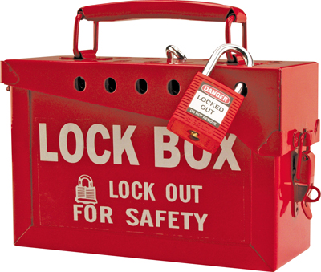
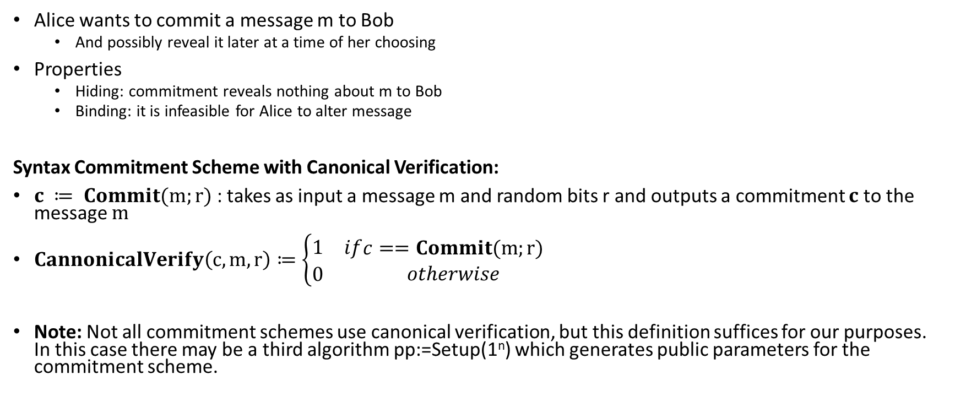
Commitment Schemes
Alice wants to commit a message m to Bob
  And possibly reveal it later at a time of her choosing
Properties
  Hiding: commitment reveals nothing about m to Bob
  Binding: it is infeasible for Alice to alter message
Syntax Commitment Scheme with Canonical Verification:
$c ≔ Commit(m;r)$ : takes as input a message m and random bits r and outputs a commitment $c$ to the message $m$
$CannonicalVerify\left(c,m,r\right)≔\left\{\begin{matrix}1 & if \\ 0 & \end{matrix}\begin{aligned}c==Commit(m;r) \\ otherwise\end{aligned}\right.$
Note: Not all commitment schemes use canonical verification, but this definition suffices for our purposes. In this case there may be a third algorithm pp:=Setup(1^{n}) which generates public parameters for the commitment scheme.

Slide 4


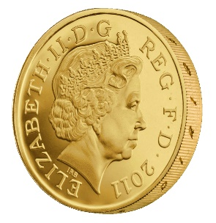



Commitment Hiding (${Hiding}_{A,Com}(n)$)
m₀,m₁
commit(m_{b};r)
b’
$${Hiding}_{A,Com}(n)\text{=}\left\{\begin{aligned}1 if b=b^{′} \\ 0 otherwise \end{aligned}\right.$$
r = Gen(.)
Bit b
$$∀PPT A ∃μ (negligible) s.t$$
$$Pr\left[{Hiding}_{A,Com}\left(n\right)=1\right]≤\frac{1}{2}+μ(n)$$

Slide 5

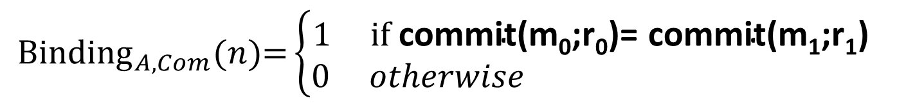
Commitment Binding (${Binding}_{A,Com}(n)$)
r₀,r₁,m₀,m₁
$${Binding}_{A,Com}(n)\text{=}\left\{\begin{aligned}1 if \text{commit}\text{(}\text{m}\text{0}\text{;}\text{r}\text{0}\text{)= }\text{commit}\text{(}\text{m}\text{1}\text{;}\text{r}\text{1}\text{) } \\ 0 otherwise \end{aligned}\right.$$
$$∀PPT A ∃μ (negligible) s.t$$
$$Pr\left[{Binding}_{A,Com}\left(n\right)=1\right]≤μ(n)$$

Slide 6

Secure Commitment Scheme
Definition: A secure commitment scheme is hiding and binding
Hiding
Binding
$$∀PPT A ∃μ (negligible) s.t$$
$$Pr\left[{Hiding}_{A,Com}\left(n\right)=1\right]≤\frac{1}{2}+μ(n)$$
$$∀PPT A ∃μ (negligible) s.t$$
$$Pr\left[{Binding}_{A,Com}\left(n\right)=1\right]≤μ(n)$$

Slide 7
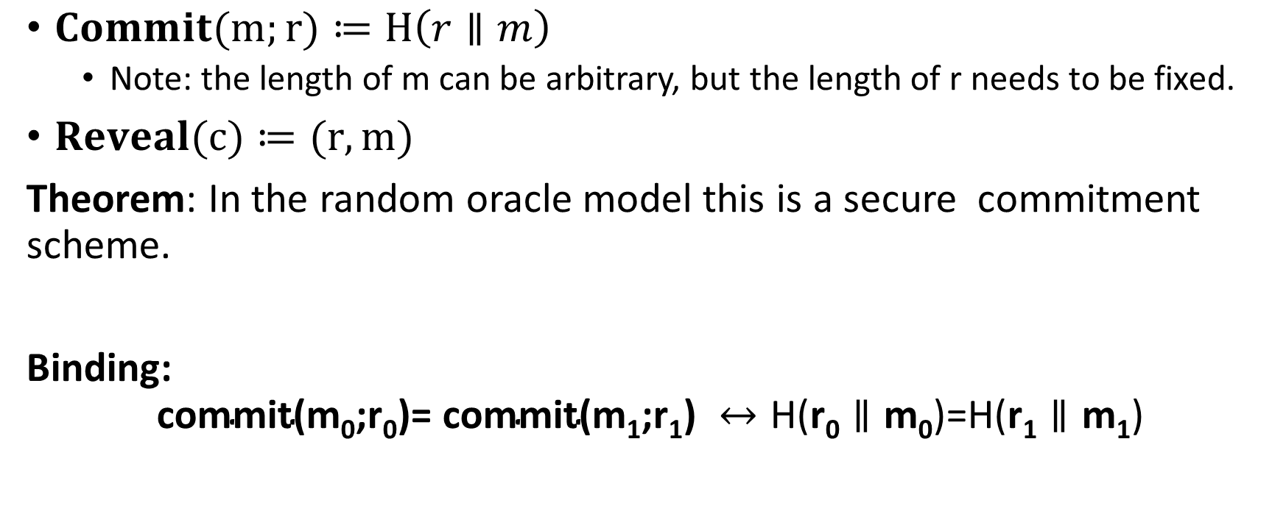
Commitment Scheme in Random Oracle Model
$Commit(m;r)≔H\left(r∥m\right)$
  Note: the length of m can be arbitrary, but the length of r needs to be fixed.
$Reveal(c)≔(r,m)$
Theorem: In the random oracle model this is a secure commitment scheme.
Binding:
$$\text{commit}\text{(}\text{m}\text{0}\text{;}\text{r}\text{0}\text{)= }\text{commit}\text{(}\text{m}\text{1}\text{;}\text{r}\text{1}\text{) }↔\text{H}\text{(}\text{r}\text{0}∥\text{m}\text{0}\text{)}\text{=}\text{H}\text{(}\text{r}\text{1}∥\text{m}\text{1}\text{)}$$

Slide 8



Commitment Hiding (${Hiding}_{A,Com}(n)$)
m₀,m₁
$$H\left(r∥m_{b}\right)$$
b’
$${Hiding}_{A,Com}(n)\text{=}\left\{\begin{aligned}1 ifb=b^{′} \\ 0 otherwise \end{aligned}\right.$$
r = Gen(.)
Bit b
$$∀PPT A making q\left(n\right) queries s.t$$
$$Pr\left[{Hiding}_{A,Com}\left(n\right)=1\right]≤\frac{1}{2}+\frac{q(n)}{2^{\left|r\right|}}$$
Notes:
Proof: Suppose we gave attacker extra information for every query. Tell him if r matches. Now unless he sends

Slide 9

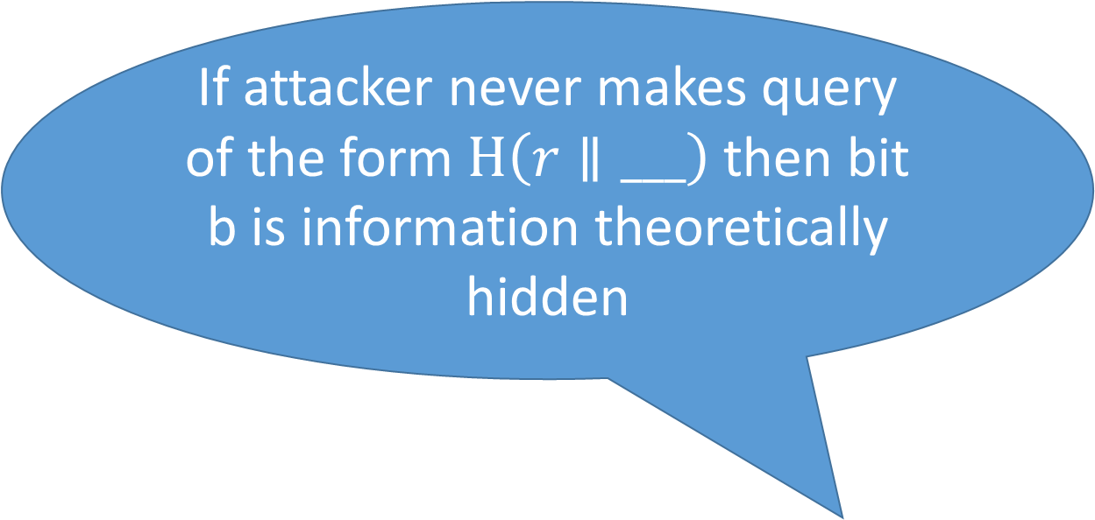
Commitment Hiding (${Hiding}_{A,Com}(n)$)
m₀,m₁
$$H\left(r∥m_{b}\right)$$
b’
If attacker never makes query of the form $H\left(r∥___\right)$ then bit b is information theoretically hidden
$${Hiding}_{A,Com}(n)\text{=}\left\{\begin{aligned}1 ifb=b^{′} \\ 0 otherwise \end{aligned}\right.$$
r = Gen(1^{n})
Bit b
$$∀PPT A making q\left(n\right) queries s.t$$
$$Pr\left[{Hiding}_{A,Com}\left(n\right)=1\right]≤\frac{1}{2}+\frac{q(n)}{2^{n}}$$
Notes:
Proof: Suppose we gave attacker extra information for every query. Tell him if r matches. Now unless he sends

Slide 10
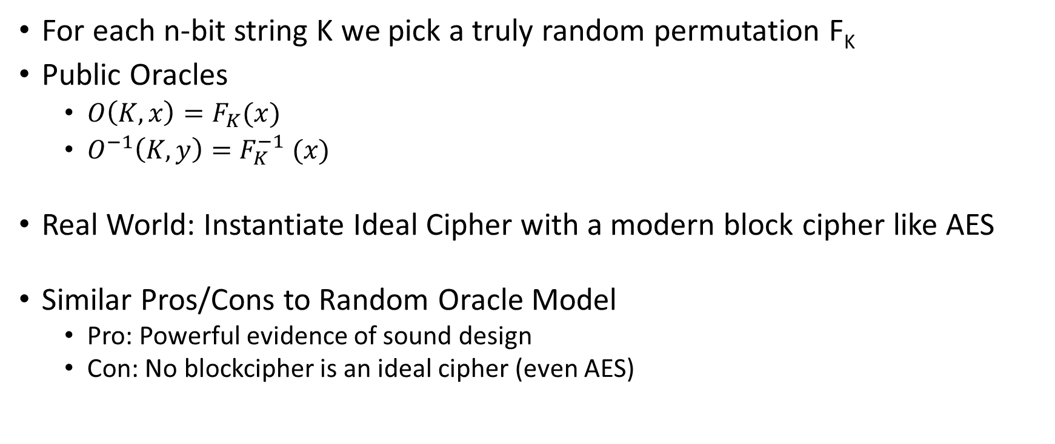
Ideal Cipher Model
For each n-bit string K we pick a truly random permutation F_{K}
Public Oracles
  $O\left(K,x\right)=F_{K}(x)$
  $O^{−1}\left(K,y\right)=F_{K}^{−1} (x)$
Real World: Instantiate Ideal Cipher with a modern block cipher like AES
Similar Pros/Cons to Random Oracle Model
  Pro: Powerful evidence of sound design
  Con: No blockcipher is an ideal cipher (even AES)

Slide 11
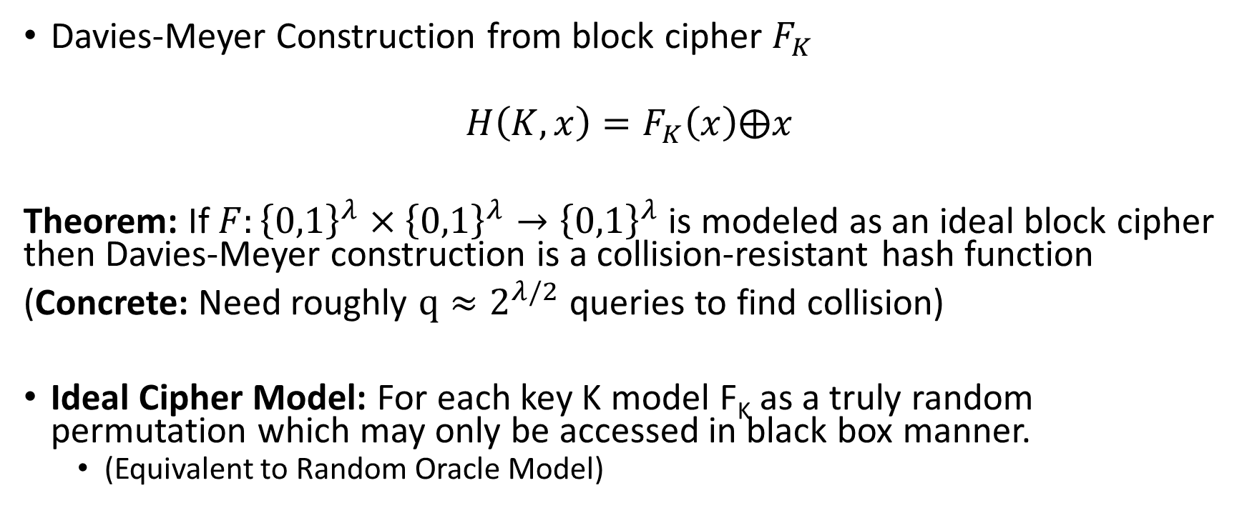
Hash Functions from Ideal Block Ciphers
Davies-Meyer Construction from block cipher $F_{K}$
$$H\left(K,x\right)=F_{K}\left(x\right)⨁x$$
Theorem: If $F:{\left\{0,1\right\}}^{λ}×{\left\{0,1\right\}}^{λ}→{\left\{0,1\right\}}^{λ}$ is modeled as an ideal block cipher then Davies-Meyer construction is a collision-resistant hash function
(Concrete: Need roughly $q≈2^{λ/2}$ queries to find collision)
Ideal Cipher Model: For each key K model F_{K} as a truly random permutation which may only be accessed in black box manner.
  (Equivalent to Random Oracle Model)

Slide 12
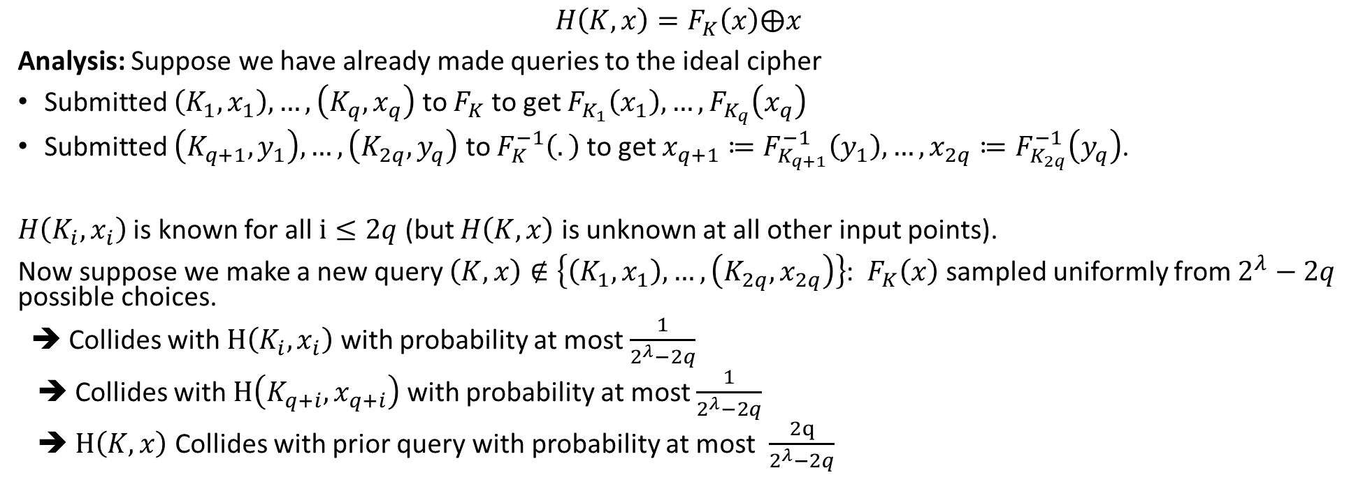
Hash Functions from Block Ciphers
$$H\left(K,x\right)=F_{K}\left(x\right)⨁x$$
Analysis: Suppose we have already made queries to the ideal cipher
Submitted $\left(K_{1},x_{1}\right),…,\left(K_{q},x_{q}\right)$ to $F_{K}$ to get $F_{K_{1}}\left(x_{1}\right),…,F_{K_{q}}\left(x_{q}\right)$
Submitted $\left(K_{q+1},y_{1}\right),…,\left(K_{2q},y_{q}\right)$ to $F_{K}^{−1}\left(.\right)$ to get $x_{q+1}≔F_{K_{q+1}}^{−1}\left(y_{1}\right),…,x_{2q}≔F_{K_{2q}}^{−1}\left(y_{q}\right)$.
$H\left(K_{i},x_{i}\right)$ is known for all $i≤2q$ (but $H\left(K,x\right)$ is unknown at all other input points).
Now suppose we make a new query $\left(K,x\right)∉\left\{\left(K_{1},x_{1}\right),…,\left(K_{2q},x_{2q}\right)\right\}$: $F_{K}\left(x\right)$ sampled uniformly from $2^{λ}−2q$ possible choices.
➔ Collides with $H\left(K_{i},x_{i}\right)$ with probability at most $\frac{1}{2^{λ}−2q}$
➔ Collides with $H\left(K_{q+i},x_{q+i}\right)$ with probability at most $\frac{1}{2^{λ}−2q}$
➔ $H\left(K,x\right)$ Collides with prior query with probability at most $\frac{2q}{2^{λ}−2q}$

Slide 13
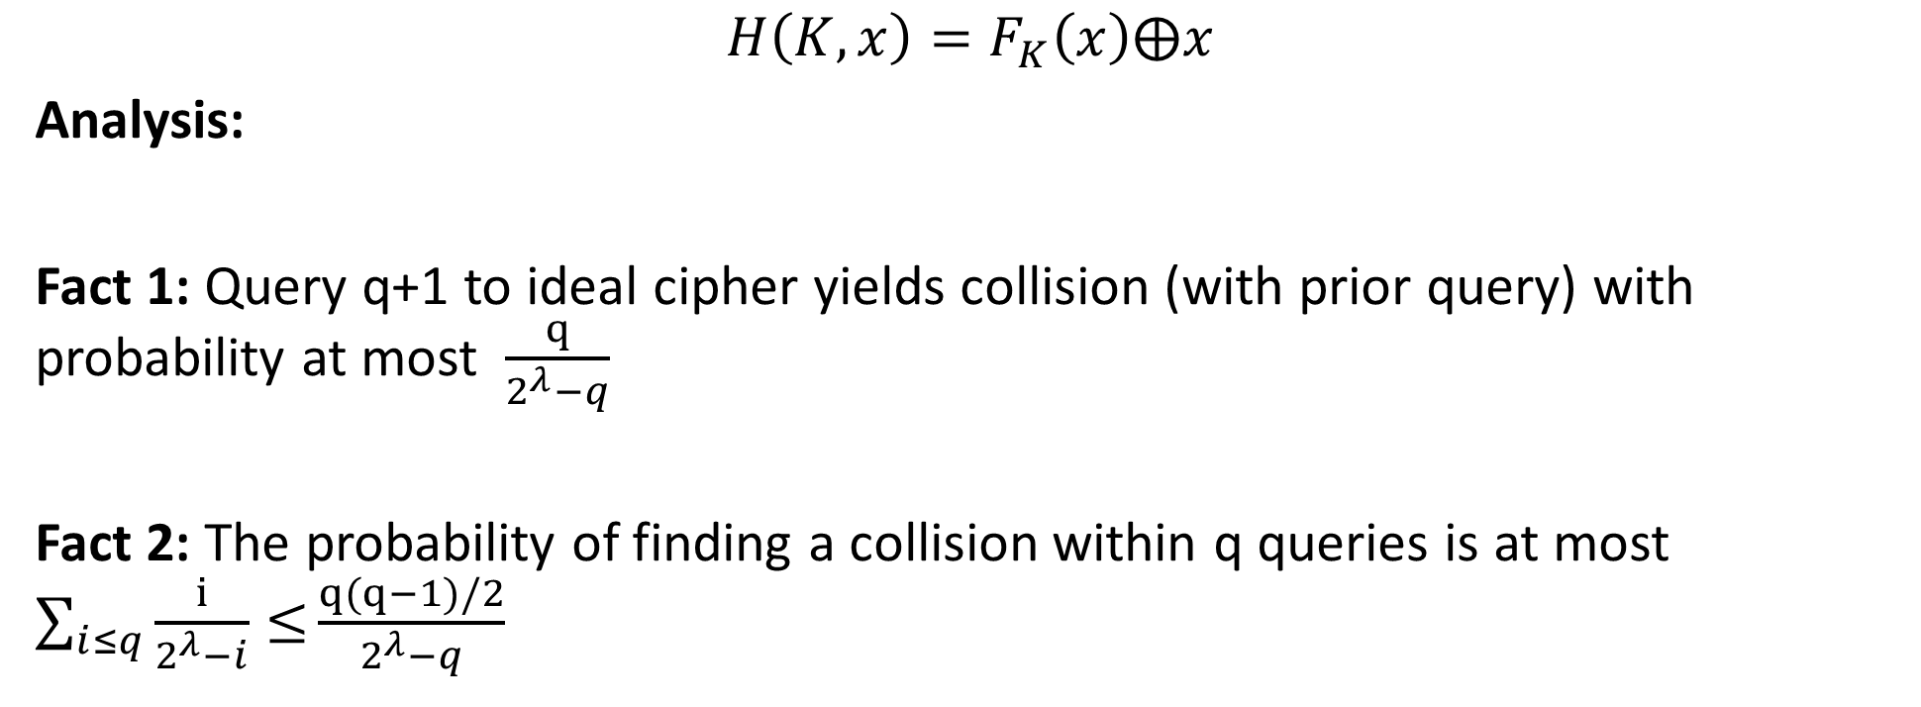
Hash Functions from Block Ciphers
$$H\left(K,x\right)=F_{K}\left(x\right)⨁x$$
Analysis:
Fact 1: Query q+1 to ideal cipher yields collision (with prior query) with probability at most $\frac{q}{2^{λ}−q}$
Fact 2: The probability of finding a collision within q queries is at most $\sum_{i≤q}{\frac{i}{2^{λ}−i}≤}\frac{q(q−1)/2}{2^{λ}−q}$

Slide 14
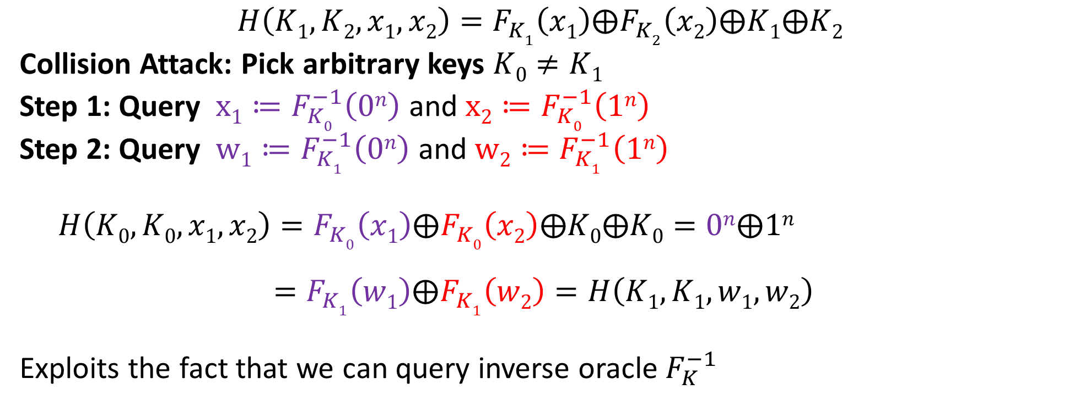
A Broken Attempt
$$H\left(K1,K2,x1,x2\right)=F_{K1}\left(x1\right)⨁F_{K2}\left(x2\right)⨁K1⨁K2$$
Collision Attack: Pick arbitrary keys $K0≠K1$
Step 1: Query $x1≔F_{K0}^{−1}\left(0n\right)$ and $x2≔F_{K0}^{−1}\left(1n\right)$
Step 2: Query $w1≔F_{K1}^{−1}\left(0n\right)$ and $w2≔F_{K1}^{−1}\left(1n\right)$
$$H\left(K0,K0,x1,x2\right)=F_{K0}\left(x1\right)⨁F_{K0}\left(x2\right)⨁K0⨁K0=0n⨁1n$$
$$=F_{K1}\left(w1\right)⨁F_{K1}\left(w2\right)=H\left(K1,K1,w1,w2\right)$$
Exploits the fact that we can query inverse oracle $F_{K}^{−1}$

Slide 15
Other Applications
Password Hashing
Key Derivation
Later
  Key Encapsulation Mechanism
  Digital Signatures (RSA-FDH etc...)

Slide 16
CS 555: Week 6: Topic 1
Block Ciphers

Slide 17

An Existential Crisis?
We have used primitives like PRGs, PRFs to build secure MACs, CCA-Secure Encryption, Authenticated Encryption etc…
Do such primitives exist in practice?
How do we build them?

Slide 18
Recap
Hash Functions/PRGs/PRFs, CCA-Secure Encryption, MACs
Goals for This Week:
Practical Constructions of Symmetric Key Primitives
Today’s Goals: Block Ciphers
Sbox
Confusion Diffusion Paradigm
Feistel Networks

Slide 19

Pseudorandom Permutation
A keyed function $F:{\left\{0,1\right\}}^{n}×{\left\{0,1\right\}}^{n}→{\left\{0,1\right\}}^{n}$, which is invertible and “looks random” without the secret key k.
Similar to a PRF, but
Computing F_{k}(x) and $F_{k}^{−1}\left(x\right)$ is efficient (polynomial-time)
Definition 3.28: A keyed function $F:{\left\{0,1\right\}}^{n}×{\left\{0,1\right\}}^{n}→{\left\{0,1\right\}}^{n}$ is a strong pseudorandom permutation if for all PPT distinguishers D there is a negligible function $μ$ s.t.
$$\left|Pr\left[D^{F_{k}\left(.\right),F_{k}^{−1}\left(.\right)}\left(1^{n}\right)\right]−Pr\left[D^{f\left(.\right),f^{−1}\left(.\right)}\left(1^{n}\right)\right]\right|≤μ\left(n\right)$$

Slide 20
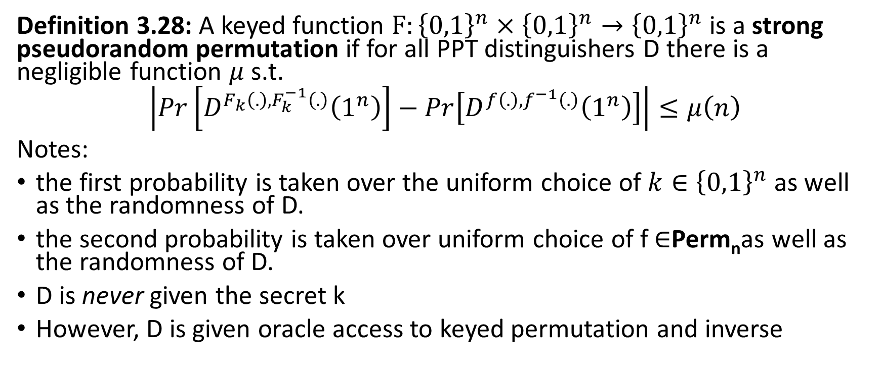
Pseudorandom Permutation
Definition 3.28: A keyed function $F:{\left\{0,1\right\}}^{n}×{\left\{0,1\right\}}^{n}→{\left\{0,1\right\}}^{n}$ is a strong pseudorandom permutation if for all PPT distinguishers D there is a negligible function $μ$ s.t.
$$\left|Pr\left[D^{F_{k}\left(.\right),F_{k}^{−1}\left(.\right)}\left(1^{n}\right)\right]−Pr\left[D^{f\left(.\right),f^{−1}\left(.\right)}\left(1^{n}\right)\right]\right|≤μ\left(n\right)$$
Notes:
the first probability is taken over the uniform choice of ${k∈\left\{0,1\right\}}^{n}$ as well as the randomness of D.
the second probability is taken over uniform choice of f $∈$Perm_{n}as well as the randomness of D.
D is never given the secret k
However, D is given oracle access to keyed permutation and inverse

Slide 21

How many permutations?
|Perm_{n}|=?
Answer: 2^{n}!
How many bits to store f $∈$Perm_{n}?
Answer:
$$\log\left(\text{2}\text{n}\text{!}\right)=\sum_{i=1}^{\text{2}\text{n}}{\log\left(\text{i}\right)}$$
$$≥\sum_{i=2^{n−1}}^{2^{n}}{n−1}≥(n−1)×2^{n−1}$$

Slide 22
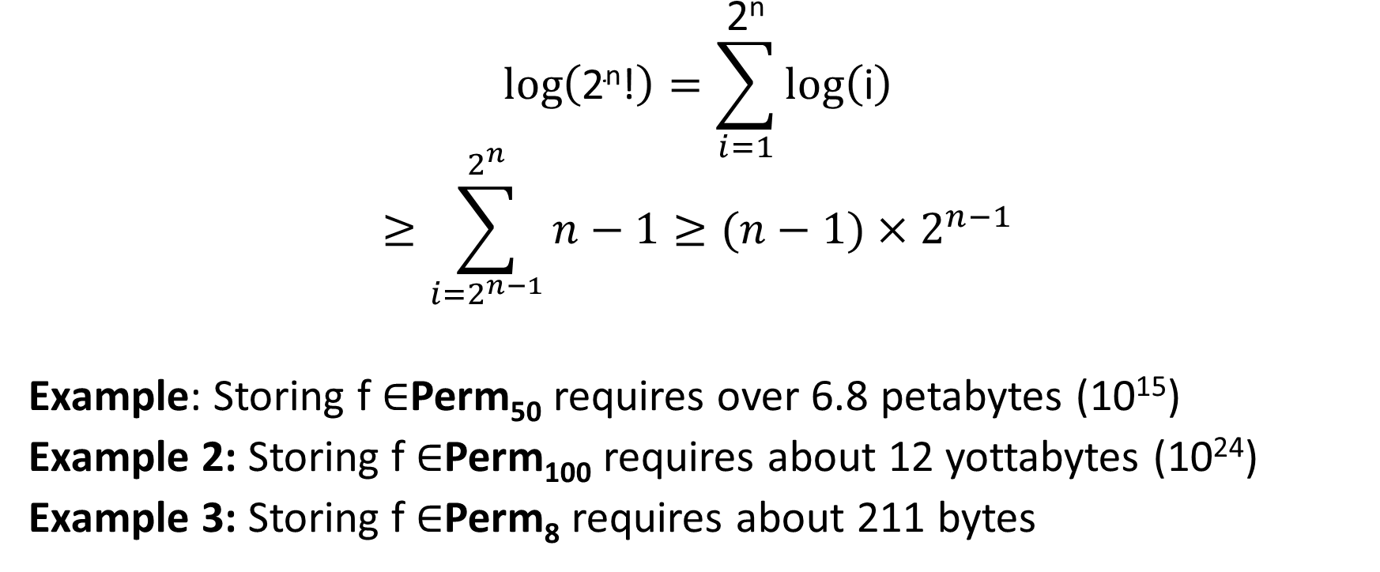
How many bits to store permutations?
$$\log\left(\text{2}\text{n}\text{!}\right)=\sum_{i=1}^{\text{2}\text{n}}{\log\left(\text{i}\right)}$$
$$≥\sum_{i=2^{n−1}}^{2^{n}}{n−1}≥(n−1)×2^{n−1}$$
Example: Storing f $∈$Perm₅₀ requires over 6.8 petabytes (10¹⁵)
Example 2: Storing f $∈$Perm₁₀₀ requires about 12 yottabytes (10²⁴)
Example 3: Storing f $∈$Perm₈ requires about 211 bytes

Slide 23
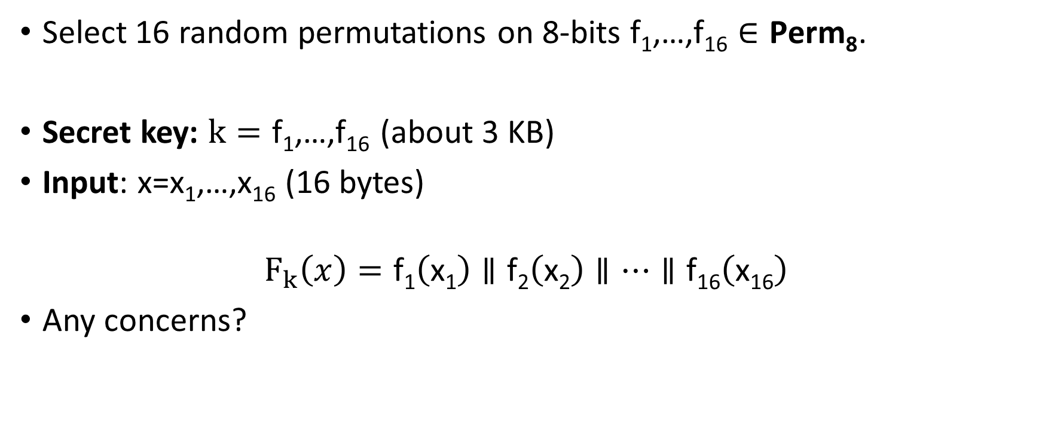
Attempt 1: Pseudorandom Permutation
Select 16 random permutations on 8-bits $\text{f}\text{1}\text{,…,}\text{f}\text{16}∈\text{Perm}\text{8}$.
Secret key: $k=\text{f}\text{1}\text{,…,}\text{f}\text{16}$(about 3 KB)
Input: x=x₁,…,x₁₆ (16 bytes)
$$F_{k}\left(x\right)=\text{f}\text{1}\left(\text{x}\text{1}\right)∥\text{f}\text{2}\left(\text{x}\text{2}\right)∥…∥\text{f}\text{16}\left(\text{x}\text{16}\right)$$
Any concerns?

Slide 24
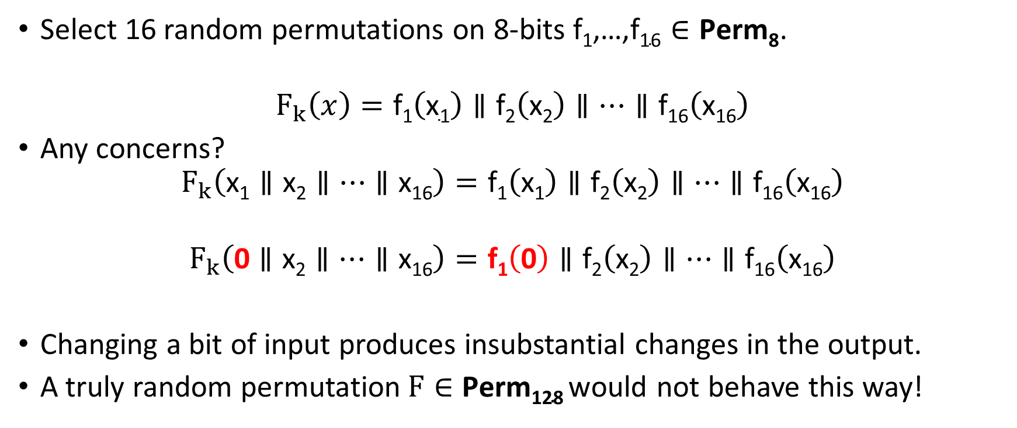
Attempt 1: Pseudorandom Permutation
Select 16 random permutations on 8-bits $\text{f}\text{1}\text{,…,}\text{f}\text{16}∈\text{Perm}\text{8}$.
$$F_{k}\left(x\right)=\text{f}\text{1}\left(\text{x}\text{1}\right)∥\text{f}\text{2}\left(\text{x}\text{2}\right)∥…∥\text{f}\text{16}\left(\text{x}\text{16}\right)$$
Any concerns?
$$F_{k}\left(\text{x}\text{1}∥\text{x}\text{2}∥…∥\text{x}\text{16}\right)=\text{f}\text{1}\left(\text{x}\text{1}\right)∥\text{f}\text{2}\left(\text{x}\text{2}\right)∥…∥\text{f}\text{16}\left(\text{x}\text{16}\right)$$
$$F_{k}\left(\text{0}∥\text{x}\text{2}∥…∥\text{x}\text{16}\right)=\text{f}\text{1}\left(\text{0}\right)∥\text{f}\text{2}\left(\text{x}\text{2}\right)∥…∥\text{f}\text{16}\left(\text{x}\text{16}\right)$$
Changing a bit of input produces insubstantial changes in the output.
A truly random permutation$F∈\text{Perm}\text{128}$would not behave this way!

Slide 25
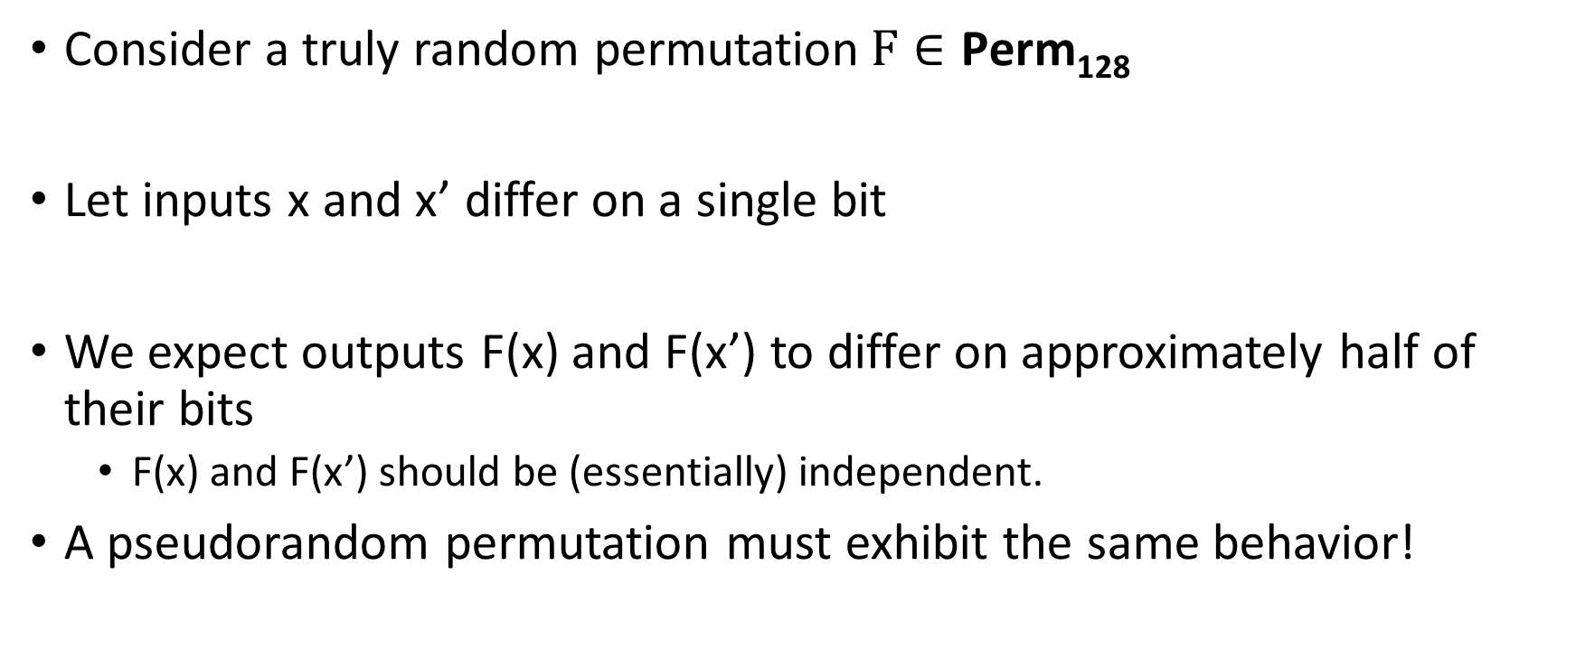
Pseudorandom Permutation Requirements
Consider a truly random permutation$F∈\text{Perm}\text{128}$
Let inputs x and x’ differ on a single bit
We expect outputs F(x) and F(x’) to differ on approximately half of their bits
  F(x) and F(x’) should be (essentially) independent.
A pseudorandom permutation must exhibit the same behavior!

Slide 26
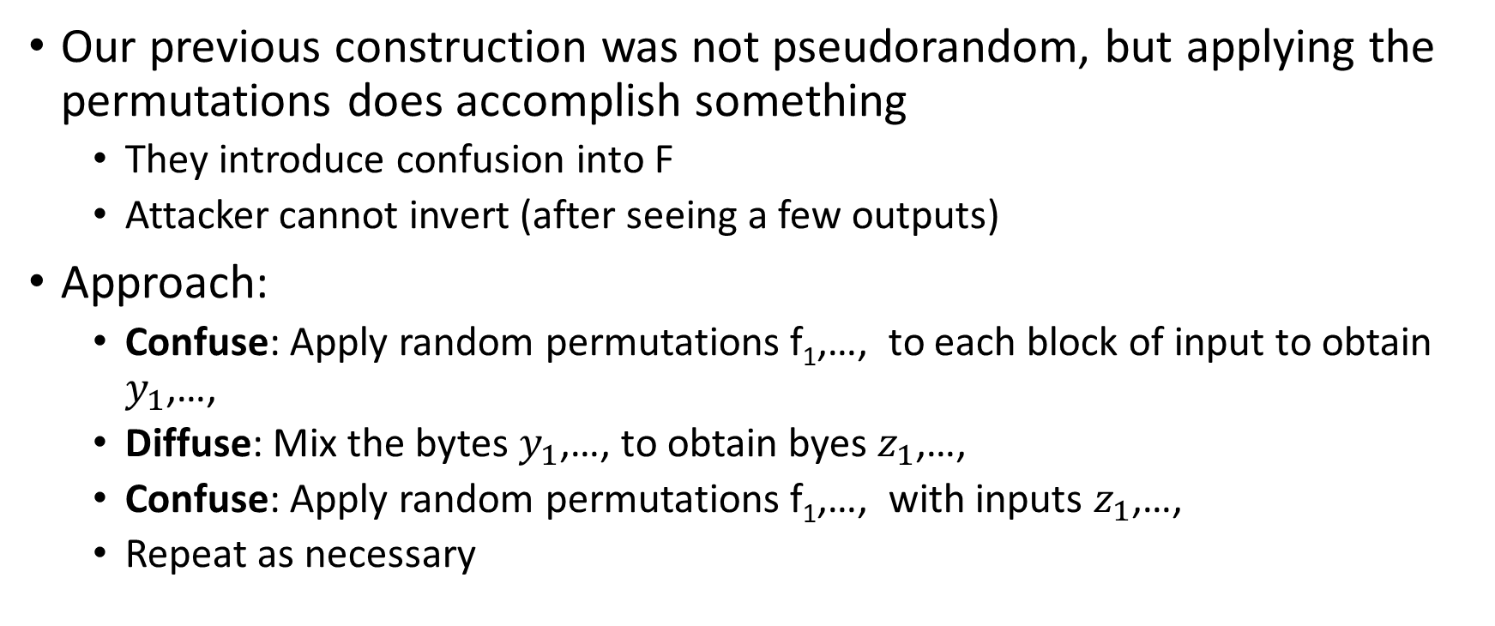
Confusion-Diffusion Paradigm
Our previous construction was not pseudorandom, but applying the permutations does accomplish something
  They introduce confusion into F
  Attacker cannot invert (after seeing a few outputs)
Approach:
  Confuse: Apply random permutations $\text{f}\text{1}\text{,…,}$ to each block of input to obtain $y_{1}$,…,
  Diffuse: Mix the bytes $y_{1}$,…, to obtain byes $z_{1}$,…,
  Confuse: Apply random permutations $\text{f}\text{1}\text{,…,}$ with inputs $z_{1}$,…,
  Repeat as necessary

Slide 27
Attempt 1: Pseudorandom Permutation
Select 16 random permutations on 8-bits $\text{f}\text{1}\text{,…,}\text{f}\text{16}∈\text{Perm}\text{8}$.
$$F_{k}\left(x\right)=\text{f}\text{1}\left(\text{x}\text{1}\right)∥\text{f}\text{2}\left(\text{x}\text{2}\right)∥…∥\text{f}\text{16}\left(\text{x}\text{16}\right)$$
Any concerns?
$$F_{k}\left(\text{x}\text{1}∥\text{x}\text{2}∥…∥\text{x}\text{16}\right)=\text{f}\text{1}\left(\text{x}\text{1}\right)∥\text{f}\text{2}\left(\text{x}\text{2}\right)∥…∥\text{f}\text{16}\left(\text{x}\text{16}\right)$$
$$F_{k}\left(\text{0}∥\text{x}\text{2}∥…∥\text{x}\text{16}\right)=\text{f}\text{1}\left(\text{0}\right)∥\text{f}\text{2}\left(\text{x}\text{2}\right)∥…∥\text{f}\text{16}\left(\text{x}\text{16}\right)$$
Changing a bit of input produces insubstantial changes in the output.
A truly random permutation$F∈\text{Perm}\text{128}$would not behave this way!

Slide 28
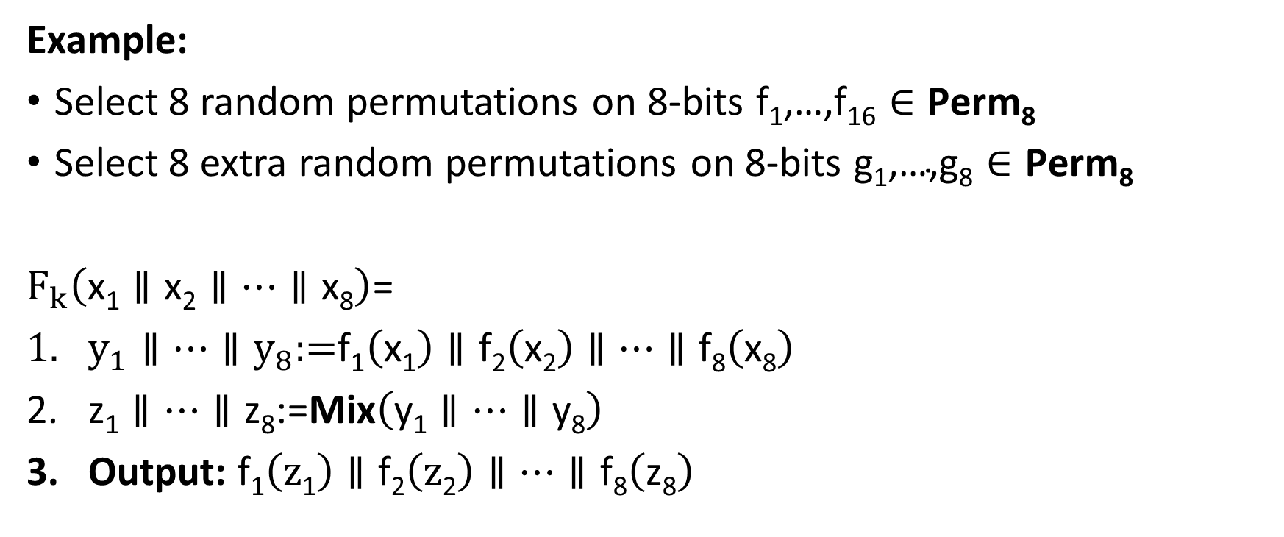
Confusion-Diffusion Paradigm
Example:
Select 8 random permutations on 8-bits $\text{f}\text{1}\text{,…,}\text{f}\text{16}∈\text{Perm}\text{8}$
Select 8 extra random permutations on 8-bits $\text{g}\text{1}\text{,…,}\text{g}\text{8}∈\text{Perm}\text{8}$
$F_{k}\left(\text{x}\text{1}∥\text{x}\text{2}∥…∥\text{x}\text{8}\right)$=
$y_{1}∥…∥y_{8}\text{:=}\text{f}\text{1}\left(\text{x}\text{1}\right)∥\text{f}\text{2}\left(\text{x}\text{2}\right)∥…∥\text{f}\text{8}\left(\text{x}\text{8}\right)$
$\text{z}\text{1}∥…∥\text{z}\text{8}\text{:=}\text{Mix}\left(\text{y}\text{1}∥…∥\text{y}\text{8}\right)$
Output: $\text{f}\text{1}\left(\text{z}\text{1}\right)∥\text{f}\text{2}\left(\text{z}\text{2}\right)∥…∥\text{f}\text{8}\left(\text{z}\text{8}\right)$

Slide 29
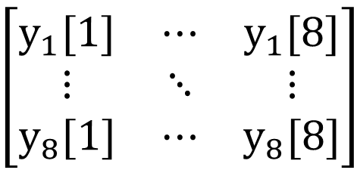





Example Mixing Function
$\text{Mix}\left(\text{y}\text{1}∥…∥\text{y}\text{8}\right)$=
For i=1 to 8
$\text{z}\text{i}\text{:=}\text{y}\text{1}\text{[}\text{i}\text{]}∥…∥\text{y}\text{8}\text{[}\text{i}\text{]}$
End For
Output: $\text{g}\text{1}\left(\text{z}\text{1}\right)∥\text{g}\text{2}\left(\text{z}\text{2}\right)∥…∥\text{g}\text{8}\left(\text{z}8\right)$
$$\text{z}\text{1}$$
$$\text{z}\text{8}$$
$$y_{1}=$$
$$\left[\begin{matrix}y_{1}[1] & ⋯ & y_{1}[8] \\ ⋮ & ⋱ & ⋮ \\ y_{8}[1] & ⋯ & y_{8}[8]\end{matrix}\right]$$
$$y_{8}=$$

Slide 30
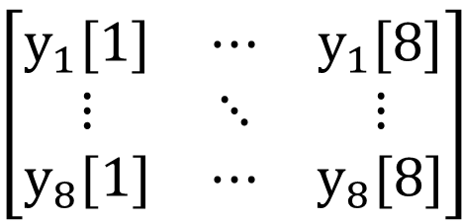

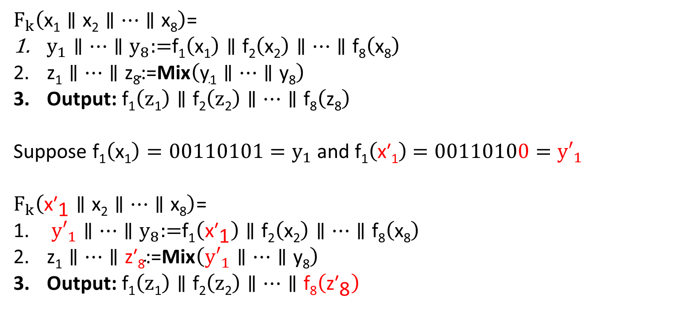



Are We Done?
$$\text{z}\text{1}$$
$$\text{z}\text{8}$$
$F_{k}\left(\text{x}\text{1}∥\text{x}\text{2}∥…∥\text{x}\text{8}\right)$=
$y_{1}∥…∥y_{8}\text{:=}\text{f}\text{1}\left(\text{x}\text{1}\right)∥\text{f}\text{2}\left(\text{x}\text{2}\right)∥…∥\text{f}\text{8}\left(\text{x}\text{8}\right)$
$\text{z}\text{1}∥…∥\text{z}\text{8}\text{:=}\text{Mix}\left(\text{y}\text{1}∥…∥\text{y}\text{8}\right)$
Output: $\text{f}\text{1}\left(\text{z}\text{1}\right)∥\text{f}\text{2}\left(\text{z}\text{2}\right)∥…∥\text{f}\text{8}\left(\text{z}\text{8}\right)$
Suppose $\text{f}\text{1}\left(\text{x}\text{1}\right)=00110101=y_{1}$ and $\text{f}\text{1}\left(\text{x}\text{′}\text{1}\right)$ $=00110100={y′}_{1}$
$F_{k}\left({\text{x}\text{′}}_{\text{1}}∥\text{x}\text{2}∥…∥\text{x}\text{8}\right)$=
${y′}_{1}∥…∥y_{8}\text{:=}\text{f}\text{1}\left({\text{x}\text{′}}_{\text{1}}\right)∥\text{f}\text{2}\left(\text{x}\text{2}\right)∥…∥\text{f}\text{8}\left(\text{x}\text{8}\right)$
$\text{z}\text{1}∥…∥\text{z}\text{′}\text{8}\text{:=}\text{Mix}\left({y′}_{1}∥…∥\text{y}\text{8}\right)$
Output: $\text{f}\text{1}\left(\text{z}\text{1}\right)∥\text{f}\text{2}\left(\text{z}\text{2}\right)∥…∥\text{f}\text{8}\left({\text{z}\text{′}}_{\text{8}}\right)$
$$y_{1}=$$
$$\left[\begin{matrix}y_{1}[1] & ⋯ & y_{1}[8] \\ ⋮ & ⋱ & ⋮ \\ y_{8}[1] & ⋯ & y_{8}[8]\end{matrix}\right]$$
$$y_{8}=$$
Highly unlikely that a truly random permutation would behave this way!

Slide 31
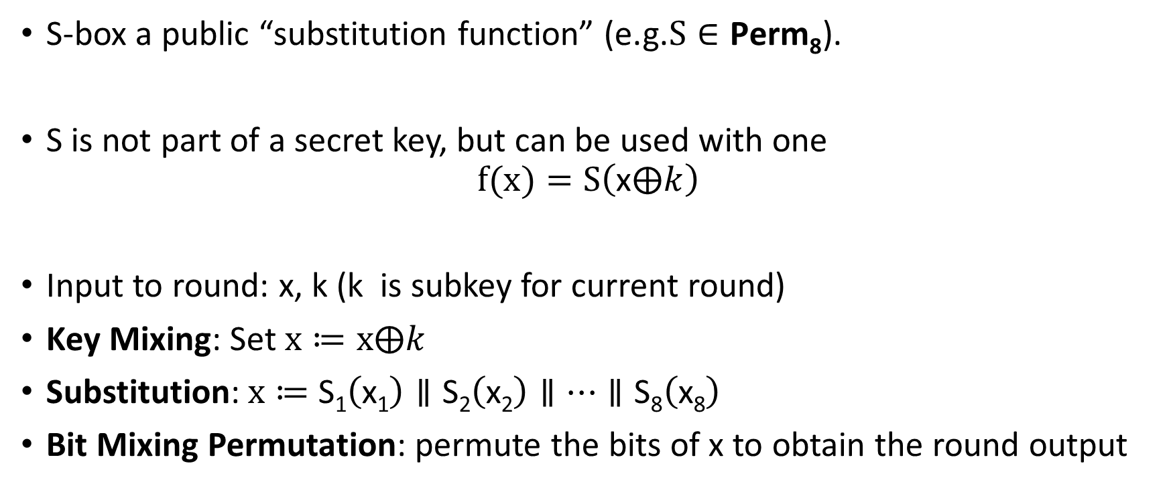
Substitution Permutation Networks
S-box a public “substitution function” (e.g.$S∈\text{Perm}\text{8}$).
S is not part of a secret key, but can be used with one
$$f(x)=S\left(\text{x}⨁k\right)$$
Input to round: x, k (k is subkey for current round)
Key Mixing: Set $x≔x⨁k$
Substitution:$x≔$ $\text{S}\text{1}\left(\text{x}\text{1}\right)∥\text{S}\text{2}\left(\text{x}\text{2}\right)∥…∥\text{S}\text{8}\left(\text{x}\text{8}\right)$
Bit Mixing Permutation: permute the bits of x to obtain the round output
Note: there are only n! possible bit mixing permutations of [n] as opposed to 2^{n}! Permutations of {0,1}^{n}

Slide 32
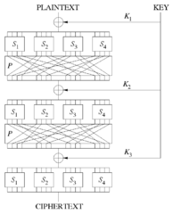
Substitution Permutation Networks
Proposition 6.3: Let F be a keyed function defined by a Substitution Permutation Network. Then for any keys/number of rounds F_{k} is a permutation.
Why? Composing permutations f,g results in another permutation h(x)=g(f(x)).

Slide 33
Remarks
Want to achieve “avalanche effect” (one bit change should “affect” every output bit)
Should a S-box be a random byte permutation?
Better to ensure that S(x) differs from x on at least 2-bits (for all x)
  Helps to maximize “avalanche effect”
Mixing Permutation should ensure that output bits of any given S-box are used as input to multiple S-boxes in the next round

Slide 34
Remarks
How many rounds?
Informal Argument: If we ensure that S(x) differs from x on at least 2-bits (for all bytes x) then every input bit affects
  2 bits of round 1 output
  4 bits of round 2 output
  8 bits of round 3 output
  ….
  128 bits of round 4 output
Need at least 7 rounds (minimum) to ensure that every input bit affects every output bit

Slide 35
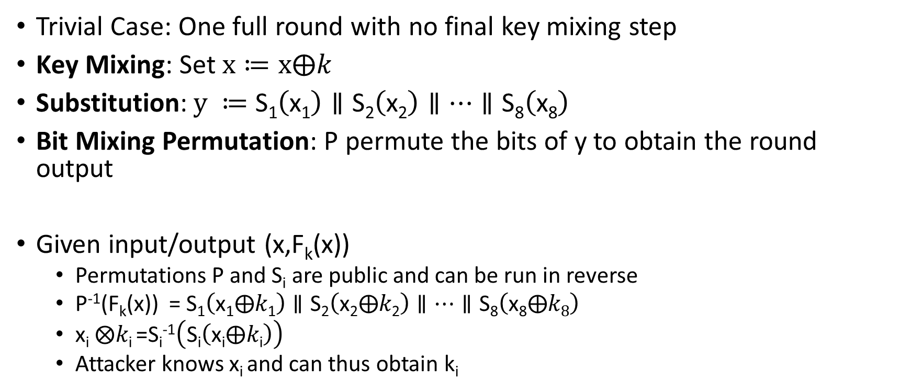
Attacking Lower Round SPNs
Trivial Case: One full round with no final key mixing step
Key Mixing: Set $x≔x⨁k$
Substitution:$y ≔$ $\text{S}\text{1}\left(\text{x}\text{1}\right)∥\text{S}\text{2}\left(\text{x}\text{2}\right)∥…∥\text{S}\text{8}\left(\text{x}\text{8}\right)$
Bit Mixing Permutation: P permute the bits of y to obtain the round output
Given input/output (x,F_{k}(x))
  Permutations P and S_{i} are public and can be run in reverse
  P⁻¹(F_{k}(x)) = $\text{S}\text{1}\left(\text{x}\text{1}⨁k\text{1}\right)∥\text{S}\text{2}\left(\text{x}\text{2}⨁k\text{2}\right)∥…∥\text{S}\text{8}\left(\text{x}\text{8}⨁k8\right)$
  $\text{x}\text{i} ⨂k\text{i}$=S_{i}⁻¹$\left(\text{S}\text{i}\left(\text{x}\text{i}⨁k\text{i}\right)\right)$
  Attacker knows x_{i} and can thus obtain k_{i}

Slide 36
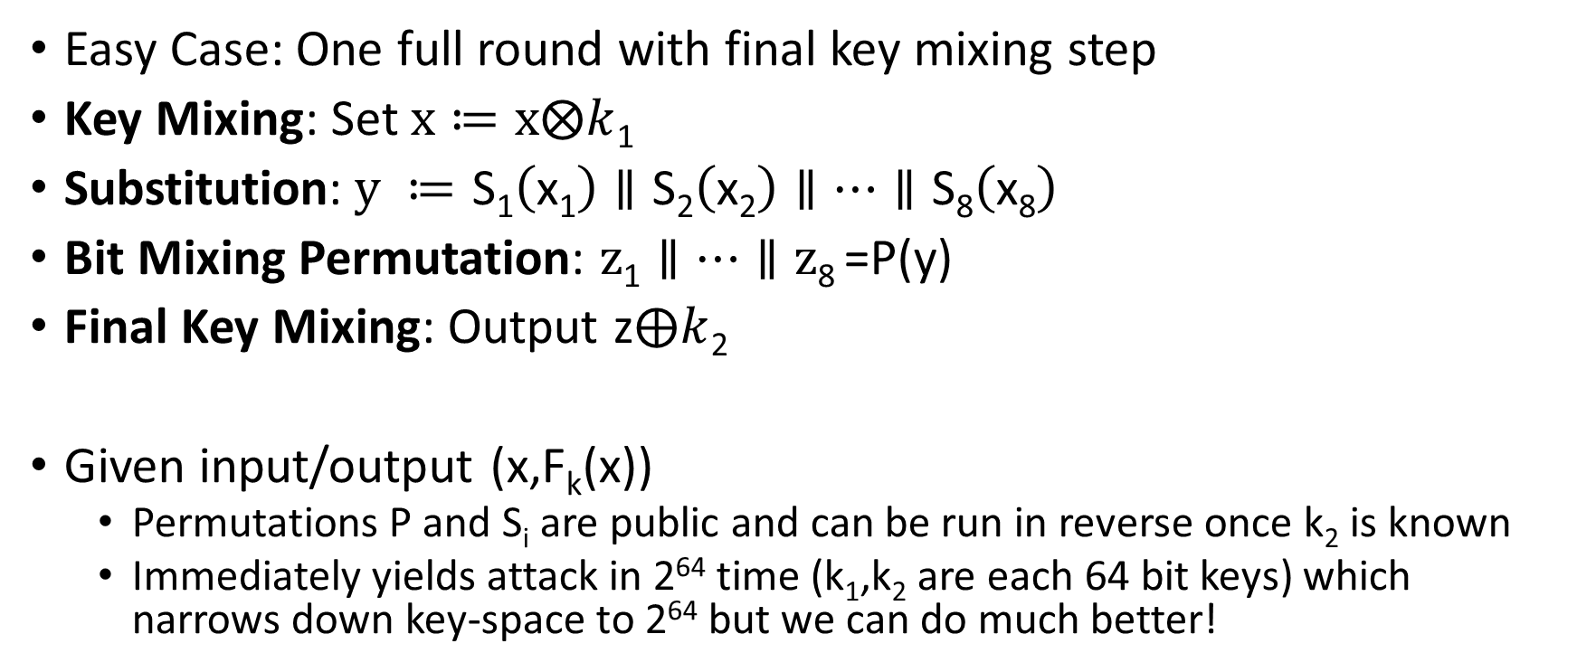
Attacking Lower Round SPNs
Easy Case: One full round with final key mixing step
Key Mixing: Set $x≔x⨂k$₁
Substitution:$y ≔$ $\text{S}\text{1}\left(\text{x}\text{1}\right)∥\text{S}\text{2}\left(\text{x}\text{2}\right)∥…∥\text{S}\text{8}\left(\text{x}\text{8}\right)$
Bit Mixing Permutation: $z\text{1}∥…∥\text{z}\text{8}$=P(y)
Final Key Mixing: Output z$⨁k$₂
Given input/output (x,F_{k}(x))
  Permutations P and S_{i} are public and can be run in reverse once k₂ is known
  Immediately yields attack in 2⁶⁴ time (k₁,k₂ are each 64 bit keys) which narrows down key-space to 2⁶⁴ but we can do much better!

Slide 37
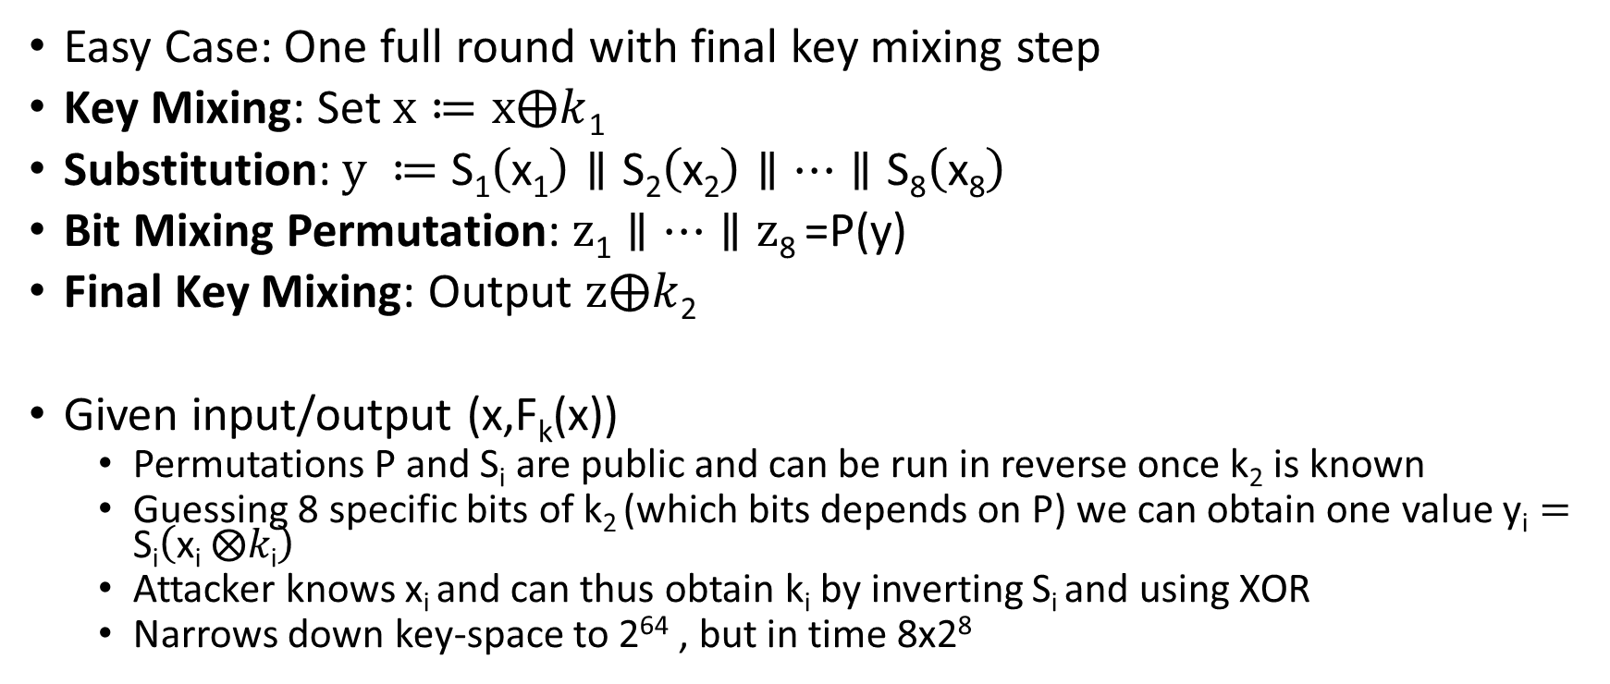
Attacking Lower Round SPNs
Easy Case: One full round with final key mixing step
Key Mixing: Set $x≔x⨁k$₁
Substitution:$y ≔$ $\text{S}\text{1}\left(\text{x}\text{1}\right)∥\text{S}\text{2}\left(\text{x}\text{2}\right)∥…∥\text{S}\text{8}\left(\text{x}\text{8}\right)$
Bit Mixing Permutation: $z\text{1}∥…∥\text{z}\text{8}$=P(y)
Final Key Mixing: Output $z⨁k$₂
Given input/output (x,F_{k}(x))
  Permutations P and S_{i} are public and can be run in reverse once k₂ is known
  Guessing 8 specific bits of k₂ (which bits depends on P) we can obtain one value $\text{y}\text{i}=\text{S}\text{i}\left(\text{x}\text{i} ⨂k\text{i}\right)$
  Attacker knows x_{i} and can thus obtain k_{i} by inverting S_{i} and using XOR
  Narrows down key-space to 2⁶⁴ , but in time 8x2⁸

Slide 38
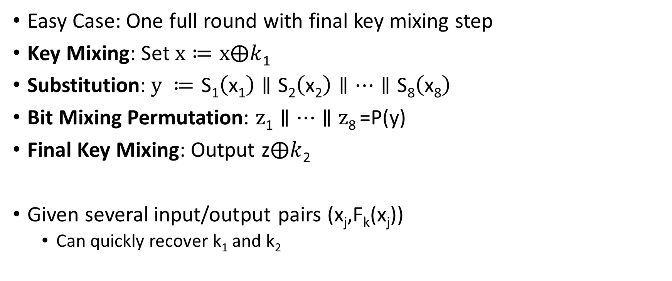
Attacking Lower Round SPNs
Easy Case: One full round with final key mixing step
Key Mixing: Set $x≔x⨁k$₁
Substitution:$y ≔$ $\text{S}\text{1}\left(\text{x}\text{1}\right)∥\text{S}\text{2}\left(\text{x}\text{2}\right)∥…∥\text{S}\text{8}\left(\text{x}\text{8}\right)$
Bit Mixing Permutation: $z\text{1}∥…∥\text{z}\text{8}$=P(y)
Final Key Mixing: Output z$⨁k$₂
Given several input/output pairs (x_{j},F_{k}(x_{j}))
  Can quickly recover k₁ and k₂

Slide 39
Attacking Lower Round SPNs
Harder Case: Two round SPN
Exercise ☺

Slide 40
Feistel Networks
Alternative to Substitution Permutation Networks
Advantage: underlying functions need not be invertible, but the result is still a permutation

Slide 41
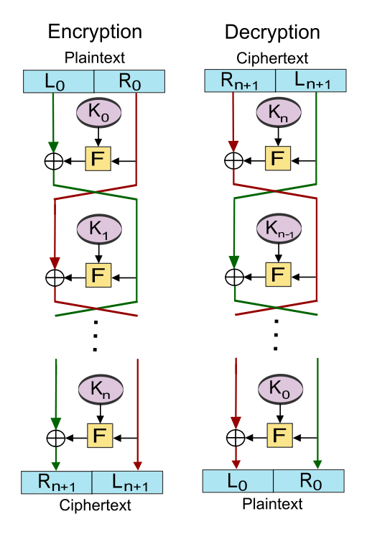
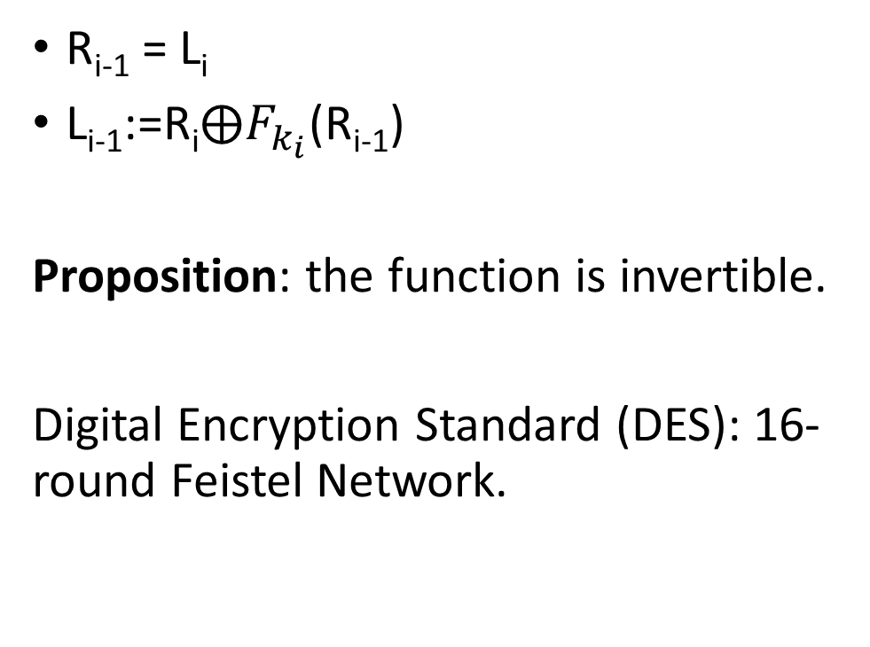
R_{i-1} = L_{i}
L_{i-1}:=$\text{R}\text{i}⨁F_{k_{i}}$(R_{i-1})
Proposition: the function is invertible.
Digital Encryption Standard (DES): 16-round Feistel Network.

Slide 42
CS 555: Week 6: Topic 2
DES, 3DES

Slide 43
Feistel Networks
Alternative to Substitution Permutation Networks
Advantage: underlying functions need not be invertible, but the result is still a permutation

Slide 44

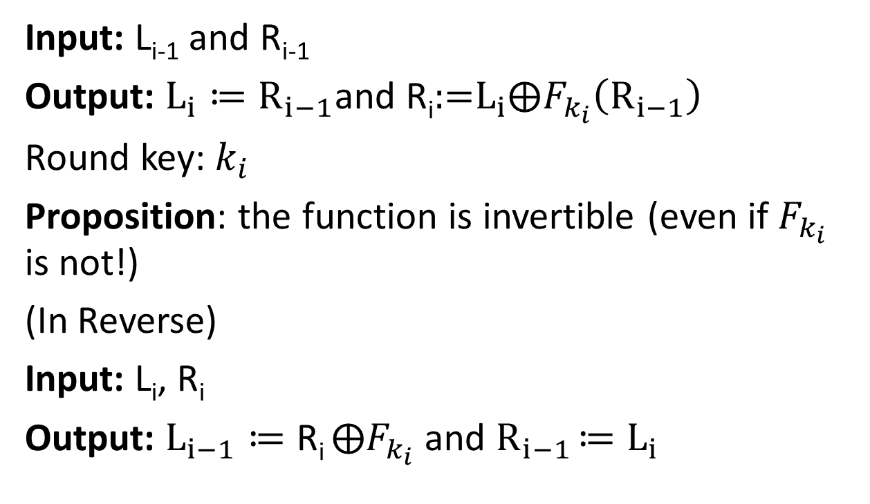

Feistel Network Round
L_{i-1}
R_{i-1}
Input: L_{i-1} and R_{i-1}
Output: $L_{i}≔R_{i−1}$and $\text{R}\text{i}\text{:=}L_{i}⨁F_{k_{i}}\left(R_{i−1}\right)$
Round key: $k_{i}$
Proposition: the function is invertible (even if $F_{k_{i}}$ is not!)
(In Reverse)
Input: L_{i}, R_{i}
Output: $L_{i−1}≔\text{R}\text{i} ⨁F_{k_{i}}$ and $R_{i−1}$ $≔L_{i}$
$$⨁$$
$$F_{K_{i}}$$
L_{i}
R_{i}

Slide 45
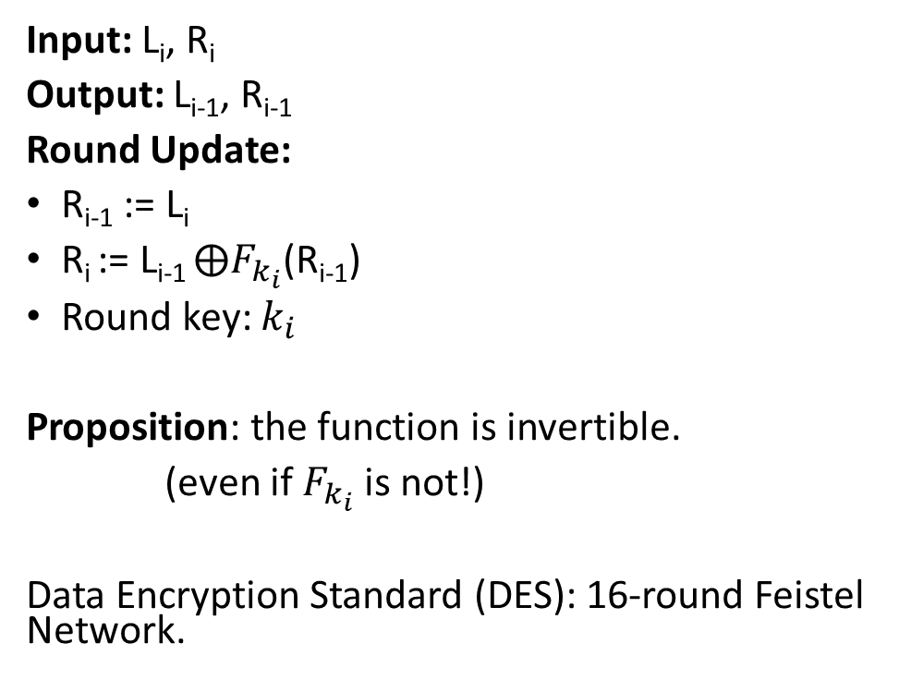
Feistel Network Round (In Reverse)
L_{i-1}
R_{i-1}
Input: L_{i}, R_{i}
Output: L_{i-1}, R_{i-1}
Round Update:
R_{i-1} := L_{i}
$\text{R}\text{i}$:= L_{i-1} $⨁F_{k_{i}}$(R_{i-1})
Round key: $k_{i}$
Proposition: the function is invertible.
(even if $F_{k_{i}}$ is not!)
Data Encryption Standard (DES): 16-round Feistel Network.
$$⨁$$
$$F_{K_{i}}$$
L_{i}
R_{i}

Slide 46
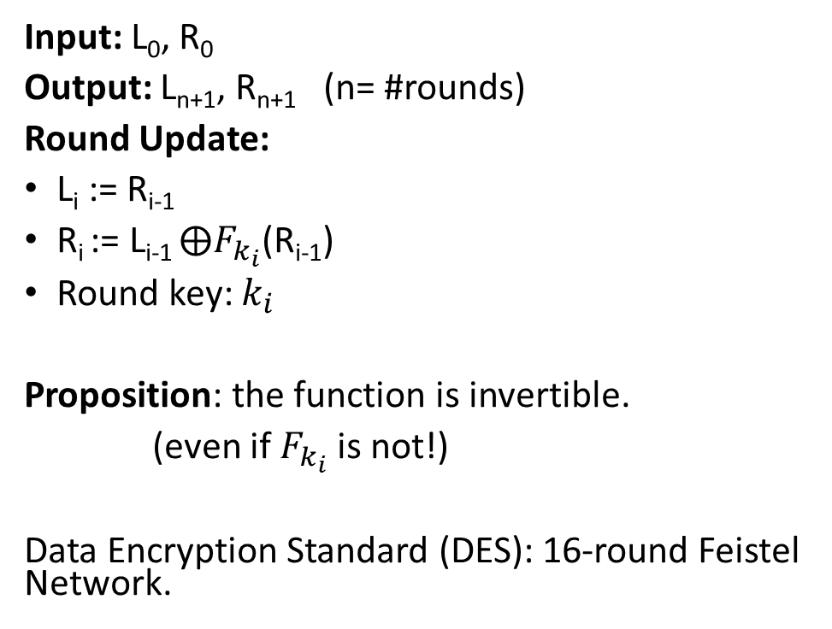
Input: L₀, R₀
Output: L_{n+1}, R_{n+1} (n= #rounds)
Round Update:
L_{i} := R_{i-1}
$\text{R}\text{i}$:= L_{i-1} $⨁F_{k_{i}}$(R_{i-1})
Round key: $k_{i}$
Proposition: the function is invertible.
(even if $F_{k_{i}}$ is not!)
Data Encryption Standard (DES): 16-round Feistel Network.

Slide 47

L_{i+1} = R_{i}
R_{i+1}≔L$\text{i}⨁F_{k_{i}}$(R_{i})
Proposition: the function is invertible.

Slide 48
Data Encryption Standard
Developed in 1970s by IBM (with help from NSA)
Adopted in 1977 as Federal Information Processing Standard (US)
Data Encryption Standard (DES): 16-round Feistel Network.
Key Length: 56 bits
  Vulnerable to brute-force attacks in modern times
  1.5 hours at 14 trillion DES evals/second e.g., Antminer S9 runs at 14 TH/s

Slide 49
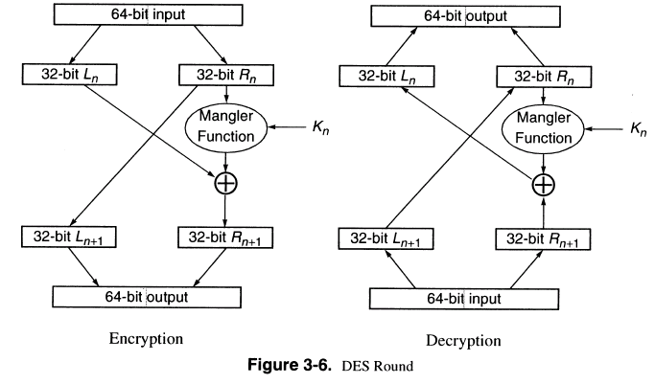
DES Round

Slide 50
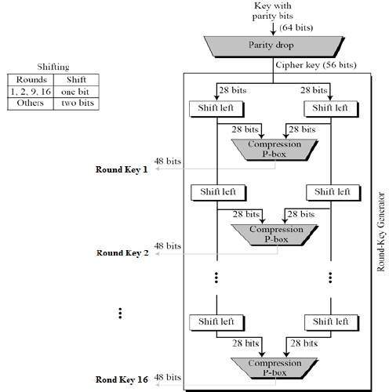
Generating the Round Keys
Initial Key: 64 bits
Effective Key Length: 56 bits
Round Key Length: 48 bits (each)
16 round keys derived from initial key

Slide 51
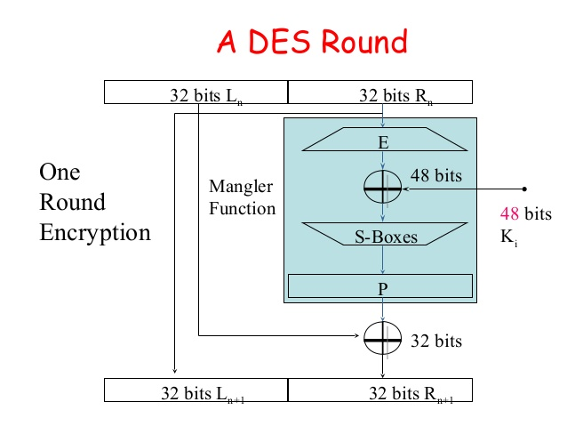
DES Mangle Function
Expand E: 32-bit input → 48-bit output (duplicates 16 bits)
S-boxes: S₁,…,S₈
  Input: 6-bits
  Output: 4 bits
  Not a permutation!
4-to-1 function
  Exactly four inputs mapped to each possible output

Slide 52
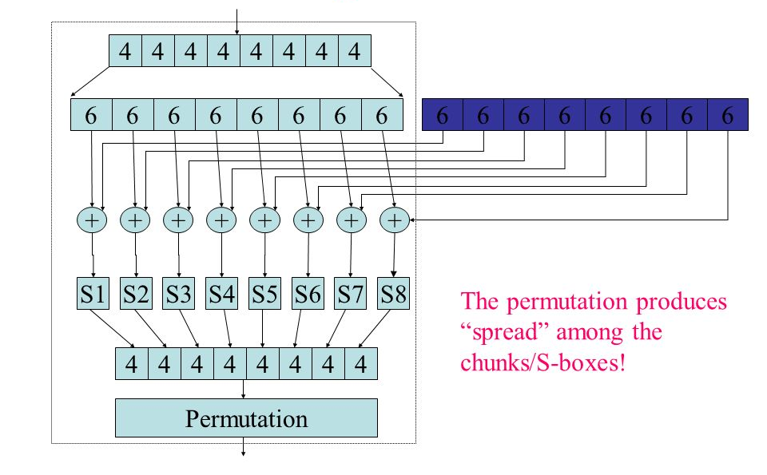
Mangle Function
32 bit input
48 bit output of expand
48-bit sub key
XOR block before
Applying S-Boxes
Each S-box outputs 4 bits

Slide 53
S-Box Representation as Table
4 columns (2 bits)
 | 00 | 01 | 10 | 11
0000
0001
0010
0011
0100
0101
0110 |  |  |  | S(x)=1101
…. | …. | …. | …. | ….
1111
16 columns (4 bits)
x =101101
S(x) = Table[0110,11]

Slide 54
S-Box Representation
Each column is permutation
4 columns (2 bits)
 | 00 | 01 | 10 | 11
0000
0001
0010
0011
0100
0101
0110 |  |  |  | S(x)=1101
…. | …. | …. | …. | ….
1111
16 columns (4 bits)
S(x) = T[0110,11]
x =101101

Slide 55
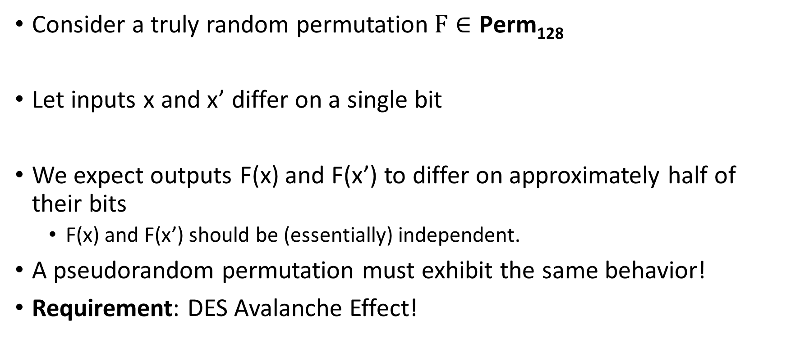
Pseudorandom Permutation Requirements
Consider a truly random permutation$F∈\text{Perm}\text{128}$
Let inputs x and x’ differ on a single bit
We expect outputs F(x) and F(x’) to differ on approximately half of their bits
  F(x) and F(x’) should be (essentially) independent.
A pseudorandom permutation must exhibit the same behavior!
Requirement: DES Avalanche Effect!

Slide 56
DES Avalanche Effect
Permutation the end of the mangle function helps to mix bits
Special S-box property #1
Let x and x’ differ on one bit then S_{i}(x) differs from S_{i}(x’) on two bits.

Slide 57
Avalanche Effect Example
Consider two 64 bit inputs
  (L_{n},R_{n}) and (L_{n}’,R’_{n}=R_{n})
  L_{n} and L_{n}’ differ on one bit
This is worst case example
  L_{n+1} = L_{n+1}’=R_{n}
  But now R’_{n+1} and R_{n+1} differ on one bit
Even if we are unlucky E(R’_{n+1}) and E(R_{n+1}) differ on 1 bit
→ R_{n+2} and R’_{n+2} differ on two bits
→ L_{n+2} = R’_{n+1} and L_{n+2}’ = R’_{n+1} differ in one bit

Slide 58
Avalanche Effect Example
R_{n+2} and R’_{n+2} differ on two bits
L_{n+2} = R_{n+1} and L_{n+2}’ = R’_{n+1} differ in one bit
→R_{n+3} and R’_{n+3} differ on four bits since we have different inputs to two of the S-boxes
L_{n+3} = R’_{n+2} and L_{n+2}’ = R’_{n+2} now differ on two bits
Seven rounds we expect all 32 bits in right half to be “affected” by input change
…
DES has sixteen rounds

Slide 59
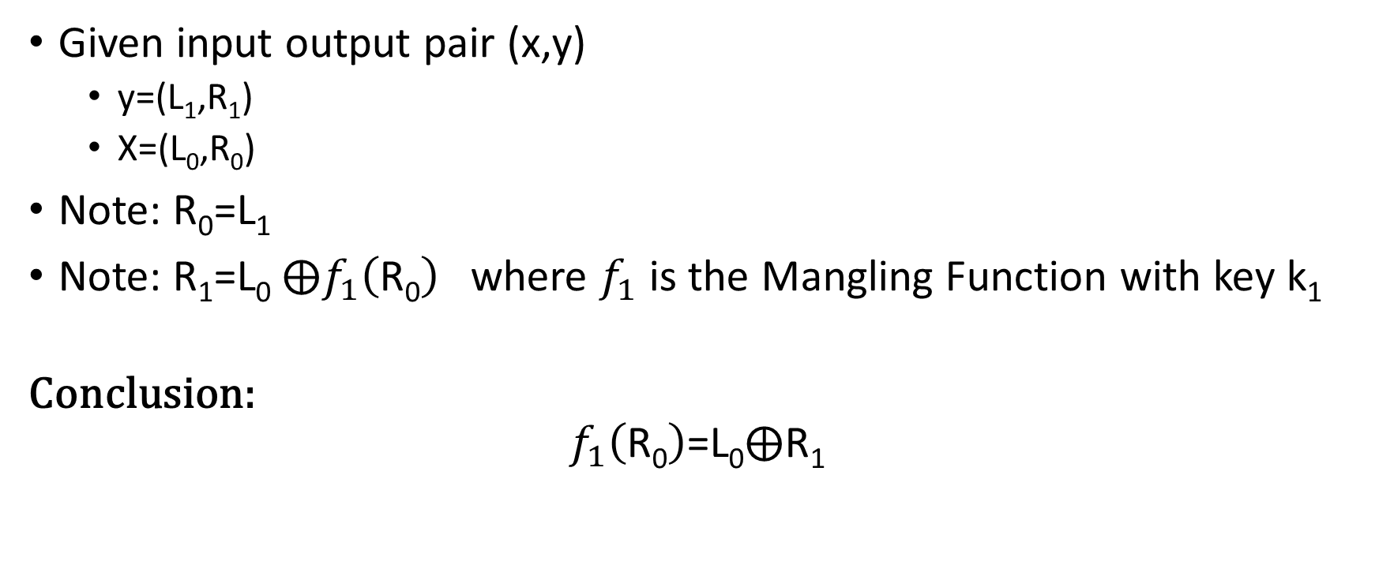
Attack on One-Round DES
Given input output pair (x,y)
  y=(L₁,R₁)
  X=(L₀,R₀)
Note: R₀=L₁
Note: R₁=L₀ $⨁f_{1}\left(\text{R}\text{0}\right)$ where $f_{1}$ is the Mangling Function with key k₁
Conclusion:
$$f_{1}\left(\text{R}\text{0}\right)\text{=}\text{L}\text{0}⨁\text{R}\text{1}$$

Slide 60


Attack on One-Round DES
$$\text{R}\text{0}$$
Second Input/Output Pair would (likely)
allow us to narrow down to 1 Key
Four possible values
Possible Keys: 4⁸ << 2⁴⁸
Trivial to Recover
$$\text{L}\text{0}⨁\text{R}\text{1}$$

Slide 61

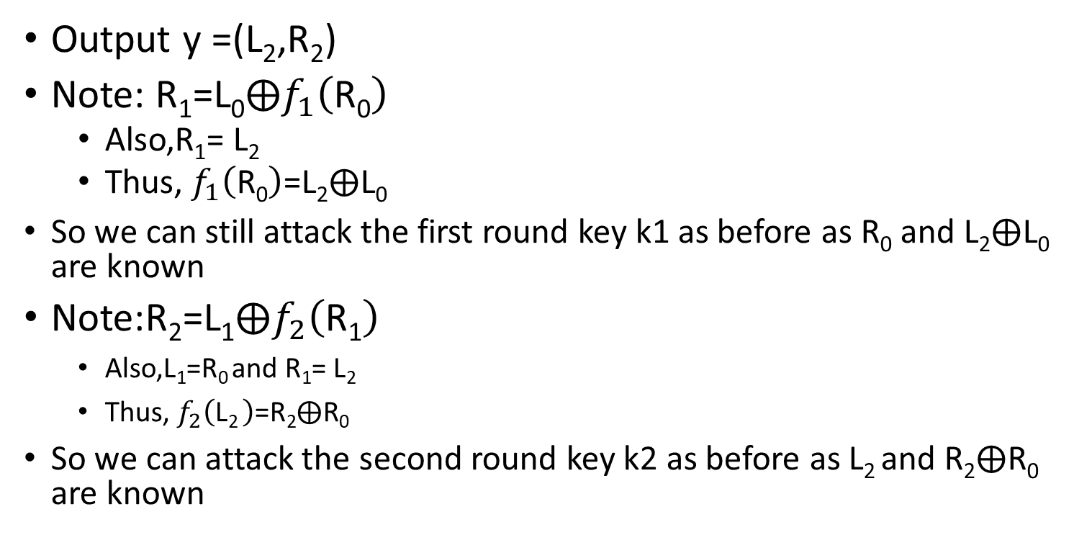



Attack on Two-Round DES
L₀
R₀
K₁
Output y =(L₂,R₂)
Note: $\text{R}\text{1}\text{=}\text{L}\text{0}⨁f_{1}\left(\text{R}\text{0}\right)$
  Also,$\text{R}\text{1}\text{=}$ $\text{L}\text{2}$
  Thus, $f_{1}\left(\text{R}\text{0}\right)\text{=}\text{L}\text{2}⨁\text{L}\text{0}$
  So we can still attack the first round key k1 as before as $\text{R}\text{0}$ and $\text{L}\text{2}⨁\text{L}\text{0}$ are known
Note:$\text{R}\text{2}\text{=}\text{L}\text{1}⨁f_{2}\left(\text{R}\text{1}\right)$
    Also,$\text{L}\text{1}\text{=}\text{R}\text{0 }$and $\text{R}\text{1}\text{=}$ $\text{L}\text{2}$
    Thus, $f_{2}\left(\text{L}\text{2 }\right)\text{=}\text{R}\text{2}⨁\text{R}\text{0}$
  So we can attack the second round key k2 as before as $\text{L}\text{2}$and $\text{R}\text{2}⨁\text{R}\text{0}$ are known
  $$f_{1}\left(\text{R}\text{0}\right)\text{=}\text{L}\text{2}⨁\text{L}\text{0}$$
$$⨁$$
F
L₁
R₁
K₂
  $$f_{2}\left(\text{R}\text{0}\right)\text{=}\text{L}\text{2}⨁\text{L}\text{0}$$
$$⨁$$
F
L₂
R₂

Slide 62
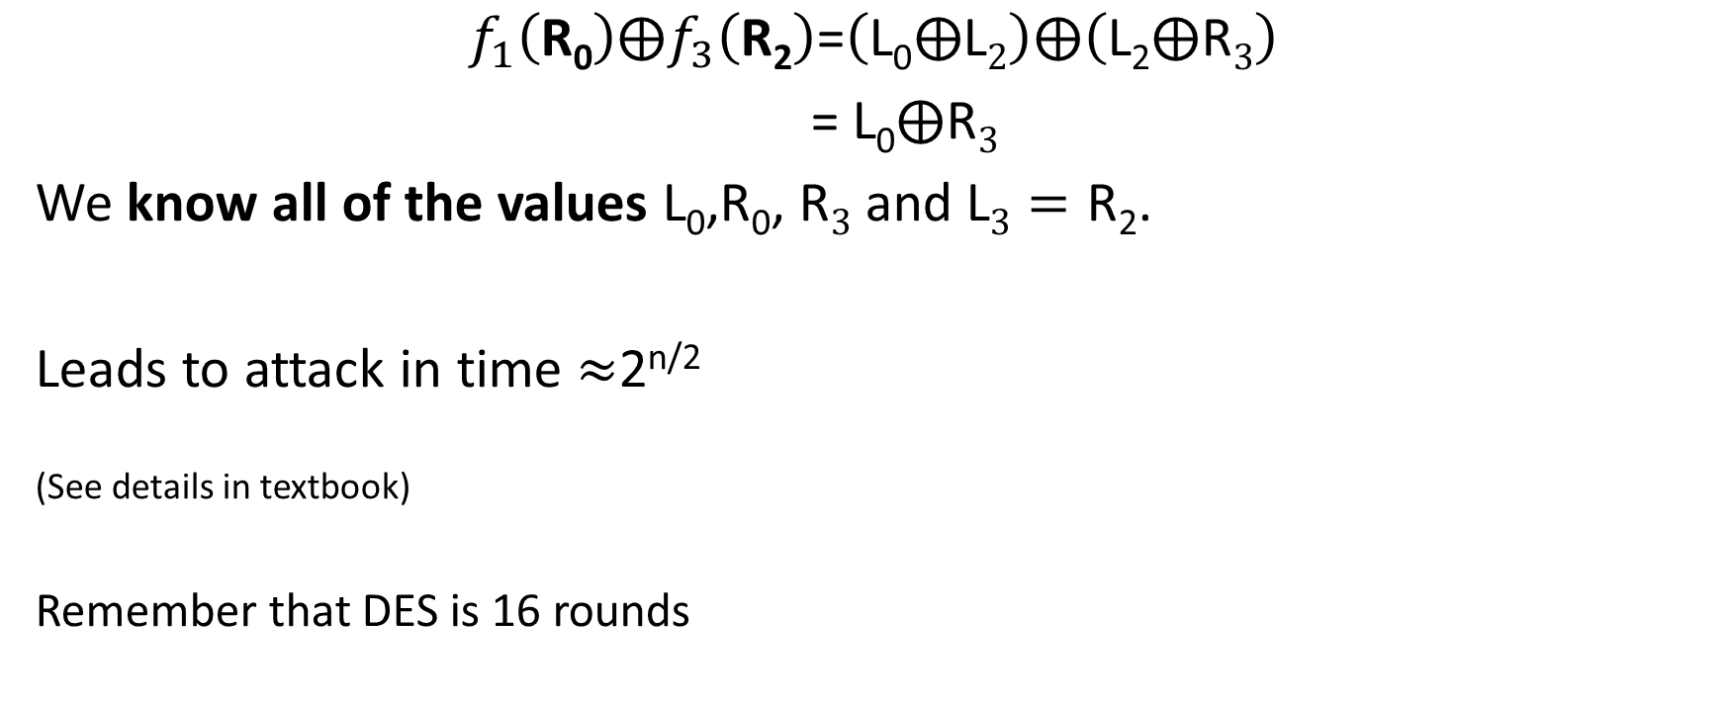
Attack on Three-Round DES
$$f_{1}\left(\text{R}\text{0}\right)⨁f_{3}\left(\text{R}\text{2}\right)\text{=}\left(\text{L}\text{0}⨁\text{L}2\right)⨁\left(\text{L}\text{2}⨁\text{R}3\right)$$
$\text{=}$ $\text{L}\text{0}⨁\text{R}3$
We know all of the values $\text{L}\text{0}\text{,}\text{R}\text{0}$, $\text{R}3$ and $\text{L}3=\text{R}\text{2}$.
Leads to attack in time $≈$2^{n/2}
^{(See details in textbook)}
^{Remember that DES is 16 rounds}

Slide 63
DES Security
Best Known attack is brute-force 2⁵⁶
  Except under unrealistic conditions (e.g., 2⁴³ known plaintexts)
Brute force is not too difficult on modern hardware
Attack can be accelerated further after precomputation
  Output is a few terabytes
  Subsequently keys are cracked in 2³⁸ DES evaluations (minutes)
Precomputation costs amortize over number of DES keys cracked
Even in 1970 there were objections to the short key length for DES

Slide 64
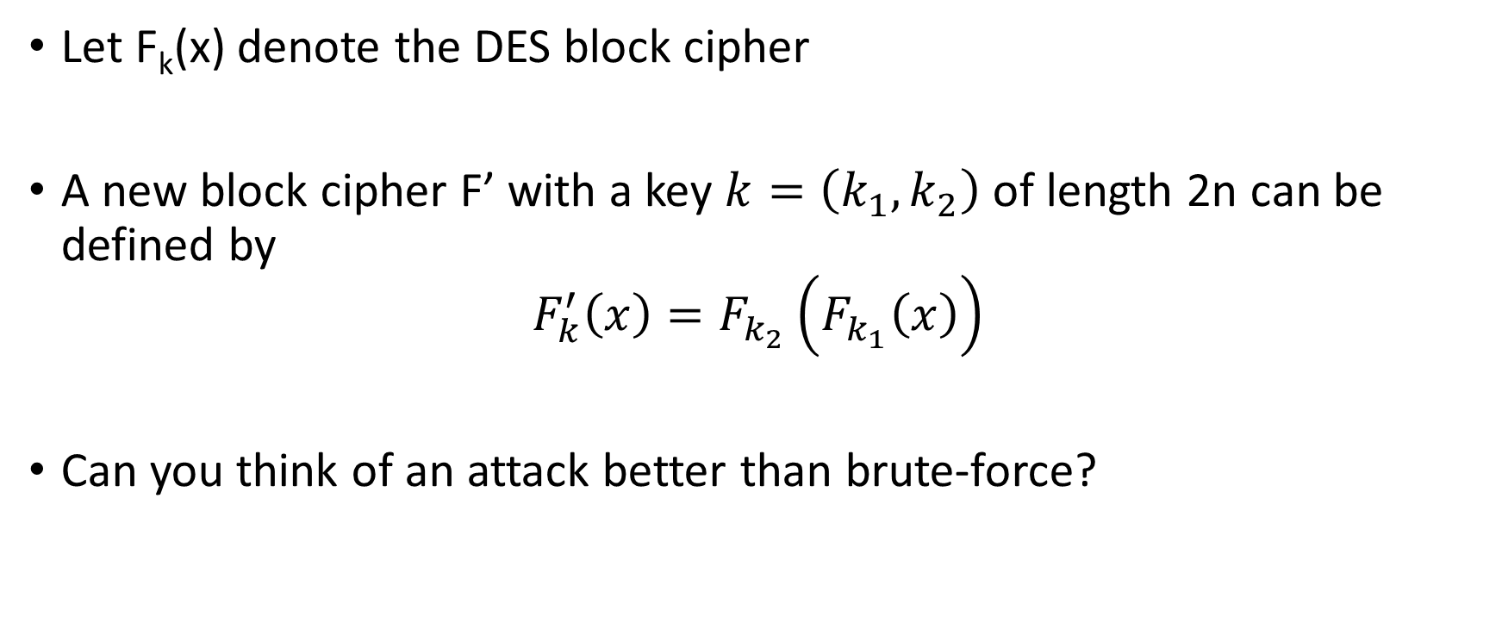
Double DES
Let F_{k}(x) denote the DES block cipher
A new block cipher F’ with a key $k=\left(k_{1},k_{2}\right)$ of length 2n can be defined by
$$F_{k}^{′}\left(x\right)=F_{k_{2}}\left(F_{k_{1}}\left(x\right)\right)$$
Can you think of an attack better than brute-force?

Slide 65
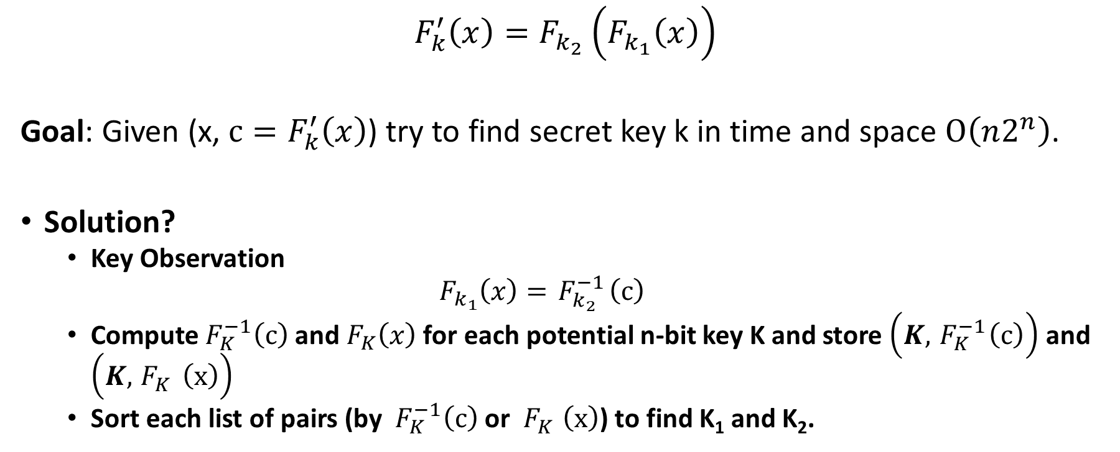
Meet in the Middle Attack
$$F_{k}^{′}\left(x\right)=F_{k_{2}}\left(F_{k_{1}}\left(x\right)\right)$$
Goal: Given (x, $c=F_{k}^{′}\left(x\right)$) try to find secret key k in time and space $O\left(n2^{n}\right)$.
Solution?
  Key Observation
  $$F_{k_{1}}\left(x\right)={ F}_{k_{2}}^{−1}\left(c\right)$$
  Compute${ F}_{K}^{−1}\left(c\right)$ and${ F}_{K}\left(x\right)$ for each potential n-bit key K and store $\left(K,{ F}_{K}^{−1}\left(c\right)\right)$ and $\left(K,{ F}_{K}^{}\left(x\right)\right)$
  Sort each list of pairs (by ${ F}_{K}^{−1}\left(c\right)$ or ${ F}_{K}^{}\left(x\right)$) to find K₁ and K₂.

Slide 66
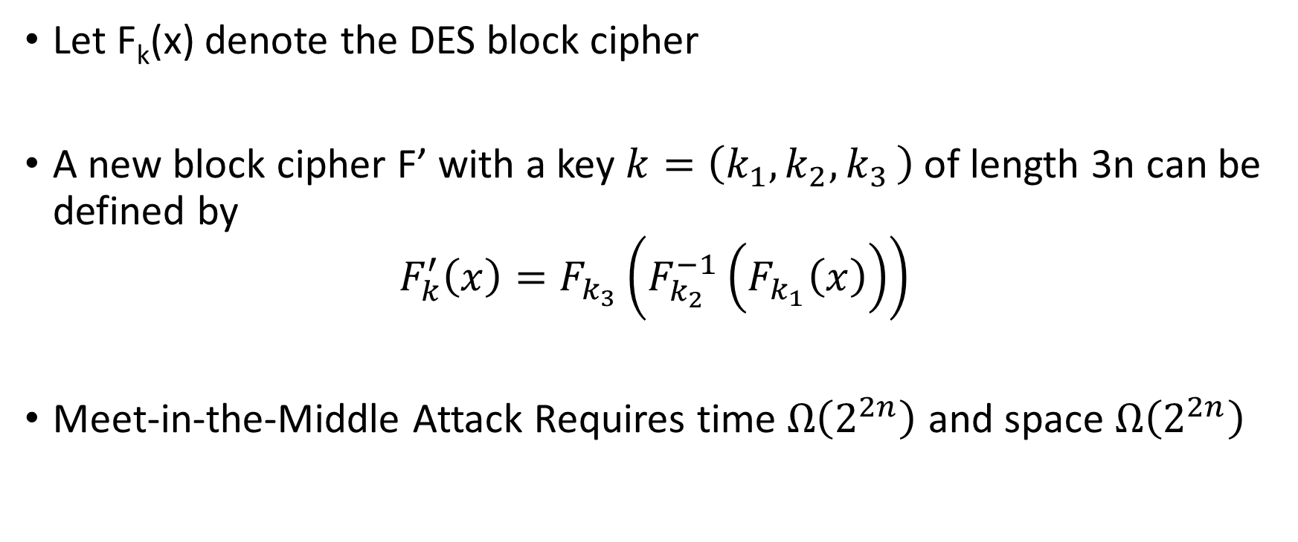
Triple DES Variant 1
Let F_{k}(x) denote the DES block cipher
A new block cipher F’ with a key $k=\left(k_{1},k_{2}{,k}_{3}\right)$ of length 3n can be defined by
$$F_{k}^{′}\left(x\right)=F_{k_{3}}\left(F_{k_{2}}^{−1}\left(F_{k_{1}}\left(x\right)\right)\right)$$
Meet-in-the-Middle Attack Requires time $Ω\left(2^{2n}\right)$ and space $Ω\left(2^{2n}\right)$

Slide 67
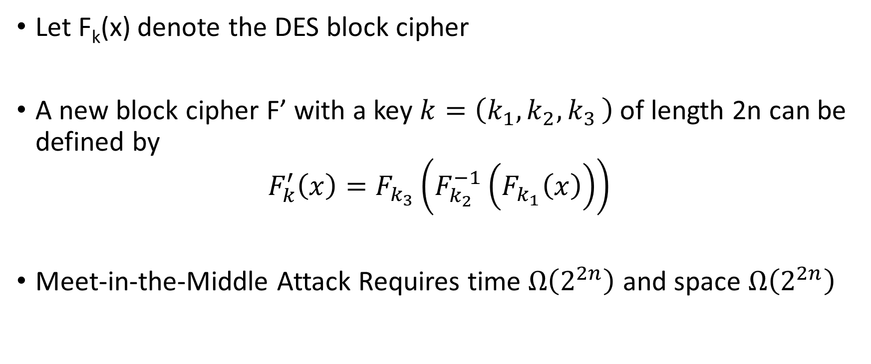
Triple DES Variant 1
Allows backward compatibility with DES by setting k₁=k₂=k₃
Let F_{k}(x) denote the DES block cipher
A new block cipher F’ with a key $k=\left(k_{1},k_{2}{,k}_{3}\right)$ of length 2n can be defined by
$$F_{k}^{′}\left(x\right)=F_{k_{3}}\left(F_{k_{2}}^{−1}\left(F_{k_{1}}\left(x\right)\right)\right)$$
Meet-in-the-Middle Attack Requires time $Ω\left(2^{2n}\right)$ and space $Ω\left(2^{2n}\right)$

Slide 68
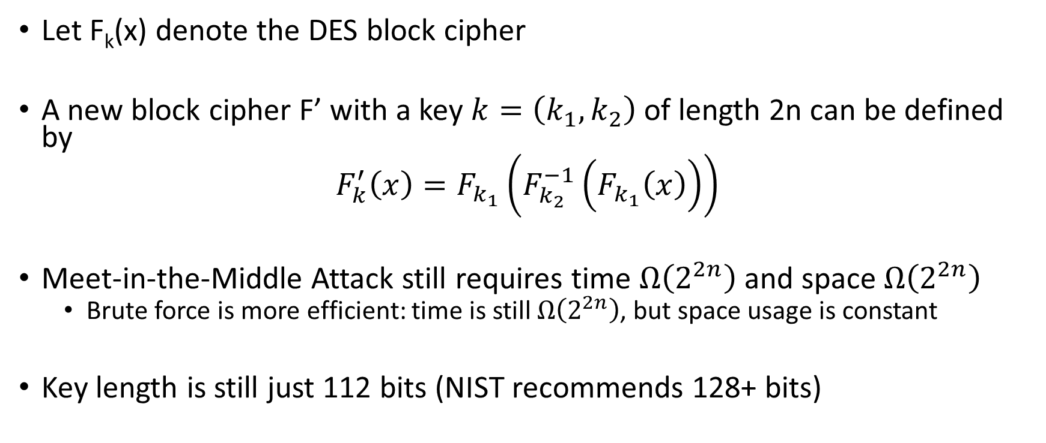
Triple DES Variant 2
Just two keys!
Let F_{k}(x) denote the DES block cipher
A new block cipher F’ with a key $k=\left(k_{1},k_{2}\right)$ of length 2n can be defined by
$$F_{k}^{′}\left(x\right)=F_{k_{1}}\left(F_{k_{2}}^{−1}\left(F_{k_{1}}\left(x\right)\right)\right)$$
Meet-in-the-Middle Attack still requires time $Ω\left(2^{2n}\right)$ and space $Ω\left(2^{2n}\right)$
  Brute force is more efficient: time is still $Ω\left(2^{2n}\right)$, but space usage is constant
Key length is still just 112 bits (NIST recommends 128+ bits)

Slide 69
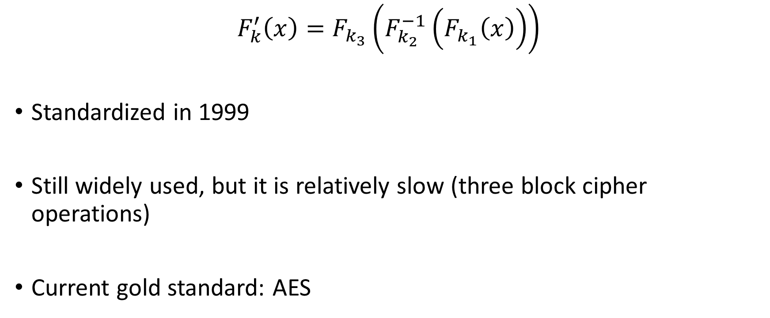
Triple DES Variant 1
$$F_{k}^{′}\left(x\right)=F_{k_{3}}\left(F_{k_{2}}^{−1}\left(F_{k_{1}}\left(x\right)\right)\right)$$
Standardized in 1999
Still widely used, but it is relatively slow (three block cipher operations)
Current gold standard: AES

Slide 70
Next Class
Read Katz and Lindell 6.2.5-6.3
AES & Differential Cryptanalysis

Slide 71
CS 555:Week 6: Topic 2
Stream Ciphers

Slide 72






PRG Security as a Game
R
Random bit b
If b=1
$r←{\left\{0,1\right\}}^{n}$
R = G(r)
Else
$$R←{\left\{0,1\right\}}^{ℓ\left(n\right)}$$
b’
$$∀\begin{matrix} & \\ & \\ & \end{matrix} Pr\left[\begin{matrix} & \\ & \end{matrix} Guesses b^{′}=b\right]≤\frac{1}{2}+μ(n)$$
$$ppt attacker$$
$$negligible function$$
Notes:
Suppose we have m,m’,c’ s.t. Pr[EncK(m)= c’] > Pr[EncK(m’)=c’] then adversary can select m0= m, m1=m’. If the ciphertext challenge c=c’ then the adversary outputs guess b’ = 1. Otherwise, the adversary outputs random guess b’.

Slide 73

Stream Cipher vs PRG
PRG pseudorandom bits output all at once
Stream Cipher
  Pseudorandom bits can be output as a stream
  RC4, RC5 (Ron’s Code)
st₀ := Init(s)
For i=1 to $ℓ$:
  (y_{i},st_{i}):=GetBits(st_{i-1})
Output: y₁,…,y$ℓ$

Slide 74

Linear Feedback Shift Register

Slide 75

Linear Feedback Shift Register
State at time t:${ s}_{n−1}^{t},…,{ s}_{1}^{t},{ s}_{0}^{t}$ (n registers)
Feedback Coefficients: $S⊆\left\{0,…,n\right\}$

Slide 76

Linear Feedback Shift Register
State at time t:${ s}_{n−1}^{t},…,{ s}_{1}^{t},{ s}_{0}^{t}$ (n registers)
Feedback Coefficients: $S⊆\left\{0,…,n−1\right\}$
State at time t+1:${⨁_{i∈S}s_{i}^{t}, s}_{n−1}^{t},…,{ s}_{1}^{t},$
$${ s}_{n−1}^{t+1}=⨁_{i∈S}s_{i}^{t}, and { s}_{i}^{t+1}={ s}_{i+1}^{t} for i<n−1$$
Output at time t+1: $y_{t+1}{=s}_{0}^{t}$

Slide 77

Linear Feedback Shift Register
Observation 1: First n bits of output reveal initial state
$$y_{1},…,y_{n}{=s}_{0}^{0},{ s}_{1}^{0},…,s_{n−1}^{0}$$
Observation 2: Next n bits allow us to solve for n unknowns
$$x_{i}=\left\{\begin{aligned}1 if i∈S \\ 0 otherwise \end{aligned}\right.$$
$$y_{n+1}=y_{n}x_{n−1}+…+y_{1}x_{0}$$

Slide 78

Linear Feedback Shift Register
Observation 1: First n bits of output reveal initial state
$$y_{1},…,y_{n}{=s}_{0}^{0},{ s}_{1}^{0},…,s_{n−1}^{0}$$
Observation 2: Next n bits allow us to solve for n unknowns
$$x_{i}=\left\{\begin{aligned}1 if i∈S \\ 0 otherwise \end{aligned}\right.$$
$$y_{n+1}=y_{n}x_{n−1}+…+y_{1}x_{0} \text{mod}\text{ 2}$$

Slide 79

Linear Feedback Shift Register
Observation 2: Next n bits allow us to solve for n unknowns
$$x_{i}=\left\{\begin{aligned}1 if i∈S \\ 0 otherwise \end{aligned}\right.$$
$$y_{n+1}=y_{n}x_{n−1}+…+y_{1}x_{0} \text{mod}\text{ 2 }$$
$$y_{2n}=y_{2n−1}x_{n−1}+…+y_{n}x_{0} \text{mod}\text{ 2}$$
N unknowns &
N linear independent constraints
…

Slide 80

Removing Linearity
Attacks exploited linear relationship between state and output bits
Nonlinear Feedback:
$${ s}_{n−1}^{t+1}=⨁_{i∈S}s_{i}^{t},$$
$${ s}_{n−1}^{t+1}=g\left(s_{0}^{t},{ s}_{1}^{t},…,s_{n−1}^{t}\right)$$
Non linear function

Slide 81

Removing Linearity
Attacks exploited linear relationship between state and output bits
Nonlinear Combination:
$$y_{t+1}{=s}_{0}^{t}$$
$${ y}_{t+1}^{}=f\left(s_{0}^{t},{ s}_{1}^{t},…,s_{n−1}^{t}\right)$$
Important: f must be balanced!
$$Pr\left[f\left(x\right)=1\right]≈\frac{1}{2}$$
Non linear function

Slide 82

Trivium (2008)
Won the eSTREAM competition
Currently, no known attacks are better than brute force
Couples Output from three nonlinear Feedback Shift Registers
First 4*288 “output bits” are discared

Slide 83
Trivium (2008)

Slide 84
Trivium (2008)
AND (Non-linear)

Slide 85
Trivium (2008)
(Non-linear) Feedback

Slide 86
Combination Generator
Attacks exploited linear relationship between state and output bits
Nonlinear Combination:
$$y_{t+1}{=s}_{0}^{t}$$
$${ y}_{t+1}^{}=f\left(s_{0}^{t},{ s}_{1}^{t},…,s_{n−1}^{t}\right)$$
Important: f must be balanced!
$$Pr\left[f\left(x\right)=1\right]≈\frac{1}{2}$$
Non linear function

Slide 87
Feedback Shift Registers
Good performance in hardware
Performance is less ideal for software

Slide 88

Stream Ciphers
RC4
  A proprietary cipher owned by RSA, designed by Ron Rivest in 1987 (public 1994)
  Widely used (web SSL/TLS, wireless WEP).
  Distinguishable from random stream
    Second byte of output is 0 with probability $≈\frac{2}{256}$ (vs. $\frac{1}{256}$ for a truly random stream)
Newer Versions: RC5 and RC6
Salsa20
Rijndael selected by NIST as AES in 2000
Notes:
This cipher algorithm was developed by two Belgian cryptographers, Joan Daemen and Vincent Rijmen, and submitted to the AES selection process under the name "Rijndael", a portmanteau of the names of the inventors. (Rijndael is pronounced [rɛindaːl]).^{[2]}
S

Slide 89
The RC4 Cipher
The cipher internal state consists of
  a 256-byte array S, which contains a permutation of 0 to 255
    total number of possible states is 256! ≈ 2¹⁷⁰⁰
  two indexes: i, j
  i = j = 0
  Loop
    i = (i + 1) (mod 256)
    j = (j + S[i]) (mod 256)
    swap(S[i], S[j])
    output S[S[i] + S[j] (mod 256)]
  End Loop

Slide 90


Distinguishing Attack
Let $S_{0}$ denote initial state
Suppose that $S_{0}$[2]=0 and $S_{0}$[1]$=X≠0$
  i = j = 0
  Loop
    i = (i + 1) (mod 256)
    j = (j + S[i]) (mod 256)
    swap(S[i], S[j])
    output S[S[i] + S[j] (mod 256)]
  End Loop
 | 1 | 2 | 3 | … | X | … | 255
$$S_{0}$$ | $S_{0}$[1]$≠0$ | 0 | $S_{0}$[3] |  | $S_{0}$[X] |  | $S_{0}$[255]

Slide 91

Distinguishing Attack
Let $S_{0}$ denote initial state
Suppose that $S_{0}$[2]=0 and $S_{0}$[1]$=X≠0$
  i = j = 0
  Loop
    i = (i + 1) (mod 256)
    j = (j + S[i]) (mod 256)
    swap(S[i], S[j])
    output S[S[i] + S[j] (mod 256)]
  End Loop
 | 1 | 2 | 3 | … | X | … | 255
$$S_{0}$$ | $$X≠0$$ | 0 | $S_{0}$[3] |  | $S_{0}$[X] |  | $S_{0}$[255]
i=1, j =X

Slide 92



Distinguishing Attack
 | 1 | 2 | 3 | … | X | … | 255
$$S_{0}$$ | $$X≠0$$ | 0 | $S_{0}$[3] |  | $S_{0}$[X] |  | $S_{0}$[255]
$$S_{1}$$ | $S_{0}$[X] | 0 | $S_{0}$[3] |  | $$X≠0$$ |  | $S_{0}$[255]
Let $S_{0}$ denote initial state
Suppose that $S_{0}$[2]=0 and $S_{0}$[1]$=X≠0$
  i = j = 0
  Loop
    i = (i + 1) (mod 256)
    j = (j + S[i]) (mod 256)
    swap(S[i], S[j])
    output S[S[i] + S[j] (mod 256)]
  End Loop
i=1, j =X
Output y₁= $S_{1}$[S[i]+S[j]]
i=2, j =X

Slide 93

Distinguishing Attack
 | 1 | 2 | 3 | … | X | … | 255
$$S_{0}$$ | $$X≠0$$ | 0 | $S_{0}$[3] |  | $S_{0}$[X] |  | $S_{0}$[255]
$$S_{1}$$ | $S_{0}$[X] | 0 | $S_{0}$[3] |  | $$X≠0$$ |  | $S_{0}$[255]
$$S_{2}$$ | $S_{0}$[X] | $$X≠0$$ | $S_{0}$[3] |  | 0
Let $S_{0}$ denote initial state
Suppose that $S_{0}$[2]=0 and $S_{0}$[1]$=X≠0$
  i = j = 0
  Loop
    i = (i + 1) (mod 256)
    j = (j + S[i]) (mod 256)
    swap(S[i], S[j])
    output S[S[i] + S[j] (mod 256)]
  End Loop
i=2, j =X
Output:
y₂= S₂[S₂[2]+S₂[X]]
= S₂[0+X]
=0

Slide 94

Distinguishing Attack
Let $p=Pr\left[S_{0}\text{[2]=0 }\text{and} S_{0}\text{[1]} ≠2\right]$
$$p=\frac{1}{256}\left(1−\frac{1}{255}\right)$$
Probability second output byte is 0
$$Pr\left[y2=0{ | S}_{0}\text{[2]=0 }\text{and} S_{0}\text{[1]} ≠2\right]p+Pr\left[y2=0{ | S}_{0}\text{[2]}≠\text{0 }\text{or} S_{0}\text{[1]}=2\right](1−p)$$
$$=p+\left(1−p\right)\frac{1}{256}$$
$$=\frac{1}{256}\left(1−\frac{1}{255}\right)+\left(1−\frac{1}{256}+\frac{1}{256}\frac{1}{255}\right)\frac{1}{256}$$
$$≈\frac{2}{256}$$

Slide 95
RC4 Attacks
Wired Equivalent Privacy (WEP) encryption used RC4 with an initialization vector
Description of RC4 doesn’t involve initialization vector…
  But WEP imposes an initialization vector
  K=IV || K’
  Since IV is transmitted attacker may have first few bytes of the secret key K!
  Giving the attacker partial knowledge of K often allows recovery of the entire key K’ over time!

Slide 96

Hash Functions from Block Ciphers
Davies-Meyer Construction from block cipher $F_{K}$
$$H\left(K,x\right)=F_{K}\left(x\right)⨁x$$
Theorem: If $F:{\left\{0,1\right\}}^{λ}×{\left\{0,1\right\}}^{λ}→{\left\{0,1\right\}}^{λ}$ is modeled as an ideal block cipher then Davies-Meyer construction is a collision-resistant hash function
(Concrete: Need roughly $q≈2^{λ/2}$ queries to find collision)
Ideal Cipher Model: For each key K model F_{K} as a truly random permutation which may only be accessed in black box manner.
  (Equivalent to Random Oracle Model)

Slide 97
Advanced Encryption Standard (AES)
(1997) US National Institute of Standards and Technology (NIST) announces competition for new block cipher to replace DES
Fifteen algorithms were submitted from all over the world
  Analyzed by NIST
Contestants given a chance to break competitors schemes
October, 2000 NIST announces a winner Rijndael
  Vincent Rijmen and Joan Daemen
  No serious vulnerabilities found in four other finalists
  Rijndael was selected for efficiency, hardware performance, flexibility etc…

Slide 98
Advanced Encryption Standard
Block Size: 128 bits (viewed as 4x4 byte array)
Key Size: 128, 192 or 256
Essentially a Substitution Permutation Network
  AddRoundKey: Generate 128-bit sub-key from master key XOR with current state
  SubBytes: Each byte of state array (16 bytes) is replaced by another byte according to a single S-box (lookup table)
  ShiftRows – shift ith row by i bytes
  MixColumns – permute the bits in each column

Slide 99

Substitution Permutation Networks
S-box a public “substitution function” (e.g.$S∈\text{Perm}\text{8}$).
S is not part of a secret key, but can be used with one
$$f(x)=S\left(\text{x}⨁k\right)$$
Input to round: x, k (k is subkey for current round)
Key Mixing: Set $x≔x⨁k$
Substitution:$x≔$ $\text{S}\text{1}\left(\text{x}\text{1}\right)∥\text{S}\text{2}\left(\text{x}\text{2}\right)∥…∥\text{S}\text{8}\left(\text{x}\text{8}\right)$
Bit Mixing Permutation: permute the bits of x to obtain the round output
Note: there are only n! possible bit mixing permutations of [n] as opposed to 2^{n}! Permutations of {0,1}^{n}

Slide 100
Recap: Substitution Permutation Networks
Proposition 6.3: Let F be a keyed function defined by a Substitution Permutation Network. Then for any keys/number of rounds F_{k} is a permutation.
Why? Composing permutations f,g results in another permutation h(x)=g(f(x)).

Slide 101
Advanced Encryption Standard
Key Mixing
Block Size: 128 bits
Key Size: 128, 192 or 256
Essentially a Substitution Permutation Network
  AddRoundKey: Generate 128-bit sub-key from master key, XOR with current state array
  SubBytes: Each byte of state array (16 bytes) is replaced by another byte according a single S-box (lookup table)
  ShiftRows
  MixColumns
Permutation
Substitution

Slide 102


AddRoundKey:
Round Key (16 Bytes)
00001111
10100011 | …
11001100 |  | …
01111111 |  |  | …
$$⨁$$
State
11110000
01100010 | …
00110000 |  | …
11111111 |  |  | …
$$=$$
11111111
11000001 | …
11111100 |  | …
10000000 |  |  | …

Slide 103
AddRoundKey:
Round Key (16 Bytes)
10100011 | …
 |  | …
 |  |  | …
State
11111111
11000001 | …
11111100 |  | …
10000000 |  |  | …
SubBytes (Apply S-box)
S(11111111)
S(11000001) | S(…)
S(11111100) |  | S(…)
S(10000000) |  |  | S(…)

Slide 104
AddRoundKey:
Round Key (16 Bytes)
10100011 | …
 |  | …
 |  |  | …
State
S(11111111)
S(11000001) | S(…)
S(11111100) |  | S(…)
S(10000000) |  |  | S(…)
Shift Rows
S(11111111)
 | S(11000001) | S(…)
S(…) |  | S(11111100)
 |  | S(…) | S(10000000)

Slide 105
AddRoundKey:
Round Key (16 Bytes)
10100011 | …
 |  | …
 |  |  | …
State
S(11111111)
 | S(11000001) | S(…)
S(…) |  | S(11111100)
 |  | S(…) | S(10000000)
Mix Columns
Invertible (linear) transformation.
Key property: if inputs differ in b>0 bytes then output differs in 5-b bytes (minimum)

Slide 106
AES
We just described one round of the SPN
AES uses
  10 rounds (with 128 bit key)
  12 rounds (with 192 bit key)
  14 rounds (with 256 bit key)

Slide 107
Announcements
Homework 2 Solutions Posted (See Piazza).
  Please read through carefully and make sure you understand the solutions to each problem.
  Grading in progress
No Class on Tuesday (October Break)
Look for Practice Midterm Next Week

Slide 108
Recap
2DES, Meet in the Middle Attack
3DES
Stream Ciphers
  Breaking Linear Feedback Shift Registers
  Trivium
AES

Slide 109
AES Attacks?
Side channel attacks affect a few specific implementations
  But, this is not a weakness of AES itself
  Timing attack on OpenSSL’s implementation AES encryption (2005, Bernstein)
(2009) Related-Key Attack on 11 round version of AES
  Related Key Attack: Attacker convinces Alice to use two related (but unknown) keys
  recovers 256-bit key in time 2⁷⁰
  But AES is 14 round (with 256 bit key) so the attack doesn’t apply in practice
(2009) Related Key Attack on 192-bit and 256 bit version of AES
  recovers 256-bit key in time 2^{99.5}.
(2011) Key Recovery attack on AES-128 in time 2^{126.2}.
  Improved to 2^{126.0} for AES-128, 2^{189.9} for AES-192 and 2^{254.3} for AES-256
First public cipher approved by NSA for Top Secret information
  SECRET level (AES-128,AES-192 & AES-256), TOP SECRET level (AES-128,AES-192 & AES-256)
Notes:
In April 2005, D.J. Bernstein announced a cache-timing attack that he used to break a custom server that used OpenSSL's AES encryption.^{[20]} The custom server was designed to give out as much timing information as possible (the server reports back the number of machine cycles taken by the encryption operation), and the attack required over 200 million chosen plaintexts.^{[21]}

Slide 110

NIST Recommendations
Ok, as CRHF and in Digital Signatures
Ok, to use for HMAC, Key Derivation and as PRG
80 bits-security is no longer acceptable
Recommendations from Other Groups (Including NIST): www.keylength.com

Slide 111

Linear Cryptanalysis
$$y=F_{K}\left(x\right)$$
Definition: Fixed set of input bits $i_{1},…,i_{in}$ and output bits $i_{1}′,…,i_{out}′$ are said to have $ε$-linear bias if the following holds
$$\left|Pr\left[x_{i_{1}}⨁x_{i_{2}}…⨁x_{i_{in}}⨁y_{i_{1}′}⨁y_{i_{2}′}…⨁y_{i_{out}′}\right]\right|=ε$$
(randomness taken over the selection of input x and secret key K)

Slide 112

Linear Cryptanalysis
Definition: Fixed set of input bits $i_{1},…,i_{in}$ and output bits $i_{1}′,…,i_{out}′$ are said to have $ε$-linear bias if the following holds
$$\left|Pr\left[x_{i_{1}}⨁x_{i_{2}}…⨁x_{i_{in}}⨁y_{i_{1}′}⨁y_{i_{2}′}…⨁y_{i_{out}′}\right]−\frac{1}{2}\right|=ε$$
(randomness taken over the selection of input x and secret key K, $y=F_{K}\left(x\right)$)
Matsui: DES can be broken with just $2^{43}$ known plaintext/ciphertext pairs.
Lots of examples needed!
But the examples do not need to be chosen plaintext/ciphertext pairs…
One encrypted file can provide a large amounts of known plaintext

Slide 113

Differential Cryptanalysis
Definition: We say that the differential $\left(△_{x},△_{y}\right)$ occurs with probability $p$ in the keyed block cipher $F$ if
$$Pr\left[F_{K}\left(x_{1}\right)⨁F_{K}\left(x_{1}⨁△_{x}\right)=△_{y}\right]≥p$$
Can Lead to Efficient (Round) Key Recovery Attacks
Exploiting Weakness Requires: well over $\frac{1}{p}$ chosen plaintext-ciphertext pairs
Differentials in S-box can lead to (weaker) differentials in SPN.

