Slide 1
Cryptography
CS 555
Week 5:
Cryptographic Hash Functions
HMACs
Generic Attacks
Random Oracle Model
Applications of Hashing
Readings: Katz and Lindell Chapter 5, Appendix A.4
Spring 2021

Slide 2
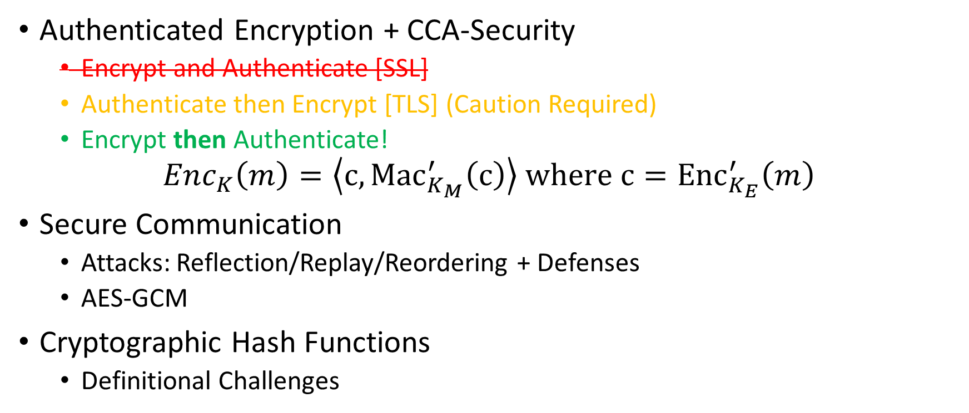
Recap
Authenticated Encryption + CCA-Security
  Encrypt and Authenticate [SSL]
  Authenticate then Encrypt [TLS] (Caution Required)
  Encrypt then Authenticate!
$${Enc}_{K}\left(m\right)=\left\langle c,{Mac}_{K_{M}}^{′}\left(c\right)\right\rangle where{ c=Enc}_{K_{E}}^{′}\left(m\right)$$
Secure Communication
  Attacks: Reflection/Replay/Reordering + Defenses
  AES-GCM
Cryptographic Hash Functions
  Definitional Challenges

Slide 3
Week 5: Topic 1:
Cryptographic Hash Functions

Slide 4
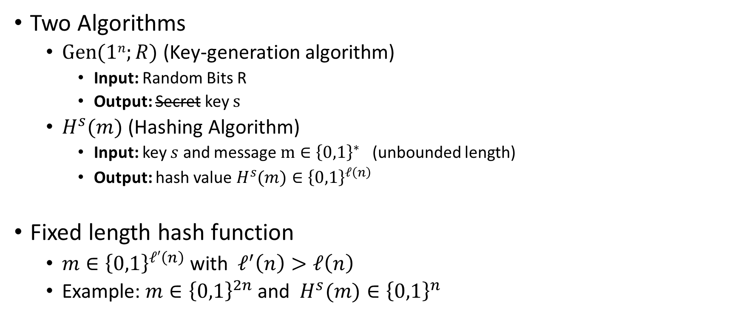
Keyed Hash Function Syntax
Two Algorithms
  $\operatorname{Gen}{(1n;R)}$ (Key-generation algorithm)
    Input: Random Bits R
    Output: Secret key $s$
  $H^{s}{(m)}$ (Hashing Algorithm)
    Input: key $s$ and message $m∈{\left\{0,1\right\}}^{∗}$ (unbounded length)
    Output: hash value${ H}^{s}{(m)}∈{\left\{0,1\right\}}^{ℓ\left(n\right)}$
Fixed length hash function
  $m∈{\left\{0,1\right\}}^{ℓ′\left(n\right)}$ with$ℓ^{′}\left(n\right)>ℓ\left(n\right)$
  Example: $m∈{\left\{0,1\right\}}^{2n}$ and ${ H}^{s}{(m)}∈{\left\{0,1\right\}}^{n}$

Slide 5


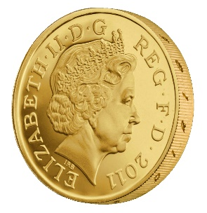



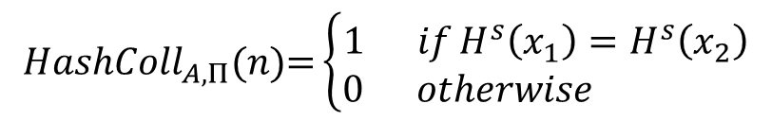
Collision Experiment (${HashColl}_{A,Π}(n)$)
s
x₁,x₂
$${HashColl}_{A,Π}(n)\text{=}\left\{\begin{aligned}1 ifH^{s}\left(x_{1}\right)=H^{s}\left(x_{2}\right) \\ 0 otherwise \end{aligned}\right.$$
$$s=Gen{(1n;R)}$$
Definition: (Gen,H) is a collision resistant hash function if
$$∀PPT A ∃μ (negligible) s.t$$
$$Pr\left[{HashColl}_{A,Π}(n)\text{=}1\right]≤μ(n)$$

Slide 6
Collision Experiment (${HashColl}_{A,Π}(n)$)
For simplicity we will sometimes just say that H (or H^{s}) is a collision resistant hash function
s
Key is not key secret (just random)
x₁,x₂
$${HashColl}_{A,Π}(n)\text{=}\left\{\begin{aligned}1 ifH^{s}\left(x_{1}\right)=H^{s}\left(x_{2}\right) \\ 0 otherwise \end{aligned}\right.$$
$$s=Gen{(1n;R)}$$
Definition: (Gen,H) is a collision resistant hash function if
$$∀PPT A ∃μ (negligible) s.t$$
$$Pr\left[{HashColl}_{A,Π}(n)\text{=}1\right]≤μ(n)$$

Slide 7
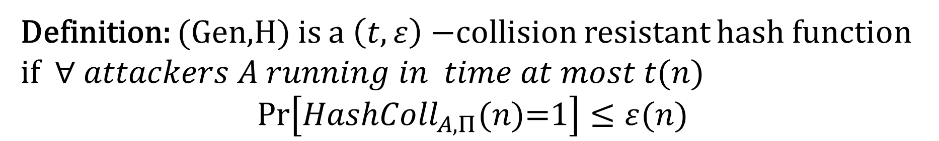

Concrete Security (${HashColl}_{A,Π}(n)$)
s
x₁,x₂
$${HashColl}_{A,Π}(n)\text{=}\left\{\begin{aligned}1 ifH^{s}\left(x_{1}\right)=H^{s}\left(x_{2}\right) \\ 0 otherwise \end{aligned}\right.$$
$$s=Gen{(1n;R)}$$
Definition: (Gen,H) is a $\left(t,ε\right)−$collision resistant hash function if $∀ attackers A running in time at most t(n)$
$$Pr\left[{HashColl}_{A,Π}(n)\text{=}1\right]≤ε(n)$$

Slide 8
Theory vs Practice
Most cryptographic hash functions used in practice are un-keyed
  Examples: MD5, SHA1, SHA2, SHA3, Blake2B
Tricky to formally define collision resistance for keyless hash function
  There is a PPT algorithm to find collisions
  We just usually can’t find this algorithm ☺
  Guarantee for protocol using H
    If we know an explicit efficient algorithm A
    breaking our protocol then there is an efficient
    blackbox reduction transforming A into an efficient
    collision finding algorithm.

Slide 9
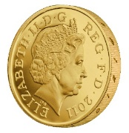
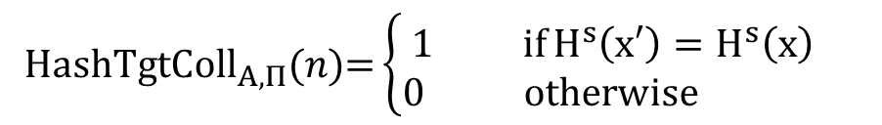

Weaker Requirements for Cryptographic Hash
Target-Collision Resistance
s,x
x’
$${HashTgtColl}_{A,Π}(n)\text{=}\left\{\begin{aligned}1 ifH^{s}\left(x′\right)=H^{s}\left(x\right) \\ 0 otherwise \end{aligned}\right.$$
$$s=Gen{(1n;R)}$$
$${x∈\left\{0,1\right\}}^{n}$$
Question: Why is collision resistance stronger?

Slide 10
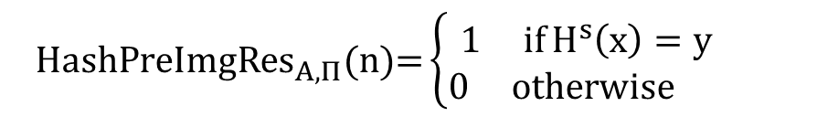



Weaker Requirements for Cryptographic Hash
Preimage Resistance (One-Wayness)
s, $y$
$$\text{x}$$
$${HashPreImgRes}_{A,Π}(n)\text{=}\left\{\begin{aligned}1 ifH^{s}\left(x\right)=y \\ 0 otherwise \end{aligned}\right.$$
$$s=Gen{(1n;R)}$$
$${y∈\left\{0,1\right\}}^{ℓ(n)}$$
Question: Why is collision resistance stronger?

Slide 11
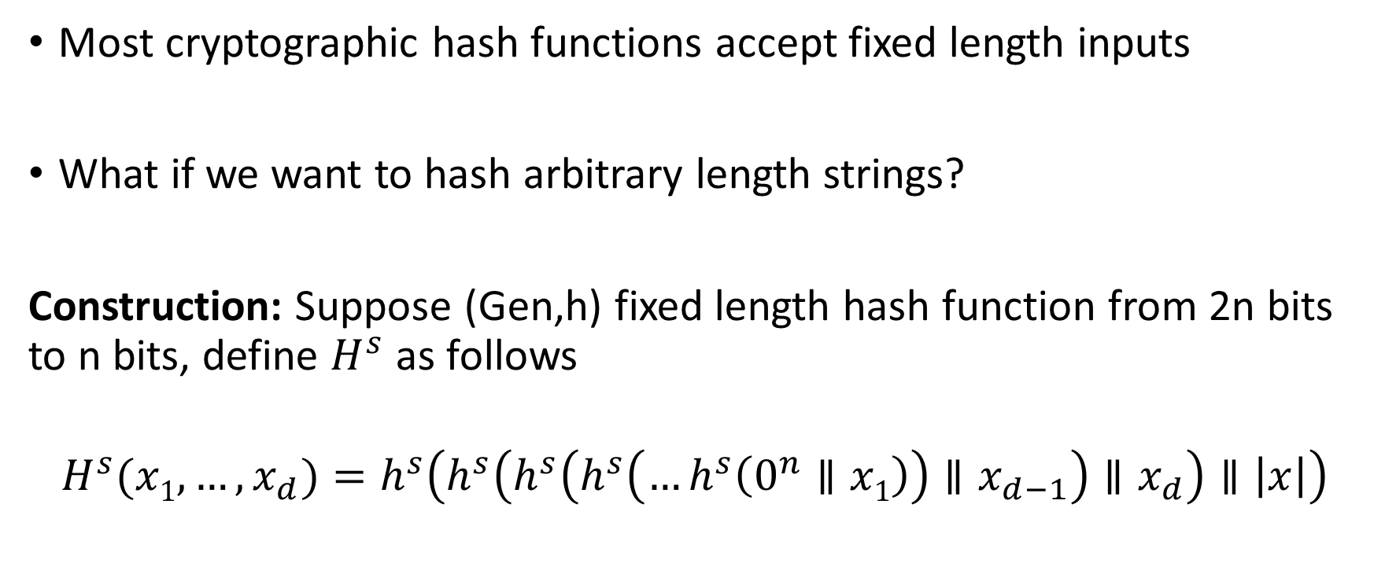
Merkle-Damgård Transform
Most cryptographic hash functions accept fixed length inputs
What if we want to hash arbitrary length strings?
Construction: Suppose (Gen,h) fixed length hash function from 2n bits to n bits, define $H^{s}$ as follows
$$H^{s}{(x1,…,x_{d})}=h^{s}\left(h^{s}\left(h^{s}\left(h^{s}\left(…h^{s}\left(0^{n}∥x1\right)\right)∥x_{d−1}\right)∥x_{d}\right)∥\left|x\right|\right)$$

Slide 12
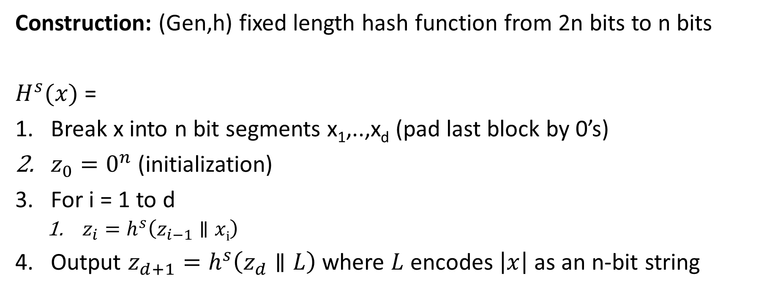
Merkle-Damgård Transform
Construction: (Gen,h) fixed length hash function from 2n bits to n bits
$H^{s}{(x)}$ =
Break x into n bit segments x₁,..,x_{d} (pad last block by 0’s)
$z_{0}=0^{n}$ (initialization)
For i = 1 to d
  $z_{i}=h^{s}\left(z_{i−1}∥xi\right)$
Output $z_{d+1}=h^{s}\left(z_{d}∥L\right)$ where $L$ encodes $\left|x\right|$ as an n-bit string

Slide 13
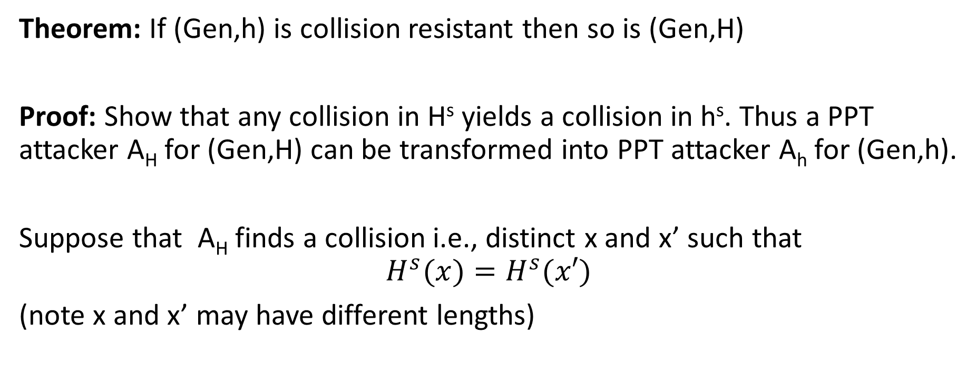
Merkle-Damgård Transform
Theorem: If (Gen,h) is collision resistant then so is (Gen,H)
Proof: Show that any collision in H^{s} yields a collision in h^{s}. Thus a PPT attacker A_{H} for (Gen,H) can be transformed into PPT attacker A_{h} for (Gen,h).
Suppose that A_{H} finds a collision i.e., distinct x and x’ such that
$$H^{s}{(x)}=H^{s}{(x′)}$$
(note x and x’ may have different lengths)

Slide 14

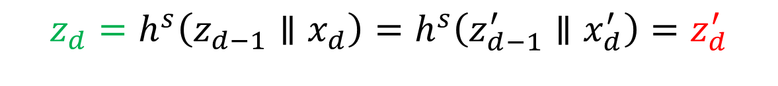
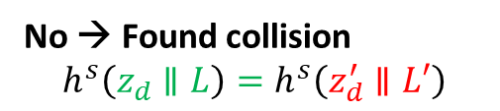

Merkle-Damgård Transform
Theorem: If (Gen,h) is collision resistant then so is (Gen,H)
Proof: Suppose that $H^{s}{(x)}=H^{s}{(x′)}$. We will extract a collision for $h^{s}$.
Case 1: L=|x|=|x’|=L’ (proof for case two is similar)
$${H^{s}{(x)}=z}_{d+1}=h^{s}\left(z_{d}∥L\right){=H}^{s}{(x′)}=z_{d+1}^{′}=h^{s}\left(z_{d}^{′}∥L′\right)$$
$$z_{d}∥L=?z_{d}^{′}∥L′$$
No → Found collision
$$h^{s}\left(z_{d}∥L\right)=h^{s}\left(z_{d}^{′}∥L′\right)$$
Yes?
$${z_{d}=h}^{s}\left(z_{d−1}∥x_{d}\right)=h^{s}\left(z_{d−1}^{′}∥x_{d}^{′}\right)=z_{d}^{′}$$

Slide 15
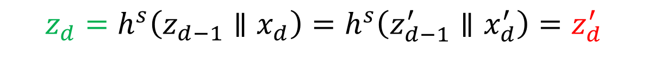
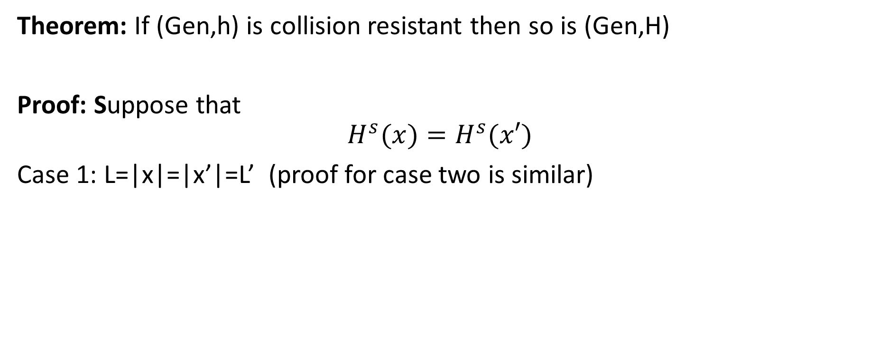
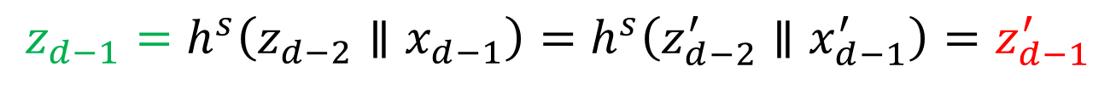
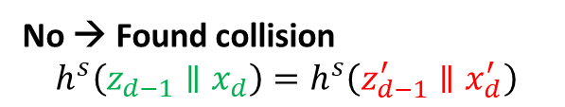
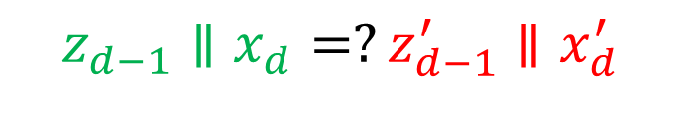
Merkle-Damgård Transform
Theorem: If (Gen,h) is collision resistant then so is (Gen,H)
Proof: Suppose that
$$H^{s}{(x)}=H^{s}{(x′)}$$
Case 1: L=|x|=|x’|=L’ (proof for case two is similar)
$${z_{d}=h}^{s}\left(z_{d−1}∥x_{d}\right)=h^{s}\left(z_{d−1}^{′}∥x_{d}^{′}\right)=z_{d}^{′}$$
$$z_{d−1}∥x_{d}=?z_{d−1}^{′}∥x_{d}^{′}$$
No → Found collision
$$h^{s}\left(z_{d−1}∥x_{d}\right)=h^{s}\left(z_{d−1}^{′}∥x_{d}^{′}\right)$$
Yes?
$${z_{d−1}=h}^{s}\left(z_{d−2}∥x_{d−1}\right)=h^{s}\left(z_{d−2}^{′}∥x_{d−1}^{′}\right)=z_{d−1}^{′}$$

Slide 16
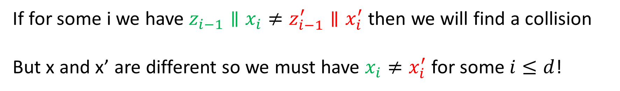

Merkle-Damgård Transform
Theorem: If (Gen,h) is collision resistant then so is (Gen,H)
Proof: Suppose that
$$H^{s}{(x)}=H^{s}{(x′)}$$
Case 1: |x|=|x’| (proof for case two is similar)
If for some i we have $z_{i−1}∥x_{i}≠z_{i−1}^{′}∥x_{i}^{′}$ then we will find a collision
But x and x’ are different so we must have $x_{i}≠x_{i}^{′}$ for some $i≤d$!

Slide 17
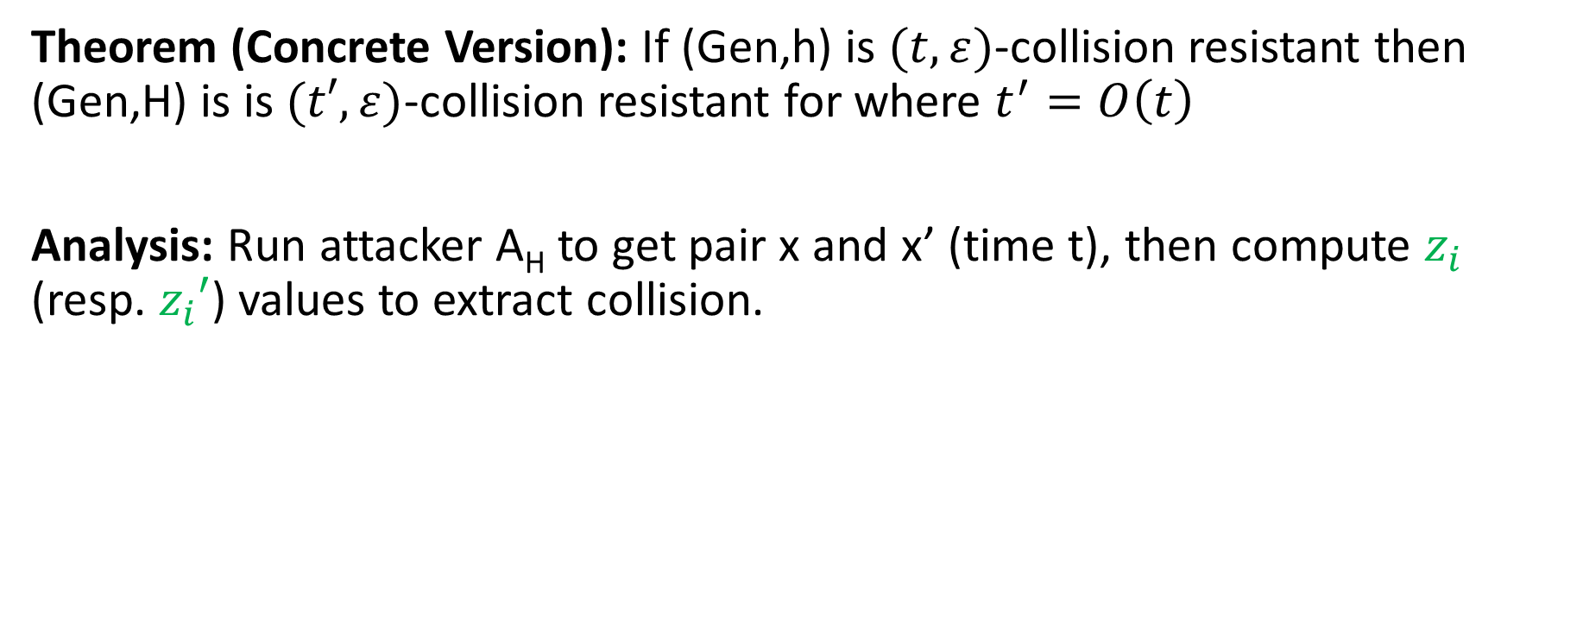
Merkle-Damgård Transform
Theorem (Concrete Version): If (Gen,h) is $(t,ε)$-collision resistant then (Gen,H) is is $(t′,ε)$-collision resistant for where $t^{′}=O\left(t\right)$
Analysis: Run attacker A_{H} to get pair x and x’ (time t), then compute $z_{i}$ (resp. $z_{i}′$) values to extract collision.
$${H^{s}{(x)}=z}_{d+1}=h^{s}\left(z_{d}∥L\right){=H}^{s}{(x′)}=z_{d+1}^{′}=h^{s}\left(z_{d}^{′}∥L′\right)$$
$$z_{d}∥L=?z_{d}^{′}∥L′$$
No → Found collision
$$h^{s}\left(z_{d}∥L\right)=h^{s}\left(z_{d}^{′}∥L′\right)$$
Yes?
$${z_{d}=h}^{s}\left(z_{d−1}∥x_{d}\right)=h^{s}\left(z_{d−1}^{′}∥x_{d}^{′}\right)=z_{d}^{′}$$

Slide 18
Week 5: Topic 2:
HMACs and Generic Attacks

Slide 19
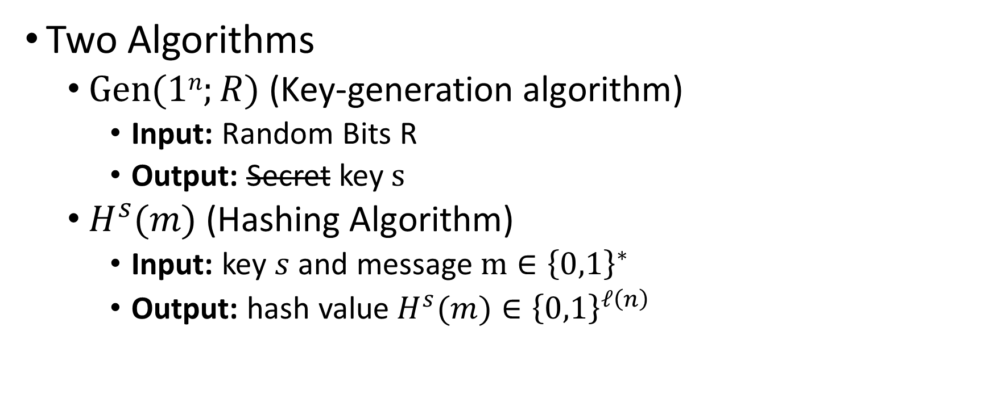
Keyed Hash Function Syntax
Two Algorithms
  $\operatorname{Gen}{(1n;R)}$ (Key-generation algorithm)
    Input: Random Bits R
    Output: Secret key $s$
  $H^{s}{(m)}$ (Hashing Algorithm)
    Input: key $s$ and message $m∈{\left\{0,1\right\}}^{∗}$
    Output: hash value${ H}^{s}{(m)}∈{\left\{0,1\right\}}^{ℓ\left(n\right)}$

Slide 20
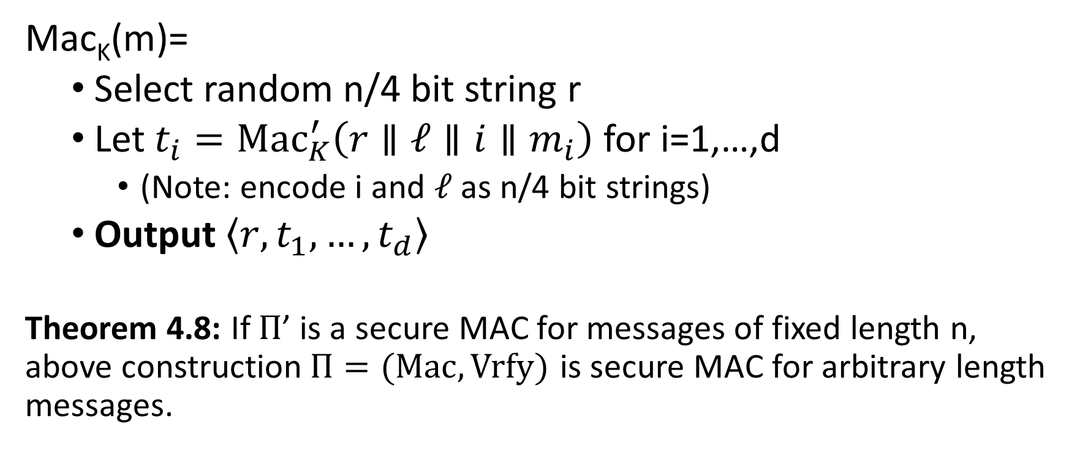
MACs for Arbitrary Length Messages
Mac_{K}(m)=
  Select random n/4 bit string r
  Let $t_{i}={Mac}_{K}^{′}\left(r∥ℓ∥i{∥m}_{i}\right)$ for i=1,…,d
    (Note: encode i and $ℓ$ as n/4 bit strings)
  Output $\left\langle r,t_{1},…,t_{d}\right\rangle$
Theorem 4.8: If $Π$’ is a secure MAC for messages of fixed length n, above construction$Π=(Mac,Vrfy)$ is secure MAC for arbitrary length messages.
Notes:
Disadvage for not using randomized construction.
1. This may not be a Strong-MAC.

Slide 21
MACs for Arbitrary Length Messages
Disadvantages: Lose Strong-MAC Guarantee
(Multiple valid MACs of same message)
Disadvantage 1: Long output
Mac_{K}(m)=
  Select random n/4 bit string r
  Let $t_{i}={Mac}_{K}^{′}\left(r∥ℓ∥i{∥m}_{i}\right)$ for i=1,…,d
    (Note: encode i and $ℓ$ as n/4 bit strings)
  Output $\left\langle r,t_{1},…,t_{d}\right\rangle$
Theorem 4.8: If $Π$’ is a secure MAC for messages of fixed length n, above construction$Π=(Mac,Vrfy)$ is secure MAC for arbitrary length messages.
Randomized Construction (no canonical verification). Disadvantage?
Notes:
Disadvage for not using randomized construction.
1. This may not be a Strong-MAC.

Slide 22
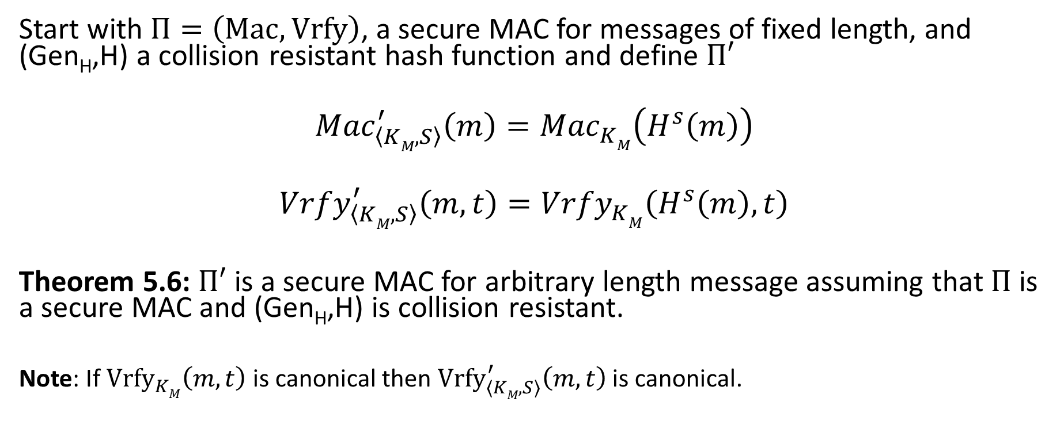
Hash and MAC Construction
Start with $Π=\left(Mac,Vrfy\right)$, a secure MAC for messages of fixed length, and (Gen_{H},H) a collision resistant hash function and define $Π′$
$${Mac}_{\left\langle KM,S\right\rangle }^{′}\left(m\right)={Mac}_{KM}^{}\left(H^{s}\left(m\right)\right)$$
$${Vrfy}_{\left\langle KM,S\right\rangle }^{′}\left(m,t\right)={Vrfy}_{KM}^{}\left(H^{s}\left(m\right),t\right)$$
Theorem 5.6: $Π′$ is a secure MAC for arbitrary length message assuming that $Π$ is a secure MAC and (Gen_{H},H) is collision resistant.
Note: If ${Vrfy}_{KM}^{}\left(m,t\right)$ is canonical then ${Vrfy}_{\left\langle KM,S\right\rangle }^{′}\left(m,t\right)$ is canonical.

Slide 23
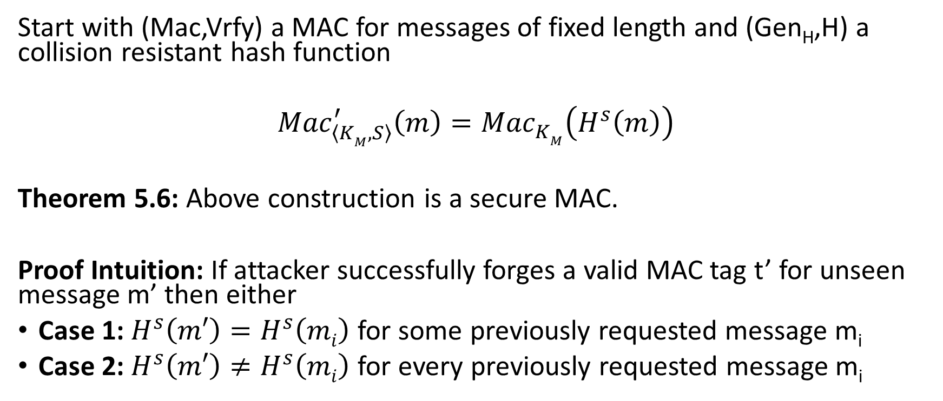
Hash and MAC Construction
Start with (Mac,Vrfy) a MAC for messages of fixed length and (Gen_{H},H) a collision resistant hash function
$${Mac}_{\left\langle KM,S\right\rangle }^{′}\left(m\right)={Mac}_{KM}^{}\left(H^{s}\left(m\right)\right)$$
Theorem 5.6: Above construction is a secure MAC.
Proof Intuition: If attacker successfully forges a valid MAC tag t’ for unseen message m’ then either
Case 1: $H^{s}\left(m′\right)=H^{s}\left(mi\right)$ for some previously requested message m_{i}
Case 2: $H^{s}\left(m′\right)≠H^{s}\left(mi\right)$ for every previously requested message m_{i}

Slide 24
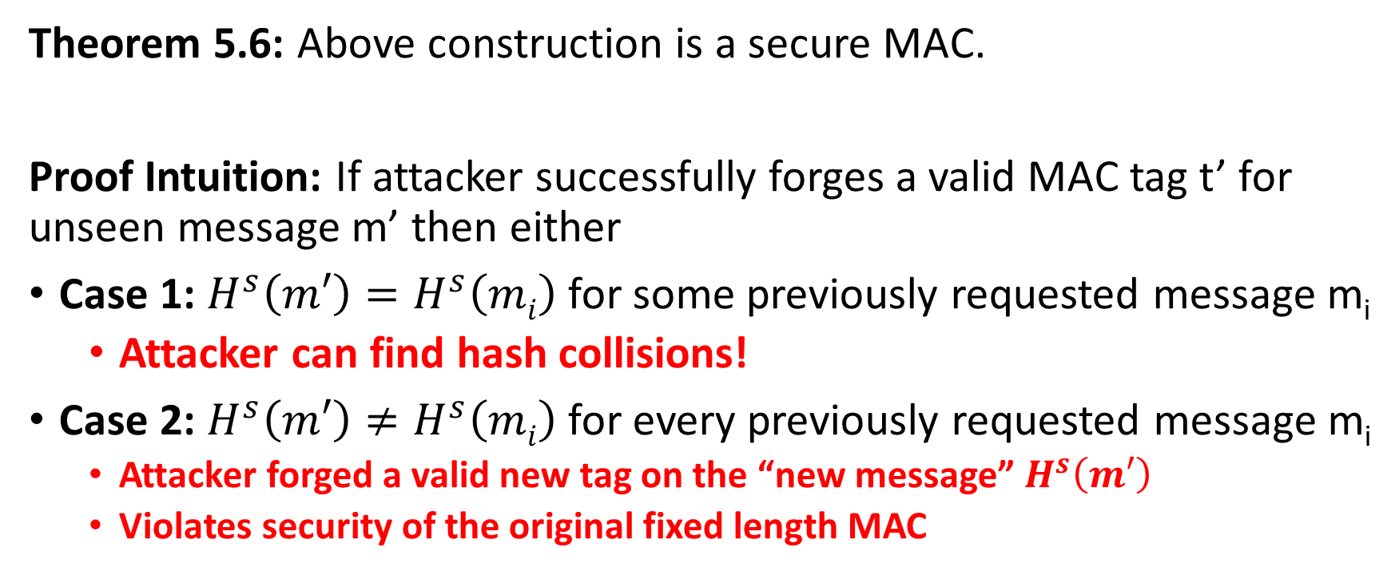
Hash and MAC Construction
Theorem 5.6: Above construction is a secure MAC.
Proof Intuition: If attacker successfully forges a valid MAC tag t’ for unseen message m’ then either
Case 1: $H^{s}\left(m′\right)=H^{s}\left(mi\right)$ for some previously requested message m_{i}
  Attacker can find hash collisions!
Case 2: $H^{s}\left(m′\right)≠H^{s}\left(mi\right)$ for every previously requested message m_{i}
  Attacker forged a valid new tag on the “new message” $H^{s}\left(m′\right)$
  Violates security of the original fixed length MAC

Slide 25
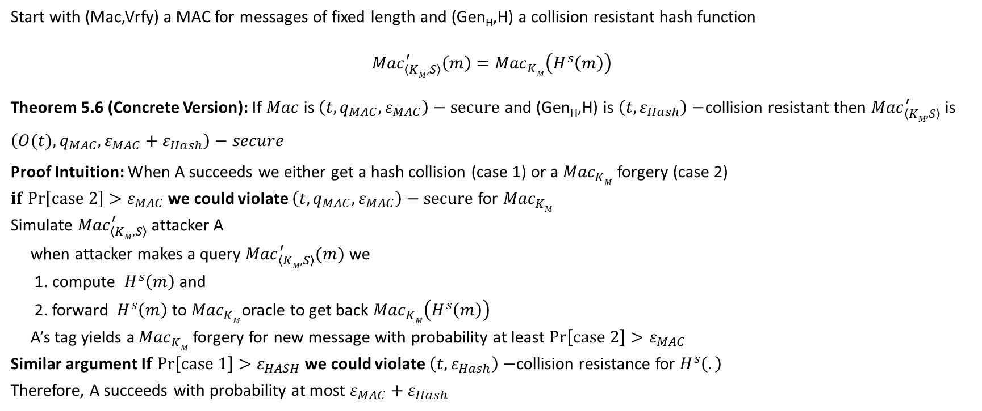
Hash and MAC Construction
Start with (Mac,Vrfy) a MAC for messages of fixed length and (Gen_{H},H) a collision resistant hash function
$${Mac}_{\left\langle KM,S\right\rangle }^{′}\left(m\right)={Mac}_{KM}^{}\left(H^{s}\left(m\right)\right)$$
Theorem 5.6 (Concrete Version): If $Mac$ is $\left(t,q_{MAC},ε_{MAC}\right)−secure$ and (Gen_{H},H) is $\left(t,ε_{Hash}\right)−$collision resistant then ${Mac}_{\left\langle KM,S\right\rangle }^{′}$ is $\left(O(t),q_{MAC},ε_{MAC}+ε_{Hash}\right)−secure$
Proof Intuition: When A succeeds we either get a hash collision (case 1) or a ${Mac}_{KM}^{}$ forgery (case 2)
$if Pr\left[case 2\right]>ε_{MAC}$we could violate $\left(t,q_{MAC},ε_{MAC}\right)−secure$ for ${Mac}_{KM}^{}$
Simulate ${Mac}_{\left\langle KM,S\right\rangle }^{′}$ attacker A
when attacker makes a query ${Mac}_{\left\langle KM,S\right\rangle }^{′}(m)$ we
1. compute $H^{s}\left(m\right)$ and
2. forward $H^{s}\left(m\right)$ to ${Mac}_{KM}^{}$oracle to get back ${Mac}_{KM}^{}\left(H^{s}\left(m\right)\right)$
A’s tag yields a ${Mac}_{KM}^{}$ forgery for new message with probability at least $Pr\left[case 2\right]>ε_{MAC}$
Similar argument I$f Pr\left[case 1\right]>ε_{HASH}$we could violate $\left(t,ε_{Hash}\right)−$collision resistance for $H^{s}\left(.\right)$
Therefore, A succeeds with probability at most $ε_{MAC}+ε_{Hash}$

Slide 26
Recap
Definition of Collision Resistant Hash Functions (Gen,H)
  Definitional challenges
  Gen(1^{n}) outputs a public seed.
Merkle-Damgård construction to hash arbitrary length strings
  Proof of correctness
Hash and MAC construction
  Proof of correctness

Slide 27
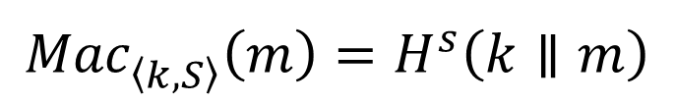
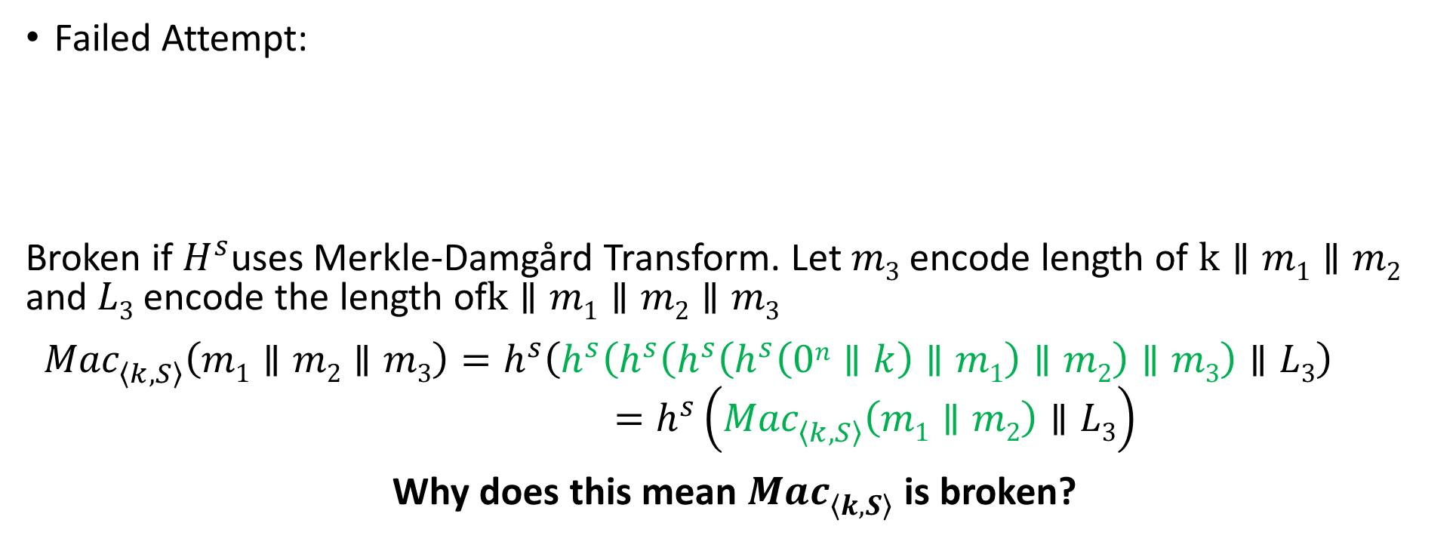
MAC from Collision Resistant Hash
Failed Attempt:
Broken if $H^{s}$uses Merkle-Damgård Transform. Let $m3$ encode length of $k∥m1∥m2$ and $L3$ encode the length of$k∥m1∥m2∥m3$
${Mac}_{\left\langle k,S\right\rangle }^{}\left(m1∥m2∥m3\right)=h^{s}\left(h^{s}\left(h^{s}\left(h^{s}\left(h^{s}\left(0n∥k\right)∥m1\right)∥m2\right)∥m3\right)∥L3\right)$
$$=h^{s}\left({Mac}_{\left\langle k,S\right\rangle }^{}\left(m1∥m2\right)∥L3\right)$$
Why does this mean ${Mac}_{\left\langle k,S\right\rangle }^{}$ is broken?
$${Mac}_{\left\langle k,S\right\rangle }^{}\left(m\right)=H^{s}\left(k∥m\right)$$

Slide 28
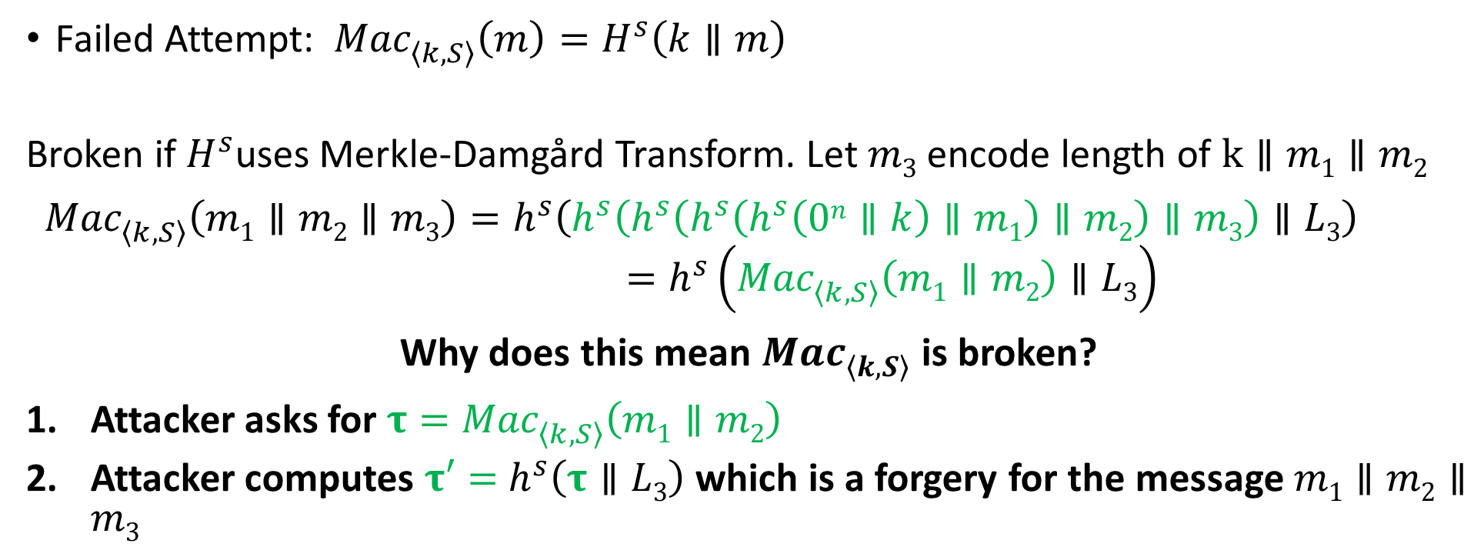
MAC from Collision Resistant Hash
Failed Attempt: ${Mac}_{\left\langle k,S\right\rangle }^{}\left(m\right)=H^{s}\left(k∥m\right)$
Broken if $H^{s}$uses Merkle-Damgård Transform. Let $m3$ encode length of $k∥m1∥m2$
${Mac}_{\left\langle k,S\right\rangle }^{}\left(m1∥m2∥m3\right)=h^{s}\left(h^{s}\left(h^{s}\left(h^{s}\left(h^{s}\left(0n∥k\right)∥m1\right)∥m2\right)∥m3\right)∥L3\right)$
$$=h^{s}\left({Mac}_{\left\langle k,S\right\rangle }^{}\left(m1∥m2\right)∥L3\right)$$
Why does this mean ${Mac}_{\left\langle k,S\right\rangle }^{}$ is broken?
Attacker asks for $τ={Mac}_{\left\langle k,S\right\rangle }^{}\left(m1∥m2\right)$
Attacker computes $τ′=$ $h^{s}\left(τ∥L3\right)$ which is a forgery for the message $m1∥m2∥m3$

Slide 29


HMAC
$${Mac}_{\left\langle k,S\right\rangle }^{}\left(m\right)=H^{s}\left(\left(k⨁opad\right)∥H^{s}\left(\left(k⨁ipad\right)∥m\right)\right)$$
$$ipad?$$
Notes:
Bad joke, I know…

Slide 30
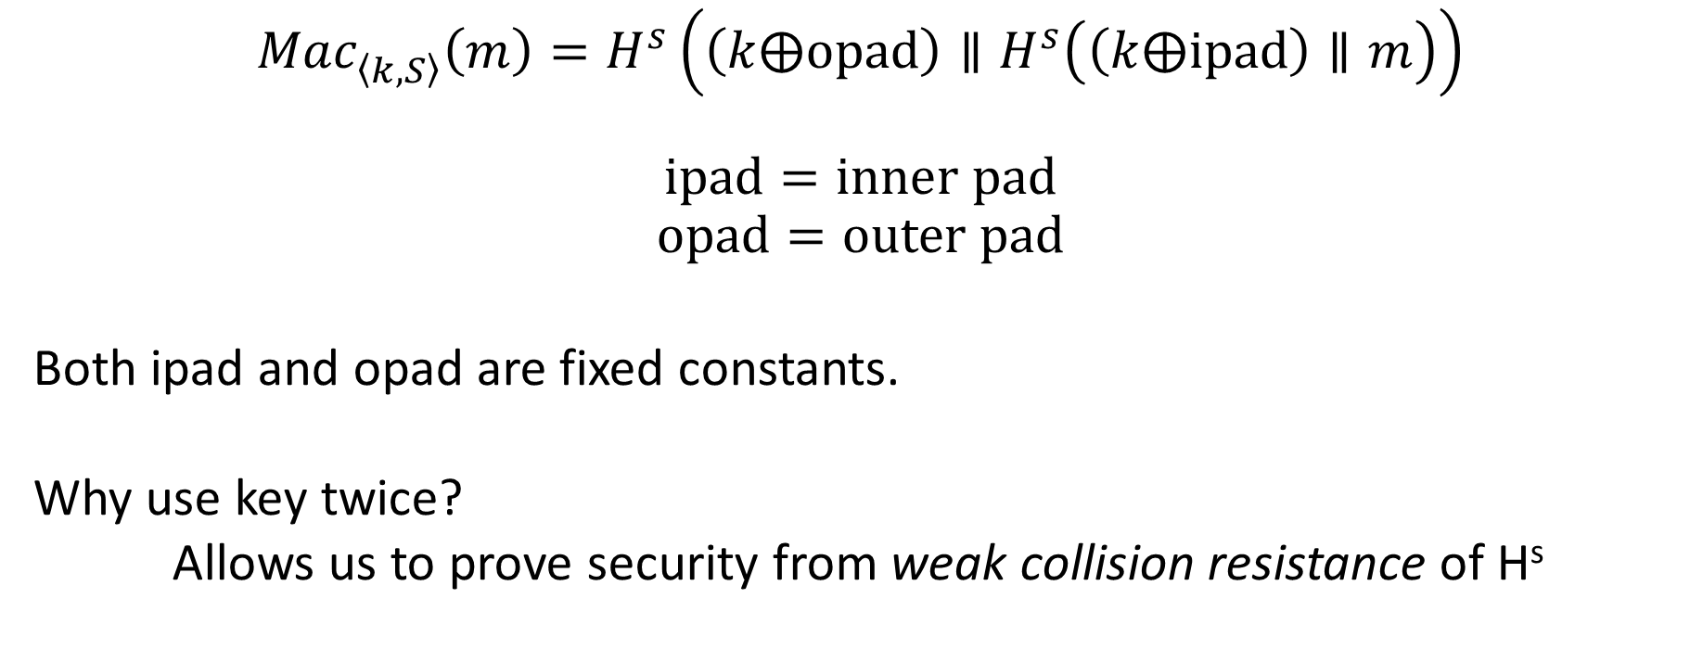
HMAC
$${Mac}_{\left\langle k,S\right\rangle }^{}\left(m\right)=H^{s}\left(\left(k⨁opad\right)∥H^{s}\left(\left(k⨁ipad\right)∥m\right)\right)$$
$$ipad=inner pad$$
$$opad=outer pad$$
Both ipad and opad are fixed constants.
Why use key twice?
Allows us to prove security from weak collision resistance of H^{s}
Notes:
Bad joke, I know…

Slide 31
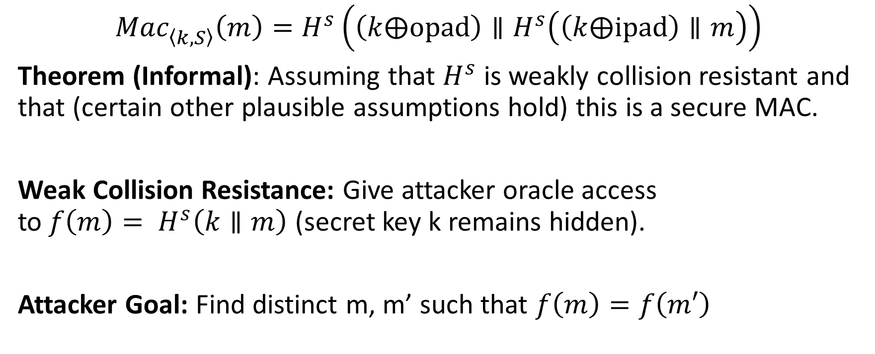
HMAC Security
$${Mac}_{\left\langle k,S\right\rangle }^{}\left(m\right)=H^{s}\left(\left(k⨁opad\right)∥H^{s}\left(\left(k⨁ipad\right)∥m\right)\right)$$
Theorem (Informal): Assuming that $H^{s}$ is weakly collision resistant and that (certain other plausible assumptions hold) this is a secure MAC.
Weak Collision Resistance: Give attacker oracle access to${ f\left(m\right)= H}^{s}\left(k∥m\right)$ (secret key k remains hidden).
Attacker Goal: Find distinct m, m’ such that $f\left(m\right)=f\left(m′\right)$

Slide 32
HMAC in Practice
MD5 can no longer be viewed as collision resistant
However, HMAC-MD5 remained unbroken after MD5 was broken
  Gave developers time to replace HMAC-MD5
  Nevertheless, don’t use HMAC-MD5!
HMAC-SHA1 still seems to be okay (temporarily), despite collision
HMAC is efficient and unbroken
  CBC-MAC was not widely deployed because it is “too slow”
  Instead practitioners often used heuristic constructions (which were breakable)

Slide 33
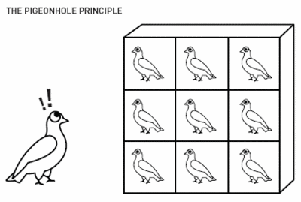

Finding Collisions
Can we do better?
Ideal Hashing Algorithm
  Random function H from {0,1}* to {0,1}$ℓ$
  Suppose attacker has oracle access to H(.)
Attack 1: Evaluate H(.) on 2$ℓ$+1 distinct inputs.

Slide 34
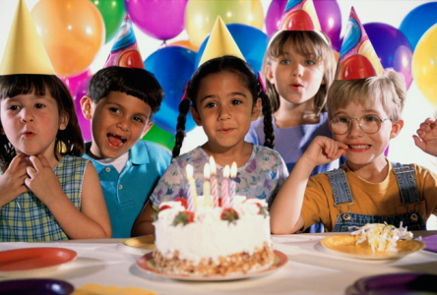
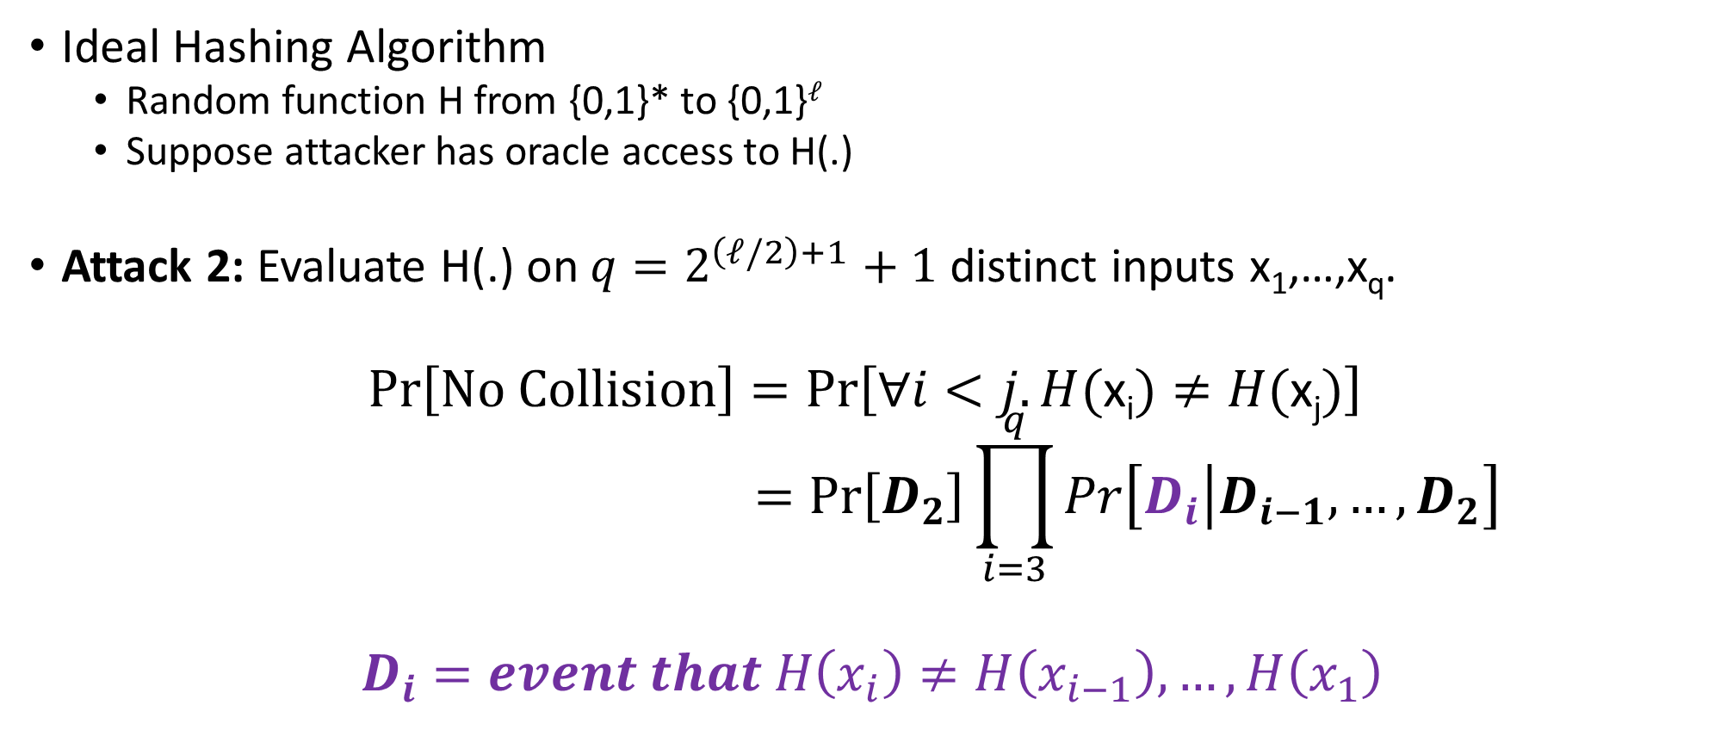
Birthday Attack for Finding Collisions
Ideal Hashing Algorithm
  Random function H from {0,1}* to {0,1}$ℓ$
  Suppose attacker has oracle access to H(.)
Attack 2: Evaluate H(.) on ${q=2}^{\left(ℓ/2\right)+1}+1$ distinct inputs x₁,…,x_{q}.
$$Pr\left[No Collision\right]=Pr\left[∀i<j. H(\text{x}\text{i})≠H(\text{x}\text{j})\right]$$
$$=Pr\left[D_{2}\right]\prod_{i=3}^{q}{Pr\left[D_{i}\left|D_{i−1}\right.,…,D_{2}\right]}$$
$$D_{i}=event that H\left(x_{i}\right)≠H\left(x_{i−1}\right),…,H\left(x_{1}\right)$$

Slide 35
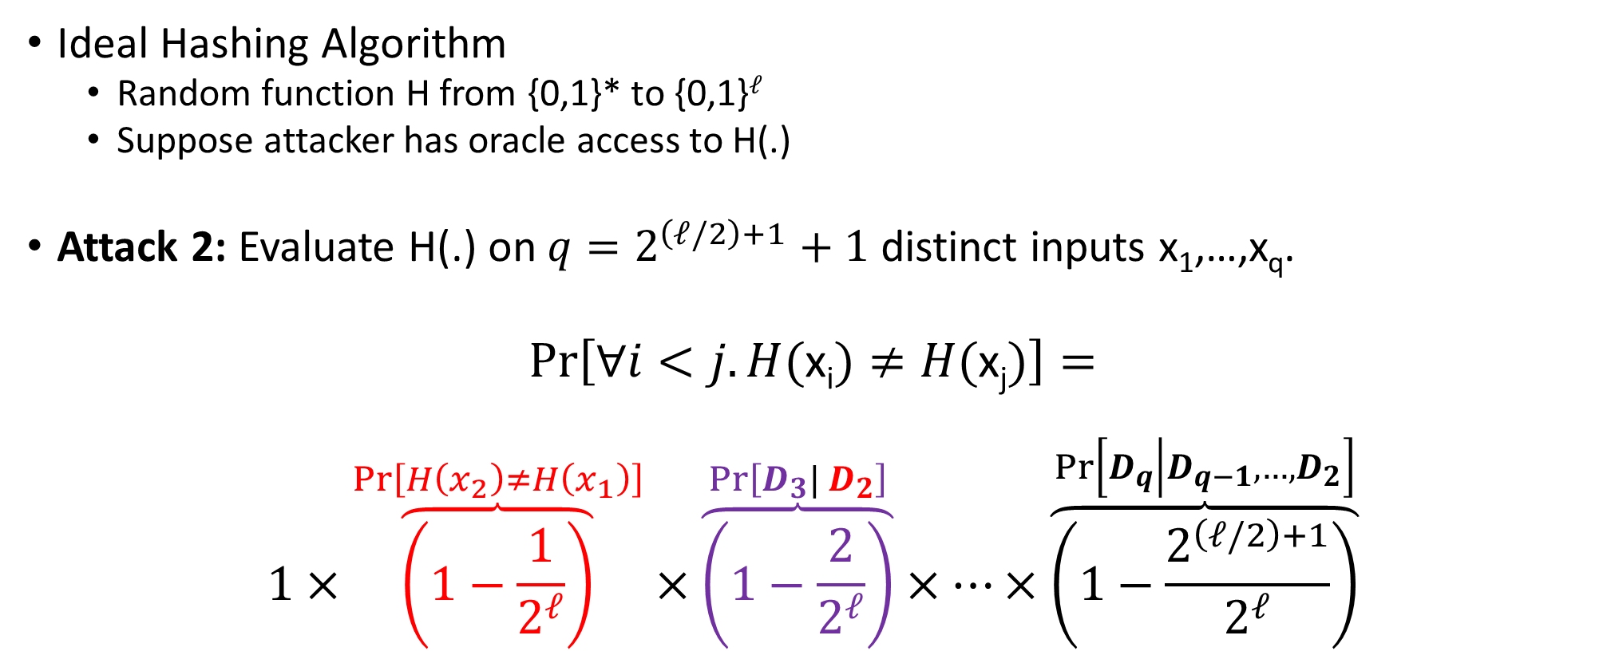
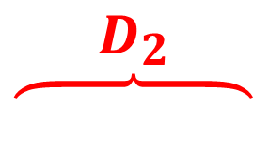
Birthday Attack for Finding Collisions
Ideal Hashing Algorithm
  Random function H from {0,1}* to {0,1}$ℓ$
  Suppose attacker has oracle access to H(.)
Attack 2: Evaluate H(.) on ${q=2}^{\left(ℓ/2\right)+1}+1$ distinct inputs x₁,…,x_{q}.
$$Pr\left[∀i<j. H(\text{x}\text{i})≠H(\text{x}\text{j})\right]=$$
$$1×\overset{Pr\left[H\left(x_{2}\right)≠H\left(x_{1}\right)\right]}{\overbrace{\left(1−\frac{1}{2^{ℓ}}\right)}}×\overset{Pr\left[D_{3}| D_{2}\right]}{\overbrace{\left(1−\frac{2}{2^{ℓ}}\right)}}×…×\overset{Pr\left[D_{q}\left|D_{q−1}\right.,…,D_{2}\right]}{\overbrace{\left(1−\frac{2^{\left(ℓ/2\right)+1}}{2^{ℓ}}\right)}}$$
$$\overset{D_{2}}{\overbrace{ }}$$

Slide 36
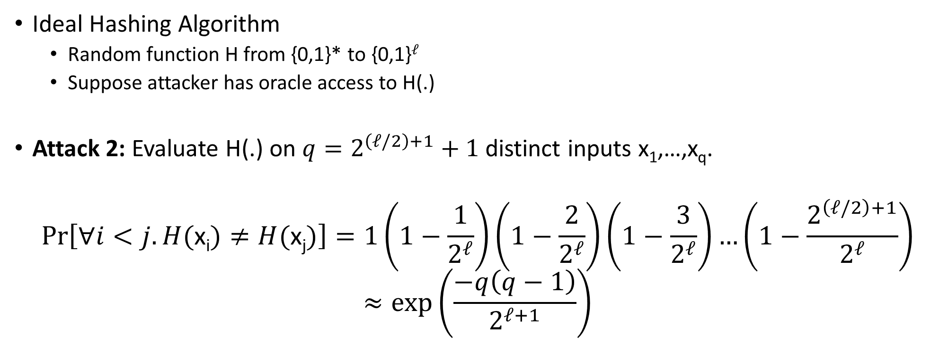
Birthday Attack for Finding Collisions
Ideal Hashing Algorithm
  Random function H from {0,1}* to {0,1}$ℓ$
  Suppose attacker has oracle access to H(.)
Attack 2: Evaluate H(.) on ${q=2}^{\left(ℓ/2\right)+1}+1$ distinct inputs x₁,…,x_{q}.
$$Pr\left[∀i<j. H(\text{x}\text{i})≠H(\text{x}\text{j})\right]=1\left(1−\frac{1}{2^{ℓ}}\right)\left(1−\frac{2}{2^{ℓ}}\right)\left(1−\frac{3}{2^{ℓ}}\right)…\left(1−\frac{2^{\left(ℓ/2\right)+1}}{2^{ℓ}}\right)$$
$$≈exp\left(\frac{−q\left(q−1\right)}{2^{ℓ+1}}\right)$$

Slide 37
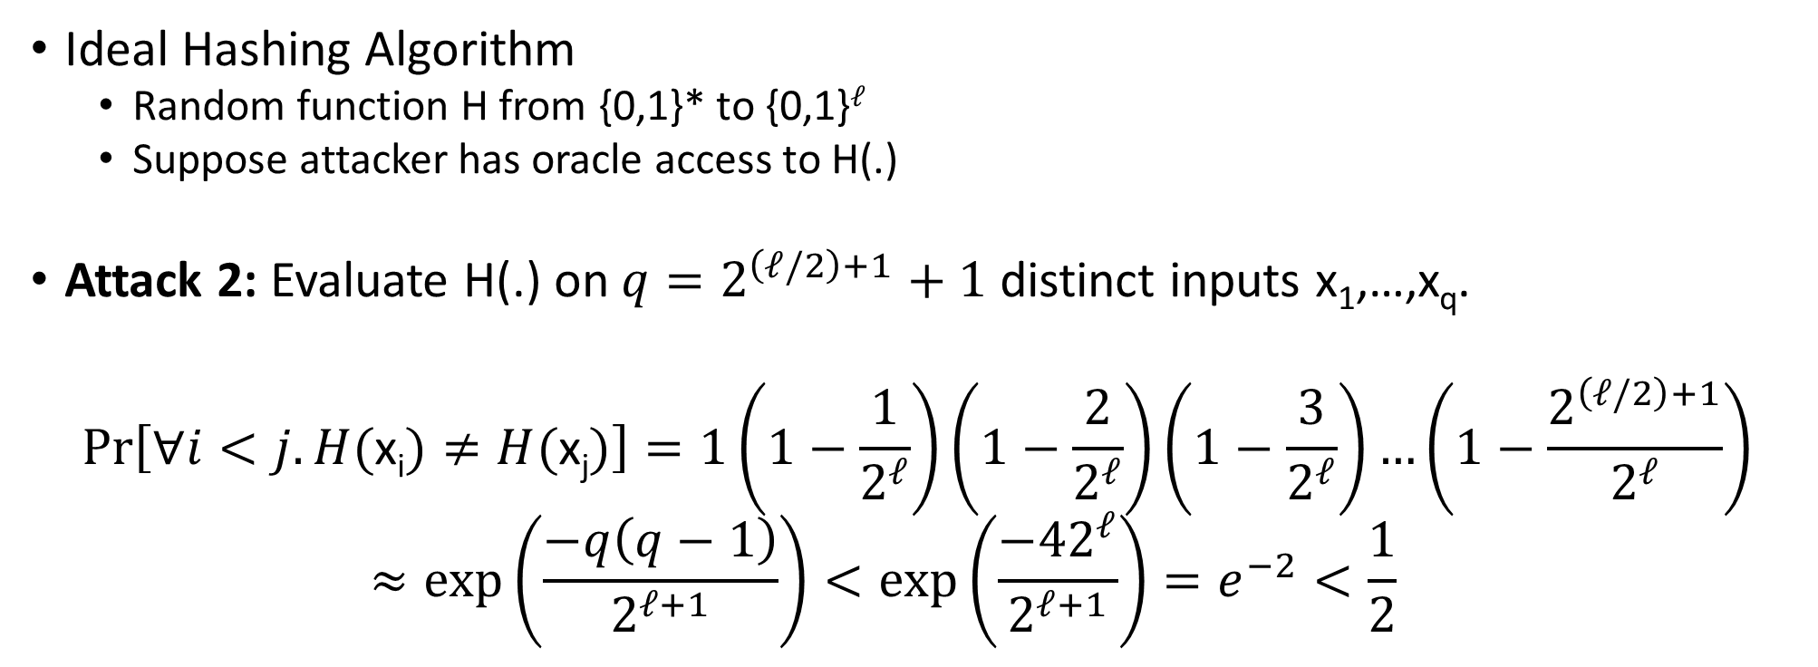
Birthday Attack for Finding Collisions
Ideal Hashing Algorithm
  Random function H from {0,1}* to {0,1}$ℓ$
  Suppose attacker has oracle access to H(.)
Attack 2: Evaluate H(.) on ${q=2}^{\left(ℓ/2\right)+1}+1$ distinct inputs x₁,…,x_{q}.
$$Pr\left[∀i<j. H(\text{x}\text{i})≠H(\text{x}\text{j})\right]=1\left(1−\frac{1}{2^{ℓ}}\right)\left(1−\frac{2}{2^{ℓ}}\right)\left(1−\frac{3}{2^{ℓ}}\right)…\left(1−\frac{2^{\left(ℓ/2\right)+1}}{2^{ℓ}}\right)$$
  $$≈exp\left(\frac{−q\left(q−1\right)}{2^{ℓ+1}}\right)<exp\left(\frac{−42^{ℓ}}{2^{ℓ+1}}\right)=e^{−2}<\frac{1}{2}$$

Slide 38
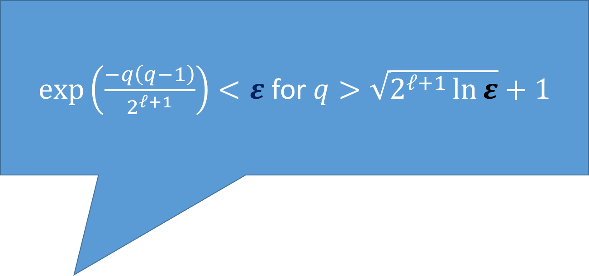
Birthday Attack for Finding Collisions
$exp\left(\frac{−q\left(q−1\right)}{2^{ℓ+1}}\right)<ε$ for $q>\sqrt{2^{ℓ+1}\ln{ε}}+1$
Ideal Hashing Algorithm
  Random function H from {0,1}* to {0,1}$ℓ$
  Suppose attacker has oracle access to H(.)
Attack 2: Evaluate H(.) on ${q=2}^{\left(ℓ/2\right)+1}+1$ distinct inputs x₁,…,x_{q}.
$$Pr\left[∀i<j. H(\text{x}\text{i})≠H(\text{x}\text{j})\right]=1\left(1−\frac{1}{2^{ℓ}}\right)\left(1−\frac{2}{2^{ℓ}}\right)\left(1−\frac{3}{2^{ℓ}}\right)…\left(1−\frac{2^{\left(ℓ/2\right)+1}}{2^{ℓ}}\right)$$
  $$≈exp\left(\frac{−q\left(q−1\right)}{2^{ℓ+1}}\right)<exp\left(\frac{−42^{ℓ}}{2^{ℓ+1}}\right)=e^{−2}<\frac{1}{2}$$

Slide 39
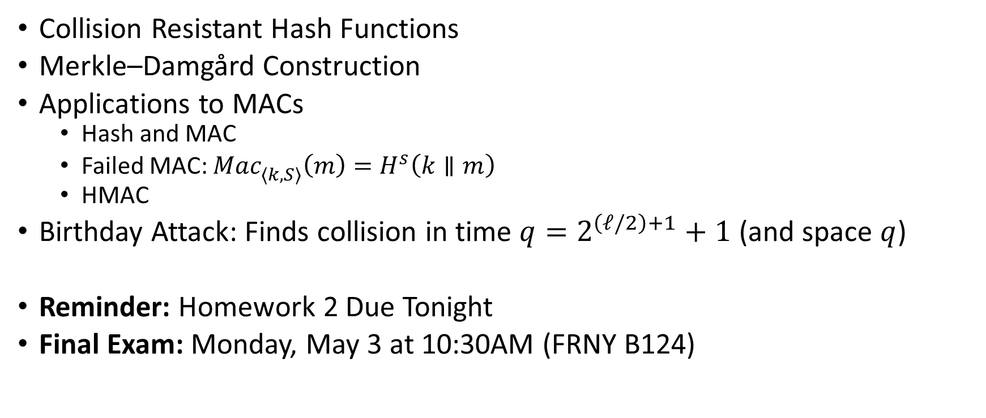
Recap
Collision Resistant Hash Functions
Merkle–Damgård Construction
Applications to MACs
  Hash and MAC
  Failed MAC: ${Mac}_{\left\langle k,S\right\rangle }^{}\left(m\right)=H^{s}\left(k∥m\right)$
  HMAC
Birthday Attack: Finds collision in time ${q=2}^{\left(ℓ/2\right)+1}+1$ (and space $q$)
Reminder: Homework 2 Due Tonight
Final Exam: Monday, May 3 at 10:30AM (FRNY B124)

Slide 40
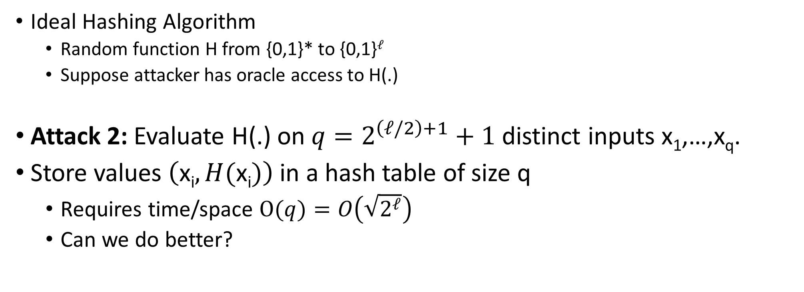
Birthday Attack for Finding Collisions
Ideal Hashing Algorithm
  Random function H from {0,1}* to {0,1}$ℓ$
  Suppose attacker has oracle access to H(.)
Attack 2: Evaluate H(.) on ${q=2}^{\left(ℓ/2\right)+1}+1$ distinct inputs x₁,…,x_{q}.
Store values $\left(\text{x}\text{i},H(\text{x}\text{i})\right)$ in a hash table of size q
  Requires time/space $\text{O}(q)=O\left(\sqrt{2^{ℓ}}\right)$
  Can we do better?

Slide 41
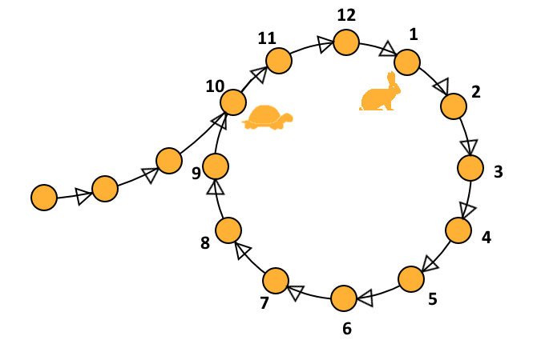
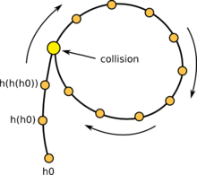














Floyd’s Cycle Finding Algorithm
A cycle denotes a hash collision
  $\text{x}\text{3}\text{=}\text{H}\text{(}\text{x}\text{2}\text{)}\text{=}\text{H}\text{(}\text{x}\text{12}\text{)}$
Occurs after O$\left(2^{ℓ/2}\right)$ steps by birthday paradox
First attack phase detects cycle
Second phase identifies collision
$$\text{x}\text{5}$$
$$X\text{4}=H(\text{x}\text{3})$$
$$\text{x}\text{6}$$
$$\text{x}\text{7}$$
$$\text{x}\text{3}\text{=}\text{H}\text{(}\text{x}\text{2}\text{)}$$
$$\text{x}\text{8}$$
$$\text{x}\text{2}$$
Analogy: Cycle detection in linked list
Can traverse “linked list” by computing H
$$\text{x}\text{12}$$
$$\text{x}\text{9}$$
$$\text{x}\text{1}$$
$$\text{x}\text{11}$$
$$\text{x}\text{10}$$
$$\text{x}\text{0}$$
Notes:
Let j denote the length of the chain before the cycle starts (3) in the example and let c denote the length of the cycle
Let c denote length of cycle and suppose that x_{2i} = x_i then we have 2i-j=i-j mod c. Implies that 2i=c+i.
We have h(x_{j-1}) = h(x_{j+c-1}),
X reaches x_{j-1} in j-1 steps and x’ reaches x_{j+c-1}=x_{j+2c-1} in j-1 – steps (since we start at j)

Slide 42



Small Space Birthday Attack
Attack 2: Select random $\text{x}\text{0}$, define $\text{x}\text{i}≔H(\text{x}\text{i}\text{−1})$
  $\text{Initialize}\text{: }\text{x}\text{=}\text{x}\text{0}$ and $\text{x}\text{′}\text{=}\text{x}\text{0}$
  Repeat for i=1,2,…
    $\text{x}\text{:}\text{=}\text{H}\text{(}\text{x}\text{) }\text{now} x =\text{x}\text{i}$
    $\text{x}\text{′:=}\text{H}\text{(}\text{H}\text{(}\text{x}\text{′))}$ now $x′=\text{x}\text{2}\text{i}$
    If x=x’ then break
  $\text{Reset} \text{x}\text{=}\text{x}\text{0}$ and set $\text{x}\text{′=}\text{x}$ and remember i
  Repeat for j=1 to i
    If H(x) = H(x’) then output x,x’
    Else x:= H(x), x’ = H(x) Now x=$\text{x}\text{j}$ AND $x′=\text{x}\text{i}\text{+}\text{j}$
  Claim: for some $k≤i$ the collision is
  $\text{x}\text{k}\text{=}\text{H}\text{(}x_{k−1}\text{)=}\text{H}\text{(}x_{k+i−1}\text{)}$
  Proof: Let C be length of cycle,
  Let k= #steps before cycle
  2i-k = i-k mod C ➔ i= mod C
Tortoise takes i-k steps inside cycle
(equivalent to k backwards steps)
Hare takes 2i-k total steps inside cycle, looping around before ending in same place
Initially, for phase 2 we have $\text{x}\text{′=}\text{x}\text{i}$ and $x=\text{x}\text{0}$ after j=k-1 steps we have $\text{x}\text{=}x_{k−1}$
and
$$\text{x}\text{′=}\text{x}\text{i}\text{+}\text{K}\text{-1=}\text{x}\text{k}\text{+}\text{C}\text{−1}$$

Slide 43


Small Space Birthday Attack
Finds collision after O$\left(2^{ℓ/2}\right)$steps in expectation
Attack 2: Select random $\text{x}\text{0}$, define $\text{x}\text{i}=H(\text{x}\text{i}\text{−1})$
  $\text{Initialize}\text{: }\text{x}\text{=}\text{x}\text{0}$ and $\text{x}\text{′}\text{=}\text{x}\text{0}$
  Repeat for i=1,2,…
    $\text{x}\text{:}\text{=}\text{H}\text{(}\text{x}\text{) }\text{now} x =\text{x}\text{i}$
    $\text{x}\text{′:=}\text{H}\text{(}\text{H}\text{(}\text{x}\text{′))}$ now $x′=\text{x}\text{2}\text{i}$
    If x=x’ then break
  $\text{Reset} \text{x}\text{=}\text{x}\text{0}$ and set $\text{x}\text{′=}\text{x}$
  Repeat for j=1 to i
    If H(x) = H(x’) then output x,x’
    Else x:= H(x), x’ = H(x) Now x=$\text{x}\text{j}$ AND $x′=\text{x}\text{i}\text{+}\text{j}$
Notes:
Let j denote the length of the chain before the cycle starts (3) in the example and let c denote the length of the cycle
Let c denote length of cycle and suppose that x_{2i} = x_i then we have 2i-j=i-j mod c. Implies that 2i=c+i.
We have h(x_{j-1}) = h(x_{j+c-1}),
X reaches x_{j-1} in j-1 steps and x’ reaches x_{j+c-1}=x_{j+2c-1} in j-1 – steps (since we start at j)

Slide 44

Small Space Birthday Attack
Can be adapted to find “meaningful collisions” if we have a large message space O$\left(2^{ℓ}\right)$
Example: $S=S_{1}∪S_{2}$ with $\left|S_{1}\right|=\left|S_{2}\right|=2^{ℓ−1}$
  $S_{1}$ = Set of positive recommendation letters
  $S_{2}$ = Set of negative recommendation letters
Goal: find ${z1∈S}_{1}$, ${z2∈S}_{2}$, such that H(z₁) = H(z₂)
Can adapt previous attack by defining an injective mapping $b:\left\{0,1\right\}ℓ→S$
$$\text{x}\text{i}=H(\text{b}\left(\text{x}\text{i}\text{−1}\right))$$
If $\text{x}\text{i}=\text{x}\text{i}\text{+}\text{j}$ then $H\left(\text{b}\left(\text{x}\text{i}\text{−1}\right)\right)=H\left(\text{b}\left(\text{x}\text{i}\text{+}\text{j}\text{−1}\right)\right)$ ➔ Colliding inputs are both in S

Slide 45

Pre-Computation Attacks for Targeted Collision
Challenger: Picks random x and sends y=H(x) to attacker
Attacker’s Goal: Find some x’ (not necessarily x) s.t. y=H(x’)
Brute-Force Attack: Requires $2^{ℓ−1}$ queries to H on average.
Pre-Computation Attack: What if we know we will need to do this multiple times?
  Pre-Processing Cost (one-time cost): $O(2^{ℓ})$
  Post-Processing Cost: ${≪2}^{ℓ}$ (is this possible?)
Applications:
  Targeted Hash Inversion, MAC forgery, Signature Forgery, Key-Recovery, Password Cracking etc…

Slide 46















Pre-Computation Attacks for Targeted Collision
Precomputation ($t×s$ steps, $2s$ memory)
$${sp}_{1}=x_{1}^{1}$$
$${sp}_{2}=x_{1}^{2}$$
$${sp}_{s}=x_{1}^{s}$$
$${sp}_{1}=x_{1}^{1}$$
$$x_{2}^{1}=H\left(x_{1}^{1}\right)$$
$$x_{2}^{2}=H\left(x_{1}^{2}\right)$$
…
$$x_{2}^{s}=H\left(x_{1}^{s}\right)$$
…
…
…
$$x_{i+1}^{2}=H\left(x_{i}^{2}\right)$$
…
$$x_{i+1}^{s}=H\left(x_{i}^{s}\right)$$
$$x_{i+1}^{1}=H\left(x_{i}^{1}\right)$$
…
…
…
$$x_{t}^{1}={ep}_{1}$$
$$x_{t}^{2}={ep}_{2}$$
$$x_{t}^{s}={ep}_{s}$$
$$x_{t}^{1}={ep}_{1}$$

Slide 47










Pre-Computation Attacks for Targeted Collision
Precomputation ($t×s$ steps, $2s×ℓ$ memory)
$${sp}_{j}=x_{1}^{j}$$
Goal: Find collision for target $y=H(x)$
…
$$x_{2}^{j}=H\left(x_{1}^{j}\right)$$
…
$$y_{0}=y$$
…
$$y_{1}=H\left(y_{0}\right)$$
…
$$x_{i+1}^{j}=H\left(x_{i}^{j}\right)$$
…
…
…
$$y_{i}=H\left(y_{i−1}\right)$$
…
$$x_{t}^{j}={ep}_{j}$$
$$y_{k}={ep}_{j}$$

Slide 48



Pre-Computation Attacks for Targeted Collision
Suppose $y=x_{i}^{j}$ for some $i≤t$, $j≤s$
→
$$y=H\left(x_{i−1}^{j}\right)=H^{i−1}\left({sp}_{j}\right)$$
(takes t steps to recover $x_{i−1}^{j}$ from ${sp}_{j}$)
Precomputation ($t×s$ steps, $2s×ℓ$ memory)
$${sp}_{j}=x_{1}^{j}$$
Goal: Find collision for target $y=H(x)$
What We Hope is True:
$t×s>2^{ℓ+2}$ → good chance that
$y=x_{i}^{j}$ for some $i≤t$, $j≤s$
…
$$x_{2}^{j}=H\left(x_{1}^{j}\right)$$
…
$$y_{0}=y$$
…
$$y_{1}=H\left(y_{0}\right)$$
…
$$x_{i+1}^{j}=H\left(x_{i}^{j}\right)$$
…
…
… Not quite true…chains can intersect and may not represent $t×s$ distinct points
…
$$y_{i}=H\left(y_{i−1}\right)$$
…
$$x_{t}^{j}={ep}_{j}$$
$$y_{k}={ep}_{j}$$

Slide 49







Intersecting Chains
Precomputation ($t×s$ steps, $2s$ memory)
Intersecting chains contain $≪st$ distinct points.
$${sp}_{j}=x_{1}^{j}$$
$${sp}_{j′}=x_{1}^{j′}$$
$$x_{2}^{j}=H\left(x_{1}^{j}\right)$$
$$x_{2}^{j′}=H\left(x_{1}^{j′}\right)$$
…
…
…
After initial intersection the chains merge together ☹
$$x_{k}^{j′}=x_{i+1}^{j}$$
$$x_{k}^{j′}=H\left(x_{k}^{j′}\right)$$
$$x_{i+1}^{j}=H\left(x_{i}^{j}\right)$$
…
$$x_{t}^{j}={ep}_{j}$$
…
$$x_{t}^{j′}={ep}_{j′}$$

Slide 50


Targeted Collision Attacks
Fact: If $t^{2}×s<$ $2^{ℓ}$ then chains contain $Ω\left(ts\right)$ distinct points, but then
Pr[y in CHAIN]$≈\frac{1}{t}$
Precomputation ($t×s$ steps, $2s$ memory)
$${sp}_{1}=x_{1}^{1}$$
$${sp}_{2}=x_{1}^{2}$$
$${sp}_{s}=x_{1}^{s}$$
$${sp}_{1}=x_{1}^{1}$$
$$x_{2}^{1}=H\left(x_{1}^{1}\right)$$
$$x_{2}^{2}=H\left(x_{1}^{2}\right)$$
…
$$x_{2}^{s}=H\left(x_{1}^{s}\right)$$
…
…
…
Solution: Repeat T=O(t) times using different H₁,…, H_{T} where $H_{i}\left(x\right):=H\left(F_{K_{i}}\left(x\right)\right)$
s chains for each H_{j} ➔ (sT chains total)
$$x_{i+1}^{2}=H\left(x_{i}^{2}\right)$$
…
$$x_{i+1}^{s}=H\left(x_{i}^{s}\right)$$
$$x_{i+1}^{1}=H\left(x_{i}^{1}\right)$$
…
…
…
$$x_{t}^{1}={ep}_{1}$$
$$x_{t}^{2}={ep}_{2}$$
$$x_{t}^{s}={ep}_{s}$$
$$x_{t}^{1}={ep}_{1}$$

Slide 51













Targeted Collision Attacks
Precomputation ($stT$ steps, $2sT$memory)
$${sp}_{1}=x_{1}^{1}$$
$${sp}_{j}=x_{1}^{j}$$
$${sp}_{j}=x_{1}^{j}$$
$${sp}_{j}=x_{1}^{j}$$
$$x_{2}^{j,1}=H_{1}\left(x_{1}^{j,1}\right)$$
$$x_{2}^{j,2}=H_{2}\left(x_{1}^{j,2}\right)$$
…
$$x_{2}^{j,T}=H_{T}\left(x_{1}^{j,s}\right)$$
…
…
…
$$x_{i+1}^{j,2}=H_{2}\left(x_{i}^{j,2}\right)$$
…
$$x_{i+1}^{j,T}=H_{T}\left(x_{i}^{j,s}\right)$$
$$x_{i+1}^{j,1}=H_{1}\left(x_{i}^{j,1}\right)$$
…
…
…
$$x_{t}^{j,1}={ep}_{j,1}$$
$$x_{t}^{j,2}={ep}_{j,2}$$
$$x_{t}^{j,T}={ep}_{j,T}$$
$$x_{t}^{1}={ep}_{1}$$

Slide 52





Targeted Collision Attacks
Repeat for each starting point ${sp}_{j}$ with $1≤j≤s$
$$H_{i}\left(x\right)=H\left(F_{K_{i}}\left(x\right)\right)$$
Precomputation ($stT$ steps, $2sT$ memory)
$${sp}_{1}=x_{1}^{1}$$
$${sp}_{j}=x_{1}^{j}$$
$${sp}_{j}=x_{1}^{j}$$
$${sp}_{j}=x_{1}^{j}$$
$$x_{2}^{j,1}=H_{1}\left(x_{1}^{j,1}\right)$$
$$x_{2}^{j,2}=H_{2}\left(x_{1}^{j,2}\right)$$
…
$$x_{2}^{j,T}=H_{T}\left(x_{1}^{j,s}\right)$$
…
…
…
$$x_{i+1}^{j,2}=H_{2}\left(x_{i}^{j,2}\right)$$
…
$$x_{i+1}^{j,T}=H_{T}\left(x_{i}^{j,s}\right)$$
$$x_{i+1}^{j,1}=H_{1}\left(x_{i}^{j,1}\right)$$
…
…
…
$$x_{t}^{j,1}={ep}_{j,1}$$
$$x_{t}^{j,2}={ep}_{j,2}$$
$$x_{t}^{j,T}={ep}_{j,T}$$
$$x_{t}^{1}={ep}_{1}$$

Slide 53






Targeted Collision Attacks
$$H_{i}\left(x\right)=H\left(F_{K_{i}}\left(x\right)\right)$$
Precomputation ($st^{2}$ steps, $2st$ memory)
$${sp}_{1}=x_{1}^{1}$$
$${sp}_{j}=x_{1}^{j}$$
$${sp}_{j}=x_{1}^{j}$$
$${sp}_{j}=x_{1}^{j}$$
$$x_{2}^{j,1}=H_{1}\left(x_{1}^{j,1}\right)$$
$$x_{2}^{j,2}=H_{2}\left(x_{1}^{j,2}\right)$$
…
$$x_{2}^{j,T}=H_{T}\left(x_{1}^{j,s}\right)$$
Each $H_{i}$ Chains Contain: $Ω\left(st\right)$ distinct points
As long as $st^{2}≤2^{ℓ}$
…
…
…
$$x_{i+1}^{j,2}=H_{i}\left(x_{i}^{j,2}\right)$$
…
Untangling Chains: $H_{i}$ won’t remain tangled with $H_{j}$ chains
➔ all chains cover $Ω\left(stT\right)=Ω\left(st^{2}\right)$ points
$$x_{i+1}^{j,1}=H_{1}\left(x_{i}^{j,1}\right)$$
$$x_{i+1}^{j,T}=H_{i}\left(x_{i}^{j,s}\right)$$
…
…
…
$$x_{t}^{j,1}={ep}_{j,1}$$
$$x_{t}^{j,2}={ep}_{j,2}$$
$$x_{t}^{j,T}={ep}_{j,T}$$
$$x_{t}^{1}={ep}_{1}$$

Slide 54





Post-Processing
$$y_{0,i}=y$$
Input: y
For each $i≤T$ // Compute T chains of length t
$y′≔y$ // Start each chain at $y$
For each $j≤t$
$y^{′}:=H_{i}\left(y′\right)$ // $y^{′}=y_{j,i}$
For each k’ such that $y^{′}={ep}_{k^{′},i}$
$w′≔{sp}_{k^{′}}$ // recompute $H_{i}$ chain at ${sp}_{k^{′}}$
For each $j′≤t$
If $y==H_{i}\left(w′\right)$ return $F_{K_{i}}\left(w′\right)$ else $w^{′}:=H_{i}\left(w′\right)$
$$y_{1,i}=H_{i}\left(y_{0}\right)$$
…
$$y_{j,i}=H_{i}\left(y_{j−1}\right)$$
…
$$y_{k,i}={ep}_{k^{′},i }$$

Slide 55

Post-Processing
Observation 1: If y is on any of the chains i.e., $y=x_{k}^{j,i }$ for some $i≤T,j ≤t$, $k≤s$
We will hit the endpoint $y^{′}={ep}_{k^{′},i}$
We will find a pre-image of y
$$y_{0,i}=y$$
Input: y
For each $i≤T$ // Compute T chains of length t
$y′≔y$ // Start each chain at $y$
For each $j≤t$
$y^{′}:=H_{i}\left(y′\right)$ // $y^{′}=y_{j,i}$
For each k’ such that $y^{′}={ep}_{k^{′},i}$
$w′≔{sp}_{k^{′}}$ // recompute $H_{i}$ chain at ${sp}_{k^{′}}$
For each $j′≤t$
If $y==H_{i}\left(w′\right)$ return $F_{K_{i}}\left(w′\right)$ else $w^{′}:=H_{i}\left(w′\right)$
$$y_{1,i}=H_{i}\left(y_{0}\right)$$
…
$$y_{j,i}=H_{i}\left(y_{j−1}\right)$$
…
$$y_{k,i}={ep}_{k^{′},i }$$

Slide 56

Post-Processing
Observation 2: If $y^{′}={ep}_{k^{′},i}$ when y is not on the $H_{i}$ chain starting at ${sp}_{k^{′}}$ then we waste t steps checking this chain.
Let $Z_{k,i,k′}$ be an indicator random variable for the event that $y_{k,i}={ep}_{k^{′},i}$ even though y is not on the chain
$$E\left[Z_{k,i,k′}\right]=\operatorname{Pr}\left[y_{k,i}={ep}_{k^{′},i}\right]≈2^{−ℓ}$$
Let Z be total number of false positives
$$E\left[Z\right]=E\left[\sum_{i,k^{′},k}{Z_{k,i,k′}}\right]≈stT2^{−ℓ}$$
$$y_{0,i}=y$$
Input: y
For each $i≤T$ // Compute T chains of length t
$y′≔y$ // Start each chain at $y$
For each $j≤t$
$y^{′}:=H_{i}\left(y′\right)$ // $y^{′}=y_{j,i}$
For each k’ such that $y^{′}={ep}_{k^{′},i}$
$w′≔{sp}_{k^{′}}$ // recompute $H_{i}$ chain at ${sp}_{k^{′}}$
For each $j′≤t$
If $y==H_{i}\left(w′\right)$ return $F_{K_{i}}\left(w′\right)$ else $w^{′}:=H_{i}\left(w′\right)$
$$y_{1,i}=H_{i}\left(y_{0}\right)$$
…
$$y_{j,i}=H_{i}\left(y_{j−1}\right)$$
…
$$y_{k,i}={ep}_{k^{′},i }$$

Slide 57

Post-Processing
Let Z be total number of false positives
$$E\left[Z\right]=E\left[\sum_{i,k^{′},k}{Z_{k,i,k′}}\right]≈stT2^{−ℓ}$$
Total Running Time: $O\left(Tt+Zt\right)$
If $stT≈2^{ℓ}$ and $T=O\left(t\right)$ then total running time is $O\left(t^{2}\right)$
$$y_{0,i}=y$$
Input: y
For each $i≤T$ // Compute T chains of length t
$y′≔y$ // Start each chain at $y$
For each $j≤t$
$y^{′}:=H_{i}\left(y′\right)$ // $y^{′}=y_{j,i}$
For each k’ such that $y^{′}={ep}_{k^{′},i}$
$w′≔{sp}_{k^{′}}$ // recompute $H_{i}$ chain at ${sp}_{k^{′}}$
For each $j′≤t$
If $y==H_{i}\left(w′\right)$ return $F_{K_{i}}\left(w′\right)$ else $w^{′}:=H_{i}\left(w′\right)$
$$y_{1,i}=H_{i}\left(y_{0}\right)$$
…
$$y_{j,i}=H_{i}\left(y_{j−1}\right)$$
…
$$y_{k,i}={ep}_{k^{′},i }$$

Slide 58


Targeted Collision Attacks
$$H_{i}\left(x\right)=H\left(F_{K_{i}}\left(x\right)\right)$$
Precomputation ($t×s$ steps, $2s$ memory)
$${sp}_{1}=x_{1}^{1}$$
$${sp}_{j}=x_{1}^{j}$$
$${sp}_{j}=x_{1}^{j}$$
$${sp}_{j}=x_{1}^{j}$$
$$x_{2}^{j,1}=H_{1}\left(x_{1}^{1}\right)$$
$$x_{2}^{j,2}=H_{2}\left(x_{1}^{j,2}\right)$$
…
$$x_{2}^{j,T}=H_{T}\left(x_{1}^{j,s}\right)$$
Ensures Chains Contain: $Ω\left(st\right)$ distinct points
$$small overlap between chains$$
…
…
…
$$x_{i+1}^{j,2}=H_{i}\left(x_{i}^{j,2}\right)$$
…
$$x_{i+1}^{j,T}=H_{i}\left(x_{i}^{j,s}\right)$$
$$x_{i+1}^{j,1}=H_{1}\left(x_{i}^{j,1}\right)$$
…
…
…
$$x_{t}^{j,1}={ep}_{j,1}$$
$$x_{t}^{j,2}={ep}_{j,2}$$
$$x_{t}^{j,T}={ep}_{j,T}$$
$$x_{t}^{1}={ep}_{1}$$

Slide 59









Targeted Collision Attacks
Suppose $y=x_{i}^{j}$ for some $i≤t$, $j≤s$
→
$$y=H_{j}\left(F_{K_{i−1}}\left(x_{i−1}^{j}\right)\right)$$
(takes t steps to recover $x_{i−1}^{j}$ from ${sp}_{j}$)
Precomputation ($t×s$ steps, $2s×ℓ$ memory)
$${sp}_{j}=x_{1}^{j}$$
$t×s>2^{ℓ+2}$ → good chance that
$y=x_{i}^{j}$ for some $i≤t$, $j≤s$
Goal: Find collision for target $y=H(x)$
…
$$x_{2}^{j}=H_{1}\left(x_{1}^{j}\right)$$
…
$$y_{j}=y$$
$False Positive:$ What happens if $y_{i}$=ep_{j’}
Even though y was not on chain j’?
Answer: We will waste t steps to discover the error.
Analysis: each $y_{i}$ is a false positive with probability $O\left(s/2^{ℓ}\right)$. Expected #false positives =$O\left({st}^{2}/2^{ℓ}\right)$ times since we compute $t$ chains of length $t$.
→
Total Running Time: $O\left(\frac{{st}^{3}}{2^{ℓ}}+t2\right)=O\left(t2\right)$
…
$$y_{1,j}=H_{j}\left(y_{0}\right)$$
…
$$x_{i+1}^{j}=H_{i−1}\left(x_{i}^{j}\right)$$
…
…
…
$$y_{i,j}=H_{j}\left(y_{i−1}\right)$$
…
$$x_{t}^{j}={ep}_{j}$$
$$y_{k,j}={ep}_{j′}$$

Slide 60





Targeted Collision Attacks
Precomputation ($tT×s$ steps, $2sT×ℓ$ memory)
$${sp}_{j}=x_{1}^{j}$$
Goal: Find collision for target $y=H(x)$
Set $s=2^{\frac{2ℓ}{3}+1}$, $T=t=2^{\frac{ℓ}{3}+1}$
Precomputation: $O\left(2^{ℓ}\right)$
Space: $O\left(2^{\frac{2ℓ}{3}}×ℓ\right)$
Targeted Collision Search: $O\left(2^{\frac{2ℓ}{3}}\right)$
…
$$x_{2}^{j}=H_{1}\left(x_{1}^{j}\right)$$
…
$$y_{0}=y$$
…
Total Cost to find $2^{\frac{ℓ}{3}}$ targeted collisions is just $O\left(2^{ℓ}\right)$
$$y_{1}=H_{1}\left(y_{0}\right)$$
…
$$x_{i+1}^{j}=H_{i−1}\left(x_{i}^{j}\right)$$
…
…
…
$$y_{i}=H_{i−1}\left(y_{i−1}\right)$$
…
$$x_{t}^{j}={ep}_{j}$$
$$y_{k}={ep}_{j}$$

Slide 61

Applications
Key-Recovery Attacks on Block Cipher $E:𝒦×{\left\{0,1\right\}}^{n}→{\left\{0,1\right\}}^{n}$
  Pre-Computation: $O\left(\left|𝒦\right|\right)$
  Crack $2^{\frac{n}{3}}$ secret keys in total time $O\left(\left|𝒦\right|\right)$ with space $s=O\left(2^{\frac{2n}{3}}\right)$
  Run prior attack with “hash function” $H:{\left\{0,1\right\}}^{n}→{\left\{0,1\right\}}^{n}$
    $H\left(K\right)= E_{K}\left(r\right)$ for some random (fixed) $r∈{\left\{0,1\right\}}^{n}$
Password Cracking
  Attacker is given $H′\left(x_{1}\right)$,…, $H′\left(x_{k}\right)$ for passwords $x_{1},…,x_{k}∈𝒫𝒲𝒟𝓈$ with $\left|𝒫𝒲𝒟𝓈\right|≪\left|𝒦\right|$
  Goal: Recover passwords $x_{1},…,x_{k}$
  Can crack all $k={\left|𝒫𝒲𝒟𝓈\right|}^{1/3}$ passwords in total time $O\left(\left|𝒫𝒲𝒟𝓈\right|\right)$ with space $s=O\left({\left|𝒫𝒲𝒟𝓈\right|}^{2/3}\right)$
  Domain Challenge: $H^{′}:\left|𝒫𝒲𝒟𝓈\right|→{\left\{0,1\right\}}^{n}$ with $\left|𝒫𝒲𝒟𝓈\right|≪2n$
    Define (pseudo)random mapping $μ:{\left\{0,1\right\}}^{n}→𝒫𝒲𝒟𝓈$
    Run prior attack with “hash function” $H:𝒫𝒲𝒟𝓈→𝒫𝒲𝒟𝓈$ as $H\left(x\right)=μ\left(H^{′}\left(x\right)\right)$

Slide 62
Week 5: Topic 3:
Random Oracle Model + Hashing Applications

Slide 63

(Recap) Collision-Resistant Hash Function
Intuition: Hard for computationally bounded attacker to find x,y s.t.
H(x) = H(y)
How to formalize this intuition?
Attempt 1: For all PPT A,
$$Pr\left[A_{x,y}\left(1^{n}\right)=\left(x,y\right) s.t H\left(x\right)=H(y)\right]≤negl(n)$$
The Problem: Let x,y be given s.t. H(x)=H(y)
$$A_{x,y}\left(1^{n}\right)=(x,y)$$
We are assuming that |x| > |H(x)|. Why?
  H(x)=x is perfectly collision resistant! (but with no compression)

Slide 64

(Recap) Keyed Hash Function Syntax
Two Algorithms
  $\operatorname{Gen}{(1n;R)}$ (Key-generation algorithm)
    Input: Random Bits R
    Output: Secret key $s$
  $H^{s}{(m)}$ (Hashing Algorithm)
    Input: key $s$ and message $m∈{\left\{0,1\right\}}^{∗}$ (unbounded length)
    Output: hash value${ H}^{s}{(m)}∈{\left\{0,1\right\}}^{ℓ\left(n\right)}$
Fixed length hash function
  $m∈{\left\{0,1\right\}}^{ℓ′\left(n\right)}$ with$ℓ^{′}\left(n\right)>ℓ\left(n\right)$

Slide 65


When Collision Resistance Isn’t Enough
Example: Message Commitment
  Alice sends Bob: $c=Hs\left(r∥m\right)$ (e.g., predicted winner of NCAA Tournament)
  Alice can later reveal message (e.g., after the tournament is over)
    Just send r and m (note: r has fixed length)
    Why can Alice not change her message?
      Collision Resistance ➔ Alice can’t find r’ and m’ s.t. $c=Hs\left(r′∥m′\right)$
  In the meantime Bob shouldn’t learn anything about m
Problem: Let (Gen,H’) be collision resistant then so is (Gen,H)
$$H^{s}\left(x_{1},…,x_{d}\right)=H^{′s}\left(x_{1},…,x_{d}\right)∥x_{d}$$
Notes:
Why include r in the hash? Brute-force attack if message space is small…attacker can quickly learn message is not _____

Slide 66

When Collision Resistance Isn’t Enough
Problem: Let (Gen,H’) be collision resistant then so is (Gen,H)
$$H^{s}\left(x_{1},…,x_{d}\right)=H^{′s}\left(x_{1},…,x_{d}\right)∥x_{d}$$
Note: An $H^{s}$ collision trivially yields a ${H′}^{s}$ collision
(Gen,H) definitely does not hide all information about input ($x1,…,x_{d}$)
Conclusion: Collision resistance is not sufficient for message commitment

Slide 67

The Tension
Example: Message Commitment
  Alice sends Bob: $Hs\left(r∥m\right)$ (e.g., predicted winners of NCAA Final Four)
  Alice can later reveal message (e.g., after the Final Four is decided)
  In the meantime Bob shouldn’t learn anything about m
This is still a reasonable approach in practice!
No attacks when instantiated with any reasonable candidate (e.g., SHA3)
Cryptographic hash functions seem to provide “something” beyond collision resistance, but how do we model this capability?

Slide 68
Random Oracle Model
Model hash function H as a truly random function
Algorithms can only interact with H as an oracle
  Query: x
  Response: H(x)
If we submit the same query you see the same response
If x has not been queried, then the value of H(x) is uniform
Real World: H instantiated as cryptographic hash function (e.g., SHA3) of fixed length (no Merkle-Damgård)

Slide 69

Back to Message Commitment
Example: Message Commitment
  Alice sends Bob: $H\left(r∥m\right)$ (e.g., predicted winners of NCAA Final Four)
  Alice can later reveal message (e.g., after the Final Four is decided)
    Just send r and m (note: r has fixed length)
    Why can Alice not change her message?
  In the meantime Bob shouldn’t learn anything about m
Random Oracle Model: Above message commitment scheme is secure (Alice cannot change m + Bob learns nothing about m)
Security Definition + Proof later…
Notes:
Suppose when attacker submits query H(r’|m’) we tell him that r’ is correct/incorrect. As long as r’ is incorrect the attacker learns nothing in an information theoretic sense. The probability of submitting r’=r is at most (1/2^|r|)

Slide 70
Random Oracle Model: Pros
It is easier to prove security in Random Oracle Model
Suppose we are simulating attacker A in a reduction
  Extractability: When A queries H at x we see this query and learn x (and can easily find H(x))
  Programmability: We can set the value of H(x) to a value of our choice
    As long as the value is correctly distribute i.e., close to uniform
Both Extractability and Programmability are useful tools for a security reduction!

Slide 71
Random Oracle Model: Pros
It is easier to prove security in Random Oracle Model
Provably secure constructions in random oracle model are often much more efficient (compared to provably secure construction is “standard model”
Sometimes we only know how to design provably secure protocol in random oracle model

Slide 72
Random Oracle Model: Cons
Lack of formal justification
Why should security guarantees translate when we instantiate random oracle with a real cryptographic hash function?
We can construct (contrived) examples of protocols which are
  Secure in random oracle model…
  But broken in the real world

Slide 73
Random Oracle Model: Justification
“A proof of security in the random-oracle model is significantly better than no proof at all.”
Evidence of sound design (any weakness involves the hash function used to instantiate the random oracle)
Empirical Evidence for Security
“there have been no successful real-world attacks on
schemes proven secure in the random oracle model”

Slide 74
Hash Function Application: Fingerprinting
The hash h(x) of a file x is a unique identifier for the file
  Collision Resistance → No need to worry about another file y with H(y)=H(y)
Application 1: Virus Fingerprinting
Application 2: P2P File Sharing
Application 3: Data deduplication

Slide 75




Tamper Resistant Storage
m₁
H(m₁)
m₁’

Slide 76
Tamper Resistant Storage
File Index | Hash
1 | H(m₁)
2 | H(m₂)
3 | H(m₃)
Disadvantage: Too many hashes to store
m₁,m₂,m₃
Send file 1
m₁’

Slide 77
Tamper Resistant Storage
Disadvantage: Need all files to compute hash m₁,m₂,m₃
H(m₁,m₂,m₃)
m₁,m₂,m₃
Send file 1
m₁’

Slide 78






Merkle Trees
${MT}^{s}\left(x\right)≔\text{h}\text{s}\left(x\right)$
${MT}^{s}\left(x_{1},…,x_{2^{i}}\right)≔$
$\text{h}\text{s}\left({MT}^{s}\left(x_{1},…,x_{2^{i−1}}\right),{MT}^{s}\left(x_{2^{i−1}+1},…,x_{2^{i}}\right)\right)$
Theorem: Let (Gen, h^{s}) be a collision resistant hash function then ${MT}^{s}$ is collision resistant.
$$x_{1}$$
$$x_{2}$$

Slide 79

Merkle Trees
Theorem: Let (Gen, h^{s}) be a collision resistant hash function then ${MT}^{s}$
is collision resistant.

Slide 80
Merkle Trees
Proof of Correctness for data block 2
Verify that root matches
Proof consists of just log(n) hashes
  Verifier only needs to permanently store
  only one hash value

Slide 81
Tamper Resistant Storage
Root: H₁₋₄
m₁,m₂,m₃,m₄
Send file 2
m₂’,h₁,h₃₋₄

Slide 82
Commitment Schemes
Alice wants to commit a message m to Bob
  And possibly reveal it later at a time of her choosing
Properties
  Hiding: commitment reveals nothing about m to Bob
  Binding: it is infeasible for Alice to alter message

Slide 83



Commitment Hiding (${Hiding}_{A,Com}(n)$)
m₀,m₁
commit(r,m_{b})
b’
$${Hiding}_{A,Com}(n)\text{=}\left\{\begin{aligned}1 if b=b^{′} \\ 0 otherwise \end{aligned}\right.$$
r = Gen(.)
Bit b
$$∀PPT A ∃μ (negligible) s.t$$
$$Pr\left[{Hiding}_{A,Com}\left(n\right)=1\right]≤\frac{1}{2}+μ(n)$$

Slide 84


Commitment Binding (${Binding}_{A,Com}(n)$)
r₀,r₁,m₀,m₁
$${Binding}_{A,Com}(n)\text{=}\left\{\begin{aligned}1 if \text{commit}\text{(}\text{r}\text{0}\text{,}\text{m}\text{0}\text{)= }\text{commit}\text{(}\text{r}\text{1}\text{,}\text{m}\text{1}\text{) } \\ 0 otherwise \end{aligned}\right.$$
$$∀PPT A ∃μ (negligible) s.t$$
$$Pr\left[{Binding}_{A,Com}\left(n\right)=1\right]≤μ(n)$$

Slide 85

Secure Commitment Scheme
Definition: A secure commitment scheme is hiding and binding
Hiding
Binding
$$∀PPT A ∃μ (negligible) s.t$$
$$Pr\left[{Hiding}_{A,Com}\left(n\right)=1\right]≤\frac{1}{2}+μ(n)$$
$$∀PPT A ∃μ (negligible) s.t$$
$$Pr\left[{Binding}_{A,Com}\left(n\right)=1\right]≤μ(n)$$

Slide 86

Commitment Scheme in Random Oracle Model
Commit(r,m):=H(m|r)
Reveal(c):= (m,r)
Theorem: In the random oracle model this is a secure commitment scheme.
Proof Intuition: Let BAD event that attacker queries $H\left(r∥m′\right)$ for any message m’ on any of q queries
  As long as the event BAD never occurs Bob learns nothing about m (in an information theoretic sense)
  If r is a random n-bit string then $Pr\left[BAD\right]≤\frac{q}{2n}$

Slide 87


Commitment Hiding (${Hiding}_{A,Com}(n)$)
m₀,m₁
H(r,m_{b})
b’
$${Hiding}_{A,Com}(n)\text{=}\left\{\begin{aligned}1 ifb=b^{′} \\ 0 otherwise \end{aligned}\right.$$
r = Gen(1^{n})
Bit b
$$∀PPT A making at most q\left(n\right) queries$$
$$Pr\left[{Hiding}_{A,Com}\left(n\right)=1\right]≤\frac{1}{2}+\frac{q(n)}{2^{n}}$$
Notes:
Information Theoretic Guarantee against any attacker with q queries to H
Let BAD event that attacker queries $H\left(r∥m′\right)$ for any message m’ on any of q queries
As long as the event BAD never occurs Bob learns nothing about m (in an information theoretic sense)
If r is a random n-bit string then $Pr\left[BAD\right]≤\frac{q}{2n}$

Slide 88
Other Applications
Password Hashing
Key Derivation

Slide 89
Next Week
Stream Ciphers
Block Ciphers
Feistel Networks
DES, 3DES
Read Katz and Lindell 6.1-6.2

