Slide 1
Cryptography CS 555
Week 3:
Building CPA-Secure Encryption Schemes
Pseudorandom Functions/Permutations
Block Ciphers + Modes of Operation
CCA-Security (definition)
Message Authentication Codes [time permitting]
Readings: Katz and Lindell Chapter 3.5-3.7
Reminder: Homework 3 is due on Thursday at 11:59PM on Gradescope
Spring 2021

Slide 2
Recap
Using PRGs to achieve Semantic Security (Single Message Eavesdropping)
Multiple Message Eavesdropping Experiment
Impossible to achieve with stateless/deterministic encryption scheme
Chosen Plaintext Attacks and CPA-Security
PRF Security: $∀PPT D (distinguisher) ∃μ\left(.\right)(negligible)$)
$$ADVD≔\left|Pr\left[D^{F_{k}(.)}\left(1^{n}\right)\right]−Pr\left[D^{f(.)}\left(1^{n}\right)\right]\right|≤μ\left(n\right)$$
where $f(.)$ is a truly random function and PRF key k is picked randomly

Slide 3
Recap CPA-Security
Defend against eavesdropping attacker’s ability to influence messages that honest party encrypts
More powerful than known plaintext attacks (knows vs controls encrypted message)
Historical Importance: Battle of Midway
CPA-Security Equivalence
Multiple vs Single Encryption Game
Limitations of Threat Model
Passive vs Active Attacker
What if attacker can get honest party to (partially) decrypt some messages?

Slide 4
Chosen Plaintext Attacks (Examples)
CPA-attacker influences messages that honest party encrypts
Eve sends Bob a document/e-mail expecting that Bob will encrypt it and forward it to Alice
Eve registers herself in a database expecting that Bob (employee) will forward the encrypted database to her boss.
Eve generate important news that Bob will encrypt and pass on to Alice
Plant objects at specific GPS coordinates
Broadcast Message (Battle of Midway)

Slide 5
Week 3: Topic 1: Pseudorandom Functions and CPA-Security

Slide 6
Pseudorandom Function (PRF)
A keyed function $F:{\left\{0,1\right\}}^{ℓ_{key}\left(n\right)}×{\left\{0,1\right\}}^{ℓ_{in}\left(n\right)}→{\left\{0,1\right\}}^{ℓ_{out}\left(n\right)}$, which “looks random” without the secret key k.
$ℓ_{key}\left(n\right)$ - length of secret key k
$ℓ_{in}\left(n\right)$ - length of input
$ℓ_{out}\left(n\right)$ - length of output
Typically, $ℓ_{key}\left(n\right)$=$ℓ_{in}\left(n\right)$=$ℓ_{out}\left(n\right)$ =n (unless otherwise specified)
Computing F_{K}(x) is efficient (polynomial-time)

Slide 7
PRF vs. PRG
Pseudorandom Generator G is not a keyed function
PRG Security Model: Attacker sees only output G(r)
Attacker who sees r can easily distinguish G(r) from random
PRF Security Model: Attacker sees both inputs and outputs (r_{i},F_{k}(r_{i}))
In fact, attacker can select inputs r_{i}
Attacker Goal: distinguish F from a truly random function

Slide 8
Truly Random Function
Let Func_{n} denote the set of all functions ${f:\left\{0,1\right\}}^{n}→{\left\{0,1\right\}}^{n}$.
Question: How big is the set Func_{n}?
Hint: Consider the lookup table.
2^{n} entries in lookup table
n bits per entry ($f\left(x\right)$)
n2^{n} bits to encode f$∈$Func_{n}
Answer: $\left|\text{Func}\text{n} \right|=2^{n2^{n}}$ (by comparison only $\left|𝒦\right|=2^{n}$ n-bit keys)
$$x$$ | $$f\left(x\right)$$
$$0…00$$ | $$f\left(0…00 \right)$$
$$0…01$$ | $$f\left(0…01 \right)$$
$$0…10$$ | $$f\left(0…10 \right)$$
$$…$$ | $$…$$
$$1…11$$ | $$f\left(1…11 \right)$$
$$2^{n}$$

Slide 9
Truly Random Function
Let Func_{n} denote the set of all functions ${f:\left\{0,1\right\}}^{n}→{\left\{0,1\right\}}^{n}$.
Can view entries in lookup table as populated in advance (uniformly)
Space: n2^{n} bits to encode $f∈{Func}_{n}$
Alternatively, can view entries as populated uniformly “on-the-fly”
Space: $2n×q\left(n\right)$ bits after $q\left(n\right)$ queries to store prior responses
Alternate view is often useful in security reductions
Doesn’t require time to fully specify $f∈{Func}_{n}$

Slide 10
Oracle Notation
We use A^{f(.)} to denote an algorithm A with oracle access to a function f.
A may adaptively query f(.) on multiple different inputs x₁,x₂,… and A receives the answers f(x₁),f(x₂),…
However, A can only use f(.) as a blackbox (no peaking at the source code in the box)

Slide 11
PRF Security
Definition 3.25: A keyed function $F:{\left\{0,1\right\}}^{n}×{\left\{0,1\right\}}^{n}→{\left\{0,1\right\}}^{n}$ is a pseudorandom function if for all PPT distinguishers D there is a negligible function $μ$ s.t.
$$\left|Pr\left[D^{F_{k}(.)}\left(1^{n}\right)\right]−Pr\left[D^{f(.)}\left(1^{n}\right)\right]\right|≤μ\left(n\right)$$
Notes:
the first probability is taken over the uniform choice of ${k∈\left\{0,1\right\}}^{n}$ as well as the randomness of D.
the second probability is taken over uniform choice of f $∈$Func_{n}as well as the randomness of D.
D is not given the secret k in the first probability (otherwise easy to distinguish…how?)

Slide 12
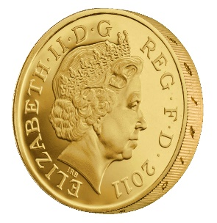
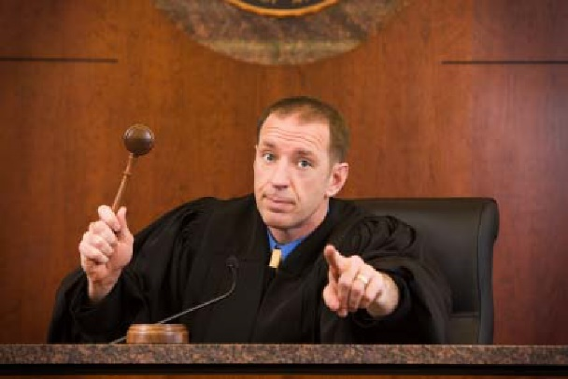
PRF-Security as a Game
m₁
r₁
m₂
r₂
m₃
r₃
…
$$∀PPT A ∃μ (negligible) s.t$$
$$Pr\left[A Guesses b^{′}=b\right]≤\frac{1}{2}+μ(n)$$
b’
Random bit b
$K←Gen\left(1^{n}\right)$
Truly random func R
r_{i} = F_{K}(m_{i}) if b=1
R(m_{i}) o.w

Slide 13
PRF Security Concrete Version
Definition 3.25: A keyed function $F:{\left\{0,1\right\}}^{n}×{\left\{0,1\right\}}^{n}→{\left\{0,1\right\}}^{n}$ is a $\left(t\left(n\right),q\left(n\right),ε\left(n\right)\right)$-secure pseudorandom function if for all distinguishers D running in time at most $t\left(n\right)$ and making at most $q\left(n\right)$ queries we have
$$\left|Pr\left[D^{F_{k}(.)}\left(1^{n}\right)\right]−Pr\left[D^{f(.)}\left(1^{n}\right)\right]\right|≤ε\left(n\right)$$

Slide 14
Reminder: CPA-Security (Single Message)
m₀,m₁
c = Enc_{K}(m_{b})
m₂
c₂ = Enc_{K}(m₂)
m₃
c₃ = Enc_{K}(m₃)
…
$$∀PPT A ∃μ (negligible) s.t$$
$$Pr\left[A Guesses b^{′}=b\right]≤\frac{1}{2}+μ(n)$$
b’
Random bit b
$K←Gen\left(1^{n}\right)$

Slide 15
CPA-Secure Encryption
Gen: on input 1^{n} pick uniform ${k∈\left\{0,1\right\}}^{n}$
Enc: Input ${k∈\left\{0,1\right\}}^{n}$ and ${m∈\left\{0,1\right\}}^{n}$
Output $c=\left\langle r,F_{k}\left(r\right)⨁m\right\rangle$ for uniform ${r∈\left\{0,1\right\}}^{n}$
Dec: Input ${k∈\left\{0,1\right\}}^{n}$ and$c=\left\langle r,s\right\rangle$
Output $m=F_{k}\left(r\right)⨁s$
Theorem: If F is a pseudorandom function, then (Gen,Enc,Dec) is a CPA-secure encryption scheme for messages of length n.
How to begin proof?

Slide 16
Breaking CPA-Security (Single Message)
m₀,m₁
$$\left\langle r,F_{k}\left(r\right)⨁m_{b}\right\rangle$$
m₂
$$\left\langle r_{2},F_{k}\left(r_{2}\right)⨁m_{2}\right\rangle$$
m₃
$$\left\langle r_{3},F_{k}\left(r_{3}\right)⨁m_{3}\right\rangle$$
…
Assumption: $∃$PPT $A, P (non−negligible) s.t$
$$Pr\left[A Guesses b^{′}=b\right]≥\frac{1}{2}+P(n)$$
b’
Random bit b
$$K←Gen\left(1^{n}\right)$$

Slide 17
Security Reduction
Step 1: Assume for contraction that we have a PPT attacker A that breaks CPA-Security.
Step 2: Construct a PPT distinguisher D which breaks PRF security.
Distinguisher D^{O} (oracle O --- either f or F_{k})
Simulate A
Whenever A queries its encryption oracle on a message m
Select random r and query O(r)
Return $c=\left\langle r,O\left(r\right)⨁m\right\rangle$
Whenever A outputs messages m₀,m₁
Select random r and bit b
Return $c=\left\langle r,O\left(r\right)⨁m_{b}\right\rangle$
Whenever A outputs b’
Output 1 if b=b’
Output 0 otherwise
Analysis: Suppose that O = f then
$\text{Pr}\left[{\text{D}}^{F_{k}}=1\right]\text{=} \text{Pr}\left[{PrivK}_{A,Π }^{cpa}=1\right]$
Suppose that O = f then
$$\text{Pr}\left[{\text{D}}^{f}=\text{1}\right]\text{=}\text{Pr}\left[{PrivK}_{A,\tilde{Π} }^{cpa}=1\right]$$
where $\tilde{Π}$ denotes the encryption scheme in which F_{k} is replaced by truly random f.

Slide 18
Security Reduction
Step 1: Assume for contraction that we have a PPT attacker A that breaks CPA-Security.
Step 2: Construct a PPT distinguisher D which breaks PRF security.
Distinguisher D^{O} (oracle O --- either f or F_{k})
Simulate A
Whenever A queries its encryption oracle on a message m
Select random r and query O(r)
Return $c=\left\langle r,O\left(r\right)⨁m\right\rangle$
Whenever A outputs messages m₀,m₁
Select random r and bit b
Return $c=\left\langle r,O\left(r\right)⨁m_{b}\right\rangle$
Whenever A outputs b’
Output 1 if b=b’
Output 0 otherwise
Analysis: By PRF security, for some negligible function $μ,$ we have
$$\left|\text{Pr}\left[{PrivK}_{A,Π }^{cpa}=1\right]−\text{Pr}\left[{PrivK}_{A,\tilde{Π} }^{cpa}=1\right]\right|=\left|\text{Pr}\text{[}{\text{D}}^{F_{k}}=1\text{]}−\text{Pr}\text{[}{\text{D}}^{f}=1\text{]}\right|≤μ(n)$$
Implies: $\text{Pr}\left[{PrivK}_{A,\tilde{Π} }^{cpa}=1\right]≥\text{Pr}\left[{PrivK}_{A,Π }^{cpa}=1\right]−μ(n)$

Slide 19
Security Reduction
Fact: $\text{Pr}\left[{PrivK}_{A,\tilde{Π} }^{cpa}=1\right]≥\text{Pr}\left[{PrivK}_{A,Π }^{cpa}=1\right]$-$μ(n)$
Claim: For any attacker A making at most q(n) queries we have
$$\text{Pr}\left[{PrivK}_{A,\tilde{Π} }^{cpa}=1\right]≤\frac{1}{2}+\frac{q(n)}{2^{n}}$$
Conclusion: For any attacker A making at most q(n) queries we have
$$\text{Pr}\left[{PrivK}_{A,Π }^{cpa}=1\right]≤\frac{1}{2}+\frac{q\left(n\right)}{2^{n}}+μ\left(n\right)$$
where $\frac{q\left(n\right)}{2^{n}}+μ\left(n\right)$ is negligible.

Slide 20
Finishing Up
Claim: For any attacker A making at most q(n) queries we have
$$\text{Pr}\left[{PrivK}_{A,\tilde{Π} }^{cpa}=1\right]≤\frac{1}{2}+\frac{q(n)}{2^{n}}$$
Proof: Let m₀,m₁ denote the challenge messages and let r* denote the random string used to produce the challenge ciphertext
$$c=\left\langle r^{∗},f\left(r^{∗}\right)⨁m_{b}\right\rangle$$
And let $r_{1}\text{,…,}r_{q}$ denote the random strings used to produce the other ciphertexts $ci=\left\langle r_{i},f\left(r_{i}\right)⨁m_{i}\right\rangle$.
If $r^{∗}≠r_{1}\text{,…,}r_{q}$then then c leaks no information about b (information theoretically).

Slide 21
Finishing Up
Claim: For any attacker A making at most q(n) queries we have
$$\text{Pr}\left[{PrivK}_{A,\tilde{Π} }^{cpa}=1\right]≤\frac{1}{2}+\frac{q(n)}{2^{n}}$$
Proof: If $r^{∗}≠r_{1}\text{,…,}r_{q}$ then then c leaks no information about b (information theoretically). We have
$$\text{Pr}\left[{PrivK}_{A,\tilde{Π} }^{cpa}=1\right]≤\text{Pr}\left[{PrivK}_{A,\tilde{Π} }^{cpa}=1\left|r^{∗}≠r_{1}\text{,…,}r_{q}\right.\right]+\text{Pr}\left[\text{r}\text{∗}∈\left\{r_{1}\text{,…,}r_{q}\right\} \right]$$
$$≤\frac{1}{2}+\frac{q(n)}{2^{n}}$$

Slide 22
Conclusion
$$\text{Enc}\text{k}\text{(}\text{m}\text{)}=\left\langle r,F_{k}\left(r\right)⨁m\right\rangle$$
$$\text{Dec}\text{k}\text{(}\left\langle r,s\right\rangle \text{)}=F_{k}\left(r\right)⨁s$$
For any attacker A making at most q(n) queries we have
$$\text{Pr}\left[{PrivK}_{A,Π }^{cpa}=1\right]≤\frac{1}{2}+\frac{q\left(n\right)}{2^{n}}+μ\left(n\right)$$
PRF Security
Suggested Exercise: Work out concrete version of security proof

Slide 23
Are PRFs or PRGs more Powerful?
Easy to construct a secure PRG from a PRF
G(s) = F_{s}(1)|…|F_{s}($ℓ$)
Construct a PRF from a PRG?
Tricky, but possible… (Katz and Lindell Section 7.5)

Slide 24
PRFs from PRGs
Theorem: Suppose that there is a PRG G with expansion factor $ℓ\left(n\right)=2n.$ Then there is a secure PRF.
Let G(x) = G₀(x)||G₁(x) (first/last n bits of output)
$$F_{K}\left(x_{1},…,x_{n}\right)=G_{x_{n}}\left(…\left(G_{x_{2}}\left(G_{x_{1}}\left(K\right)\right)\right)…\right)$$
Theorem: If G is a PRG then F_{k} is a PRF

Slide 25
PRFs from PRGs
Theorem: Suppose that there is a PRG G with expansion factor $ℓ\left(n\right)=2n.$ Then there is a secure PRF.
k
1
F_{k}(011)=G₁(G₁(G₀(k)))
0
G₀(k)
G₁(k)
0
1
1
0
G₀(G₀(k))
G₁(G₀(k))
G₀(G₁(k))
G₁(G₁(k))
1
…
…
0
1
0
1
…
0
1
…
0
…
…
…
…

Slide 26
Construct PRF from PRG
Define: G(s)= G₀(s)| G₁(s)
PRF: $F_{k}\left(x\right)=G_{x_{1}}\left({…G}_{x_{n−1}}\left(G_{x_{n}}\left(k\right)\right)\right)$
Recursive Definition: $F_{k}\left(x\right)=\text{H}\text{k}\text{(}\text{x}\text{)}$ where
H_{k}(1)$:=$ G₁(k)
H_{k}(0)$:=$ G₀(k)
H_{k}(1|x)$:=$G₁(H_{k}(x))
H_{k}(0|x)$:=$ G₀(H_{k}(x))
Theorem: If G is a PRG then F_{k} is a PRF

Slide 27
Stream Ciphers Modes
What if we don’t know the length of the message to be encrypted a priori?
Stream Cipher: $G_{∞}\left(s,1^{n}\right)$ outputs n pseudorandom bits as follows
Initial State: st₀ = Initialize(s)
Repeat
(y_{i},st_{i})=GetBits(st_{i-1})
Output y_{i}
Synchronized Mode
Message sequence: m₁,m₂,…
Ciphertext sequence: c_{i} = m_{i} $⨁$y_{i} (same length as ciphertext!)
“CPA-like” security follows from cipher security (must stop after n-bits)
Deterministic encryption, what gives???
Requires both parties to maintain state (not good for sporadic communication)

Slide 28
Stream Ciphers Modes
What if we don’t want to keep state?
Unsynchronized Mode
Message sequence: m₁,m₂,…
Ciphertext sequence: $ci=\left\langle \text{IV}\text{, }m_{i}⨁ G_{∞}\left(k,IV,1^{\left|m_{i}\right|}\right)\right\rangle$
CPA-Secure if F_{k}(IV) $=G_{∞}\left(k,IV,1^{n}\right)$ is a (weak) PRF.
No shared state, but longer ciphertexts….

Slide 29
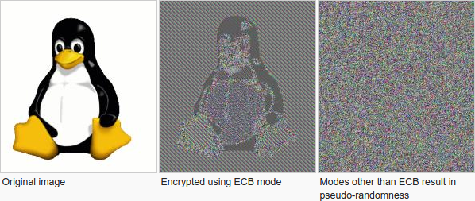
Week 3: Topic 2: Modes of Encryption, The Penguin and CCA security

Slide 30
Pseudorandom Permutation
A keyed function $F:{\left\{0,1\right\}}^{n}×{\left\{0,1\right\}}^{n}→{\left\{0,1\right\}}^{n}$, which is invertible and “looks random” without the secret key k.
Similar to a PRF, but
Computing F_{k}(x) and $F_{k}^{−1}\left(x\right)$ is efficient (polynomial-time)
Definition 3.28: A keyed function $F:{\left\{0,1\right\}}^{n}×{\left\{0,1\right\}}^{n}→{\left\{0,1\right\}}^{n}$ is a strong pseudorandom permutation if for all PPT distinguishers D there is a negligible function $μ$ s.t.
$$\left|Pr\left[D^{F_{k}\left(.\right),F_{k}^{−1}\left(.\right)}\left(1^{n}\right)\right]−Pr\left[D^{f\left(.\right),f^{−1}\left(.\right)}\left(1^{n}\right)\right]\right|≤μ\left(n\right)$$

Slide 31
Pseudorandom Permutation
Definition 3.28: A keyed function $F:{\left\{0,1\right\}}^{n}×{\left\{0,1\right\}}^{n}→{\left\{0,1\right\}}^{n}$ is a strong pseudorandom permutation if for all PPT distinguishers D there is a negligible function $μ$ s.t.
$$\left|Pr\left[D^{F_{k}\left(.\right),F_{k}^{−1}\left(.\right)}\left(1^{n}\right)\right]−Pr\left[D^{f\left(.\right),f^{−1}\left(.\right)}\left(1^{n}\right)\right]\right|≤μ\left(n\right)$$
Notes:
the first probability is taken over the uniform choice of ${k∈\left\{0,1\right\}}^{n}$ as well as the randomness of D.
the second probability is taken over uniform choice of f $∈$Perm_{n}as well as the randomness of D.
D is never given the secret k
However, D is given oracle access to (keyed) permutation and inverse
Strong pseudorandom permutation: attacker doesn’t get oracle access to inverse
Can build strong pseudorandom permutation given pseudorandom function

Slide 32
Electronic Code Book (ECB) Mode
Uses strong PRP F_{k}(x) and $F_{k}^{−1}\left(x\right)$
Enc_{k}
Input: m₁,…,m$ℓ$
Output: $\left\langle \text{F}\text{k}\text{(}\text{m}\text{1}\text{)},…,\text{F}\text{k}\text{(}\text{m}ℓ \text{)}\right\rangle$
How to decrypt?
Is this secure?
Hint: Encryption is deterministic.
Implication: Not CPA-Secure
But, it gets even worse

Slide 33
ECB Mode (A Failed Approach)

Slide 34
The Penguin Principle
If you can still see the penguin after “encrypting” the image something is very very wrong with the encryption scheme.

Slide 35
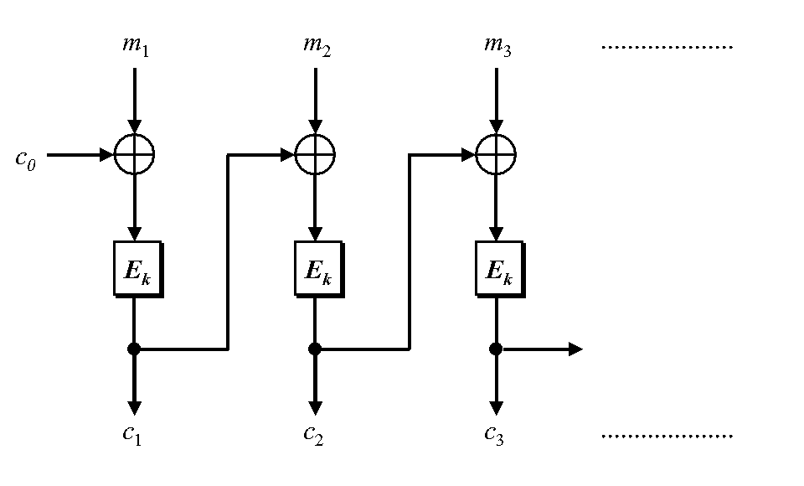
Cipher Block Chaining
CBC-Mode (below) is CPA-secure if E_{k} is a PRP
Reduces bandwidth!
Message: 3n bits
Ciphertext: 4n bits
IV
IV
How to decrypt? (Hint: Can be done in parallel)

Slide 36
Recap
PRFs/PRPs
CPA-Secure Encryption + Security Reduction
$${Enc}_{k}\left(m\right)=\left\langle r,F_{k}\left(r\right)⨁m\right\rangle$$
ECB Mode + Penguin Principle
CBC Mode (CPA Secure)
Chained CBC-Mode
Reminder: HW Due Tonight
11:59PM on Gradescope

Slide 37
Chained CBC-Mode
m₄
m₅
m₆
IV
c₃
IV
c₄
c₅
c₆
First glance: seems similar to CBC-Mode and reduces bandwidth
Vulnerable to CPA-Attack! (Set $m4=IV⨁c3⨁m_{1}^{′}$ and c₄=c₁ iff m₁=m₁’)
Moral: Be careful when tweaking encryption scheme!

Slide 38
Chained CBC-Mode
m₄
m₅
m₆
IV
c₃
IV
c₄
c₅
c₆
Vulnerable to CPA-Attack! (Set $m4=IV⨁c3⨁m_{1}^{′}$ and c₄=c₁ iff m₁=m₁’)

Slide 39
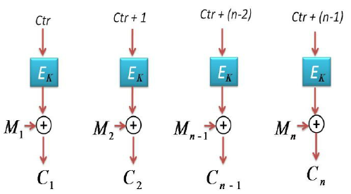
Counter Mode
Input: m₁,…,m_{n}
Output: c = (ctr, c₁,c₂,…,c_{n}) where ctr is chosen uniformly at random
Theorem: If E_{k} is PRF (or PRP) then counter mode is CPA-Secure
Advantages: Parallelizable encryption/decryption

Slide 40
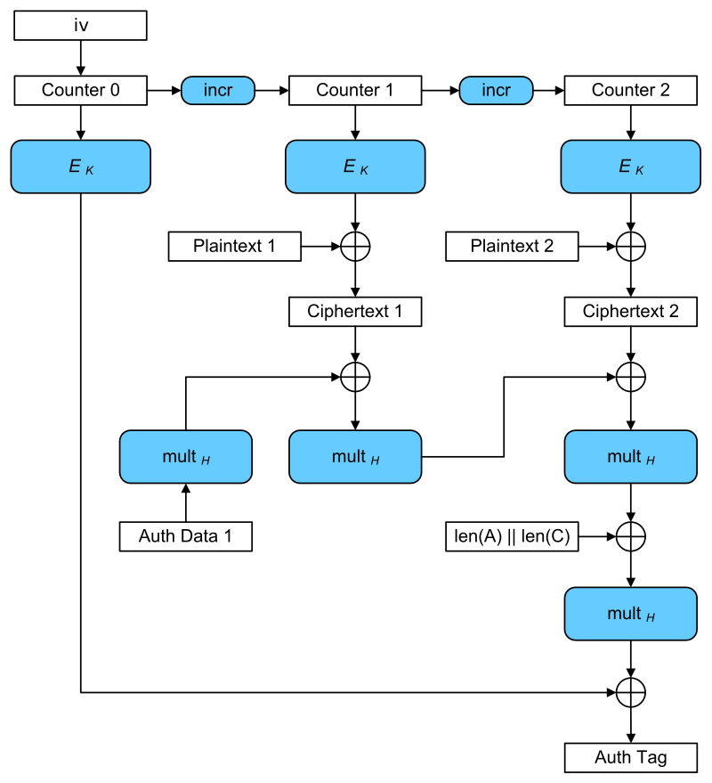
Galois Counter Mode (GCM)
Input: plaintexts 1 & 2
AES-GCM is CCA-secure (> CPA-security)
Bonus: Authentication Encryption with Associated Data
Ensure integrity of ciphertext
Attacker cannot even generate new/valid ciphertext!
Ensures attacker cannot tamper with associated packet data
Source IP
Destination IP
Why can’t these values be encrypted?
Encryption is largely parallelizable!
Outputs: iv, ciphertexts 1 & 2, authentication tag

Slide 41
Recap
Pseudorandom Functions
CPA-Security
Today’s Goals:
Evaluate several modes of operation for stream-ciphers + block-ciphers
Introduce Chosen Ciphertext Attacks/CCA-Security
Construct encryption scheme with CCA-Security

Slide 42
Week 3: Topic 3: CCA-Security

Slide 43
Chosen Ciphertext Attacks
Sometimes an attacker has ability to obtain (partial) decryptions of ciphertexts of its choice.
CPA-Security does not model this ability.
Examples:
An attacker may learn that a ciphertext corresponds to an ill-formed plaintext based on the reaction (e.g., server replies with “invalid message”).
Monitor enemy behavior after receiving an encrypted message.
Authentication Protocol: Send Enc_{k}(r) to recipient who authenticates by responding with r.

Slide 44
CCA-Security (Ind-CCA2)
We could set m₀ = m₋₁ or m₁ = m₋₂ etc…
m₋₁
c₋₁ = Enc_{K}(m₋₁)
c₋₂
…
m₋₂ = Dec_{K}(c₋₂)
m₀,m₁
However, we could still flip 1 bit of c and ask challenger to decrypt
c = Enc_{K}(m_{b})
m₂
c₂ = Enc_{K}(m₂)
Random bit b
K = Gen(.)
c₃
m₃ = Dec_{K}(c₃)
c₄ =c
…
“No Way!”
b’

Slide 45
CCA-Security $\left({PrivK}_{A,Π}^{cca}\left(n\right)\right)$
Challenger generates a secret key k and a bit b
Adversary (A) is given oracle access to Enc_{k} and Dec_{k}
Adversary outputs m₀,m₁
Challenger sends the adversary c=Enc_{k}(m_{b}).
Adversary maintains oracle access to Enc_{k} and Dec_{k} ,however the adversary is not allowed to query Dec_{k}(c).
Eventually, Adversary outputs b’.
$${PrivK}_{A,Π}^{cca}\left(n\right)=1 if b=b^{′};otherwise 0.$$
CCA-Security: For all PPT A exists a negligible function negl(n) s.t.
$$Pr\left[{PrivK}_{A,Π}^{cca}\left(n\right)=1\right]≤\frac{1}{2}+negl(n)$$

Slide 46
CCA-Security
Definition 3.33: An encryption scheme $Π$ is CCA-secure if for all PPT A there is a negligible function negl(n) such that
$$Pr\left[{PrivK}_{A,Π}^{cca}\left(n\right)=1\right]≤\frac{1}{2}+negl(n)$$

Slide 47
CPA-Security doesn’t imply CCA-Security
$$\text{Enc}\text{k}\text{(}\text{m}\text{)}=\left\langle r,F_{k}\left(r\right)⨁m\right\rangle$$
Attacker: Selects m₀ = 0^{n} and m₁ = 1^{n}
Attacker Receives: $c=\left\langle r, s\right\rangle$ ${\text{where} s=F}_{k}\left(r\right)⨁m_{b}$
Attacker Queries: Dec_{k}(c’) for
$$c′=\left\langle r,s⨁{10}^{n−1}\right\rangle$$
Attacker Receives: $m=\left\{\begin{matrix}{10}^{n−1} & if b=0 \\ {01}^{n−1} & if b=1\end{matrix}\right.$
Example Shows: CPA-Security doesn’t imply CCA Security (Why?)

Slide 48
Attacks in the Wild
Padding Oracle Attack
Length of plaintext message must be multiple of block length (e.g., 16 bytes)
Popular fix PKCS #5 padding
1 bytes of padding (0x01)
2 bytes of padding (0x0202)
3 bytes of padding (0x030303)
4 bytes of padding (0x04040404)
Invalid: (0x020303)
“Bad Padding Error”
Adversary submits ciphertext(s) and waits to if this error is produced
Attacker can repeatedly modify ciphertext to reveal original plaintext piece by piece!

Slide 49
Example
M=“hello…please keep this message secret”+0x030303
$$C=\left\langle r,s=F_{k}\left(r\right)⨁M\right\rangle$$
$C^{′}=\left\langle r,F_{k}\left(r\right)⨁M⨁\text{0}\text{x}\text{0000}….\text{30}\text{303}⨁\text{0}\text{x}\text{00000}…\text{0}\text{2}\text{0}2\right\rangle$
Ask to decrypt C’
If we added 3 bytes of padding?
→ C’ can be decrypted (Looks like the message M’ = M + 0x0301 with 1 byte padding).
If we added $>$ 3 (or < 3) bytes of padding?
→We will get a decryption error (bad padding)!
Once we know we have three bits of padding we can set
$$C^{′′}=\left\langle r,s=F_{k}\left(r\right)⨁\left(M⨁\text{0}\text{x}\text{0000}….\text{0}\text{30303}\right)⨁\text{0}\text{x}\text{0}…gg0\text{4}\text{0}\text{4}\text{0}\text{4}\right\rangle$$
If C’’ decrypts then we can infer the byte t s.t. $M=x∥t∥(0x030303)$ since $t⨁gg=0x04$.

Slide 50
Example
M=“hello…please keep this message secret”+0x030303
$$C=\left\langle r,s=F_{k}\left(r\right)⨁M\right\rangle$$
Once we know we have three bits of padding we can set
$$C^{′′}=\left\langle r,s=F_{k}\left(r\right)⨁\left(M⨁\text{0}\text{x}\text{0000}….\text{0}\text{30303}\right)⨁\text{0}\text{x}\text{0}…gg0\text{4}\text{0}\text{4}\text{0}\text{4}\right\rangle$$
If C’’ decrypts then we can infer the byte t s.t. $M=x∥t∥(0x030303)$ since $t⨁gg=0x04$.
Question: How do we infer the next byte t’?
Answer: Set $C′′′=C′′⨁\text{0}\text{x}\text{0}…gg050\text{5}\text{0}\text{5}\text{0}\text{5}$
if decryption is successful then $t′⨁gg=0x05$

Slide 51
CCA-Security
CCA-Security is strictly stronger than CPA-Security
Note: If a scheme has indistinguishable encryptions under one chosen-ciphertext attack then it has indistinguishable multiple encryptions under chosen-ciphertext attacks.
None of the encryption schemes we have considered so far are CCA-Secure ☹
Achieving CCA-Security?
Useful to guarantee integrity of the ciphertext
Idea: If attacker cannot generate valid new ciphertext c’ (distinct from ciphertext obtained via eavesdropping) then ability to query decryption oracle is useless!
CCA-Security requires non-malleability.
Intuition: if attacker tampers with ciphertext c then c’ is either invalid or m’ is unrelated to m
Let $c={Enc}_{K}\left(\text{m}\text{b}\right).$Suppose attacker could generate a new valid ciphertext $c′≠c$ such that $m′$ is related to $\text{m}\text{b}$the but not message $m_{1−b}$
How can the attacker win the CCA-Security game?
Ask for decryption of c’ and check if $m′$ is related to $m_{1}$ or $m_{0}$

Slide 52
Week 3: Topic 4: Message Authentication Codes (Part 1)

Slide 53
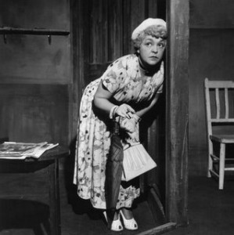
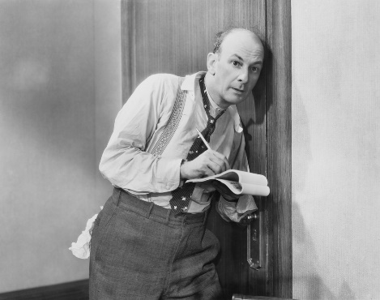
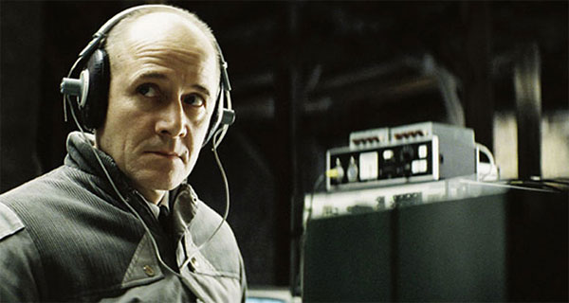
What Does It Mean to “Secure Information”
Confidentiality (Security/Privacy)
Only intended recipient can see the communication

Slide 54
What Does It Mean to “Secure Information”
Confidentiality (Security/Privacy)
Only intended recipient can see the communication
Integrity (Authenticity)
The message was actually sent by the alleged sender
I love you Alice… - Bob
We need to break up -Bob
Alice
Bob

Slide 55
Message Authentication Codes
CPA-Secure Encryption: Focus on Secrecy
But does not promise integrity
Message Authentication Codes: Focus on Integrity
But does not promise secrecy
CCA-Secure Encryption: Requires Integrity and Secrecy

Slide 56
What Does It Mean to “Secure Information”
Integrity (Authenticity)
The message was actually sent by the alleged sender
And the received message matches the original
Pay robot devil $50
Pay robot devil $5,000
Alice
Bob
Notes:
Example: HTTP is stateless. Cookies can be stored on the client, but can the server trust the client not to modify the cookie?

Slide 57
Error Correcting Codes?
Tool to detect/correct a small number of random errors in transmission
Examples: Parity Check, Reed-Solomon Codes, LDPC, Hamming Codes …
Provides no protection against a malicious adversary who can introduce an arbitrary number of errors
Still useful when implementing crypto in the real world (Why?)

Slide 58
Modifying Ciphertexts
$$\text{Enc}\text{k}\text{(}\text{m}\text{)}=c=\left\langle r,F_{k}\left(r\right)⨁m\right\rangle$$
$$c^{′}=\left\langle r,F_{k}\left(r\right)⨁m⨁y\right\rangle =\text{Enc}\text{k}\text{(}m⨁y\text{)}$$
$$\text{Dec}\text{k} {(c}^{′})=F_{k}\left(r\right)⨁F_{k}\left(r\right)⨁m⨁y=m⨁y$$
If attacker knows original message he can forge c’ to decrypt to any message he wants.
Even if attacker doesn’t know message he may find it advantageous to flip certain bits (e.g., decimal places)

Slide 59
Message Authentication Code Syntax
Definition 4.1: A message authentication code (MAC) consists of three algorithms
$\operatorname{Gen}{(1^{n};R)}$ (Key-generation algorithm)
Input: security parameter 1^{n} (unary) and random bits R
Output: Secret key $k∈𝒦$
$\operatorname{Mack}{(m;R)}$ (Tag Generation algorithm)
Input: Secret key $k∈𝒦$ and message $m∈ℳ$ and random bits R
Output: a tag t
$\operatorname{Vrfyk}{(m,t)}$ (Verification algorithm)
Input: Secret key $k∈𝒦,$ a message m and a tag t
Output: a bit b (b=1 means “valid” and b=0 means “invalid”)
Invariant?

Slide 60
Message Authentication Code Syntax
Definition 4.1: A message authentication code (MAC) consists of three algorithms
$\operatorname{Gen}{(1^{n};R)}$ (Key-generation algorithm)
Input: security parameter 1^{n} (unary) and random bits R
Output: Secret key $k∈𝒦$
$\operatorname{Mack}{(m;R)}$ (Tag Generation algorithm)
Input: Secret key $k∈𝒦$ and message $m∈ℳ$ and random bits R
Output: a tag t
$\operatorname{Vrfyk}{(m,t)}$ (Verification algorithm)
Input: Secret key $k∈𝒦,$ a message m and a tag t
Output: a bit b (b=1 means “valid” and b=0 means “invalid”)
Invariant?

Slide 61
Message Authentication Code Syntax
Definition 4.1: A message authentication code (MAC) consists of three algorithms $Π=\left(Gen, Mac, Vrfy\right)$
$\operatorname{Gen}{(1^{n};R)}$ (Key-generation algorithm)
Input: security parameter 1^{n} (unary) and random bits R
Output: Secret key $k∈𝒦$
$\operatorname{Mack}{(m;R)}$ (Tag Generation algorithm)
Input: Secret key $k∈𝒦$ and message $m∈ℳ$ and random bits R
Output: a tag t
$\operatorname{Vrfyk}{(m,t)}$ (Verification algorithm)
Input: Secret key $k∈𝒦,$ a message m and a tag t
Output: a bit b (b=1 means “valid” and b=0 means “invalid”)
$$\operatorname{Vrfyk}{(m,\operatorname{Mack}{(m;R)})}=1$$
Security Goal (Informal): Attacker should not be able to forge a valid tag t’ for new message m’ that s/he wants to send.

Slide 62
MAC Authentication Game (${Macforge}_{A,Π}(n)$)
m₁
t₁ = Mac_{K}(m₁)
m₂
…
t₂ = Mac_{K} (m₂)
m_{q}
t_{q} = Mac_{K}(m_{q})
$\left(m,t\right)$ s.t $m∉\left\{m1,…,m_{q}\right\}$
$${Macforge}_{A,Π}(n)=Vrfyk{(m,t)}$$
K = Gen(.)
$$∀PPT A ∃μ (negligible) s.t$$
$$Pr\left[{Macforge}_{A,Π}\left(n\right)=1\right]≤μ(n)$$

Slide 63
Discussion
Is the definition too strong?
Attacker wins if he can forge any message
Does not necessarily attacker can forge a “meaningful message”
“Meaningful Message” is context dependent
Conservative Approach: Prove Security against more powerful attacker
Conservative security definition can be applied broadly
Replay Attacks?
t=Mac_{K}(“Pay Bob $1,000 from Alice’s bank account”)
Alice cannot modify message to say $10,000, but…
She may try to replay it 10 times

Slide 64
Replay Attacks
MACs alone do not protect against replay attacks (they are stateless)
Common Defenses:
Include Sequence Numbers in Messages (requires synchronized state)
Can be tricky over a lossy channel
Timestamp Messages
Double check timestamp before taking action

Slide 65
Strong MACs
Previous game ensures attacker cannot generate a valid tag for a new message.
However, attacker may be able to generate a second valid tag t’ for a message m after observing (m,t)
Strong MAC: attacker cannot generate second valid tag, even for a known message

Slide 66
Strong MAC Authentication (${Macsforge}_{A,Π}(n)$)
m₁
t₁ = Mac_{K}(m₁)
m₂
…
t₂ = Mac_{K} (m₂)
m_{q}
t_{q} = Mac_{K}(m_{q})
$\left(m,t\right)$ s.t $\left(m,t\right)∉\left\{(m1,t1),…,(mq,tq)\right\}$
$${Macsforge}_{A,Π}(n)=Vrfyk{(m,t)}$$
K = Gen(.)
$$∀PPT A ∃μ (negligible) s.t$$
$$Pr\left[{Macsforge}_{A,Π}\left(n\right)=1\right]≤μ(n)$$

Slide 67
Deterministic MACs
Canonical Verification Algorithm
$$\operatorname{Vrfyk}{(m,t)}=\left\{\begin{aligned}\begin{matrix}1 & if t=Mack(m)\end{matrix} \\ \begin{matrix}0 & otherwise\end{matrix}\end{aligned}\right.{}$$
“All real-world MACs use canonical verification” – page 115

Slide 68
Strong MAC vs Regular MAC
Proposition 4.4: Let $Π=\left(Gen, Mac, Vrfy\right)$ be a secure MAC that uses canonical verification. Then $Π$ is a strong MAC.
“All real-world MACs use canonical verification” – page 115
Should attacker have access to Vrfy_{K}(.) oracle in games?
(e.g., CPA vs CCA security for encryption)
Irrelevant if the MAC uses canonical verification!

Slide 69
Timing Attacks (Side Channel)
Naïve Canonical Verification Algorithm
Input: m,t’
t=Mac_{K}(m)
for i=1 to tag-length
if t[i] != t’[i] then
return 0
return 1
Example
t= 1 0 1 0 1 1 1 0
t’= 1 0 1 0 1 1 1 1
Returns 0 after 8 steps

Slide 70
Timing Attacks (Side Channel)
Naïve Canonical Verification Algorithm
Input: m,t’
t=Mac_{K}(m)
for i=1 to tag-length
if t[i] != t’[i] then
return 0
return 1
Example
t= 1 0 1 0 1 1 1 0
t’= 0 0 1 0 1 1 1 0
Returns 0 after 1 step

Slide 71
Timing Attack
MACs used to verify code updates for Xbox 360
Implementation allowed different rejection times (side-channel)
Attacks exploited vulnerability to load pirated games onto hardware
Moral: Ensure verification is time-independent

Slide 72
Improved Canonical Verification Algorithm
Input: m,t’
B=1
t=Mac_{K}(m)
for i=1 to tag-length
if t[i] != t’[i] then
B=0
else (dummy op)
return B
Example
t= 1 0 1 0 1 1 1 0
t’= 0 0 1 0 1 0 1 0
Returns 0 after 8 steps

Slide 73
Side-Channel Attacks
Cryptographic Definition
Attacker only observes outputs of oracles (Enc, Dec, Mac) and nothing else
When attacker gains additional information like timing (not captured by model) we call it a side channel attack.
Other Examples
Differential Power Analysis
Cache Timing Attack
Power Monitoring
Acoustic Cryptanalysis
…many others

Slide 74
Recap
Data Integrity
Message Authentication Codes
Side-Channel Attacks
Build Secure MACs
Construct CCA-Secure Encryption Scheme
Current Goal:
Build a Secure MAC
Key tool in Construction of CCA-Secure Encryption Schemes

Slide 75
Message Authentication Code Syntax
Definition 4.1: A message authentication code (MAC) consists of three algorithms $Π=\left(Gen, Mac, Vrfy\right)$
$\operatorname{Gen}{(1^{n};R)}$ (Key-generation algorithm)
Input: security parameter 1^{n} (unary) and random bits R
Output: Secret key $k∈𝒦$
$\operatorname{Mack}{(m;R)}$ (Tag Generation algorithm)
Input: Secret key $k∈𝒦$ and message $m∈ℳ$ and random bits R
Output: a tag t
$\operatorname{Vrfyk}{(m,t)}$ (Verification algorithm)
Input: Secret key $k∈𝒦,$ a message m and a tag t
Output: a bit b (b=1 means “valid” and b=0 means “invalid”)
$$\operatorname{Vrfyk}{(m,\operatorname{Mack}{(m;R)})}=1$$

Slide 76
General vs Fixed Length MAC
$$ℳ={\left\{0,1\right\}}^{∗}$$
versus
$$ℳ={\left\{0,1\right\}}^{ℓ(n)}$$

Slide 77
Strong MAC Construction (Fixed Length)
Simply uses a secure PRF F
$$\operatorname{Mack}{(m)}=FK(m)$$
Question: How to verify the a MAC?
Canonical Verification Algorithm…
$$\operatorname{Vrfyk}{(m,t)}=\left\{\begin{aligned}\begin{matrix}1 & if t=FK(m) \end{matrix} \\ \begin{matrix}0 & otherwise\end{matrix}\end{aligned}\right.$$

Slide 78
Strong MAC Authentication (${Macsforge}_{A,Π}(n)$)
m₁
t₁ = Mac_{K}(m₁)
m₂
…
t₂ = Mac_{K} (m₂)
m_{q}
t_{q} = Mac_{K}(m_{q})
$\left(m,t\right)$ s.t $\left(m,t\right)∉\left\{(m1,t1),…,(mq,tq)\right\}$
$${Macsforge}_{A,Π}(n)=Vrfyk{(m,t)}$$
K = Gen(.)
$$∀PPT A ∃μ (negligible) s.t$$
$$Pr\left[{Macsforge}_{A,Π}\left(n\right)=1\right]≤μ(n)$$

Slide 79
Concrete Version: $\left(t\left(n\right),q\left(n\right),ε(n)\right)$-secure MAC
m₁
t₁ = Mac_{K}(m₁)
m₂
…
t₂ = Mac_{K} (m₂)
m_{q}
t_{q} = Mac_{K}(m_{q})
$\left(m,t\right)$ s.t $\left(m,t\right)∉\left\{(m1,t1),…,(mq,tq)\right\}$
$${Macsforge}_{A,Π}(n)=Vrfyk{(m,t)}$$
K = Gen(.)
$$∀ A with \left(time(A)≤t\left(n\right),queries(A)≤q\left(n\right)\right)$$
$$Pr\left[{Macsforge}_{A,Π}\left(n\right)=1\right]≤ε(n)$$

Slide 80
Strong MAC Construction (Fixed Length)
$$\operatorname{Mack}{(m)}=FK(m)$$
$$\operatorname{Vrfyk}{(m,t)}=\left\{\begin{aligned}\begin{matrix}1 & if t=FK(m) \end{matrix} \\ \begin{matrix}0 & otherwise\end{matrix}\end{aligned}\right.$$
Theorem 4.6: If F is a PRF then this is a secure (fixed-length) MAC for messages of length n.
Proof: Start with attacker who breaks MAC security and build an attacker who breaks PRF security (contradiction!)
Sufficient to start with attacker who breaks regular MAC security (why?)

Slide 81
Breaking MAC Security (${Macforge}_{A,Π}(n)$)
m₁
$$t_{1}=F_{K}\left(m_{1}\right)$$
m₂
…
$$t_{2}=F_{K}\left(m_{2}\right)$$
m_{q}
$$t_{q}=F_{K}\left(m_{q}\right)$$
$\left(m,t\right)$ s.t $m∉\left\{m_{1},…,m_{q}\right\}$
$${Macforge}_{A,Π}(n)=Vrfyk{(m,t)}$$
K = Gen(.)
$$∃PPT A and g(.) (positive/non negligible) s.t$$
$$Pr\left[{Macforge}_{A,Π}\left(n\right)=1\right]>g(n)$$

Slide 82
A Similar Game (${Macforge}_{A,\tilde{Π}}(n)$)
Why? Because f(m) is distributed uniformly
in {0,1}^{n} so Pr[f(m)=t]=2^{-n}
m₁
t₁ = f(m₁)
m₂
…
t₂ = f (m₂)
m_{q}
t_{q} = f(m_{q})
$\left(m,t\right)$ s.t $m∉\left\{m_{1},…,m_{q}\right\}$
$${Macforge}_{A,\tilde{Π}}(n)=Vrfyk{(m,t)}$$
Truly Random Function
f $∈$Func_{n}
Claim: $∀A \left(not just PPT\right)$
$$Pr\left[{Macforge}_{A,\tilde{Π}}\left(n\right)=1\right]≤2^{−n}$$

Slide 83
PRF Distinguisher D
Given oracle O (either F_{K} or truly random f)
Run PPT Macforge adversary A
When adversary queries with message m, respond with O(m)
Output 1 if attacker wins (otherwise 0)
If O = f then
$$Pr\left[DO\left(1n\right)=1\right]=Pr\left[{Macforge}_{A,\tilde{Π}}\left(n\right)=1\right]≤2^{−n}$$
If O=F_{K} then
$$Pr\left[DO\left(1n\right)=1\right]=Pr\left[{Macforge}_{A,Π}\left(n\right)=1\right]>g(n)$$

Slide 84
PRF Distinguisher D
If O = f then
$$Pr\left[DO\left(1n\right)=1\right]=Pr\left[{Macforge}_{A,\tilde{Π}}\left(n\right)=1\right]≤2^{−n}$$
If O=F_{K} then
$$Pr\left[DO\left(1n\right)=1\right]=Pr\left[{Macforge}_{A,Π}\left(n\right)=1\right]>g(n)$$
Advantage:
$$\left|Pr\left[D^{F_{K}}\left(1n\right)=1\right]−Pr\left[Df\left(1n\right)=1\right]\right|>g\left(n\right)−2^{−n}$$
Note that $g\left(n\right)−2^{−n}$ is non-negligible and D runs in PPT if A does.

Slide 85
Strong MAC Construction (Fixed Length)
$$\operatorname{Mack}{(m)}=FK(m)$$
$$\operatorname{Vrfyk}{(m,t)}=\left\{\begin{aligned}\begin{matrix}1 & if t=FK(m) \end{matrix} \\ \begin{matrix}0 & otherwise\end{matrix}\end{aligned}\right.$$
Theorem 4.6: If F is a PRF then this is a secure (fixed-length) MAC for messages of length n.

Slide 86
Strong MAC Construction (Fixed Length)
$$\operatorname{Mack}{(m)}=FK(m)$$
$$\operatorname{Vrfyk}{(m,t)}=\left\{\begin{aligned}\begin{matrix}1 & if t=FK(m) \end{matrix} \\ \begin{matrix}0 & otherwise\end{matrix}\end{aligned}\right.$$
Theorem (Concrete): If F is a $\left(t\left(n\right),q\left(n\right),ε(n)\right)$-secure PRF then the above construction is a $\left(t\left(n\right)−O\left(n\right),q\left(n\right),ε\left(n\right)+2^{−n}\right)$-secure MAC for $ℳ={\left\{0,1\right\}}^{n}$ (messages of length n).
Example: F is a $\left(2^{n},2^{n/2},2^{−n}\right)$-secure PRF-→ the above MAC construction is
$\left(2^{n}−O\left(n\right),2^{n/2},2^{−n+1}\right)$-secure

Slide 87
Strong MAC Construction (Fixed Length)
$$\operatorname{Mack}{(m)}=FK(m)$$
$$\operatorname{Vrfyk}{(m,t)}=\left\{\begin{aligned}\begin{matrix}1 & if t=FK(m) \end{matrix} \\ \begin{matrix}0 & otherwise\end{matrix}\end{aligned}\right.$$
Theorem (Concrete): If F is a $\left(t\left(n\right),q\left(n\right),ε(n)\right)$-secure PRF then the above construction is a $\left(t\left(n\right)−O\left(n\right),q\left(n\right),ε\left(n\right)+2^{−n}\right)$-secure MAC for $ℳ={\left\{0,1\right\}}^{n}$ (messages of length n).
Limitation: What if we want to authenticate a longer message? $ℳ={\left\{0,1\right\}}^{∗}$

Slide 88
MACs for Arbitrary Length Messages
Building Block $Π$’=(Mac’,Vrfy’), a secure MAC for length n messages
First: A few failed attempts
Let m = m₁,…,m_{d} where each m_{i} is n bits and let $t_{i}={Mac}_{K}^{′}\left(m_{i}\right)$
$$\text{Mac}\text{K}\text{(}\text{m}\text{)}=\left\langle t_{1},…,t_{d}\right\rangle$$
What is wrong?
Block-reordering attack
$$\text{Mac}\text{K}\text{(}\text{m}\text{d}\text{,…,}m_{1}\text{)}=\left\langle t_{d},…,t_{1}\right\rangle$$
$m_{1}=$“I love you”
$m_{2}=$“I will never say that”
$m_{3}=$“you are stupid”

Slide 89
MACs for Arbitrary Length Messages
Building Block $Π$’=(Mac’,Vrfy’), a secure MAC for length n messages
Attempt 2
Let m = m₁,…,m_{d} where each m_{i} is n bits and let $t_{i}={Mac}_{K}^{′}\left(i{∥m}_{i}\right)$
$$\text{Mac}\text{K}\text{(}\text{m}\text{)}=\left\langle t_{1},…,t_{d}\right\rangle$$
Addresses block-reordering attack.
Any other concerns?
Truncation attack!
$$\text{Mac}\text{K}\text{(}\text{m}\text{1}\text{,…,}m_{d−1}\text{)}=\left\langle t_{1},…,t_{d−1}\right\rangle$$
Suppose $m_{1},…,m_{d−1},m_{d}=$
“I don’t like you. I LOVE you!”

Slide 90
MACs for Arbitrary Length Messages
Building Block $Π$’=(Mac’,Vrfy’), a secure MAC for length n messages
Attempt 3
Let m = m₁,…,m_{d} where each m_{i} is n bits and m has length $ℓ=nd$
Let $t_{i}={Mac}_{K}^{′}\left(i{∥ℓ∥m}_{i}\right)$
$$\text{Mac}\text{K}\text{(}\text{m}\text{)}=\left\langle t_{1},…,t_{d}\right\rangle$$
Addresses truncation.
Any other concerns?
Mix and Match Attack!

Slide 91
MACs for Arbitrary Length Messages
Let m = m₁,…,m_{d} where each m_{i} is n bits and m has length $ℓ=nd$
Let m’ = m’₁,…,m’_{d} where each m’_{i} is n bits and m has length $ℓ=nd$
Let $t_{i}={Mac}_{K}^{′}\left(i{∥ℓ∥m}_{i}\right)$ and ${t′}_{i}={Mac}_{K}^{′}\left(i{∥ℓ∥m}_{i}′\right)$
$$\text{Mac}\text{K}\text{(}\text{m}\text{)}=\left\langle t_{1},…,t_{d}\right\rangle$$
$$\text{Mac}\text{K}\text{(}\text{m}\text{′}\text{)}=\left\langle {t′}_{1},…,{t′}_{d}\right\rangle$$
Mix and Match Attack!
$$\text{Mac}\text{K}\text{(}\text{m}\text{1}\text{,}\text{m}\text{′}\text{2}\text{,}\text{m}\text{3}\text{,...}\text{)}=\left\langle t_{1},{t′}_{2},t_{3},…\right\rangle$$

Slide 92
$m_{1}=$“What will I say to Eve?”
$m_{2}=$“You are evil and vile.”
$m_{3}=$“Please leave me alone!”
$m_{4}=$“Your sworn enemy - BOB”
$$t=\left\langle t_{1},t_{2},,t_{3},t_{4}\right\rangle$$
$m_{1}′=$“Dear Alice”
$m_{2}′=$“You are wonderful.”
$m_{3}′=$“I can’t wait to see you!”
$m_{4}′=$“XOXOXOXOXO - BOB”
$$t^{′}=\left\langle t_{1}′,t_{2}′,,t_{3}′,t_{4}′\right\rangle$$
$m_{1}′=$“Dear Alice”
$m_{2}=$“You are evil and vile.”
$m_{3}=$“Please leave me alone!”
$m_{4}=$“Your sworn enemy - BOB”
$$t^{′′}=\left\langle t_{1}′,t_{2},,t_{3},t_{4}\right\rangle$$

Slide 93
MACs for Arbitrary Length Messages
A non-failed approach ☺
Building Block $Π$’=(Mac’,Vrfy’), a secure MAC for length n messages
Let m = m₁,…,m_{d} where each m_{i} is n/4 bits and m has length $ℓ<2^{n/4}$
Mac_{K}(m)=
Select random $\frac{n}{4}$ bit nonce $r$
Let $t_{i}={Mac}_{K}^{′}\left(r∥ℓ∥i{∥m}_{i}\right)$ for i=1,…,d
(Note: encode i and $ℓ$ as $\frac{n}{4}$ bit strings)
Output $\left\langle r,t_{1},…,t_{d}\right\rangle$

Slide 94
MACs for Arbitrary Length Messages
Mac_{K}(m)=
Select random n/4 bit string r
Let $t_{i}={Mac}_{K}^{′}\left(r∥ℓ∥i{∥m}_{i}\right)$ for i=1,…,d
(Note: encode i and $ℓ$ as n/4 bit strings)
Output $\left\langle r,t_{1},…,t_{d}\right\rangle$
Theorem 4.8: If $Π′$ is a secure MAC for messages of fixed length n, above construction$Π=(Mac,Vrfy)$ is secure MAC for arbitrary length messages.

Slide 95
Recap
CPA-Security vs. CCA-Security
PRFs
Today’s Goals:
Introduce Message Authentication Codes (MACs)
Key tool in Construction of CCA-Secure Encryption Schemes
Build Secure MACs

