Slide 1
Reminder: Course Feedback
Course Summary
Course Code | Course Title | Survey Start Date | Survey End Date | Report Access Start | Response Rate
wl.202120.CS.55500.FNY.18101 | Cryptography | 4/19/2021 9:00 AM | 5/2/2021 11:59 PM | 5/12/2021 12:00 AM | 50.00% (4/8)
If you haven’t already please complete your course evaluation before Sunday at 11:59PM.
What did you like about the course? What could be improved? Let me know! Your feedback is valuable and I carefully read through any comments after the semester is over.
Thanks to everyone who already completed there course evaluation!
Your feedback is anonymous and will not impact your grade (I cannot view your feedback until after grades are entered).

Slide 2
Announcements
Quiz 6: Due tomorrow (4/28) at 11:59PM
Homework 5: Due Thursday (4/29) at 11:59PM
Late submissions allowed up until Friday (3/30) at 11:59PM
We plan to release the solutions on Saturday
Final Exam: Monday, May 3 at 10:30 AM
Location: FRNY B124 (right here!)
Time: 10:30AM – 12:30PM
(Practice Final Exam on Piazza)

Slide 3
Final Exam
Cumulative, but will focus a bit more heavily on topics from the second half of the semester
You are allowed to prepare one page (8.5x11) of handwritten notes. Double sided
Practice Exam on Piazza
  The real final will be shorter
  The real exam will have more short answer questions

Slide 4
Cryptography
CS 555
Week 15:
Zero-Knowledge Proofs
Hot Topics in Cryptography
Memory Hard Functions + Password Hashing
Spring 2021

Slide 5
Recap: Zero-Knowledge Proof
Two parties: Prover P (PPT) and Verifier V (PPT)
(P is given witness w for claim x)
Completeness: If claim x is true honest prover can always convince honest verifier to accept.
Soundness: If claim x is false then Verifier should reject with probability at least ½. (Even if the prover tries to cheat)
Zero-Knowledge: Verifier doesn’t learn anything about prover’s input w from the protocol (other than that the claim x is true).
Formalizing this last statement is tricky
Zero-Knowledge: should hold even if the attacker is dishonest!

Slide 6


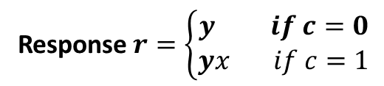

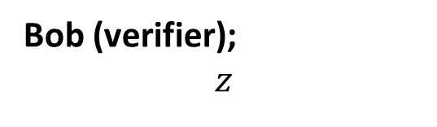

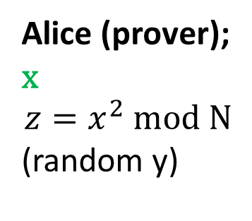
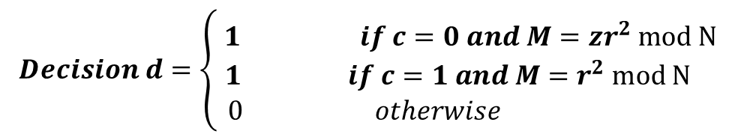
Zero-Knowledge Proof for Square Root mod N
$$M={zy}^{2} mod N$$
$$challenge c∈\left\{0,1\right\}$$
Response $r=\left\{\begin{aligned}y if c=0 \\ yx if c=1\end{aligned}\right.$
Bob (verifier);
$$z$$
Alice (prover);
x
$${z=x}^{2} mod N$$
(random y)
$$Decision d=\left\{ \begin{aligned}1 if c=0 and M={zr}^{2} mod N \\ 1 if c=1 and M=r^{2} mod N \\ 0 otherwise \end{aligned}\right.$$
Zero-Knowledge: How does the simulator work?

Slide 7
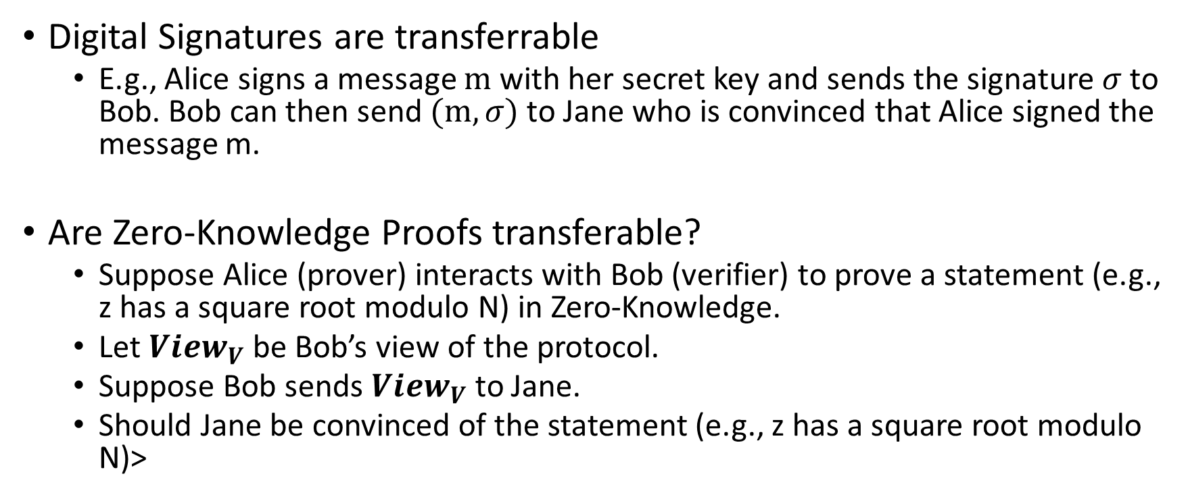
Zero-Knowledge Proof vs. Digital Signature
Digital Signatures are transferrable
  E.g., Alice signs a message $m$ with her secret key and sends the signature $σ$ to Bob. Bob can then send $(m,σ)$ to Jane who is convinced that Alice signed the message m.
Are Zero-Knowledge Proofs transferable?
  Suppose Alice (prover) interacts with Bob (verifier) to prove a statement (e.g., z has a square root modulo N) in Zero-Knowledge.
  Let ${View}_{V}$ be Bob’s view of the protocol.
  Suppose Bob sends ${View}_{V}$ to Jane.
  Should Jane be convinced of the statement (e.g., z has a square root modulo N)>

Slide 8
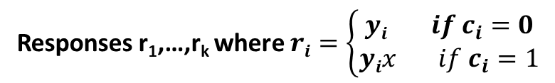
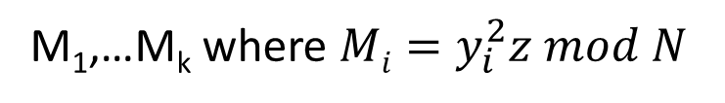
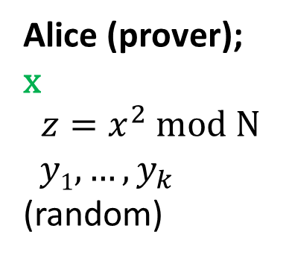
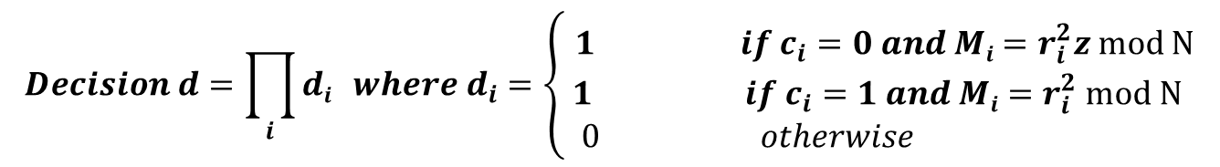
Non-Interactive Zero-Knowledge Proof (NIZK)
M₁,…M_{k} where $Mi=y_{i}^{2}z mod N$
$$challenges c=\left(c_{1},….,c_{k}\right)=H(z,\text{M}\text{1}\text{,…}M_{k})$$
Responses r₁,…,r_{k} where $ri=\left\{\begin{aligned}yi if c_{i}=0 \\ yix if c_{i}=1\end{aligned}\right.$
Bob (verifier);
$$z$$
Alice (prover);
x
$${z=x}^{2} mod N$$
$y1,…,y_{k}$ (random)
$$Decision d=\prod_{i}{di} where d_{i}=\left\{ \begin{aligned}1 if c_{i}=0 and Mi=r_{i}^{2}z mod N \\ 1 if c_{i}=1 and Mi=r_{i}^{2} mod N \\ 0 otherwise \end{aligned}\right.$$
Simulator Power: Can program the random oracle

Slide 9
Non-Interactive Zero-Knowledge Proof (NIZK)
M₁,…M_{k} where $Mi=y_{i}^{2}z mod N$
$$challenges c=\left(c_{1},….,c_{k}\right)=H(\text{z}\text{,}\text{M}\text{1}\text{,…}M_{k})$$
Responses r₁,…,r_{k} where $ri=\left\{\begin{aligned}yi if c_{i}=0 \\ yix if c_{i}=1\end{aligned}\right.$
Bob (verifier);
$$z$$
Alice (prover);
x
$${z=x}^{2} mod N$$
$y1,…,y_{k}$ (random)
$$Decision d=\prod_{i}{di} where d_{i}=\left\{ \begin{aligned}1 if c_{i}=0 and Mi=r_{i}^{2}z mod N \\ 1 if c_{i}=1 and Mi=r_{i}^{2} mod N \\ 0 otherwise \end{aligned}\right.$$
Completeness: If Alice is honest Bob will always accept

Slide 10
Non-Interactive Zero-Knowledge Proof (NIZK)
M₁,…M_{k} where $Mi=y_{i}^{2}z mod N$
$$challenges c=\left(c_{1},….,c_{k}\right)=H(\text{z}\text{,}\text{M}\text{1}\text{,…}M_{k})$$
Responses r₁,…,r_{k} where $ri=\left\{\begin{aligned}yi if c_{i}=0 \\ yix if c_{i}=1\end{aligned}\right.$
Bob (verifier);
$$z$$
Alice (prover);
x
$${z=x}^{2} mod N$$
$y1,…,y_{k}$ (random)
$$Decision d=\prod_{i}{di} where d_{i}=\left\{ \begin{aligned}1 if c_{i}=0 and Mi=r_{i}^{2}z mod N \\ 1 if c_{i}=1 and Mi=r_{i}^{2} mod N \\ 0 otherwise \end{aligned}\right.$$
Soundness: If the statement is false a malicious PPT prover should not be able to
Produce a proof that Bob accepts.

Slide 11

Non-Interactive Zero-Knowledge Proof (NIZK)
Fact: If ${z≠x}^{2} mod N$ is not a square root then for each i< k either
$Mi$ does not have a square root and Alice won’t be able to respond when $c_{i}=1$, or
$z^{−1}Mi$ does not have a square root and Alice won’t be able to respond when $c_{i}=0$
M₁,…M_{k} where $Mi=y_{i}^{2}z mod N$
$$challenges c=\left(c_{1},….,c_{k}\right)=H(\text{z}\text{,}\text{M}\text{1}\text{,…}M_{k})$$
Responses r₁,…,r_{k} where $ri=\left\{\begin{aligned}yi if c_{i}=0 \\ yix if c_{i}=1\end{aligned}\right.$
Bob (verifier);
$$z$$
Alice (prover);
x
$${z=x}^{2} mod N$$
$y1,…,y_{k}$ (random)
$$Decision d=\prod_{i}{di} where d_{i}=\left\{ \begin{aligned}1 if c_{i}=0 and Mi=r_{i}^{2}z mod N \\ 1 if c_{i}=1 and Mi=r_{i}^{2} mod N \\ 0 otherwise \end{aligned}\right.$$
Soundness: If the statement is false a malicious PPT prover should not be able to
Produce a proof that Bob accepts.

Slide 12

Non-Interactive Zero-Knowledge Proof (NIZK)
Definition: Call a random oracle query $H(\text{M}\text{1}\text{,…}M_{k})$ lucky if Alice can respond to all challenges. Let L_{j}=1 if and only if query j is lucky.
Fact: $Pr\left[Lj=1 |L1,…, Lj≠1\right]≤ 2^{−k}$
Union Bound: $Pr\left[∃j≤q. Lj=1 \right]≤q2^{−k}$
M₁,…M_{k} where $Mi=y_{i}^{2}z mod N$
$$challenges c=\left(c_{1},….,c_{k}\right)=H(\text{z}\text{,}\text{M}\text{1}\text{,…}M_{k})$$
Responses r₁,…,r_{k} where $ri=\left\{\begin{aligned}yi if c_{i}=0 \\ yix if c_{i}=1\end{aligned}\right.$
Bob (verifier);
$$z$$
Alice (prover);
x
$${z=x}^{2} mod N$$
$y1,…,y_{k}$ (random)
$$Decision d=\prod_{i}{di} where d_{i}=\left\{ \begin{aligned}1 if c_{i}=0 and Mi=r_{i}^{2}z mod N \\ 1 if c_{i}=1 and Mi=r_{i}^{2} mod N \\ 0 otherwise \end{aligned}\right.$$
Soundness: If the statement is false a malicious PPT prover should not be able to
produce a proof that Bob accepts.

Slide 13
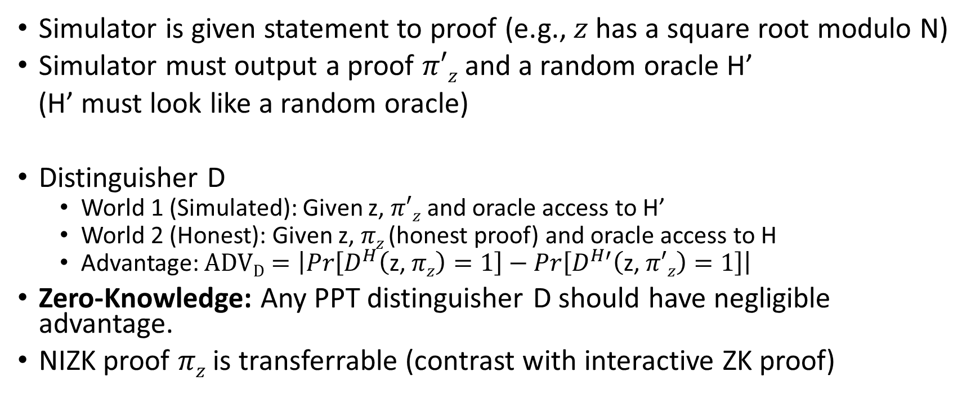
NIZK Security (Random Oracle Model)
Simulator is given statement to proof (e.g., $z$ has a square root modulo N)
Simulator must output a proof $π′z$ and a random oracle H’
(H’ must look like a random oracle)
Distinguisher D
  World 1 (Simulated): Given z, $π′z$ and oracle access to H’
  World 2 (Honest): Given z, $πz$(honest proof) and oracle access to H
  Advantage: $ADVD=\left|Pr\left[D^{H}\left(\text{z}\text{, }πz\right)=1\right]−Pr\left[D^{H′}\left(\text{z}\text{, }π′z\right)=1\right]\right|$
Zero-Knowledge: Any PPT distinguisher D should have negligible advantage.
NIZK proof $πz$ is transferrable (contrast with interactive ZK proof)

Slide 14
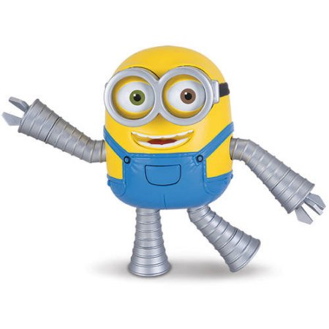
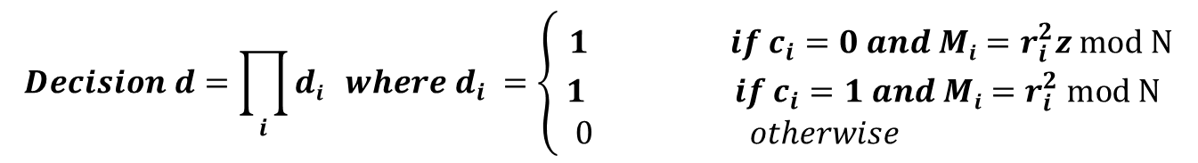
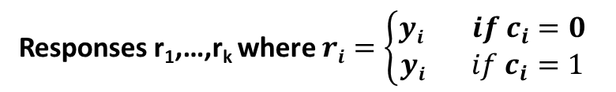
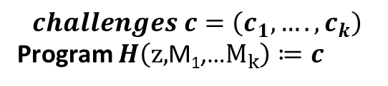
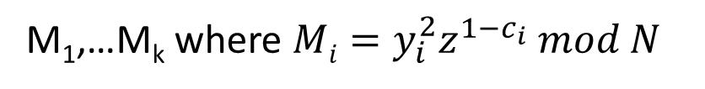
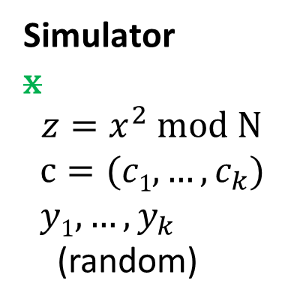
Non-Interactive Zero-Knowledge Proof (NIZK)
M₁,…M_{k} where $Mi=y_{i}^{2}z^{{1−c}_{i}} mod N$
$$challenges c=\left(c_{1},….,c_{k}\right)$$
Program $H\left(\text{z}\text{,}\text{M}\text{1}\text{,…}M_{k}\right)≔c$
Responses r₁,…,r_{k} where $ri=\left\{\begin{aligned}yi if c_{i}=0 \\ yi if c_{i}=1\end{aligned}\right.$
Bob (verifier);
$$z$$
Simulator
x
$${z=x}^{2} mod N$$
$c=(c1,…,c_{k})$
$y1,…,y_{k}$
(random)
$$Decision d=\prod_{i}{di} where d_{i} =\left\{ \begin{aligned}1 if c_{i}=0 and Mi=r_{i}^{2}z mod N \\ 1 if c_{i}=1 and Mi=r_{i}^{2} mod N \\ 0 otherwise \end{aligned}\right.$$
Simulator Power: Can program the random oracle

Slide 15
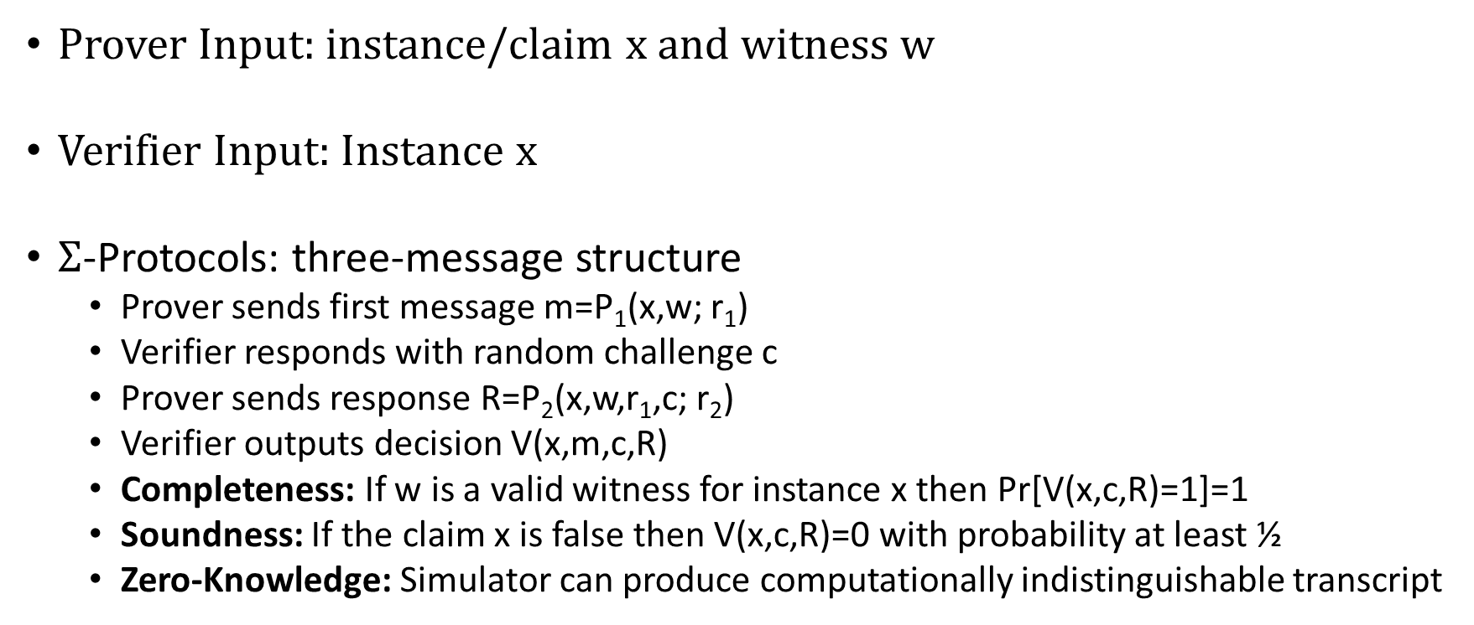
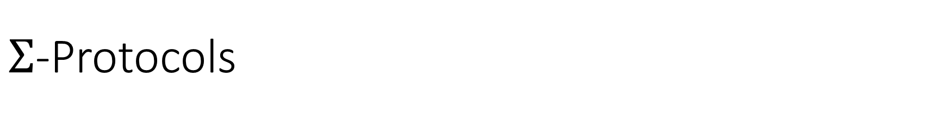
$Σ$-Protocols
Prover Input: instance/claim x and witness w
Verifier Input: Instance x
$Σ$-Protocols: three-message structure
  Prover sends first message m=P₁(x,w; r₁)
  Verifier responds with random challenge c
  Prover sends response R=P₂(x,w,r₁,c; r₂)
  Verifier outputs decision V(x,m,c,R)
  Completeness: If w is a valid witness for instance x then Pr[V(x,c,R)=1]=1
  Soundness: If the claim x is false then V(x,c,R)=0 with probability at least ½
  Zero-Knowledge: Simulator can produce computationally indistinguishable transcript

Slide 16
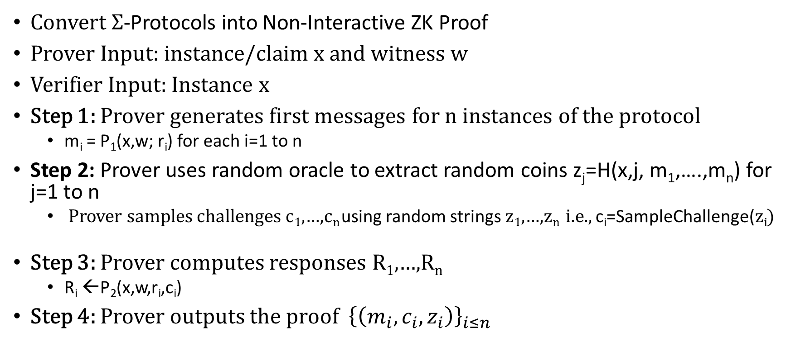
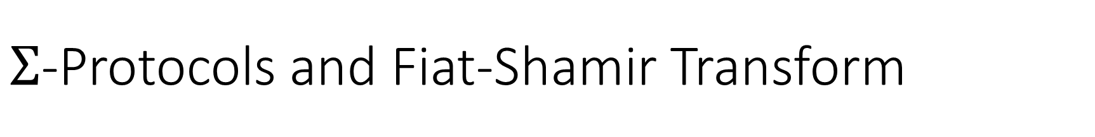
$Σ$-Protocols and Fiat-Shamir Transform
Convert $Σ$-Protocols into Non-Interactive ZK Proof
Prover Input: instance/claim x and witness w
Verifier Input: Instance x
Step 1: Prover generates first messages for n instances of the protocol
  m_{i} = P₁(x,w; r_{i}) for each i=1 to n
Step 2: Prover uses random oracle to extract random coins z_{j}=H(x,j, m₁,….,m_{n}) for j=1 to n
  Prover samples challenges c₁,…,c_{n} using random strings z₁,…,z_{n} i.e., c_{i}=SampleChallenge(z_{i})
Step 3: Prover computes responses R₁,…,R_{n}
  R_{i} ←P₂(x,w,r_{i},c_{i})
Step 4: Prover outputs the proof ${\left\{\left(m_{i},c_{i},z_{i}\right)\right\}}_{i≤n}$

Slide 17
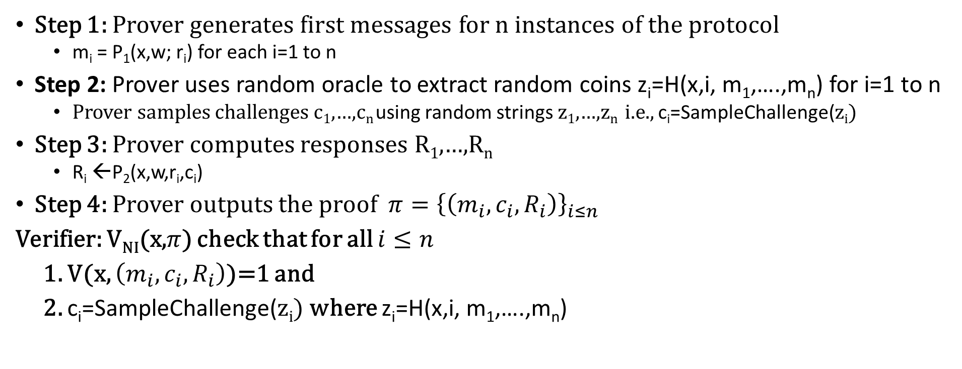
$Σ$-Protocols and Fiat-Shamir Transform
Step 1: Prover generates first messages for n instances of the protocol
  m_{i} = P₁(x,w; r_{i}) for each i=1 to n
Step 2: Prover uses random oracle to extract random coins z_{i}=H(x,i, m₁,….,m_{n}) for i=1 to n
  Prover samples challenges c₁,…,c_{n} using random strings z₁,…,z_{n} i.e., c_{i}=SampleChallenge(z_{i})
Step 3: Prover computes responses R₁,…,R_{n}
  R_{i} ←P₂(x,w,r_{i},c_{i})
Step 4: Prover outputs the proof ${π=\left\{\left(m_{i},c_{i},R_{i}\right)\right\}}_{i≤n}$
Verifier: V_{NI}(x,$π$) check that for all $i≤n$
1. V(x, $\left(m_{i},c_{i},R_{i}\right)$)=1 and
2. c_{i}=SampleChallenge(z_{i}) where z_{i}=H(x,i, m₁,….,m_{n})

Slide 18
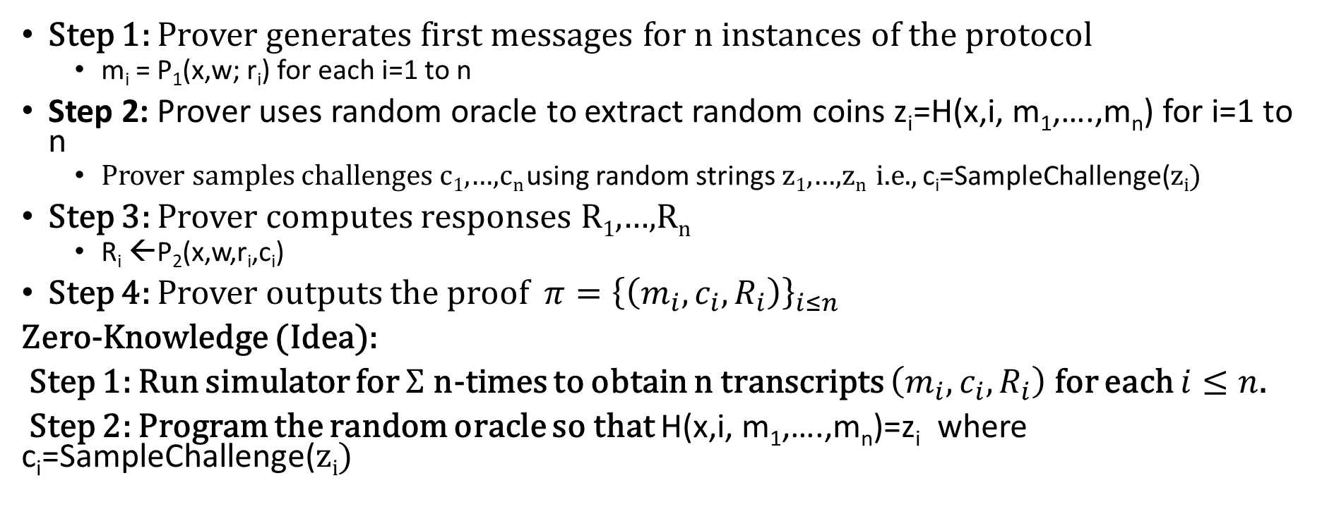
$Σ$-Protocols and Fiat-Shamir Transform
Step 1: Prover generates first messages for n instances of the protocol
  m_{i} = P₁(x,w; r_{i}) for each i=1 to n
Step 2: Prover uses random oracle to extract random coins z_{i}=H(x,i, m₁,….,m_{n}) for i=1 to n
  Prover samples challenges c₁,…,c_{n} using random strings z₁,…,z_{n} i.e., c_{i}=SampleChallenge(z_{i})
Step 3: Prover computes responses R₁,…,R_{n}
  R_{i} ←P₂(x,w,r_{i},c_{i})
Step 4: Prover outputs the proof ${π=\left\{\left(m_{i},c_{i},R_{i}\right)\right\}}_{i≤n}$
Zero-Knowledge (Idea):
Step 1: Run simulator for $Σ$ n-times to obtain n transcripts $\left(m_{i},c_{i},R_{i}\right)$ for each $i≤n$.
Step 2: Program the random oracle so that H(x,i, m₁,….,m_{n})=z_{i} where c_{i}=SampleChallenge(z_{i})

Slide 19
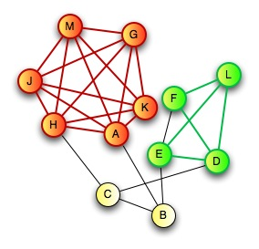
Zero-Knowledge Proof for all NP
CLIQUE
  Input: Graph G=(V,E) and integer k>0
  Question: Does G have a clique of size k?
CLIQUE is NP-Complete
  Any problem in NP reduces to CLIQUE
  A zero-knowledge proof for CLIQUE yields proof for all of NP via reduction
Prover:
  Knows k vertices v₁,…,v_{k} in G=(V,E) that form a clique

Slide 20

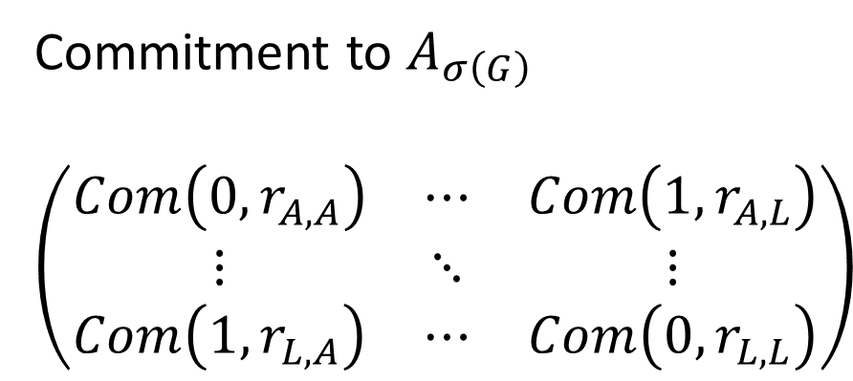
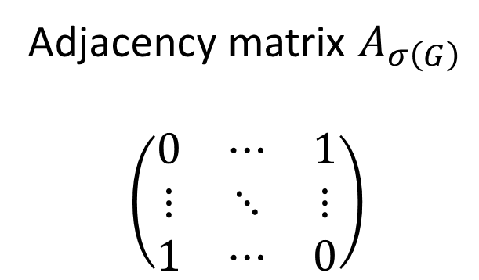
Zero-Knowledge Proof for all NP
C
D
$$σ\left(G\right)$$
E
H
G
A
F
B
J
I
L
K
Commitment to $A_{σ\left(G\right)}$
$$\left(\begin{matrix}Com\left(0,r_{A,A}\right) & ⋯ & Com\left(1,r_{A,L}\right) \\ ⋮ & ⋱ & ⋮ \\ Com\left(1,r_{L,A}\right) & ⋯ & Com\left(0,r_{L,L}\right)\end{matrix}\right)$$
Adjacency matrix $A_{σ\left(G\right)}$
$$\left(\begin{matrix}0 & ⋯ & 1 \\ ⋮ & ⋱ & ⋮ \\ 1 & ⋯ & 0\end{matrix}\right)$$
A
L
A
L
A
A
L
L

Slide 21
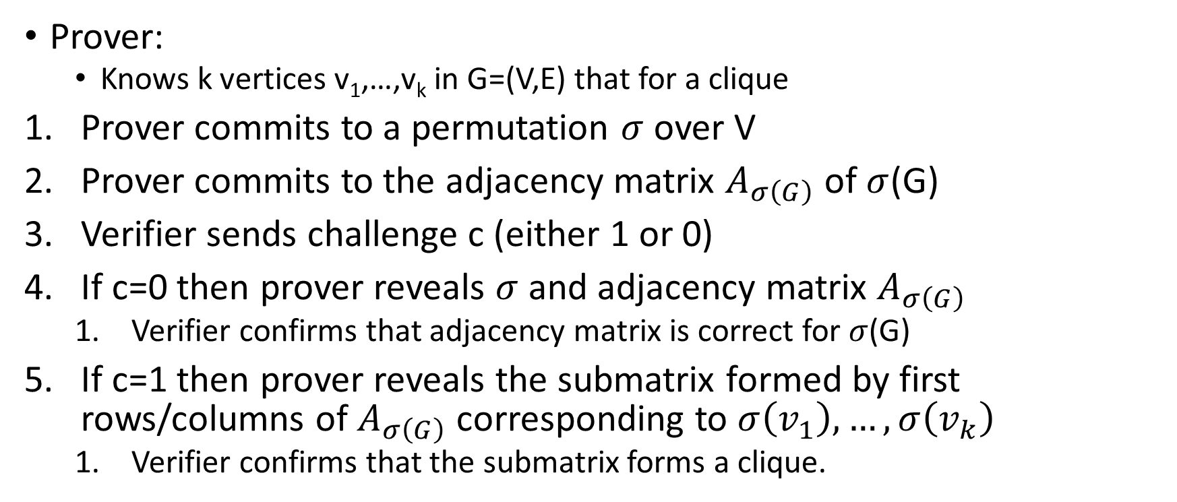
Zero-Knowledge Proof for all NP
C
D
E
H
G
A
F
B
J
Prover:
  Knows k vertices v₁,…,v_{k} in G=(V,E) that for a clique
Prover commits to a permutation $σ$ over V
Prover commits to the adjacency matrix $A_{σ\left(G\right)}$ of $σ$(G)
Verifier sends challenge c (either 1 or 0)
If c=0 then prover reveals $σ$ and adjacency matrix $A_{σ\left(G\right)}$
  Verifier confirms that adjacency matrix is correct for $σ$(G)
If c=1 then prover reveals the submatrix formed by first rows/columns of $A_{σ\left(G\right)}$ corresponding to $σ\left(v_{1}\right),…,σ\left(v_{k}\right)$
  Verifier confirms that the submatrix forms a clique.
I
L
K

Slide 22
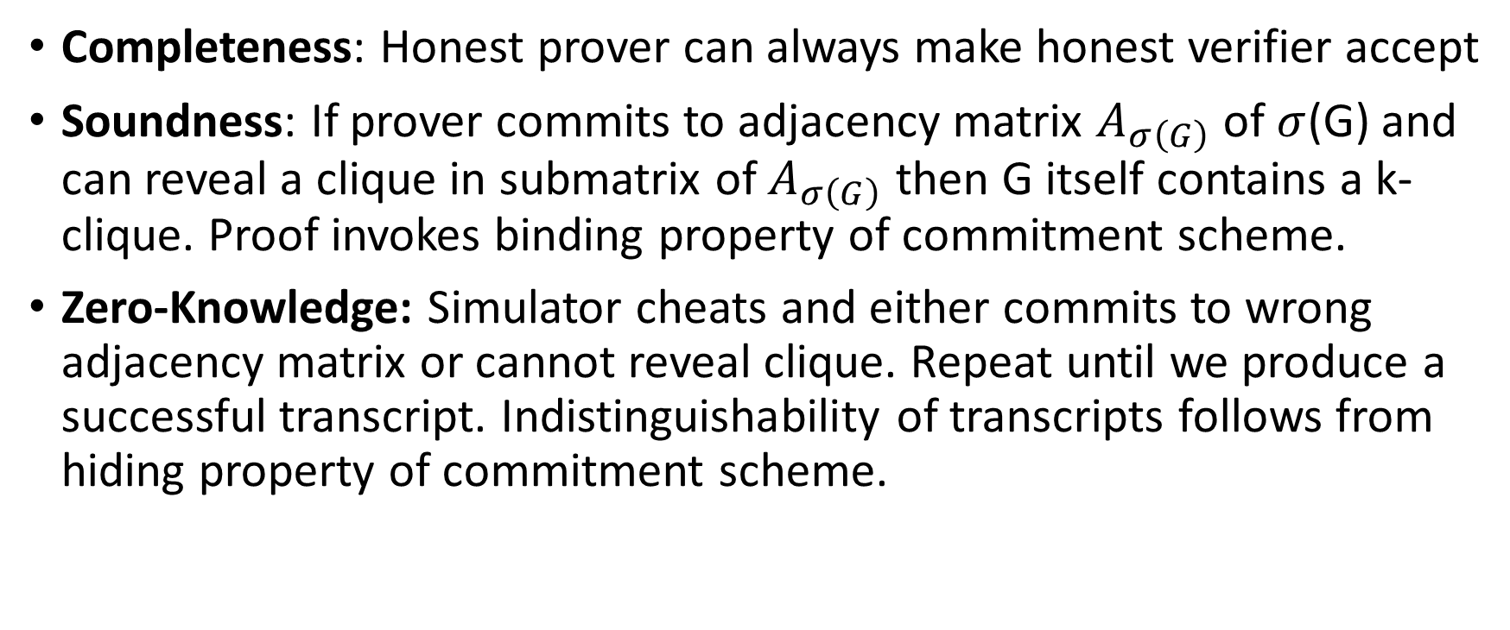
Zero-Knowledge Proof for all NP
Completeness: Honest prover can always make honest verifier accept
Soundness: If prover commits to adjacency matrix $A_{σ\left(G\right)}$ of $σ$(G) and can reveal a clique in submatrix of $A_{σ\left(G\right)}$ then G itself contains a k-clique. Proof invokes binding property of commitment scheme.
Zero-Knowledge: Simulator cheats and either commits to wrong adjacency matrix or cannot reveal clique. Repeat until we produce a successful transcript. Indistinguishability of transcripts follows from hiding property of commitment scheme.

Slide 23
Secure Multiparty Computation (Adversary Models)
Semi-Honest (“honest, but curious”)
  All parties follow protocol instructions, but…
  dishonest parties may be curious to violate privacy of others when possible
Fully Malicious Model
  Adversarial Parties may deviate from the protocol arbitrarily
    Quit unexpectedly
    Send different messages
  It is much harder to achieve security in the fully malicious model
Convert Secure Semi-Honest Protocol into Secure Protocol in Fully Malicious Mode?
  Tool: Zero-Knowledge Proofs
  Prove: My behavior in the protocol is consistent with honest party

Slide 24
Reminder: Course Feedback
Course Summary
Course Code | Course Title | Survey Start Date | Survey End Date | Report Access Start | Response Rate
wl.202120.CS.55500.FNY.18101 | Cryptography | 4/19/2021 9:00 AM | 5/2/2021 11:59 PM | 5/12/2021 12:00 AM | 50.00% (4/8)
If you haven’t already please complete your course evaluation before Sunday at 11:59PM.
What did you like about the course? What could be improved? Let me know! Your feedback is valuable and I carefully read through any comments after the semester is over.
Thanks to everyone who already completed there course evaluation!
Your feedback is anonymous and will not impact your grade (I cannot view your feedback until after grades are entered).

Slide 25
Announcements
Quiz 6: Due tomorrow (4/28) at 11:59PM
Homework 5: Due Thursday (4/29) at 11:59PM
Late submissions allowed up until Friday (3/30) at 11:59PM
We plan to release the solutions on Saturday
Final Exam: Monday, May 3 at 10:30 AM
Location: FRNY B124 (right here!)
Time: 10:30AM – 12:30PM
(Practice Final Exam on Piazza. Solutions released soon!)

Slide 26
Final Exam
Cumulative, but will focus a bit more heavily on topics from the second half of the semester
You are allowed to prepare one page (8.5x11) of handwritten notes. Double sided
Practice Exam on Piazza
  The real final will be shorter
  The real exam will have more short answer questions

Slide 27
CS 555:Week 15: Hot Topics

Slide 28
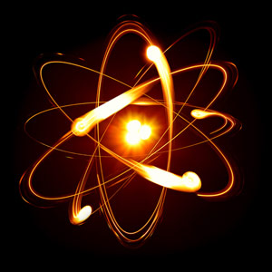
Shor’s Algorithm
Quantum Algorithm to Factor Integers
Running Time
O((log N)²(log log N)(log log log N))
Building Quantum Circuits is challenging, but...
RSA is broken if we build a quantum computer
  Current record: Factor 21=3x7 with Shor’s Algorithm
  Source: Experimental Realisation of Shor’s Quatum Factoring Algorithm Using Quibit Recycling (https://arxiv.org/pdf/1111.4147.pdf)
https://en.wikipedia.org/wiki/Shor%27s_algorithm

Slide 29
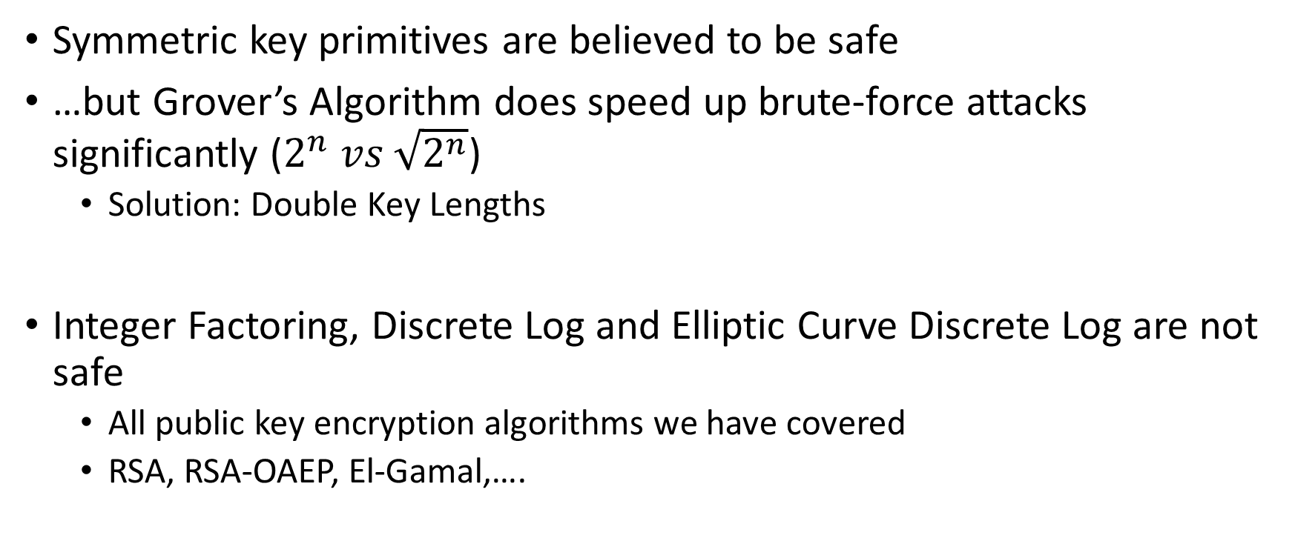
Quantum Resistant Crypto
Symmetric key primitives are believed to be safe
…but Grover’s Algorithm does speed up brute-force attacks significantly ($2^{n} vs \sqrt{2^{n}}$)
  Solution: Double Key Lengths
Integer Factoring, Discrete Log and Elliptic Curve Discrete Log are not safe
  All public key encryption algorithms we have covered
  RSA, RSA-OAEP, El-Gamal,….
https://en.wikipedia.org/wiki/Lattice-based_cryptography

Slide 30
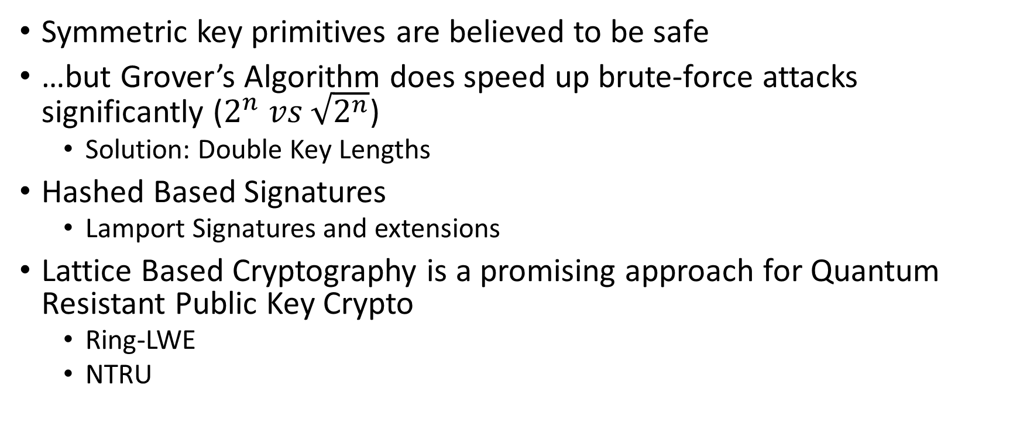
Post Quantum Cryptography
Symmetric key primitives are believed to be safe
…but Grover’s Algorithm does speed up brute-force attacks significantly ($2^{n} vs \sqrt{2^{n}}$)
  Solution: Double Key Lengths
Hashed Based Signatures
  Lamport Signatures and extensions
Lattice Based Cryptography is a promising approach for Quantum Resistant Public Key Crypto
  Ring-LWE
  NTRU
https://security.googleblog.com/2016/07/experimenting-with-post-quantum.html

Slide 31
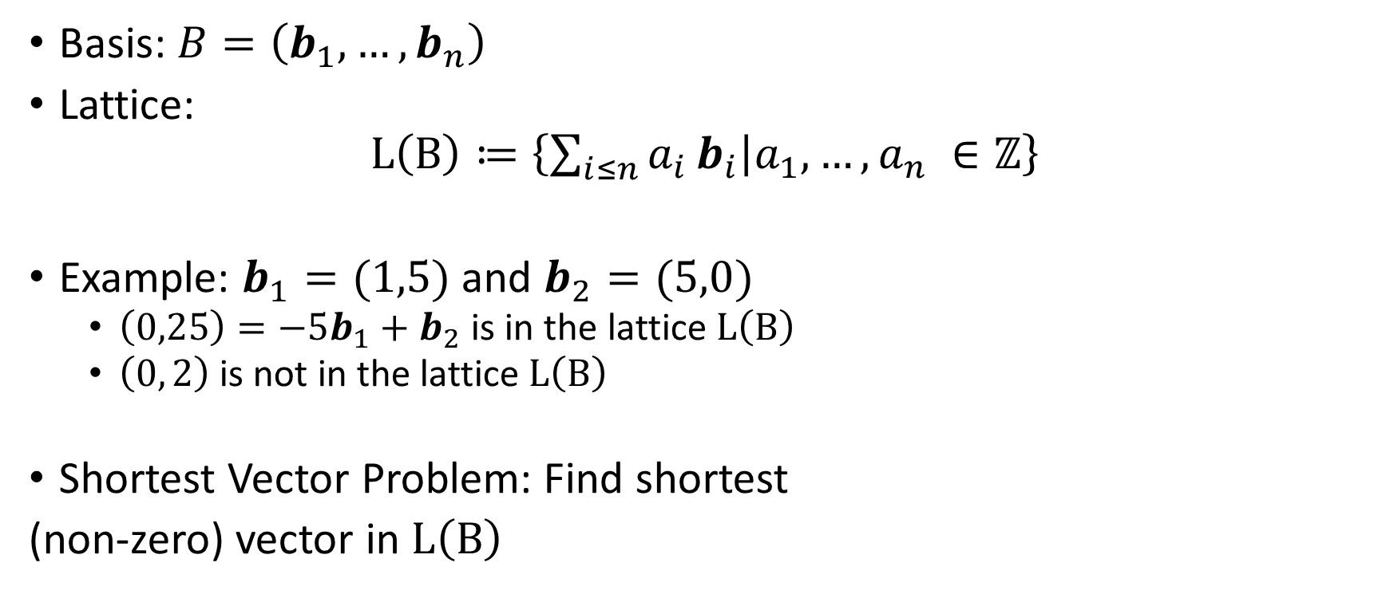
Lattices
Each $b_{i}$ is a vector $b_{i}∈ℝ^{n}$ , $span\left(b_{1},…,b_{n}\right)=ℝ^{n}$
Basis: $B=\left(b_{1},…,b_{n}\right)$
Lattice:
$$L\left(B\right)≔\left\{\sum_{i≤n}{a_{i}}b_{i} | a_{1},…,a_{n} ∈ℤ\right\}$$
Example: $b_{1}=(1,5)$ and $b_{2}=(5,0)$
  $\left(0,25\right)=−5b_{1}+b_{2}$ is in the lattice $L\left(B\right)$
  $\left(0, 2\right)$ is not in the lattice $L\left(B\right)$
Shortest Vector Problem: Find shortest
(non-zero) vector in $L\left(B\right)$
integers
Usually defined using Euclidean Norm

Slide 32
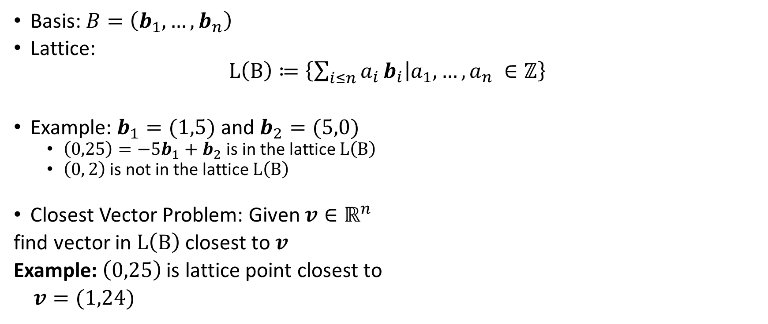
Lattices
Each $b_{i}$ is a vector $b_{i}∈ℝ^{n}$ , $span\left(b_{1},…,b_{n}\right)=ℝ^{n}$
Basis: $B=\left(b_{1},…,b_{n}\right)$
Lattice:
$$L\left(B\right)≔\left\{\sum_{i≤n}{a_{i}}b_{i} | a_{1},…,a_{n} ∈ℤ\right\}$$
Example: $b_{1}=(1,5)$ and $b_{2}=(5,0)$
  $\left(0,25\right)=−5b_{1}+b_{2}$ is in the lattice $L\left(B\right)$
  $\left(0, 2\right)$ is not in the lattice $L\left(B\right)$
Closest Vector Problem: Given $v∈ℝ^{n}$
find vector in $L\left(B\right)$ closest to $v$
Example: $\left(0,25\right)$ is lattice point closest to
$v=(1,24)$
integers

Slide 33
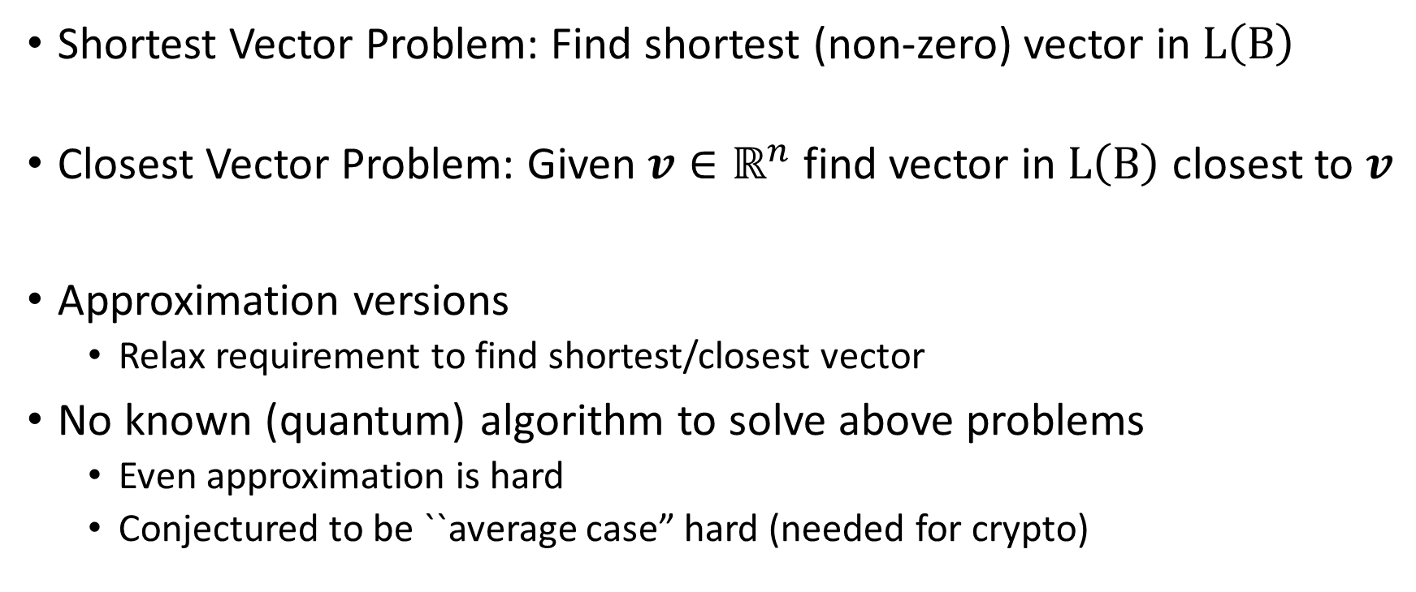
Hard Lattice Problems
Shortest Vector Problem: Find shortest (non-zero) vector in $L\left(B\right)$
Closest Vector Problem: Given $v∈ℝ^{n}$ find vector in $L\left(B\right)$ closest to $v$
Approximation versions
  Relax requirement to find shortest/closest vector
No known (quantum) algorithm to solve above problems
  Even approximation is hard
  Conjectured to be ``average case” hard (needed for crypto)

Slide 34
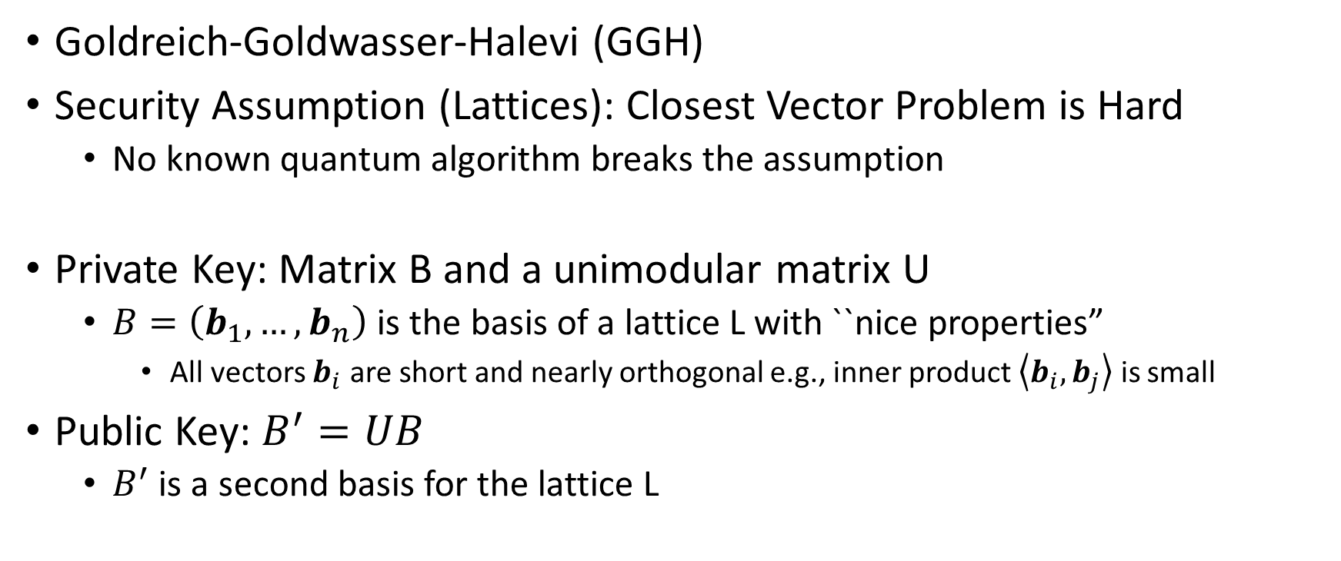
GGH Encryption Scheme
Goldreich-Goldwasser-Halevi (GGH)
Security Assumption (Lattices): Closest Vector Problem is Hard
  No known quantum algorithm breaks the assumption
Private Key: Matrix B and a unimodular matrix U
  $B=\left(b_{1},…,b_{n}\right)$ is the basis of a lattice L with ``nice properties”
    All vectors $b_{i}$ are short and nearly orthogonal e.g., inner product $\left\langle b_{i},b_{j}\right\rangle$ is small
Public Key: $B^{′}=UB$
  $B^{′}$ is a second basis for the lattice L

Slide 35
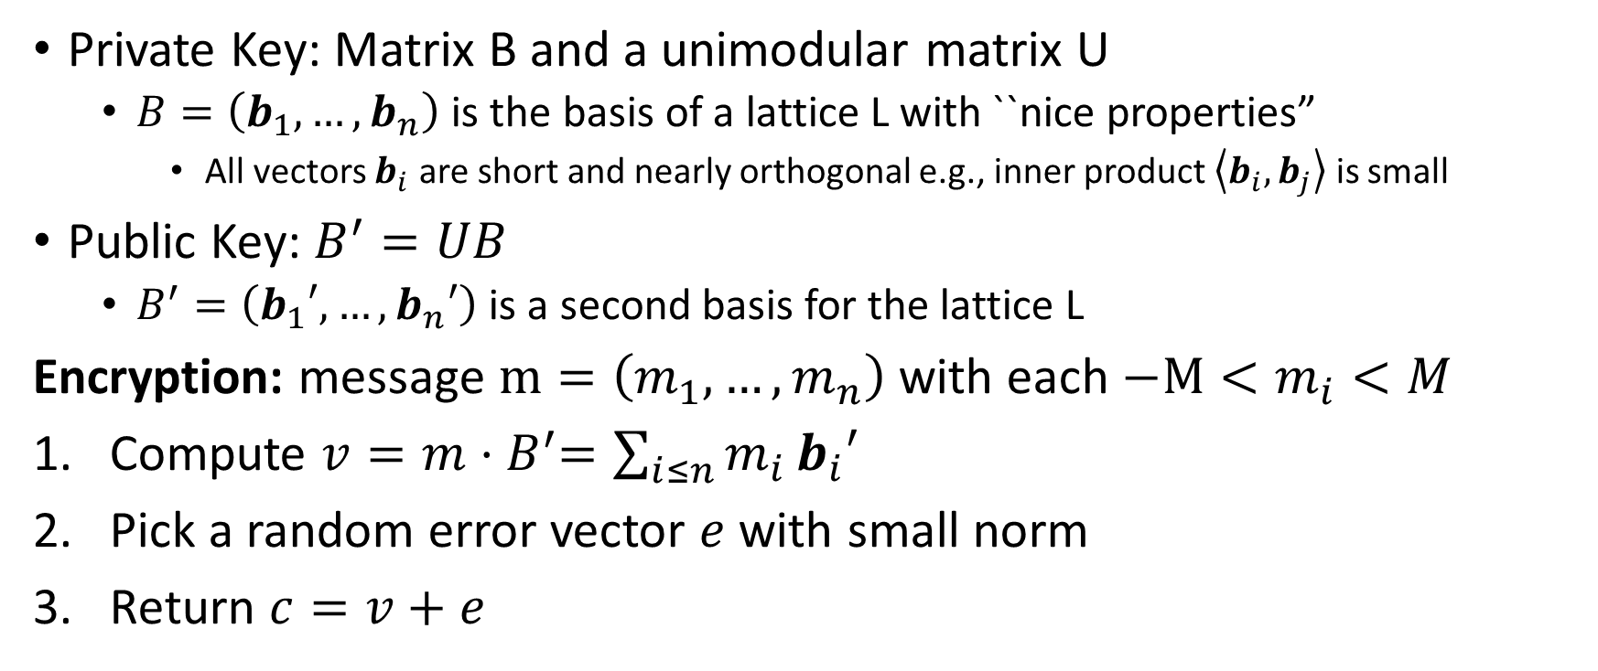
GGH Encryption Scheme
Private Key: Matrix B and a unimodular matrix U
  $B=\left(b_{1},…,b_{n}\right)$ is the basis of a lattice L with ``nice properties”
    All vectors $b_{i}$ are short and nearly orthogonal e.g., inner product $\left\langle b_{i},b_{j}\right\rangle$ is small
Public Key: $B^{′}=UB$
  $B^{′}=\left(b_{1}′,…,b_{n}′\right)$ is a second basis for the lattice L
Encryption: message $m=\left(m_{1},…,m_{n}\right)$ with each $−M<m_{i}<M$
Compute $v=m{⋅B}^{′}=\sum_{i≤n}{m_{i}}b_{i}′$
Pick a random error vector $e$ with small norm
Return $c=v+e$

Slide 36
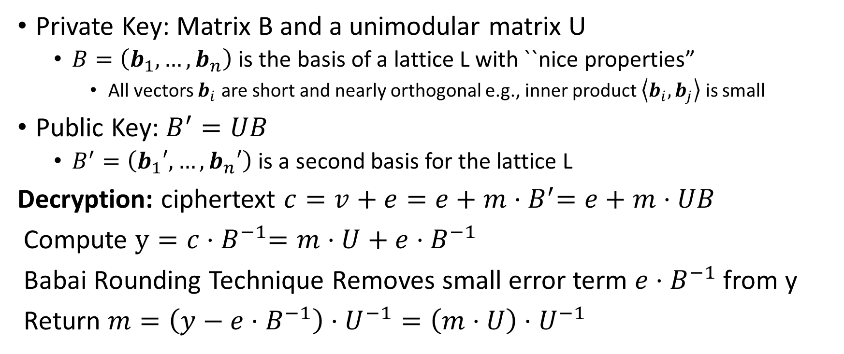
GGH Encryption Scheme
Private Key: Matrix B and a unimodular matrix U
  $B=\left(b_{1},…,b_{n}\right)$ is the basis of a lattice L with ``nice properties”
    All vectors $b_{i}$ are short and nearly orthogonal e.g., inner product $\left\langle b_{i},b_{j}\right\rangle$ is small
Public Key: $B^{′}=UB$
  $B^{′}=\left(b_{1}′,…,b_{n}′\right)$ is a second basis for the lattice L
Decryption: ciphertext $c=v+e=e+m{⋅B}^{′}=e+m⋅UB$
Compute $y=c{⋅B}^{−1}=m⋅U+$ $e{⋅B}^{−1}$
Babai Rounding Technique Removes small error term $e{⋅B}^{−1}$from y
Return $m=\left(y−e{⋅B}^{−1}\right)⋅U^{−1}=\left(m⋅U\right)⋅U^{−1}$

Slide 37
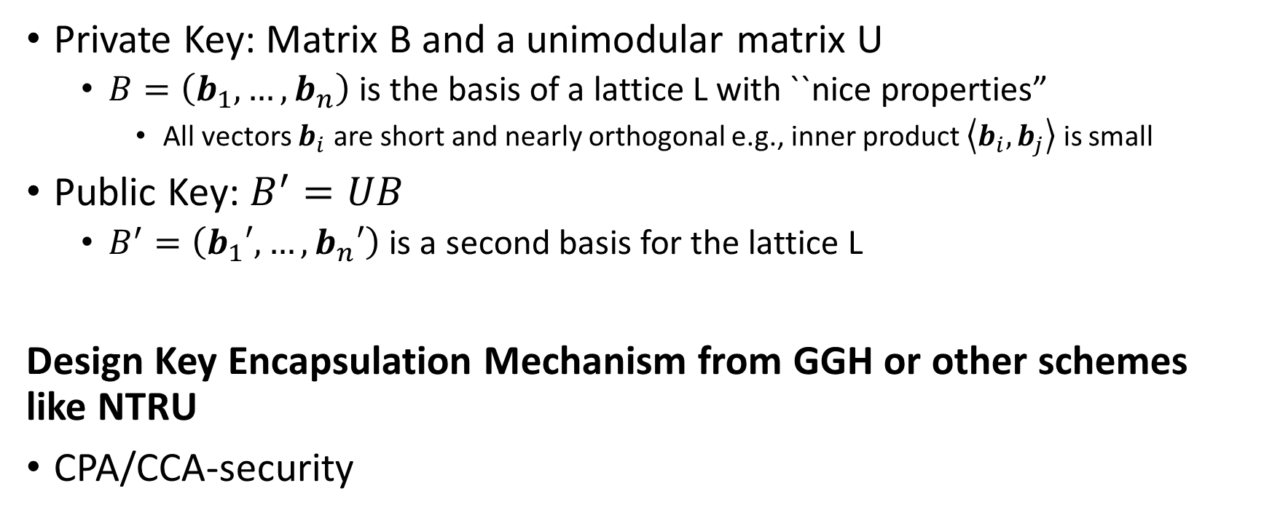
GGH Encryption Scheme
Private Key: Matrix B and a unimodular matrix U
  $B=\left(b_{1},…,b_{n}\right)$ is the basis of a lattice L with ``nice properties”
    All vectors $b_{i}$ are short and nearly orthogonal e.g., inner product $\left\langle b_{i},b_{j}\right\rangle$ is small
Public Key: $B^{′}=UB$
  $B^{′}=\left(b_{1}′,…,b_{n}′\right)$ is a second basis for the lattice L
Design Key Encapsulation Mechanism from GGH or other schemes like NTRU
CPA/CCA-security

Slide 38
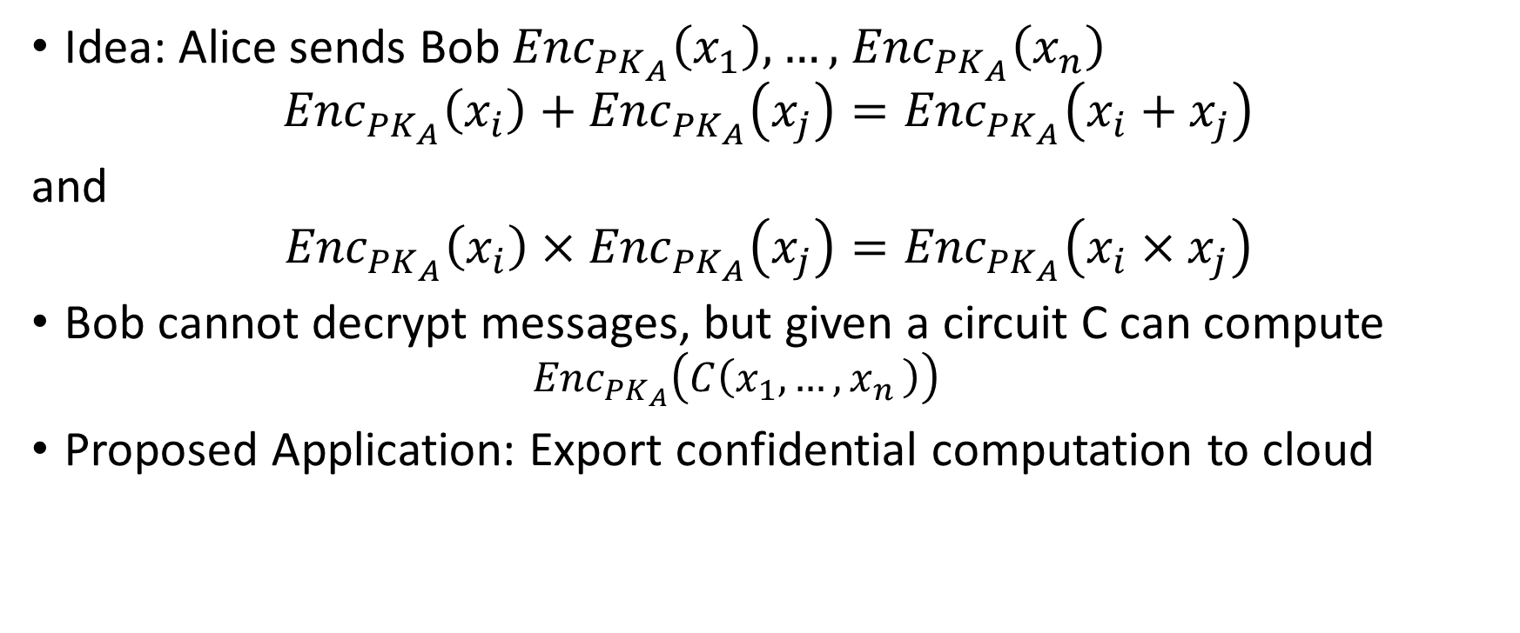
Fully Homomorphic Encryption (FHE)
Idea: Alice sends Bob ${Enc}_{{PK}_{A}}\left(x_{1}\right),…,$ ${Enc}_{{PK}_{A}}\left(x_{n}\right)$
$${Enc}_{{PK}_{A}}\left(x_{i}\right)+{Enc}_{{PK}_{A}}\left(x_{j}\right)={Enc}_{{PK}_{A}}\left(x_{i}+x_{j}\right)$$
and
$${Enc}_{{PK}_{A}}\left(x_{i}\right)×{Enc}_{{PK}_{A}}\left(x_{j}\right)={Enc}_{{PK}_{A}}\left(x_{i}×x_{j}\right)$$
Bob cannot decrypt messages, but given a circuit C can compute
  $${Enc}_{{PK}_{A}}\left(C\left(x_{1},…{,x}_{n}\right)\right)$$
Proposed Application: Export confidential computation to cloud
https://simons.berkeley.edu/talks/shai-halevi-2015-05-18a (Lecture by Shai Halevi)

Slide 39
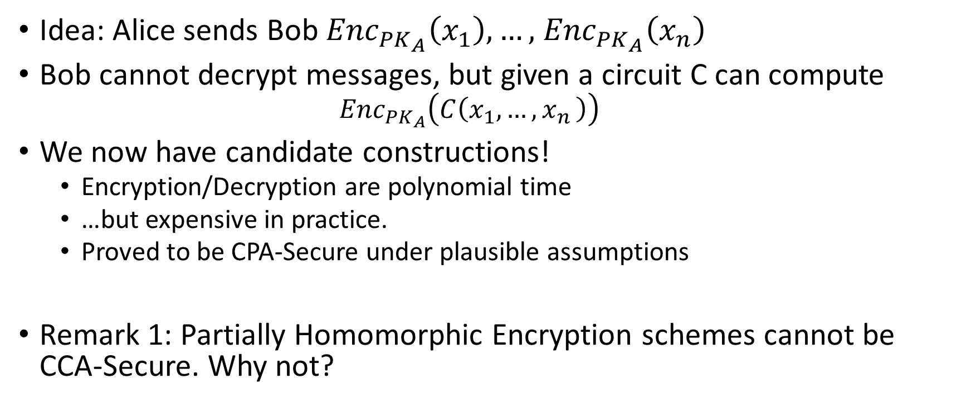
Fully Homomorphic Encryption (FHE)
Idea: Alice sends Bob ${Enc}_{{PK}_{A}}\left(x_{1}\right),…,$ ${Enc}_{{PK}_{A}}\left(x_{n}\right)$
Bob cannot decrypt messages, but given a circuit C can compute
  $${Enc}_{{PK}_{A}}\left(C\left(x_{1},…{,x}_{n}\right)\right)$$
We now have candidate constructions!
  Encryption/Decryption are polynomial time
  …but expensive in practice.
  Proved to be CPA-Secure under plausible assumptions
Remark 1: Partially Homomorphic Encryption schemes cannot be CCA-Secure. Why not?
https://simons.berkeley.edu/talks/shai-halevi-2015-05-18a (Lecture by Shai Halevi)

Slide 40
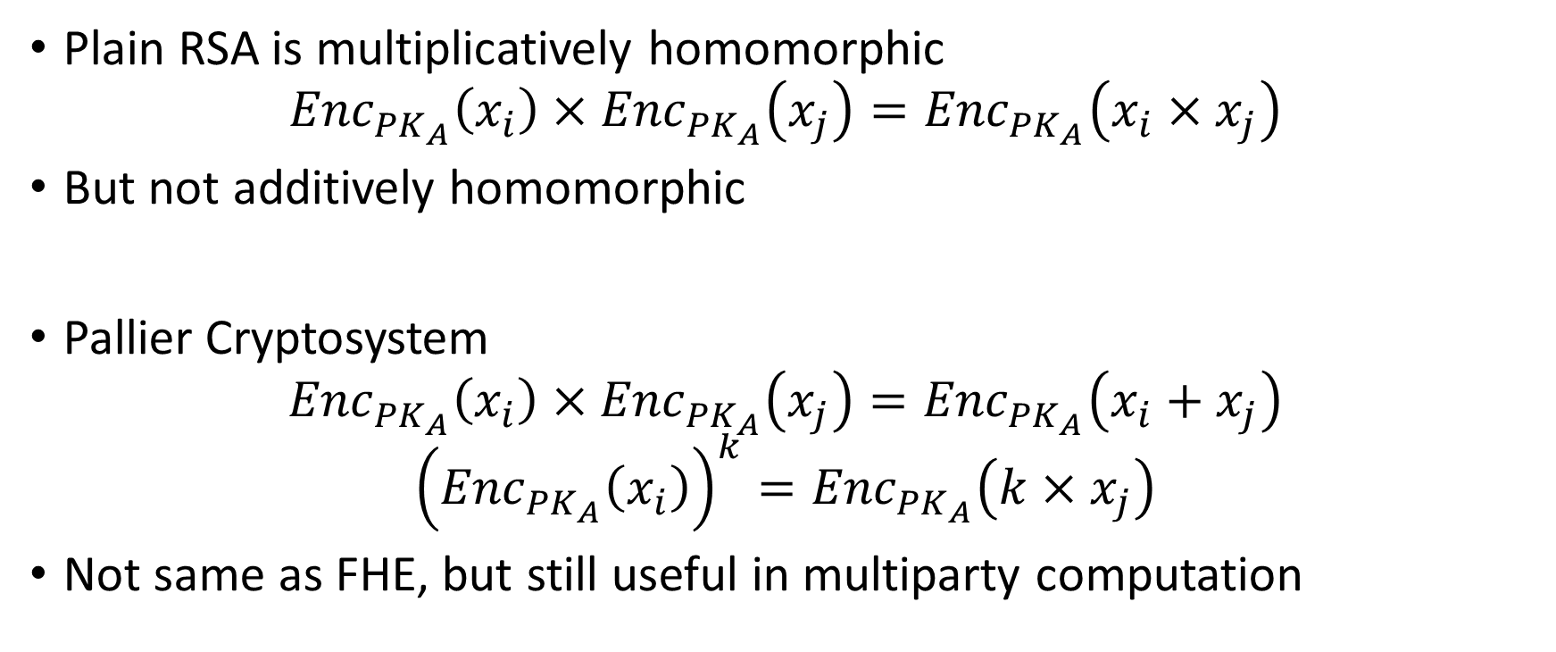
Partially Homomorphic Encryption
Plain RSA is multiplicatively homomorphic
$${Enc}_{{PK}_{A}}\left(x_{i}\right)×{Enc}_{{PK}_{A}}\left(x_{j}\right)={Enc}_{{PK}_{A}}\left(x_{i}×x_{j}\right)$$
But not additively homomorphic
Pallier Cryptosystem
$${Enc}_{{PK}_{A}}\left(x_{i}\right)×{Enc}_{{PK}_{A}}\left(x_{j}\right)={Enc}_{{PK}_{A}}\left(x_{i}+x_{j}\right)$$
$${\left({Enc}_{{PK}_{A}}\left(x_{i}\right)\right)}^{k}={Enc}_{{PK}_{A}}\left(k×x_{j}\right)$$
Not same as FHE, but still useful in multiparty computation
https://en.wikipedia.org/wiki/Paillier_cryptosystem

Slide 41

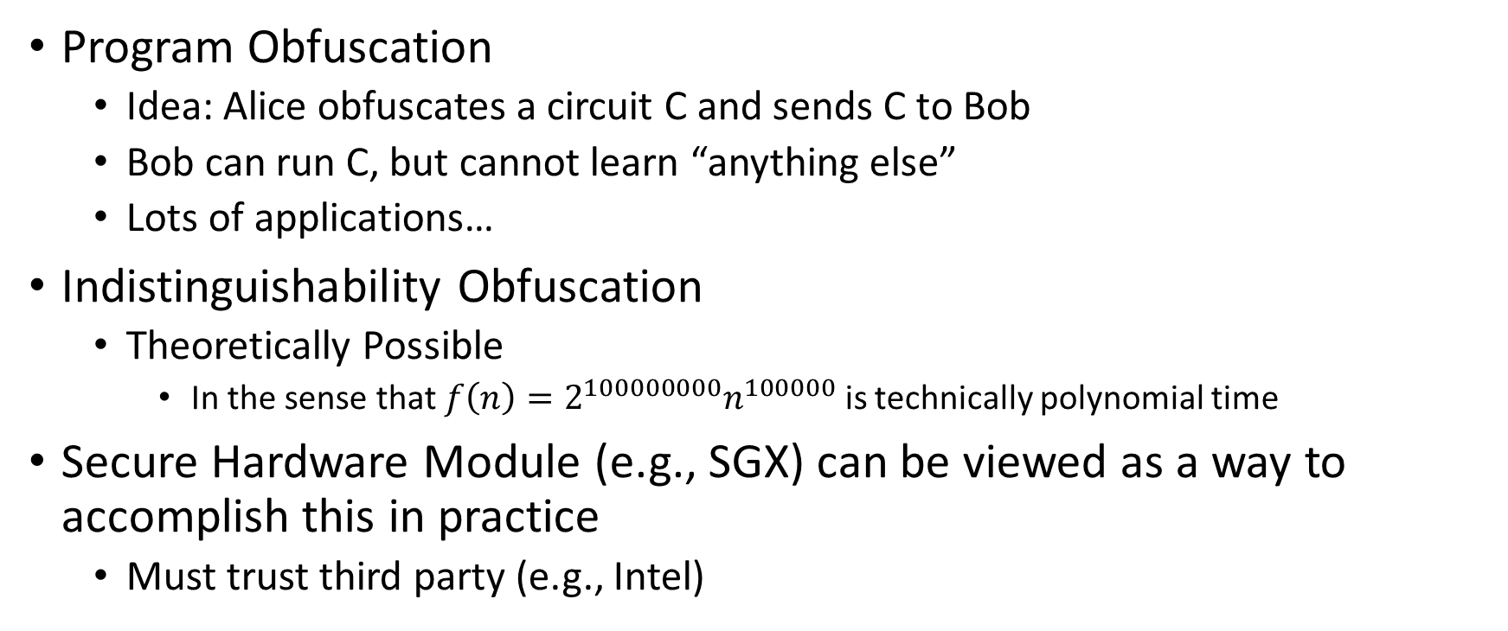
Program Obfuscation (Theoretical Cryptography)
Program Obfuscation
  Idea: Alice obfuscates a circuit C and sends C to Bob
  Bob can run C, but cannot learn “anything else”
  Lots of applications…
Indistinguishability Obfuscation
  Theoretically Possible
    In the sense that $f\left(n\right)=2^{100000000}n^{100000}$ is technically polynomial time
Secure Hardware Module (e.g., SGX) can be viewed as a way to accomplish this in practice
  Must trust third party (e.g., Intel)
https://simons.berkeley.edu/talks/amit-sahai-2015-05-19a (Lecture by Amit Sahai)

Slide 42
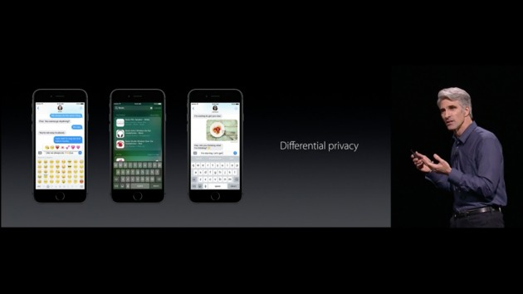



Differential Privacy

Slide 43


Release Aggregate Statistics?
Question 1: How many people in this room have cancer?
Question 2: How many students in this room have cancer?
The difference (A1-A2) exposes my answer!

Slide 44
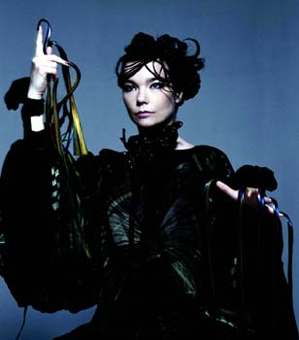
Differential Privacy: Definition
n people
Neighboring datasets:
  Replace x with x’
Name CS Prof? … STD?
Name CS Prof? … STD?
J Blocki +1 … -1
Bjork -1 … ???
[DMNS06, DKMMN06]
D
D’

Slide 45
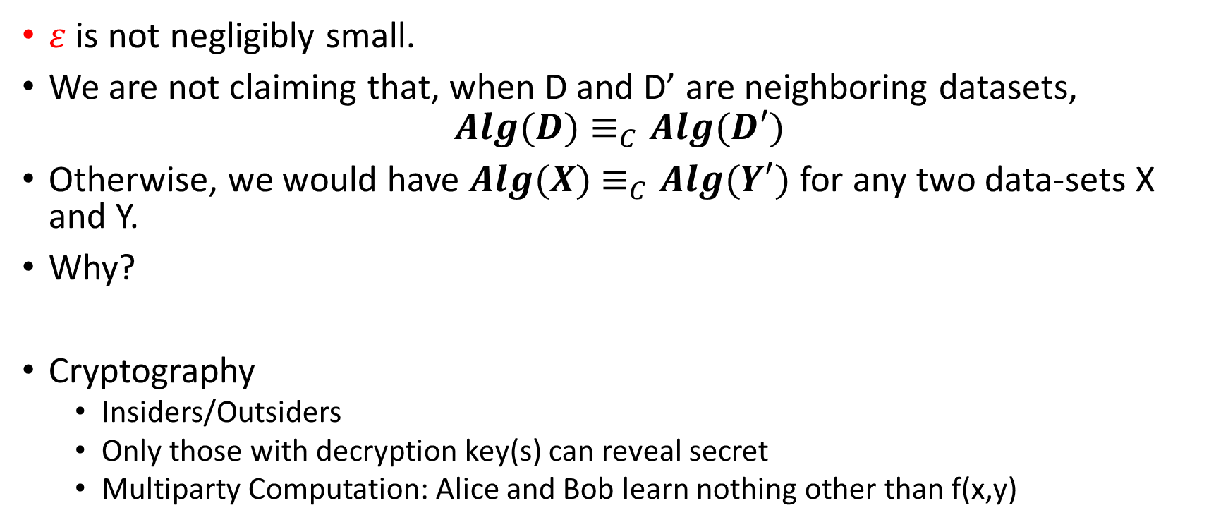
Differential Privacy vs Cryptography
$ε$ is not negligibly small.
We are not claiming that, when D and D’ are neighboring datasets,
$$Alg(D)≡_{C}Alg(D′)$$
Otherwise, we would have $Alg(X)$ $≡_{C}Alg(Y′)$ for any two data-sets X and Y.
Why?
Cryptography
  Insiders/Outsiders
  Only those with decryption key(s) can reveal secret
  Multiparty Computation: Alice and Bob learn nothing other than f(x,y)

Slide 46
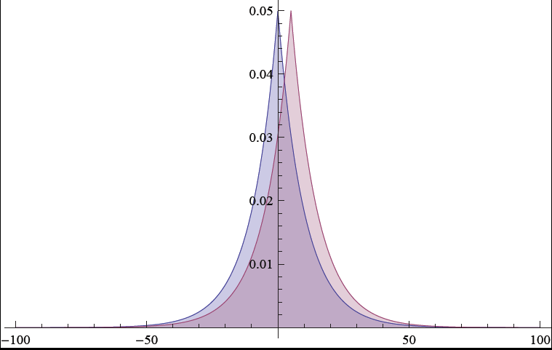
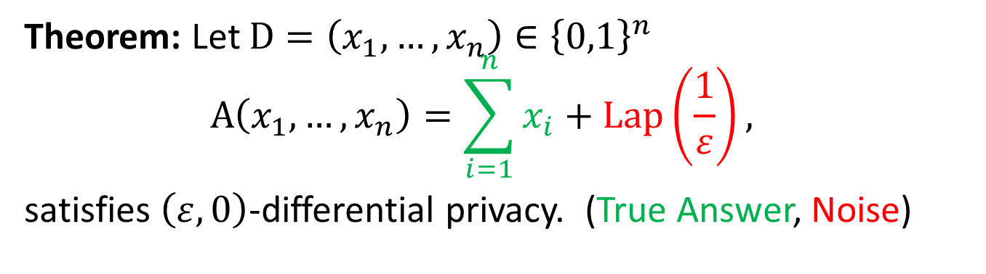
Traditional Differential Privacy Mechanism
Theorem: Let $D=\left(x_{1},…,x_{n}\right)∈{\left\{0,1\right\}}^{n}$
$$A\left(x_{1},…,x_{n}\right)=\sum_{i=1}^{n}{x_{i}}+\operatorname{Lap}\left(\frac{1}{ε}\right),$$
satisfies $\left(ε,0\right)$-differential privacy. (True Answer, Noise)

Slide 47
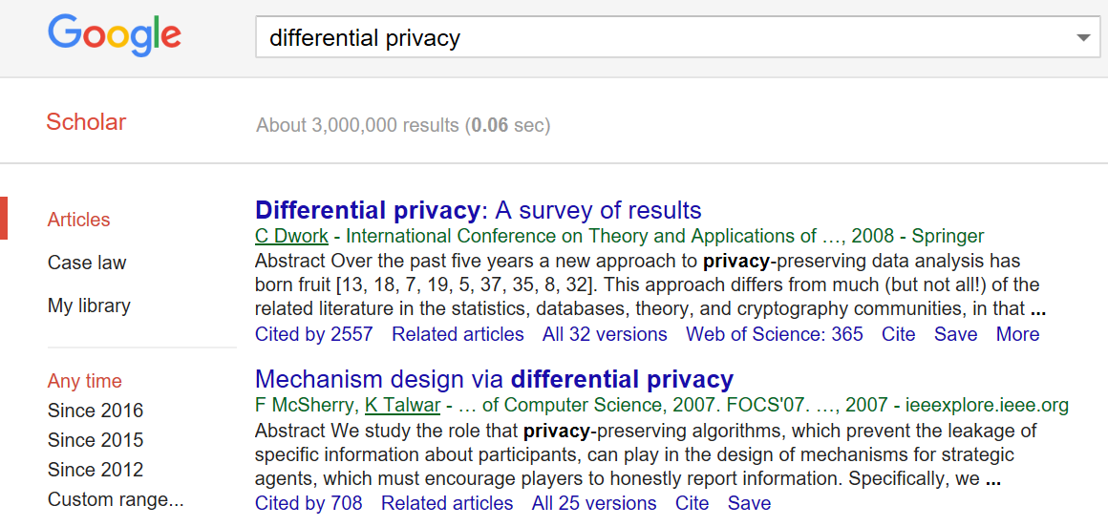
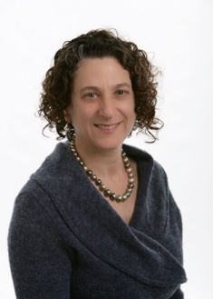


Slide 48



Resources
$99
Free PDF: https://www.cis.upenn.edu/~aaroth/Papers/privacybook.pdf

Slide 49







Password Storage and Key Derivation Functions
jblocki, 123456
Username
jblocki
Salt
89d978034a3f6
Hash
85e23cfe0021f584e3db87aa72630a9a2345c062
SHA1(12345689d978034a3f6)=85e23cfe0021f584e3db87aa72630a9a2345c062
+
Notes:
As a motivating example consider an adversary who breaks into an authentication server and steals a users crptographic hash value. The adversary can execute an offline attack against the password by comparing the hash value with the hashes of likely password guesses. The adversary is limited only by the resources that he is willing to invest cracking the passwords.

Slide 50













Offline Attacks: A Common Problem
Password breaches at major companies have affected millions billions of user accounts.
Notes:
Unfortunately, offline dictionary attacks are quite common. Password breaches at major companies have affected millions of users.

Slide 51

Offline Attacks: A Common Problem
Password breaches at major companies have affected millions billions of user accounts.
Notes:
Unfortunately, offline dictionary attacks are quite common. Password breaches at major companies have affected millions of users.

Slide 52





Goal: Moderately Expensive Hash Function
Fast on PC and
Expensive on ASIC?
Notes:
This motivates the need for moderately hard functions. The basic idea is to build a password hash function that is moderately expensive to compute to limit the number of guesses that an adversary would be willing to try. An honest server only needs to compute the function once during a typical authentication session. However, the adversary potentially has an advantage in this game. While the honest server must typically evaluate the function on standard hardware, the adversary could use potentially reduce the cost per password guess by developing customized hardware (GPUs, FPGAs, ASICs) to evaluate the password hash function. Thus, we want to ensure that the cost to evaluate this function is equitable across platforms.

Slide 53
Attempt 1: Hash Iteration
BCRYPT
PBKDF2
100,000 SHA256 computations
(iterative)
Estimated Cost on ASIC: $1 per billion password guesses [BS14]

Slide 54
The Challenge
Cost SHA256
USD $
Standard Patience Units
User Patience
Time
Disclaimer: This slide is entirely for humorous effect.

Slide 55




Memory Hard Function (MHF)
Intuition: computation costs dominated by memory costs
vs.
Data Independent Memory Hard Function (iMHF)
  Memory access pattern should not depend on input
Notes:
In this work we study a special type of memory hard function called data-independent memory hard functions. As the name suggests the memory access pattern will not depend on the input making the functions resistant to side-channel attacks.

Slide 56

(2013-2015)
https://password-hashing.net/

Slide 57

We recommend that you use Argon2…
(2013-2015)
https://password-hashing.net/

Slide 58
We recommend that you use Argon2…
There are two main versions of Argon2, Argon2i and Argon2d. Argon2i is the safest against side-channel attacks
(2013-2015)
https://password-hashing.net/

Slide 59

Depth-Robustness: The Key Property
Necessary [AB16] and sufficient [ABP16] for secure iMHFs

Slide 60

Question
Are existing iMHF candidates based on depth-robust DAGs?

Slide 61

Answer: No

Slide 62

Can we build a secure iMHF?
Github: https://github.com/Practical-Graphs/Argon2-Practical-Graph

