Slide 1
Cryptography CS 555
Week 10:
RSA
Attacks on Plain RSA
Discrete Log/DDH
Readings: Katz and Lindell Chapter 8.2-8.3,11.5.1
Spring 2021

Slide 2
Recap
Polynomial time algorithms (in bit lengths $\left\|a\right\|$, $\left\|b\right\|$ and $\left\|N\right\|$) to do important computations on integers
GCD(a,b)
Find multiplicative inverse a⁻¹ of a such that 1=[aa⁻¹ mod N] (if it exists)
PowerMod: [a^{b} mod N]
Draw uniform sample from $ℤ_{N}^{∗}= \left\{x∈ℤN | \gcd\left(N,x\right)=1\right\}$
Fact:$\left[g^{x}mod N\right]=\left[g^{[x mod φ\left(N\right)]}mod N\right]$ where $φ\left(N\right)=\left|ℤ_{N}^{∗}\right|$
Proof: Group Theory
Chinese Remainder Theorem

Slide 3
CS 555: Week 10: Topic 1 Finding Prime Numbers, RSA

Slide 4
Recap
Number Theory Basics
Polynomial Time Operations on Integers
Addition/Subtraction/Multiplication/Division
Exponentiation Modulo N
GCD
Find Modular Inverse of${ x∈ℤ}_{N}^{∗}$
$φ\left(N\right)=\left|ℤ_{N}^{∗}\right|$
Special Case: $φ\left(pq\right)=\left(p−1\right)\left(q−1\right)$ for distinct primes p and q
Key Property: For each ${g∈ℤ}_{N}^{∗}$ and integer $x∈ℕ$ we have
$$\left[g^{x}mod N\right]=\left[g^{[x mod φ\left(N\right)]}mod N\right]$$

Slide 5
RSA Key-Generation
KeyGeneration(1^{n})
Step 1: Pick two random n-bit primes p and q
Step 2: Let N=pq, $φ\left(N\right)=(p−1)(q−1)$
Step 3: …
Question: How do we accomplish step one?

Slide 6
Bertrand’s Postulate
Theorem 8.32. For any n > 1 the fraction of n-bit integers that are prime is at least $1/{3n}$.
GenerateRandomPrime(1^{n})
For i=1 to 3n²:
p’← {0,1}^{n-1}
p← $1\left\|p′\right.$
if isPrime(p) then
return p
return fail
Can we do this in polynomial time?

Slide 7
Bertrand’s Postulate
Theorem 8.32. For any n > 1 the fraction of n-bit integers that are prime is at least $1/{3n}$.
GenerateRandomPrime(1^{n})
For i=1 to 3n²:
p’← {0,1}^{n-1}
p← $1\left\|p′\right.$
if isPrime(p) then
return p
return fail
Assume for now that we can run isPrime(p). What are the odds that the algorithm fails?
On each iteration the probability that p is not a prime is $\left(1−\frac{1}{3n}\right)$
We fail if we pick a non-prime in all 3n² iterations. The probability of failure is at most
$${\left(1−\frac{1}{3n}\right)}^{3n^{2}}={\left({\left(1−\frac{1}{3n}\right)}^{3n}\right)}^{n}≤e^{−n}$$

Slide 8
isPrime(p): Miller-Rabin Test
We can check for primality of p in polynomial time in $\left\|p\right\|$.
Theory: Deterministic algorithm to test for primality.
See breakthrough paper “Primes is in P”
https://www.cse.iitk.ac.in/users/manindra/algebra/primality_v6.pdf
Practice: Miller-Rabin Test (randomized algorithm)
Guarantee 1: If p is prime then the test outputs YES
Guarantee 2: If p is not prime then the test outputs NO (except with negligible probability).

Slide 9
The “Almost” Miller-Rabin Test
Input: Integer N and parameter 1^{t}
Output: “prime” or “composite”
for i=1 to t:
a ← {1,…,N-1}
if $a^{N−1} ≠1 mod N$ then return “composite”
Return “prime”
Claim: If N is prime then algorithm always outputs “prime”
Proof: For any $a∈\text{\{1,…,}\text{N}\text{−1\}}$ we have $a^{N−1}=a^{φ\left(N\right)}=1 mod N$
$φ\left(N\right)=N−1$ for primes N

Slide 10
The “Almost” Miller-Rabin Test
Need a bit of extra work to handle Carmichael numbers (see textbook).
Input: Integer N and parameter 1^{t}
Output: “prime” or “composite”
for i=1 to t:
a ← {1,…,N-1} //random
if $a^{N−1} ≠1 mod N$ then return “composite”
Return “prime”
Fact: If N is composite and not a Carmichael number then the algorithm outputs “composite” with probability
$$1−2^{−t}$$

Slide 11
Miller-Rabin Primality Test
Input: Integer N and parameter 1^{t}
Output: “prime” or “composite”
If Even(N) or PerfectPower(N) return “composite”
Else find $u$ (odd) and $r≥1$ s.t. $N−1=2^{r}u$
for j=1 to t:
pick $a$ in [2,N-2] randomly
if $a^{u}≠±1 mod N$ and $a^{2^{i}u}≠−1 mod N$ for all $1≤ i≤ r−1$
return “composite”
Return “prime”

Slide 12
Miller-Rabin Primality Test
Lemma: If p is prime and
$x^{2}=1 mod p$ then
$$x=±1 mod p$$
Input: Integer N and parameter 1^{t}
Output: “prime” or “composite”
If Even(N) or PerfectPower(N) return “composite”
Else find $u$ (odd) and $r≥1$ s.t. $N−1=2^{r}u$
for j=1 to t:
pick $a$ in [2,N-2] randomly
if $a^{u}≠±1 mod N$ and $a^{2^{i}u}≠−1 mod N$ for all $1≤ i≤ r−1$
return “composite”
Return “prime”

Slide 13
Miller-Rabin Primality Test
If N is prime then:
$${\left(a^{2^{r−1}u}\right)}^{2}=a^{N−1} mod N$$
$=1 mod N$
Input: Integer N and parameter 1^{t}
Output: “prime” or “composite”
If Even(N) or PerfectPower(N) return “composite”
Else find $u$ (odd) and $r≥1$ s.t. $N−1=2^{r}u$
for j=1 to t:
pick $a$ in [2,N-2] randomly
if $a^{u}≠±1 mod N$ and $a^{2^{i}u}≠−1 mod N$ for all $1≤ i≤ r−1$
return “composite”
Return “prime”
$$a^{2^{i}u}−1=\left(a^{2^{i−1}u}−1\right)\left(a^{2^{i−1}u}+1\right)$$

Slide 14
Miller-Rabin Primality Test
Input: Integer N and parameter 1^{t}
Output: “prime” or “composite”
If Even(N) or PerfectPower(N) return “composite”
Else find $u$ (odd) and $r≥1$ s.t. $N−1=2^{r}u$
for j=1 to t:
pick $a$ in [2,N-2] randomly
if $a^{u}≠±1 mod N$ and $a^{2^{i}u}≠−1 mod N$ for all $1≤ i≤ r−1$
return “composite”
Return “prime”
If N is prime we won’t return composite
$$0=\left(a^{2^{r}u}−1\right)=\left(a^{2^{r−1}u}−1\right)\left(a^{2^{r−1}u}+1\right)$$
$$=…=\left(a^{2^{r−2}u}−1\right)\left(a^{2^{r−2}u}+1\right)\left(a^{2^{r−1}u}+1\right)$$
$$a^{2^{i}u}−1=\left(a^{2^{i−1}u}−1\right)\left(a^{2^{i−1}u}+1\right)$$

Slide 15
Miller-Rabin Primality Test
Input: Integer N and parameter 1^{t}
Output: “prime” or “composite”
If Even(N) or PerfectPower(N) return “composite”
Else find $u$ (odd) and $r≥1$ s.t. $N−1=2^{r}u$
for j=1 to t:
pick $a$ in [2,N-2] randomly
if $a^{u}≠±1 mod N$ and $a^{2^{i}u}≠−1 mod N$ for all $1≤ i≤ r−1$
return “composite”
Return “prime”
If N is prime we won’t return composite
$$0=\left(a^{2^{r}u}\right)−1=…=\left(a^{u}−1\right)\prod_{i=0}^{r−1}{\left(a^{2^{i}u}+1\right)}$$
$$a^{2^{i}u}−1=\left(a^{2^{i−1}u}−1\right)\left(a^{2^{i−1}u}+1\right)$$

Slide 16
Miller-Rabin Primality Test
One of these factors must be 0 (mod N)
Input: Integer N and parameter 1^{t}
Output: “prime” or “composite”
If Even(N) or PerfectPower(N) return “composite”
Else find $u$ (odd) and $r≥1$ s.t. $N−1=2^{r}u$
for j=1 to t:
pick $a$ in [2,N-2] randomly
if $a^{u}≠±1 mod N$ and $a^{2^{i}u}≠−1 mod N$ for all $1≤ i≤ r−1$
return “composite”
Return “prime”
If N is prime we won’t return composite
$$0=\left(a^{2^{r}u}\right)−1=…=\left(a^{u}−1\right)\prod_{i=0}^{r−1}{\left(a^{2^{i}u}+1\right)}$$
$$a^{2^{i}u}−1=\left(a^{2^{i−1}u}−1\right)\left(a^{2^{i−1}u}+1\right)$$

Slide 17
Miller-Rabin Primality Test
If N is prime then:
$${\left(a^{2^{r−1}u}\right)}^{2}=a^{N−1} mod N$$
$=1 mod N$
Input: Integer N and parameter 1^{t}
Output: “prime” or “composite”
If Even(N) or PerfectPower(N) return “composite”
Else find $u$ (odd) and $r≥1$ s.t. $N−1=2^{r}u$
for j=1 to t:
if $a^{u}≠±1 mod N$ and $a^{2^{i}u}≠−1 mod N$ for all $1≤ i≤ r−1$
return “composite”
Return “prime”
One of the factors must be 0 (mod N)
If N is prime we won’t return composite
$$0=\left(a^{2^{r}u}\right)−1=…=\left(a^{u}−1\right)\prod_{i=0}^{r−1}{\left(a^{2^{i}u}+1\right)}$$

Slide 18
Miller-Rabin Primality Test
Input: Integer N and parameter 1^{t}
Output: “prime” or “composite”
If Even(N) or PerfectPower(N) return “composite”
Else find $u$ (odd) and $r≥1$ s.t. $N−1=2^{r}u$
for j=1 to t:
if $a^{u}≠±1 mod N$ and $a^{2^{i}u}≠−1 mod N$ for all $1≤ i≤ r−1$
return “composite”
Return “prime”
Claim: If N is composite then at most ¼ choices of random value a in [2,n-1] will pass the test

Slide 19
Miller-Rabin Primality Test
Input: Integer N and parameter 1^{t}
Output: “prime” or “composite”
If Even(N) or PerfectPower(N) return “composite”
Else find $u$ (odd) and $r≥1$ s.t. $N−1=2^{r}u$
for j=1 to t:
if $a^{u}≠±1 mod N$ and $a^{2^{i}u}≠−1 mod N$ for all $1≤ i≤ r−1$
return “composite”
Return “prime”
Claim: If N is composite then we return prime with probability at most $4^{−t}$
Proof: (See textbook ☺)

Slide 20
Back to RSA Key-Generation
KeyGeneration(1^{n})
Step 1: Pick two random n-bit primes p and q
Step 2: Let N=pq, $φ\left(N\right)=(p−1)(q−1)$
Step 3: Pick e > 1 such that gcd(e, $φ\left(N\right)$)=1
Step 4: Set d=[e⁻¹ mod $φ\left(N\right)$] (secret key)
Return: N, e, d
How do we find d?
Answer: Use extended gcd algorithm to find e⁻¹mod $φ\left(N\right)$.

Slide 21
Back to RSA Key-Generation
KeyGeneration(1^{n})
Step 1: Pick two random n-bit primes p and q
Step 2: Let N=pq, $φ\left(N\right)=(p−1)(q−1)$
Step 3: Pick e > 1 such that gcd(e, $φ\left(N\right)$)=1
Step 4: Set d=[e⁻¹ mod $φ\left(N\right)$] (secret key)
Return: N, e, d
What is the probability that e⁻¹mod $φ\left(N\right)$ exists when we pick e randomly?
Hint: $φ\left(φ\left(N\right)\right)$ choices of e in $ℤ_{φ\left(N\right)}^{}$ have a multiplicative inverse mod $φ\left(N\right)$.

Slide 22
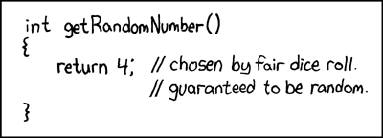
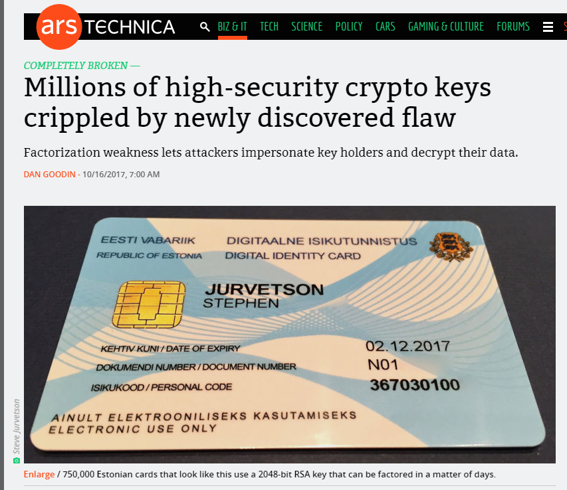
Be Careful Where You Get Your “Random Bits!”
RSA Keys Generated with weak PRG
Implementation Flaw
Unfortunately Commonplace
Resulting Keys are Vulnerable
Sophisticated Attack
Coppersmith’s Method
The Return of Coppersmith's Attack: Practical Factorization of Widely Used RSA Moduli (CCS 2017)

Slide 23
(Plain) RSA Encryption
Public Key: PK=(N,e)
Message $m∈ℤ_{N}^{}$
$$\text{Enc}\text{PK}\text{(}\text{m}\text{)}= \left[m^{e}\operatorname{mod}{N}\right]$$
Remark: Encryption is efficient if we use the power mod algorithm.

Slide 24
(Plain) RSA Decryption
Secret Key: SK=(N,d)
Ciphertext $c∈ℤ_{N}^{}$
$$\text{D}\text{e}\text{c}\text{S}\text{K}\text{(}\text{c}\text{)}= \left[c^{d}\operatorname{mod}{N}\right]$$
Remark 1: Decryption is efficient if we use the power mod algorithm.
Remark 2: Suppose that $m∈ ℤ_{N}^{∗}$ and let c=$\text{Enc}\text{PK}\text{(}\text{m}\text{)}= \left[m^{e}\operatorname{mod}{N}\right]$
$$\text{De}\text{c}\text{SK}\text{(}\text{c}\text{)}= \left[{\left(m^{e}\right)}^{d}\operatorname{mod}{N}\right]= \left[m^{ed}\operatorname{mod}{N}\right]$$
$$= \left[m^{[ed mod φ\left(N\right)]}\operatorname{mod}{N}\right]$$
$$= \left[m1\operatorname{mod}{N}\right]=m$$

Slide 25
Chinese Remainder Theorem
Theorem: Let N = pq (where gcd(p,q)=1) be given and let ${f:ℤ}_{N}^{}→ℤp×ℤq$ be defined as follows
$$f\left(x\right)=\left([x mod p],[x mod q]\right)$$
then
f is a bijective mapping (invertible)
f and its inverse$f^{−1}:ℤp×ℤq→ℤ_{N}^{}$ can be computed efficiently
$f\left(x+y\right)=f\left(x\right)+f(y)$
The restriction of f to $ℤ_{N}^{∗}$ yields a bijective mapping to $ℤ_{p}^{∗}×ℤ_{q}^{∗}$
For inputs ${x,y∈ℤ}_{N}^{∗}$ we have $f\left(x\right)f\left(y\right)=f\left(xy\right)$

Slide 26
RSA Decryption
Secret Key: SK=(N,d)
Ciphertext $c∈ℤ_{N}^{}$
$$\text{D}\text{e}\text{c}\text{S}\text{K}\text{(}\text{c}\text{)}= \left[c^{d}\operatorname{mod}{N}\right]$$
Remark 1: Decryption is efficient if we use the power mod algorithm.
Remark 2: Suppose that $m∈ ℤ_{N}^{∗}$ and let c=$\text{Enc}\text{PK}\text{(}\text{m}\text{)}= \left[m^{e}\operatorname{mod}{N}\right]$ then
$$\text{De}\text{c}\text{SK}\text{(}\text{c}\text{)}= m$$
Remark 3: Even if $m∈ℤ_{N}^{}\backslash ℤ_{N}^{∗}$ and let $c=\text{Enc}\text{PK}\text{(}\text{m}\text{)}= \left[m^{e}\operatorname{mod}{N}\right]$ then
$$\text{De}\text{c}\text{SK}\text{(}\text{c}\text{)}= m$$
Use Chinese Remainder Theorem to show this
$$ed=1+k\left(p−1\right)\left(q−1\right)$$
$$→f\left(c^{d}\right)=\left(\left[m^{ed}\operatorname{mod}{p}\right],\left[m^{ed}\operatorname{mod}{q}\right]\right)=\left(\left[m^{1}\operatorname{mod}{p}\right],\left[m^{1}\operatorname{mod}{q}\right]\right)$$
$$→f^{−1}\left(f\left(c^{d}\right)\right)=f^{−1}\left(\left[m^{1}\operatorname{mod}{p}\right],\left[m^{1}\operatorname{mod}{q}\right]\right)=m$$

Slide 27
Plain RSA (Summary)
Public Key (pk): N = pq, e such that $GCD\left(e,φ\left(N\right)\right)=1$
$φ\left(N\right)=\left(p−1\right)\left(q−1\right)$ for distinct primes p and q
Secret Key (sk): N, d such that ed=1 mod $φ\left(N\right)$
Encrypt(pk=(N,e),m) = $m^{e} mod N$
Decrypt(sk=(N,d),c) = $c^{d} mod N$
$Decryption Works because$
$$\left[c^{d}mod N\right]=\left[m^{ed}mod N\right]=\left[m^{[ed mod φ\left(N\right)]}mod N\right]=\left[m mod N\right]$$

Slide 28
Factoring Assumption
Let GenModulus(1^{n}) be a randomized algorithm that outputs (N=pq,p,q) where p and q are n-bit primes (except with negligible probability negl(n)).
Experiment FACTOR_{A,n}
(N=pq,p,q) ← GenModulus(1^{n})
Attacker A is given N as input
Attacker A outputs p’ > 1 and q’ > 1
Attacker A wins if N=p’q’.

Slide 29
Factoring Assumption
Necessary for security of RSA.
Not known to be sufficient.
Experiment FACTOR_{A,n}
(N=pq,p,q) ← GenModulus(1^{n})
Attacker A is given N as input
Attacker A outputs p’ > 1 and q’ > 1
Attacker A wins ($\text{FACTOR}\text{A}\text{,}\text{n}=1$) if and only if N=p’q’.
$$∀PPT A ∃μ (negligible) s.t Pr\left[\text{FACTOR}\text{A}\text{,}\text{n}=1\right]≤μ(n)$$

Slide 30
RSA-Inversion Assumption
RSA-Experiment: RSA-INV_{A,n}
Run KeyGeneration(1^{n}) to obtain (N,e,d)
Pick uniform $y∈ ℤ_{N}^{∗}$
Attacker A is given N, e, y and outputs $x∈ ℤ_{N}^{∗}$
Attacker wins (RSA-INV_{A,n}=1) if $x^{e}=y mod N$
$$∀PPT A ∃μ (negligible) s.t Pr\left[\text{RSA}\text{−}\text{INVA}\text{,}\text{n} =1\right]≤μ(n)$$

Slide 31
RSA-Assumption
RSA-Experiment: RSA-INV_{A,n}
Run KeyGeneration(1^{n}) to obtain (N,e,d)
Pick uniform $y∈ ℤ_{N}^{∗}$
Attacker A is given N, e, y and outputs $x∈ ℤ_{N}^{∗}$
Attacker wins (RSA-INV_{A,n}=1) if $x^{e}=y mod N$
$$∀PPT A ∃μ (negligible) s.t Pr\left[\text{RSA}\text{−}\text{INVA}\text{,}\text{n}=1\right]≤μ(n)$$
Plain RSA Encryption behaves like a one-way function
Attacker cannot invert encryption of random message

Slide 32
Discussion of RSA-Assumption
Plain RSA Encryption behaves like a one-way-function
Decryption key is a “trapdoor” which allows us to invert the OWF
RSA-Assumption ➔ OWFs exist

Slide 33
Recap
Plain RSA
Public Key (pk): N = pq, e such that $GCD\left(e,φ\left(N\right)\right)=1$
$φ\left(N\right)=\left(p−1\right)\left(q−1\right)$ for distinct primes p and q
Secret Key (sk): N, d such that ed=1 mod $φ\left(N\right)$
Encrypt(pk=(N,e),m) = $m^{e} mod N$
Decrypt(sk=(N,d),c) = $c^{d} mod N$
$Decryption Works because$
$$\left[c^{d}mod N\right]=\left[m^{ed}mod N\right]=\left[m^{[ed mod φ\left(N\right)]}mod N\right]=\left[m mod N\right]$$

Slide 34
Mathematica Demo
https://www.cs.purdue.edu/homes/jblocki/courses/555_Spring17/slides/Lecture24Demo.nb
http://develop.wolframcloud.com/app/
Note: Online version of mathematica available at https://sandbox.open.wolframcloud.com (reduced functionality, but can be used to solve homework bonus problems)

Slide 35
(Toy) RSA Implementation in Mathematica
(* Random Seed 123456 is not secure, but it allows us to repeat the experiment *)
SeedRandom[123456]
(* Step 1: Generate primes for an RSA key *)
p = RandomPrime[{10^1000, 10^1050}];
q = RandomPrime[{10^1000, 10^1050}];
NN = p q; (*Symbol N is protected in mathematica *)
phi = (p - 1) (q - 1);
https://www.cs.purdue.edu/homes/jblocki/courses/555_Spring17/slides/Lecture24Demo.nb

Slide 36
(Toy) RSA Implementation in Mathematica
(* Step 1.A: Find e *)
GCD[phi,7]
Output: 7
(* GCD[phi,7] is not 1, so he have to try a different value of e *)
GCD[phi,3]
Output: 1
(* We can set e=3 *)
e=3;
https://www.cs.purdue.edu/homes/jblocki/courses/555_Spring17/slides/Lecture24Demo.nb

Slide 37
(Toy) RSA Implementation in Mathematica
(* Step 1.B find d s.t. ed = 1 mod N by using the extended GCD algorithm *)
(* Mathematica is clever enough to do this automatically *)
Solve[e x == 1, Modulus->phi]
Output:
{{x->36469680590663028301700626132883867272718728905205088...
…………………………………………………………………………………………………………
394069421778610209425624440980084481398131}}
(* We can now set d = x *)
d=364696805…. 8131;

Slide 38
(Toy) RSA Implementation in Mathematica
(* Double Check 1 = [ed mod $φ\left(N\right)]$ *)
Mod [e d, (p-1)(q-1)]
Output: 1
(* Encrypt the message 200, c= m^e mod N *)
m = 200;
PowerMod[m,e,NN]
Output: 8 000 000

Slide 39
(Toy) RSA Implementation in Mathematica
(* Encrypt the message 200, c= m^e mod N *)
m = 200;
PowerMod[m,e,NN]
Output: 8 000 000
(* Hm...That doesn't seem too secure *)
CubeRoot[PowerMod[m,e,NN]]
Output: 200
(* Moral: if $m^{e}<N$then Plain RSA does not hide the message m. *)

Slide 40
RSA Implementation in Mathematica
(* Encrypt a larger message, c= m^e mod N *)
SeedRandom[1234567];
m2= RandomInteger[{10^1500,10^1501}];
c=PowerMod[m2,e,NN]
Output: 405215834903772786……… 388068292685976133
(* Does it Decrypt Properly? *)
PowerMod[c,d, NN]-m2
Output: 0
(* Yes! *)

Slide 41
CS 555: Week 10: Topic 2 Attacks on Plain RSA

Slide 42
(Plain) RSA Discussion
We have not introduced security models like CPA-Security or CCA-security for Public Key Cryptosystems
However, notice that (Plain) RSA Encryption is stateless and deterministic.
→Plain RSA is not secure against chosen-plaintext attacks
As we will see Plain RSA is also highly vulnerable to chosen-ciphertext attacks

Slide 43
(Plain) RSA Discussion
However, notice that (Plain) RSA Encryption is stateless and deterministic.
→Plain RSA is not secure against chosen-plaintext attacks
Remark: In a public key setting the attacker who knows the public key always has access to an encryption oracle
Encrypted messages with low entropy are particularly vulnerable to brute-force attacks
Example: If $m<B$ then attacker can recover $m$ from $c={Enc}_{pk}\left(m\right)$after at most $B$ queries to encryption oracle (using public key)

Slide 44
Chosen Ciphertext Attack on Plain RSA
Attacker intercepts ciphertext $c=\left[m^{e}\operatorname{mod}{N}\right]$
Attacker generates ciphertext c’ for secret message 2m as follows
$\text{c}\text{’}=\left[\left(c2^{e}\right)\operatorname{mod}{N}\right]$
$=\left[\left(m^{e}2^{e}\right)\operatorname{mod}{N}\right]$
$=\left[{\left(2m\right)}^{e}\operatorname{mod}{N}\right]$
Attacker asks for decryption of $\left[c2^{e}\operatorname{mod}{N}\right]$ and receives 2m.
Divide by two to recover message
Above Example: Shows plain RSA is highly vulnerable to ciphertext-tampering attacks

Slide 45
More Weaknesses: Plain RSA with small e
(Small Messages) If m^{e} < N then we can decrypt c = m^{e} mod N directly e.g., m=c^{(1/e)}
(Partially Known Messages) If an attacker knows first 1-(1/e) bits of secret message $m=m_{1}\left\|??\right.$ then he can recover m given
$$Encrypt\left(pk,m\right)=m^{e} mod N$$
Theorem[Coppersmith]: If p(x) is a polynomial of degree e then in polynomial time (in log(N), 2e) we can find all m such that p(m) = 0 mod N and |m|<N^{(1/e)}

Slide 46
More Weaknesses: Plain RSA with small e
Theorem[Coppersmith]: If p(x) is a polynomial of degree e then in polynomial time (in log(N), e) we can find all m such that p(m) = 0 mod N and |m|<N^{(1/e)}
Example: e = 3, $m=m1\left\|m2\right.$ and attacker knows $m1\left(2k bits\right)$ and $c={\left(m1\left\|m2\right.\right)}^{e}mod N$, but not $m2\left(k bits\right)$
$$p\left(x\right)={\left(2^{k}m1+x\right)}^{3}−c$$
Polynomial has a small root mod N at x= $m2$ and coppersmith’s method will find it!
D. Coppersmith (1996). "Finding a Small Root of a Univariate Modular Equation".

Slide 47
More Weaknesses: Plain RSA with small e
Theorem[Coppersmith]: Can also find small roots of bivariate polynomial $p\left(x_{1},x_{2}\right)$
Similar Approach used to factor weak RSA secret keys N=q₁q₂
Weak PRG → Can guess many of the bits of prime factors
Obtain $\tilde{q_{1}}≈q_{1}$ and $\tilde{q_{2}}≈q_{2}$
Coppersmith Attack: Define polynomial p(.,.) as follows
$$p\left(x_{1},x_{2}\right)=\left(x_{1}+\tilde{q_{1}}\right)\left(x_{2}+\tilde{q_{2}}\right)−N$$
Small Roots of $p\left(x_{1},x_{2}\right)$: $x_{1}=q_{1}−\tilde{q_{1}}$ and $x_{2}=q_{2}−\tilde{q_{2}}$
D. Coppersmith (1996). "Finding a Small Root of a Bivariate Integer Equation; Factoring with high bits known"

Slide 48
The Return of Coppersmith's Attack: Practical Factorization of Widely Used RSA Moduli (CCS 2017)

Slide 49
RSA-Assumption
RSA-Experiment: RSA-INV_{A,n}
Run KeyGeneration(1^{n}) to obtain (N,e,d)
Pick uniform $y∈ ℤ_{N}^{∗}$
Attacker A is given N, e, y and outputs $x∈ ℤ_{N}^{∗}$
Attacker wins (RSA-INV_{A,n}=1) if $x^{e}=y mod N$
$$∀PPT A ∃μ (negligible) s.t Pr\left[\text{RSA}\text{−}\text{INVA}\text{,}\text{n} =1\right]≤μ(n)$$

Slide 50
(Plain) RSA Discussion
However, notice that (Plain) RSA Encryption is stateless and deterministic.
→Plain RSA is not secure against chosen-plaintext attacks
In a public key setting the attacker does have access to an encryption oracle
Encrypted messages with low entropy are vulnerable to a brute-force attack.

Slide 51
Chinese Remainder Theorem
Application of CRT: Faster computation
Example: Compute [11⁵³ mod 15]
f(11)=([-1 mod 3],[1 mod 5])
f(11⁵³) =([(-1)⁵³ mod 3],[1⁵³ mod 5])= (-1,1)
$f^{−1}$(-1,1)=11
Thus, 11=[11⁵³ mod 15]

Slide 52
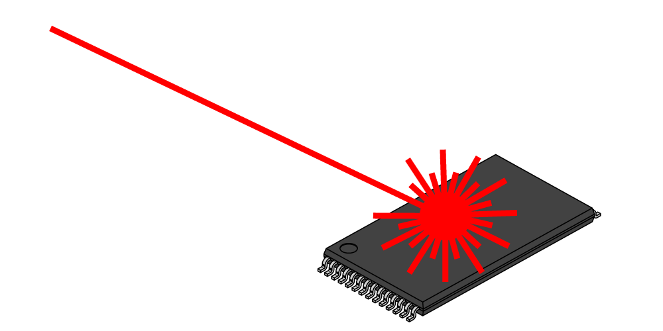
A Side Channel Attack on RSA with CRT
Suppose that decryption is done via Chinese Remainder Theorem for speed.
$${Dec}_{sk}^{}\left(c\right)=c^{d} mod N↔\left(c^{d} mod p,c^{d} mod q\right)$$
Attacker has physical access to smartcard
Can mess up computation of $c^{d} mod p$
Response is $R↔\left(r,c^{d} mod q\right)$
$R−m↔\left(r−m mod p,0 mod q\right)$
GCD(R-m,N)=q

Slide 53
Recovering Encrypted Message faster than Brute-Force
Claim: Let m < 2^{n} be a secret message. For some constant $α=\frac{1}{2}+ε.$ We can recover m in in time ${T=2}^{αn}$ with high probability.
For r=1,…,T
let $xr=\left[cr^{−e}mod N\right]$, where $r^{−e}={\left(r^{−1}\right)}^{e}mod N$
Sort $L={\left\{\left(r,x_{r}\right)\right\}}_{r=1}^{T}$ (by the x_{r} values)
For s=1,…,T
if $\left[s^{e}mod N\right]=x_{r}$ for some r then
return $\left[rs mod N\right]$

Slide 54
Recovering Encrypted Message faster than Brute-Force
Brute Force Attack: Suppose we know the secret message m < 2^{n}
We can recover m from ciphertext c=m^{e} mod N in time 2^{n}
(Solution: Search from m’ < 2^{n} s.t. c=m’^{e} mod N)
Claim: Let m < 2^{n} be a secret message. For some constant $α=\frac{1}{2}+ε.$ We can recover m in in time ${T=2}^{αn}$ with high probability.
Roughly $\sqrt{B}$ steps to find a secret message m < B
Similar to birthday attack

Slide 55
Recovering Encrypted Message faster than Brute-Force
For r=1,…,T
let $xr=\left[cr^{−e}mod N\right]$, where $r^{−e}={\left(r^{−1}\right)}^{e}mod N$
Sort $L={\left\{\left(r,x_{r}\right)\right\}}_{r=1}^{T}$ (by the x_{r} values)
For s=1,…,T
if $\left[s^{e}mod N\right]=x_{r}$ for some r then
return $\left[rs mod N\right]$
Analysis: $\left[rs mod N\right]=\left[r\left(s^{e}\right)d mod N\right]=\left[r\left(xr\right)d mod N\right]$
$$=\left[r\left(cr^{−e}\right)d mod N\right]=\left[rr^{−ed}\left(c\right)d mod N\right]$$
$$=\left[rr^{−1}m mod N\right]=m$$

Slide 56
Recovering Encrypted Message faster than Brute-Force
For r=1,…,T
let $xr=\left[cr^{−e}mod N\right]$, where $r^{−e}={\left(r^{−1}\right)}^{e}mod N$
Sort $L={\left\{\left(r,x_{r}\right)\right\}}_{r=1}^{T}$ (by the x_{r} values)
For s=1,…,T
if $\left[s^{e}mod N\right]=x_{r}$ for some r then
return $\left[rs mod N\right]$
Fact: some constant $α=\frac{1}{2}+ε$ setting ${T=2}^{αn}$ with high probability we will find a pair s and x_{r} with $\left[s^{e}mod N\right]=xr$.

Slide 57
Fixes for Plain RSA
Approach 1: RSA-OAEP
Incorporates random nonce r
CCA-Secure (in random oracle model)
Approach 2: Use RSA to exchange symmetric key for Authenticated Encryption scheme (e.g., AES)
Key Encapsulation Mechanism (KEM)
Alice has public key (N,e)
Bob picks random $r∈ℤ_{N}$ and sends $c=re mod N$ to Alice
Alice and Bob use the symmetric secret key $K=H(r)$ for authenticated encryption
Intuition:
If attacker never queries $H(r)$ then $K$ can be viewed as truly random secret key (Random Oracle Model)
If attacker does query $H(r)$ with non-negligible probability then we can win RSA-Inversion game using A
More details in future lectures…stay tuned!

Slide 58
Recap and Announcements
Plain RSA
Primality Tests and Key Generation
Encryption/Decryption
Factoring/RSA-Inversion
Attacks on Plain RSA
Fixes: RSA-OAEP, Key-Exchange + Authenticated Encryption (more coming)
Announcements
Quiz 4 released today (Due: Saturday (3/27) at 11:30PM on Brightspace)
Homework 4 released (Due: April 8th at 11:59 PM on Gradescope)
Q4: Programming Assignment
Q2: Programming Assignment or Written Solution (You pick!)

Slide 59
CS 555: Week 10: Topic 3 Discrete Log + DDH Assumption

Slide 60
(Recap) Finite Groups
Definition: A (finite) group is a (finite) set $𝔾$with a binary operation $∘$ (over G) for which we have
(Closure:) For all $g,h∈𝔾$ we have $g∘h∈𝔾$
(Identity:) There is an element $e∈𝔾$ such that for all $g∈𝔾$ we have
$$g∘e=g=e∘g$$
(Inverses:) For each element $g∈𝔾$ we can find $h∈𝔾$ such that $g∘h=e$. We say that h is the inverse of g.
(Associativity: ) For all $g1,g2,g3∈𝔾$ we have
$$\left(g1∘g2\right)∘g3=g1∘\left(g2∘g3\right)$$
We say that the group is abelian if
(Commutativity:) For all $g,h∈𝔾$ we have $g∘h=$ $h∘g$

Slide 61
Finite Abelian Groups (Examples)
Example 1: $ℤ_{N}^{}$ when $∘$ denotes addition modulo N
Identity: 0, since 0 $∘$x =[0+x mod N] = [x mod N].
Inverse of x? Set x⁻¹=N-x so that [x⁻¹+x mod N] = [N-x+x mod N] = 0.
Example 2: $ℤ_{N}^{∗}$ when $∘$ denotes multiplication modulo N
Identity: 1, since 1$∘$x =[1(x) mod N] = [x mod N].
Inverse of x? Run extended GCD to obtain integers a and b such that
$$ax+bN=\gcd\left(x,N\right)=1$$
Observe that: x⁻¹ = a. Why?

Slide 62
Cyclic Group
Let $𝔾 be a group with order m=\left|𝔾\right|$with a binary operation $∘$ (over G) and let $g∈𝔾$ be given consider the set
$$\left\langle g\right\rangle =\left\{g0,g1,g2,…\right\}$$
Fact: $\left\langle g\right\rangle$ defines a subgroup of $𝔾.$
Identity: $g0$
Closure: $gi∘gj=g^{i+j}∈\left\langle g\right\rangle$
g is called a “generator” of the subgroup.
Fact: Let $r=\left|\left\langle g\right\rangle \right|$ then $g^{i }=gj$ if and only if $i=j mod r$. Also m is divisible by r.

Slide 63
Finite Abelian Groups (Examples)
Fact: Let p be a prime then $ℤ_{p}^{∗}$ is a cyclic group of order p-1.
Note: Number of generators g s.t. of $\left\langle g\right\rangle =ℤ_{p}^{∗}$ is $φ\left(p−1\right)$
Example (non-generator): p=7, g=2
<2>={1,2,4}
Example (generator): p=7, g=5
<5>={1,5,4,6,2,3}

Slide 64
Discrete Log Experiment DLog_{A,G}(n)
Run G(1^{n}) to obtain a cyclic group $𝔾$ of order q (with $\left\|q\right\|=n$) and a generator g such that $<g>=𝔾$.
Select$h∈𝔾$ uniformly at random.
Attacker A is given $𝔾$, q, g, h and outputs integer x.
Attacker wins (DLog_{A,G}(n)=1) if and only if g^{x}=h.
We say that the discrete log problem is hard relative to generator G if
$$∀PPT A ∃μ (negligible) s.t Pr\left[\text{DLog}\text{A}\text{,}\text{n} =1\right]≤μ(n)$$

Slide 65
Diffie-Hellman Problems
Computational Diffie-Hellman Problem (CDH)
Attacker is given $h1=g^{x_{1}}∈𝔾$ and $h2=g^{x_{2}}∈𝔾.$
Attackers goal is to find${ g}^{x_{1}x_{2}}={\left(h1\right)}^{x_{2}}={\left(h2\right)}^{x_{1}}$
CDH Assumption: For all PPT A there is a negligible function negl upper bounding the probability that A succeeds with probability at most negl(n).
Decisional Diffie-Hellman Problem (DDH)
L$et z0={ g}^{x_{1}x_{2}}$ and let $z1={ g}^{r}$, where x₁,x₂ and r are random
Attacker is given $g^{x_{1}}$, $g^{x_{2}}$ and $zb$ (for a random bit b)
Attackers goal is to guess b
DDH Assumption: For all PPT A there is a negligible function negl such that A succeeds with probability at most ½ + negl(n).

Slide 66
Secure key-agreement with DDH
Alice publishes ${ g}^{xA}$ and Bob publishes ${ g}^{xB}$
Alice and Bob can both compute ${K_{A,B}=g}^{xB xA}$ but to Eve this key is indistinguishable from a random group element (by DDH)
Remark: Protocol is vulnerable to Man-In-The-Middle Attacks if Bob cannot validate ${ g}^{xA}$.

Slide 67
Can we find a cyclic group where DDH holds?
Example 1: $ℤ_{p}^{∗}$ where p is a random n-bit prime.
CDH is believed to be hard
DDH is *not* hard (Exercise 13.15)
Theorem: $Let$p=rq+1 be a random n-bit prime where q is a large $λ$-bit prime then the set of r^{th} residues modulo p is a cyclic subgroup of order q. Then $𝔾_{r}=\left\{[h^{r}mod p] | {h∈ℤ}_{p}^{∗}\right\}$is a cyclic subgroup of $ℤ_{p}^{∗}$ of order q.
Remark 1: DDH is believed to hold for such a group
Remark 2: It is easy to generate uniformly random elements of $𝔾_{r}$
Remark 3: Any element (besides 1) is a generator of $𝔾_{r}$

Slide 68
Can we find a cyclic group where DDH holds?
Theorem: $Let$p=rq+1 be a random n-bit prime where q is a large $λ$-bit prime then the set of rth residues modulo p is a cyclic subgroup of order q. Then $𝔾_{r}=\left\{[h^{r}mod p] | {h∈ℤ}_{p}^{∗}\right\}$is a cyclic subgroup of $ℤ_{p}^{∗}$ of order q.
Closure: $hrgr={\left(hg\right)}^{r}$
Inverse of $hr$ is ${\left(h^{−1}\right)}^{r}∈𝔾_{r}$
Size ${\left(hr\right)}^{x}=h^{[rx mod rq]}={{\left(hr\right)}^{x}=h}^{r[x mod q]}={\left(hr\right)}^{[x mod q]}mod p$
Remark: Two known attacks on Discrete Log Problem for $𝔾_{r}$(Section 9.2).
First runs in time $O\left(\sqrt{q}\right)=O\left(2^{λ/2}\right)$
Second runs in time $2^{O\left(\sqrt[3]{n}{\left(\log{n}\right)}^{2/3}\right)}$

Slide 69
Can we find a cyclic group where DDH holds?
Remark: Two known attacks (Section 9.2).
First runs in time $O\left(\sqrt{q}\right)=O\left(2^{λ/2}\right)$
Second runs in time $2^{O\left(\sqrt[3]{n}{\left(\log{n}\right)}^{2/3}\right)},$where n is bit length of p
Goal: Set $λ$ and n to balance attacks
$$λ=O\left(\sqrt[3]{n}{\left(\log{n}\right)}^{2/3}\right)$$
How to sample p=rq+1?
First sample a random $λ$-bit prime q and
Repeatedly check if rq+1 is prime for a random n- $λ$ bit value r

Slide 70
Can we find a cyclic group where DDH holds?
Elliptic Curves Example: Let p be a prime (p > 3) and let A, B be constants. Consider the equation
$$y2=x3+Ax+B mod p$$
And let
$$E\left(ℤ_{p}^{}\right)=\left\{\left(x,y\right)∈ℤ_{p}^{2} | y2=x3+Ax+B mod p \right\}∪\left\{𝒪\right\}$$
Note: $𝒪$ is defined to be an additive identity $\left(x,y\right)+𝒪=\left(x,y\right)$
W$hat is \left(x1,y1\right)+\left(x2,y2\right)?$

Slide 71
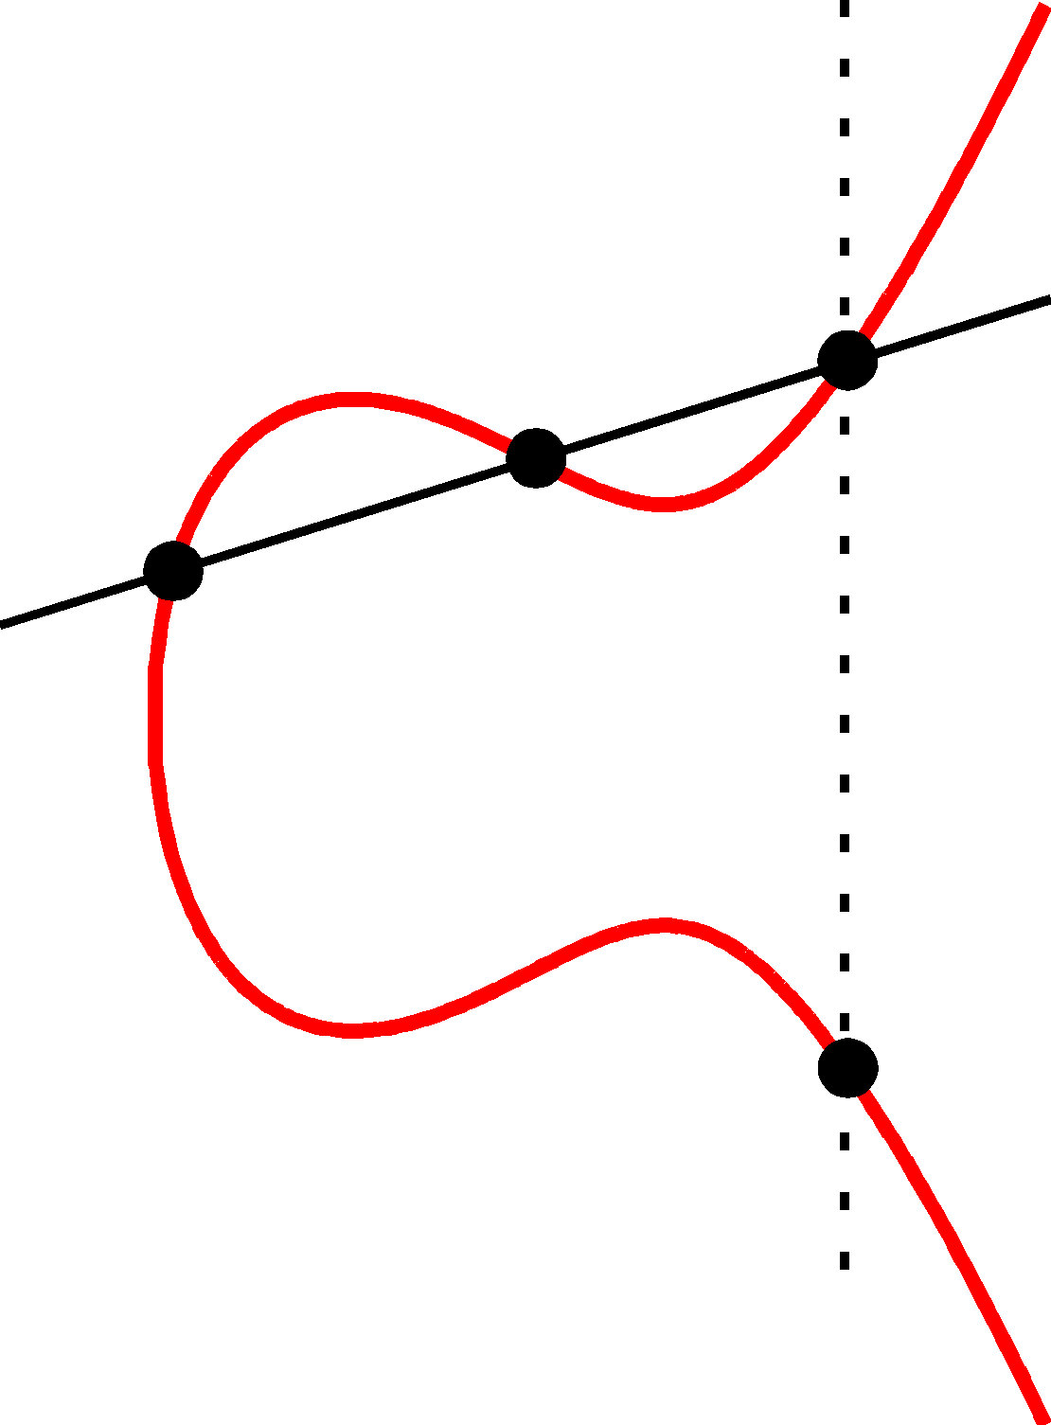
Elliptic Curve Example
$$\left(x2,y2\right)$$
(x₃,y₃)
The line passing through $\left(x1,y1\right)$ and $\left(x2,y2\right)$ has the equation
$$y=m\left(x−x1\right)+y1 mod P$$
Where the slope
$$m=\left[\frac{y1−y2}{x1−x2} mod p\right]$$
$$\left(x1,y1\right)$$
(x₃,-y₃)=$\left(x1,y1\right)+\left(x2,y2\right)$

Slide 72
Elliptic Curve Example
$$\left(x2,y2\right)$$
(x₃,y₃)
$$\left(x1,y1\right)$$
Formally, let
$$m=\left[\frac{y1−y2}{x1−x2} mod p\right]$$
Be the slope. Then the line passing through $\left(x1,y1\right)$ and $\left(x2,y2\right)$ has the equation
$$y=m\left(x−x1\right)+y1 mod P$$
$$\left(m\left(x−x1\right)+y1\right)2=x3+Ax+B mod p$$
(x₃,-y₃)=$\left(x1,y1\right)+\left(x2,y2\right)$
$$x3=[m2−x1−x2 mod p]$$
$$y3=[m\left(x3−x1\right)+y1 mod p]$$

Slide 73
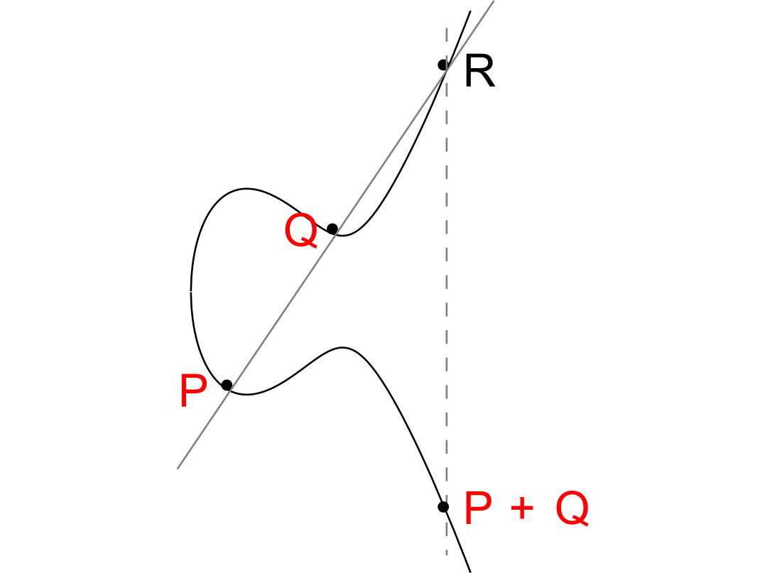

Slide 74
Elliptic Curve Example
No third point R on the elliptic curve.
P+Q = 0
(Inverse)

Slide 75
Elliptic Curve Special Cases
No third point R on the elliptic curve.
P+Q = 0
(Inverse)
Z+Z=0
Z

Slide 76
Elliptic Curve Special Cases
-R
Z
Z+Z=R
How to find R?
R

Slide 77
Can we find a cyclic group where DDH holds?
Elliptic Curves Example: Let p be a prime (p > 3) and let A, B be constants. Consider the equation
$$y2=x3+Ax+B mod p$$
And let
$$E\left(ℤ_{p}^{}\right)=\left\{\left(x,y\right)∈ℤ_{p}^{2} | y2=x3+Ax+B mod p \right\}∪\left\{𝒪\right\}$$
Fact: $E\left(ℤ_{p}^{}\right)$ defines an abelian group
For appropriate curves the DDH assumption is believed to hold
If you make up your own curve there is a good chance it is broken…
NIST has a list of recommendations
Bad Elliptic Curves:
Order is p, p+1, order divides $p^{k}−1$ for “small” k,…

Slide 78
Generic Group Model
Suppose $p<2^{n}$ is a prime
Fact: Every prime order group is isomorphic to $ℤ_{p}$, +
Random (injective mapping) $τ:ℤ_{p}→{\left\{0,1\right\}}^{n}$
Access to Group via Two Oracles
$Mult\left(τ\left(x\right),τ\left(y\right)\right)=τ\left(x+y mod p\right)$
Inverse$\left(τ\left(x\right)\right)=τ\left(p−x\right)$
Discrete Log Problem: Attacker is given $g=τ(1)$ and $g=τ\left(x\right)$ for a random $0≤ x<p$.
Attacker Goal: Find x
DDH Problem: Challenger picks random bit b and random values $0≤ x,y,r<p$
Attacker is given $g=τ\left(1\right), g=τ\left(x\right), g=τ\left(y\right),$and
$g=τ\left(r\right)$ if b=0
$g=τ\left(xy\right)$ if b=1

Slide 79
Generic Group Model
Suppose $p<2^{n}$ is a prime
Fact: Every prime order group is isomorphic to $ℤ_{p}$, +
Random (injective mapping) $τ:ℤ_{p}→{\left\{0,1\right\}}^{n}$
Access to Group via Two Oracles
$Mult\left(τ\left(x\right),τ\left(y\right)\right)=τ\left(x+y mod p\right)$
Inverse$\left(τ\left(x\right)\right)=τ\left(p−x\right)$
Discrete Log Problem: Attacker is given $g=τ(1)$ and $g=τ\left(x\right)$ for a random $0≤ x<p$.
Attacker Goal: Find x
Fact: Any attacker A making at most q queries to group oracles finds x with probability at most $O(q/2^{n/2})$
Matching Attack: Birthday Bound
Intuition: Suppose we know i input/output pairs ($x1,τ\left(x1\right)),…(xi,τ\left(xi\right))$ but $x≠x1,…xi$
Can view x as a yet to be sampled element from $ℤ_{p}\backslash \left\{x1,…xi\right\}$

Slide 80
Generic Group Model
Suppose $p<2^{n}$ is a prime
Fact: Every prime order group is isomorphic to $ℤ_{p}$, +
Random (injective mapping) $τ:ℤ_{p}→{\left\{0,1\right\}}^{n}$
Access to Group via Two Oracles
$Mult\left(τ\left(x\right),τ\left(y\right)\right)=τ\left(x+y mod p\right)$
Inverse$\left(τ\left(x\right)\right)=τ\left(p−x\right)$
DDH Problem: Challenger picks random bit b and random values $0≤ x,y,r<p$
Attacker is given $g=τ\left(1\right), g=τ\left(x\right), g=τ\left(y\right),$and
$g=τ\left(r\right)$ if b=0
$g=τ\left(xy\right)$ if b=1
Fact: Any attacker A making at most q queries to group oracles guesses b with probability at most $\frac{1}{2}+O(q/2^{n/2})$

Slide 81
Week 12 Topic 2: Formalizing Public Key Cryptography

Slide 82
Public Key Encryption: Basic Terminology
Plaintext/Plaintext Space
A message $m∈ℳ$
Ciphertext $c∈𝒞$
Public/Private Key Pair $\left(pk,sk\right)∈𝓚$

Slide 83
Public Key Encryption Syntax
Three Algorithms
$\operatorname{Gen}{(1^{n},R)}$ (Key-generation algorithm)
Input: Random Bits R
Output: $\left(pk,sk\right)∈𝓚$
$\operatorname{Encpk}{(m)}$ $∈𝒞$ (Encryption algorithm)
$\operatorname{Decsk}{(c)}$ (Decryption algorithm)
Input: Secret key $sk$ and a ciphertex$c$
Output: a plaintext message $m∈ℳ$
Invariant: Dec_{sk}(Enc_{pk}(m))=m
Alice must run key generation algorithm in advance an publishes the public key: pk
Assumption: Adversary only gets to see pk (not sk)

Slide 84
Chosen-Plaintext Attacks
Model ability of adversary to control or influence what the honest parties encrypt.
Historical Example: Battle of Midway (WWII).
US Navy cryptanalysts were able to break Japanese code by tricking Japanese navy into encrypting a particular message
Private Key Cryptography
Notes:
Batle of Midway. In May 1942, US Navy cryptanal

Slide 85
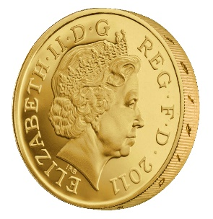
Recap CPA-Security (Symmetric Key Crypto)
m_{0,1},m_{1,1}
c₁ = Enc_{K}(m_{b,1})
m_{0,2},m_{1,2}
c₂ = Enc_{K}(m_{b,2})
m_{0,3},m_{1,3}
c₃ = Enc_{K}(m_{b,3})
…
$$∀PPT A ∃μ (negligible) s.t$$
$$Pr\left[A Guesses b^{′}=b\right]≤\frac{1}{2}+μ(n)$$
b’
Random bit b
K = Gen(.)

Slide 86
Chosen-Plaintext Attacks
Model ability of adversary to control or influence what the honest parties encrypt.
Private Key Crypto
Attacker tricks victim into encrypting particular messages
Public Key Cryptography
The attacker already has the public key pk
Can encrypt any message s/he wants!
CPA Security is critical!
Notes:
Batle of Midway. In May 1942, US Navy cryptanal

Slide 87
CPA-Security (${PubK}_{A,Π}^{LR−cpa}\left(n\right)$)
Public Key: pk
$$m_{0}^{1},m_{1}^{1}$$
$$c_{1}={Enc}_{pk}\left(m_{b}^{1}\right)$$
$$m_{0}^{2},m_{1}^{2}$$
$$c_{2}={Enc}_{pk}\left(m_{b}^{2}\right)$$
$$m_{0}^{3},m_{1}^{3}$$
$$c_{3}={Enc}_{pk}\left(m_{b}^{3}\right)$$
$$∀PPT A ∃μ (negligible) s.t$$
$$Pr\left[{PubK}_{A,Π}^{LR−cpa}\left(n\right)=1\right]≤\frac{1}{2}+μ(n)$$
…
b’
Random bit b
(pk,sk) = Gen(.)

Slide 88
CPA-Security (Single Message)
m₀,m₁
$$Formally, let Π= \left(Gen,Enc,Dec\right) denote the encryption scheme,$$
$$call the experiment {PubK}_{A,Π}^{LR−cpa}\left(n\right) and define a random variable$$
$${PubK}_{A,Π}^{LR−cpa}\left(n\right)=\left\{\begin{matrix}1 & if b=b^{′} \\ 0 & otherwise\end{matrix}\begin{aligned} \\ \end{aligned}\right.$$
$$Π has indistinguishable encryptions under a chosen plaintext attack$$
$if for all PPT adversaries A, there is a$negligible function $μ$ such that
Pr[${PubK}_{A,Π}^{LR−cpa}\left(n\right)=1$] $≤\frac{1}{2}+μ(n)$
c = Enc_{K}(m_{b})
m₂
c₂ = Enc_{K}(m₂)
m₃
c₃ = Enc_{K}(m₃)
…
$$∀PPT A ∃μ (negligible) s.t$$
$$Pr\left[A Guesses b^{′}=b\right]≤\frac{1}{2}+μ(n)$$
b’
Random bit b
K = Gen(.)

Slide 89
Private Key Crypto
CPA Security was stronger than eavesdropping security
$$EncK(m)=G(K)⨁m$$
Vs.
$$EncK(m)= \left\langle r,F_{k}\left(r\right)⨁m\right\rangle$$

Slide 90
Public Key Crypto
Fact 1: CPA Security and Eavesdropping Security are Equivalent
Key Insight: The attacker has the public key so he doesn’t gain anything from being able to query the encryption oracle!
Fact 2: Any deterministic encryption scheme is not CPA-Secure
Historically overlooked in many real world public key crypto systems
Fact 3: Plain RSA is not CPA-Secure
Fact 4: No Public Key Cryptosystem can achieve Perfect Secrecy!
Exercise 11.1
Hint: Unbounded attacker can keep encrypting the message m using the public key to recover all possible encryptions of m.

Slide 91
Encrypting Longer Messages
Claim 11.7: Let $Π= \left(Gen,Enc,Dec\right)$ denote a CPA-Secure public key encryption scheme and let $Π′= \left(Gen,Enc′,Dec′\right)$be defined such that
$${Enc}_{pk}^{′}\left(m_{1}∥m_{2}∥…∥m_{ℓ}\right)={Enc}_{pk}^{}\left(m_{1}\right)∥…∥{Enc}_{pk}^{}\left(m_{ℓ}\right)$$
Then $Π′$ is also CPA-Secure.

Slide 92
Chosen Ciphertext Attacks
Models ability of attacker to obtain (partial) decryption of selected ciphertexts
Attacker might intercept ciphertext c (sent from S to R) and send c’ instead.
After that attacker can observe receiver’s behavior (abort, reply etc…)
Attacker might send a modified ciphertext c’ to receiver R in his own name.
E-mail response: Receiver might decrypt c’ to obtain m’ and include m’ in the response to the attacker

Slide 93
Recap CCA-Security (Symmetric Key Crypto)
We could set m₀ = m₋₁ or m₁ = m₋₂
m₋₁
c₋₁ = Enc_{K}(m₋₁)
c₋₂
…
m₋₂ = Dec_{K}(c₋₂)
m₀,m₁
However, we could still flip 1 bit of c and ask challenger to decrypt
c = Enc_{K}(m_{b})
m₃
c₂ = Enc_{K}(m₂)
Random bit b
K = Gen(.)
c₃
m₃ = Dec_{K}(m₃)
c₄ =c
…
“No Way!”
b’

Slide 94
Recap CCA-Security $\left({PrivK}_{A,Π}^{cca}\left(n\right)\right)$
Challenger generates a secret key k and a bit b
Adversary (A) is given oracle access to Enc_{k} and Dec_{k}
Adversary outputs m₀,m₁
Challenger sends the adversary c=Enc_{k}(m_{b}).
Adversary maintains oracle access to Enc_{k} and Dec_{k} ,however the adversary is not allowed to query Dec_{k}(c).
Eventually, Adversary outputs b’.
$${PrivK}_{A,Π}^{cca}\left(n\right)=1 if b=b^{′};otherwise 0.$$
CCA-Security: For all PPT A exists a negligible function negl(n) s.t.
$$Pr\left[{PrivK}_{A,Π}^{cca}\left(n\right)=1\right]≤\frac{1}{2}+negl(n)$$

Slide 95
CCA-Security (${PubK}_{A,Π}^{cca}\left(n\right)$)
Public Key: pk
$$c_{−1}$$
$$m_{−1}={Dec}_{sk}\left(c_{−1}\right)$$
…
$$m_{0}^{},m_{1}^{}$$
$$c_{b}={Enc}_{pk}\left(m_{b}^{}\right)$$
$$c_{k}$$
$$∀PPT A ∃μ (negligible) s.t$$
$$Pr\left[{PubK}_{A,Π}^{cca}\left(n\right)=1\right]≤\frac{1}{2}+μ(n)$$
$$m_{k}={Dec}_{sk}\left(c_{k}\right)$$
b’
…
Random bit b
(pk,sk) = Gen(.)

Slide 96
Encrypting Longer Messages
Claim 11.7: Let $Π= \left(Gen,Enc,Dec\right)$ denote a CPA-Secure public key encryption scheme and let $Π′= \left(Gen,Enc′,Dec′\right)$be defined such that
$${Enc}_{pk}^{′}\left(m_{1}∥m_{2}∥…∥m_{ℓ}\right)={Enc}_{pk}^{}\left(m_{1}\right)∥…∥{Enc}_{pk}^{}\left(m_{ℓ}\right)$$
Then $Π′$ is also CPA-Secure.
Claim? Let $Π= \left(Gen,Enc,Dec\right)$ denote a CCA-Secure public key encryption scheme and let $Π′= \left(Gen,Enc′,Dec′\right)$be defined such that
$${Enc}_{pk}^{′}\left(m_{1}∥m_{2}∥…∥m_{ℓ}\right)={Enc}_{pk}^{}\left(m_{1}\right)∥…∥{Enc}_{pk}^{}\left(m_{ℓ}\right)$$
Then $Π′$ is also CCA-Secure.
Is this second claim true?

Slide 97
Encrypting Longer Messages
Claim? Let $Π= \left(Gen,Enc,Dec\right)$ denote a CCA-Secure public key encryption scheme and let $Π′= \left(Gen,Enc′,Dec′\right)$be defined such that
$${Enc}_{pk}^{′}\left(m_{1}∥m_{2}∥…∥m_{ℓ}\right)={Enc}_{pk}^{}\left(m_{1}\right)∥…∥{Enc}_{pk}^{}\left(m_{ℓ}\right)$$
Then $Π′$ is also CCA-Secure.
Is this second claim true?
Answer: No!

Slide 98
Encrypting Longer Messages
Fact: Let $Π= \left(Gen,Enc,Dec\right)$ denote a CCA-Secure public key encryption scheme and let $Π′= \left(Gen,Enc′,Dec′\right)$be defined such that
$${Enc}_{pk}^{′}\left(m_{1}∥m_{2}∥…∥m_{ℓ}\right)={Enc}_{pk}^{}\left(m_{1}\right)∥…∥{Enc}_{pk}^{}\left(m_{ℓ}\right)$$
Then $Π′$ is Provably Not CCA-Secure.
Attacker sets $m_{0}=0n∥1n$ $∥1n$ and $m_{1}=0n∥0n∥ 1n$ and gets $c_{b}={Enc}_{pk}^{′}\left(m_{b}\right)$ $=c_{b,1}∥c_{b,2}∥c_{b,3}$
Attacker sets $c′=c_{b,2}∥c_{b,3}∥c_{b,1}$ , queries the decryption oracle and gets
$${Dec}_{sk}^{′}\left(c′\right)=\left\{\begin{aligned} \\ 1n ∥1n∥0n \text{if} \text{b}\text{=}0 \\ 0n∥1n∥0n otherwise \end{aligned}\right.$$

Slide 99
Achieving CPA and CCA-Security
Plain RSA is not CPA Secure (therefore, not CCA-Secure)
El-Gamal (future) is CPA-Secure, but not CCA-Secure
Tools to obtain CCA-Security in Public Key Setting
RSA-OAEP, Cramer-Shoup
Key Encapsulation Mechanism

Slide 100
Key Encapsulation Mechanism (KEM)
Three Algorithms
$\operatorname{Gen}{(1^{n},R)}$ (Key-generation algorithm)
Input: Random Bits R
Output: $\left(pk,sk\right)∈𝓚$
$\operatorname{Encapspk}{(1^{n},R)}$
Input: security parameter, random bits R
Output: Symmetric key $k∈{\left\{0,1\right\}}^{ℓ\left(n\right)}$ and a ciphertext c
$\operatorname{Decapssk}{(c)}$ (Deterministic algorithm)
Input: Secret key $sk∈𝒦$ and a ciphertex$c$
Output: a symmetric key${\left\{0,1\right\}}^{ℓ\left(n\right)}$ or $⊥$ (fail)
Invariant: $Decapssk$(c)=k whenever (c,k) = $Encapspk$($1^{n},R$)

Slide 101
KEM CCA-Security (${KEM}_{A,Π}^{cca}\left(n\right)$)
$$\left(pk,c,k_{b}\right)$$
…
$$c_{1}≠c$$
$${Decaps}_{sk}\left(c_{1}\right)$$
$$c_{2}≠c$$
$$∀PPT A ∃μ (negligible) s.t$$
$$Pr\left[{KEM}_{A,Π}^{cca}=1\right]≤\frac{1}{2}+μ(n)$$
$${Decaps}_{sk}\left(c_{2}\right)$$
b’
…
Random bit b
(pk,sk) = Gen(.)
$$\left(c,k0\right)={Encaps}_{pk}\left(.\right)$$
$$k1 ⟵{\left\{0,1\right\}}^{n}$$

Slide 102
CCA-Secure Encryption from CCA-Secure KEM
$${Enc}_{pk}^{}\left(m;R\right)=\left\langle c,{Enc}_{k}^{∗}\left(m\right)\right\rangle$$
Where
$\left(c,k\right)←{Encaps}_{pk}^{}\left(1^{n};R\right)$,
${Enc}_{k}^{∗}$ is a CCA-Secure symmetric key encryption algorithm, and
${Encaps}_{pk}^{}$ is a CCA-Secure KEM.
Theorem 11.14: ${Enc}_{pk}^{}$ is CCA-Secure public key encryption scheme.

Slide 103
CCA-Secure KEM in the Random Oracle Model
Let (N,e,d) be an RSA key (pk =(N,e), sk=(N,d)).
$$\operatorname{Encapspk}\left(1^{n},R\right)=\left(r^{e} mod N, k=H\left(r\right)\right)$$
Remark 1: k is completely random string unless the adversary can query random oracle H on input r.
Remark 2: If Plain-RSA is hard to invert for a random input then PPT attacker finds r with negligible probability.

Slide 104
Using a CCA-Secure KEM
Let (N,e,d) be an RSA key (pk =(N,e), sk=(N,d)).
$\operatorname{Encpk}\left(m;R\right)=(c, AEnck(m))$ where
$$c=\operatorname{Encapspk}\left(1^{n},R\right)$$
Remark 1: k is completely random string unless the adversary can query random oracle H on input r.
Remark 2: If Plain-RSA is hard to invert for a random input then PPT attacker finds r with negligible probability.

Slide 105
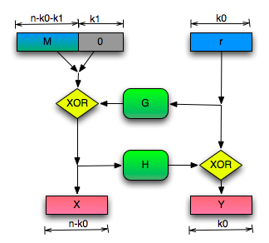
RSA-OAEP (Optimal Asymmetric Encryption Padding)
${Enc}_{pk}^{} (m;r){=[\left(x∥y\right)}^{e} mod N\text{]}$
Where $x∥y ←OAEP(m∥0^{k1}∥r)$
${Dec}_{sk}^{} \left(c\right)=$
$\tilde{m}←{[\left(c\right)}^{d} mod N\text{]}$
If $\left\|\tilde{m}\right\|>n$ return fail
${m∥z∥r←OAEP}^{−1}(\tilde{m})$
If $z≠0^{k1}$ then output fail
Otherwise output m

Slide 106
Recap RSA-Assumption
RSA-Experiment: RSA-INV_{A,n}
Run KeyGeneration(1^{n}) to obtain (N,e,d)
Pick uniform $y∈ ℤ_{N}^{∗}$
Attacker A is given N, e, y and outputs $x∈ ℤ_{N}^{∗}$
Attacker wins (${\text{RSA}\text{−}\text{INV}}_{A,n}$=1) if $x^{e}=y mod N$
$$∀PPT A ∃μ (negligible) s.t Pr\left[{\text{RSA}\text{−}\text{INV}}_{A,n} =1\right]≤μ(n)$$

Slide 107
RSA-OAEP (Optimal Asymmetric Encryption Padding)
Theorem: If we model G and H as
Random oracles then RSA-OAEP is
a CCA-Secure public key encryption scheme
(given RSA-Inversion assumption).
Bonus: One of the fastest in practice!

Slide 108
PKCS #1 v2.0
Implementation of RSA-OAEP
James Manger found a chosen-ciphertext attack.
What gives?

Slide 109
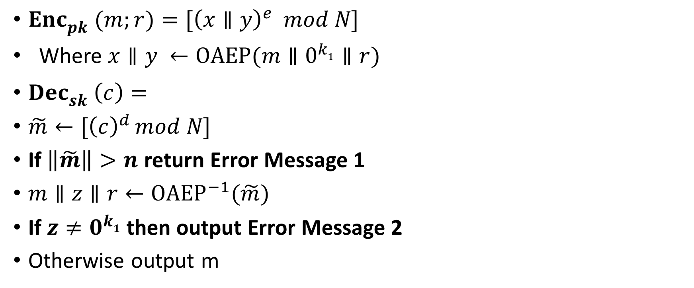
PKCS #1 v2.0 (Bad Implementation)
${Enc}_{pk}^{} (m;r){=[\left(x∥y\right)}^{e} mod N\text{]}$
Where $x∥y ←OAEP(m∥0^{k1}∥r)$
${Dec}_{sk}^{} \left(c\right)=$
$\tilde{m}←{[\left(c\right)}^{d} mod N\text{]}$
If $\left\|\tilde{m}\right\|>n$ return Error Message 1
${m∥z∥r←OAEP}^{−1}(\tilde{m})$
If $z≠0^{k1}$ then output Error Message 2
Otherwise output m

Slide 110
PKCS #1 v2.0 (Attack)
Manger’s CCA-Attack recovers secret message
Step 1: Use decryption oracle to check if $2\tilde{m}≥ 2^{n}$
$c={[\left(\tilde{m}\right)}^{e} mod N\text{]}$ →$2^{e}c={[\left(2\tilde{m}\right)}^{e} mod N\text{]}$
Requires $\left\|N\right\| queries to decryption oracle.$
Attack also works as a side channel attack
Even if error messages are the same the time to respond could be different in each case.
Fix: Implementation should return same error message and should make sure that the time to return each error is the same.

