Slide 1
Advanced Cryptography CS 655
Week 1:
Course Overview & Policy
Review
Concrete Security Analysis
Spring 2021

Slide 2
Topic 0: Course Overview

Slide 3
Course Resources
Instructor: Jeremiah Blocki
Office Hours: Thursdays from 4:30-6:30PM
TA: Mohammad Hassan Ameri
Office Hours: TBD
Course Web Page: Slides, homeworks and schedule https://www.cs.purdue.edu/homes/jblocki/courses/655_Spring23/index.html

Slide 4
Technology
Brightspace
Syllabus (You are responsible for reading and understanding course policies)
Grades
Gradescope
Submit homework assignments
View Graded Assignments and Exams
Piazza
Course Discussion Board
Announcements/Questions
Preferred method of communication
https://piazza.com/purdue/spring2023/cs655/home

Slide 5
Grades
Course Project: 30%
Homework: 20%
Midterm Exam: 15%
Final Exam: 25%
Course Presentation: 10%
Collaboration is permitted on homework assignments, but you completely understand your solutions and you must write the solutions entirely in your own words.
No collaboration on exams

Slide 6
Expected Background
Prerequisites: CS555 (or equivalent) and CS 526
We will assume mathematical maturity
Ability to Write Proofs
Ability to Understand/Interpret Crypto Definitions
Security Reductions
Probability Theory
Combinatorics
Counting

Slide 7
Course Topics (Tentative)
The course will review several cutting edge research topics in the field of cryptography.
Cryptography is a big field ➔ There will be many interesting topics that we cannot cover.
Tentative List of Topics: Concrete Security Analysis, Idealized Models, Preprocessing Attacks and Lower Bounds, Proofs of Space, Proofs of Sequential Work, Verifiable Delay Functions, Memory Tight Reductions, Memory Hard Functions, Oblivious RAM, Obfuscation + Applications, Differential Privacy, Functional Secret Sharing, Quantum Random Oracle Model + Compressed Oracles, Differential Privacy, Fully Homomorphic Encryption

Slide 8
Homeworks (20%)
There will be between 4 to 6 homework assignments. Homeworks must be submitted via Gradescope before the stated deadline.
You should typeset your assignment (preferably using LaTeX). It is ok to include handdrawn figures in your pdf.
You are encouraged to collaborate with others, but you must completely understand your solution and you should cite any resources that you use
Late Policy:
On Time: No penalty
< 1 Day Late: 10-point penalty
< 2 Days Late: 25-point penalty
> 2 days late: no credit

Slide 9
Course Presentation (10%)
Pick a recent paper (last 15 years) from a cryptography conference and give a 15 minute presentation in class
12 minutes for presentation + 3 minutes for questions
Suggested conferences include CRYPTO, EUROCRYPT, TCC, ASIACRYPT.
If you would like to pick a crypto paper from another venue (e.g., S&P, CCS) you will need to verify that the focus of the paper is crypto and then request permission from the instructor.

Slide 10
Course Project (30%)
Project Proposal: 5%
Progress Report: 5%
Final Project Report: 10%
Final Project Presentation: 10%
We will provide some ideas for projects. You are also welcome to propose your own topics.
Example: New security analysis of ___ construction
Example Twists: Tighter Security Analysis in Ideal Model? Memory-Tight Reduction? Security proof in Quantum Random Oracle Model?
Implementation: pick a recent crypto construction and implement it

Slide 11
Topic 1: Review

Slide 12
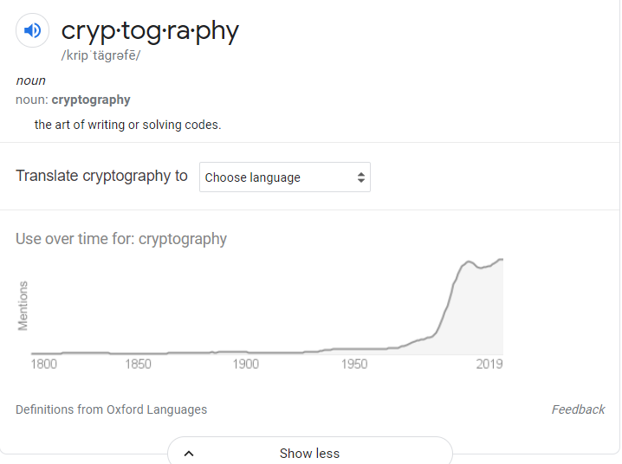
What is Cryptography?
“the art of writing or solving codes” – Concise Oxford English Dictionary

Slide 13
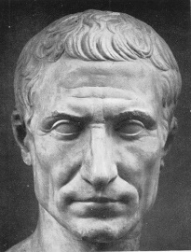
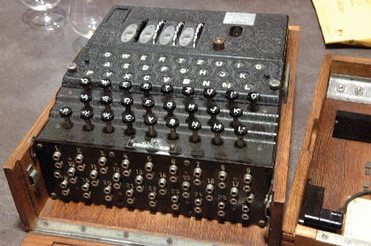
What is Cryptography?
“the art of writing or solving codes” – Concise Oxford English Dictionary
“The study of mathematical techniques for securing digital information, systems and distributed computation against adversarial attacks.”
-- Intro to Modern Cryptography
Late 20th century
Art
Science

Slide 14
What is Cryptography?
Precise Mathematical Security Definitions
Specific Algorithmic Assumptions
Formal Security Reductions/Proofs
Experience
Intuition
Creativity

Slide 15
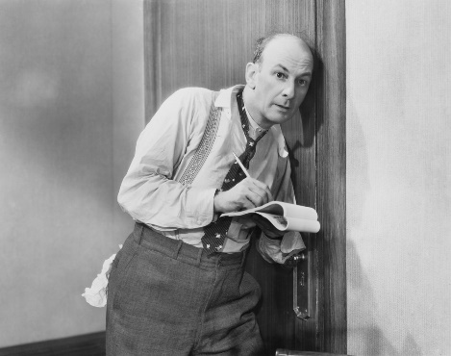
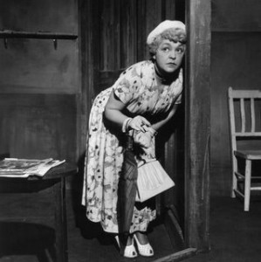
What Does It Mean to “Secure Information”
Confidentiality (Security/Privacy)
Only intended recipient can see the communication

Slide 16
What Does It Mean to “Secure Information”
Confidentiality (Security/Privacy)
Only intended recipient can see the communication
Integrity (Authenticity)
The message was actually sent by the alleged sender
I love you Alice… - Bob
We need to break up -Bob
Alice
Bob

Slide 17
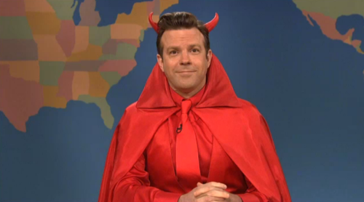
Two Attacker Models
Passive Attacker (Eve)
Attacker can eavesdrop
Protection Requires?
Confidentiality
Active Attacker (Mallory)
Has full control over communication channel
Protection Requires?
Confidentiality & Integrity

Slide 18
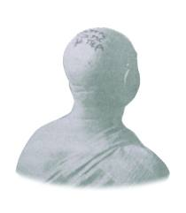
Steganography vs Cryptography
Steganography
Goal: Hide existence of a message
Invisible Ink, Tattoo Underneath Hair, …
Assumption: Method is secret
Notes:
Herodotus, an entertaining but less than reliable Greek historian, reports a more ingenious method. Histaeus, ruler of Miletus, wanted to send a message to his friend Aristagorus, urging revolt against the Persians. Histaeus shaved the head of his most trusted slave, then tattooed a message on the slave's scalp. After the hair grew back, the slave was sent to Aristagorus with the message safely hidden.
Later in Herodotus' histories, the Spartans received word that Xerxes was preparing to invade Greece. Their informant, Demeratus, was a Greek in exile in Persia. Fearing discovery, Demeratus wrote his message on the wood backing of a wax tablet. He then hid the message underneath a fresh layer of wax. The apparently blank tablet sailed easily past sentries on the road.
A more subtle method, nearly as old, is to use invisible ink. Described as early as the first century AD, invisible inks were commonly used for serious communications until WWII. The simplest are organic compounds, such as lemon juice, milk, or urine, all of which turn dark when held over a flame. In 1641, Bishop John Wilkins suggested onion juice, alum, ammonia salts, and for glow-in-the dark writing the "distilled Juice of Glowworms." Modern invisible inks fluoresce under ultraviolet light and are used as anti-counterfeit devices. For example, "VOID" is printed on checks and other official documents in an ink that appears under the strong ultraviolet light used for photocopies.
A modern area that is related to both is information hiding or covert channels. Embed messages in places not intended for storing information. They can use cryptographic approaches to ensure secrecy, and do not rely only on secrecy of method.

Slide 19
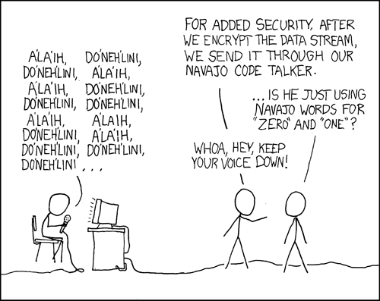
Steganography vs Cryptography
Steganography
Goal: Hide existence of a message
Invisible Ink, Tattoo Underneath Hair, …
Assumption: Method is secret
Cryptography
Goal: Hide the meaning of a message
Depends only on secrecy of a (short) key
Kerckhoff’s Principle: Cipher method should
not be required to be secret.
Notes:
Herodotus, an entertaining but less than reliable Greek historian, reports a more ingenious method. Histaeus, ruler of Miletus, wanted to send a message to his friend Aristagorus, urging revolt against the Persians. Histaeus shaved the head of his most trusted slave, then tattooed a message on the slave's scalp. After the hair grew back, the slave was sent to Aristagorus with the message safely hidden.
Later in Herodotus' histories, the Spartans received word that Xerxes was preparing to invade Greece. Their informant, Demeratus, was a Greek in exile in Persia. Fearing discovery, Demeratus wrote his message on the wood backing of a wax tablet. He then hid the message underneath a fresh layer of wax. The apparently blank tablet sailed easily past sentries on the road.
A more subtle method, nearly as old, is to use invisible ink. Described as early as the first century AD, invisible inks were commonly used for serious communications until WWII. The simplest are organic compounds, such as lemon juice, milk, or urine, all of which turn dark when held over a flame. In 1641, Bishop John Wilkins suggested onion juice, alum, ammonia salts, and for glow-in-the dark writing the "distilled Juice of Glowworms." Modern invisible inks fluoresce under ultraviolet light and are used as anti-counterfeit devices. For example, "VOID" is printed on checks and other official documents in an ink that appears under the strong ultraviolet light used for photocopies.
A modern area that is related to both is information hiding or covert channels. Embed messages in places not intended for storing information. They can use cryptographic approaches to ensure secrecy, and do not rely only on secrecy of method.

Slide 20
Symmetric Key Encryption
What cryptography has historically been all about (Pre 1970)
Two parties (sender and receiver) share secret key
Sender uses key to encrypt (“scramble”) the message before transmission
Receiver uses the key to decrypt (“unscramble”) and recover the original message

Slide 21
Encryption: Basic Terminology
Plaintext
The original message m
Plaintext Space (Message Space)
The set $ℳ$ of all possible plaintext messages
Example 1: $ℳ=\left\{{}^{′}attack^{′},^{′}retreat^{′},{}_{}^{′}hold current position′\right\}$
Example 2: $ℳ=\left\{0,1\right\}n$ --- all n-bit messages
Ciphertext $c∈𝒞$
An encrypted (“scrambled”) message $c∈𝒞$ (ciphertext space)
Key/Keyspace $k∈𝒦$

Slide 22
Private Key Encryption Syntax
Typically picks $k∈𝒦$
uniformly at random
Message Space: $ℳ$
Key Space: $𝒦$
Three Algorithms $Π=\left(Gen,Enc,Dec\right)$
$\operatorname{Gen}{(R)}$ (Key-generation algorithm)
Input: Random Bits R
Output: Secret key $k∈𝒦$
$\operatorname{Enck}{(m)}$ (Encryption algorithm)
Input: Secret key $k∈𝒦$ and message $m∈ℳ$
Output: ciphertext c
$\operatorname{Deck}{(c)}$ (Decryption algorithm)
Input: Secret key $k∈𝒦$ and a ciphertex$c$
Output: a plaintext message $m∈ℳ$
Invariant: Dec_{k}(Enc_{k}(m))=m
Trusted Parties (e.g., Alice and Bob) must run Gen in advance to obtain secret k.
Assumption: Adversary does not get to see output of Gen

Slide 23
Example: Shift Cipher
Key Space: $𝒦$={0,1,…,25}
Message Space: $ℳ$={a,b,c,…,z}*
Right Shift Operation
RS₁(a) = b
RS₁(b) = c
...
RS₁(z) = ?
RS_{i+1}(a)=RS_{i}(b)

Slide 24
Shift Cipher
Key Space: $𝒦$={0,1,…,25}
Message Space: $ℳ$={a,b,c,…,z}*
Right Shift Operation
RS₁(a) = b
RS₁(b) = c
...
RS₁(z) = a
RS_{i+1}(a)=RS_{i}(b)
$\operatorname{Enck}{(m_{1}∘…{∘m}_{n})}={RS}_{k}\left(m_{1}\right)∘…{∘RS}_{k}\left(m_{n}\right)$
Each letter in plaintext message $m=m_{1}∘…{∘m}_{n}$ is right shifted k times RS_{k}
Question: what is ciphertext space $𝒞$?

Slide 25
Example: Shift Cipher (Multiple Characters)
Key Space: $𝒦$={0,1,…,25}
Message Space: $ℳ$={a,b,c,…,z}*
$$\operatorname{Enck}{(m_{1}∘…{∘m}_{n})}={RS}_{k}\left(m_{1}\right)∘…{∘RS}_{k}\left(m_{n}\right)$$
$$\operatorname{Deck}{(c_{1}∘…{∘c}_{n})}={LS}_{k}\left(c_{1}\right)∘…{∘LS}_{k}\left(c_{n}\right)$$
Note:
$$\operatorname{Deck}\left(\operatorname{Enck}\left(m_{1}∘…{∘m}_{n}\right)\right)=m_{1}∘…{∘m}_{n}$$
since
$${LS}_{k}\left({RS}_{k}\left(m_{i}\right)\right)=m_{i}$$

Slide 26
Recap:
Syllabus
What is cryptography
Science vs Art
Authenticity vs Integrity
Steganography vs Cryptography
Hiding existence vs. meaning of a message

Slide 27
Review: Symmetric Key Encryption
What cryptography has historically been all about (Pre 1970)
Two parties (sender and receiver) share secret key
Sender uses key to encrypt (“scramble”) the message before transmission
Receiver uses the key to decrypt (“unscramble”) and recover the original message

Slide 28
Review: Encryption: Basic Terminology
Plaintext
The original message m
Plaintext Space (Message Space)
The set $ℳ$ of all possible plaintext messages
Example 1: $ℳ=\left\{{}^{′}attack^{′},{}_{}^{′}retreat^{′},{}_{}^{′}hold current position′\right\}$
Example 2: $ℳ=\left\{0,1\right\}n$ - $all n−bit messages$
Ciphertext $c∈𝒞$
An encrypted (“scrambled”) message $c∈𝒞$ (ciphertext space)
Key/Keyspace $k∈𝒦$

Slide 29
Review: Private Key Encryption Syntax
Typically picks $k∈𝒦$
uniformly at random
Message Space: $ℳ$
Key Space: $𝒦$
Three Algorithms $Π=\left(Gen,Enc,Dec\right)$
$\operatorname{Gen}{(R)}$ (Key-generation algorithm)
Input: Random Bits R
Output: Secret key $k∈𝒦$
$\operatorname{Enck}{(m)}$ (Encryption algorithm)
Input: Secret key $k∈𝒦$ and message $m∈ℳ$
Output: ciphertext c
$\operatorname{Deck}{(c)}$ (Decryption algorithm)
Input: Secret key $k∈𝒦$ and a ciphertex$c$
Output: a plaintext message $m∈ℳ$
Invariant: Dec_{k}(Enc_{k}(m))=m
Trusted Parties (e.g., Alice and Bob) must run Gen in advance to obtain secret k.
Assumption: Adversary does not get to see output of Gen

Slide 30
Topic 2: Historical Ciphers (& How to Break Them)

Slide 31
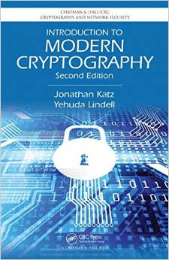
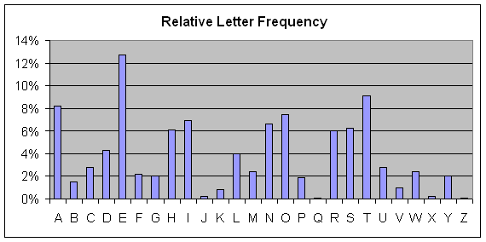
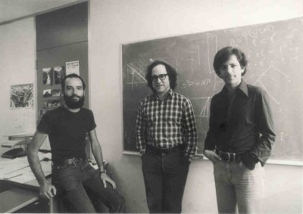
Cryptography History
2500+ years
Ongoing battle
Codemakers and codebreakers
Formalization of Modern Crypto (1976+)
Caesar Shift Cipher (50 BC)
Shannon Entropy/Perfect Secrecy
(~1950)
1970s
Cipher Machines (1900s)
Frequency Analysis
Public Key Crypto/RSA

Slide 32
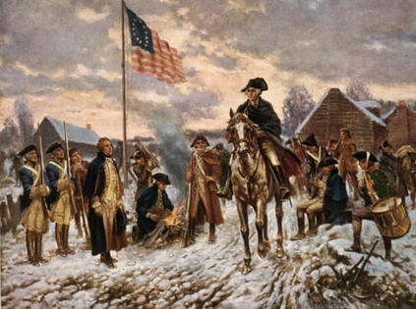
Who Uses Cryptography
Traditionally: Militias
Modern Times: Everyone!
Caesar Shift Cipher (50 BC)
Revolutionary War
Modern Crypto

Slide 33
Caesar Cipher
Three shall be the number of thy shifting and the number of thy shifting shall be three. Four shalt thou not shift, neither shift thou two, excepting that thou then proceed to three. Five is right out…..
Caesar adopted the shift cipher with secret key k=3

Slide 34
Caesar Cipher (Example)
BEGINTHEATTACKNOW
→
EHJLQWKHDWWDFNQRZ
Caesar adopted the shift cipher with secret key k=3

Slide 35
Caesar Cipher (Example)
BEGINTHEATTACKNOW
→
EHJLQWKHDWWDFNQRZ
Immediate Issue: anyone who knows method can decrypt
(since k=3 is fixed)

Slide 36
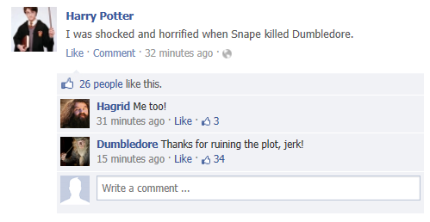
Modern Application: Avoid Spoilers (ROT13)

Slide 37
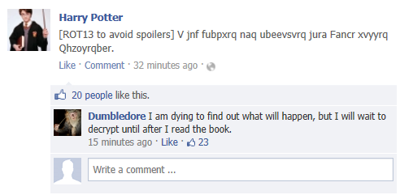
Modern Application: Avoid Spoilers (ROT13)

Slide 38
Shift Cipher: Brute Force Attack
Ciphertext: “lwxrw ztn sd ndj iwxcz xh gxvwi?”
k=1 → m = “mxysx auo te oek jxyda yi hywxj?”
k=2 → m=“nyzty bvp uf pfl kyzeb zj izxyk?”
k=3 → m=“ozauz cwq vg qgm lzafc ak jayzl?”
k=4 → m = “pabva dxr wh rhn mabgd bl kbzam?”
k=5 → m=“qbcwb eys xi sio nbche cm lcabn?”
k=6 → m=“rcdxc fzt yj tjp ocdif dn mdbco?”

Slide 39
Shift Cipher: Brute Force Attack
Ciphertext: “lwxrw ztn sd ndj iwxcz xh gxvwi?”
…
k=7 → m=“sdeyd gau zk ukq pdejg eo necdp?”
k=8 → m=“tefze hbv al vlr qefkh fp ofdeq?”
k=9 → m = “ufgaf icw bm wms rfgli gq pgefr?”
k=10 → m=“vghbg jdx cn xnt sghmj hr qhfgs?”
k=11→ m= “which key do you think is right?”
k=12→ m= “xijdi lfz ep zpv uijol jt sjhiu?”

Slide 40
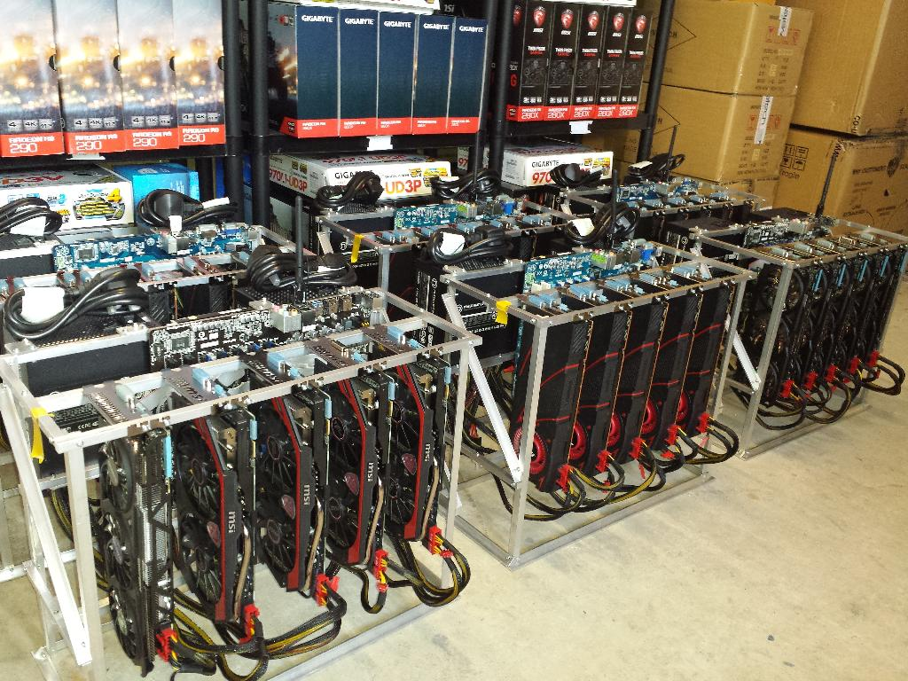
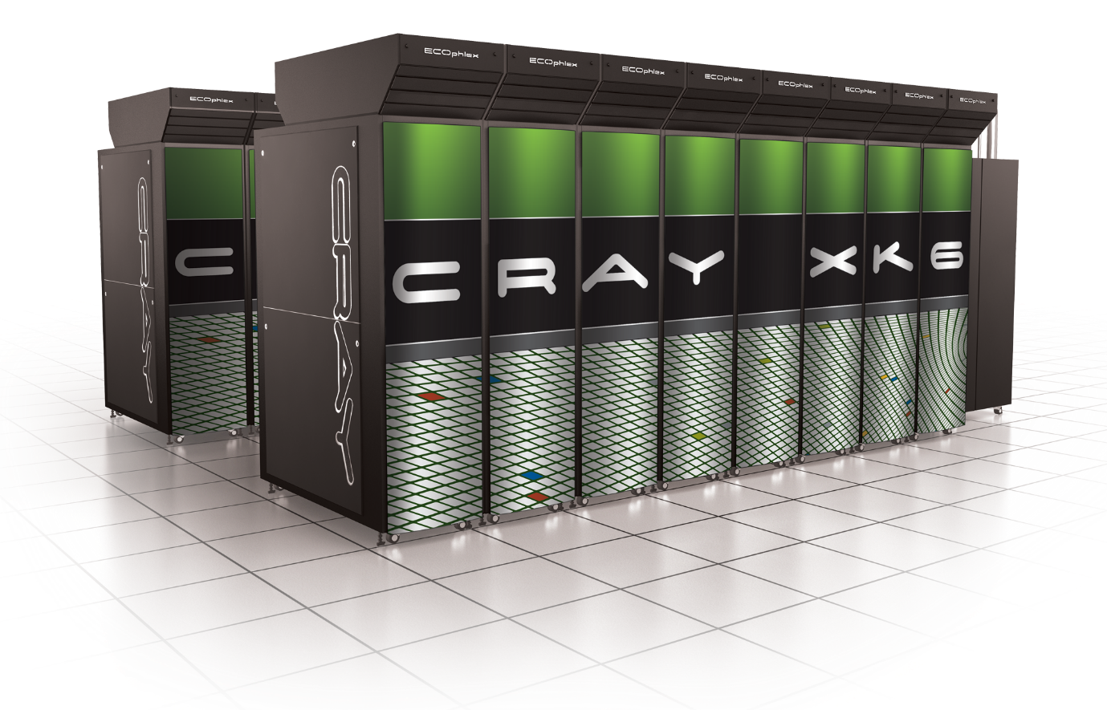
Sufficient Key Space Principle
“Any secure encryption scheme must have a key space that is sufficiently large to make an exhaustive search attack infeasible.”
Notes:
Attackers can user supercomputer, GPUs, Application Specific Integrated Circtuits etc… to speed up brute-force attacks. Key space should have size at least 2^70….probably larger to provide long term security against well funded attackers…

Slide 41
Sufficient Key Space Principle
“Any secure encryption scheme must have a key space that is sufficiently large to make an exhaustive search attack infeasible.”
Question 1: How big is big enough? Complicated question….
Question 2: If the key space is large is the encryption scheme necessarily secure?

Slide 42
Substitution Cipher
Secret key K is permutation of the alphabet
Example:
A B C D E F G H I J K L M N O P Q R S T U V W X Y Z
X E U A D N B K V M R O C Q F S Y H W G L Z I J P T
Encryption: apply permutation K to each letter in message
TELLHIMABOUTME → GDOOKVCXEFLGCD
Decryption: reverse the permutation

Slide 43
Substitution Cipher
Secret key K is a permutation of the alphabet
Example:
A B C D E F G H I J K L M N O P Q R S T U V W X Y Z
X E U A D N B K V M R O C Q F S Y H W G L Z I J P T
Question: What is the size of the keyspace $𝒦$?
$$\left|𝒦\right|=26! ≈2^{88}$$

Slide 45
Frequency Analysis
Observation 1: If e is mapped to d then every appearance of e in the plaintext results in the appearance of a d in the ciphertext
Observation 2: Some letters occur much more frequently in English.
Observation 3: Texts consisting of a few sentences tend to have a distribution close to average.
Step 1: Find letter in ciphertext that occurs with
frequency > 11%. This letter is probably e…

Slide 46
Vigenère Cipher
Generalizes Shift Cipher
K=k₁,…,k_{t}
Enc_{K}(m)
Shift first letter right k₁ times
Shift second letter right k₂ times
…
Shift t^{th} letter right k_{t} times
Shift t+1st letter right k₁ times
…
Question: Size of key-space?
Answer: 26^{t} (brute force may not be useful)

Slide 47
Vigenère Cipher
Still vulnerable to frequency analysis
Good guess: Select K=k₁,…,k_{t} to maximize number of e’s in resulting ciphertext
See Katz and Lindell 1.3 for even more sophisticated heuristics.
Attack works when the initial message m is sufficiently long
Vigenère is “perfectly secret” if the message m is at most t letters long.

Slide 48
Conclusions
Designing secure ciphers is hard
Vigenère remained “unbroken” for a long time
Complex schemes are not secure
All historical ciphers have fallen

Slide 49
Homework 1 Released
Due: Thursday, February 4th at 11:59 PM on Gradescope (2 weeks)
Solutions should be typeset (preferably in Latex)
You may collaborate with classmates, but you must write up your own solution and you must understand this solution
Ask clarification questions on Piazza or during office hours

Slide 50
Topic 3: Perfect Secrecy + One-Time-Pads

Slide 51
Principles of Modern Cryptography
Need formal definitions of “security”
If you don’t understand what you want to achieve, how can you possibly know when (or if) you have achieved it?
Attempt 1: Impossible/infeasible for attacker to recover secret key K
$\operatorname{Enck}{(m)}=m$
Attempt 2: Impossible for attacker to recover entire plaintext from ciphertext?
Ok to decrypt 90% of message?
Attempt 3: Impossible for attacker to figure out any particular character of the plaintext from the ciphertext?
[Too Weak] Does employee make more than $100,000 per year?
[Too Strong] Lucky guess? Prior Information? (e.g., letters always begin “Dear ….”)

Slide 52
Principles of Modern Cryptography
Need formal definitions of “security”
If you don’t understand what you want to achieve, how can you possibly know when (or if) you have achieved it?
Final Attempt: Regardless of information an attacker already has, a ciphertext should leak no additional information about the underlying plaintext.
This is the “right” approach
Still need to formalize mathematically
Security definition includes goal and threat-model

Slide 53
Principles of Modern Cryptography
Proofs of Security are critical
Iron-clad guarantee that attacker will not succeed (relative to definition/assumptions)
Experience: intuition is often misleading in cryptography
An “intuitively secure” scheme may actually be badly broken.
Before deploying in the real world
Consider definition/assumptions in security definition
Does the threat model capture the attackers true abilities?

Slide 54
Perfect Secrecy Intuition
Regardless of information an attacker already has, a ciphertext should leak no additional information about the underlying plaintext.
We will formalize this intuition
And show how to achieve it

Slide 55
Private Key Encryption Syntax
Typically picks $k∈𝒦$
uniformly at random
Message Space: $ℳ$
Key Space: $𝒦$
Three Algorithms $Π=\left(Gen,Enc,Dec\right)$
$\operatorname{Gen}{(R)}$ (Key-generation algorithm)
Input: Random Bits R
Output: Secret key $k∈𝒦$.
$\operatorname{Enck}{(m)}$ (Encryption algorithm)
Input: Secret key $k∈𝒦$ and message $m∈ℳ$
Output: ciphertext c
$\operatorname{Deck}{(c)}$ (Decryption algorithm)
Input: Secret key $k∈𝒦$ and a ciphertex$c$
Output: a plaintext message $m∈ℳ$
Invariant: Dec_{k}(Enc_{k}(m))=m
Trusted Parties (e.g., Alice and Bob) must run Gen in advance to obtain secret k.
Assumption: Adversary does not get to see output of Gen

Slide 56
An Example
Enemy knows that Caesar likes to fight in the rain and it is raining today
$$Pr\left[m=wait\right]=0.3$$
$$Pr\left[m=attack\right]=0.7$$
Suppose that Caesar sends c=Enc_{K}(m) to generals and that the attacker intercepts the ciphertext c and calculates
$$Pr\left[m=wait |\text{c}\text{=}\text{EncK}\text{(}\text{m}\text{)}\right]=0.2$$
$$Pr\left[m=attack |\text{c}\text{=}\text{EncK}\text{(}\text{m}\text{)}\right]=0.8$$
Did the attacker learn anything useful?

Slide 57
Perfect Secrecy
Definition 1: An encryption scheme $Π=\left(Gen,Enc,Dec\right)$with message space $ℳ$ is perfectly secret if for every probability distribution $𝒟$ over $ℳ,$every message $m∈ℳ$ and every ciphertext $c∈𝒞$ for which $Pr\left[C=c\right]>0$:
$$Pr\left[M=m\left|C=c\right.\right]=Pr\left[M=m\right].$$
(where $M←𝒟$, $K=Gen(R)$ and $C=EncK\left(M\right)$)
Definition 2: For every $m,m′∈ℳ$ and $c∈𝒞$
$$Pr\left[EncK\left(m\right)=c\right]=Pr\left[EncK\left(m^{′}\right)=c\right].$$
(where the probabilities are taken over the randomness of Gen and Enc)
Lemma 2.4: The above definitions are equivalent.
Notes:
Proof: Suppose first that (Gen,Enc,Dec) does not satisfy definition 2. Then there exists $m,m′∈ℳ$ and $c∈𝒞$ such that
$$Pr\left[EncK\left(m\right)=c\right]≠Pr\left[EncK\left(m^{′}\right)=c\right] (1).$$
Now suppose for contradiction that Definition 1 holds and define the distribution $𝒟$ such that Pr[M=m]=1/2=Pr[M=m’] when $M←𝒟$. By definition 1 we have $Pr\left[M=m\left|C=c\right.\right]=Pr\left[M=m\left|EncK\left(m\right)=c\right.\right]=\text{Pr}\text{[}\text{M}\text{=}\text{m}\text{]}=\frac{1}{2}=Pr\left[M=m′\left|EncK\left(m′\right)=c\right.\right].$ Notice that by Bayes Theorem we have
$$\frac{1}{2}=Pr\left[M=m\left|EncK\left(m\right)=c\right.\right]=\frac{Pr\left[C=c\left|M=m\right.\right]\text{Pr}\text{[}\text{M}\text{=}\text{m}\text{]}}{\text{Pr}\text{[}\text{C}\text{=}\text{c}\text{]}}=\frac{Pr\left[C=c\left|M=m\right.\right]}{2\text{Pr}\text{[}\text{C}\text{=}\text{c}\text{]}}(2)$$
And similarly
$$\frac{1}{2}=Pr\left[M=m′\left|EncK\left(m′\right)=c\right.\right]=\frac{Pr\left[C=c\left|M=m′\right.\right]}{2\text{Pr}\text{[}\text{C}\text{=}\text{c}\text{]}} (3)$$
It follows that
$$Pr\left[C=c\left|M=m′\right.\right]=Pr\left[C=c\left|M=m\right.\right] (4)$$
We now observe that
$$Pr\left[C=c\left|M=m\right.\right]=Pr\left[EncK\left(m\right)=c\left|M=m\right.\right]=Pr\left[EncK\left(m\right)=c\right] (5)$$
Where the first inequality follows by definition of C and the second follows because we condition on the event that M=m.
From (4) + (5) we reach the conclusion that
$$Pr\left[EncK\left(m\right)=c\right]=Pr\left[EncK\left(m^{′}\right)=c\right]$$
In contradiction of our assumption (1). See textbook for other direction of proof.

Slide 58
Perfect Secrecy
Definition 1: An encryption scheme $Π=\left(Gen,Enc,Dec\right)$with message space $ℳ$ is perfectly secret if for every probability distribution $𝒟$ over $ℳ,$every message $m∈ℳ$ and every ciphertext $c∈𝒞$ for which $Pr\left[C=c\right]>0$:
$$Pr\left[M=m\left|C=c\right.\right]=Pr\left[M=m\right].$$
(where $M←𝒟$, $K=Gen(R)$ and $C=EncK\left(M\right)$)
Definition 2: For every $m,m′∈ℳ$ and $c∈𝒞$
$$Pr\left[EncK\left(m\right)=c\right]=Pr\left[EncK\left(m^{′}\right)=c\right].$$
(where the probabilities are taken over the randomness of Gen and Enc)
Lemma 2.4: The above definitions are equivalent.
Definition 1 is more compelling as a security definition (attacker gains no information).
Easier to prove an encryption scheme satisfied definition 2.
Notes:
Proof: Suppose first that (Gen,Enc,Dec) does not satisfy definition 2. Then there exists $m,m′∈ℳ$ and $c∈𝒞$ such that
$$Pr\left[EncK\left(m\right)=c\right]≠Pr\left[EncK\left(m^{′}\right)=c\right] (1).$$
Now suppose for contradiction that Definition 1 holds and define the distribution $𝒟$ such that Pr[M=m]=1/2=Pr[M=m’] when $M←𝒟$. By definition 1 we have $Pr\left[M=m\left|C=c\right.\right]=Pr\left[M=m\left|EncK\left(m\right)=c\right.\right]=\text{Pr}\text{[}\text{M}\text{=}\text{m}\text{]}=\frac{1}{2}=Pr\left[M=m′\left|EncK\left(m′\right)=c\right.\right].$ Notice that by Bayes Theorem we have
$$\frac{1}{2}=Pr\left[M=m\left|EncK\left(m\right)=c\right.\right]=\frac{Pr\left[C=c\left|M=m\right.\right]\text{Pr}\text{[}\text{M}\text{=}\text{m}\text{]}}{\text{Pr}\text{[}\text{C}\text{=}\text{c}\text{]}}=\frac{Pr\left[C=c\left|M=m\right.\right]}{2\text{Pr}\text{[}\text{C}\text{=}\text{c}\text{]}}(2)$$
And similarly
$$\frac{1}{2}=Pr\left[M=m′\left|EncK\left(m′\right)=c\right.\right]=\frac{Pr\left[C=c\left|M=m′\right.\right]}{2\text{Pr}\text{[}\text{C}\text{=}\text{c}\text{]}} (3)$$
It follows that
$$Pr\left[C=c\left|M=m′\right.\right]=Pr\left[C=c\left|M=m\right.\right] (4)$$
We now observe that
$$Pr\left[C=c\left|M=m\right.\right]=Pr\left[EncK\left(m\right)=c\left|M=m\right.\right]=Pr\left[EncK\left(m\right)=c\right] (5)$$
Where the first inequality follows by definition of C and the second follows because we condition on the event that M=m.
From (4) + (5) we reach the conclusion that
$$Pr\left[EncK\left(m\right)=c\right]=Pr\left[EncK\left(m^{′}\right)=c\right]$$
In contradiction of our assumption (1). See textbook for other direction of proof.

Slide 59
Proof (Def 1 ➔ Def 2):
Suppose first that (Gen,Enc,Dec) does not satisfy definition 2. Then there exists $m,m′∈ℳ$ and $c∈𝒞$ such that
$$Pr\left[EncK\left(m\right)=c\right]≠Pr\left[EncK\left(m^{′}\right)=c\right] (1).$$
We will now prove that definition 1 does not hold. Define $𝒟$ such that
$$\text{Pr}\text{[}\text{M}\text{=}\text{m}\text{]=}\text{Pr}\text{[}\text{M}\text{=}\text{m}\text{′}\text{]}\text{=}\frac{1}{2}$$
Assume for the sake of contradiction that Definition 1 were satisfied then we would have
$$Pr\left[M=m\left|C=c\right.\right]=Pr\left[M=m\right]=\frac{1}{2}, and$$
$$Pr\left[M=m′\left|C=c\right.\right]=Pr\left[M=m′\right]=\frac{1}{2}$$
which implies
$$Pr\left[M=m\left|C=c\right.\right]=Pr\left[M=m′\left|C=c\right.\right] (∗)$$

Slide 60
Proof (Def 1 ➔ Def 2):
Suppose first that (Gen,Enc,Dec) does not satisfy definition 2. Then there exists $m,m′∈ℳ$ and $c∈𝒞$ such that
$$Pr\left[EncK\left(m\right)=c\right]≠Pr\left[EncK\left(m^{′}\right)=c\right] (1).$$
Define $𝒟$ such that $\text{Pr}\text{[}\text{M}\text{=}\text{m}\text{]=}\text{Pr}\text{[}\text{M}\text{=}\text{m}\text{′}\text{]}\text{=}\frac{1}{2}$
Bayes Rule (1)
$$Pr\left[M=m\left|EncK\left(M\right)=c\right.\right]=\frac{Pr\left[C=c\left|M=m\right.\right]\text{Pr}\text{[}\text{M}\text{=}\text{m}\text{]}}{\text{Pr}\text{[}\text{C}\text{=}\text{c}\text{]}}$$
$$=\frac{1}{2}\frac{Pr\left[EncK\left(m\right)=c\right]}{\text{Pr}\text{[}\text{C}\text{=}\text{c}\text{]}} (2)$$

Slide 61
Proof (Def 1 ➔ Def 2):
Suppose first that (Gen,Enc,Dec) does not satisfy definition 2. Then there exists $m,m′∈ℳ$ and $c∈𝒞$ such that
$$Pr\left[EncK\left(m\right)=c\right]≠Pr\left[EncK\left(m^{′}\right)=c\right] (1).$$
Define $𝒟$ such that $\text{Pr}\text{[}\text{M}\text{=}\text{m}\text{]=}\text{Pr}\text{[}\text{M}\text{=}\text{m}\text{′}\text{]}\text{=}\frac{1}{2}$
Bayes Rule (2)
$$Pr\left[M=m′\left|EncK\left(M\right)=c\right.\right]=\frac{Pr\left[C=c\left|M=m′\right.\right]\text{Pr}\text{[}\text{M}\text{=}\text{m}\text{′}\text{]}}{\text{Pr}\text{[}\text{C}\text{=}\text{c}\text{]}}$$
$$=\frac{1}{2}\frac{Pr\left[EncK\left(m′\right)=c\right]}{\text{Pr}\text{[}\text{C}\text{=}\text{c}\text{]}} (3)$$

Slide 62
Proof (Def 1 ➔ Def 2):
Suppose first that (Gen,Enc,Dec) does not satisfy definition 2. Then there exists $m,m′∈ℳ$ and $c∈𝒞$ such that
$$Pr\left[EncK\left(m\right)=c\right]≠Pr\left[EncK\left(m^{′}\right)=c\right] (1).$$
Define $𝒟$ such that $\text{Pr}\text{[}\text{M}\text{=}\text{m}\text{]=}\text{Pr}\text{[}\text{M}\text{=}\text{m}\text{′}\text{]}\text{=}\frac{1}{2}$
Combining equations (2) and (3), Bayes Rule implies that
$$Pr\left[M=m′\left|EncK\left(M\right)=c\right.\right]=\frac{1}{2}\frac{Pr\left[EncK\left(m′\right)=c\right]}{\text{Pr}\text{[}\text{C}\text{=}\text{c}\text{]}}$$
$$≠\frac{1}{2}\frac{Pr\left[EncK\left(m\right)=c\right]}{\text{Pr}\text{[}\text{C}\text{=}\text{c}\text{]}}=Pr\left[M=m\left|EncK\left(M\right)=c\right.\right] (∗∗)$$

Slide 63
Proof (Def 1 ➔ Def 2):
Thus, Bayes Rule implies that
$$Pr\left[M=m′\left|EncK\left(M\right)=c\right.\right]=\frac{1}{2}\frac{Pr\left[EncK\left(m′\right)=c\right]}{\text{Pr}\text{[}\text{C}\text{=}\text{c}\text{]}}$$
$$≠\frac{1}{2}\frac{Pr\left[EncK\left(m\right)=c\right]}{\text{Pr}\text{[}\text{C}\text{=}\text{c}\text{]}}=Pr\left[M=m\left|EncK\left(M\right)=c\right.\right] (∗∗)$$
We previously showed that definition 2 implies
$$Pr\left[M=m\left|C=c\right.\right]=Pr\left[M=m′\left|C=c\right.\right] (∗)$$
Contradiction!
(Still need to prove Def 2 ➔ Def 1 --- See textbook for details)
Notes:
Proof 2 ➔ 1
Assume that $Pr\left[EncK\left(m\right)=c\right]=Pr\left[EncK\left(m^{′}\right)=c\right]$ for all messages m,m’ and ciphertexts c.
Fix any distribution D over messages and any ciphertext c with Pr[C=c]>0 and message m.
If Pr[M=m] = 0 (when M is sampled from D) then trivially Pr[M=m | C= c] = 0 = Pr[M=m].
Otherwise we observe that $Pr\left[C=c\left|M=m\right.\right]=Pr\left[EncK\left(M\right)=c\left|M=m\right.\right]=Pr\left[EncK\left(m\right)=c\right]$
Notice that $pc=Pr\left[C=c\left|M=m\right.\right]=Pr\left[EncK\left(m\right)=c\right]=Pr\left[EncK\left(m′\right)=c\right]$ for any other message m’ (definition 1)
Applying Bayes’ Theorem
$$Pr\left[M=m\left|C=c\right.\right]=\frac{Pr\left[C=c\left|M=m\right.\right] Pr[M=m]}{Pr[C=c]}=\frac{Pr\left[C=c\left|M=m\right.\right] Pr[M=m]}{\sum_{m′}{Pr[M=m^{′}]Pr[C=c|M=m′]}}=\frac{pc Pr[M=m]}{\sum_{m′}{Pr[M=m^{′}]pc}}=\frac{ Pr[M=m]}{\sum_{m′}{Pr[M=m^{′}] }}=\frac{ Pr[M=m]}{1}=Pr[M=m]$$

Slide 64
Proof (Def 2 ➔ Def 1):
Assume that Definition 2 holds then for all messages m,m’ and ciphertexts we have
$$Pr\left[EncK\left(m\right)=c\right]=Pr\left[EncK\left(m^{′}\right)=c\right]$$
Now to show that Definition 1 holds we fix any distribution D and any message m and ciphertext c for which $\operatorname{Pr}\left[C=c\right]>0$
(when $C=EncK\left(M\right)$for a randomly sampled message M from D)
We need to prove that $Pr\left[M=m\left|C=c\right.\right]=\operatorname{Pr}\left[M=m\right]$
Observation 1: If $\operatorname{Pr}\left[M=m\right]=0$ then $Pr\left[M=m\left|C=c\right.\right]=0=\operatorname{Pr}\left[M=m\right]$

Slide 65
Proof (Def 2 ➔ Def 1):
We need to prove that $Pr\left[M=m\left|C=c\right.\right]=\operatorname{Pr}\left[M=m\right]$
Observation 1: If $\operatorname{Pr}\left[M=m\right]=0$ then $Pr\left[M=m\left|C=c\right.\right]=0=\operatorname{Pr}\left[M=m\right]$
Otherwise, define $pc≔Pr\left[C=c\left|M=m\right.\right]$ and notice that
$$Pr\left[C=c\left|M=m\right.\right]=Pr\left[EncK\left(M\right)=c\left|M=m\right.\right]=Pr\left[EncK\left(m\right)=c\right] (1)$$
For any other message m’ we have
$$Pr\left[EncK\left(m′\right)=c\right]=Pr\left[EncK\left(m\right)=c\right]=Pr\left[C=c\left|M=m\right.\right]=pc$$
Def 1
Eq 1
Definition

Slide 66
Proof (Def 2 ➔ Def 1):
$$Pr\left[M=m\left|C=c\right.\right]=\frac{Pr\left[C=c\left|M=m\right.\right] Pr[M=m]}{Pr[C=c]} (Bayes Theorem)$$
$$=\frac{Pr\left[C=c\left|M=m\right.\right]Pr[M=m]}{\sum_{m′}{Pr[M=m^{′}]Pr[C=c|M=m′]}}$$
$$=\frac{pc Pr[M=m]}{\sum_{m′}{Pr[M=m^{′}]pc}}=\frac{ Pr[M=m]}{\sum_{m′}{Pr[M=m^{′}] }}$$
$$=\frac{ Pr[M=m]}{1}=Pr\left[M=m\right]$$
This is what we wanted to prove
QED

Slide 67
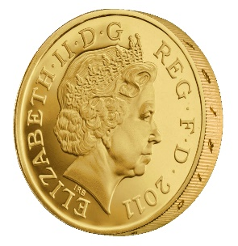
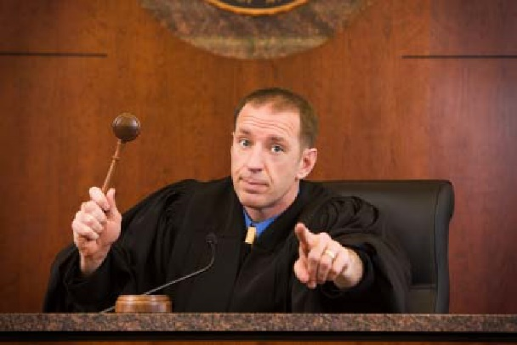
Another Equivalent Definition (Game)
m₀, m₁
Random bit b
K ← Gen(.)
c = Enc_{K}(m_{b})
c
b’
$$∀\begin{matrix} & \\ & \\ & \end{matrix} Pr\left[\begin{matrix} & \\ & \end{matrix} Guesses b^{′}=b\right]=\frac{1}{2}$$
Notes:
Suppose we have m,m’,c’ s.t. Pr[EncK(m)= c’] > Pr[EncK(m’)=c’] then adversary can select m0= m, m1=m’. If the ciphertext challenge c=c’ then the adversary outputs guess b’ = 1. Otherwise, the adversary outputs random guess b’.

Slide 68
Another Equivalent Definition (Game)
$Formally, let Π= \left(Gen,Enc,Dec\right) denote the encryption scheme,$and let A denote an eavesdropping attacker. $Call the game the adversarial indistinguishability experiment and$
$$define a random variable{ PrivK}_{A,Π }^{eav} as follows$$
$${ PrivK}_{A,Π }^{eav}=\left\{\begin{matrix}1 & if b=b^{′}(attacker is correct) \\ 0 & otherwise(attacker is not correct)\end{matrix}\right.$$
$$Π has indistinguishable encryptions in the presence of$$
$an eavesdropper if for all eavesdropping adversaries A we have$
$$Pr\left[{PrivK}_{A,Π }^{eav}=1\right]=\frac{1}{2}$$
m₀, m₁
Random bit b
K = Gen(.)
c = Enc_{K}(m_{b})
c
b’
$$∀\begin{matrix} & \\ & \\ & \end{matrix} Pr\left[\begin{matrix} & \\ & \end{matrix} Guesses b^{′}=b\right]=\frac{1}{2}$$
Notes:
Suppose we have m,m’,c’ s.t. Pr[EncK(m)= c’] > Pr[EncK(m’)=c’] then adversary can select m0= m, m1=m’. If the ciphertext challenge c=c’ then the adversary outputs guess b’ = 1. Otherwise, the adversary outputs random guess b’.

Slide 69
Another Equivalent Definition (Game)
m₀, m₁
Random bit b
K ← Gen(.)
c = Enc_{K}(m_{b})
c
b’
Suppose we have m,m’,c’ s.t. Pr[Enc_{K}(m)= c’] > Pr[Enc_{K}(m’)=c’] then the adversary can win the game w.p > ½. How?
What else do we need to establish to prove that the definitions are equivalent?
Notes:
Suppose we have m,m’,c’ s.t. Pr[EncK(m)= c’] > Pr[EncK(m’)=c’] then adversary can select m0= m, m1=m’. If the ciphertext challenge c=c’ then the adversary outputs guess b’ = 1. Otherwise, the adversary outputs random guess b’. Let Wins
Denote the event that the attacker wins the game.
Pr[Wins|c!=c’] = 1/2
Pr[Wins|c=c’] = Pr[b=1|c=c’] = Pr[b=1 and c=c’]/Pr[c=c’] = (1/2)Pr[Enck(m1)=c’]/Pr[c=c’]
Pr[Wins|c=c’] *Pr[c=c’] = (1/2) Pr[Enck(m1)]
Pr[Wins] = Pr[Wins|c!=c’]*Pr[c!=c’] + Pr[c=c’]*Pr[Wins|c=c’] = (½)*Pr[c!=c’]+(½) Pr[Enck(m1)] = (½) (1-½ * Pr[Enck(m0)=c’]-½ Pr[Enck(m1)=c’]) ’]+(½) Pr[Enck(m1)] = ½ – ¼ Pr[Enck(m0)=c’] + ¼ Pr[Enck(m1)=c’] > ½
The above derivation only establishes one direction of the proof.
Suppose now that for all m,m’, c’ we have Pr[Enc_{K}(m)= c’] = Pr[Enc_{K}(m’)=c’] . Now we need to argue that the adversary cannot win the game with probability > ½. How to argue? Let m0,m1 denote the messages played in round 1, and let c be the challenge cipher text sent in round 2. Note that Pr[Enc_{K}(m₀)= c’] = Pr[Enc_{K}(m₁)=c’] (by definition) so we have
Pr[b=1 | c] = Pr[b and c]/Pr[c] = (1/2) Pr[Enc_{K}(m₁)=c]/ Pr[c] = (1/2) Pr[Enc_{K}(m₀)=c]/ Pr[c] = Pr[b=0|c]
Note that Pr[b=1 | c] +Pr[b=0|c] =1. Thus, Pr[b=0|c] = ½ and Pr[b=1|c] = ½ so whatever bit b’ the attacker guesses after seeing c he will win with probability ½.
QED.

Slide 70
One Time Pad [Vernam 1917]
$${Enc}_{K}\left(m\right)=K⨁m$$
$${Dec}_{K}\left(c\right)=K⨁c$$
$Example=1011⨁$0011 = ???
Theorem: The one-time pad encryption scheme is perfectly secret
The following calculation holds for any c, m
Pr[Enc_{K}(m)=c] = Pr[$K⨁$m =c] = Pr[K=c$⨁$m] = $1/{\left|𝒦\right|}$.
Thus, for any m, m’, c we have
Pr[Enc_{K}(m)=c]=$1/{\left|𝒦\right|}$ =Pr[Enc_{K}(m’)=c].
Notes:
The following calculation holds for any c, m’ Pr[C=c|M=m’] = Pr[Enc_{K}(m’)=c] = Pr[$K⨁$m’ =c] = Pr[K=c$⨁$m’] = $1/{\left|𝒦\right|}$

Slide 71
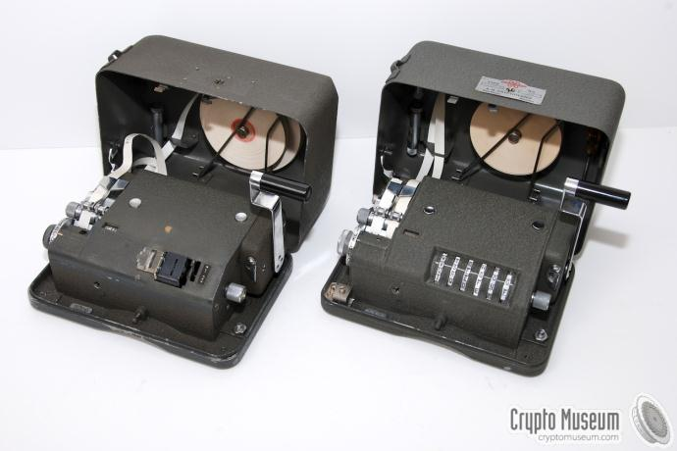
One Time Pad [Vernam 1917]
$${Enc}_{K}\left(m\right)=K⨁m$$
$${Dec}_{K}\left(c\right)=K⨁c$$
$Example=1011⨁$0011 = ???
Notes:
Examples

Slide 72
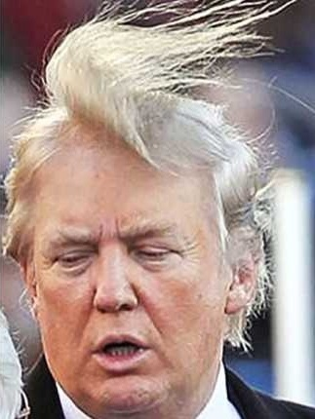
One Time Pad

Slide 73
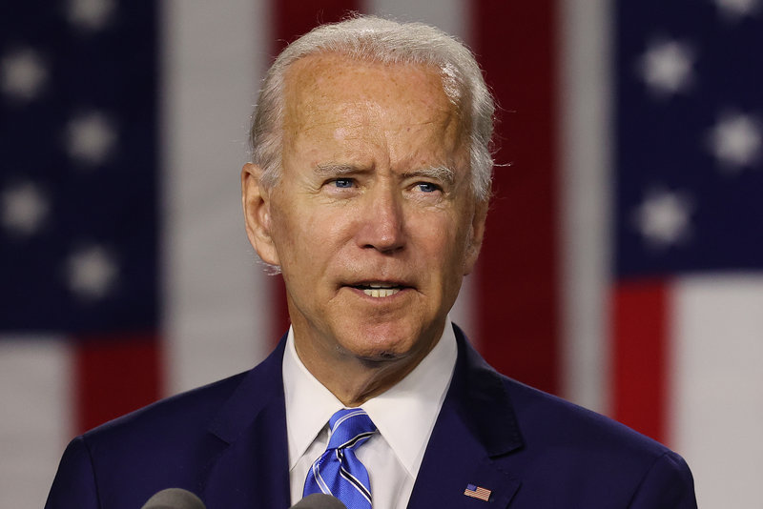
One Time Pad

Slide 74
Perfect Secrecy Limitations
Theorem: If (Gen,Enc,Dec) is a perfectly secret encryption scheme then
$$\left|𝒦\right|≥\left|ℳ\right|$$
Notes:
Proof: Suppose for contradiction that $\left|𝒦\right|<\left|ℳ\right|$. Given a ciphertext c let $ℳ\left(c\right)=\left\{m\left|m={Dec}_{k}\left(c\right)\right. for some key k ∈𝒦\right\}$. Trivially $\left|ℳ\left(c\right)\right|≤\left|𝒦\right|<\left|ℳ\right|$. This implies that there is some message$m∈ℳ\backslash ℳ\left(c\right)$ so that
$$Pr\left[M=m\left|C=c\right.\right]=0≠Pr\left[M=m\right].$$

Slide 75
One Time Pad Limitations
The key is as long as the message
How to exchange long messages?
Need to exchange/secure lots of one-time pads!
OTPs can only be used once
As the name suggests
VENONA project (US + UK)
Decrypt ciphertexts sent by Soviet Union which were mistakenly encrypted with portions of the same one-time pad over several decades
$$c⨁c^{′}=\left(m⨁k\right)⨁\left(m^{′}⨁k\right)=m⨁m′$$
Notes:
Other Limitations?
Integrity

Slide 76
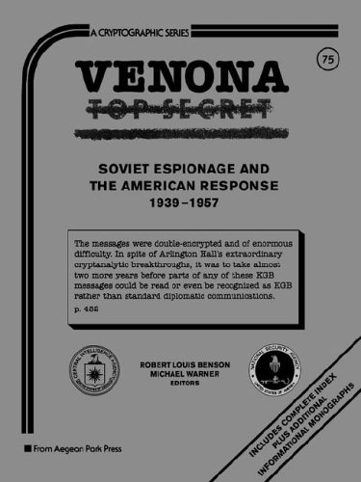
VENONA project

Slide 77
Shannon’s Theorem
Theorem: Let (Gen,Enc,Dec) be an encryption scheme with $\left|𝒦\right|=\left|ℳ\right|=\left|𝒞\right|.$Then the scheme is perfectly secret if and only if:
Every key k $∈$ $𝒦$ is chosen with (equal) probability $1/{\left|𝒦\right|}$ by the algorithm Gen, and
For every $m∈ℳ$ and every $c∈𝒞$ there exists a unique key k $∈$ $𝒦$such that Enc_{k}(m)=c$.$

Slide 78
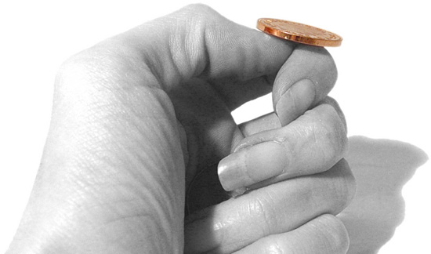
An Important Remark on Randomness
In our analysis we have made (and will
continue to make) a key assumption:
We have access to true “randomness”
to generate a secret key K
Example: K = one time pad
Independent Random Bits
Unbiased Coin flips
Radioactive decay?

Slide 79
In Practice
Hard to flip thousands/millions of coins
Mouse-movements/keys
Uniform bits?
Independent bits?
Use Randomness Extractors
As long as input has high entropy, we can extract (almost) uniform/independent bits
Hot research topic in theory

Slide 80
In Practice
Hard to flip thousands/millions of coins
Mouse-movements/keys
Customized Randomness Chip?

Slide 81
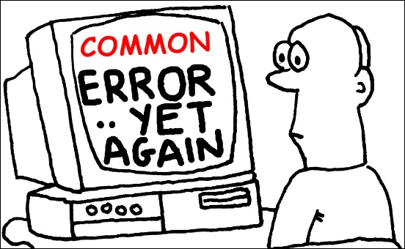
Caveat: Don’t do this!
Rand() in C stdlib.h is no good for cryptographic applications
Source of many real
world flaws

Slide 82
Perfect Secrecy
What capabilities do we assume the attacker has?
Eavesdropping (Passive Adversary)
That’s it!
Implicit Assumption: No ability to tamper with messages!
Remark on One-Time Pads: If attacker has the ability to tamper with the ciphertext then s/he can easily flip the last bit of the message. How?
Answer: Flip the last bit of the intercepted ciphertext $c=K⨁m$ to obtain
$c^{′}=c⨁00…01$
$${Dec}_{K}\left(c′\right)=K⨁c^{′}=\left(K⨁c\right)⨁00…01=m⨁00…01$$

Slide 83
Perfect Secrecy
Would it be appropriate to use one time pads for message broadcast?
(assume lifetime supply of one-time pads already exchanged)

Slide 84
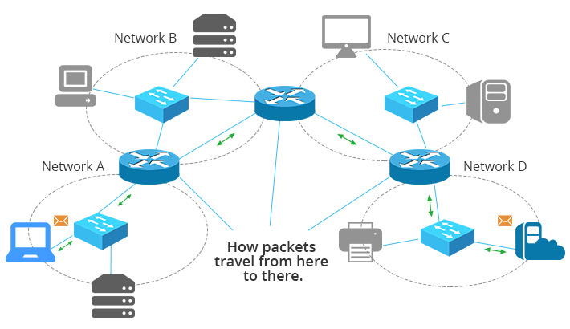
Perfect Secrecy
Would it be appropriate to use one time pads for message routing on the internet? (assume lifetime supply of one-time pads already exchanged)

Slide 85
Week 1: Topic 4: Computational Security

Slide 86
Recap
Perfect Secrecy, One-time-Pads
Theorem: If (Gen,Enc,Dec) is a perfectly secret encryption scheme then
$$\left|𝒦\right|≥\left|ℳ\right|$$

Slide 87
What if we want to send a longer message?
K₁,K₂,K₃
K₁,K₂,K₃
$${Enc}_{K_{1}}\left("Dear Alice, I wrote this poem for you"\right)$$
$${Enc}_{K_{2}}\left("Roses are red, …."\right)$$
$${Enc}_{K_{3}}\left("I am out of space, but the rest was awesome"\right)$$
Notes:
Alice doesn’t respond to Bob since they are out of one-time-pads so they stop talking. Can we save their relationship?

Slide 88
What if we want to send many messages?
K₁,K₂,K₃
K₁,K₂,K₃
$${Enc}_{K_{1}}\left("Whats up, Alice?"\right)$$
$${Enc}_{K_{2}}\left("Not too much, you?"\right)$$
$${Enc}_{K_{3}}\left("Just chilling out"\right)$$
Notes:
Alice doesn’t respond to Bob since they are out of one-time-pads so they stop talking. Can we save their relationship?

Slide 89
Can we save their relationship?
K₁,K₂,K₃
K₁,K₂,K₃
$${Enc}_{K_{1}}\left("Whats up, Alice?"\right)$$
$${Enc}_{K_{2}}\left("Not too much, you?"\right)$$
$${Enc}_{K_{3}}\left("Just chilling out"\right)$$
Notes:
Alice doesn’t respond to Bob since they are out of one-time-pads so they stop talking. Can we save their relationship?

Slide 90
Perfect Secrecy vs Computational Security
Perfect Secrecy is Information Theoretic
Guarantee is independent of attacker resources
Computational Security
Security against computationally bounded attacker
An attacker with infinite resources might break security
Attacker might succeed with very small probability
Example: Lucky guess reveals secret key
Very Small Probability: $2^{−100},$ $2^{−1000}$, …

Slide 91
Current Goal
Define computational security in presence of eavesdropper who intercepts a single (long) message
If you don’t understand what you want to achieve, how can you possibly know when (or if) you have achieved it?
Show how to build a symmetric encryption scheme with computational security in the presence of an eavesdropper.
Define computational security against an active attacker who might modify the message
Define computational security for multiple messages in presence of an eavesdropper

Slide 92
Concrete Security
“A scheme is (t,ε)-secure if every adversary running for time at most t succeeds in breaking the scheme with probability at most ε”
Example: t = 2⁶⁰ CPU cycles
9 years on a 4GHz processor
< 1 minute on fastest supercomputer (in parallel)
Full formal definition needs to specify “break”
Important Metric in Practice
Caveat 1: difficult to provide/prove such precise statements
Caveat 2: hardware improves over time

Slide 93
Asymptotic Approach to Security
A scheme is secure if every probabilistic polynomial time (ppt) adversary “succeeds” with negligible probability.
Two Key Concepts
Polynomial time algorithm
Negligible Function
Definition: A function $f: ℕ⟶ℝ_{≥0}$ is negligible if for every positive polynomial p there is an integer N>0 such that for all n > N we have
$$f(n)<\frac{1}{p(n) }$$

Slide 94
Asymptotic Approach to Security
Definition: A function $f: ℕ⟶ℝ_{≥0}$ is negligible if for every positive polynomial $p\left(.\right)>0$ there is an integer N>0 such that for all n > N we have
$$f(n)<\frac{1}{p(n) }$$
Intuition: If we choose the security parameter n to be sufficiently large then we can make the adversaries success probability very small (negligibly small).

Slide 95
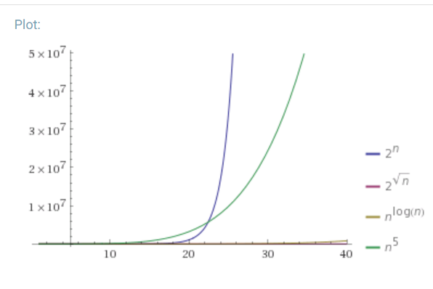
Asymptotic Approach to Security
Definition: A function $f: ℕ⟶ℝ_{≥0}$ is negligible if for every positive polynomial p there is an integer N>0 such that for all n > N we have
$$f(n)<\frac{1}{p(n) }$$
Which functions below are negligible?
${f\left(n\right)=2}^{−n}$
$f\left(n\right)=n^{−5}$
$f\left(n\right)={2^{−1000}1000n}^{1000}$
${f\left(n\right)=2^{100}2}^{−\sqrt{n}}$
${f\left(n\right)=2}^{−\log{n}}$
${f\left(n\right)=n}^{−\log{n}}$

Slide 96
Asymptotic Approach to Security
Definition: A function $f: ℕ⟶ℝ_{≥0}$ is negligible if for every positive polynomial p there is an integer N>0 such that for all n > N we have
$$f(n)<\frac{1}{p(n) }$$
Which functions below are negligible?
${f\left(n\right)=2}^{−n}$
$f\left(n\right)=n^{−5}$
$f\left(n\right)={2^{−1000}1000n}^{1000}$
${f\left(n\right)=2^{100}2}^{−\sqrt{n}}$
${f\left(n\right)=2}^{−\log{n}}$
${f\left(n\right)=n}^{−\log{n}}$

Slide 97
Asymptotic Approach to Security
Definition: An (randomized) algorithm A runs in polynomial time if there exists a polynomial p(.) such that for every n-bit input x, A(x) terminates in at most p(n) steps in expectation.
Intuition: If an algorithm A does not run in polynomial time then, for sufficiently large n, it will quickly become impractical for any attacker to run the algorithm A.

Slide 98
Asymptotic Approach to Security
A scheme is secure if every probabilistic polynomial time (ppt) adversary “succeeds” with negligible probability.
General Attack 1: Test all possible secret keys $k′∈𝒦$
Doesn’t run in polynomial time, since $\left|𝒦\right|=2^{n}$
General Attack 2: Select random key $k^{′}∈𝒦,$check if it is correct (otherwise output $⊥$for “fail”).
Only successful with negligible probability $2^{−n}$

Slide 99
Advantages of Asymptotic Approach
Closure
If subroutine B runs in polynomial time and algorithm A makes poly(n) queries to the subroutine B then A also runs in polynomial time.
If f and g are negligible functions then h(n) = f(n)+g(n) is a negligible function
If p(.) is a positive polynomial, and f(.) is a negligible function then the function g(n)=f(n)p(n) is also negligible.
Church-Turing Thesis: “reasonable” model of computations are all polynomially equivalent.
Implication: No need to worry about different models of computation (circuits, random access machines, etc…)
Disadvantage: Limited guidance on how big to make security parameter n in practice.

Slide 100
Note: Asymptotic vs Concrete Security
Theory of Cryptography: Often follows Asymptotic Approach
Course Textbook (Katz-Lindell) follows the asymptotic approach
Applied Cryptography: Concrete Security Analysis is more useful
This Course: We will consider both approaches

Slide 101
Private Key Encryption Syntax (Revisited)
Message Space: $ℳ$
Key Space: $𝒦$
Three Algorithms
$\operatorname{Gen}{(1^{n};R)}$ (Key-generation algorithm)
Input: 1^{n} (security parameter in unary) + Random Bits R,
Output: Secret key $k∈𝒦$
$\operatorname{Enck}{(m;R)}$ (Encryption algorithm)
Input: Secret key $k∈𝒦$ and message $m∈ℳ$ + Random Bits R,
Output: ciphertext c
$\operatorname{Deck}{(c)}$ (Decryption algorithm)
Input: Secret key $k∈𝒦$ and a ciphertex$c$
Output: a plaintext message $m∈ℳ$ or $⊥(i.e$“Fail”)
Invariant: Dec_{k}(Enc_{k}(m))=m
Requirement: all three algorithms run in probabilistic polynomial time
Trusted Parties (e.g., Alice and Bob) must run Gen in advance to obtain secret k.
Typically picks $k∈𝒦$
uniformly at random
Quick Comment on Notation:
$K=\operatorname{Gen}{(1^{n};R)}$ vs.
$K←\operatorname{Gen}{(1^{n})}$

Slide 102
Private Key Encryption Syntax (Revisited)
Message Space: $ℳ$
Key Space: $𝒦$
Three Algorithms
$\operatorname{Gen}{(1^{n};R)}$ (Key-generation algorithm)
Input: 1^{n} (security parameter in unary) + Random Bits R,
Output: Secret key $k∈𝒦$
$\operatorname{Enck}{(m;R)}$ (Encryption algorithm)
Input: Secret key $k∈𝒦$ and message $m∈ℳ$ + Random Bits R,
Output: ciphertext c
$\operatorname{Deck}{(c)}$ (Decryption algorithm)
Input: Secret key $k∈𝒦$ and a ciphertex$c$
Output: a plaintext message $m∈ℳ$ or $⊥(i.e$“Fail”)
Invariant: Dec_{k}(Enc_{k}(m))=m
Requirement: all three algorithms run in probabilistic polynomial time
Trusted Parties (e.g., Alice and Bob) must run Gen in advance to obtain secret k.
Typically picks $k∈𝒦$
uniformly at random
Quick Comment on Notation:
$K=\operatorname{Gen}{(1^{n};R)}$ vs.
$K←\operatorname{Gen}{(1^{n})}$

Slide 103
Adversarial Indistinguishability Experiment
m₀, m₁
Random bit b
K ← Gen(1^{n})
c ← Enc_{K}(m_{b})
c
b’
$$∀\begin{matrix} & \\ & ∃μ \\ & \end{matrix} Pr\left[\begin{matrix} & \\ & \end{matrix} Guesses b^{′}=b\right]≤\frac{1}{2}+μ_{}(n)$$
$$ppt attacker$$
$$negligible function$$
$$negligible function$$

Slide 104
Adversarial Indistinguishability Experiment
$$Formally, let Π= \left(Gen,Enc,Dec\right) denote the encryption scheme,$$
$$call the game the adversarial indistinguishability experiment and$$
$$define a random variable{ PrivK}_{A,Π }^{eav}\left(\text{1}\text{n}\right) as follows$$
$${ PrivK}_{A,Π }^{eav}\left(\text{1}\text{n}\right)=\left\{\begin{matrix}1 & if b=b′ \\ 0 & otherwise\end{matrix}\right.$$
$$Π has indistinguishable encryptions in the presence of$$
$$an eavesdropper if for all PPT adversary A, there exists a$$
negligible function $μ(.)$ such that
Pr[${PrivK}_{A,Π }^{eav}=1$] $≤\frac{1}{2}+μ(n)$
m₀, m₁
Random bit b
K = Gen(1^{n})
c = Enc_{K}(m_{b})
c
b’
$$∀\begin{matrix} & \\ & \\ & \end{matrix} Pr\left[\begin{matrix} & \\ & \end{matrix} Guesses b^{′}=b\right]≤\frac{1}{2}+μ(n)$$
$$ppt attacker$$
$$negligible function$$

Slide 105
EAV-Secure
m₀, m₁
Random bit b
K ← Gen(1^{n})
c ← Enc_{K}(m_{b})
c
b’
$$∀\begin{matrix} & \\ & ∃μ \\ & \end{matrix} Pr\left[\begin{matrix} & \\ & \end{matrix} Guesses b^{′}=b\right]≤\frac{1}{2}+μ_{}(n)$$
$$ppt attacker$$
$$negligible function$$
$$negligible function$$

Slide 106
EAV-Secure (Equivalent)
m₀, m₁
Random bit b
K ← Gen(1^{n})
c ← Enc_{K}(m_{b})
c
b’
$$∀\begin{matrix} & \\ & ∃μ \\ & \end{matrix} Pr\left[\begin{matrix} & \\ & \end{matrix} Guesses b^{′}=b\right]≤\frac{1}{2}+μ_{}(n)$$
$$ppt attacker$$
$$negligible function$$
$$negligible function$$

Slide 107
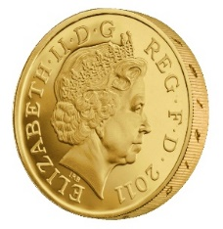
$\left(t\left(n\right),ε\left(n\right)\right)$-EAV-Secure (Concrete Version)
m₀, m₁
Random bit b
K ← Gen(1^{n})
c = Enc_{K}(m_{b})
c
b’
$$∀\begin{matrix} & \\ & \\ & \end{matrix} Pr\left[\begin{matrix} & \\ & \end{matrix} Guesses b^{′}=b\right]≤\frac{1}{2}+ε(n)$$
$$running in time at most t(n)$$
$$specific function$$
(same for all attackers)
Notes:
Suppose we have m,m’,c’ s.t. Pr[EncK(m)= c’] > Pr[EncK(m’)=c’] then adversary can select m0= m, m1=m’. If the ciphertext challenge c=c’ then the adversary outputs guess b’ = 1. Otherwise, the adversary outputs random guess b’.

Slide 108
Aside: Message and Ciphertext Length
In the previous game we typically require that |m₀|=|m₁|. Why?
It is impossible to support arbitrary length messages while hiding all information about plaintext length
Limitation: When could message length be sensitive?
Numeric data (5 figure vs 6 figure salary)
Database Searches: number of records returned can reveal information about the query
Compressed Data: Short compressed string indicates that original plaintext has a lot of redundancy (e.g., CRIME attack on session cookies in HTTPS)

Slide 109
Implications of Indistinguishability
i^{th} bit of message
Theorem 3.10: Let (Gen, Enc, Dec) be a fixed-length private key encryption scheme for message of length $ℓ$ that satisfies indistinguishability (prior definition) then for all PPT attackers A and any $i≤ℓ$ we have
$$Pr\left[A\left(1^{n},{Enc}_{K}\left(m\right)\right)=m^{i}\right]≤\frac{1}{2}+negl(n)$$
Where the randomness is taken over $K←Gen\left(1^{n}\right)$, uniform $m∈{\left\{0,1\right\}}^{ℓ}$ and the randomness of $Enc$ and A.
Remark: A bit weaker than saying eavesdropping attacker obtains ``no additional” information about message m.

Slide 110
Semantic Security
Definition 3.12: Let $Π=\left(\text{Gen}\text{, }\text{Enc}\text{, }\text{Dec}\right)$be a fixed-length private key encryption scheme for message of length $ℓ$. We say that the scheme is semantically secure if for all PPT attackers A there exists a PPT algorithm A’ such that for any PPT algorithm Sample all any polynomial time computable functions f and h we have
$$\left|Pr\left[A\left(1^{n},{Enc}_{K}\left(m\right),h(m)\right)=f(m)\right]−Pr\left[A′\left(1^{n},\left|m\right|,h(m)\right)=f(m)\right]\right|≤negl(n)$$
Where the randomness is taken over $K←Gen\left(1^{n}\right)$, $m←Samp\left(1^{n}\right)$ and the randomness of $Enc$, A and A’.

Slide 111
Semantic Security
A’ doesn’t even get to see an encryption of m! Just the length of m!
h(m) background knowledge the attacker might have about m.
Example:
f(m) = 1 if m > 100,000;
f(m) = 0 otherwise .
Definition 3.12: Let $Π=\left(\text{Gen}\text{, }\text{Enc}\text{, }\text{Dec}\right)$be a fixed-length private key encryption scheme for message of length $ℓ$. We say that the scheme is semantically secure if for all PPT attackers A there exists a PPT algorithm A’ such that for any PPT algorithm Sample all any polynomial time computable functions f and h we have
$$\left|Pr\left[A\left(1^{n},{Enc}_{K}\left(m\right),h(m)\right)=f(m)\right]−Pr\left[A′\left(1^{n},\left|m\right|,h(m)\right)=f(m)\right]\right|≤negl(n)$$
Where the randomness is taken over $K←Gen\left(1^{n}\right)$, $m←Samp\left(1^{n}\right)$ and the randomness of $Enc$, A and A’.

Slide 112
Semantic Security
Definition 3.12: Let $Π=\left(\text{Gen}\text{, }\text{Enc}\text{, }\text{Dec}\right)$be a fixed-length private key encryption scheme for message of length $ℓ$. We say that the scheme is semantically secure if for all PPT attackers A there exists a PPT algorithm A’ such that for any PPT algorithm Sample all any polynomial time computable functions f and h we have
$$\left|Pr\left[A\left(1^{n},{Enc}_{K}\left(m\right),h(m)\right)=f(m)\right]−Pr\left[A′\left(1^{n},\left|m\right|,h(m)\right)=f(m)\right]\right|≤negl(n)$$
Where the randomness is taken over $K←Gen\left(1^{n}\right)$, $m←Samp\left(1^{n}\right)$ and the randomness of $Enc$, A and A’.
Theorem 3.13. (Equivalent Definitions) $Π$ is Semantically secure if and only if $Π$ has indistinguishable encryptions in the presence of an eavesdropper.

Slide 113
Another Interpretation of Semantic Security
World 2: Perfect Secrecy (Attacker doesn’t even see ciphertext).
For all attackers A’ (even unbounded) with background knowledge h(m) we have
$$Pr\left[A′\left(1^{n},\left|m\right|,h(m)\right)=f(m)\right]=Pr\left[f(m)\left| h\left(m\right),\right.\left|m\right|\right]$$
World 1: Attacker is PPT and sees ciphertext
Best World 1 attacker does no better than World 2 attacker
$\left|Pr\left[A\left(1^{n},{Enc}_{K}\left(m\right),h(m)\right)=f(m)\right]−Pr\left[A′\left(1^{n},\left|m\right|,h(m)\right)=f(m)\right]\right|≤negl(n)$
What is probability over?

Slide 114
Coming Up in Week 2…
Computational Security
Pseudorandomness + Stream Ciphers
Chosen Plaintext Attacks and CPA Security
Week 2 Reading: Katz and Lindell 3.1-3.4

