Slide 1
Cryptography CS 555
Topic 9: Message Authentication Codes

Slide 2
Reminder: Homework 1
Due on Friday at the beginning of class
Please typeset your solutions

Slide 3
Recap
CPA-Security vs. CCA-Security
PRFs
Today’s Goals:
Introduce Message Authentication Codes (MACs)
Key tool in Construction of CCA-Secure Encryption Schemes
Build Secure MACs

Slide 4
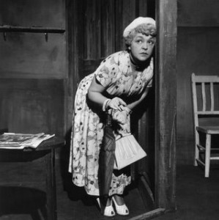
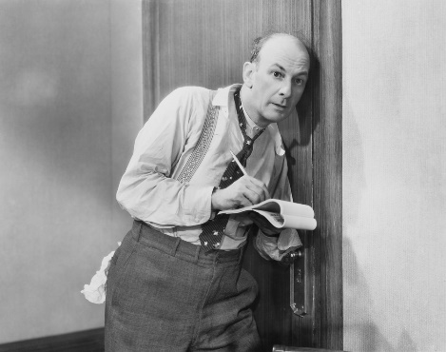
What Does It Mean to “Secure Information”
Confidentiality (Security/Privacy)
Only intended recipient can see the communication

Slide 5
What Does It Mean to “Secure Information”
Confidentiality (Security/Privacy)
Only intended recipient can see the communication
Integrity (Authenticity)
The message was actually sent by the alleged sender
I love you Alice… - Bob
We need to break up -Bob
Alice
Bob

Slide 6
Message Authentication Codes
CPA-Secure Encryption: Focus on Secrecy
But does not promise integrity
Message Authentication Codes: Focus on Integrity
But does not promise secrecy
CCA-Secure Encryption: Requires Integrity and Secrecy

Slide 7
What Does It Mean to “Secure Information”
Integrity (Authenticity)
The message was actually sent by the alleged sender
And the received message matches the original
Pay robot devil $50
Pay robot devil $5,000
Alice
Bob
Notes:
Example: HTTP is stateless. Cookies can be stored on the client, but can the server trust the client not to modify the cookie?

Slide 8
Error Correcting Codes?
Tool to detect/correct a small number of random errors in transmission
Examples: Parity Check, Reed-Solomon Codes, LDPC, Hamming Codes …
Provides no protection against a malicious adversary who can introduce an arbitrary number of errors
Still useful when implementing crypto in the real world (Why?)

Slide 9
Modifying Ciphertexts
$$\text{Enc}\text{k}\text{(}\text{m}\text{)}=c=\left\langle r,F_{k}\left(r\right)⨁m\right\rangle$$
$$c^{′}=\left\langle r,F_{k}\left(r\right)⨁m⨁y\right\rangle$$
$$\text{Dec}\text{k} {(c}^{′})=F_{k}\left(r\right)⨁F_{k}\left(r\right)⨁m⨁y=m⨁y$$
If attacker knows original message he can forge c’ to decrypt to any message he wants.
Even if attacker doesn’t know message he may find it advantageous to flip certain bits (e.g., decimal places)

Slide 10
Message Authentication Code Syntax
Definition 4.1: A message authentication code (MAC) consists of three algorithms
$\operatorname{Gen}{(1^{n};R)}$ (Key-generation algorithm)
Input: security parameter 1^{n} (unary) and random bits R
Output: Secret key $k∈𝒦$
$\operatorname{Mack}{(m;R)}$ (Tag Generation algorithm)
Input: Secret key $k∈𝒦$ and message $m∈ℳ$ and random bits R
Output: a tag t
$\operatorname{Vrfyk}{(m,t)}$ (Verification algorithm)
Input: Secret key $k∈𝒦,$ a message m and a tag t
Output: a bit b (b=1 means “valid” and b=0 means “invalid”)
Invariant?

Slide 11
Message Authentication Code Syntax
Definition 4.1: A message authentication code (MAC) consists of three algorithms
$\operatorname{Gen}{(1^{n};R)}$ (Key-generation algorithm)
Input: security parameter 1^{n} (unary) and random bits R
Output: Secret key $k∈𝒦$
$\operatorname{Mack}{(m;R)}$ (Tag Generation algorithm)
Input: Secret key $k∈𝒦$ and message $m∈ℳ$ and random bits R
Output: a tag t
$\operatorname{Vrfyk}{(m,t)}$ (Verification algorithm)
Input: Secret key $k∈𝒦,$ a message m and a tag t
Output: a bit b (b=1 means “valid” and b=0 means “invalid”)
Invariant?

Slide 12
Message Authentication Code Syntax
Definition 4.1: A message authentication code (MAC) consists of three algorithms $Π=\left(Gen, Mac, Vrfy\right)$
$\operatorname{Gen}{(1^{n};R)}$ (Key-generation algorithm)
Input: security parameter 1^{n} (unary) and random bits R
Output: Secret key $k∈𝒦$
$\operatorname{Mack}{(m;R)}$ (Tag Generation algorithm)
Input: Secret key $k∈𝒦$ and message $m∈ℳ$ and random bits R
Output: a tag t
$\operatorname{Vrfyk}{(m,t)}$ (Verification algorithm)
Input: Secret key $k∈𝒦,$ a message m and a tag t
Output: a bit b (b=1 means “valid” and b=0 means “invalid”)
$$\operatorname{Vrfyk}{(m,\operatorname{Mack}{(m;R)})}=1$$

Slide 13
General vs Fixed Length MAC
$$ℳ={\left\{0,1\right\}}^{∗}$$
versus
$$ℳ={\left\{0,1\right\}}^{ℓ(n)}$$

Slide 14
Deterministic MACs
Canonical Verification Algorithm
$$\operatorname{Vrfyk}{(m,t)}=\left\{\begin{aligned}\begin{matrix}1 & if t=Mack(m)\end{matrix} \\ \begin{matrix}0 & otherwise\end{matrix}\end{aligned}\right.{}$$
“All real-world MACs use canonical verification” – page 115

Slide 15
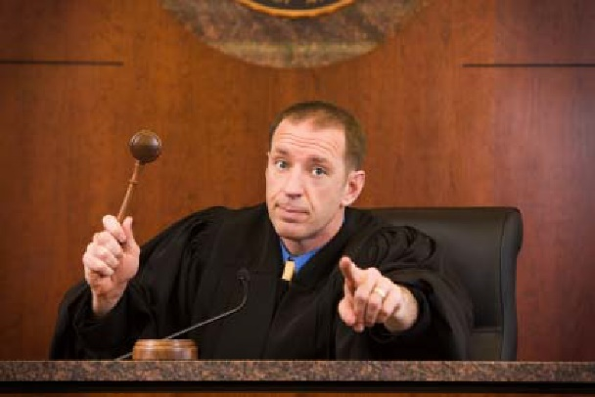
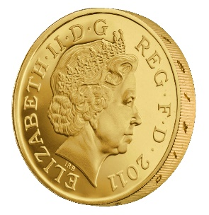
MAC Authentication Game (${Macforge}_{A,Π}(n)$)
m₁
t₁ = Mac_{K}(m₁)
m₂
…
t₂ = Mac_{K} (m₂)
m_{q}
t_{q} = Mac_{K}(m_{q})
$\left(m,t\right)$ s.t $m∉\left\{m1,…,m_{q}\right\}$
$${Macforge}_{A,Π}(n)=Vrfyk{(m,t)}$$
K = Gen(.)
$$∀PPT A ∃μ (negligible) s.t$$
$$Pr\left[{Macforge}_{A,Π}\left(n\right)=1\right]≤μ(n)$$

Slide 16
Discussion
Is the definition too strong?
Attacker wins if he can forge any message
Does not necessarily attacker can forge a “meaningful message”
“Meaningful Message” is context dependent
Conservative Approach: Prove Security against more powerful attacker
Conservative security definition can be applied broadly
Replay Attacks?
t=Mac_{K}(“Pay Bob $1,000 from Alice’s bank account”)
Alice cannot modify message to say $10,000, but…
She may try to replay it 10 times

Slide 17
Replay Attacks
MACs alone do not protect against replay attacks (they are stateless)
Common Defenses:
Include Sequence Numbers in Messages (requires synchronized state)
Can be tricky over a lossy channel
Timestamp Messages
Double check timestamp before taking action

Slide 18
Strong MACs
Previous game ensures attacker cannot generate a valid tag for a new message.
However, attacker may be able to generate a second valid tag t’ for a message m after observing (m,t)
Strong MAC: attacker cannot generate second valid tag, even for a known message

Slide 19
Strong MAC Authentication (${Macsforge}_{A,Π}(n)$)
m₁
t₁ = Mac_{K}(m₁)
m₂
…
t₂ = Mac_{K} (m₂)
m_{q}
t_{q} = Mac_{K}(m_{q})
$\left(m,t\right)$ s.t $\left(m,t\right)∉\left\{(m1,t1),…,(mq,tq)\right\}$
$${Macsforge}_{A,Π}(n)=Vrfyk{(m,t)}$$
K = Gen(.)
$$∀PPT A ∃μ (negligible) s.t$$
$$Pr\left[{Macsforge}_{A,Π}\left(n\right)=1\right]≤μ(n)$$

Slide 20
Strong MAC vs Regular MAC
Proposition 4.4: Let $Π=\left(Gen, Mac, Vrfy\right)$ be a secure MAC that uses canonical verification. Then $Π$ is a strong MAC.
“All real-world MACs use canonical verification” – page 115
Should attacker have access to Vrfy_{K}(.) oracle in games?
(e.g., CPA vs CCA security for encryption)
Irrelevant if the MAC uses canonical verification!

Slide 21
Timing Attacks (Side Channel)
Naïve Canonical Verification Algorithm
Input: m,t’
t=Mac_{K}(m)
for i=1 to tag-length
if t[i] != t’[i] then
return 0
return 1
Example
t= 1 0 1 0 1 1 1 0
t’= 1 0 1 0 1 0 1 1
Returns 0 after 8 steps

Slide 22
Timing Attacks (Side Channel)
Naïve Canonical Verification Algorithm
Input: m,t’
t=Mac_{K}(m)
for i=1 to tag-length
if t[i] != t’[i] then
return 0
return 1
Example
t= 1 0 1 0 1 1 1 0
t’= 0 0 1 0 1 0 1 0
Returns 0 after 1 step

Slide 23
Timing Attack
MACs used to verify code updates for Xbox 360
Implementation allowed different rejection times (side-channel)
Attacks exploited vulnerability to load pirated games onto hardware
Moral: Ensure verification is time-independent

Slide 24
Improved Canonical Verification Algorithm
Input: m,t’
B=1
t=Mac_{K}(m)
for i=1 to tag-length
if t[i] != t’[i] then
B=0
else (dummy op)
return B
Example
t= 1 0 1 0 1 1 1 0
t’= 0 0 1 0 1 0 1 0
Returns 0 after 8 steps

Slide 25
Side-Channel Attacks
Cryptographic Definition
Attacker only observes outputs of oracles (Enc, Dec, Mac) and nothing else
When attacker gains additional information like timing (not captured by model) we call it a side channel attack.
Other Examples
Differential Power Analysis
Cache Timing Attack
Power Monitoring
Acoustic Cryptanalysis
…many others

Slide 26
Next Class
Read Katz and Lindell 4.3
Message Authentication Codes (MACs) Part 2
Constructing Secure MACs

