Slide 1
Cryptography CS 555
Topic 8: Modes of Encryption, The Penguin and CCA security

Slide 2
Reminder: Homework 1
Due on Friday at the beginning of class
Please typeset your solutions

Slide 3
Recap
Pseudorandom Functions
CPA-Security
Today’s Goals:
Evaluate several modes of operation for stream-ciphers + block-ciphers
Introduce Chosen Ciphertext Attacks/CCA-Security
Construct encryption scheme with CCA-Security

Slide 4
Chosen Ciphertext Attacks
Sometimes an attacker has ability to obtain (partial) decryptions of ciphertexts of its choice.
CPA-Security does not model this ability.
Examples:
An attacker may learn that a ciphertext corresponds to an ill-formed plaintext based on the reaction (e.g., server replies with “invalid message”).
Monitor enemy behavior after receiving and encrypted message.
Authentication Protocol: Send Enc_{k}(r) to recipient who authenticates by responding with r.

Slide 5
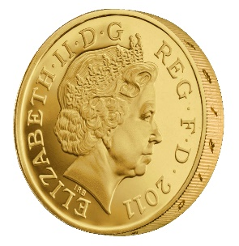
CCA-Security (Ind-CCA2)
We could set m₀ = m₋₁ or m₁ = m₋₂
m₋₁
c₋₁ = Enc_{K}(m₋₁)
c₋₂
…
m₋₂ = Dec_{K}(c₋₂)
m₀,m₁
However, we could still flip 1 bit of c and ask challenger to decrypt
c = Enc_{K}(m_{b})
m₃
c₂ = Enc_{K}(m₂)
Random bit b
K = Gen(.)
c₃
m₃ = Dec_{K}(m₃)
c₄ =c
…
“No Way!”
b’

Slide 6
CCA-Security $\left({PrivK}_{A,Π}^{cca}\left(n\right)\right)$
Challenger generates a secret key k and a bit b
Adversary (A) is given oracle access to Enc_{k} and Dec_{k}
Adversary outputs m₀,m₁
Challenger sends the adversary c=Enc_{k}(m_{b}).
Adversary maintains oracle access to Enc_{k} and Dec_{k} ,however the adversary is not allowed to query Dec_{k}(c).
Eventually, Adversary outputs b’.
$${PrivK}_{A,Π}^{cca}\left(n\right)=1 if b=b^{′};otherwise 0.$$
CCA-Security: For all PPT A exists a negligible function negl(n) s.t.
$$Pr\left[{PrivK}_{A,Π}^{cca}\left(n\right)=1\right]≤\frac{1}{2}+negl(n)$$

Slide 7
CCA-Security
Definition 3.33: An encryption scheme $Π$ is CCA-secure if for all PPT A there is a negligible function negl(n) such that
$$Pr\left[{PrivK}_{A,Π}^{cca}\left(n\right)=1\right]≤\frac{1}{2}+negl(n)$$

Slide 8
CPA-Security doesn’t imply CCA-Security
$$\text{Enc}\text{k}\text{(}\text{m}\text{)}=\left\langle r,F_{k}\left(r\right)⨁m\right\rangle$$
Attacker: Selects m₀ = 0^{n} and m₁ = 1^{n}
Attacker Receives: $c=\left\langle r, s\right\rangle$ ${\text{where} s=F}_{k}\left(r\right)⨁m_{b}$
Attacker Queries: Dec_{k}(c’) for
$$c′=\left\langle r,s⨁{10}^{n−1}\right\rangle$$
Attacker Receives: ${10}^{n−1}$ (if b=0) or ${01}^{n−1}$ (if b=1)
Example Shows: CCA-Security doesn’t imply CCA1 Security (Why?)

Slide 9
Attacks in the Wild
Padding Oracle Attack
Length of plaintext message must be multiple of block length
Popular fix PKCS #5 padding
4 bytes of padding (0x04040404)
3 bytes of padding (0x030303)
“Bad Padding Error”
Adversary submits ciphertext(s) and waits to if this error is produced
Attacker can repeatedly modify ciphertext to reveal original plaintext piece by piece!

Slide 10
Example
M=“hello…please keep this message secret”+0x030303
$$C=\left\langle r,s=F_{k}\left(r\right)⨁m\right\rangle$$
$C^{′}=\left\langle r,F_{k}\left(r\right)⨁m⨁\text{0}\text{x}\text{0000}….\text{30}\text{000} \right\rangle$
Ask to decrypt C’
If we added < 3 bits of padding C’ can be decrypted.
Otherwise, we will get a decryption error.
Once we know we have three bits of padding we can set
$$C^{′′}=\left\langle r,s=F_{k}\left(r\right)⨁\text{0}\text{x}\text{0000}….\text{30}\text{3}\text{0}\text{3}⨁\text{0}\text{x}\text{0}…gg0\text{4}\text{0}\text{4}\text{0}\text{4}\right\rangle$$
If C’’ decrypts then we can infer the last byte “t” from $gg⨁0x04$.

Slide 11
CCA-Security
Gold Standard: CCA-Security is strictly stronger than CPA-Security
If a scheme has indistinguishable encryptions under one chosen-ciphertext attack then it has indistinguishable multiple encryptions under chosen-ciphertext attacks.
None of the encryption schemes we have considered so far are CCA-Secure ☹
CCA-Security implies non-malleability (message integrity)
An attacker who modifies a ciphertext c produces c’ which is either
Invalid, or
Decryptions to unrelated message

Slide 12
Back to CPA-Security
We will build a CCA-Secure Encryption scheme later in the course
We will need to introduce additional tools (Message Authentication Codes)
Remaining Lecture: Modes of Operation for Stream-Ciphers and Block-Ciphers

Slide 13
CPA-Secure Encryption
$$\text{Enc}\text{k}\text{(}\text{m}\text{)}=\left\langle r,F_{k}\left(r\right)⨁m\right\rangle$$
$$\text{Dec}\text{k}\text{(}\left\langle r,s\right\rangle \text{)}=F_{k}\left(r\right)⨁s$$
Drawbacks:
Encryption is for fixed length messages only
Length of ciphertext is twice as long as message
Attacker can still tamper with ciphertexts to flip bits of plaintext
Stream Ciphers/Block Ciphers
CCA Security

Slide 14
Stream Ciphers Modes
What if we don’t know the length of the message to be encrypted a priori?
Stream Cipher: $G_{∞}\left(s,1^{n}\right)$ outputs n pseudorandom bits as follows
Initial State: st₀ = Initialize(s)
Repeat
(y_{i},st_{i})=GetBits(st_{i-1})
Output y_{i}
Synchronized Mode
Message sequence: m₁,m₂,…
Ciphertext sequence: c_{i} = m_{i} $⨁$y_{i} (same length as ciphertext!)
“CPA-like” security follows from cipher security (must stop after n-bits)
Deterministic encryption, what gives???
Requires both parties to maintain state (not good for sporadic communication)

Slide 15
Stream Ciphers Modes
What if we don’t want to keep state?
Unsynchronized Mode
Message sequence: m₁,m₂,…
Ciphertext sequence: $ci=\left\langle \text{IV}\text{, }m_{i}⨁ G_{∞}\left(s,IV,1^{\left|m_{i}\right|}\right)\right\rangle$
CPA-Secure if F_{k}(IV) $=G_{∞}\left(k,IV,1^{n}\right)$ is a (weak) PRF.
No shared state, but longer ciphertexts….

Slide 16
CPA-Secure Encryption: Drawbacks
$$\text{Enc}\text{k}\text{(}\text{m}\text{)}=\left\langle r,F_{k}\left(r\right)⨁m\right\rangle$$
Ciphertext is twice as long as the message |c|=2|m|
Is this always necessary?
What if we know we are going to transmit several messages m₁,m₂,…

Slide 17
Pseudorandom Permutation
A keyed function $F:{\left\{0,1\right\}}^{n}×{\left\{0,1\right\}}^{n}→{\left\{0,1\right\}}^{n}$, which is invertible and “looks random” without the secret key k.
Similar to a PRF, but
Computing F_{k}(x) and $F_{k}^{−1}\left(x\right)$ is efficient (polynomial-time)
Definition 3.28: A keyed function $F:{\left\{0,1\right\}}^{n}×{\left\{0,1\right\}}^{n}→{\left\{0,1\right\}}^{n}$ is a strong pseudorandom permutation if for all PPT distinguishers D there is a negligible function $μ$ s.t.
$$\left|Pr\left[D^{F_{k}\left(.\right),F_{k}^{−1}\left(.\right)}\left(1^{n}\right)\right]−Pr\left[D^{f\left(.\right),f^{−1}\left(.\right)}\left(1^{n}\right)\right]\right|≤μ\left(n\right)$$

Slide 18
Pseudorandom Permutation
Definition 3.28: A keyed function $F:{\left\{0,1\right\}}^{n}×{\left\{0,1\right\}}^{n}→{\left\{0,1\right\}}^{n}$ is a strong pseudorandom permutation if for all PPT distinguishers D there is a negligible function $μ$ s.t.
$$\left|Pr\left[D^{F_{k}\left(.\right),F_{k}^{−1}\left(.\right)}\left(1^{n}\right)\right]−Pr\left[D^{f\left(.\right),f^{−1}\left(.\right)}\left(1^{n}\right)\right]\right|≤μ\left(n\right)$$
Notes:
the first probability is taken over the uniform choice of ${k∈\left\{0,1\right\}}^{n}$ as well as the randomness of D.
the second probability is taken over uniform choice of f $∈$Perm_{n}as well as the randomness of D.
D is never given the secret k
However, D is given oracle access to keyed permutation and inverse

Slide 19
Electronic Code Book (ECB) Mode
Uses strong PRP F_{k}(x) and $F_{k}^{−1}\left(x\right)$
Enc_{k}
Input: m₁,…,m$ℓ$
Output: $\left\langle \text{F}\text{k}\text{(}\text{m}\text{1}\text{)},…,\text{F}\text{k}\text{(}\text{m}ℓ \text{)}\right\rangle$
How to decrypt?
Is this secure?
Hint: Encryption is deterministic.
Implication: Not CPA-Secure
But, it gets even worse

Slide 20
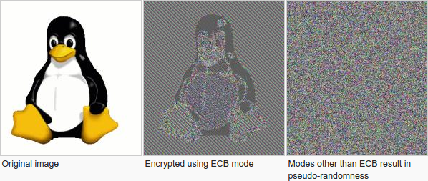
ECB Mode (A Failed Approach)

Slide 21
The Penguin Principle
If you can still see the penguin after “encrypting” the image something is very very wrong with the encryption scheme.

Slide 22
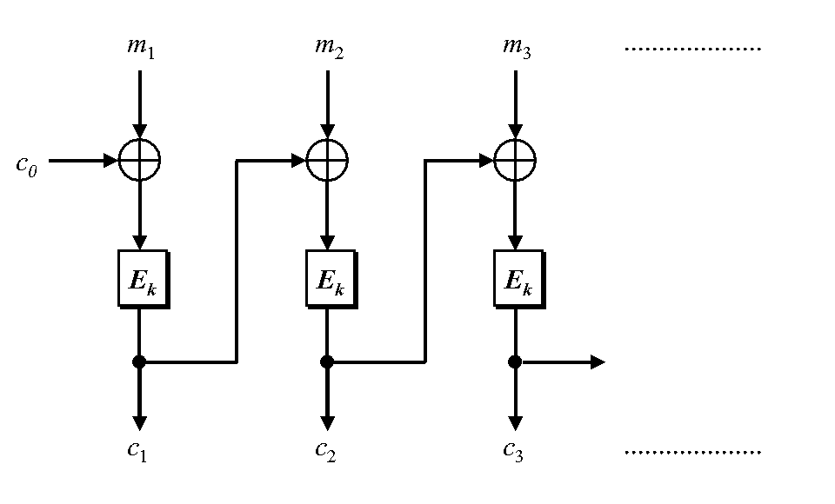
Cipher Block Chaining
CBC-Mode (below) is CPA-secure if E_{k} is a PRP
Reduces bandwidth!
Message: 3n bits
Ciphertext: 4n bits
IV
IV

Slide 23
Chained CBC-Mode
m₄
m₅
m₆
IV
c₃
IV
c₄
c₅
c₆
First glance: seems similar to CBC-Mode and reduces bandwidth
Vulnerable to CPA-Attack! (Set $m4=IV⨁c3⨁m_{1}^{′}$ and c₄=c₁ iff m₁=m₁’)
Moral: Be careful when tweaking encryption scheme!

Slide 24
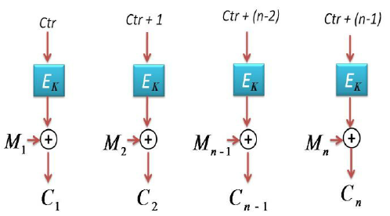
Counter Mode
Input: m₁,…,m_{n}
Output: c = (ctr, c₁,c₂,…,c_{n}) where ctr is chosen uniformly at random
Theorem: If E_{k} is PRF then counter mode is CPA-Secure
Advantages: Parallelizable encryption/decryption

Slide 25
Next Class
Read Katz and Lindell 4.1-4.2
Message Authentication Codes (MACs) Part 1

