Slide 1
Cryptography CS 555
Topic 6: CPA-Security

Slide 2
Homework 1 Released
Due in class on Friday, February 3rd (2 weeks)
Solutions should be typeset (preferably in Latex)
You may collaborate with classmates, but you must write up your own solution and you must understand this solution
One question covers PRFs which we will cover early next week.
Clarification questions: spring-2017-cs-55500-wng@lists.purdue.edu

Slide 3
Recap
Sematic Security/Indistinguishable Encryptions against eavesdropping attacker with one ciphertext
Pseudorandom Number Generators
Today’s Goal: Multiple Message Security and CPA-Security.
Build CPA-secure encryption scheme

Slide 4
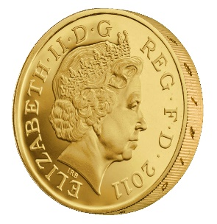
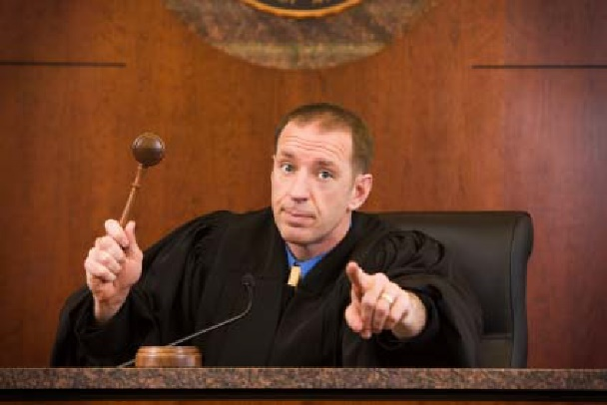
Multiple Message Eavesdropping Experiment
(m_{0,1},…,m_{0,t}), (m_{1,1},…,m_{1,t})
(c₁,…,c_{t})
Random bit b
K = Gen(.)
c_{i} = Enc_{K}(m_{b,i})
b’
$$∀\begin{matrix} & \\ & \\ & \end{matrix} Pr\left[\begin{matrix} & \\ & \end{matrix} Guesses b^{′}=b\right]≤\frac{1}{2}+μ(n)$$
$$ppt attacker$$
$$negligible function$$

Slide 5
Multiple Message Eavesdropping Experiment
$$Formally, let Π= \left(Gen,Enc,Dec\right) denote the encryption scheme,$$
$call the experiment PrivKmult$ $and define a random variable$
${PrivK}_{A,Π }^{mult}=1 if b=b^{′}$
$${PrivK}_{A,Π }^{mult}=0 otherwise$$
$$Π has indistinguishable multiple encryptions in the presence of$$
$$an eavesdropper if for all PPT adversary A, there is a$$
Negligible function $μ$ such that Pr[${PrivK}_{A,Π }^{mult}=1$] $≤\frac{1}{2}+μ(n)$
m₀, m₁
Random bit b
K = Gen(.)
c = Enc_{K}(m_{b})
c
b’
$$∀\begin{matrix} & \\ & \\ & \end{matrix} Pr\left[\begin{matrix} & \\ & \end{matrix} Guesses b^{′}=b\right]≤\frac{1}{2}+μ(n)$$
$$ppt attacker$$
$$negligible function$$

Slide 6
A Simple Observation
If$Π$has indistinguishable multiple encryptions in the presence of an eavesdropper
then
$Π$ also has indistinguishable encryptions in the presence of an eavesdropper.
In fact indistinguishable multiple encryptions is a strictly stronger security notion.

Slide 7
Example
$$Encs(m)=G(s)⨁m$$
$$Decs(c)=G(s)⨁c$$
Recall: $Π= \left(Gen,Enc,Dec\right)$has indistinguishable encryptions in the presence of an eavesdropper.
Claim: $Π= \left(Gen,Enc,Dec\right)$does not have indistinguishable multiple encryptions in the presence of an eavesdropper.

Slide 8
Multiple Message Eavesdropping
(0^{ℓ(𝑛)}, 0^{ℓ(𝑛)}), (0^{ℓ(𝑛)}, 1^{ℓ(𝑛)})
$$(G(s)⨁\text{m}\text{b}\text{,}\text{1}\text{,} G(s)⨁\text{m}\text{b}\text{,2})$$
Random bit b
s = Gen(.)
c_{i} = Enc_{K}(m_{b,i})
b’
b’ = 1 if c₁=c₂
0 otherwise
Analysis: If b=1 then c₁= $G(s)⨁$ 0^{ℓ(𝑛)} =c₂
Analysis: If b=0 then c₁= $G(s)⨁\text{0}\text{ℓ(}\text{n}\text{)}≠G(s)⨁$ 1^{ℓ(𝑛)} =c₂

Slide 9
Did We Cheat?
Attack specifically exploited the fact that we can ask to see multiple encryptions of the same message…
The above argument might appear to show that no encryption scheme provides secure indistinguishable multiple encryptions in the presence of an eavesdropper.
Theorem: If $Π$ is (stateless) encryption scheme and Enc is deterministic then $Π$ does not provide secure indistinguishable multiple encryptions

Slide 10
Did We Cheat?
Option 1: Weaken the security definition so that attacker cannot request two encryptions of the same message.
Undesirable!
Example: Dataset in which many people have the last name “Smith”
We will actually want to strengthen the definition later…
Option 2: Consider randomized encryption algorithms

Slide 11
Chosen-Plaintext Attacks
Model ability of adversary to control or influence what the honest parties encrypt.
During World War 2 the British placed mines at specific locations, knowing that the Germans, upon finding the mines, would encrypt the location and send them back to headquarters. The encrypted messages helped cryptanalysts at Bletchley Park to break the German encryption scheme.
Notes:
Batle of Midway. In May 1942, US Navy cryptanal

Slide 12
Chosen-Plaintext Attacks
Model ability of adversary to control or influence what the honest parties encrypt.
Battle of Midway (WWII). US Navy cryptanalysts intercept and encrypted message which they are able to partially decode (May 1942).
The message stated that the Japanese were planning an attack on AF?
Cryptanalysts could not decode ciphertext fragment AF.
Best Guess: AF = “Midway Island.”
Notes:
Batle of Midway. In May 1942, US Navy cryptanal

Slide 13
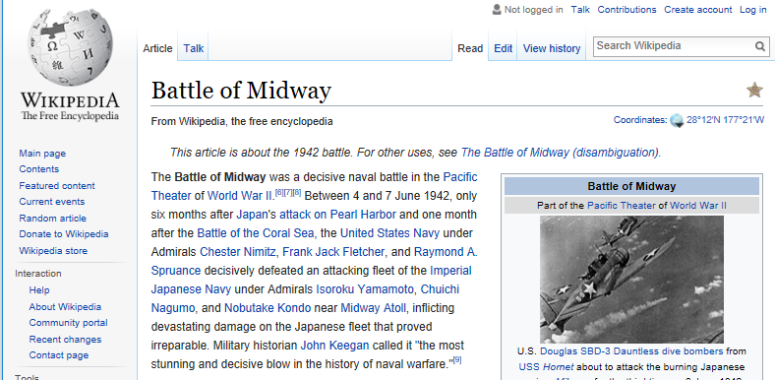
Battle of Midway (WWII).
US Navy cryptanalysts intercept and encrypted message which they are able to partially decode (May 1942).
Message stated that the Japanese were planning a surpise attack on “AF”
Cryptanalysts could not decode ciphertext fragment AF.
Best Guess: AF = “Midway Island.”
Washington believed Midway couldn’t possibly be the target.
Cryptanalysts then told forces at Midway to send a fake message “freshwater supplies low”
The Japanese intercepted and transmitted an encrypted message stating that “AF is low on water.”
Notes:
Batle of Midway. In May 1942, US Navy cryptanal

Slide 14
Battle of Midway (WWII).
US Navy cryptanalysts intercept and encrypted message which they are able to partially decode (May 1942).
Message stated that the Japanese were planning a surpise attack on “AF”
Cryptanalysts could not decode ciphertext fragment AF.
Best Guess: AF = “Midway Island.”
Washington believed Midway couldn’t possibly be the target.
Cryptanalysts then told forces at Midway to send a fake message “freshwater supplies low”
The Japanese intercepted and transmitted an encrypted message stating that “AF is low on water.”

Slide 15
Multiple Message Security and CPA-Attacks
Multiple Message Security
Attacker must select all messages at the same time.
Significant Limitation!
In the WWII attacks cryptanalysts selected the message adaptively
Selected message(s) to encrypt after observing target ciphertext

Slide 16
CPA-Security (Single Message)
m₀,m₁
c = Enc_{K}(m_{b})
m₂
c₂ = Enc_{K}(m₂)
m₃
c₃ = Enc_{K}(m₃)
…
$$∀PPT A ∃μ (negligible) s.t$$
$$Pr\left[A Guesses b^{′}=b\right]≤\frac{1}{2}+μ(n)$$
b’
Random bit b
K = Gen(.)

Slide 17
CPA-Security (Single Message)
m₀,m₁
$$Formally, let Π= \left(Gen,Enc,Dec\right) denote the encryption scheme,$$
$call the experiment PrivKcpa$ $and define a random variable$
${PrivK}_{A,Π }^{cpa}=1 if b=b^{′}$
$${PrivK}_{A,Π }^{cpa}=0 otherwise$$
$$Π has indistinguishable encryptions under a chosen plaintext attack$$
$if for all PPT adversaries A, there is a$negligible function $μ$ such that
Pr[${PrivK}_{A,Π }^{cpa}=1$] $≤\frac{1}{2}+μ(n)$
c = Enc_{K}(m_{b})
m₂
c₂ = Enc_{K}(m₂)
m₃
c₃ = Enc_{K}(m₃)
…
$$∀PPT A ∃μ (negligible) s.t$$
$$Pr\left[A Guesses b^{′}=b\right]≤\frac{1}{2}+μ(n)$$
b’
Random bit b
K = Gen(.)

Slide 18
CPA-Security (Multiple Messages)
m_{0,1},m_{1,1}
c₁ = Enc_{K}(m_{b,1})
m_{0,2},m_{1,2}
c₂ = Enc_{K}(m_{b,2})
m_{0,3},m_{1,3}
c₃ = Enc_{K}(m_{b,3})
…
$$∀PPT A ∃μ (negligible) s.t$$
$$Pr\left[A Guesses b^{′}=b\right]≤\frac{1}{2}+μ(n)$$
b’
Random bit b
K = Gen(.)

Slide 19
CPA-Security
Theorem: An encryption scheme $Π= \left(Gen,Enc,Dec\right)$ that is CPA-Secure for single encryptions is also CPA-secure for multiple encryptions.
We will simply say CPA-security for simplicity
To show CPA-Security it suffices to show CPA-security for single encryptions.
To reason about security of a protocol using $Π$ we can use game with multiple encryptions.

Slide 20
CPA-Security
CPA-security vs Multiple Message Encryption
CPA-security is stronger guarantee
Attacker can select messages adaptively
CPA-security minimal security notion for a modern cryptosystem
Limitations of CPA-Security: Does not model and adversary who
Attempts to modify messages
Can get honest party to (partially) decrypt some messages

Slide 21
CPA-Security and Message Length
Observation: Given a CPA-secure encryption scheme $Π= \left(Gen,Enc,Dec\right)$ that supports messages of a single bit ($ℳ=\left\{0,1\right\}$) it is easy to build a CPA-secure scheme $Π$’$= \left(Gen′,Enc′,Dec′\right)$ that supports messages m = m₁,…,m_{n}$∈\left\{0,1\right\}n$ of length n.
$${Enc}_{k}^{′}\left(m\right)={Enc}_{k}^{′}\left(m1\right),…,{Enc}_{k}^{′}\left(mn\right)$$
Exercise: How would you prove $Π$’ is CPA-secure?

Slide 22
Security Reduction
Step 1: Assume for contraction that we have a PPT attacker A that breaks CPA-Security.
Step 2: Construct a PPT distinguisher D which breaks PRF security.

Slide 23
Next Class
Read Katz and Lindell 3.5-3.6.1
Constructing CPA-Security with Pseudorandom Functions

