Slide 1
Course Business
Homework due today
Final Exam Review on Monday, April 24th
  Practice Final Exam Solutions Released Monday
Final Exam on Monday, May 1st (in this classroom)
  Adib will proctor
I am traveling April 25-May 3rd
  Will still be available by e-mail to answer questions
Guest Lectures on April 26 and 28
  Secret Sharing --- Prof. Kate (April 26)
  TBD --- Prof. Spafford (April 28)

Slide 2
Cryptography
CS 555
Topic 40: Password Hashing and Authentication
Slide Credit: Slides about Pythia PRF Service from Tom Ristenpart

Slide 3





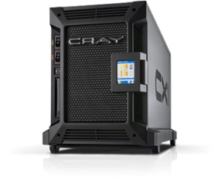

Password Storage
jblocki, 123456
Username
jblocki
Salt
89d978034a3f6
Hash
85e23cfe0021f584e3db87aa72630a9a2345c062
SHA1(12345689d978034a3f6)=85e23cfe0021f584e3db87aa72630a9a2345c062
+
Notes:
As a motivating example consider an adversary who breaks into an authentication server and steals a users crptographic hash value. The adversary can execute an offline attack against the password by comparing the hash value with the hashes of likely password guesses. The adversary is limited only by the resources that he is willing to invest cracking the passwords.

Slide 4

How to send the password?
jblocki, password
Hey, thanks!
Notes:
As a motivating example consider an adversary who breaks into an authentication server and steals a users crptographic hash value. The adversary can execute an offline attack against the password by comparing the hash value with the hashes of likely password guesses. The adversary is limited only by the resources that he is willing to invest cracking the passwords.

Slide 5
How to send the password?
jblocki, c=Enc_{K}(password)
Let me save this
jblocki, c
Suppose K is a shared secret key between user and server and Enc_{K} is CCA-Secure
Unlikely that user and server share secret key anyway…
Notes:
As a motivating example consider an adversary who breaks into an authentication server and steals a users crptographic hash value. The adversary can execute an offline attack against the password by comparing the hash value with the hashes of likely password guesses. The adversary is limited only by the resources that he is willing to invest cracking the passwords.

Slide 6





How to send the password?
RSA key: (N,e,d)
jblocki
$$r$$
$${c=\left(mr\right)}^{e} mod N$$
Can I use this?
$$m=ToInt(password)$$
$${m=c}^{d}r^{−1} mod N$$
VerifyPasswordGuess(guess)
Let $m′←ToInt\left(guess\right)$
Check if $c==$ ${\left(m′r\right)}^{e}$
Notes:
As a motivating example consider an adversary who breaks into an authentication server and steals a users crptographic hash value. The adversary can execute an offline attack against the password by comparing the hash value with the hashes of likely password guesses. The adversary is limited only by the resources that he is willing to invest cracking the passwords.

Slide 7
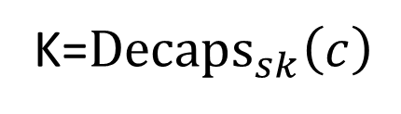

How to send the password?
(pk,sk)
Jblocki, c, Enc_{K}(password)
Can I use this?
$$\left(c,k\right)={Encaps}_{pk}\left(R\right)$$
K=${Decaps}_{sk}\left(c\right)$
jblocki, c, Enc_{K}(password)
joe, c, Enc_{K}(password)
Notes:
As a motivating example consider an adversary who breaks into an authentication server and steals a users crptographic hash value. The adversary can execute an offline attack against the password by comparing the hash value with the hashes of likely password guesses. The adversary is limited only by the resources that he is willing to invest cracking the passwords.

Slide 8

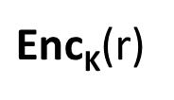
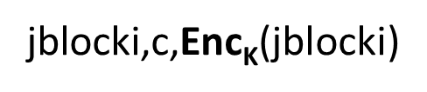

How to send the password?
jblocki,c,$\text{Enc}\text{K}\text{(}\text{jblocki}$)
$\text{Enc}\text{K}\text{(}$r)
$$\text{Enc}\text{K}\text{(}\text{jblocki}∥\text{password}∥\text{r}\text{)}$$
$$\left(c,k\right)={Encaps}_{pk}\left(R\right)$$
Curses! The Encaps/Enc are CCA-Secure and the
ciphertext is bound to the username/session
Notes:
As a motivating example consider an adversary who breaks into an authentication server and steals a users crptographic hash value. The adversary can execute an offline attack against the password by comparing the hash value with the hashes of likely password guesses. The adversary is limited only by the resources that he is willing to invest cracking the passwords.

Slide 9
How to send the password?
jblocki,c,$\text{Enc}\text{K}\text{(}\text{jblocki}$)
$\text{Enc}\text{K}\text{(}$r)
$$\text{Enc}\text{K}\text{(}\text{jblocki}∥\text{password}∥\text{r}\text{)}$$
$$\left(c,k\right)={Encaps}_{pk}\left(R\right)$$
But wait a second…was the password padded?
Notes:
As a motivating example consider an adversary who breaks into an authentication server and steals a users crptographic hash value. The adversary can execute an offline attack against the password by comparing the hash value with the hashes of likely password guesses. The adversary is limited only by the resources that he is willing to invest cracking the passwords.

Slide 10
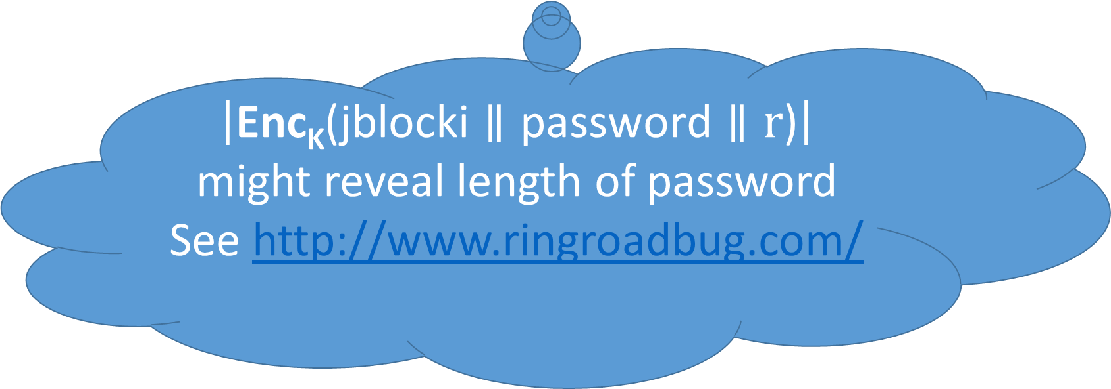
How to send the password?
jblocki,c,$\text{Enc}\text{K}\text{(}\text{jblocki}$)
$\text{Enc}\text{K}\text{(}$r)
$$\text{Enc}\text{K}\text{(}\text{jblocki}∥\text{password}∥\text{r}\text{)}$$
$$\left(c,k\right)={Encaps}_{pk}\left(R\right)$$
$\left|\text{Enc}\text{K}\text{(}\text{jblocki}∥\text{password}∥\text{r}\text{)}\right|$ might reveal length of password See http://www.ringroadbug.com/
Notes:
As a motivating example consider an adversary who breaks into an authentication server and steals a users crptographic hash value. The adversary can execute an offline attack against the password by comparing the hash value with the hashes of likely password guesses. The adversary is limited only by the resources that he is willing to invest cracking the passwords.

Slide 12

How to send the password?
TLS handshake
$$\text{Enc}\text{K}\text{(}\text{jblocki}∥\text{password}\text{) }$$
Exchange Symmetric Key(s)
Send encrypted passwords
  Encrypt then MAC
  CCA-Secure Encryption
  Authenticated Encryption (AES-GCM)
(still need to worry about padding!)
Notes:
As a motivating example consider an adversary who breaks into an authentication server and steals a users crptographic hash value. The adversary can execute an offline attack against the password by comparing the hash value with the hashes of likely password guesses. The adversary is limited only by the resources that he is willing to invest cracking the passwords.

Slide 13
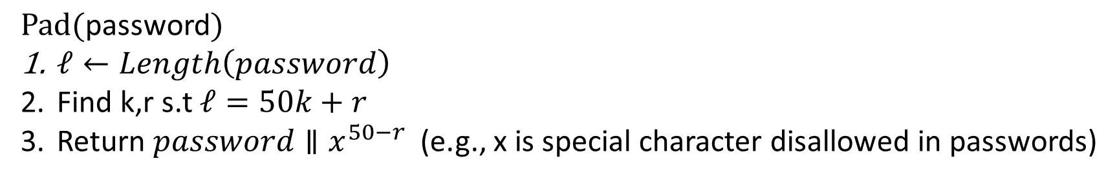

How to send the password?
TLS handshake
$$\text{Enc}\text{K}\text{(}\text{jblocki}∥\text{Pad}\text{(}\text{password}\text{)}\text{)}$$
$\text{Pad}\text{(}\text{password}\text{)}$
$ℓ←Length\left(password\right)$
Find k,r s.t $ℓ=50k+r$
Return $password∥x^{50−r}$ (e.g., x is special character disallowed in passwords)
Notes:
As a motivating example consider an adversary who breaks into an authentication server and steals a users crptographic hash value. The adversary can execute an offline attack against the password by comparing the hash value with the hashes of likely password guesses. The adversary is limited only by the resources that he is willing to invest cracking the passwords.

Slide 14

How to send the password?
TLS handshake
$$\text{Enc}\text{K}\text{(}\text{jblocki}∥\text{h}\text{=}\text{H}\text{(}\text{jblocki}∥\text{password}\text{)}\text{)}$$
Authenticated Encryption (AES-GCM)
Advantage if server doesn’t salt or hash passwords
See http://plaintextoffenders.com/
Username
jblocki
Salt
89d978034a3f6
Hash
85e23cfe0021f584e3db87aa72630a9a2345c062
MHF(h,89d978034a3f6)=85e23cfe0021f584e3db87aa72630a9a2345c062
Notes:
As a motivating example consider an adversary who breaks into an authentication server and steals a users crptographic hash value. The adversary can execute an offline attack against the password by comparing the hash value with the hashes of likely password guesses. The adversary is limited only by the resources that he is willing to invest cracking the passwords.

Slide 15

Password checking systems
tom | password1
alice | 123456
bob | p@ssword!
tom, password1
tom | salt₁ , H^{c}(password1,salt₁)
alice | salt₂ , H^{c}(123456,salt₂)
bob | salt₃ , H^{c}(p@ssword!,salt₃)
Login
server
Websites should never store passwords directly,
they should be (at least) hashed with a salt (also stored)
Cryptographic hash function H
(H = SHA-256, SHA-512, etc.)
c times
H
H
…
H
Common choice is c = 10,000
pw||salt
Better: scrypt, argon2
UNIX password hashing scheme, PKCS #5
Formal analyses: [Wagner, Goldberg 2000] [Bellare, R., Tessaro 2012]

Slide 16
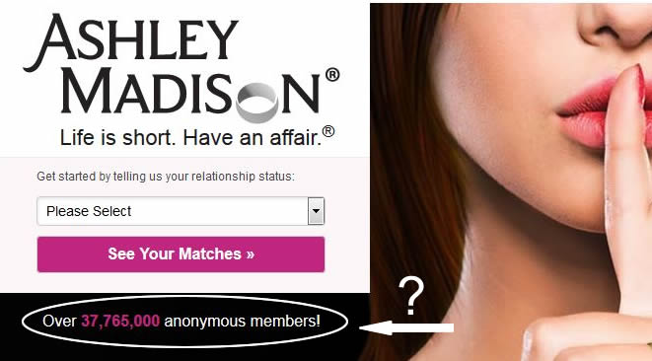
AshleyMadison hack: 36 million user hashes
Salts + Passwords hashed using bcrypt with c = 2¹² = 4096
4,007 cracked directly with trivial approach
290729 123456
79076 12345
76789 123456789
59462 password
49952 iloveyou
33291 princess
…
Password cracker
List of possible passwords in
order of their likelihood
Recompute hash and check
Examples: Hashcat, Johntheripper, academic projects

Slide 17
AshleyMadison hack: 36 million user hashes
Salts + Passwords hashed using bcrypt with c = 2¹² = 4096
4,007 cracked directly with trivial approach
CynoSure analysis: 11 million hashes cracked
>630,000 people used usernames as passwords
MD5 hashes left lying around accidentally
http://cynosureprime.blogspot.com/2015/09/csp-our-take-on-cracked-am-passwords.html

Slide 18
A voyeuristic tour of passwords
mypasswordispassword
superhardpassword
thebestpasswordever
thisisagoodpassword
ishouldnotbedoingthis
ithinkilovemywife
thisiswrong
whatthehellamidoing
likeimreallygoingtocheat
justcheckingitout
justtryingthisout
goodguydoingthewrongthing
http://cynosureprime.blogspot.com/2015/09/csp-our-take-on-cracked-am-passwords.html

Slide 19

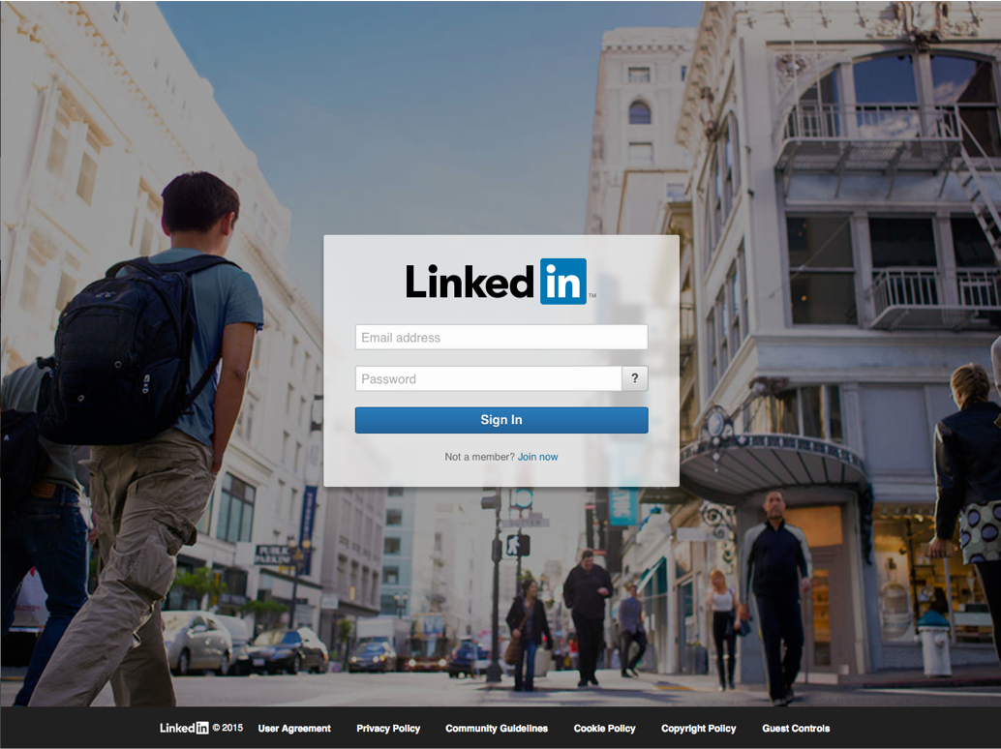

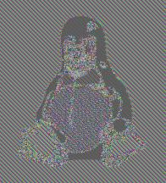

AshleyMadison in good company
…
32.6 million leaked (2012)
32.6 million recovered (plaintext!)
6.5 million leaked (2012)
5.85 million recovered in 2 weeks
442,832 leaked (2012)
442,832 recovered
36 million accounts leaked (2013)
Encrypted, but with ECB mode
…

Slide 20
(1) Password protections often implemented
incorrectly in practice
(2) Even in best case, hashing slows down but does not prevent password recovery

Slide 21

Facebook password onion
$cur = ‘password’
$cur = md5($cur)
$salt = randbytes(20)
$cur = hmac_sha1($cur, $salt)
$cur = remote_hmac_sha256($cur, $secret)
$cur = scrypt($cur, $salt)
$cur = hmac_sha256($cur, $salt)

Slide 22


Strengthening password hash storage
tom, password1
h
K
f = HMAC(K, h)
Back-end
crypto
service
h = H^{c}(password1|| salt)
Store salt, f
HMAC is pseudorandom function (PRF).
f’ = H^{c}(123456 || salt)
f = f’?
f’ = HMAC(K, h’)
K
H^{c}(1234567 || salt)
Back-end
crypto
service
Must still perform online
brute-force attack
Exfiltration doesn’t help
H^{c}(12345 || salt)
…

Slide 23
Strengthening password hash storage
tom, password1
h
K
f = HMAC(K, h)
Back-end
crypto
service
h = H^{c}(password1|| salt)
Store salt, f
Critical limitation: can’t rotate K to a new secret K’
Idea 1: Version database and update as users log in
  But doesn’t update old hashes
Idea 2: Invalidate old hashes
  But requires password reset
Idea 3: Use secret-key encryption instead of PRF
  But requires sending keys to web server (or high bandwidth)

Slide 24
The Pythia PRF Service
Blinding means service learns nothing about passwords
tom, password1
user id, blinded h
K
Blinded PRF output f
Back-end
crypto
service
h = H^{c}(password1|| salt)
Blind h, pick user ID
Unblind PRF output f
Store user ID, salt, f
User ID reveals fine-grained query patterns to service.
Compromise detection & rate limiting
Cryptographically erases f:
Useless to attacker in the future
Combine token and f
to generate f’ = F(K’,h)
K
Token(K->K’)
Back-end
crypto
service
Server learns nothing about K or K’
K’

Slide 25
New crypto: partially-oblivious PRF
Groups G₁ , G₂ , G_{T} w/ bilinear pairing e : G₁ x G₂ -> G_{T} e(a^{x},b^{y}) = e(a,b)^{xy}
K
tom, password1
user id, h^{r}
y
t = H(user id)
y = e(t^{K},h^{r})
h = H^{c}(password1|| salt)
Choose random r
f = y^{1/r}
Store user ID, salt, f
f = e(t^{K},h^{r})^{1/r} = e(t,h)^{Kr*1/r} = e(t,h)^{K}
Pairing cryptographically binds user id with password hash
Can add verifiability (proof that PRF properly applied)
Key rotation straightforward: Token(K -> K’) = K’ / K
Interesting formal security analysis (see paper)

Slide 26



The Pythia PRF Service
Queries are fast despite pairings
  PRF query: 11.8 ms (LAN) 96 ms (WAN)
Parallelizable password onions
  H^{c} and PRF query made in parallel (hides latency)
Multi-tenant (theoretically: scales to 100 million servers)
Easy to deploy
  Open-source reference implementation at
    http://pages.cs.wisc.edu/~ace/pythia.html

Slide 27
Next Class
Review for Final Exam
Recommendation: Try to complete the practice final exam over the weekend

Slide 28
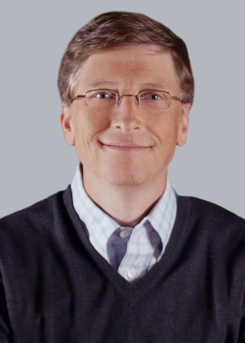
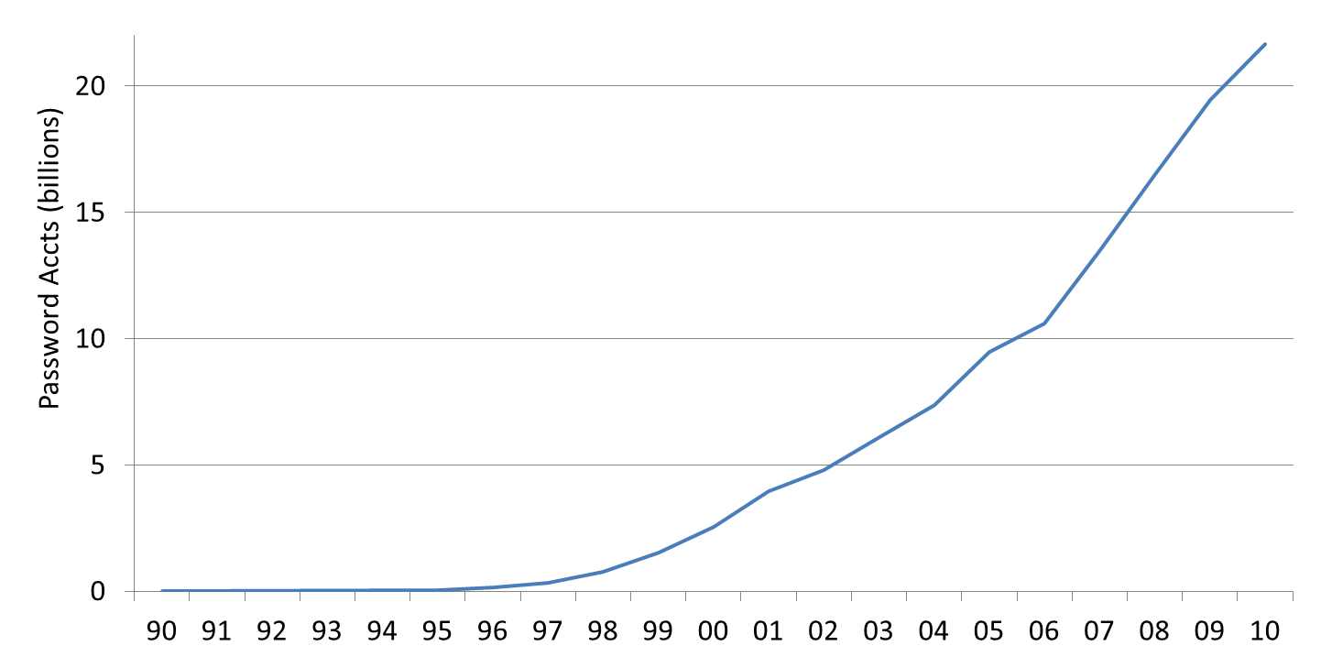
Passwords vs time: Look how far we’ve come
Source: Cormac’s estimate
“The password is dead”
Netscape IPO
Dotcom crash

Slide 29
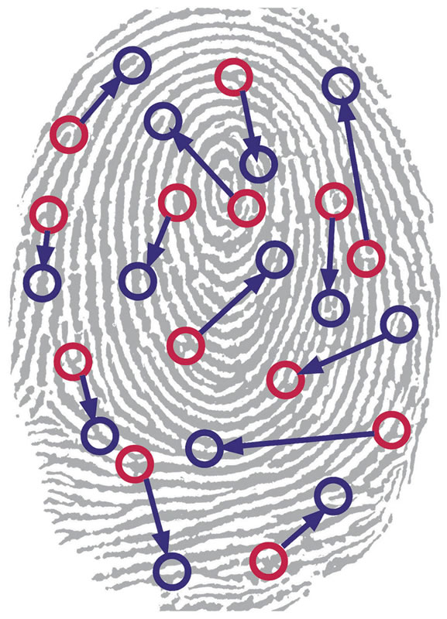
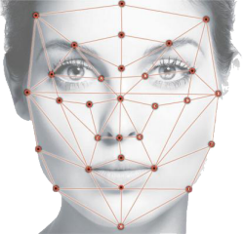
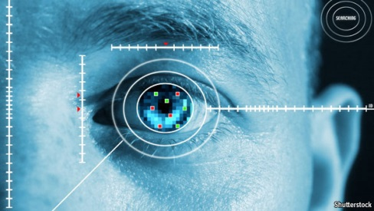

Biometrics
Notes:
Another line of research has sought to eliminate text passwords. One might ask whether or not password research will be relevant in the future. Bonneau, et al. considered each of these alternatives to text passwords in 2012 and concluded that there was no silver bullet to replace text passwords. While every proposed replacement has desirable properties, every replacement scheme they evaluated also had its disadvantages. For example, biometrics signals like fingerprints cannot be changed if they are compromised.
Quest to Replace Passwords
Bonneau, J. ; Univ. of Cambridge, Cambridge, UK ; Herley, C. ; van Oorschot, P.C. ; Stajano, F.

Slide 30
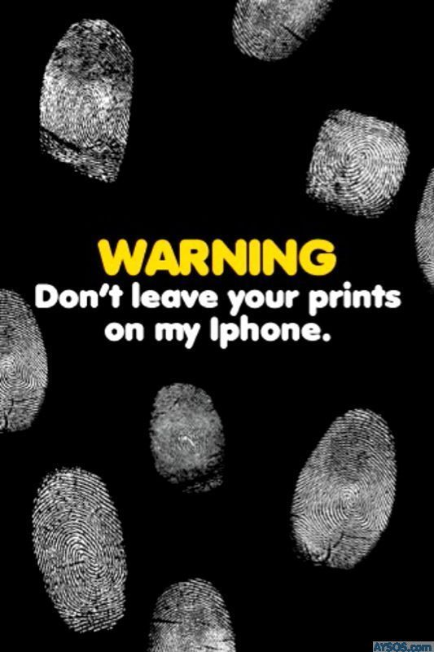
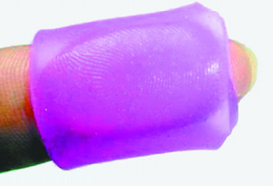
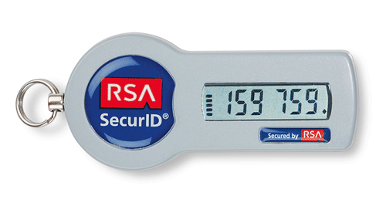


Biometrics
Challenges: Revoke? Secrecy?
Alternatives to Passwords
Notes:
Another line of research has sought to eliminate text passwords. One might ask whether or not password research will be relevant in the future. Bonneau, et al. considered each of these alternatives to text passwords in 2012 and concluded that there was no silver bullet to replace text passwords. While every proposed replacement has desirable properties, every replacement scheme they evaluated also had its disadvantages. For example, biometrics signals like fingerprints cannot be changed if they are compromised.
Quest to Replace Passwords
Bonneau, J. ; Univ. of Cambridge, Cambridge, UK ; Herley, C. ; van Oorschot, P.C. ; Stajano, F.

Slide 31
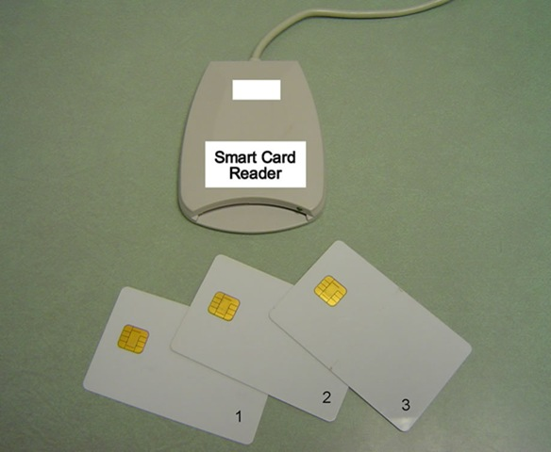
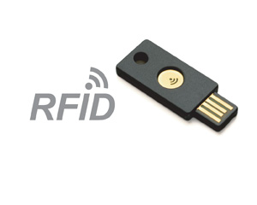
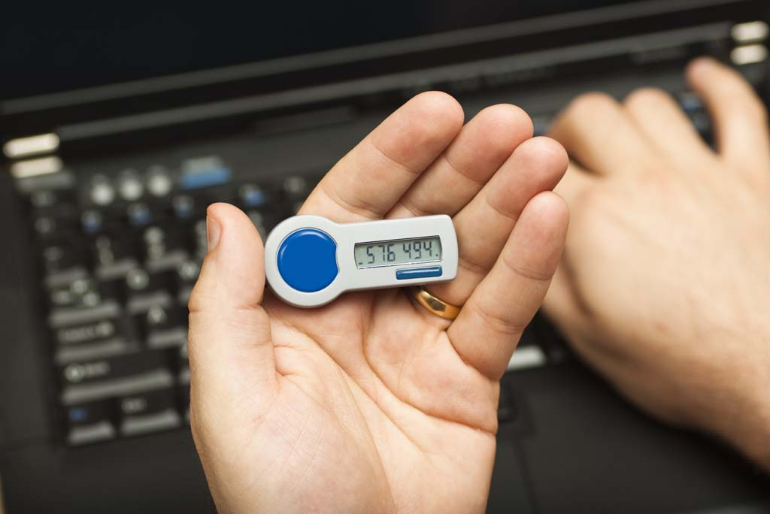
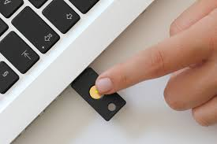
Hardware Tokens
Notes:
Another line of research has sought to eliminate text passwords. One might ask whether or not password research will be relevant in the future. Bonneau, et al. considered each of these alternatives to text passwords in 2012 and concluded that there was no silver bullet to replace text passwords. While every proposed replacement has desirable properties, every replacement scheme they evaluated also had its disadvantages. For example, biometrics signals like fingerprints cannot be changed if they are compromised.
Quest to Replace Passwords
Bonneau, J. ; Univ. of Cambridge, Cambridge, UK ; Herley, C. ; van Oorschot, P.C. ; Stajano, F.

Slide 32
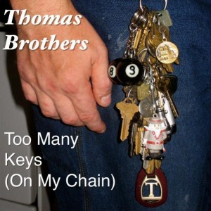
Hardware Tokens
Challenge: $$$ + more stuff to carry around
Alternatives to Passwords
Notes:
Another line of research has sought to eliminate text passwords. One might ask whether or not password research will be relevant in the future. Bonneau, et al. considered each of these alternatives to text passwords in 2012 and concluded that there was no silver bullet to replace text passwords. While every proposed replacement has desirable properties, every replacement scheme they evaluated also had its disadvantages. For example, biometrics signals like fingerprints cannot be changed if they are compromised.
Quest to Replace Passwords
Bonneau, J. ; Univ. of Cambridge, Cambridge, UK ; Herley, C. ; van Oorschot, P.C. ; Stajano, F.

Slide 33
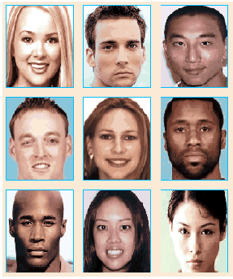
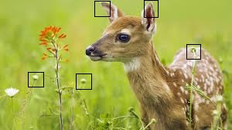
Graphical Passwords
Examples:
  Passfaces, Cued Click Points, Windows 8
…
Notes:
Graphical passwords have been an active area of research over the past 2 decades. Graphical password schemes aim to make passwords easier to remember by taking advantage of the natural human capacity for visual memory and cued recall. We will seek to exploit visual and associative memory with Person-Action-Object stories. The key difference is that we are focused on strategies for creating and remembering multiple passwords.
Graphical password authentication using cued click points
S Chiasson, PC van Oorschot, R Biddle - Computer Security–ESORICS

Slide 34



Graphical Passwords
Challenge: Multiple Passwords
Graphical Passwords
  Passfaces, Cued Click Points, Windows 8
…
Notes:
Graphical passwords have been an active area of research over the past 2 decades. Graphical password schemes aim to make passwords easier to remember by taking advantage of the natural human capacity for visual memory and cued recall. We will seek to exploit visual and associative memory with Person-Action-Object stories. The key difference is that we are focused on strategies for creating and remembering multiple passwords.
Graphical password authentication using cued click points
S Chiasson, PC van Oorschot, R Biddle - Computer Security–ESORICS

Slide 35
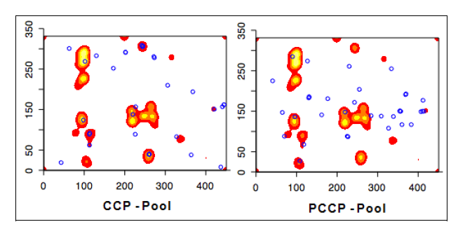
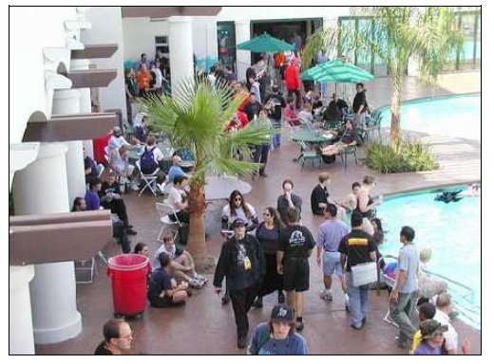
Graphical Passwords: Hotspots

Slide 36
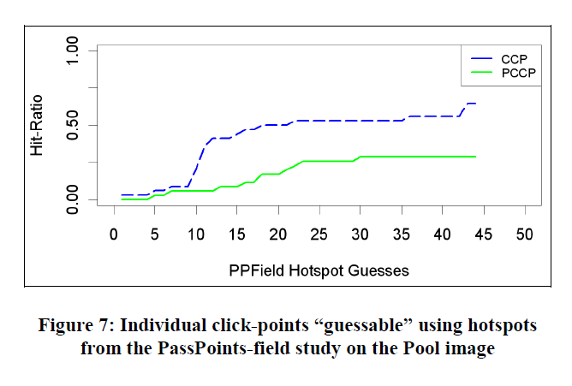
Graphical Passwords: Hotspots

Slide 37

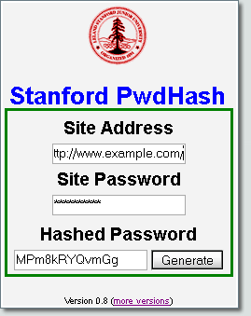
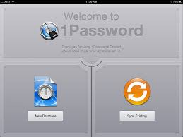
Password Managers
Password Management Software
Notes:
LastPass
KeePass
1Password
A Usability Study and Critique of Two Password Managers ∗
by S Chiasson, PC van Oorschot, R Biddle
PwdHash
Blake Ross, Collin Jackson, Nicholas Miyake, Dan Boneh and John C. Mitchell

Slide 38
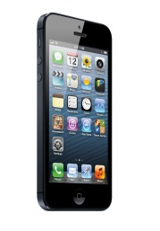
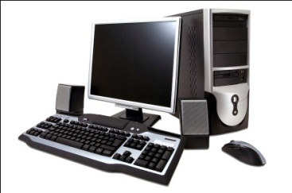
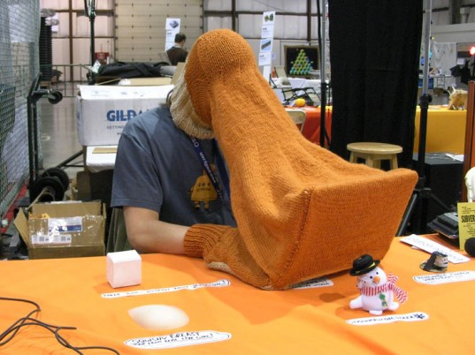



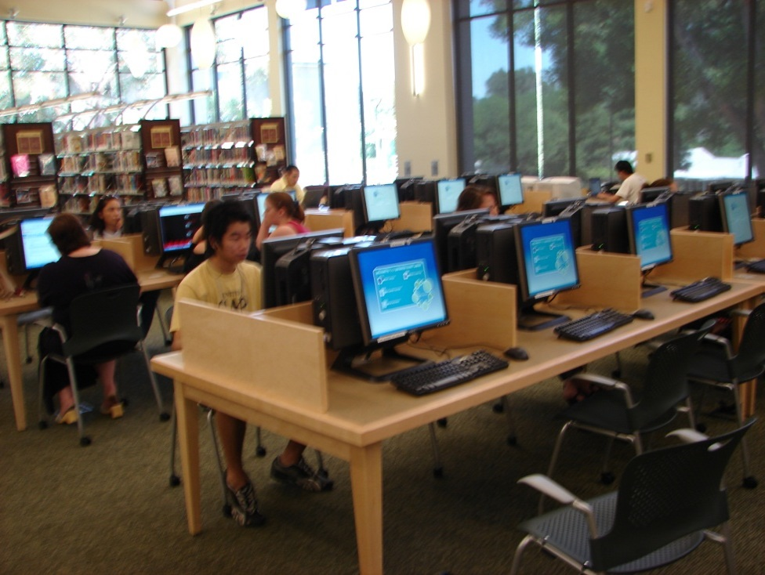
Related Work
Challenge: Single point of failure
Password Management Software
Notes:
LastPass
KeePass
1Password
A Usability Study and Critique of Two Password Managers ∗
by S Chiasson, PC van Oorschot, R Biddle
PwdHash
Blake Ross, Collin Jackson, Nicholas Miyake, Dan Boneh and John C. Mitchell

Slide 39
References
Depth-Robust Graphs and Their Cumulative Memory Complexity. with Joel Alwen and Krzysztof Pietrzak. EUROCRYPT 2017 (to appear). [ePrint]
On the Computational Complexity of Minimal Cumulative Cost Graph Pebbling. with Samson Zhou. (Working Paper). [arXiv]
Towards Practical Attacks on Argon2i and Balloon Hashing. with Joel Alwen. EuroS&P 2017 (to appear). [ePrint]
Efficiently Computing Data Independent Memory Hard Functions. with Joel Alwen. CRYPTO 2016. [Full Version]

