Slide 1
Cryptography CS 555
Topic 4: Computational Security

Slide 2
Recap
Perfect Secrecy, One-time-Pads
Theorem: If (Gen,Enc,Dec) is a perfectly secret encryption scheme then
$$\left|𝒦\right|≥\left|ℳ\right|$$

Slide 3
What if we want to send a longer message?
K1,K2,K3
K1,K2,K3
$${Enc}_{k1}\left("Dear Alice, I wrote this poem for you"\right)$$
$${Enc}_{k2}\left("Roses are red, …."\right)$$
$${Enc}_{k3}\left("I am out of space, but the rest was awesome"\right)$$
Notes:
Alice doesn’t respond to Bob since they are out of one-time-pads so they stop talking. Can we save their relationship?

Slide 4
What if we want to send many messages?
K1,K2,K3
K1,K2,K3
$${Enc}_{k1}\left("Whats up, Alice?"\right)$$
$${Enc}_{k2}\left("Not too much, you?"\right)$$
$${Enc}_{k3}\left("Just chilling out?"\right)$$
Notes:
Alice doesn’t respond to Bob since they are out of one-time-pads so they stop talking. Can we save their relationship?

Slide 5
Can we save their relationship?
K1,K2,K3
K1,K2,K3
$${Enc}_{k1}\left("Whats up, Alice?"\right)$$
$${Enc}_{k2}\left("Not too much, you?"\right)$$
$${Enc}_{k3}\left("Just chilling out?"\right)$$
Notes:
Alice doesn’t respond to Bob since they are out of one-time-pads so they stop talking. Can we save their relationship?

Slide 6
Perfect Secrecy vs Computational Security
Perfect Secrecy is Information Theoretic
Guarantee is independent of attacker resources
Computational Security
Security against computationally bounded attacker
An attacker with infinite resources might break security
Attacker might succeed with very small probability
Example: Lucky guess reveals secret key
Very Small Probability: $2^{−100},$ $2^{−1000}$, …

Slide 7
Today’s Goal
Define computational security in presence of eavesdropper who intercepts a single (long) message
If you don’t understand what you want to achieve, how can you possibly know when (or if) you have achieved it?
Show how to build a symmetric encryption scheme with computational security in the presence of an eavesdropper.
Define computational security against an active attacker who might modify the message
Define computational security for multiple messages in presence of an eavesdropper

Slide 8
Concrete Security
“A scheme is (t,ε)-secure if every adversary running for time at most t succeeds in breaking the scheme with probability at most ε”
Example: t = 2⁶⁰ CPU cycles
9 years on a 4GHz processor
< 1 minute on fastest supercomputer (in parallel)
Full formal definition needs to specify “break”
Important Metric in Practice
Caveat 1: difficult to provide/prove such precise statements
Caveat 2: hardware improves over time

Slide 9
Asymptotic Approach to Security
A scheme is secure if every probabilistic polynomial time (ppt) adversary “succeeds” with negligible probability.
Two Key Concepts
Polynomial time algorithm
Negligible Function
Definition: A function $f: ℕ⟶ℝ_{≥0}$ is negligible if for every positive polynomial p there is an integer N>0 such that for all n > N we have
$$f(n)<\frac{1}{p(n) }$$

Slide 10
Asymptotic Approach to Security
Definition: A function $f: ℕ⟶ℝ_{≥0}$ is negligible if for every positive polynomial p there is an integer N>0 such that for all n > N we have
$$f(n)<\frac{1}{p(n) }$$
Intuition: If we choose the security parameter n to be sufficiently large then we can make the adversaries success probability very small (negligibly small).

Slide 11
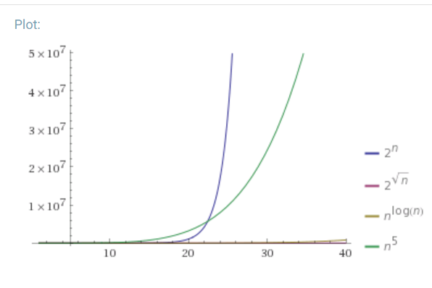
Asymptotic Approach to Security
Definition: A function $f: ℕ⟶ℝ_{≥0}$ is negligible if for every positive polynomial p there is an integer N>0 such that for all n > N we have
$$f(n)<\frac{1}{p(n) }$$
Which functions below are negligible?
${f\left(n\right)=2}^{−n}$
$f\left(n\right)=n^{−3}$
$f\left(n\right)={2^{−1000}1000n}^{1000}$
${f\left(n\right)=2^{100}2}^{−\sqrt{n}}$
${f\left(n\right)=2}^{−\log{n}}$

Slide 12
Asymptotic Approach to Security
Definition: A function $f: ℕ⟶ℝ_{≥0}$ is negligible if for every positive polynomial p there is an integer N>0 such that for all n > N we have
$$f(n)<\frac{1}{p(n) }$$
Which functions below are negligible?
${f\left(n\right)=2}^{−n}$
$f\left(n\right)=n^{−3}$
$f\left(n\right)={2^{−1000}1000n}^{1000}$
${f\left(n\right)=2^{100}2}^{−\sqrt{n}}$
${f\left(n\right)=2}^{−\log{n}}$

Slide 13
Asymptotic Approach to Security
Definition: An (randomized) algorithm A runs in polynomial time if there exists a polynomial p such that for every n-bit input x, A(x) terminates in at most p(n) steps in expectation.
Intuition: If an algorithm A does not run in polynomial time then, for sufficiently large n, it will quickly become impractical for any attacker to run the algorithm A.

Slide 14
Asymptotic Approach to Security
A scheme is secure if every probabilistic polynomial time (ppt) adversary “succeeds” with negligible probability.
General Attack 1: Test all possible secret keys $k′∈𝒦$
Doesn’t run in polynomial time, since $\left|𝒦\right|=2^{n}$
General Attack 2: Select random key $k^{′}∈𝒦,$check if it is correct (otherwise output $⊥$for “fail”).
Only successful with negligible probability $2^{−n}$

Slide 15
Advantages of Asymptotic Approach
Closure
If subroutine B runs in polynomial time and algorithm A makes p(n) queries to B then A also runs in polynomial time.
If f and g are negligible functions then h(n) = f(n)+g(n) is a negligible function
If p is a positive polynomial, and f is a negligible function then the function g(n)=f(n)p(n) is also negligible.
Church-Turing Thesis: “reasonable” model of computations are all polynomially equivalent.
Implication: No need to worry about different models of computation (circuits, random access machines, etc…)
Disadvantage: Limited guidance on how big to make security parameter n in practice.

Slide 16
Private Key Encryption Syntax (Revisited)
Message Space: $ℳ$
Key Space: $𝒦$
Three Algorithms
$\operatorname{Gen}{(1^{n};R)}$ (Key-generation algorithm)
Input: 1^{n} (security parameter in unary) + Random Bits R,
Output: Secret key $k∈𝒦$
$\operatorname{Enck}{(m;R)}$ (Encryption algorithm)
Input: Secret key $k∈𝒦$ and message $m∈ℳ$ + Random Bits R,
Output: ciphertext c
$\operatorname{Deck}{(c)}$ (Decryption algorithm)
Input: Secret key $k∈𝒦$ and a ciphertex$c$
Output: a plaintext message $m∈ℳ$ or $⊥(i.e$“Fail”)
Invariant: Dec_{k}(Enc_{k}(m))=m
Requirement: all three algorithms run in probabilistic polynomial time
Trusted Parties (e.g., Alice and Bob) must run Gen in advance to obtain secret k.
Typically picks $k∈𝒦$
uniformly at random

Slide 17
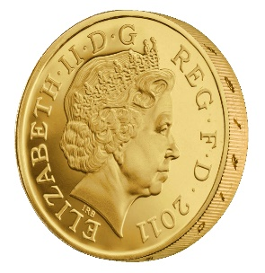
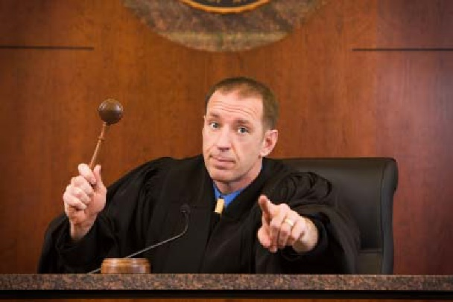
Adversarial Indistinguishability Experiment
m₀, m₁
Random bit b
K = Gen(.)
c = Enc_{K}(m_{b})
c
b’
$$∀\begin{matrix} & \\ & \\ & \end{matrix} Pr\left[\begin{matrix} & \\ & \end{matrix} Guesses b^{′}=b\right]≤\frac{1}{2}+μ(n)$$
$$ppt attacker$$
$$negligible function$$

Slide 18
Adversarial Indistinguishability Experiment
$$Formally, let Π= \left(Gen,Enc,Dec\right) denote the encryption scheme,$$
$call the experiment PrivKeav$ $and define a random variable$
${PrivK}_{A,Π }^{eav}=1 if b=b^{′}$
$${PrivK}_{A,Π }^{eav}=0 otherwise$$
$$Π has indistinguishable encryptions in the presence of$$
$$an eavesdropper if for all PPT adversary A, there is a$$
Negligible function $μ$ such that Pr[${PrivK}_{A,Π }^{eav}=1$] $≤\frac{1}{2}+μ(n)$
m₀, m₁
Random bit b
K = Gen(.)
c = Enc_{K}(m_{b})
c
b’
$$∀\begin{matrix} & \\ & \\ & \end{matrix} Pr\left[\begin{matrix} & \\ & \end{matrix} Guesses b^{′}=b\right]≤\frac{1}{2}+μ(n)$$
$$ppt attacker$$
$$negligible function$$

Slide 19
Semantic Security
m₀, m₁
Random bit b
K = Gen(.)
c = Enc_{K}(m_{b})
c
b’
$$∀\begin{matrix} & \\ & \\ & \end{matrix} Pr\left[\begin{matrix} & \\ & \end{matrix} Guesses b^{′}=b\right]≤\frac{1}{2}+μ(n)$$
$$ppt attacker$$
$$negligible function$$
Notes:
Suppose we have m,m’,c’ s.t. Pr[EncK(m)= c’] > Pr[EncK(m’)=c’] then adversary can select m0= m, m1=m’. If the ciphertext challenge c=c’ then the adversary outputs guess b’ = 1. Otherwise, the adversary outputs random guess b’.

Slide 20
Aside: Message and Ciphertext Length
In the previous game we typically require that |m₀|=|m₁|. Why?
It is impossible to support arbitrary length messages while hiding all information about plaintext length
Limitation: When could message length be sensitive?
Numeric data (5 figure vs 6 figure salary)
Database Searches: number of records returned can reveal information about the query
Compressed Data: Short compressed string indicates that original plaintext has a lot of redundancy. (CRIME attack on session cookies in HTTPS)

Slide 21
Implications of Indistinguishability
Theorem 3.10: Let (Gen, Enc, Dec) be a fixed-length private key encryption scheme for message of length $ℓ$ that satisfies indistinguishability (prior definition) then for all PPT attackers A and any $i≤ℓ$ we have
$$Pr\left[A\left(1^{n},{Enc}_{K}\left(m\right)\right)=m^{i}\right]≤\frac{1}{2}+negl(n)$$
Where the randomness is taken over $K←Gen\left(1^{n}\right)$, uniform $m∈{\left\{0,1\right\}}^{ℓ}$ and the randomness of $Enc$ and A.

Slide 22
Semantic Security
h(m) background knowledge the attacker might have about m.
Example:
f(m) = 1 if m > 100,000;
f(m) = 0 otherwise .
Definition 3.12: Let (Gen, Enc, Dec) be a fixed-length private key encryption scheme for message of length $ℓ$. We say that the scheme is semantically secure if for all PPT attackers A there exists a PPT algorithm A’ such that for any PPT algorithm Sample all any polynomial time computable functions f and h we have
$$\left|Pr\left[A\left(1^{n},{Enc}_{K}\left(m\right),h(m)\right)=f(m)\right]−Pr\left[A′\left(1^{n},\left|m\right|,h(m)\right)=f(m)\right]\right|≤negl(n)$$
Where the randomness is taken over $K←Gen\left(1^{n}\right)$, $m←Samp\left(1^{n}\right)$ and the randomness of $Enc$, A and A’.
A’ doesn’t even get to see an encryption of m! Just the length of m!

Slide 23
Semantic Security
Definition 3.12: Let (Gen, Enc, Dec) be a fixed-length private key encryption scheme for message of length $ℓ$. We say that the scheme is semantically secure if for all PPT attackers A there exists a PPT algorithm A’ such that for any PPT algorithm Sample all any polynomial time computable functions f and h we have
$$\left|Pr\left[A\left(1^{n},{Enc}_{K}\left(m\right),h(m)\right)=f(m)\right]−Pr\left[A′\left(1^{n},\left|m\right|,h(m)\right)=f(m)\right]\right|≤negl(n)$$
Where the randomness is taken over $K←Gen\left(1^{n}\right)$, $m←Samp\left(1^{n}\right)$ and the randomness of $Enc$, A and A’.
Theorem 3.13: Both security definitions (indistinguishable encryptions/semantic security) are equivalent.

Slide 24
Coming Up…
Before Next Class (Friday)
Read: Katz and Lindell 3.3
Constructing Secure Encryption Schemes
Homework 1 released Friday

