Slide 1
Course Business
I am traveling April 25-May 3rd
  Will still be available by e-mail to answer questions
Final Exam Review on Monday, April 24th
Guest Lectures on April 26 and 28 (TBD)
Final Exam on Monday, May 1st (in this classroom)
  Adib will proctor
Practice Final Exam released soon

Slide 2
Cryptography
CS 555
Topic 39: Password Hashing

Slide 3

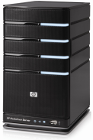
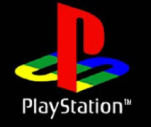
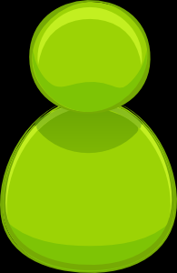

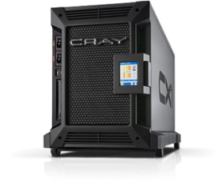

Password Storage
jblocki, 123456
Username
jblocki
Salt
89d978034a3f6
Hash
85e23cfe0021f584e3db87aa72630a9a2345c062
SHA1(12345689d978034a3f6)=85e23cfe0021f584e3db87aa72630a9a2345c062
+
Notes:
As a motivating example consider an adversary who breaks into an authentication server and steals a users crptographic hash value. The adversary can execute an offline attack against the password by comparing the hash value with the hashes of likely password guesses. The adversary is limited only by the resources that he is willing to invest cracking the passwords.

Slide 4






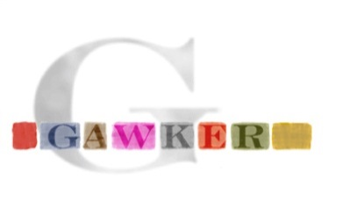

Offline Attacks: A Common Problem
Password breaches at major companies have affected millions of users.
Notes:
Unfortunately, offline dictionary attacks are quite common. Password breaches at major companies have affected millions of users. In the past few years I have had to update the slide several times.

Slide 5






Offline Attacks: A Common Problem
Password breaches at major companies have affected millions of users.
Notes:
Unfortunately, offline dictionary attacks are quite common. Password breaches at major companies have affected millions of users.

Slide 6
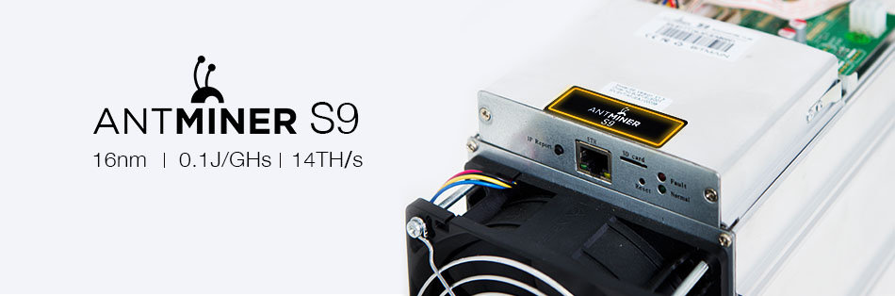

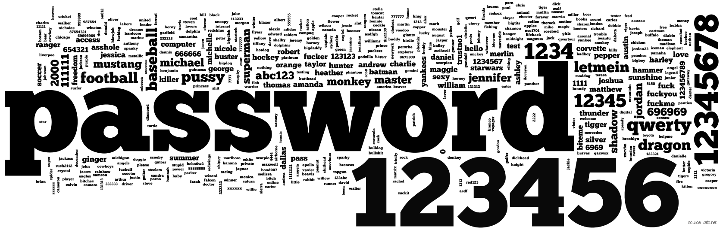

A Dangerous Problem
Can we increase guessing costs for the attacker?
$2,400 on Amazon

Slide 7
Attempt 1: Hash Iteration
BCRYPT
PBKDF2
100,000 SHA256 computations
(iterative)
Estimated Cost on ASIC: $1 per billion password guesses [BS14]

Slide 8
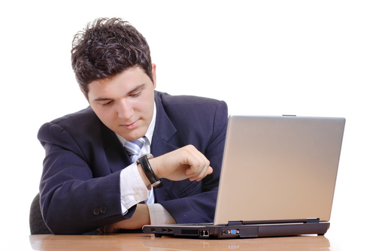
The Challenge
Cost SHA256
USD $
Units of Patience
User Patience
Time
Disclaimer: This slide is entirely for humorous effect.

Slide 9
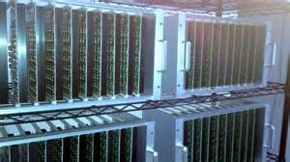
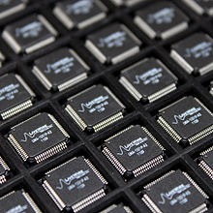
Goal: Moderately Expensive Hash Function
Fast on PC and
Expensive on ASIC?
Notes:
This motivates the need for moderately hard functions. The basic idea is to build a password hash function that is moderately expensive to compute to limit the number of guesses that an adversary would be willing to try. An honest server only needs to compute the function once during a typical authentication session. However, the adversary potentially has an advantage in this game. While the honest server must typically evaluate the function on standard hardware, the adversary could use potentially reduce the cost per password guess by developing customized hardware (GPUs, FPGAs, ASICs) to evaluate the password hash function. Thus, we want to ensure that the cost to evaluate this function is equitable across platforms.

Slide 10
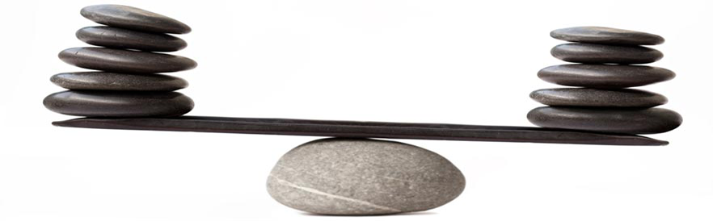
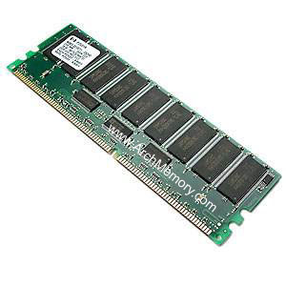
Memory Costs: Equitable Across Architectures
Notes:
By contrast, memory costs tends to be much more equitable across different architectures

Slide 11
Outline
Motivation
Data Independent Memory Hard Functions (iMHFs)
  Graph Pebbling
  Measuring Pebbling Costs
  Desiderata
Attacks on iMHF Constructions
Constructing iMHFs
Open Questions

Slide 12



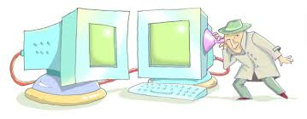
Memory Hard Function (MHF)
Intuition: computation costs dominated by memory costs
vs.
Data Independent Memory Hard Function (iMHF)
  Memory access pattern should not depend on input
Notes:
In this work we study a special type of memory hard function called data-independent memory hard functions. As the name suggests the memory access pattern will not depend on the input making the functions resistant to side-channel attacks.

Slide 13

iMHF Candidates
Catena [FLW15]
  Special Recognition at Password Hashing Competition
  Two Variants: Dragonfly and Double-Butterfly
Argon2 [BDK15]
  Winner of the Password Hashing Competition
  Argon2i (data-independent mode) is recommended for Password Hashing
Balloon Hashing [BCS16]
  Newer proposal (three variants in original proposal)
Notes:
In terms of depth-robustness two of these variants were similar to Catena and one variant was similar to Argon.

Slide 14


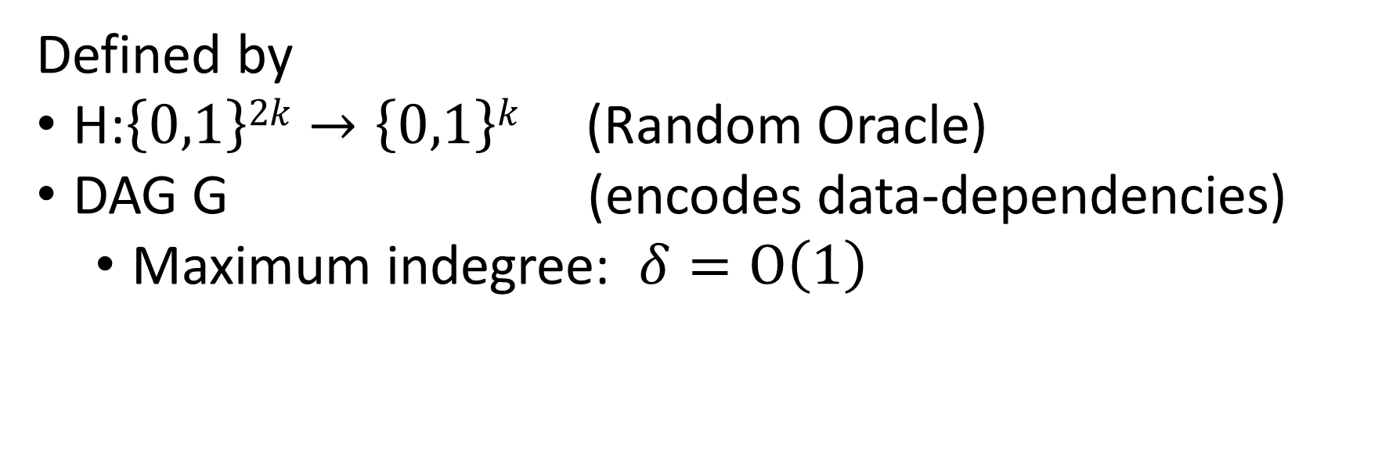
iMHF (f_{G,H})
Defined by
H:$\left\{0,1\right\}2k→\left\{0,1\right\}k$ (Random Oracle)
DAG G (encodes data-dependencies)
  Maximum indegree: $δ=O\left(1\right)$
Input: pwd, salt
2
4
1
Output: f_{G,H} (pwd,salt)= L₄
1
3
$$L1=H(pwd,salt)$$
$$L3=H(L2,L1)$$

Slide 15
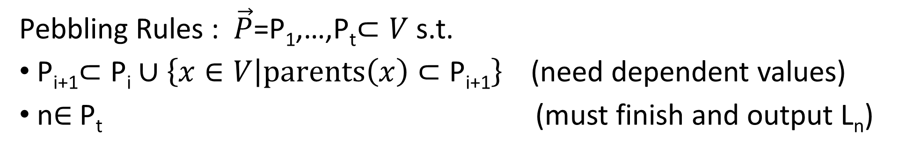


Evaluating an iMHF (pebbling)
2
4
Output: L₄
Input:
1
1
pwd, salt
3
$$L1=H(pwd,salt)$$
$$L3=H(L2,L1)$$
Pebbling Rules : $\vec{P}$=P₁,…,P_{t}$⊂V$ s.t.
P_{i+1}$⊂\text{P}\text{i}∪\left\{x∈V | parents\left(x\right)⊂\text{P}\text{i}\text{+1}\right\}$(need dependent values)
n$∈$P_{t} (must finish and output L_{n})
Notes:
We will describe our algorithms for evaluating an iMHF using the language of graph pebbling. Placing a pebble on a node corresponds to computing the corresponding label, and keeping a pebble on the graph corresponds to storing that label in memory. Of course we can only compute a label if we have all of the dependent labels. Thus, in a legal pebbling we cannot place a pebble on a node until we have pebbles on the parents of that node. If the adversary is parallel then we are allowed to place multiple pebbles on the graph in each round. We can remove pebbles from the graph at any point in time.

Slide 16
Pebbling Example
4
5
3
4
5
1
3
1
2

Slide 17
Pebbling Example
1
2
3
4
5
P₁ = {1}

Slide 18
Pebbling Example
1
2
3
4
5
P₁ = {1}
P₂ = {1,2}

Slide 19
Pebbling Example
1
2
3
4
5
P₁ = {1}
P₂ = {1,2}
P₃ = {3}

Slide 20
Pebbling Example
1
2
3
4
5
P₁ = {1}
P₂ = {1,2}
P₃ = {3}
P₄ = {3,4}

Slide 21
Pebbling Example
1
2
3
4
5
P₁ = {1}
P₂ = {1,2}
P₃ = {3}
P₄ = {3,4}
P₅ = {5}

Slide 22
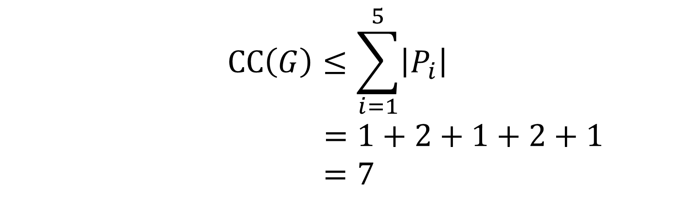
Pebbling Example (CC)
1
2
3
4
5
P₁ = {1}
$$CC\left(G\right)≤\sum_{i=1}^{5}{\left|P_{i}\right|}$$
$$=1+2+1+2+1$$
$=7$
P₂ = {1,2}
P₃ = {3}
P₄ = {3,4}
P₅ = {5}

Slide 23
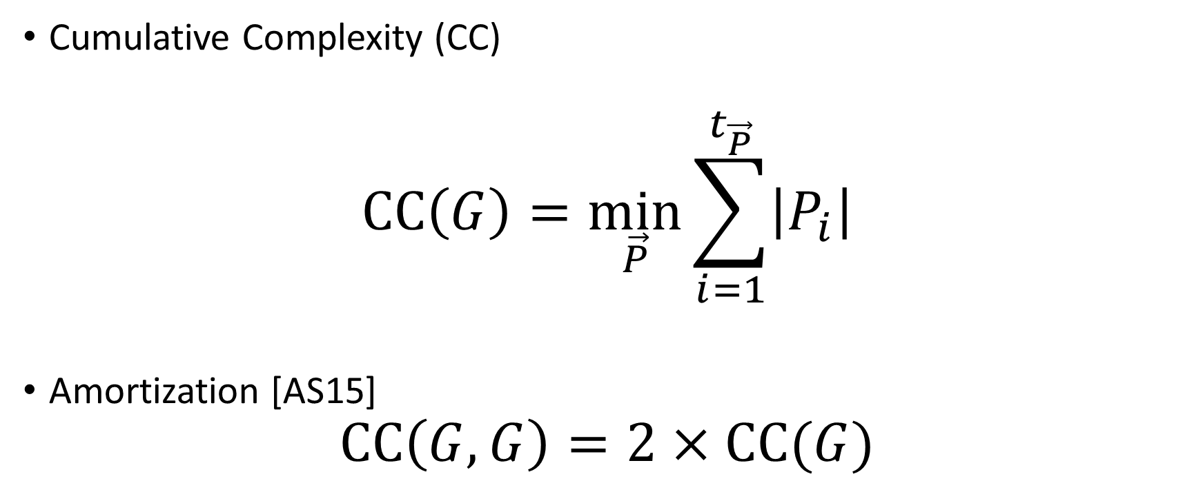
Measuring Cost
Cumulative Complexity (CC)
$$CC\left(G\right)=\min_{\vec{P}}{\sum_{i=1}^{t_{\vec{P}}}{\left|P_{i}\right|}}$$
Amortization [AS15]
$$CC\left(G,G\right)=2×CC(G)$$

Slide 24
Pebbling Example (CC)
1
2
3
4
5
P₁ = {1}
$$CC\left(G\right)≤\sum_{i=1}^{5}{\left|P_{i}\right|}$$
$$=1+2+1+2+1$$
$=7$
P₂ = {1,2}
P₃ = {3}
P₄ = {3,4}
P₅ = {5}

Slide 25
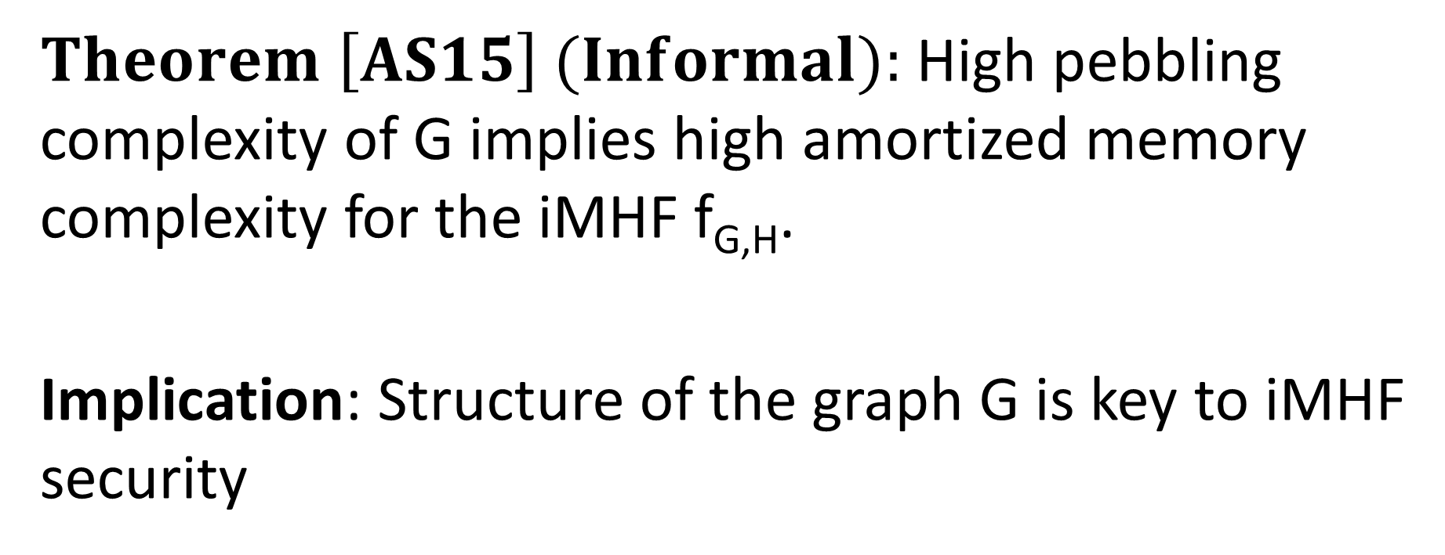
Pebbling Equivalence
$Theorem \left[AS15\right] (Informal):$High pebbling complexity of G implies high amortized memory complexity for the iMHF f_{G,H}.
Implication: Structure of the graph G is key to iMHF security

Slide 26
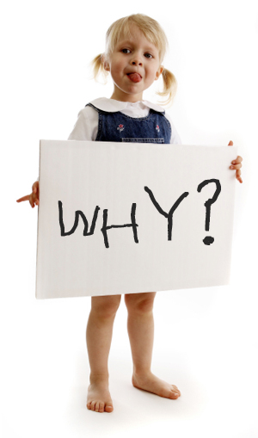

Desiderata
Find a DAG G on n nodes such that
Constant Indegree ($δ=2)$
CC(G) $≥\frac{n2}{τ}$ for some small value $τ$.
Maximize costs for fixed n
(Users are impatient)

Slide 27
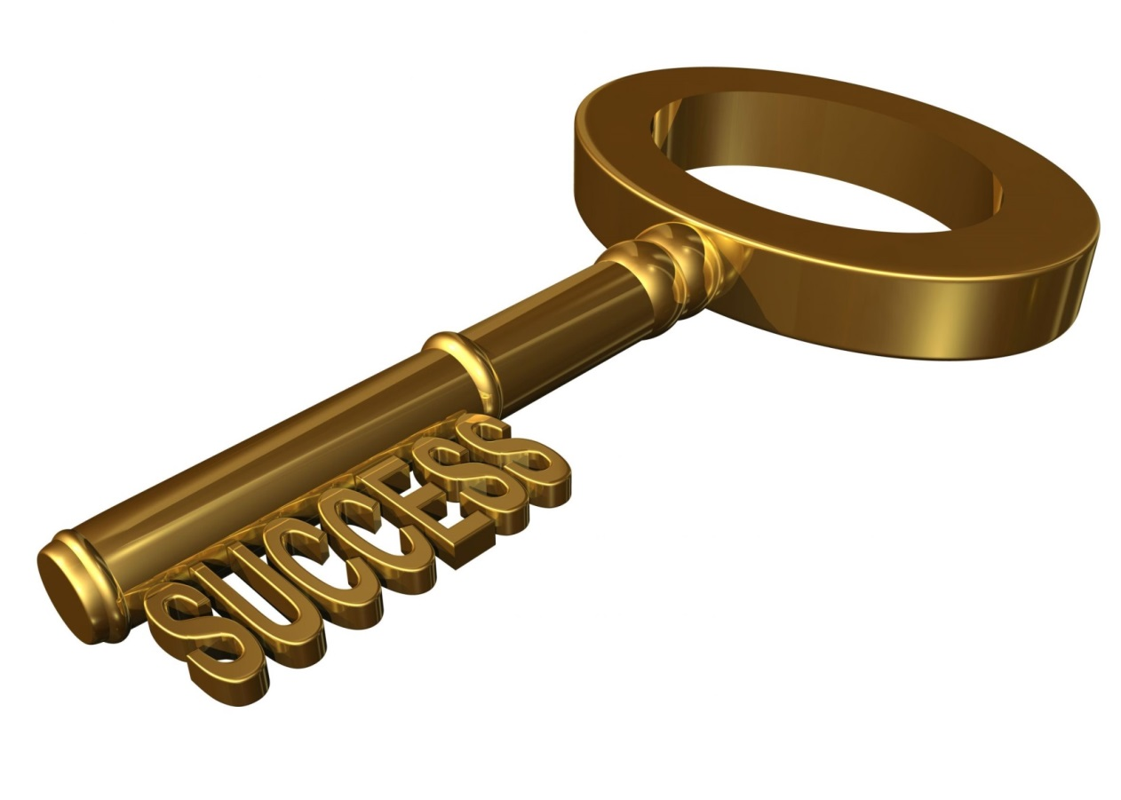
Depth-Robustness: The Key Property
Necessary [AB16] and sufficient [ABP16] for secure iMHFs

Slide 28

Depth Robustness
Definition: A DAG G=(V,E) is (e,d)-reducible if there exists $S⊆V$
s.t. $\left|S\right|≤e$ and depth(G-S) $≤d.$
Otherwise, we say that G is (e,d)-depth robust.
Example: (1,2)-reducible
1
2
3
4
5

Slide 29

Depth Robustness
Definition: A DAG G=(V,E) is (e,d)-reducible if there exists $S⊆V$
s.t. $\left|S\right|≤e$ and depth(G-S) $≤d.$
Otherwise, we say that G is (e,d)-depth robust.
Example: (1,2)-reducible
1
2
3
4
5

Slide 30
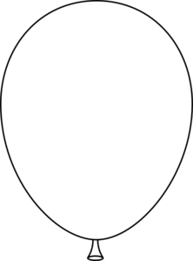
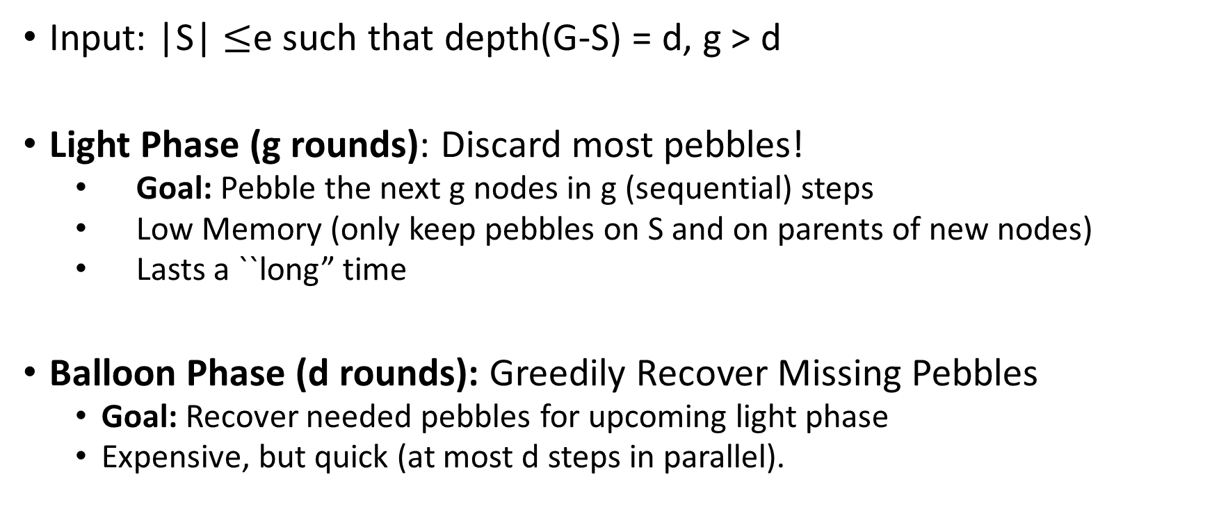
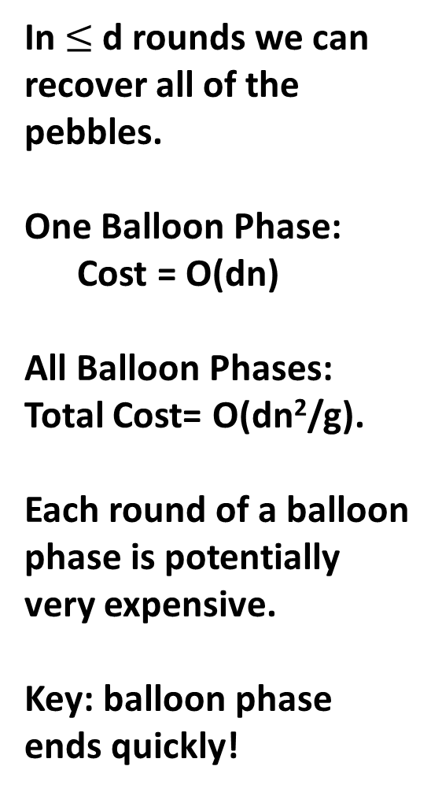
Attacking (e,d)-reducible DAGs
Input: |S| $≤$e such that depth(G-S) = d, g > d
Light Phase (g rounds): Discard most pebbles!
  Goal: Pebble the next g nodes in g (sequential) steps
  Low Memory (only keep pebbles on S and on parents of new nodes)
  Lasts a ``long” time
Balloon Phase (d rounds): Greedily Recover Missing Pebbles
  Goal: Recover needed pebbles for upcoming light phase
  Expensive, but quick (at most d steps in parallel).
In $≤$d rounds we can recover all of the pebbles.
One Balloon Phase:
Cost = O(dn)
All Balloon Phases:
Total Cost= O(dn²/g).
Each round of a balloon phase is potentially very expensive.
Key: balloon phase ends quickly!
Light Phase: Discard most pebbles!
Only keep pebbles on parents of next g nodes.
One Light Phase: Cost = O(g|S|)
All Light Phases: Total Cost = O(g|S|(n/g))= O(n|S|)

Slide 31
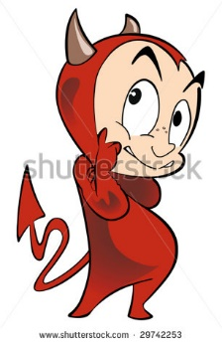

Depth Robustness is Necessary
Theorem (Depth-Robustness is a necessary condition): If G is not (e,d)-node robust then $\operatorname{CC}\left(G\right)=O\left(en+\sqrt{n3d}\right)$ .
In particular, $\operatorname{CC}\left(G\right)=o\left(n2\right)$ for e,d=o(n).
Are existing iMHF candidates based on depth-robust DAGs?

Slide 32
Attacking (e,d)-reducible DAGs
In $≤$d rounds we can recover all of the pebbles.
One Balloon Phase:
Cost = O(dn)
All Balloon Phases:
Total Cost= O(dn²/g).
Each round of a balloon phase is potentially very expensive.
Key: balloon phase ends quickly!

Slide 33

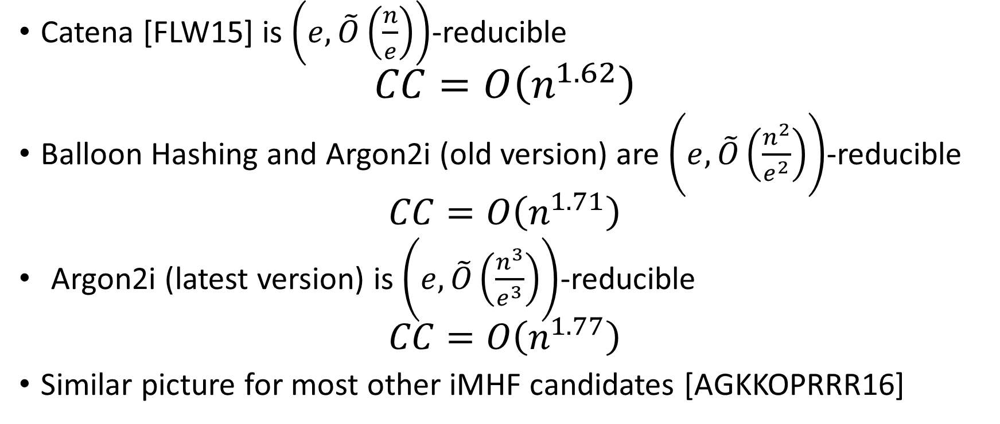
Answer: No
Catena [FLW15] is $\left(e,\tilde{O}\left(\frac{n}{e}\right)\right)$-reducible
$$CC=O\left(n^{1.62}\right)$$
Balloon Hashing and Argon2i (old version) are $\left(e,\tilde{O}\left(\frac{n^{2}}{e^{2}}\right)\right)$-reducible
  $$CC=O\left(n^{1.71}\right)$$
  Argon2i (latest version) is $\left(e,\tilde{O}\left(\frac{n^{3}}{e^{3}}\right)\right)$-reducible
  $$CC=O\left(n^{1.77}\right)$$
Similar picture for most other iMHF candidates [AGKKOPRRR16]

Slide 34

Argon2i [BDK]
Argon2: Winner of the password hashing competition[2015]
Authors recommend Argon2i variant (data-independent) for password hashing.
Notes:
Alex Biryukov, Daniel Dinu, and Dmitry Khovratovich from University of Luxembourg.

Slide 35
Argon2i
…
1
2
3
4
i
n

Slide 36
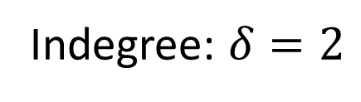
Argon2i
random predecessor r(i) < i
…
1
2
3
4
i
n
Indegree: $δ=2$

Slide 37


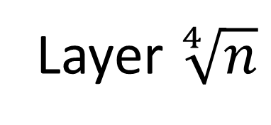


Argon2i: Reducing depth to $\sqrt{n}$
…
…
n
Layer $\sqrt[4]{n}$
…
…
…
$${2n}^{3/4}$$
Layer 1
…
…
1
2
3
$$\sqrt[4]{n}$$
$$n^{3/4}$$
Layer 0

Slide 38

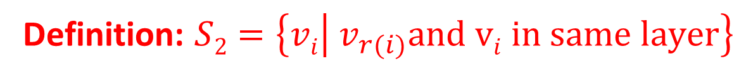
Argon2i: Reducing depth to $\sqrt{n}$
Definition: $S2=\left\{vi | v_{r(i)}and vi in same layer\right\}$
…
…
n
Layer $\sqrt[4]{n}$
…
…
…
$${2n}^{3/4}$$
Layer 1
…
…
1
2
3
$$\sqrt[4]{n}$$
$$n^{3/4}$$
Layer 0
$$Claim:S2is small$$

Slide 39



Argon2i is a layered DAG (almost)
Let S = S₁+S₂
…
…
n
Layer $\sqrt[4]{n}$
…
…
…
+2
+3
$${2n}^{3/4}$$
Layer 1
…
…
1
2
3
$$\sqrt[4]{n}$$
$$n^{3/4}$$
Layer 0
$$Fact:Easy to reduce the depth of a path$$

Slide 40
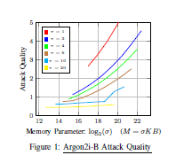
Attack Simulation [AB16b]
Parameter setting could easily be chosen when following Argon2i-B guidelines
…
Pessimistic Argon 2i-B parameter
Attack on Argon 2i-B is practical even for pessimistic parameter ranges
(brown line).

Slide 41
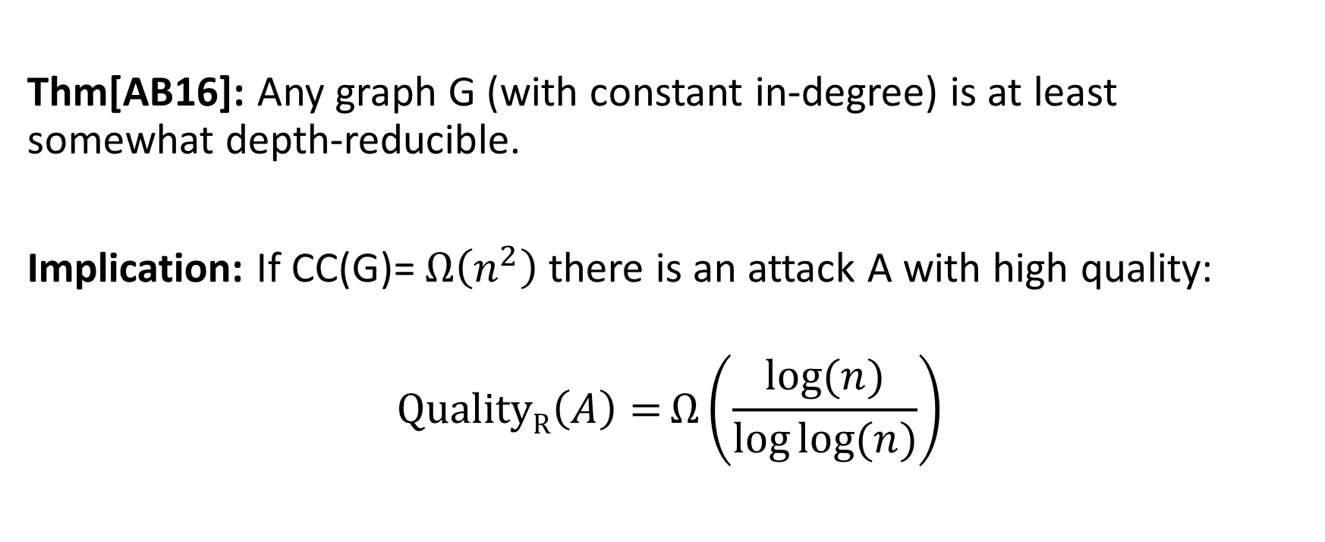
Ideal iMHFs Don’t Exist
Thm[AB16]: Any graph G (with constant in-degree) is at least somewhat depth-reducible.
Implication: If CC(G)= $Ω\left(n^{2}\right)$there is an attack A with high quality:
$$\operatorname{QualityR}\left(A\right)=Ω\left(\frac{log⁡(n)}{\log{log⁡(n)}}\right)$$

Slide 42
But, we cannot rule them out in practice

Slide 43
Outline
Motivation
Data Independent Memory Hard Functions (iMHFs)
Attacks
Constructing iMHFs (New!)
  Depth-Robustness is sufficient
Conclusions and Open Questions
Notes:
Joint work with Joel Alwen and Krzysztof Pietrzak

Slide 44
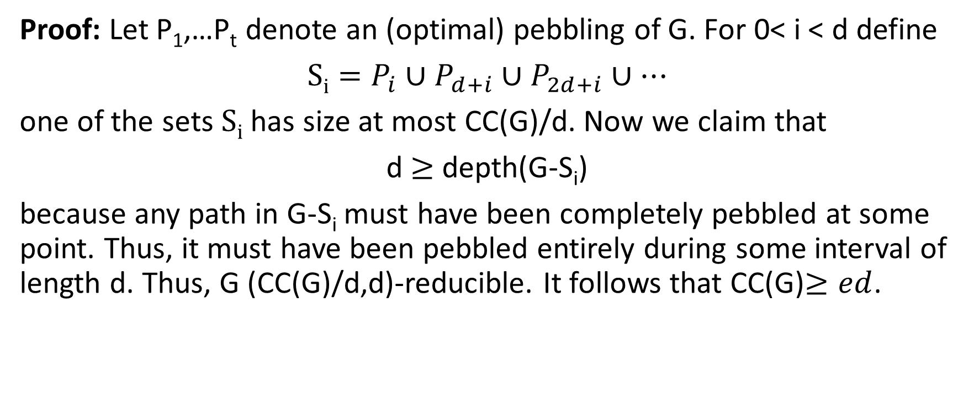
Depth-Robustness is Sufficient! [ABP16]
$Key Theorem:$Let G=(V,E) be (e,d)-depth robust then CC(G)$≥ed$.
Proof: Let P₁,…P_{t} denote an (optimal) pebbling of G. For 0< i < d define
$Si=P_{i}∪P_{d+i}∪P_{2d+i}$ $∪…$
one of the sets $Si$ has size at most CC(G)/d. Now we claim that
d $≥$depth(G-S_{i})
because any path in G-S_{i} must have been completely pebbled at some point. Thus, it must have been pebbled entirely during some interval of length d. Thus, G (CC(G)/d,d)-reducible. It follows that CC(G)$≥ed$.

Slide 45
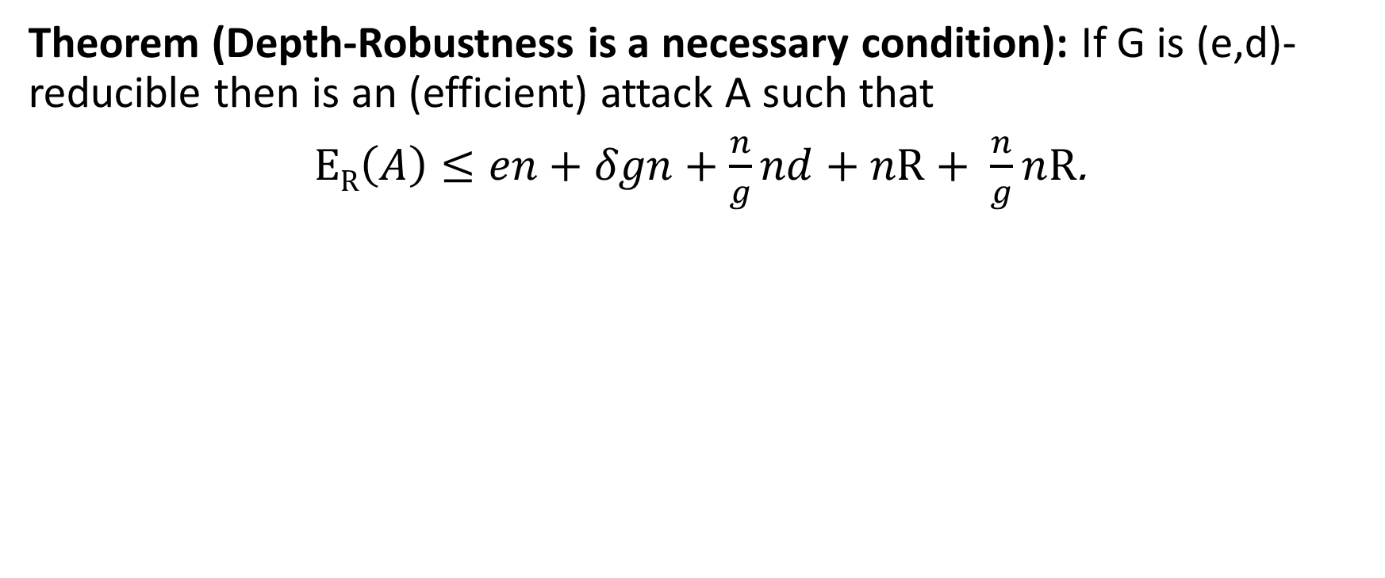
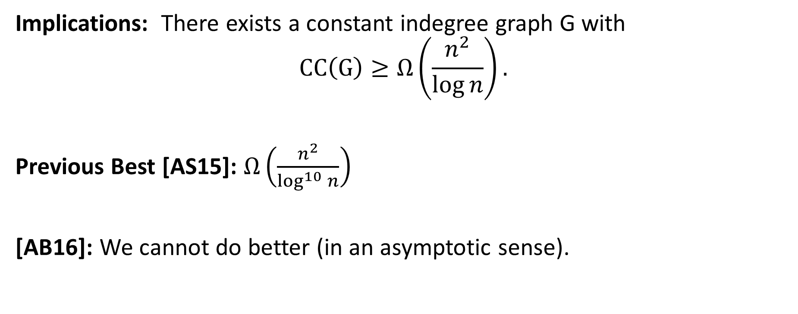
Depth-Robustness is Sufficient! [ABP16]
$Key Theorem:$Let G=(V,E) be (e,d)-depth robust then CC(G)$≥ed$.
Implications: There exists a constant indegree graph G with
$$CC\left(G\right)≥Ω\left(\frac{n^{2}}{\log{n}}\right).$$
Previous Best [AS15]: $Ω\left(\frac{n^{2}}{\log^{10}{n}}\right)$
[AB16]: We cannot do better (in an asymptotic sense).

Slide 46
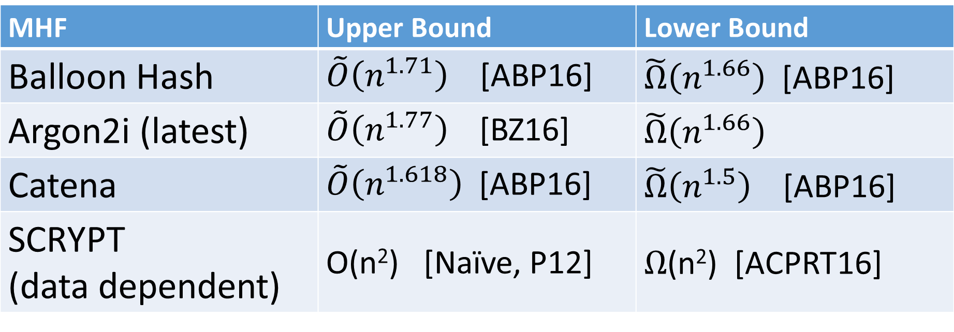
More New Results
MHF | Upper Bound | Lower Bound
Balloon Hash | $\tilde{O}\left(n^{1.71}\right)$ [ABP16] | $\tilde{Ω}\left(n^{1.66}\right)$ [ABP16]
Argon2i (latest) | $\tilde{O}\left(n^{1.77}\right)$ [BZ16] | $\tilde{Ω}\left(n^{1.66}\right)$
Catena | $\tilde{O}\left(n^{1.618}\right)$ [ABP16] | $\tilde{Ω}\left(n^{1.5}\right)$ [ABP16]
SCRYPT (data dependent) | O(n²) [Naïve, P12] | $Ω$(n²) [ACPRT16]

Slide 47
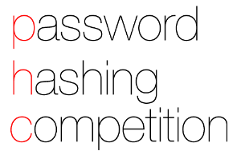

Summary
BCRYPT and PBKDF2 are no longer sufficient for password hashing
Argon2i is an improvement over BCRYPT and PBKDF2
  But still has its flaws [AB16,AB17]
Current Recommendation: Argon2id
  No side channel attacks? Resists known attacks
  Side channel attacks reduce security to Argon2i
Look for improvements in the near future using depth-robust graphs [ABP17]

Slide 48
Conclusions
Depth-robustness is a necessary and sufficient for secure iMHFs
  [AB16] [ABP16]
Big Challenge: Improved Constructions of Depth-Robust Graphs
  We already have constructions in theory [EGS77, PR80, …]
  But constants matter!

Slide 49

Thanks for Listening

Slide 50
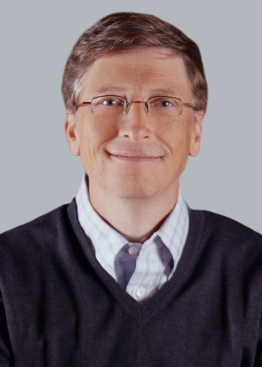
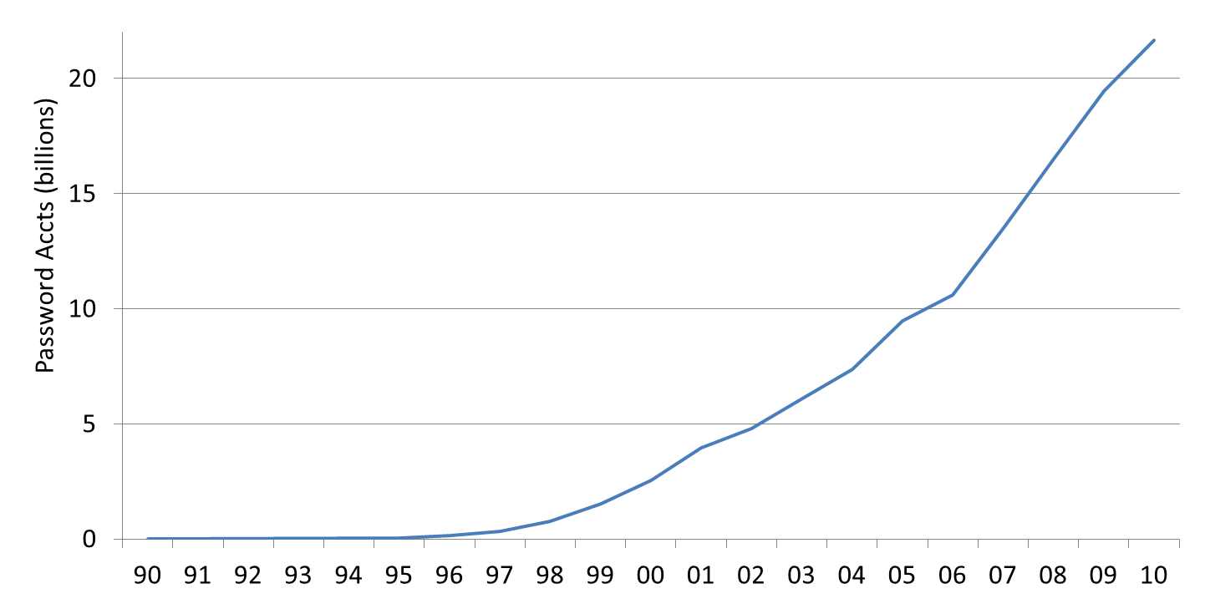
Passwords vs time: Look how far we’ve come
Source: Cormac’s estimate
“The password is dead”
Netscape IPO
Dotcom crash

Slide 51
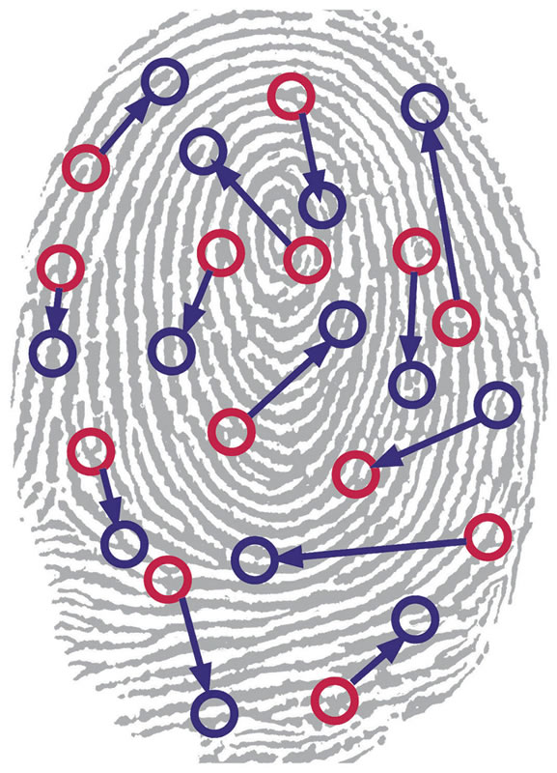
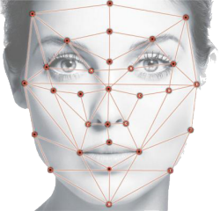
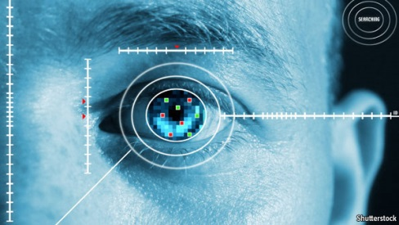

Biometrics
Notes:
Another line of research has sought to eliminate text passwords. One might ask whether or not password research will be relevant in the future. Bonneau, et al. considered each of these alternatives to text passwords in 2012 and concluded that there was no silver bullet to replace text passwords. While every proposed replacement has desirable properties, every replacement scheme they evaluated also had its disadvantages. For example, biometrics signals like fingerprints cannot be changed if they are compromised.
Quest to Replace Passwords
Bonneau, J. ; Univ. of Cambridge, Cambridge, UK ; Herley, C. ; van Oorschot, P.C. ; Stajano, F.

Slide 52
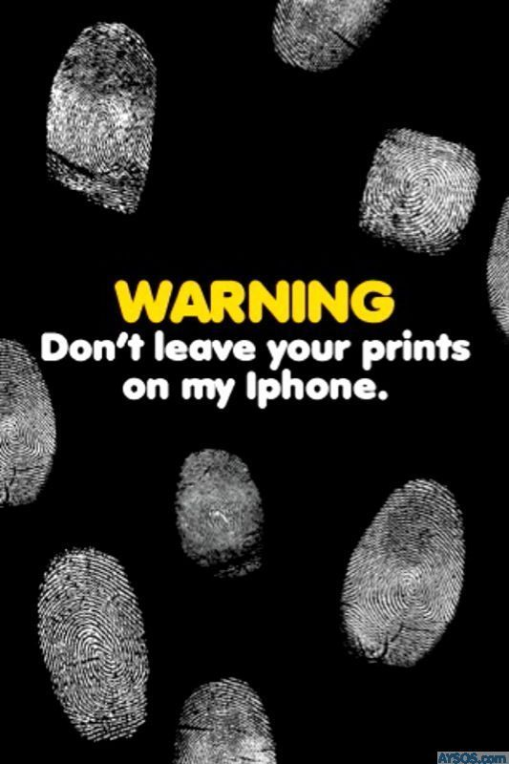
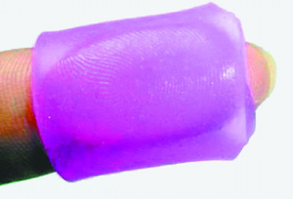
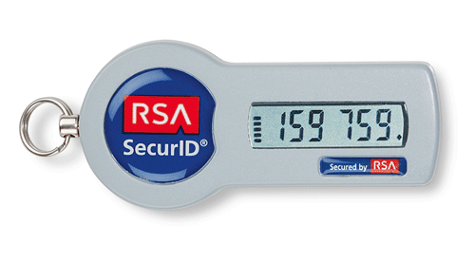
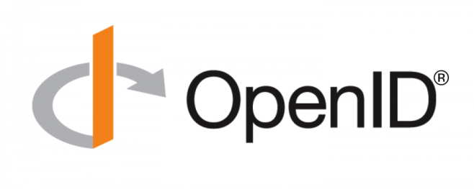

Biometrics
Challenges: Revoke? Secrecy?
Alternatives to Passwords
Notes:
Another line of research has sought to eliminate text passwords. One might ask whether or not password research will be relevant in the future. Bonneau, et al. considered each of these alternatives to text passwords in 2012 and concluded that there was no silver bullet to replace text passwords. While every proposed replacement has desirable properties, every replacement scheme they evaluated also had its disadvantages. For example, biometrics signals like fingerprints cannot be changed if they are compromised.
Quest to Replace Passwords
Bonneau, J. ; Univ. of Cambridge, Cambridge, UK ; Herley, C. ; van Oorschot, P.C. ; Stajano, F.

Slide 53
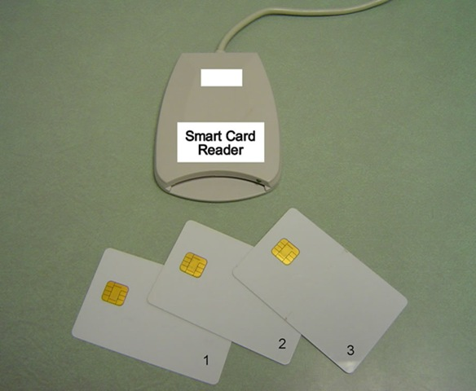
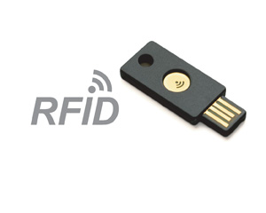


Hardware Tokens
Notes:
Another line of research has sought to eliminate text passwords. One might ask whether or not password research will be relevant in the future. Bonneau, et al. considered each of these alternatives to text passwords in 2012 and concluded that there was no silver bullet to replace text passwords. While every proposed replacement has desirable properties, every replacement scheme they evaluated also had its disadvantages. For example, biometrics signals like fingerprints cannot be changed if they are compromised.
Quest to Replace Passwords
Bonneau, J. ; Univ. of Cambridge, Cambridge, UK ; Herley, C. ; van Oorschot, P.C. ; Stajano, F.

Slide 54

Hardware Tokens
Challenge: $$$ + more stuff to carry around
Alternatives to Passwords
Notes:
Another line of research has sought to eliminate text passwords. One might ask whether or not password research will be relevant in the future. Bonneau, et al. considered each of these alternatives to text passwords in 2012 and concluded that there was no silver bullet to replace text passwords. While every proposed replacement has desirable properties, every replacement scheme they evaluated also had its disadvantages. For example, biometrics signals like fingerprints cannot be changed if they are compromised.
Quest to Replace Passwords
Bonneau, J. ; Univ. of Cambridge, Cambridge, UK ; Herley, C. ; van Oorschot, P.C. ; Stajano, F.

Slide 55


Graphical Passwords
Examples:
  Passfaces, Cued Click Points, Windows 8
…
Notes:
Graphical passwords have been an active area of research over the past 2 decades. Graphical password schemes aim to make passwords easier to remember by taking advantage of the natural human capacity for visual memory and cued recall. We will seek to exploit visual and associative memory with Person-Action-Object stories. The key difference is that we are focused on strategies for creating and remembering multiple passwords.
Graphical password authentication using cued click points
S Chiasson, PC van Oorschot, R Biddle - Computer Security–ESORICS

Slide 56



Graphical Passwords
Challenge: Multiple Passwords
Graphical Passwords
  Passfaces, Cued Click Points, Windows 8
…
Notes:
Graphical passwords have been an active area of research over the past 2 decades. Graphical password schemes aim to make passwords easier to remember by taking advantage of the natural human capacity for visual memory and cued recall. We will seek to exploit visual and associative memory with Person-Action-Object stories. The key difference is that we are focused on strategies for creating and remembering multiple passwords.
Graphical password authentication using cued click points
S Chiasson, PC van Oorschot, R Biddle - Computer Security–ESORICS

Slide 57


Graphical Passwords: Hotspots

Slide 58

Graphical Passwords: Hotspots

Slide 59



Password Managers
Password Management Software
Notes:
LastPass
KeePass
1Password
A Usability Study and Critique of Two Password Managers ∗
by S Chiasson, PC van Oorschot, R Biddle
PwdHash
Blake Ross, Collin Jackson, Nicholas Miyake, Dan Boneh and John C. Mitchell

Slide 60







Related Work
Challenge: Single point of failure
Password Management Software
Notes:
LastPass
KeePass
1Password
A Usability Study and Critique of Two Password Managers ∗
by S Chiasson, PC van Oorschot, R Biddle
PwdHash
Blake Ross, Collin Jackson, Nicholas Miyake, Dan Boneh and John C. Mitchell

Slide 61
References
Depth-Robust Graphs and Their Cumulative Memory Complexity. with Joel Alwen and Krzysztof Pietrzak. EUROCRYPT 2017 (to appear). [ePrint]
On the Computational Complexity of Minimal Cumulative Cost Graph Pebbling. with Samson Zhou. (Working Paper). [arXiv]
Towards Practical Attacks on Argon2i and Balloon Hashing. with Joel Alwen. EuroS&P 2017 (to appear). [ePrint]
Efficiently Computing Data Independent Memory Hard Functions. with Joel Alwen. CRYPTO 2016. [Full Version]

