Slide 1
Introduction to Differential Privacy
Jeremiah Blocki
CS-555
11/22/2016
Credit: Some slides are from Adam Smith

Slide 2
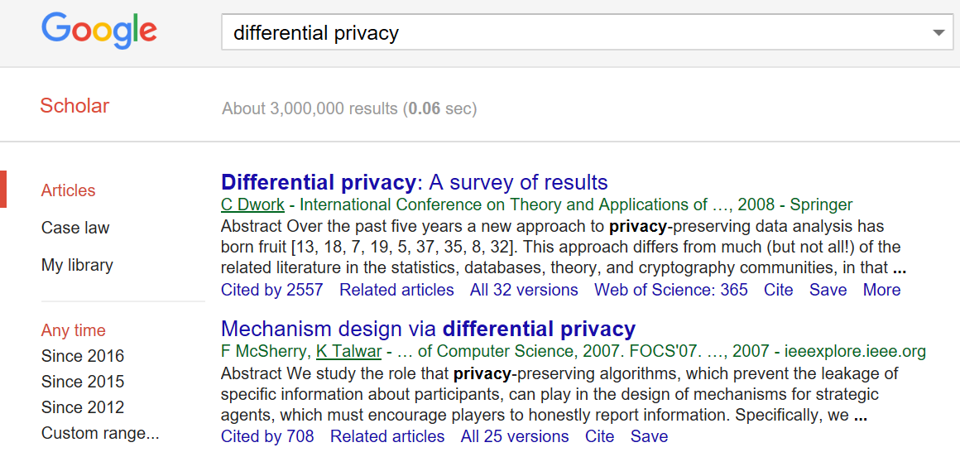



Slide 3
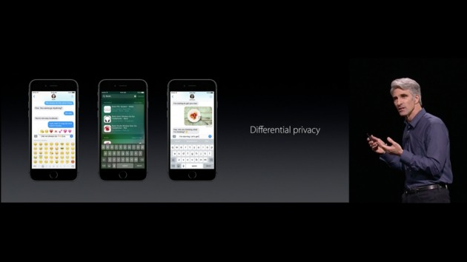



Differential Privacy

Slide 4


Privacy in Statistical Databases
Individuals Server/agency
x₁
Users
Government, researchers, businesses (or) Malicious adversary
₍ queries ₎
answers
x₂
A
..
.
x_{n}
What information can be released?
Two conflicting goals
  Utility: Users can extract “global” statistics
  Privacy: Individual information stays hidden
How can these be made precise?
  (How context-dependent must they be?)

Slide 5
Secure Function Evaluation
a.k.a.“multi-party computation”
Several parties, each with input x_{i}, want to compute a function f(x₁,x₂,...,x_{n})
Ideal world: all parties hand their inputs to a trusted party who computes f(x₁,...,x_{n}) and releases the result There exist secure protocols for this task
  Idea: a simulator can geneerate a dummy transcript given only the value of f
Privacy: use SFE protocols to jointly data mine
  Horizontal vs vertical
  Lots of papers
•
•
•

Slide 6
Why not use crypto definitions?
•
Attempt #1:
Def’n: For every entry i, no information about x_{i} is leaked (as if encrypted)
Problem: no information at all is revealed!
Tradeoff privacy vs utility
Attempt #2:
Agree on summary statistics f(DB) that are safe
Def’n: No information except f(DB)
•
Problem: why is f(DB) safe to release?
Tautology trap
(Also: how do you figure out what f is?)
C
C
C
C
C
C
8

Slide 7


A Problem Case
Question 1: How many people in this room have cancer?
Question 2: How many students in this room have cancer?
The difference (A1-A2) exposes my answer!

Slide 8
Why not use crypto definitions?
•
Problem: Crypto makes sense in settings where the line between “inside” and “outside” is well-defined
E.g. psychologist:
  “inside” = psychologist and patient
  “outside” = everyone else
•
Statistical databases: fuzzy line between inside and outside
9

Slide 9
Privacy in Statistical Databases
Individuals Server/agency
x₁
Users
Government, researchers, businesses (or) Malicious adversary
₍ queries ₎
answers
x₂
A
..
.
x_{n}
What information can be released?
Two conflicting goals
  Utility: Users can extract “global” statistics
  Privacy: Individual information stays hidden
How can these be made precise?
  (How context-dependent must they be?)

Slide 10



Straw Man #0
Omit ``Personally-Identifiable Information” and publish the data
e.g., Name, Social Security Number
This has been tried before….many time

Slide 11
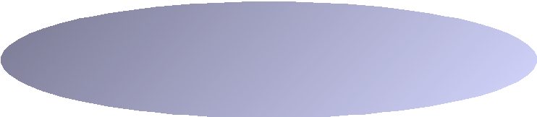
Straw man #1: Exact Disclosure
x₁
x₂
query answer¹ 1
San _{M}
query
¢ ¢ ¢ answer^{T} T
random coins
x₃
DB=
M
^{x}n-1 x_{n}
Adversary A
Def’n: safe if adversary cannot learn any entry exactly
  leads to nice (but hard) combinatorial problems
  Does not preclude learning value with 99% certainty or narrowing down to a small interval
Historically:
  Focus: auditing interactive queries
  Difficulty: understanding relationships between queries
  E.g. two queries with small difference
11

Slide 12
Two Intuitions for Data Privacy
•
“If the release of statistics S makes it possible to determine the value [of private information] more
accurately than is possible without access to S, a disclosure has taken place.” [Dalenius]
Learning more about me should be hard
•
Privacy is “protection from being brought to the attention of others.” [Gavison]
Safety is blending into a crowd

Slide 13
A Problem Example?
Suppose adversary knows that I smoke.
Question 0: How many patients smoke?
Question1: How many smokers have cancer?
Question 2: How many patients have cancer?
If adversary learns that smoking → cancer then he learns my health status.
Privacy Violation?

Slide 14
Preventing Attribute Disclosure
x₁
query answer¹ 1
San _{M}
query
¢ ¢ ¢ answer^{T} T
random coins
x₂
x₃
M
DB=
^{x}n-1 x_{n}
Adversary A
Large class of definitions
  safe if adversary can’t learn “too much” about any entry
➢ E.g.:
•
•
Cannot narrow X_{i} down to small interval
For uniform X_{i}, mutual information I(X_{i}; San(DB) ) · ε
How can we decide among these definitions?

Slide 15
Differential Privacy
x₁
query answer¹ 1
San _{M}
query
¢ ¢ ¢ answer^{T} T
random coins
x₂
x₃
M
DB=
^{x}n-1 x_{n}
Adversary A
Lithuanians example:
  Adv. learns height even if Alice not in DB
Intuition [DM]:
  “Whatever is learned would be learned regardless of whether or not Alice participates”
  Dual:Whatever is already known, situation won’t get worse

Slide 16




Approach: Indistinguishability
x₁
x
₍ queries ₎
answers
x₁
₍ queries ₎
answers
A
_{x}i
..2
.. 2
A
.
x_{n}
.
x_{n}
local random coins
local random coins
x’ is a neighbor of x
if they differ in one row
26

Slide 17



Approach: Indistinguishability
x₁
x
₍ queries ₎
answers
x₁
₍ queries ₎
answers
A
_{x}i
..2
.. 2
A
.
x_{n}
.
x_{n}
local random coins
local random coins
x’ is a neighbor of x
if they differ in one row
Neighboring databases induce close distributions on transcripts
26

Slide 18


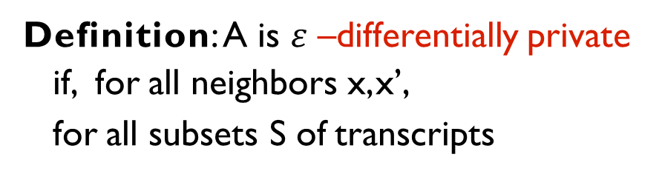
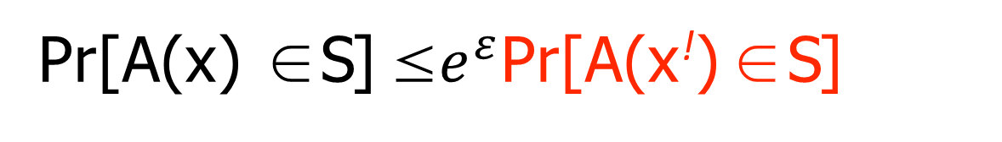
Approach: Indistinguishability
x₁
x
₍ queries ₎
answers
x₁
₍ queries ₎
answers
A
_{x}i
..2
.. 2
A
.
x_{n}
.
x_{n}
local random coins
local random coins
x’ is a neighbor of x
if they differ in one row
Neighboring databases
Definition: A is $ε$–differentially private if, for all neighbors x, x’,
for all subsets S of transcripts
induce close distributions
on transcripts
Pr[A(x) ∈ S] ${\text{≤}e}^{ε}$Pr[A(x!) ∈ S]
26

Slide 19
Approach: Indistinguishability
Note that ε has to be non-negligible here
  Triangle inequality: any pair of databases at distance < εn
  If ε < 1/n then users get no info!
Why this measure?
  Statistical difference doesn’t make sense with ε > 1/n
  E.g. choose random i and release i, xi
  This compromises someone’s privacy w.p. 1
Neighboring databases
Definition: A is $ε$–differentially private if, for all neighbors x, x’,
for all subsets S of transcripts
induce close distributions
on transcripts
Pr[A(x) ∈ S] ${\text{≤}e}^{ε}$Pr[A(x!) ∈ S]

Slide 20

Differential Privacy
•
Another interpretation [DM]:
You learn the same things about me regardless of whether I am in the database
•
Suppose you know I am the height of median Canadian
You could learn my height from database!
But it didn’t matter whether or not my data was part of it.
Has my privacy been compromised? No!
Neighboring databases
Definition: A is $ε$–differentially private if, for all neighbors x, x’,
for all subsets S of transcripts
induce close distributions
on transcripts
Pr[A(x) ∈ S] ${\text{≤}e}^{ε}$Pr[A(x!) ∈ S]

Slide 21





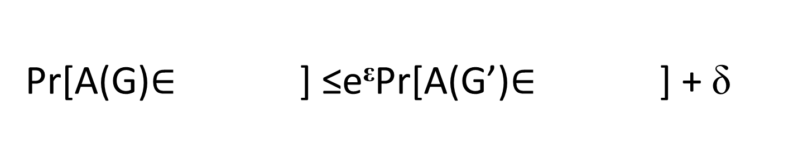
Graphs: Edge Adjacency
G
G’
~
Pr[A(G)$∈$ ] ≤e^{ε}Pr[A(G’)$∈$ ] + δ
Notes:
If a mechanism A satisfies differential privacy then the mechanism must produce similar distributions over both graphs.
Intuition: Johnny’s mom may be able tell if he watched an R-rated movie.

Slide 22
Graphs: Edge Adjacency
G
G’
~
Johnny’s mom does not learn if he watched Saw from the output A(G).
Notes:
If a mechanism A satisfies differential privacy then the mechanism must produce similar distributions over both graphs.
Intuition: Johnny’s mom may be able tell if he watched an R-rated movie.

Slide 23

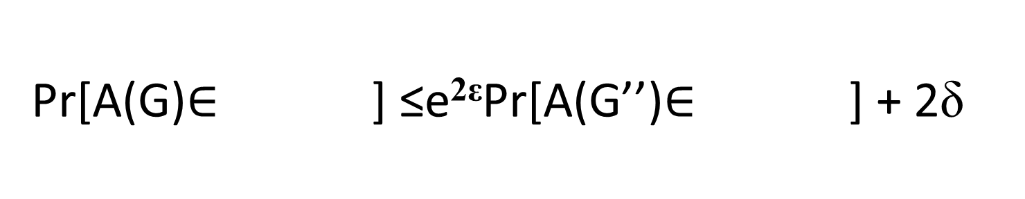
Privacy for Two Edges?
G
G’’
~
Pr[A(G)$∈$ ] ≤e^{2ε}Pr[A(G’’)$∈$ ] + 2δ
23

Slide 24
Limitations
G
G^{t}
~
…
…
Johnny’s mom may now be able tell if he watches R-rated movies from A(G).
Notes:
Now the graphs are not neighbors

Slide 25

Output Perturbation
Individuals Server/agency
x₁
x₂
A
“Tell me f(x)”
f(x) + noise
..
User
.
x_{n}
local random coins
Intuition: f(x) can be released accurately when f is insensitive to individual entries x1, x2, . . . , xn
32

Slide 26

Global Sensitivity
$$∆Q≔\max_{G\sim G′}\left|Q\left(G\right)−Q\left(G′\right)\right|$$

Slide 27
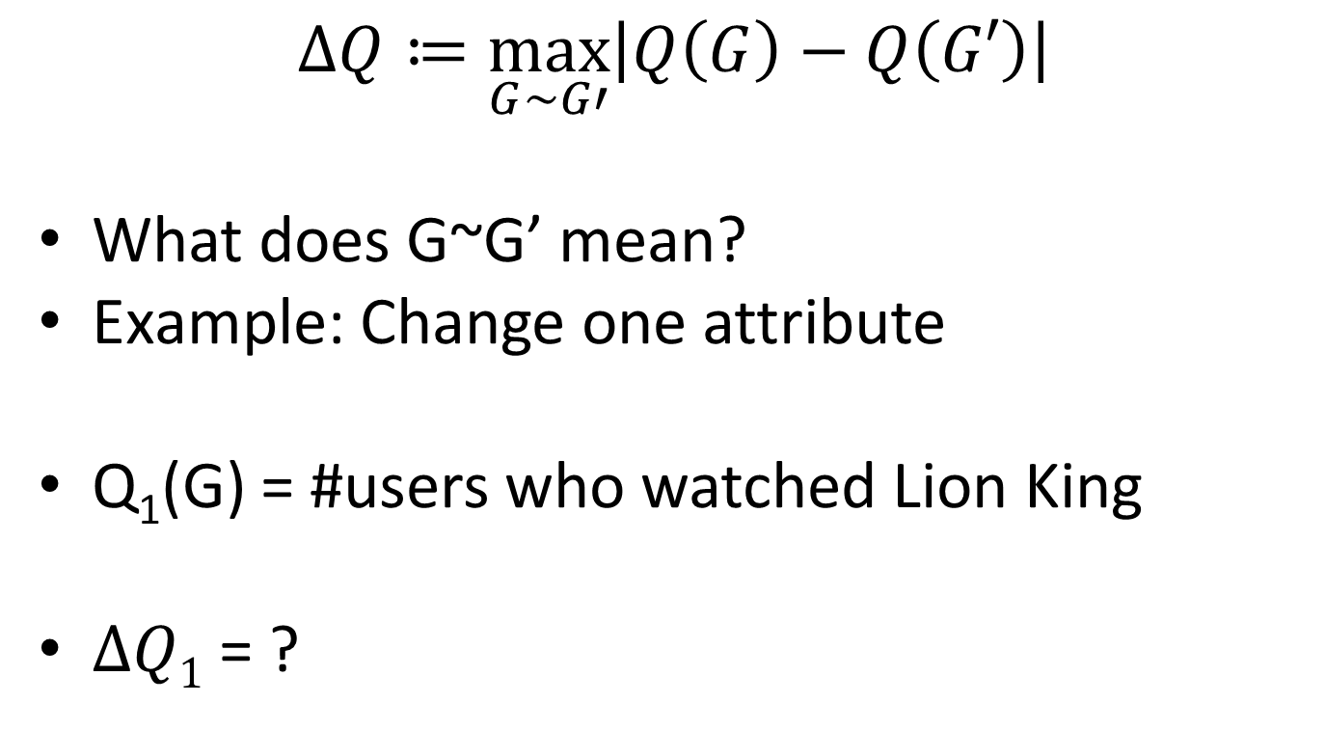
Global Sensitivity
$$∆Q≔\max_{G\sim G′}\left|Q\left(G\right)−Q\left(G′\right)\right|$$
What does G~G’ mean?
Example: Change one attribute
Q₁(G) = #users who watched Lion King
$∆Q1$ = ?

Slide 28
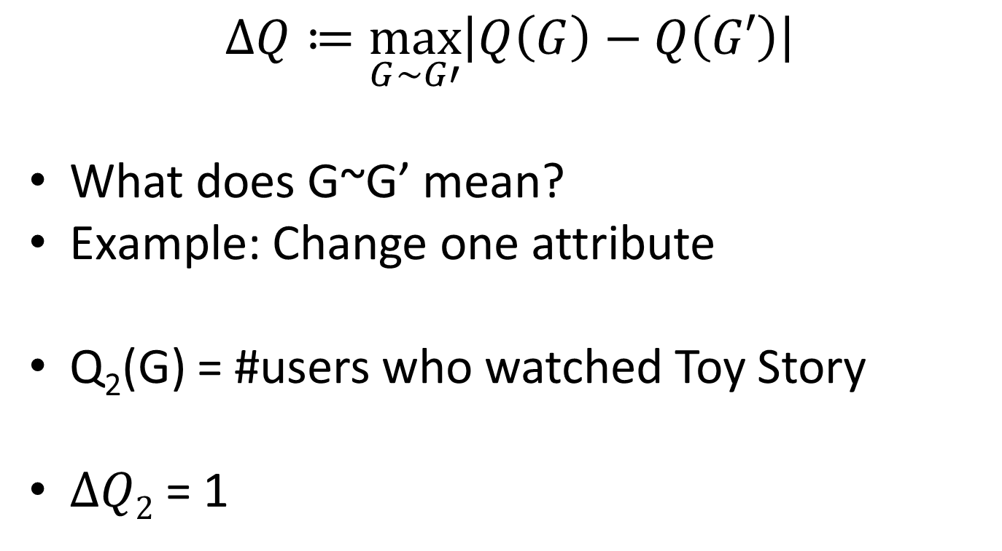
Global Sensitivity
$$∆Q≔\max_{G\sim G′}\left|Q\left(G\right)−Q\left(G′\right)\right|$$
What does G~G’ mean?
Example: Change one attribute
Q₂(G) = #users who watched Toy Story
$∆Q2$ = 1

Slide 29
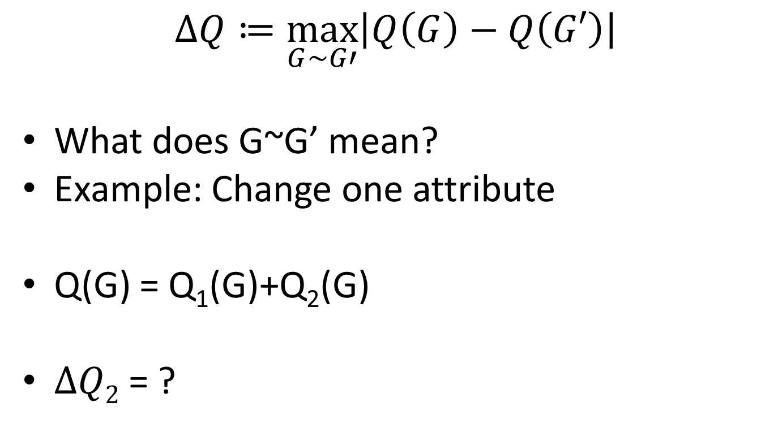
Global Sensitivity
$$∆Q≔\max_{G\sim G′}\left|Q\left(G\right)−Q\left(G′\right)\right|$$
What does G~G’ mean?
Example: Change one attribute
Q(G) = Q₁(G)+Q₂(G)
$∆Q2$ = ?

Slide 30
Global Sensitivity
$$∆Q≔\max_{G\sim G′}\left|Q\left(G\right)−Q\left(G′\right)\right|$$
What does G~G’ mean?
Example: Change one attribute
Q₁(G) = #users who watched Lion King
$∆Q1$ = ?

Slide 31
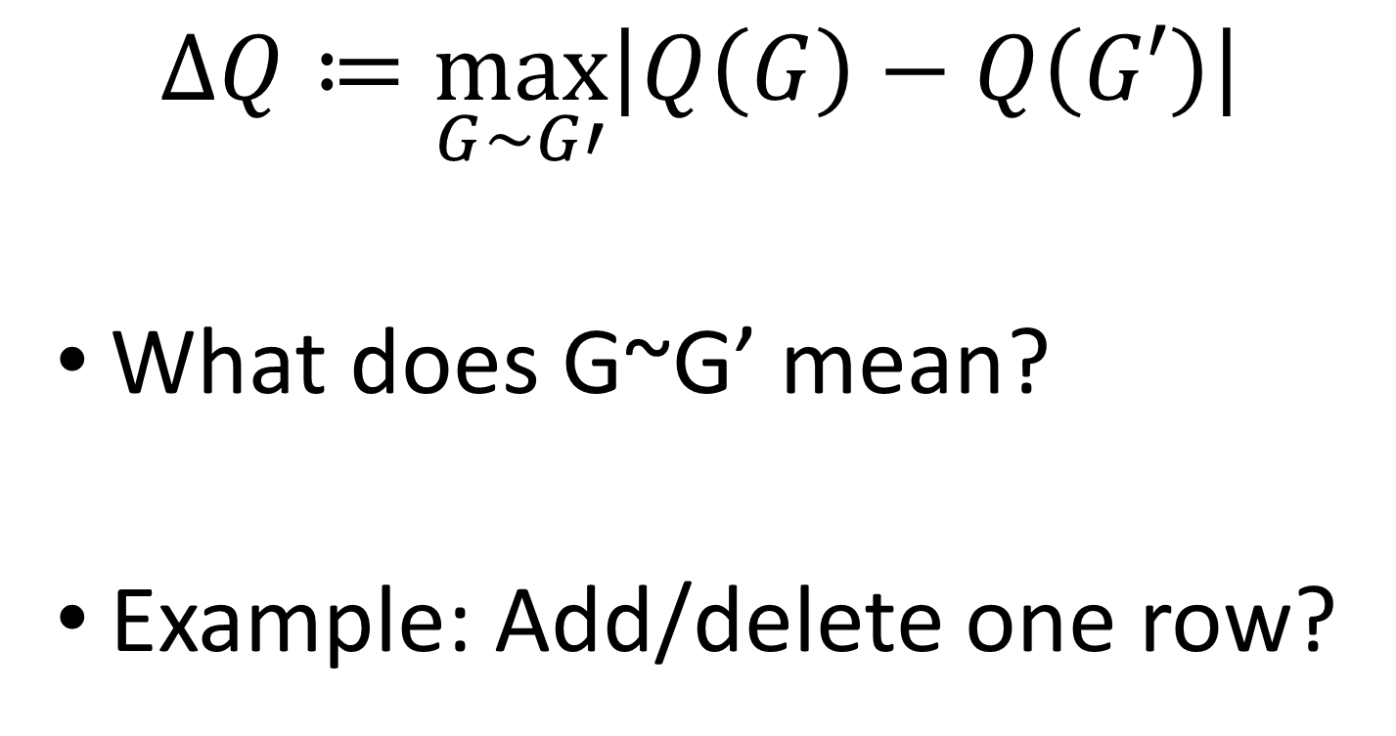
Global Sensitivity
$$∆Q≔\max_{G\sim G′}\left|Q\left(G\right)−Q\left(G′\right)\right|$$
What does G~G’ mean?
Example: Add/delete one row?

Slide 32
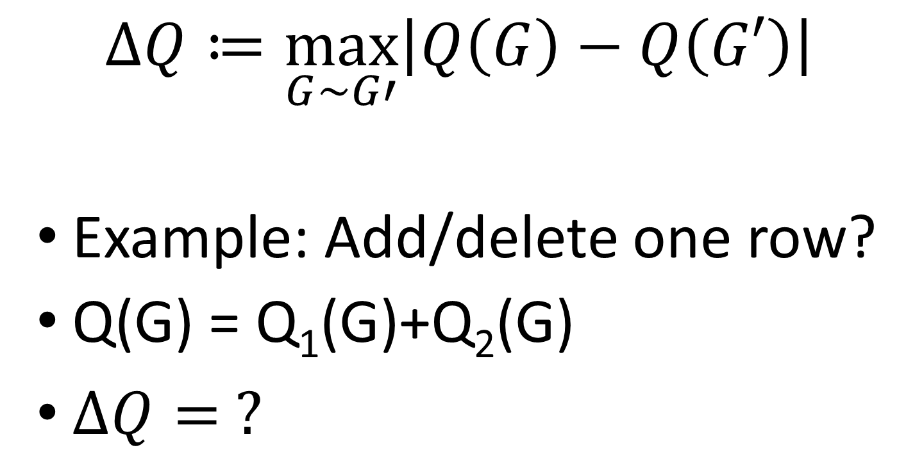
Global Sensitivity
$$∆Q≔\max_{G\sim G′}\left|Q\left(G\right)−Q\left(G′\right)\right|$$
Example: Add/delete one row?
Q(G) = Q₁(G)+Q₂(G)
$∆Q= ?$

Slide 33
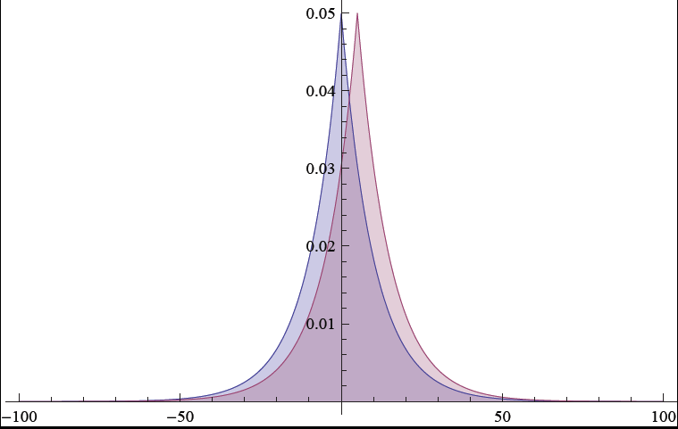
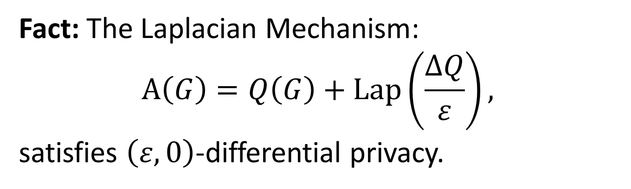
Traditional Differential Privacy Mechanism
Fact: The Laplacian Mechanism:
$$A\left(G\right)=Q\left(G\right)+\operatorname{Lap}\left(\frac{∆Q}{ε}\right),$$
satisfies $\left(ε,0\right)$-differential privacy.

Slide 34

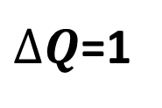
Traditional Differential Privacy Mechanism
$$PDFG\left(x \right)∝e^{−\left|xε\right|}$$
$PDFG′\left(x \right)∝e^{−\left|(x−1)ε\right|}$
$∆Q$=1

Slide 35

Traditional Differential Privacy Mechanism
$$∀x,\frac{PDFG\left(x \right)}{PDFG′\left(x \right)}=\frac{e^{−\left|xε\right|}}{e^{−\left|(x−1)ε\right|}}≤e^{−ε}$$

Slide 36
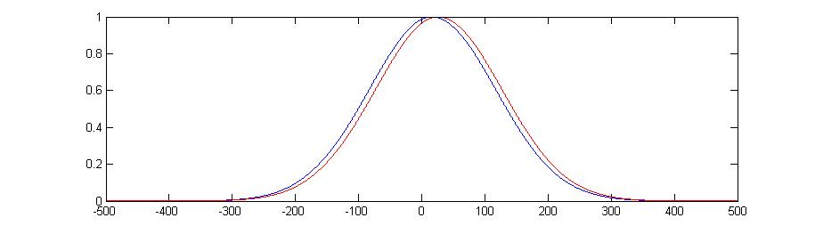
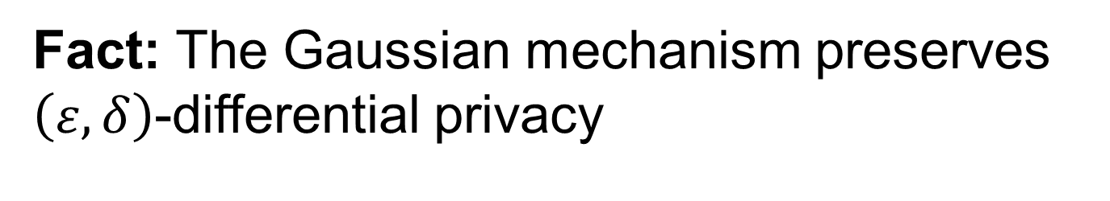

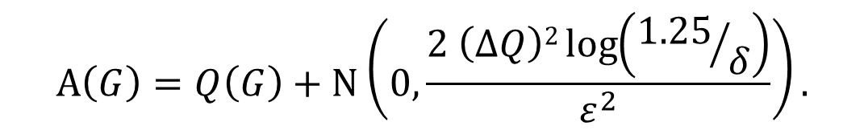
Traditional Mechanism #2
Fact: The Gaussian mechanism preserves $\left(ε,δ\right)$-differential privacy
$$A\left(G\right)=Q\left(G\right)+N\left(0, \frac{2 \left(∆Q\right)2\log\left({1.25}/δ\right)}{ε^{2}}\right).$$
S
$δ$/2

Slide 37
Differential Privacy
x₁
x₂ 0
M
query an¹swer 1
San
DB=
M
query
^{x}n-1 x_{n}
¢ ¢ ¢
random coins
an^{T}swer T
Adversary A
29

Slide 38
Examples of low global sensitivity
•
Example: GS_{average} =
1
n
if x ∈ [0, 1]^{n}
Add noise Lap( ¹ )
n
Comparison: to estimate a frequency (e.g. proportion of
diabetics) in underlying population, get sampling noise ¹
√_{n}
Many natural functions have low GS, e.g.:
  Histograms and contingency tables
  Covariance matrix
  Distance to a property
  Functions that can be approximated from a random sample
[BDMN] Many data-mining and learning algorithms access the data via a sequence of low-sensitivity questions
  e.g. perceptron, some “EM” algorithms, SQ learning algorithms

Slide 39
Why does this help?
With relatively little noise:
Averages Contingency tables
Matrix decompositions Certain types of clustering
…
•
•
•
•
•

Slide 40

Differential Privacy
Protocols
Lower bounds
Limits on communication models
Noninteractive [DMNS’06]
“Local” [NSW’07]
Limits on accuracy
“Many” good answers allow reconstructing database
• [DiNi’03,DMT’07]
Necessity of “differential” guarantees [DN]
•
Output perturbation (Release f(x) + noise)
Sum queries
• [DiN’03,DwN’04,BDMN’05]
“Sensitivity” frameworks
• [DMNS’06, NRS’07]
Input perturbation (“randomized response”)
Frequent item sets [EGS’03]
(Various learning results)
•
•
•
•
38

Slide 41

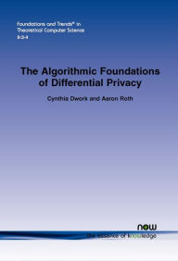

Resources
$99
Free PDF: https://www.cis.upenn.edu/~aaroth/Papers/privacybook.pdf

