Slide 1
Cryptography CS 555
Topic 31: RSA Attacks + Fixes

Slide 2
Recap
CPA/CCA Security for Public Key Crypto
Key Encapsulation Mechanism
El-Gamal

Slide 3
Recap
Plain RSA
Public Key (pk): N = pq, e such that $GCD\left(e,φ\left(N\right)\right)=1$
$φ\left(N\right)=\left(p−1\right)\left(q−1\right)$ for distinct primes p and q
Secret Key (sk): N, d such that ed=1 mod $φ\left(N\right)$
$${Enc}_{pk}^{}\left(m\right)=m^{e} mod N$$
$${Dec}_{sk}^{}\left(c\right)=c^{d} mod N$$
$Decryption Works because$
$$\left[c^{d}mod N\right]=\left[m^{ed}mod N\right]=\left[m^{[ed mod φ\left(N\right)]}mod N\right]=\left[m mod N\right]$$

Slide 4
Recap RSA-Assumption
RSA-Experiment: RSA-INV_{A,n}
Run KeyGeneration(1^{n}) to obtain (N,e,d)
Pick uniform $y∈ ℤ_{N}^{∗}$
Attacker A is given N, e, y and outputs $x∈ ℤ_{N}^{∗}$
Attacker wins (RSA-INV_{A,n}=1) if $x^{e}=y mod N$
$$∀PPT A ∃μ (negligible) s.t Pr\left[\text{RSA}\text{−}\text{INVA}\text{,}\text{n} =1\right]≤μ(n)$$

Slide 5
(Review) Attacks on Plain RSA
We have not introduced security models like CPA-Security or CCA-security for Public Key Cryptosystems
However, notice that (Plain) RSA Encryption is stateless and deterministic.
→Plain RSA is not secure against chosen-plaintext attacks
Plain RSA is also highly vulnerable to chosen-ciphertext attacks
Attacker intercepts ciphertext c of secret message m
Attacker generates ciphertext c’ for secret message 2m
Attacker asks for decryption of c’ to obtain 2m
Divide by 2 to recover original message m

Slide 6
(Plain) RSA Discussion
However, notice that (Plain) RSA Encryption is stateless and deterministic.
→Plain RSA is not secure against chosen-plaintext attacks
In a public key setting the attacker does have access to an encryption oracle
Encrypted messages with low entropy are vulnerable to a brute-force attack.
If m < B then attacker can recover m after at most B queries to encryption oracle (using public key)

Slide 7
Recovering Encrypted Message faster than Brute-Force
Claim: Let m < 2^{n} be a secret message. For some constant $α=\frac{1}{2}+ε.$ We can recover m in in time ${T=2}^{αn}$ with high probability.
For r=1,…,T
let $xr=\left[cr^{−e}mod N\right]$, where $r^{−e}={\left(r^{−1}\right)}^{e}mod N$
Sort $L={\left\{\left(r,x_{r}\right)\right\}}_{r=1}^{T}$ (by the x_{r} values)
For s=1,…,T
if $\left[s^{e}mod N\right]=xr$ for some r then
return $\left[sr mod N\right]$

Slide 8
Recovering Encrypted Message faster than Brute-Force
Claim: Let m < 2^{n} be a secret message. For some constant $α=\frac{1}{2}+ε.$ We can recover m in in time ${T=2}^{αn}$ with high probability.
Roughly $\sqrt{B}$ steps to find a secret message m < B

Slide 9
More Weaknesses: Plain RSA with small e
(Small Messages) If m^{e} < N then we can decrypt c = m^{e} mod N directly e.g., m=c^{(1/e)}
(Partially Known Messages) If an attacker knows first 1-(1/e) bits of secret message $m=m_{1}\left\|??\right.$ then he can recover m given
$${Enc}_{pk}^{} (m)=m^{e}mod N$$
Theorem[Coppersmith]: If p(x) is a polynomial of degree e then in polynomial time (in log(N), e) we can find all m such that p(m) = 0 mod N and |m|<N^{(1/e)}

Slide 10
More Attacks: Encrypting Related Messages
Sender encrypts m and $m+δ$, where offset $δ$ is known to attacker
Attacker intercepts
$${c1=Enc}_{pk}^{}\left(m\right)=m^{e} mod N$$
and
$${c2=Enc}_{pk}^{}\left(m+δ\right)={\left(m+δ\right)}^{e} mod N$$
Attacker defines polynomials
$$f1\left(x\right)=x^{e}−c1 mod N$$
and
$$f2\left(x\right)={\left(x+δ\right)}^{e}−c2 mod N$$

Slide 11
More Attacks: Encrypting Related Messages
$${c1=Enc}_{pk}^{}\left(m\right)=m^{e} mod N$$
$${c2=Enc}_{pk}^{}\left(m+δ\right)={\left(m+δ\right)}^{e} mod N$$
Attacker defines polynomials
$$f1\left(x\right)=x^{e}−c1 mod N$$
and
$$f2\left(x\right)={\left(x+δ\right)}^{e}−c2 mod N$$
Both polynomials have a root at x=m, thus (x-m) is a factor of both polynomials
The GCD operation can be extended to operate over polynomials ☺
GCD($f1\left(x\right)$, $f2\left(x\right)$) reveals the factor (x-m), and hence the message m

Slide 12
Sending the Same Message to Multiple Receivers
Homework 3 Bonus Question
c₁${=[m}^{3} mod N$₁]
c₂${=[m}^{3} mod N2$]
c₂${=[m}^{3} mod N3$]
Since gcd($N\text{1},N2$)= gcd($N\text{1},N3$)= gcd($N2,N3$)= 1, we can find a unique number x< $N\text{1}N2N3$ such that ${ x=m}^{3} mod Ni$
This, number is ${ x=m}^{3}$
Mathematica Demo

Slide 13
Sending the Same Message to Multiple Receivers
Homework 3 Bonus Question
c₁${=[m}^{3} mod N$₁]
c₂${=[m}^{3} mod N2$]
c₂${=[m}^{3} mod N3$]
Since gcd($N\text{1},N2$)= gcd($N\text{1},N3$)= gcd($N2,N3$)= 1, we can find a unique number x< $N\text{1}N2N3$ such that ${ x=m}^{3} mod Ni$
This, number is ${ x=m}^{3}$
Question: What if gcd($N2,N3$)> 1?
Either$N2=N3$ or gcd($N2,N3$) reveals a shared factor of $N2,N3$

Slide 14
Apply GCD to Pairs of RSA Moduli?
Fact: If we pick two random RSA moduli $N1$ and $N2$ then except with negligible probability gcd($N1,N2$)= 1
In theory the attack shouldn’t work, but…
In practice, many people generated RSA moduli using weak pseudorandom number generators.
.5% of TLS hosts
.03% of SSH hosts
See https://factorable.net

Slide 15
Dependent Keys Part 1
Suppose an organization generates N=pq and a pair (e_{i},d_{i}) for each employee I subject to the constraints e_{i}d_{i}=1 mod $φ\left(N\right).$
Question: Is this secure?
Answer: No, given e_{i}d_{i} employee i can factor N (and then recover everyone else's secret key).
See Theorem 8.50 in the textbook

Slide 16
Dependent Keys Part 2
Suppose an organization generates N=pq and a pair (e_{i},d_{i}) for each employee i subject to the constraints e_{i}d_{i}=1 mod $φ\left(N\right).$
Suppose that each employee is trusted (so it is ok if employee i factors N)
Suppose that a message m is encrypted and sent to employee 1 and 2.
Attacker intercepts c₁${=[m}^{e_{1}} mod N$] and c₂${=[m}^{e_{2}}mod N2$]

Slide 17
Dependent Keys Part 2
Suppose an organization generates N=pq and a pair (e_{i},d_{i}) for each employee i subject to the constraints e_{i}d_{i}=1 mod $φ\left(N\right).$
Suppose that a message m is encrypted and sent to employee 1 and 2.
Attacker intercepts c₁${=[m}^{e_{1}} mod N$] and c₂${=[m}^{e_{2}}mod N2$]
If gcd(e₁,e₂)=1 (which is reasonably likely) then attacker can run extended GCD algorithm to find X,Y such that Xe₁+Ye₂=1.
$${[\text{c}\text{1}}^{X}{c2}^{Y}mod N2]={[m}^{{Xe}_{1}}m^{Ye_{2}}mod N2]={[m}^{{Xe}_{1}+Ye_{2}} mod N2]=m$$

Slide 18
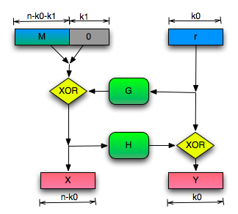
RSA-OAEP (Optimal Asymmetric Encryption Padding)
${Enc}_{pk}^{} (m;r){=[\left(x∥y\right)}^{e} mod N\text{]}$
Where $x∥y ←OAEP(m∥0^{k1}∥r)$
${Dec}_{sk}^{} \left(c\right)=$
$\tilde{m}←{[\left(c\right)}^{d} mod N\text{]}$
If $\left\|\tilde{m}\right\|>n$ return fail
${m∥z∥r←OAEP}^{−1}(\tilde{m})$
If $z≠0^{k1}$ then output fail
Otherwise output m

Slide 19
RSA-OAEP (Optimal Asymmetric Encryption Padding)
Theorem: If we model G and H as
Random oracles then RSA-OAEP is
a CCA-Secure public key encryption scheme.
Bonus: One of the fastest in practice!

Slide 20
PKCS #1 v2.0
Implementation of RSA-OAEP
James Manger found a chosen-ciphertext attack.
What gives?

Slide 21
PKCS #1 v2.0 (Bad Implementation)
${Enc}_{pk}^{} (m;r){=[\left(x∥y\right)}^{e} mod N\text{]}$
Where $x∥y ←OAEP(m∥0^{k1}∥r)$
${Dec}_{sk}^{} \left(c\right)=$
$\tilde{m}←{[\left(c\right)}^{d} mod N\text{]}$
If $\left\|\tilde{m}\right\|>n$ return Error Message 1
${m∥z∥r←OAEP}^{−1}(\tilde{m})$
If $z≠0^{k1}$ then output Error Message 2
Otherwise output

Slide 22
PKCS #1 v2.0 (Attack)
Manger’s CCA-Attack recovers secret key
Requires $\left\|N\right\| queries to decryption oracle.$
Attack also works as a side channel attack
Even if error messages are the same the time to respond could be different in each case.
Implementations should return same error message and should make sure that the time to return each error is the same.

Slide 23
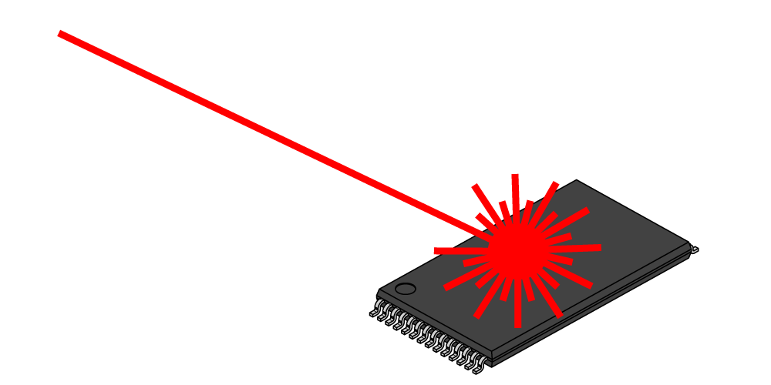
Another Side Channel Attack on RSA
Suppose that decryption is done via Chinese Remainder Theorem for speed.
$${Dec}_{sk}^{}\left(c\right)=c^{d} mod N↔\left(c^{d} mod p,c^{d} mod q\right)$$
Attacker has physical access to smartcard
Can mess up computation of $c^{d} mod p$
Response is $r↔\left(r,c^{d} mod q\right)$
$r−m↔\left(r−m mod p,0 mod q\right)$
GCD(R-m,N)=q

Slide 24
Next Class: Digital Signatures Part 1
Read Katz and Lindell: 12.1-12.3

