Slide 1
Cryptography
CS 555
Topic 30: El-Gamal Encryption

Slide 2
Recap
CPA/CCA Security for Public Key Crypto
Key Encapsulation Mechanism

Slide 3
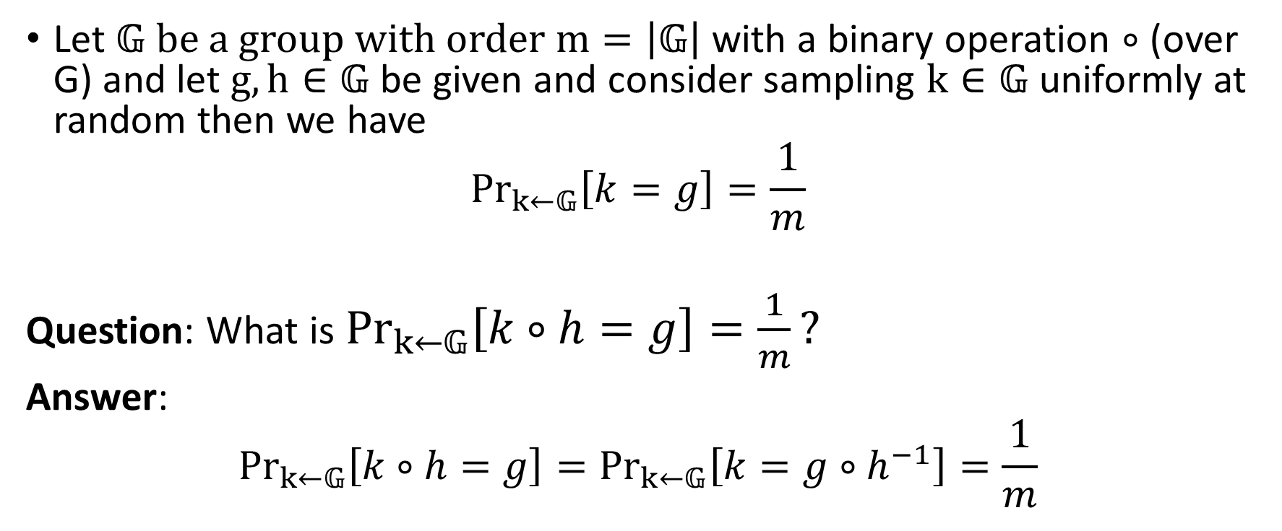
A Quick Remark about Groups
Let $𝔾 be a group with order m=\left|𝔾\right|$with a binary operation $∘$ (over G) and let $g,h∈𝔾$ be given and consider sampling $k∈𝔾$ uniformly at random then we have
$${Pr}_{k←𝔾}\left[k=g\right]=\frac{1}{m}$$
Question: What is ${Pr}_{k←𝔾}\left[k∘h=g\right]=\frac{1}{m}?$
Answer:
$${Pr}_{k←𝔾}\left[k∘h=g\right]={Pr}_{k←𝔾}\left[k=g∘h^{−1}\right]=\frac{1}{m}$$

Slide 4
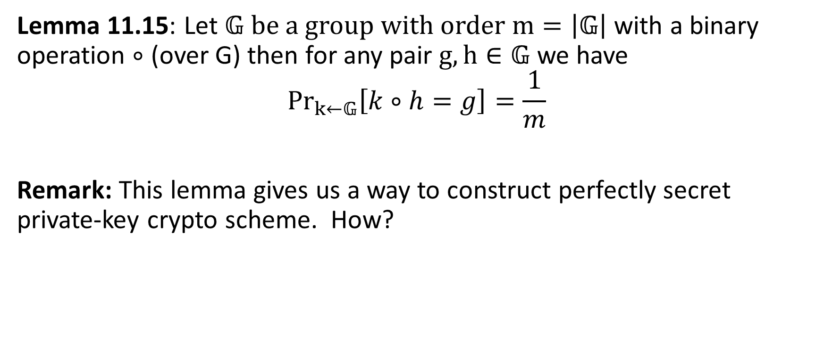
A Quick Remark about Groups
Lemma 11.15: Let $𝔾 be a group with order m=\left|𝔾\right|$with a binary operation $∘$ (over G) then for any pair $g,h∈𝔾$ we have
$${Pr}_{k←𝔾}\left[k∘h=g\right]=\frac{1}{m}$$
Remark: This lemma gives us a way to construct perfectly secret private-key crypto scheme. How?

Slide 5
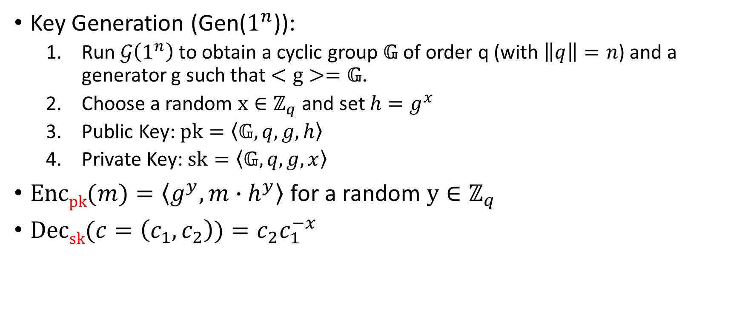
El-Gamal Encryption
Key Generation (Gen($1^{n}$)):
  Run $𝒢\left(1^{n}\right)$ to obtain a cyclic group $𝔾$ of order q (with $\left\|q\right\|=n$) and a generator g such that $<g>=𝔾$.
  Choose a random $x∈ℤ_{q}$ and set $h=g^{x}$
  Public Key: $pk=\left\langle 𝔾,q,g,h\right\rangle$
  Private Key: $sk=\left\langle 𝔾,q,g,x\right\rangle$
$\operatorname{Encpk}{(m)}=\left\langle g^{y},m∙h^{y}\right\rangle$ for a random $y∈ℤ_{q}$
$\operatorname{Decsk}{(c=\left(c_{1},c_{2}\right))}=c_{2}c_{1}^{−x}$

Slide 6
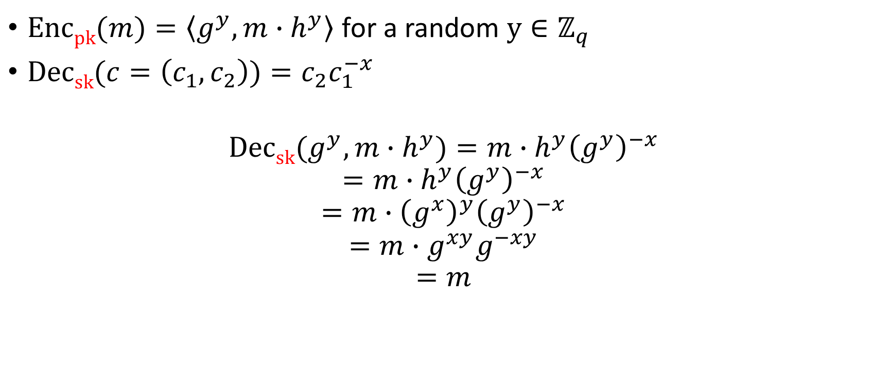
El-Gamal Encryption
$\operatorname{Encpk}{(m)}=\left\langle g^{y},m∙h^{y}\right\rangle$ for a random $y∈ℤ_{q}$
$\operatorname{Decsk}{(c=\left(c_{1},c_{2}\right))}=c_{2}c_{1}^{−x}$
$$\operatorname{Decsk}{(g^{y},m∙h^{y})}=m∙h^{y}{\left(g^{y}\right)}^{−x}$$
$$=m∙h^{y}{\left(g^{y}\right)}^{−x}$$
$$=m∙{\left(g^{x}\right)}^{y}{\left(g^{y}\right)}^{−x}$$
$$=m∙g^{xy}g^{−xy}$$
$$=m$$

Slide 7


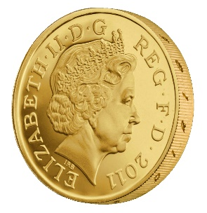






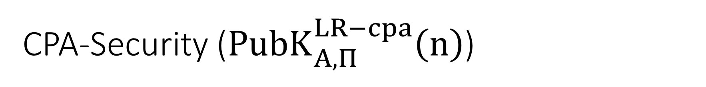

CPA-Security (${PubK}_{A,Π}^{LR−cpa}\left(n\right)$)
Public Key: pk
$$m_{0}^{1},m_{1}^{1}$$
$$c_{1}={Enc}_{pk}\left(m_{b}^{1}\right)$$
$$m_{0}^{2},m_{1}^{2}$$
$$c_{2}={Enc}_{pk}\left(m_{b}^{2}\right)$$
$$m_{0}^{3},m_{1}^{3}$$
$$c_{3}={Enc}_{pk}\left(m_{b}^{3}\right)$$
$$∀PPT A ∃μ (negligible) s.t$$
$$Pr\left[{PubK}_{A,Π}^{LR−cpa}\left(n\right)=1\right]≤\frac{1}{2}+μ(n)$$
…
b’
Random bit b
(pk,sk) = Gen(.)

Slide 8
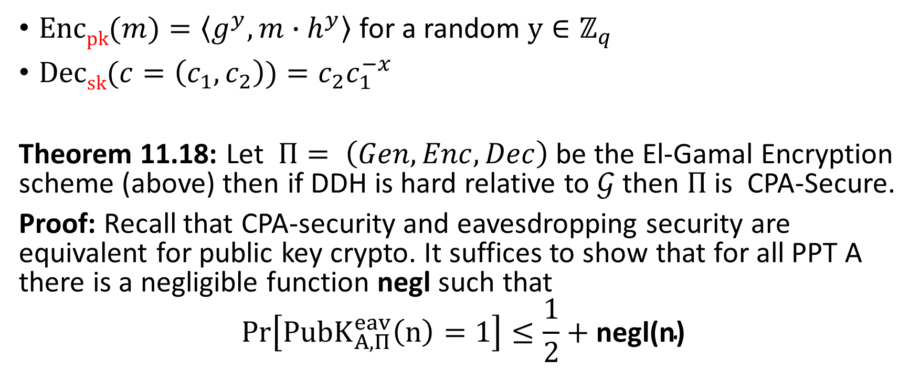
El-Gamal Encryption
$\operatorname{Encpk}{(m)}=\left\langle g^{y},m∙h^{y}\right\rangle$ for a random $y∈ℤ_{q}$
$\operatorname{Decsk}{(c=\left(c_{1},c_{2}\right))}=c_{2}c_{1}^{−x}$
Theorem 11.18: Let $Π= \left(Gen,Enc,Dec\right)$ be the El-Gamal Encryption scheme (above) then if DDH is hard relative to $𝒢$then $Π$is CPA-Secure.
Proof: Recall that CPA-security and eavesdropping security are equivalent for public key crypto. It suffices to show that for all PPT A there is a negligible function negl such that
$$Pr\left[{PubK}_{A,Π}^{eav}\left(n\right)=1\right]≤\frac{1}{2}+\text{negl}\text{(}\text{n}\text{)}$$

Slide 9
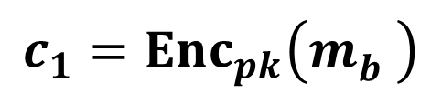
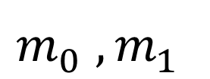


Eavesdropping Security (${PubK}_{A,Π}^{eav}\left(n\right)$)
Public Key: pk
$$m_{0}^{},m_{1}^{}$$
$$c_{1}={Enc}_{pk}\left(m_{b}^{}\right)$$
b’
$$∀PPT A ∃μ (negligible) s.t$$
$$Pr\left[{PubK}_{A,Π}^{eav}\left(n\right)=1\right]≤\frac{1}{2}+μ(n)$$
Random bit b
(pk,sk) = Gen(.)

Slide 10
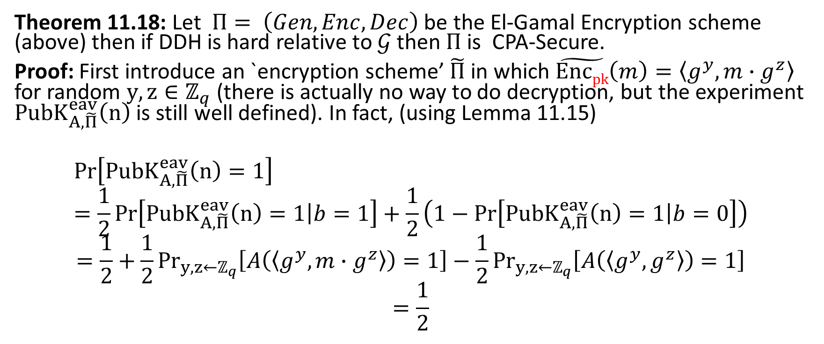
El-Gamal Encryption
Theorem 11.18: Let $Π= \left(Gen,Enc,Dec\right)$ be the El-Gamal Encryption scheme (above) then if DDH is hard relative to $𝒢$then $Π$is CPA-Secure.
Proof: First introduce an `encryption scheme’ $\tilde{Π}$ in which $\tilde{Encpk}\left(m\right)=\left\langle g^{y},m∙g^{z}\right\rangle$ for random $y,z∈ℤ_{q}$ (there is actually no way to do decryption, but the experiment ${PubK}_{A,\tilde{Π}}^{eav}\left(n\right)$ is still well defined). In fact, (using Lemma 11.15)
$$Pr\left[{PubK}_{A,\tilde{Π}}^{eav}\left(n\right)=1\right]=\frac{1}{2}Pr\left[{PubK}_{A,\tilde{Π}}^{eav}\left(n\right)=1\left|b=1\right.\right]+\frac{1}{2}\left(1−Pr\left[{PubK}_{A,\tilde{Π}}^{eav}\left(n\right)=1\left|b=0\right.\right]\right)$$
$$=\frac{1}{2}+\frac{1}{2}{Pr}_{y,z←ℤ_{q}}\left[A\left(\left\langle g^{y},m∙g^{z}\right\rangle \right)=1\right]−\frac{1}{2}{Pr}_{y,z←ℤ_{q}}\left[A\left(\left\langle g^{y}, g^{z}\right\rangle \right)=1\right]$$
$$=\frac{1}{2}$$

Slide 11
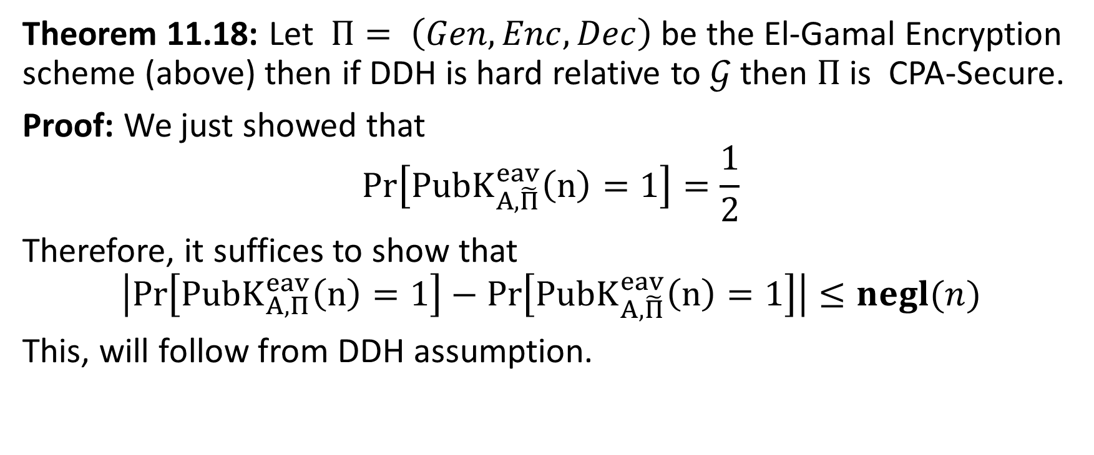
El-Gamal Encryption
Theorem 11.18: Let $Π= \left(Gen,Enc,Dec\right)$ be the El-Gamal Encryption scheme (above) then if DDH is hard relative to $𝒢$then $Π$is CPA-Secure.
Proof: We just showed that
$$Pr\left[{PubK}_{A,\tilde{Π}}^{eav}\left(n\right)=1\right]=\frac{1}{2}$$
Therefore, it suffices to show that
$$\left|Pr\left[{PubK}_{A,Π}^{eav}\left(n\right)=1\right]−Pr\left[{PubK}_{A,\tilde{Π}}^{eav}\left(n\right)=1\right]\right|≤negl(n)$$
This, will follow from DDH assumption.

Slide 12
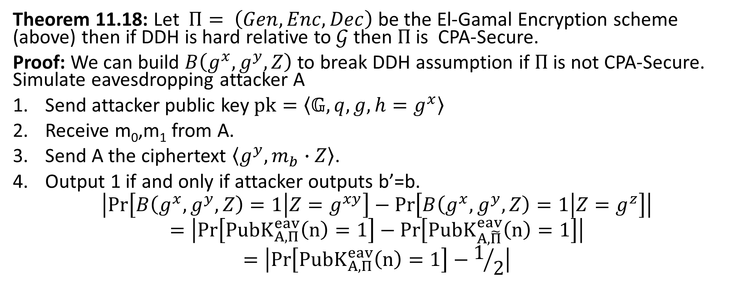
El-Gamal Encryption
Theorem 11.18: Let $Π= \left(Gen,Enc,Dec\right)$ be the El-Gamal Encryption scheme (above) then if DDH is hard relative to $𝒢$then $Π$is CPA-Secure.
Proof: We can build $B\left(g^{x},g^{y},Z\right)$ to break DDH assumption if $Π$is not CPA-Secure. Simulate eavesdropping attacker A
Send attacker public key$pk=\left\langle 𝔾,q,g,h=g^{x}\right\rangle$
Receive m₀,m₁ from A.
Send A the ciphertext $\left\langle g^{y},m_{b}∙Z\right\rangle$.
Output 1 if and only if attacker outputs b’=b.
$$\left|Pr\left[B\left(g^{x},g^{y},Z\right)=1\left|Z=g^{xy}\right.\right]−Pr\left[B\left(g^{x},g^{y},Z\right)=1\left|Z=g^{z}\right.\right]\right|$$
$$=\left|Pr\left[{PubK}_{A,Π}^{eav}\left(n\right)=1\right]−Pr\left[{PubK}_{A,\tilde{Π}}^{eav}\left(n\right)=1\right]\right|$$
$$=\left|Pr\left[{PubK}_{A,Π}^{eav}\left(n\right)=1\right]−1/2\right|$$
Notes:
$$=\left|{Pr}_{y←ℤ_{q}}\left[A\left(g^{x},\left\langle g^{y},m_{b}∙g^{xy}\right\rangle \right)=1\right]−{Pr}_{y,z←ℤ_{q}}\left[A\left(g^{x},\left\langle g^{y},m_{b}∙g^{z}\right\rangle \right)=1\right]\right|$$
$$=\left|{Pr}_{y←ℤ_{q}}\left[A\left(h,\left\langle g^{y},m_{b}∙h^{z}\right\rangle \right)=1\right]−{Pr}_{y,z←ℤ_{q}}\left[A\left(h,\left\langle g^{y},m_{b}∙g^{z}\right\rangle \right)=1\right]\right|$$

Slide 13
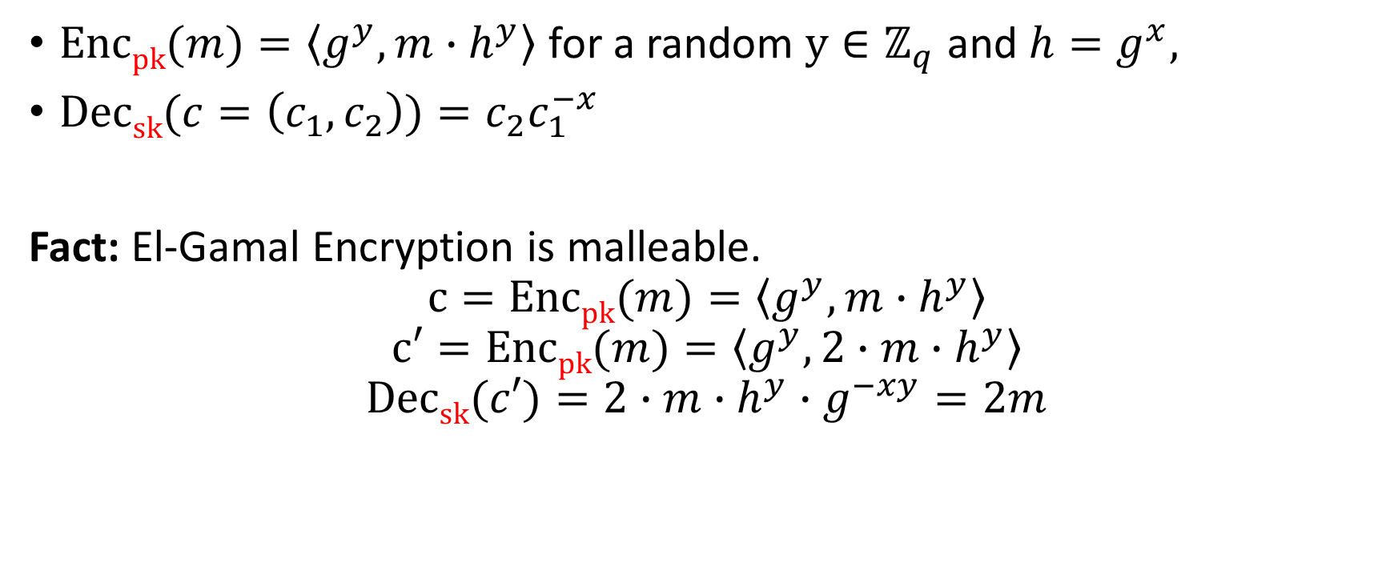
El-Gamal Encryption
$\operatorname{Encpk}{(m)}=\left\langle g^{y},m∙h^{y}\right\rangle$ for a random $y∈ℤ_{q}$ and ${h=g}^{x},$
$\operatorname{Decsk}{(c=\left(c_{1},c_{2}\right))}=c_{2}c_{1}^{−x}$
Fact: El-Gamal Encryption is malleable.
$$c=Encpk{(m)}=\left\langle g^{y},m∙h^{y}\right\rangle$$
$$c′=Encpk{(m)}=\left\langle g^{y},2∙m∙h^{y}\right\rangle$$
$$\operatorname{Decsk}{(c′)}=2∙m∙h^{y}∙g^{−xy}=2m$$

Slide 14
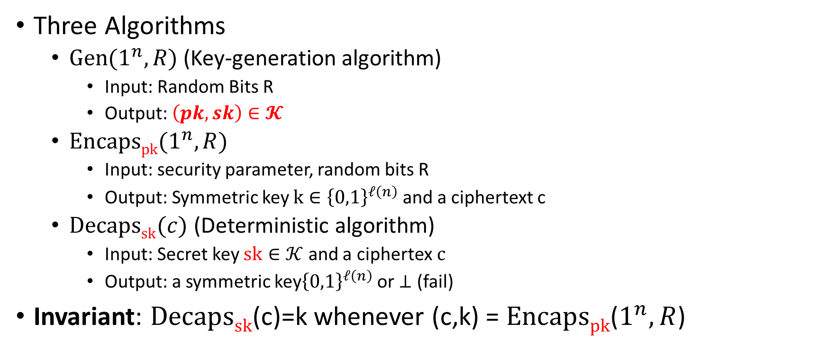
Key Encapsulation Mechanism (KEM)
Three Algorithms
  $\operatorname{Gen}{(1^{n},R)}$ (Key-generation algorithm)
    Input: Random Bits R
    Output: $\left(pk,sk\right)∈𝓚$
  $\operatorname{Encapspk}{(1^{n},R)}$
    Input: security parameter, random bits R
    Output: Symmetric key $k∈{\left\{0,1\right\}}^{ℓ\left(n\right)}$ and a ciphertext c
  $\operatorname{Decapssk}{(c)}$ (Deterministic algorithm)
    Input: Secret key $sk∈𝒦$ and a ciphertex$c$
    Output: a symmetric key${\left\{0,1\right\}}^{ℓ\left(n\right)}$ or $⊥$ (fail)
Invariant: $Decapssk$(c)=k whenever (c,k) = $Encapspk$($1^{n},R$)

Slide 15








KEM CCA-Security (${KEM}_{A,Π}^{cca}\left(n\right)$)
$$\left(pk,c,kb\right)$$
…
$$c_{1}≠c$$
$${Decaps}_{sk}\left(c_{1}\right)$$
$$c_{2}≠c$$
$$∀PPT A ∃μ (negligible) s.t$$
$$Pr\left[{KEM}_{A,Π}^{cca}=1\right]≤\frac{1}{2}+μ(n)$$
$${Decaps}_{sk}\left(c_{2}\right)$$
b’
…
Random bit b
(pk,sk) = Gen(.)
$$\left(c,k0\right)={Encaps}_{pk}\left(.\right)$$
$$k1 ⟵{\left\{0,1\right\}}^{n}$$

Slide 16
Recall: Last Lecture
CCA-Secure KEM from RSA in Random Oracle Model
What if we want security proof in the standard model?
Answer: DDH yields a CPA-Secure KEM in standard model

Slide 17



KEM CPA-Security (${KEM}_{A,Π}^{cpa}\left(n\right)$)
$$\left(pk,c,kb\right)$$
b’
$$∀PPT A ∃μ (negligible) s.t$$
$$Pr\left[{KEM}_{A,Π}^{cpa}=1\right]≤\frac{1}{2}+μ(n)$$
Random bit b
(pk,sk) = Gen(.)
$$\left(c,k0\right)={Encaps}_{pk}\left(.\right)$$
$$k1 ⟵{\left\{0,1\right\}}^{n}$$

Slide 18
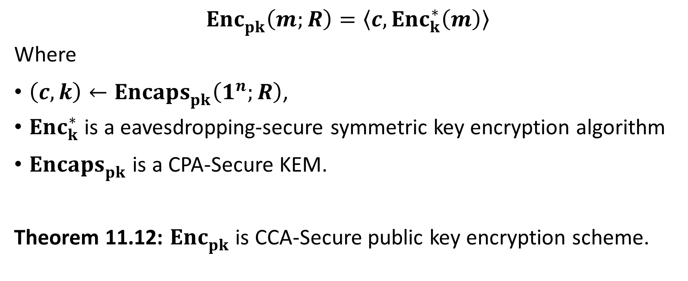
CCA-Secure Encryption from CPA-Secure KEM
$${Enc}_{pk}^{}\left(m;R\right)=\left\langle c,{Enc}_{k}^{∗}\left(m\right)\right\rangle$$
Where
$\left(c,k\right)←{Encaps}_{pk}^{}\left(1^{n};R\right)$,
${Enc}_{k}^{∗}$ is a eavesdropping-secure symmetric key encryption algorithm
${Encaps}_{pk}^{}$ is a CPA-Secure KEM.
Theorem 11.12: ${Enc}_{pk}^{}$ is CCA-Secure public key encryption scheme.

Slide 19
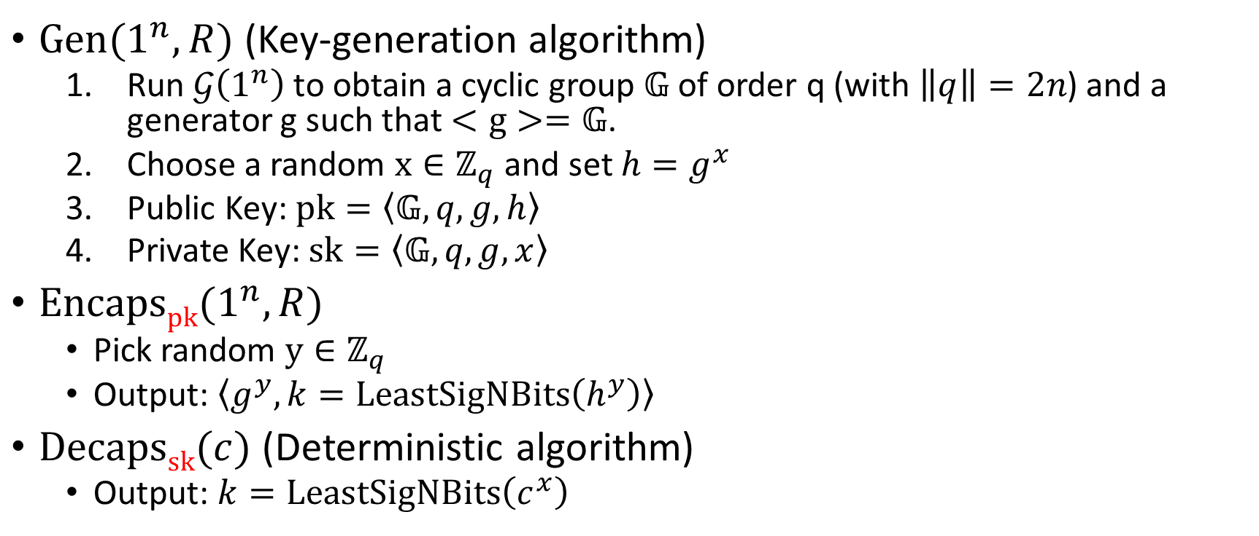
CPA-Secure KEM with El-Gamal
$\operatorname{Gen}{(1^{n},R)}$ (Key-generation algorithm)
  Run $𝒢\left(1^{n}\right)$ to obtain a cyclic group $𝔾$ of order q (with $\left\|q\right\|=2n$) and a generator g such that $<g>=𝔾$.
  Choose a random $x∈ℤ_{q}$ and set $h=g^{x}$
  Public Key: $pk=\left\langle 𝔾,q,g,h\right\rangle$
  Private Key: $sk=\left\langle 𝔾,q,g,x\right\rangle$
$\operatorname{Encapspk}{(1^{n},R)}$
  Pick random $y∈ℤ_{q}$
  Output: $\left\langle g^{y},k=LeastSigNBits\left(h^{y}\right)\right\rangle$
$\operatorname{Decapssk}{(c)}$ (Deterministic algorithm)
  Output: $k=LeastSigNBits\left(c^{x}\right)$

Slide 20
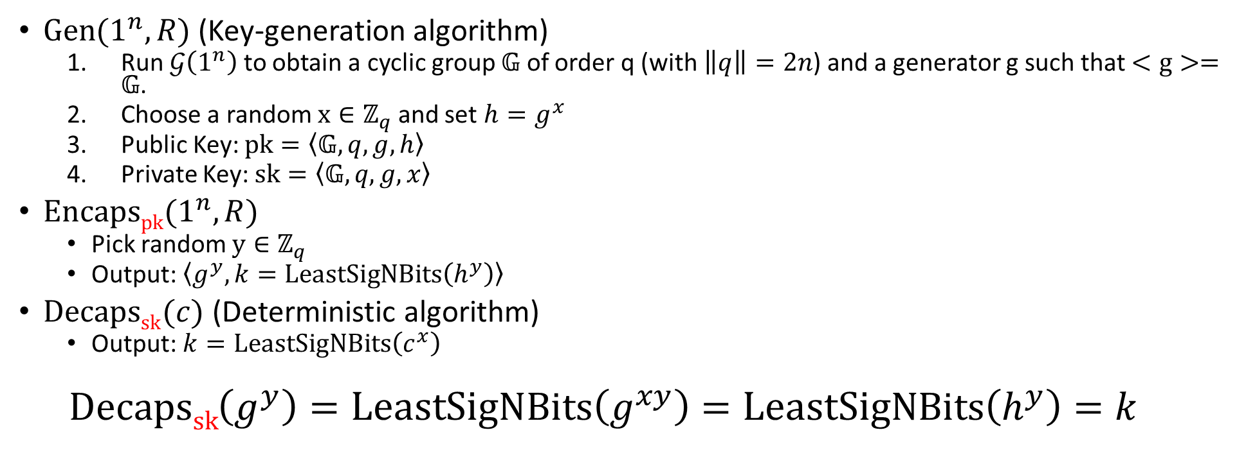
CPA-Secure KEM with El-Gamal
$\operatorname{Gen}{(1^{n},R)}$ (Key-generation algorithm)
  Run $𝒢\left(1^{n}\right)$ to obtain a cyclic group $𝔾$ of order q (with $\left\|q\right\|=2n$) and a generator g such that $<g>=𝔾$.
  Choose a random $x∈ℤ_{q}$ and set $h=g^{x}$
  Public Key: $pk=\left\langle 𝔾,q,g,h\right\rangle$
  Private Key: $sk=\left\langle 𝔾,q,g,x\right\rangle$
$\operatorname{Encapspk}{(1^{n},R)}$
  Pick random $y∈ℤ_{q}$
  Output: $\left\langle g^{y},k=LeastSigNBits\left(h^{y}\right)\right\rangle$
$\operatorname{Decapssk}{(c)}$ (Deterministic algorithm)
  Output: $k=LeastSigNBits\left(c^{x}\right)$
  $$\operatorname{Decapssk}\left(g^{y}\right)=LeastSigNBits\left(g^{xy}\right)=LeastSigNBits\left(h^{y}\right)=k$$

Slide 21
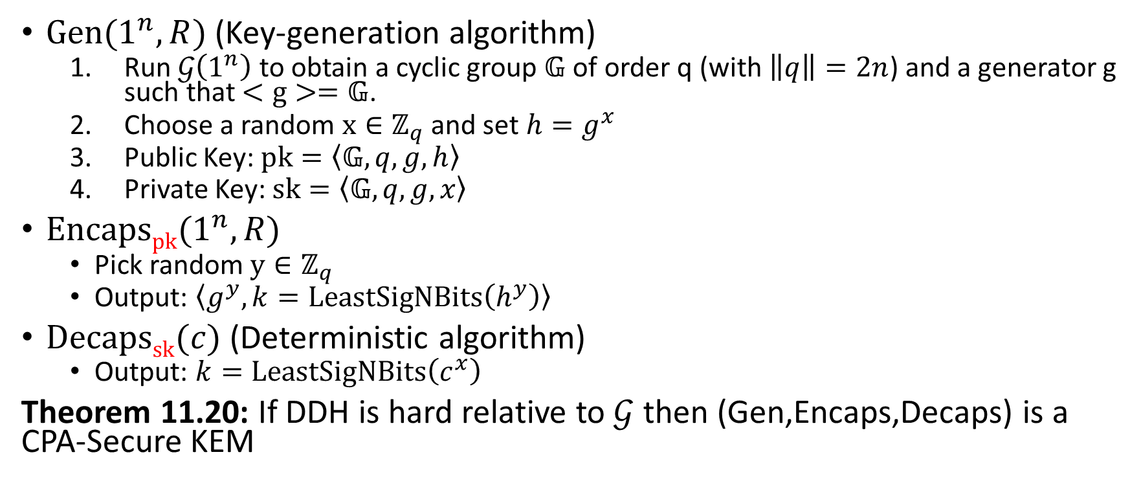
CPA-Secure KEM with El-Gamal
$\operatorname{Gen}{(1^{n},R)}$ (Key-generation algorithm)
  Run $𝒢\left(1^{n}\right)$ to obtain a cyclic group $𝔾$ of order q (with $\left\|q\right\|=2n$) and a generator g such that $<g>=𝔾$.
  Choose a random $x∈ℤ_{q}$ and set $h=g^{x}$
  Public Key: $pk=\left\langle 𝔾,q,g,h\right\rangle$
  Private Key: $sk=\left\langle 𝔾,q,g,x\right\rangle$
$\operatorname{Encapspk}{(1^{n},R)}$
  Pick random $y∈ℤ_{q}$
  Output: $\left\langle g^{y},k=LeastSigNBits\left(h^{y}\right)\right\rangle$
$\operatorname{Decapssk}{(c)}$ (Deterministic algorithm)
  Output: $k=LeastSigNBits\left(c^{x}\right)$
Theorem 11.20: If DDH is hard relative to $𝒢$ then (Gen,Encaps,Decaps) is a CPA-Secure KEM

Slide 22
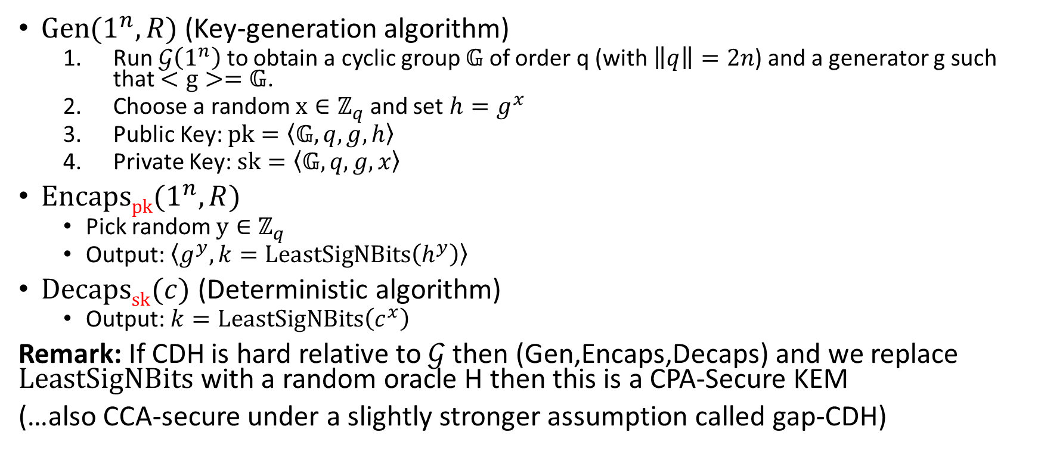
CPA-Secure KEM with El-Gamal
$\operatorname{Gen}{(1^{n},R)}$ (Key-generation algorithm)
  Run $𝒢\left(1^{n}\right)$ to obtain a cyclic group $𝔾$ of order q (with $\left\|q\right\|=2n$) and a generator g such that $<g>=𝔾$.
  Choose a random $x∈ℤ_{q}$ and set $h=g^{x}$
  Public Key: $pk=\left\langle 𝔾,q,g,h\right\rangle$
  Private Key: $sk=\left\langle 𝔾,q,g,x\right\rangle$
$\operatorname{Encapspk}{(1^{n},R)}$
  Pick random $y∈ℤ_{q}$
  Output: $\left\langle g^{y},k=LeastSigNBits\left(h^{y}\right)\right\rangle$
$\operatorname{Decapssk}{(c)}$ (Deterministic algorithm)
  Output: $k=LeastSigNBits\left(c^{x}\right)$
Remark: If CDH is hard relative to $𝒢$ then (Gen,Encaps,Decaps) and we replace $LeastSigNBits$ with a random oracle H then this is a CPA-Secure KEM
(…also CCA-secure under a slightly stronger assumption called gap-CDH)

Slide 23
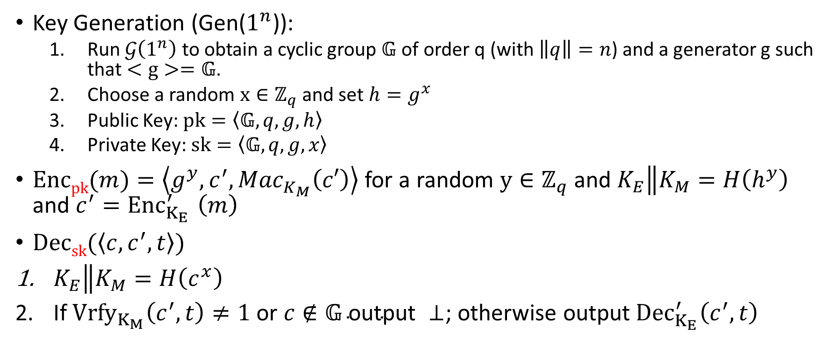
CCA-Secure Variant in Random Oracle Model
Key Generation (Gen($1^{n}$)):
  Run $𝒢\left(1^{n}\right)$ to obtain a cyclic group $𝔾$ of order q (with $\left\|q\right\|=n$) and a generator g such that $<g>=𝔾$.
  Choose a random $x∈ℤ_{q}$ and set $h=g^{x}$
  Public Key: $pk=\left\langle 𝔾,q,g,h\right\rangle$
  Private Key: $sk=\left\langle 𝔾,q,g,x\right\rangle$
$\operatorname{Encpk}{(m)}=\left\langle g^{y},c^{′}, {Mac}_{K_{M}}^{}\left(c′\right)\right\rangle$ for a random $y∈ℤ_{q}$ and $K_{E}\left\|K_{M}\right.=H\left(h^{y}\right)$ and $c^{′}{=Enc}_{K_{E}}^{′}\left(m\right)$
$\operatorname{Decsk}{(\left\langle c,c^{′},t\right\rangle )}$
$K_{E}\left\|K_{M}\right.=H\left(c^{x}\right)$
If ${Vrfy}_{K_{M}}\left(c^{′},t\right)≠1 \text{or} c∉𝔾 \text{output} ⊥$; otherwise output${Dec}_{K_{E}}^{′}\left(c^{′},t\right)$

Slide 24
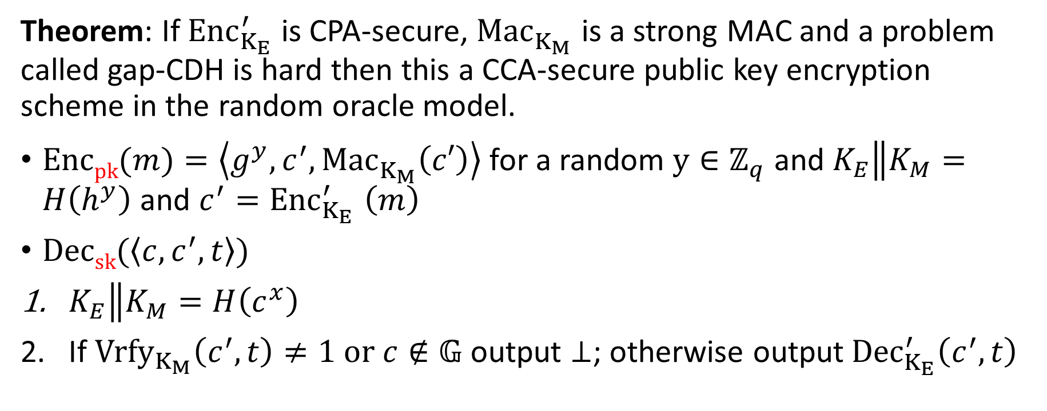
CCA-Secure Variant in Random Oracle Model
Theorem: If ${Enc}_{K_{E}}^{′}$ is CPA-secure, ${Mac}_{K_{M}}^{}$ is a strong MAC and a problem called gap-CDH is hard then this a CCA-secure public key encryption scheme in the random oracle model.
$\operatorname{Encpk}{(m)}=\left\langle g^{y},c^{′}, {Mac}_{K_{M}}^{}\left(c′\right)\right\rangle$ for a random $y∈ℤ_{q}$ and $K_{E}\left\|K_{M}\right.=H\left(h^{y}\right)$ and $c^{′}{=Enc}_{K_{E}}^{′}\left(m\right)$
$\operatorname{Decsk}{(\left\langle c,c^{′},t\right\rangle )}$
$K_{E}\left\|K_{M}\right.=H\left(c^{x}\right)$
If ${Vrfy}_{K_{M}}\left(c^{′},t\right)≠1 or c∉𝔾$ output $⊥$; otherwise output${Dec}_{K_{E}}^{′}\left(c^{′},t\right)$

Slide 25
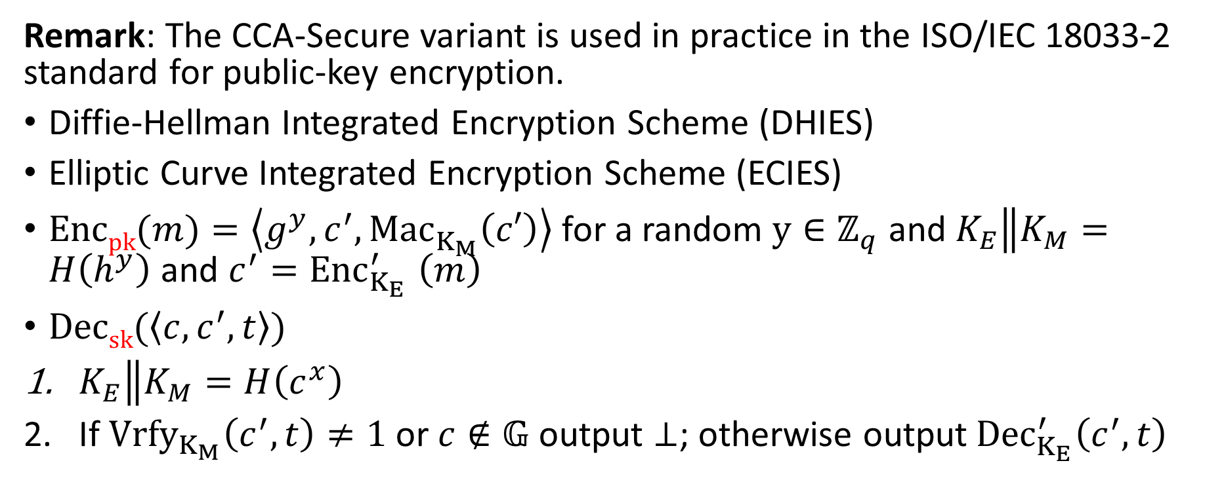
CCA-Secure Variant in Random Oracle Model
Remark: The CCA-Secure variant is used in practice in the ISO/IEC 18033-2 standard for public-key encryption.
Diffie-Hellman Integrated Encryption Scheme (DHIES)
Elliptic Curve Integrated Encryption Scheme (ECIES)
$\operatorname{Encpk}{(m)}=\left\langle g^{y},c^{′}, {Mac}_{K_{M}}^{}\left(c′\right)\right\rangle$ for a random $y∈ℤ_{q}$ and $K_{E}\left\|K_{M}\right.=H\left(h^{y}\right)$ and $c^{′}{=Enc}_{K_{E}}^{′}\left(m\right)$
$\operatorname{Decsk}{(\left\langle c,c^{′},t\right\rangle )}$
$K_{E}\left\|K_{M}\right.=H\left(c^{x}\right)$
If ${Vrfy}_{K_{M}}\left(c^{′},t\right)≠1$ or$c∉𝔾$ output $⊥$; otherwise output${Dec}_{K_{E}}^{′}\left(c^{′},t\right)$

Slide 26
Next Class: RSA Attacks + Fixes
Read Katz and Lindell: 11.5

