Slide 1
Cryptography CS 555
Topic 3: Perfect Secrecy

Slide 2
Recap
Caesar Cipher, Shift Cipher, Substitution Cipher, Vigenere Cipher
All historical ciphers have fallen

Slide 3
Perfect Secrecy Intuition
Regardless of information an attacker already has, a ciphertext should leak no additional information about the underlying plaintext.
We will formalize this intuition
And show how to achieve it

Slide 4
Private Key Encryption Syntax
Typically picks $k∈𝒦$
uniformly at random
Message Space: $ℳ$
Key Space: $𝒦$
Three Algorithms
$\operatorname{Gen}{(R)}$ (Key-generation algorithm)
Input: Random Bits R
Output: Secret key $k∈𝒦$
$\operatorname{Enck}{(m)}$ (Encryption algorithm)
Input: Secret key $k∈𝒦$ and message $m∈ℳ$
Output: ciphertext c
$\operatorname{Deck}{(c)}$ (Decryption algorithm)
Input: Secret key $k∈𝒦$ and a ciphertex$c$
Output: a plaintext message $m∈ℳ$
Invariant: Dec_{k}(Enc_{k}(m))=m
Trusted Parties (e.g., Alice and Bob) must run Gen in advance to obtain secret k.
Assumption: Adversary does not get to see output of Gen

Slide 5
An Example
Enemy knows that Caesar likes to fight in the rain and it is raining today
$$Pr\left[m=wait\right]=0.3$$
$$Pr\left[m=attack\right]=0.7$$
Suppose that Caesar sends c=Enc_{K}(m) to generals and that the attacker calculates
$$Pr\left[m=wait |\text{c}\text{=}\text{EncK}\text{(}\text{m}\text{)}\right]=0.2$$
$$Pr\left[m=attack |\text{c}\text{=}\text{EncK}\text{(}\text{m}\text{)}\right]=0.8$$
Did the attacker learn anything useful?

Slide 6
Perfect Secrecy
Definition 1: An encryption scheme (Gen, Enc, Dec) with message space $ℳ$ is perfectly secret if for every probability distribution over $ℳ,$every message $m∈ℳ$ and every ciphertext $c∈𝒞$ for which $Pr\left[C=c\right]>0$:
$$Pr\left[M=m\left|C=c\right.\right]=Pr\left[M=m\right].$$
Definition 2: For every $m,m′∈ℳ$ and $c∈𝒞$
$$Pr\left[EncK\left(m\right)=c\right]=Pr\left[EncK\left(m^{′}\right)=c\right].$$
(where the probabilities are taken over the randomness of Gen and Enc)
Lemma 2.4: The above definitions are equivalent.

Slide 7
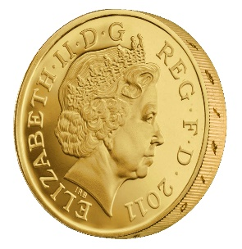
Another Equivalent Definition (Game)
m₀, m₁
Random bit b
K = Gen(.)
c = Enc_{K}(m_{b})
c
b’
$$∀\begin{matrix} & \\ & \\ & \end{matrix} Pr\left[\begin{matrix} & \\ & \end{matrix} Guesses b^{′}=b\right]=\frac{1}{2}$$
Notes:
Suppose we have m,m’,c’ s.t. Pr[EncK(m)= c’] > Pr[EncK(m’)=c’] then adversary can select m0= m, m1=m’. If the ciphertext challenge c=c’ then the adversary outputs guess b’ = 1. Otherwise, the adversary outputs random guess b’.

Slide 8
Another Equivalent Definition (Game)
m₀, m₁
Random bit b
K = Gen(.)
c = Enc_{K}(m_{b})
c
b’
Suppose we have m,m’,c’ s.t. Pr[Enc_{K}(m)= c’] > Pr[Enc_{K}(m’)=c’] then the adversary can win the game w.p > ½. How?
What else do we need to establish to prove that the definitions are equivalent?
Notes:
Suppose we have m,m’,c’ s.t. Pr[EncK(m)= c’] > Pr[EncK(m’)=c’] then adversary can select m0= m, m1=m’. If the ciphertext challenge c=c’ then the adversary outputs guess b’ = 1. Otherwise, the adversary outputs random guess b’. Let Wins
Denote the event that the attacker wins the game.
Pr[Wins|c!=c’] = 1/2
Pr[Wins|c=c’] = Pr[b=1|c=c’] = Pr[b=1 and c=c’]/Pr[c=c’] = (1/2)Pr[Enck(m1)=c’]/Pr[c=c’]
Pr[Wins|c=c’] *Pr[c=c’] = (1/2) Pr[Enck(m1)]
Pr[Wins] = Pr[Wins|c!=c’]*Pr[c!=c’] + Pr[c=c’]*Pr[Wins|c=c’] = (½)*Pr[c!=c’]+(½) Pr[Enck(m1)] = (½) (1-½ * Pr[Enck(m0)=c’]-½ Pr[Enck(m1)=c’]) ’]+(½) Pr[Enck(m1)] = ½ – ¼ Pr[Enck(m0)=c’] + ¼ Pr[Enck(m1)=c’] > ½
The above derivation only establishes one direction of the proof.
Suppose now that for all m,m’, c’ we have Pr[Enc_{K}(m)= c’] > Pr[Enc_{K}(m’)=c’] . Now we need to argue that the adversary cannot win the game with probability > ½. How to argue? Let m0,m1 denote the messages played in round 1, and let c be the challenge cipher text sent in round 2. Note that Pr[Enc_{K}(m₀)= c’] > Pr[Enc_{K}(m₁)=c’] (by definition) so we have
Pr[b=1 | c] = Pr[b and c]/Pr[c] = (1/2) Pr[Enc_{K}(m₁)=c]/ Pr[c] = (1/2) Pr[Enc_{K}(m₀)=c]/ Pr[c] = Pr[b=0|c]
Note that Pr[b=1 | c] +Pr[b=0|c] =1. Thus, Pr[b=0|c] = ½ and Pr[b=1|c] = ½ so whatever bit b’ the attacker guesses after seeing c he will win with probability ½.
QED.

Slide 9
One Time Pad [Vernam 1917]
$${Enc}_{K}\left(m\right)=K⨁m$$
$${Dec}_{K}\left(c\right)=K⨁c$$
$Example=1011⨁$0011 = ???
Theorem: The one-time pad encryption scheme is perfectly secret
The following calculation holds for any c, m
Pr[Enc_{K}(m)=c] = Pr[$K⨁$m =c] = Pr[K=c$⨁$m] = $1/{\left|𝒦\right|}$.
Thus, for any m, m’, c we have
Pr[Enc_{K}(m)=c]=$1/{\left|𝒦\right|}$ =Pr[Enc_{K}(m’)=c].
Notes:
The following calculation holds for any c, m’ Pr[C=c|M=m’] = Pr[Enc_{K}(m’)=c] = Pr[$K⨁$m’ =c] = Pr[K=c$⨁$m’] = $1/{\left|𝒦\right|}$

Slide 10
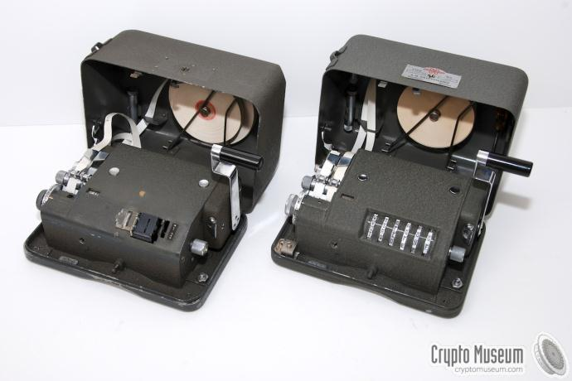
One Time Pad [Vernam 1917]
$${Enc}_{K}\left(m\right)=K⨁m$$
$${Dec}_{K}\left(c\right)=K⨁c$$
$Example=1011⨁$0011 = ???
Notes:
Examples

Slide 11
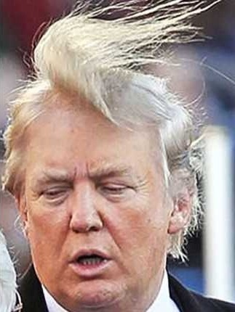
One Time Pad

Slide 12
Perfect Secrecy Limitations
Theorem: If (Gen,Enc,Dec) is a perfectly secret encryption scheme then
$$\left|𝒦\right|≥\left|ℳ\right|$$

Slide 13
One Time Pad Limitations
The key is as long as the message
How to exchange long messages?
Need to exchange/secure lots of one-time pads!
OTPs can only be used once
As the name suggests
VENONA project (US + UK)
Decrypt ciphertexts sent by Soviet Union which were mistakenly encrypted with portions of the same one-time pad over several decades
$$c⨁c^{′}=\left(m⨁k\right)⨁\left(m^{′}⨁k\right)=m⨁m′$$

Slide 14
VENONA project

Slide 15
Shannon’s Theorem
Theorem: Let (Gen,Enc,Dec) be an encryption scheme with $\left|𝒦\right|=\left|ℳ\right|=\left|𝒞\right|.$Then the scheme is perfectly secret if and only if:
Every key k $∈$ $𝒦$ is chosen with (equal) probability $1/{\left|𝒦\right|}$ by the algorithm Gen, and
For every $m∈ℳ$ and every $c∈𝒞$ there exists a unique key k $∈$ $𝒦$such that Enc_{k}(m)=c$.$

Slide 16
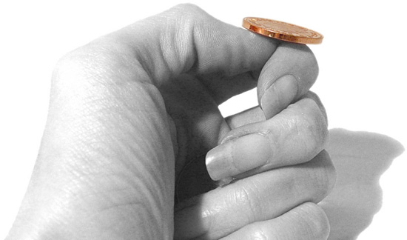
An Important Remark on Randomness
In our analysis we have made (and will
continue to make) a key assumption:
We have access to true “randomness”
to generate the one time pad K
Independent Random Bits
Unbiased Coin flips
Radioactive decay?

Slide 17
In Practice
Hard to flip thousands/millions of coins
Mouse-movements/keys
Uniform bits?
Independent bits?
Use Randomness Extractors
As long as input has high entropy, we can extract (almost) uniform/independent bits
Hot research topic in theory

Slide 18
In Practice
Hard to flip thousands/millions of coins
Mouse-movements/keys
Customized Randomness Chip?

Slide 19
Caveat: Don’t do this!
Rand() in C stdlib.h is no good for cryptographic applications
Source of many real
world flaws

Slide 20
Coming Up…
MLK Day (No Class)
Before Next Class (Wednesday)
Read: Katz and Lindell 3.1-3.2

