Slide 1
Cryptography
CS 555
Topic 29: Formalizing Public Key Cryptography

Slide 2
Recap
Key Management
Diffie Hellman Key Exchange
Password Authenticated Key Exchange (PAKEs)

Slide 3

Public Key Encryption: Basic Terminology
Plaintext/Plaintext Space
  A message $m∈ℳ$
Ciphertext $c∈𝒞$
Public/Private Key Pair $\left(pk,sk\right)∈𝓚$

Slide 4
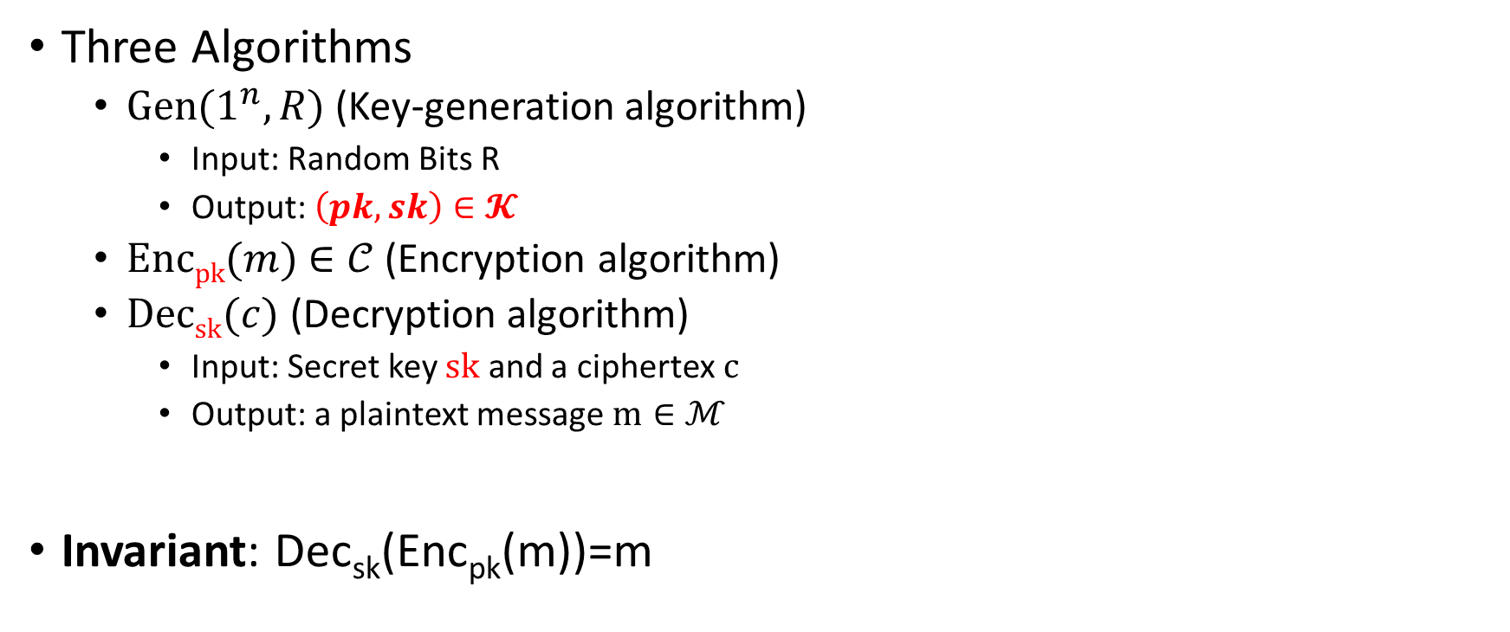
Public Key Encryption Syntax
Three Algorithms
  $\operatorname{Gen}{(1^{n},R)}$ (Key-generation algorithm)
    Input: Random Bits R
    Output: $\left(pk,sk\right)∈𝓚$
  $\operatorname{Encpk}{(m)}$ $∈𝒞$ (Encryption algorithm)
  $\operatorname{Decsk}{(c)}$ (Decryption algorithm)
    Input: Secret key $sk$ and a ciphertex$c$
    Output: a plaintext message $m∈ℳ$
Invariant: Dec_{sk}(Enc_{pk}(m))=m
    Alice must run key generation algorithm in advance an publishes the public key: pk
    Assumption: Adversary only gets to see pk (not sk)

Slide 5
Chosen-Plaintext Attacks
Model ability of adversary to control or influence what the honest parties encrypt.
Historical Example: Battle of Midway (WWII).
  US Navy cryptanalysts were able to break Japanese code by tricking Japanese navy into encrypting a particular message
Private Key Cryptography
Notes:
Batle of Midway. In May 1942, US Navy cryptanal

Slide 6
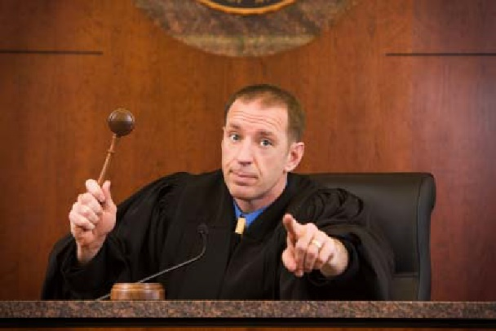

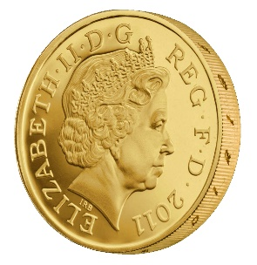

Recap CPA-Security (Symmetric Key Crypto)
m_{0,1},m_{1,1}
c₁ = Enc_{K}(m_{b,1})
m_{0,2},m_{1,2}
c₂ = Enc_{K}(m_{b,2})
m_{0,3},m_{1,3}
c₃ = Enc_{K}(m_{b,3})
…
$$∀PPT A ∃μ (negligible) s.t$$
$$Pr\left[A Guesses b^{′}=b\right]≤\frac{1}{2}+μ(n)$$
b’
Random bit b
K = Gen(.)

Slide 7
Chosen-Plaintext Attacks
Model ability of adversary to control or influence what the honest parties encrypt.
Private Key Crypto
  Attacker tricks victim into encrypting particular messages
Public Key Cryptography
  The attacker already has the public key pk
  Can encrypt any message s/he wants!
  CPA Security is critical!
Notes:
Batle of Midway. In May 1942, US Navy cryptanal

Slide 8






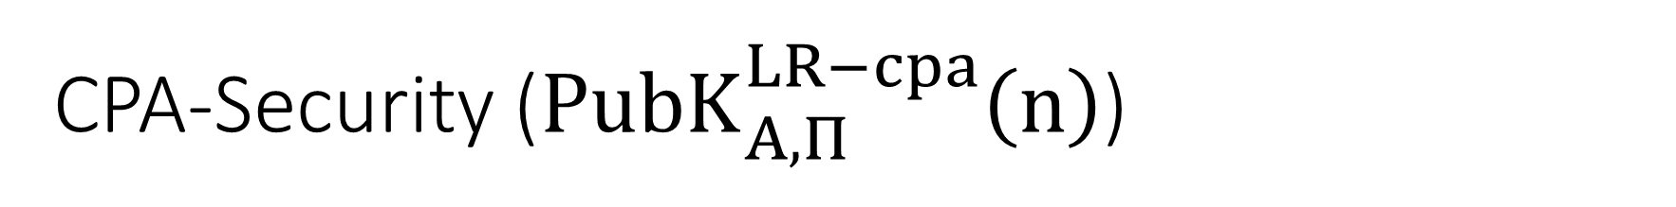

CPA-Security (${PubK}_{A,Π}^{LR−cpa}\left(n\right)$)
Public Key: pk
$$m_{0}^{1},m_{1}^{1}$$
$$c_{1}={Enc}_{pk}\left(m_{b}^{1}\right)$$
$$m_{0}^{2},m_{1}^{2}$$
$$c_{2}={Enc}_{pk}\left(m_{b}^{2}\right)$$
$$m_{0}^{3},m_{1}^{3}$$
$$c_{3}={Enc}_{pk}\left(m_{b}^{3}\right)$$
$$∀PPT A ∃μ (negligible) s.t$$
$$Pr\left[{PubK}_{A,Π}^{LR−cpa}\left(n\right)=1\right]≤\frac{1}{2}+μ(n)$$
…
b’
Random bit b
(pk,sk) = Gen(.)

Slide 9
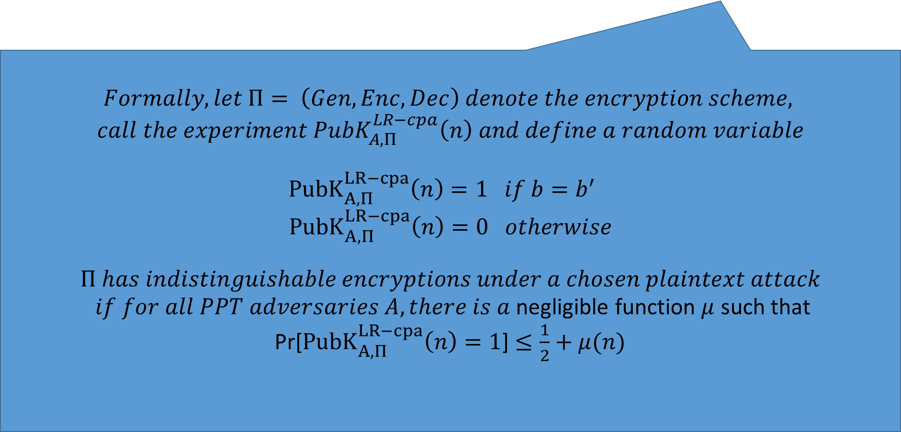
CPA-Security (Single Message)
m₀,m₁
$$Formally, let Π= \left(Gen,Enc,Dec\right) denote the encryption scheme,$$
$$call the experiment {PubK}_{A,Π}^{LR−cpa}\left(n\right) and define a random variable$$
${PubK}_{A,Π}^{LR−cpa}\left(n\right)=1 if b=b^{′}$
$${PubK}_{A,Π}^{LR−cpa}\left(n\right)=0 otherwise$$
$$Π has indistinguishable encryptions under a chosen plaintext attack$$
$if for all PPT adversaries A, there is a$negligible function $μ$ such that
Pr[${PubK}_{A,Π}^{LR−cpa}\left(n\right)=1$] $≤\frac{1}{2}+μ(n)$
c = Enc_{K}(m_{b})
m₂
c₂ = Enc_{K}(m₂)
m₃
c₃ = Enc_{K}(m₃)
…
$$∀PPT A ∃μ (negligible) s.t$$
$$Pr\left[A Guesses b^{′}=b\right]≤\frac{1}{2}+μ(n)$$
b’
Random bit b
K = Gen(.)

Slide 10

Private Key Crypto
CPA Security was stronger than eavesdropping security
  $$EncK(m)=G(K)⨁m$$
Vs.
$$EncK(m)= \left\langle r,F_{k}\left(r\right)⨁m\right\rangle$$

Slide 11

Public Key Crypto
Fact 1: CPA Security and Eavesdropping Security are Equivalent
  Key Insight: The attacker has the public key so he doesn’t gain anything from being able to query the encryption oracle!
Fact 2: Any deterministic encryption scheme is not CPA-Secure
  Historically overlooked in many real world public key crypto systems
Fact 3: Plain RSA is not CPA-Secure
Fact 4: No Public Key Cryptosystem can achieve Perfect Secrecy!
  Exercise 11.1
  Hint: Unbounded attacker can keep encrypting the message m using the public key to recover all possible encryptions of m.

Slide 12

Encrypting Longer Messages
Claim 11.7: Let $Π= \left(Gen,Enc,Dec\right)$ denote a CPA-Secure public key encryption scheme and let $Π′= \left(Gen,Enc′,Dec′\right)$be defined such that
$${Enc}_{pk}^{′}\left(m_{1}∥m_{2}∥…∥m_{ℓ}\right)={Enc}_{pk}^{}\left(m_{1}\right)∥…∥{Enc}_{pk}^{}\left(m_{ℓ}\right)$$
Then $Π′$ is also CPA-Secure.

Slide 13
Chosen Ciphertext Attacks
Models ability of attacker to obtain (partial) decryption of selected ciphertexts
Attacker might intercept ciphertext c (sent from S to R) and send c’ instead.
  After that attacker can observe receiver’s behavior (abort, reply etc…)
Attacker might send a modified ciphertext c’ to receiver R in his own name.
  E-mail response: Receiver might decrypt c’ to obtain m’ and include m’ in the response to the attacker

Slide 14
Recap CCA-Security (Symmetric Key Crypto)
We could set m₀ = m₋₁ or m₁ = m₋₂
m₋₁
c₋₁ = Enc_{K}(m₋₁)
c₋₂
…
m₋₂ = Dec_{K}(c₋₂)
m₀,m₁
However, we could still flip 1 bit of c and ask challenger to decrypt
c = Enc_{K}(m_{b})
m₃
c₂ = Enc_{K}(m₂)
Random bit b
K = Gen(.)
c₃
m₃ = Dec_{K}(m₃)
c₄ =c
…
“No Way!”
b’

Slide 15

Recap CCA-Security $\left({PrivK}_{A,Π}^{cca}\left(n\right)\right)$
Challenger generates a secret key k and a bit b
Adversary (A) is given oracle access to Enc_{k} and Dec_{k}
Adversary outputs m₀,m₁
Challenger sends the adversary c=Enc_{k}(m_{b}).
Adversary maintains oracle access to Enc_{k} and Dec_{k} ,however the adversary is not allowed to query Dec_{k}(c).
Eventually, Adversary outputs b’.
$${PrivK}_{A,Π}^{cca}\left(n\right)=1 if b=b^{′};otherwise 0.$$
CCA-Security: For all PPT A exists a negligible function negl(n) s.t.
$$Pr\left[{PrivK}_{A,Π}^{cca}\left(n\right)=1\right]≤\frac{1}{2}+negl(n)$$

Slide 16






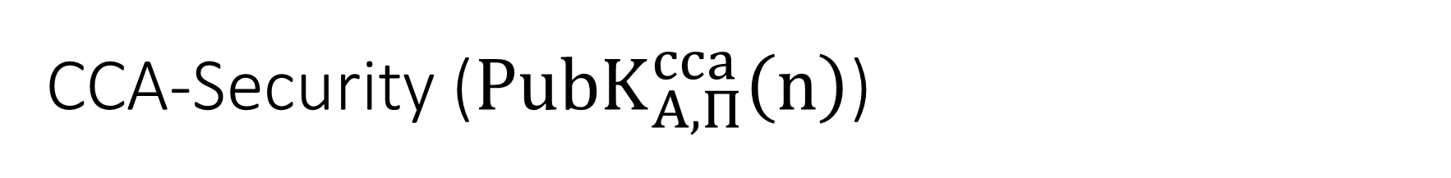

CCA-Security (${PubK}_{A,Π}^{cca}\left(n\right)$)
Public Key: pk
$$c_{−1}$$
$$m_{−1}={Dec}_{sk}\left(c_{−1}\right)$$
…
$$m_{0}^{},m_{1}^{}$$
$$c_{b}={Enc}_{pk}\left(m_{b}^{}\right)$$
$$c_{k}$$
$$∀PPT A ∃μ (negligible) s.t$$
$$Pr\left[{PubK}_{A,Π}^{cca}\left(n\right)=1\right]≤\frac{1}{2}+μ(n)$$
$$m_{k}={Dec}_{sk}\left(c_{k}\right)$$
b’
…
Random bit b
(pk,sk) = Gen(.)

Slide 17
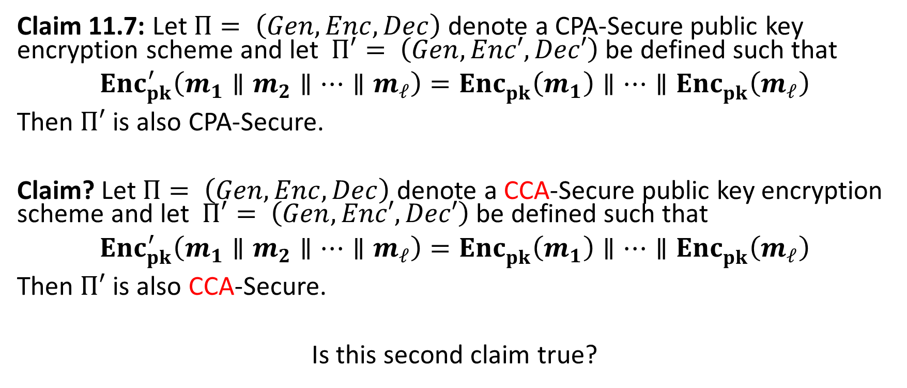
Encrypting Longer Messages
Claim 11.7: Let $Π= \left(Gen,Enc,Dec\right)$ denote a CPA-Secure public key encryption scheme and let $Π′= \left(Gen,Enc′,Dec′\right)$be defined such that
$${Enc}_{pk}^{′}\left(m_{1}∥m_{2}∥…∥m_{ℓ}\right)={Enc}_{pk}^{}\left(m_{1}\right)∥…∥{Enc}_{pk}^{}\left(m_{ℓ}\right)$$
Then $Π′$ is also CPA-Secure.
Claim? Let $Π= \left(Gen,Enc,Dec\right)$ denote a CCA-Secure public key encryption scheme and let $Π′= \left(Gen,Enc′,Dec′\right)$be defined such that
$${Enc}_{pk}^{′}\left(m_{1}∥m_{2}∥…∥m_{ℓ}\right)={Enc}_{pk}^{}\left(m_{1}\right)∥…∥{Enc}_{pk}^{}\left(m_{ℓ}\right)$$
Then $Π′$ is also CCA-Secure.
Is this second claim true?

Slide 18
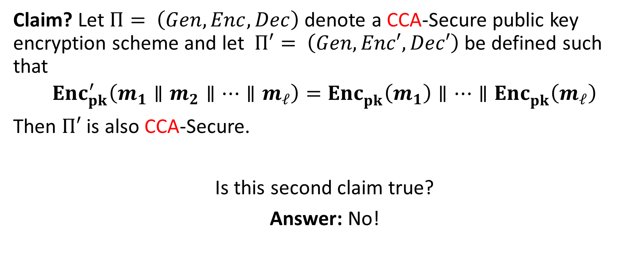
Encrypting Longer Messages
Claim? Let $Π= \left(Gen,Enc,Dec\right)$ denote a CCA-Secure public key encryption scheme and let $Π′= \left(Gen,Enc′,Dec′\right)$be defined such that
$${Enc}_{pk}^{′}\left(m_{1}∥m_{2}∥…∥m_{ℓ}\right)={Enc}_{pk}^{}\left(m_{1}\right)∥…∥{Enc}_{pk}^{}\left(m_{ℓ}\right)$$
Then $Π′$ is also CCA-Secure.
Is this second claim true?
Answer: No!

Slide 19
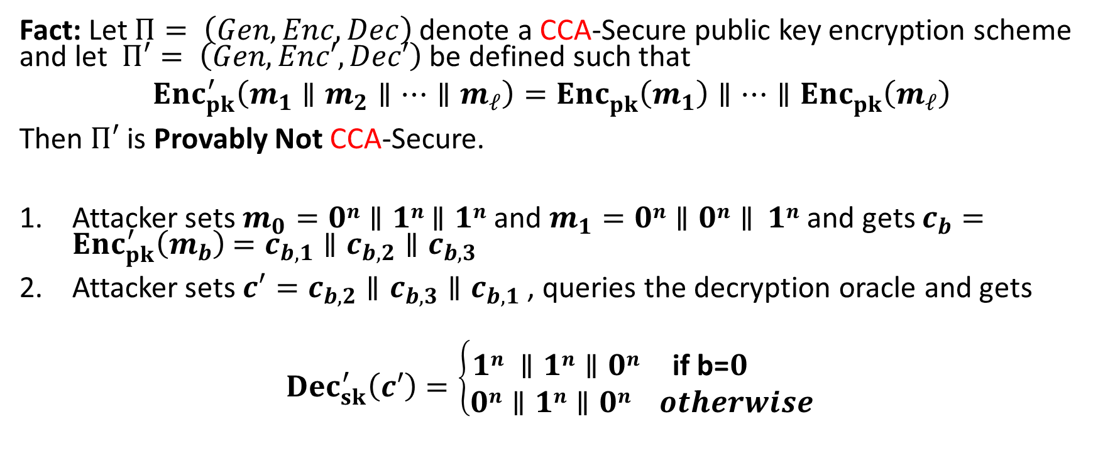
Encrypting Longer Messages
Fact: Let $Π= \left(Gen,Enc,Dec\right)$ denote a CCA-Secure public key encryption scheme and let $Π′= \left(Gen,Enc′,Dec′\right)$be defined such that
$${Enc}_{pk}^{′}\left(m_{1}∥m_{2}∥…∥m_{ℓ}\right)={Enc}_{pk}^{}\left(m_{1}\right)∥…∥{Enc}_{pk}^{}\left(m_{ℓ}\right)$$
Then $Π′$ is Provably Not CCA-Secure.
Attacker sets $m_{0}=0n∥1n$ $∥1n$ and $m_{1}=0n∥0n∥ 1n$ and gets $c_{b}={Enc}_{pk}^{′}\left(m_{b}\right)$ $=c_{b,1}∥c_{b,2}∥c_{b,3}$
Attacker sets $c′=c_{b,2}∥c_{b,3}∥c_{b,1}$ , queries the decryption oracle and gets
$${Dec}_{sk}^{′}\left(c′\right)=\left\{\begin{aligned} \\ 1n ∥1n∥0n \text{if} \text{b}\text{=}0 \\ 0n∥1n∥0n otherwise \end{aligned}\right.$$

Slide 20
Achieving CPA and CCA-Security
Plain RSA is not CPA Secure (therefore, not CCA-Secure)
El-Gamal (next class) is CPA-Secure, but not CCA-Secure
  Homework 4
Tools to build CCA-Secure Encryption
  Key Encapsulation Mechanism

Slide 21
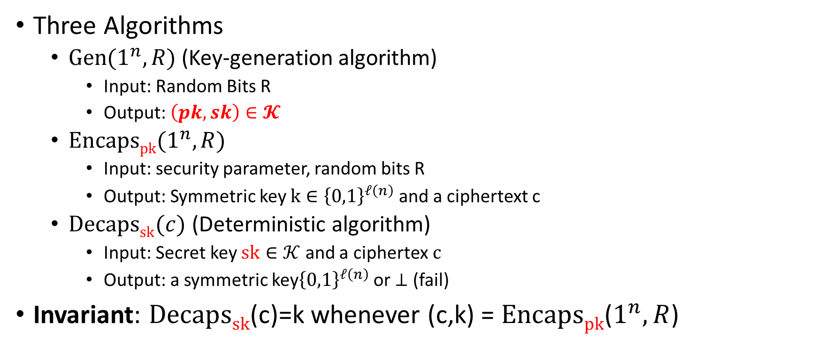
Key Encapsulation Mechanism (KEM)
Three Algorithms
  $\operatorname{Gen}{(1^{n},R)}$ (Key-generation algorithm)
    Input: Random Bits R
    Output: $\left(pk,sk\right)∈𝓚$
  $\operatorname{Encapspk}{(1^{n},R)}$
    Input: security parameter, random bits R
    Output: Symmetric key $k∈{\left\{0,1\right\}}^{ℓ\left(n\right)}$ and a ciphertext c
  $\operatorname{Decapssk}{(c)}$ (Deterministic algorithm)
    Input: Secret key $sk∈𝒦$ and a ciphertex$c$
    Output: a symmetric key${\left\{0,1\right\}}^{ℓ\left(n\right)}$ or $⊥$ (fail)
Invariant: $Decapssk$(c)=k whenever (c,k) = $Encapspk$($1^{n},R$)

Slide 22








KEM CCA-Security (${KEM}_{A,Π}^{cca}\left(n\right)$)
$$\left(pk,c,k_{b}\right)$$
…
$$c_{1}≠c$$
$${Decaps}_{sk}\left(c_{1}\right)$$
$$c_{2}≠c$$
$$∀PPT A ∃μ (negligible) s.t$$
$$Pr\left[{KEM}_{A,Π}^{cca}=1\right]≤\frac{1}{2}+μ(n)$$
$${Decaps}_{sk}\left(c_{2}\right)$$
b’
…
Random bit b
(pk,sk) = Gen(.)
$$\left(c,k0\right)={Encaps}_{pk}\left(.\right)$$
$$k1 ⟵{\left\{0,1\right\}}^{n}$$

Slide 23
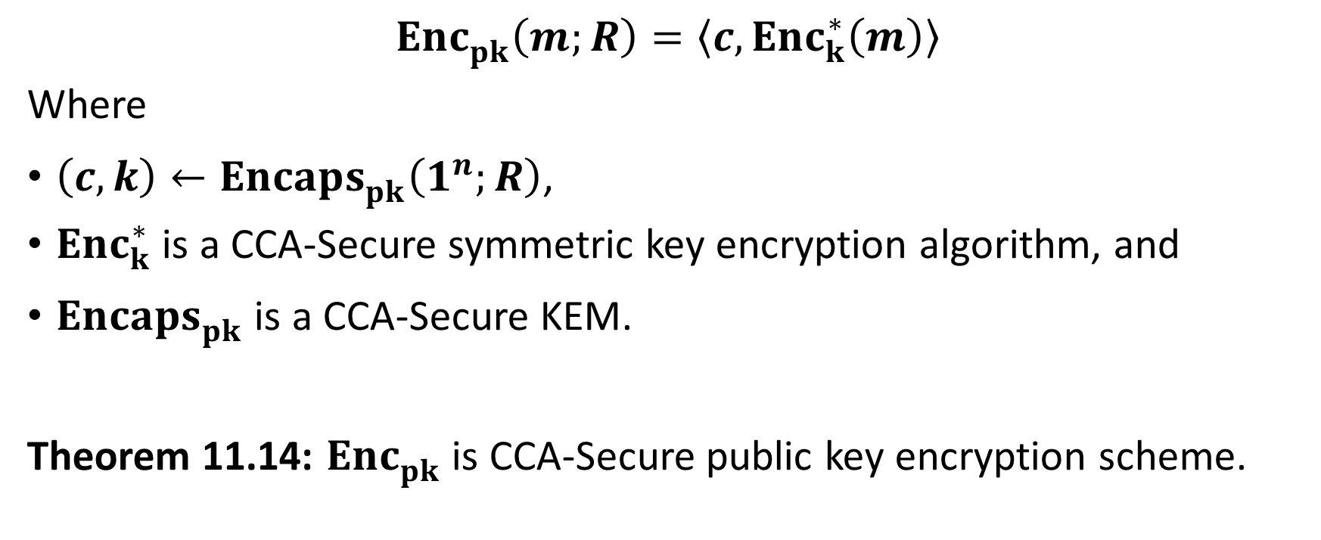
CCA-Secure Encryption from CCA-Secure KEM
$${Enc}_{pk}^{}\left(m;R\right)=\left\langle c,{Enc}_{k}^{∗}\left(m\right)\right\rangle$$
Where
$\left(c,k\right)←{Encaps}_{pk}^{}\left(1^{n};R\right)$,
${Enc}_{k}^{∗}$ is a CCA-Secure symmetric key encryption algorithm, and
${Encaps}_{pk}^{}$ is a CCA-Secure KEM.
Theorem 11.14: ${Enc}_{pk}^{}$ is CCA-Secure public key encryption scheme.

Slide 24
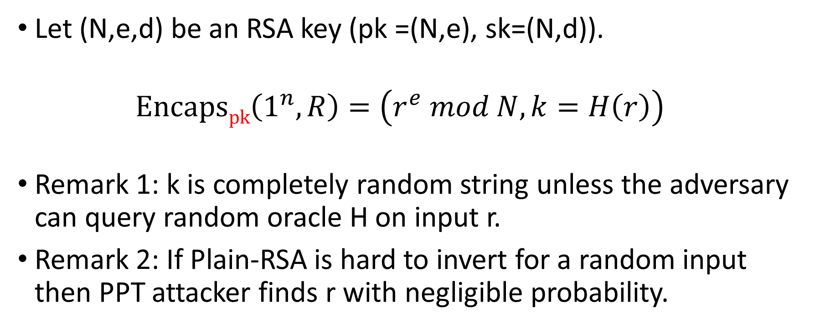
CCA-Secure KEM in the Random Oracle Model
Let (N,e,d) be an RSA key (pk =(N,e), sk=(N,d)).
  $$\operatorname{Encapspk}\left(1^{n},R\right)=\left(r^{e} mod N, k=H\left(r\right)\right)$$
  Remark 1: k is completely random string unless the adversary can query random oracle H on input r.
Remark 2: If Plain-RSA is hard to invert for a random input then PPT attacker finds r with negligible probability.

Slide 25
Next Class: El-Gamal
Read Katz and Lindell: 11.4

