Slide 1
Homework 3 and 4
Homework 3 is due now
Homework 4 has been posted

Slide 2
Cryptography CS 555
Topic 28: Key-Management, Diffie-Hellman Key Exchange

Slide 3
Recap
Factoring Algorithms
Discrete Log Attacks
NIST Security Recommendations

Slide 4
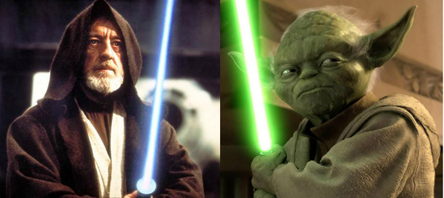
Key-Exchange Problem
Key-Exchange Problem:
Obi-Wan and Yoda want to communicate securely
Suppose that
Obi-Wan and Yoda don’t have time to meet privately and generate one
Obi-Wan and Yoda share a symmetric key with Anakin
Suppose that they fully trust Anakin

Slide 5
Key-Distribution Center (with Symmetric Key-Crypto)
Enc(K_{obiwan} ,”I would like to talk to Yoda”)
Ok, here is a fresh key that no sith lord has seen
c₁=Enc(K_{obiwan} ,ts, K_{new}),
c₂=Enc(K_{yoda} , ts, “Obiwan/Yoda”, K_{new})
K_{obiwan}: Shared key between Obiwan and Anakin
K_{yoda}: Shared key between yoda and Anakin

Slide 6
Key-Distribution Center (with Symmetric Key-Crypto)
Enc(K_{obiwan} ,”I would like to talk to Yoda”)
Ok, here is a fresh key that no sith lord has seen
c₁=Enc(K_{obiwan} ,ts, K_{new}),
c₂=Enc(K_{yoda} , ts, “Obiwan/Yoda”, K_{new})
Enc(K_{new}, “Its me, Obiwan, let’s talk”)
c₂=Enc(K_{yoda} ,ts, “Obiwan/Yoda”, K_{new})

Slide 7
Key-Distribution Center (with Symmetric Key-Crypto)
Vulnerability: If Key-Distribution Center is compromised then all security guarantees are broken.
KDC is a valuable target for attackers
Possibility of insider attacks (e.g., employees)
Denial of Service (DOS) Attack: If KDC is down then secure communication is temporarily impossible.

Slide 8
Key-Distribution Center (with Symmetric Key-Crypto)
Benefit: Authenticated Encryption provides authentication as well
Yoda can be sure he is talking to Obiwan (assuming he trusts the KDC)
Kerberos uses similar protocol
Yoda’s key and Obiwan’s key are typically derived from a password that they known.
Vulnerability: An eavesdropping attacker can mount a brute-force attack on the (low-entropy) passwords to recover K_{yoda} and K_{obiwan}.
Recommendation: Always use Public Key Initialization with Kerberos

Slide 9
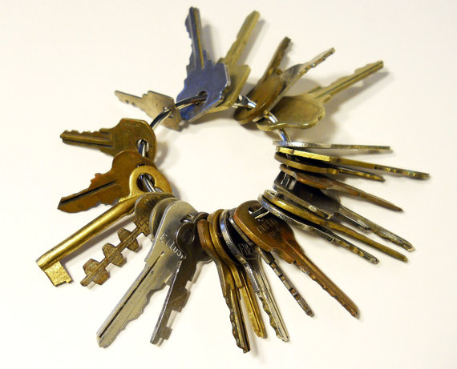
Key-Explosion Problem
To avoid use a trusted KDC we could have every pair of users exchange private keys
How many private keys per person?
Answer: n-1
Need to meet up with n-1 different users in person!
Key Explosion Problem
n can get very big if you are Google or Amazon!

Slide 10
Diffie-Hellman Key Exchange
Alice picks $xA$ and sends ${ g}^{xA}$ to Bob
Bob picks $xB$ and sends ${ g}^{xB}$ to Alice
Alice and Bob can both compute ${K_{A,B}=g}^{xB xA}$

Slide 11
Key-Exchange Experiment ${KE}_{A,Π}^{eav}\left(n\right)$:
Two parties run $Π$ to exchange secret messages (with security parameter 1^{n}).
Let trans be a transcript which contains all messages sent and let k be the secret key output by each party.
Let b be a random bit and let k_{b} = k if b=0; otherwise k_{b} is sampled uniformly at random.
Attacker A is given trans and k_{b} (passive attacker).
Attacker outputs b’ (${KE}_{A,Π}^{eav}\left(n\right)$=1 if and only if b=b’)
Security of $Π$ against an eavesdropping attacker: For all PPT A there is a negligible function negl such that
$$Pr\left[{KE}_{A,Π}^{eav}\left(n\right)\right]\text{=}\text{½}+negl\left(n\right).$$

Slide 12
Diffie-Hellman Key-Exchange is Secure
Theorem: If the decisional Diffie-Hellman problem is hard relative to group generator $𝒢$ then the Diffie-Hellman key-exchange protocol $Π$is secure in the presence of an eavesdropper (*).
(*) Assuming keys are chosen uniformly at random from the cyclic group $𝔾$
Protocol $Π$
Alice picks $xA$ and sends ${ g}^{xA}$ to Bob
Bob picks $xB$ and sends ${ g}^{xB}$ to Alice
Alice and Bob can both compute ${K_{A,B}=g}^{xB xA}$

Slide 13
Discrete Log Experiment DLog_{A,G}(n)
Run $𝒢$(1^{n}) to obtain a cyclic group $𝔾$ of order q (with $\left\|q\right\|=n$) and a generator g such that $<g>=𝔾$.
Select$h∈𝔾$ uniformly at random.
Attacker A is given $𝔾$, q, g, h and outputs integer x.
Attacker wins (DLog_{A,G}(n)=1) if and only if g^{x}=h.
We say that the discrete log problem is hard relative to generator G if
$$∀PPT A ∃μ (negligible) s.t Pr\left[\text{DLog}\text{A}\text{,}\text{n} =1\right]≤μ(n)$$

Slide 14
Diffie-Hellman Assumptions
Computational Diffie-Hellman Problem (CDH)
Attacker is given $h1=g^{x_{1}}∈𝔾$ and $h2=g^{x_{2}}∈𝔾.$
Attackers goal is to find${ g}^{x_{1}x_{2}}={\left(h1\right)}^{x_{2}}={\left(h2\right)}^{x_{1}}$
CDH Assumption: For all PPT A there is a negligible function negl upper bounding the probability that A succeeds
Decisional Diffie-Hellman Problem (DDH)
L$et z0={ g}^{x_{1}x_{2}}$ and let $z1={ g}^{r}$, where x₁,x₂ and r are random
Attacker is given $g^{x_{1}}$, $g^{x_{2}}$ and $zb$ (for a random bit b)
Attackers goal is to guess b
DDH Assumption: For all PPT A there is a negligible function negl such that A succeeds with probability at most ½ + negl(n).

Slide 15
Diffie-Hellman Key Exchange
Alice picks $xA$ and sends ${ g}^{xA}$ to Bob
Bob picks $xB$ and sends ${ g}^{xB}$ to Alice
Alice and Bob can both compute ${K_{A,B}=g}^{xB xA}$
Intuition: Decisional Diffie-Hellman assumption implies that a passive attacker who observes ${ g}^{xA}$ and ${ g}^{xB}$ still cannot distinguish between ${K_{A,B}=g}^{xB xA}$ and a random group element.

Slide 16
Diffie-Hellman Key-Exchange is Secure
Theorem: If the decisional Diffie-Hellman problem is hard relative to group generator $𝒢$ then the Diffie-Hellman key-exchange protocol $Π$is secure in the presence of an eavesdropper (*).
Proof:
$$Pr\left[{KE}_{A,Π}^{eav}\left(n\right)=1\right]$$
$$\text{=}\text{½}Pr\left[{KE}_{A,Π}^{eav}\left(n\right)=1|b=1\right]+\text{½}Pr\left[{KE}_{A,Π}^{eav}\left(n\right)=1|b=0\right]$$
$$\text{=}\text{½}Pr\left[A\left(𝔾 ,g,q,g^{x},g^{y},g^{xy}\right)=1\right]+\text{½}Pr\left[A\left(𝔾 ,g,q,g^{x},g^{y},g^{z}\right)=1\right]$$
$$\text{=}\text{½}\text{+}\text{½}\left(Pr\left[A\left(𝔾 ,g,q,g^{x},g^{y},g^{xy}\right)=1\right]−Pr\left[A\left(𝔾 ,g,q,g^{x},g^{y},g^{z}\right)=1\right]\right).$$
$$≤\text{½}\text{ + }\text{½}\text{negl}\text{(}\text{n}\text{) (}\text{by} \text{DDH}\text{)}$$
(*) Assuming keys are chosen uniformly at random from the cyclic group $𝔾$

Slide 17
Diffie-Hellman Key Exchange
Alice picks $xA$ and sends ${ g}^{xA}$ to Bob
Bob picks $xB$ and sends ${ g}^{xB}$ to Alice
Alice and Bob can both compute ${K_{A,B}=g}^{xB xA}$
Intuition: Decisional Diffie-Hellman assumption implies that a passive attacker who observes ${ g}^{xA}$ and ${ g}^{xB}$ still cannot distinguish between ${K_{A,B}=g}^{xB xA}$ and a random group element.
Remark: The protocol is vulnerable against active attackers who can tamper with messages.

Slide 18
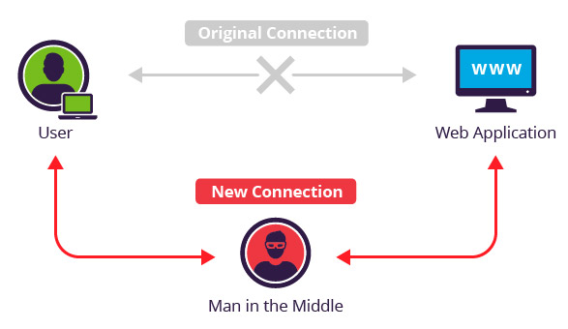
Man in the Middle Attack (MITM)

Slide 19
Man in the Middle Attack (MITM)
Alice picks $xA$ and sends ${ g}^{xA}$ to Bob
Eve intercepts ${ g}^{xA}$ , picks $xE$ and sends ${ g}^{xE}$ to Bob instead
Bob picks $xB$ and sends ${ g}^{xB}$ to Alice
Eve intercepts${ g}^{xB}$, picks $xE′$ and sends ${ g}^{xE′}$ to Alice instead
Eve computes ${ g}^{xE′xA}$ and ${ g}^{xExB}$
Alice computes secret key${ g}^{xE′xA}$ (shared with Eve not Bob)
Bob computes${ g}^{xExB}$(shared with Eve not Alice)
Eve forwards messages between Alice and Bob (tampering with the messages if desired)
Neither Alice nor Bob can detect the attack

Slide 20
Password Authenticated Key-Exchange
Suppose Alice and Bob share a low-entropy password pwd and wish to communicate securely
(without using any trusted party)
Assuming an active attacker may try to mount a man-in-the-middle attack
Can they do it?
Tempting Approach:
Alice and Bob both compute K= KDF(pwd)=H^{n}(pwd) and communicate with using an authenticated encryption scheme.
Midterm Exam: Secure in random oracle model if attacker cannot query random oracle too many time.

Slide 21
Password Authenticated Key-Exchange
Tempting Approach:
Alice and Bob both compute K= KDF(pwd)=H^{n}(pwd) and communicate with using an authenticated encryption scheme.
Midterm Exam: Secure in random oracle model if attacker cannot query random oracle too many time.
Problems:
In practice the attacker can (and will) query the random oracle many times.
In practice people tend to pick very weak passwords
Brute-force attack: Attacker enumerates over a dictionary of passwords and attempts to decrypt messages with K_{pwd’}=KDF(pwd’) (only succeeds if K_{pwd’}=K).
An offline attack (brute-force) will almost always succeed

Slide 22
Password Authenticated Key-Exchange (PAKE)
Better Approach (PAKE):
Alice and Bob both compute $W=g^{pwd}$
Alice picks $xA$ and sends “$\text{Alice}\text{"}\text{,} {X=g}^{xA}$ to Bob
Bob picks $xB$ computes $r=H\left(1, Alice, Bob,X\right) and Y={\left(X×{\left(W\right)}^{r}\right)}^{xB}$and sends Alice the following message:$"Bob," Y$
Alice computes $K=Y^{Z}{=g}^{xB}$ where $z=1/{\left(\left(pwd×r\right)+xA\right)} mod p$. Alice sends the message V_{A}= H(2,Alice,Bob,X,Y,K) to Bob.
Bob verifies that V_{A}== H(2,Alice,Bob,X,Y,K) where K = ${ g}^{xB}$. Bob generates V_{B}= H(3,Alice,Bob,X,Y,K) and sends V_{B} to Alice.
Alice verifies that V_{B}==H(3,Alice,Bob,X,Y, $Y^{Z}$ ) where $z=1/{\left(\left(pwd×r\right)+xA\right)}$.
If Alice and Bob don’t terminate the session key is H(4,Alice,Bob,X,Y, $K$)
Security:
No offline attack (brute-force) is possible. Attacker get’s one password guess per instantiation of the protocol.
If attacker is incorrect and he tampers with messages then he will cause the Alice & Bob to quit.
If Alice and Bob accept the secret key K and the attacker did not know/guess the password then K is “just as good” as a truly random secret key.
See RFC 6628
Notes:
Attacker could impersonate Alice, guess K’ and send g^{Ky}to Bob. Attacker receives H_{B}=H(sk’, 1) where sk’ = $H\left({Alice, Bob,g^{K′K^{−1}y},{ g}^{xB},g}^{K′K^{−1}yxB}\right)$

Slide 23
Key-Explosion Problem
So far neither Diffie-Hellman Key Exchange nor PAKEs completely solved the problem
PAKEs require a shared password
(n-1) shared passwords?
Diffie-Hellman Key Exchange is vulnerable to man-in-the-middle
Can use KDC to store database of public-keys (e.g., ${ g}^{xA}$) for each party.
Breached KDC doesn’t reveal secret keys

Slide 24
Public Key Revolution
Digital Signatures can help
Private-Key Analogue: MAC
Private Key required to produce signature for a message m
Anyone with Public Key can verify the message
An authority could sign the message “Alice’s public key is ${ g}^{xA}$”
Anyone could use the authority’s public key to validate Alice’s public key
The authority does not actually need to store ${ g}^{xA}$.
In fact, if Alice has signature then she can use this to prove her identity to Bob (and Bob doesn’t need to interact the authority)

Slide 25
Next Class: Formalizing Public Key Encryption
Formalizing Public Key Encryption
Read Katz and Lindell: 11.1-11.2

