Slide 1
Cryptography CS 555
Topic 26: Discrete LOG Applications

Slide 2
Recap
Plain RSA + Attacks
Discrete Log Assumptions
CDH: Computational Diffie Hellman
DDH: Decisional Diffie Hellman
Cyclic Groups under which CDH/DDH might hold
$ℤ_{p}^{∗}$ where p is a random n-bit prime.
CDH is believed to be hard
DDH is *not* hard (Exercise 13.15)
$𝔾=\left\{[hr mod p] | {h∈ℤ}_{p}^{∗}\right\}$, where p=rq+1 (q is bit prime; p is n bit prime)
DDH and CDH are believed to be hard
Set $λ=O\left(\sqrt[3]{n}{\left(\log{n}\right)}^{2/3}\right)$ to maximize resistance against known attacks.
Elliptic Curves
DDH is believed to be hard for appropriate choice of curve

Slide 3
Cyclic Group
Let $𝔾 be a group with order m=\left|𝔾\right|$with a binary operation $∘$ (over G) and let $g∈𝔾$ be given consider the set
$$\left\langle g\right\rangle =\left\{g0,g1,g2,…\right\}$$
Fact: $\left\langle g\right\rangle$ defines a subgroup of $𝔾.$
Identity: $g0$
Closure: $gi∘gj=g^{i+j}∈\left\langle g\right\rangle$
g is called a “generator” of the subgroup.
Fact: Let $r=\left|\left\langle g\right\rangle \right|$ then $g^{i }=gj$ if and only if $i=j mod r$. Also m is divisible by r.

Slide 4
Diffie-Hellman Problems
Computational Diffie-Hellman Problem (CDH)
Attacker is given $h1=g^{x_{1}}∈𝔾$ and $h2=g^{x_{2}}∈𝔾.$
Attackers goal is to find${ g}^{x_{1}x_{2}}={\left(h1\right)}^{x_{2}}={\left(h2\right)}^{x_{1}}$
CDH Assumption: For all PPT A there is a negligible function negl upper bounding the probability that A succeeds
Decisional Diffie-Hellman Problem (DDH)
L$et z0={ g}^{x_{1}x_{2}}$ and let $z1={ g}^{r}$, where x₁,x₂ and r are random
Attacker is given $g^{x_{1}}$, $g^{x_{2}}$ and $zb$ (for a random bit b)
Attackers goal is to guess b
DDH Assumption: For all PPT A there is a negligible function negl such that A succeeds with probability at most ½ + negl(n).

Slide 5
Can we find a cyclic group where DDH holds?
Elliptic Curves Example: Let p be a prime (p > 3) and let A, B be constants. Consider the equation
$$y2=x3+Ax+B mod p$$
And let
$$E\left(ℤ_{p}^{}\right)=\left\{\left(x,y\right)∈ℤ_{p}^{2} | y2=x3+Ax+B mod p \right\}∪\left\{𝒪\right\}$$
Note: $𝒪$ is defined to be an additive identity $\left(x,y\right)+𝒪=\left(x,y\right)$
W$hat is \left(x1,y1\right)+\left(x2,y2\right)?$

Slide 6
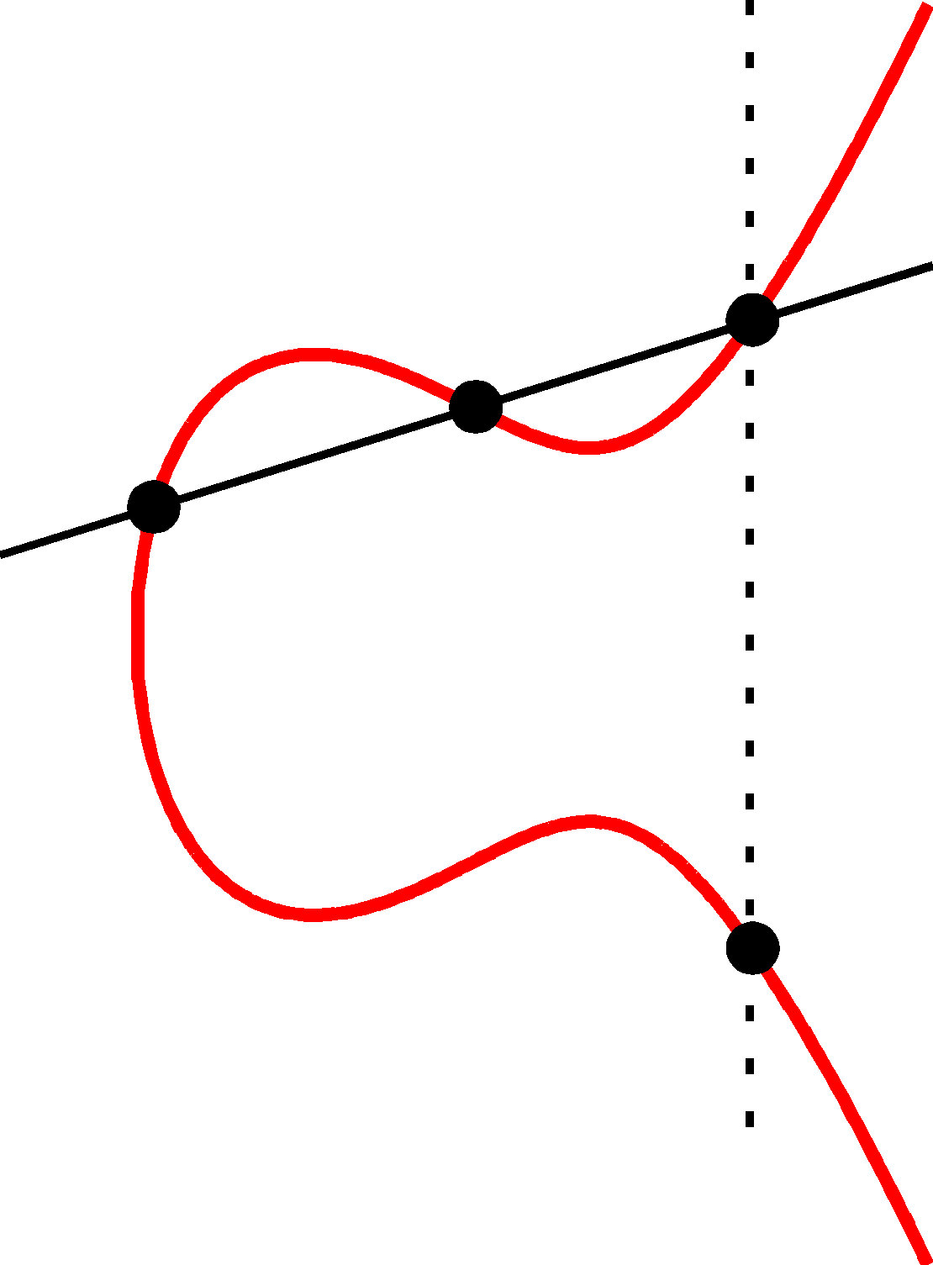
Elliptic Curve Example
$$\left(x2,y2\right)$$
(x₃,y₃)
Formally, let
$$m=\left[\frac{y1−y2}{x1−x2} mod p\right]$$
be the slope.
Then the line passing through $\left(x1,y1\right)$ and $\left(x2,y2\right)$ has the equation
$$y=m\left(x−x1\right)+y1 mod P$$
$$\left(x1,y1\right)$$
(x₃,-y₃)=$\left(x1,y1\right)+\left(x2,y2\right)$

Slide 7
Elliptic Curve Example
$$\left(x2,y2\right)$$
(x₃,y₃)
$$\left(x1,y1\right)$$
Formally, let
$$m=\left[\frac{y1−y2}{x1−x2} mod p\right]$$
Be the slope. Then the line passing through $\left(x1,y1\right)$ and $\left(x2,y2\right)$ has the equation
$$y=m\left(x−x1\right)+y1 mod P$$
$$\left(m\left(x−x1\right)+y1\right)2=x3+Ax+B mod p$$
(x₃,-y₃)=$\left(x1,y1\right)+\left(x2,y2\right)$
$$x3=[m2−x1−x2 mod p]$$
$$y3=[m\left(x3−x1\right)+y1 mod p]$$

Slide 8
Elliptic Curve Example
$$\left(x1,y1\right)$$
$$𝒪=\left(x1,y1\right)+\left(x2,y2\right)$$
$$\left(x2,y2\right)$$

Slide 9
Can we find a cyclic group where DDH holds?
Elliptic Curves Example: Let p be a prime (p > 3) and let A, B be constants. Consider the equation
$$y2=x3+Ax+B mod p$$
And let
$$E\left(ℤ_{p}^{}\right)=\left\{\left(x,y\right)∈ℤ_{p}^{2} | y2=x3+Ax+B mod p \right\}∪\left\{𝒪\right\}$$
Fact: $E\left(ℤ_{p}^{}\right)$ defines an abelian group
For appropriate curves the DDH assumption is believed to hold
If you make up your own curve there is a good chance it is broken…
NIST has a list of recommendations

Slide 10
RSA-Assumption vs Symmetric Key Crypto
Recall: We can build (essentially) all of symmetric key crypto from one-way functions.
CCA-Secure Encryption, MACs, PRGs, PRFs
Collision Resistant Hash Functions
Symmetric Key Crypto → OWFs
Example: Can build OWFs from eavesdropping secure encryption scheme (weaker than CPA-secure/CCA-secure encryption)
OWFs are necessary and sufficient for symmetric key crypto
Not known to be sufficient for public key crypto
Does the RSA-Assumption → OWFs?

Slide 11
RSA-Assumption
RSA-Experiment: RSA-INV_{A,n}
Run KeyGeneration(1^{n}) to obtain (N,e,d)
Pick uniform $y∈ ℤ_{N}^{∗}$
Attacker A is given N, e, y and outputs $x∈ ℤ_{N}^{∗}$
Attacker wins (RSA-INV_{A,n}=1) if $x^{e}=y mod N$
$$∀PPT A ∃μ (negligible) s.t Pr\left[\text{RSA}\text{−}\text{INVA}\text{,}\text{n} =1\right]≤μ(n)$$

Slide 12
Does the RSA-Assumption → OWFs?
Answer: Yes! (and by extension RSA-Assumption is sufficient for any symmetric key cryptosystem).
In fact the factoring assumption (weaker than RSA) is sufficient for OWFS.
Proof:
Let $Gen\left(1^{n};r\right)$ output (N,p,q) where N=pq and p and q are random primes (selected with random bits r).
$f_{Gen}\left(x\right)=$
(N,p,q) = $Gen\left(1^{n};x\right)$
Return N
Claim: $f_{Gen}\left(x\right)$ is a OWF.

Slide 13
Does the RSA-Assumption → OWFs?
$f_{Gen}\left(x\right)=$
(N,p,q) = $Gen\left(1^{n};x\right)$
Return N
Claim: $f_{Gen}\left(x\right)$ is a OWF.
Proof: Given a PPT attacker A that breaks OWF security we can run $A\left(f_{Gen}\left(x\right)\right)$ to obtain x’ such that $f_{Gen}\left(x\right)=f_{Gen}\left(x′\right)$ (A succeeds with non-negligible probability). Given x’ we can run $Gen\left(1^{n};x′\right)$ to obtain a tuple (N,p’,q’) such that N=p’q’ and p’q’ are prime. By uniqueness of prime factorization we have {p’,q’} = {p,q}.

Slide 14
Does the RSA-Assumption → OWFs?
$f_{Gen}\left(x\right)=$
(N,p,q) = $Gen\left(1^{n};x\right)$
Return N
Claim: $f_{Gen}\left(x\right)$ is a OWF.
Remark 1: Also possible to construct One-Way-Permutation from RSA-Assumption
Remark 2: Possible to construct OWFs from Discrete-Log Assumption

Slide 15
Does the RSA-Assumption → OWFs?
$f_{Gen}\left(x\right)=$
(N,p,q) = $Gen\left(1^{n};x\right)$
Return N
Claim: $f_{Gen}\left(x\right)$ is a OWF.
Remark 1: Also possible to construct One-Way-Permutation from RSA-Assumption
Remark 2: Possible to construct OWFs from Discrete-Log Assumption

Slide 16
Discrete Log Experiment DLog_{A,G}(n)
Run $𝒢\left(1^{n}\right)$ to obtain a cyclic group $𝔾$ of order q (with $\left\|q\right\|=n$) and a generator g such that $<g>=𝔾$.
Select$h∈𝔾$ uniformly at random.
Attacker A is given $𝔾$, q, g, h and outputs integer x.
Attacker wins (DLog_{A,G}(n)=1) if and only if g^{x}=h.
We say that the discrete log problem is hard relative to generator $𝒢$ if
$$∀PPT A ∃μ (negligible) s.t Pr\left[\text{DLog}\text{A}\text{,}\text{n} =1\right]≤μ(n)$$

Slide 17
Collision Resistant Hash Functions
Not known how to build CRHFs from OWFs
Can build collision resistant hash functions from Discrete Logarithm Assumption
Let $𝒢\left(1^{n}\right)$ output $\left(𝔾,q,g\right)$ where $𝔾$ is a cyclic group of order $q$ and g is a generator of the group.
Suppose that discrete log problem is hard relative to generator $𝒢.$
$$∀PPT A ∃μ (negligible) s.t Pr\left[\text{DLog}\text{A}\text{,}\text{n} =1\right]≤μ(n)$$

Slide 18
Collision Resistant Hash Functions
Let $𝒢\left(1^{n}\right)$ output $\left(𝔾,q,g\right)$ where $𝔾$ is a cyclic group of order $q$ and g is a generator of the group.
Collision Resistant Hash Function (Gen,H):
$Gen\left(1^{n}\right)$
$\left(𝔾,q,g\right) ←𝒢\left(1^{n}\right)$
Select random $h← 𝔾$
Output $s=\left(𝔾,q,g,h\right)$
$H^{s}\left(x_{1},x_{2}\right)=g^{x_{1}}h^{x_{2}}$ (where, $x_{1},x_{2}{∈ℤ}_{q}^{}$)
Claim: (Gen,H) is collision resistant

Slide 19
Collision Resistant Hash Functions
$H^{s}\left(x_{1},x_{2}\right)=g^{x_{1}}h^{x_{2}}$ (where, $x_{1},x_{2}{∈ℤ}_{q}^{}$)
Claim: (Gen,H) is collision resistant
Proof: Suppose we find a collision $H^{s}\left(x_{1},x_{2}\right)=H^{s}\left(y_{1},y_{2}\right)$ then we have $g^{x_{1}}h^{x_{2}}=g^{y_{1}}h^{y_{2}}$ which implies
$$h^{x_{2}−y_{2}}=g^{y_{1−}x_{1}}$$
Use extended GCD to find ${\left(x_{2}−y_{2}\right)}^{−1} mod q$ then
$${h=h}^{\left(x_{2}−y_{2}\right){\left(x_{2}−y_{2}\right)}^{−1} mod q}=g^{\left(y_{1−}x_{1}\right){\left(x_{2}−y_{2}\right)}^{−1} mod q}$$
Which means that $\left(y_{1−}x_{1}\right){\left(x_{2}−y_{2}\right)}^{−1} mod q$ is the discrete log of h.

Slide 20
Pollard’s p-1 Algorithm (Factoring)
Let $N=pq$ where (p-1) has only “small” prime factors.
Pollard’s p-1 algorithm can factor N.
Remark 1: This happens with very small probability if p is a random n bit prime.
Remark 2: One convenient/fast way to generate big primes it to multiply many small primes and add 1.
Example: $2×3×5×7+1=211$ which is prime
Claim: Suppose we are given an integer B such that (p-1) divides B but (q-1) does not divide B then we can factor N.

Slide 21
Pollard’s p-1 Algorithm (Factoring)
Claim: Suppose we are given an integer B such that (p-1) divides B but (q-1) does not divide B then we can factor N.
Proof: B=c(p-1) for some integer c and let $y=\left[x^{B}−1 mod N\right]$. Applying the Chinese Remainder Theorem we have
$$y↔\left(x^{B}−1 mod p,x^{B}−1 mod q\right)$$
$$=\left(0, x^{B}−1 mod q\right)$$
This means that p divides y, but q does not divide y (unless $x^{B}=1 mod q$, which is very unlikely).
Thus, GCD(y,N) = p

Slide 22
Pollard’s p-1 Algorithm (Factoring)
Let $N=pq$ where (p-1) has only “small” prime factors.
Pollard’s p-1 algorithm can factor N.
Claim: Suppose we are given an integer B such that (p-1) divides B but (q-1) does not divide B then we can factor N.
Goal: Find B such that (p-1) divides B but (q-1) does not divide B.
Remark: This is difficult if (p-1) has a large prime factor.
$$B=\prod_{i=1}^{k}{p_{i}^{\left[n/\log{pi}\right]}}$$

Slide 23
Pollard’s p-1 Algorithm (Factoring)
Goal: Find B such that (p-1) divides B but (q-1) does not divide B.
Remark: This is difficult if (p-1) has a large prime factor.
$$B=\prod_{i=1}^{k}{p_{i}^{\left[n/\log{pi}\right]}}$$
Here p₁=2,p₂=3,…
Fact: If (q-1) has prime factor larger than p_{k} then (q-1) does not divide B.
Fact: If (p-1) does not have prime factor larger than p_{k} then (p-1) does divide B.

Slide 24
Pollard’s p-1 Algorithm (Factoring)
Option 1: To defeat this attack we can choose strong primes p and q
A prime p is strong if (p-1) has a large prime factor
Drawback: It takes more time to generate (provably) strong primes
Option 2: A random prime is strong with high probability
Current Consensus: Just pick a random prime

Slide 25
Next Class: Factoring Algorithms
Factoring Algorithms
Read Katz and Lindell: Chapter 9
Homework 3 Due

