Slide 1
Cryptography CS 555
Topic 25: Discrete LOG, DDH + Attacks on Plain RSA

Slide 2
Recap
Plain RSA
Public Key (pk): N = pq, e such that $GCD\left(e,φ\left(N\right)\right)=1$
$φ\left(N\right)=\left(p−1\right)\left(q−1\right)$ for distinct primes p and q
Secret Key (sk): N, d such that ed=1 mod $φ\left(N\right)$
Encrypt(pk=(N,e),m) = $m^{e} mod N$
Decrypt(sk=(N,d),c) = $c^{d} mod N$
$Decryption Works because$
$$\left[c^{d}mod N\right]=\left[m^{ed}mod N\right]=\left[m^{[ed mod φ\left(N\right)]}mod N\right]=\left[m mod N\right]$$

Slide 3
RSA-Assumption
RSA-Experiment: RSA-INV_{A,n}
Run KeyGeneration(1^{n}) to obtain (N,e,d)
Pick uniform $y∈ ℤ_{N}^{∗}$
Attacker A is given N, e, y and outputs $x∈ ℤ_{N}^{∗}$
Attacker wins (RSA-INV_{A,n}=1) if $x^{e}=y mod N$
$$∀PPT A ∃μ (negligible) s.t Pr\left[\text{RSA}\text{−}\text{INVA}\text{,}\text{n} =1\right]≤μ(n)$$

Slide 4
(Plain) RSA Discussion
We have not introduced security models like CPA-Security or CCA-security for Public Key Cryptosystems
However, notice that (Plain) RSA Encryption is stateless and deterministic.
→Plain RSA is not secure against chosen-plaintext attacks
Plain RSA is also highly vulnerable to chosen-ciphertext attacks
Attacker intercepts ciphertext c of secret message m
Attacker generates ciphertext c’ for secret message 2m
Attacker asks for decryption of c’ to obtain 2m
Divide by 2 to recover original message m

Slide 5
(Plain) RSA Discussion
However, notice that (Plain) RSA Encryption is stateless and deterministic.
→Plain RSA is not secure against chosen-plaintext attacks
In a public key setting the attacker does have access to an encryption oracle
Encrypted messages with low entropy are vulnerable to a brute-force attack.
If m < B then attacker can recover m after at most B queries to encryption oracle (using public key)

Slide 6
More Weaknesses: Plain RSA with small e
(Small Messages) If m^{e} < N then we can decrypt c = m^{e} mod N directly e.g., m=c^{(1/e)}
(Partially Known Messages) If an attacker knows first 1-(1/e) bits of secret message $m=m_{1}\left\|??\right.$ then he can recover m given
$$Encrypt(pk,m)=m^{e}mod N$$
Theorem[Coppersmith]: If p(x) is a polynomial of degree e then in polynomial time (in log(N), e) we can find all m such that p(m) = 0 mod N and |m|<N^{(1/e)}

Slide 7
More Weaknesses: Plain RSA with small e
Theorem[Coppersmith]: If p(x) is a polynomial of degree e then in polynomial time (in log(N), e) we can find all m such that p(m) = 0 mod N and |m|<N^{(1/e)}
Example: e = 3, $m=m1\left\|m2\right.$ and attacker knows $m1\left(2k bits\right)$ and $c={\left(m1\left\|m2\right.\right)}^{e}mod N$, but not $m2\left(k bits\right)$
$$p\left(x\right)={\left(2^{k}m1+x\right)}^{3}−c$$
Polynomial has a small root mod N at x= $m2$ and coppersmith’s method will find it!

Slide 8
Recovering Encrypted Message faster than Brute-Force
Claim: Let m < 2^{n} be a secret message. For some constant $α=\frac{1}{2}+ε.$ We can recover m in in time ${T=2}^{αn}$ with high probability.
For r=1,…,T
let $xr=\left[cr^{−e}mod N\right]$, where $r^{−e}={\left(r^{−1}\right)}^{e}mod N$
Sort $L={\left\{\left(r,xr\right)\right\}}_{r=1}^{T}$ (by the x_{r} values)
For s=1,…,T
if $\left[s^{e}mod N\right]=xr$ for some r then
return $\left[rs mod N\right]$

Slide 9
Recovering Encrypted Message faster than Brute-Force
For r=1,…,T
let $xr=\left[cr^{−e}mod N\right]$, where $r^{−e}={\left(r^{−1}\right)}^{e}mod N$
Sort $L={\left\{\left(r,xr\right)\right\}}_{r=1}^{T}$ (by the x_{r} values)
For s=1,…,T
if $\left[s^{e}mod N\right]=xr$ for some r then
return $\left[rs mod N\right]$
Analysis: $\left[rs mod N\right]=\left[r\left(xr\right)d mod N\right]$
$$=\left[r\left(cr^{−e}\right)d mod N\right]=\left[rr^{−ed}\left(c\right)d mod N\right]$$
$$=\left[rr^{−1}m mod N\right]=m$$

Slide 10
Recovering Encrypted Message faster than Brute-Force
For r=1,…,T
let $xr=\left[cr^{−e}mod N\right]$, where $r^{−e}={\left(r^{−1}\right)}^{e}mod N$
Sort $L={\left\{\left(r,xr\right)\right\}}_{r=1}^{T}$ (by the x_{r} values)
For s=1,…,T
if $\left[s^{e}mod N\right]=xr$ for some r then
return $\left[rs mod N\right]$
Fact: some constant $α=\frac{1}{2}+ε$ setting ${T=2}^{αn}$ with high probability we will find a pair s and x_{r} with $\left[s^{e}mod N\right]=xr$.

Slide 11
Recovering Encrypted Message faster than Brute-Force
Claim: Let m < 2^{n} be a secret message. For some constant $α=\frac{1}{2}+ε.$ We can recover m in in time ${T=2}^{αn}$ with high probability.
Roughly $\sqrt{B}$ steps to find a secret message m < B

Slide 12
(Recap) Finite Groups
Definition: A (finite) group is a (finite) set $𝔾$with a binary operation $∘$ (over G) for which we have
(Closure:) For all $g,h∈𝔾$ we have $g∘h∈𝔾$
(Identity:) There is an element $e∈𝔾$ such that for all $g∈𝔾$ we have
$$g∘e=g=e∘g$$
(Inverses:) For each element $g∈𝔾$ we can find $h∈𝔾$ such that $g∘h=e$. We say that h is the inverse of g.
(Associativity: ) For all $g1,g2,g3∈𝔾$ we have
$$\left(g1∘g2\right)∘g3=g1∘\left(g2∘g3\right)$$
We say that the group is abelian if
(Commutativity:) For all $g,h∈𝔾$ we have $g∘h=$ $h∘g$

Slide 13
Finite Abelian Groups (Examples)
Example 1: $ℤ_{N}^{}$ when $∘$ denotes addition modulo N
Identity: 0, since 0 $∘$x =[0+x mod N] = [x mod N].
Inverse of x? Set x⁻¹=N-x so that [x⁻¹+x mod N] = [N-x+x mod N] = 0.
Example 2: $ℤ_{N}^{∗}$ when $∘$ denotes multiplication modulo N
Identity: 1, since 1$∘$x =[1(x) mod N] = [x mod N].
Inverse of x? Run extended GCD to obtain integers a and b such that
$$ax+bN=\gcd\left(x,N\right)=1$$
Observe that: x⁻¹ = a. Why?

Slide 14
Cyclic Group
Let $𝔾 be a group with order m=\left|𝔾\right|$with a binary operation $∘$ (over G) and let $g∈𝔾$ be given consider the set
$$\left\langle g\right\rangle =\left\{g0,g1,g2,…\right\}$$
Fact: $\left\langle g\right\rangle$ defines a subgroup of $𝔾.$
Identity: $g0$
Closure: $gi∘gj=g^{i+j}∈\left\langle g\right\rangle$
g is called a “generator” of the subgroup.
Fact: Let $r=\left|\left\langle g\right\rangle \right|$ then $g^{i }=gj$ if and only if $i=j mod r$. Also m is divisible by r.

Slide 15
Finite Abelian Groups (Examples)
Fact: Let p be a prime then $ℤ_{p−1}^{∗}$ is a cyclic group of order p-1.
Note: A generator g of this group must have gcd(g,p-1)=1
Example (non-generator): p=7, g=2
<2>={1,2,4}
Example (generator): p=7, g=5
<2>={1,5,4,6,2,3}

Slide 16
Discrete Log Experiment DLog_{A,G}(n)
Run G(1^{n}) to obtain a cyclic group $𝔾$ of order q (with $\left\|q\right\|=n$) and a generator g such that $<g>=𝔾$.
Select$h∈𝔾$ uniformly at random.
Attacker A is given $𝔾$, q, g, h and outputs integer x.
Attacker wins (DLog_{A,G}(n)=1) if and only if g^{x}=h.
We say that the discrete log problem is hard relative to generator G if
$$∀PPT A ∃μ (negligible) s.t Pr\left[\text{DLog}\text{A}\text{,}\text{n} =1\right]≤μ(n)$$

Slide 17
Diffie-Hellman Problems
Computational Diffie-Hellman Problem (CDH)
Attacker is given $h1=g^{x_{1}}∈𝔾$ and $h2=g^{x_{2}}∈𝔾.$
Attackers goal is to find${ g}^{x_{1}x_{2}}={\left(h1\right)}^{x_{2}}={\left(h2\right)}^{x_{1}}$
CDH Assumption: For all PPT A there is a negligible function negl upper bounding the probability that A succeeds
Decisional Diffie-Hellman Problem (DDH)
L$et z0={ g}^{x_{1}x_{2}}$ and let $z1={ g}^{r}$, where x₁,x₂ and r are random
Attacker is given $g^{x_{1}}$, $g^{x_{2}}$ and $zb$ (for a random bit b)
Attackers goal is to guess b
DDH Assumption: For all PPT A there is a negligible function negl such that A succeeds with probability at most ½ + negl(n).

Slide 18
Secure key-agreement with DDH
Alice publishes ${ g}^{xA}$ and Bob publishes ${ g}^{xB}$
Alice and Bob can both compute ${K_{A,B}=g}^{xB xA}$ but to Eve this key is indistinguishable from a random group element (by DDH)
Remark: Protocol is vulnerable to Man-In-The-Middle Attacks if Bob cannot validate ${ g}^{xA}$.

Slide 19
Can we find a cyclic group where DDH holds?
Example 1: $ℤ_{p}^{∗}$ where p is a random n-bit prime.
CDH is believed to be hard
DDH is *not* hard (Exercise 13.15)
Theorem: $Let$p=rq+1 be a random n-bit prime where q is a large $λ$-bit prime then the set of r^{th} residues modulo p is a cyclic subgroup of order q. Then $𝔾=\left\{[hr mod p] | {h∈ℤ}_{p}^{∗}\right\}$is a cyclic subgroup of $ℤ_{p}^{∗}$ of order q.
Remark 1: DDH is believed to hold for such a group
Remark 2: It is easy to generate uniform elements
Remark 3: Any element (besides 1) is a generator of $𝔾$

Slide 20
Can we find a cyclic group where DDH holds?
Theorem: $Let$p=rq+1 be a random n-bit prime where q is a large $λ$-bit prime then the set of rth residues modulo p is a cyclic subgroup of order q. Then $𝔾=\left\{[hr mod p] | {h∈ℤ}_{p}^{∗}\right\}$is a cyclic subgroup of $ℤ_{p}^{∗}$ of order q.
Closure: $hrgr={\left(hg\right)}^{r}$
Inverse of $hr$ is ${\left(h^{−1}\right)}^{r}∈𝔾$
Size ${\left(hr\right)}^{x}=h^{[rx mod rq]}={{\left(hr\right)}^{x}=h}^{r[x mod q]}={\left(hr\right)}^{[x mod q]}mod p$
Remark: Two known attacks (Section 9.2).
First runs in time $O\left(\sqrt{q}\right)=O\left(2^{λ/2}\right)$
Second runs in time $2^{O\left(\sqrt[3]{n}{\left(\log{n}\right)}^{2/3}\right)}$

Slide 21
Can we find a cyclic group where DDH holds?
Remark: Two known attacks (Section 9.2).
First runs in time $O\left(\sqrt{q}\right)=O\left(2^{λ/2}\right)$
Second runs in time $2^{O\left(\sqrt[3]{n}{\left(\log{n}\right)}^{2/3}\right)},$where n is bit length of p
Goal: Set $λ$ and n to balance attacks
$$λ=O\left(\sqrt[3]{n}{\left(\log{n}\right)}^{2/3}\right)$$
How to sample p=rq+1?
First sample a random $λ$-bit prime q and
Repeatedly check if rq+1 is prime for a random n- $λ$ bit value r

Slide 22
Can we find a cyclic group where DDH holds?
Elliptic Curves Example: Let p be a prime (p > 3) and let A, B be constants. Consider the equation
$$y2=x3+Ax+B mod p$$
And let
$$E\left(ℤ_{p}^{}\right)=\left\{\left(x,y\right)∈ℤ_{p}^{2} | y2=x3+Ax+B mod p \right\}∪\left\{𝒪\right\}$$
Note: $𝒪$ is defined to be an additive identity $\left(x,y\right)+𝒪=\left(x,y\right)$
W$hat is \left(x1,y1\right)+\left(x2,y2\right)?$

Slide 23
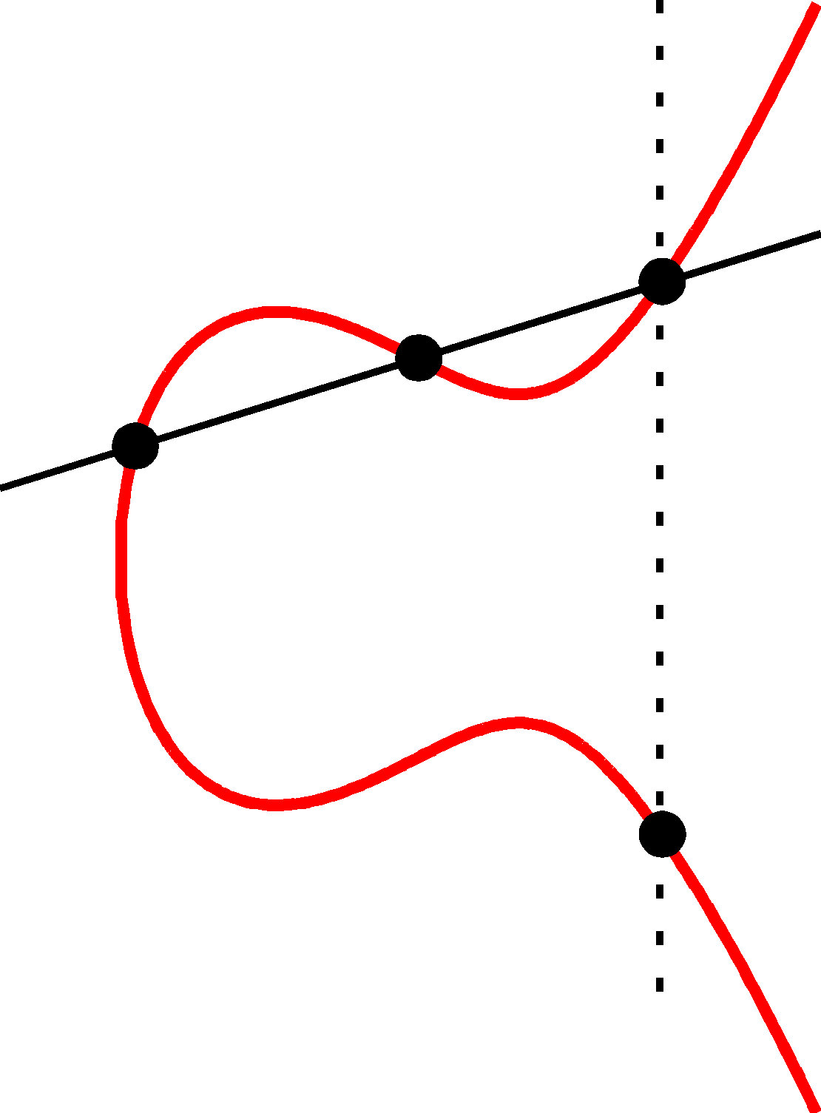
Elliptic Curve Example
$$\left(x2,y2\right)$$
(x₃,y₃)
Formally, let
$$m=\left[\frac{y1−y2}{x1−x2} mod p\right]$$
be the slope.
Then the line passing through $\left(x1,y1\right)$ and $\left(x2,y2\right)$ has the equation
$$y=m\left(x−x1\right)+y1 mod P$$
$$\left(x1,y1\right)$$
(x₃,-y₃)=$\left(x1,y1\right)+\left(x2,y2\right)$

Slide 24
Elliptic Curve Example
$$\left(x2,y2\right)$$
(x₃,y₃)
$$\left(x1,y1\right)$$
Formally, let
$$m=\left[\frac{y1−y2}{x1−x2} mod p\right]$$
Be the slope. Then the line passing through $\left(x1,y1\right)$ and $\left(x2,y2\right)$ has the equation
$$y=m\left(x−x1\right)+y1 mod P$$
$$\left(m\left(x−x1\right)+y1\right)2=x3+Ax+B mod p$$
(x₃,-y₃)=$\left(x1,y1\right)+\left(x2,y2\right)$
$$x3=[m2−x1−x2 mod p]$$
$$y3=[m\left(x3−x1\right)+y1 mod p]$$

Slide 25
Elliptic Curve Example
$$\left(x1,y1\right)$$
$$𝒪=\left(x1,y1\right)+\left(x2,y2\right)$$
$$\left(x2,y2\right)$$

Slide 26
Can we find a cyclic group where DDH holds?
Elliptic Curves Example: Let p be a prime (p > 3) and let A, B be constants. Consider the equation
$$y2=x3+Ax+B mod p$$
And let
$$E\left(ℤ_{p}^{}\right)=\left\{\left(x,y\right)∈ℤ_{p}^{2} | y2=x3+Ax+B mod p \right\}∪\left\{𝒪\right\}$$
Fact: $E\left(ℤ_{p}^{}\right)$ defines an abelian group
For appropriate curves the DDH assumption is believed to hold
If you make up your own curve there is a good chance it is broken…
NIST has a list of recommendations

Slide 27
Next Week: Spring Break!
Next class on Monday, March 20th.
Read Katz and Lindell 8.4
DDH Applications

