Slide 1
Cryptography
CS 555
Topic 24: Finding Prime Numbers, RSA

Slide 2
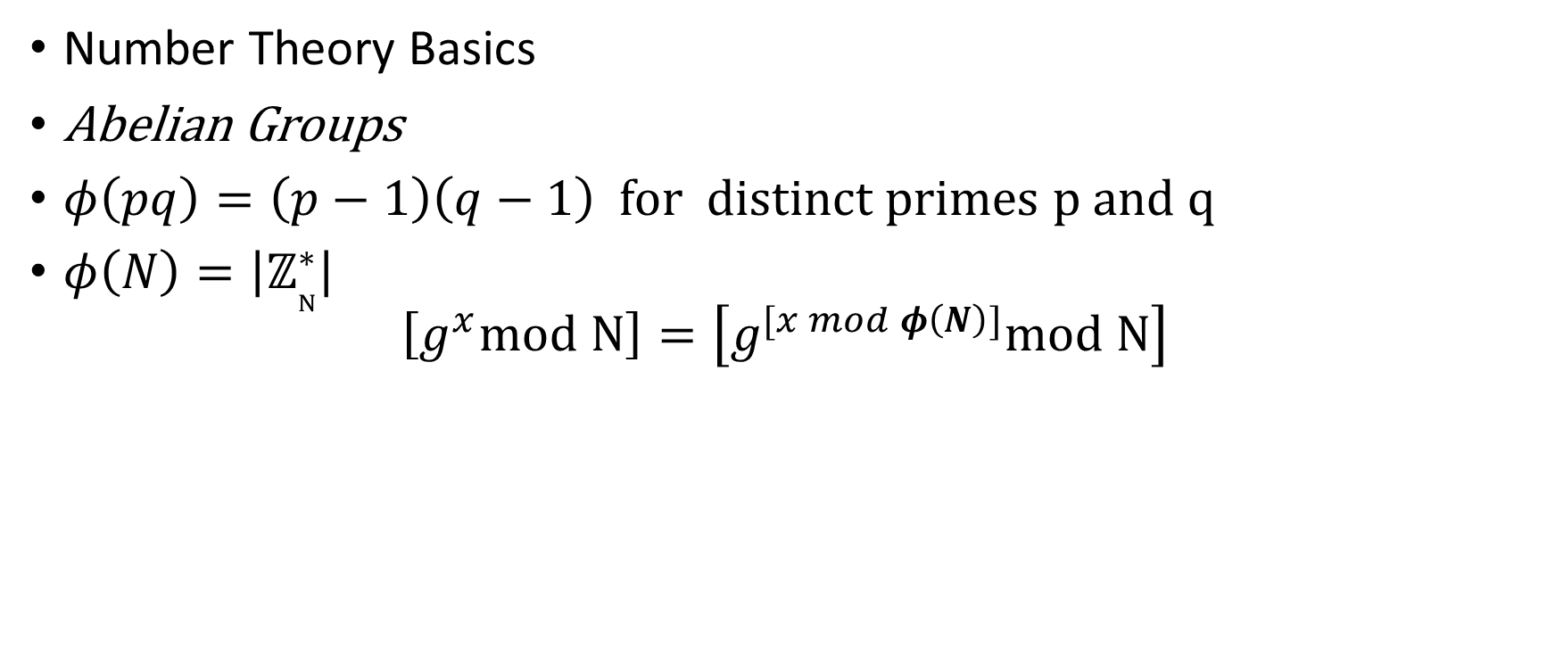
Recap
Number Theory Basics
Abelian Groups
$φ\left(pq\right)=\left(p−1\right)\left(q−1\right)$ for distinct primes p and q
$φ\left(N\right)=\left|ℤ_{N}^{∗}\right|$
$$\left[g^{x}mod N\right]=\left[g^{[x mod φ\left(N\right)]}mod N\right]$$

Slide 3
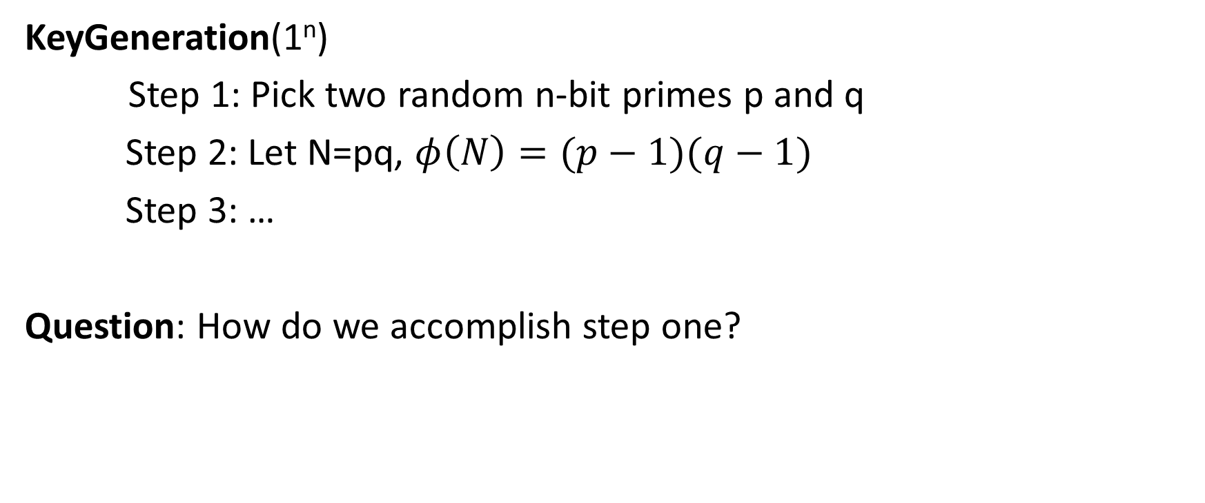
RSA Key-Generation
KeyGeneration(1^{n})
Step 1: Pick two random n-bit primes p and q
Step 2: Let N=pq, $φ\left(N\right)=(p−1)(q−1)$
Step 3: …
Question: How do we accomplish step one?

Slide 4
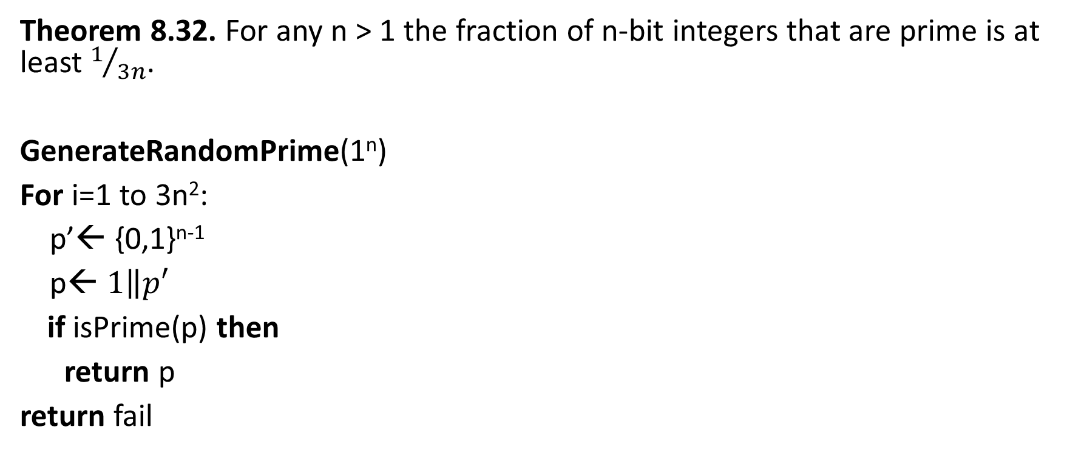
Bertrand’s Postulate
Theorem 8.32. For any n > 1 the fraction of n-bit integers that are prime is at least $1/{3n}$.
GenerateRandomPrime(1^{n})
For i=1 to 3n²:
p’← {0,1}^{n-1}
p← $1\left\|p′\right.$
if isPrime(p) then
return p
return fail
Can we do this in polynomial time?

Slide 5


Bertrand’s Postulate
Theorem 8.32. For any n > 1 the fraction of n-bit integers that are prime is at least $1/{3n}$.
GenerateRandomPrime(1^{n})
For i=1 to 3n²:
p’← {0,1}^{n-1}
p← $1\left\|p′\right.$
if isPrime(p) then
return p
return fail
Assume for now that we can run isPrime(p). What are the odds that the algorithm fails?
On each iteration the probability that p is not a prime is $\left(1−\frac{1}{3n}\right)$
We fail if we pick a non-prime in all 3n² iterations. The probability is
$${\left(1−\frac{1}{3n}\right)}^{3n^{2}}={\left({\left(1−\frac{1}{3n}\right)}^{3n}\right)}^{n}≤e^{−n}$$

Slide 6
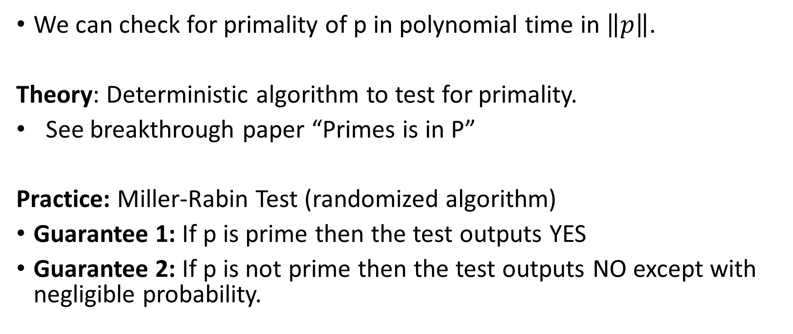
isPrime(p): Miller-Rabin Test
We can check for primality of p in polynomial time in $\left\|p\right\|$.
Theory: Deterministic algorithm to test for primality.
See breakthrough paper “Primes is in P”
Practice: Miller-Rabin Test (randomized algorithm)
Guarantee 1: If p is prime then the test outputs YES
Guarantee 2: If p is not prime then the test outputs NO except with negligible probability.
https://www.cse.iitk.ac.in/users/manindra/algebra/primality_v6.pdf

Slide 7
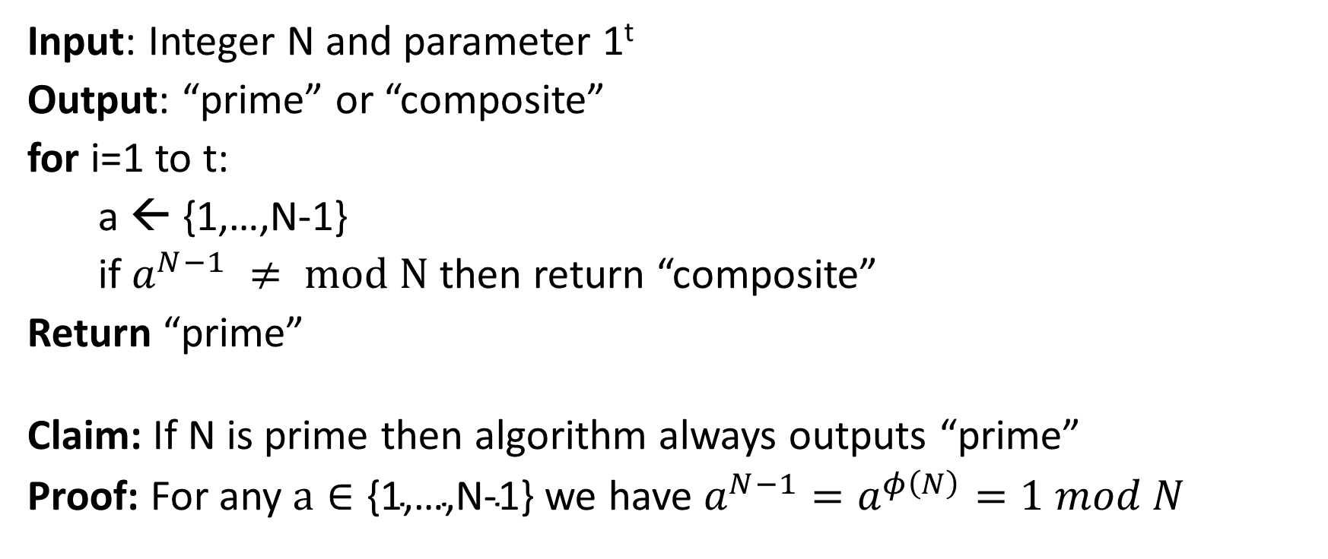
The “Almost” Miller-Rabin Test
Input: Integer N and parameter 1^{t}
Output: “prime” or “composite”
for i=1 to t:
a ← {1,…,N-1}
if $a^{N−1} ≠ mod N$ then return “composite”
Return “prime”
Claim: If N is prime then algorithm always outputs “prime”
Proof: For any $a∈\text{\{1,…,}\text{N}\text{−1\}}$ we have $a^{N−1}=a^{φ\left(N\right)}=1 mod N$

Slide 8
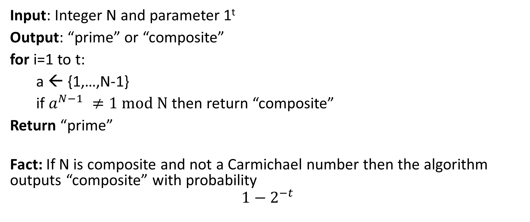
The “Almost” Miller-Rabin Test
Need a bit of extra work to handle Carmichael numbers.
Input: Integer N and parameter 1^{t}
Output: “prime” or “composite”
for i=1 to t:
a ← {1,…,N-1}
if $a^{N−1} ≠1 mod N$ then return “composite”
Return “prime”
Fact: If N is composite and not a Carmichael number then the algorithm outputs “composite” with probability
$$1−2^{−t}$$

Slide 9
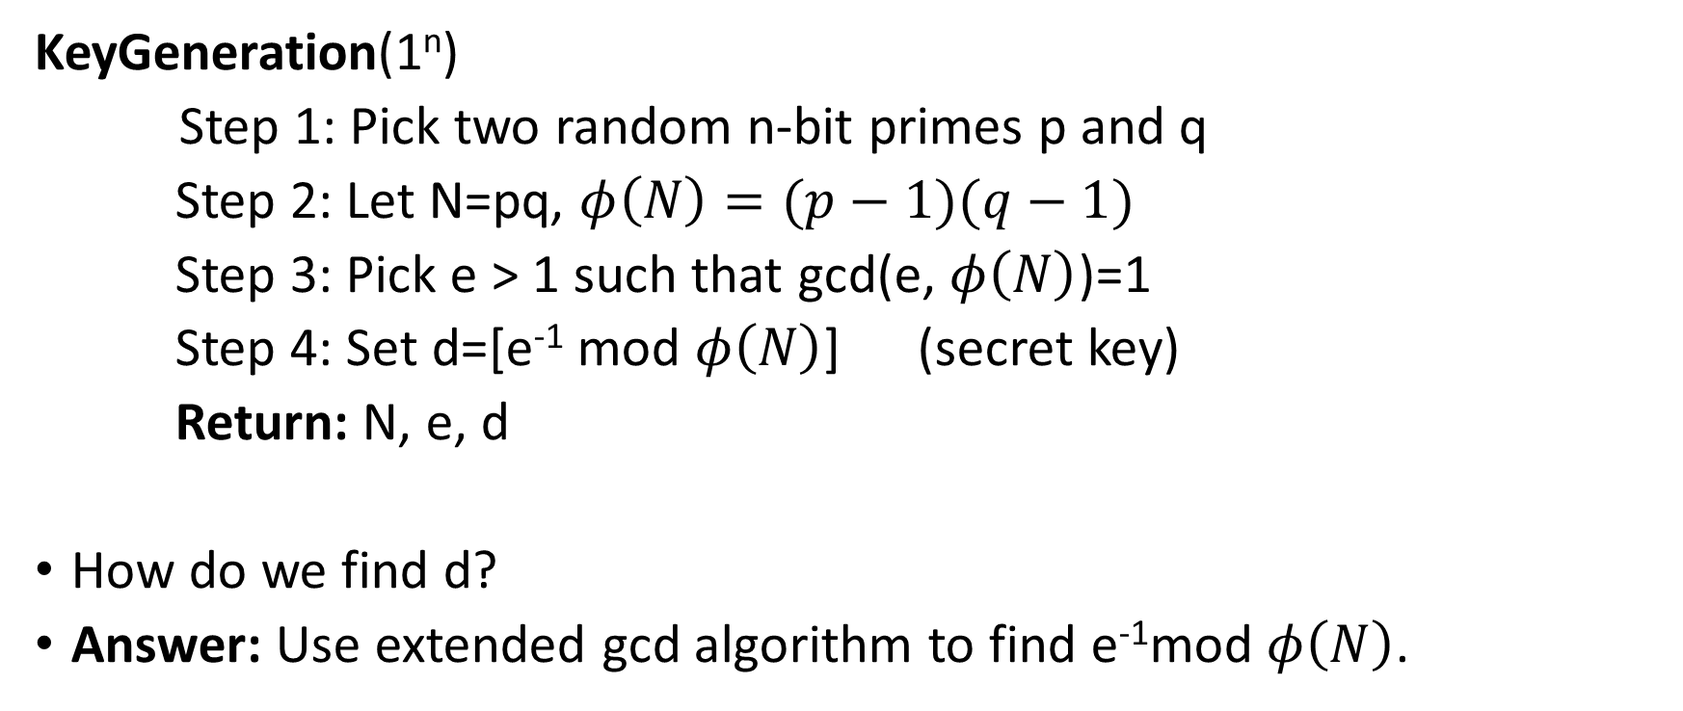
Back to RSA Key-Generation
KeyGeneration(1^{n})
Step 1: Pick two random n-bit primes p and q
Step 2: Let N=pq, $φ\left(N\right)=(p−1)(q−1)$
Step 3: Pick e > 1 such that gcd(e, $φ\left(N\right)$)=1
Step 4: Set d=[e⁻¹ mod $φ\left(N\right)$] (secret key)
Return: N, e, d
How do we find d?
Answer: Use extended gcd algorithm to find e⁻¹mod $φ\left(N\right)$.

Slide 10
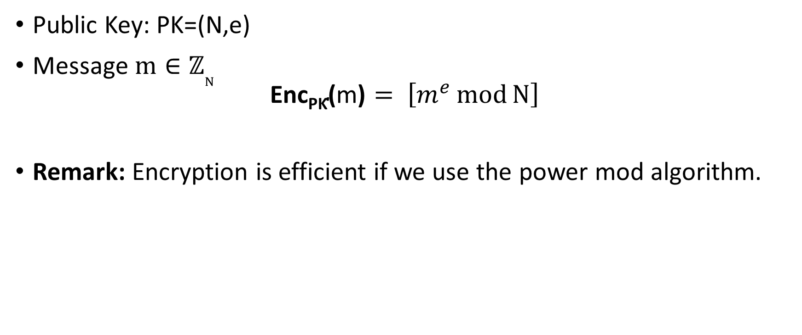
(Plain) RSA Encryption
Public Key: PK=(N,e)
Message $m∈ℤ_{N}^{}$
$$\text{Enc}\text{PK}\text{(}\text{m}\text{)}= \left[m^{e}\operatorname{mod}{N}\right]$$
Remark: Encryption is efficient if we use the power mod algorithm.

Slide 11
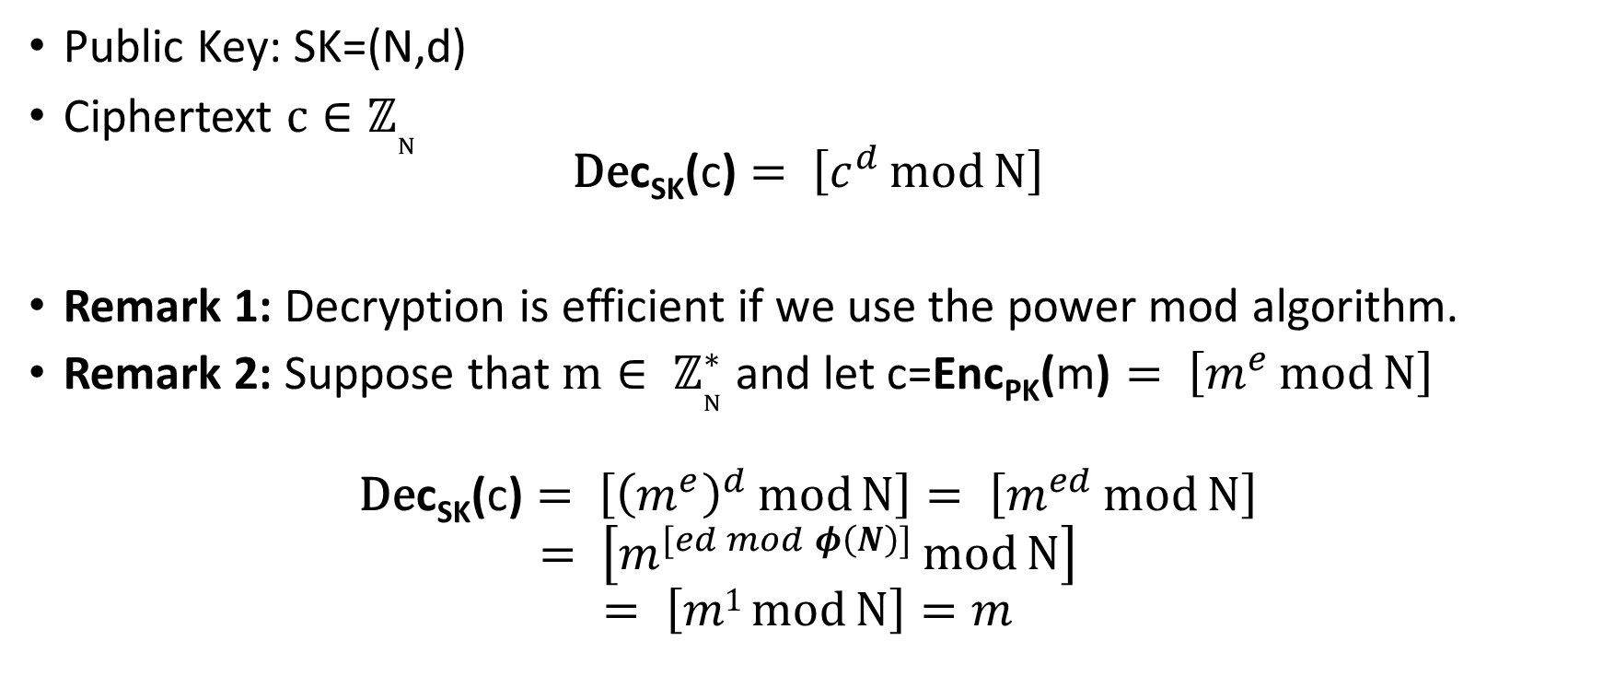
(Plain) RSA Decryption
Public Key: SK=(N,d)
Ciphertext $c∈ℤ_{N}^{}$
$$\text{D}\text{e}\text{c}\text{S}\text{K}\text{(}\text{c}\text{)}= \left[c^{d}\operatorname{mod}{N}\right]$$
Remark 1: Decryption is efficient if we use the power mod algorithm.
Remark 2: Suppose that $m∈ ℤ_{N}^{∗}$ and let c=$\text{Enc}\text{PK}\text{(}\text{m}\text{)}= \left[m^{e}\operatorname{mod}{N}\right]$
$$\text{De}\text{c}\text{SK}\text{(}\text{c}\text{)}= \left[{\left(m^{e}\right)}^{d}\operatorname{mod}{N}\right]= \left[m^{ed}\operatorname{mod}{N}\right]$$
$$= \left[m^{[ed mod φ\left(N\right)]}\operatorname{mod}{N}\right]$$
$$= \left[m1\operatorname{mod}{N}\right]=m$$

Slide 12
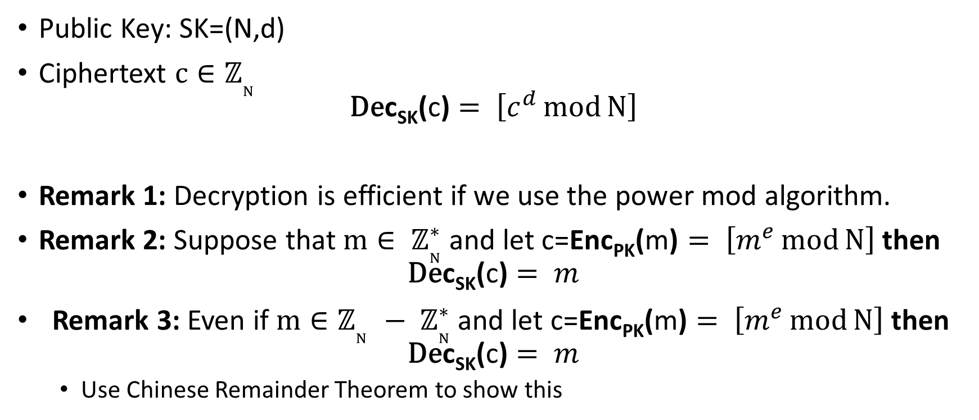
RSA Decryption
Public Key: SK=(N,d)
Ciphertext $c∈ℤ_{N}^{}$
$$\text{D}\text{e}\text{c}\text{S}\text{K}\text{(}\text{c}\text{)}= \left[c^{d}\operatorname{mod}{N}\right]$$
Remark 1: Decryption is efficient if we use the power mod algorithm.
Remark 2: Suppose that $m∈ ℤ_{N}^{∗}$ and let c=$\text{Enc}\text{PK}\text{(}\text{m}\text{)}= \left[m^{e}\operatorname{mod}{N}\right]$ then
$$\text{De}\text{c}\text{SK}\text{(}\text{c}\text{)}= m$$
Remark 3: Even if $m∈ℤ_{N}^{}− ℤ_{N}^{∗}$ and let c=$\text{Enc}\text{PK}\text{(}\text{m}\text{)}= \left[m^{e}\operatorname{mod}{N}\right]$ then
$$\text{De}\text{c}\text{SK}\text{(}\text{c}\text{)}= m$$
  Use Chinese Remainder Theorem to show this

Slide 13
Factoring Assumption
Let GenModulus(1^{n}) be a randomized algorithm that outputs (N=pq,p,q) where p and q are n-bit primes (except with negligible probability negl(n)).
Experiment FACTOR_{A,n}
(N=pq,p,q) ← GenModulus(1^{n})
Attacker A is given N as input
Attacker A outputs p’ > 1 and q’ > 1
Attacker A wins if N=p’q’.

Slide 14
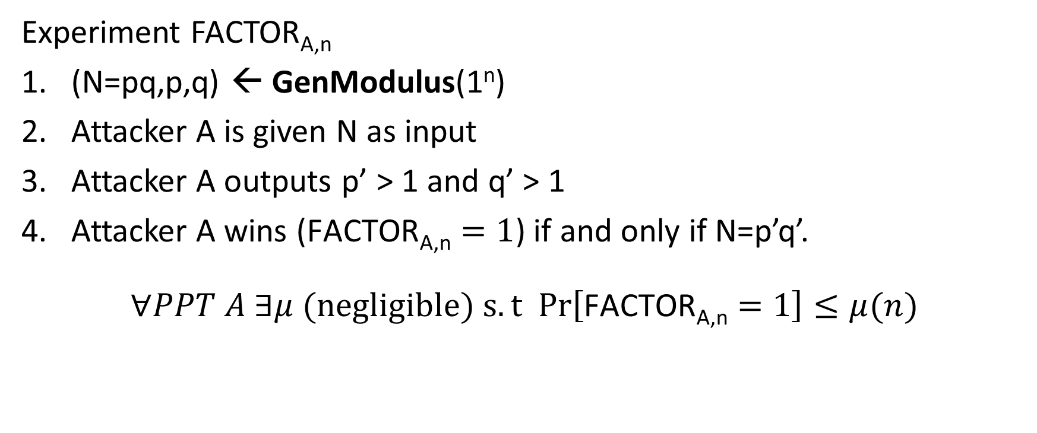
Factoring Assumption
Necessary for security of RSA.
Not known to be sufficient.
Experiment FACTOR_{A,n}
(N=pq,p,q) ← GenModulus(1^{n})
Attacker A is given N as input
Attacker A outputs p’ > 1 and q’ > 1
Attacker A wins ($\text{FACTOR}\text{A}\text{,}\text{n}=1$) if and only if N=p’q’.
$$∀PPT A ∃μ (negligible) s.t Pr\left[\text{FACTOR}\text{A}\text{,}\text{n}=1\right]≤μ(n)$$

Slide 15
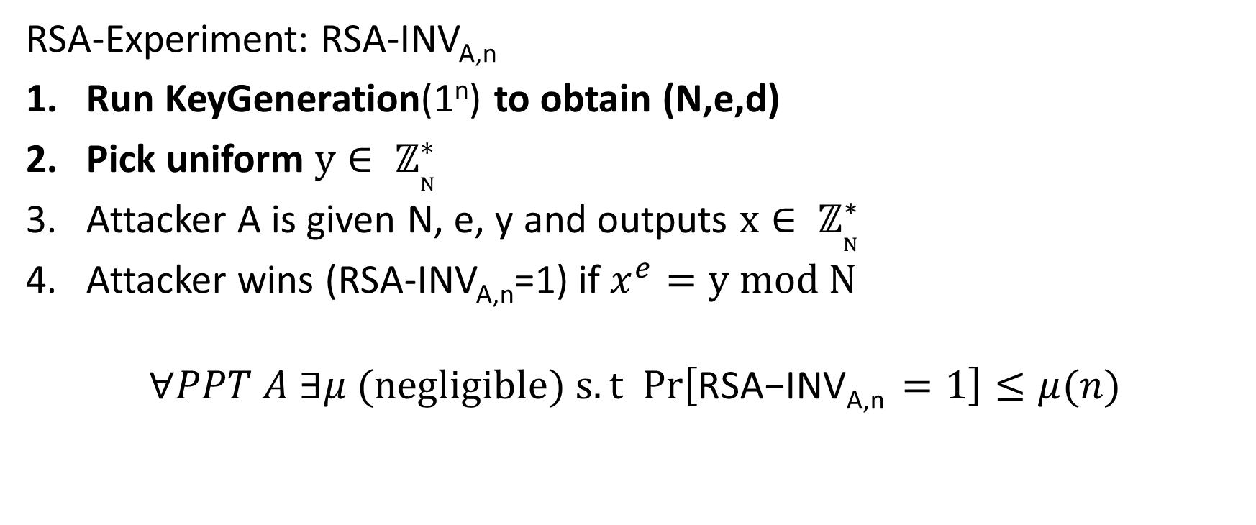
RSA-Assumption
RSA-Experiment: RSA-INV_{A,n}
Run KeyGeneration(1^{n}) to obtain (N,e,d)
Pick uniform $y∈ ℤ_{N}^{∗}$
Attacker A is given N, e, y and outputs $x∈ ℤ_{N}^{∗}$
Attacker wins (RSA-INV_{A,n}=1) if $x^{e}=y mod N$
$$∀PPT A ∃μ (negligible) s.t Pr\left[\text{RSA}\text{−}\text{INVA}\text{,}\text{n} =1\right]≤μ(n)$$

Slide 16
(Plain) RSA Discussion
We have not introduced security models like CPA-Security or CCA-security for Public Key Cryptosystems
However, notice that (Plain) RSA Encryption is stateless and deterministic.
→Plain RSA is not secure against chosen-plaintext attacks
Plain RSA is also highly vulnerable to chosen-ciphertext attacks
  Attacker intercepts ciphertext c of secret message m
  Attacker generates ciphertext c’ for secret message 2m
  Attacker asks for decryption of c’ to obtain 2m
  Divide by 2 to recover original message m

Slide 17
(Plain) RSA Discussion
However, notice that (Plain) RSA Encryption is stateless and deterministic.
→Plain RSA is not secure against chosen-plaintext attacks
In a public key setting the attacker does have access to an encryption oracle
Encrypted messages with low entropy are vulnerable to a brute-force attack

Slide 18
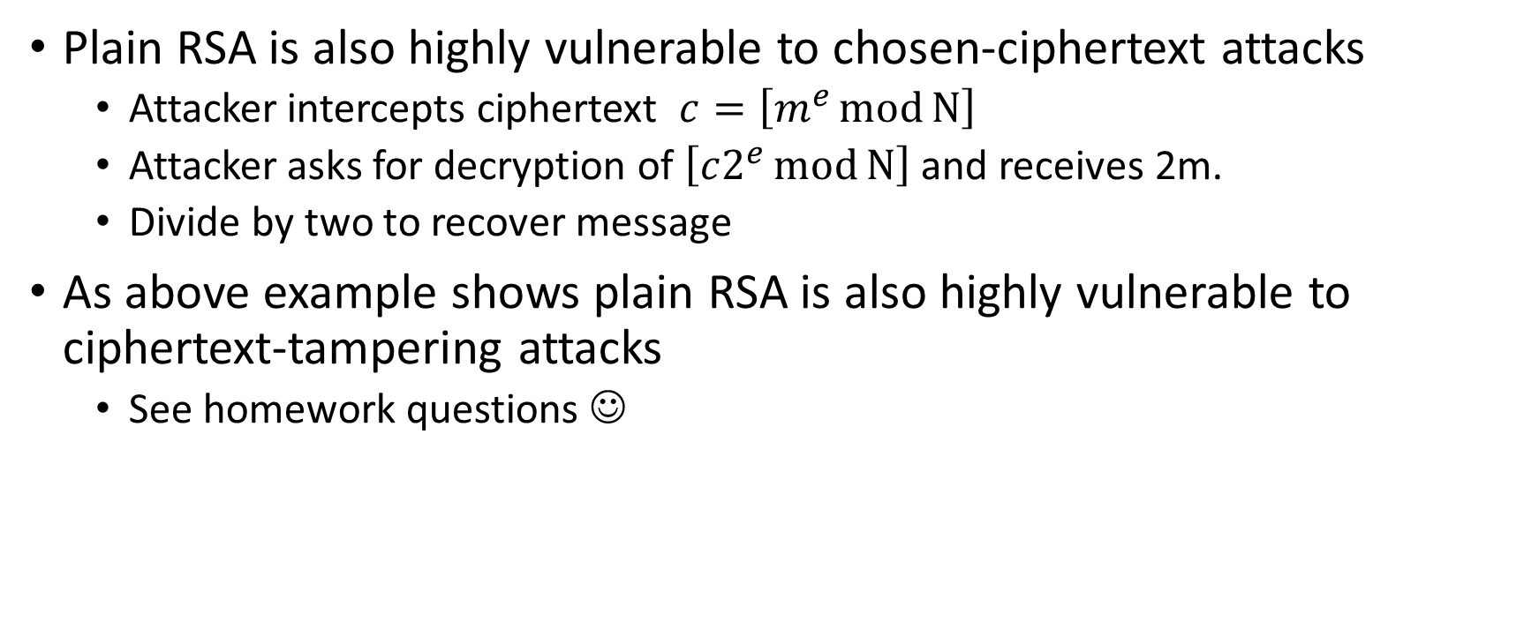
(Plain) RSA Discussion
Plain RSA is also highly vulnerable to chosen-ciphertext attacks
  Attacker intercepts ciphertext $c=\left[m^{e}\operatorname{mod}{N}\right]$
  Attacker asks for decryption of $\left[c2^{e}\operatorname{mod}{N}\right]$ and receives 2m.
  Divide by two to recover message
As above example shows plain RSA is also highly vulnerable to ciphertext-tampering attacks
  See homework questions ☺

Slide 19
Mathematica Demo
https://www.cs.purdue.edu/homes/jblocki/courses/555_Spring17/slides/Lecture24Demo.nb
Note: Online version of mathematica available at https://sandbox.open.wolframcloud.com (reduced functionality, but can be used to solve homework bonus problems)

Slide 20
Next Class
Read Katz and Lindell 8.3, 11.5.1
Discrete Log, DDH + Attacks on Plain RSA

