Slide 1
Course Business
Midterm is on March 1 (Wednesday next week)
  Allowed to bring one index card (double sided)
Final Exam is Monday, May 1 (7 PM)
  Location: Right here

Slide 2
Cryptography
CS 555
Topic 20: Assumptions for Private-Key Cryptography + Computational Indistinguishability

Slide 3
Recap
Last Class:
  One Way Functions, PRGs, PRFs
Today:
  Assumptions for Private Key Cryptography
  Computational Indistinguishability

Slide 4
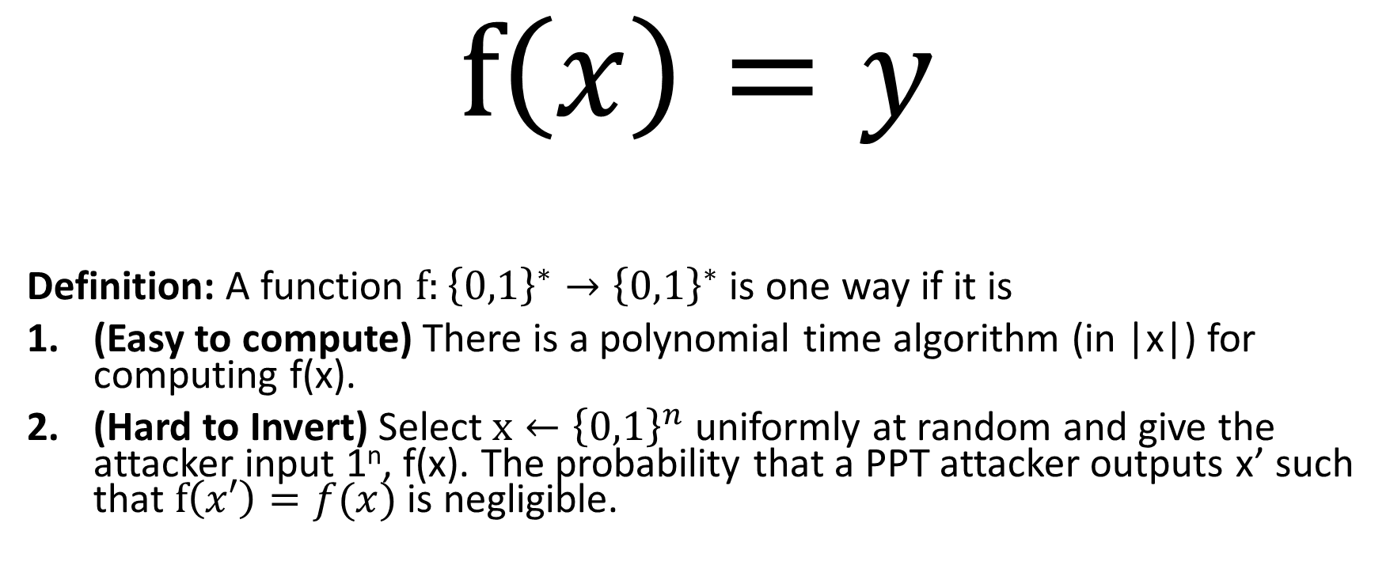
One-Way Functions (OWFs)
$$f\left(x\right)=y$$
Definition: A function $f:{\left\{0,1\right\}}^{∗}→{\left\{0,1\right\}}^{∗}$ is one way if it is
(Easy to compute) There is a polynomial time algorithm (in |x|) for computing f(x).
(Hard to Invert) Select $x←{\left\{0,1\right\}}^{n}$ uniformly at random and give the attacker input 1^{n}, f(x). The probability that a PPT attacker outputs x’ such that $f\left(x′\right)=f(x)$ is negligible.

Slide 5
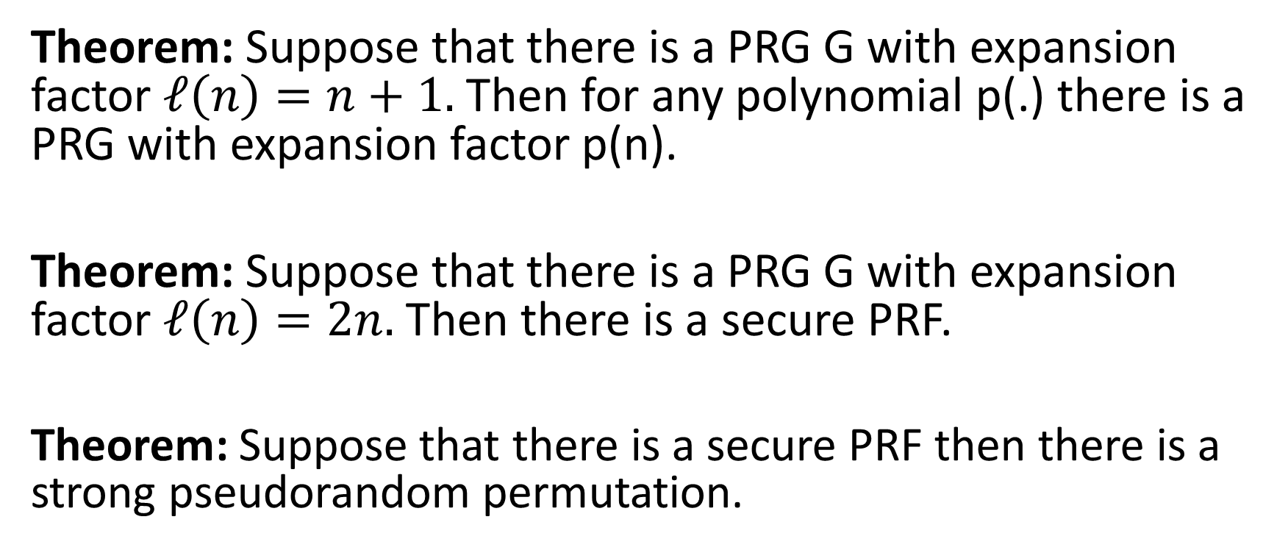
From OWFs (Recap)
Theorem: Suppose that there is a PRG G with expansion factor $ℓ\left(n\right)=n+1.$ Then for any polynomial p(.) there is a PRG with expansion factor p(n).
Theorem: Suppose that there is a PRG G with expansion factor $ℓ\left(n\right)=2n.$ Then there is a secure PRF.
Theorem: Suppose that there is a secure PRF then there is a strong pseudorandom permutation.

Slide 6
From OWFs (Recap)
Corollary: If one-way functions exist then PRGs, PRFs and strong PRPs all exist.
Corollary: If one-way functions exist then there exist CCA-secure encryption schemes and secure MACs.

Slide 7
Are OWFs Necessary for Private Key Crypto
Previous results show that OWFs are sufficient.
Can we build Private Key Crypto from weaker assumptions?
Short Answer: No, OWFs are also necessary for most private-key crypto primitives

Slide 8
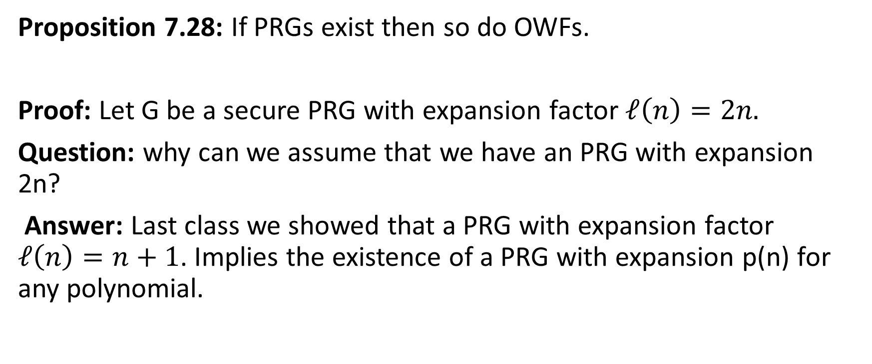
PRGs → OWFs
Proposition 7.28: If PRGs exist then so do OWFs.
Proof: Let G be a secure PRG with expansion factor $ℓ\left(n\right)=2n.$
Question: why can we assume that we have an PRG with expansion 2n?
Answer: Last class we showed that a PRG with expansion factor $ℓ\left(n\right)=n+1$. Implies the existence of a PRG with expansion p(n) for any polynomial.

Slide 9
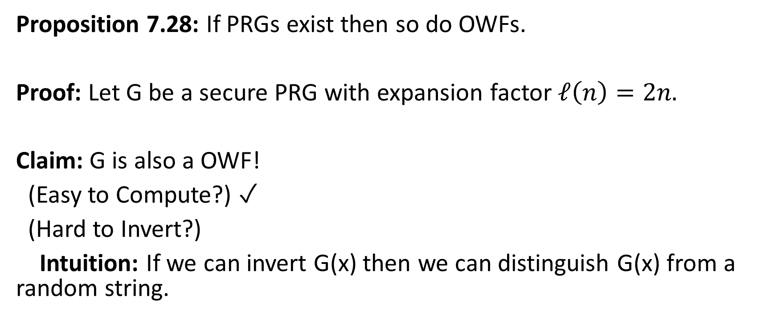
PRGs → OWFs
Proposition 7.28: If PRGs exist then so do OWFs.
Proof: Let G be a secure PRG with expansion factor $ℓ\left(n\right)=2n.$
Claim: G is also a OWF!
(Easy to Compute?) ✓
(Hard to Invert?)
Intuition: If we can invert G(x) then we can distinguish G(x) from a random string.

Slide 10
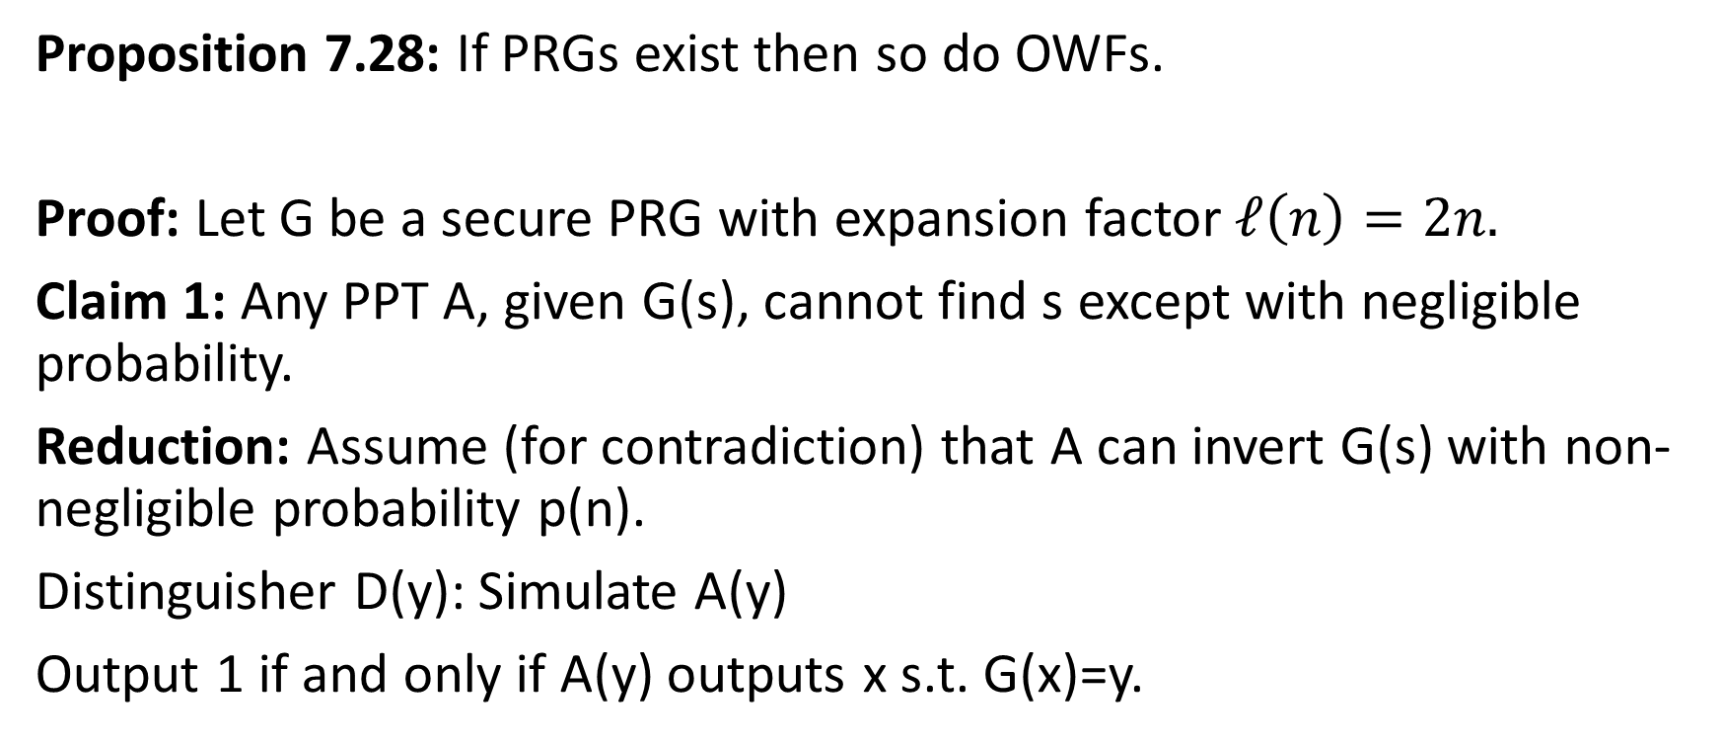
PRGs → OWFs
Proposition 7.28: If PRGs exist then so do OWFs.
Proof: Let G be a secure PRG with expansion factor $ℓ\left(n\right)=2n.$
Claim 1: Any PPT A, given G(s), cannot find s except with negligible probability.
Reduction: Assume (for contradiction) that A can invert G(s) with non-negligible probability p(n).
Distinguisher D(y): Simulate A(y)
Output 1 if and only if A(y) outputs x s.t. G(x)=y.

Slide 11
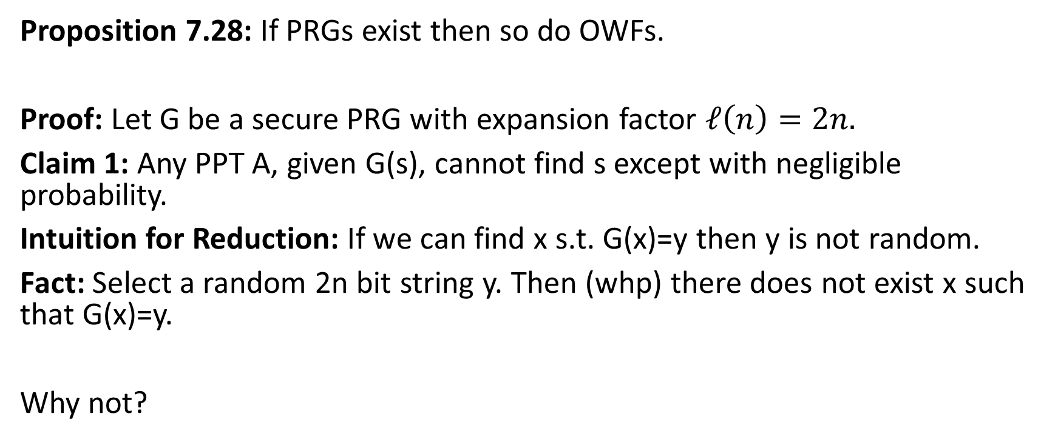
PRGs → OWFs
Proposition 7.28: If PRGs exist then so do OWFs.
Proof: Let G be a secure PRG with expansion factor $ℓ\left(n\right)=2n.$
Claim 1: Any PPT A, given G(s), cannot find s except with negligible probability.
Intuition for Reduction: If we can find x s.t. G(x)=y then y is not random.
Fact: Select a random 2n bit string y. Then (whp) there does not exist x such that G(x)=y.
Why not?

Slide 12
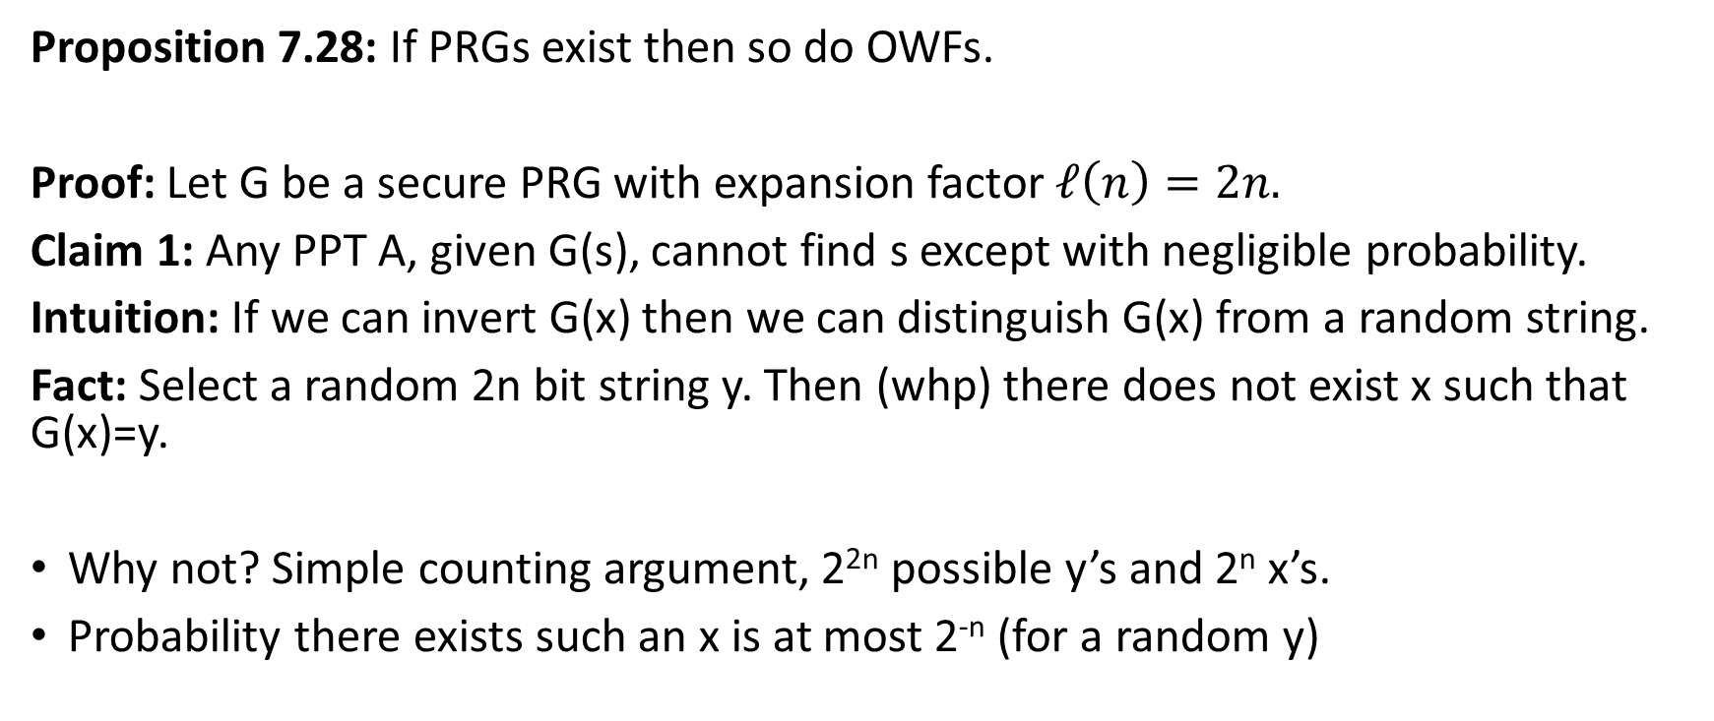
PRGs → OWFs
Proposition 7.28: If PRGs exist then so do OWFs.
Proof: Let G be a secure PRG with expansion factor $ℓ\left(n\right)=2n.$
Claim 1: Any PPT A, given G(s), cannot find s except with negligible probability.
Intuition: If we can invert G(x) then we can distinguish G(x) from a random string.
Fact: Select a random 2n bit string y. Then (whp) there does not exist x such that G(x)=y.
Why not? Simple counting argument, 2^{2n} possible y’s and 2^{n} x’s.
Probability there exists such an x is at most 2^{-n} (for a random y)

Slide 13
What other assumptions imply OWFs?
PRGs → OWFs
(Easy Extension) PRFs → PRGs → OWFs
Does secure crypto scheme imply OWFs?
  CCA-secure? (Strongest)
  CPA-Secure? (Weaker)
  EAV-secure? (Weakest)
    As long as the plaintext is longer than the secret key
  Perfect Secrecy? X (Guarantee is information theoretic)

Slide 14
EAV-Secure Crypto → OWFs
Proposition 7.29: If there exists a EAV-secure private-key encryption scheme that encrypts messages twice as long as its key, then a one-way function exists.
Recap: EAV-secure.
Attacker picks two plaintexts m₀,m₁ and is given c=Enc_{K}(m_{b}) for random bit b.
Attacker attempts to guess b.
No ability to request additional encryptions (chosen-plaintext attacks)
In fact, no ability to observe any additional encryptions

Slide 15
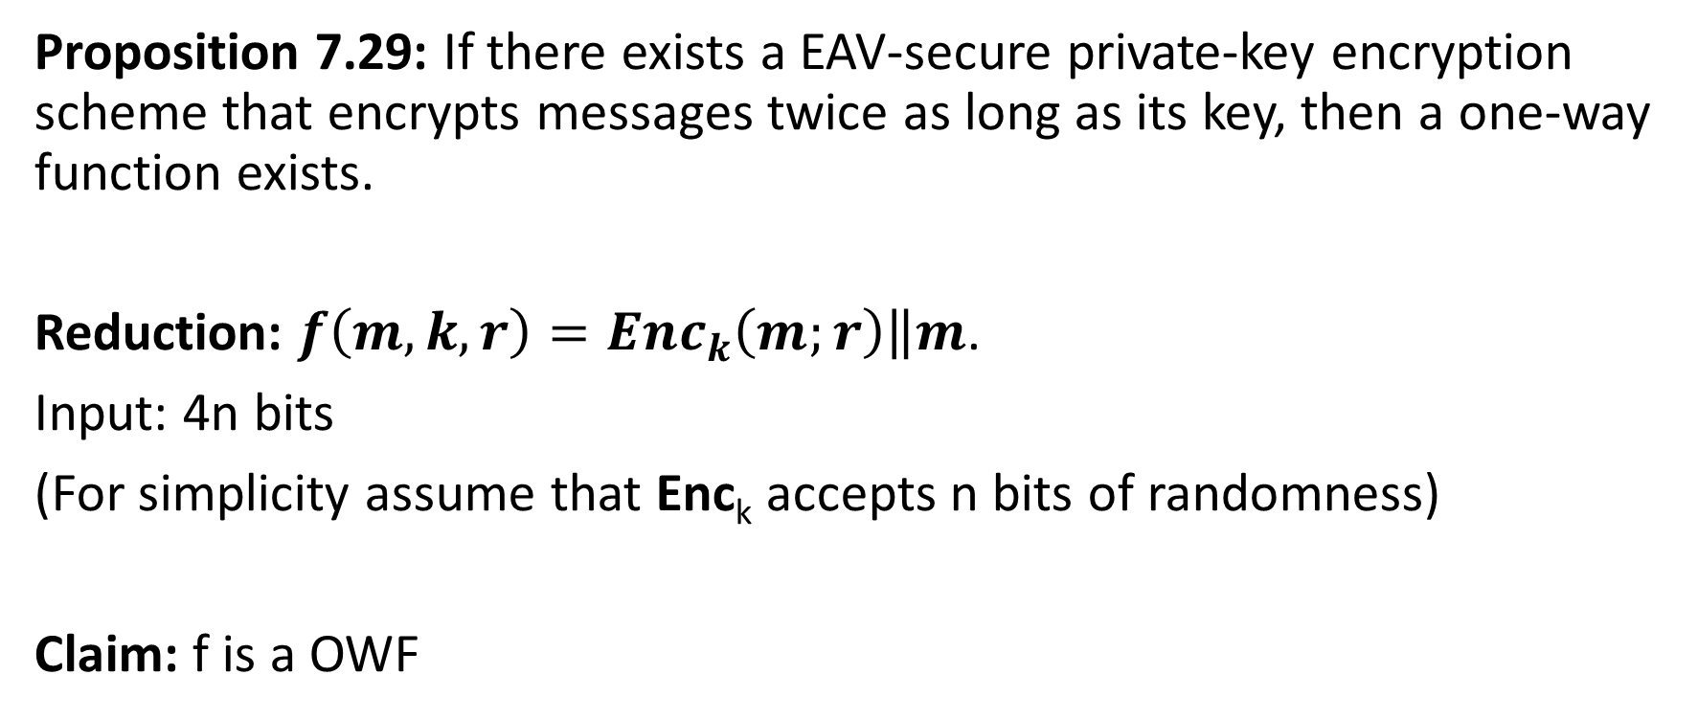
EAV-Secure Crypto → OWFs
Proposition 7.29: If there exists a EAV-secure private-key encryption scheme that encrypts messages twice as long as its key, then a one-way function exists.
Reduction: $f\left(m,k,r\right)={Enc}_{k}\left(m;r\right)\left\|m\right.$.
Input: 4n bits
(For simplicity assume that Enc_{k} accepts n bits of randomness)
Claim: f is a OWF

Slide 16
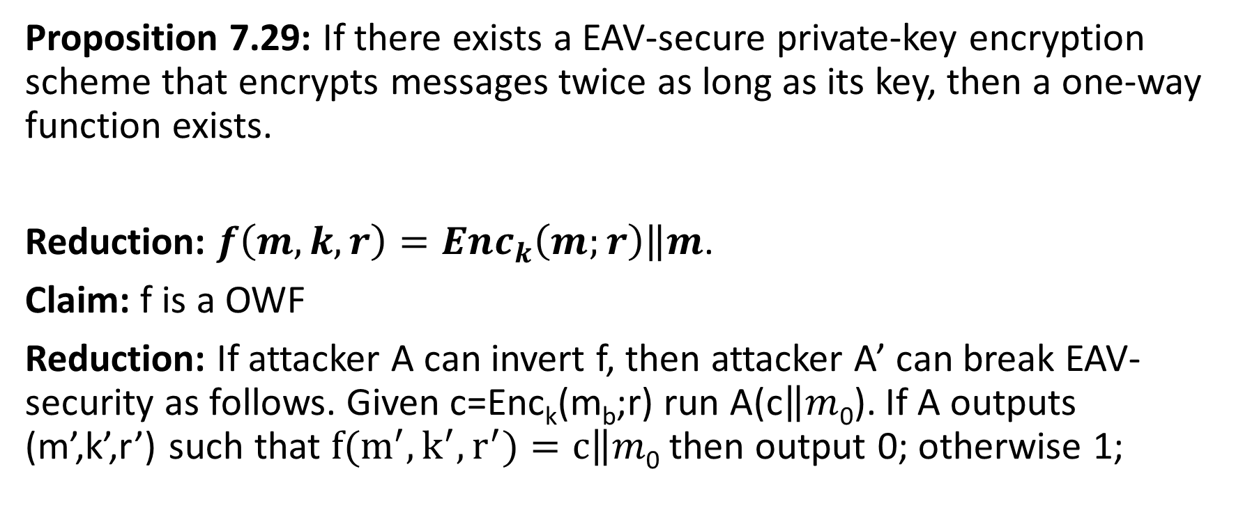
EAV-Secure Crypto → OWFs
Proposition 7.29: If there exists a EAV-secure private-key encryption scheme that encrypts messages twice as long as its key, then a one-way function exists.
Reduction: $f\left(m,k,r\right)={Enc}_{k}\left(m;r\right)\left\|m\right.$.
Claim: f is a OWF
Reduction: If attacker A can invert f, then attacker A’ can break EAV-security as follows. Given c=Enc_{k}(m_{b};r) run A(c$\left\|m\right.$₀). If A outputs (m’,k’,r’) such that $f(m^{′},k^{′},r^{′})=c\left\|m\right.$₀ then output 0; otherwise 1;

Slide 17
MACs→ OWFs
In particular, given a MAC that satisfies MAC security (Definition 4.2) against an attacker who sees an arbitrary (polynomial) number of message/tag pairs.
Conclusions: OWFs are necessary and sufficient for all (non-trivial) private key cryptography.
→OWFs are a minimal assumption for private-key crypto.
Public Key Crypto/Hashing?
OWFs are known to be necessary
Not known (or believed) to be sufficient.

Slide 18
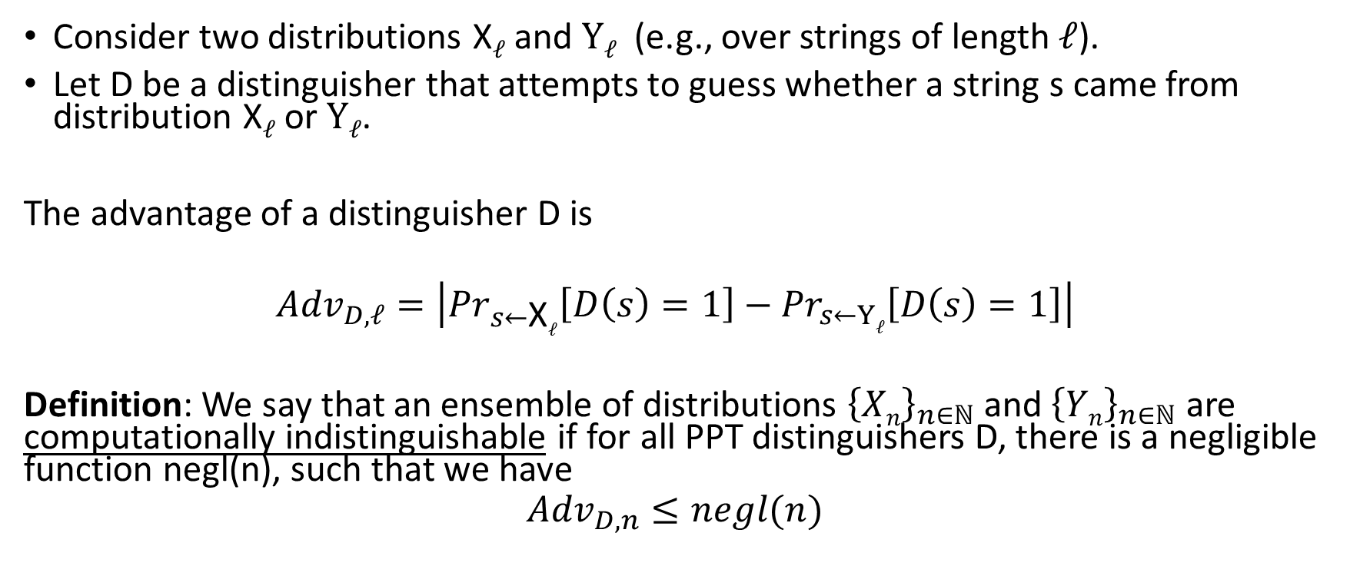
Computational Indistinguishability
Consider two distributions X$ℓ$ and $Yℓ$ (e.g., over strings of length $ℓ$).
Let D be a distinguisher that attempts to guess whether a string s came from distribution X$ℓ$ or $Yℓ$.
The advantage of a distinguisher D is
$${Adv}_{D,ℓ}=\left|{Pr}_{s←\text{X}ℓ}\left[D\left(s\right)=1\right]−{Pr}_{s←Yℓ}\left[D\left(s\right)=1\right]\right|$$
Definition: We say that an ensemble of distributions ${\left\{Xn\right\}}_{n∈ℕ}$ and ${\left\{Yn\right\}}_{n∈ℕ}$ are computationally indistinguishable if for all PPT distinguishers D, there is a negligible function negl(n), such that we have
$${Adv}_{D,n}≤negl(n)$$

Slide 19
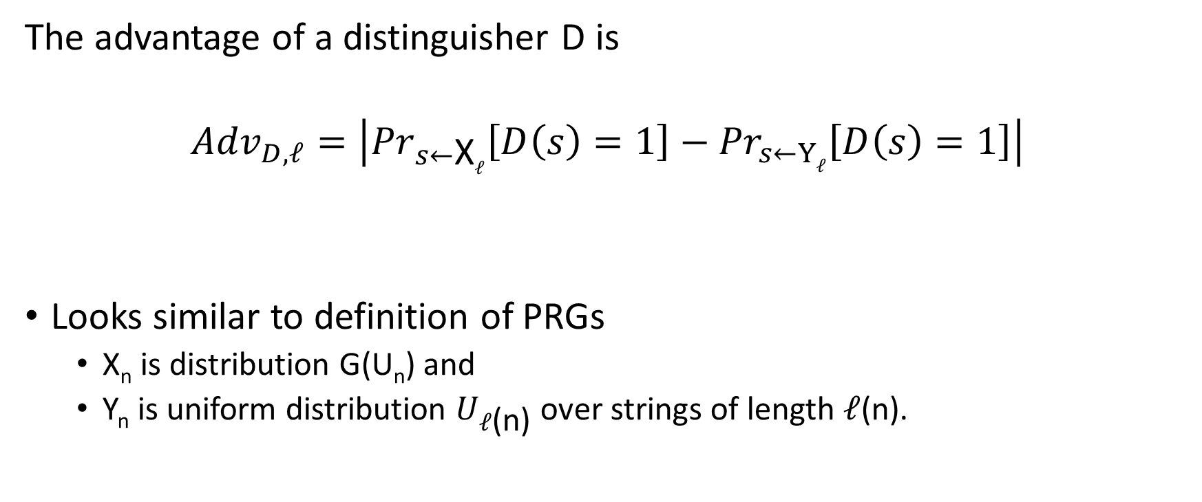
Computational Indistinguishability
The advantage of a distinguisher D is
$${Adv}_{D,ℓ}=\left|{Pr}_{s←\text{X}ℓ}\left[D\left(s\right)=1\right]−{Pr}_{s←Yℓ}\left[D\left(s\right)=1\right]\right|$$
Looks similar to definition of PRGs
  X_{n} is distribution G(U_{n}) and
  Y_{n} is uniform distribution $U_{ℓ\text{(}\text{n}\text{)}}$ over strings of length $ℓ$(n).

Slide 20
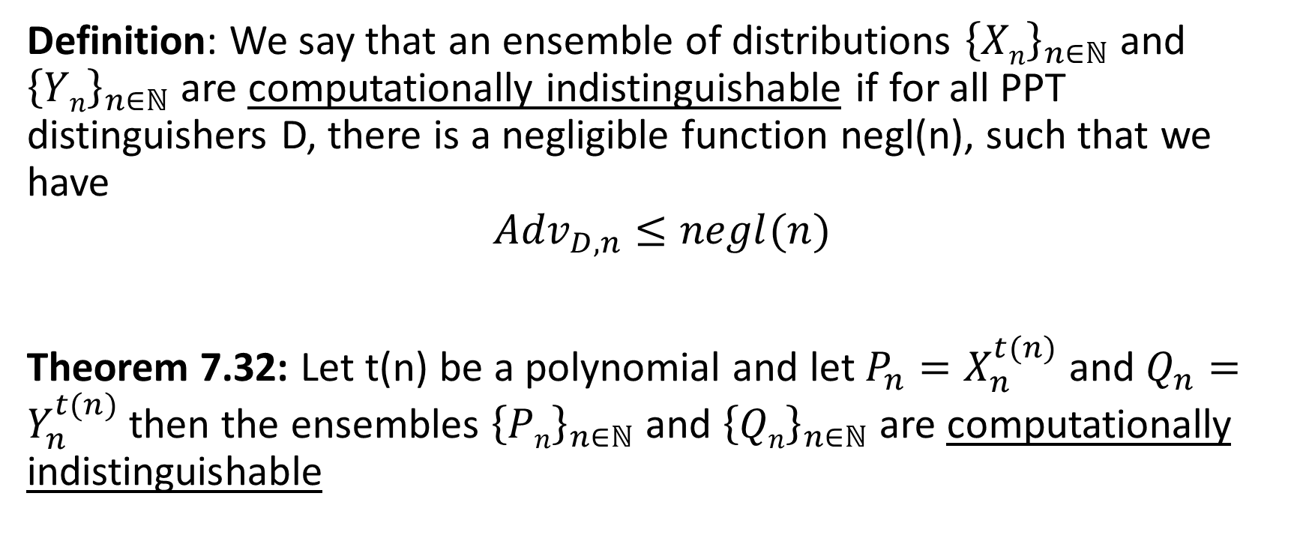
Computational Indistinguishability
Definition: We say that an ensemble of distributions ${\left\{Xn\right\}}_{n∈ℕ}$ and ${\left\{Yn\right\}}_{n∈ℕ}$ are computationally indistinguishable if for all PPT distinguishers D, there is a negligible function negl(n), such that we have
$${Adv}_{D,n}≤negl(n)$$
Theorem 7.32: Let t(n) be a polynomial and let $P_{n}=X_{n}^{t(n)}$ and $Q_{n}=Y_{n}^{t(n)}$then the ensembles ${\left\{Pn\right\}}_{n∈ℕ}$ and ${\left\{Qn\right\}}_{n∈ℕ}$ are computationally indistinguishable

Slide 21
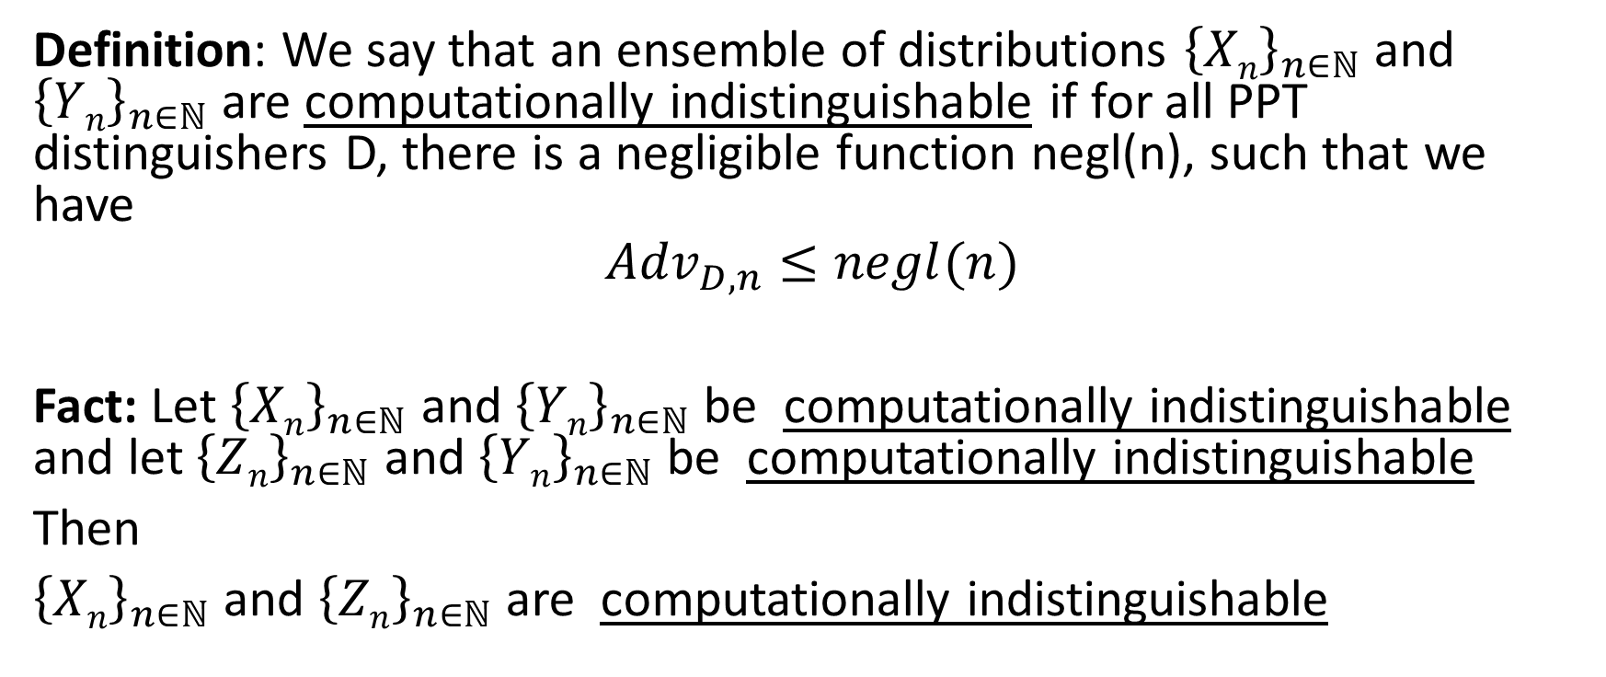
Computational Indistinguishability
Definition: We say that an ensemble of distributions ${\left\{Xn\right\}}_{n∈ℕ}$ and ${\left\{Yn\right\}}_{n∈ℕ}$ are computationally indistinguishable if for all PPT distinguishers D, there is a negligible function negl(n), such that we have
$${Adv}_{D,n}≤negl(n)$$
Fact: Let ${\left\{Xn\right\}}_{n∈ℕ}$ and ${\left\{Yn\right\}}_{n∈ℕ}$ be computationally indistinguishable and let ${\left\{Zn\right\}}_{n∈ℕ}$ and ${\left\{Yn\right\}}_{n∈ℕ}$ be computationally indistinguishable
Then
${\left\{Xn\right\}}_{n∈ℕ}$ and ${\left\{Zn\right\}}_{n∈ℕ}$ are computationally indistinguishable

Slide 22
Next Class
Review for Midterm
Review Homework Solutions
Review Key Definitions and Results
  Perfect Secrets/EAV-Security/CPA-Security/CCA-Security + Constructions
  Primitives: PRGs, PRFs, MACs, Collision Resistant Hash Functions
Multiple Choice Questions
Allowed to bring index card

