Slide 1
Cryptography
CS 555
Topic 2: Historical Ciphers (& How to Break Them)

Slide 2
Symmetric Key Encryption
What cryptography has historically been all about (Pre 1970)
Two parties (sender and receiver) share secret key
Sender uses key to encrypt (“scramble”) the message before transmission
Receiver uses the key to decrypt (“unscramble”) and recover the original message

Slide 3
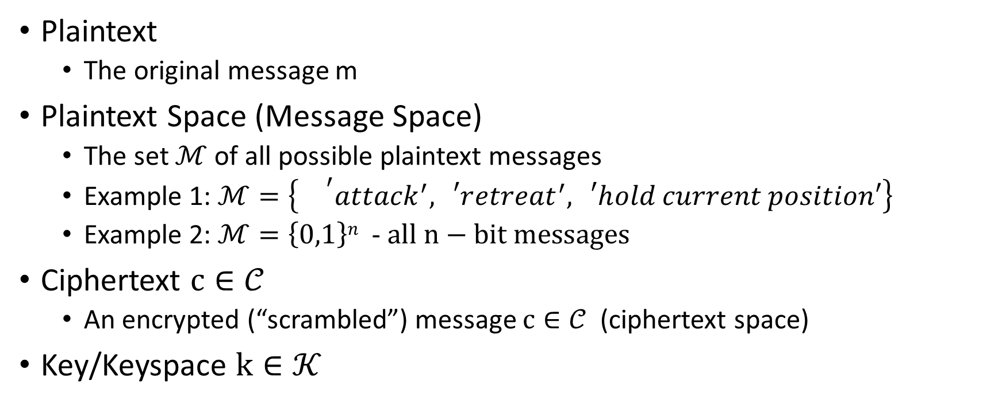
Encryption: Basic Terminology
Plaintext
  The original message m
Plaintext Space (Message Space)
  The set $ℳ$ of all possible plaintext messages
  Example 1: $ℳ=\left\{{}^{′}attack^{′},{}_{}^{′}retreat^{′},{}_{}^{′}hold current position′\right\}$
  Example 2: $ℳ=\left\{0,1\right\}n$ - $all n−bit messages$
Ciphertext $c∈𝒞$
  An encrypted (“scrambled”) message $c∈𝒞$ (ciphertext space)
Key/Keyspace $k∈𝒦$

Slide 4
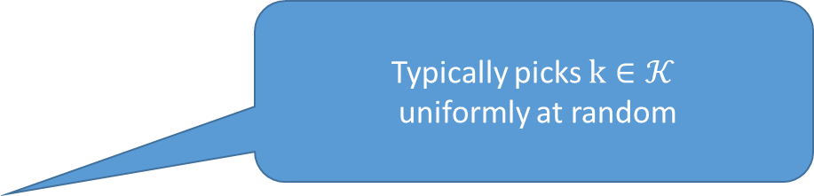
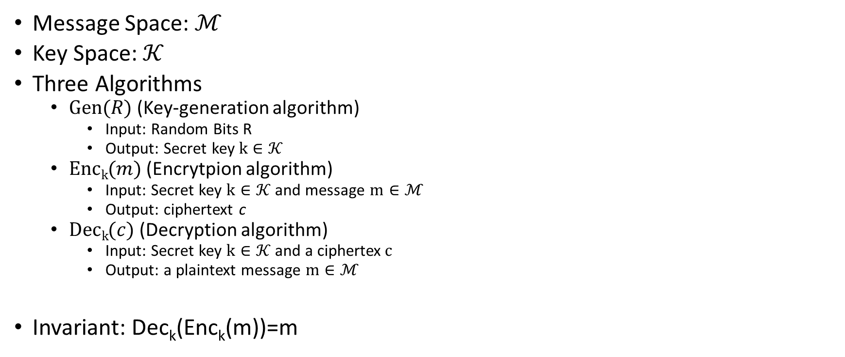
Private Key Encryption Syntax
    Typically picks $k∈𝒦$
uniformly at random
Message Space: $ℳ$
Key Space: $𝒦$
Three Algorithms
  $\operatorname{Gen}{(R)}$ (Key-generation algorithm)
    Input: Random Bits R
    Output: Secret key $k∈𝒦$
  $\operatorname{Enck}{(m)}$ (Encrytpion algorithm)
    Input: Secret key $k∈𝒦$ and message $m∈ℳ$
    Output: ciphertext c
  $\operatorname{Deck}{(c)}$ (Decryption algorithm)
    Input: Secret key $k∈𝒦$ and a ciphertex$c$
    Output: a plaintext message $m∈ℳ$
Invariant: Dec_{k}(Enc_{k}(m))=m
    Trusted Parties (e.g., Alice and Bob) must run Gen in advance to obtain secret k.
    Assumption: Adversary does not get to see output of Gen

Slide 5
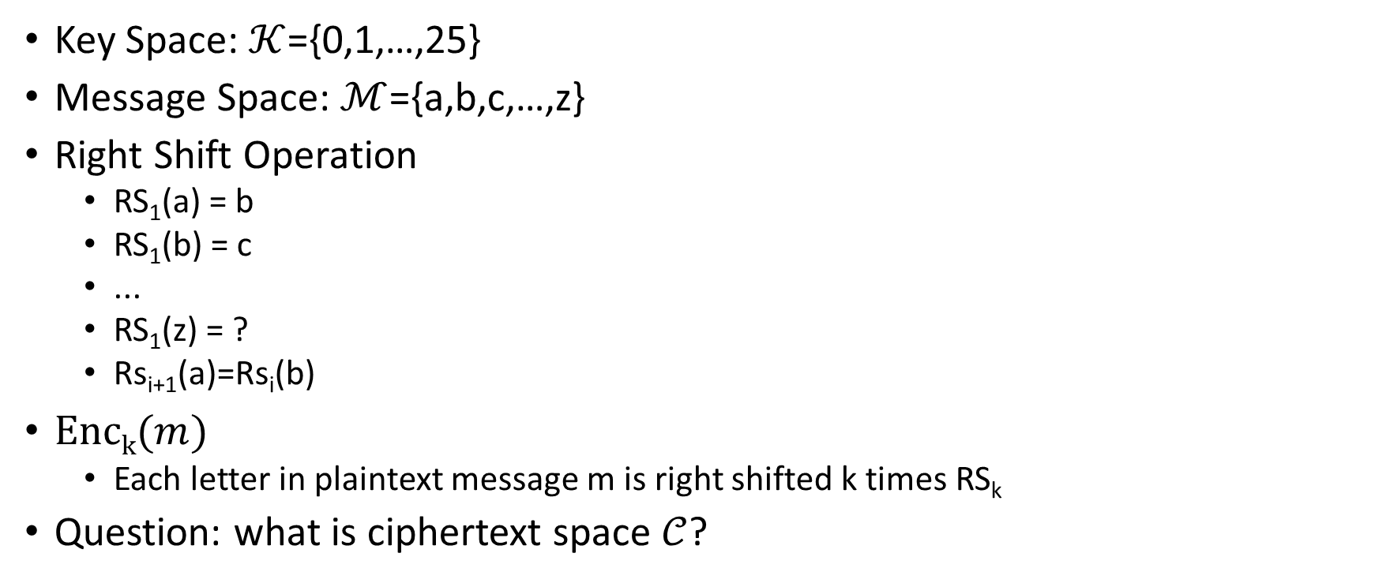
Shift Cipher
Key Space: $𝒦$={0,1,…,25}
Message Space: $ℳ$={a,b,c,…,z}
Right Shift Operation
  RS₁(a) = b
  RS₁(b) = c
  ...
  RS₁(z) = ?
  Rs_{i+1}(a)=Rs_{i}(b)
$\operatorname{Enck}{(m)}$
  Each letter in plaintext message m is right shifted k times RS_{k}
Question: what is ciphertext space $𝒞$?

Slide 6
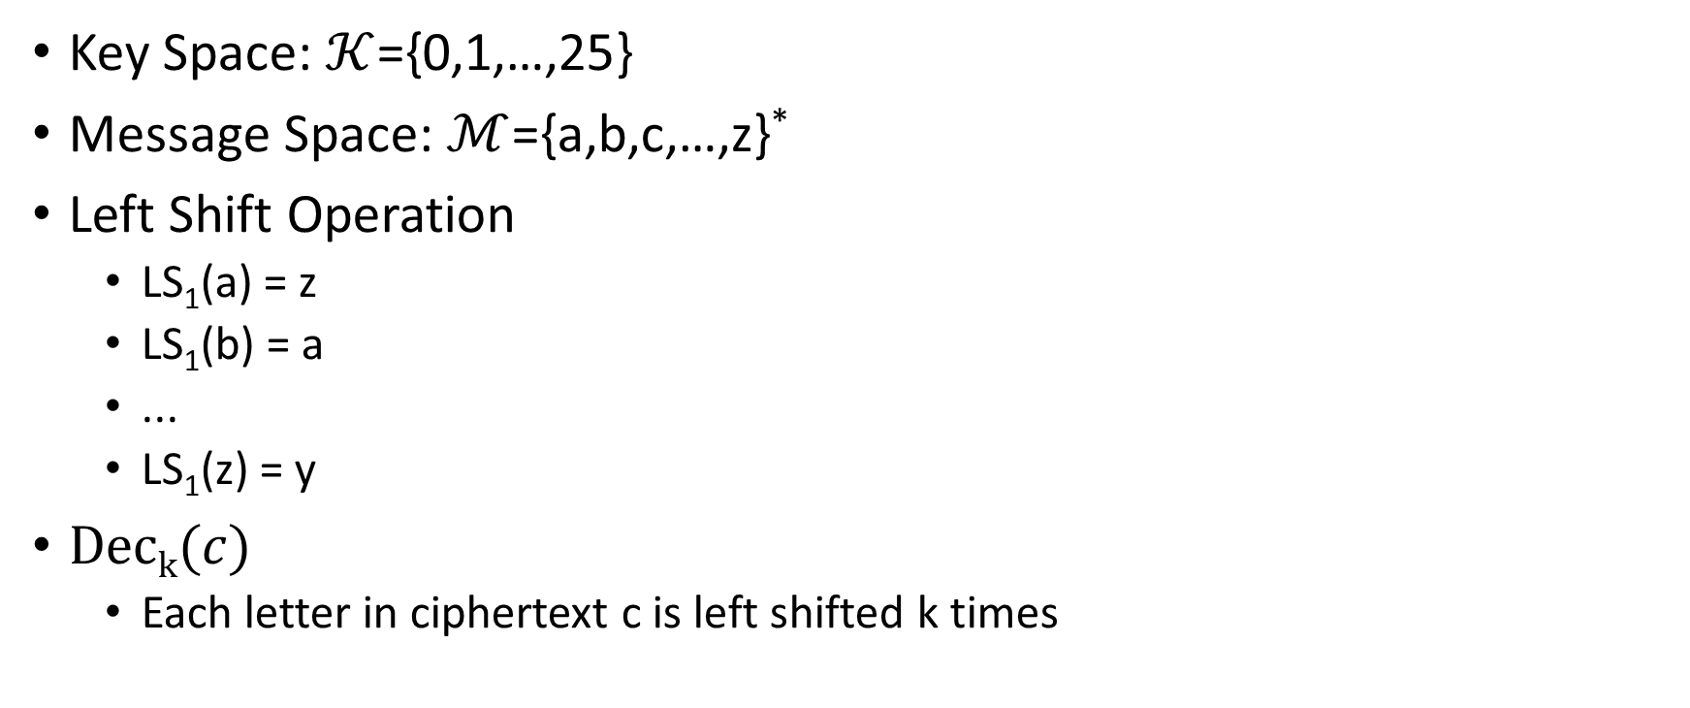
Shift Cipher
Key Space: $𝒦$={0,1,…,25}
Message Space: $ℳ$={a,b,c,…,z}*
Left Shift Operation
  LS₁(a) = z
  LS₁(b) = a
  ...
  LS₁(z) = y
$\operatorname{Deck}{(c)}$
  Each letter in ciphertext c is left shifted k times

Slide 7
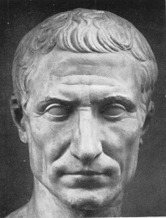
Caesar Cipher
Three shall be the number of thy shifting and the number of thy shifting shall be three. Four shalt thou not shift, neither shift thou two, excepting that thou then proceed to three. Five is right out…..
Caesar adopted the shift cipher with secret key k=3

Slide 8
Caesar Cipher (Example)
BEGINTHEATTACKNOW
→
EHJLQWKHDWWDFNQRZ
Caesar adopted the shift cipher with secret key k=3

Slide 9
Caesar Cipher (Example)
BEGINTHEATTACKNOW
→
EHJLQWKHDWWDFNQRZ
Immediate Issue: anyone who knows method can decrypt
(since k=3 is fixed)

Slide 10
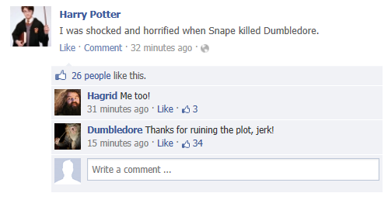
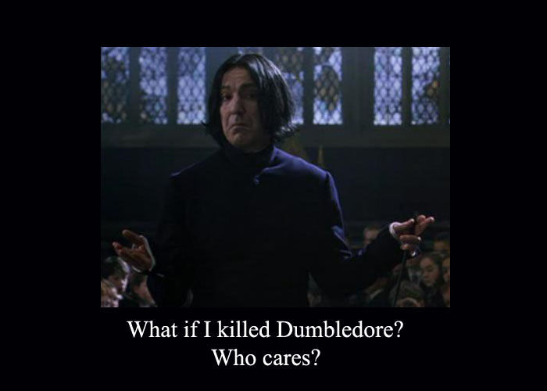
Modern Application: Avoid Spoilers (ROT13)

Slide 11
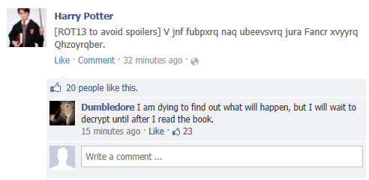
Modern Application: Avoid Spoilers (ROT13)

Slide 12
Shift Cipher: Brute Force Attack
Ciphertext: “lwxrw ztn sd ndj iwxcz xh gxvwi?”
  k=1 → m = “mxysx auo te oek jxyda yi hywxj?”
  k=2 → m=“nyzty bvp uf pfl kyzeb zj izxyk?”
  k=3 → m=“ozauz cwq vg qgm lzafc ak jayzl?”
  k=4 → m = “pabva dxr wh rhn mabgd bl kbzam?”
  k=5 → m=“qbcwb eys xi sio nbche cm lcabn?”
  k=6 → m=“rcdxc fzt yj tjp ocdif dn mdbco?”

Slide 13
Shift Cipher: Brute Force Attack
Ciphertext: “lwxrw ztn sd ndj iwxcz xh gxvwi?”
  …
  k=7 → m=“sdeyd gau zk ukq pdejg eo necdp?”
  k=8 → m=“tefze hbv al vlr qefkh fp ofdeq?”
  k=9 → m = “ufgaf icw bm wms rfgli gq pgefr?”
  k=10 → m=“vghbg jdx cn xnt sghmj hr qhfgs?”
  k=11→ m= “which key do you think is right?”
  k=12→ m= “xijdi lfz ep zpv uijol jt sjhiu?”

Slide 14
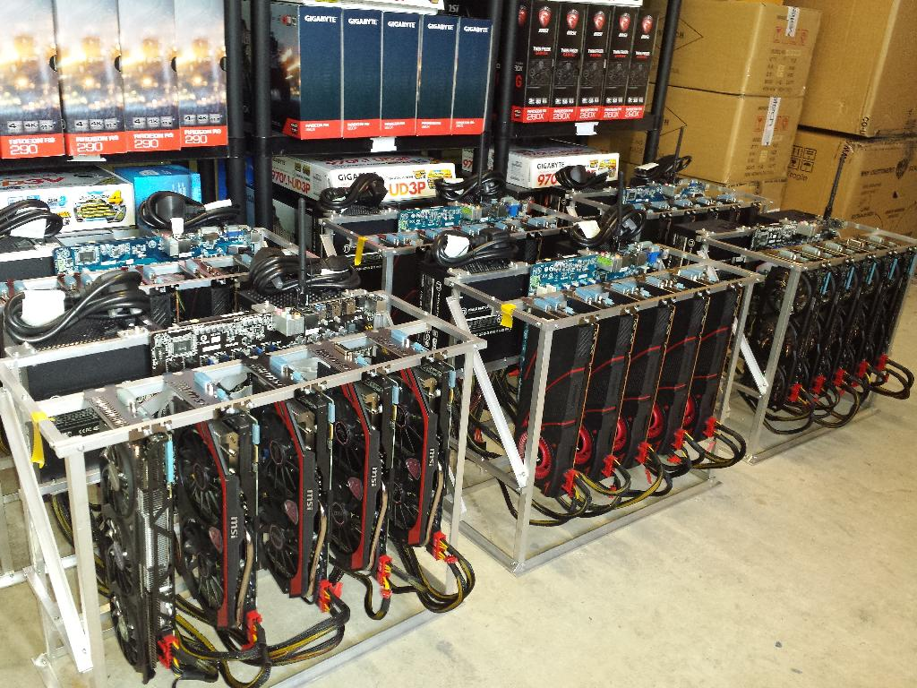
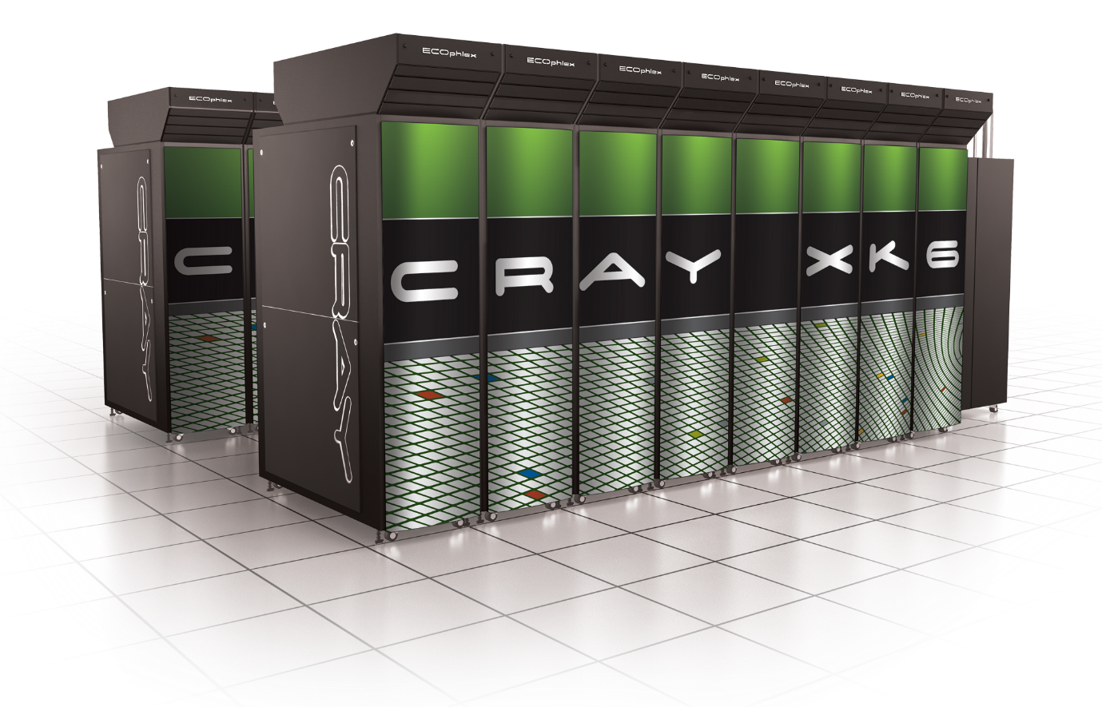
Sufficient Key Space Principle
“Any secure encryption scheme must have a key space that is sufficiently large to make an exhaustive search attack infeasible.”
Notes:
Attackers can user supercomputer, GPUs, Application Specific Integrated Circtuits etc… to speed up brute-force attacks. Key space should have size at least 2^70….probably larger to provide long term security against well funded attackers…

Slide 15
Sufficient Key Space Principle
“Any secure encryption scheme must have a key space that is sufficiently large to make an exhaustive search attack infeasible.”
Question 1: How big is big enough? Complicated question….
Question 2: If the key space is large is the encryption scheme necessarily secure?

Slide 16
Substitution Cipher
Secret key K is permutation of the alphabet
  Example:
    A B C D E F G H I J K L M N O P Q R S T U V W X Y Z
    X E U A D N B K V M R O C Q F S Y H W G L Z I J P T
Encryption: apply permutation K to each letter in message
  TELLHIMABOUTME → GDOOKVCXEFLGCD
Decryption: reverse the permutation

Slide 17
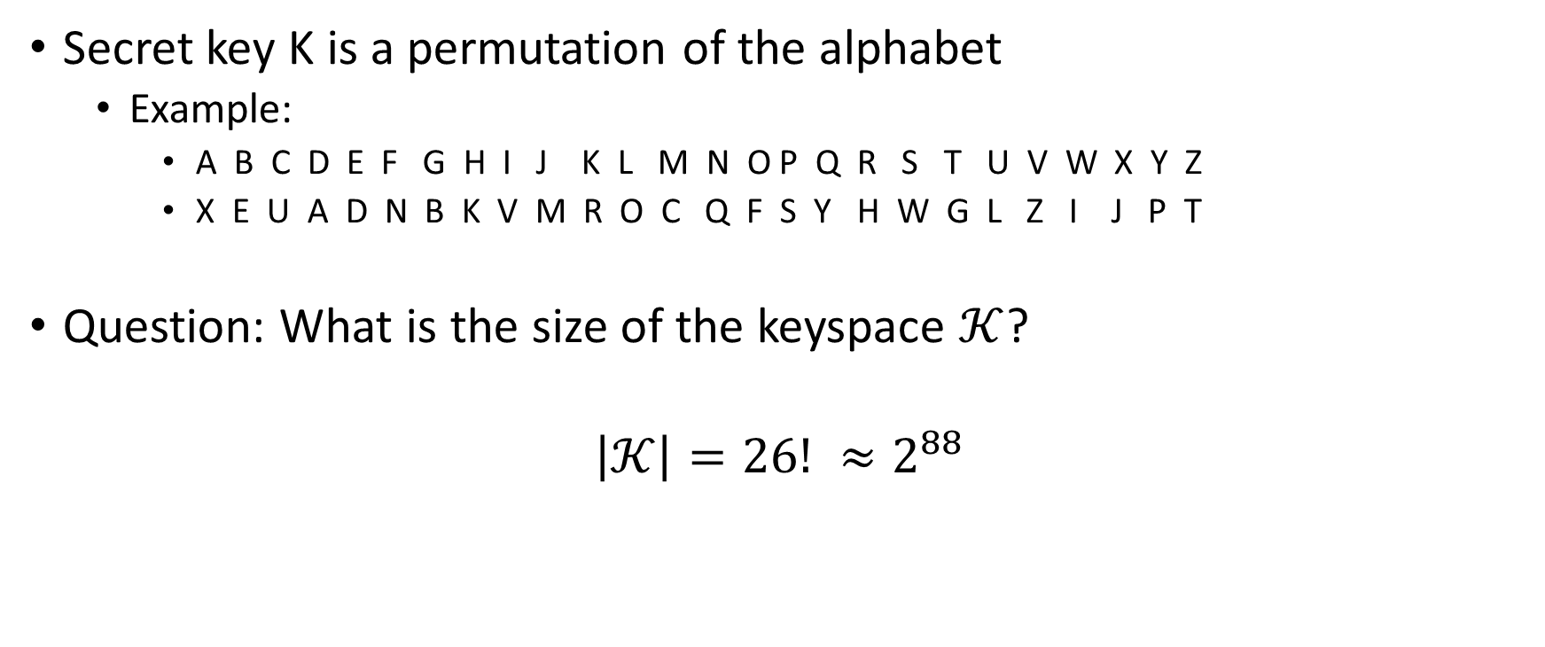
Substitution Cipher
Secret key K is a permutation of the alphabet
  Example:
    A B C D E F G H I J K L M N O P Q R S T U V W X Y Z
    X E U A D N B K V M R O C Q F S Y H W G L Z I J P T
Question: What is the size of the keyspace $𝒦$?
$$\left|𝒦\right|=26! ≈2^{88}$$

Slide 18
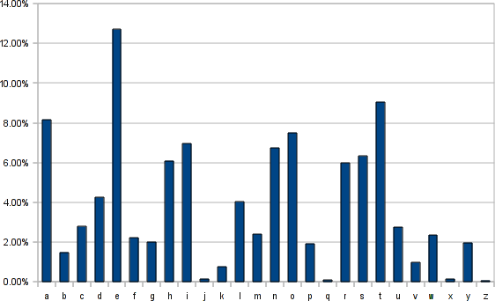
Frequency Analysis
Observation 1: If e is mapped to d then every appearance of e in the plaintext results in the appearance of a d in the ciphertext
Observation 2: Some letters occur much more frequently in English.
Observation 3: Texts consisting of a few sentences tend to have a distribution close to average.
Step 1: Find letter in ciphertext that occurs with
frequency > 11%. This letter is probably e…

Slide 19
Vigenere Cipher
Generalizes Shift Cipher
K=k₁,…,k_{t}
Enc_{K}(m)
  Shift first letter right k₁ times
  Shift second letter right k₂ times
  …
  Shift t^{th} letter right k_{t} times
  Shift t+1st letter right k₁ times
  …
Question: Size of key-space?
Answer: 26^{t} (brute force may not be useful)

Slide 20
Vigenere Cipher
Still vulnerable to frequency analysis
Good guess: Select K=k₁,…,k_{t} to maximize number of e’s in resulting ciphertext
  See Katz and Lindell 1.3 for even more sophisticated heuristics.
Works if the initial message m is long enough
Vigenere is perfectly secure if the message m is at most t letters long.

Slide 21
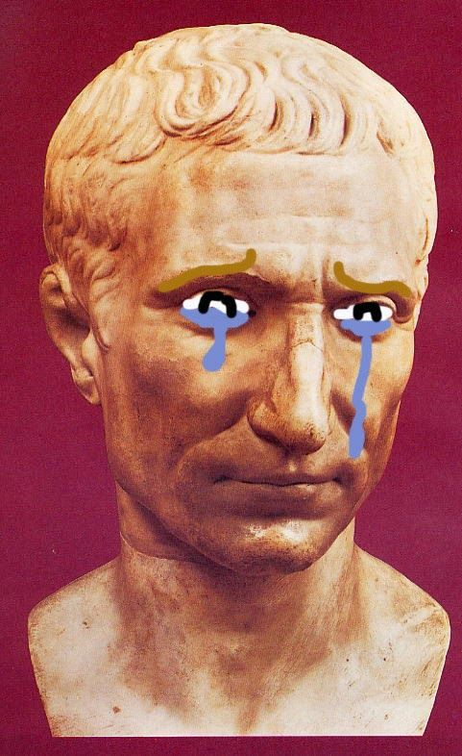
Conclusions
Designing secure ciphers is hard
Vigenere remained “unbroken” for a long time
Complex schemes are not secure
All historical ciphers have fallen

Slide 22
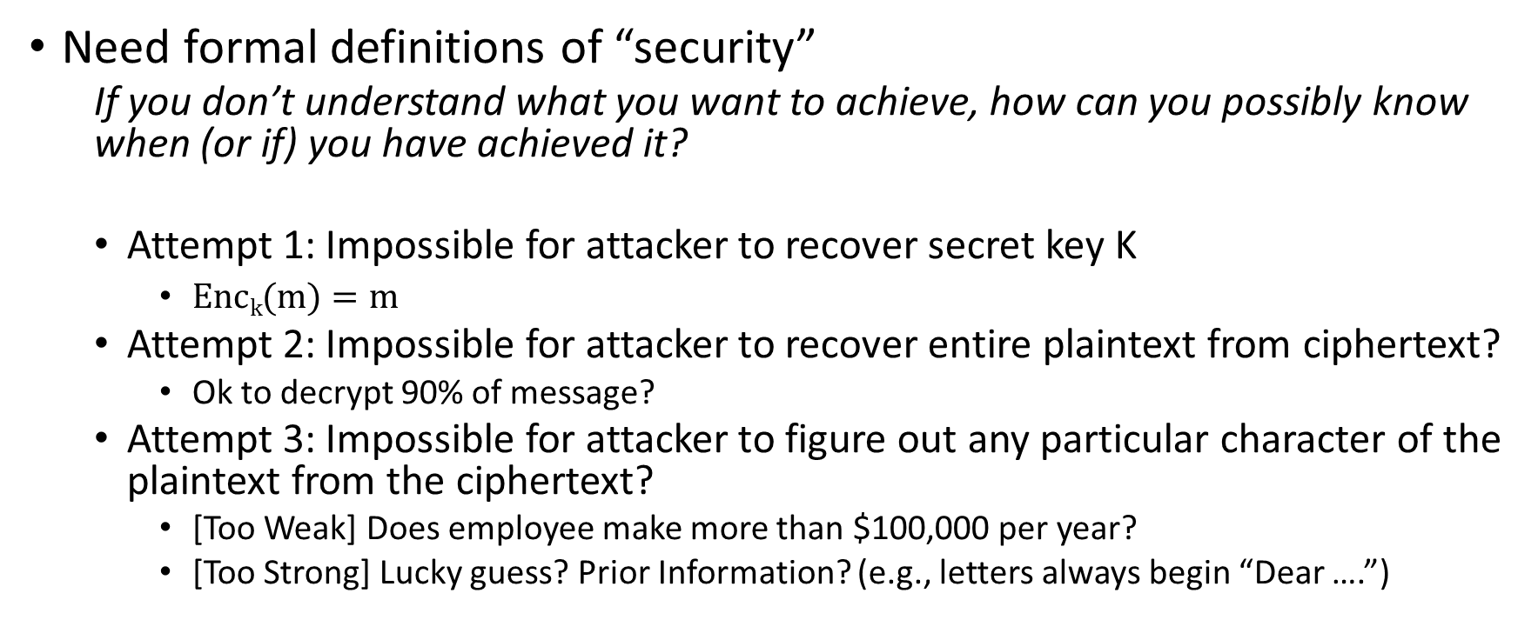
Principles of Modern Cryptography
Need formal definitions of “security”
  If you don’t understand what you want to achieve, how can you possibly know when (or if) you have achieved it?
  Attempt 1: Impossible for attacker to recover secret key K
    $\operatorname{Enck}{(m)}=m$
  Attempt 2: Impossible for attacker to recover entire plaintext from ciphertext?
    Ok to decrypt 90% of message?
  Attempt 3: Impossible for attacker to figure out any particular character of the plaintext from the ciphertext?
    [Too Weak] Does employee make more than $100,000 per year?
    [Too Strong] Lucky guess? Prior Information? (e.g., letters always begin “Dear ….”)

Slide 23
Principles of Modern Cryptography
Need formal definitions of “security”
  If you don’t understand what you want to achieve, how can you possibly know when (or if) you have achieved it?
  Final Attempt: Regardless of information an attacker already has, a ciphertext should leak no additional information about the underlying plaintext.
    This is the “right” approach
    Still need to formalize mathematically
Security definition includes goal and threat-model

Slide 24
Principles of Modern Cryptography
Proofs of Security are critical
  Iron-clad guarantee that attacker will not succeed (relative to definition/assumptions)
Experience: intuition is often misleading in cryptography
  An “intuitively secure” scheme may actually be badly broken.
Before deploying in the real world
  Consider definition/assumptions in security definition
  Does the threat model capture the attackers true abilities?

Slide 25
Coming Up…
Perfect Secrecy
Before Next Class
  Read: Katz and Lindell Chapter 2
  (Assumes familiarity with basic probability theory, see Appendix A.3)

