Slide 1
Course Business
Midterm is on March 1
  Allowed to bring one index card (double sided)
Final Exam is Monday, May 1 (7 PM)
  Location: Right here

Slide 2
Cryptography
CS 555
Topic 19: One Way Functions, Pseudorandomness

Slide 3
Recap
Last Week+:
Practical Constructions of Symmetric Key Primitives
Remainder of the Weak:
Theoretical Foundations for Cryptography
Today:
  One Way Functions, PRGs, PRFs

Slide 4
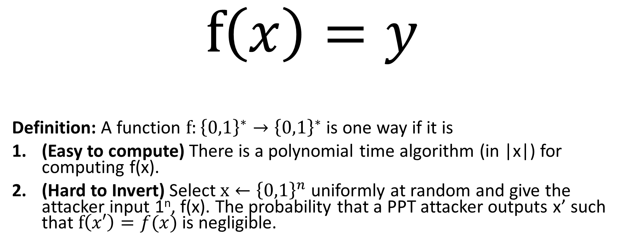
One-Way Functions (OWFs)
$$f\left(x\right)=y$$
Definition: A function $f:{\left\{0,1\right\}}^{∗}→{\left\{0,1\right\}}^{∗}$ is one way if it is
(Easy to compute) There is a polynomial time algorithm (in |x|) for computing f(x).
(Hard to Invert) Select $x←{\left\{0,1\right\}}^{n}$ uniformly at random and give the attacker input 1^{n}, f(x). The probability that a PPT attacker outputs x’ such that $f\left(x′\right)=f(x)$ is negligible.

Slide 5
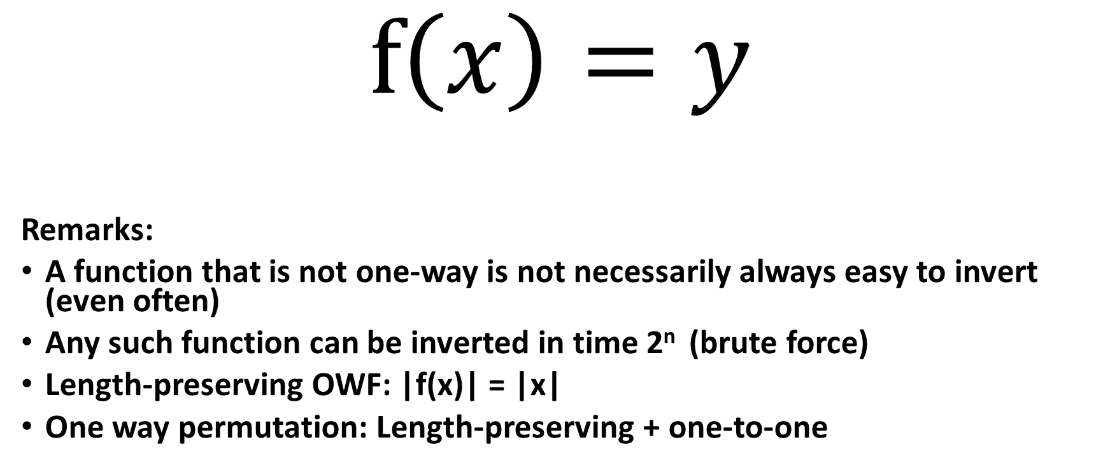
One-Way Functions (OWFs)
$$f\left(x\right)=y$$
Remarks:
A function that is not one-way is not necessarily always easy to invert (even often)
Any such function can be inverted in time 2^{n} (brute force)
Length-preserving OWF: |f(x)| = |x|
One way permutation: Length-preserving + one-to-one

Slide 6
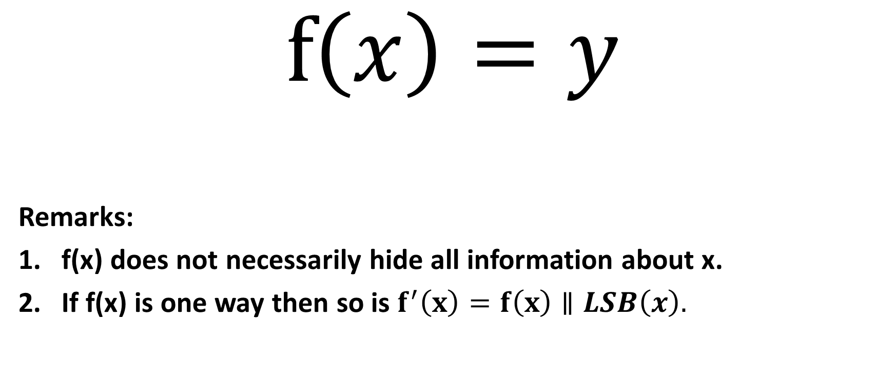
One-Way Functions (OWFs)
$$f\left(x\right)=y$$
Remarks:
f(x) does not necessarily hide all information about x.
If f(x) is one way then so is $f^{′}\left(x\right)=f\left(x\right)∥LSB\left(x\right).$

Slide 7
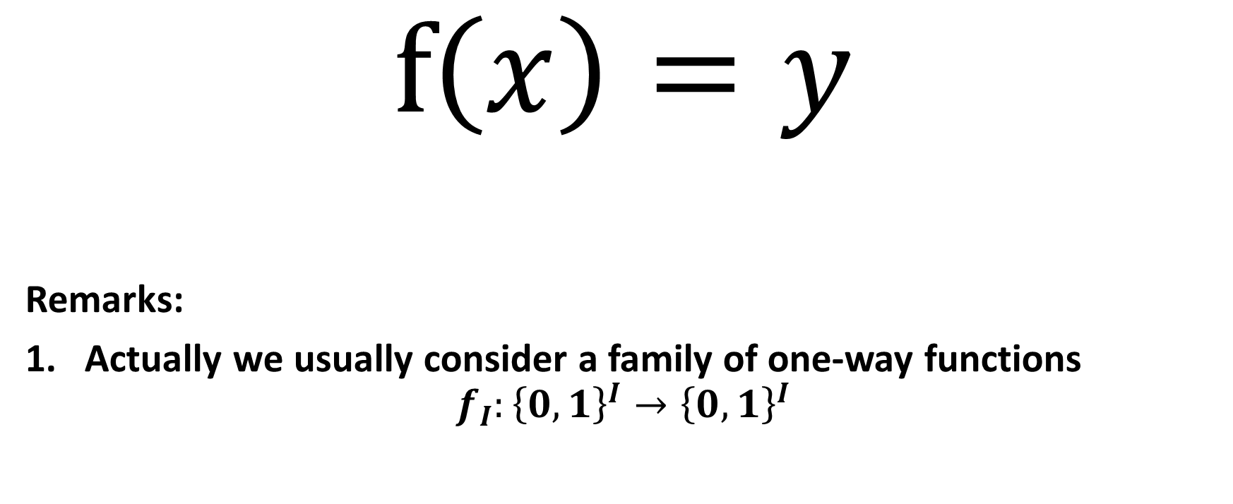
One-Way Functions (OWFs)
$$f\left(x\right)=y$$
Remarks:
Actually we usually consider a family of one-way functions
$$f_{I}:{\left\{0,1\right\}}^{I}→{\left\{0,1\right\}}^{I}$$

Slide 8
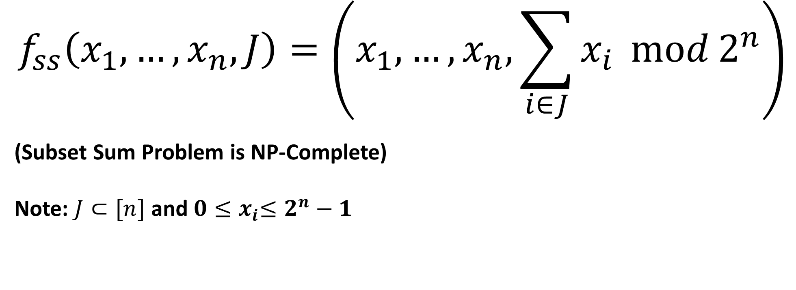
Candidate One-Way Functions
$$f_{ss}\left(x_{1},…,x_{n},J\right)=\left(x_{1},…,x_{n},\sum_{i∈J}{x_{i}}\operatorname{mod}{2^{n}}\right)$$
(Subset Sum Problem is NP-Complete)
Note: $J⊂[n]$ and $0{≤x}_{i}≤2^{n}−1$

Slide 9
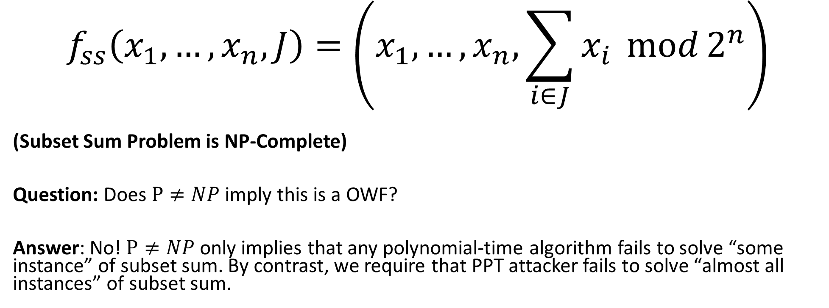
Candidate One-Way Functions
$$f_{ss}\left(x_{1},…,x_{n},J\right)=\left(x_{1},…,x_{n},\sum_{i∈J}{x_{i}}\operatorname{mod}{2^{n}}\right)$$
(Subset Sum Problem is NP-Complete)
Question: Does $P≠NP$ imply this is a OWF?
Answer: No! $P≠NP$ only implies that any polynomial-time algorithm fails to solve “some instance” of subset sum. By contrast, we require that PPT attacker fails to solve “almost all instances” of subset sum.

Slide 10
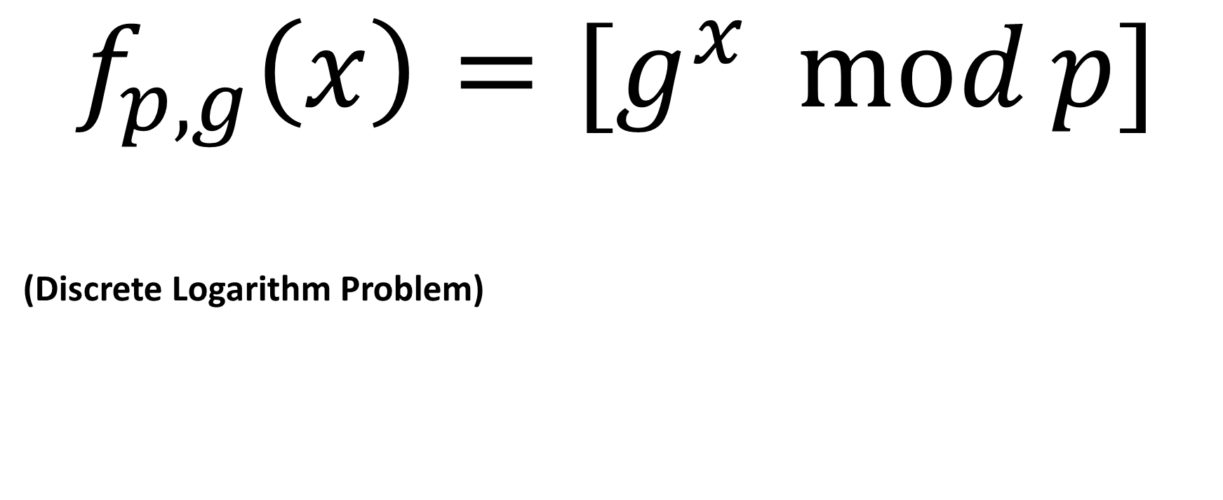
Candidate One-Way Functions (OWFs)
$$f_{p,g}\left(x\right)=[g^{x}\operatorname{mod}{p}]$$
(Discrete Logarithm Problem)

Slide 11
Hard Core Predicates
Recall that a one-way function f may potentially reveal lots of information about input
Example: f(x₁,x₂)=(x₁,g(x₂)), where g is a one-way function.
Claim: f is one-way (even if f(x₁,x₂) reveals half of the input bits!)

Slide 12
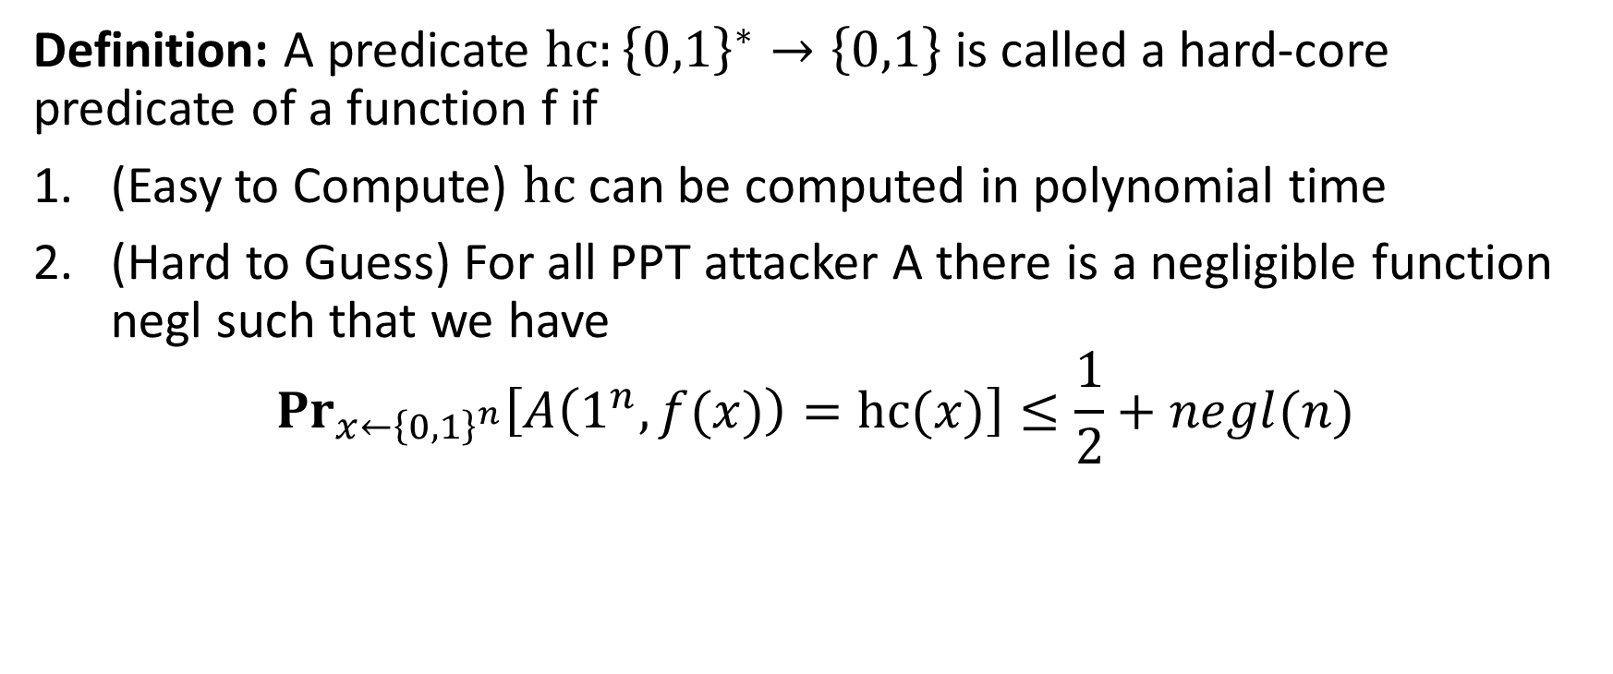
Hard Core Predicates
Definition: A predicate $hc:{\left\{0,1\right\}}^{∗}→\left\{0,1\right\}$ is called a hard-core predicate of a function f if
(Easy to Compute) $hc$ can be computed in polynomial time
(Hard to Guess) For all PPT attacker A there is a negligible function negl such that we have
$${Pr}_{x←{\left\{0,1\right\}}^{n}}\left[A\left(1^{n},f(x)\right)=hc(x)\right]≤\frac{1}{2}+negl(n)$$

Slide 13
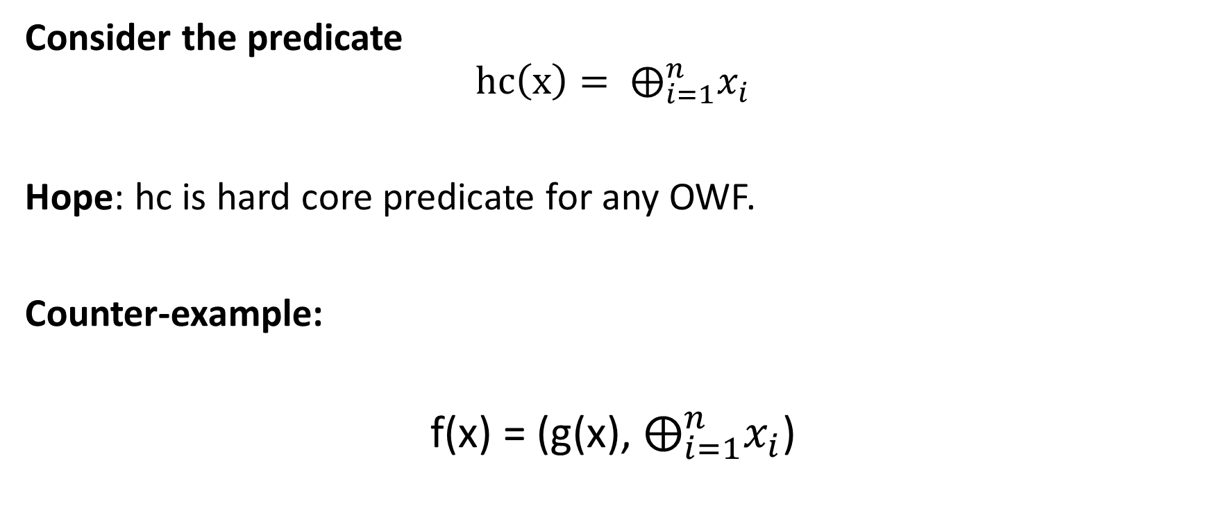
Attempt 1: Hard-Core Predicate
Consider the predicate
$$hc\left(x\right)= ⨁_{i=1}^{n}x_{i}$$
Hope: hc is hard core predicate for any OWF.
Counter-example:
f(x) = (g(x), $⨁_{i=1}^{n}x_{i}$)

Slide 14
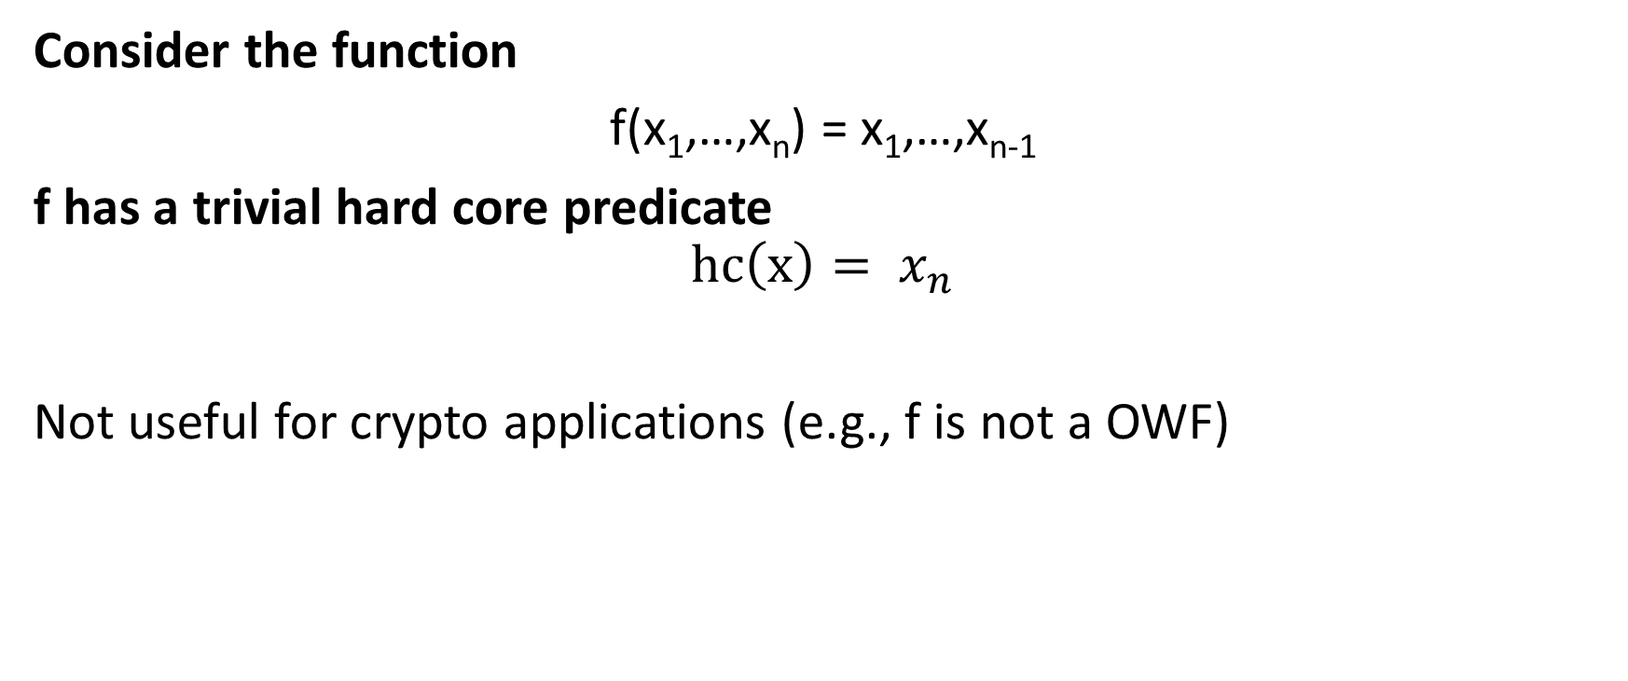
Trivial Hard-Core Predicate
Consider the function
f(x₁,…,x_{n}) = x₁,…,x_{n-1}
f has a trivial hard core predicate
$$hc\left(x\right)= x_{n}$$
Not useful for crypto applications (e.g., f is not a OWF)

Slide 15
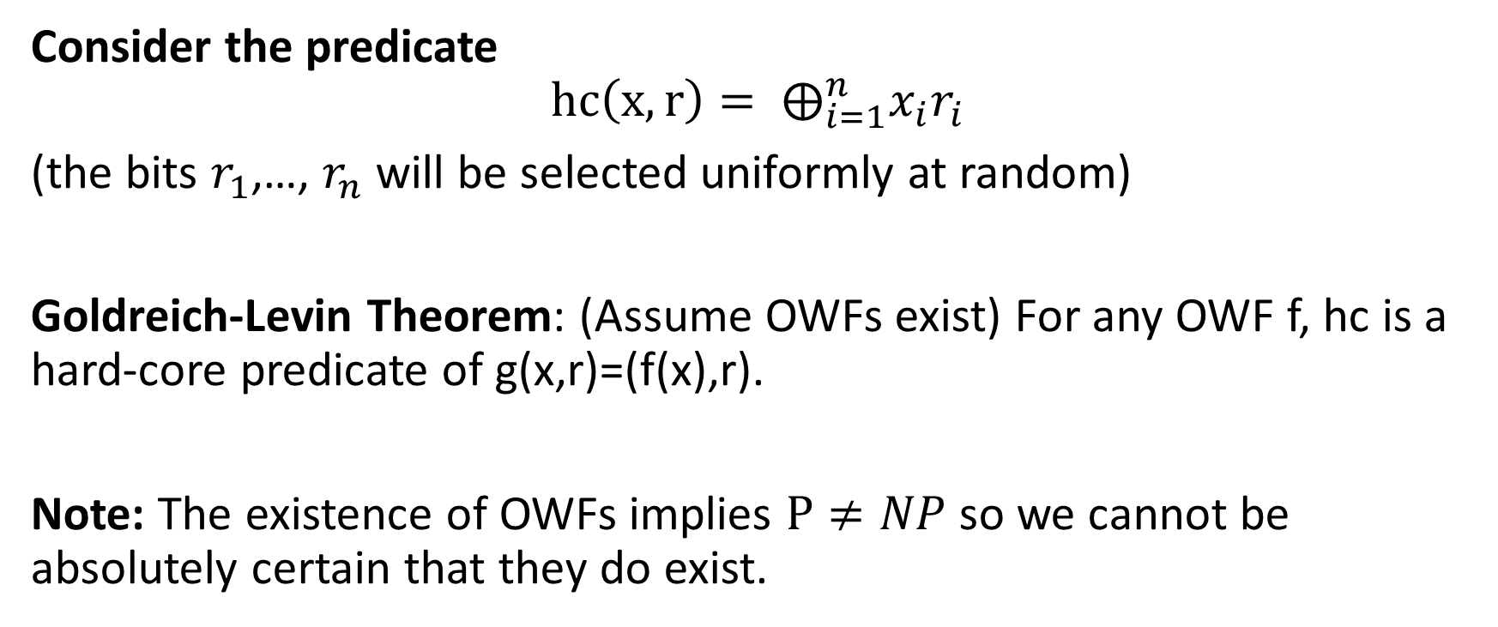
Attempt 3: Hard-Core Predicate
Consider the predicate
$$hc\left(x,r\right)= ⨁_{i=1}^{n}x_{i}r_{i}$$
(the bits $r_{1}$,…, $r_{n}$ will be selected uniformly at random)
Goldreich-Levin Theorem: (Assume OWFs exist) For any OWF f, hc is a hard-core predicate of g(x,r)=(f(x),r).
Note: The existence of OWFs implies $P≠NP$ so we cannot be absolutely certain that they do exist.

Slide 16
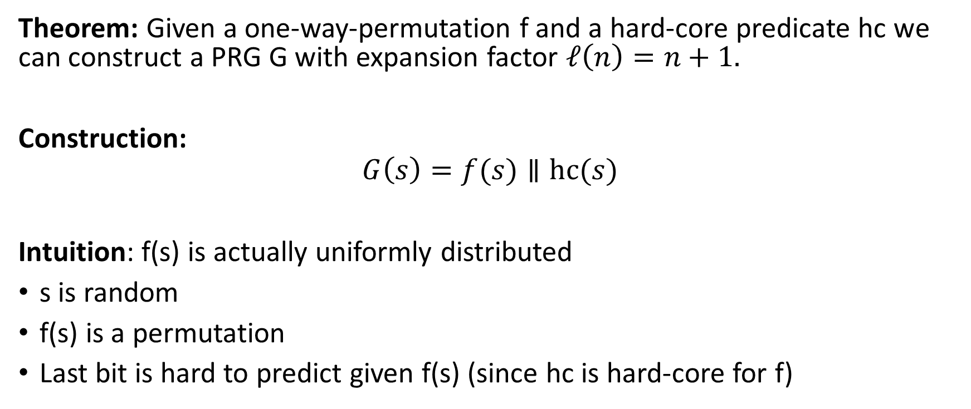
Using Hard-Core Predicates
Theorem: Given a one-way-permutation f and a hard-core predicate hc we can construct a PRG G with expansion factor $ℓ\left(n\right)=n+1.$
Construction:
$$G\left(s\right)=f(s)∥hc(s)$$
Intuition: f(s) is actually uniformly distributed
s is random
f(s) is a permutation
Last bit is hard to predict given f(s) (since hc is hard-core for f)

Slide 17
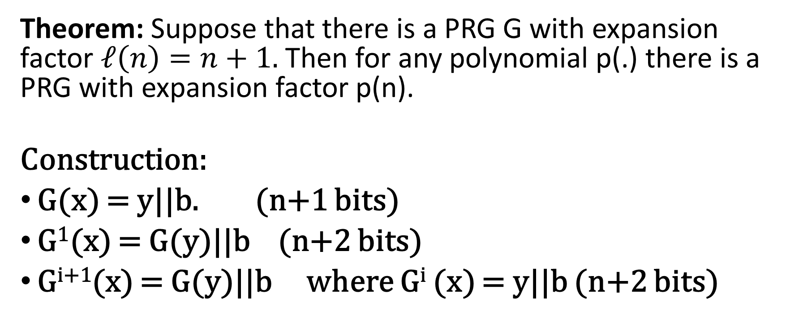
Arbitrary Expansion
Theorem: Suppose that there is a PRG G with expansion factor $ℓ\left(n\right)=n+1.$ Then for any polynomial p(.) there is a PRG with expansion factor p(n).
Construction:
G(x) = y||b. (n+1 bits)
G¹(x) = G(y)||b (n+2 bits)
G^{i+1}(x) = G(y)||b where G^{i} (x) = y||b (n+2 bits)

Slide 18
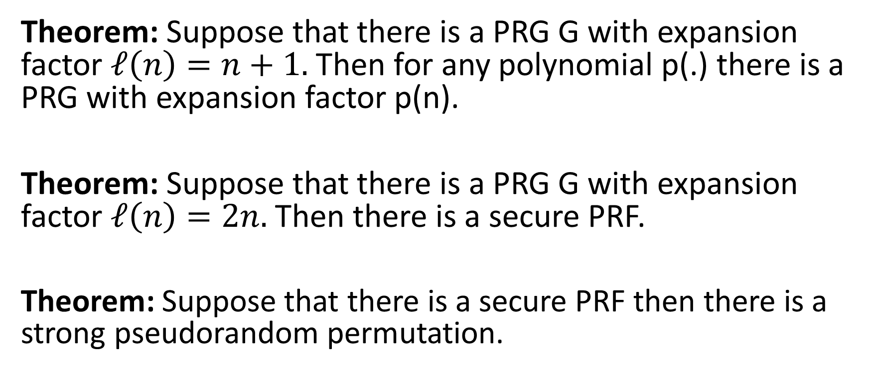
Any Beyond
Theorem: Suppose that there is a PRG G with expansion factor $ℓ\left(n\right)=n+1.$ Then for any polynomial p(.) there is a PRG with expansion factor p(n).
Theorem: Suppose that there is a PRG G with expansion factor $ℓ\left(n\right)=2n.$ Then there is a secure PRF.
Theorem: Suppose that there is a secure PRF then there is a strong pseudorandom permutation.

Slide 19
Any Beyond
Corollary: If one-way functions exist then PRGs, PRFs and strong PRPs all exist.
Corollary: If one-way functions exist then there exist CCA-secure encryption schemes and secure MACs.

Slide 20
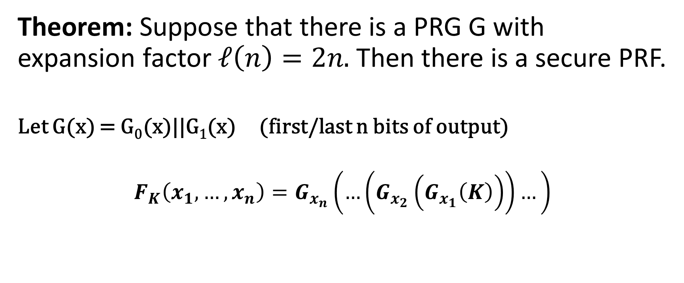
PRFs from PRGs
Theorem: Suppose that there is a PRG G with expansion factor $ℓ\left(n\right)=2n.$ Then there is a secure PRF.
Let G(x) = G₀(x)||G₁(x) (first/last n bits of output)
$$F_{K}\left(x_{1},…,x_{n}\right)=G_{x_{n}}\left(…\left(G_{x_{2}}\left(G_{x_{1}}\left(K\right)\right)\right)…\right)$$

Slide 21

PRFs from PRGs
Theorem: Suppose that there is a PRG G with expansion factor $ℓ\left(n\right)=2n.$ Then there is a secure PRF.
k
1
0
F_{k}(011)=G₁(G₁(G₀(k)))
G₀(k)
G₁(k)
0
1
1
0
G₀(G₀(k))
G₁(G₀(k))
G₀(G₁(k))
G₁(G₁(k))
1
…
…
0
1
0
1
…
0
1
…
0
…
…
…
…

Slide 22
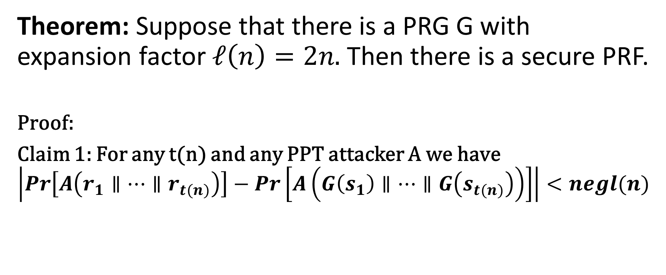
PRFs from PRGs
Theorem: Suppose that there is a PRG G with expansion factor $ℓ\left(n\right)=2n.$ Then there is a secure PRF.
Proof:
Claim 1: For any t(n) and any PPT attacker A we have
$$\left|Pr\left[A\left(r_{1}∥…∥r_{t(n)}\right)\right]−Pr\left[A\left(G\left(s_{1}\right)∥…∥G\left(s_{t(n)}\right)\right)\right]\right|<negl(n)$$

Slide 23
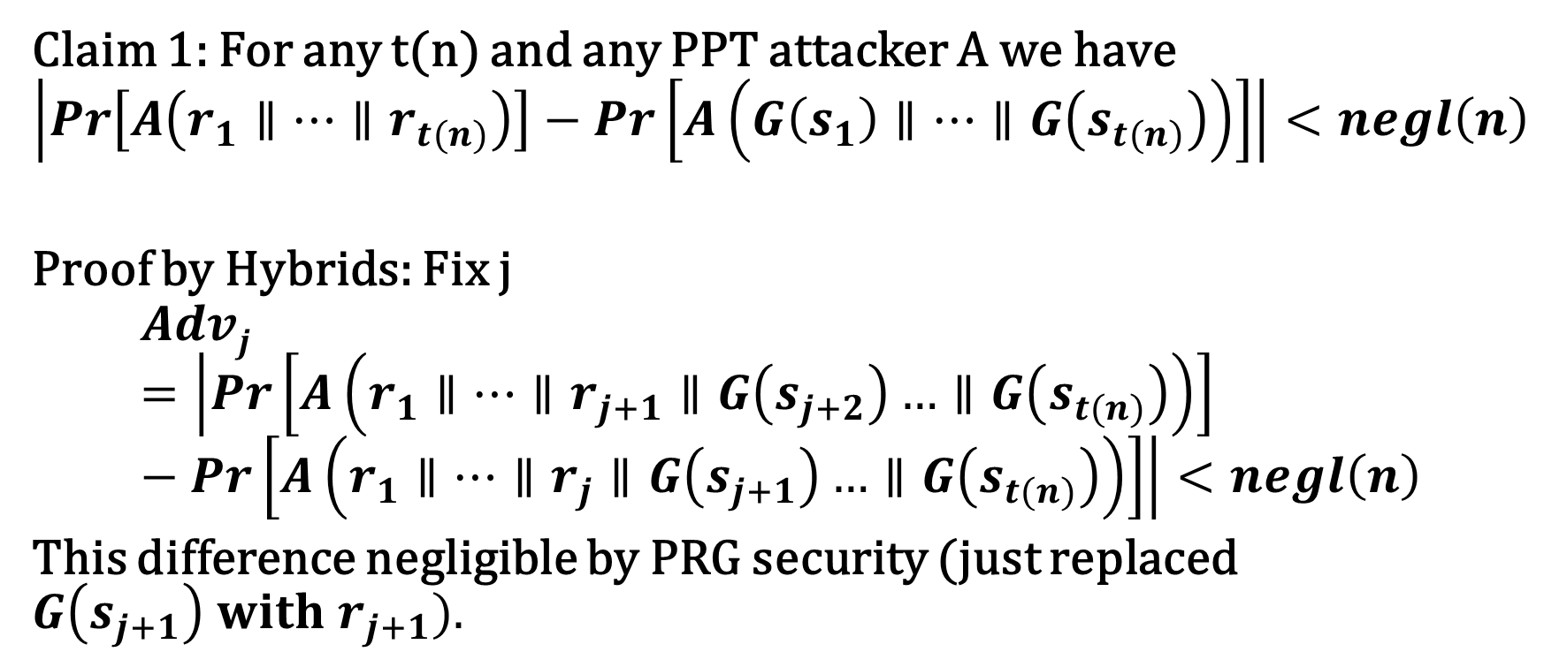
PRFs from PRGs
Claim 1: For any t(n) and any PPT attacker A we have
$$\left|Pr\left[A\left(r_{1}∥…∥r_{t(n)}\right)\right]−Pr\left[A\left(G\left(s_{1}\right)∥…∥G\left(s_{t(n)}\right)\right)\right]\right|<negl\left(n\right)$$
Proof by Hybrids: Fix j
$$Advj=\left|Pr\left[A\left(r_{1}∥…∥r_{j+1}∥G\left(s_{j+2}\right)…∥G\left(s_{t(n)}\right)\right)\right]−Pr\left[A\left(r_{1}∥…∥r_{j}∥G\left(s_{j+1}\right)…∥G\left(s_{t(n)}\right)\right)\right]\right|<negl\left(n\right)$$
This difference negligible by PRG security (just replaced $G\left(s_{j+1}\right) with r_{j+1}).$

Slide 24
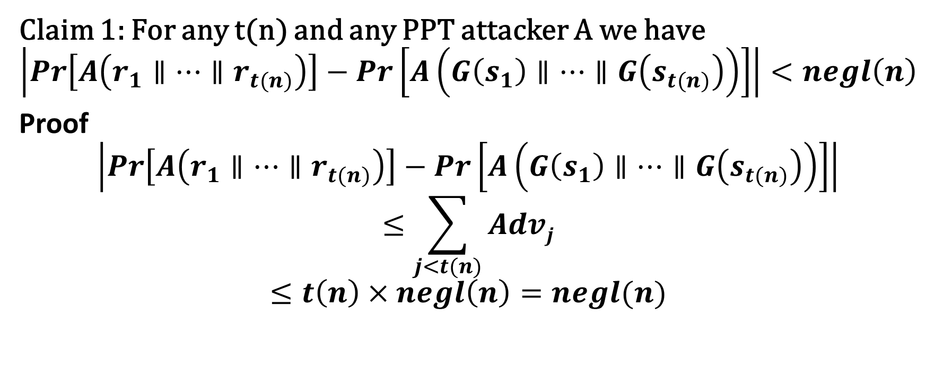
PRFs from PRGs
Claim 1: For any t(n) and any PPT attacker A we have
$$\left|Pr\left[A\left(r_{1}∥…∥r_{t(n)}\right)\right]−Pr\left[A\left(G\left(s_{1}\right)∥…∥G\left(s_{t(n)}\right)\right)\right]\right|<negl\left(n\right)$$
Proof
$$\left|Pr\left[A\left(r_{1}∥…∥r_{t(n)}\right)\right]−Pr\left[A\left(G\left(s_{1}\right)∥…∥G\left(s_{t(n)}\right)\right)\right]\right|$$
$$≤\sum_{j<t(n)}{Advj}$$
$$≤t\left(n\right)×negl\left(n\right)=negl(n)$$

Slide 25
PRFs from PRGs
Claim 1: For any t(n) and any PPT attacker A we have
$$\left|Pr\left[A\left(r_{1}∥…∥r_{t(n)}\right)\right]−Pr\left[A\left(G\left(s_{1}\right)∥…∥G\left(s_{t(n)}\right)\right)\right]\right|<negl\left(n\right)$$
Proof
$$\left|Pr\left[A\left(r_{1}∥…∥r_{t(n)}\right)\right]−Pr\left[A\left(G\left(s_{1}\right)∥…∥G\left(s_{t(n)}\right)\right)\right]\right|$$
$$≤\sum_{j<t(n)}{Advj}$$
$$≤t\left(n\right)×negl\left(n\right)=negl(n)$$

Slide 26
Hybrid H₁
r
1
0
r₀
r₁
0
1
1
0
G₀(r0)
G₁(r0)
G₀(r₁)
G₁(r₁)
1
…
…
0
1
0
1
…
0
1
…
0
…
…
…
…
26

Slide 27
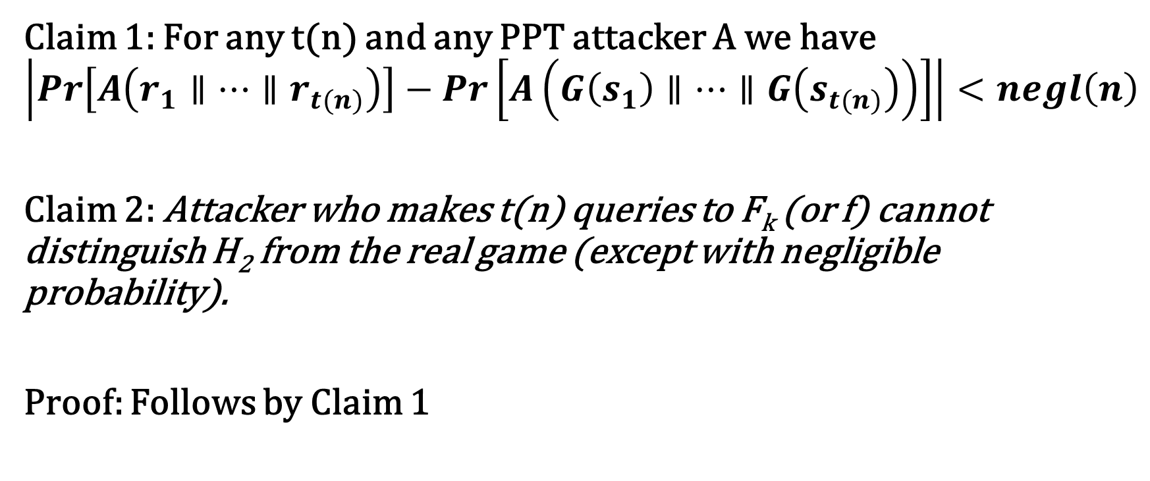
Hybrid H₁ vs H₂
Claim 1: For any t(n) and any PPT attacker A we have
$$\left|Pr\left[A\left(r_{1}∥…∥r_{t(n)}\right)\right]−Pr\left[A\left(G\left(s_{1}\right)∥…∥G\left(s_{t(n)}\right)\right)\right]\right|<negl\left(n\right)$$
Claim 2: Attacker who makes t(n) queries to F_{k} (or f) cannot distinguish H₂ from the real game (except with negligible probability).
Proof: Follows by Claim 1

Slide 28
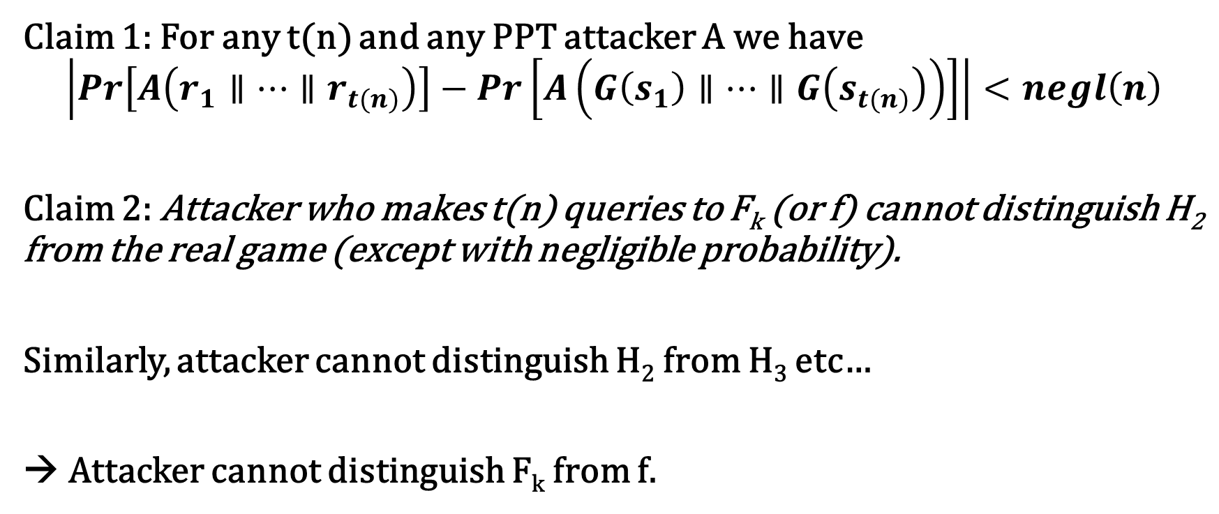
Hybrid H₂
Claim 1: For any t(n) and any PPT attacker A we have
$$\left|Pr\left[A\left(r_{1}∥…∥r_{t(n)}\right)\right]−Pr\left[A\left(G\left(s_{1}\right)∥…∥G\left(s_{t(n)}\right)\right)\right]\right|<negl\left(n\right)$$
Claim 2: Attacker who makes t(n) queries to F_{k} (or f) cannot distinguish H₂ from the real game (except with negligible probability).
Similarly, attacker cannot distinguish H₂ from H₃ etc…
→ Attacker cannot distinguish F_{k} from f.

Slide 29
Next Class
Read Katz and Lindell 7.7-7.8
Theoretical Foundations for Symmetric Key Cryptography
  Private Key Crypto from OWFs
  Computational Indistinguishability

