Slide 1
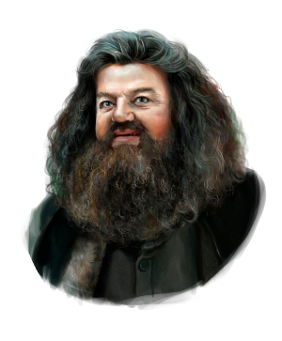
Course Business
Homework 2 Due Now
Midterm is on March 1
Final Exam is Monday, May 1 (7 PM)
Location: Right here
Harry
Hagrid

Slide 2
Cryptography CS 555
Topic 17: DES, 3DES

Slide 3
Recap
Goals for This Week:
Practical Constructions of Symmetric Key Primitives
Last Class: Block Ciphers
Today’s Goals: DES/3DES
Data Encryption Standard

Slide 4
Feistel Networks
Alternative to Substitution Permutation Networks
Advantage: underlying functions need not be invertible, but the result is still a permutation

Slide 5
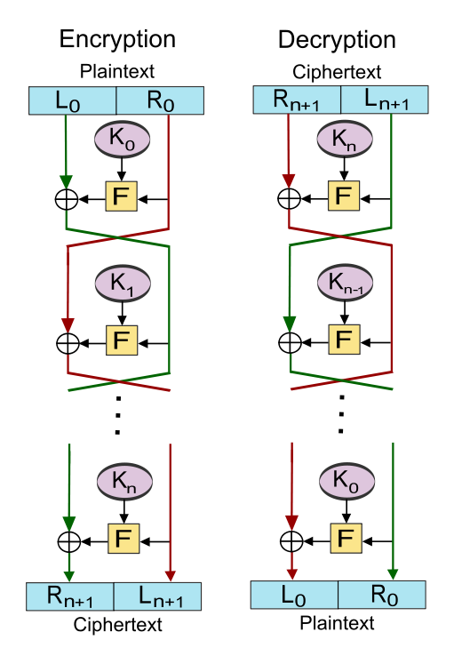
L_{i+1} = R_{i}
R_{i+1}≔L$\text{i}⨁F_{k_{i}}$(R_{i})
Proposition: the function is invertible.

Slide 6
Data Encryption Standard
Developed in 1970s by IBM (with help from NSA)
Adopted in 1977 as Federal Information Processing Standard (US)
Data Encryption Standard (DES): 16-round Feistel Network.
Key Length: 56 bits
Vulnerable to brute-force attacks in modern times
1.5 hours at 14 trillion keys/second (e.g., Antminer S9)

Slide 7
DES Round

Slide 8
DES Mangle Function
Expand E: 32-bit input → 48-bit output (duplicates 16 bits)
S-boxes: S₁,…,S₈
Input: 6-bits
Output: 4 bits
Not a permutation!
4-to-1 function
Exactly four inputs mapped to each possible output

Slide 9
Mangle Function
32 bit input
48 bit output of expand
48-bit sub key
XOR block before
Applying S-Boxes
Each S-box outputs 4 bits

Slide 10
S-Box Representation as Table
4 columns (2 bits)
 | 00 | 01 | 10 | 11
0000
0001
0010
0011
0100
0101
0110 |  |  |  | S(x)=1101
…. | …. | …. | …. | ….
1111
16 columns (4 bits)
x =101101
S(x) = Table[0110,11]

Slide 11
S-Box Representation
Each column is permutation
4 columns (2 bits)
 | 00 | 01 | 10 | 11
0000
0001
0010
0011
0100
0101
0110 |  |  |  | S(x)=1101
…. | …. | …. | …. | ….
1111
16 columns (4 bits)
S(x) = T[0110,11]
x =101101

Slide 12
Pseudorandom Permutation Requirements
Consider a truly random permutation$F∈\text{Perm}\text{128}$
Let inputs x and x’ differ on a single bit
We expect outputs F(x) and F(x’) to differ on approximately half of their bits
F(x) and F(x’) should be (essentially) independent.
A pseudorandom permutation must exhibit the same behavior!
Requirement: DES Avalanche Effect!

Slide 13
DES Avalanche Effect
Permutation the end of the mangle function helps to mix bits
Special S-box property #1
Let x and x’ differ on one bit then S_{i}(x) differs from S_{i}(x’) on two bits.

Slide 14
Avalanche Effect Example
Consider two 64 bit inputs
(L_{n},R_{n}) and (L_{n}’,R’_{n}=R_{n})
L_{n} and L_{n}’ differ on one bit
This is worst case example
L_{n+1} = L_{n+1}’=R_{n}
But now R’_{n+1} and R_{n+1} differ on one bit
Even if we are unlucky E(R’_{n+1}) and E(R_{n+1}) differ on 1 bit
→ R_{n+2} and R’_{n+2} differ on two bits
→ L_{n+2} = R’_{n+1} and L_{n+2}’ = R’_{n+1} differ in one bit

Slide 15
Avalanche Effect Example
R_{n+2} and R’_{n+2} differ on two bits
L_{n+2} = R_{n+1} and L_{n+2}’ = R’_{n+1} differ in one bit
→R_{n+3} and R’_{n+3} differ on four bits since we have different inputs to two of the S-boxes
L_{n+3} = R’_{n+2} and L_{n+2}’ = R’_{n+2} now differ on two bits
Seven rounds we expect all 32 bits in right half to be “affected” by input change
…
DES has sixteen rounds

Slide 16
Attack on One-Round DES
Given input output pair (x,y)
y=(L₁,R₁)
X=(L₀,R₀)
Note: R₀=L₁
Note: R₁=L₀ $⨁f_{1}\left(\text{R}\text{0}\right)$ where f is the Mangling Function with key k₁
Conclusion:
$$f_{1}\left(\text{R}\text{0}\right)\text{=}\text{L}\text{0}⨁\text{R}\text{1}$$

Slide 17
Attack on One-Round DES
$$\text{R}\text{0}$$
Four possible inputs
Trivial to Recover
$$\text{L}\text{0}⨁\text{R}\text{1}$$

Slide 18
Attack on Two-Round DES
Output y =(L₂,R₂)
Note: $\text{R}\text{1}\text{=}\text{L}\text{0}⨁f_{1}\left(\text{R}\text{0}\right)$
Also,$\text{R}\text{1}\text{=}$ $\text{L}\text{2}$
Thus, $f_{1}\left(\text{R}\text{0}\right)\text{=}\text{L}\text{2}⨁\text{L}\text{0}$
So we can still attack the first round key k1 as before as $\text{R}\text{0}$ and $\text{L}\text{2}⨁\text{L}\text{0}$ are known
Note:$\text{R}\text{2}\text{=}\text{L}\text{1}⨁f_{2}\left(\text{R}\text{1}\right)$
Also,$\text{L}\text{1}\text{=}\text{R}\text{0 }$and $\text{R}\text{1}\text{=}$ $\text{L}\text{2}$
Thus, $f_{2}\left(\text{L}\text{2 }\right)\text{=}\text{R}\text{2}⨁\text{R}\text{0}$
So we can attack the second round key k2 as before as $\text{L}\text{2}$and $\text{R}\text{2}⨁\text{R}\text{0}$ are known

Slide 19
Attack on Three-Round DES
$$f_{1}\left(\text{R}\text{0}\right)⨁f_{3}\left(\text{R}\text{2}\right)\text{=}\left(\text{L}\text{0}⨁\text{L}2\right)⨁\left(\text{L}\text{2}⨁\text{R}3\right)$$
$\text{=}$ $\text{L}\text{0}⨁\text{R}3$
We know all of the values $\text{L}\text{0}\text{,}\text{R}\text{0}$, $\text{R}3$ and $\text{L}3=\text{R}\text{2}$.
Leads to attack in time $≈$2^{n/2}
^{(See details in textbook)}
^{Remember that DES is 16 rounds}

Slide 20
DES Security
Best Known attack is brute-force 2⁵⁶
Except under unrealistic conditions (e.g., 2⁴³ known plaintexts)
Brute force is not too difficult on modern hardware
Attack can be accelerated further after precomputation
Output is a few terabytes
Subsequently keys are cracked in 2³⁸ DES evaluations (minutes)
Precomputation costs amortize over number of DES keys cracked
Even in 1970 there were objections to the short key length for DES

Slide 21
Double DES
Let F_{k}(x) denote the DES block cipher
A new block cipher F’ with a key $k=\left(k_{1},k_{2}\right)$ of length 2n can be defined by
$$F_{k}^{′}\left(x\right)=F_{k_{2}}\left(F_{k_{1}}\left(x\right)\right)$$
Can you think of an attack better than brute-force?

Slide 22
Meet in the Middle Attack
$$F_{k}^{′}\left(x\right)=F_{k_{2}}\left(F_{k_{1}}\left(x\right)\right)$$
Goal: Given (x, $F_{k}^{′}\left(x\right)$) try to find secret key k in time and space $O\left(n2^{n}\right)$.
Solution?
See Homework 1 ☺

Slide 23
Triple DES Variant 1
Let F_{k}(x) denote the DES block cipher
A new block cipher F’ with a key $k=\left(k_{1},k_{2}{,k}_{3}\right)$ of length 2n can be defined by
$$F_{k}^{′}\left(x\right)=F_{k_{3}}\left(F_{k_{2}}^{−1}\left(F_{k_{1}}\left(x\right)\right)\right)$$
Meet-in-the-Middle Attack Requires time $Ω\left(2^{2n}\right)$ and space $Ω\left(2^{2n}\right)$

Slide 24
Triple DES Variant 1
Allows backward compatibility with DES by setting k₁=k₂=k₃
Let F_{k}(x) denote the DES block cipher
A new block cipher F’ with a key $k=\left(k_{1},k_{2}{,k}_{3}\right)$ of length 2n can be defined by
$$F_{k}^{′}\left(x\right)=F_{k_{3}}\left(F_{k_{2}}^{−1}\left(F_{k_{1}}\left(x\right)\right)\right)$$
Meet-in-the-Middle Attack Requires time $Ω\left(2^{2n}\right)$ and space $Ω\left(2^{2n}\right)$

Slide 25
Triple DES Variant 2
Just two keys!
Let F_{k}(x) denote the DES block cipher
A new block cipher F’ with a key $k=\left(k_{1},k_{2}\right)$ of length 2n can be defined by
$$F_{k}^{′}\left(x\right)=F_{k_{1}}\left(F_{k_{2}}^{−1}\left(F_{k_{1}}\left(x\right)\right)\right)$$
Meet-in-the-Middle Attack still requires time $Ω\left(2^{2n}\right)$ and space $Ω\left(2^{2n}\right)$
Key length is still just 112 bits (128 bits is recommended)

Slide 26
Triple DES Variant 1
$$F_{k}^{′}\left(x\right)=F_{k_{3}}\left(F_{k_{2}}^{−1}\left(F_{k_{1}}\left(x\right)\right)\right)$$
Standardized in 1999
Still widely used, but it is relatively slow (three block cipher operations)
Current gold standard: AES

Slide 27
Next Class
Read Katz and Lindell 6.2.5-6.3
AES & Differential Cryptanalysis + Hash Functions

