Slide 1
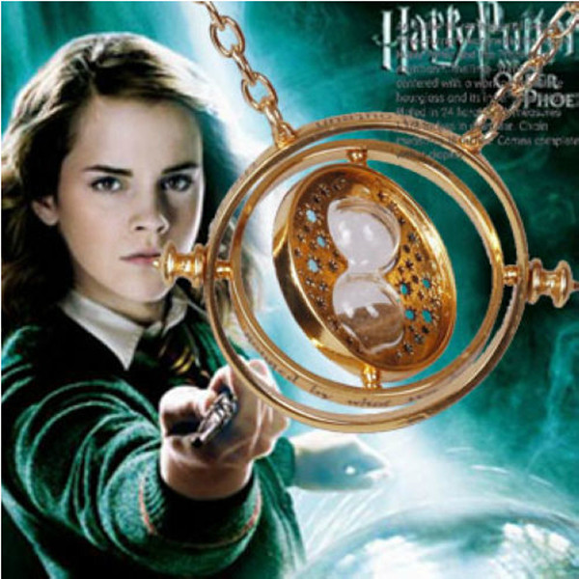
Course Business
Homework 2 Due on Friday at 11:30 AM
Course Schedule Updated
  “Duplicate week” removed
Midterm is on March 1
Final Exam is Monday, May 1 (7 PM)
  Location: Right here

Slide 2
Cryptography
CS 555
Topic 16: Block Ciphers

Slide 3

An Existential Crisis?
We have used primitives like PRGs, PRFs to build secure MACs, CCA-Secure Encryption etc…
Do such primitives exist? In practice?
How do we build them?

Slide 4
Recap
Last Class: Stream Ciphers
  Linear Feedback Shift Registers (and attacks)
  RC4 (and attacks)
  Trivium
Goals for This Week:
Practical Constructions of Symmetric Key Primitives
Today’s Goals: Stream Ciphers
Block Ciphers

Slide 5

Pseudorandom Permutation
A keyed function $F:{\left\{0,1\right\}}^{n}×{\left\{0,1\right\}}^{n}→{\left\{0,1\right\}}^{n}$, which is invertible and “looks random” without the secret key k.
Similar to a PRF, but
Computing F_{k}(x) and $F_{k}^{−1}\left(x\right)$ is efficient (polynomial-time)
Definition 3.28: A keyed function $F:{\left\{0,1\right\}}^{n}×{\left\{0,1\right\}}^{n}→{\left\{0,1\right\}}^{n}$ is a strong pseudorandom permutation if for all PPT distinguishers D there is a negligible function $μ$ s.t.
$$\left|Pr\left[D^{F_{k}\left(.\right),F_{k}^{−1}\left(.\right)}\left(1^{n}\right)\right]−Pr\left[D^{f\left(.\right),f^{−1}\left(.\right)}\left(1^{n}\right)\right]\right|≤μ\left(n\right)$$

Slide 6
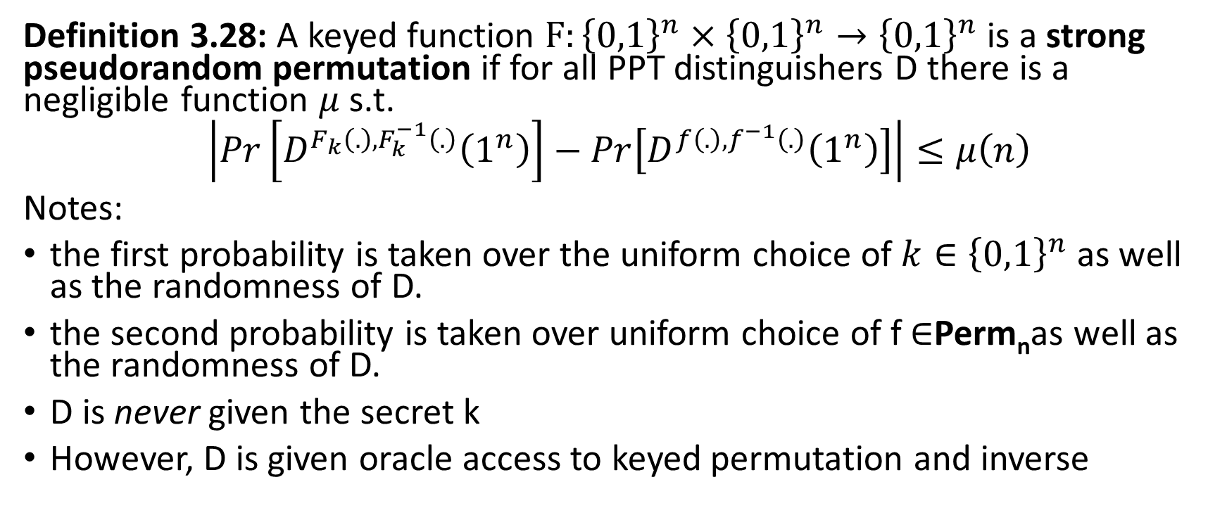
Pseudorandom Permutation
Definition 3.28: A keyed function $F:{\left\{0,1\right\}}^{n}×{\left\{0,1\right\}}^{n}→{\left\{0,1\right\}}^{n}$ is a strong pseudorandom permutation if for all PPT distinguishers D there is a negligible function $μ$ s.t.
$$\left|Pr\left[D^{F_{k}\left(.\right),F_{k}^{−1}\left(.\right)}\left(1^{n}\right)\right]−Pr\left[D^{f\left(.\right),f^{−1}\left(.\right)}\left(1^{n}\right)\right]\right|≤μ\left(n\right)$$
Notes:
the first probability is taken over the uniform choice of ${k∈\left\{0,1\right\}}^{n}$ as well as the randomness of D.
the second probability is taken over uniform choice of f $∈$Perm_{n}as well as the randomness of D.
D is never given the secret k
However, D is given oracle access to keyed permutation and inverse

Slide 7

How many permutations?
|Perm_{n}|=?
Answer: 2^{n}!
How many bits to store f $∈$Perm_{n}?
Answer:
$$\log\left(\text{2}\text{n}\text{!}\right)=\sum_{i=1}^{\text{2}\text{n}}{\log\left(\text{i}\right)}$$
$$≥\sum_{i=2^{n−1}}^{2^{n}}{n−1}≥(n−1)×2^{n−1}$$

Slide 8
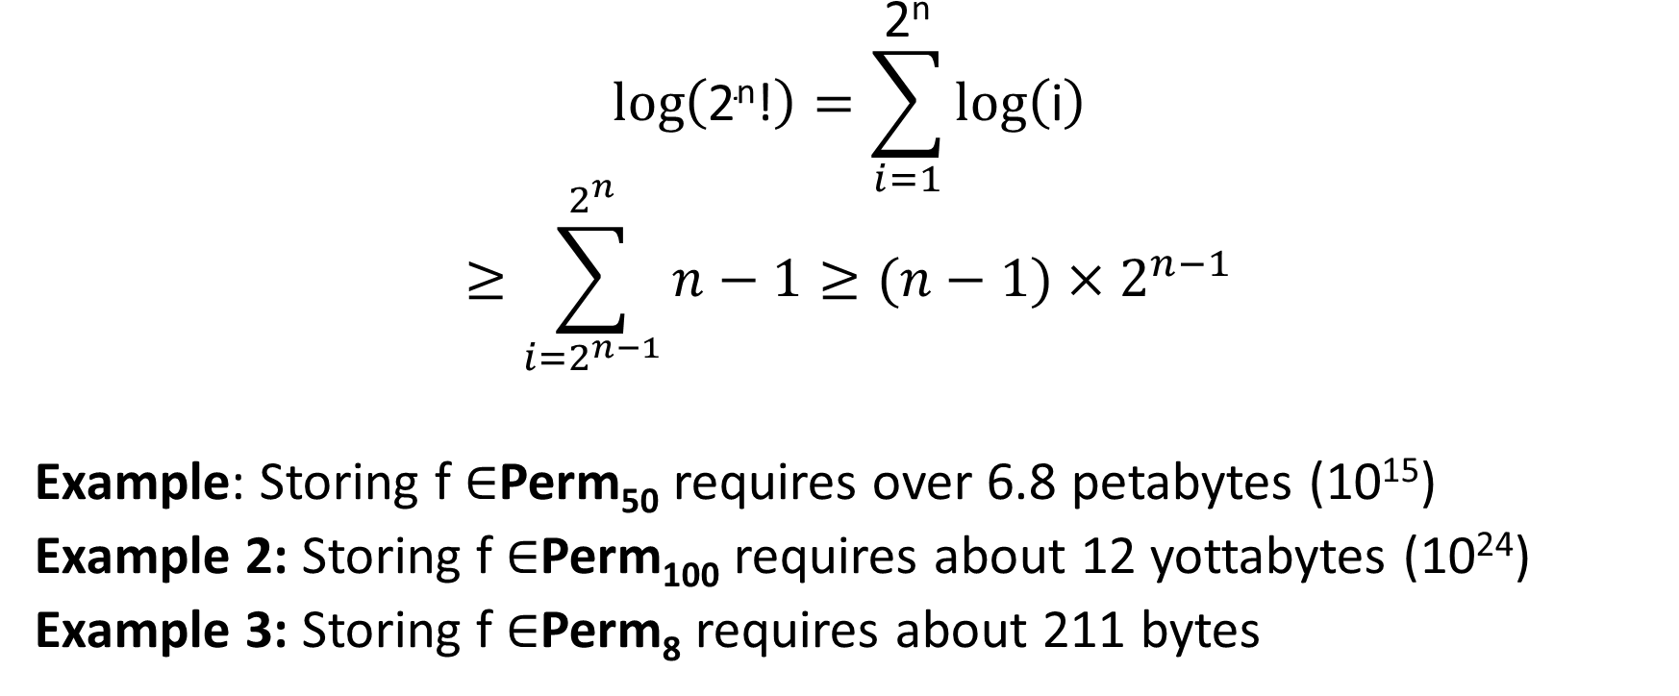
How many bits to store permutations?
$$\log\left(\text{2}\text{n}\text{!}\right)=\sum_{i=1}^{\text{2}\text{n}}{\log\left(\text{i}\right)}$$
$$≥\sum_{i=2^{n−1}}^{2^{n}}{n−1}≥(n−1)×2^{n−1}$$
Example: Storing f $∈$Perm₅₀ requires over 6.8 petabytes (10¹⁵)
Example 2: Storing f $∈$Perm₁₀₀ requires about 12 yottabytes (10²⁴)
Example 3: Storing f $∈$Perm₈ requires about 211 bytes

Slide 9
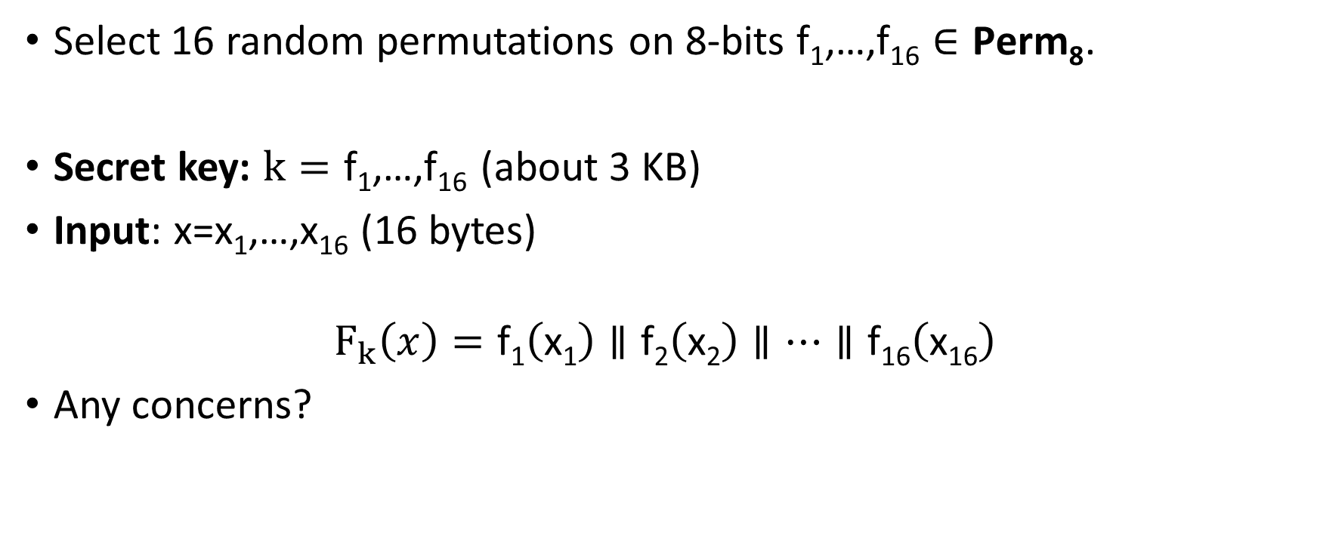
Attempt 1: Pseudorandom Permutation
Select 16 random permutations on 8-bits $\text{f}\text{1}\text{,…,}\text{f}\text{16}∈\text{Perm}\text{8}$.
Secret key: $k=\text{f}\text{1}\text{,…,}\text{f}\text{16}$(about 3 KB)
Input: x=x₁,…,x₁₆ (16 bytes)
$$F_{k}\left(x\right)=\text{f}\text{1}\left(\text{x}\text{1}\right)∥\text{f}\text{2}\left(\text{x}\text{2}\right)∥…∥\text{f}\text{16}\left(\text{x}\text{16}\right)$$
Any concerns?

Slide 10
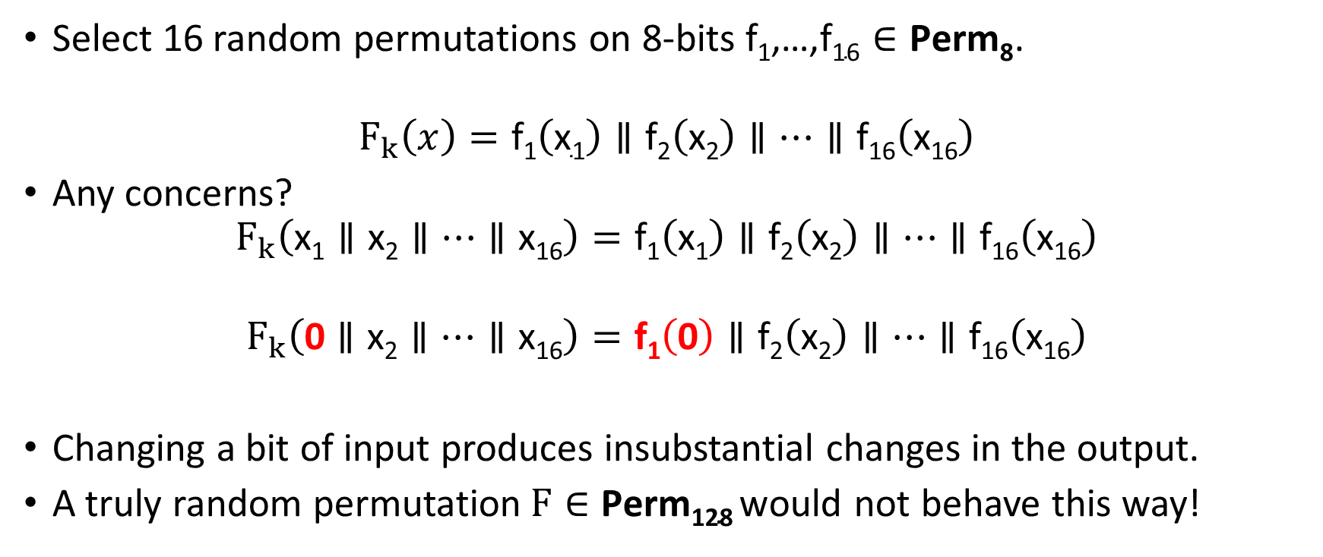
Attempt 1: Pseudorandom Permutation
Select 16 random permutations on 8-bits $\text{f}\text{1}\text{,…,}\text{f}\text{16}∈\text{Perm}\text{8}$.
$$F_{k}\left(x\right)=\text{f}\text{1}\left(\text{x}\text{1}\right)∥\text{f}\text{2}\left(\text{x}\text{2}\right)∥…∥\text{f}\text{16}\left(\text{x}\text{16}\right)$$
Any concerns?
$$F_{k}\left(\text{x}\text{1}∥\text{x}\text{2}∥…∥\text{x}\text{16}\right)=\text{f}\text{1}\left(\text{x}\text{1}\right)∥\text{f}\text{2}\left(\text{x}\text{2}\right)∥…∥\text{f}\text{16}\left(\text{x}\text{16}\right)$$
$$F_{k}\left(\text{0}∥\text{x}\text{2}∥…∥\text{x}\text{16}\right)=\text{f}\text{1}\left(\text{0}\right)∥\text{f}\text{2}\left(\text{x}\text{2}\right)∥…∥\text{f}\text{16}\left(\text{x}\text{16}\right)$$
Changing a bit of input produces insubstantial changes in the output.
A truly random permutation$F∈\text{Perm}\text{128}$would not behave this way!

Slide 11
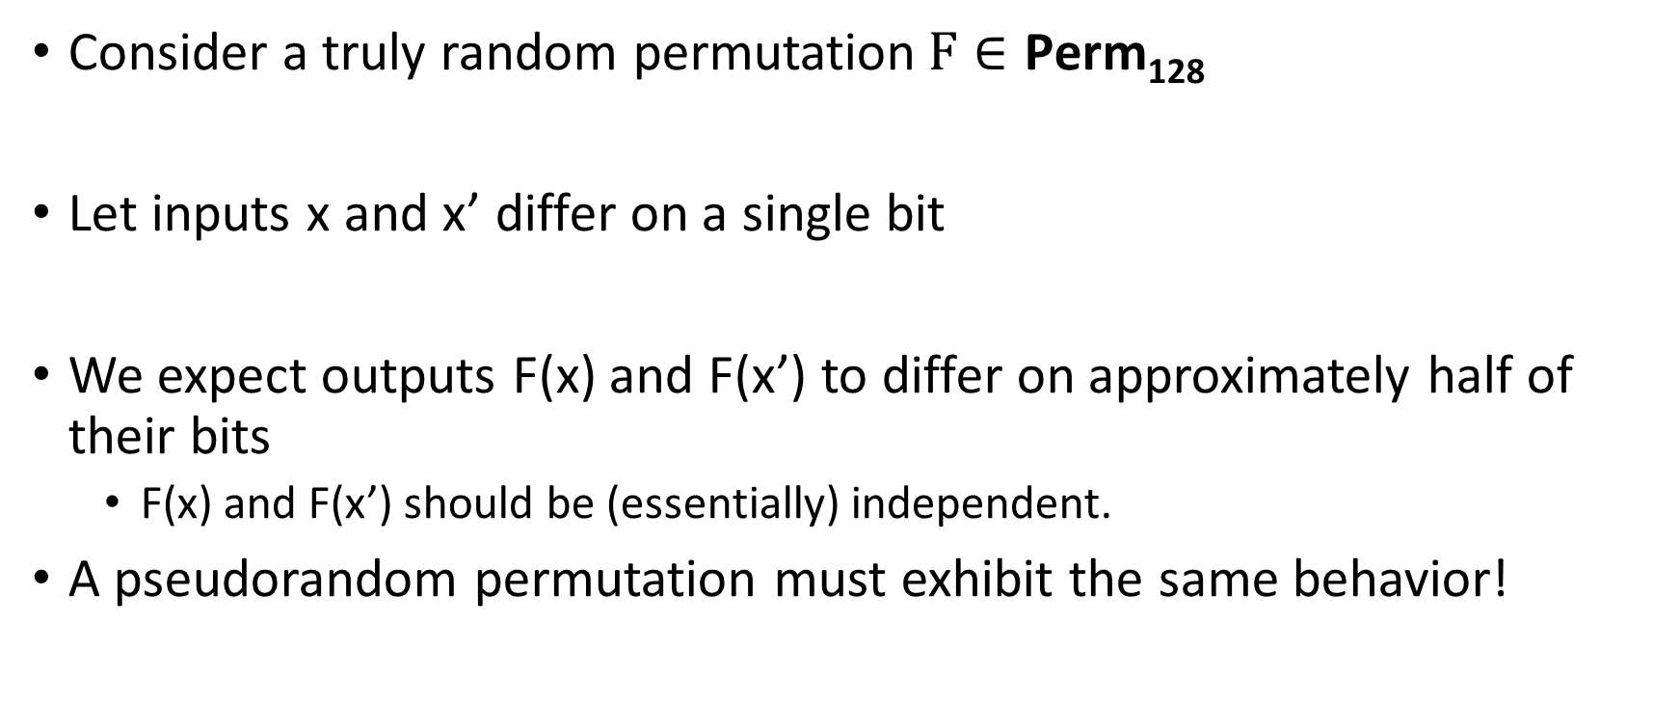
Pseudorandom Permutation Requirements
Consider a truly random permutation$F∈\text{Perm}\text{128}$
Let inputs x and x’ differ on a single bit
We expect outputs F(x) and F(x’) to differ on approximately half of their bits
  F(x) and F(x’) should be (essentially) independent.
A pseudorandom permutation must exhibit the same behavior!

Slide 12
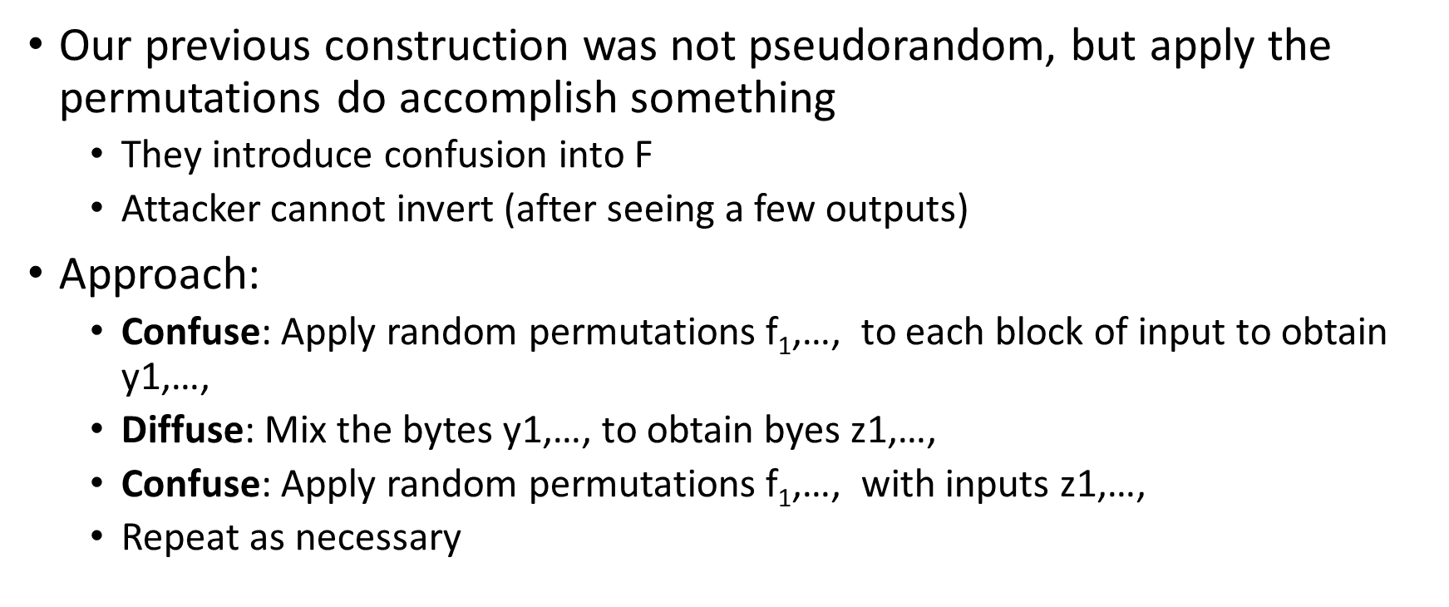
Confusion-Diffusion Paradigm
Our previous construction was not pseudorandom, but apply the permutations do accomplish something
  They introduce confusion into F
  Attacker cannot invert (after seeing a few outputs)
Approach:
  Confuse: Apply random permutations $\text{f}\text{1}\text{,…,}$ to each block of input to obtain y1,…,
  Diffuse: Mix the bytes y1,…, to obtain byes z1,…,
  Confuse: Apply random permutations $\text{f}\text{1}\text{,…,}$ with inputs z1,…,
  Repeat as necessary

Slide 13
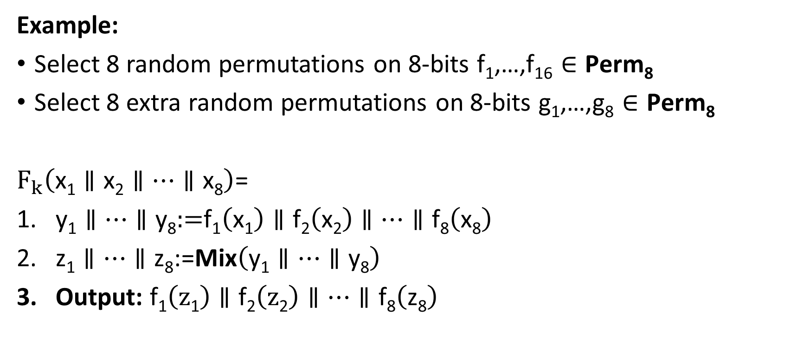
Confusion-Diffusion Paradigm
Example:
Select 8 random permutations on 8-bits $\text{f}\text{1}\text{,…,}\text{f}\text{16}∈\text{Perm}\text{8}$
Select 8 extra random permutations on 8-bits $\text{g}\text{1}\text{,…,}\text{g}\text{8}∈\text{Perm}\text{8}$
$F_{k}\left(\text{x}\text{1}∥\text{x}\text{2}∥…∥\text{x}\text{8}\right)$=
$\text{y}\text{1}∥…∥\text{y}\text{8}\text{:=}\text{f}\text{1}\left(\text{x}\text{1}\right)∥\text{f}\text{2}\left(\text{x}\text{2}\right)∥…∥\text{f}\text{8}\left(\text{x}\text{8}\right)$
$\text{z}\text{1}∥…∥\text{z}\text{8}\text{:=}\text{Mix}\left(\text{y}\text{1}∥…∥\text{y}\text{8}\right)$
Output: $\text{f}\text{1}\left(\text{z}\text{1}\right)∥\text{f}\text{2}\left(\text{z}\text{2}\right)∥…∥\text{f}\text{8}\left(\text{z}\text{8}\right)$

Slide 14

Example Mixing Function
$\text{Mix}\left(\text{y}\text{1}∥…∥\text{y}\text{8}\right)$=
For i=1 to 8
$\text{z}\text{i}\text{:=}\text{y}\text{1}\text{[}\text{i}\text{]}∥…∥\text{y}\text{8}\text{[}\text{i}\text{]}$
End For
Output: $\text{g}\text{1}\left(\text{z}\text{1}\right)∥\text{g}\text{2}\left(\text{z}\text{2}\right)∥…∥\text{g}\text{8}\left(\text{z}8\right)$

Slide 15
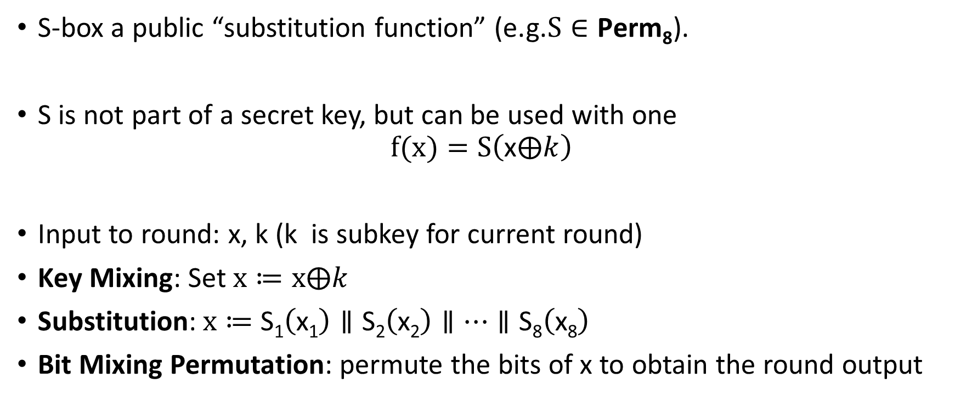
Substitution Permutation Networks
S-box a public “substitution function” (e.g.$S∈\text{Perm}\text{8}$).
S is not part of a secret key, but can be used with one
$$f(x)=S\left(\text{x}⨁k\right)$$
Input to round: x, k (k is subkey for current round)
Key Mixing: Set $x≔x⨁k$
Substitution:$x≔$ $\text{S}\text{1}\left(\text{x}\text{1}\right)∥\text{S}\text{2}\left(\text{x}\text{2}\right)∥…∥\text{S}\text{8}\left(\text{x}\text{8}\right)$
Bit Mixing Permutation: permute the bits of x to obtain the round output
Note: there are only n! possible bit mixing permutations of [n] as opposed to 2^{n}! Permutations of {0,1}^{n}

Slide 16
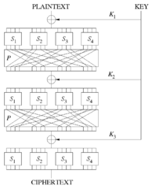
Substitution Permutation Networks
Proposition 6.3: Let F be a keyed function defined by a Substitution Permutation Network. Then for any keys/number of rounds F_{k} is a permutation.
Why? Composing permutations f,g results in another permutation h(x)=g(f(x)).

Slide 17
Remarks
Want to achieve “avalanche effect” (one bit change should “affect” every output bit)
Should a S-box be a random byte permutation?
Better to ensure that S(x) differs from x on at least 2-bits (for all x)
  Helps to maximize “avalanche effect”
Mixing Permutation should ensure that output bits of any given S-box are used as input to multiple S-boxes in the next round

Slide 18
Remarks
How many rounds?
Informal Argument: If we ensure that S(x) differs from S(x’) on at least 2-bits (for all x,x’ differing on at least 1 bit) then every input bit effects
  2 bits of round 1 output
  4 bits of round 2 output
  8 bits of round 3 output
  ….
  128 bits of round 4 output
Need at least 7 rounds (minimum) to ensure that every input bit effects every output bit

Slide 19
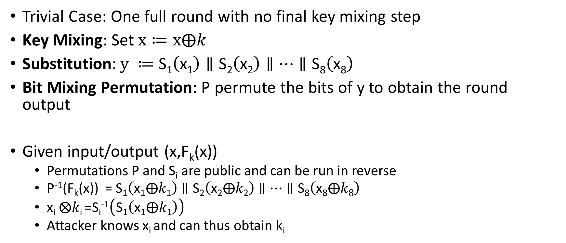
Attacking Lower Round SPNs
Trivial Case: One full round with no final key mixing step
Key Mixing: Set $x≔x⨁k$
Substitution:$y ≔$ $\text{S}\text{1}\left(\text{x}\text{1}\right)∥\text{S}\text{2}\left(\text{x}\text{2}\right)∥…∥\text{S}\text{8}\left(\text{x}\text{8}\right)$
Bit Mixing Permutation: P permute the bits of y to obtain the round output
Given input/output (x,F_{k}(x))
  Permutations P and S_{i} are public and can be run in reverse
  P⁻¹(F_{k}(x)) = $\text{S}\text{1}\left(\text{x}\text{1}⨁k\text{1}\right)∥\text{S}\text{2}\left(\text{x}\text{2}⨁k\text{2}\right)∥…∥\text{S}\text{8}\left(\text{x}\text{8}⨁k8\right)$
  $\text{x}\text{i} ⨂k\text{i}$=S_{i}⁻¹$\left(\text{S}\text{1}\left(\text{x}\text{1}⨁k\text{1}\right)\right)$
  Attacker knows x_{i} and can thus obtain k_{i}

Slide 20
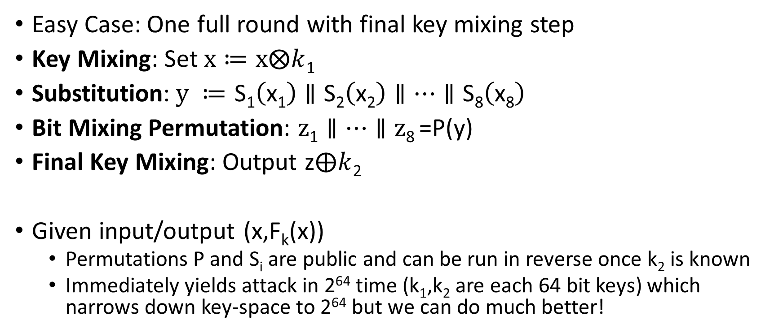
Attacking Lower Round SPNs
Easy Case: One full round with final key mixing step
Key Mixing: Set $x≔x⨂k$₁
Substitution:$y ≔$ $\text{S}\text{1}\left(\text{x}\text{1}\right)∥\text{S}\text{2}\left(\text{x}\text{2}\right)∥…∥\text{S}\text{8}\left(\text{x}\text{8}\right)$
Bit Mixing Permutation: $z\text{1}∥…∥\text{z}\text{8}$=P(y)
Final Key Mixing: Output z$⨁k$₂
Given input/output (x,F_{k}(x))
  Permutations P and S_{i} are public and can be run in reverse once k₂ is known
  Immediately yields attack in 2⁶⁴ time (k₁,k₂ are each 64 bit keys) which narrows down key-space to 2⁶⁴ but we can do much better!

Slide 21
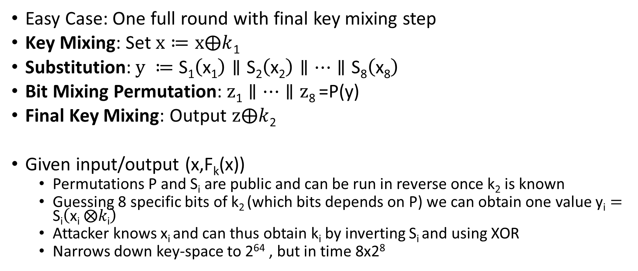
Attacking Lower Round SPNs
Easy Case: One full round with final key mixing step
Key Mixing: Set $x≔x⨁k$₁
Substitution:$y ≔$ $\text{S}\text{1}\left(\text{x}\text{1}\right)∥\text{S}\text{2}\left(\text{x}\text{2}\right)∥…∥\text{S}\text{8}\left(\text{x}\text{8}\right)$
Bit Mixing Permutation: $z\text{1}∥…∥\text{z}\text{8}$=P(y)
Final Key Mixing: Output $z⨁k$₂
Given input/output (x,F_{k}(x))
  Permutations P and S_{i} are public and can be run in reverse once k₂ is known
  Guessing 8 specific bits of k₂ (which bits depends on P) we can obtain one value $\text{y}\text{i}=\text{S}\text{i}\left(\text{x}\text{i} ⨂k\text{i}\right)$
  Attacker knows x_{i} and can thus obtain k_{i} by inverting S_{i} and using XOR
  Narrows down key-space to 2⁶⁴ , but in time 8x2⁸

Slide 22
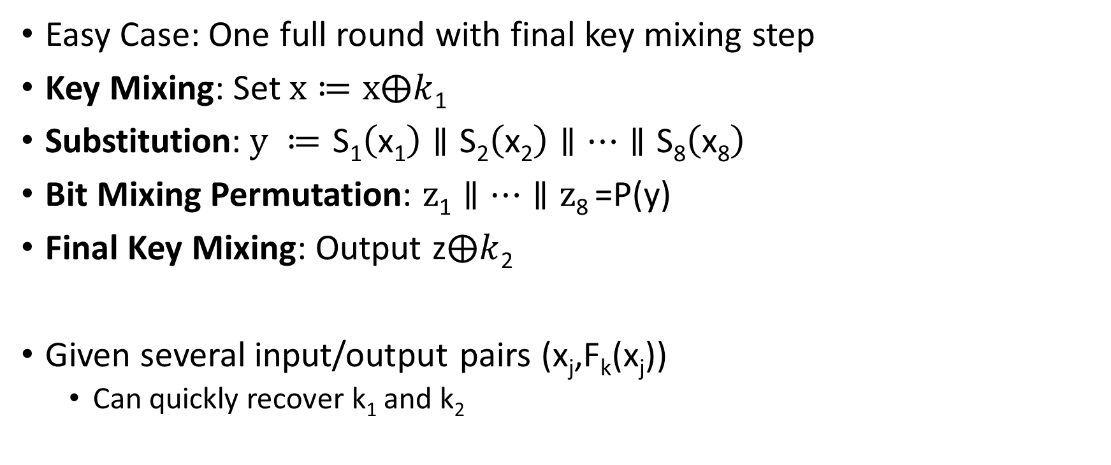
Attacking Lower Round SPNs
Easy Case: One full round with final key mixing step
Key Mixing: Set $x≔x⨁k$₁
Substitution:$y ≔$ $\text{S}\text{1}\left(\text{x}\text{1}\right)∥\text{S}\text{2}\left(\text{x}\text{2}\right)∥…∥\text{S}\text{8}\left(\text{x}\text{8}\right)$
Bit Mixing Permutation: $z\text{1}∥…∥\text{z}\text{8}$=P(y)
Final Key Mixing: Output z$⨁k$₂
Given several input/output pairs (x_{j},F_{k}(x_{j}))
  Can quickly recover k₁ and k₂

Slide 23
Attacking Lower Round SPNs
Harder Case: Two round SPN
Exercise ☺

Slide 24
Feistel Networks
Alternative to Substitution Permutation Networks
Advantage: underlying functions need not be invertible, but the result is still a permutation

Slide 25
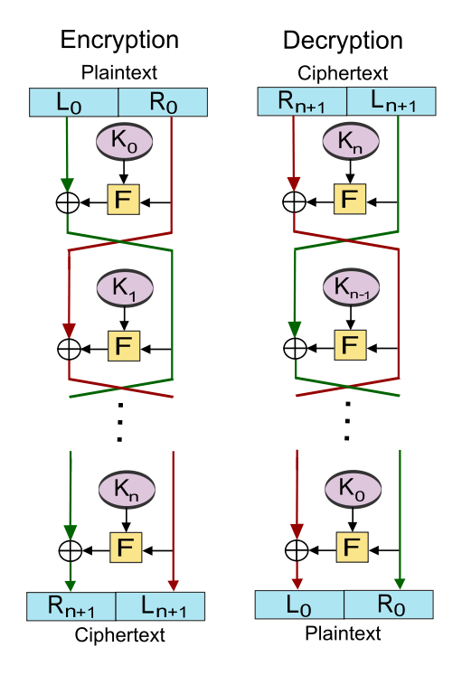
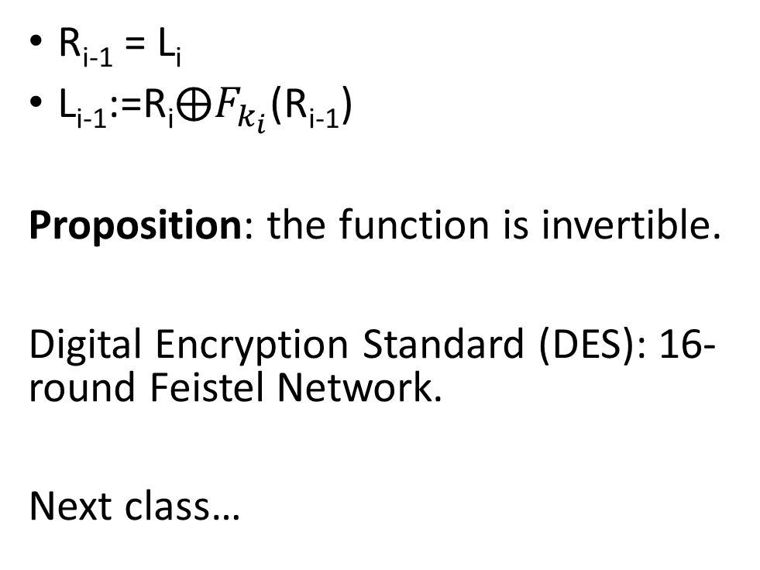
R_{i-1} = L_{i}
L_{i-1}:=$\text{R}\text{i}⨁F_{k_{i}}$(R_{i-1})
Proposition: the function is invertible.
Digital Encryption Standard (DES): 16-round Feistel Network.
Next class…

Slide 26
Next Class
Read Katz and Lindell 6.2.3-6.2.4
DES, 3DES & Attacks

