Slide 1
Cryptography CS 555
Topic 14: Random Oracle Model, Hashing Applications

Slide 2
Recap
HMACs
Birthday Attack
Small Space Birthday Attack
Precomputation Attack
Today’s Goals:
Random Oracle Model
Applications of Hash Functions

Slide 3
(Recap) Collision-Resistant Hash Function
Intuition: Hard for computationally bounded attacker to find x,y s.t.
H(x) = H(y)
How to formalize this intuition?
Attempt 1: For all PPT A,
$$Pr\left[A_{x,y}\left(1^{n}\right)=\left(x,y\right) s.t H\left(x\right)=H(y)\right]≤negl(n)$$
The Problem: Let x,y be given s.t. H(x)=H(y)
$$A_{x,y}\left(1^{n}\right)=(x,y)$$
We are assuming that |x| > |H(x)|. Why?
H(x)=x is perfectly collision resistant! (but with no compression)

Slide 4
(Recap) Keyed Hash Function Syntax
Two Algorithms
$\operatorname{Gen}{(1n;R)}$ (Key-generation algorithm)
Input: Random Bits R
Output: Secret key $s$
$H^{s}{(m)}$ (Hashing Algorithm)
Input: key $s$ and message $m∈{\left\{0,1\right\}}^{∗}$ (unbounded length)
Output: hash value${ H}^{s}{(m)}∈{\left\{0,1\right\}}^{ℓ\left(n\right)}$
Fixed length hash function
$m∈{\left\{0,1\right\}}^{ℓ′\left(n\right)}$ with$ℓ^{′}\left(n\right)>ℓ\left(n\right)$

Slide 5
When Collision Resistance Isn’t Enough
Example: Message Commitment
Alice sends Bob: $Hs\left(r∥m\right)$ (e.g., predicted winner of NCAA Tournament)
Alice can later reveal message (e.g., after the tournament is over)
Just send r and m (note: r has fixed length)
Why can Alice not change her message?
In the meantime Bob shouldn’t learn anything about m
Problem: Let (Gen,H’) be collision resistant then so is (Gen,H)
$$H^{s}\left(x1,…,xd\right)=H^{′s}\left(x1,…,xd\right)∥xd$$
Notes:
Why include r in the hash? Brute-force attack if message space is small…attacker can quickly learn message is not _____

Slide 6
When Collision Resistance Isn’t Enough
Problem: Let (Gen,H’) be collision resistant then so is (Gen,H)
$$H^{s}\left(x1,…,xd\right)=H^{′s}\left(x1,…,xd\right)∥xd$$
(Gen,H) definitely does not hide all information about input ($x1,…,xd$)
Conclusion: Collision resistance is not sufficient for message commitment

Slide 7
The Tension
Example: Message Commitment
Alice sends Bob: $Hs\left(r∥m\right)$ (e.g., predicted winners of NCAA Final Four)
Alice can later reveal message (e.g., after the Final Four is decided)
In the meantime Bob shouldn’t learn anything about m
This is still a reasonable approach in practice!
No attacks when instantiated with any reasonable candidate (e.g., SHA3)
Cryptographic hash functions seem to provide “something” beyond collision resistance, but how do we model this capability?

Slide 8
Random Oracle Model
Model hash function H as a truly random function
Algorithms can only interact with H as an oracle
Query: x
Response: H(x)
If we submit the same query you see the same response
If x has not been queried, then the value of H(x) is uniform
Real World: H instantiated as cryptographic hash function (e.g., SHA3) of fixed length (no Merkle-Damgård)

Slide 9
Back to Message Commitment
Example: Message Commitment
Alice sends Bob: $H\left(r∥m\right)$ (e.g., predicted winners of NCAA Final Four)
Alice can later reveal message (e.g., after the Final Four is decided)
Just send r and m (note: r has fixed length)
Why can Alice not change her message?
In the meantime Bob shouldn’t learn anything about m
Random Oracle Model: Above message commitment scheme is secure (Alice cannot change m + Bob learns nothing about m)
Information Theoretic Guarantee against any attacker with q queries to H
Notes:
Suppose when attacker submits query H(r’|m’) we tell him that r’ is correct/incorrect. As long as r’ is incorrect the attacker learns nothing in an information theoretic sense. The probability of submitting r’=r is at most (1/2^|r|)

Slide 10
Random Oracle Model: Pros
It is easier to prove security in Random Oracle Model
Suppose we are simulating attacker A in a reduction
Extractability: When A queries H at x we see this query and learn x (and can easily find H(x))
Programmability: We can set the value of H(x) to a value of our choice
As long as the value is correctly distribute i.e., close to uniform
Both Extractability and Programmability are useful tools for a security reduction!

Slide 11
Random Oracle Model: Pros
It is easier to prove security in Random Oracle Model
Provably secure constructions in random oracle model are often much more efficient (compared to provably secure construction is “standard model”
Sometimes we only know how to design provably secure protocol in random oracle model

Slide 12
Random Oracle Model: Cons
Lack of formal justification
Why should security guarantees translate when we instantiate random oracle with a real cryptographic hash function?
We can construct (contrived) examples of protocols which are
Secure in random oracle model…
But broken in the real world

Slide 13
Random Oracle Model: Justification
“A proof of security in the random-oracle model is significantly better than no proof at all.”
Evidence of sound design (any weakness involves the hash function used to instantiate the random oracle)
Empirical Evidence for Security
“there have been no successful real-world attacks on
schemes proven secure in the random oracle model”

Slide 14
Hash Function Application: Fingerprinting
The hash h(x) of a file x is a unique identifier for the file
Collision Resistance → No need to worry about another file y with H(y)=H(y)
Application 1: Virus Fingerprinting
Application 2: P2P File Sharing
Application 3: Data deduplication

Slide 15
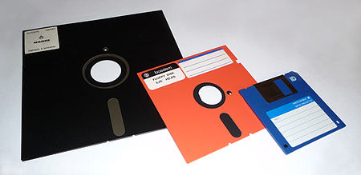
Tamper Resistant Storage
m₁
H(m₁)
m₁’

Slide 16
Tamper Resistant Storage
File Index | Hash
1 | H(m₁)
2 | H(m₂)
3 | H(m₃)
Disadvantage: Too many hashes to store
m₁,m₂,m₃
Send file 1
m₁’

Slide 17
Tamper Resistant Storage
Disadvantage: Need all files to compute hash m₁,m₂,m₃
H(m₁,m₂,m₃)
m₁,m₂,m₃
Send file 1
m₁’

Slide 18
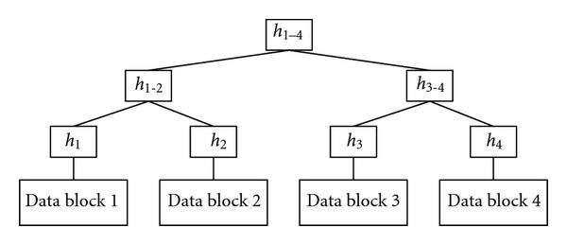
Merkle Trees
Proof of Correctness for data block 2
Verify that root matches
Proof consists of just log(n) hashes
Verifier only needs to permanently store
only one hash value

Slide 19
Merkle Trees
Theorem: Let (Gen, h^{s}) be a collision resistant hash function and let H^{s}(m)
return the root hash in a Merkle Tree. Then H^{s} is collision resistant.

Slide 20
Tamper Resistant Storage
Root: H₁₋₄
m₁,m₂,m₃,m₄
Send file 2
m₂’,h₁,h₃₋₄

Slide 21
Commitment Schemes
Alice wants to commit a message m to Bob
And possibly reveal it later at a time of her choosing
Properties
Hiding: commitment reveals nothing about m to Bob
Binding: it is infeasible for Alice to alter message

Slide 22
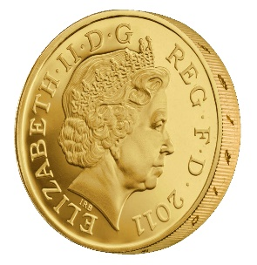
Commitment Hiding (${Hiding}_{A,Com}(n)$)
m₀,m₁
commit(r,m_{b})
b’
$${Hiding}_{A,Com}(n)\text{=}\left\{\begin{aligned}1 if b=b^{′} \\ 0 otherwise \end{aligned}\right.$$
r = Gen(.)
Bit b
$$∀PPT A ∃μ (negligible) s.t$$
$$Pr\left[{Hiding}_{A,Com}\left(n\right)=1\right]≤\frac{1}{2}+μ(n)$$

Slide 23
Commitment Binding (${Binding}_{A,Com}(n)$)
r₀,r₁,m₀,m₁
$${Binding}_{A,Com}(n)\text{=}\left\{\begin{aligned}1 if \text{commit}\text{(}\text{r}\text{0}\text{,}\text{m}\text{0}\text{)= }\text{commit}\text{(}\text{r}\text{1}\text{,}\text{m}\text{1}\text{) } \\ 0 otherwise \end{aligned}\right.$$
$$∀PPT A ∃μ (negligible) s.t$$
$$Pr\left[{Binding}_{A,Com}\left(n\right)=1\right]≤μ(n)$$

Slide 24
Secure Commitment Scheme
Definition: A secure commitment scheme is hiding and binding
Hiding
Binding
$$∀PPT A ∃μ (negligible) s.t$$
$$Pr\left[{Hiding}_{A,Com}\left(n\right)=1\right]≤\frac{1}{2}+μ(n)$$
$$∀PPT A ∃μ (negligible) s.t$$
$$Pr\left[{Binding}_{A,Com}\left(n\right)=1\right]≤μ(n)$$

Slide 25
Commitment Scheme in Random Oracle Model
Commit(r,m):=H(m|r)
Reveal(c):= (m,r)
Theorem: In the random oracle model this is a secure commitment scheme.

Slide 26
Commitment Hiding (${Hiding}_{A,Com}(n)$)
m₀,m₁
H(r,m_{b})
b’
$${Hiding}_{A,Com}(n)\text{=}\left\{\begin{aligned}1 ifb=b^{′} \\ 0 otherwise \end{aligned}\right.$$
r = Gen(.)
Bit b
$$∀PPT A making q\left(n\right) queries s.t$$
$$Pr\left[{Hiding}_{A,Com}\left(n\right)=1\right]≤\frac{1}{2}+\frac{q(n)}{2^{\left|r\right|}}$$
Notes:
Proof: Suppose we gave attacker extra information for every query. Tell him if r matches. Now unless he sends

Slide 27
Other Applications
Password Hashing
Key Derivation

Slide 28
Next Class
Read Katz and Lindell 6.1
Stream Ciphers

