Slide 1
Cryptography CS 555
Topic 13: HMACs and Generic Attacks

Slide 2
Recap
Cryptographic Hash Functions
Merkle-Damgård Transform
Today’s Goals:
HMACs (constructing MACs from collision-resistant hash functions)
Generic Attacks on Hash functions

Slide 3
MACs for Arbitrary Length Messages
Mac_{K}(m)=
Select random n/4 bit string r
Let $t_{i}={Mac}_{K}^{′}\left(r∥ℓ∥i{∥m}_{i}\right)$ for i=1,…,d
(Note: encode i and $ℓ$ as n/4 bit strings)
Output $\left\langle r,t_{1},…,t_{d}\right\rangle$
Theorem 4.8: If $Π$’ is a secure MAC for messages of fixed length n, above construction$Π=(Mac,Vrfy)$ is secure MAC for arbitrary length messages.
Notes:
Disadvage for not using randomized construction.
1. This may not be a Strong-MAC.

Slide 4
MACs for Arbitrary Length Messages
Two Disadvantages:
Lose Strong-MAC Guarantee
Security game arguably should give attacker Vrfy(.) oracle
(CPA vs CCA security)
Disadvantage 1: Long output
Mac_{K}(m)=
Select random n/4 bit string r
Let $t_{i}={Mac}_{K}^{′}\left(r∥ℓ∥i{∥m}_{i}\right)$ for i=1,…,d
(Note: encode i and $ℓ$ as n/4 bit strings)
Output $\left\langle r,t_{1},…,t_{d}\right\rangle$
Theorem 4.8: If $Π$’ is a secure MAC for messages of fixed length n, above construction$Π=(Mac,Vrfy)$ is secure MAC for arbitrary length messages.
Randomized Construction (no canonical verification). Disadvantage?
Notes:
Disadvage for not using randomized construction.
1. This may not be a Strong-MAC.

Slide 5
Hash and MAC Construction
Start with (Mac,Vrfy) a MAC for messages of fixed length and (Gen_{H},H) a collision resistant hash function
$${Mac}_{\left\langle KM,S\right\rangle }^{′}\left(m\right)={Mac}_{KM}^{}\left(H^{s}\left(m\right)\right)$$
Theorem 5.6: Above construction is a secure MAC.
Note: If ${Vrfy}_{KM}^{}\left(m,t\right)$ is canonical then ${Vrfy}_{\left\langle KM,S\right\rangle }^{′}\left(m,t\right)$ can be canonical.

Slide 6
Hash and MAC Construction
Start with (Mac,Vrfy) a MAC for messages of fixed length and (Gen_{H},H) a collision resistant hash function
$${Mac}_{\left\langle KM,S\right\rangle }^{′}\left(m\right)={Mac}_{KM}^{}\left(H^{s}\left(m\right)\right)$$
Theorem 5.6: Above construction is a secure MAC.
Proof Intuition: If attacker successfully forges a valid MAC tag t’ for unseen message m’ then either
Case 1: $H^{s}\left(m′\right)=H^{s}\left(mi\right)$ for some previously requested message m_{i}
Case 2: $H^{s}\left(m′\right)≠H^{s}\left(mi\right)$ for every previously requested message m_{i}

Slide 7
Hash and MAC Construction
Theorem 5.6: Above construction is a secure MAC.
Proof Intuition: If attacker successfully forges a valid MAC tag t’ for unseen message m’ then either
Case 1: $H^{s}\left(m′\right)=H^{s}\left(mi\right)$ for some previously requested message m_{i}
Attacker can find hash collisions!
Case 2: $H^{s}\left(m′\right)≠H^{s}\left(mi\right)$ for every previously requested message m_{i}
Attacker forged a valid new tag on the “new message” $H^{s}\left(m′\right)$
Violates security of the original fixed length MAC

Slide 8
MAC from Collision Resistant Hash
Failed Attempt:
Broken if $H^{s}$uses Merkle-Damgård Transform
${Mac}_{\left\langle k,S\right\rangle }^{}\left(m1∥m2∥m3\right)=h^{s}\left(h^{s}\left(h^{s}\left(h^{s}\left(0n∥k\right)∥m1\right)∥m2\right)∥m3\right)$
$$=h^{s}\left({Mac}_{\left\langle k,S\right\rangle }^{}\left(m1∥m2\right)∥m3\right)$$
Why does this mean ${Mac}_{\left\langle k,S\right\rangle }^{}$ is broken?
$${Mac}_{\left\langle k,S\right\rangle }^{}\left(m\right)=H^{s}\left(k∥m\right)$$

Slide 9
HMAC
$${Mac}_{\left\langle k,S\right\rangle }^{}\left(m\right)=H^{s}\left(\left(k⨁opad\right)∥H^{s}\left(\left(k⨁ipad\right)∥m\right)\right)$$
$$ipad?$$
Notes:
Bad joke, I know…

Slide 10
HMAC
$${Mac}_{\left\langle k,S\right\rangle }^{}\left(m\right)=H^{s}\left(\left(k⨁opad\right)∥H^{s}\left(\left(k⨁ipad\right)∥m\right)\right)$$
$$ipad=inner pad$$
$$opad=outer pad$$
Both ipad and opad are fixed constants.
Why use key twice?
Allows us to prove security from weak collision resistance of H^{s}
Notes:
Bad joke, I know…

Slide 11
HMAC Security
$${Mac}_{\left\langle k,S\right\rangle }^{}\left(m\right)=H^{s}\left(\left(k⨁opad\right)∥H^{s}\left(\left(k⨁ipad\right)∥m\right)\right)$$
Theorem (Informal): Assuming that $H^{s}$ is weakly collision resistant and that (certain other plausible assumptions hold) this is a secure MAC.
Weak Collision Resistance: Give attacker oracle access to${ f\left(m\right)= H}^{s}\left(k∥m\right)$ (secret key k remains hidden).
Attacker Goal: Find distinct m,m’ such that $f\left(m\right)=f\left(m′\right)$

Slide 12
HMAC in Practice
MD5 can no longer be viewed as collision resistant
However, HMAC-MD5 remained unbroken after MD5 was broken
Gave developers time to replace HMAC-MD5
Nevertheless, don’t use HMAC-MD5!
HMAC is efficient and unbroken
CBC-MAC was not widely deployed because it as “too slow”
Instead practitioners often used heuristic constructions (which were breakable)

Slide 13
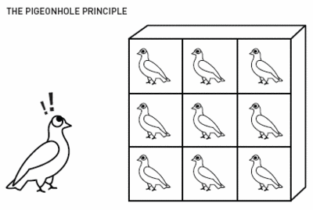
Finding Collisions
Can we do better?
Ideal Hashing Algorithm
Random function H from {0,1}* to {0,1}$ℓ$
Suppose attacker has oracle access to H(.)
Attack 1: Evaluate H(.) on 2$ℓ$+1 distinct inputs.

Slide 14
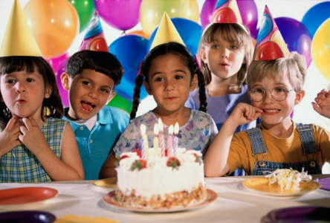
Birthday Attack for Finding Collisions
Ideal Hashing Algorithm
Random function H from {0,1}* to {0,1}$ℓ$
Suppose attacker has oracle access to H(.)
Attack 2: Evaluate H(.) on ${q=2}^{\left(ℓ/2\right)+1}+1$ distinct inputs x₁,…,x_{q}.
$$Pr\left[∀i<j. H(\text{x}\text{i})≠H(\text{x}\text{j})\right]=1\left(1−\frac{1}{2^{ℓ}}\right)\left(1−\frac{2}{2^{ℓ}}\right)\left(1−\frac{3}{2^{ℓ}}\right)…\left(1−\frac{2^{\left(ℓ/2\right)+1}}{2^{ℓ}}\right)<\frac{1}{2}$$

Slide 15
Birthday Attack for Finding Collisions
Ideal Hashing Algorithm
Random function H from {0,1}* to {0,1}$ℓ$
Suppose attacker has oracle access to H(.)
Attack 2: Evaluate H(.) on ${q=2}^{\left(ℓ/2\right)+1}+1$ distinct inputs x₁,…,x_{q}.
Store values $\left(\text{x}\text{i},H(\text{x}\text{i})\right)$ in a hash table of size q
Requires time/space $\text{O}(q)=O\left(\sqrt{2^{ℓ}}\right)$
Can we do better?

Slide 16
Small Space Birthday Attack
Attack 2: Select random $\text{x}\text{0}$, define $\text{x}\text{i}=H(\text{x}\text{i}\text{−1})$
$\text{Initialize}\text{: }\text{x}\text{=}\text{x}\text{0}$ and $\text{x}\text{′}\text{=}\text{x}\text{0}$
Repeat for i=1,2,…
$\text{x}\text{:}\text{=}\text{H}\text{(}\text{x}\text{) }\text{now} x =\text{x}\text{i}$
$\text{x}\text{′:=}\text{H}\text{(}\text{H}\text{(}\text{x}\text{′))}$ now $x′=\text{x}\text{2}\text{i}$
If x=x’ then break
$\text{Reset} \text{x}\text{=}\text{x}\text{0}$ and set $\text{x}\text{′=}\text{x}$
Repeat for j=1 to i
If H(x) = H(x’) then output x,x’
Else x:= H(x), x’ = H(x) Now x=$\text{x}\text{j}$ AND $x′=\text{x}\text{i}\text{+}\text{j}$

Slide 17
Small Space Birthday Attack
Finds collision after O$\left(2^{ℓ/2}\right)$steps in expectation
Attack 2: Select random $\text{x}\text{0}$, define $\text{x}\text{i}=H(\text{x}\text{i}\text{−1})$
$\text{Initialize}\text{: }\text{x}\text{=}\text{x}\text{0}$ and $\text{x}\text{′}\text{=}\text{x}\text{0}$
Repeat for i=1,2,…
$\text{x}\text{:}\text{=}\text{H}\text{(}\text{x}\text{) }\text{now} x =\text{x}\text{i}$
$\text{x}\text{′:=}\text{H}\text{(}\text{H}\text{(}\text{x}\text{′))}$ now $x′=\text{x}\text{2}\text{i}$
If x=x’ then break
$\text{Reset} \text{x}\text{=}\text{x}\text{0}$ and set $\text{x}\text{′=}\text{x}$
Repeat for j=1 to i
If H(x) = H(x’) then output x,x’
Else x:= H(x), x’ = H(x) Now x=$\text{x}\text{j}$ AND $x′=\text{x}\text{i}\text{+}\text{j}$
Notes:
Let j denote the length of the chain before the cycle starts (3) in the example and let c denote the length of the cycle
Let c denote length of cycle and suppose that x_{2i} = x_i then we have 2i-j=i-j mod c. Implies that 2i=c+i.
We have h(x_{j-1}) = h(x_{j+c-1}),
X reaches x_{j-1} in j-1 steps and x’ reaches x_{j+c-1}=x_{j+2c-1} in j-1 – steps (since we start at j)

Slide 18
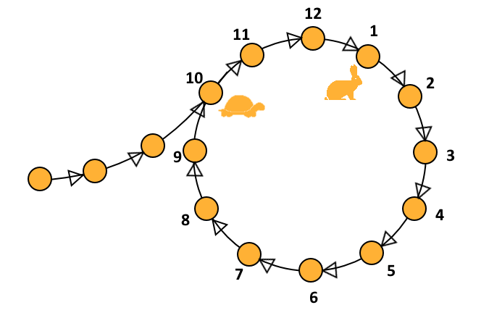
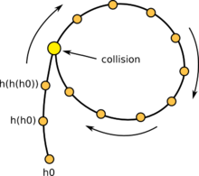
Floyd’s Cycle Finding Algorithm
A cycle denotes a hash collision
Occurs after O$\left(2^{ℓ/2}\right)$ steps by birthday paradox
First attack phase detects cycle
Second phase identifies collision
Analogy: Cycle detection in linked list
Can traverse “linked list” by computing H
Notes:
Let j denote the length of the chain before the cycle starts (3) in the example and let c denote the length of the cycle
Let c denote length of cycle and suppose that x_{2i} = x_i then we have 2i-j=i-j mod c. Implies that 2i=c+i.
We have h(x_{j-1}) = h(x_{j+c-1}),
X reaches x_{j-1} in j-1 steps and x’ reaches x_{j+c-1}=x_{j+2c-1} in j-1 – steps (since we start at j)

Slide 19
Small Space Birthday Attack
Can be adapted to find “meaningful collisions” if we have a large message space O$\left(2^{ℓ}\right)$
Example: $S=S_{1}∪S_{2}$ with $\left|S_{1}\right|=\left|S_{2}\right|=2^{ℓ−1}$
$S_{1}$ = Set of positive recommendation letters
$S_{2}$ = Set of negative recommendation letters
Goal: find ${z1∈S}_{1}$, ${z2∈S}_{2}$, such that H(z₁) = H(z₂)
Can adapt previous attack by assigning unique binary string $b\left(x\right)∈\left\{0,1\right\}ℓ$ of length to each $x∈S$
$$\text{x}\text{i}=H(\text{b}\left(\text{x}\text{i}\text{−1}\right))$$

Slide 20
Targeted Collision (e.g., Password Cracking)
Attacker is given y=H(pwd)
Goal find x’ s.t. H(x’) = y
There is an attack which requires
Precomputation Time: $O(\left|PASSWORDS\right|)$
Space: ${\left|PASSWORDS\right|}^{2/3}$
On input y finds pwd in Time:${ \left|PASSWORDS\right|}^{2/3}$
Cracking costs amortize over many users…
Other time-memory tradeoffs are possible…
Defense 1: y=H(pwd|salt) [password salting]
Defense 2: Make sure that H is moderately expensive to compute (MHFs)
Notes:
Expected number of j’s such that EP_{j}=y_{i} is s/2$ℓ$

Slide 21
Targeted Collision (e.g., Password Cracking)
Attacker is given y=H(x)
Goal find x’ s.t. H(x’) = y
Precomputation (sketch)
Store $s=2^{ℓ/3}$ pairs $\left(\text{S}\text{P}\text{i}\text{,}\text{E}\text{P}\text{i}\right)$ where$\text{EP}\text{i}=Ht\left(\text{SP}\text{i}\right)$ and t = $2^{ℓ/3}$
Let y=y₀
For i=1,2…., $2^{ℓ/3}$
$\text{y}\text{i}=H(\text{y}\text{i}\text{−1})$
For each j s.t EP_{j}=y_{i}
Check if y is in the hash chain $\left(\text{SP}\text{i}\text{,}\text{EPi}\right)$
Yes → Found desired x’
Space: $2^{ℓ/3}$
Precomputation Time: $2^{2ℓ/3}$
Total $\#j^{′}s=\frac{st2}{2^{ℓ }}<O(1)$
Total $Runtime=O\left(t\right)=O(2^{ℓ/3})$
S$uccess Rate≈\frac{1}{4t}$
Notes:
Expected number of j’s such that EP_{j}=y_{i} is s/2$ℓ$

Slide 22
Targeted Collision (e.g., Password Cracking)
Attacker is given y=H(x)
Goal find x’ s.t. H(x’) = y
Precomputation (sketch)
Store $4st={4×2}^{2ℓ/3}$ pairs $\left({SP}_{i}^{j}\text{,}{EP}_{i}^{j}\right)$ where${ EP}_{i}^{j}=Ht\left(cj⨁\text{SP}\text{i}\right)$ and t = $2^{ℓ/3}$
Let y=y₀
For i=1,2…., $2^{ℓ/3}$
${ y}_{i}^{j}=H(cj⨁\text{y}\text{i}\text{−1})$
Foreach j s.t ${ EP}_{i}^{j}={ y}_{i}^{j}$
Check if y is in the hash chain $\left(\text{SP}\text{i}\text{,}\text{EPi}\right)$
Yes → Found desired x’
Space: $2^{2ℓ/3}$
Precomputation Time: $2^{ℓ}$=$2^{2ℓ/3}2^{ℓ/3}$
Repeat for each j < t
Total $Runtime=O\left(t×t\right)=O(2^{2ℓ/3})$
S$uccess Rate>0.63$
Notes:
Expected number of j’s such that EP_{j}=y_{i} is s/2$ℓ$

Slide 23
Targeted Collisions (Other Applications)
Define H(K) = F_{k}(x)
Suppose attacker obtains a pair x,F_{k}(x) (chosen plaintext attack)
There is a key recovery attack with
Precomputation Time: $\left|𝒦\right|$
Space: ${ \left|𝒦\right|}^{2/3}$
Cracking Time: ${ \left|𝒦\right|}^{2/3}$
Precomputation costs amortize if we are attacking multiple different keys
As long as we have x,F_{k’}(x) we don’t need to repeat precomputation phase

Slide 24
Next Class
Read Katz and Lindell 5.5-5.6
Random Oracle Model + Applications of Hashing.

