Slide 1
Homework 2 Posted
Due Friday, February 17th at the beginning of class.
Topics
  Pseudorandom Permutations
  (Weak) Pseudorandom Functions
  MACs
  Hashing

Slide 2
Cryptography
CS 555
Topic 12: Cryptographic Hash Functions

Slide 3
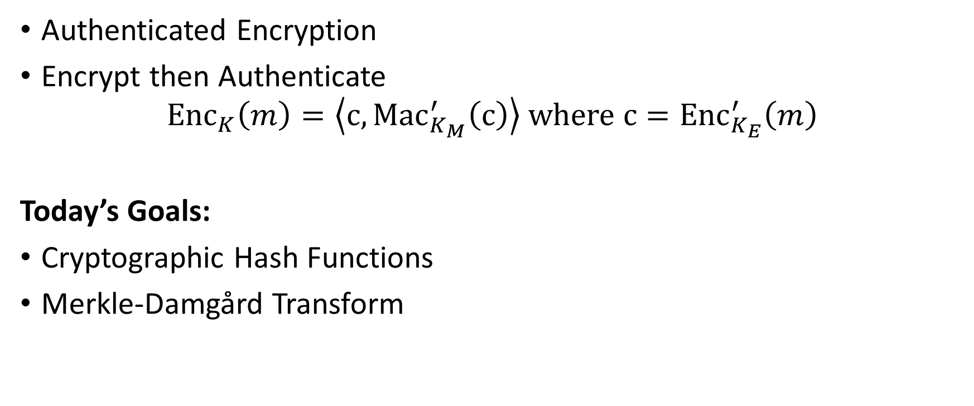
Recap
Authenticated Encryption
Encrypt then Authenticate
$${Enc}_{K}\left(m\right)=\left\langle c,{Mac}_{K_{M}}^{′}\left(c\right)\right\rangle where{ c=Enc}_{K_{E}}^{′}\left(m\right)$$
Today’s Goals:
Cryptographic Hash Functions
Merkle-Damgård Transform

Slide 4
Hash Functions
H(x)=y
Long Input: x
Short Output: y

Slide 5
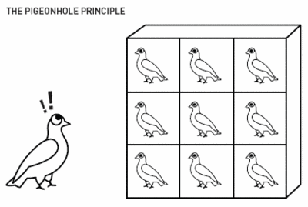
Pigeonhole Principle
“You cannot fit 10 pigeons into 9 pigeonholes”

Slide 6
Hash Collisions
By Pigeonhole Principle there must exist x and y s.t.
H(x) = H(y)

Slide 7
Classical Hash Function Applications
Hash Tables
  O(1) lookup*
“Good hash function” should yield “few collisions”
* Certain terms and conditions apply

Slide 8
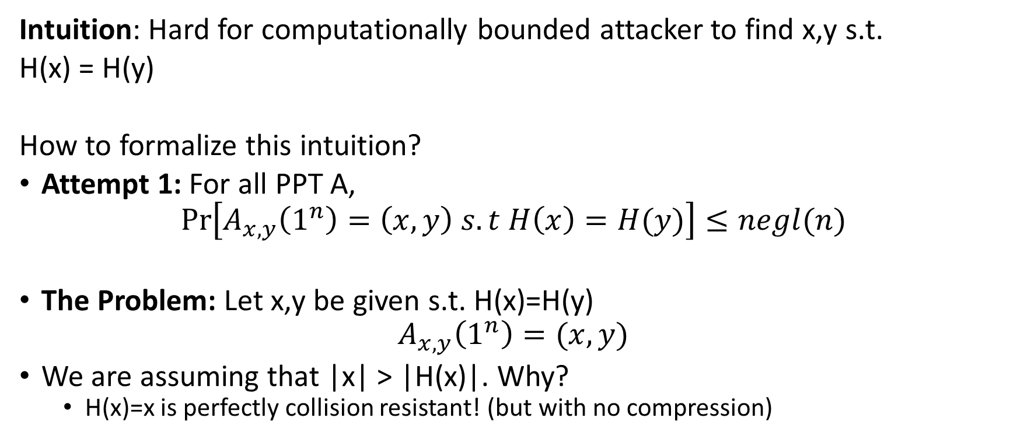
Collision-Resistant Hash Function
Intuition: Hard for computationally bounded attacker to find x,y s.t.
H(x) = H(y)
How to formalize this intuition?
Attempt 1: For all PPT A,
$$Pr\left[A_{x,y}\left(1^{n}\right)=\left(x,y\right) s.t H\left(x\right)=H(y)\right]≤negl(n)$$
The Problem: Let x,y be given s.t. H(x)=H(y)
$$A_{x,y}\left(1^{n}\right)=(x,y)$$
We are assuming that |x| > |H(x)|. Why?
  H(x)=x is perfectly collision resistant! (but with no compression)

Slide 9
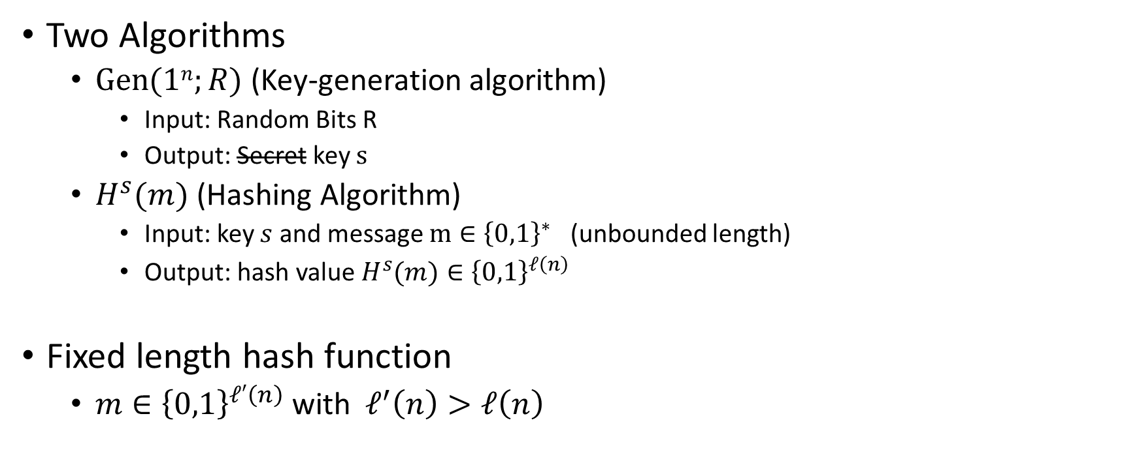
Keyed Hash Function Syntax
Two Algorithms
  $\operatorname{Gen}{(1n;R)}$ (Key-generation algorithm)
    Input: Random Bits R
    Output: Secret key $s$
  $H^{s}{(m)}$ (Hashing Algorithm)
    Input: key $s$ and message $m∈{\left\{0,1\right\}}^{∗}$ (unbounded length)
    Output: hash value${ H}^{s}{(m)}∈{\left\{0,1\right\}}^{ℓ\left(n\right)}$
Fixed length hash function
  $m∈{\left\{0,1\right\}}^{ℓ′\left(n\right)}$ with$ℓ^{′}\left(n\right)>ℓ\left(n\right)$

Slide 10


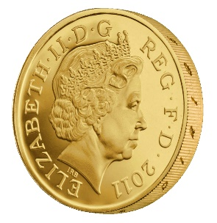



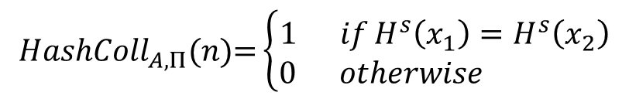
Collision Experiment (${HashColl}_{A,Π}(n)$)
s
x₁,x₂
$${HashColl}_{A,Π}(n)\text{=}\left\{\begin{aligned}1 ifH^{s}\left(x_{1}\right)=H^{s}\left(x_{2}\right) \\ 0 otherwise \end{aligned}\right.$$
$$s=Gen{(1n;R)}$$
Definition: (Gen,H) is a collision resistant hash function if
$$∀PPT A ∃μ (negligible) s.t$$
$$Pr\left[{HashColl}_{A,Π}(n)\text{=}1\right]≤μ(n)$$

Slide 11
Collision Experiment (${HashColl}_{A,Π}(n)$)
For simplicity we will sometimes just say that H (or H^{s}) is a collision resistant hash function
s
Key is not key secret (just random)
x₁,x₂
$${HashColl}_{A,Π}(n)\text{=}\left\{\begin{aligned}1 ifH^{s}\left(x_{1}\right)=H^{s}\left(x_{2}\right) \\ 0 otherwise \end{aligned}\right.$$
$$s=Gen{(1n;R)}$$
Definition: (Gen,H) is a collision resistant hash function if
$$∀PPT A ∃μ (negligible) s.t$$
$$Pr\left[{HashColl}_{A,Π}(n)\text{=}1\right]≤μ(n)$$

Slide 12
Theory vs Practice
Most cryptographic hash functions used in practice are un-keyed
  Examples: MD5, SHA1, SHA2, SHA3
Tricky to formally define collision resistance for keyless hash function
  There is a PPT algorithm to find collisions
  We just usually can’t find this algorithm ☺

Slide 13
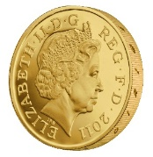
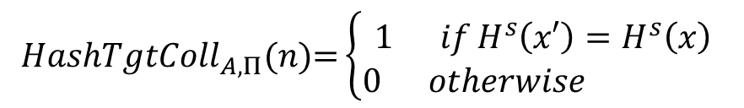

Weaker Requirements for Cryptographic Hash
Target-Collision Resistance
s,x
x’
$${HashTgtColl}_{A,Π}(n)\text{=}\left\{\begin{aligned}1 ifH^{s}\left(x′\right)=H^{s}\left(x\right) \\ 0 otherwise \end{aligned}\right.$$
$$s=Gen{(1n;R)}$$
$${x∈\left\{0,1\right\}}^{n}$$
Question: Why is collision resistance stronger?

Slide 14
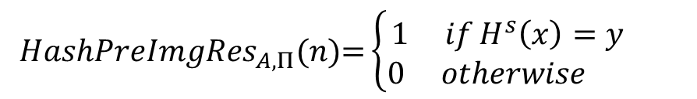



Weaker Requirements for Cryptographic Hash
Preimage Resistance (One-Wayness)
s, $y$
$$\text{x}$$
$${HashPreImgRes}_{A,Π}(n)\text{=}\left\{\begin{aligned}1 ifH^{s}\left(x\right)=y \\ 0 otherwise \end{aligned}\right.$$
$$s=Gen{(1n;R)}$$
$${y∈\left\{0,1\right\}}^{ℓ(n)}$$
Question: Why is collision resistance stronger?

Slide 15
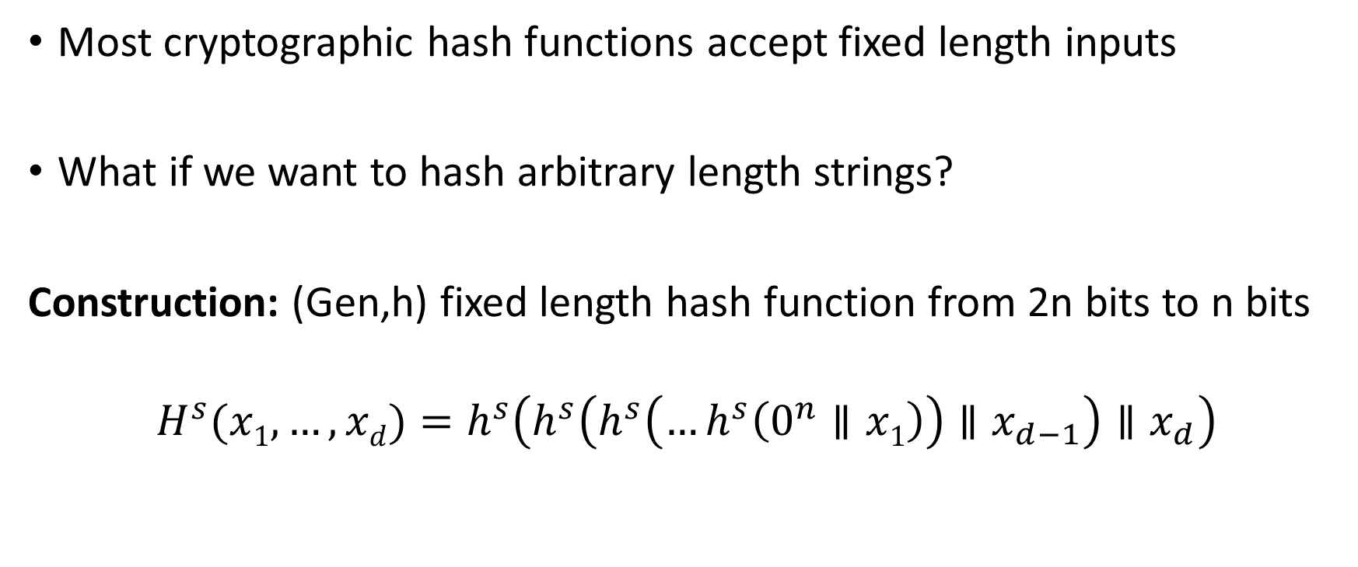
Merkle-Damgård Transform
Most cryptographic hash functions accept fixed length inputs
What if we want to hash arbitrary length strings?
Construction: (Gen,h) fixed length hash function from 2n bits to n bits
$$H^{s}{(x1,…,xd)}=h^{s}\left(h^{s}\left(h^{s}\left(…h^{s}\left(0^{n}∥x1\right)\right)∥x_{d−1}\right)∥x_{d}\right)$$

Slide 16
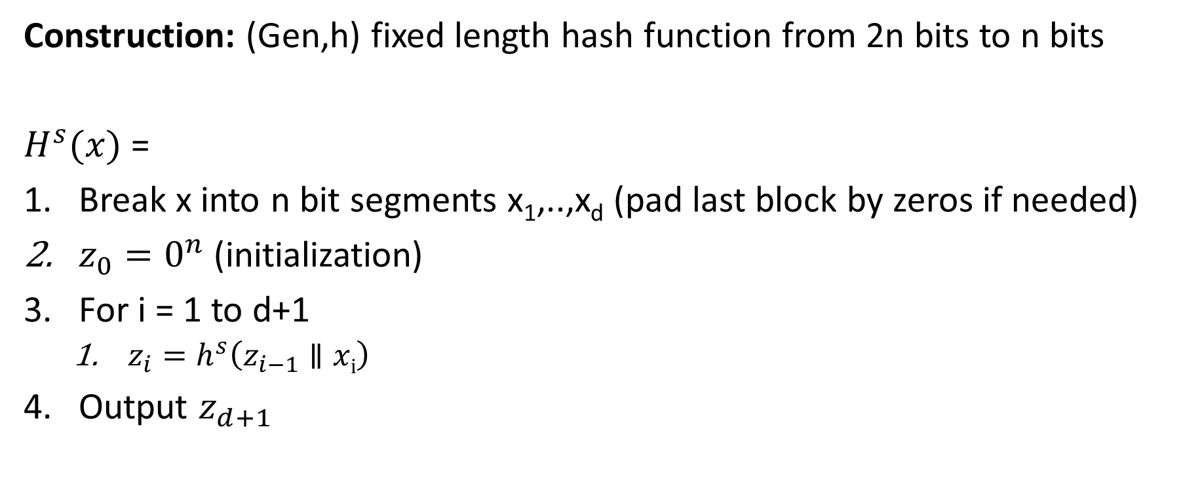
Merkle-Damgård Transform
Construction: (Gen,h) fixed length hash function from 2n bits to n bits
$H^{s}{(x)}$ =
Break x into n bit segments x₁,..,x_{d} (pad last block by zeros if needed)
$z_{0}=0^{n}$ (initialization)
For i = 1 to d+1
  $z_{i}=h^{s}\left(z_{i−1}∥xi\right)$
Output $z_{d+1}$

Slide 17
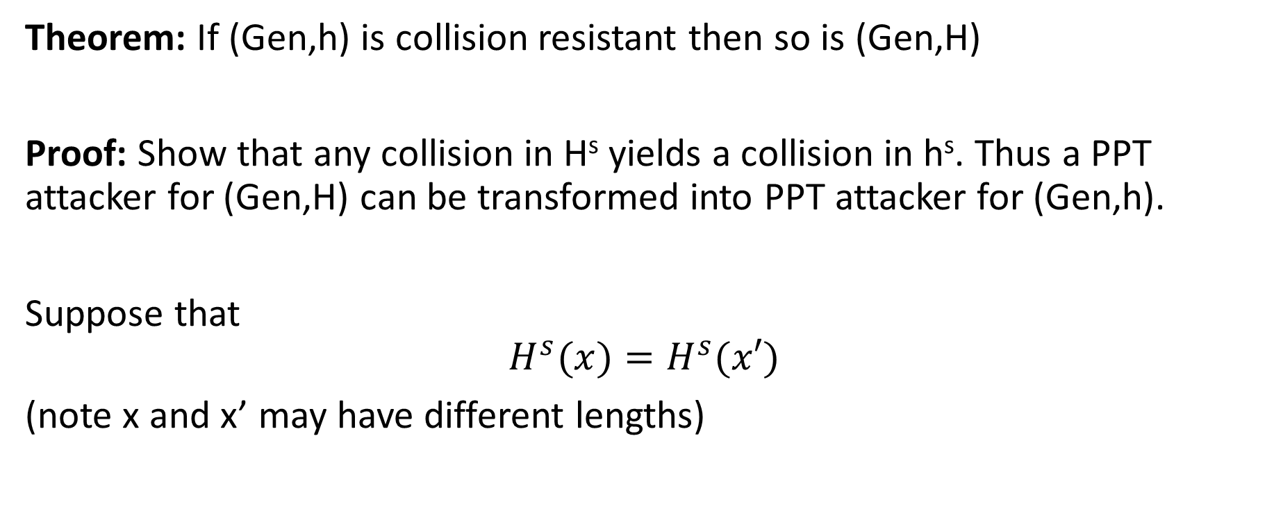
Merkle-Damgård Transform
Theorem: If (Gen,h) is collision resistant then so is (Gen,H)
Proof: Show that any collision in H^{s} yields a collision in h^{s}. Thus a PPT attacker for (Gen,H) can be transformed into PPT attacker for (Gen,h).
Suppose that
$$H^{s}{(x)}=H^{s}{(x′)}$$
(note x and x’ may have different lengths)

Slide 18

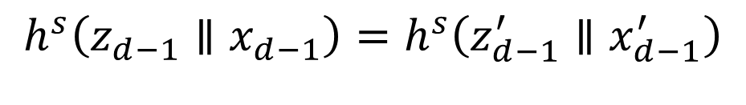
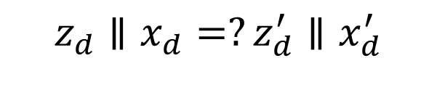
Merkle-Damgård Transform
Theorem: If (Gen,h) is collision resistant then so is (Gen,H)
Proof: Suppose that
$$H^{s}{(x)}=H^{s}{(x′)}$$
Case 1: |x|=|x’| (proof for case two is similar)
$${H^{s}{(x)}=z}_{d+1}=h^{s}\left(z_{d}∥x_{d}\right){=H}^{s}{(x′)}=z_{d+1}^{′}=h^{s}\left(z_{d}^{′}∥x_{d}^{′}\right)$$
$$z_{d}∥x_{d}=?z_{d}^{′}∥x_{d}^{′}$$
No → Found collision
Yes?
$$h^{s}\left(z_{d−1}∥x_{d−1}\right)=h^{s}\left(z_{d−1}^{′}∥x_{d−1}^{′}\right)$$

Slide 19
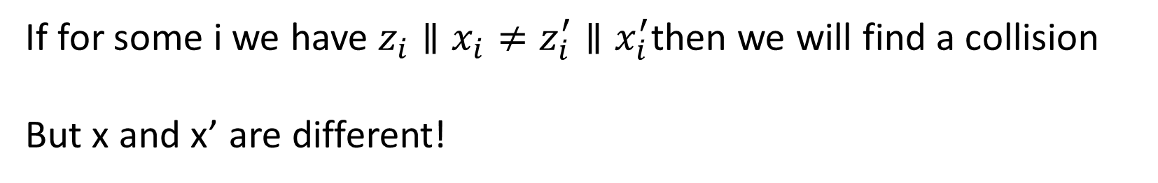

Merkle-Damgård Transform
Theorem: If (Gen,h) is collision resistant then so is (Gen,H)
Proof: Suppose that
$$H^{s}{(x)}=H^{s}{(x′)}$$
Case 1: |x|=|x’| (proof for case two is similar)
If for some i we have $z_{i}∥x_{i}≠z_{i}^{′}∥x_{i}^{′}$then we will find a collision
But x and x’ are different!

Slide 20
Next Class
Read Katz and Lindell 5.3-5.4 + A.4
Appendix A.4 (“Birthday Problem”)
HMACs + Generic Attacks on Hash Functions
Work on Homework 2 ☺

