Slide 1
Cryptography CS 555
Topic 1: Course Overview & What is Cryptography

Slide 2
Administrative Note
Professor Blocki is traveling and will be back on Wednesday.
E-mail: jblocki@purdue.edu
Thanks to Professor Spafford for covering the first lecture!
https://www.cs.purdue.edu/homes/jblocki/courses/555_Spring17/index.html
(also on syllabus)

Slide 3
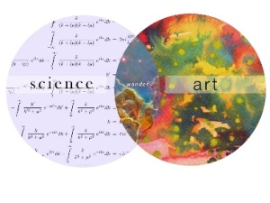
What is Cryptography?
“the art of writing or solving codes” – Concise Oxford English Dictionary

Slide 4
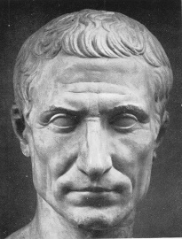
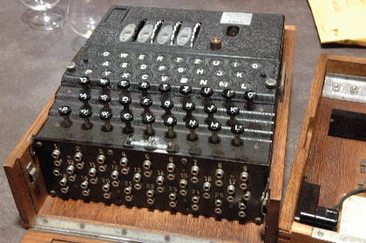
What is Cryptography?
“the art of writing or solving codes” – Concise Oxford English Dictionary
“The study of mathematical techniques for securing digital information, systems and distributed computation against adversarial attacks.”
-- Intro to Modern Cryptography
Late 20th century
Art
Science

Slide 5
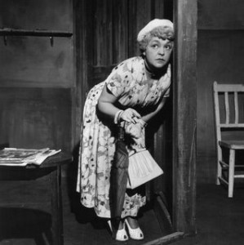
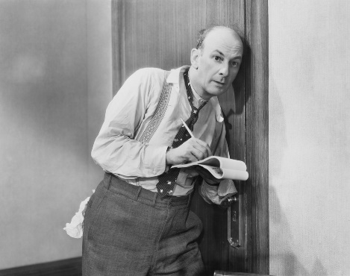
What Does It Mean to “Secure Information”
Confidentiality (Security/Privacy)
Only intended recipient can see the communication

Slide 6
What Does It Mean to “Secure Information”
Confidentiality (Security/Privacy)
Only intended recipient can see the communication
Integrity (Authenticity)
The message was actually sent by the alleged sender
I love you Alice… - Bob
We need to break up -Bob
Alice
Bob

Slide 7
Two Attacker Models
Passive Attacker
Attacker can eavesdrop
Protection Requires?
Confidentiality
Active Attacker
Has full control over communication channel
Protection Requires?
Confidentiality & Integrity

Slide 8
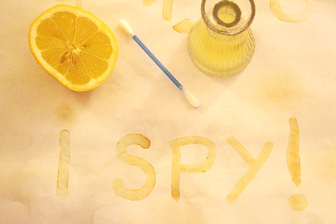
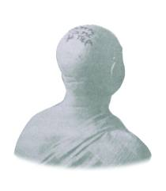
Steganography vs Cryptography
Steganography
Goal: Hide existence of a message
Invisible Ink, Tattoo Underneath Hair, …
Assumption: Method is secret
Notes:
Herodotus, an entertaining but less than reliable Greek historian, reports a more ingenious method. Histaeus, ruler of Miletus, wanted to send a message to his friend Aristagorus, urging revolt against the Persians. Histaeus shaved the head of his most trusted slave, then tattooed a message on the slave's scalp. After the hair grew back, the slave was sent to Aristagorus with the message safely hidden.
Later in Herodotus' histories, the Spartans received word that Xerxes was preparing to invade Greece. Their informant, Demeratus, was a Greek in exile in Persia. Fearing discovery, Demeratus wrote his message on the wood backing of a wax tablet. He then hid the message underneath a fresh layer of wax. The apparently blank tablet sailed easily past sentries on the road.
A more subtle method, nearly as old, is to use invisible ink. Described as early as the first century AD, invisible inks were commonly used for serious communications until WWII. The simplest are organic compounds, such as lemon juice, milk, or urine, all of which turn dark when held over a flame. In 1641, Bishop John Wilkins suggested onion juice, alum, ammonia salts, and for glow-in-the dark writing the "distilled Juice of Glowworms." Modern invisible inks fluoresce under ultraviolet light and are used as anti-counterfeit devices. For example, "VOID" is printed on checks and other official documents in an ink that appears under the strong ultraviolet light used for photocopies.
A modern area that is related to both is information hiding or covert channels. Embed messages in places not intended for storing information. They can use cryptographic approaches to ensure secrecy, and do not rely only on secrecy of method.

Slide 9
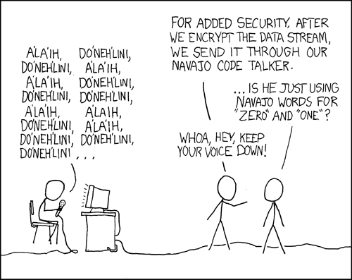
Steganography vs Cryptography
Steganography
Goal: Hide existence of a message
Invisible Ink, Tattoo Underneath Hair, …
Assumption: Method is secret
Cryptography
Goal: Hide the meaning of a message
Depends only on secrecy of a (short) key
Kerckhoff’s Principle: Cipher method should
not be required to be secret.
Notes:
Herodotus, an entertaining but less than reliable Greek historian, reports a more ingenious method. Histaeus, ruler of Miletus, wanted to send a message to his friend Aristagorus, urging revolt against the Persians. Histaeus shaved the head of his most trusted slave, then tattooed a message on the slave's scalp. After the hair grew back, the slave was sent to Aristagorus with the message safely hidden.
Later in Herodotus' histories, the Spartans received word that Xerxes was preparing to invade Greece. Their informant, Demeratus, was a Greek in exile in Persia. Fearing discovery, Demeratus wrote his message on the wood backing of a wax tablet. He then hid the message underneath a fresh layer of wax. The apparently blank tablet sailed easily past sentries on the road.
A more subtle method, nearly as old, is to use invisible ink. Described as early as the first century AD, invisible inks were commonly used for serious communications until WWII. The simplest are organic compounds, such as lemon juice, milk, or urine, all of which turn dark when held over a flame. In 1641, Bishop John Wilkins suggested onion juice, alum, ammonia salts, and for glow-in-the dark writing the "distilled Juice of Glowworms." Modern invisible inks fluoresce under ultraviolet light and are used as anti-counterfeit devices. For example, "VOID" is printed on checks and other official documents in an ink that appears under the strong ultraviolet light used for photocopies.
A modern area that is related to both is information hiding or covert channels. Embed messages in places not intended for storing information. They can use cryptographic approaches to ensure secrecy, and do not rely only on secrecy of method.

Slide 10
Symmetric Key Encryption
What cryptography has historically been all about (Pre 1970)
Two parties (sender and receiver) share secret key
Sender uses key to encrypt (“scramble”) the message before transmission
Receiver uses the key to decrypt (“unscramble”) and recover the original message

Slide 11
Encryption: Basic Terminology
Plaintext
The original message m
Plaintext Space (Message Space)
The set $ℳ$ of all possible plaintext messages
Example 1: $ℳ=\left\{{}^{′}attack^{′},{}_{}^{′}retreat^{′},{}_{}^{′}hold current position′\right\}$
Example 2: $ℳ=\left\{0,1\right\}n$ - $all n−bit messages$
Ciphertext $c∈𝒞$
An encrypted (“scrambled”) message $c∈𝒞$ (ciphertext space)
Key/Keyspace $k∈𝒦$

Slide 12
Private Key Encryption Syntax
Typically picks $k∈𝒦$
uniformly at random
Message Space: $ℳ$
Key Space: $𝒦$
Three Algorithms
$\operatorname{Gen}{(R)}$ (Key-generation algorithm)
Input: Random Bits R
Output: Secret key $k∈𝒦$
$\operatorname{Enck}{(m)}$ (Encryption algorithm)
Input: Secret key $k∈𝒦$ and message $m∈ℳ$
Output: ciphertext c
$\operatorname{Deck}{(c)}$ (Decryption algorithm)
Input: Secret key $k∈𝒦$ and a ciphertex$c$
Output: a plaintext message $m∈ℳ$
Invariant: Dec_{k}(Enc_{k}(m))=m
Trusted Parties (e.g., Alice and Bob) must run Gen in advance to obtain secret k.
Assumption: Adversary does not get to see output of Gen

Slide 13
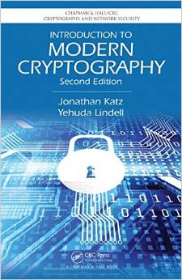
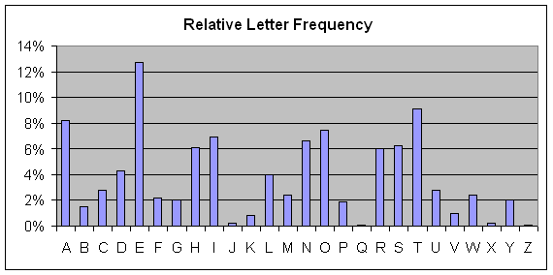
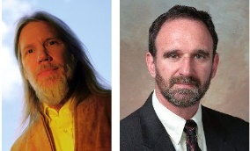
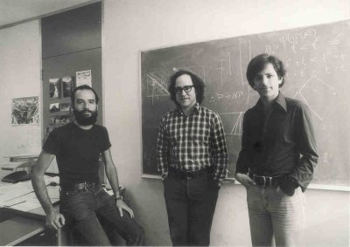
Cryptography History
2500+ years
Ongoing battle
Codemakers and codebreakers
Formalization of Modern Crypto (1976+)
Caesar Shift Cipher (50 BC)
Shannon Entropy/Perfect Secrecy
(~1950)
1970s
Cipher Machines (1900s)
Frequency Analysis
Public Key Crypto/RSA

Slide 14
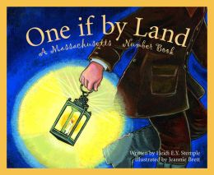
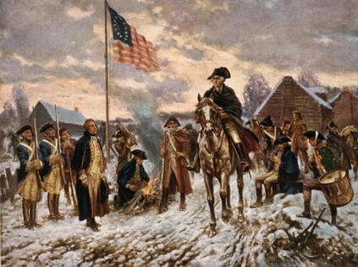
Who Uses Cryptography
Traditionally: Militias
Modern Times: Everyone!
Caesar Shift Cipher (50 BC)
Revolutionary War
Modern Crypto

Slide 15
Course Goals
Understand the mathematics underlying cryptographic algorithms and protocols
Understand the power (and limitations) of common cryptographic tools
Understand the formal approach to security in modern cryptography

Slide 16
Course Background
Some probability
Algorithms and complexity
General Mathematical Maturity
Understand what is (is not) a proper definition
Know how to write a proof

Slide 17
Coming Up…
Classic Ciphers + Frequency Analysis
Before Next Class
Read: Katz and Lindell 1.3
Plus Katz and Lindell 1.1-1.2 if you haven’t already

