Slide 1
Homework 2
Due: Tuesday, October 2nd at 3PM (beginning of class)
Please Typeset Your Solutions (LaTeX, Word etc…)
You may collaborate, but must write up your own solutions in your own words

Slide 2
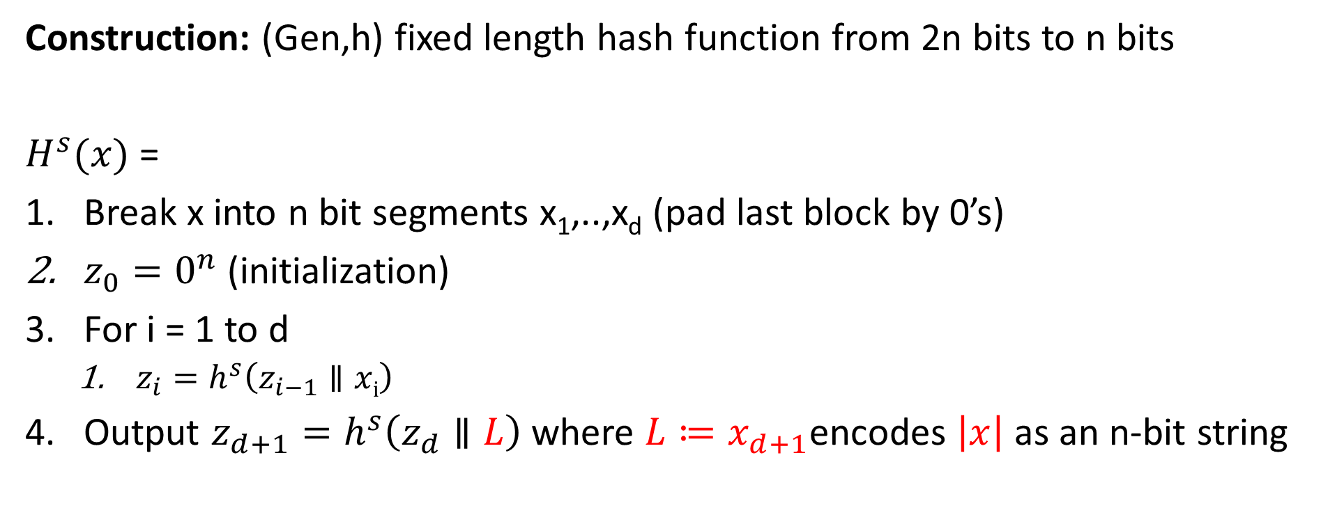
Merkle-Damgård Transform
Construction: (Gen,h) fixed length hash function from 2n bits to n bits
$H^{s}{(x)}$ =
Break x into n bit segments x₁,..,x_{d} (pad last block by 0’s)
$z_{0}=0^{n}$ (initialization)
For i = 1 to d
  $z_{i}=h^{s}\left(z_{i−1}∥xi\right)$
Output $z_{d+1}=h^{s}\left(z_{d}∥L\right)$ where $L≔x_{d+1}$encodes $\left|x\right|$ as an n-bit string

Slide 3
Cryptography
CS 555
Week 6:
Random Oracle Model
Applications of Hashing
Stream Ciphers (time permitting)
Block Ciphers
Feistel Networks
DES, 3DES
Readings: Katz and Lindell Chapter 6-6.2.4
Fall 2017

Slide 4
Recap
Hash Functions
  Definition
  Merkle-Damgard
HMAC construction
Generic Attacks on Hash Function
  Birthday Attack
  Small Space Birthday Attacks (cycle detection)
Pre-Computation Attacks: Time/Space Tradeoffs

Slide 5
Week 6: Topic 1:
Random Oracle Model + Hashing Applications

Slide 6
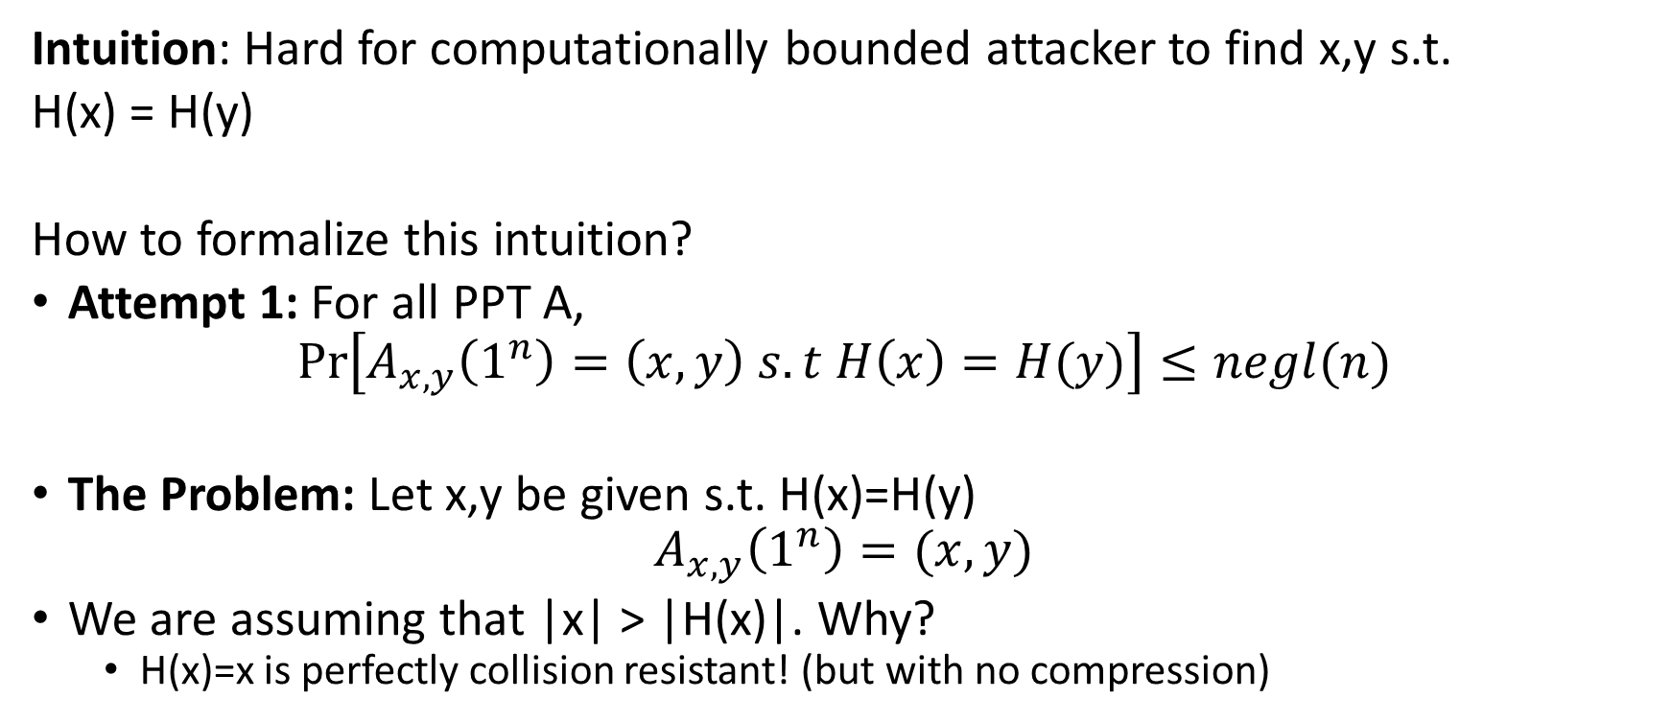
(Recap) Collision-Resistant Hash Function
Intuition: Hard for computationally bounded attacker to find x,y s.t.
H(x) = H(y)
How to formalize this intuition?
Attempt 1: For all PPT A,
$$Pr\left[A_{x,y}\left(1^{n}\right)=\left(x,y\right) s.t H\left(x\right)=H(y)\right]≤negl(n)$$
The Problem: Let x,y be given s.t. H(x)=H(y)
$$A_{x,y}\left(1^{n}\right)=(x,y)$$
We are assuming that |x| > |H(x)|. Why?
  H(x)=x is perfectly collision resistant! (but with no compression)

Slide 7
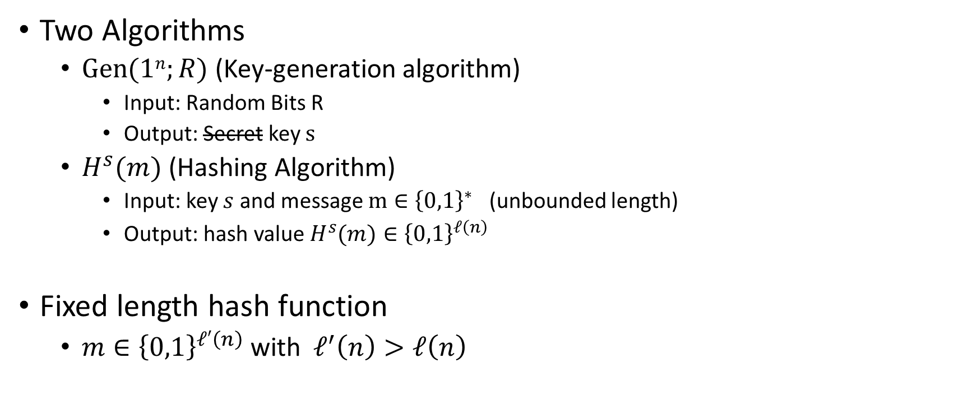
(Recap) Keyed Hash Function Syntax
Two Algorithms
  $\operatorname{Gen}{(1n;R)}$ (Key-generation algorithm)
    Input: Random Bits R
    Output: Secret key $s$
  $H^{s}{(m)}$ (Hashing Algorithm)
    Input: key $s$ and message $m∈{\left\{0,1\right\}}^{∗}$ (unbounded length)
    Output: hash value${ H}^{s}{(m)}∈{\left\{0,1\right\}}^{ℓ\left(n\right)}$
Fixed length hash function
  $m∈{\left\{0,1\right\}}^{ℓ′\left(n\right)}$ with$ℓ^{′}\left(n\right)>ℓ\left(n\right)$

Slide 8


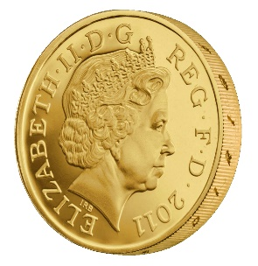
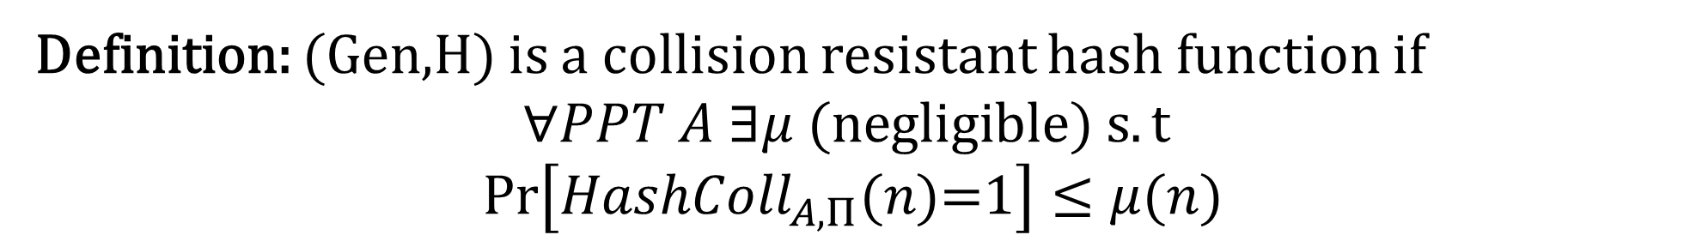


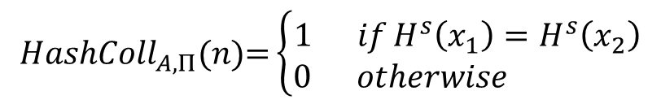
Collision Experiment (${HashColl}_{A,Π}(n)$)
s
x₁,x₂
$${HashColl}_{A,Π}(n)\text{=}\left\{\begin{aligned}1 ifH^{s}\left(x_{1}\right)=H^{s}\left(x_{2}\right) \\ 0 otherwise \end{aligned}\right.$$
$$s=Gen{(1n;R)}$$
Definition: (Gen,H) is a collision resistant hash function if
$$∀PPT A ∃μ (negligible) s.t$$
$$Pr\left[{HashColl}_{A,Π}(n)\text{=}1\right]≤μ(n)$$

Slide 9
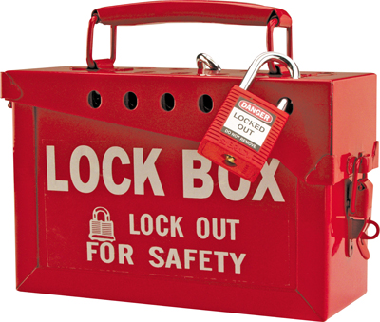
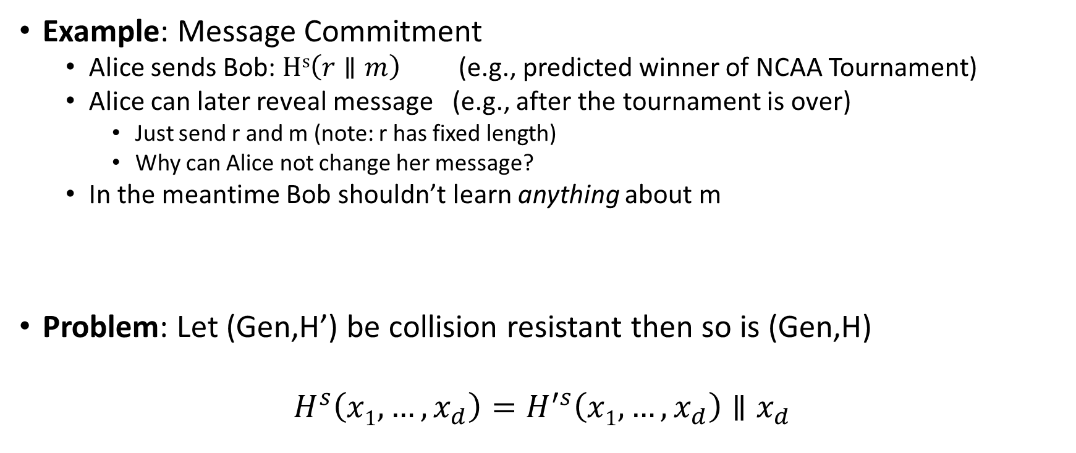
When Collision Resistance Isn’t Enough
Example: Message Commitment
  Alice sends Bob: $Hs\left(r∥m\right)$ (e.g., predicted winner of NCAA Tournament)
  Alice can later reveal message (e.g., after the tournament is over)
    Just send r and m (note: r has fixed length)
    Why can Alice not change her message?
  In the meantime Bob shouldn’t learn anything about m
Problem: Let (Gen,H’) be collision resistant then so is (Gen,H)
$$H^{s}\left(x1,…,x_{d}\right)=H^{′s}\left(x1,…,x_{d}\right)∥x_{d}$$
Notes:
Why include r in the hash? Brute-force attack if message space is small…attacker can quickly learn message is not _____

Slide 10
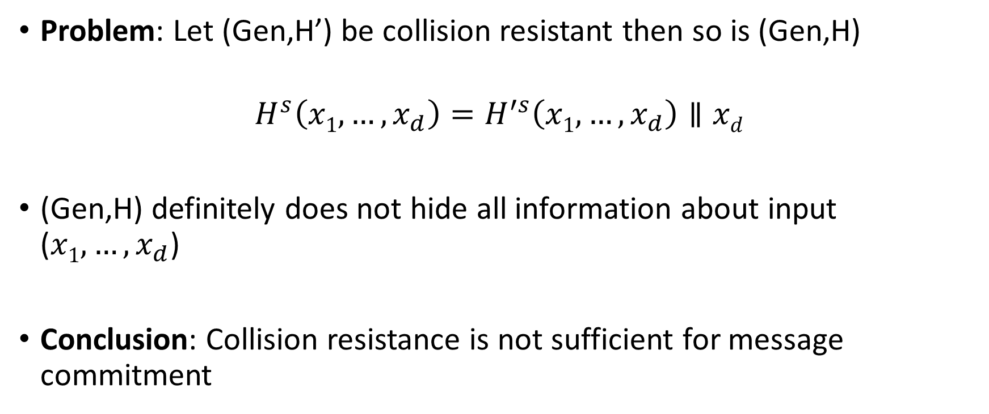
When Collision Resistance Isn’t Enough
Problem: Let (Gen,H’) be collision resistant then so is (Gen,H)
$$H^{s}\left(x1,…,x_{d}\right)=H^{′s}\left(x1,…,x_{d}\right)∥xd$$
(Gen,H) definitely does not hide all information about input ($x1,…,x_{d}$)
Conclusion: Collision resistance is not sufficient for message commitment

Slide 11
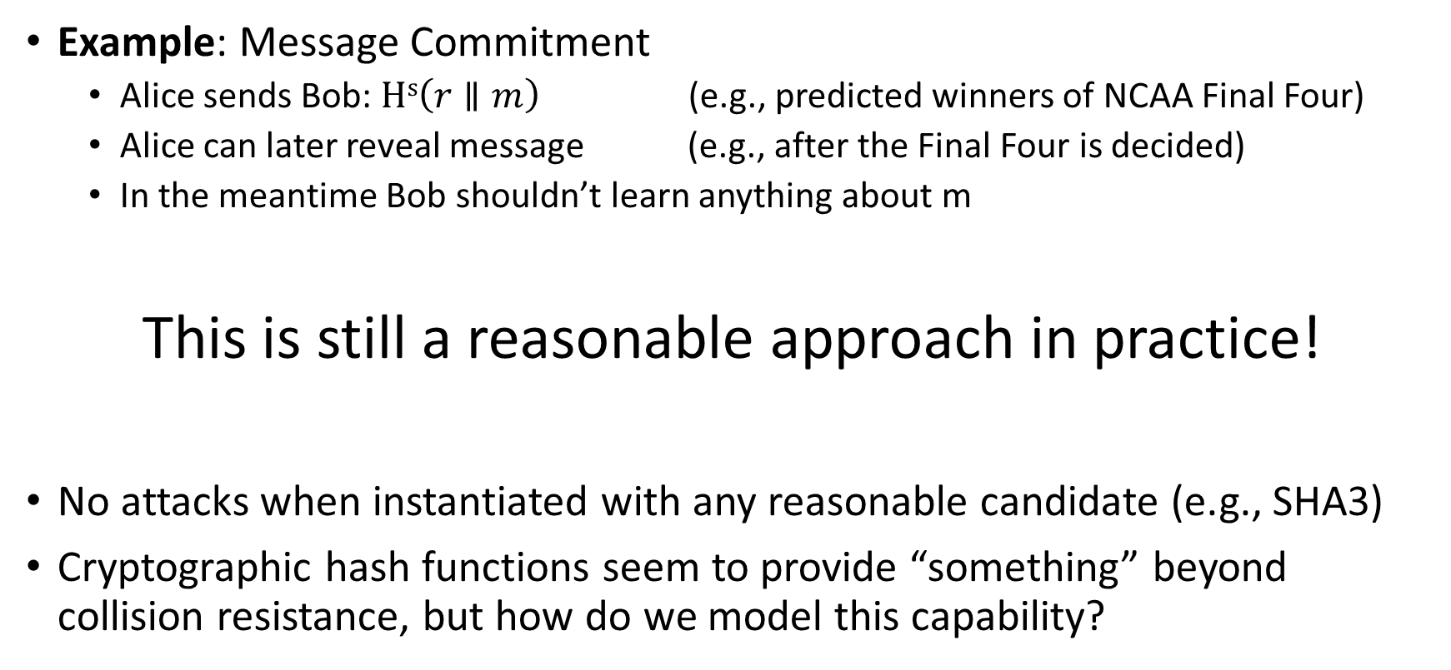
The Tension
Example: Message Commitment
  Alice sends Bob: $Hs\left(r∥m\right)$ (e.g., predicted winners of NCAA Final Four)
  Alice can later reveal message (e.g., after the Final Four is decided)
  In the meantime Bob shouldn’t learn anything about m
This is still a reasonable approach in practice!
No attacks when instantiated with any reasonable candidate (e.g., SHA3)
Cryptographic hash functions seem to provide “something” beyond collision resistance, but how do we model this capability?

Slide 12
Random Oracle Model
Model hash function H as a truly random function
Algorithms can only interact with H as an oracle
  Query: x
  Response: H(x)
If we submit the same query you see the same response
If x has not been queried, then the value of H(x) is uniform
Real World: H instantiated as cryptographic hash function (e.g., SHA3) of fixed length (no Merkle-Damgård)

Slide 13
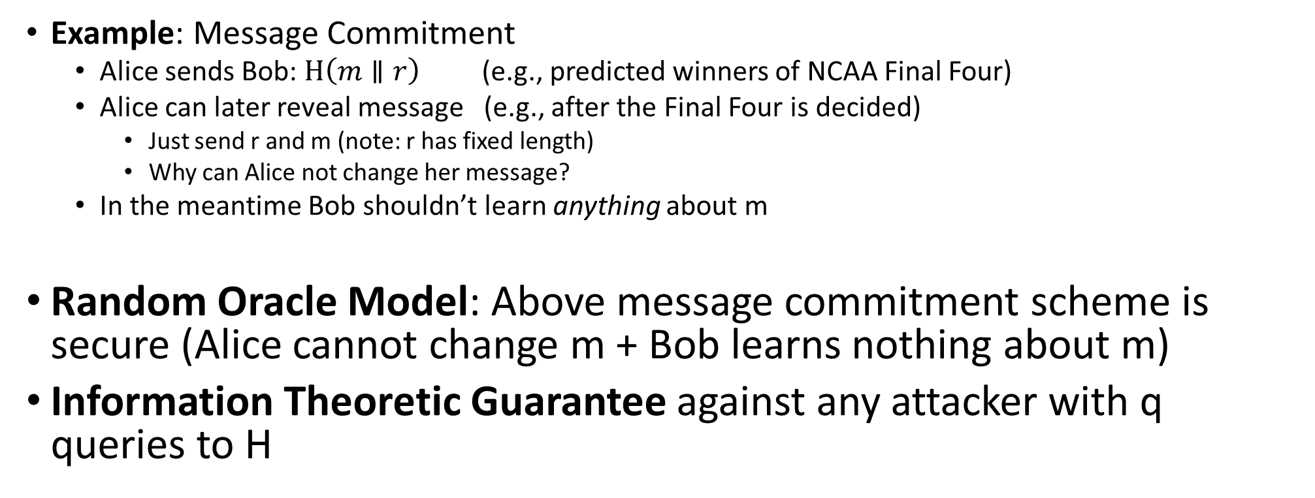
Back to Message Commitment
Example: Message Commitment
  Alice sends Bob: $H\left(m∥r\right)$ (e.g., predicted winners of NCAA Final Four)
  Alice can later reveal message (e.g., after the Final Four is decided)
    Just send r and m (note: r has fixed length)
    Why can Alice not change her message?
  In the meantime Bob shouldn’t learn anything about m
Random Oracle Model: Above message commitment scheme is secure (Alice cannot change m + Bob learns nothing about m)
Information Theoretic Guarantee against any attacker with q queries to H
Notes:
Suppose when attacker submits query H(r’|m’) we tell him that r’ is correct/incorrect. As long as r’ is incorrect the attacker learns nothing in an information theoretic sense. The probability of submitting r’=r is at most (1/2^|r|)

Slide 14
Random Oracle Model: Pros
It is easier to prove security in Random Oracle Model
Suppose we are simulating attacker A in a reduction
  Extractability: When A queries H at x we see this query and learn x (and can easily find H(x))
  Programmability: We can set the value of H(x) to a value of our choice
    As long as the value is correctly distribute i.e., close to uniform
Both Extractability and Programmability are useful tools for a security reduction!

Slide 15
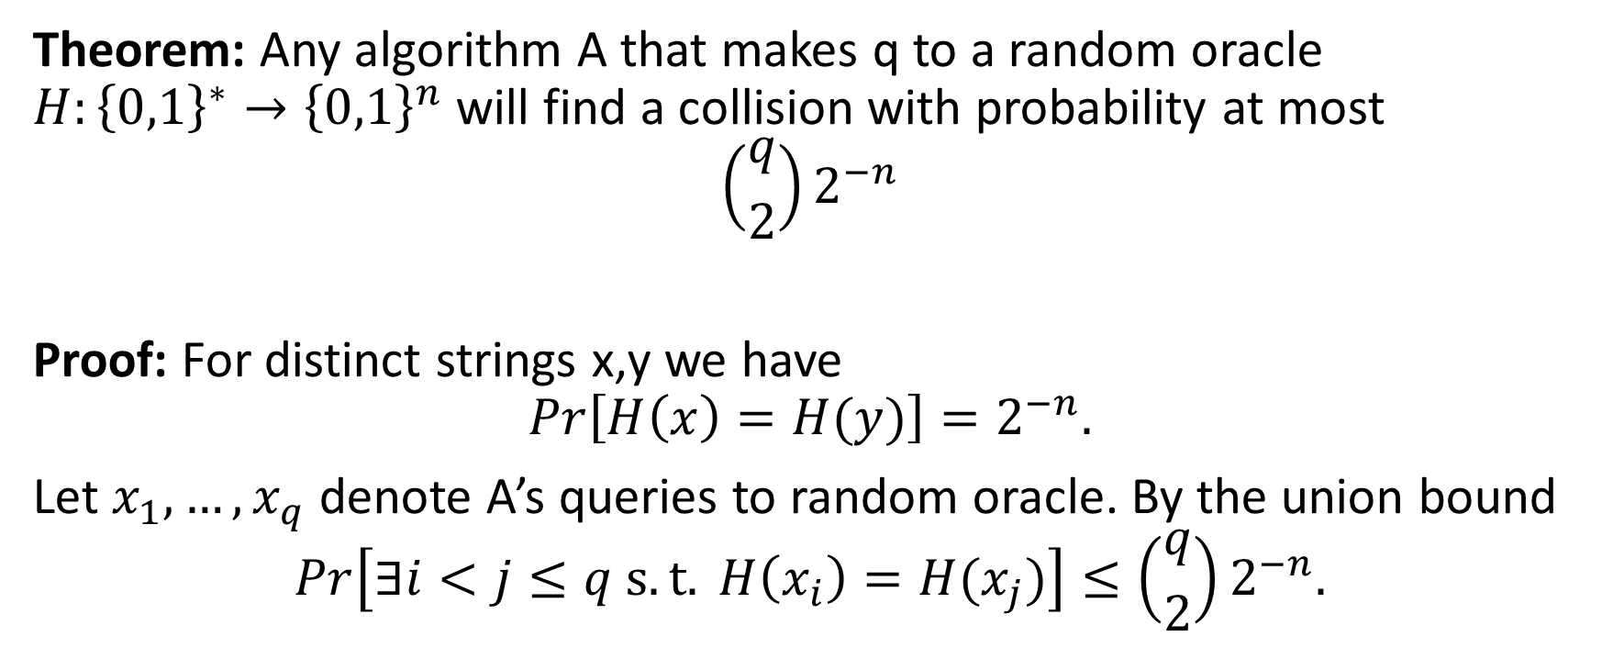
Random Oracle Claim
Theorem: Any algorithm A that makes q to a random oracle $H:{\left\{0,1\right\}}^{∗}→{\left\{0,1\right\}}^{n}$ will find a collision with probability at most
$$\left({q \atop 2}\right)2^{−n}$$
Proof: For distinct strings x,y we have
$$Pr\left[H\left(x\right)=H(y)\right]=2^{−n}.$$
Let $x_{1},…,x_{q}$ denote A’s queries to random oracle. By the union bound
$$Pr\left[∃i<j≤q s.t. H\left(x_{i}\right)=H(x_{j})\right]≤\left({q \atop 2}\right)2^{−n}.$$

Slide 16
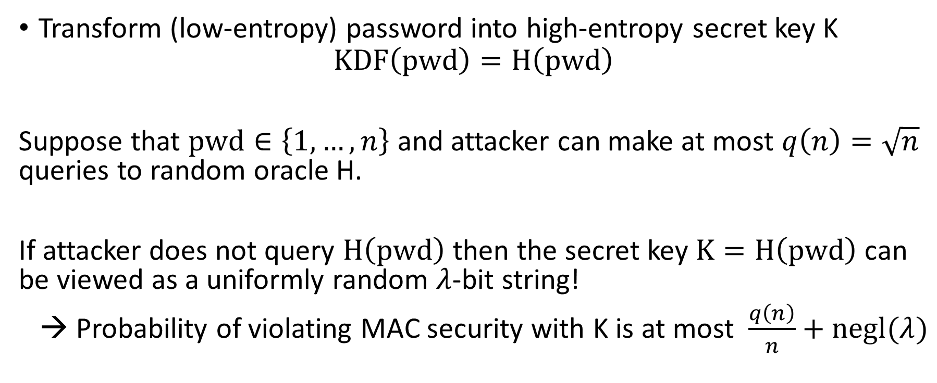
Key Derivation
Transform (low-entropy) password into high-entropy secret key K
$$KDF\left(pwd\right)=H\left(pwd\right)$$
Suppose that $pwd∈\left\{1,…,n\right\}$ and attacker can make at most $q\left(n\right)=\sqrt{n}$ queries to random oracle H.
If attacker does not query $H\left(pwd\right)$ then the secret key $K=H\left(pwd\right)$ can be viewed as a uniformly random $λ$-bit string!
→ Probability of violating MAC security with K is at most $\frac{q\left(n\right)}{n}+negl(λ)$

Slide 17
Random Oracle Model: Pros
It is easier to prove security in Random Oracle Model
Provably secure constructions in random oracle model are often much more efficient (compared to provably secure construction is “standard model”
Sometimes we only know how to design provably secure protocol in random oracle model

Slide 18
Random Oracle Model: Cons
Lack of formal justification
Why should security guarantees translate when we instantiate random oracle with a real cryptographic hash function?
We can construct (contrived) examples of protocols which are
  Secure in random oracle model…
  But broken in the real world

Slide 19
Random Oracle Model: Justification
“A proof of security in the random-oracle model is significantly better than no proof at all.”
Evidence of sound design (any weakness involves the hash function used to instantiate the random oracle)
Empirical Evidence for Security
“there have been no successful real-world attacks on
schemes proven secure in the random oracle model”

Slide 20
Hash Function Application: Fingerprinting
The hash h(x) of a file x is a unique identifier for the file
  Collision Resistance → No need to worry about another file y with H(y)=H(y)
Application 1: Virus Fingerprinting
Application 2: P2P File Sharing
Application 3: Data deduplication

Slide 21
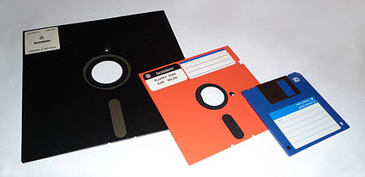



Tamper Resistant Storage
m₁
H(m₁)
m₁’

Slide 22
Tamper Resistant Storage
File Index | Hash
1 | H(m₁)
2 | H(m₂)
3 | H(m₃)
Disadvantage: Too many hashes to store
m₁,m₂,m₃
Send file 1
m₁’

Slide 23
Tamper Resistant Storage
Disadvantage: Need all files to compute hash m₁,m₂,m₃
H(m₁,m₂,m₃)
m₁,m₂,m₃
Send file 1
m₁’

Slide 24
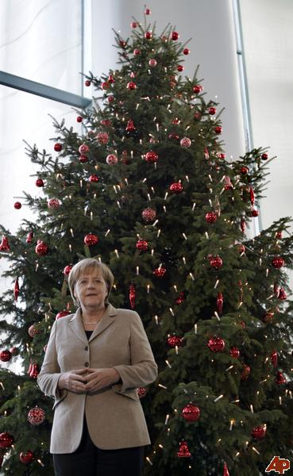
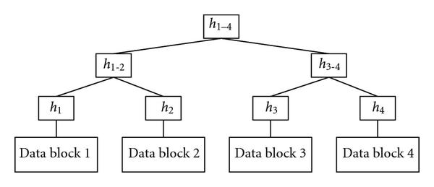
Merkle Trees
Proof of Correctness for data block 2
Verify that root matches
Proof consists of just log(n) hashes
  Verifier only needs to permanently store
  only one hash value

Slide 25
Merkle Trees
Theorem: Let (Gen, h^{s}) be a collision resistant hash function and let H^{s}(m)
return the root hash in a Merkle Tree. Then H^{s} is collision resistant.

Slide 26
Tamper Resistant Storage
Root: H₁₋₄
m₁,m₂,m₃,m₄
Send file 2
m₂’,h₁,h₃₋₄

Slide 27
Commitment Schemes
Alice wants to commit a message m to Bob
  And possibly reveal it later at a time of her choosing
Properties
  Hiding: commitment reveals nothing about m to Bob
  Binding: it is infeasible for Alice to alter message

Slide 28



Commitment Hiding (${Hiding}_{A,Com}(n)$)
m₀,m₁
commit(r,m_{b})
b’
$${Hiding}_{A,Com}(n)\text{=}\left\{\begin{aligned}1 if b=b^{′} \\ 0 otherwise \end{aligned}\right.$$
r = Gen(.)
Bit b
$$∀PPT A ∃μ (negligible) s.t$$
$$Pr\left[{Hiding}_{A,Com}\left(n\right)=1\right]≤\frac{1}{2}+μ(n)$$

Slide 29

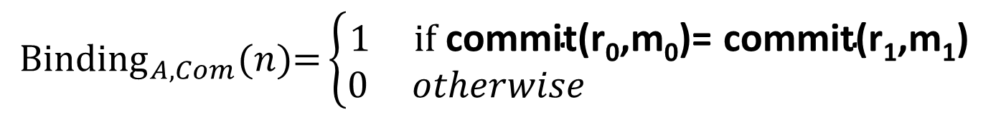
Commitment Binding (${Binding}_{A,Com}(n)$)
r₀,r₁,m₀,m₁
$${Binding}_{A,Com}(n)\text{=}\left\{\begin{aligned}1 if \text{commit}\text{(}\text{r}\text{0}\text{,}\text{m}\text{0}\text{)= }\text{commit}\text{(}\text{r}\text{1}\text{,}\text{m}\text{1}\text{) } \\ 0 otherwise \end{aligned}\right.$$
$$∀PPT A ∃μ (negligible) s.t$$
$$Pr\left[{Binding}_{A,Com}\left(n\right)=1\right]≤μ(n)$$

Slide 30

Secure Commitment Scheme
Definition: A secure commitment scheme is hiding and binding
Hiding
Binding
$$∀PPT A ∃μ (negligible) s.t$$
$$Pr\left[{Hiding}_{A,Com}\left(n\right)=1\right]≤\frac{1}{2}+μ(n)$$
$$∀PPT A ∃μ (negligible) s.t$$
$$Pr\left[{Binding}_{A,Com}\left(n\right)=1\right]≤μ(n)$$

Slide 31
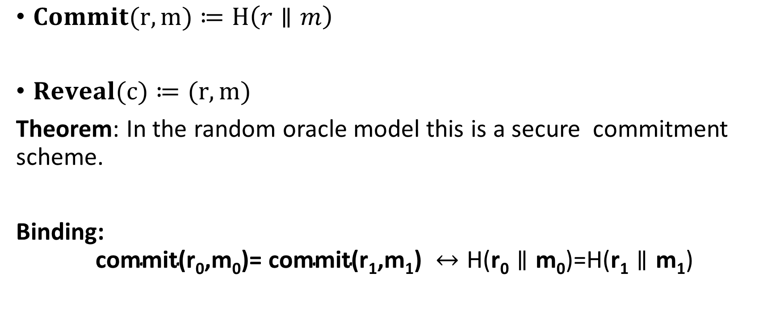
Commitment Scheme in Random Oracle Model
$Commit(r,m)≔H\left(r∥m\right)$
$Reveal(c)≔(r,m)$
Theorem: In the random oracle model this is a secure commitment scheme.
Binding:
$$\text{commit}\text{(}\text{r}\text{0}\text{,}\text{m}\text{0}\text{)= }\text{commit}\text{(}\text{r}\text{1}\text{,}\text{m}\text{1}\text{) }↔\text{H}\text{(}\text{r}\text{0}∥\text{m}\text{0}\text{)}\text{=}\text{H}\text{(}\text{r}\text{1}∥\text{m}\text{1}\text{)}$$

Slide 32



Commitment Hiding (${Hiding}_{A,Com}(n)$)
m₀,m₁
$$H\left(r∥m_{b}\right)$$
b’
$${Hiding}_{A,Com}(n)\text{=}\left\{\begin{aligned}1 ifb=b^{′} \\ 0 otherwise \end{aligned}\right.$$
r = Gen(.)
Bit b
$$∀PPT A making q\left(n\right) queries s.t$$
$$Pr\left[{Hiding}_{A,Com}\left(n\right)=1\right]≤\frac{1}{2}+\frac{q(n)}{2^{\left|r\right|}}$$
Notes:
Proof: Suppose we gave attacker extra information for every query. Tell him if r matches. Now unless he sends

Slide 33
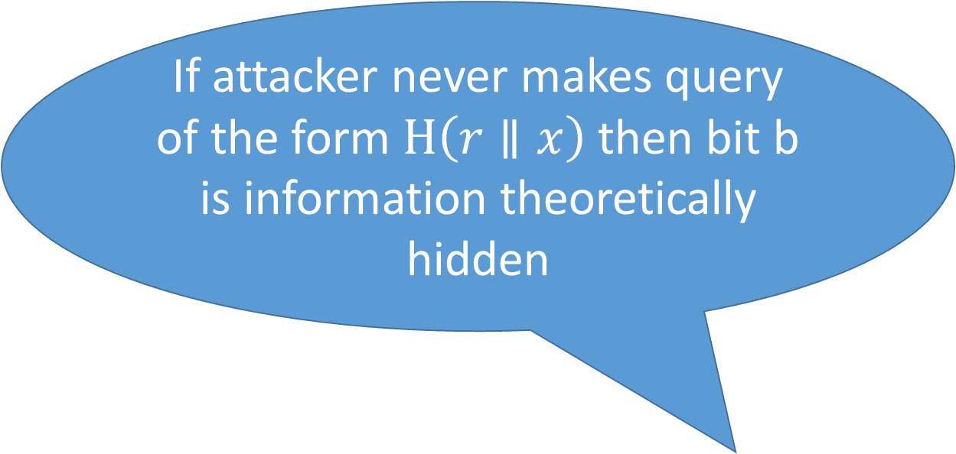
Commitment Hiding (${Hiding}_{A,Com}(n)$)
m₀,m₁
$$H\left(r∥m_{b}\right)$$
b’
If attacker never makes query of the form $H\left(r∥x\right)$ then bit b is information theoretically hidden
$${Hiding}_{A,Com}(n)\text{=}\left\{\begin{aligned}1 ifb=b^{′} \\ 0 otherwise \end{aligned}\right.$$
r = Gen(.)
Bit b
$$∀PPT A making q\left(n\right) queries s.t$$
$$Pr\left[{Hiding}_{A,Com}\left(n\right)=1\right]≤\frac{1}{2}+\frac{q(n)}{2^{\left|r\right|}}$$
Notes:
Proof: Suppose we gave attacker extra information for every query. Tell him if r matches. Now unless he sends

Slide 34
Other Applications
Password Hashing
Key Derivation
Later
  Key Encapsulation Mechanism
  RSA-FDH etc...

Slide 35
CS 555: Week 6: Topic 6
Block Ciphers

Slide 36

An Existential Crisis?
We have used primitives like PRGs, PRFs to build secure MACs, CCA-Secure Encryption, Authenticated Encryption etc…
Do such primitives exist in practice?
How do we build them?

Slide 37
Recap
Hash Functions/PRGs/PRFs, CCA-Secure Encryption, MACs
Goals for This Week:
Practical Constructions of Symmetric Key Primitives
Today’s Goals: Block Ciphers
Sbox
Confusion Diffusion Paradigm
Feistel Networks

Slide 38

Pseudorandom Permutation
A keyed function $F:{\left\{0,1\right\}}^{n}×{\left\{0,1\right\}}^{n}→{\left\{0,1\right\}}^{n}$, which is invertible and “looks random” without the secret key k.
Similar to a PRF, but
Computing F_{k}(x) and $F_{k}^{−1}\left(x\right)$ is efficient (polynomial-time)
Definition 3.28: A keyed function $F:{\left\{0,1\right\}}^{n}×{\left\{0,1\right\}}^{n}→{\left\{0,1\right\}}^{n}$ is a strong pseudorandom permutation if for all PPT distinguishers D there is a negligible function $μ$ s.t.
$$\left|Pr\left[D^{F_{k}\left(.\right),F_{k}^{−1}\left(.\right)}\left(1^{n}\right)\right]−Pr\left[D^{f\left(.\right),f^{−1}\left(.\right)}\left(1^{n}\right)\right]\right|≤μ\left(n\right)$$

Slide 39
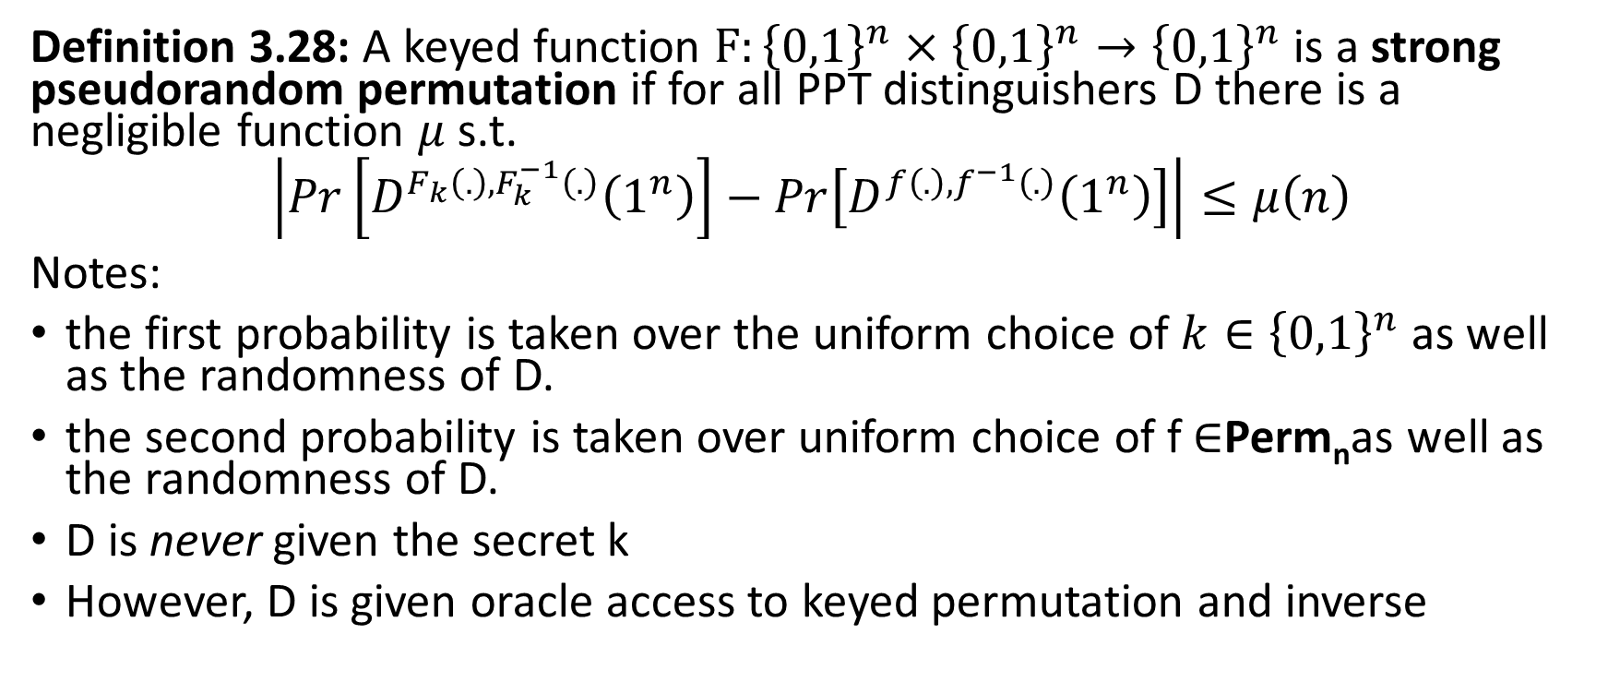
Pseudorandom Permutation
Definition 3.28: A keyed function $F:{\left\{0,1\right\}}^{n}×{\left\{0,1\right\}}^{n}→{\left\{0,1\right\}}^{n}$ is a strong pseudorandom permutation if for all PPT distinguishers D there is a negligible function $μ$ s.t.
$$\left|Pr\left[D^{F_{k}\left(.\right),F_{k}^{−1}\left(.\right)}\left(1^{n}\right)\right]−Pr\left[D^{f\left(.\right),f^{−1}\left(.\right)}\left(1^{n}\right)\right]\right|≤μ\left(n\right)$$
Notes:
the first probability is taken over the uniform choice of ${k∈\left\{0,1\right\}}^{n}$ as well as the randomness of D.
the second probability is taken over uniform choice of f $∈$Perm_{n}as well as the randomness of D.
D is never given the secret k
However, D is given oracle access to keyed permutation and inverse

Slide 40

How many permutations?
|Perm_{n}|=?
Answer: 2^{n}!
How many bits to store f $∈$Perm_{n}?
Answer:
$$\log\left(\text{2}\text{n}\text{!}\right)=\sum_{i=1}^{\text{2}\text{n}}{\log\left(\text{i}\right)}$$
$$≥\sum_{i=2^{n−1}}^{2^{n}}{n−1}≥(n−1)×2^{n−1}$$

Slide 41
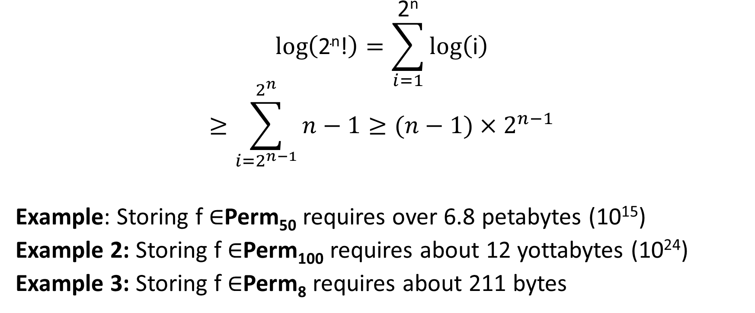
How many bits to store permutations?
$$\log\left(\text{2}\text{n}\text{!}\right)=\sum_{i=1}^{\text{2}\text{n}}{\log\left(\text{i}\right)}$$
$$≥\sum_{i=2^{n−1}}^{2^{n}}{n−1}≥(n−1)×2^{n−1}$$
Example: Storing f $∈$Perm₅₀ requires over 6.8 petabytes (10¹⁵)
Example 2: Storing f $∈$Perm₁₀₀ requires about 12 yottabytes (10²⁴)
Example 3: Storing f $∈$Perm₈ requires about 211 bytes

Slide 42
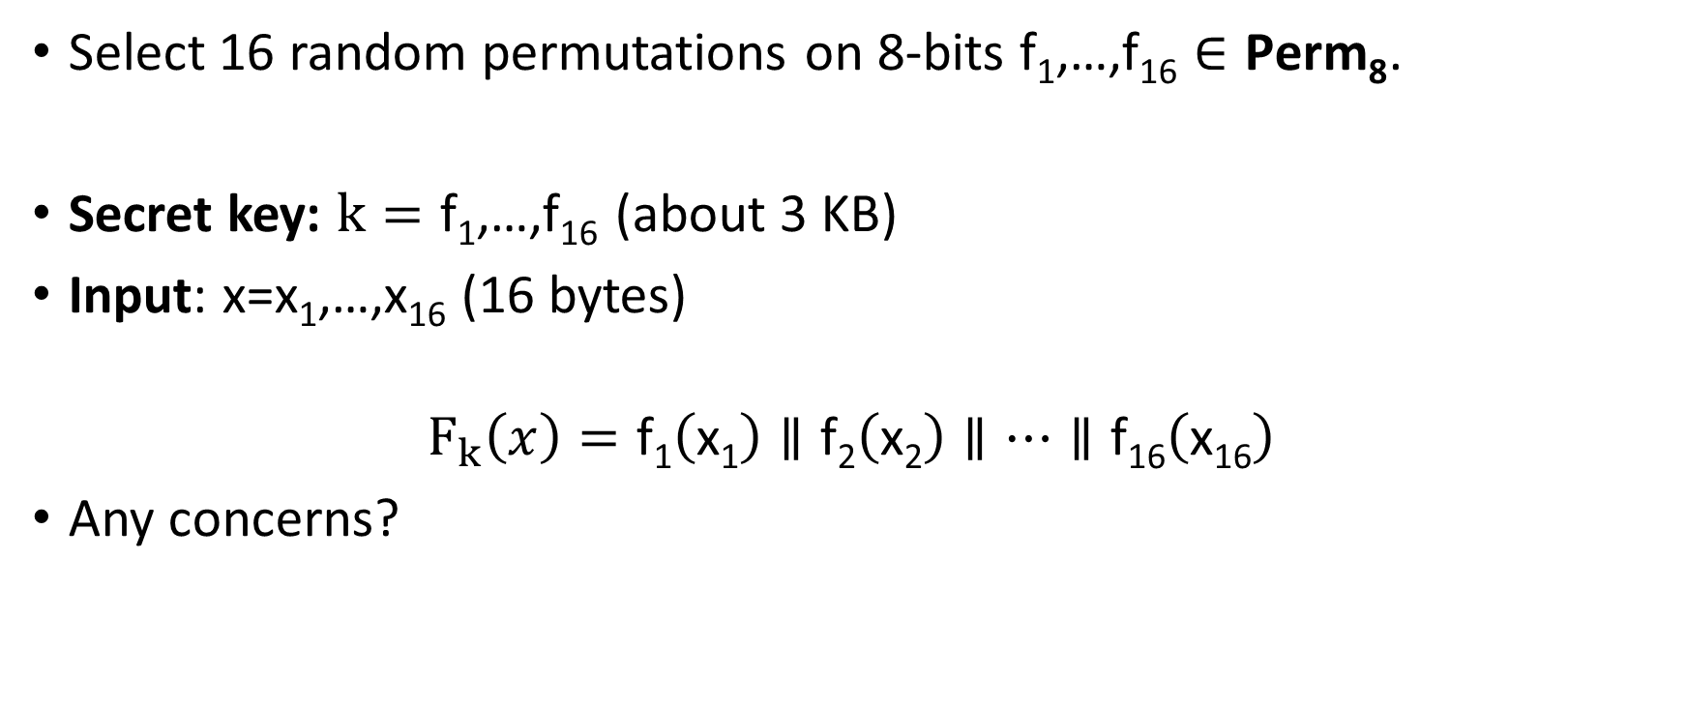
Attempt 1: Pseudorandom Permutation
Select 16 random permutations on 8-bits $\text{f}\text{1}\text{,…,}\text{f}\text{16}∈\text{Perm}\text{8}$.
Secret key: $k=\text{f}\text{1}\text{,…,}\text{f}\text{16}$(about 3 KB)
Input: x=x₁,…,x₁₆ (16 bytes)
$$F_{k}\left(x\right)=\text{f}\text{1}\left(\text{x}\text{1}\right)∥\text{f}\text{2}\left(\text{x}\text{2}\right)∥…∥\text{f}\text{16}\left(\text{x}\text{16}\right)$$
Any concerns?

Slide 43
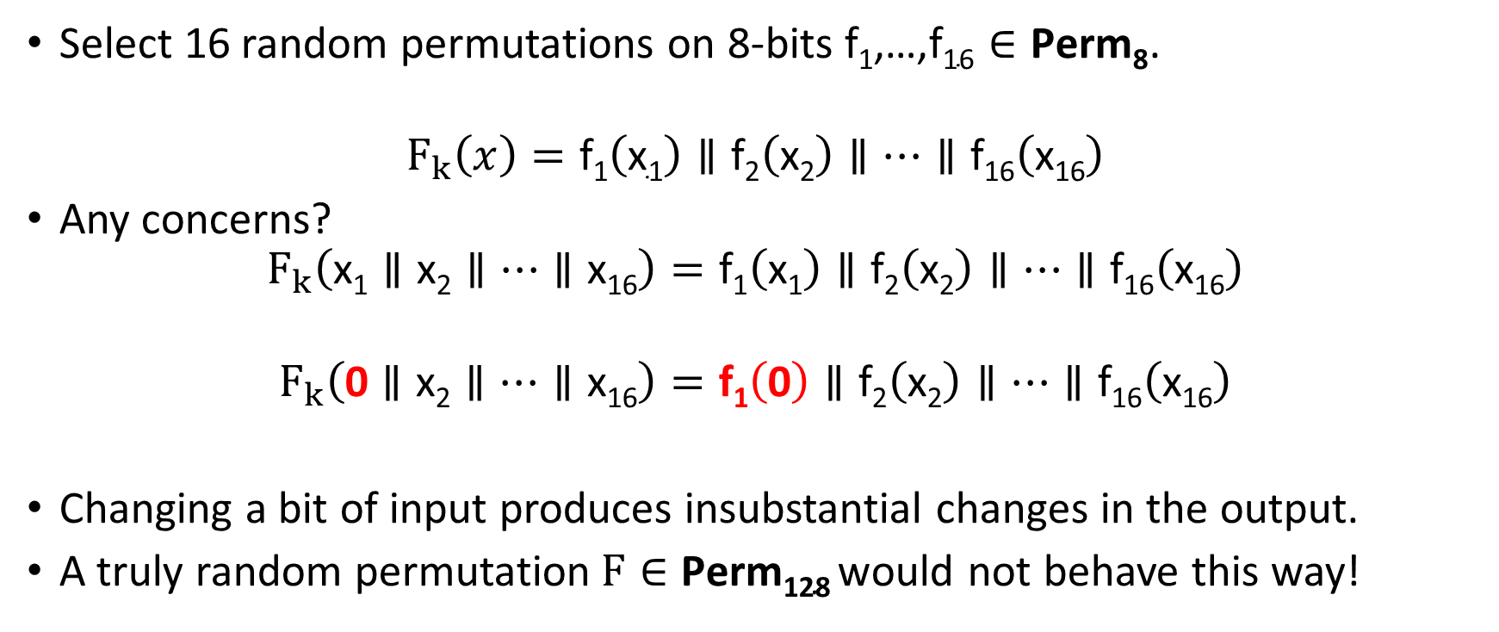
Attempt 1: Pseudorandom Permutation
Select 16 random permutations on 8-bits $\text{f}\text{1}\text{,…,}\text{f}\text{16}∈\text{Perm}\text{8}$.
$$F_{k}\left(x\right)=\text{f}\text{1}\left(\text{x}\text{1}\right)∥\text{f}\text{2}\left(\text{x}\text{2}\right)∥…∥\text{f}\text{16}\left(\text{x}\text{16}\right)$$
Any concerns?
$$F_{k}\left(\text{x}\text{1}∥\text{x}\text{2}∥…∥\text{x}\text{16}\right)=\text{f}\text{1}\left(\text{x}\text{1}\right)∥\text{f}\text{2}\left(\text{x}\text{2}\right)∥…∥\text{f}\text{16}\left(\text{x}\text{16}\right)$$
$$F_{k}\left(\text{0}∥\text{x}\text{2}∥…∥\text{x}\text{16}\right)=\text{f}\text{1}\left(\text{0}\right)∥\text{f}\text{2}\left(\text{x}\text{2}\right)∥…∥\text{f}\text{16}\left(\text{x}\text{16}\right)$$
Changing a bit of input produces insubstantial changes in the output.
A truly random permutation$F∈\text{Perm}\text{128}$would not behave this way!

Slide 44
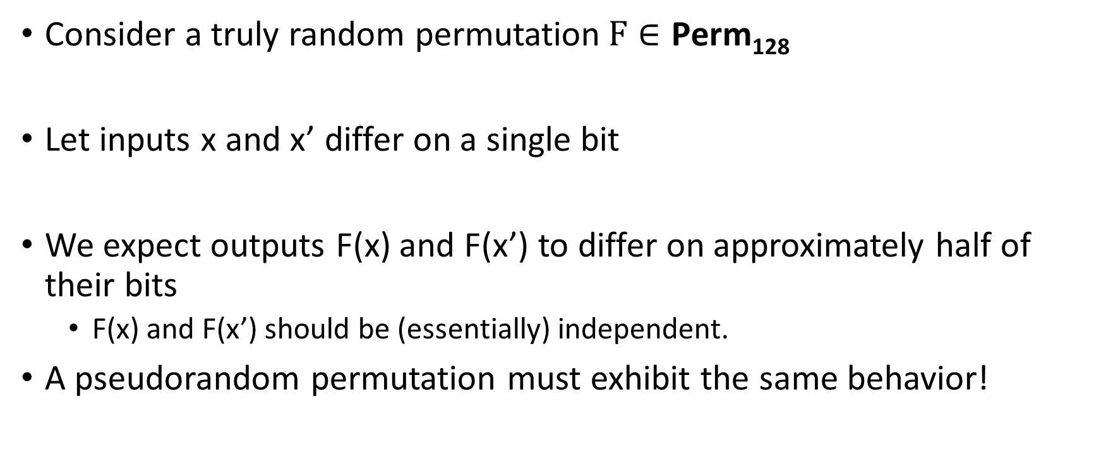
Pseudorandom Permutation Requirements
Consider a truly random permutation$F∈\text{Perm}\text{128}$
Let inputs x and x’ differ on a single bit
We expect outputs F(x) and F(x’) to differ on approximately half of their bits
  F(x) and F(x’) should be (essentially) independent.
A pseudorandom permutation must exhibit the same behavior!

Slide 45
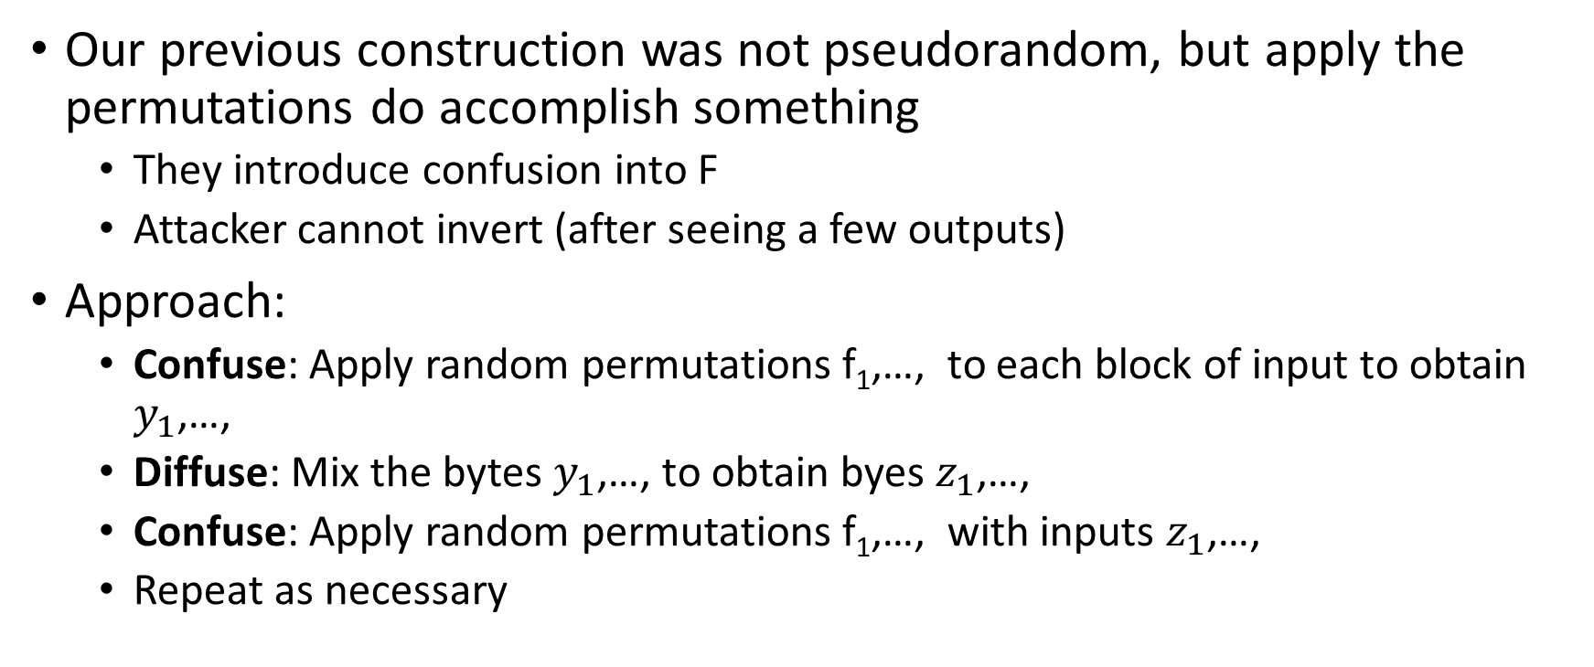
Confusion-Diffusion Paradigm
Our previous construction was not pseudorandom, but apply the permutations do accomplish something
  They introduce confusion into F
  Attacker cannot invert (after seeing a few outputs)
Approach:
  Confuse: Apply random permutations $\text{f}\text{1}\text{,…,}$ to each block of input to obtain $y_{1}$,…,
  Diffuse: Mix the bytes $y_{1}$,…, to obtain byes $z_{1}$,…,
  Confuse: Apply random permutations $\text{f}\text{1}\text{,…,}$ with inputs $z_{1}$,…,
  Repeat as necessary

Slide 46
Attempt 1: Pseudorandom Permutation
Select 16 random permutations on 8-bits $\text{f}\text{1}\text{,…,}\text{f}\text{16}∈\text{Perm}\text{8}$.
$$F_{k}\left(x\right)=\text{f}\text{1}\left(\text{x}\text{1}\right)∥\text{f}\text{2}\left(\text{x}\text{2}\right)∥…∥\text{f}\text{16}\left(\text{x}\text{16}\right)$$
Any concerns?
$$F_{k}\left(\text{x}\text{1}∥\text{x}\text{2}∥…∥\text{x}\text{16}\right)=\text{f}\text{1}\left(\text{x}\text{1}\right)∥\text{f}\text{2}\left(\text{x}\text{2}\right)∥…∥\text{f}\text{16}\left(\text{x}\text{16}\right)$$
$$F_{k}\left(\text{0}∥\text{x}\text{2}∥…∥\text{x}\text{16}\right)=\text{f}\text{1}\left(\text{0}\right)∥\text{f}\text{2}\left(\text{x}\text{2}\right)∥…∥\text{f}\text{16}\left(\text{x}\text{16}\right)$$
Changing a bit of input produces insubstantial changes in the output.
A truly random permutation$F∈\text{Perm}\text{128}$would not behave this way!

Slide 47
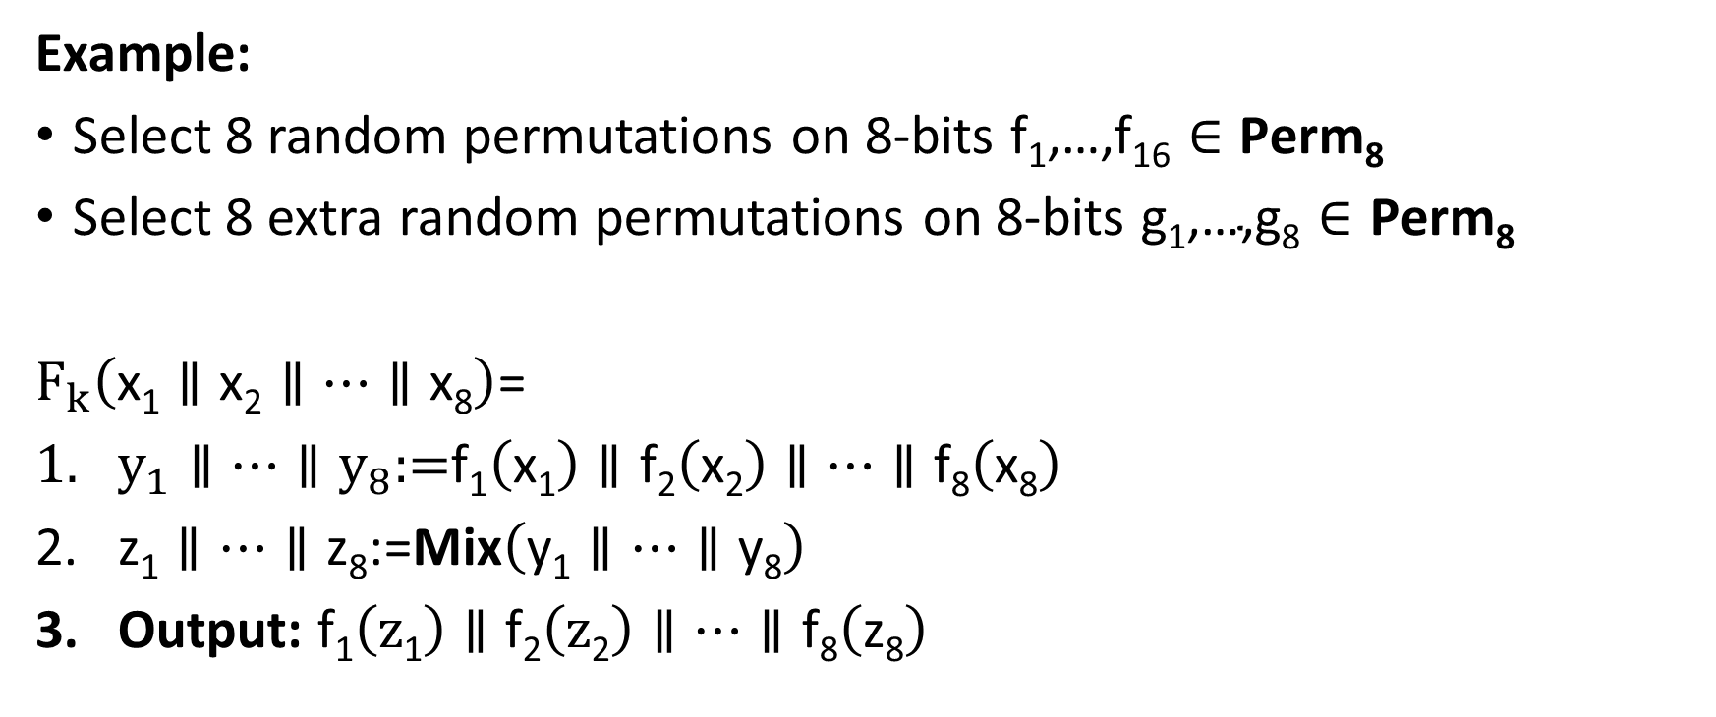
Confusion-Diffusion Paradigm
Example:
Select 8 random permutations on 8-bits $\text{f}\text{1}\text{,…,}\text{f}\text{16}∈\text{Perm}\text{8}$
Select 8 extra random permutations on 8-bits $\text{g}\text{1}\text{,…,}\text{g}\text{8}∈\text{Perm}\text{8}$
$F_{k}\left(\text{x}\text{1}∥\text{x}\text{2}∥…∥\text{x}\text{8}\right)$=
$y_{1}∥…∥y_{8}\text{:=}\text{f}\text{1}\left(\text{x}\text{1}\right)∥\text{f}\text{2}\left(\text{x}\text{2}\right)∥…∥\text{f}\text{8}\left(\text{x}\text{8}\right)$
$\text{z}\text{1}∥…∥\text{z}\text{8}\text{:=}\text{Mix}\left(\text{y}\text{1}∥…∥\text{y}\text{8}\right)$
Output: $\text{f}\text{1}\left(\text{z}\text{1}\right)∥\text{f}\text{2}\left(\text{z}\text{2}\right)∥…∥\text{f}\text{8}\left(\text{z}\text{8}\right)$

Slide 48
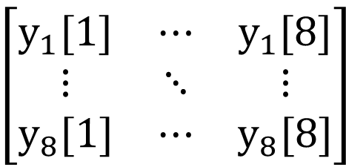





Example Mixing Function
$\text{Mix}\left(\text{y}\text{1}∥…∥\text{y}\text{8}\right)$=
For i=1 to 8
$\text{z}\text{i}\text{:=}\text{y}\text{1}\text{[}\text{i}\text{]}∥…∥\text{y}\text{8}\text{[}\text{i}\text{]}$
End For
Output: $\text{g}\text{1}\left(\text{z}\text{1}\right)∥\text{g}\text{2}\left(\text{z}\text{2}\right)∥…∥\text{g}\text{8}\left(\text{z}8\right)$
$$\text{z}\text{1}$$
$$\text{z}\text{8}$$
$$y_{1}=$$
$$\left[\begin{matrix}y_{1}[1] & ⋯ & y_{1}[8] \\ ⋮ & ⋱ & ⋮ \\ y_{8}[1] & ⋯ & y_{8}[8]\end{matrix}\right]$$
$$y_{8}=$$

Slide 49
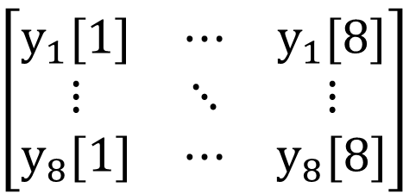

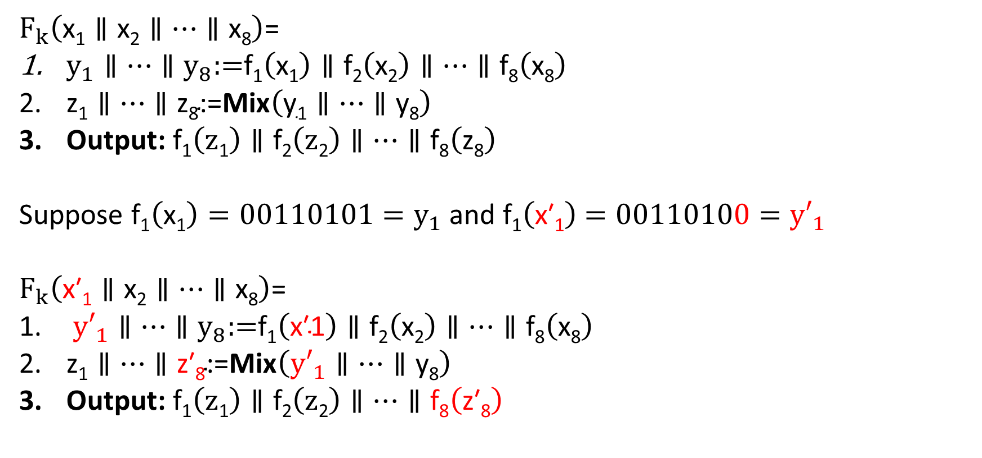



Are We Done?
$$\text{z}\text{1}$$
$$\text{z}\text{8}$$
$F_{k}\left(\text{x}\text{1}∥\text{x}\text{2}∥…∥\text{x}\text{8}\right)$=
$y_{1}∥…∥y_{8}\text{:=}\text{f}\text{1}\left(\text{x}\text{1}\right)∥\text{f}\text{2}\left(\text{x}\text{2}\right)∥…∥\text{f}\text{8}\left(\text{x}\text{8}\right)$
$\text{z}\text{1}∥…∥\text{z}\text{8}\text{:=}\text{Mix}\left(\text{y}\text{1}∥…∥\text{y}\text{8}\right)$
Output: $\text{f}\text{1}\left(\text{z}\text{1}\right)∥\text{f}\text{2}\left(\text{z}\text{2}\right)∥…∥\text{f}\text{8}\left(\text{z}\text{8}\right)$
Suppose $\text{f}\text{1}\left(\text{x}\text{1}\right)=00110101=y_{1}$ and $\text{f}\text{1}\left(\text{x}\text{′}\text{1}\right)$ $=00110100={y′}_{1}$
$F_{k}\left(\text{x}\text{′1}∥\text{x}\text{2}∥…∥\text{x}\text{8}\right)$=
${y′}_{1}∥…∥y_{8}\text{:=}\text{f}\text{1}\left(\text{x}\text{′1}\right)∥\text{f}\text{2}\left(\text{x}\text{2}\right)∥…∥\text{f}\text{8}\left(\text{x}\text{8}\right)$
$\text{z}\text{1}∥…∥\text{z}\text{′}\text{8}\text{:=}\text{Mix}\left({y′}_{1}∥…∥\text{y}\text{8}\right)$
Output: $\text{f}\text{1}\left(\text{z}\text{1}\right)∥\text{f}\text{2}\left(\text{z}\text{2}\right)∥…∥\text{f}\text{8}\left(\text{z}\text{′8}\right)$
$$y_{1}=$$
$$\left[\begin{matrix}y_{1}[1] & ⋯ & y_{1}[8] \\ ⋮ & ⋱ & ⋮ \\ y_{8}[1] & ⋯ & y_{8}[8]\end{matrix}\right]$$
$$y_{8}=$$
Highly unlikely that a truly random permutation would behave this way!

Slide 50
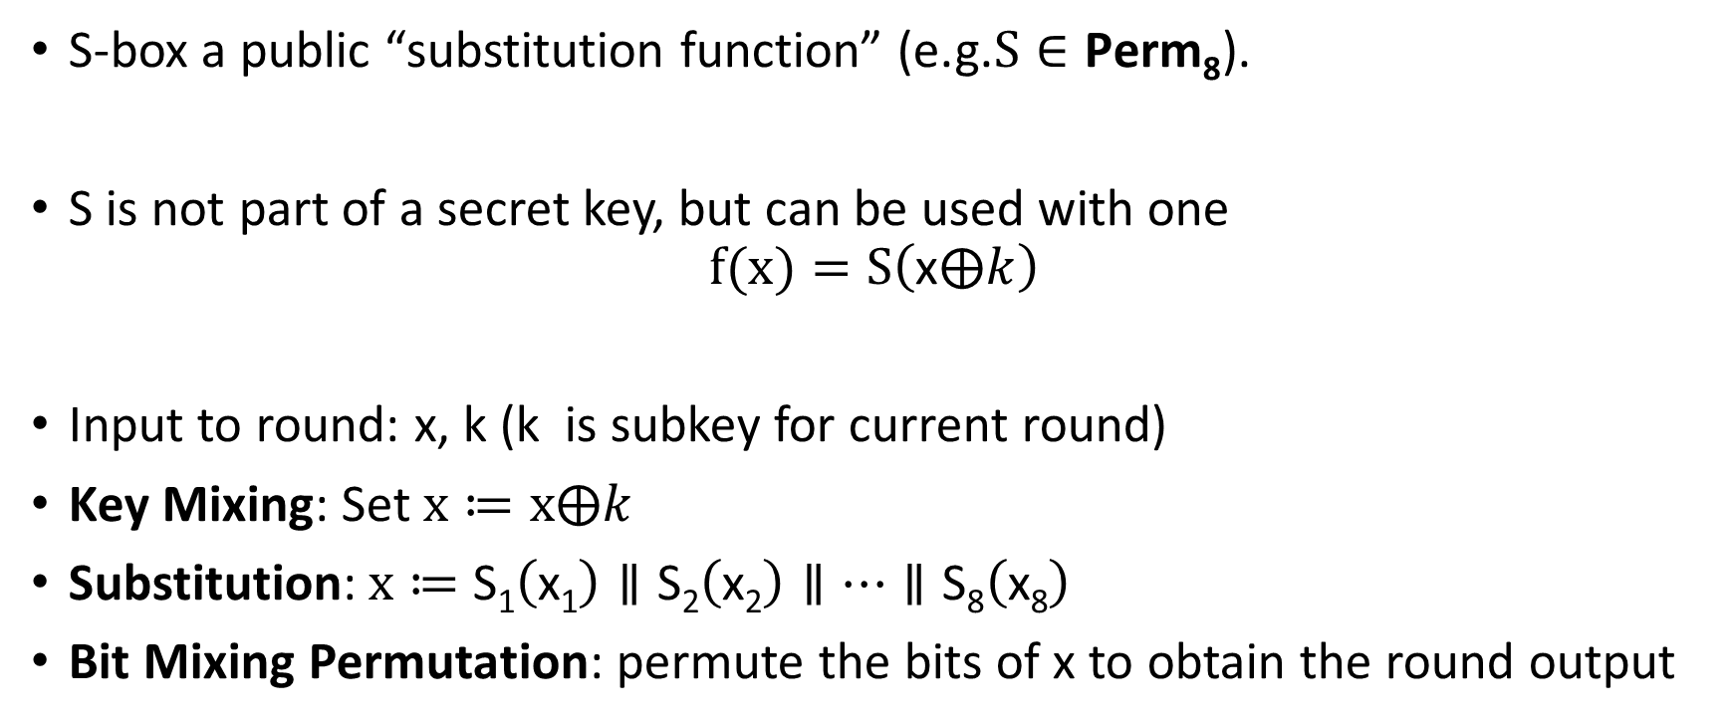
Substitution Permutation Networks
S-box a public “substitution function” (e.g.$S∈\text{Perm}\text{8}$).
S is not part of a secret key, but can be used with one
$$f(x)=S\left(\text{x}⨁k\right)$$
Input to round: x, k (k is subkey for current round)
Key Mixing: Set $x≔x⨁k$
Substitution:$x≔$ $\text{S}\text{1}\left(\text{x}\text{1}\right)∥\text{S}\text{2}\left(\text{x}\text{2}\right)∥…∥\text{S}\text{8}\left(\text{x}\text{8}\right)$
Bit Mixing Permutation: permute the bits of x to obtain the round output
Note: there are only n! possible bit mixing permutations of [n] as opposed to 2^{n}! Permutations of {0,1}^{n}

Slide 51
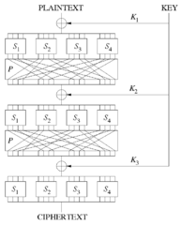
Substitution Permutation Networks
Proposition 6.3: Let F be a keyed function defined by a Substitution Permutation Network. Then for any keys/number of rounds F_{k} is a permutation.
Why? Composing permutations f,g results in another permutation h(x)=g(f(x)).

Slide 52
Remarks
Want to achieve “avalanche effect” (one bit change should “affect” every output bit)
Should a S-box be a random byte permutation?
Better to ensure that S(x) differs from x on at least 2-bits (for all x)
  Helps to maximize “avalanche effect”
Mixing Permutation should ensure that output bits of any given S-box are used as input to multiple S-boxes in the next round

Slide 53
Remarks
How many rounds?
Informal Argument: If we ensure that S(x) differs from x on at least 2-bits (for all bytes x) then every input bit affects
  2 bits of round 1 output
  4 bits of round 2 output
  8 bits of round 3 output
  ….
  128 bits of round 4 output
Need at least 7 rounds (minimum) to ensure that every input bit affects every output bit

Slide 54
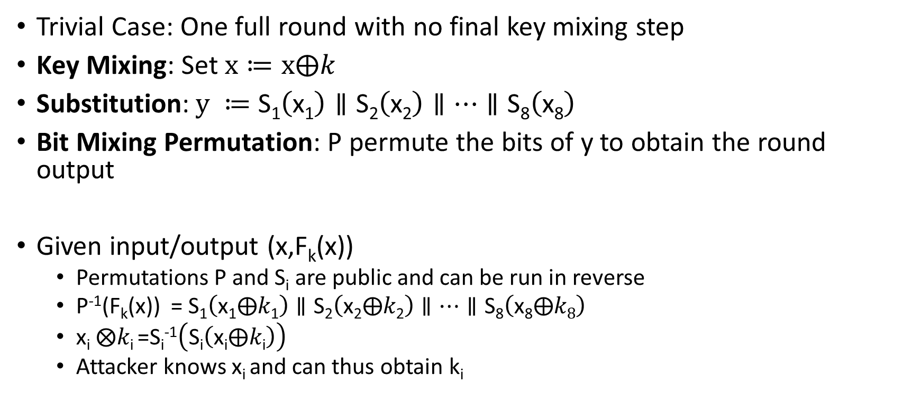
Attacking Lower Round SPNs
Trivial Case: One full round with no final key mixing step
Key Mixing: Set $x≔x⨁k$
Substitution:$y ≔$ $\text{S}\text{1}\left(\text{x}\text{1}\right)∥\text{S}\text{2}\left(\text{x}\text{2}\right)∥…∥\text{S}\text{8}\left(\text{x}\text{8}\right)$
Bit Mixing Permutation: P permute the bits of y to obtain the round output
Given input/output (x,F_{k}(x))
  Permutations P and S_{i} are public and can be run in reverse
  P⁻¹(F_{k}(x)) = $\text{S}\text{1}\left(\text{x}\text{1}⨁k\text{1}\right)∥\text{S}\text{2}\left(\text{x}\text{2}⨁k\text{2}\right)∥…∥\text{S}\text{8}\left(\text{x}\text{8}⨁k8\right)$
  $\text{x}\text{i} ⨂k\text{i}$=S_{i}⁻¹$\left(\text{S}\text{i}\left(\text{x}\text{i}⨁k\text{i}\right)\right)$
  Attacker knows x_{i} and can thus obtain k_{i}

Slide 55
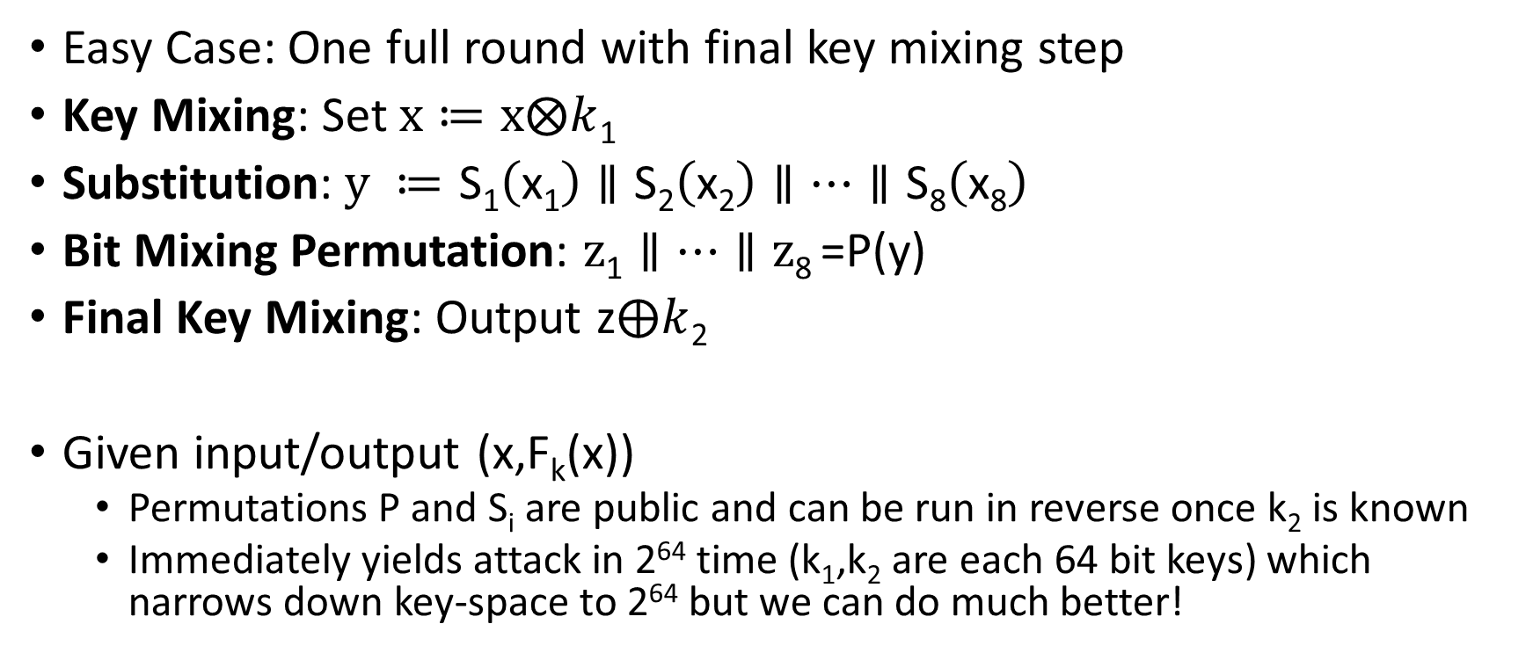
Attacking Lower Round SPNs
Easy Case: One full round with final key mixing step
Key Mixing: Set $x≔x⨂k$₁
Substitution:$y ≔$ $\text{S}\text{1}\left(\text{x}\text{1}\right)∥\text{S}\text{2}\left(\text{x}\text{2}\right)∥…∥\text{S}\text{8}\left(\text{x}\text{8}\right)$
Bit Mixing Permutation: $z\text{1}∥…∥\text{z}\text{8}$=P(y)
Final Key Mixing: Output z$⨁k$₂
Given input/output (x,F_{k}(x))
  Permutations P and S_{i} are public and can be run in reverse once k₂ is known
  Immediately yields attack in 2⁶⁴ time (k₁,k₂ are each 64 bit keys) which narrows down key-space to 2⁶⁴ but we can do much better!

Slide 56
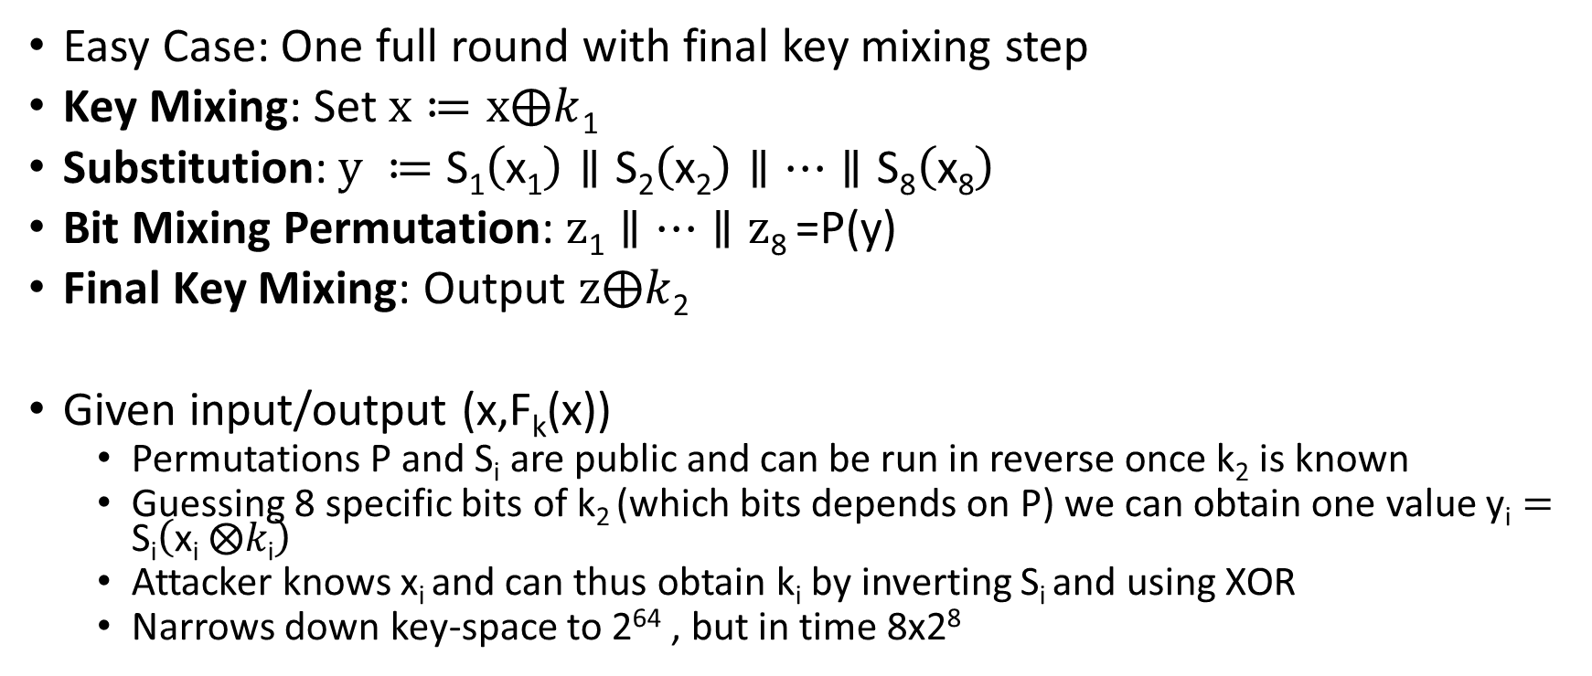
Attacking Lower Round SPNs
Easy Case: One full round with final key mixing step
Key Mixing: Set $x≔x⨁k$₁
Substitution:$y ≔$ $\text{S}\text{1}\left(\text{x}\text{1}\right)∥\text{S}\text{2}\left(\text{x}\text{2}\right)∥…∥\text{S}\text{8}\left(\text{x}\text{8}\right)$
Bit Mixing Permutation: $z\text{1}∥…∥\text{z}\text{8}$=P(y)
Final Key Mixing: Output $z⨁k$₂
Given input/output (x,F_{k}(x))
  Permutations P and S_{i} are public and can be run in reverse once k₂ is known
  Guessing 8 specific bits of k₂ (which bits depends on P) we can obtain one value $\text{y}\text{i}=\text{S}\text{i}\left(\text{x}\text{i} ⨂k\text{i}\right)$
  Attacker knows x_{i} and can thus obtain k_{i} by inverting S_{i} and using XOR
  Narrows down key-space to 2⁶⁴ , but in time 8x2⁸

Slide 57
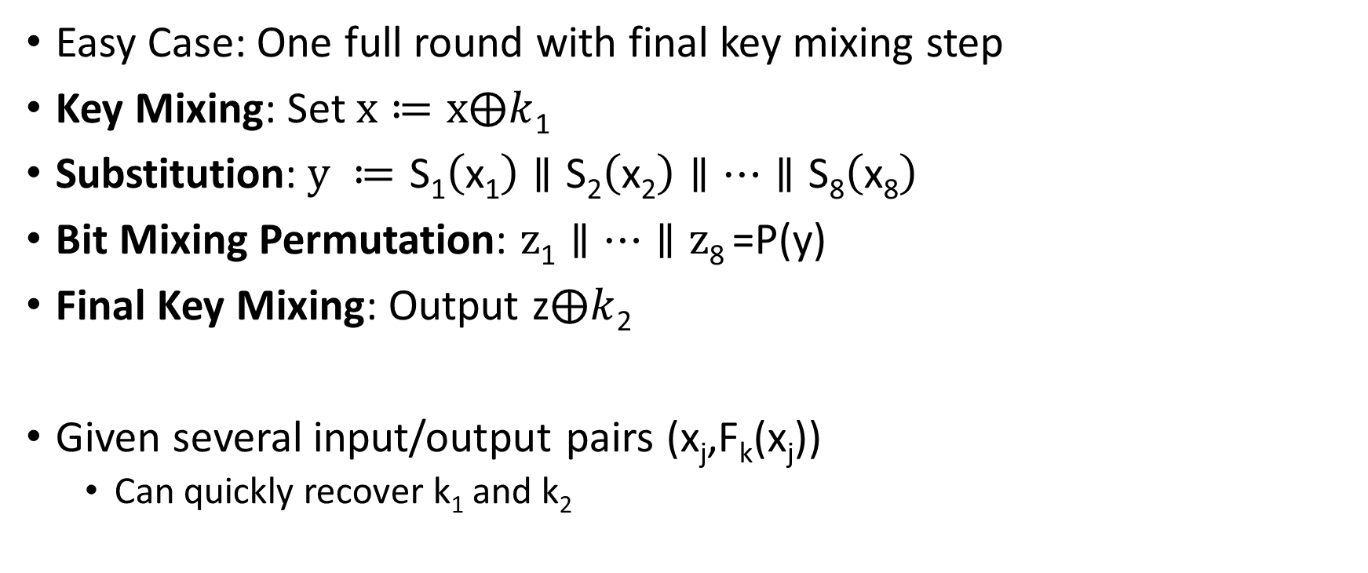
Attacking Lower Round SPNs
Easy Case: One full round with final key mixing step
Key Mixing: Set $x≔x⨁k$₁
Substitution:$y ≔$ $\text{S}\text{1}\left(\text{x}\text{1}\right)∥\text{S}\text{2}\left(\text{x}\text{2}\right)∥…∥\text{S}\text{8}\left(\text{x}\text{8}\right)$
Bit Mixing Permutation: $z\text{1}∥…∥\text{z}\text{8}$=P(y)
Final Key Mixing: Output z$⨁k$₂
Given several input/output pairs (x_{j},F_{k}(x_{j}))
  Can quickly recover k₁ and k₂

Slide 58
Attacking Lower Round SPNs
Harder Case: Two round SPN
Exercise ☺

Slide 59
Feistel Networks
Alternative to Substitution Permutation Networks
Advantage: underlying functions need not be invertible, but the result is still a permutation

Slide 60
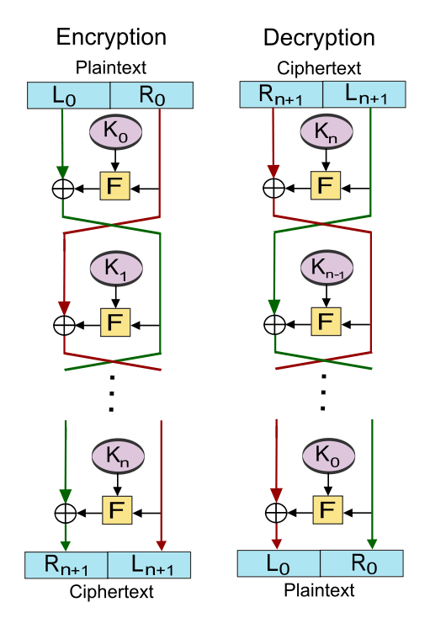
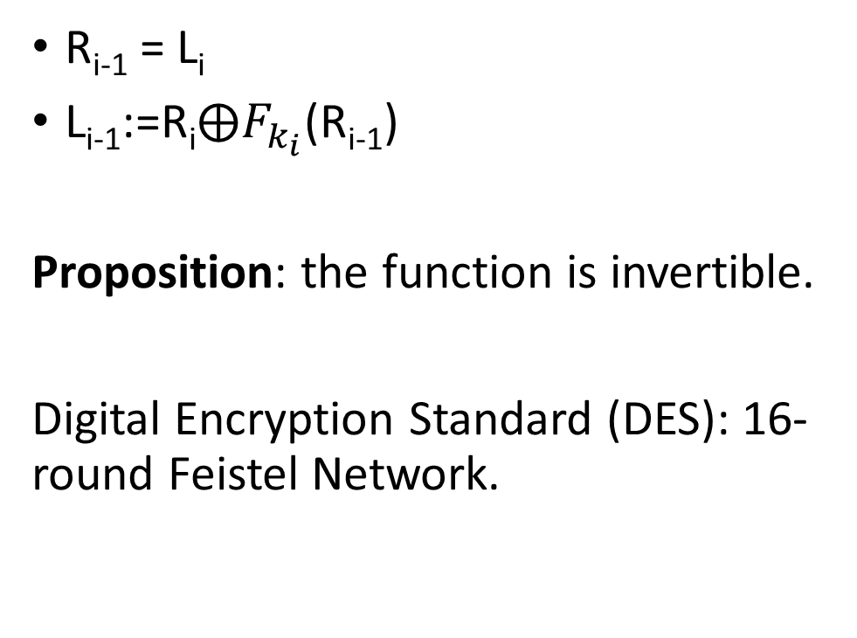
R_{i-1} = L_{i}
L_{i-1}:=$\text{R}\text{i}⨁F_{k_{i}}$(R_{i-1})
Proposition: the function is invertible.
Digital Encryption Standard (DES): 16-round Feistel Network.

Slide 61
CS 555: Week 6: Topic 4
DES, 3DES

Slide 62
Feistel Networks
Alternative to Substitution Permutation Networks
Advantage: underlying functions need not be invertible, but the result is still a permutation

Slide 63

L_{i+1} = R_{i}
R_{i+1}≔L$\text{i}⨁F_{k_{i}}$(R_{i})
Proposition: the function is invertible.

Slide 64
Data Encryption Standard
Developed in 1970s by IBM (with help from NSA)
Adopted in 1977 as Federal Information Processing Standard (US)
Data Encryption Standard (DES): 16-round Feistel Network.
Key Length: 56 bits
  Vulnerable to brute-force attacks in modern times
  1.5 hours at 14 trillion DES evals/second e.g., Antminer S9 runs at 14 TH/s

Slide 65
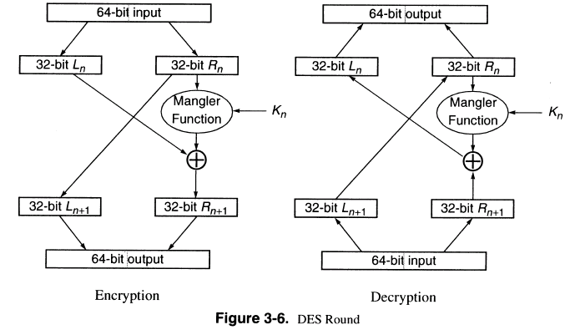
DES Round

Slide 66
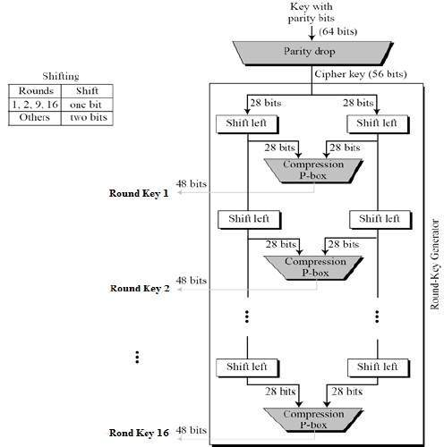
Generating the Round Keys
Initial Key: 64 bits
Effective Key Length: 56 bits
Round Key Length: 48 bits (each)
16 round keys derived from initial key

Slide 67
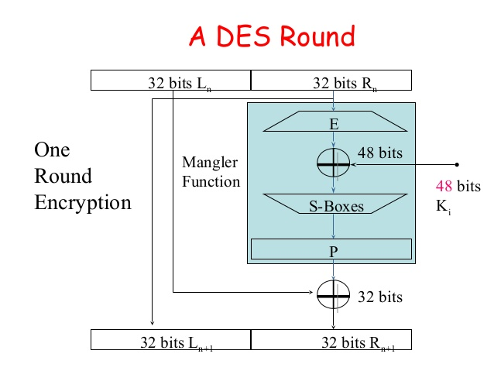
DES Mangle Function
Expand E: 32-bit input → 48-bit output (duplicates 16 bits)
S-boxes: S₁,…,S₈
  Input: 6-bits
  Output: 4 bits
  Not a permutation!
4-to-1 function
  Exactly four inputs mapped to each possible output

Slide 68
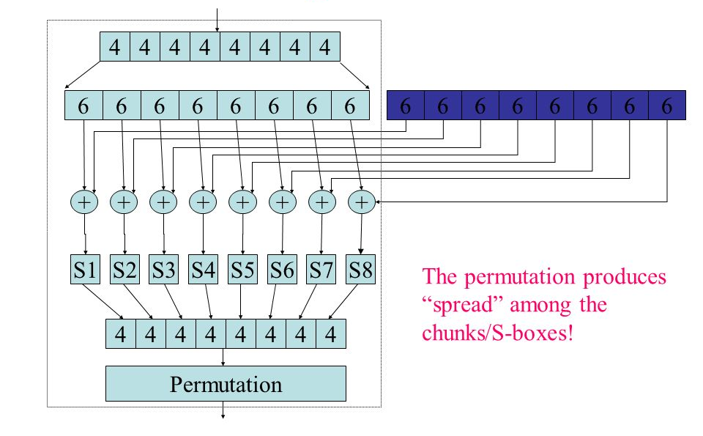
Mangle Function
32 bit input
48 bit output of expand
48-bit sub key
XOR block before
Applying S-Boxes
Each S-box outputs 4 bits

Slide 69
S-Box Representation as Table
4 columns (2 bits)
 | 00 | 01 | 10 | 11
0000
0001
0010
0011
0100
0101
0110 |  |  |  | S(x)=1101
…. | …. | …. | …. | ….
1111
16 columns (4 bits)
x =101101
S(x) = Table[0110,11]

Slide 70
S-Box Representation
Each column is permutation
4 columns (2 bits)
 | 00 | 01 | 10 | 11
0000
0001
0010
0011
0100
0101
0110 |  |  |  | S(x)=1101
…. | …. | …. | …. | ….
1111
16 columns (4 bits)
S(x) = T[0110,11]
x =101101

Slide 71
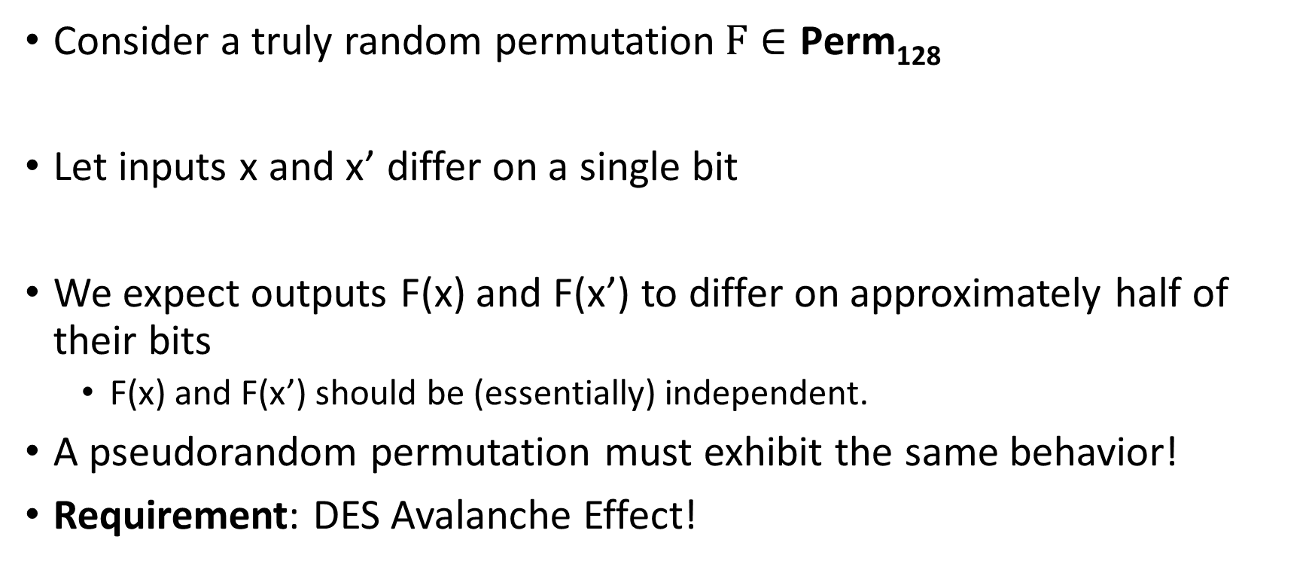
Pseudorandom Permutation Requirements
Consider a truly random permutation$F∈\text{Perm}\text{128}$
Let inputs x and x’ differ on a single bit
We expect outputs F(x) and F(x’) to differ on approximately half of their bits
  F(x) and F(x’) should be (essentially) independent.
A pseudorandom permutation must exhibit the same behavior!
Requirement: DES Avalanche Effect!

Slide 72
DES Avalanche Effect
Permutation the end of the mangle function helps to mix bits
Special S-box property #1
Let x and x’ differ on one bit then S_{i}(x) differs from S_{i}(x’) on two bits.

Slide 73
Avalanche Effect Example
Consider two 64 bit inputs
  (L_{n},R_{n}) and (L_{n}’,R’_{n}=R_{n})
  L_{n} and L_{n}’ differ on one bit
This is worst case example
  L_{n+1} = L_{n+1}’=R_{n}
  But now R’_{n+1} and R_{n+1} differ on one bit
Even if we are unlucky E(R’_{n+1}) and E(R_{n+1}) differ on 1 bit
→ R_{n+2} and R’_{n+2} differ on two bits
→ L_{n+2} = R’_{n+1} and L_{n+2}’ = R’_{n+1} differ in one bit

Slide 74
Avalanche Effect Example
R_{n+2} and R’_{n+2} differ on two bits
L_{n+2} = R_{n+1} and L_{n+2}’ = R’_{n+1} differ in one bit
→R_{n+3} and R’_{n+3} differ on four bits since we have different inputs to two of the S-boxes
L_{n+3} = R’_{n+2} and L_{n+2}’ = R’_{n+2} now differ on two bits
Seven rounds we expect all 32 bits in right half to be “affected” by input change
…
DES has sixteen rounds

Slide 75
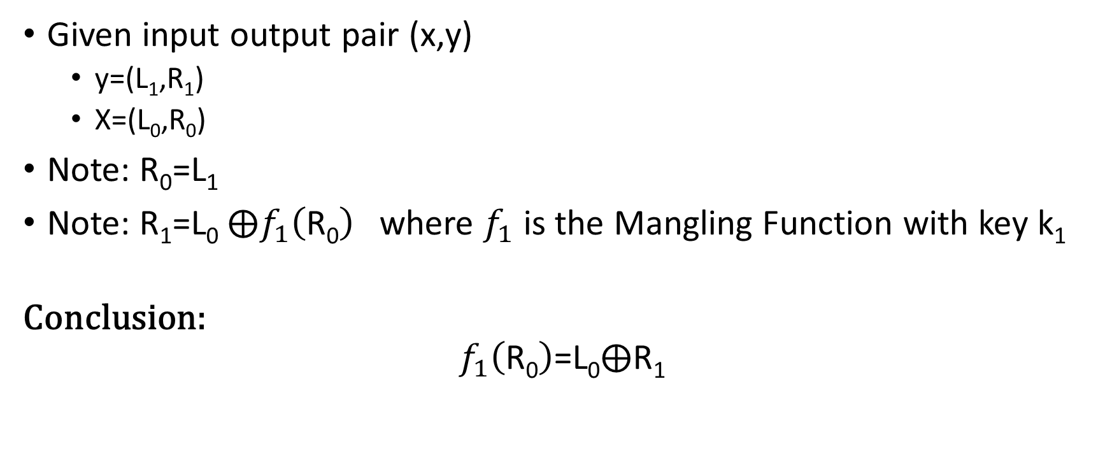
Attack on One-Round DES
Given input output pair (x,y)
  y=(L₁,R₁)
  X=(L₀,R₀)
Note: R₀=L₁
Note: R₁=L₀ $⨁f_{1}\left(\text{R}\text{0}\right)$ where $f_{1}$ is the Mangling Function with key k₁
Conclusion:
$$f_{1}\left(\text{R}\text{0}\right)\text{=}\text{L}\text{0}⨁\text{R}\text{1}$$

Slide 76


Attack on One-Round DES
$$\text{R}\text{0}$$
Four possible inputs
Trivial to Recover
$$\text{L}\text{0}⨁\text{R}\text{1}$$

Slide 77

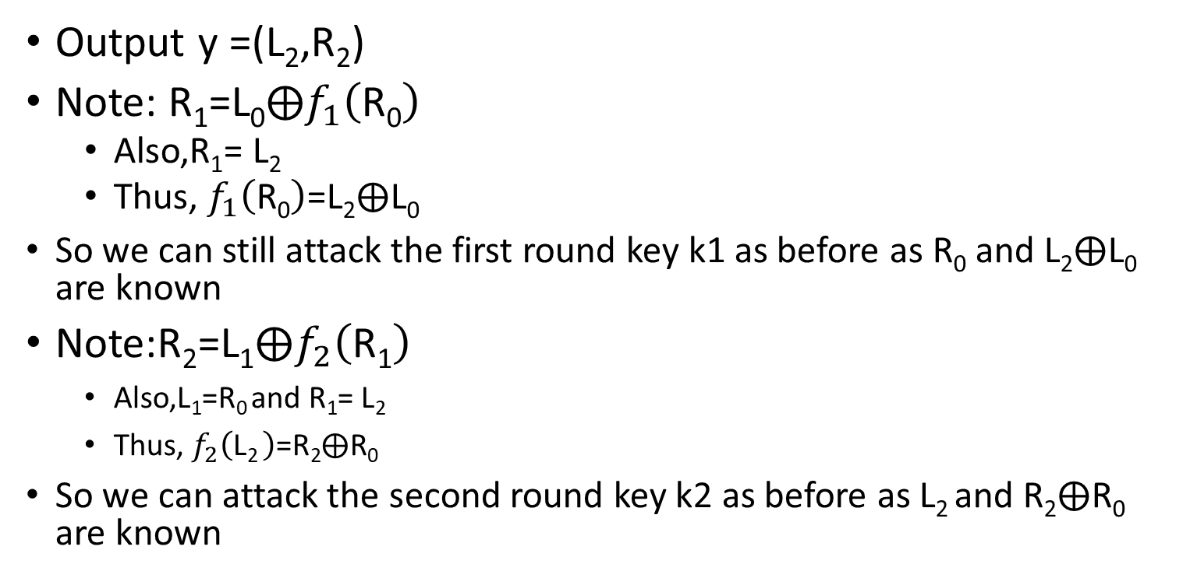



Attack on Two-Round DES
L₀
R₀
K₁
Output y =(L₂,R₂)
Note: $\text{R}\text{1}\text{=}\text{L}\text{0}⨁f_{1}\left(\text{R}\text{0}\right)$
  Also,$\text{R}\text{1}\text{=}$ $\text{L}\text{2}$
  Thus, $f_{1}\left(\text{R}\text{0}\right)\text{=}\text{L}\text{2}⨁\text{L}\text{0}$
  So we can still attack the first round key k1 as before as $\text{R}\text{0}$ and $\text{L}\text{2}⨁\text{L}\text{0}$ are known
Note:$\text{R}\text{2}\text{=}\text{L}\text{1}⨁f_{2}\left(\text{R}\text{1}\right)$
    Also,$\text{L}\text{1}\text{=}\text{R}\text{0 }$and $\text{R}\text{1}\text{=}$ $\text{L}\text{2}$
    Thus, $f_{2}\left(\text{L}\text{2 }\right)\text{=}\text{R}\text{2}⨁\text{R}\text{0}$
  So we can attack the second round key k2 as before as $\text{L}\text{2}$and $\text{R}\text{2}⨁\text{R}\text{0}$ are known
  $$f_{1}\left(\text{R}\text{0}\right)\text{=}\text{L}\text{2}⨁\text{L}\text{0}$$
$$⨁$$
F
L₁
R₁
K₂
  $$f_{2}\left(\text{R}\text{0}\right)\text{=}\text{L}\text{2}⨁\text{L}\text{0}$$
$$⨁$$
F
L₂
R₂

Slide 78
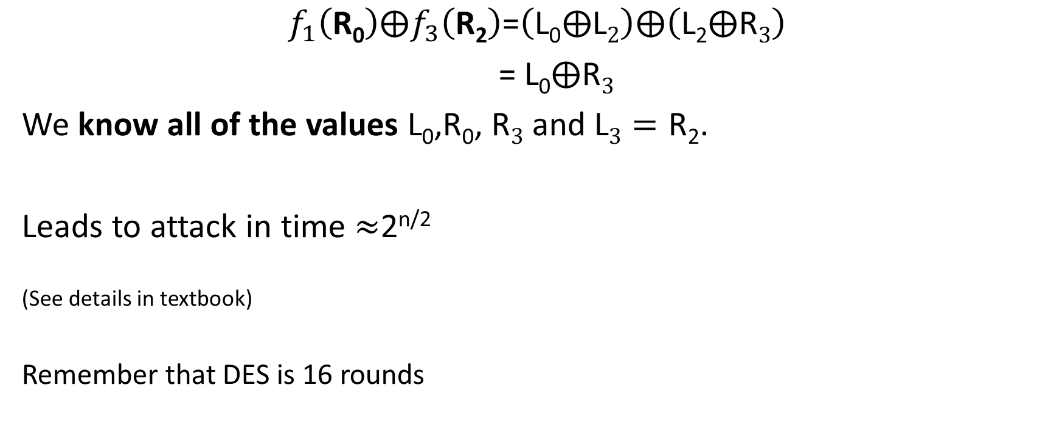
Attack on Three-Round DES
$$f_{1}\left(\text{R}\text{0}\right)⨁f_{3}\left(\text{R}\text{2}\right)\text{=}\left(\text{L}\text{0}⨁\text{L}2\right)⨁\left(\text{L}\text{2}⨁\text{R}3\right)$$
$\text{=}$ $\text{L}\text{0}⨁\text{R}3$
We know all of the values $\text{L}\text{0}\text{,}\text{R}\text{0}$, $\text{R}3$ and $\text{L}3=\text{R}\text{2}$.
Leads to attack in time $≈$2^{n/2}
^{(See details in textbook)}
^{Remember that DES is 16 rounds}

Slide 79
DES Security
Best Known attack is brute-force 2⁵⁶
  Except under unrealistic conditions (e.g., 2⁴³ known plaintexts)
Brute force is not too difficult on modern hardware
Attack can be accelerated further after precomputation
  Output is a few terabytes
  Subsequently keys are cracked in 2³⁸ DES evaluations (minutes)
Precomputation costs amortize over number of DES keys cracked
Even in 1970 there were objections to the short key length for DES

Slide 80
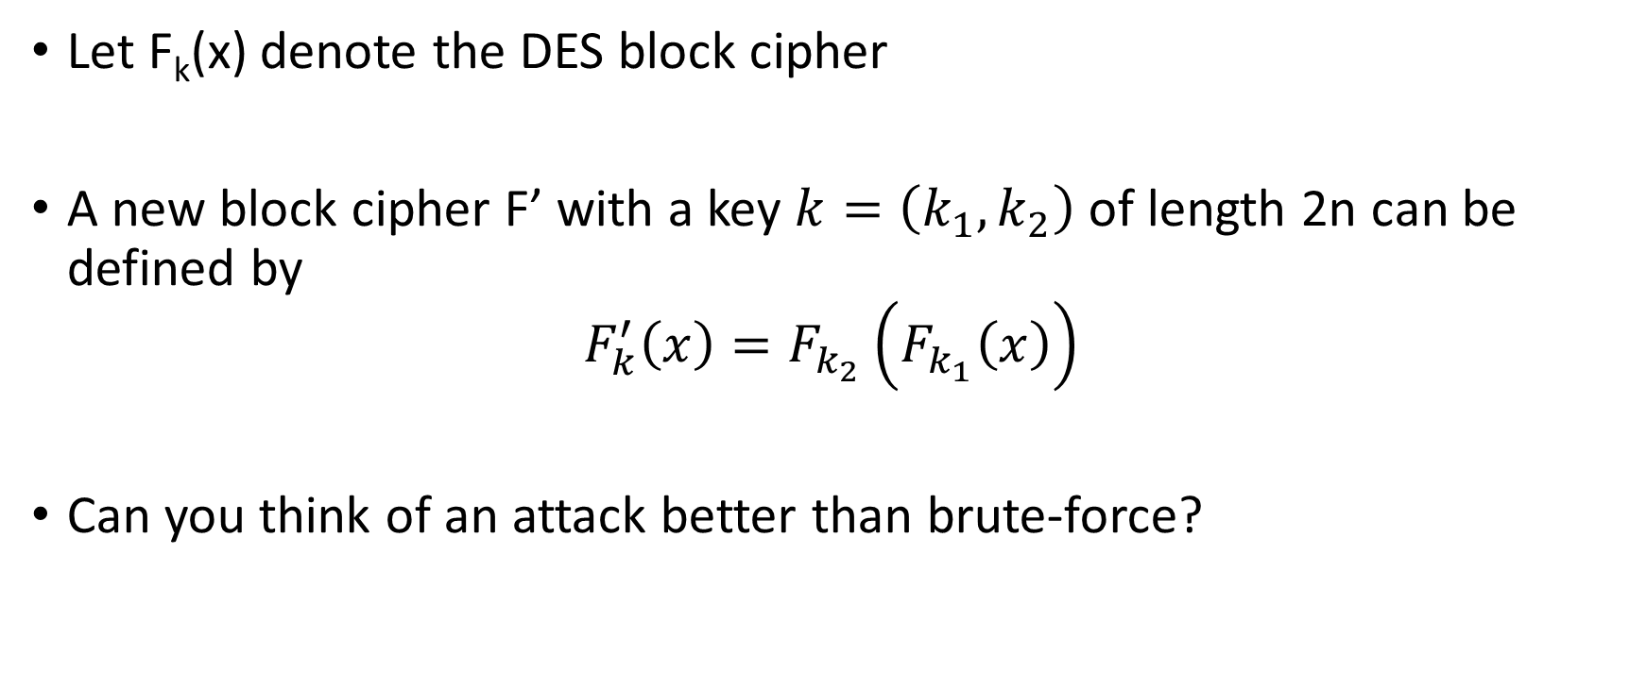
Double DES
Let F_{k}(x) denote the DES block cipher
A new block cipher F’ with a key $k=\left(k_{1},k_{2}\right)$ of length 2n can be defined by
$$F_{k}^{′}\left(x\right)=F_{k_{2}}\left(F_{k_{1}}\left(x\right)\right)$$
Can you think of an attack better than brute-force?

Slide 81

Meet in the Middle Attack
$$F_{k}^{′}\left(x\right)=F_{k_{2}}\left(F_{k_{1}}\left(x\right)\right)$$
Goal: Given (x, $c=F_{k}^{′}\left(x\right)$) try to find secret key k in time and space $O\left(n2^{n}\right)$.
Solution?
  Key Observation
  $$F_{k_{1}}\left(x\right)={ F}_{k_{2}}^{−1}\left(c\right)$$
  Compute${ F}_{K}^{−1}\left(c\right)$ and${ F}_{K}\left(x\right)$ for each potential n-bit key K and store $\left(K,{ F}_{K}^{−1}\left(c\right)\right)$ and $\left(K,{ F}_{K}^{}\left(x\right)\right)$
  Sort each list of pairs (by ${ F}_{K}^{−1}\left(c\right)$ or ${ F}_{K}^{}\left(x\right)$) to find K₁ and K₂.

Slide 82

Triple DES Variant 1
Let F_{k}(x) denote the DES block cipher
A new block cipher F’ with a key $k=\left(k_{1},k_{2}{,k}_{3}\right)$ of length 2n can be defined by
$$F_{k}^{′}\left(x\right)=F_{k_{3}}\left(F_{k_{2}}^{−1}\left(F_{k_{1}}\left(x\right)\right)\right)$$
Meet-in-the-Middle Attack Requires time $Ω\left(2^{2n}\right)$ and space $Ω\left(2^{2n}\right)$

Slide 83
Triple DES Variant 1
Allows backward compatibility with DES by setting k₁=k₂=k₃
Let F_{k}(x) denote the DES block cipher
A new block cipher F’ with a key $k=\left(k_{1},k_{2}{,k}_{3}\right)$ of length 2n can be defined by
$$F_{k}^{′}\left(x\right)=F_{k_{3}}\left(F_{k_{2}}^{−1}\left(F_{k_{1}}\left(x\right)\right)\right)$$
Meet-in-the-Middle Attack Requires time $Ω\left(2^{2n}\right)$ and space $Ω\left(2^{2n}\right)$

Slide 84

Triple DES Variant 2
Just two keys!
Let F_{k}(x) denote the DES block cipher
A new block cipher F’ with a key $k=\left(k_{1},k_{2}\right)$ of length 2n can be defined by
$$F_{k}^{′}\left(x\right)=F_{k_{1}}\left(F_{k_{2}}^{−1}\left(F_{k_{1}}\left(x\right)\right)\right)$$
Meet-in-the-Middle Attack still requires time $Ω\left(2^{2n}\right)$ and space $Ω\left(2^{2n}\right)$
Key length is still just 112 bits (NIST recommends 128+ bits)

Slide 85

Triple DES Variant 1
$$F_{k}^{′}\left(x\right)=F_{k_{3}}\left(F_{k_{2}}^{−1}\left(F_{k_{1}}\left(x\right)\right)\right)$$
Standardized in 1999
Still widely used, but it is relatively slow (three block cipher operations)
Current gold standard: AES

Slide 86

Hash Functions from Block Ciphers
Davies-Meyer Construction from block cipher $F_{K}$
$$H\left(K,x\right)=F_{K}\left(x\right)$$
Theorem: If $F:{\left\{0,1\right\}}^{λ}×{\left\{0,1\right\}}^{λ}→{\left\{0,1\right\}}^{λ}$ is modeled as an ideal block cipher then Davies-Meyer construction is a collision-resistant hash function
(Concrete: Need roughly $q≈2^{λ/2}$ queries to find collision)
Ideal Cipher Model: For each key K model F_{K} as a truly random permutation which may only be accessed in black box manner.
  (Equivalent to Random Oracle Model)

Slide 87
Next Class
Read Katz and Lindell 6.2.5-6.3
AES & Differential Cryptanalysis

Slide 88
CS 555:Week 6: Topic 2
Stream Ciphers

Slide 89






PRG Security as a Game
R
Random bit b
If b=1
$r←{\left\{0,1\right\}}^{n}$
R = G(r)
Else
$$R←{\left\{0,1\right\}}^{ℓ\left(n\right)}$$
b’
$$∀\begin{matrix} & \\ & \\ & \end{matrix} Pr\left[\begin{matrix} & \\ & \end{matrix} Guesses b^{′}=b\right]≤\frac{1}{2}+μ(n)$$
$$ppt attacker$$
$$negligible function$$
Notes:
Suppose we have m,m’,c’ s.t. Pr[EncK(m)= c’] > Pr[EncK(m’)=c’] then adversary can select m0= m, m1=m’. If the ciphertext challenge c=c’ then the adversary outputs guess b’ = 1. Otherwise, the adversary outputs random guess b’.

Slide 90

Stream Cipher vs PRG
PRG pseudorandom bits output all at once
Stream Cipher
  Pseudorandom bits can be output as a stream
  RC4, RC5 (Ron’s Code)
st₀ := Init(s)
For i=1 to $ℓ$:
  (y_{i},st_{i}):=GetBits(st_{i-1})
Output: y₁,…,y$ℓ$

Slide 91

Linear Feedback Shift Register

Slide 92

Linear Feedback Shift Register
State at time t:${ s}_{n−1}^{t},…,{ s}_{1}^{t},{ s}_{0}^{t}$ (n registers)
Feedback Coefficients: $S⊆\left\{0,…,n\right\}$

Slide 93

Linear Feedback Shift Register
State at time t:${ s}_{n−1}^{t},…,{ s}_{1}^{t},{ s}_{0}^{t}$ (n registers)
Feedback Coefficients: $S⊆\left\{0,…,n−1\right\}$
State at time t+1:${⨁_{i∈S}s_{i}^{t}, s}_{n−1}^{t},…,{ s}_{1}^{t},$
$${ s}_{n−1}^{t+1}=⨁_{i∈S}s_{i}^{t}, and { s}_{i}^{t+1}={ s}_{i+1}^{t} for i<n−1$$
Output at time t+1: $y_{t+1}{=s}_{0}^{t}$

Slide 94

Linear Feedback Shift Register
Observation 1: First n bits of output reveal initial state
$$y_{1},…,y_{n}{=s}_{0}^{0},{ s}_{1}^{0},…,s_{n−1}^{0}$$
Observation 2: Next n bits allow us to solve for n unknowns
$$x_{i}=\left\{\begin{aligned}1 if i∈S \\ 0 otherwise \end{aligned}\right.$$
$$y_{n+1}=y_{n}x_{n−1}+…+y_{1}x_{0}$$

Slide 95

Linear Feedback Shift Register
Observation 1: First n bits of output reveal initial state
$$y_{1},…,y_{n}{=s}_{0}^{0},{ s}_{1}^{0},…,s_{n−1}^{0}$$
Observation 2: Next n bits allow us to solve for n unknowns
$$x_{i}=\left\{\begin{aligned}1 if i∈S \\ 0 otherwise \end{aligned}\right.$$
$$y_{n+1}=y_{n}x_{n−1}+…+y_{1}x_{0} \text{mod}\text{ 2}$$

Slide 96

Linear Feedback Shift Register
Observation 2: Next n bits allow us to solve for n unknowns
$$x_{i}=\left\{\begin{aligned}1 if i∈S \\ 0 otherwise \end{aligned}\right.$$
$$y_{n+1}=y_{n}x_{n−1}+…+y_{1}x_{0} \text{mod}\text{ 2 }$$
$$y_{2n}=y_{2n−1}x_{n−1}+…+y_{n}x_{0} \text{mod}\text{ 2}$$
N unknowns &
N linear independent constraints
…

Slide 97

Removing Linearity
Attacks exploited linear relationship between state and output bits
Nonlinear Feedback:
$${ s}_{n−1}^{t+1}=⨁_{i∈S}s_{i}^{t},$$
$${ s}_{n−1}^{t+1}=g\left(s_{0}^{t},{ s}_{1}^{t},…,s_{n−1}^{t}\right)$$
Non linear function

Slide 98

Removing Linearity
Attacks exploited linear relationship between state and output bits
Nonlinear Combination:
$$y_{t+1}{=s}_{0}^{t}$$
$${ y}_{t+1}^{}=f\left(s_{0}^{t},{ s}_{1}^{t},…,s_{n−1}^{t}\right)$$
Important: f must be balanced!
$$Pr\left[f\left(x\right)=1\right]≈\frac{1}{2}$$
Non linear function

Slide 99

Trivium (2008)
Won the eSTREAM competition
Currently, no known attacks are better than brute force
Couples Output from three nonlinear Feedback Shift Registers
First 4*288 “output bits” are discared

Slide 100
Trivium (2008)

Slide 101
Trivium (2008)
AND (Non-linear)

Slide 102
Trivium (2008)
(Non-linear) Feedback

Slide 103
Combination Generator
Attacks exploited linear relationship between state and output bits
Nonlinear Combination:
$$y_{t+1}{=s}_{0}^{t}$$
$${ y}_{t+1}^{}=f\left(s_{0}^{t},{ s}_{1}^{t},…,s_{n−1}^{t}\right)$$
Important: f must be balanced!
$$Pr\left[f\left(x\right)=1\right]≈\frac{1}{2}$$
Non linear function

Slide 104
Feedback Shift Registers
Good performance in hardware
Performance is less ideal for software

Slide 105
The RC4 Stream Cipher
A proprietary cipher owned by RSA, designed by Ron Rivest in 1987.
Became public in 1994.
Simple and effective design.
Variable key size (typical 40 to 256 bits),
Output unbounded number of bytes.
Widely used (web SSL/TLS, wireless WEP).
Extensively studied, not a completely secure PRNG, when used correctly, no known attacks exist
Newer Versions: RC5 and RC6
Rijndael selected by NIST as AES in 2000
Notes:
This cipher algorithm was developed by two Belgian cryptographers, Joan Daemen and Vincent Rijmen, and submitted to the AES selection process under the name "Rijndael", a portmanteau of the names of the inventors. (Rijndael is pronounced [rɛindaːl]).^{[2]}
S

Slide 106
The RC4 Cipher
The cipher internal state consists of
  a 256-byte array S, which contains a permutation of 0 to 255
    total number of possible states is 256! ≈ 2¹⁷⁰⁰
  two indexes: i, j
  i = j = 0
  Loop
    i = (i + 1) (mod 256)
    j = (j + S[i]) (mod 256)
    swap(S[i], S[j])
    output S[S[i] + S[j] (mod 256)]
  End Loop

Slide 107


Distinguishing Attack
Let $S_{0}$ denote initial state
Suppose that $S_{0}$[2]=0 and $S_{0}$[1]$=X≠0$
  i = j = 0
  Loop
    i = (i + 1) (mod 256)
    j = (j + S[i]) (mod 256)
    swap(S[i], S[j])
    output S[S[i] + S[j] (mod 256)]
  End Loop
 | 1 | 2 | 3 | … | X | … | 255
$$S_{0}$$ | $S_{0}$[1]$≠0$ | 0 | $S_{0}$[3] |  | $S_{0}$[X] |  | $S_{0}$[255]

Slide 108

Distinguishing Attack
Let $S_{0}$ denote initial state
Suppose that $S_{0}$[2]=0 and $S_{0}$[1]$=X≠0$
  i = j = 0
  Loop
    i = (i + 1) (mod 256)
    j = (j + S[i]) (mod 256)
    swap(S[i], S[j])
    output S[S[i] + S[j] (mod 256)]
  End Loop
 | 1 | 2 | 3 | … | X | … | 255
$$S_{0}$$ | $$X≠0$$ | 0 | $S_{0}$[3] |  | $S_{0}$[X] |  | $S_{0}$[255]
i=1, j =X

Slide 109



Distinguishing Attack
 | 1 | 2 | 3 | … | X | … | 255
$$S_{0}$$ | $$X≠0$$ | 0 | $S_{0}$[3] |  | $S_{0}$[X] |  | $S_{0}$[255]
$$S_{1}$$ | $S_{0}$[X] | 0 | $S_{0}$[3] |  | $$X≠0$$ |  | $S_{0}$[255]
Let $S_{0}$ denote initial state
Suppose that $S_{0}$[2]=0 and $S_{0}$[1]$=X≠0$
  i = j = 0
  Loop
    i = (i + 1) (mod 256)
    j = (j + S[i]) (mod 256)
    swap(S[i], S[j])
    output S[S[i] + S[j] (mod 256)]
  End Loop
i=1, j =X
Output y₁= $S_{1}$[S[i]+S[j]]
i=2, j =X

Slide 110

Distinguishing Attack
 | 1 | 2 | 3 | … | X | … | 255
$$S_{0}$$ | $$X≠0$$ | 0 | $S_{0}$[3] |  | $S_{0}$[X] |  | $S_{0}$[255]
$$S_{1}$$ | $S_{0}$[X] | 0 | $S_{0}$[3] |  | $$X≠0$$ |  | $S_{0}$[255]
$$S_{2}$$ | $S_{0}$[X] | $$X≠0$$ | $S_{0}$[3] |  | 0
Let $S_{0}$ denote initial state
Suppose that $S_{0}$[2]=0 and $S_{0}$[1]$=X≠0$
  i = j = 0
  Loop
    i = (i + 1) (mod 256)
    j = (j + S[i]) (mod 256)
    swap(S[i], S[j])
    output S[S[i] + S[j] (mod 256)]
  End Loop
i=2, j =X
Output:
y₂= S₂[S₂[2]+S₂[X]]
= S₂[0+X]
=0

Slide 111

Distinguishing Attack
Let $p=Pr\left[S_{0}\text{[2]=0 }\text{and} S_{0}\text{[1]} ≠2\right]$
$$p=\frac{1}{256}\left(1−\frac{1}{255}\right)$$
Probability second output byte is 0
$$Pr\left[y2=0{ | S}_{0}\text{[2]=0 }\text{and} S_{0}\text{[1]} ≠2\right]p+Pr\left[y2=0{ | S}_{0}\text{[2]}≠\text{0 }\text{or} S_{0}\text{[1]}≠2\right](1−p)$$
$$=p+\left(1−p\right)\frac{1}{256}$$
$$=\frac{1}{256}\left(1−\frac{1}{255}\right)+\left(1−\frac{1}{256}+\frac{1}{256}\frac{1}{255}\right)\frac{1}{256}$$
$$≈\frac{2}{256}$$

Slide 112
Other Attacks
Wired Equivalent Privacy (WEP) encryption used RC4 with an initialization vector
Description of RC4 doesn’t involve initialization vector…
  But WEP imposes an initialization vector
  K=IV || K’
  Since IV is transmitted attacker may have first few bytes of K!
  Giving the attacker partial knowledge of K often allows recovery of the entire key K’ over time!

