Slide 1
Homework 2 Released
Due: Tuesday, October 2nd at 3PM (beginning of class)
Please Typeset Your Solutions (LaTeX, Word etc…)
You may collaborate, but must write up your own solutions in your own words

Slide 2
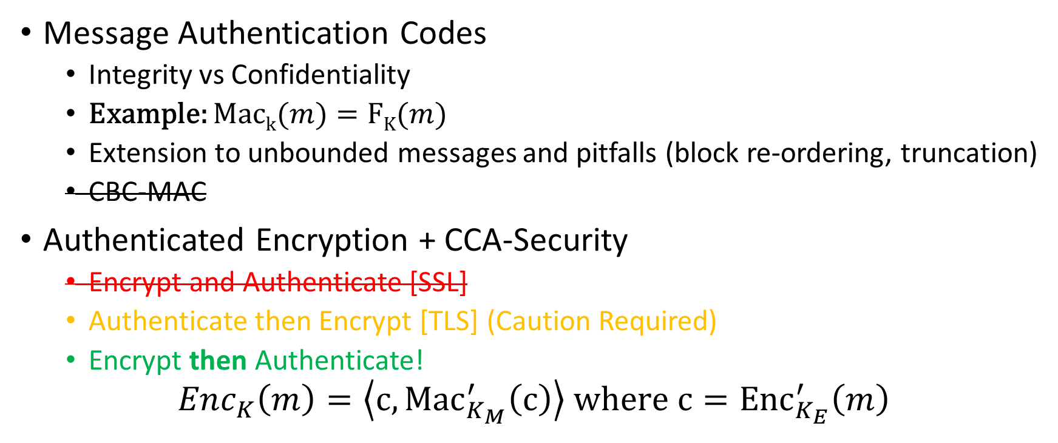
Recap
Message Authentication Codes
  Integrity vs Confidentiality
  Example: $\operatorname{Mack}{(m)}=FK(m)$
  Extension to unbounded messages and pitfalls (block re-ordering, truncation)
  CBC-MAC
Authenticated Encryption + CCA-Security
  Encrypt and Authenticate [SSL]
  Authenticate then Encrypt [TLS] (Caution Required)
  Encrypt then Authenticate!
$${Enc}_{K}\left(m\right)=\left\langle c,{Mac}_{K_{M}}^{′}\left(c\right)\right\rangle where{ c=Enc}_{K_{E}}^{′}\left(m\right)$$

Slide 3
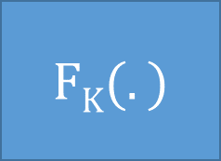
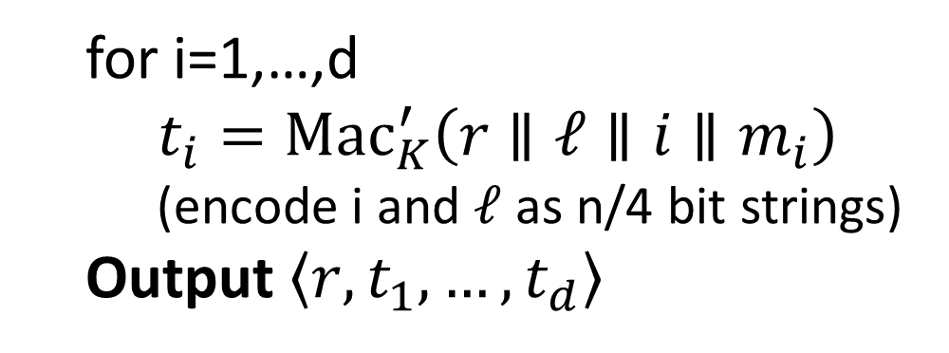


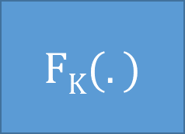








CBC-MAC
Caveat: Tricky Padding Issues arise if |m| is not a multiple of the block-length. See textbook.
We will see a simpler MAC construction using hash functions soon.
$$m_{1}$$
$$m_{2}$$
$$m_{3}$$
$${\left|m\right|}_{}$$
$$⨁$$
$$⨁$$
$$⨁$$
$$FK(.)$$
$$FK(.)$$
$$FK(.)$$
$$FK(.)$$
$$τ={Mac}_{K}\left(m\right)$$
Advantages over Previous Solution
Both MACs are secure
Works for unbounded length messages
Canonical Verification
Short Authentication tag
Parallelizable
  for i=1,…,d
  $t_{i}={Mac}_{K}^{′}\left(r∥ℓ∥i{∥m}_{i}\right)$
    (encode i and $ℓ$ as n/4 bit strings)
  Output $\left\langle r,t_{1},…,t_{d}\right\rangle$

Slide 4
Recap: Authenticated Encryption
Authenticated Encryption → CCA-Security (by definition)
Conceptual Distinction
  CCA-Security the goal is secrecy (hide message from active adversary)
  Authenticated Encryption: the goal is integrity + secrecy
CCA-Security does not necessarily imply Authenticate Encryption
  But most natural CCA-Secure constructions are also Authenticated Encryption Schemes
  Some constructions are CCA-Secure, but do not provide Authenticated Encryptions, but they are less efficient.

Slide 5
Secure Communication Session
Solution Protocol? Alice transmits c₁ = Enc_{K}(m₁) to Bob, who decrypts and sends Alice c₂ = Enc_{K}(m₂) etc…
Authenticated Encryption scheme is
  Stateless
  For fixed length-messages
We still need to worry about
  Re-ordering attacks
    Alice sends 2n-bit message to Bob as c₁ = Enc_{K}(m₁), c₂ = Enc_{K}(m₂)
  Replay Attacks
    Attacker who intercepts message c₁ = Enc_{K}(m₁) can replay this message later in the conversation
  Reflection Attack
    Attacker intercepts message c₁ = Enc_{K}(m₁) sent from Alice to Bob and replays to c₁ Alice only

Slide 6
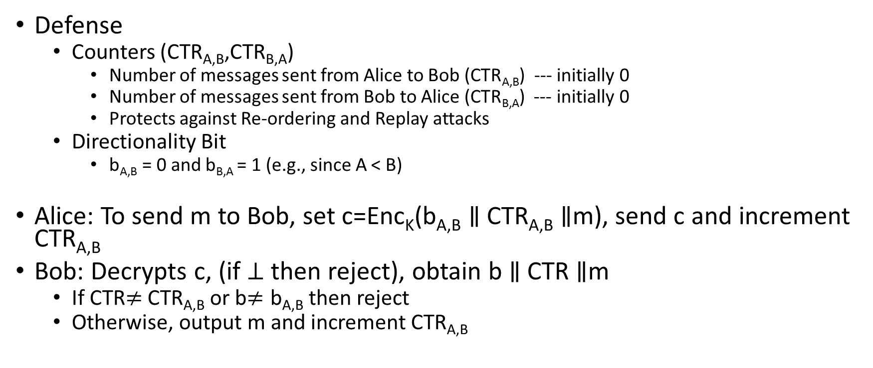
Secure Communication Session
Defense
  Counters (CTR_{A,B},CTR_{B,A})
    Number of messages sent from Alice to Bob (CTR_{A,B}) --- initially 0
    Number of messages sent from Bob to Alice (CTR_{B,A}) --- initially 0
    Protects against Re-ordering and Replay attacks
  Directionality Bit
    b_{A,B} = 0 and b_{B,A} = 1 (e.g., since A < B)
Alice: To send m to Bob, set c=Enc_{K}(b_{A,B} $∥$ CTR_{A,B} $∥$m), send c and increment CTR_{A,B}
Bob: Decrypts c, (if $⊥$ then reject), obtain b $∥$ CTR $∥$m
  If CTR$≠$CTR_{A,B} or b$≠\text{b}\text{A}\text{,}\text{B}$ then reject
  Otherwise, output m and increment CTR_{A,B}

Slide 7
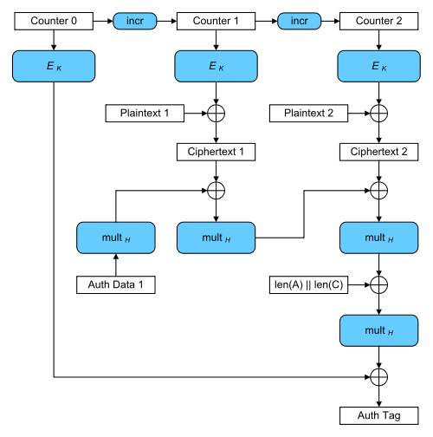
Galois Counter Mode (GCM)
AES-GCM is an Authenticated Encryption Scheme
  Bonus: Authentication Encryption with Associated Data
  Ensure integrity of ciphertext
  Attacker cannot even generate new/valid ciphertext!
  Ensures attacker cannot tamper with associated packet data
    Source IP
    Destination IP
    Why can’t these values be encrypted?
Encryption is largely parallelizable!

Slide 8
Cryptography
CS 555
Week 5:
Cryptographic Hash Functions
HMACs
Generic Attacks
Random Oracle Model
Applications of Hashing
Readings: Katz and Lindell Chapter 5, Appendix A.4
Fall 2017

Slide 9
Week 5: Topic 1:
Cryptographic Hash Functions

Slide 10


Hash Functions
H(x)=y
Long Input: $x$
Short Output: y s.t.
$$\left|y\right|≪\left|x \right|$$

Slide 11
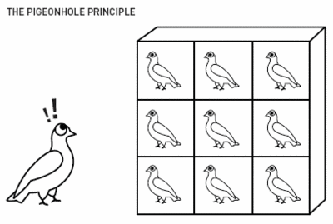
Pigeonhole Principle
“You cannot fit 10 pigeons into 9 pigeonholes”

Slide 12
Hash Collisions
By Pigeonhole Principle there must exist x and y s.t.
H(x) = H(y)

Slide 13
Classical Hash Function Applications
Hash Tables
  O(1) lookup*
“Good hash function” should yield “few collisions”
* Certain terms and conditions apply

Slide 14
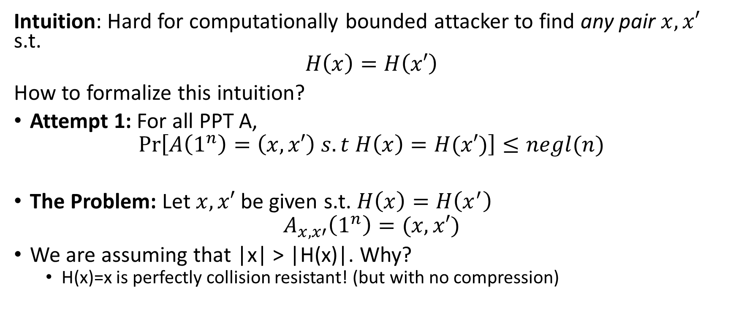
Collision-Resistant Hash Function
Intuition: Hard for computationally bounded attacker to find any pair $x, x′$ s.t.
$$H\left(x\right)=H\left(x′\right)$$
How to formalize this intuition?
Attempt 1: For all PPT A,
$$Pr\left[A\left(1^{n}\right)=\left(x,x′\right) s.t H\left(x\right)=H(x′)\right]≤negl(n)$$
The Problem: Let $x,x′$ be given s.t. $H\left(x\right)=H\left(x^{′}\right)$
$$A_{x,x′}\left(1^{n}\right)=(x,x′)$$
We are assuming that |x| > |H(x)|. Why?
  H(x)=x is perfectly collision resistant! (but with no compression)

Slide 15
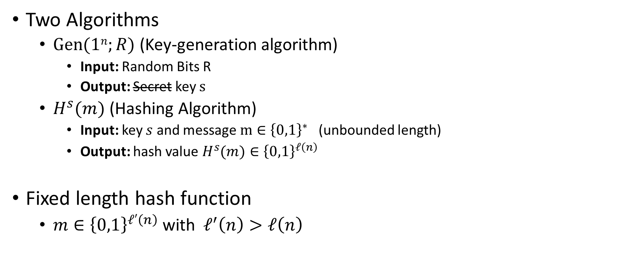
Keyed Hash Function Syntax
Two Algorithms
  $\operatorname{Gen}{(1n;R)}$ (Key-generation algorithm)
    Input: Random Bits R
    Output: Secret key $s$
  $H^{s}{(m)}$ (Hashing Algorithm)
    Input: key $s$ and message $m∈{\left\{0,1\right\}}^{∗}$ (unbounded length)
    Output: hash value${ H}^{s}{(m)}∈{\left\{0,1\right\}}^{ℓ\left(n\right)}$
Fixed length hash function
  $m∈{\left\{0,1\right\}}^{ℓ′\left(n\right)}$ with$ℓ^{′}\left(n\right)>ℓ\left(n\right)$

Slide 16


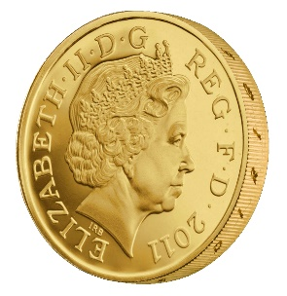



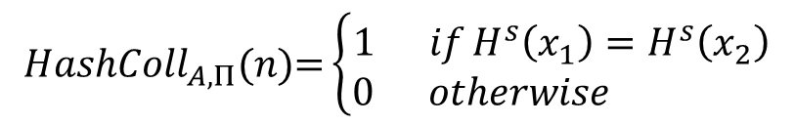
Collision Experiment (${HashColl}_{A,Π}(n)$)
s
x₁,x₂
$${HashColl}_{A,Π}(n)\text{=}\left\{\begin{aligned}1 ifH^{s}\left(x_{1}\right)=H^{s}\left(x_{2}\right) \\ 0 otherwise \end{aligned}\right.$$
$$s=Gen{(1n;R)}$$
Definition: (Gen,H) is a collision resistant hash function if
$$∀PPT A ∃μ (negligible) s.t$$
$$Pr\left[{HashColl}_{A,Π}(n)\text{=}1\right]≤μ(n)$$

Slide 17
Collision Experiment (${HashColl}_{A,Π}(n)$)
For simplicity we will sometimes just say that H (or H^{s}) is a collision resistant hash function
s
Key is not key secret (just random)
x₁,x₂
$${HashColl}_{A,Π}(n)\text{=}\left\{\begin{aligned}1 ifH^{s}\left(x_{1}\right)=H^{s}\left(x_{2}\right) \\ 0 otherwise \end{aligned}\right.$$
$$s=Gen{(1n;R)}$$
Definition: (Gen,H) is a collision resistant hash function if
$$∀PPT A ∃μ (negligible) s.t$$
$$Pr\left[{HashColl}_{A,Π}(n)\text{=}1\right]≤μ(n)$$

Slide 18
Theory vs Practice
Most cryptographic hash functions used in practice are un-keyed
  Examples: MD5, SHA1, SHA2, SHA3
Tricky to formally define collision resistance for keyless hash function
  There is a PPT algorithm to find collisions
  We just usually can’t find this algorithm ☺

Slide 19
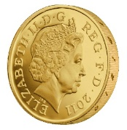
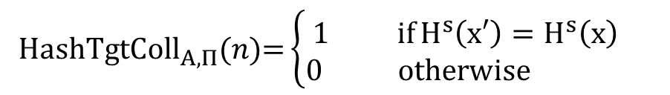

Weaker Requirements for Cryptographic Hash
Target-Collision Resistance
s,x
x’
$${HashTgtColl}_{A,Π}(n)\text{=}\left\{\begin{aligned}1 ifH^{s}\left(x′\right)=H^{s}\left(x\right) \\ 0 otherwise \end{aligned}\right.$$
$$s=Gen{(1n;R)}$$
$${x∈\left\{0,1\right\}}^{n}$$
Question: Why is collision resistance stronger?

Slide 20
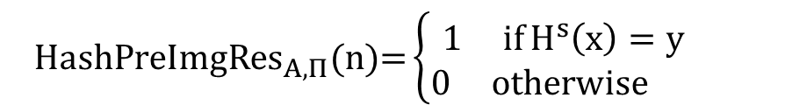



Weaker Requirements for Cryptographic Hash
Preimage Resistance (One-Wayness)
s, $y$
$$\text{x}$$
$${HashPreImgRes}_{A,Π}(n)\text{=}\left\{\begin{aligned}1 ifH^{s}\left(x\right)=y \\ 0 otherwise \end{aligned}\right.$$
$$s=Gen{(1n;R)}$$
$${y∈\left\{0,1\right\}}^{ℓ(n)}$$
Question: Why is collision resistance stronger?

Slide 21
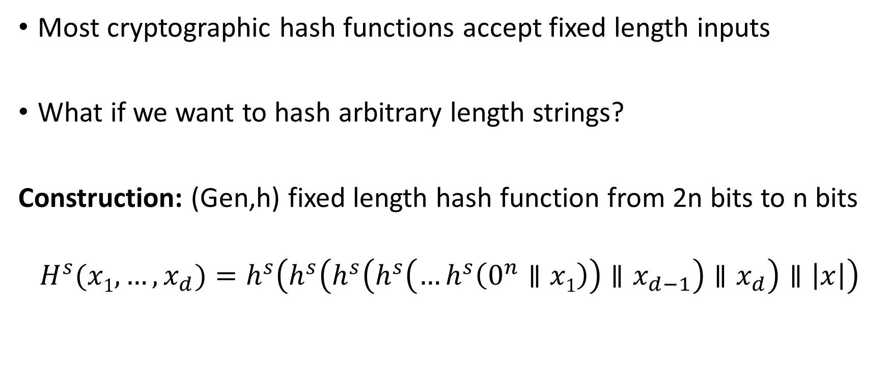
Merkle-Damgård Transform
Most cryptographic hash functions accept fixed length inputs
What if we want to hash arbitrary length strings?
Construction: (Gen,h) fixed length hash function from 2n bits to n bits
$$H^{s}{(x1,…,x_{d})}=h^{s}\left(h^{s}\left(h^{s}\left(h^{s}\left(…h^{s}\left(0^{n}∥x1\right)\right)∥x_{d−1}\right)∥x_{d}\right)∥\left|x\right|\right)$$

Slide 22
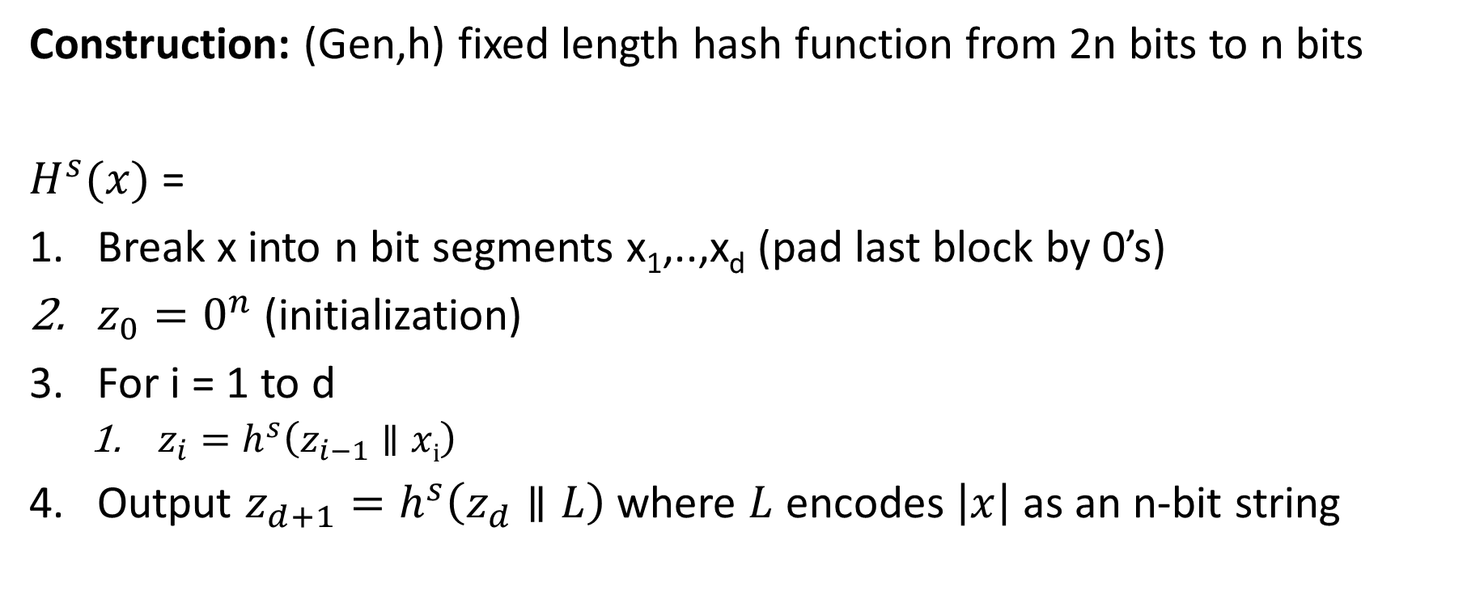
Merkle-Damgård Transform
Construction: (Gen,h) fixed length hash function from 2n bits to n bits
$H^{s}{(x)}$ =
Break x into n bit segments x₁,..,x_{d} (pad last block by 0’s)
$z_{0}=0^{n}$ (initialization)
For i = 1 to d
  $z_{i}=h^{s}\left(z_{i−1}∥xi\right)$
Output $z_{d+1}=h^{s}\left(z_{d}∥L\right)$ where $L$ encodes $\left|x\right|$ as an n-bit string

Slide 23
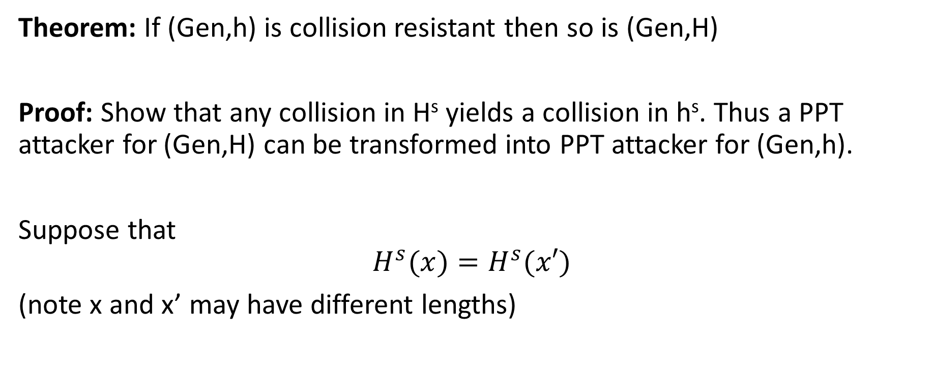
Merkle-Damgård Transform
Theorem: If (Gen,h) is collision resistant then so is (Gen,H)
Proof: Show that any collision in H^{s} yields a collision in h^{s}. Thus a PPT attacker for (Gen,H) can be transformed into PPT attacker for (Gen,h).
Suppose that
$$H^{s}{(x)}=H^{s}{(x′)}$$
(note x and x’ may have different lengths)

Slide 24

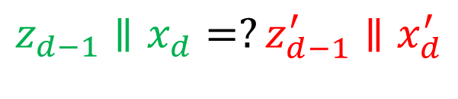
Merkle-Damgård Transform
Theorem: If (Gen,h) is collision resistant then so is (Gen,H)
Proof: Suppose that
$$H^{s}{(x)}=H^{s}{(x′)}$$
Case 1: |x|=|x’| (proof for case two is similar)
$${H^{s}{(x)}=z}_{d}=h^{s}\left(z_{d−1}∥x_{d}\right){=H}^{s}{(x′)}=z_{d}^{′}=h^{s}\left(z_{d−1}^{′}∥x_{d}^{′}\right)$$
$$z_{d−1}∥x_{d}=?z_{d−1}^{′}∥x_{d}^{′}$$
No → Found collision
Yes?
$${z_{d−1}=h}^{s}\left(z_{d−2}∥x_{d−1}\right)=h^{s}\left(z_{d−2}^{′}∥x_{d−1}^{′}\right)=z_{d−1}^{′}$$

Slide 25
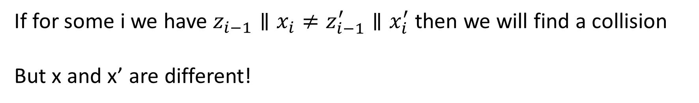

Merkle-Damgård Transform
Theorem: If (Gen,h) is collision resistant then so is (Gen,H)
Proof: Suppose that
$$H^{s}{(x)}=H^{s}{(x′)}$$
Case 1: |x|=|x’| (proof for case two is similar)
If for some i we have $z_{i−1}∥x_{i}≠z_{i−1}^{′}∥x_{i}^{′}$ then we will find a collision
But x and x’ are different!

Slide 26
Week 5: Topic 2:
HMACs and Generic Attacks

Slide 27
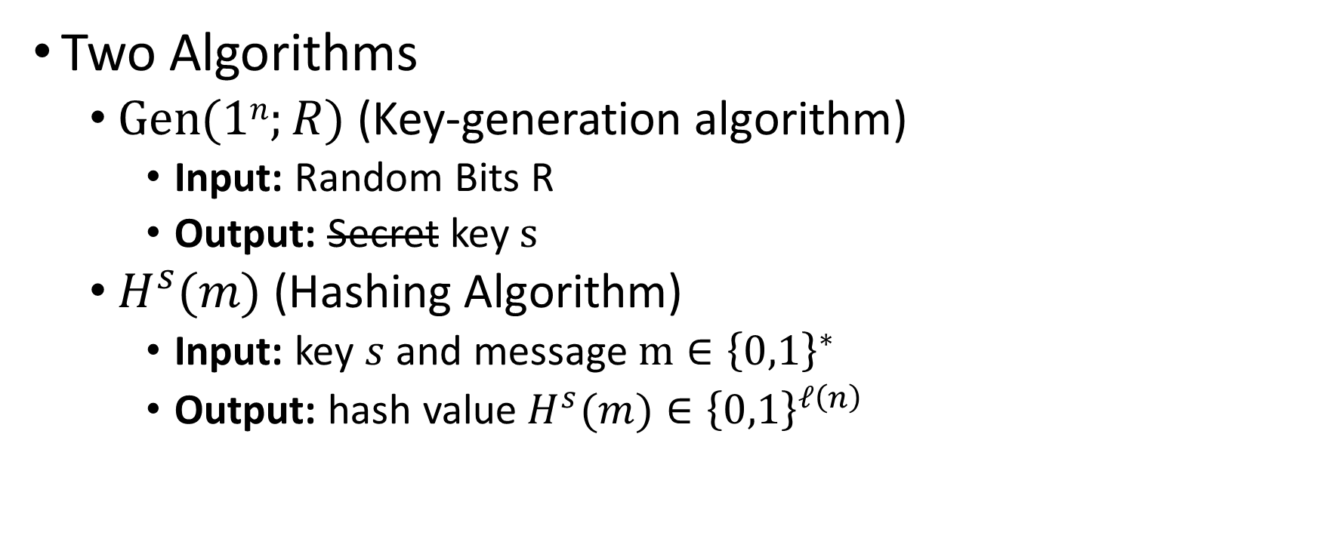
Keyed Hash Function Syntax
Two Algorithms
  $\operatorname{Gen}{(1n;R)}$ (Key-generation algorithm)
    Input: Random Bits R
    Output: Secret key $s$
  $H^{s}{(m)}$ (Hashing Algorithm)
    Input: key $s$ and message $m∈{\left\{0,1\right\}}^{∗}$
    Output: hash value${ H}^{s}{(m)}∈{\left\{0,1\right\}}^{ℓ\left(n\right)}$

Slide 28
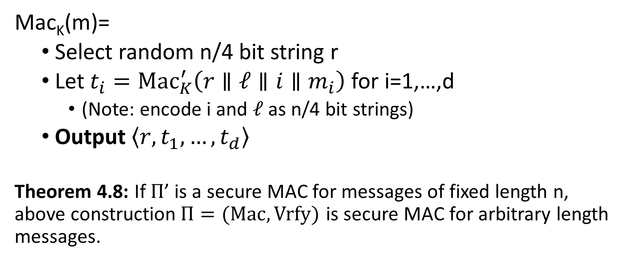
MACs for Arbitrary Length Messages
Mac_{K}(m)=
  Select random n/4 bit string r
  Let $t_{i}={Mac}_{K}^{′}\left(r∥ℓ∥i{∥m}_{i}\right)$ for i=1,…,d
    (Note: encode i and $ℓ$ as n/4 bit strings)
  Output $\left\langle r,t_{1},…,t_{d}\right\rangle$
Theorem 4.8: If $Π$’ is a secure MAC for messages of fixed length n, above construction$Π=(Mac,Vrfy)$ is secure MAC for arbitrary length messages.
Notes:
Disadvage for not using randomized construction.
1. This may not be a Strong-MAC.

Slide 29
MACs for Arbitrary Length Messages
Disadvantages: Lose Strong-MAC Guarantee
(Multiple valid MACs of same message)
Disadvantage 1: Long output
Mac_{K}(m)=
  Select random n/4 bit string r
  Let $t_{i}={Mac}_{K}^{′}\left(r∥ℓ∥i{∥m}_{i}\right)$ for i=1,…,d
    (Note: encode i and $ℓ$ as n/4 bit strings)
  Output $\left\langle r,t_{1},…,t_{d}\right\rangle$
Theorem 4.8: If $Π$’ is a secure MAC for messages of fixed length n, above construction$Π=(Mac,Vrfy)$ is secure MAC for arbitrary length messages.
Randomized Construction (no canonical verification). Disadvantage?
Notes:
Disadvage for not using randomized construction.
1. This may not be a Strong-MAC.

Slide 30
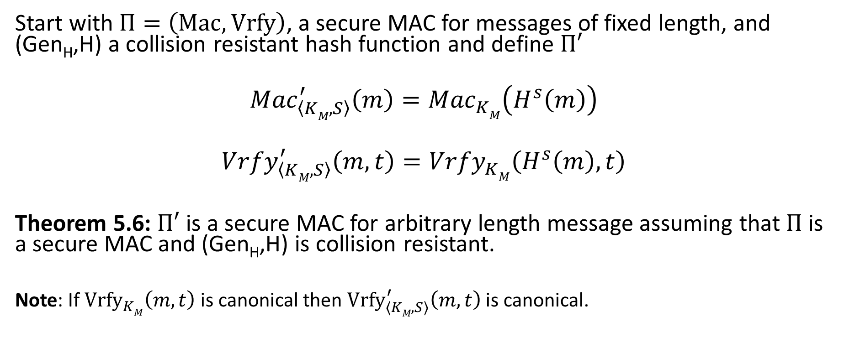
Hash and MAC Construction
Start with $Π=\left(Mac,Vrfy\right)$, a secure MAC for messages of fixed length, and (Gen_{H},H) a collision resistant hash function and define $Π′$
$${Mac}_{\left\langle KM,S\right\rangle }^{′}\left(m\right)={Mac}_{KM}^{}\left(H^{s}\left(m\right)\right)$$
$${Vrfy}_{\left\langle KM,S\right\rangle }^{′}\left(m,t\right)={Vrfy}_{KM}^{}\left(H^{s}\left(m\right),t\right)$$
Theorem 5.6: $Π′$ is a secure MAC for arbitrary length message assuming that $Π$ is a secure MAC and (Gen_{H},H) is collision resistant.
Note: If ${Vrfy}_{KM}^{}\left(m,t\right)$ is canonical then ${Vrfy}_{\left\langle KM,S\right\rangle }^{′}\left(m,t\right)$ is canonical.

Slide 31
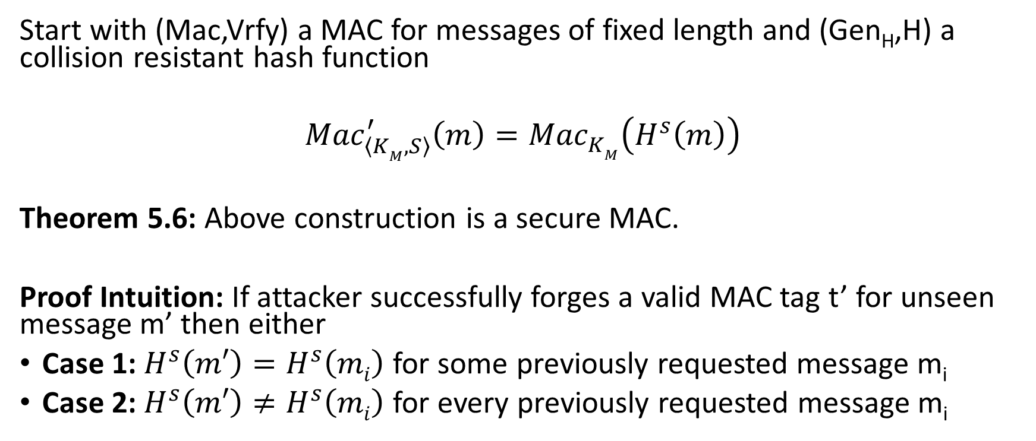
Hash and MAC Construction
Start with (Mac,Vrfy) a MAC for messages of fixed length and (Gen_{H},H) a collision resistant hash function
$${Mac}_{\left\langle KM,S\right\rangle }^{′}\left(m\right)={Mac}_{KM}^{}\left(H^{s}\left(m\right)\right)$$
Theorem 5.6: Above construction is a secure MAC.
Proof Intuition: If attacker successfully forges a valid MAC tag t’ for unseen message m’ then either
Case 1: $H^{s}\left(m′\right)=H^{s}\left(mi\right)$ for some previously requested message m_{i}
Case 2: $H^{s}\left(m′\right)≠H^{s}\left(mi\right)$ for every previously requested message m_{i}

Slide 32
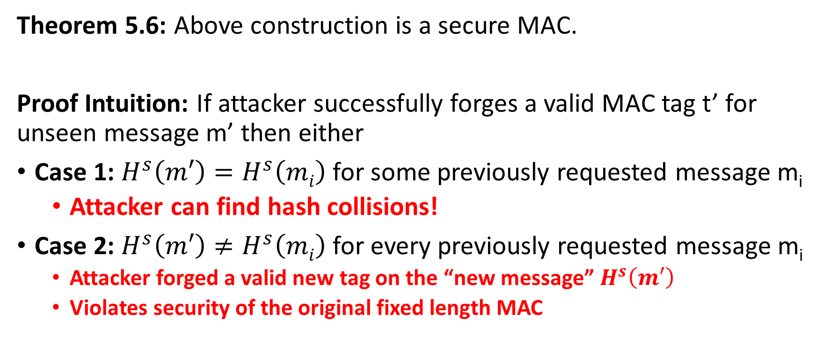
Hash and MAC Construction
Theorem 5.6: Above construction is a secure MAC.
Proof Intuition: If attacker successfully forges a valid MAC tag t’ for unseen message m’ then either
Case 1: $H^{s}\left(m′\right)=H^{s}\left(mi\right)$ for some previously requested message m_{i}
  Attacker can find hash collisions!
Case 2: $H^{s}\left(m′\right)≠H^{s}\left(mi\right)$ for every previously requested message m_{i}
  Attacker forged a valid new tag on the “new message” $H^{s}\left(m′\right)$
  Violates security of the original fixed length MAC

Slide 33
Recap
Definition of Collision Resistant Hash Functions (Gen,H)
  Definitional challenges
  Gen(1^{n}) outputs a public seed.
Merkle-Damgård construction to hash arbitrary length strings
  Proof of correctness
Hash and MAC construction
  Proof of correctness

Slide 34
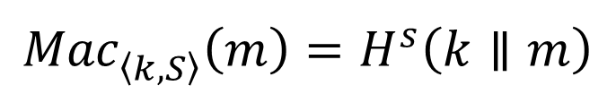
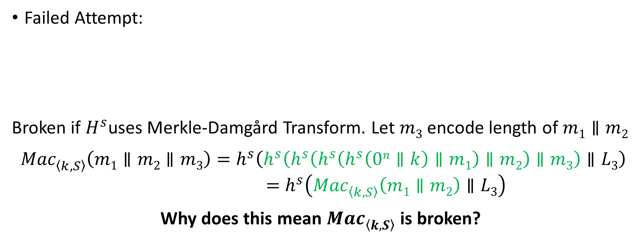
MAC from Collision Resistant Hash
Failed Attempt:
Broken if $H^{s}$uses Merkle-Damgård Transform. Let $m3$ encode length of $m1∥m2$
${Mac}_{\left\langle k,S\right\rangle }^{}\left(m1∥m2∥m3\right)=h^{s}\left(h^{s}\left(h^{s}\left(h^{s}\left(h^{s}\left(0n∥k\right)∥m1\right)∥m2\right)∥m3\right)∥L3\right)$
$$=h^{s}\left({Mac}_{\left\langle k,S\right\rangle }^{}\left(m1∥m2\right)∥L3\right)$$
Why does this mean ${Mac}_{\left\langle k,S\right\rangle }^{}$ is broken?
$${Mac}_{\left\langle k,S\right\rangle }^{}\left(m\right)=H^{s}\left(k∥m\right)$$

Slide 35


HMAC
$${Mac}_{\left\langle k,S\right\rangle }^{}\left(m\right)=H^{s}\left(\left(k⨁opad\right)∥H^{s}\left(\left(k⨁ipad\right)∥m\right)\right)$$
$$ipad?$$
Notes:
Bad joke, I know…

Slide 36
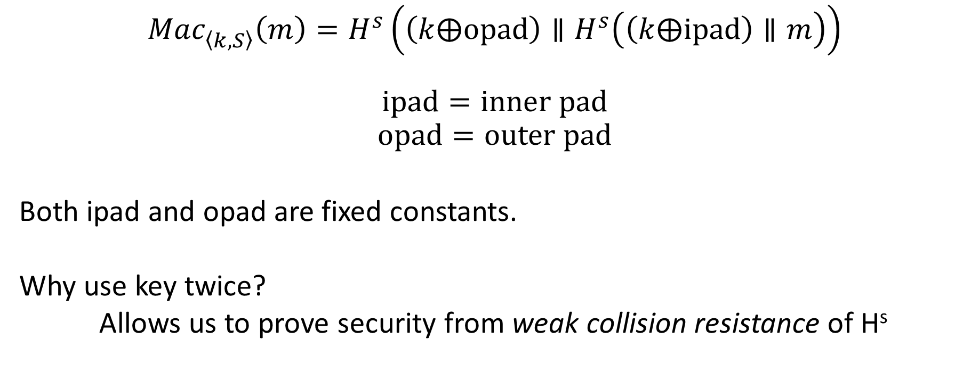
HMAC
$${Mac}_{\left\langle k,S\right\rangle }^{}\left(m\right)=H^{s}\left(\left(k⨁opad\right)∥H^{s}\left(\left(k⨁ipad\right)∥m\right)\right)$$
$$ipad=inner pad$$
$$opad=outer pad$$
Both ipad and opad are fixed constants.
Why use key twice?
Allows us to prove security from weak collision resistance of H^{s}
Notes:
Bad joke, I know…

Slide 37
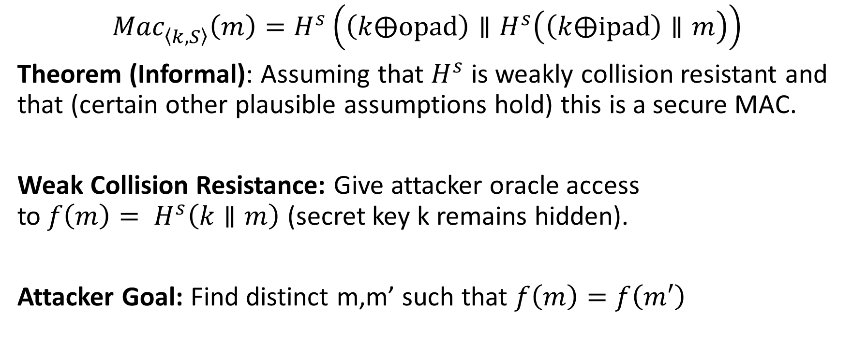
HMAC Security
$${Mac}_{\left\langle k,S\right\rangle }^{}\left(m\right)=H^{s}\left(\left(k⨁opad\right)∥H^{s}\left(\left(k⨁ipad\right)∥m\right)\right)$$
Theorem (Informal): Assuming that $H^{s}$ is weakly collision resistant and that (certain other plausible assumptions hold) this is a secure MAC.
Weak Collision Resistance: Give attacker oracle access to${ f\left(m\right)= H}^{s}\left(k∥m\right)$ (secret key k remains hidden).
Attacker Goal: Find distinct m,m’ such that $f\left(m\right)=f\left(m′\right)$

Slide 38
HMAC in Practice
MD5 can no longer be viewed as collision resistant
However, HMAC-MD5 remained unbroken after MD5 was broken
  Gave developers time to replace HMAC-MD5
  Nevertheless, don’t use HMAC-MD5!
HMAC-SHA1 still seems to be okay (temporarily), despite collision
HMAC is efficient and unbroken
  CBC-MAC was not widely deployed because it is “too slow”
  Instead practitioners often used heuristic constructions (which were breakable)

Slide 39

Finding Collisions
Can we do better?
Ideal Hashing Algorithm
  Random function H from {0,1}* to {0,1}$ℓ$
  Suppose attacker has oracle access to H(.)
Attack 1: Evaluate H(.) on 2$ℓ$+1 distinct inputs.

Slide 40
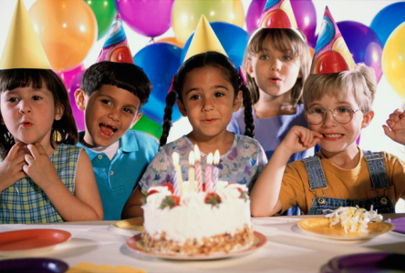
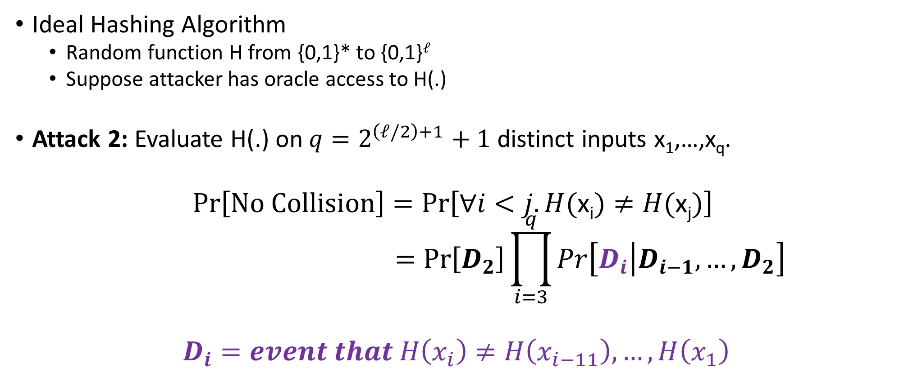
Birthday Attack for Finding Collisions
Ideal Hashing Algorithm
  Random function H from {0,1}* to {0,1}$ℓ$
  Suppose attacker has oracle access to H(.)
Attack 2: Evaluate H(.) on ${q=2}^{\left(ℓ/2\right)+1}+1$ distinct inputs x₁,…,x_{q}.
$$Pr\left[No Collision\right]=Pr\left[∀i<j. H(\text{x}\text{i})≠H(\text{x}\text{j})\right]$$
$$=Pr\left[D_{2}\right]\prod_{i=3}^{q}{Pr\left[D_{i}\left|D_{i−1}\right.,…,D_{2}\right]}$$
$$D_{i}=event that H\left(x_{i}\right)≠H\left(x_{i−11}\right),…,H\left(x_{1}\right)$$

Slide 41
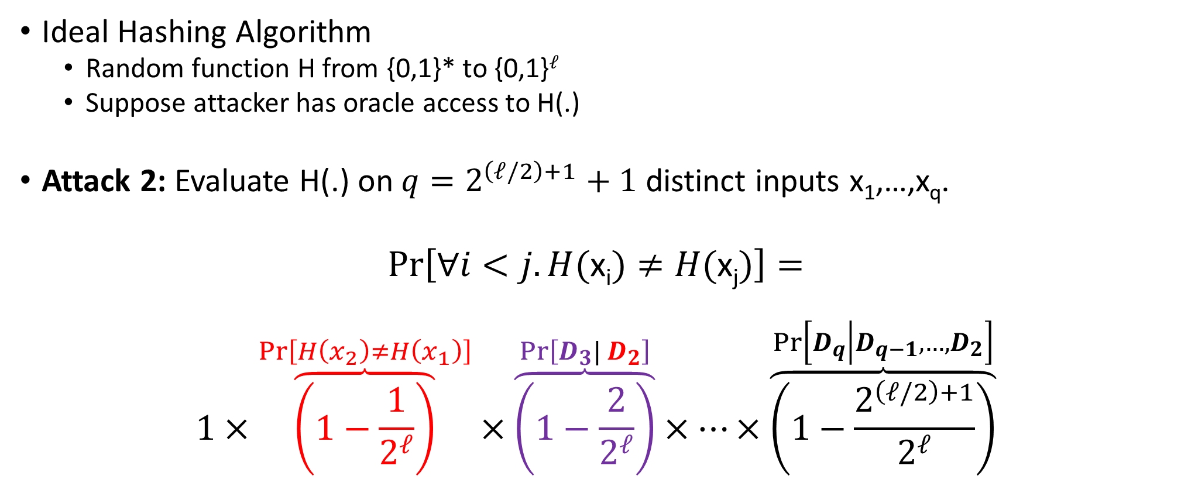
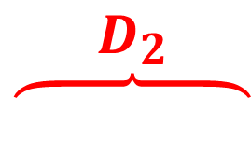
Birthday Attack for Finding Collisions
Ideal Hashing Algorithm
  Random function H from {0,1}* to {0,1}$ℓ$
  Suppose attacker has oracle access to H(.)
Attack 2: Evaluate H(.) on ${q=2}^{\left(ℓ/2\right)+1}+1$ distinct inputs x₁,…,x_{q}.
$$Pr\left[∀i<j. H(\text{x}\text{i})≠H(\text{x}\text{j})\right]=$$
$$1×\overset{Pr\left[H\left(x_{2}\right)≠H\left(x_{1}\right)\right]}{\overbrace{\left(1−\frac{1}{2^{ℓ}}\right)}}×\overset{Pr\left[D_{3}| D_{2}\right]}{\overbrace{\left(1−\frac{2}{2^{ℓ}}\right)}}×…×\overset{Pr\left[D_{q}\left|D_{q−1}\right.,…,D_{2}\right]}{\overbrace{\left(1−\frac{2^{\left(ℓ/2\right)+1}}{2^{ℓ}}\right)}}$$
$$\overset{D_{2}}{\overbrace{ }}$$

Slide 42
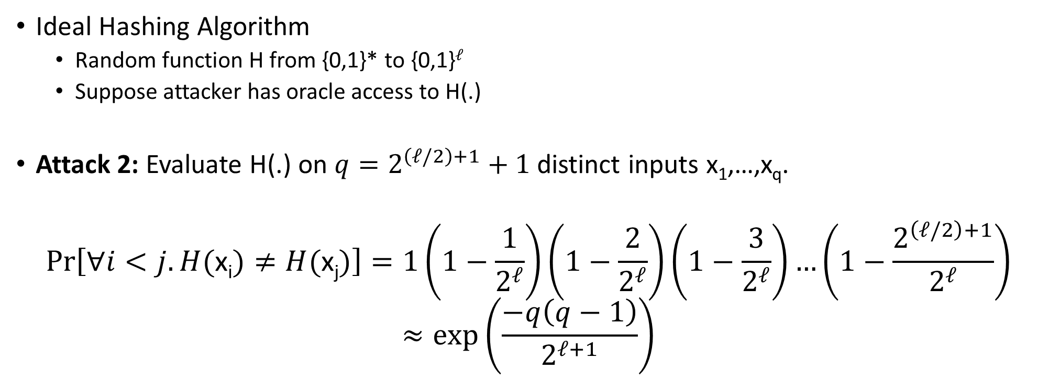
Birthday Attack for Finding Collisions
Ideal Hashing Algorithm
  Random function H from {0,1}* to {0,1}$ℓ$
  Suppose attacker has oracle access to H(.)
Attack 2: Evaluate H(.) on ${q=2}^{\left(ℓ/2\right)+1}+1$ distinct inputs x₁,…,x_{q}.
$$Pr\left[∀i<j. H(\text{x}\text{i})≠H(\text{x}\text{j})\right]=1\left(1−\frac{1}{2^{ℓ}}\right)\left(1−\frac{2}{2^{ℓ}}\right)\left(1−\frac{3}{2^{ℓ}}\right)…\left(1−\frac{2^{\left(ℓ/2\right)+1}}{2^{ℓ}}\right)$$
$$≈exp\left(\frac{−q\left(q−1\right)}{2^{ℓ+1}}\right)$$

Slide 43
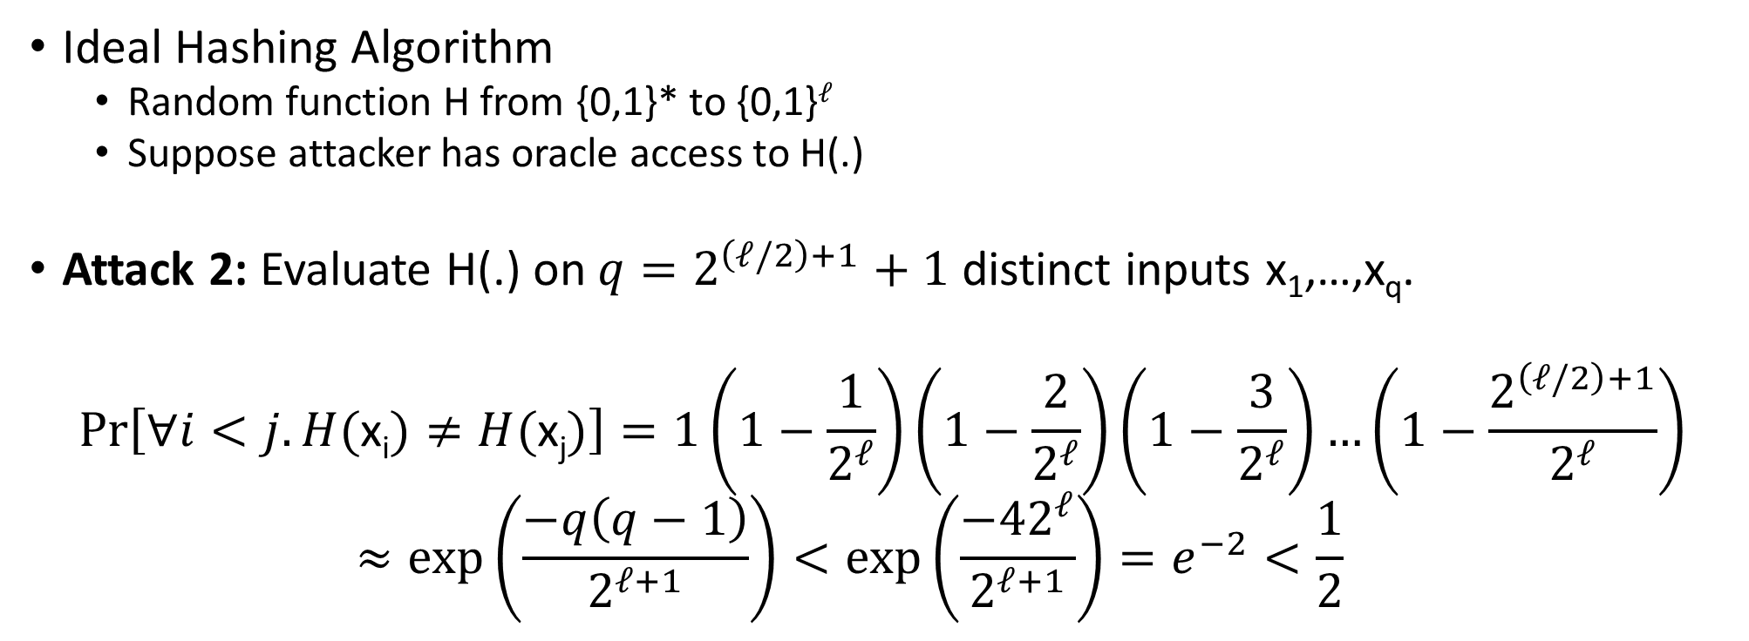
Birthday Attack for Finding Collisions
Ideal Hashing Algorithm
  Random function H from {0,1}* to {0,1}$ℓ$
  Suppose attacker has oracle access to H(.)
Attack 2: Evaluate H(.) on ${q=2}^{\left(ℓ/2\right)+1}+1$ distinct inputs x₁,…,x_{q}.
$$Pr\left[∀i<j. H(\text{x}\text{i})≠H(\text{x}\text{j})\right]=1\left(1−\frac{1}{2^{ℓ}}\right)\left(1−\frac{2}{2^{ℓ}}\right)\left(1−\frac{3}{2^{ℓ}}\right)…\left(1−\frac{2^{\left(ℓ/2\right)+1}}{2^{ℓ}}\right)$$
  $$≈exp\left(\frac{−q\left(q−1\right)}{2^{ℓ+1}}\right)<exp\left(\frac{−42^{ℓ}}{2^{ℓ+1}}\right)=e^{−2}<\frac{1}{2}$$

Slide 44
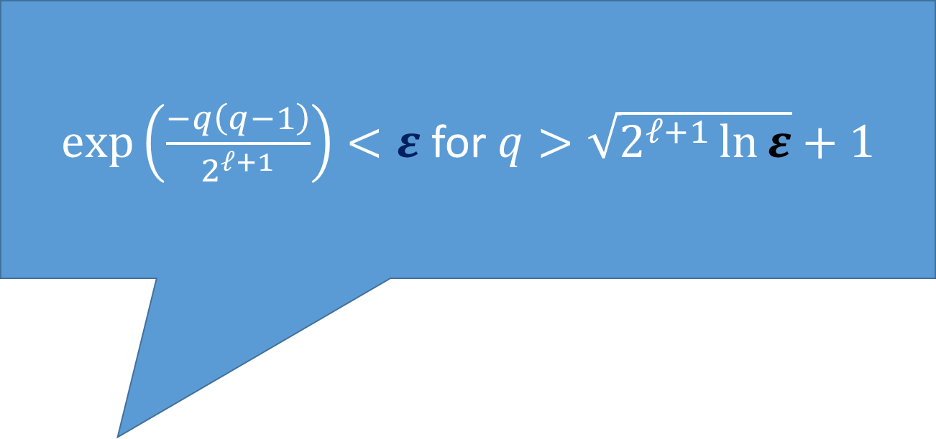
Birthday Attack for Finding Collisions
$exp\left(\frac{−q\left(q−1\right)}{2^{ℓ+1}}\right)<ε$ for $q>\sqrt{2^{ℓ+1}\ln{ε}}+1$
Ideal Hashing Algorithm
  Random function H from {0,1}* to {0,1}$ℓ$
  Suppose attacker has oracle access to H(.)
Attack 2: Evaluate H(.) on ${q=2}^{\left(ℓ/2\right)+1}+1$ distinct inputs x₁,…,x_{q}.
$$Pr\left[∀i<j. H(\text{x}\text{i})≠H(\text{x}\text{j})\right]=1\left(1−\frac{1}{2^{ℓ}}\right)\left(1−\frac{2}{2^{ℓ}}\right)\left(1−\frac{3}{2^{ℓ}}\right)…\left(1−\frac{2^{\left(ℓ/2\right)+1}}{2^{ℓ}}\right)$$
  $$≈exp\left(\frac{−q\left(q−1\right)}{2^{ℓ+1}}\right)<exp\left(\frac{−42^{ℓ}}{2^{ℓ+1}}\right)=e^{−2}<\frac{1}{2}$$

Slide 45
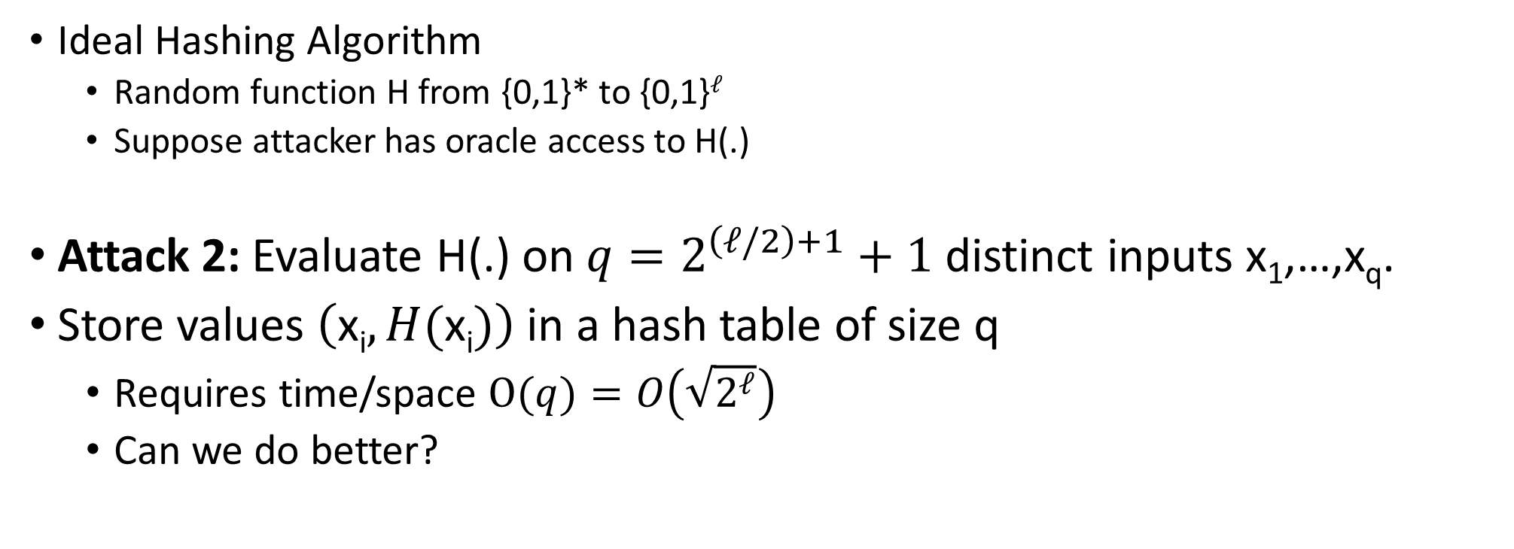
Birthday Attack for Finding Collisions
Ideal Hashing Algorithm
  Random function H from {0,1}* to {0,1}$ℓ$
  Suppose attacker has oracle access to H(.)
Attack 2: Evaluate H(.) on ${q=2}^{\left(ℓ/2\right)+1}+1$ distinct inputs x₁,…,x_{q}.
Store values $\left(\text{x}\text{i},H(\text{x}\text{i})\right)$ in a hash table of size q
  Requires time/space $\text{O}(q)=O\left(\sqrt{2^{ℓ}}\right)$
  Can we do better?

Slide 46
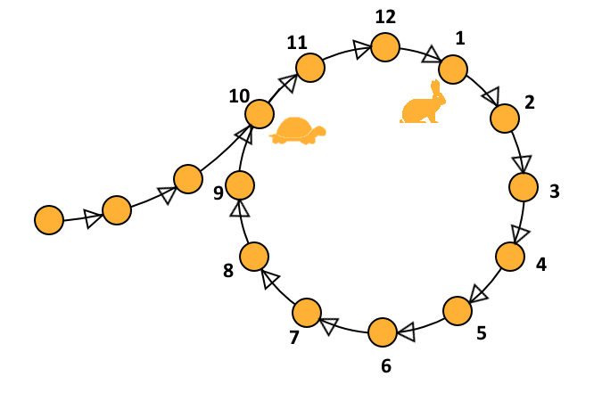
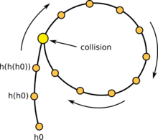
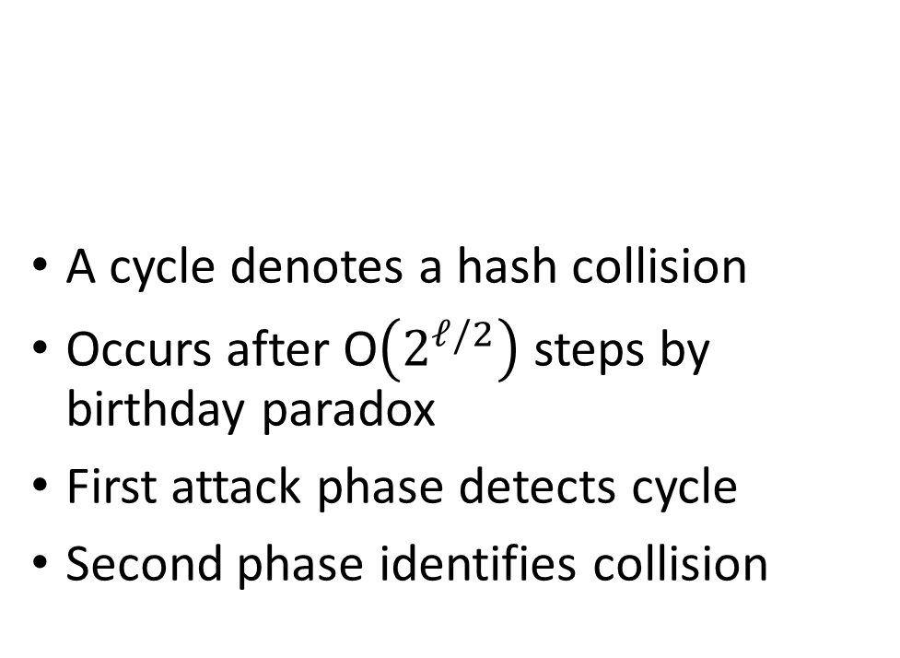
Floyd’s Cycle Finding Algorithm
A cycle denotes a hash collision
Occurs after O$\left(2^{ℓ/2}\right)$ steps by birthday paradox
First attack phase detects cycle
Second phase identifies collision
Analogy: Cycle detection in linked list
Can traverse “linked list” by computing H
Notes:
Let j denote the length of the chain before the cycle starts (3) in the example and let c denote the length of the cycle
Let c denote length of cycle and suppose that x_{2i} = x_i then we have 2i-j=i-j mod c. Implies that 2i=c+i.
We have h(x_{j-1}) = h(x_{j+c-1}),
X reaches x_{j-1} in j-1 steps and x’ reaches x_{j+c-1}=x_{j+2c-1} in j-1 – steps (since we start at j)

Slide 47
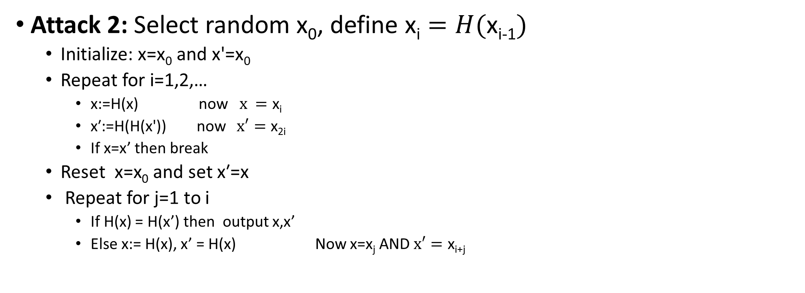
Small Space Birthday Attack
Attack 2: Select random $\text{x}\text{0}$, define $\text{x}\text{i}=H(\text{x}\text{i}\text{−1})$
  $\text{Initialize}\text{: }\text{x}\text{=}\text{x}\text{0}$ and $\text{x}\text{′}\text{=}\text{x}\text{0}$
  Repeat for i=1,2,…
    $\text{x}\text{:}\text{=}\text{H}\text{(}\text{x}\text{) }\text{now} x =\text{x}\text{i}$
    $\text{x}\text{′:=}\text{H}\text{(}\text{H}\text{(}\text{x}\text{′))}$ now $x′=\text{x}\text{2}\text{i}$
    If x=x’ then break
  $\text{Reset} \text{x}\text{=}\text{x}\text{0}$ and set $\text{x}\text{′=}\text{x}$
  Repeat for j=1 to i
    If H(x) = H(x’) then output x,x’
    Else x:= H(x), x’ = H(x) Now x=$\text{x}\text{j}$ AND $x′=\text{x}\text{i}\text{+}\text{j}$

Slide 48
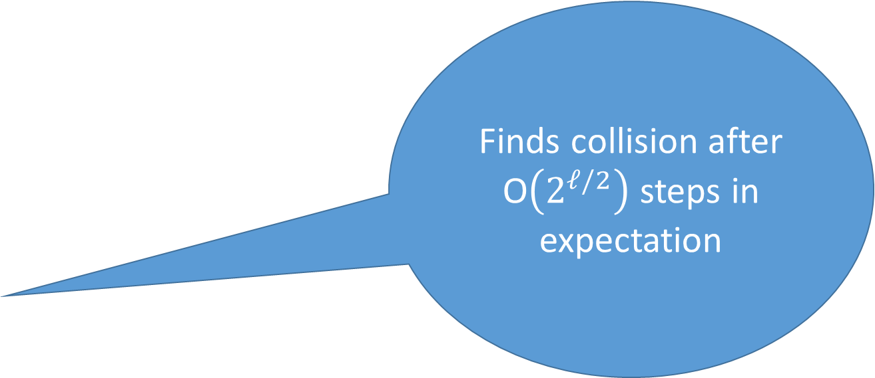
Small Space Birthday Attack
Finds collision after O$\left(2^{ℓ/2}\right)$steps in expectation
Attack 2: Select random $\text{x}\text{0}$, define $\text{x}\text{i}=H(\text{x}\text{i}\text{−1})$
  $\text{Initialize}\text{: }\text{x}\text{=}\text{x}\text{0}$ and $\text{x}\text{′}\text{=}\text{x}\text{0}$
  Repeat for i=1,2,…
    $\text{x}\text{:}\text{=}\text{H}\text{(}\text{x}\text{) }\text{now} x =\text{x}\text{i}$
    $\text{x}\text{′:=}\text{H}\text{(}\text{H}\text{(}\text{x}\text{′))}$ now $x′=\text{x}\text{2}\text{i}$
    If x=x’ then break
  $\text{Reset} \text{x}\text{=}\text{x}\text{0}$ and set $\text{x}\text{′=}\text{x}$
  Repeat for j=1 to i
    If H(x) = H(x’) then output x,x’
    Else x:= H(x), x’ = H(x) Now x=$\text{x}\text{j}$ AND $x′=\text{x}\text{i}\text{+}\text{j}$
Notes:
Let j denote the length of the chain before the cycle starts (3) in the example and let c denote the length of the cycle
Let c denote length of cycle and suppose that x_{2i} = x_i then we have 2i-j=i-j mod c. Implies that 2i=c+i.
We have h(x_{j-1}) = h(x_{j+c-1}),
X reaches x_{j-1} in j-1 steps and x’ reaches x_{j+c-1}=x_{j+2c-1} in j-1 – steps (since we start at j)

Slide 49
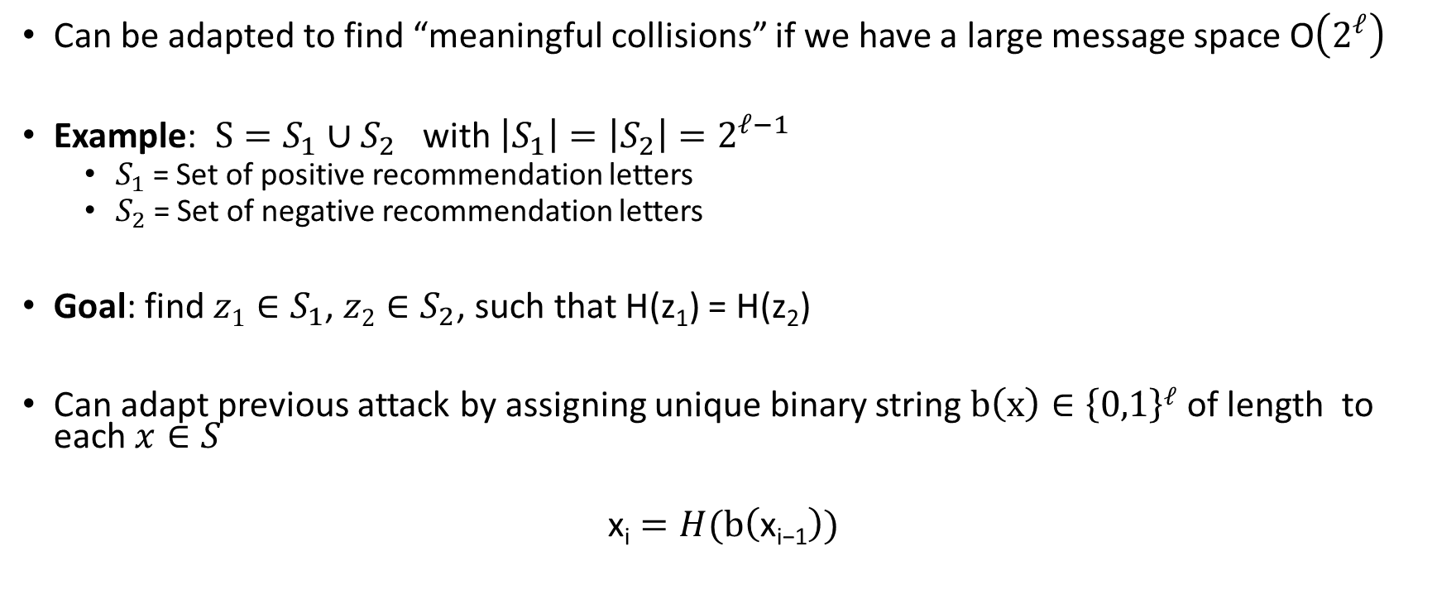
Small Space Birthday Attack
Can be adapted to find “meaningful collisions” if we have a large message space O$\left(2^{ℓ}\right)$
Example: $S=S_{1}∪S_{2}$ with $\left|S_{1}\right|=\left|S_{2}\right|=2^{ℓ−1}$
  $S_{1}$ = Set of positive recommendation letters
  $S_{2}$ = Set of negative recommendation letters
Goal: find ${z1∈S}_{1}$, ${z2∈S}_{2}$, such that H(z₁) = H(z₂)
Can adapt previous attack by assigning unique binary string $b\left(x\right)∈\left\{0,1\right\}ℓ$ of length to each $x∈S$
$$\text{x}\text{i}=H(\text{b}\left(\text{x}\text{i}\text{−1}\right))$$

Slide 50















Targeted Collision Attacks
Precomputation ($t×s$ steps, $2s$ memory)
$${sp}_{1}=x_{1}^{1}$$
$${sp}_{2}=x_{1}^{2}$$
$${sp}_{s}=x_{1}^{s}$$
$${sp}_{1}=x_{1}^{1}$$
$$x_{2}^{1}=H\left(x_{1}^{1}\right)$$
$$x_{2}^{2}=H\left(x_{1}^{2}\right)$$
…
$$x_{2}^{s}=H\left(x_{1}^{s}\right)$$
…
…
…
$$x_{i+1}^{2}=H\left(x_{i}^{2}\right)$$
…
$$x_{i+1}^{s}=H\left(x_{i}^{s}\right)$$
$$x_{i+1}^{1}=H\left(x_{i}^{1}\right)$$
…
…
…
$$x_{t}^{1}={ep}_{1}$$
$$x_{t}^{2}={ep}_{2}$$
$$x_{t}^{s}={ep}_{s}$$
$$x_{t}^{1}={ep}_{1}$$

Slide 51










Targeted Collision Attacks
Precomputation ($t×s$ steps, $2s×ℓ$ memory)
$${sp}_{j}=x_{1}^{j}$$
Goal: Find collision for target $y=H(x)$
…
$$x_{2}^{j}=H\left(x_{1}^{j}\right)$$
…
$$y_{0}=y$$
…
$$y_{1}=H\left(y_{0}\right)$$
…
$$x_{i+1}^{j}=H\left(x_{i}^{j}\right)$$
…
…
…
$$y_{i}=H\left(y_{i−1}\right)$$
…
$$x_{t}^{j}={ep}_{j}$$
$$y_{k}={ep}_{j}$$

Slide 52



Targeted Collision Attacks
Suppose $y=x_{i}^{j}$ for some $i≤t$, $j≤s$
→
$$y=H\left(x_{i−1}^{j}\right)=H^{i−1}\left({sp}_{j}\right)$$
(takes t steps to recover $x_{i−1}^{j}$ from ${sp}_{j}$)
Precomputation ($t×s$ steps, $2s×ℓ$ memory)
$${sp}_{j}=x_{1}^{j}$$
Goal: Find collision for target $y=H(x)$
$t×s>2^{ℓ+2}$ → good chance that
$y=x_{i}^{j}$ for some $i≤t$, $j≤s$
…
$$x_{2}^{j}=H\left(x_{1}^{j}\right)$$
…
$$y_{0}=y$$
…
$$y_{1}=H\left(y_{0}\right)$$
…
$$x_{i+1}^{j}=H\left(x_{i}^{j}\right)$$
…
…
… Not quite true…chains can intersect and may not represent $t×s$ distinct points
…
$$y_{i}=H\left(y_{i−1}\right)$$
…
$$x_{t}^{j}={ep}_{j}$$
$$y_{k}={ep}_{j}$$

Slide 53







Intersecting Chains
Precomputation ($t×s$ steps, $2s$ memory)
Intersecting chains contain $≪st$ distinct points.
$${sp}_{j}=x_{1}^{j}$$
$${sp}_{j′}=x_{1}^{j′}$$
$$x_{2}^{j}=H\left(x_{1}^{j}\right)$$
$$x_{2}^{j′}=H\left(x_{1}^{j′}\right)$$
…
…
…
After initial intersection the chains merge together ☹
$$x_{k}^{j′}=x_{i+1}^{j}$$
$$x_{k}^{j′}=H\left(x_{k}^{j′}\right)$$
$$x_{i+1}^{j}=H\left(x_{i}^{j}\right)$$
…
$$x_{t}^{j}={ep}_{j}$$
…
$$x_{t}^{j′}={ep}_{j′}$$

Slide 54
Targeted Collision Attacks
Precomputation ($t×s$ steps, $2s$ memory)
$${sp}_{1}=x_{1}^{1}$$
$${sp}_{2}=x_{1}^{2}$$
$${sp}_{s}=x_{1}^{s}$$
$${sp}_{1}=x_{1}^{1}$$
$$x_{2}^{1}=H\left(x_{1}^{1}\right)$$
$$x_{2}^{2}=H\left(x_{1}^{2}\right)$$
…
$$x_{2}^{s}=H\left(x_{1}^{s}\right)$$
…
…
…
$$x_{i+1}^{2}=H\left(x_{i}^{2}\right)$$
…
$$x_{i+1}^{s}=H\left(x_{i}^{s}\right)$$
$$x_{i+1}^{1}=H\left(x_{i}^{1}\right)$$
…
…
…
$$x_{t}^{1}={ep}_{1}$$
$$x_{t}^{2}={ep}_{2}$$
$$x_{t}^{s}={ep}_{s}$$
$$x_{t}^{1}={ep}_{1}$$

Slide 55







Targeted Collision Attacks
$$H_{i}\left(x\right)=H\left(F_{K_{i}}\left(x\right)\right)$$
Precomputation ($t×s$ steps, $2s$ memory)
$${sp}_{1}=x_{1}^{1}$$
$${sp}_{2}=x_{1}^{2}$$
$${sp}_{s}=x_{1}^{s}$$
$${sp}_{1}=x_{1}^{1}$$
$$x_{2}^{1}=H_{1}\left(x_{1}^{1}\right)$$
$$x_{2}^{2}=H_{1}\left(x_{1}^{2}\right)$$
…
$$x_{2}^{s}=H_{1}\left(x_{1}^{s}\right)$$
…
…
…
$$x_{i+1}^{2}=H_{i}\left(x_{i}^{2}\right)$$
…
$$x_{i+1}^{s}=H_{i}\left(x_{i}^{s}\right)$$
$$x_{i+1}^{1}=H_{i}\left(x_{i}^{1}\right)$$
…
…
…
$$x_{t}^{1}={ep}_{1}$$
$$x_{t}^{2}={ep}_{2}$$
$$x_{t}^{s}={ep}_{s}$$
$$x_{t}^{1}={ep}_{1}$$

Slide 56


Targeted Collision Attacks
$$H_{i}\left(x\right)=H\left(F_{K_{i}}\left(x\right)\right)$$
Precomputation ($t×s$ steps, $2s$ memory)
$${sp}_{1}=x_{1}^{1}$$
$${sp}_{2}=x_{1}^{2}$$
$${sp}_{s}=x_{1}^{s}$$
$${sp}_{1}=x_{1}^{1}$$
$$x_{2}^{1}=H_{1}\left(x_{1}^{1}\right)$$
$$x_{2}^{2}=H_{1}\left(x_{1}^{2}\right)$$
…
$$x_{2}^{s}=H_{1}\left(x_{1}^{s}\right)$$
Ensures Chains Contain: $Ω\left(st\right)$ distinct points
$$small overlap between chains$$
…
…
…
$$x_{i+1}^{2}=H_{i}\left(x_{i}^{2}\right)$$
…
$$x_{i+1}^{s}=H_{i}\left(x_{i}^{s}\right)$$
$$x_{i+1}^{1}=H_{i}\left(x_{i}^{1}\right)$$
Untangling Chains: If $x_{i}^{1}=x_{j}^{2}$ with $i≠j$ then (whp) $H_{i}\left(x_{i}^{1}\right)≠H_{j}\left(x_{j}^{2}\right)$
…
…
…
$$x_{t}^{1}={ep}_{1}$$
$$x_{t}^{2}={ep}_{2}$$
$$x_{t}^{s}={ep}_{s}$$
$$x_{t}^{1}={ep}_{1}$$

Slide 57







Targeted Collision Attacks
Suppose $y=x_{i}^{j}$ for some $i≤t$, $j≤s$
→
$$y=H_{i−1}\left(F_{K_{i−1}}\left(x_{i−1}^{j}\right)\right)$$
(takes t steps to recover $x_{i−1}^{j}$ from ${sp}_{j}$)
Precomputation ($t×s$ steps, $2s×ℓ$ memory)
$${sp}_{j}=x_{1}^{j}$$
Goal: Find collision for target $y=H(x)$
$t×s>2^{ℓ+2}$ → good chance that
$y=x_{i}^{j}$ for some $i≤t$, $j≤s$
…
$$x_{2}^{j}=H_{1}\left(x_{1}^{j}\right)$$
…
$$y_{0}=y$$
…
$$y_{1}=H_{1}\left(y_{0}\right)$$
…
$$False Positive:$$
$$y≠x_{i}^{j} \text{for} \text{any} i≤t\text{, }j≤s$$
(expect about $O\left(st^{2}/2^{ℓ}\right)$)
→
Running Time: $O\left(st^{3}/2^{ℓ}\right)$
$$x_{i+1}^{j}=H_{i−1}\left(x_{i}^{j}\right)$$
…
…
…
$$y_{i}=H_{i−1}\left(y_{i−1}\right)$$
…
$$x_{t}^{j}={ep}_{j}$$
$$y_{k}={ep}_{j}$$

Slide 58


Targeted Collision Attacks
Precomputation ($t×s$ steps, $2s×ℓ$ memory)
$${sp}_{j}=x_{1}^{j}$$
Goal: Find collision for target $y=H(x)$
Set $s=2^{\frac{2ℓ}{3}+1}$, $t=2^{\frac{ℓ}{3}+1}$
Precomputation: $O\left(2^{ℓ}\right)$
Space: $O\left(2^{\frac{2ℓ}{3}}×ℓ\right)$
Collision Search: $O\left(2^{\frac{2ℓ}{3}}\right)$
…
$$x_{2}^{j}=H_{1}\left(x_{1}^{j}\right)$$
…
$$y_{0}=y$$
…
Amortized cost to find $2^{\frac{ℓ}{3}}$ targeted collisions
$$y_{1}=H_{1}\left(y_{0}\right)$$
…
$$x_{i+1}^{j}=H_{i−1}\left(x_{i}^{j}\right)$$
…
…
…
$$y_{i}=H_{i−1}\left(y_{i−1}\right)$$
…
$$x_{t}^{j}={ep}_{j}$$
$$y_{k}={ep}_{j}$$

Slide 59

Applications
Key-Recovery Attacks on Block Cipher $E:𝒦×{\left\{0,1\right\}}^{n}→{\left\{0,1\right\}}^{n}$
  Pre-Computation: $O\left(\left|𝒦\right|\right)$
  Crack $2^{\frac{n}{3}}$ secret keys in total time $O\left(\left|𝒦\right|\right)$ with space $s=O\left(2^{\frac{2n}{3}}\right)$
  Run prior attack with “hash function” $H:{\left\{0,1\right\}}^{n}→{\left\{0,1\right\}}^{n}$
    $H\left(K\right)= E_{K}\left(r\right)$ for some random (fixed) $r∈{\left\{0,1\right\}}^{n}$
Password Cracking
  Attacker is given $H′\left(x_{1}\right)$,…, $H′\left(x_{k}\right)$ for passwords $x_{1},…,x_{k}∈𝒫𝒲𝒟𝓈$ with $\left|𝒫𝒲𝒟𝓈\right|≪\left|𝒦\right|$
  Goal: Recover passwords $x_{1},…,x_{k}$
  Can crack all $k={\left|𝒫𝒲𝒟𝓈\right|}^{1/3}$ passwords in total time $O\left(\left|𝒫𝒲𝒟𝓈\right|\right)$ with space $s=O\left({\left|𝒫𝒲𝒟𝓈\right|}^{2/3}\right)$
  Domain Challenge: $H^{′}:\left|𝒫𝒲𝒟𝓈\right|→{\left\{0,1\right\}}^{n}$ with $\left|𝒫𝒲𝒟𝓈\right|≪2n$
    Define (pseudo)random mapping $μ:{\left\{0,1\right\}}^{n}→𝒫𝒲𝒟𝓈$
    Run prior attack with “hash function” $H:𝒫𝒲𝒟𝓈→𝒫𝒲𝒟𝓈$ as $H\left(x\right)=μ\left(H^{′}\left(x\right)\right)$

Slide 60
Week 5: Topic 3:
Random Oracle Model + Hashing Applications

Slide 61

(Recap) Collision-Resistant Hash Function
Intuition: Hard for computationally bounded attacker to find x,y s.t.
H(x) = H(y)
How to formalize this intuition?
Attempt 1: For all PPT A,
$$Pr\left[A_{x,y}\left(1^{n}\right)=\left(x,y\right) s.t H\left(x\right)=H(y)\right]≤negl(n)$$
The Problem: Let x,y be given s.t. H(x)=H(y)
$$A_{x,y}\left(1^{n}\right)=(x,y)$$
We are assuming that |x| > |H(x)|. Why?
  H(x)=x is perfectly collision resistant! (but with no compression)

Slide 62

(Recap) Keyed Hash Function Syntax
Two Algorithms
  $\operatorname{Gen}{(1n;R)}$ (Key-generation algorithm)
    Input: Random Bits R
    Output: Secret key $s$
  $H^{s}{(m)}$ (Hashing Algorithm)
    Input: key $s$ and message $m∈{\left\{0,1\right\}}^{∗}$ (unbounded length)
    Output: hash value${ H}^{s}{(m)}∈{\left\{0,1\right\}}^{ℓ\left(n\right)}$
Fixed length hash function
  $m∈{\left\{0,1\right\}}^{ℓ′\left(n\right)}$ with$ℓ^{′}\left(n\right)>ℓ\left(n\right)$

Slide 63


When Collision Resistance Isn’t Enough
Example: Message Commitment
  Alice sends Bob: $Hs\left(r∥m\right)$ (e.g., predicted winner of NCAA Tournament)
  Alice can later reveal message (e.g., after the tournament is over)
    Just send r and m (note: r has fixed length)
    Why can Alice not change her message?
  In the meantime Bob shouldn’t learn anything about m
Problem: Let (Gen,H’) be collision resistant then so is (Gen,H)
$$H^{s}\left(x1,…,xd\right)=H^{′s}\left(x1,…,xd\right)∥xd$$
Notes:
Why include r in the hash? Brute-force attack if message space is small…attacker can quickly learn message is not _____

Slide 64

When Collision Resistance Isn’t Enough
Problem: Let (Gen,H’) be collision resistant then so is (Gen,H)
$$H^{s}\left(x1,…,x_{d}\right)=H^{′s}\left(x1,…,x_{d} \right)∥xd$$
(Gen,H) definitely does not hide all information about input ($x1,…,x_{d}$)
Conclusion: Collision resistance is not sufficient for message commitment

Slide 65

The Tension
Example: Message Commitment
  Alice sends Bob: $Hs\left(r∥m\right)$ (e.g., predicted winners of NCAA Final Four)
  Alice can later reveal message (e.g., after the Final Four is decided)
  In the meantime Bob shouldn’t learn anything about m
This is still a reasonable approach in practice!
No attacks when instantiated with any reasonable candidate (e.g., SHA3)
Cryptographic hash functions seem to provide “something” beyond collision resistance, but how do we model this capability?

Slide 66
Random Oracle Model
Model hash function H as a truly random function
Algorithms can only interact with H as an oracle
  Query: x
  Response: H(x)
If we submit the same query you see the same response
If x has not been queried, then the value of H(x) is uniform
Real World: H instantiated as cryptographic hash function (e.g., SHA3) of fixed length (no Merkle-Damgård)

Slide 67

Back to Message Commitment
Example: Message Commitment
  Alice sends Bob: $H\left(r∥m\right)$ (e.g., predicted winners of NCAA Final Four)
  Alice can later reveal message (e.g., after the Final Four is decided)
    Just send r and m (note: r has fixed length)
    Why can Alice not change her message?
  In the meantime Bob shouldn’t learn anything about m
Random Oracle Model: Above message commitment scheme is secure (Alice cannot change m + Bob learns nothing about m)
Information Theoretic Guarantee against any attacker with q queries to H
Notes:
Suppose when attacker submits query H(r’|m’) we tell him that r’ is correct/incorrect. As long as r’ is incorrect the attacker learns nothing in an information theoretic sense. The probability of submitting r’=r is at most (1/2^|r|)

Slide 68
Random Oracle Model: Pros
It is easier to prove security in Random Oracle Model
Suppose we are simulating attacker A in a reduction
  Extractability: When A queries H at x we see this query and learn x (and can easily find H(x))
  Programmability: We can set the value of H(x) to a value of our choice
    As long as the value is correctly distribute i.e., close to uniform
Both Extractability and Programmability are useful tools for a security reduction!

Slide 69
Random Oracle Model: Pros
It is easier to prove security in Random Oracle Model
Provably secure constructions in random oracle model are often much more efficient (compared to provably secure construction is “standard model”
Sometimes we only know how to design provably secure protocol in random oracle model

Slide 70
Random Oracle Model: Cons
Lack of formal justification
Why should security guarantees translate when we instantiate random oracle with a real cryptographic hash function?
We can construct (contrived) examples of protocols which are
  Secure in random oracle model…
  But broken in the real world

Slide 71
Random Oracle Model: Justification
“A proof of security in the random-oracle model is significantly better than no proof at all.”
Evidence of sound design (any weakness involves the hash function used to instantiate the random oracle)
Empirical Evidence for Security
“there have been no successful real-world attacks on
schemes proven secure in the random oracle model”

Slide 72
Hash Function Application: Fingerprinting
The hash h(x) of a file x is a unique identifier for the file
  Collision Resistance → No need to worry about another file y with H(y)=H(y)
Application 1: Virus Fingerprinting
Application 2: P2P File Sharing
Application 3: Data deduplication

Slide 73




Tamper Resistant Storage
m₁
H(m₁)
m₁’

Slide 74
Tamper Resistant Storage
File Index | Hash
1 | H(m₁)
2 | H(m₂)
3 | H(m₃)
Disadvantage: Too many hashes to store
m₁,m₂,m₃
Send file 1
m₁’

Slide 75
Tamper Resistant Storage
Disadvantage: Need all files to compute hash m₁,m₂,m₃
H(m₁,m₂,m₃)
m₁,m₂,m₃
Send file 1
m₁’

Slide 76


Merkle Trees
Proof of Correctness for data block 2
Verify that root matches
Proof consists of just log(n) hashes
  Verifier only needs to permanently store
  only one hash value

Slide 77
Merkle Trees
Theorem: Let (Gen, h^{s}) be a collision resistant hash function and let H^{s}(m)
return the root hash in a Merkle Tree. Then H^{s} is collision resistant.

Slide 78
Tamper Resistant Storage
Root: H₁₋₄
m₁,m₂,m₃,m₄
Send file 2
m₂’,h₁,h₃₋₄

Slide 79
Commitment Schemes
Alice wants to commit a message m to Bob
  And possibly reveal it later at a time of her choosing
Properties
  Hiding: commitment reveals nothing about m to Bob
  Binding: it is infeasible for Alice to alter message

Slide 80



Commitment Hiding (${Hiding}_{A,Com}(n)$)
m₀,m₁
commit(r,m_{b})
b’
$${Hiding}_{A,Com}(n)\text{=}\left\{\begin{aligned}1 if b=b^{′} \\ 0 otherwise \end{aligned}\right.$$
r = Gen(.)
Bit b
$$∀PPT A ∃μ (negligible) s.t$$
$$Pr\left[{Hiding}_{A,Com}\left(n\right)=1\right]≤\frac{1}{2}+μ(n)$$

Slide 81


Commitment Binding (${Binding}_{A,Com}(n)$)
r₀,r₁,m₀,m₁
$${Binding}_{A,Com}(n)\text{=}\left\{\begin{aligned}1 if \text{commit}\text{(}\text{r}\text{0}\text{,}\text{m}\text{0}\text{)= }\text{commit}\text{(}\text{r}\text{1}\text{,}\text{m}\text{1}\text{) } \\ 0 otherwise \end{aligned}\right.$$
$$∀PPT A ∃μ (negligible) s.t$$
$$Pr\left[{Binding}_{A,Com}\left(n\right)=1\right]≤μ(n)$$

Slide 82

Secure Commitment Scheme
Definition: A secure commitment scheme is hiding and binding
Hiding
Binding
$$∀PPT A ∃μ (negligible) s.t$$
$$Pr\left[{Hiding}_{A,Com}\left(n\right)=1\right]≤\frac{1}{2}+μ(n)$$
$$∀PPT A ∃μ (negligible) s.t$$
$$Pr\left[{Binding}_{A,Com}\left(n\right)=1\right]≤μ(n)$$

Slide 83
Commitment Scheme in Random Oracle Model
Commit(r,m):=H(m|r)
Reveal(c):= (m,r)
Theorem: In the random oracle model this is a secure commitment scheme.

Slide 84


Commitment Hiding (${Hiding}_{A,Com}(n)$)
m₀,m₁
H(r,m_{b})
b’
$${Hiding}_{A,Com}(n)\text{=}\left\{\begin{aligned}1 ifb=b^{′} \\ 0 otherwise \end{aligned}\right.$$
r = Gen(.)
Bit b
$$∀PPT A making at most q\left(n\right) queries$$
$$Pr\left[{Hiding}_{A,Com}\left(n\right)=1\right]≤\frac{1}{2}+\frac{q(n)}{2^{\left|r\right|}}$$
Notes:
Proof: Suppose we gave attacker extra information for every query. Tell him if r matches. Now unless he sends

Slide 85
Other Applications
Password Hashing
Key Derivation

Slide 86
Next Week
Stream Ciphers
Block Ciphers
Feistel Networks
DES, 3DES
Read Katz and Lindell 6.1-6.2

