Slide 1
Cryptography CS 555
Week 3:
Building CPA-Secure Encryption Schemes
Pseudorandom Functions/Permutations
Block Ciphers + Modes of Operation
CCA-Security (definition)
Message Authentication Codes [time permitting]
Readings: Katz and Lindell Chapter 3.5-3.7
Fall 2018

Slide 2
Recap
Using PRGs to achieve Semantic Security (Single Message Eavesdropping)
Multiple Message Eavesdropping Experiment
Impossible to achieve with stateless/deterministic encryption scheme
Chosen Plaintext Attacks and CPA-Security

Slide 3
Recap CPA-Security
Defend against evesdropping attacker’s ability to influence messages that honest party encrypts
More powerful than known plaintext attacks (knows vs controls encrypted message)
Historical Importance: Battle of Midway
CPA-Security Equivalence
Multiple vs Single Encryption Game
Limitations of Threat Model
Passive vs Active Attacker
What if attacker can get honest party to (partially) decrypt some messages?

Slide 4
Chosen Plaintext Attacks (Examples)
CPA-attacker influences messages that honest party encrypts
Eve sends Bob a document/e-mail expecting that Bob will encrypt it and forward it to Alice
Eve registers herself in a database expecting that Bob (employee) will forward the encrypted database to her boss.
Eve generate important news that Bob will encrypt and pass on to Alice
Plant objects at specific GPS coordinates
Broadcast Message (Battle of Midway)

Slide 5
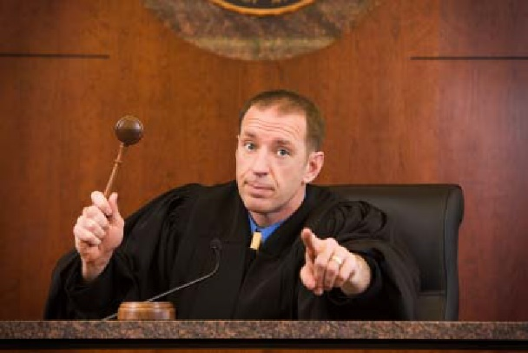
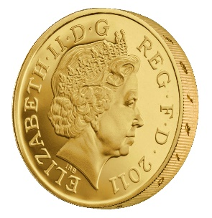
CPA-Security (Multiple Messages)
m_{0,1},m_{1,1}
c₁ = Enc_{K}(m_{b,1})
m_{0,2},m_{1,2}
c₂ = Enc_{K}(m_{b,2})
m_{0,3},m_{1,3}
c₃ = Enc_{K}(m_{b,3})
…
$$∀PPT A ∃μ (negligible) s.t$$
$$Pr\left[{PrivK}_{A,Π }^{cpa}\right]≤\frac{1}{2}+μ(n)$$
b’
Random bit b
$K←Gen\left(1^{n}\right)$

Slide 6
CPA-Security
Theorem: An encryption scheme $Π= \left(Gen,Enc,Dec\right)$ that is CPA-Secure for single encryptions is also CPA-secure for multiple encryptions.
We will simply say CPA-security for simplicity
To show CPA-Security it suffices to show CPA-security for single encryptions.
To reason about security of a protocol using $Π$ we can use game with multiple encryptions.

Slide 7
CPA-Security
CPA-security vs Multiple Message Encryption
CPA-security is stronger guarantee
Attacker can select messages adaptively
CPA-security: minimal security notion for a modern cryptosystem
Limitations of CPA-Security: Does not model and adversary who
Attempts to modify messages
Can get honest party to (partially) decrypt some messages

Slide 8
CPA-Security and Message Length
Observation: Given a CPA-secure encryption scheme $Π= \left(Gen,Enc,Dec\right)$ that supports messages of a single bit ($ℳ=\left\{0,1\right\}$) it is easy to build a CPA-secure scheme $Π′= \left(Gen′,Enc′,Dec′\right)$ that supports messages m = m₁,…,m_{n}$∈\left\{0,1\right\}n$ of length n.
$${Enc}_{k}^{′}\left(m\right)=\left\langle {Enc}_{k}^{}\left(m1\right),…,{Enc}_{k}^{}\left(mn\right)\right\rangle$$
Exercise: How would you prove $Π$’ is CPA-secure?

Slide 9
Security Reduction
Step 1: Assume for contraction that we have a PPT attacker A’ that breaks CPA-Security of $Π$’.
Step 2: Construct a PPT attacker A that breaks CPA-Security of $Π$.

Slide 10
The Reduction
Random bit b
$$\text{K}←\text{Gen}\left(1^{n}\right)$$
Multiple Message CPA-Game
m₀[0], m₁[0]
m₀, m₁
Enc_{K}(m_{b}[0])
$$c′={Enc′}_{K}\left(m_{b′}\right)$$
$Π$’ Encryption Attacker
…
…
g=b’
b’
$Π$ Encryption Attacker
$${Enc}_{k}^{′}\left(m\right)=\left\langle {Enc}_{k}^{}\left(m1\right),…,{Enc}_{k}^{}\left(mn\right)\right\rangle$$

Slide 11
Week 3: Topic 1: Pseudorandom Functions and CPA-Security

Slide 12
Pseudorandom Function (PRF)
A keyed function $F:{\left\{0,1\right\}}^{ℓ_{key}\left(n\right)}×{\left\{0,1\right\}}^{ℓ_{in}\left(n\right)}→{\left\{0,1\right\}}^{ℓ_{out}\left(n\right)}$, which “looks random” without the secret key k.
$ℓ_{key}\left(n\right)$ - length of secret key k
$ℓ_{in}\left(n\right)$ - length of input
$ℓ_{out}\left(n\right)$ - length of output
Typically, $ℓ_{key}\left(n\right)$=$ℓ_{in}\left(n\right)$=$ℓ_{out}\left(n\right)$ =n (unless otherwise specified)
Computing F_{K}(x) is efficient (polynomial-time)

Slide 13
PRF vs. PRG
Pseudorandom Generator G is not a keyed function
PRG Security Model: Attacker sees only output G(r)
Attacker who sees r can easily distinguish G(r) from random
PRF Security Model: Attacker sees both inputs and outputs (r_{i},F_{k}(r_{i}))
In fact, attacker can select inputs r_{i}
Attacker Goal: distinguish F from a truly random function

Slide 14
Truly Random Function
Let Func_{n} denote the set of all functions ${f:\left\{0,1\right\}}^{n}→{\left\{0,1\right\}}^{n}$.
Question: How big is the set Func_{n}?
Hint: Consider the lookup table.
2^{n} entries in lookup table
n bits per entry ($f\left(x\right)$)
n2^{n} bits to encode f$∈$Func_{n}
Answer: $\left|\text{Func}\text{n} \right|=2^{n2^{n}}$ (by comparison only $\left|𝒦\right|=2^{n}$ n-bit keys)
$$x$$ | $$f\left(x\right)$$
$$0…00$$ | $$f\left(0…00 \right)$$
$$0…01$$ | $$f\left(0…01 \right)$$
$$0…10$$ | $$f\left(0…10 \right)$$
$$…$$ | $$…$$
$$1…11$$ | $$f\left(1…11 \right)$$
$$2^{n}$$

Slide 15
Truly Random Function
Let Func_{n} denote the set of all functions ${f:\left\{0,1\right\}}^{n}→{\left\{0,1\right\}}^{n}$.
Can view entries in lookup table as populated in advance (uniformly)
Space: n2^{n} bits to encode $f∈{Func}_{n}$
Alternatively, can view entries as populated uniformly “on-the-fly”
Space: $2n×q\left(n\right)$ bits after $q\left(n\right)$ queries to store prior responses
Alternate view is often useful in security reductions
Doesn’t require time to fully specify $f∈{Func}_{n}$

Slide 16
Oracle Notation
We use A^{f(.)} to denote an algorithm A with oracle access to a function f.
A may adaptively query f(.) on multiple different inputs x₁,x₂,… and A receives the answers f(x₁),f(x₂),…
However, A can only use f(.) as a blackbox (no peaking at the source code in the box)

Slide 17
PRF Security
Definition 3.25: A keyed function $F:{\left\{0,1\right\}}^{n}×{\left\{0,1\right\}}^{n}→{\left\{0,1\right\}}^{n}$ is a pseudorandom function if for all PPT distinguishers D there is a negligible function $μ$ s.t.
$$\left|Pr\left[D^{F_{k}(.)}\left(1^{n}\right)\right]−Pr\left[D^{f(.)}\left(1^{n}\right)\right]\right|≤μ\left(n\right)$$
Notes:
the first probability is taken over the uniform choice of ${k∈\left\{0,1\right\}}^{n}$ as well as the randomness of D.
the second probability is taken over uniform choice of f $∈$Func_{n}as well as the randomness of D.
D is not given the secret k in the first probability (otherwise easy to distinguish…how?)

Slide 18
PRF-Security as a Game
m₁
r₁
m₂
r₂
m₃
r₃
…
$$∀PPT A ∃μ (negligible) s.t$$
$$Pr\left[A Guesses b^{′}=b\right]≤\frac{1}{2}+μ(n)$$
b’
Random bit b
$K←Gen\left(1^{n}\right)$
Truly random func R
r_{i} = F_{K}(m_{i}) if b=1
R(m_{i}) o.w

Slide 19
PRF Security Concrete Version
Definition 3.25: A keyed function $F:{\left\{0,1\right\}}^{n}×{\left\{0,1\right\}}^{n}→{\left\{0,1\right\}}^{n}$ is a $\left(t\left(n\right),q\left(n\right),ε\left(n\right)\right)$-secure pseudorandom function if for all distinguishers D running in time at most $t\left(n\right)$ and making at most $q\left(n\right)$ queries we have
$$\left|Pr\left[D^{F_{k}(.)}\left(1^{n}\right)\right]−Pr\left[D^{f(.)}\left(1^{n}\right)\right]\right|≤ε\left(n\right)$$

Slide 20
Reminder: CPA-Security (Single Message)
m₀,m₁
c = Enc_{K}(m_{b})
m₂
c₂ = Enc_{K}(m₂)
m₃
c₃ = Enc_{K}(m₃)
…
$$∀PPT A ∃μ (negligible) s.t$$
$$Pr\left[A Guesses b^{′}=b\right]≤\frac{1}{2}+μ(n)$$
b’
Random bit b
$K←Gen\left(1^{n}\right)$

Slide 21
CPA-Secure Encryption
Gen: on input 1^{n} pick uniform ${k∈\left\{0,1\right\}}^{n}$
Enc: Input ${k∈\left\{0,1\right\}}^{n}$ and ${m∈\left\{0,1\right\}}^{n}$
Output $c=\left\langle r,F_{k}\left(r\right)⨁m\right\rangle$ for uniform ${r∈\left\{0,1\right\}}^{n}$
Dec: Input ${k∈\left\{0,1\right\}}^{n}$ and$c=\left\langle r,s\right\rangle$
Output $m=F_{k}\left(r\right)⨁s$
Theorem: If F is a pseudorandom function, then (Gen,Enc,Dec) is a CPA-secure encryption scheme for messages of length n.
How to begin proof?

Slide 22
Breaking CPA-Security (Single Message)
m₀,m₁
$$\left\langle r,F_{k}\left(r\right)⨁m_{b}\right\rangle$$
m₂
$$\left\langle r_{2},F_{k}\left(r_{2}\right)⨁m_{2}\right\rangle$$
m₃
$$\left\langle r_{3},F_{k}\left(r_{3}\right)⨁m_{3}\right\rangle$$
…
Assumption: $∃$PPT $A, P (non−negligible) s.t$
$$Pr\left[A Guesses b^{′}=b\right]≥\frac{1}{2}+P(n)$$
b’
Random bit b
$$K←Gen\left(1^{n}\right)$$

Slide 23
Security Reduction
Step 1: Assume for contraction that we have a PPT attacker A that breaks CPA-Security.
Step 2: Construct a PPT distinguisher D which breaks PRF security.
Distinguisher D^{O} (oracle O --- either f or F_{k})
Simulate A
Whenever A queries its encryption oracle on a message m
Select random r
Return $c=\left\langle r,O\left(r\right)⨁m\right\rangle$
Whenever A outputs messages m₀,m₁
Select random r and bit b
Return $c=\left\langle r,O\left(r\right)⨁m_{b}\right\rangle$
Whenever A outputs b’
Output 1 if b=b’
Output 0 otherwise
Analysis: Suppose that O = f then
$\text{Pr}\left[{\text{D}}^{F_{k}}=1\right]\text{=} \text{Pr}\left[{PrivK}_{A,Π }^{cpa}=1\right]$
Suppose that O = f then
$$\text{Pr}\left[{\text{D}}^{f}=\text{1}\right]\text{=}\text{Pr}\left[{PrivK}_{A,\tilde{Π} }^{cpa}=1\right]$$
where $\tilde{Π}$ denotes the encryption scheme in which F_{k} is replaced by truly random f.

Slide 24
Security Reduction
Step 1: Assume for contraction that we have a PPT attacker A that breaks CPA-Security.
Step 2: Construct a PPT distinguisher D which breaks PRF security.
Distinguisher D^{O} (oracle O --- either f or F_{k})
Simulate A
Whenever A queries its encryption oracle on a message m
Select random r
Return $c=\left\langle r,O\left(r\right)⨁m\right\rangle$
Whenever A outputs messages m₀,m₁
Select random r and bit b
Return $c=\left\langle r,O\left(r\right)⨁m_{b}\right\rangle$
Whenever A outputs b’
Output 1 if b=b’
Output 0 otherwise
Analysis: Suppose that O = F_{k} then by PRF security, for some negligible function $μ,$ we have
$$\left|\text{Pr}\left[{PrivK}_{A,Π }^{cpa}=1\right]−\text{Pr}\left[{PrivK}_{A,\tilde{Π} }^{cpa}=1\right]\right|=\left|\text{Pr}\text{[}{\text{D}}^{F_{k}}=1\text{]}−\text{Pr}\text{[}{\text{D}}^{f}=1\text{]}\right|≤μ(n)$$
Implies: $\text{Pr}\left[{PrivK}_{A,\tilde{Π} }^{cpa}=1\right]≥\text{Pr}\left[{PrivK}_{A,Π }^{cpa}=1\right]$-$μ(n)$

Slide 25
Security Reduction
Fact: $\text{Pr}\left[{PrivK}_{A,\tilde{Π} }^{cpa}=1\right]≥\text{Pr}\left[{PrivK}_{A,Π }^{cpa}=1\right]$-$μ(n)$
Claim: For any attacker A making at most q(n) queries we have
$$\text{Pr}\left[{PrivK}_{A,\tilde{Π} }^{cpa}=1\right]≤\frac{1}{2}+\frac{q(n)}{2^{n}}$$
Conclusion: For any attacker A making at most q(n) queries we have
$$\text{Pr}\left[{PrivK}_{A,Π }^{cpa}=1\right]≤\frac{1}{2}+\frac{q\left(n\right)}{2^{n}}+μ\left(n\right)$$
where $\frac{q\left(n\right)}{2^{n}}+μ\left(n\right)$ is negligible.

Slide 26
Finishing Up
Claim: For any attacker A making at most q(n) queries we have
$$\text{Pr}\left[{PrivK}_{A,\tilde{Π} }^{cpa}=1\right]≤\frac{1}{2}+\frac{q(n)}{2^{n}}$$
Proof: Let m₀,m₁ denote the challenge messages and let r* denote the random string used to produce the challenge ciphertext
$$c=\left\langle r^{∗},f\left(r^{∗}\right)⨁m_{b}\right\rangle$$
And let $r_{1}\text{,…,}r_{q}$ denote the random strings used to produce the other ciphertexts $ci=\left\langle r_{i},f\left(r_{i}\right)⨁m_{i}\right\rangle$.
If $r^{∗}≠r_{1}\text{,…,}r_{q}$then then c leaks no information about b (information theoretically).

Slide 27
Finishing Up
Claim: For any attacker A making at most q(n) queries we have
$$\text{Pr}\left[{PrivK}_{A,\tilde{Π} }^{cpa}=1\right]≤\frac{1}{2}+\frac{q(n)}{2^{n}}$$
Proof: If $r^{∗}≠r_{1}\text{,…,}r_{q}$ then then c leaks no information about b (information theoretically). We have
$$\text{Pr}\left[{PrivK}_{A,\tilde{Π} }^{cpa}=1\right]≤\text{Pr}\left[{PrivK}_{A,\tilde{Π} }^{cpa}=1\left|r^{∗}≠r_{1}\text{,…,}r_{q}\right.\right]+\text{Pr}\left[\text{r}\text{∗}∈\left\{r_{1}\text{,…,}r_{q}\right\} \right]$$
$$≤\frac{1}{2}+\frac{q(n)}{2^{n}}$$

Slide 28
Conclusion
$$\text{Enc}\text{k}\text{(}\text{m}\text{)}=\left\langle r,F_{k}\left(r\right)⨁m\right\rangle$$
$$\text{Dec}\text{k}\text{(}\left\langle r,s\right\rangle \text{)}=F_{k}\left(r\right)⨁s$$
For any attacker A making at most q(n) queries we have
$$\text{Pr}\left[{PrivK}_{A,Π }^{cpa}=1\right]≤\frac{1}{2}+\frac{q\left(n\right)}{2^{n}}+μ\left(n\right)$$
PRF Security
Suggested Exercise: Work out concrete version of security proof

Slide 29
Are PRFs or PRGs more Powerful?
Easy to construct a secure PRG from a PRF
G(s) = F_{s}(1)|…|F_{s}($ℓ$)
Construct a PRF from a PRG?
Tricky, but possible… (Katz and Lindell Section 7.5)

Slide 30
PRFs from PRGs
Theorem: Suppose that there is a PRG G with expansion factor $ℓ\left(n\right)=2n.$ Then there is a secure PRF.
Let G(x) = G₀(x)||G₁(x) (first/last n bits of output)
$$F_{K}\left(x_{1},…,x_{n}\right)=G_{x_{n}}\left(…\left(G_{x_{2}}\left(G_{x_{1}}\left(K\right)\right)\right)…\right)$$
Theorem: If G is a PRG then F_{k} is a PRF

Slide 31
PRFs from PRGs
Theorem: Suppose that there is a PRG G with expansion factor $ℓ\left(n\right)=2n.$ Then there is a secure PRF.
k
1
F_{k}(011)=G₁(G₁(G₀(k)))
0
G₀(k)
G₁(k)
0
1
1
0
G₀(G₀(k))
G₁(G₀(k))
G₀(G₁(k))
G₁(G₁(k))
1
…
…
0
1
0
1
…
0
1
…
0
…
…
…
…

Slide 32
Construct PRF from PRG
Define: G(s)= G₀(s)| G₁(s)
PRF: $F_{k}\left(x\right)=G_{x_{1}}\left({…G}_{x_{n−1}}\left(G_{x_{n}}\left(k\right)\right)\right)$
Recursive Definition: $F_{k}\left(x\right)=\text{H}\text{k}\text{(}\text{x}\text{)}$ where
H_{k}(1)$:=$ G₁(k)
H_{k}(0)$:=$ G₀(k)
H_{k}(1|x)$:=$G₁(H_{k}(x))
H_{k}(0|x)$:=$ G₀(H_{k}(x))
Theorem: If G is a PRG then F_{k} is a PRF

Slide 33
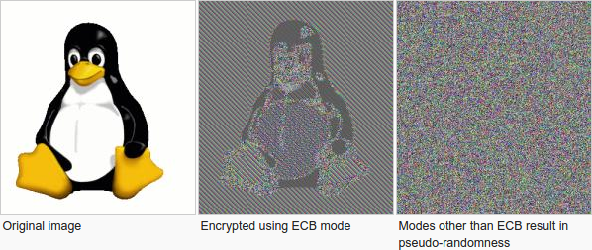
Week 3: Topic 2: Modes of Encryption, The Penguin and CCA security

Slide 34
Pseudorandom Permutation
A keyed function $F:{\left\{0,1\right\}}^{n}×{\left\{0,1\right\}}^{n}→{\left\{0,1\right\}}^{n}$, which is invertible and “looks random” without the secret key k.
Similar to a PRF, but
Computing F_{k}(x) and $F_{k}^{−1}\left(x\right)$ is efficient (polynomial-time)
Definition 3.28: A keyed function $F:{\left\{0,1\right\}}^{n}×{\left\{0,1\right\}}^{n}→{\left\{0,1\right\}}^{n}$ is a strong pseudorandom permutation if for all PPT distinguishers D there is a negligible function $μ$ s.t.
$$\left|Pr\left[D^{F_{k}\left(.\right),F_{k}^{−1}\left(.\right)}\left(1^{n}\right)\right]−Pr\left[D^{f\left(.\right),f^{−1}\left(.\right)}\left(1^{n}\right)\right]\right|≤μ\left(n\right)$$

Slide 35
Pseudorandom Permutation
Definition 3.28: A keyed function $F:{\left\{0,1\right\}}^{n}×{\left\{0,1\right\}}^{n}→{\left\{0,1\right\}}^{n}$ is a strong pseudorandom permutation if for all PPT distinguishers D there is a negligible function $μ$ s.t.
$$\left|Pr\left[D^{F_{k}\left(.\right),F_{k}^{−1}\left(.\right)}\left(1^{n}\right)\right]−Pr\left[D^{f\left(.\right),f^{−1}\left(.\right)}\left(1^{n}\right)\right]\right|≤μ\left(n\right)$$
Notes:
the first probability is taken over the uniform choice of ${k∈\left\{0,1\right\}}^{n}$ as well as the randomness of D.
the second probability is taken over uniform choice of f $∈$Perm_{n}as well as the randomness of D.
D is never given the secret k
However, D is given oracle access to (keyed) permutation and inverse
Strong pseudorandom permutation: attacker doesn’t get oracle access to inverse
Can build strong pseudorandom permutation given pseudorandom function

Slide 36
Electronic Code Book (ECB) Mode
Uses strong PRP F_{k}(x) and $F_{k}^{−1}\left(x\right)$
Enc_{k}
Input: m₁,…,m$ℓ$
Output: $\left\langle \text{F}\text{k}\text{(}\text{m}\text{1}\text{)},…,\text{F}\text{k}\text{(}\text{m}ℓ \text{)}\right\rangle$
How to decrypt?
Is this secure?
Hint: Encryption is deterministic.
Implication: Not CPA-Secure
But, it gets even worse

Slide 37
ECB Mode (A Failed Approach)

Slide 38
The Penguin Principle
If you can still see the penguin after “encrypting” the image something is very very wrong with the encryption scheme.

Slide 39
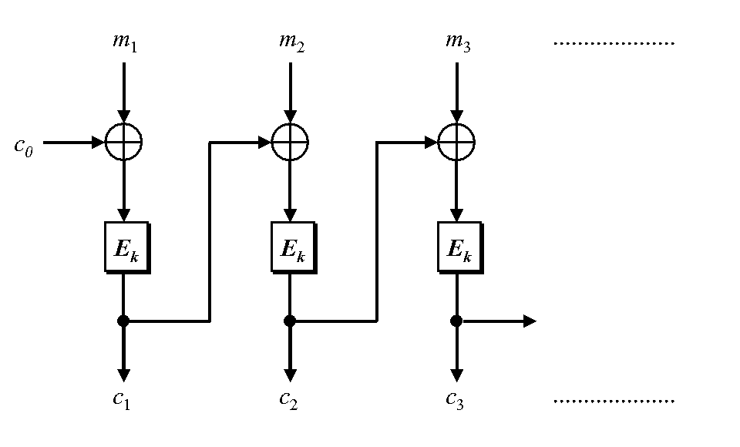
Cipher Block Chaining
CBC-Mode (below) is CPA-secure if E_{k} is a PRP
Reduces bandwidth!
Message: 3n bits
Ciphertext: 4n bits
IV
IV
How to decrypt? (Hint: Can be done in parallel)

Slide 40
Chained CBC-Mode
m₄
m₅
m₆
IV
c₃
IV
c₄
c₅
c₆
First glance: seems similar to CBC-Mode and reduces bandwidth
Vulnerable to CPA-Attack! (Set $m4=IV⨁c3⨁m_{1}^{′}$ and c₄=c₁ iff m₁=m₁’)
Moral: Be careful when tweaking encryption scheme!

Slide 41
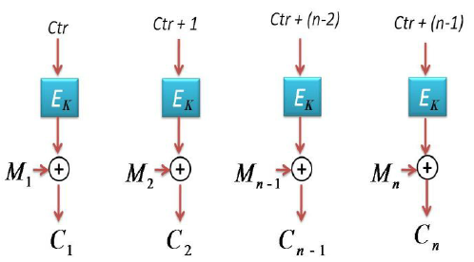
Counter Mode
Input: m₁,…,m_{n}
Output: c = (ctr, c₁,c₂,…,c_{n}) where ctr is chosen uniformly at random
Theorem: If E_{k} is PRF then counter mode is CPA-Secure
Advantages: Parallelizable encryption/decryption

Slide 42
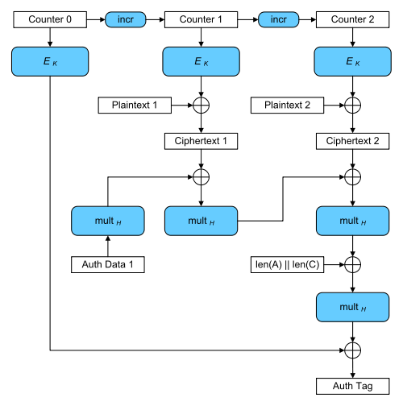
Galois Counter Mode (GCM)
AES-GCM is CCA-secure (> CPA-security)
Bonus: Authentication Encryption with Associated Data
Ensure integrity of ciphertext
Attacker cannot even generate new/valid ciphertext!
Ensures attacker cannot tamper with associated packet data
Source IP
Destination IP
Why can’t these values be encrypted?
Encryption is largely parallelizable!

Slide 43
Recap
Pseudorandom Functions
CPA-Security
Today’s Goals:
Evaluate several modes of operation for stream-ciphers + block-ciphers
Introduce Chosen Ciphertext Attacks/CCA-Security
Construct encryption scheme with CCA-Security

Slide 44
Week 3: Topic 3: CCA-Security

Slide 45
Chosen Ciphertext Attacks
Sometimes an attacker has ability to obtain (partial) decryptions of ciphertexts of its choice.
CPA-Security does not model this ability.
Examples:
An attacker may learn that a ciphertext corresponds to an ill-formed plaintext based on the reaction (e.g., server replies with “invalid message”).
Monitor enemy behavior after receiving an encrypted message.
Authentication Protocol: Send Enc_{k}(r) to recipient who authenticates by responding with r.

Slide 46
CCA-Security (Ind-CCA2)
We could set m₀ = m₋₁ or m₁ = m₋₂ etc…
m₋₁
c₋₁ = Enc_{K}(m₋₁)
c₋₂
…
m₋₂ = Dec_{K}(c₋₂)
m₀,m₁
However, we could still flip 1 bit of c and ask challenger to decrypt
c = Enc_{K}(m_{b})
m₂
c₂ = Enc_{K}(m₂)
Random bit b
K = Gen(.)
c₃
m₃ = Dec_{K}(c₃)
c₄ =c
…
“No Way!”
b’

Slide 47
CCA-Security $\left({PrivK}_{A,Π}^{cca}\left(n\right)\right)$
Challenger generates a secret key k and a bit b
Adversary (A) is given oracle access to Enc_{k} and Dec_{k}
Adversary outputs m₀,m₁
Challenger sends the adversary c=Enc_{k}(m_{b}).
Adversary maintains oracle access to Enc_{k} and Dec_{k} ,however the adversary is not allowed to query Dec_{k}(c).
Eventually, Adversary outputs b’.
$${PrivK}_{A,Π}^{cca}\left(n\right)=1 if b=b^{′};otherwise 0.$$
CCA-Security: For all PPT A exists a negligible function negl(n) s.t.
$$Pr\left[{PrivK}_{A,Π}^{cca}\left(n\right)=1\right]≤\frac{1}{2}+negl(n)$$

Slide 48
CCA-Security
Definition 3.33: An encryption scheme $Π$ is CCA-secure if for all PPT A there is a negligible function negl(n) such that
$$Pr\left[{PrivK}_{A,Π}^{cca}\left(n\right)=1\right]≤\frac{1}{2}+negl(n)$$

Slide 49
CPA-Security doesn’t imply CCA-Security
$$\text{Enc}\text{k}\text{(}\text{m}\text{)}=\left\langle r,F_{k}\left(r\right)⨁m\right\rangle$$
Attacker: Selects m₀ = 0^{n} and m₁ = 1^{n}
Attacker Receives: $c=\left\langle r, s\right\rangle$ ${\text{where} s=F}_{k}\left(r\right)⨁m_{b}$
Attacker Queries: Dec_{k}(c’) for
$$c′=\left\langle r,s⨁{10}^{n−1}\right\rangle$$
Attacker Receives: $m=\left\{\begin{matrix}{10}^{n−1} & if b=0 \\ {01}^{n−1} & if b=1\end{matrix}\right.$
Example Shows: CPA-Security doesn’t imply CCA Security (Why?)

Slide 50
Attacks in the Wild
Padding Oracle Attack
Length of plaintext message must be multiple of block length (e.g., 16 bytes)
Popular fix PKCS #5 padding
1 bytes of padding (0x01)
2 bytes of padding (0x0202)
3 bytes of padding (0x030303)
4 bytes of padding (0x04040404)
Invalid: (0x020303)
“Bad Padding Error”
Adversary submits ciphertext(s) and waits to if this error is produced
Attacker can repeatedly modify ciphertext to reveal original plaintext piece by piece!

Slide 51
Example
M=“hello…please keep this message secret”+0x030303
$$C=\left\langle r,s=F_{k}\left(r\right)⨁M\right\rangle$$
$C^{′}=\left\langle r,F_{k}\left(r\right)⨁M⨁\text{0}\text{x}\text{0000}….\text{30}\text{000} \right\rangle$
Ask to decrypt C’
If we added < 3 bytes of padding?
→ C’ can be decrypted.
If we added $≥$ 3 bytes of padding?
→We will get a decryption error (bad padding)!
Once we know we have three bits of padding we can set
$$C^{′′}=\left\langle r,s=F_{k}\left(r\right)⨁\left(M⨁\text{0}\text{x}\text{0000}….\text{0}\text{30303}\right)⨁\text{0}\text{x}\text{0}…gg0\text{4}\text{0}\text{4}\text{0}\text{4}\right\rangle$$
If C’’ decrypts then we can infer the byte t s.t. $M=x∥t∥(0x030303)$ since $t⨁gg=0x04$.

Slide 52
CCA-Security
CCA-Security is strictly stronger than CPA-Security
Note: If a scheme has indistinguishable encryptions under one chosen-ciphertext attack then it has indistinguishable multiple encryptions under chosen-ciphertext attacks.
None of the encryption schemes we have considered so far are CCA-Secure ☹
Achieving CCA-Security?
Useful to guarantee integrity of the ciphertext
Idea: If attacker cannot generate valid new ciphertext c’ (distinct from ciphertext obtained via eavesdropping) then ability to query decryption oracle is useless!
CCA-Security requires non-malleability.
Intuition: if attacker tampers with ciphertext c then c’ is either invalid or m’ is unrelated to m
Let $c={Enc}_{K}\left(\text{m}\text{b}\right).$Suppose attacker could generate a new valid ciphertext $c′≠c$ such that $m′$ is related to $\text{m}\text{b}$the but not message $m_{1−b}$
How can the attacker win the CCA-Security game?
Ask for decryption of c’ and check if $m′$ is related to $m_{1}$ or $m_{0}$

Slide 53
Back to CPA-Security
We will build a CCA-Secure Encryption scheme later in the course
We will need to introduce additional tools (Message Authentication Codes)
Remaining Lecture: Modes of Operation for Stream-Ciphers and Block-Ciphers

Slide 54
Drawbacks of $\text{Enc}\text{k}\text{(}\text{m}\text{)}=\left\langle r,F_{k}\left(r\right)⨁m\right\rangle$
CPA-Secure, but…
Ciphertext is twice as long as the message |c|=2|m|
Is this always necessary?
What if we know we are going to transmit several messages m₁,m₂,…

Slide 55
CPA-Secure Encryption
$$\text{Enc}\text{k}\text{(}\text{m}\text{)}=\left\langle r,F_{k}\left(r\right)⨁m\right\rangle$$
$$\text{Dec}\text{k}\text{(}\left\langle r,s\right\rangle \text{)}=F_{k}\left(r\right)⨁s$$
Drawbacks:
Encryption is for fixed length messages only
Length of ciphertext is twice as long as message
Attacker can still tamper with ciphertexts to flip bits of plaintext
Stream Ciphers/Block Ciphers
CCA Security

Slide 56
Stream Ciphers Modes
What if we don’t know the length of the message to be encrypted a priori?
Stream Cipher: $G_{∞}\left(s,1^{n}\right)$ outputs n pseudorandom bits as follows
Initial State: st₀ = Initialize(s)
Repeat
(y_{i},st_{i})=GetBits(st_{i-1})
Output y_{i}
Synchronized Mode
Message sequence: m₁,m₂,…
Ciphertext sequence: c_{i} = m_{i} $⨁$y_{i} (same length as ciphertext!)
“CPA-like” security follows from cipher security (must stop after n-bits)
Deterministic encryption, what gives???
Requires both parties to maintain state (not good for sporadic communication)

Slide 57
Stream Ciphers Modes
What if we don’t want to keep state?
Unsynchronized Mode
Message sequence: m₁,m₂,…
Ciphertext sequence: $ci=\left\langle \text{IV}\text{, }m_{i}⨁ G_{∞}\left(k,IV,1^{\left|m_{i}\right|}\right)\right\rangle$
CPA-Secure if F_{k}(IV) $=G_{∞}\left(k,IV,1^{n}\right)$ is a (weak) PRF.
No shared state, but longer ciphertexts….

Slide 58
Next Class
Read Katz and Lindell 4.1-4.2
Message Authentication Codes (MACs) Part 1

Slide 59
Week 3: Topic 4: Message Authentication Codes (Part 1)

Slide 60
Recap
CPA-Security vs. CCA-Security
PRFs
Today’s Goals:
Introduce Message Authentication Codes (MACs)
Key tool in Construction of CCA-Secure Encryption Schemes
Build Secure MACs

Slide 61
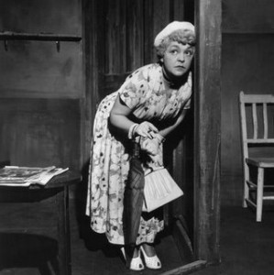
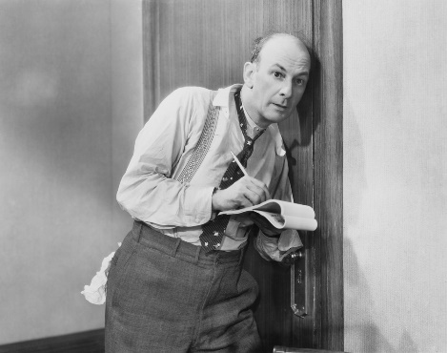
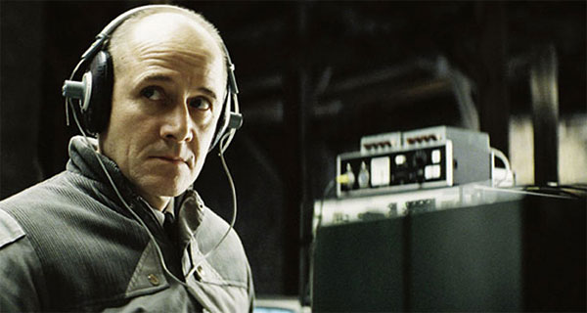
What Does It Mean to “Secure Information”
Confidentiality (Security/Privacy)
Only intended recipient can see the communication

Slide 62
What Does It Mean to “Secure Information”
Confidentiality (Security/Privacy)
Only intended recipient can see the communication
Integrity (Authenticity)
The message was actually sent by the alleged sender
I love you Alice… - Bob
We need to break up -Bob
Alice
Bob

Slide 63
Message Authentication Codes
CPA-Secure Encryption: Focus on Secrecy
But does not promise integrity
Message Authentication Codes: Focus on Integrity
But does not promise secrecy
CCA-Secure Encryption: Requires Secrecy and Non-Malleability (if attacker tampers with ciphertext it is either invalid or unrelated to original one)

Slide 64
What Does It Mean to “Secure Information”
Integrity (Authenticity)
The message was actually sent by the alleged sender
And the received message matches the original
Pay robot devil $50
Pay robot devil $5,000
Alice
Bob
Notes:
Example: HTTP is stateless. Cookies can be stored on the client, but can the server trust the client not to modify the cookie?

Slide 65
Error Correcting Codes?
Tool to detect/correct a small number of random errors in transmission
Examples: Parity Check, Reed-Solomon Codes, LDPC, Hamming Codes …
Provides no protection against a malicious adversary who can introduce an arbitrary number of errors
Still useful when implementing crypto in the real world (Why?)

Slide 66
Modifying Ciphertexts
$$\text{Enc}\text{k}\text{(}\text{m}\text{)}=c=\left\langle r,F_{k}\left(r\right)⨁m\right\rangle$$
$$c^{′}=\left\langle r,F_{k}\left(r\right)⨁m⨁y\right\rangle$$
$$\text{Dec}\text{k} {(c}^{′})=F_{k}\left(r\right)⨁F_{k}\left(r\right)⨁m⨁y=m⨁y$$
If attacker knows original message he can forge c’ to decrypt to any message he wants.
Even if attacker doesn’t know message he may find it advantageous to flip certain bits (e.g., decimal places)

Slide 67
Message Authentication Code Syntax
Definition 4.1: A message authentication code (MAC) consists of three algorithms
$\operatorname{Gen}{(1^{n};R)}$ (Key-generation algorithm)
Input: security parameter 1^{n} (unary) and random bits R
Output: Secret key $k∈𝒦$
$\operatorname{Mack}{(m;R)}$ (Tag Generation algorithm)
Input: Secret key $k∈𝒦$ and message $m∈ℳ$ and random bits R
Output: a tag t
$\operatorname{Vrfyk}{(m,t)}$ (Verification algorithm)
Input: Secret key $k∈𝒦,$ a message m and a tag t
Output: a bit b (b=1 means “valid” and b=0 means “invalid”)
Invariant?

Slide 68
Message Authentication Code Syntax
Definition 4.1: A message authentication code (MAC) consists of three algorithms
$\operatorname{Gen}{(1^{n};R)}$ (Key-generation algorithm)
Input: security parameter 1^{n} (unary) and random bits R
Output: Secret key $k∈𝒦$
$\operatorname{Mack}{(m;R)}$ (Tag Generation algorithm)
Input: Secret key $k∈𝒦$ and message $m∈ℳ$ and random bits R
Output: a tag t
$\operatorname{Vrfyk}{(m,t)}$ (Verification algorithm)
Input: Secret key $k∈𝒦,$ a message m and a tag t
Output: a bit b (b=1 means “valid” and b=0 means “invalid”)
Invariant?

Slide 69
Message Authentication Code Syntax
Definition 4.1: A message authentication code (MAC) consists of three algorithms $Π=\left(Gen, Mac, Vrfy\right)$
$\operatorname{Gen}{(1^{n};R)}$ (Key-generation algorithm)
Input: security parameter 1^{n} (unary) and random bits R
Output: Secret key $k∈𝒦$
$\operatorname{Mack}{(m;R)}$ (Tag Generation algorithm)
Input: Secret key $k∈𝒦$ and message $m∈ℳ$ and random bits R
Output: a tag t
$\operatorname{Vrfyk}{(m,t)}$ (Verification algorithm)
Input: Secret key $k∈𝒦,$ a message m and a tag t
Output: a bit b (b=1 means “valid” and b=0 means “invalid”)
$$\operatorname{Vrfyk}{(m,\operatorname{Mack}{(m;R)})}=1$$

Slide 70
General vs Fixed Length MAC
$$ℳ={\left\{0,1\right\}}^{∗}$$
versus
$$ℳ={\left\{0,1\right\}}^{ℓ(n)}$$

Slide 71
Deterministic MACs
Canonical Verification Algorithm
$$\operatorname{Vrfyk}{(m,t)}=\left\{\begin{aligned}\begin{matrix}1 & if t=Mack(m)\end{matrix} \\ \begin{matrix}0 & otherwise\end{matrix}\end{aligned}\right.{}$$
“All real-world MACs use canonical verification” – page 115

Slide 72
MAC Authentication Game (${Macforge}_{A,Π}(n)$)
m₁
t₁ = Mac_{K}(m₁)
m₂
…
t₂ = Mac_{K} (m₂)
m_{q}
t_{q} = Mac_{K}(m_{q})
$\left(m,t\right)$ s.t $m∉\left\{m1,…,m_{q}\right\}$
$${Macforge}_{A,Π}(n)=Vrfyk{(m,t)}$$
K = Gen(.)
$$∀PPT A ∃μ (negligible) s.t$$
$$Pr\left[{Macforge}_{A,Π}\left(n\right)=1\right]≤μ(n)$$

Slide 73
Discussion
Is the definition too strong?
Attacker wins if he can forge any message
Does not necessarily attacker can forge a “meaningful message”
“Meaningful Message” is context dependent
Conservative Approach: Prove security against more powerful attacker
Conservative security definition can be applied broadly
Replay Attacks?
t=Mac_{K}(“Pay Bob $1,000 from Alice’s bank account”)
Alice cannot modify message to say $10,000, but…
She may try to replay it 10 times

Slide 74
Replay Attacks
MACs alone do not protect against replay attacks (they are stateless)
Common Defenses:
Include Sequence Numbers in Messages (requires synchronized state)
Can be tricky over a lossy channel
Timestamp Messages
Double check timestamp before taking action

Slide 75
Strong MACs
Previous game ensures attacker cannot generate a valid tag for a new message.
However, attacker may be able to generate a second valid tag t’ for a message m after observing (m,t)
Strong MAC: attacker cannot generate second valid tag, even for a known message

Slide 76
Strong MAC Authentication (${Macsforge}_{A,Π}(n)$)
m₁
t₁ = Mac_{K}(m₁)
m₂
…
t₂ = Mac_{K} (m₂)
m_{q}
t_{q} = Mac_{K}(m_{q})
$\left(m,t\right)$ s.t $\left(m,t\right)∉\left\{(m1,t1),…,(mq,tq)\right\}$
$${Macsforge}_{A,Π}(n)=Vrfyk{(m,t)}$$
K = Gen(.)
$$∀PPT A ∃μ (negligible) s.t$$
$$Pr\left[{Macsforge}_{A,Π}\left(n\right)=1\right]≤μ(n)$$

Slide 77
Strong MAC vs Regular MAC
Proposition 4.4: Let $Π=\left(Gen, Mac, Vrfy\right)$ be a secure MAC that uses canonical verification. Then $Π$ is a strong MAC.
“All real-world MACs use canonical verification” – page 115
Should attacker have access to Vrfy_{K}(.) oracle in games?
(e.g., CPA vs CCA security for encryption)
Irrelevant if the MAC uses canonical verification!

Slide 78
Timing Attacks (Side Channel)
Naïve Canonical Verification Algorithm
Input: m,t’
t=Mac_{K}(m)
for i=1 to tag-length
if t[i] != t’[i] then
return 0
return 1
Example
t= 1 0 1 0 1 1 1 0
t’= 1 0 1 0 1 0 1 1
Returns 0 after 8 steps

Slide 79
Timing Attacks (Side Channel)
Naïve Canonical Verification Algorithm
Input: m,t’
t=Mac_{K}(m)
for i=1 to tag-length
if t[i] != t’[i] then
return 0
return 1
Example
t= 1 0 1 0 1 1 1 0
t’= 0 0 1 0 1 0 1 0
Returns 0 after 1 step

Slide 80
Timing Attack
MACs used to verify code updates for Xbox 360
Implementation allowed different rejection times (side-channel)
Attacks exploited vulnerability to load pirated games onto hardware
Moral: Ensure verification is time-independent

Slide 81
Improved Canonical Verification Algorithm
Input: m,t’
B=1
t=Mac_{K}(m)
for i=1 to tag-length
if t[i] != t’[i] then
B=0
else (dummy op)
return B
Example
t= 1 0 1 0 1 1 1 0
t’= 0 0 1 0 1 0 1 0
Returns 0 after 8 steps

Slide 82
Side-Channel Attacks
Cryptographic Definition
Attacker only observes outputs of oracles (Enc, Dec, Mac) and nothing else
When attacker gains additional information like timing (not captured by model) we call it a side channel attack.
Other Examples
Differential Power Analysis
Cache Timing Attack
Power Monitoring
Acoustic Cryptanalysis
…many others

Slide 83
Next Class
Read Katz and Lindell 4.3
Message Authentication Codes (MACs) Part 2
Constructing Secure MACs

