Slide 1
Homework 5 Statistics
Minimum Value | 59.00
Maximum Value | 100.00
Range | 41.00
Average | 82.73
Median | 83.50
Standard Deviation | 12.74

Slide 2
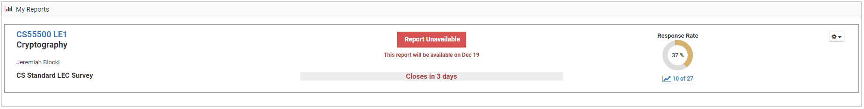
Course Evaluation
Please Complete Your Course Evaluations
Your feedback is valuable!
Homework 5 Solutions and Practice Final Available on Piazza

Slide 3
Final Exam
Time: Tuesday, December 11th at 8AM
Location: LWSN B151
Comprehensive
  …but heavier coverage of material covered in second half of semester
Format
  Multiple choice
  Fill in the blank (expect more of these questions)
  true/false/more information
Practice Exam on Piazza
Solutions to practice exam distributed on Thursday (Do not distribute!)

Slide 4
Review: Attacker Models
Passive Eavesdropping Attacker (Eve)
Active Attacker
  Chosen Plaintext Attack: Attacker can control/influence messages that are encrypted
  Chosen Ciphertext Attack: Attacker can convince honest party to (partially) decrypt ciphertexts of his/her choosing.
MPC: Semi-Honest vs Malicious
Man-In-The-Middle Attacker

Slide 5
Review: Key Concepts for Symmetric Key Crypto
Building Blocks: OWFs, OWPs, PRGs, PRFs, CRHFs, PRPs (Block Cipher)
  Constructions: PRFs from PRGs, PRPs via Feistel Network etc…
Should understand syntax (e.g., PRF uses a key, but a PRG doesn’t) and security definitions (e.g., PRG vs PRF)
MAC vs. Encryption
  Confidentiality vs Integrity
  Syntax
  Security Definition(s): Authenticated Encryption, CCA-Security, CPA-Security Perfect Secrecy, MAC-forgery game

Slide 6
Review: Collision Resistant Hash Functions (CRHF)
CRHFs are a unique object in cryptography
  No secret key (public seed) --- security definition (e.g., seeded) vs practice (e.g., SHA3)
Davies-Meyer construction in Ideal Cipher Model
Handling long inputs
  Merkle Tree
  Merkle-Damgård
Collision/Inversion Attacks
  Birthday Attack
  Small Space Birthday Attack
  Pre-Computation Attacks (Time/Space Tradeoffs)
Random Oracle Methodology

Slide 7
Review: Key Principles
Sufficient Key Space Principle
  Resist brute-force attacks
Penguin Principle
  Issues with stateless/deterministic encryption schemes
  Importance of nonces
Independent Key Principle

Slide 8
Review: Asymmetric Key Crypto
Key Assumptions:
  FACTORING
  RSA-Inversion Problem
  Discrete Logarithm Problem
  DDH vs CDH
  OWFs (for Certain Signature Schemes)
Public Key Encryption
  Syntax
  Security Definition(s): CPA vs CCA-security
  Constructions: Plain RSA, El Gamal, RSA-OAEP
Key Encapsulation Mechanism (and how to use them)

Slide 9
Review: Signatures
Goal: Message Integrity
Signature Properties:
  Public Verification
  Transferrable: Bob receives signature from Alice and can forward to Joe
  Can identify sender
  Cannot identify intended recipient
    Example: Alice signs message “I promise to pay you $50” and sends to Bob
    Eve can copy signature and forward to Joe who believes that Alice will pay him $50.
    Solution: Can bind signature to recipient, by indicating recipient inside the message
      E.g., “I promise to pay you (Bob) $50”
Contrast with MAC
  Need secret key for verification
  Cannot identify sender (anyone who has secret key)

Slide 10
Review: Signatures and MACs
What are some secure constructions of signatures?
  RSA-FDH
  Schnorr-Signatures (Fiat-Shamir)
  DSA/ECDSA
How to build a MAC?
  HMAC
  PRF: t=F_{k}(m)
Handling Long Messages: Hash and sign/mac
How to build an (in)secure signature/MAC scheme?

Slide 11
Review: Multi-Party Computation
Malicious vs Semi-Honest Security Models
Security Definition (Simulator)
  Captures intuition that Alice learns “nothing else” about Bob’s input
Yao’s Protocol (Garbled Circuits)
  What is security model?
  Building Blocks: Oblivious Transfer, CPA-Secure Encryption
Use of Zero-Knowledge Proofs in MPC

Slide 12
Review: Zero-Knowledge
Decision Problem (e.g., DDH, SAT, CLIQUE)
Properties
  Completeness
    Honest prover can always get verifier to accept a true statement
  Soundness
    A cheating prover can’t consistently get honest verifier to accept
  Zero-Knowledge
    How to build a simulator?
Interactive vs Non-Interactive Zero-Knowledge

Slide 13
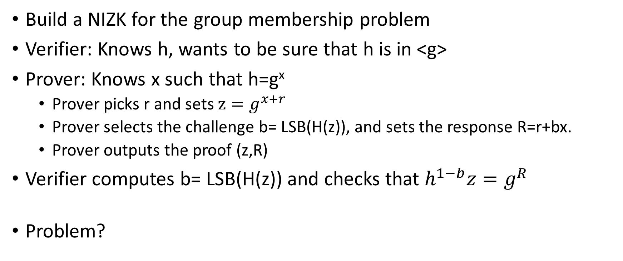
Practice Problem 1: NIZK
Build a NIZK for the group membership problem
Verifier: Knows h, wants to be sure that h is in <g>
Prover: Knows x such that h=g^{x}
  Prover picks r and sets $z=g^{x+r}$
  Prover selects the challenge b= LSB(H(z)), and sets the response R=r+bx.
  Prover outputs the proof (z,R)
Verifier computes b= LSB(H(z)) and checks that $h^{1−b}z=g^{R}$
Problem?

Slide 14
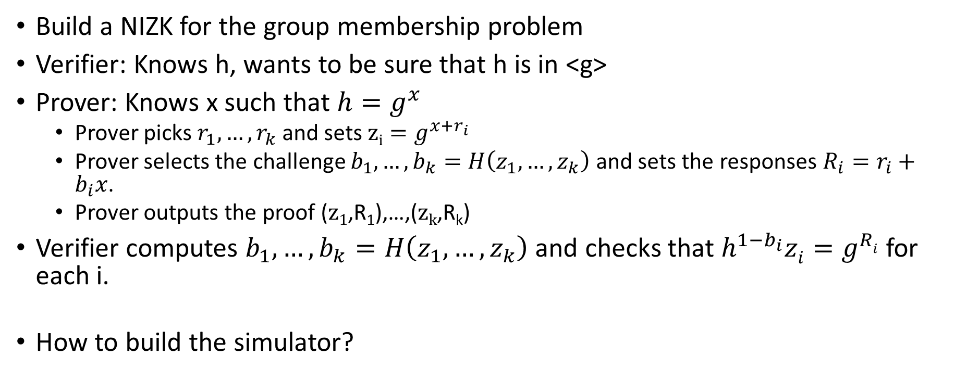
Practice Problem 1: NIZK (FIX)
Build a NIZK for the group membership problem
Verifier: Knows h, wants to be sure that h is in <g>
Prover: Knows x such that $h=g^{x}$
  Prover picks $r_{1},…,r_{k}$and sets $zi=g^{x+r_{i}}$
  Prover selects the challenge $b_{1},…,b_{k}=H\left(z_{1},…,z_{k}\right)$ and sets the responses $R_{i}=r_{i}+b_{i}x$.
  Prover outputs the proof ($z1$,R₁),…,($zk$,R_{k})
Verifier computes $b_{1},…,b_{k}=H\left(z_{1},…,z_{k}\right)$ and checks that $h^{1−b_{i}}zi=g^{Ri}$ for each i.
How to build the simulator?

Slide 15
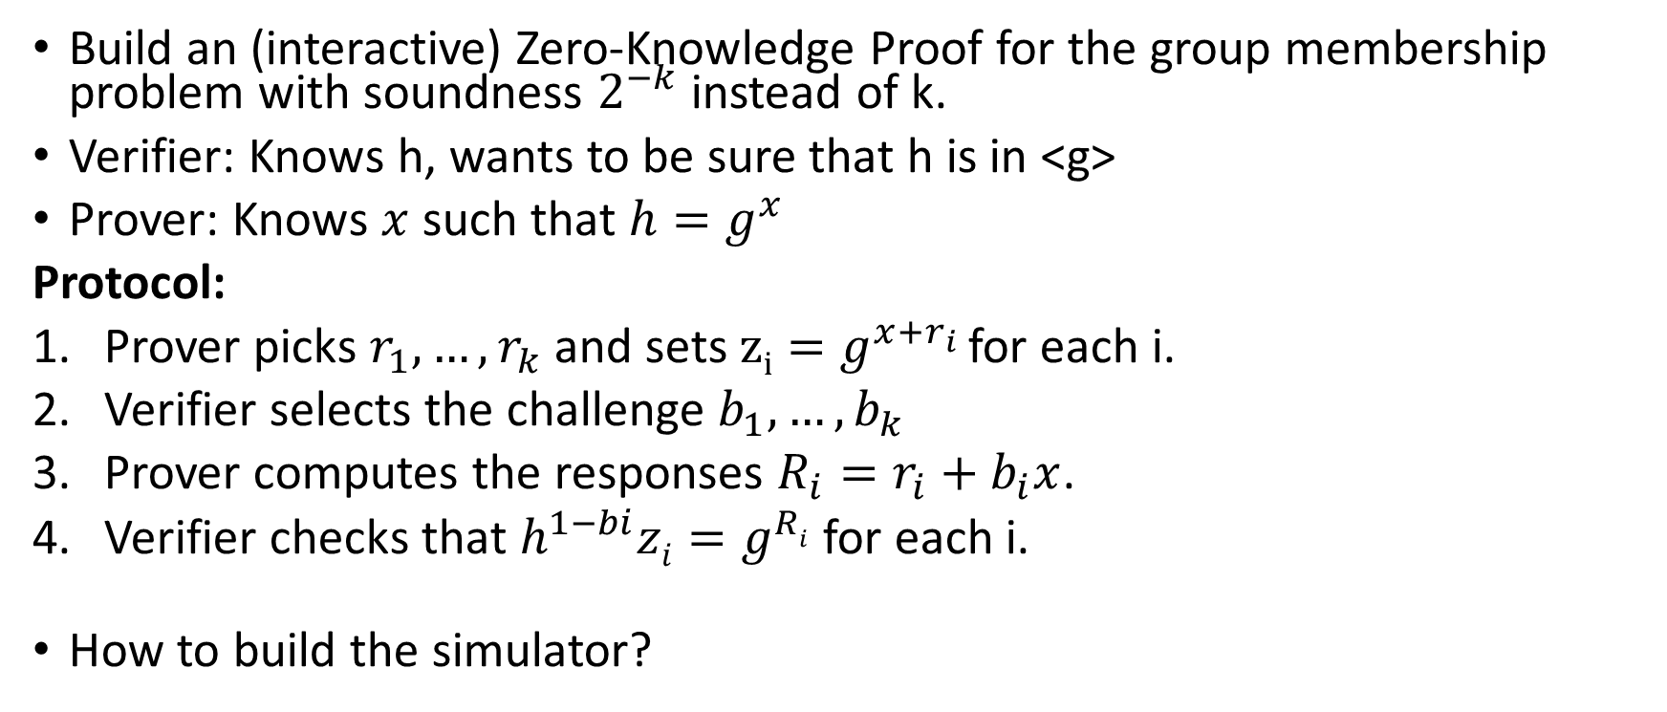
Practice Problem 2: Better Soundness
Build an (interactive) Zero-Knowledge Proof for the group membership problem with soundness $2^{−k}$ instead of k.
Verifier: Knows h, wants to be sure that h is in <g>
Prover: Knows $x$ such that $h=g^{x}$
Protocol:
Prover picks $r_{1},…,r_{k}$and sets $zi=g^{x+r_{i}}$ for each i.
Verifier selects the challenge $b_{1},…,b_{k}$
Prover computes the responses $R_{i}=r_{i}+b_{i}x$.
Verifier checks that $h^{1−bi}zi=g^{Ri}$ for each i.
How to build the simulator?

Slide 16
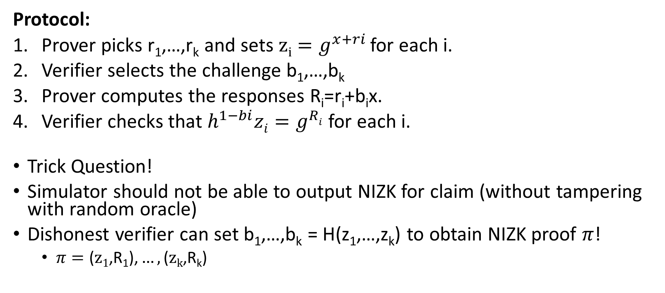
Practice Problem 2: Better Soundness in ZK
Protocol:
Prover picks r₁,…,r_{k} and sets $zi=g^{x+ri}$ for each i.
Verifier selects the challenge b₁,…,b_{k}
Prover computes the responses R_{i}=r_{i}+b_{i}x.
Verifier checks that $h^{1−bi}zi=g^{Ri}$ for each i.
Trick Question!
Simulator should not be able to output NIZK for claim (without tampering with random oracle)
Dishonest verifier can set b₁,…,b_{k} = H(z₁,…,z_{k}) to obtain NIZK proof $π$!
  $π=\text{(}z1\text{,}\text{R}\text{1}\text{)}\text{,}…,\text{(}zk\text{,}\text{R}\text{k}\text{)}$

Slide 17
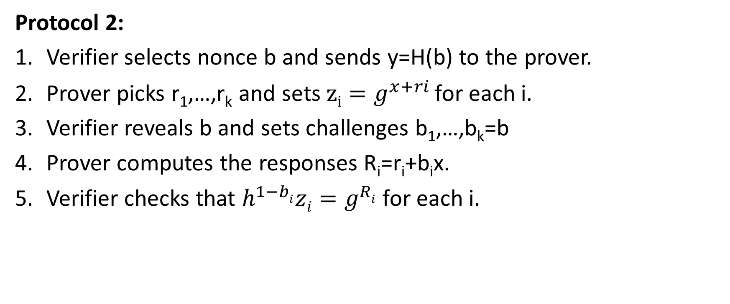
Practice Problem 2: Better Soundness in ZK
Protocol 2:
Verifier selects nonce b and sends y=H(b) to the prover.
Prover picks r₁,…,r_{k} and sets $zi=g^{x+ri}$ for each i.
Verifier reveals b and sets challenges b₁,…,b_{k}=b
Prover computes the responses R_{i}=r_{i}+b_{i}x.
Verifier checks that $h^{1−bi}zi=g^{Ri}$ for each i.

Slide 18
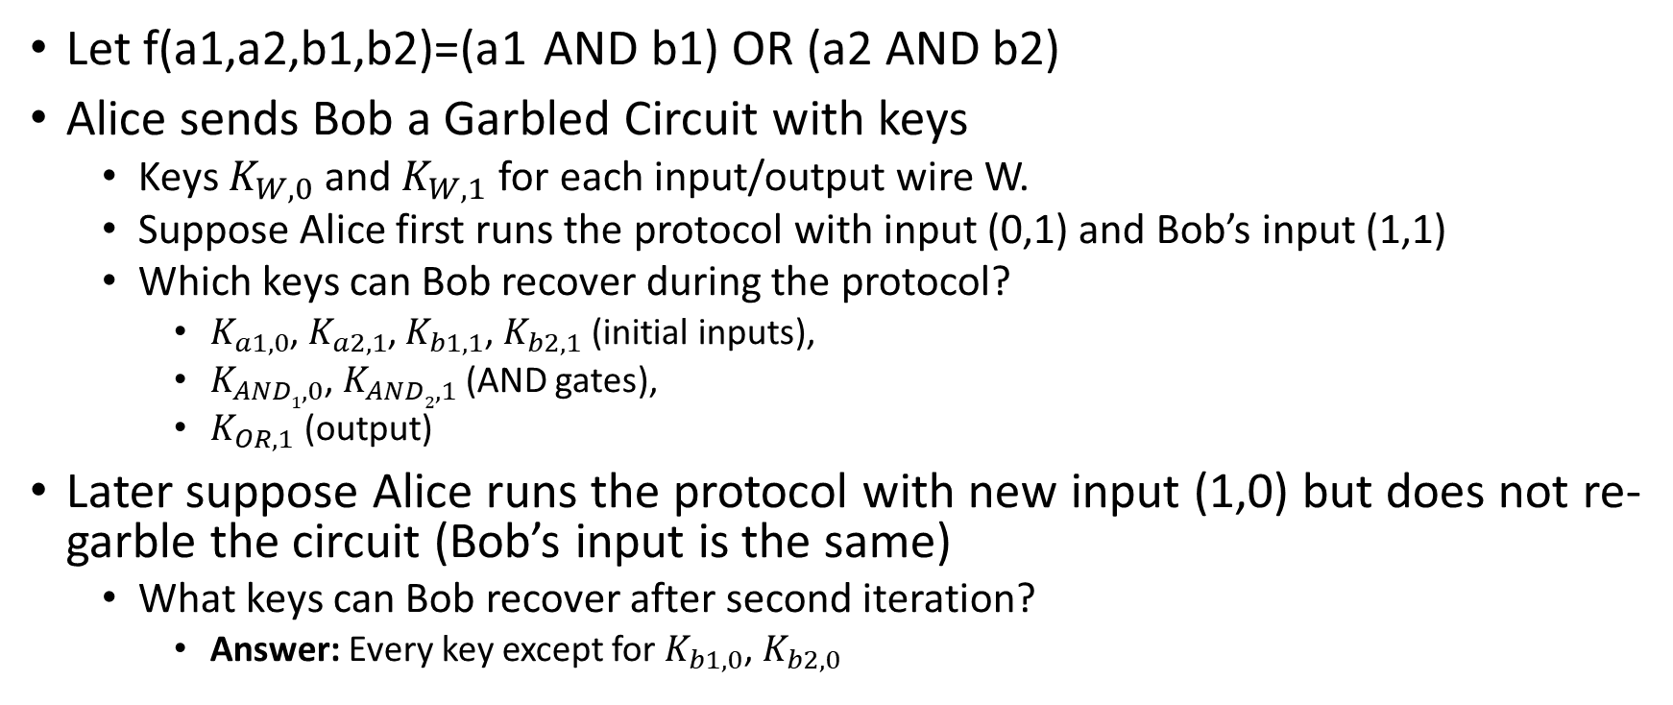
Practice Problem 3: Garbled Circuit Reuse
Let f(a1,a2,b1,b2)=(a1 AND b1) OR (a2 AND b2)
Alice sends Bob a Garbled Circuit with keys
  Keys $K_{W,0}$and $K_{W,1}$ for each input/output wire W.
  Suppose Alice first runs the protocol with input (0,1) and Bob’s input (1,1)
  Which keys can Bob recover during the protocol?
    $K_{a1,0}$, $K_{a2,1}$, $K_{b1,1}$, $K_{b2,1}$ (initial inputs),
    $K_{AND1,0}$, $K_{AND2,1}$ (AND gates),
    $K_{OR,1}$ (output)
Later suppose Alice runs the protocol with new input (1,0) but does not re-garble the circuit (Bob’s input is the same)
  What keys can Bob recover after second iteration?
    Answer: Every key except for $K_{b1,0}$, $K_{b2,0}$

Slide 19
Practice Problem 4: RSA Authentication
RSA Based Authentication
  Verifier sends random nonce r mod N to Prover
  Prover authenticates with R= r^{d} mod N
  Verifier checks that R^{e}=r mod N
What would security definition look like for generic authentication protocol?
  Define the game
Is this protocol secure?
  Yes (assuming RSA-Inversion assumption)

Slide 20
Practice Problem 5: RSA Overuse
RSA Based Authentication
  Verifier sends random nonce r mod N to Prover
  Prover authenticates with R= r^{d} mod N
  Verifier checks that R^{e}=r mod N
Suppose we use the same secret key e for Key Encapsulation and for RSA Authentication?
  KEM: outputs (y,K=H(x)) where y=x^{e} mod N
What could go wrong?

Slide 21
Cryptography
CS 555
Week 16:
Zero-Knowledge Proofs,
Hot Topics in Cryptography
Review for Final Exam
Readings: Katz and Lindell Chapter 10 & Chapter 11.1-11.2, 11.4
Fall 2018

Slide 22
CS 555:Week 15: Zero-Knowledge Proofs

Slide 23
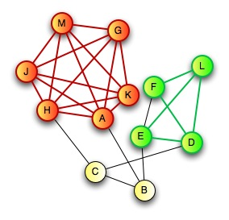
Zero-Knowledge Proof for all NP
CLIQUE
  Input: Graph G=(V,E) and integer k>0
  Question: Does G have a clique of size k?
CLIQUE is NP-Complete
  Any problem in NP reduces to CLIQUE
  A zero-knowledge proof for CLIQUE yields proof for all of NP via reduction
Prover:
  Knows k vertices v₁,…,v_{k} in G=(V,E) that form a clique

Slide 24

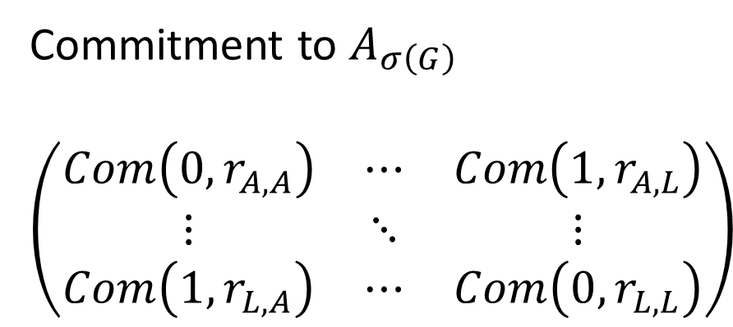
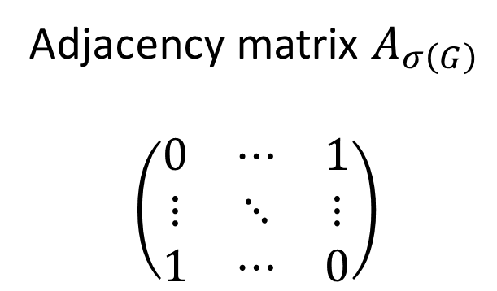
Zero-Knowledge Proof for all NP
C
D
$$σ\left(G\right)$$
E
H
G
A
F
B
J
I
L
K
Commitment to $A_{σ\left(G\right)}$
$$\left(\begin{matrix}Com\left(0,r_{A,A}\right) & ⋯ & Com\left(1,r_{A,L}\right) \\ ⋮ & ⋱ & ⋮ \\ Com\left(1,r_{L,A}\right) & ⋯ & Com\left(0,r_{L,L}\right)\end{matrix}\right)$$
Adjacency matrix $A_{σ\left(G\right)}$
$$\left(\begin{matrix}0 & ⋯ & 1 \\ ⋮ & ⋱ & ⋮ \\ 1 & ⋯ & 0\end{matrix}\right)$$
A
L
A
L
A
A
L
L

Slide 25
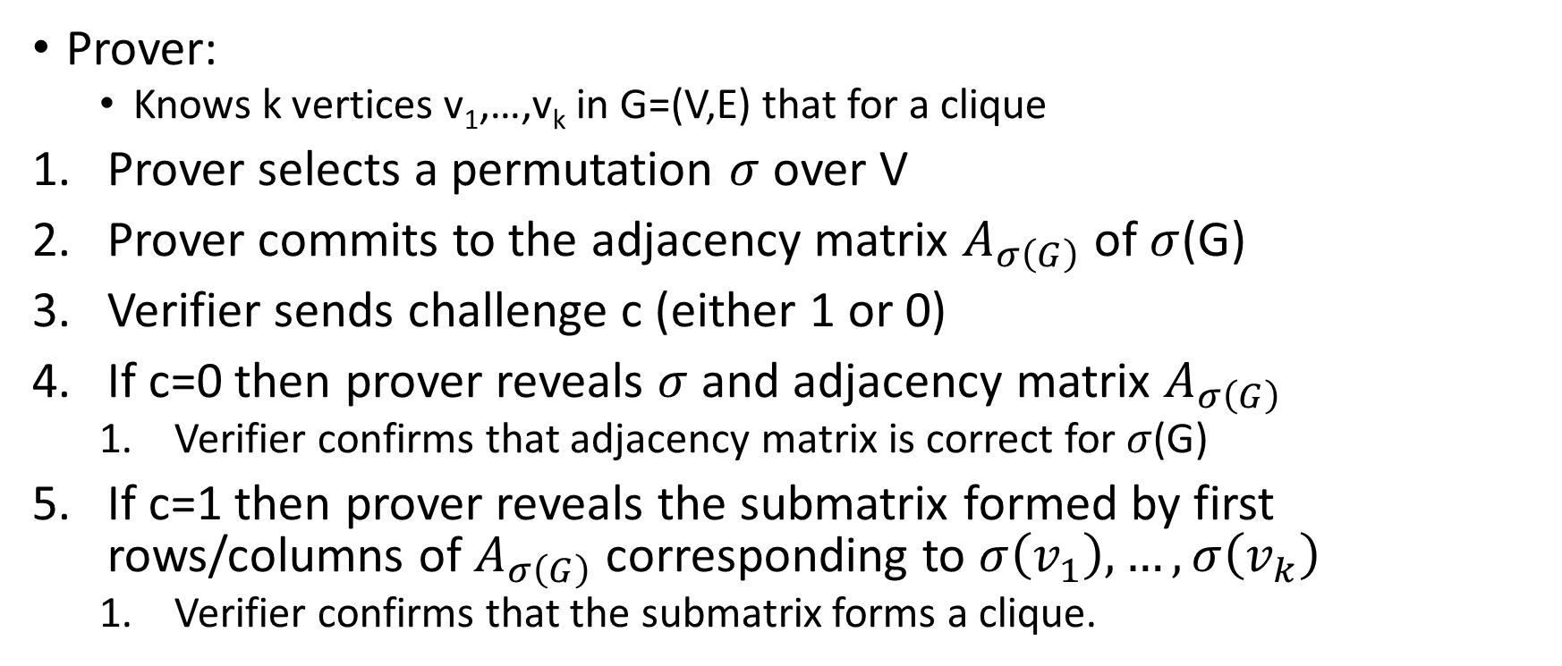
Zero-Knowledge Proof for all NP
C
D
E
H
G
A
F
B
J
Prover:
  Knows k vertices v₁,…,v_{k} in G=(V,E) that for a clique
Prover selects a permutation $σ$ over V
Prover commits to the adjacency matrix $A_{σ\left(G\right)}$ of $σ$(G)
Verifier sends challenge c (either 1 or 0)
If c=0 then prover reveals $σ$ and adjacency matrix $A_{σ\left(G\right)}$
  Verifier confirms that adjacency matrix is correct for $σ$(G)
If c=1 then prover reveals the submatrix formed by first rows/columns of $A_{σ\left(G\right)}$ corresponding to $σ\left(v_{1}\right),…,σ\left(v_{k}\right)$
  Verifier confirms that the submatrix forms a clique.
I
L
K

Slide 26
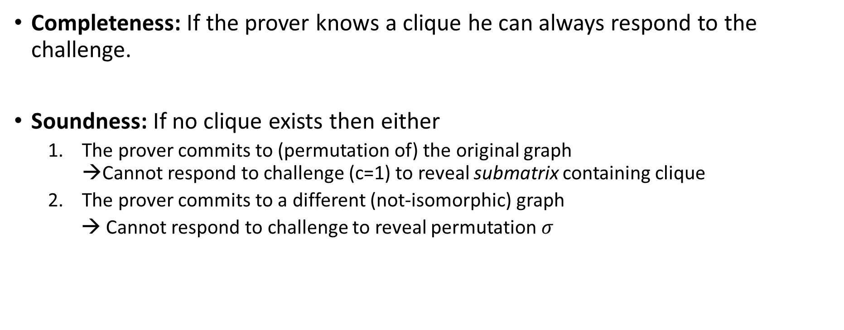
Soundness and Completeness
Completeness: If the prover knows a clique he can always respond to the challenge.
Soundness: If no clique exists then either
  The prover commits to (permutation of) the original graph →Cannot respond to challenge (c=1) to reveal submatrix containing clique
  The prover commits to a different (not-isomorphic) graph
  → Cannot respond to challenge to reveal permutation $σ$

Slide 27


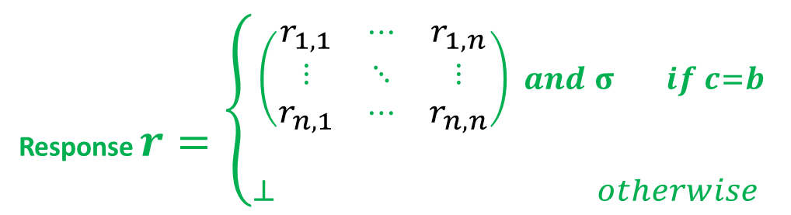
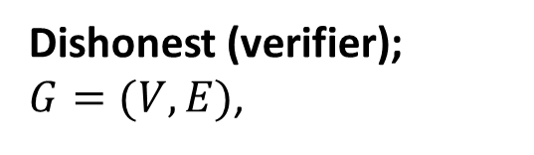
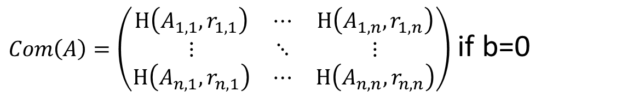

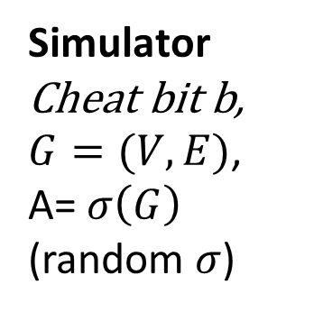

Zero-Knowledge Proof Simulator
$Com\left(A\right)=\left(\begin{matrix}H\left(A_{1,1},r_{1,1}\right) & ⋯ & H\left(A_{1,n},r_{1,n}\right) \\ ⋮ & ⋱ & ⋮ \\ H\left(A_{n,1},r_{n,1}\right) & ⋯ & H\left(A_{n,n},r_{n,n}\right)\end{matrix}\right)$ if b=0
$$challenge c=V′(G, Com\left(A\right))∈\left\{0,1\right\}$$
Response $r=\left\{{\begin{aligned}\left(\begin{matrix}r_{1,1} & ⋯ & r_{1,n} \\ ⋮ & ⋱ & ⋮ \\ r_{n,1} & ⋯ & r_{n,n}\end{matrix}\right) and σ if c=b \\ \end{aligned} \atop ⊥ otherwise }\right.$
Simulator
Cheat bit b,
$G=(V,E)$,
A= $σ\left(G\right)$
(random $σ$)
Dishonest (verifier);
$G=(V,E)$,
$$Decision d=V′(G, Com\left(A\right),c,r)$$
Zero-Knowledge: For all PPT V’ exists PPT Sim s.t ${View}_{V′}≡_{C}{Sim}^{V′(.)}\left(A\right)$
A
L
A
L

Slide 28
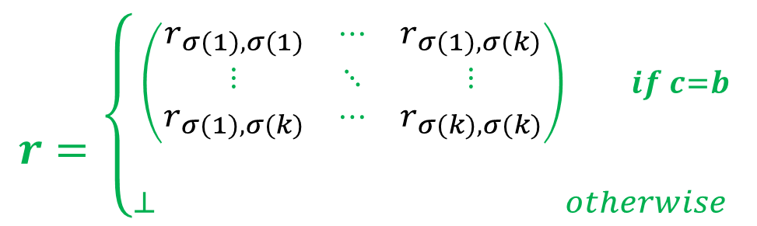
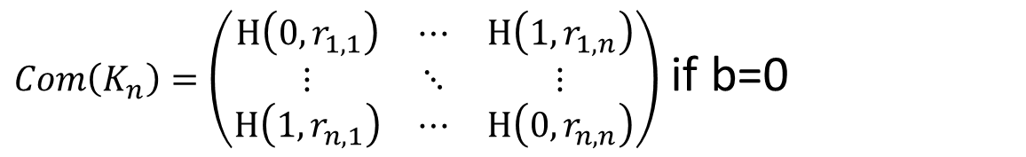
Zero-Knowledge Proof Simulator
$Com\left(K_{n}\right)=\left(\begin{matrix}H\left(0,r_{1,1}\right) & ⋯ & H\left(1,r_{1,n}\right) \\ ⋮ & ⋱ & ⋮ \\ H\left(1,r_{n,1}\right) & ⋯ & H\left(0,r_{n,n}\right)\end{matrix}\right)$ if b=0
$$challenge c=V′(G, Com\left(A\right))∈\left\{0,1\right\}$$
$r=\left\{{\begin{aligned}\left(\begin{matrix}r_{σ(1),σ(1)} & ⋯ & r_{σ(1),σ(k)} \\ ⋮ & ⋱ & ⋮ \\ r_{σ(1),σ(k)} & ⋯ & r_{σ(k),σ(k)}\end{matrix}\right) if c=b \\ \end{aligned} \atop ⊥ otherwise }\right.$
Simulator
Cheat bit b,
$G=(V,E)$,
A= $σ\left(G\right)$
(random $σ$)
Dishonest (verifier);
$G=(V,E)$,
$$Decision d=V′(G, Com\left(A\right),c,r)$$
Zero-Knowledge: For all PPT V’ exists PPT Sim s.t ${View}_{V′}≡_{C}{Sim}^{V′(.)}\left(A\right)$
A
L
A
L

Slide 29
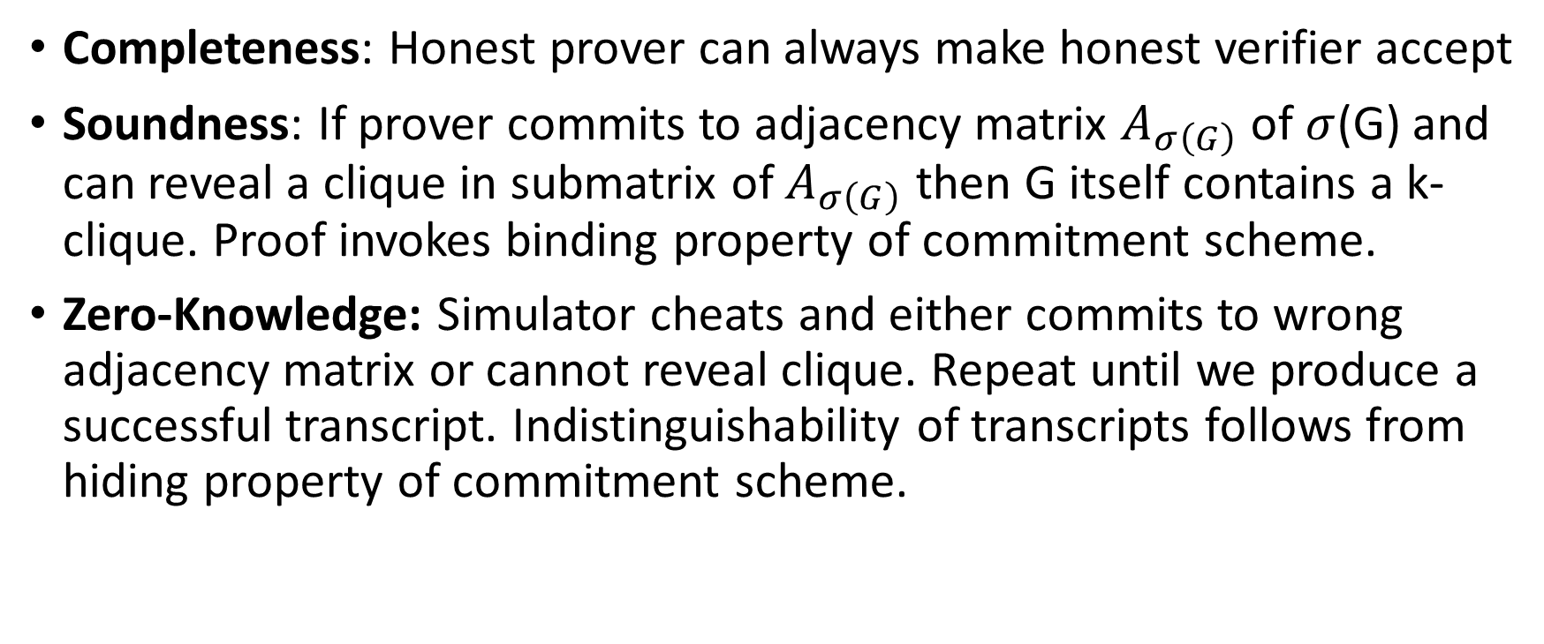
Zero-Knowledge Proof for all NP
Completeness: Honest prover can always make honest verifier accept
Soundness: If prover commits to adjacency matrix $A_{σ\left(G\right)}$ of $σ$(G) and can reveal a clique in submatrix of $A_{σ\left(G\right)}$ then G itself contains a k-clique. Proof invokes binding property of commitment scheme.
Zero-Knowledge: Simulator cheats and either commits to wrong adjacency matrix or cannot reveal clique. Repeat until we produce a successful transcript. Indistinguishability of transcripts follows from hiding property of commitment scheme.

Slide 30
Secure Multiparty Computation (Adversary Models)
Semi-Honest (“honest, but curious”)
  All parties follow protocol instructions, but…
  dishonest parties may be curious to violate privacy of others when possible
Fully Malicious Model
  Adversarial Parties may deviate from the protocol arbitrarily
    Quit unexpectedly
    Send different messages
  It is much harder to achieve security in the fully malicious model
Convert Secure Semi-Honest Protocol into Secure Protocol in Fully Malicious Mode?
  Tool: Zero-Knowledge Proofs
  Prove: My behavior in the protocol is consistent with honest party

Slide 31
CS 555:Week 15: Hot Topics

Slide 32

Shor’s Algorithm
Quantum Algorithm to Factor Integers
Running Time
O((log N)²(log log N)(log log log N))
Building Quantum Circuits is challenging, but...
RSA is broken if we build a quantum computer
  Current record: Factor 21=3x7 with Shor’s Algorithm
  Source: Experimental Realisation of Shor’s Quatum Factoring Algorithm Using Quibit Recycling (https://arxiv.org/pdf/1111.4147.pdf)
https://en.wikipedia.org/wiki/Shor%27s_algorithm

Slide 33
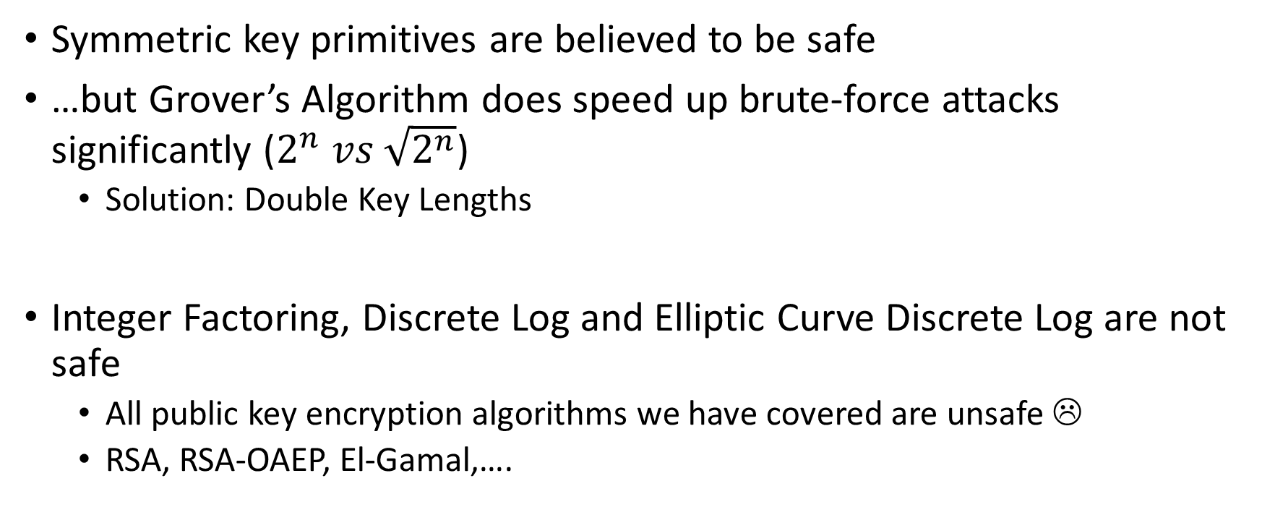
Quantum Resistant Crypto
Symmetric key primitives are believed to be safe
…but Grover’s Algorithm does speed up brute-force attacks significantly ($2^{n} vs \sqrt{2^{n}}$)
  Solution: Double Key Lengths
Integer Factoring, Discrete Log and Elliptic Curve Discrete Log are not safe
  All public key encryption algorithms we have covered are unsafe ☹
  RSA, RSA-OAEP, El-Gamal,….
https://en.wikipedia.org/wiki/Lattice-based_cryptography

Slide 34
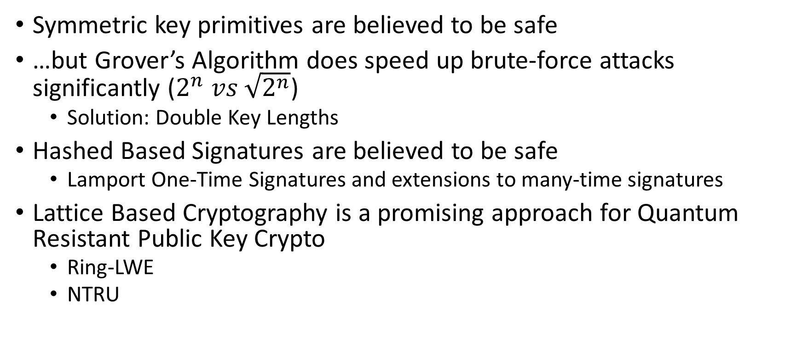
Post Quantum Cryptography
Symmetric key primitives are believed to be safe
…but Grover’s Algorithm does speed up brute-force attacks significantly ($2^{n} vs \sqrt{2^{n}}$)
  Solution: Double Key Lengths
Hashed Based Signatures are believed to be safe
  Lamport One-Time Signatures and extensions to many-time signatures
Lattice Based Cryptography is a promising approach for Quantum Resistant Public Key Crypto
  Ring-LWE
  NTRU
https://security.googleblog.com/2016/07/experimenting-with-post-quantum.html

Slide 35
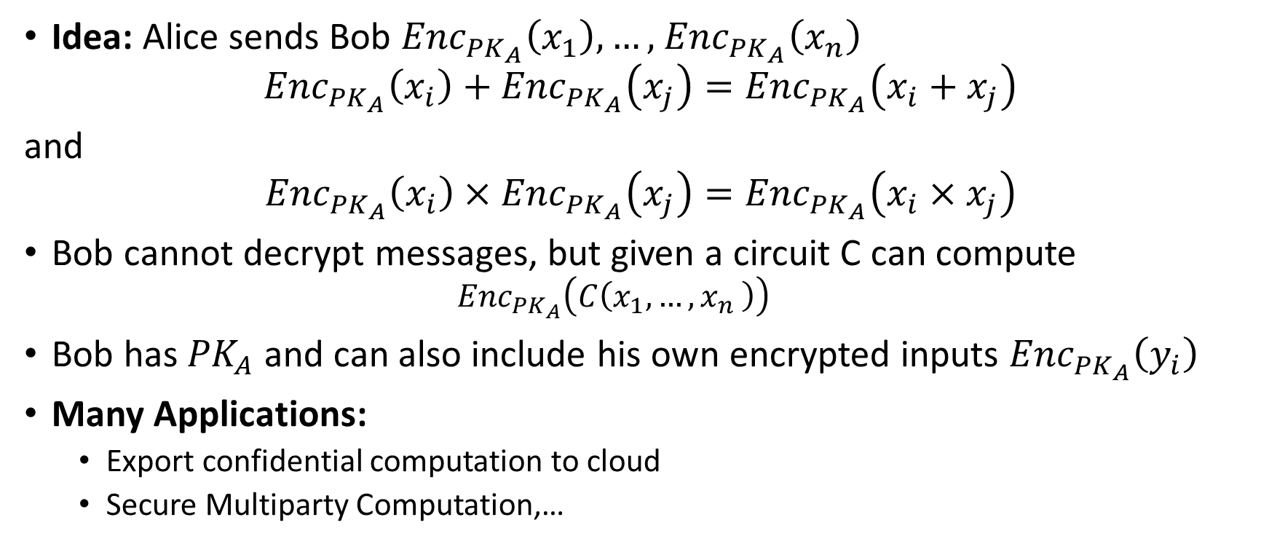
Fully Homomorphic Encryption (FHE)
Idea: Alice sends Bob ${Enc}_{{PK}_{A}}\left(x_{1}\right),…,$ ${Enc}_{{PK}_{A}}\left(x_{n}\right)$
$${Enc}_{{PK}_{A}}\left(x_{i}\right)+{Enc}_{{PK}_{A}}\left(x_{j}\right)={Enc}_{{PK}_{A}}\left(x_{i}+x_{j}\right)$$
and
$${Enc}_{{PK}_{A}}\left(x_{i}\right)×{Enc}_{{PK}_{A}}\left(x_{j}\right)={Enc}_{{PK}_{A}}\left(x_{i}×x_{j}\right)$$
Bob cannot decrypt messages, but given a circuit C can compute
  $${Enc}_{{PK}_{A}}\left(C\left(x_{1},…{,x}_{n}\right)\right)$$
Bob has ${PK}_{A}$ and can also include his own encrypted inputs ${Enc}_{{PK}_{A}}\left(y_{i}\right)$
Many Applications:
  Export confidential computation to cloud
  Secure Multiparty Computation,…
https://simons.berkeley.edu/talks/shai-halevi-2015-05-18a (Lecture by Shai Halevi)

Slide 36
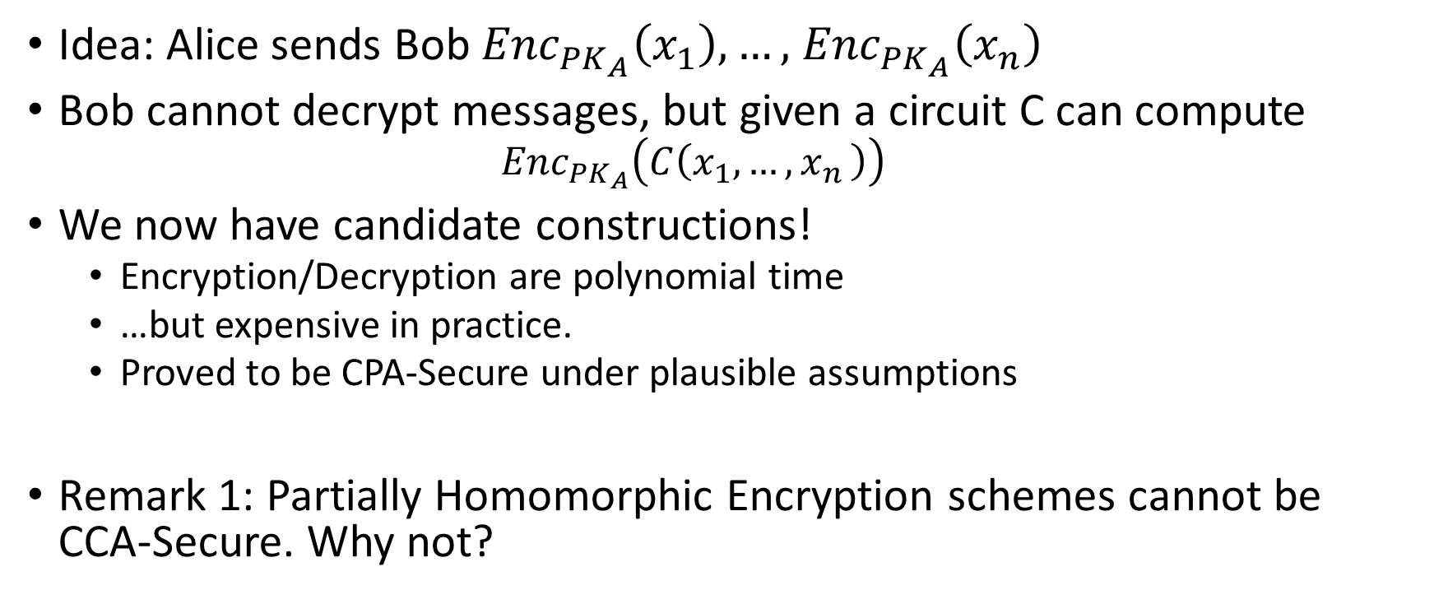
Fully Homomorphic Encryption (FHE)
Idea: Alice sends Bob ${Enc}_{{PK}_{A}}\left(x_{1}\right),…,$ ${Enc}_{{PK}_{A}}\left(x_{n}\right)$
Bob cannot decrypt messages, but given a circuit C can compute
  $${Enc}_{{PK}_{A}}\left(C\left(x_{1},…{,x}_{n}\right)\right)$$
We now have candidate constructions!
  Encryption/Decryption are polynomial time
  …but expensive in practice.
  Proved to be CPA-Secure under plausible assumptions
Remark 1: Partially Homomorphic Encryption schemes cannot be CCA-Secure. Why not?
https://simons.berkeley.edu/talks/shai-halevi-2015-05-18a (Lecture by Shai Halevi)

Slide 37
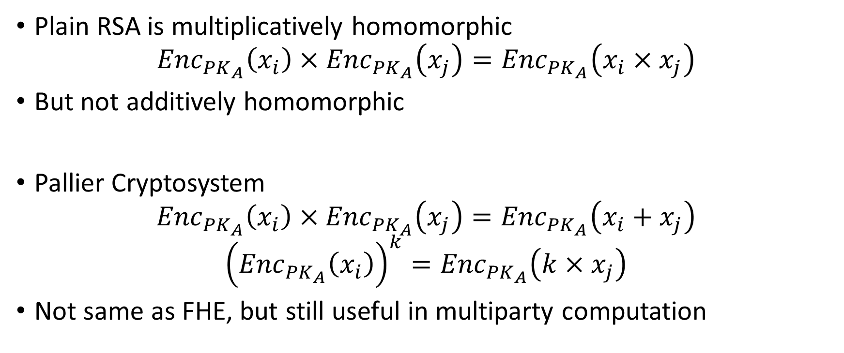
Partially Homomorphic Encryption
Plain RSA is multiplicatively homomorphic
$${Enc}_{{PK}_{A}}\left(x_{i}\right)×{Enc}_{{PK}_{A}}\left(x_{j}\right)={Enc}_{{PK}_{A}}\left(x_{i}×x_{j}\right)$$
But not additively homomorphic
Pallier Cryptosystem
$${Enc}_{{PK}_{A}}\left(x_{i}\right)×{Enc}_{{PK}_{A}}\left(x_{j}\right)={Enc}_{{PK}_{A}}\left(x_{i}+x_{j}\right)$$
$${\left({Enc}_{{PK}_{A}}\left(x_{i}\right)\right)}^{k}={Enc}_{{PK}_{A}}\left(k×x_{j}\right)$$
Not same as FHE, but still useful in multiparty computation
https://en.wikipedia.org/wiki/Paillier_cryptosystem

Slide 38
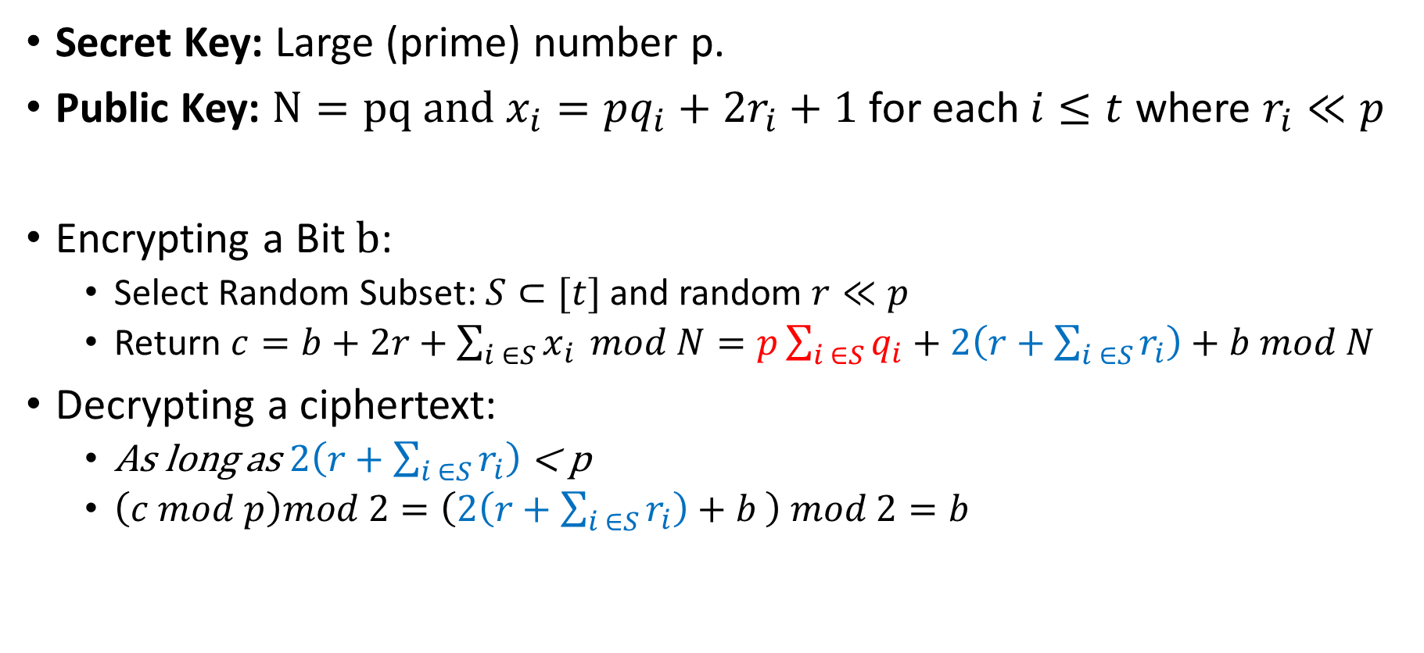
Partially Homomorphic Encryption
Secret Key: Large (prime) number p.
Public Key: $N=pq and x_{i}=pq_{i}+2r_{i}+1$ for each $i≤t$ where $r_{i}≪p$
Encrypting a Bit $b$:
  Select Random Subset: $S⊂[t]$ and random $r≪p$
  Return $c=b+2r+\sum_{i ∈S}{x_{i}} mod N=p\sum_{i ∈S}{q_{i}}+2\left(r+\sum_{i ∈S}{r_{i}}\right)+b mod N$
Decrypting a ciphertext:
  As long as $2\left(r+\sum_{i ∈S}{r_{i}}\right)$ < p
  $\left(c mod p\right)mod 2=\left(2\left(r+\sum_{i ∈S}{r_{i}}\right)+b \right) mod 2=b$

Slide 39
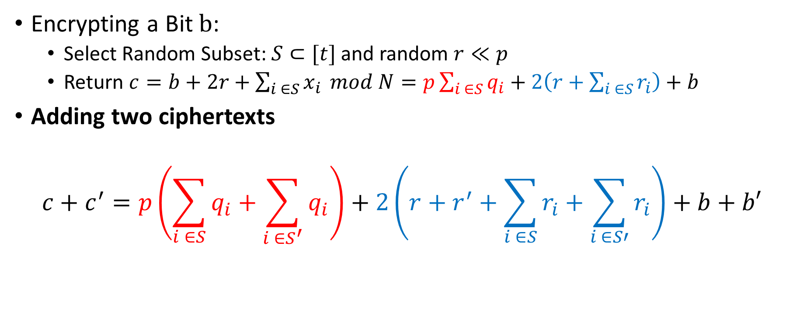
Partially Homomorphic Encryption
Encrypting a Bit $b$:
  Select Random Subset: $S⊂[t]$ and random $r≪p$
  Return $c=b+2r+\sum_{i ∈S}{x_{i}} mod N=p\sum_{i ∈S}{q_{i}}+2\left(r+\sum_{i ∈S}{r_{i}}\right)+b$
Adding two ciphertexts
$$c+c^{′}=p\left(\sum_{i ∈S}{q_{i}}+\sum_{i ∈S^{′}}{q_{i}}\right)+2\left(r+r^{′}+\sum_{i ∈S}{r_{i}}+\sum_{i ∈S′}{r_{i}}\right)+b+b′$$
Noise increases a bit

Slide 40
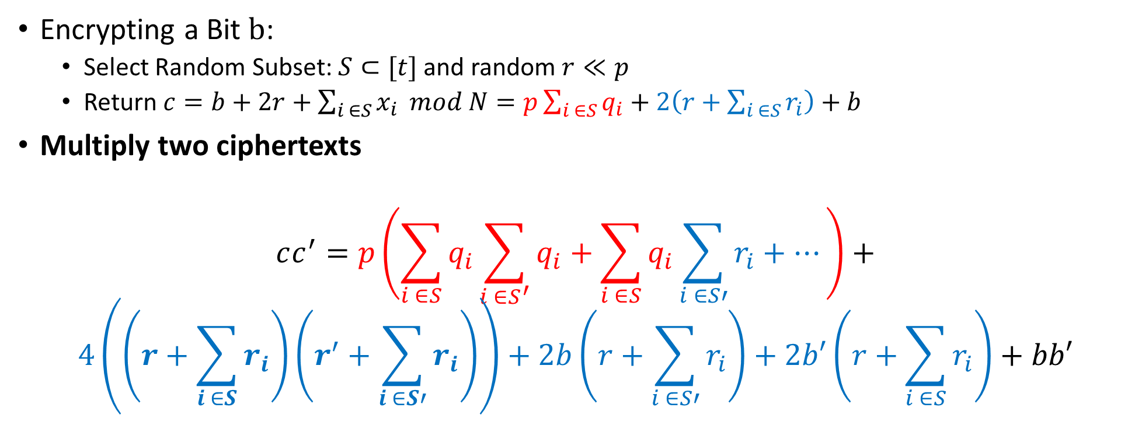
Partially Homomorphic Encryption
Encrypting a Bit $b$:
  Select Random Subset: $S⊂[t]$ and random $r≪p$
  Return $c=b+2r+\sum_{i ∈S}{x_{i}} mod N=p\sum_{i ∈S}{q_{i}}+2\left(r+\sum_{i ∈S}{r_{i}}\right)+b$
Multiply two ciphertexts
$$cc^{′}=p\left(\sum_{i ∈S}{q_{i}}\sum_{i ∈S^{′}}{q_{i}}+\sum_{i ∈S}{q_{i}}\sum_{i ∈S′}{r_{i}}+…\right)+$$
$$4\left(\left(r+\sum_{i ∈S}{r_{i}}\right)\left(r^{′}+\sum_{i ∈S′}{r_{i}}\right)\right)+2b\left(r+\sum_{i ∈S′}{r_{i}}\right)+2b′\left(r+\sum_{i ∈S}{r_{i}}\right)+bb′$$
Noise increases a bit more (multiplicative)

Slide 41
Bootstrapping (Gentry 2009)
Transform Partially Homomorphic Encryption Scheme into Fully Homomorphic Encryption Scheme
Key Idea:
  Maintain two public keys pk₁ and pk₂ for partially homomorphic encryption
    Also, encrypt sk₁ using pk₂ and encrypt sk₂ under pk₁
    The ciphertexts are included in the public key
  Run homomorphic evaluation using pk₁ until the noise gets to be too large
  Let c₁,…,c_{k} be intermediate ciphertext(s) (under key pk₁)
  Encrypt c₁,…,c_{k} bit by bit under (under key pk₂)
  Then evaluate the decryption circuit homorphically (under key pk₂)
  Challenge: Need to make sure that decryption circuit is shallow enough to evaluate…
Expensive, but there are tricks to reduce the running time

Slide 42
Fully Homomorphic Encryption Resources
Implementation: https://github.com/shaih/HElib
Tutorial: https://www.youtube.com/watch?v=jIWOR2bGC7c

Slide 43

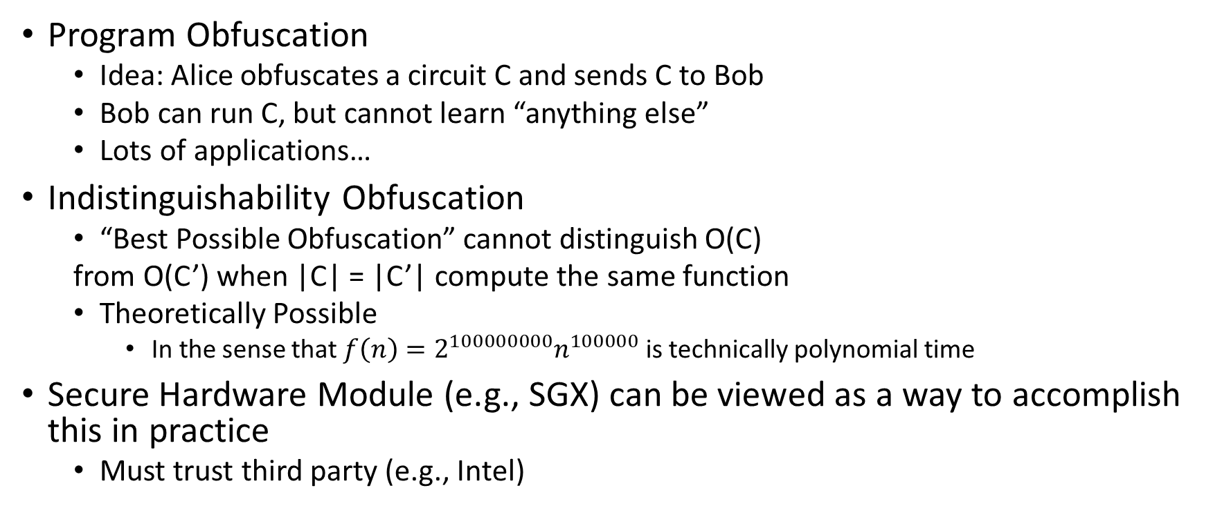
Program Obfuscation (Theoretical Cryptography)
Program Obfuscation
  Idea: Alice obfuscates a circuit C and sends C to Bob
  Bob can run C, but cannot learn “anything else”
  Lots of applications…
Indistinguishability Obfuscation
  “Best Possible Obfuscation” cannot distinguish O(C)
  from O(C’) when |C| = |C’| compute the same function
  Theoretically Possible
    In the sense that $f\left(n\right)=2^{100000000}n^{100000}$ is technically polynomial time
Secure Hardware Module (e.g., SGX) can be viewed as a way to accomplish this in practice
  Must trust third party (e.g., Intel)
https://simons.berkeley.edu/talks/amit-sahai-2015-05-19a (Lecture by Amit Sahai)

Slide 44
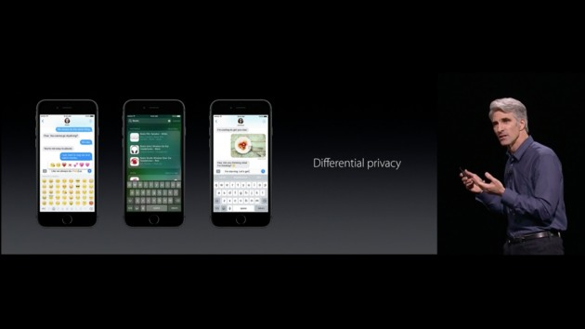



Differential Privacy

Slide 45


Release Aggregate Statistics?
Question 1: How many people in this room have cancer?
Question 2: How many students in this room have cancer?
The difference (A1-A2) exposes my answer!

Slide 46

Differential Privacy: Definition
n people
Neighboring datasets:
  Replace x with x’
Name CS Prof? … STD?
Name CS Prof? … STD?
J Blocki +1 … -1
Bjork -1 … ???
[DMNS06, DKMMN06]
D
D’

Slide 47
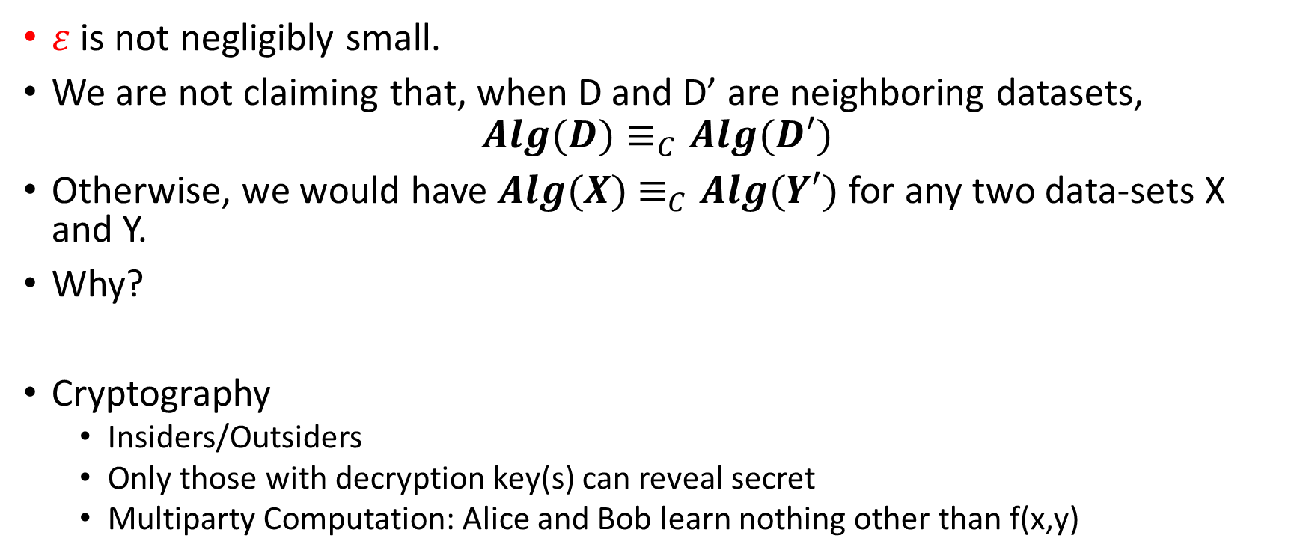
Differential Privacy vs Cryptography
$ε$ is not negligibly small.
We are not claiming that, when D and D’ are neighboring datasets,
$$Alg(D)≡_{C}Alg(D′)$$
Otherwise, we would have $Alg(X)$ $≡_{C}Alg(Y′)$ for any two data-sets X and Y.
Why?
Cryptography
  Insiders/Outsiders
  Only those with decryption key(s) can reveal secret
  Multiparty Computation: Alice and Bob learn nothing other than f(x,y)

Slide 48
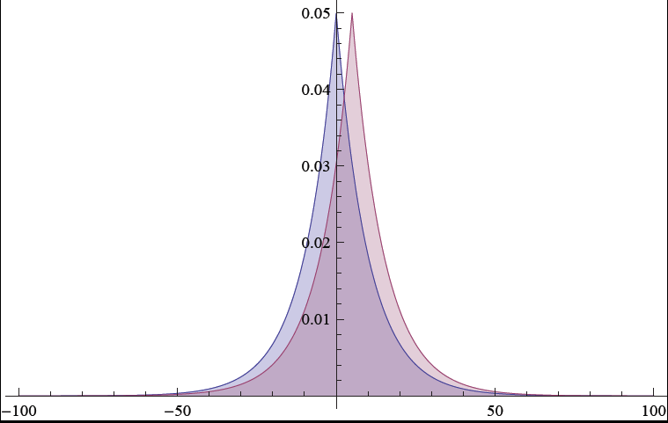
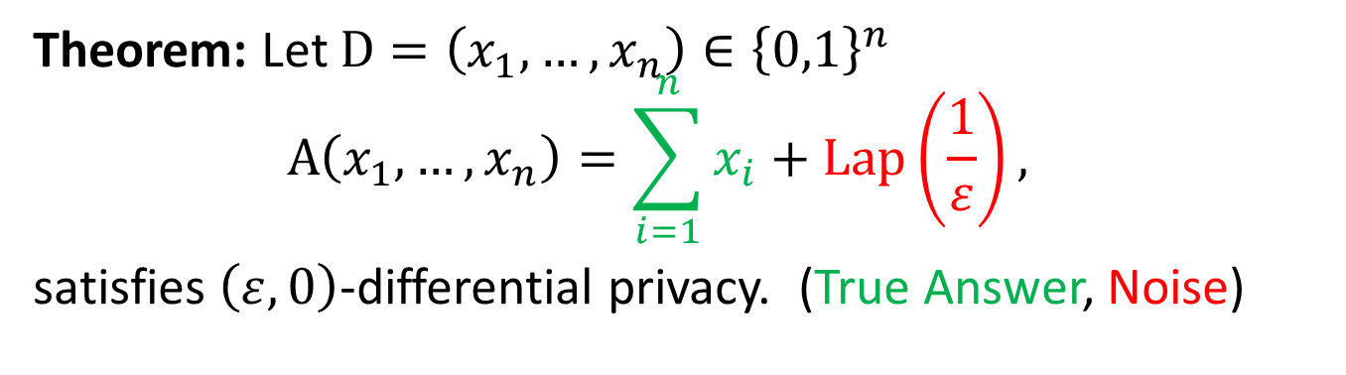
Traditional Differential Privacy Mechanism
Theorem: Let $D=\left(x_{1},…,x_{n}\right)∈{\left\{0,1\right\}}^{n}$
$$A\left(x_{1},…,x_{n}\right)=\sum_{i=1}^{n}{x_{i}}+\operatorname{Lap}\left(\frac{1}{ε}\right),$$
satisfies $\left(ε,0\right)$-differential privacy. (True Answer, Noise)

Slide 49
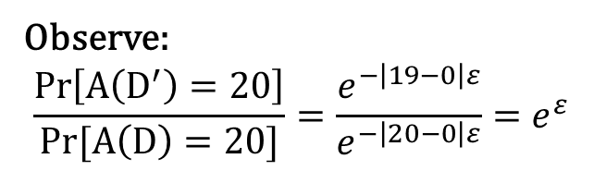

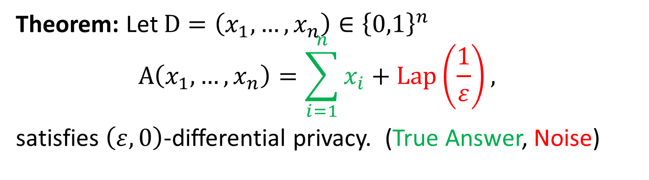

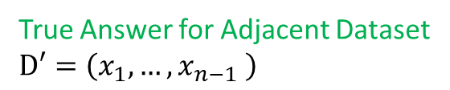
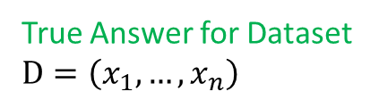
Traditional Differential Privacy Mechanism
Theorem: Let $D=\left(x_{1},…,x_{n}\right)∈{\left\{0,1\right\}}^{n}$
$$A\left(x_{1},…,x_{n}\right)=\sum_{i=1}^{n}{x_{i}}+\operatorname{Lap}\left(\frac{1}{ε}\right),$$
satisfies $\left(ε,0\right)$-differential privacy. (True Answer, Noise)
Observe:
$$\frac{Pr\left[A\left(D^{′}\right)=20\right]}{Pr[A\left(D\right)=20]}=\frac{e^{−\left|19−0\right|ε}}{e^{−\left|20−0\right|ε}}=e^{ε}$$
True Answer for Dataset
$D=\left(x_{1},…,x_{n}\right)$
True Answer for Adjacent Dataset
$D′=\left(x_{1},…,x_{n−1} \right)$
$$Pr[A\left(D′\right)=20]{∝e^{−\left|19−0\right|ε}}$$
$$Pr[A\left(D\right)=20]∝e^{−\left|20−0\right|ε}$$

Slide 50
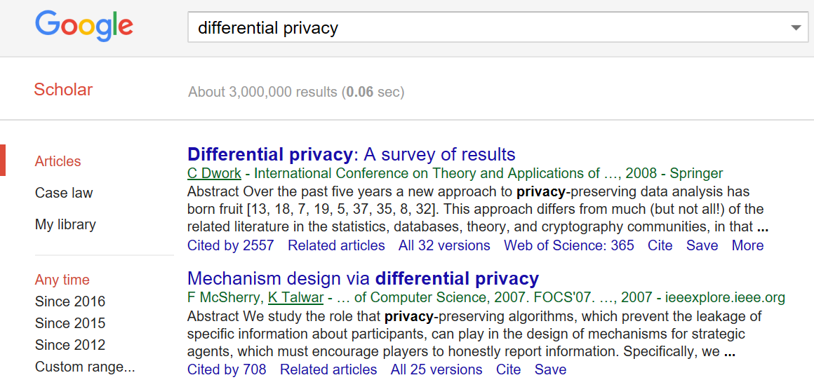
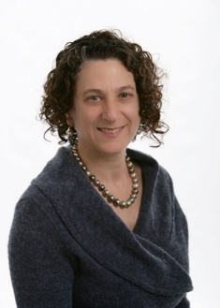


Slide 51

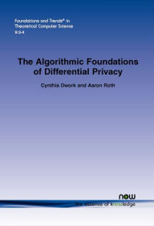

Resources
$99
Free PDF: https://www.cis.upenn.edu/~aaroth/Papers/privacybook.pdf

Slide 52





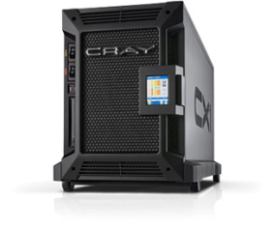

Password Storage and Key Derivation Functions
jblocki, 123456
Username
jblocki
Salt
89d978034a3f6
Hash
85e23cfe0021f584e3db87aa72630a9a2345c062
SHA1(12345689d978034a3f6)=85e23cfe0021f584e3db87aa72630a9a2345c062
+
Notes:
As a motivating example consider an adversary who breaks into an authentication server and steals a users crptographic hash value. The adversary can execute an offline attack against the password by comparing the hash value with the hashes of likely password guesses. The adversary is limited only by the resources that he is willing to invest cracking the passwords.

Slide 53













Offline Attacks: A Common Problem
Password breaches at major companies have affected millions billions of user accounts.
Notes:
Unfortunately, offline dictionary attacks are quite common. Password breaches at major companies have affected millions of users.

Slide 54
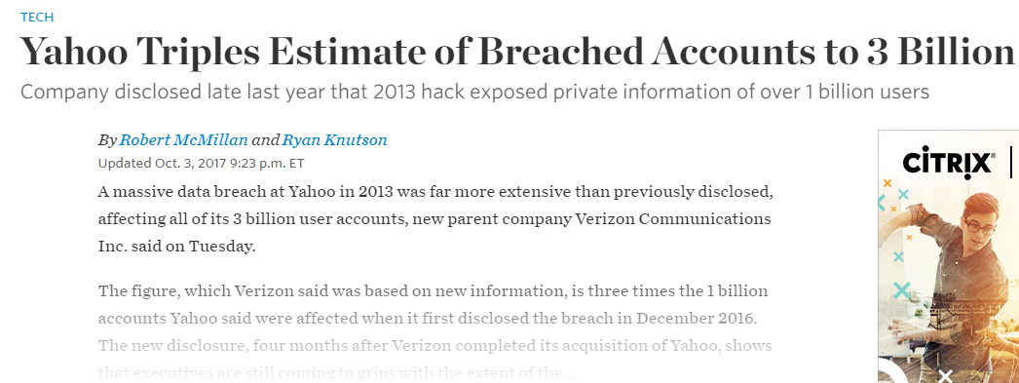
Offline Attacks: A Common Problem
Password breaches at major companies have affected millions billions of user accounts.
Notes:
Unfortunately, offline dictionary attacks are quite common. Password breaches at major companies have affected millions of users.

Slide 55
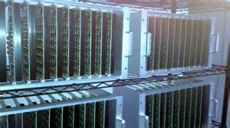



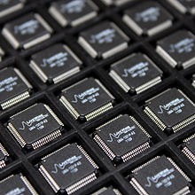
Goal: Moderately Expensive Hash Function
Fast on PC and
Expensive on ASIC?
Notes:
This motivates the need for moderately hard functions. The basic idea is to build a password hash function that is moderately expensive to compute to limit the number of guesses that an adversary would be willing to try. An honest server only needs to compute the function once during a typical authentication session. However, the adversary potentially has an advantage in this game. While the honest server must typically evaluate the function on standard hardware, the adversary could use potentially reduce the cost per password guess by developing customized hardware (GPUs, FPGAs, ASICs) to evaluate the password hash function. Thus, we want to ensure that the cost to evaluate this function is equitable across platforms.

Slide 56
Attempt 1: Hash Iteration
BCRYPT
PBKDF2
100,000 SHA256 computations
(iterative)
Estimated Cost on ASIC: $1 per billion password guesses [BS14]

Slide 57
The Challenge
Cost SHA256
USD $
Standard Patience Units
User Patience
Time
Disclaimer: This slide is entirely for humorous effect.

Slide 58
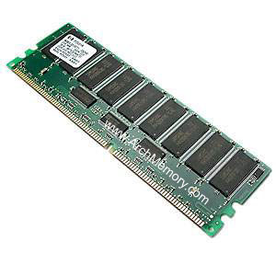



Memory Hard Function (MHF)
Intuition: computation costs dominated by memory costs
vs.
Data Independent Memory Hard Function (iMHF)
  Memory access pattern should not depend on input
Notes:
In this work we study a special type of memory hard function called data-independent memory hard functions. As the name suggests the memory access pattern will not depend on the input making the functions resistant to side-channel attacks.

Slide 59

(2013-2015)
https://password-hashing.net/

Slide 60

We recommend that you use Argon2…
(2013-2015)
https://password-hashing.net/

Slide 61
We recommend that you use Argon2…
There are two main versions of Argon2, Argon2i and Argon2d. Argon2i is the safest against side-channel attacks
(2013-2015)
https://password-hashing.net/

Slide 62

Depth-Robustness: The Key Property
Necessary [AB16] and sufficient [ABP16] for secure iMHFs

Slide 63

Question
Are existing iMHF candidates based on depth-robust DAGs?

Slide 64
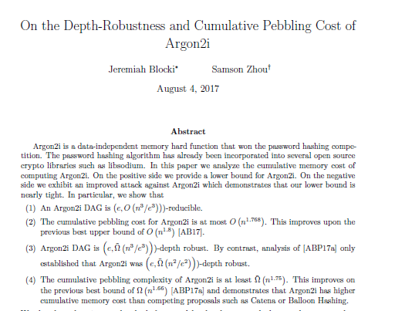
Answer: No

Slide 65

Can we build a secure iMHF?
Github: https://github.com/Practical-Graphs/Argon2-Practical-Graph

