Slide 1
Course Business
Homework 5 Extended
  Due Saturday @11PM on Gradescope
Practice Final Released Next Week
Homework 4 Statistics
Minimum Value | 72.00
Maximum Value | 110.00
Range | 38.00
Average | 94.93
Median | 96.00
Standard Deviation | 12.02

Slide 2
Cryptography
CS 555
Week 15:
Oblivious Transfer
Yao’s Garbled Circuits
Zero-Knowledge Proofs
Readings: Katz and Lindell Chapter 10 & Chapter 11.1-11.2, 11.4
Fall 2018

Slide 3


Oblivious Transfer (OT)
1 out of 2 OT
  Alice has two messages m₀ and m₁
  At the end of the protocol
    Bob gets exactly one of m₀ and m₁
    Alice does not know which one
Oblivious Transfer with a Trusted Third Party
m₀
b
1 out of 2 OT
m₁
m_{b}

Slide 4




Bellare-Micali 1-out-of-2-OT protocol
Oblivious Transfer without a Trusted Third Party
    g is a generator for a prime order group G_{q} in which CDH problem is hard
m₀
c
b
m₁
$$z0,z1$$
  $$C_{0}=\left[g^{r_{0}},H\left(z_{0}^{r_{0}}\right)⊕m_{0}\right]$$
  $$C_{1}=\left[g^{r_{1}},H\left(z_{1}^{r_{1}}\right)⊕m_{1}\right]$$
c ←_{R} G_{q}
k ←_{R} Z_{q}
$z_{b}=g^{k},$ $z_{1−b}=cg^{−k}$
Bob can decrypt C_{b}
$$z_{b}^{r_{b}}=g^{kr_{b}}$$

Slide 5

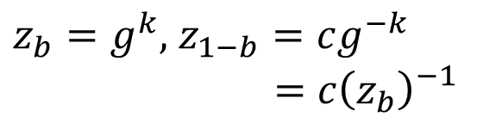
Bellare-Micali 1-out-of-2-OT protocol
Oblivious Transfer without a Trusted Third Party
    g is a generator for a prime order group G_{q} in which CDH is Hard
m₀
c
b
m₁
$$z0,z1$$
  $$C_{0}=\left[g^{r_{0}},H\left(z_{0}^{r_{0}}\right)⊕m_{0}\right]$$
  $$C_{1}=\left[g^{r_{1}},H\left(z_{1}^{r_{1}}\right)⊕m_{1}\right]$$
c ←_{R} G_{q}
k ←_{R} Z_{q}
Alice must check that
$$z_{1}=c{\left(z_{0}\right)}_{}^{−1}$$
$z_{b}=g^{k},$ $z_{1−b}=cg^{−k}$
$$=c{\left(z_{b}\right)}_{}^{−1}$$
Bob can decrypt C_{b}
$$z_{b}^{r_{b}}=g^{kr_{b}}$$

Slide 6

Bellare-Micali 1-out-of-2-OT protocol
Alice does not learn b because
$z_{1}=c{\left(z_{0}\right)}_{}^{−1}$ and
$z_{0}=c{\left(z_{1}\right)}_{}^{−1}$ and
$z_{1}$, $z_{0}$ are distributed uniformly at random subject to these condition.
This is an information theoretic guarantee!
Oblivious Transfer without a Trusted Third Party
    g is a generator for a prime order group G_{q} in which Discrete Log Problem is Hard
m₀
c
b
m₁
$$z0,z1$$
  $$C_{0}=\left[g^{r_{0}},H\left(z_{0}^{r_{0}}\right)⊕m_{0}\right]$$
  $$C_{1}=\left[g^{r_{1}},H\left(z_{1}^{r_{1}}\right)⊕m_{1}\right]$$
c ←_{R} G_{q}
k ←_{R} Z_{q}
Alice must check that
$$z_{1}=c{\left(z_{0}\right)}_{}^{−1}$$
$z_{b}=g^{k},$ $z_{1−b}=cg^{−k}$
$$=c{\left(z_{b}\right)}_{}^{−1}$$
Bob can decrypt C_{b}
$$z_{b}^{r_{b}}=g^{kr_{b}}$$

Slide 7

Bellare-Micali 1-out-of-2-OT protocol
Bob cannot decrypt C_{1-b}
Unless he queries random oracle at
$c^{r_{1−b}}g^{−kr_{1−b}}$
Given this value we can obtain $c^{r_{1−b}}$
Thus, we can break CDH assumption
given random ${c=g}^{m}$ and $g^{r_{1−b}}$ it is hard to find${ c}^{r_{1−b}}=g^{{mr}_{1−b}}$
Oblivious Transfer without a Trusted Third Party
    g is a generator for a prime order group G_{q} in which Discrete Log Problem is Hard
m₀
c
b
m₁
$$z0,z1$$
  $$C_{0}=\left[g^{r_{0}},H\left(z_{0}^{r_{0}}\right)⊕m_{0}\right]$$
  $$C_{1}=\left[g^{r_{1}},H\left(z_{1}^{r_{1}}\right)⊕m_{1}\right]$$
c ←_{R} G_{q}
k ←_{R} Z_{q}
Alice must check that
$$z_{1}=c{\left(z_{0}\right)}_{}^{−1}$$
$z_{b}=g^{k},$ $z_{1−b}=cg^{−k}$
$$=c{\left(z_{b}\right)}_{}^{−1}$$
Bob can decrypt C_{b}
$$z_{b}^{r_{b}}=g^{kr_{b}}$$

Slide 8
Yao’s Protocol
CS 380S
Vitaly Shmatikov

Slide 9
Yao’s Protocol
Compute any function securely
  … in the semi-honest model
First, convert the function into a boolean circuit
AND
AND
NOT
Alice’s inputs
Bob’s inputs
AND
OR
OR
z
z
x
y
z
x
y
z
AND
0
0
0
OR
0
0
0
Truth table:
0
1
0
Truth table:
0
1
1
x
y
1
0
0
x
y
1
0
1
1
1
1
1
1
1

Slide 10
AND
AND
NOT
Alice’s inputs
Bob’s inputs
AND
OR
OR
Overview:
Alice prepares “garbled” version C’ of C
Sends “encrypted” form x’ of her input x
Allows Bob to obtain “encrypted” form y’ of his input y via OT
Bob can compute from C’,x’,y’ the “encryption” z’ of z=C(x,y)
Bob sends z’ to Alice and she decrypts and reveals to him z
Crucial properties:
Bob never sees Alice’s input x in unencrypted form.
Bob can obtain encryption of y without Alice learning y.
Neither party learns intermediate values.
Remains secure even if parties try to cheat.

Slide 11
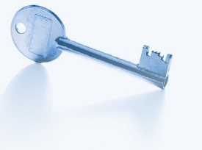

Intuition
c
AND
a
b

Slide 12

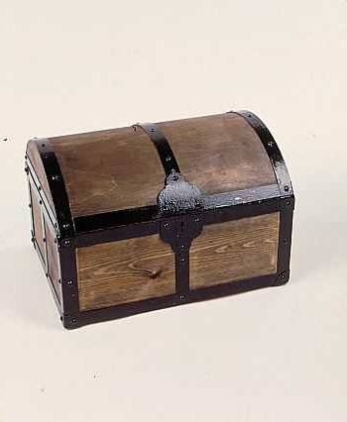



Intuition
a
b
a
b
c
a
b
AND
a
b
b
a
b
a

Slide 13
1: Pick Random Keys For Each Wire
Next, evaluate one gate securely
  Later, generalize to the entire circuit
Alice picks two random keys for each wire
  One key corresponds to “0”, the other to “1”
  6 keys in total for a gate with 2 input wires
k_{0z}, k_{1z}
z
AND
Alice
x
y
Bob
k_{0x}, k_{1x}
k_{0y}, k_{1y}

Slide 14
2: Encrypt Truth Table
Alice encrypts each row of the truth table by encrypting the output-wire key with the corresponding pair of input-wire keys
z
k_{0z}, k_{1z}
AND
Alice
x
y
Bob
k_{0x}, k_{1x}
k_{0y}, k_{1y}
E_{k0x}(E_{k0y}(k_{0z}))
x
y
z
E_{k0x}(E_{k1y}(k_{0z}))
0
0
0
Encrypted truth table:
Original truth table:
0
1
0
E_{k1x}(E_{k0y}(k_{0z}))
1
0
0
1
1
1
E_{k1x}(E_{k1y}(k_{1z}))

Slide 15
3: Send Garbled Truth Table
Alice randomly permutes (“garbles”) encrypted truth table and sends it to Bob
Does not know which row of garbled table corresponds to which row of original table
z
k_{0z}, k_{1z}
AND
Alice
x
y
Bob
k_{0x}, k_{1x}
k_{0y}, k_{1y}
E_{k1x}(E_{k0y}(k_{0z}))
E_{k0x}(E_{k0y}(k_{0z}))
E_{k0x}(E_{k1y}(k_{0z}))
E_{k0x}(E_{k1y}(k_{0z}))
Garbled truth table:
E_{k1x}(E_{k0y}(k_{0z}))
E_{k1x}(E_{k1y}(k_{1z}))
E_{k1x}(E_{k1y}(k_{1z}))
E_{k0x}(E_{k0y}(k_{0z}))

Slide 16
4: Send Keys For Alice’s Inputs
Alice sends the key corresponding to her input bit
  Keys are random, so Bob does not learn what this bit is
k_{0z}, k_{1z}
z
Learns K_{b’x} where b’ is Alice’s input bit, but not b’ (why?)
AND
Alice
x
y
Bob
k_{0x}, k_{1x}
If Alice’s bit is 1, she
simply sends k_{1x} to Bob;
if 0, she sends k_{0x}
k_{0y}, k_{1y}
E_{k1x}(E_{k0y}(k_{0z}))
Garbled truth table:
E_{k0x}(E_{k1y}(k_{0z}))
E_{k1x}(E_{k1y}(k_{1z}))
E_{k0x}(E_{k0y}(k_{0z}))

Slide 17
5: Use OT on Keys for Bob’s Input
Alice and Bob run oblivious transfer protocol
  Alice’s input is the two keys corresponding to Bob’s wire
  Bob’s input into OT is simply his 1-bit input on that wire
z
Knows K_{b’x} where b’ is Alice’s input bit and K_{by} where b is his own input bit
k_{0z}, k_{1z}
AND
Alice
x
y
Bob
k_{0x}, k_{1x}
Run oblivious transfer
Alice’s input: k_{0y}, k_{1y}
Bob’s input: his bit b
Bob learns k_{by}
What does Alice learn?
k_{0y}, k_{1y}
E_{k1x}(E_{k0y}(k_{0z}))
Garbled truth table:
E_{k0x}(E_{k1y}(k_{0z}))
E_{k1x}(E_{k1y}(k_{1z}))
E_{k0x}(E_{k0y}(k_{0z}))

Slide 18
6: Evaluate Garbled Gate
Using the two keys that he learned, Bob decrypts exactly one of the output-wire keys
  Bob does not learn if this key corresponds to 0 or 1
    Why is this important?
z
Knows K_{b’x} where b’ is Alice’s input bit and K_{by} where b is his own input bit
k_{0z}, k_{1z}
AND
Alice
x
y
Bob
k_{0x}, k_{1x}
Suppose b’=0, b=1
k_{0y}, k_{1y}
E_{k1x}(E_{k0y}(k_{0z}))
E_{k0x}(E_{k1y}(k_{0z}))
This is the only row
Bob can decrypt.
He learns K_{0z}
Garbled truth table:
E_{k1x}(E_{k1y}(k_{1z}))
E_{k0x}(E_{k0y}(k_{0z}))

Slide 19
7: Evaluate Entire Circuit
In this way, Bob evaluates entire garbled circuit
  For each wire in the circuit, Bob learns only one key
  It corresponds to 0 or 1 (Bob does not know which)
    Therefore, Bob does not learn intermediate values (why?)
Bob tells Alice the key for the final output wire and she tells him if it corresponds to 0 or 1
  Bob does not tell her intermediate wire keys (why?)
AND
AND
NOT
Alice’s inputs
Bob’s inputs
AND
OR
OR

Slide 20
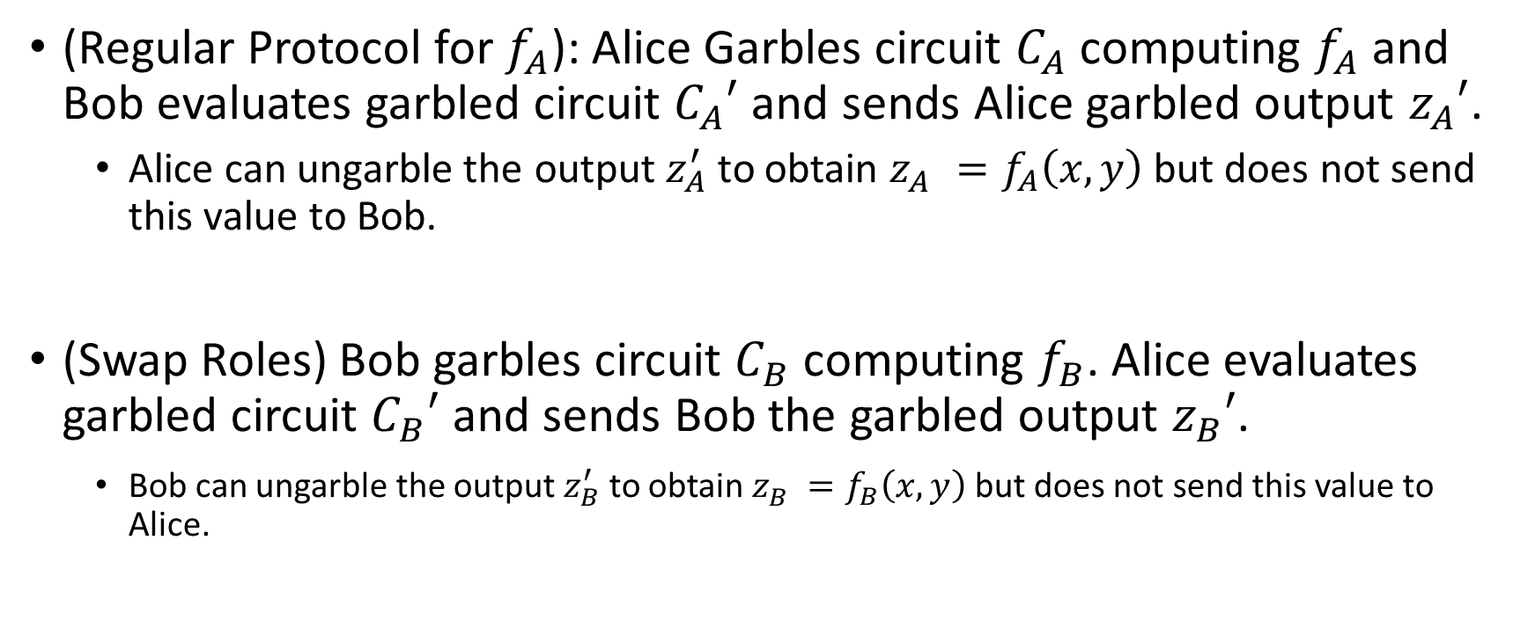

Different Circuits $f_{A}\left(x,y\right)$ and $f_{B}\left(x,y\right)$?
(Regular Protocol for $f_{A}$): Alice Garbles circuit $C_{A}$ computing $f_{A}$ and Bob evaluates garbled circuit $C_{A}′$ and sends Alice garbled output $z_{A}′$.
  Alice can ungarble the output $z_{A}^{′}$ to obtain $z_{A}^{}=f_{A}\left(x,y\right)$ but does not send this value to Bob.
(Swap Roles) Bob garbles circuit $C_{B}$ computing $f_{B}$. Alice evaluates garbled circuit $C_{B}′$ and sends Bob the garbled output $z_{B}′$.
    Bob can ungarble the output $z_{B}^{′}$ to obtain $z_{B}^{}=f_{B}\left(x,y\right)$ but does not send this value to Alice.

Slide 21
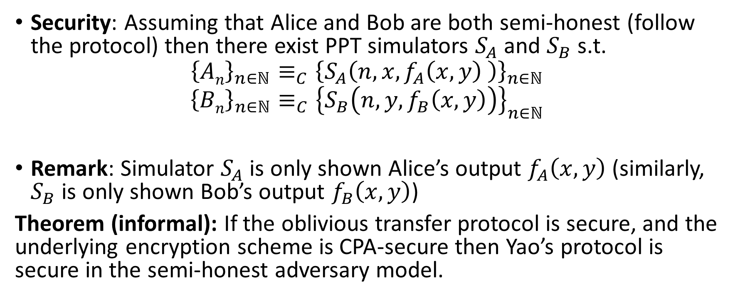
Security (Semi-Honest Model)
Security: Assuming that Alice and Bob are both semi-honest (follow the protocol) then there exist PPT simulators $S_{A}$ and $S_{B}$ s.t.
$${\left\{An\right\}}_{n∈ℕ}≡_{C}{\left\{S_{A}\left(n,x,f_{A}\left(x,y\right) \right)\right\}}_{n∈ℕ}$$
$${\left\{Bn\right\}}_{n∈ℕ}≡_{C}{\left\{S_{B}\left(n,y,f_{B}\left(x,y\right)\right)\right\}}_{n∈ℕ}$$
Remark: Simulator $S_{A}$ is only shown Alice’s output $f_{A}\left(x,y\right)$ (similarly, $S_{B}$ is only shown Bob’s output $f_{B}\left(x,y\right)$)
Theorem (informal): If the oblivious transfer protocol is secure, and the underlying encryption scheme is CPA-secure then Yao’s protocol is secure in the semi-honest adversary model.

Slide 22
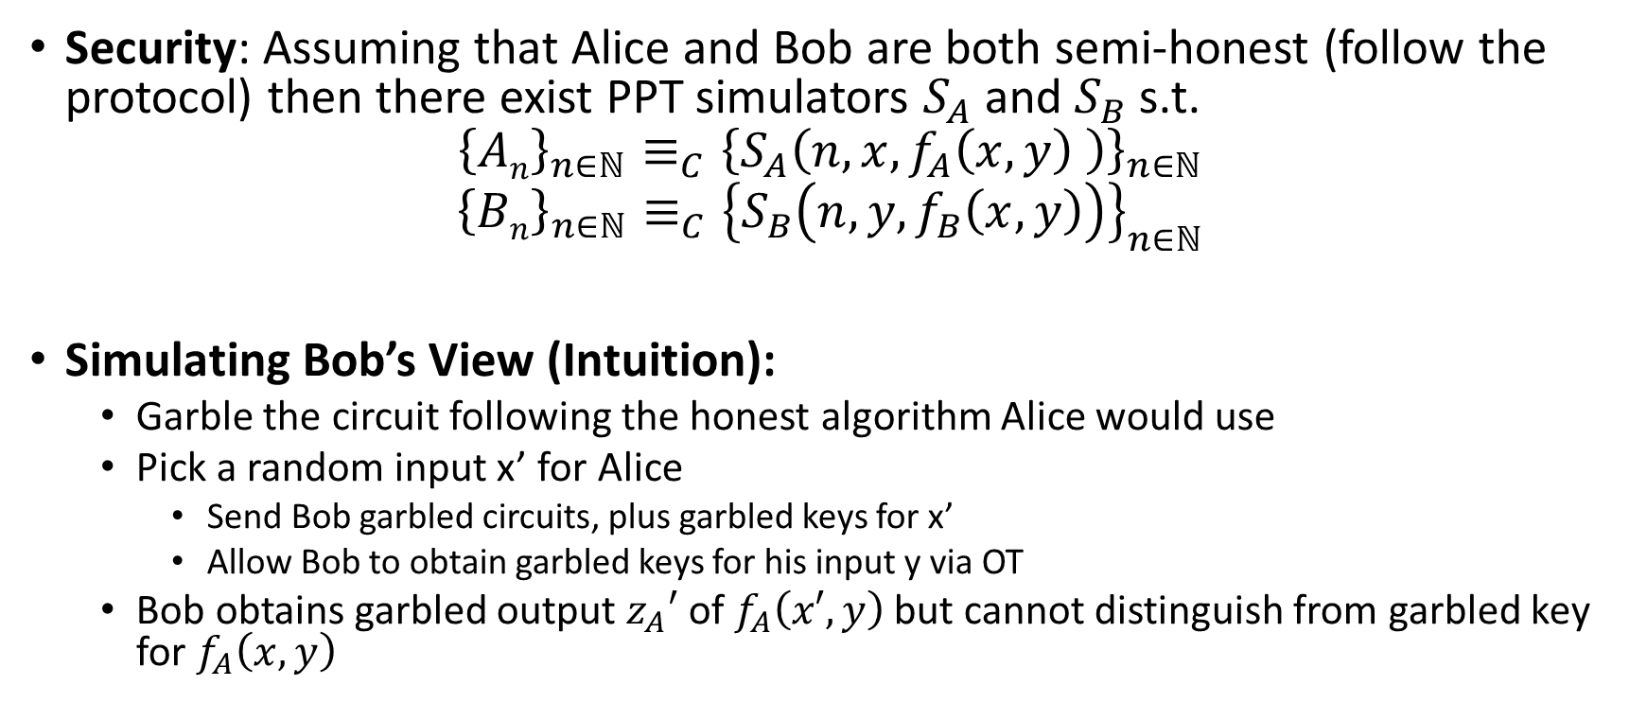
Security (Semi-Honest Model)
Security: Assuming that Alice and Bob are both semi-honest (follow the protocol) then there exist PPT simulators $S_{A}$ and $S_{B}$ s.t.
$${\left\{An\right\}}_{n∈ℕ}≡_{C}{\left\{S_{A}\left(n,x,f_{A}\left(x,y\right) \right)\right\}}_{n∈ℕ}$$
$${\left\{Bn\right\}}_{n∈ℕ}≡_{C}{\left\{S_{B}\left(n,y,f_{B}\left(x,y\right)\right)\right\}}_{n∈ℕ}$$
Simulating Bob’s View (Intuition):
  Garble the circuit following the honest algorithm Alice would use
  Pick a random input x’ for Alice
    Send Bob garbled circuits, plus garbled keys for x’
    Allow Bob to obtain garbled keys for his input y via OT
  Bob obtains garbled output $z_{A}′$ of $f_{A}\left(x′,y\right)$ but cannot distinguish from garbled key for $f_{A}\left(x,y\right)$

Slide 23
Brief Discussion of Yao’s Protocol
Function must be converted into a circuit
  For many functions, circuit will be huge
If m gates in the circuit and n inputs from Bob, then need 4m encryptions and n oblivious transfers
  Oblivious transfers for all inputs can be done in parallel
Yao’s construction gives a constant-round protocol for secure computation of any function in the semi-honest model
  Number of rounds does not depend on the number of inputs or the size of the circuit!

Slide 24
Fully Malicious Security?
Alice could initially garble the wrong circuit C(x,y)=y.
Given output of C(x,y) Alice can still send Bob the output f(x,y).
Can Bob detect/prevent this?
Fix: Assume Alice and Bob have both committed to their input: c_{A}=com(xlr_{A}) and c_{B}=com(ylr_{B}).
  Alice and Bob can use zero-knowledge proofs to convince other party that they are behaving honestly.
  Example: After sending a message A Alice proves that the message she just sent is the same message an honest party would have sent with input x s.t. c_{A}=com(xlr_{A})
  Here we assume that Alice and Bob have both committed to correct inputs (Bob might use y which does not represent his real vote etc… but this is not a problem we can address with cryptography)

Slide 25
Fully Malicious Security (Sketch)
Assume Alice and Bob have both committed to their input: c_{A}=com(xlr_{A}) and c_{B}=com(ylr_{B}).
  Here we assume that Alice and Bob have both committed to correct inputs (Bob might use y which does not represent his real vote etc… but this is not a problem we can address with cryptography)
  Alice has c_{B} and can unlock c_{A}
  Bob has c_{A} and can unlock c_{B}
Alice sets C_{f} = GarbleCircuit(f,r).
  Alice sends to Bob.
  Alice convinces Bob that C_{f} = GarbleCircuit(f,r) for some r (using a zero-knowledge proof)
For each original oblivious transfer if Alice’s inputs were originally x₀,x₁
  Alice and Bob run OT with y₀,y₁ where y_{i}=Enc_{K}(x_{i})
  Bob uses a zero-knowledge proof to convince Alice that he received the correct y_{i} (e.g. matching his previous commitment c_{B})
  Alice sends K to Bob who decrypts y_{i} to obtain x_{i}

Slide 26
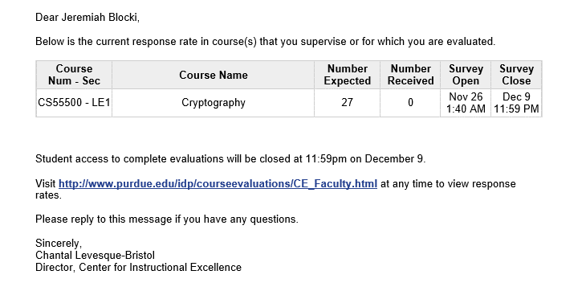
Course Feedback
This statistic is not differentially private ☺
What did you like? What could be improved?
Your feedback is valuable!

Slide 27
CS 555:Week 15: Zero-Knowledge Proofs

Slide 28
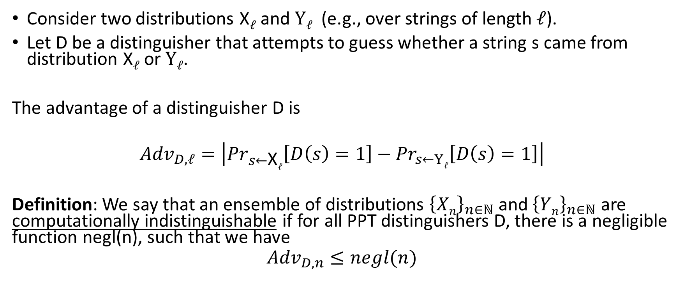
Computational Indistinguishability
Consider two distributions X$ℓ$ and $Yℓ$ (e.g., over strings of length $ℓ$).
Let D be a distinguisher that attempts to guess whether a string s came from distribution X$ℓ$ or $Yℓ$.
The advantage of a distinguisher D is
$${Adv}_{D,ℓ}=\left|{Pr}_{s←\text{X}ℓ}\left[D\left(s\right)=1\right]−{Pr}_{s←Yℓ}\left[D\left(s\right)=1\right]\right|$$
Definition: We say that an ensemble of distributions ${\left\{Xn\right\}}_{n∈ℕ}$ and ${\left\{Yn\right\}}_{n∈ℕ}$ are computationally indistinguishable if for all PPT distinguishers D, there is a negligible function negl(n), such that we have
$${Adv}_{D,n}≤negl(n)$$

Slide 29

Computational Indistinguishability
Notation: ${\left\{Xn\right\}}_{n∈ℕ}≡_{C}$ ${\left\{Yn\right\}}_{n∈ℕ}$ means that the ensembles are computationally indistinguishable.
Consider two distributions X$ℓ$ and $Yℓ$ (e.g., over strings of length $ℓ$).
Let D be a distinguisher that attempts to guess whether a string s came from distribution X$ℓ$ or $Yℓ$.
The advantage of a distinguisher D is
$${Adv}_{D,ℓ}=\left|{Pr}_{s←\text{X}ℓ}\left[D\left(s\right)=1\right]−{Pr}_{s←Yℓ}\left[D\left(s\right)=1\right]\right|$$
Definition: We say that an ensemble of distributions ${\left\{Xn\right\}}_{n∈ℕ}$ and ${\left\{Yn\right\}}_{n∈ℕ}$ are computationally indistinguishable if for all PPT distinguishers D, there is a negligible function negl(n), such that we have
$${Adv}_{D,n}≤negl(n)$$

Slide 30
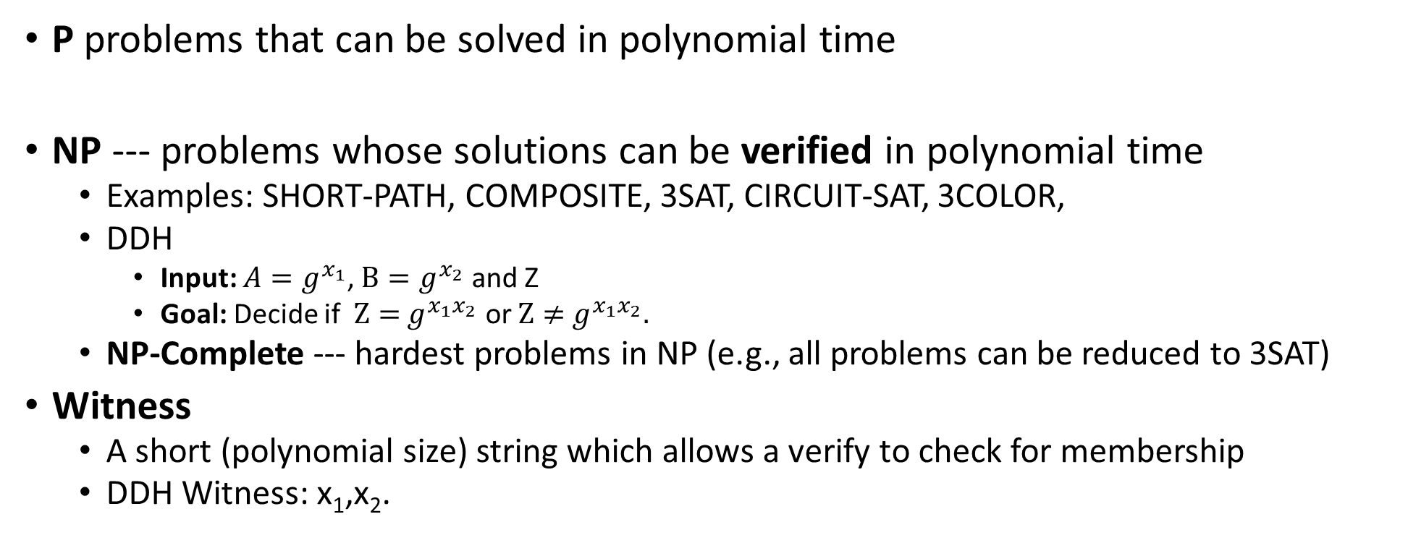
P vs NP
P problems that can be solved in polynomial time
NP --- problems whose solutions can be verified in polynomial time
  Examples: SHORT-PATH, COMPOSITE, 3SAT, CIRCUIT-SAT, 3COLOR,
  DDH
    Input: ${A=g}^{x_{1}}$, $B=g^{x_{2}}$ and Z
    Goal: Decide if $Z={ g}^{x_{1}x_{2}}$ or $Z≠{ g}^{x_{1}x_{2}}.$
  NP-Complete --- hardest problems in NP (e.g., all problems can be reduced to 3SAT)
Witness
  A short (polynomial size) string which allows a verify to check for membership
  DDH Witness: x₁,x₂.

Slide 31
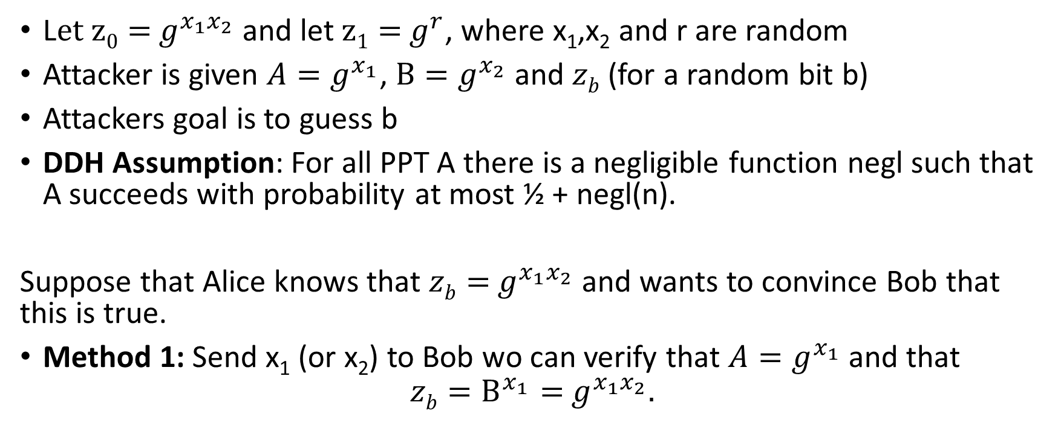
Decisional Diffie-Hellman Problem (DDH)
L$et z0={ g}^{x_{1}x_{2}}$ and let $z1={ g}^{r}$, where x₁,x₂ and r are random
Attacker is given ${A=g}^{x_{1}}$, $B=g^{x_{2}}$ and $zb$ (for a random bit b)
Attackers goal is to guess b
DDH Assumption: For all PPT A there is a negligible function negl such that A succeeds with probability at most ½ + negl(n).
Suppose that Alice knows that $zb={ g}^{x_{1}x_{2}}$ and wants to convince Bob that this is true.
Method 1: Send x₁ (or x₂) to Bob wo can verify that ${A=g}^{x_{1}}$ and that
$$zb=B^{x_{1}}={ g}^{x_{1}x_{2}}.$$

Slide 32
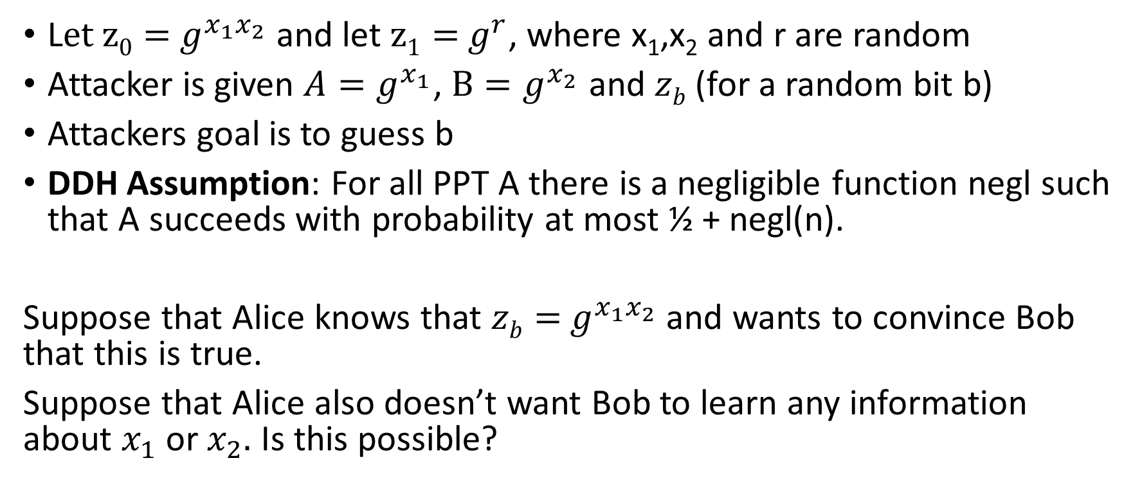
Decisional Diffie-Hellman Problem (DDH)
L$et z0={ g}^{x_{1}x_{2}}$ and let $z1={ g}^{r}$, where x₁,x₂ and r are random
Attacker is given ${A=g}^{x_{1}}$, $B=g^{x_{2}}$ and $zb$ (for a random bit b)
Attackers goal is to guess b
DDH Assumption: For all PPT A there is a negligible function negl such that A succeeds with probability at most ½ + negl(n).
Suppose that Alice knows that $zb={ g}^{x_{1}x_{2}}$ and wants to convince Bob that this is true.
Suppose that Alice also doesn’t want Bob to learn any information about $x_{1}$ or $x_{2}.$ Is this possible?

Slide 33
Zero-Knowledge Proof
Two parties: Prover P (PPT) and Verifier V (PPT)
(P is given witness for claim e.g., )
Completeness: If claim is true honest prover can always convince honest verifier to accept.
Soundness: If claim is false then Verifier should reject with probability at least ½. (Even if the prover tries to cheat)
Zero-Knowledge: Verifier doesn’t learn anything about prover’s input from the protocol (other than that the claim is true).
Formalizing this last statement is tricky
Zero-Knowledge: should hold even if the attacker is dishonest!

Slide 34
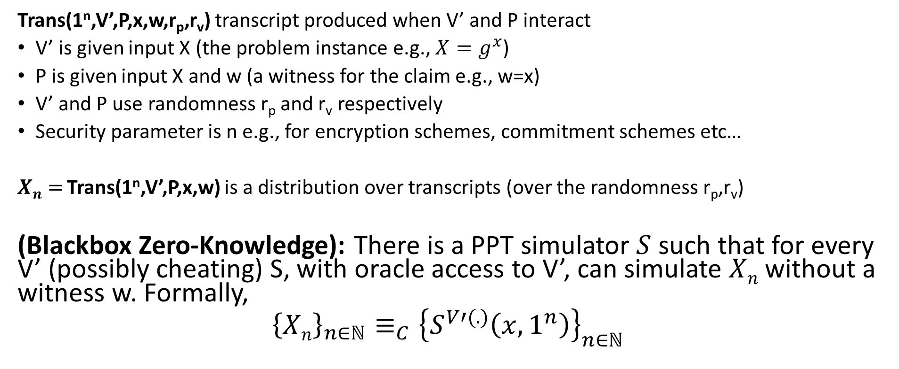
Zero-Knowledge Proof
Trans(1^{n},V’,P,x,w,r_{p},r_{v}) transcript produced when V’ and P interact
V’ is given input X (the problem instance e.g., ${X=g}^{x}$)
P is given input X and w (a witness for the claim e.g., w=x)
V’ and P use randomness r_{p} and r_{v} respectively
Security parameter is n e.g., for encryption schemes, commitment schemes etc…
$Xn=$Trans(1^{n},V’,P,x,w) is a distribution over transcripts (over the randomness r_{p},r_{v})
(Blackbox Zero-Knowledge): There is a PPT simulator $S$ such that for every V’ (possibly cheating) S, with oracle access to V’, can simulate $Xn$ without a witness w. Formally,
$${\left\{Xn\right\}}_{n∈ℕ}≡_{C}{\left\{S^{V′(.)}\left(x,1^{n}\right)\right\}}_{n∈ℕ}$$

Slide 35

Zero-Knowledge Proof
Trans(1^{n},V’,P,x,w,r_{p},r_{v}) transcript produced when V’ and P interact
V’ is given input x (the problem instance e.g., ${A=g}^{x_{1}}$, $B=g^{x_{2}}$ and $zb$ )
P is given input x and w (a witness for the claim e.g., x₁ and x₂)
V’ and P’ use randomness r_{p} and r_{w} respectively
Security parameter is n e.g., for encryption schemes, commitment schemes etc…
$Xn=$Trans(1^{n},V’,P’,x,w) is a distribution over transcripts (over the randomness r_{p},r_{w})
(Blackbox Zero-Knowledge): There is a PPT simulator $S$ such that for every V’ (possibly cheating) S, with oracle access to V’, can simulate $Xn$ without a witness w. Formally,
$${\left\{Xn\right\}}_{n∈ℕ}≡_{C}{\left\{S^{V′(.)}\left(x,1^{n}\right)\right\}}_{n∈ℕ}$$
Simulator S is not given witness w
Oracle V’(x,trans) will output the next message V’ would output given current transcript trans

Slide 36
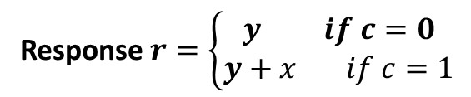

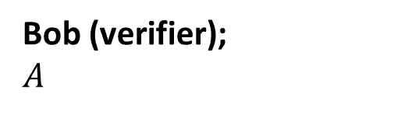
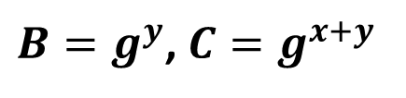
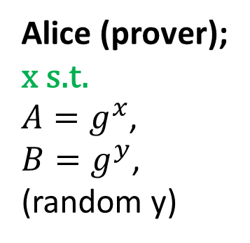
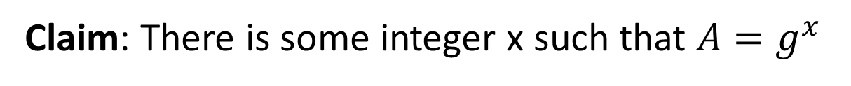
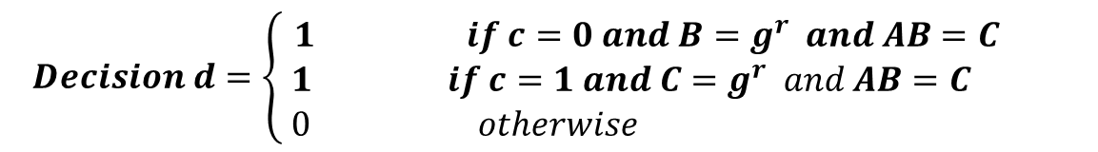
Zero-Knowledge Proof for Discrete Log Solution
$B=g^{y}$, $C=g^{x+y}$
$$challenge c∈\left\{0,1\right\}$$
Response $r=\left\{\begin{aligned}y if c=0 \\ y+x if c=1\end{aligned}\right.$
Bob (verifier);
$A$
Alice (prover);
x s.t.
${A=g}^{x}$,
${B=g}^{y}$,
(random y)
$$Decision d=\left\{ \begin{aligned}1 if c=0 and B=g^{r} and AB=C \\ 1 if c=1 and C=g^{r} and AB=C \\ 0 otherwise \end{aligned}\right.$$
Claim: There is some integer x such that ${A=g}^{x}$

Slide 37
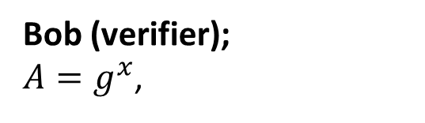
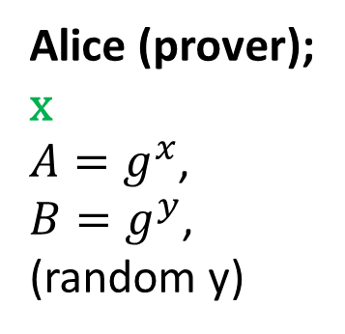
Zero-Knowledge Proof for Discrete Log Solution
$B=g^{y}$, $C=g^{x+y}$
$$challenge c∈\left\{0,1\right\}$$
Response $r=\left\{\begin{aligned}y if c=0 \\ y+x if c=1\end{aligned}\right.$
Bob (verifier);
${A=g}^{x}$,
Alice (prover);
x
${A=g}^{x}$,
${B=g}^{y}$,
(random y)
$$Decision d=\left\{ \begin{aligned}1 if c=0 and B=g^{r} and AB=C \\ 1 if c=1 and C=g^{r} and AB=C \\ 0 otherwise \end{aligned}\right.$$
Correctness: If Alice and Bob are honest then Bob will always accept

Slide 38
Zero-Knowledge Proof for Discrete Log Solution
Case 1: Challenge (c=0)
$B=g^{y}$, $C=g^{x+y}$
$$challenge c∈\left\{0,1\right\}$$
Response $r=\left\{\begin{aligned}y if c=0 \\ y+x if c=1\end{aligned}\right.$
Bob (verifier);
${A=g}^{x}$,
Alice (prover);
x
${A=g}^{x}$,
${B=g}^{y}$,
(random y)
$$Decision d=\left\{ \begin{aligned}1 if c=0 and B=g^{r} and AB=C \\ 1 if c=1 and C=g^{r} and AB=C \\ 0 otherwise \end{aligned}\right.$$
Correctness: If Alice and Bob are honest then Bob will always accept

Slide 39
Zero-Knowledge Proof for Discrete Log Solution
Case 2: Challenge (c=1)
$B=g^{y}$, $C=g^{x+y}$
$$challenge c∈\left\{0,1\right\}$$
Response $r=\left\{\begin{aligned}y if c=0 \\ y+x if c=1\end{aligned}\right.$
Bob (verifier);
${A=g}^{x}$,
Alice (prover);
x
${A=g}^{x}$,
${B=g}^{y}$,
(random y)
$$Decision d=\left\{ \begin{aligned}1 if c=0 and B=g^{r} and AB=C \\ 1 if c=1 and C=g^{r} and AB=C \\ 0 otherwise \end{aligned}\right.$$
Correctness: If Alice and Bob are honest then Bob will always accept

Slide 40
Zero-Knowledge Proof for Discrete Log Solution
$B=g^{y}$, $C=g^{x+y}$
$$challenge c∈\left\{0,1\right\}$$
Response $r=\left\{\begin{aligned}y if c=0 \\ y+x if c=1\end{aligned}\right.$
Bob (verifier);
${A=g}^{x}$,
Alice (prover);
x
${A=g}^{x}$,
${B=g}^{y}$,
(random y)
$$Decision d=\left\{ \begin{aligned}1 if c=0 and B=g^{r} and AB=C \\ 1 if c=1 and C=g^{r} and AB=C \\ 0 otherwise \end{aligned}\right.$$
Soundness: If $A≠g^{x}$ for some x then (honest) Bob will reject w.p. ½ (even if
Alice cheats)

Slide 41
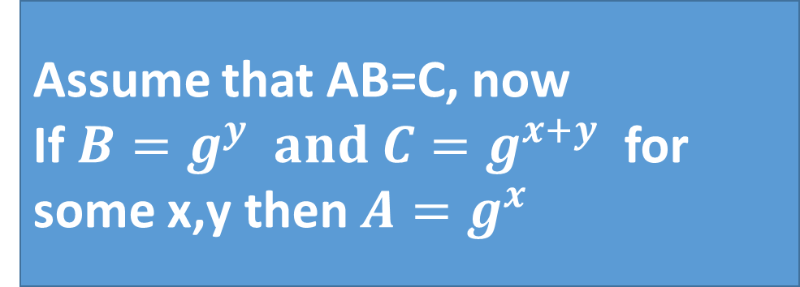
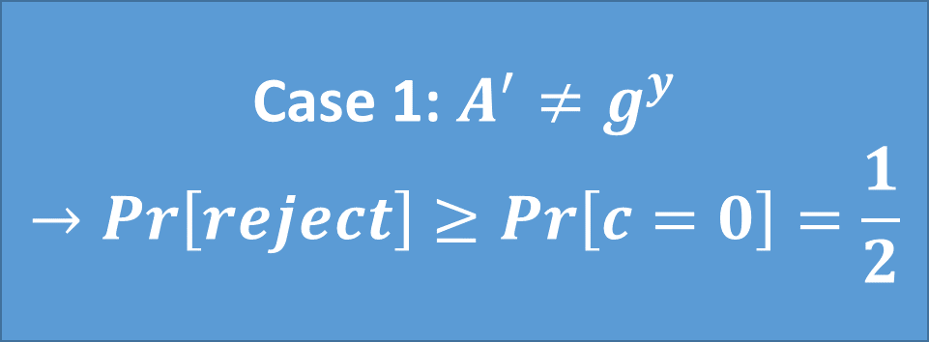
Zero-Knowledge Proof for Discrete Log Solution
Assume that AB=C, now
If $B=g^{y} and C=g^{x+y}$ for some x,y then $A=g^{x}$
$B=g^{y}$, $C=g^{x+y}$
$$challenge c∈\left\{0,1\right\}$$
Response $r=\left\{\begin{aligned}y if c=0 \\ y+x if c=1\end{aligned}\right.$
Bob (verifier);
${A=g}^{x}$,
Alice (prover);
x
${A=g}^{x}$,
${B=g}^{y}$,
(random y)
$$Decision d=\left\{ \begin{aligned}1 if c=0 and B=g^{r} and AB=C \\ 1 if c=1 and C=g^{r} and AB=C \\ 0 otherwise \end{aligned}\right.$$
Soundness: If $A≠g^{x}$ for some x then (honest) Bob will reject w.p. ½ (even if
Alice cheats)
Case 1: $A^{′}≠g^{y}$
$$→Pr\left[reject\right]≥Pr\left[c=0\right]=\frac{1}{2}$$

Slide 42


Zero-Knowledge Proof for Discrete Log Solution
Case 1: for all r $B≠g^{r}$
$$→Pr\left[reject\right]≥Pr\left[c=0\right]=\frac{1}{2}$$
Assume that AB=C, now
If $B=g^{y} and C=g^{x+y}$ for some x,y then $A=g^{x}$
$B=g^{y}$, $C=g^{x+y}$
$$challenge c∈\left\{0,1\right\}$$
Response $r=\left\{\begin{aligned}y if c=0 \\ y+x if c=1\end{aligned}\right.$
Bob (verifier);
${A=g}^{x}$,
Alice (prover);
x
${A=g}^{x}$,
${B=g}^{y}$,
(random y)
$$Decision d=\left\{ \begin{aligned}1 if c=0 and B=g^{r} and AB=C \\ 1 if c=1 and C=g^{r} and AB=C \\ 0 otherwise \end{aligned}\right.$$
Soundness: If $A≠g^{x}$ for some x then (honest) Bob will reject w.p. ½ (even if
Alice cheats)

Slide 43

Zero-Knowledge Proof for Discrete Log Solution
Case 2: for all r $C≠g^{r}$
$$→Pr\left[reject\right]≥Pr\left[c=1\right]=\frac{1}{2}$$
Assume that AB=C, now
If $B=g^{y} and C=g^{x+y}$ for some x,y then $A=g^{x}$
$B=g^{y}$, $C=g^{x+y}$
$$challenge c∈\left\{0,1\right\}$$
Response $r=\left\{\begin{aligned}y if c=0 \\ y+x if c=1\end{aligned}\right.$
Bob (verifier);
${A=g}^{x}$,
Alice (prover);
x
${A=g}^{x}$,
${B=g}^{y}$,
(random y)
$$Decision d=\left\{ \begin{aligned}1 if c=0 and B=g^{r} and AB=C \\ 1 if c=1 and C=g^{r} and AB=C \\ 0 otherwise \end{aligned}\right.$$
Soundness: If $A≠g^{x}$ for some x then (honest) Bob will reject w.p. ½ (even if
Alice cheats)

Slide 44


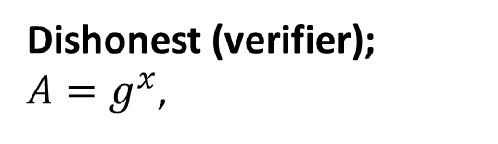

Zero-Knowledge Proof for Discrete Log Solution
$B=g^{y}$, $C=g^{x+y}$
$$challenge c=V′(A,\left(B,C\right))∈\left\{0,1\right\}$$
Response $r=\left\{\begin{aligned}y if c=0 \\ y+x if c=1\end{aligned}\right.$
Alice (honest);
x
${A=g}^{x}$,
${B=g}^{y}$,
(random y)
Dishonest (verifier);
${A=g}^{x}$,
$$Decision d=V′(A,\left(B,C\right),c,r)$$
Transcript: ${View}_{V′}=\left(A,\left(B,C\right),c,r,d\right)$

Slide 45

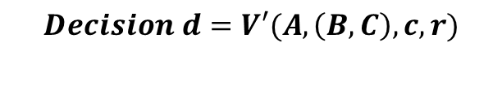
Zero-Knowledge Proof for Discrete Log Solution
$B=g^{y}$, $C=g^{x+y}$
$$challenge c=V′(A,\left(B,C\right))∈\left\{0,1\right\}$$
Response $r=\left\{\begin{aligned}y if c=0 \\ y+x if c=1\end{aligned}\right.$
Alice (honest);
x
${A=g}^{x}$,
${B=g}^{y}$,
(random y)
Dishonest (verifier);
${A=g}^{x}$,
$$Decision d=V′(A,\left(B,C\right),c,r)$$
Zero-Knowledge: For all PPT V’ exists PPT Sim s.t ${View}_{V′}≡_{C}{Sim}^{V′(.)}\left(A\right)$

Slide 46

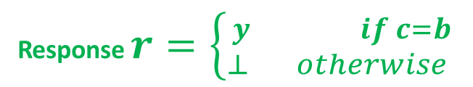
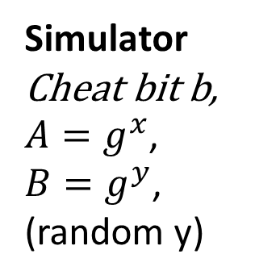
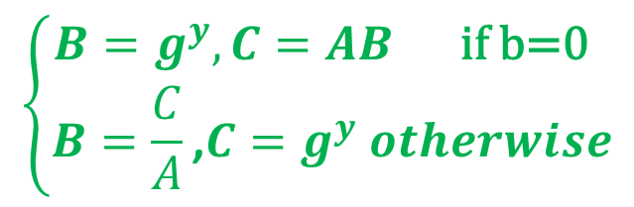
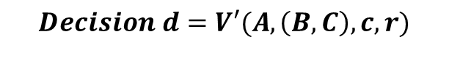
Zero-Knowledge Proof for Discrete Log Solution
$$\left\{\begin{aligned}B=g^{y},C=AB \text{if} \text{b}\text{=0} \\ B=\frac{C}{A}\text{,}C=g^{y} otherwise\end{aligned}\right.$$
$$challenge c=V′(A,\left(B,C\right))∈\left\{0,1\right\}$$
Response $r=\left\{{y if c=b \atop ⊥ otherwise }\right.$
Simulator
Cheat bit b,
${A=g}^{x}$,
${B=g}^{y}$,
(random y)
Dishonest (verifier);
${A=g}^{x}$,
$$Decision d=V′(A,\left(B,C\right),c,r)$$
Zero-Knowledge: For all PPT V’ exists PPT Sim s.t ${View}_{V′}≡_{C}{Sim}^{V′(.)}\left(A\right)$

Slide 47

Zero-Knowledge Proof for Discrete Log Solution
$$\left\{\begin{aligned}B=g^{y},C=AB \text{if} \text{b}\text{=0} \\ B=\frac{C}{A}\text{,}C=g^{y} otherwise\end{aligned}\right.$$
$$challenge c=V′(A,\left(B,C\right))∈\left\{0,1\right\}$$
Response $r=\left\{{y if c=b \atop ⊥ otherwise }\right.$
Simulator
Cheat bit b,
${A=g}^{x}$,
${B=g}^{y}$,
(random y)
Dishonest (verifier);
${A=g}^{x}$,
$$Decision d=V′(A,\left(B,C\right),c,r)$$
Zero-Knowledge: Simulator can produce identical transcripts (Repeat until $r≠⊥)$

Slide 48
Zero-Knowledge Proof for Discrete Log Solution
$$\left\{\begin{aligned}B=g^{y},C=AB \text{if} \text{b}\text{=0} \\ B=\frac{C}{A}\text{,}C=g^{y} otherwise\end{aligned}\right.$$
$$challenge c=V′(A,\left(B,C\right))∈\left\{0,1\right\}$$
Response $r=\left\{{y if c=b \atop ⊥ otherwise }\right.$
Simulator
Cheat bit b,
${A=g}^{x}$,
${B=g}^{y}$,
(random y)
Dishonest (verifier);
${A=g}^{x}$,
$$Decision d=V′(A,\left(B,C\right),c,r)$$
Zero-Knowledge: If ${A=g}^{x}$ for some x then ${View}_{V′}≡_{C}{Sim}^{V′(.)}\left(A\right)$

Slide 49
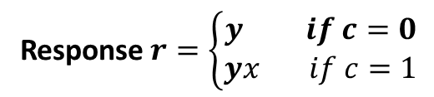


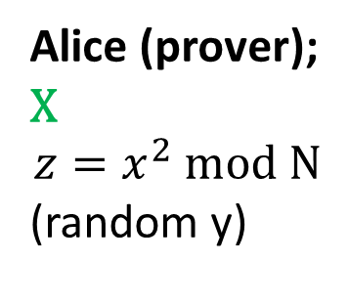
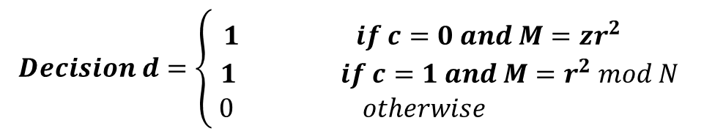
Zero-Knowledge Proof for Square Root mod N
$$M={zy}^{2} mod N$$
$$challenge c∈\left\{0,1\right\}$$
Response $r=\left\{\begin{aligned}y if c=0 \\ yx if c=1\end{aligned}\right.$
Bob (verifier);
$$z$$
Alice (prover);
X
$${z=x}^{2} mod N$$
(random y)
$$Decision d=\left\{ \begin{aligned}1 if c=0 and M={zr}^{2} \\ 1 if c=1 and M=r^{2} mod N \\ 0 otherwise \end{aligned}\right.$$
Completeness: If Alice knows x such ${z=x}^{2} mod N$ then Bob will always accept

Slide 50
Zero-Knowledge Proof for Square Root mod N
$$M={zy}^{2} mod N$$
$$challenge c∈\left\{0,1\right\}$$
Response $r=\left\{\begin{aligned}y if c=0 \\ yx if c=1\end{aligned}\right.$
Bob (verifier);
$$z$$
Alice (prover);
X
$${z=x}^{2} mod N$$
(random y)
$$Decision d=\left\{ \begin{aligned}1 if c=0 and M={zr}^{2} \\ 1 if c=1 and M=r^{2} mod N \\ 0 otherwise \end{aligned}\right.$$
Soundness: If $z≠x^{2}$ for some x then (honest) Bob will reject w.p. ½ (even if
Alice cheats)

Slide 51
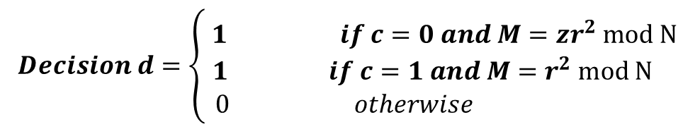
Zero-Knowledge Proof for Square Root mod N
$$M={zy}^{2} mod N$$
$$challenge c∈\left\{0,1\right\}$$
Response $r=\left\{\begin{aligned}y if c=0 \\ yx if c=1\end{aligned}\right.$
Bob (verifier);
$$z$$
Alice (prover);
X
$${z=x}^{2} mod N$$
(random y)
$$Decision d=\left\{ \begin{aligned}1 if c=0 and M={zr}^{2} mod N \\ 1 if c=1 and M=r^{2} mod N \\ 0 otherwise \end{aligned}\right.$$
Zero-Knowledge: How does the simulator work?

Slide 52
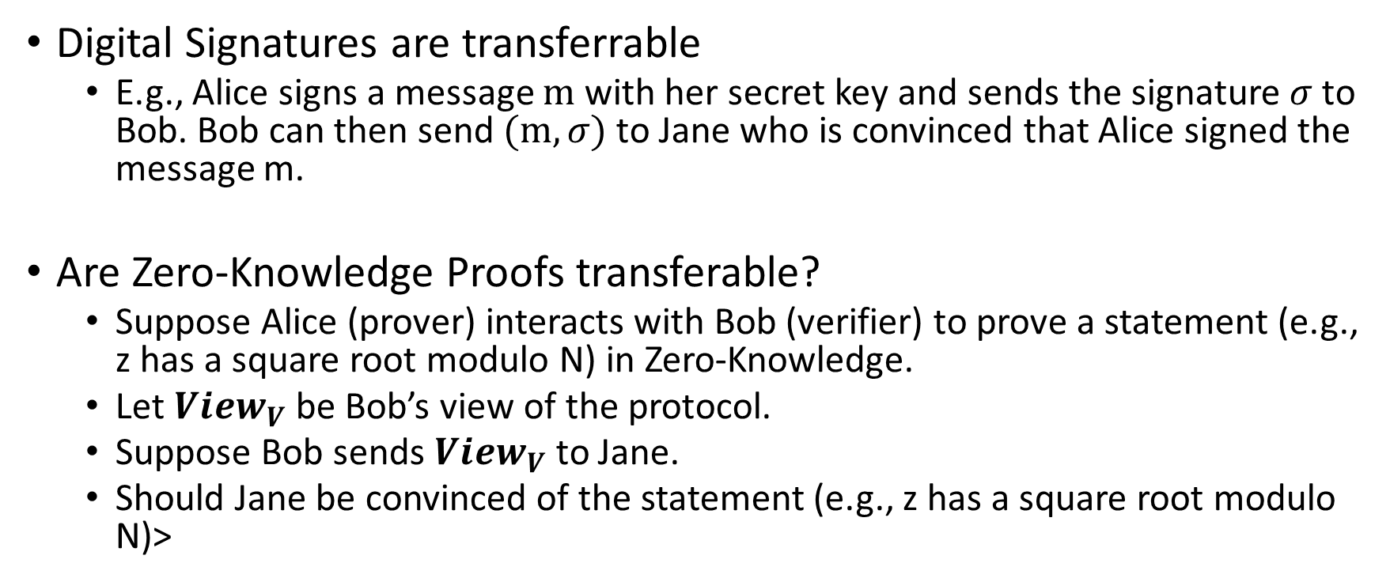
Zero-Knowledge Proof vs. Digital Signature
Digital Signatures are transferrable
  E.g., Alice signs a message $m$ with her secret key and sends the signature $σ$ to Bob. Bob can then send $(m,σ)$ to Jane who is convinced that Alice signed the message m.
Are Zero-Knowledge Proofs transferable?
  Suppose Alice (prover) interacts with Bob (verifier) to prove a statement (e.g., z has a square root modulo N) in Zero-Knowledge.
  Let ${View}_{V}$ be Bob’s view of the protocol.
  Suppose Bob sends ${View}_{V}$ to Jane.
  Should Jane be convinced of the statement (e.g., z has a square root modulo N)>

Slide 53
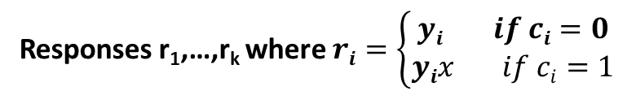
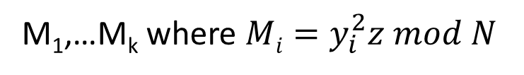
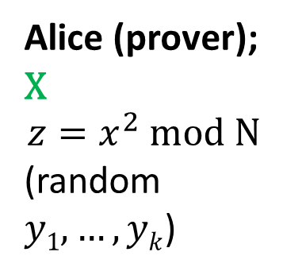
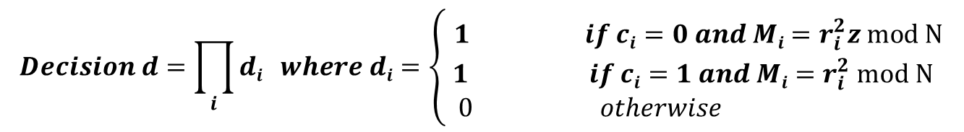
Non-Interactive Zero-Knowledge Proof (NIZK)
M₁,…M_{k} where $Mi=y_{i}^{2}z mod N$
$$challenges c=\left(c1,….,ck\right)=H(\text{M}\text{1}\text{,…}\text{Mk})$$
Responses r₁,…,r_{k} where $ri=\left\{\begin{aligned}yi if ci=0 \\ yix if ci=1\end{aligned}\right.$
Bob (verifier);
$$z$$
Alice (prover);
X
$${z=x}^{2} mod N$$
(random $y1,…,yk$)
$$Decision d=\prod_{i}{di} where di=\left\{ \begin{aligned}1 if ci=0 and Mi=r_{i}^{2}z mod N \\ 1 if ci=1 and Mi=r_{i}^{2} mod N \\ 0 otherwise \end{aligned}\right.$$
Simulator Power: Can program the random oracle

Slide 54
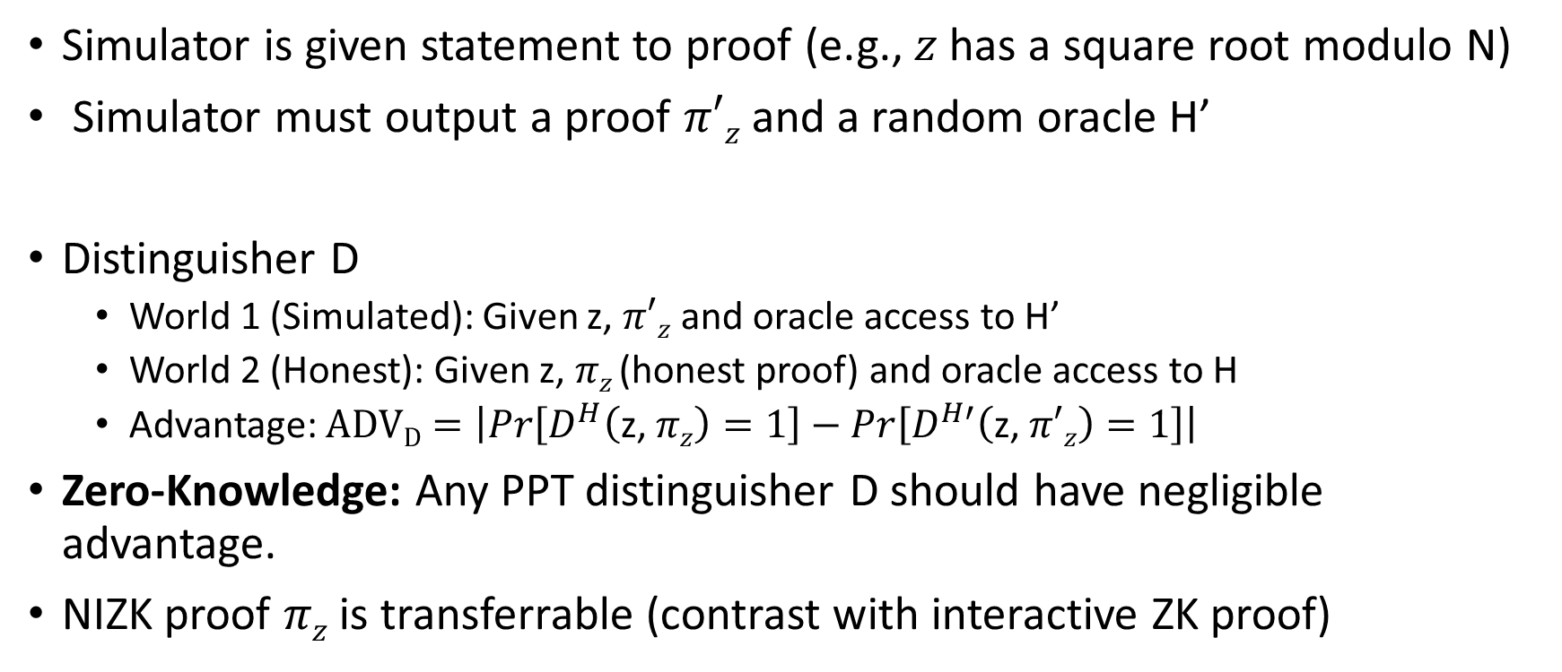
NIZK Security (Random Oracle Model)
Simulator is given statement to proof (e.g., $z$ has a square root modulo N)
Simulator must output a proof $π′z$ and a random oracle H’
Distinguisher D
  World 1 (Simulated): Given z, $π′z$ and oracle access to H’
  World 2 (Honest): Given z, $πz$(honest proof) and oracle access to H
  Advantage: $ADVD=\left|Pr\left[D^{H}\left(\text{z}\text{, }πz\right)=1\right]−Pr\left[D^{H′}\left(\text{z}\text{, }π′z\right)=1\right]\right|$
Zero-Knowledge: Any PPT distinguisher D should have negligible advantage.
NIZK proof $πz$ is transferrable (contrast with interactive ZK proof)

Slide 55
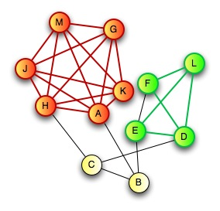
Zero-Knowledge Proof for all NP
CLIQUE
  Input: Graph G=(V,E) and integer k>0
  Question: Does G have a clique of size k?
CLIQUE is NP-Complete
  Any problem in NP reduces to CLIQUE
  A zero-knowledge proof for CLIQUE yields proof for all of NP via reduction
Prover:
  Knows k vertices v₁,…,v_{k} in G=(V,E) that form a clique

Slide 56

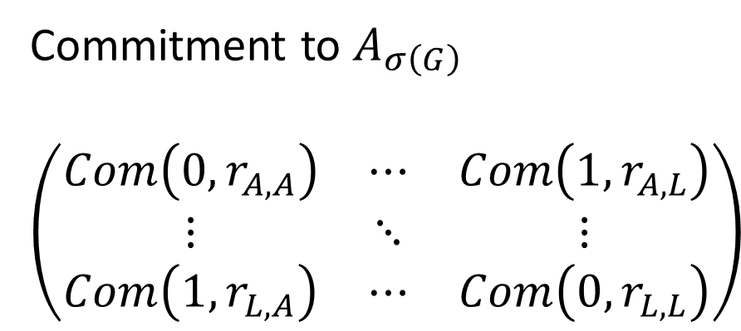
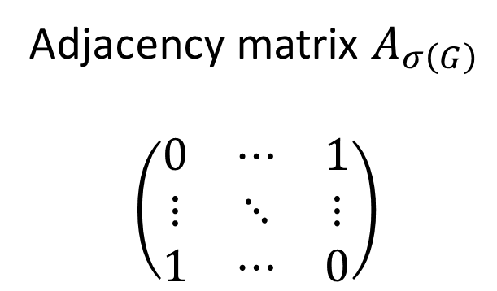
Zero-Knowledge Proof for all NP
C
D
$$σ\left(G\right)$$
E
H
G
A
F
B
J
I
L
K
Commitment to $A_{σ\left(G\right)}$
$$\left(\begin{matrix}Com\left(0,r_{A,A}\right) & ⋯ & Com\left(1,r_{A,L}\right) \\ ⋮ & ⋱ & ⋮ \\ Com\left(1,r_{L,A}\right) & ⋯ & Com\left(0,r_{L,L}\right)\end{matrix}\right)$$
Adjacency matrix $A_{σ\left(G\right)}$
$$\left(\begin{matrix}0 & ⋯ & 1 \\ ⋮ & ⋱ & ⋮ \\ 1 & ⋯ & 0\end{matrix}\right)$$
A
L
A
L
A
A
L
L

Slide 57
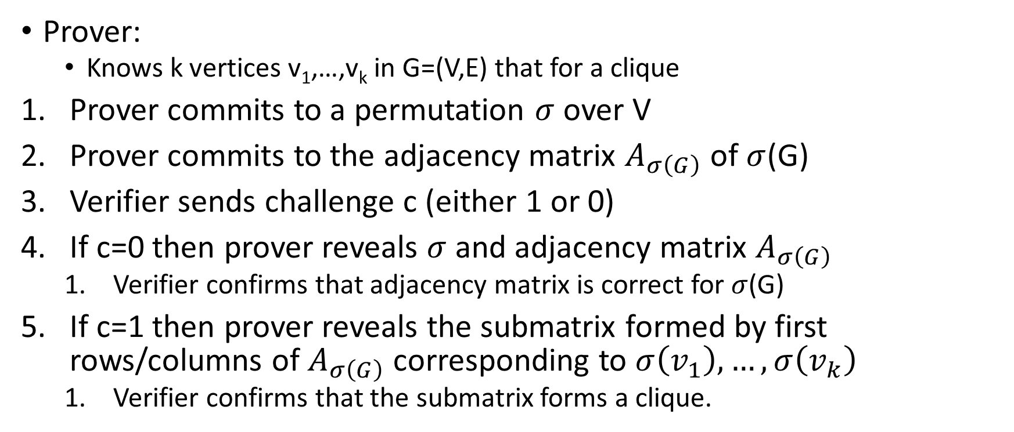
Zero-Knowledge Proof for all NP
C
D
E
H
G
A
F
B
J
Prover:
  Knows k vertices v₁,…,v_{k} in G=(V,E) that for a clique
Prover commits to a permutation $σ$ over V
Prover commits to the adjacency matrix $A_{σ\left(G\right)}$ of $σ$(G)
Verifier sends challenge c (either 1 or 0)
If c=0 then prover reveals $σ$ and adjacency matrix $A_{σ\left(G\right)}$
  Verifier confirms that adjacency matrix is correct for $σ$(G)
If c=1 then prover reveals the submatrix formed by first rows/columns of $A_{σ\left(G\right)}$ corresponding to $σ\left(v_{1}\right),…,σ\left(v_{k}\right)$
  Verifier confirms that the submatrix forms a clique.
I
L
K

Slide 58

Zero-Knowledge Proof for all NP
Completeness: Honest prover can always make honest verifier accept
Soundness: If prover commits to adjacency matrix $A_{σ\left(G\right)}$ of $σ$(G) and can reveal a clique in submatrix of $A_{σ\left(G\right)}$ then G itself contains a k-clique. Proof invokes binding property of commitment scheme.
Zero-Knowledge: Simulator cheats and either commits to wrong adjacency matrix or cannot reveal clique. Repeat until we produce a successful transcript. Indistinguishability of transcripts follows from hiding property of commitment scheme.

Slide 59
Secure Multiparty Computation (Adversary Models)
Semi-Honest (“honest, but curious”)
  All parties follow protocol instructions, but…
  dishonest parties may be curious to violate privacy of others when possible
Fully Malicious Model
  Adversarial Parties may deviate from the protocol arbitrarily
    Quit unexpectedly
    Send different messages
  It is much harder to achieve security in the fully malicious model
Convert Secure Semi-Honest Protocol into Secure Protocol in Fully Malicious Mode?
  Tool: Zero-Knowledge Proofs
  Prove: My behavior in the protocol is consistent with honest party

Slide 60
CS 555:Week 15: Hot Topics

Slide 61

Shor’s Algorithm
Quantum Algorithm to Factor Integers
Running Time
O((log N)²(log log N)(log log log N))
Building Quantum Circuits is challenging, but...
RSA is broken if we build a quantum computer
  Current record: Factor 21=3x7 with Shor’s Algorithm
  Source: Experimental Realisation of Shor’s Quatum Factoring Algorithm Using Quibit Recycling (https://arxiv.org/pdf/1111.4147.pdf)
https://en.wikipedia.org/wiki/Shor%27s_algorithm

Slide 62

Quantum Resistant Crypto
Symmetric key primitives are believed to be safe
…but Grover’s Algorithm does speed up brute-force attacks significantly ($2^{n} vs \sqrt{2^{n}}$)
  Solution: Double Key Lengths
Integer Factoring, Discrete Log and Elliptic Curve Discrete Log are not safe
  All public key encryption algorithms we have covered
  RSA, RSA-OAEP, El-Gamal,….
https://en.wikipedia.org/wiki/Lattice-based_cryptography

Slide 63

Post Quantum Cryptography
Symmetric key primitives are believed to be safe
…but Grover’s Algorithm does speed up brute-force attacks significantly ($2^{n} vs \sqrt{2^{n}}$)
  Solution: Double Key Lengths
Hashed Based Signatures
  Lamport Signatures and extensions
Lattice Based Cryptography is a promising approach for Quantum Resistant Public Key Crypto
  Ring-LWE
  NTRU
https://security.googleblog.com/2016/07/experimenting-with-post-quantum.html

Slide 64

Fully Homomorphic Encryption (FHE)
Idea: Alice sends Bob ${Enc}_{{PK}_{A}}\left(x_{1}\right),…,$ ${Enc}_{{PK}_{A}}\left(x_{n}\right)$
$${Enc}_{{PK}_{A}}\left(x_{i}\right)+{Enc}_{{PK}_{A}}\left(x_{j}\right)={Enc}_{{PK}_{A}}\left(x_{i}+x_{j}\right)$$
and
$${Enc}_{{PK}_{A}}\left(x_{i}\right)×{Enc}_{{PK}_{A}}\left(x_{j}\right)={Enc}_{{PK}_{A}}\left(x_{i}×x_{j}\right)$$
Bob cannot decrypt messages, but given a circuit C can compute
  $${Enc}_{{PK}_{A}}\left(C\left(x_{1},…{,x}_{n}\right)\right)$$
Proposed Application: Export confidential computation to cloud
https://simons.berkeley.edu/talks/shai-halevi-2015-05-18a (Lecture by Shai Halevi)

Slide 65

Fully Homomorphic Encryption (FHE)
Idea: Alice sends Bob ${Enc}_{{PK}_{A}}\left(x_{1}\right),…,$ ${Enc}_{{PK}_{A}}\left(x_{n}\right)$
Bob cannot decrypt messages, but given a circuit C can compute
  $${Enc}_{{PK}_{A}}\left(C\left(x_{1},…{,x}_{n}\right)\right)$$
We now have candidate constructions!
  Encryption/Decryption are polynomial time
  …but expensive in practice.
  Proved to be CPA-Secure under plausible assumptions
Remark 1: Partially Homomorphic Encryption schemes cannot be CCA-Secure. Why not?
https://simons.berkeley.edu/talks/shai-halevi-2015-05-18a (Lecture by Shai Halevi)

Slide 66

Partially Homomorphic Encryption
Plain RSA is multiplicatively homomorphic
$${Enc}_{{PK}_{A}}\left(x_{i}\right)×{Enc}_{{PK}_{A}}\left(x_{j}\right)={Enc}_{{PK}_{A}}\left(x_{i}×x_{j}\right)$$
But not additively homomorphic
Pallier Cryptosystem
$${Enc}_{{PK}_{A}}\left(x_{i}\right)×{Enc}_{{PK}_{A}}\left(x_{j}\right)={Enc}_{{PK}_{A}}\left(x_{i}+x_{j}\right)$$
$${\left({Enc}_{{PK}_{A}}\left(x_{i}\right)\right)}^{k}={Enc}_{{PK}_{A}}\left(k×x_{j}\right)$$
Not same as FHE, but still useful in multiparty computation
https://en.wikipedia.org/wiki/Paillier_cryptosystem

Slide 67


Program Obfuscation (Theoretical Cryptography)
Program Obfuscation
  Idea: Alice obfuscates a circuit C and sends C to Bob
  Bob can run C, but cannot learn “anything else”
  Lots of applications…
Indistinguishability Obfuscation
  Theoretically Possible
    In the sense that $f\left(n\right)=2^{100000000}n^{100000}$ is technically polynomial time
Secure Hardware Module (e.g., SGX) can be viewed as a way to accomplish this in practice
  Must trust third party (e.g., Intel)
https://simons.berkeley.edu/talks/amit-sahai-2015-05-19a (Lecture by Amit Sahai)

Slide 68




Differential Privacy

Slide 69


Release Aggregate Statistics?
Question 1: How many people in this room have cancer?
Question 2: How many students in this room have cancer?
The difference (A1-A2) exposes my answer!

Slide 70

Differential Privacy: Definition
n people
Neighboring datasets:
  Replace x with x’
Name CS Prof? … STD?
Name CS Prof? … STD?
J Blocki +1 … -1
Bjork -1 … ???
[DMNS06, DKMMN06]
D
D’

Slide 71

Differential Privacy vs Cryptography
$ε$ is not negligibly small.
We are not claiming that, when D and D’ are neighboring datasets,
$$Alg(D)≡_{C}Alg(D′)$$
Otherwise, we would have $Alg(X)$ $≡_{C}Alg(Y′)$ for any two data-sets X and Y.
Why?
Cryptography
  Insiders/Outsiders
  Only those with decryption key(s) can reveal secret
  Multiparty Computation: Alice and Bob learn nothing other than f(x,y)

Slide 72


Traditional Differential Privacy Mechanism
Theorem: Let $D=\left(x_{1},…,x_{n}\right)∈{\left\{0,1\right\}}^{n}$
$$A\left(x_{1},…,x_{n}\right)=\sum_{i=1}^{n}{x_{i}}+\operatorname{Lap}\left(\frac{1}{ε}\right),$$
satisfies $\left(ε,0\right)$-differential privacy. (True Answer, Noise)

Slide 73




Slide 74



Resources
$99
Free PDF: https://www.cis.upenn.edu/~aaroth/Papers/privacybook.pdf

Slide 75







Password Storage and Key Derivation Functions
jblocki, 123456
Username
jblocki
Salt
89d978034a3f6
Hash
85e23cfe0021f584e3db87aa72630a9a2345c062
SHA1(12345689d978034a3f6)=85e23cfe0021f584e3db87aa72630a9a2345c062
+
Notes:
As a motivating example consider an adversary who breaks into an authentication server and steals a users crptographic hash value. The adversary can execute an offline attack against the password by comparing the hash value with the hashes of likely password guesses. The adversary is limited only by the resources that he is willing to invest cracking the passwords.

Slide 76













Offline Attacks: A Common Problem
Password breaches at major companies have affected millions billions of user accounts.
Notes:
Unfortunately, offline dictionary attacks are quite common. Password breaches at major companies have affected millions of users.

Slide 77

Offline Attacks: A Common Problem
Password breaches at major companies have affected millions billions of user accounts.
Notes:
Unfortunately, offline dictionary attacks are quite common. Password breaches at major companies have affected millions of users.

Slide 78





Goal: Moderately Expensive Hash Function
Fast on PC and
Expensive on ASIC?
Notes:
This motivates the need for moderately hard functions. The basic idea is to build a password hash function that is moderately expensive to compute to limit the number of guesses that an adversary would be willing to try. An honest server only needs to compute the function once during a typical authentication session. However, the adversary potentially has an advantage in this game. While the honest server must typically evaluate the function on standard hardware, the adversary could use potentially reduce the cost per password guess by developing customized hardware (GPUs, FPGAs, ASICs) to evaluate the password hash function. Thus, we want to ensure that the cost to evaluate this function is equitable across platforms.

Slide 79
Attempt 1: Hash Iteration
BCRYPT
PBKDF2
100,000 SHA256 computations
(iterative)
Estimated Cost on ASIC: $1 per billion password guesses [BS14]

Slide 80
The Challenge
Cost SHA256
USD $
Standard Patience Units
User Patience
Time
Disclaimer: This slide is entirely for humorous effect.

Slide 81




Memory Hard Function (MHF)
Intuition: computation costs dominated by memory costs
vs.
Data Independent Memory Hard Function (iMHF)
  Memory access pattern should not depend on input
Notes:
In this work we study a special type of memory hard function called data-independent memory hard functions. As the name suggests the memory access pattern will not depend on the input making the functions resistant to side-channel attacks.

Slide 82

(2013-2015)
https://password-hashing.net/

Slide 83

We recommend that you use Argon2…
(2013-2015)
https://password-hashing.net/

Slide 84
We recommend that you use Argon2…
There are two main versions of Argon2, Argon2i and Argon2d. Argon2i is the safest against side-channel attacks
(2013-2015)
https://password-hashing.net/

Slide 85

Depth-Robustness: The Key Property
Necessary [AB16] and sufficient [ABP16] for secure iMHFs

Slide 86

Question
Are existing iMHF candidates based on depth-robust DAGs?

Slide 87

Answer: No

Slide 88

Can we build a secure iMHF?
Github: https://github.com/Practical-Graphs/Argon2-Practical-Graph

