Slide 1
Course Business
Homework 4 Released
Bonus Problems (10 Points)
  Second bonus problem (5 pts) is easiest to solve with Mathematica
  https://sandbox.open.wolframcloud.com
Homework 3 Grades
Minimum Value | 65.00
Maximum Value | 100.00
Range | 35.00
Average | 86.59
Median | 90.00
Standard Deviation | 9.31
Minimum Value | 65.00

Slide 2
Cryptography
CS 555
Week 12:
Discrete Log Attacks + NIST Recommendations for Concrete Security Parameters
Key Management
Formalizing Public Key Encryption
El Gamal
Readings: Katz and Lindell Chapter 10 & Chapter 11.1-11.2, 11.4
Fall 2018

Slide 3
Week 12: Topic 0: Discrete Log Attacks + NIST Recommendations for Concrete Security Parameters

Slide 4
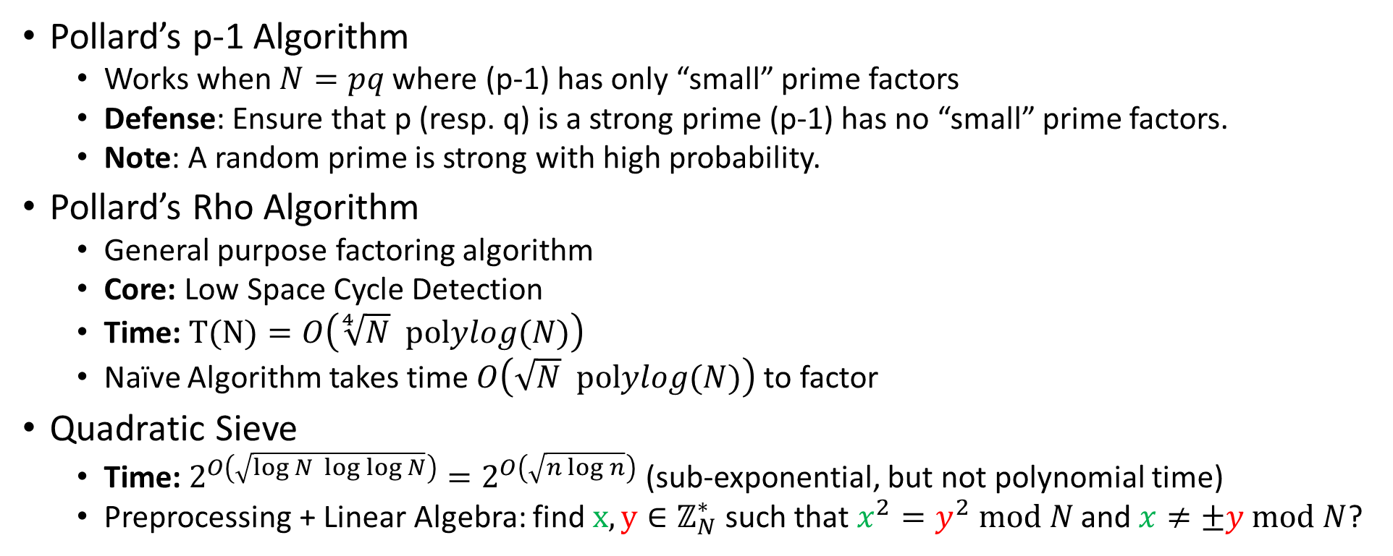
Factoring Algorithms (Summary)
Pollard’s p-1 Algorithm
  Works when $N=pq$ where (p-1) has only “small” prime factors
  Defense: Ensure that p (resp. q) is a strong prime (p-1) has no “small” prime factors.
  Note: A random prime is strong with high probability.
Pollard’s Rho Algorithm
  General purpose factoring algorithm
  Core: Low Space Cycle Detection
  Time: $T(N)=O\left(\sqrt[4]{N} polylog(N)\right)$
  Naïve Algorithm takes time $O\left(\sqrt{N} polylog(N)\right)$ to factor
Quadratic Sieve
  Time: $2^{O\left(\sqrt{\log{N} \log{\log{N}}}\right)}=2^{O\left(\sqrt{n\log{n}}\right)}$ (sub-exponential, but not polynomial time)
  Preprocessing + Linear Algebra: find $x,y∈ℤ_{N}^{∗}$ such that $x^{2}=y^{2} mod N$ and $x≠±y mod N$?

Slide 5
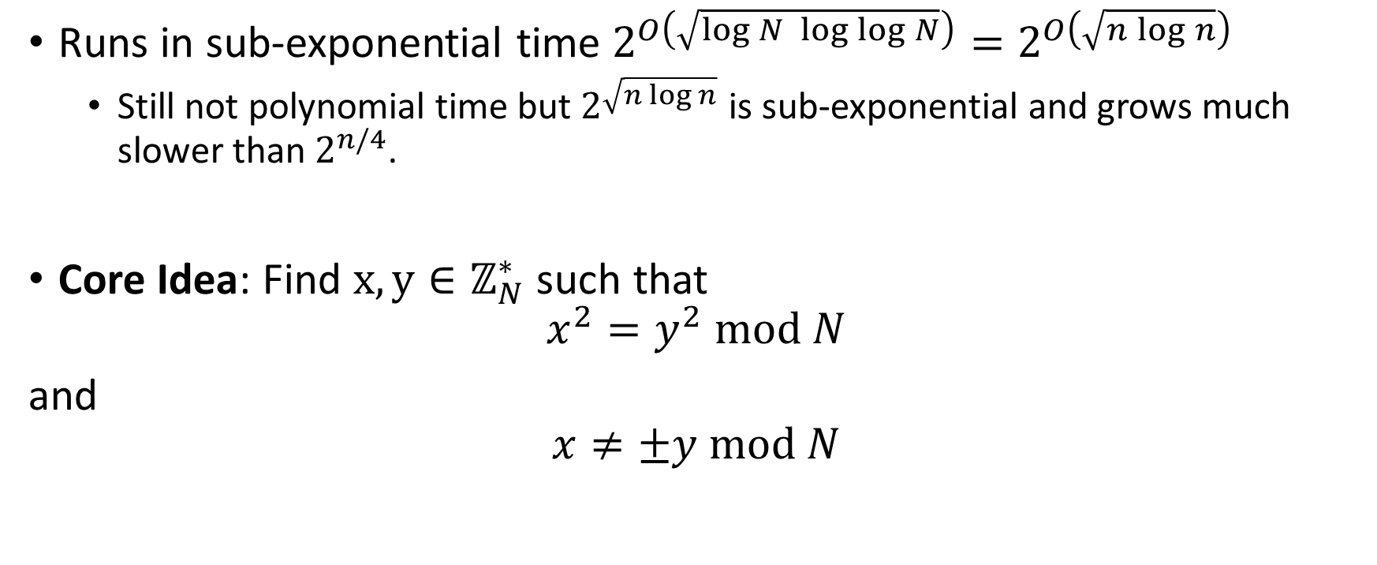
Quadratic Sieve Algorithm
Runs in sub-exponential time $2^{O\left(\sqrt{\log{N} \log{\log{N}}}\right)}=2^{O\left(\sqrt{n\log{n}}\right)}$
  Still not polynomial time but $2^{\sqrt{n\log{n}}}$ is sub-exponential and grows much slower than $2^{n/4}$.
Core Idea: Find $x,y∈ℤ_{N}^{∗}$ such that
$$x^{2}=y^{2} mod N$$
and
$$x≠±y mod N$$

Slide 6
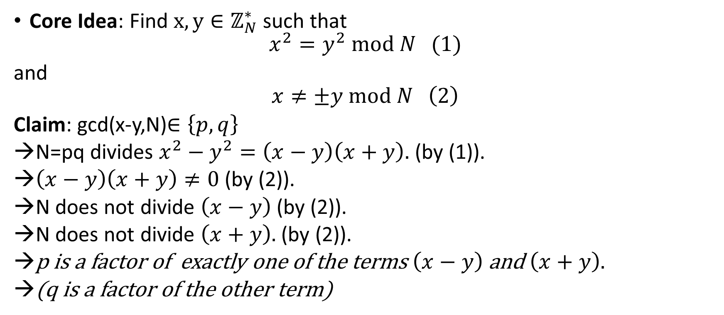
Quadratic Sieve Algorithm
Core Idea: Find $x,y∈ℤ_{N}^{∗}$ such that
$$x^{2}=y^{2} mod N (1)$$
and
$$x≠±y mod N \left(2\right)$$
Claim: gcd(x-y,N)$∈\left\{p,q\right\}$
N=pq divides $x^{2}−y^{2}=\left(x−y\right)\left(x+y\right).$ (by (1)).
$\left(x−y\right)\left(x+y\right)≠0$ (by (2)).
N does not divide $\left(x−y\right)$(by (2)).
N does not divide $\left(x+y\right).$ (by (2)).
p is a factor of exactly one of the terms $\left(x−y\right)$ and $\left(x+y\right).$
(q is a factor of the other term)

Slide 7
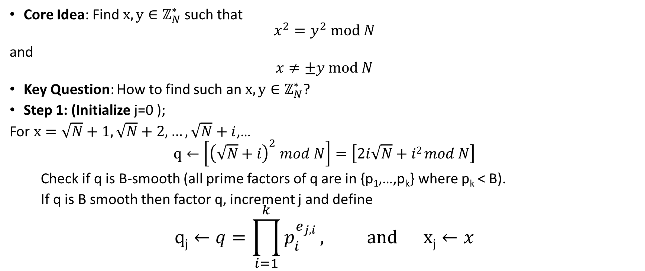
Quadratic Sieve Algorithm
Core Idea: Find $x,y∈ℤ_{N}^{∗}$ such that
$$x^{2}=y^{2} mod N$$
and
$$x≠±y mod N$$
Key Question: How to find such an $x,y∈ℤ_{N}^{∗}$?
Step 1: (Initialize j=0 );
For $x=\sqrt{N}+1,\sqrt{N}+2,…,\sqrt{N}+i$,…
$$q←\left[{\left(\sqrt{N}+i\right)}^{2} mod N\right]=\left[2i\sqrt{N}+i2 mod N\right]$$
Check if q is B-smooth (all prime factors of q are in {p₁,…,p_{k}} where p_{k} < B).
If q is B smooth then factor q, increment j and define
$$qj←q=\prod_{i=1}^{k}{p_{i}^{e_{j,i}}}, and xj←x$$

Slide 8
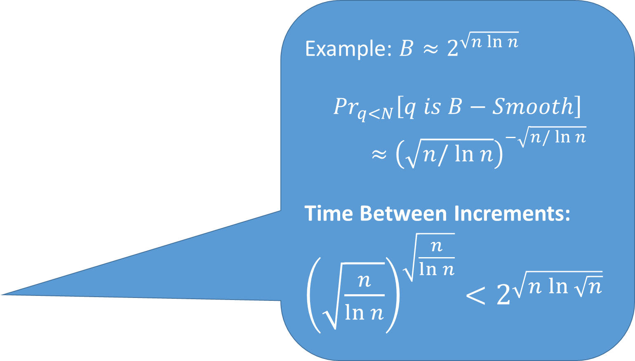
Quadratic Sieve Algorithm
Example: $B≈2^{\sqrt{n ln n} }$
$${Pr}_{q<N}\left[q is B−Smooth\right]$$
$$≈{\left(\sqrt{n/ ln n}\right)}^{−\sqrt{n/ ln n}}$$
Time Between Increments: ${\left(\sqrt{\frac{n}{\ln{n}}}\right)}^{\sqrt{\frac{n}{\ln{n}}}}<2^{\sqrt{n\ln{\sqrt{n}}}}$
Core Idea: Find $x,y∈ℤ_{N}^{∗}$ such that
$$x^{2}=y^{2} mod N$$
and
$$x≠±y mod N$$
Key Question: How to find such an $x,y∈ℤ_{N}^{∗}$?
Step 1: (Initialize j=0 );
For $x=\sqrt{N}+1,\sqrt{N}+2,…,\sqrt{N}+i$,…
$$q←\left[{\left(\sqrt{N}+i\right)}^{2} mod N\right]=\left[2i\sqrt{N}+i2 mod N\right]$$
Check if q is B-smooth (all prime factors of q are in {p₁,…,p_{k}} where p_{k} < B).
If q is B smooth then factor q, increment j and define
$$qj←q=\prod_{i=1}^{k}{p_{i}^{e_{j,i}}}, and xj←x$$

Slide 9
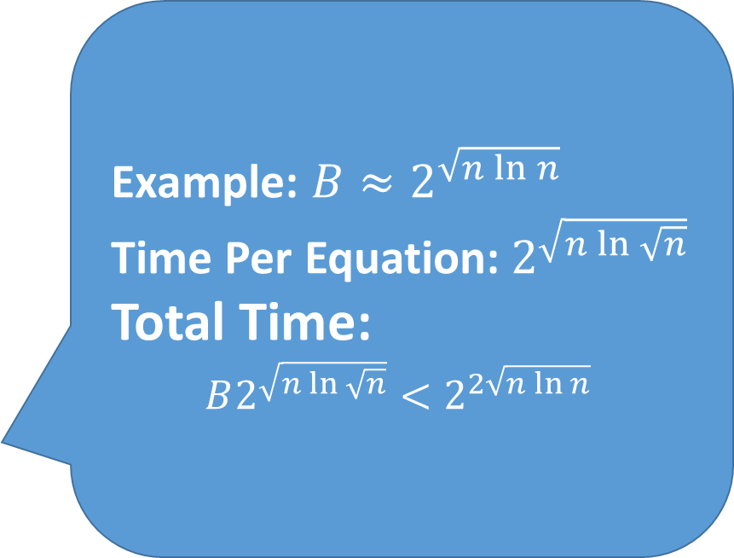
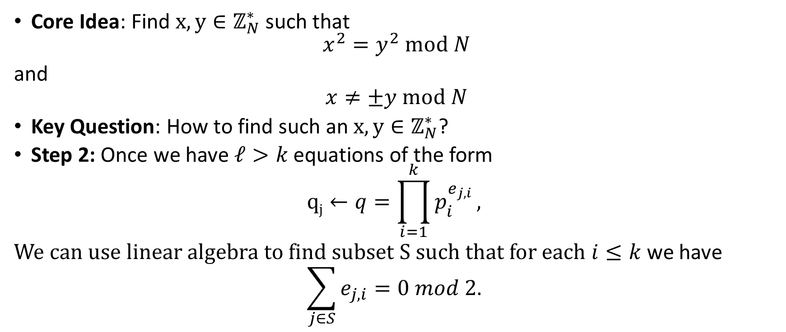
Quadratic Sieve Algorithm
Example: $B≈2^{\sqrt{n\ln{n}}}$
Time Per Equation:$2^{\sqrt{n\ln{\sqrt{n}}}}$
Total Time:
$$B2^{\sqrt{n\ln{\sqrt{n}}}}<2^{2\sqrt{n\ln{n}} }$$
Core Idea: Find $x,y∈ℤ_{N}^{∗}$ such that
$$x^{2}=y^{2} mod N$$
and
$$x≠±y mod N$$
Key Question: How to find such an $x,y∈ℤ_{N}^{∗}$?
Step 2: Once we have $ℓ>k$ equations of the form
$$qj←q=\prod_{i=1}^{k}{p_{i}^{e_{j,i}}},$$
We can use linear algebra to find subset S such that for each $i≤k$ we have
$$\sum_{j∈S}{e_{j,i}}=0 mod 2.$$

Slide 10
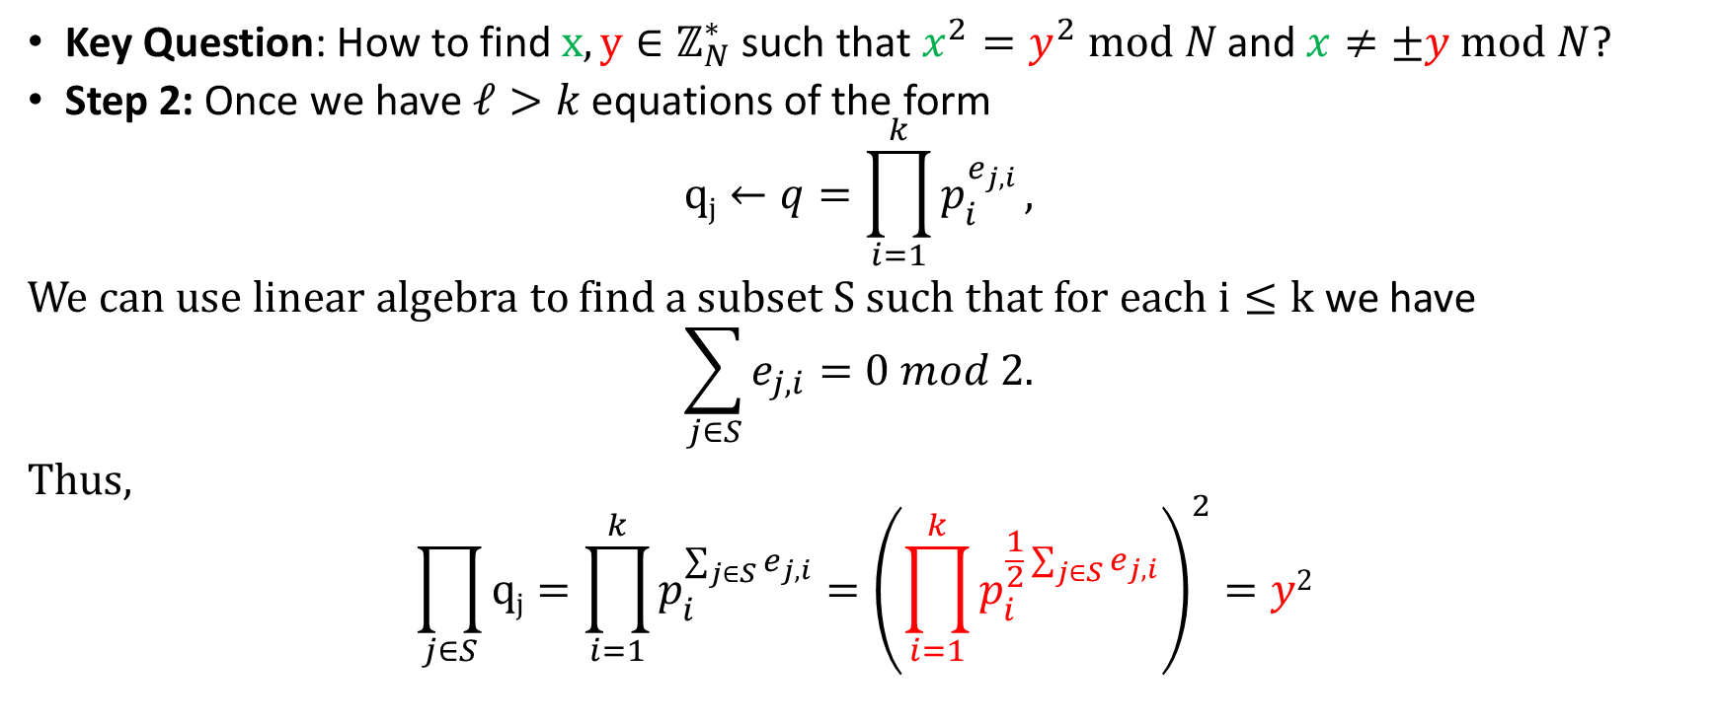
Quadratic Sieve Algorithm
Key Question: How to find $x,y∈ℤ_{N}^{∗}$ such that $x^{2}=y^{2} mod N$ and $x≠±y mod N$?
Step 2: Once we have $ℓ>k$ equations of the form
$$qj←q=\prod_{i=1}^{k}{p_{i}^{e_{j,i}}},$$
We can use linear algebra to find a subset S such that for each $i≤k$ we have
$$\sum_{j∈S}{e_{j,i}}=0 mod 2.$$
Thus,
$$\prod_{j∈S}{qj}=\prod_{i=1}^{k}{p_{i}^{\sum_{j∈S}{e_{j,i}}}}={\left(\prod_{i=1}^{k}{p_{i}^{\frac{1}{2}\sum_{j∈S}{e_{j,i}}}}\right)}^{2}=y2$$

Slide 11
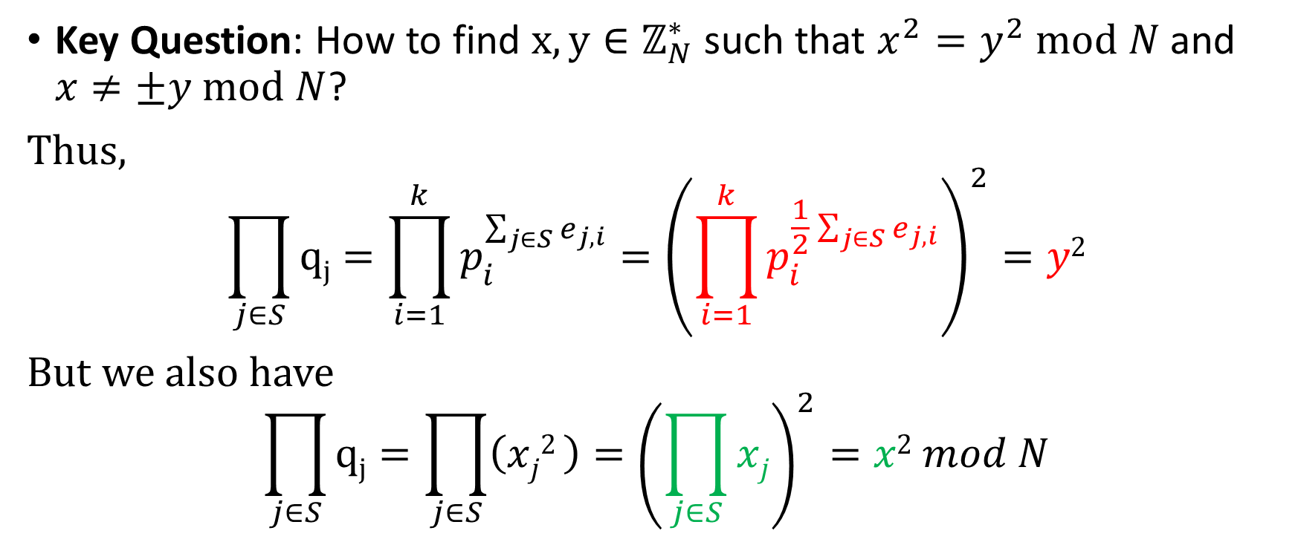
Quadratic Sieve Algorithm
Key Question: How to find $x,y∈ℤ_{N}^{∗}$ such that $x^{2}=y^{2} mod N$ and $x≠±y mod N$?
Thus,
$$\prod_{j∈S}{qj}=\prod_{i=1}^{k}{p_{i}^{\sum_{j∈S}{e_{j,i}}}}={\left(\prod_{i=1}^{k}{p_{i}^{\frac{1}{2}\sum_{j∈S}{e_{j,i}}}}\right)}^{2}=y2$$
But we also have
$$\prod_{j∈S}{qj}=\prod_{j∈S}{\left(xj2 \right)}={\left(\prod_{j∈S}{xj}\right)}^{2}=x2 mod N$$

Slide 12

Quadratic Sieve Algorithm (Summary)
Appropriate parameter tuning yields sub-exponential time algorithm $2^{O\left(\sqrt{\log{N} \log{\log{N}}}\right)}=2^{O\left(\sqrt{n\log{n}}\right)}$
  Still not polynomial time but $2^{\sqrt{n\log{n}}}$ grows much slower than $2^{n/4}$.

Slide 13
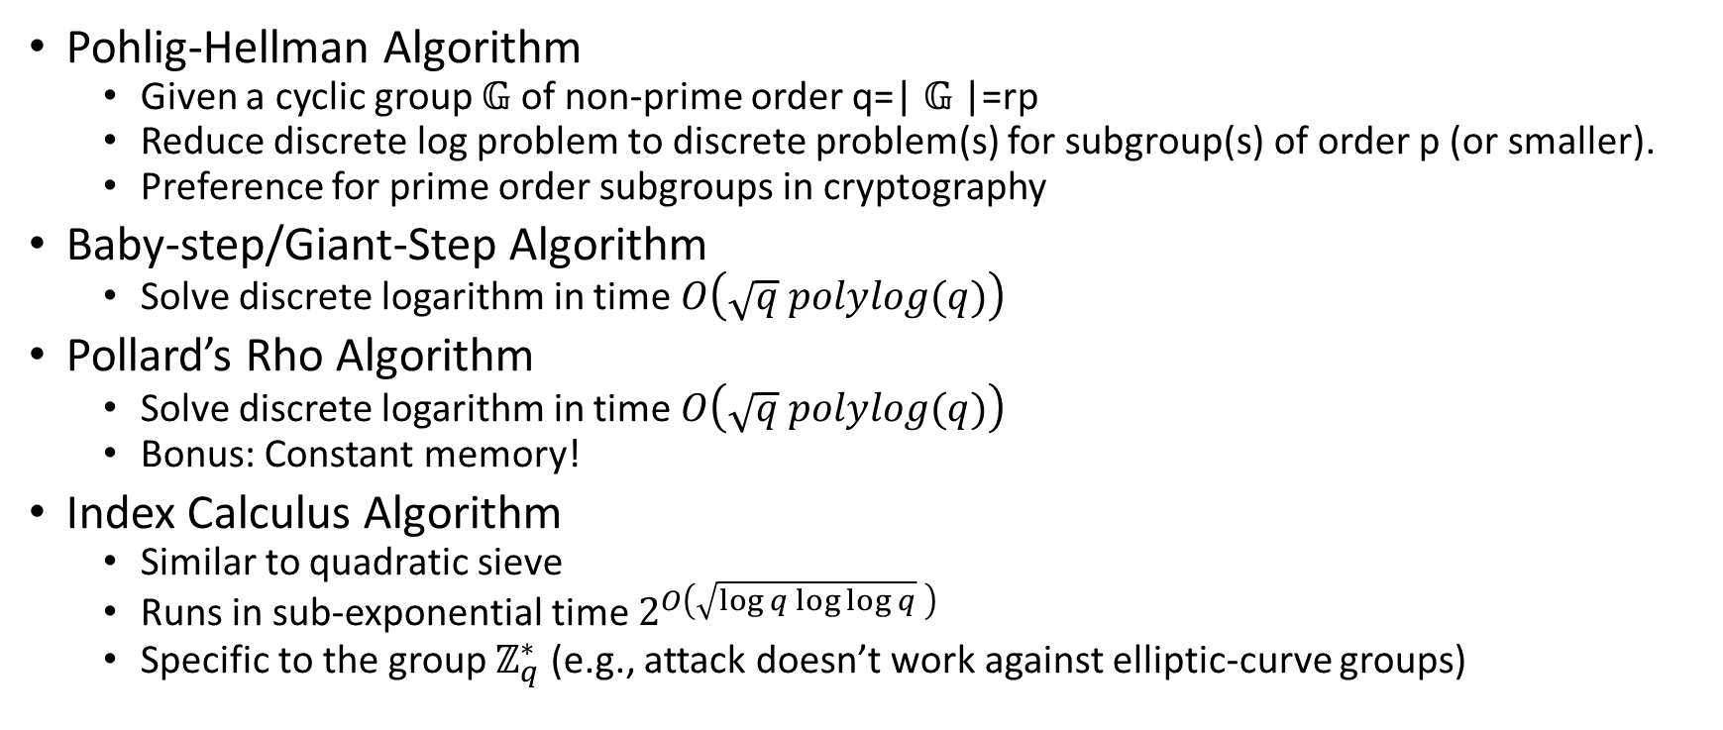
Discrete Log Attacks
Pohlig-Hellman Algorithm
  Given a cyclic group $𝔾$ of non-prime order q=| $𝔾$|=rp
  Reduce discrete log problem to discrete problem(s) for subgroup(s) of order p (or smaller).
  Preference for prime order subgroups in cryptography
Baby-step/Giant-Step Algorithm
  Solve discrete logarithm in time $O\left(\sqrt{q} polylog(q)\right)$
Pollard’s Rho Algorithm
  Solve discrete logarithm in time $O\left(\sqrt{q} polylog(q)\right)$
  Bonus: Constant memory!
Index Calculus Algorithm
  Similar to quadratic sieve
  Runs in sub-exponential time $2^{O\left(\sqrt{\log{q}\log{\log{q}}} \right)}$
  Specific to the group $ℤ_{q}^{∗}$ (e.g., attack doesn’t work against elliptic-curve groups)

Slide 14
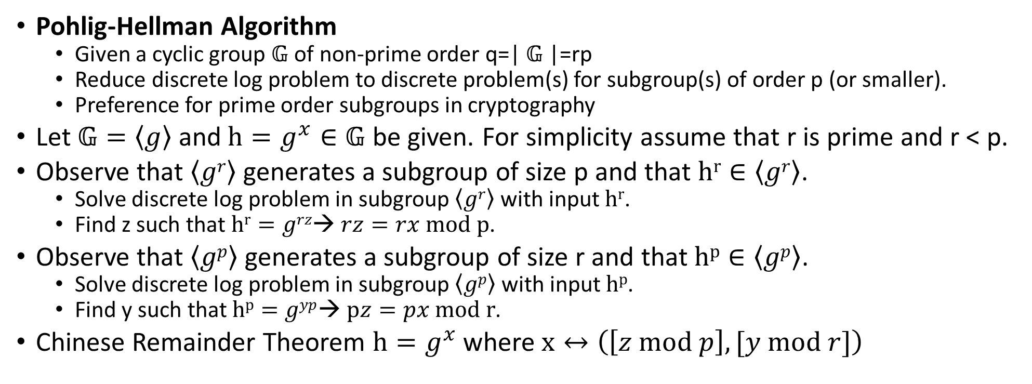
Discrete Log Attacks
Pohlig-Hellman Algorithm
  Given a cyclic group $𝔾$ of non-prime order q=| $𝔾$|=rp
  Reduce discrete log problem to discrete problem(s) for subgroup(s) of order p (or smaller).
  Preference for prime order subgroups in cryptography
Let $𝔾=\left\langle g\right\rangle$ and$h=g^{x}∈𝔾$ be given. For simplicity assume that r is prime and r < p.
Observe that $\left\langle gr\right\rangle$ generates a subgroup of size p and that $hr∈\left\langle gr\right\rangle$.
  Solve discrete log problem in subgroup $\left\langle gr\right\rangle$ with input $hr$.
  Find z such that $hr=grz$→ $rz=rx mod p$.
Observe that $\left\langle gp\right\rangle$ generates a subgroup of size r and that $hp∈\left\langle gp\right\rangle$.
  Solve discrete log problem in subgroup $\left\langle gp\right\rangle$ with input $hp$.
  Find y such that $hp=gyp$→ $pz=px mod r$.
Chinese Remainder Theorem $h=g^{x}$ where $x↔\left(\left[z mod p\right], [y mod r]\right)$

Slide 15
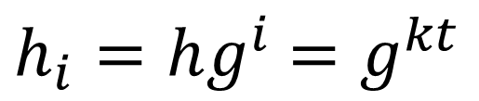
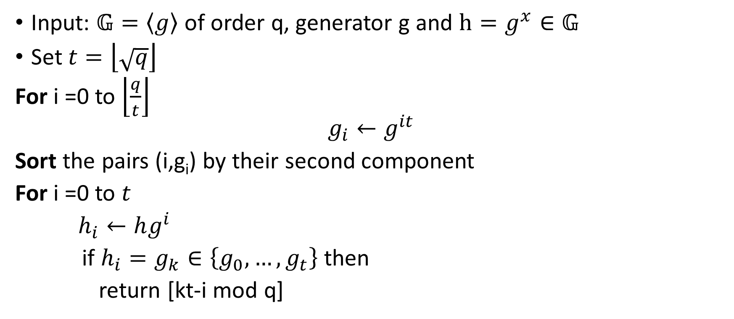
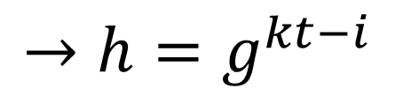
Baby-step/Giant-Step Algorithm
Input: $𝔾=\left\langle g\right\rangle$ of order q, generator g and $h=g^{x}∈𝔾$
Set $t=\left\lfloor \sqrt{q}\right\rfloor$
For i =0 to $\left\lfloor \frac{q}{t}\right\rfloor$
$$g_{i}←g^{it}$$
Sort the pairs (i,g_{i}) by their second component
For i =0 to $t$
$h_{i}←hg^{i}$
if $h_{i}=g_{k}∈\left\{g_{0},…,g_{t}\right\}$ then
return [kt-i mod q]
$h_{i}=hg^{i}$ $=g^{kt}$
$$→h=g^{kt−i}$$

Slide 16
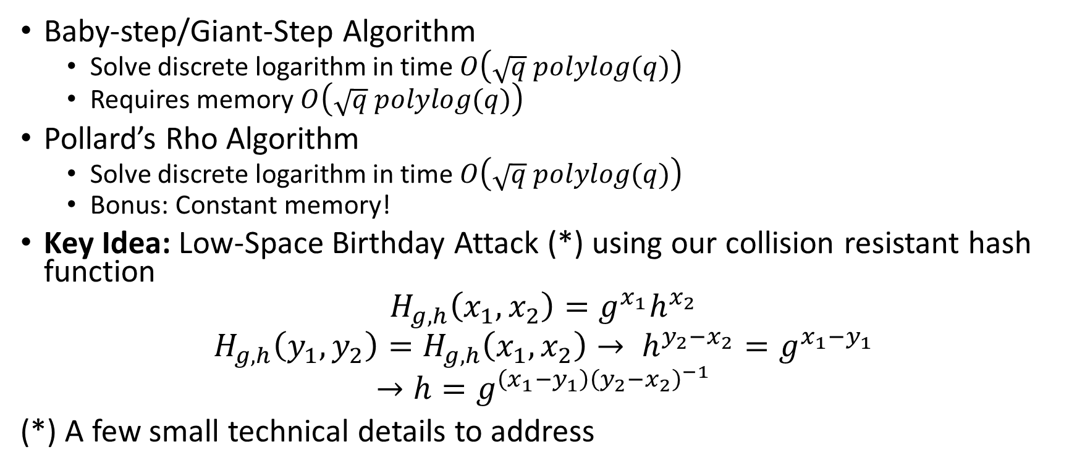
Discrete Log Attacks
Baby-step/Giant-Step Algorithm
  Solve discrete logarithm in time $O\left(\sqrt{q} polylog(q)\right)$
  Requires memory $O\left(\sqrt{q} polylog(q)\right)$
Pollard’s Rho Algorithm
  Solve discrete logarithm in time $O\left(\sqrt{q} polylog(q)\right)$
  Bonus: Constant memory!
Key Idea: Low-Space Birthday Attack (*) using our collision resistant hash function
$$H_{g,h}\left(x_{1},x_{2}\right)=g^{x_{1}}h^{x_{2}}$$
$$H_{g,h}\left(y_{1},y_{2}\right)=H_{g,h}\left(x_{1},x_{2}\right)→ h^{y_{2}−x_{2}}=g^{x_{1}−y_{1}}$$
$$→h=g^{\left(x_{1}−y_{1}\right){\left(y_{2}−x_{2}\right)}^{−1}}$$
(*) A few small technical details to address

Slide 17
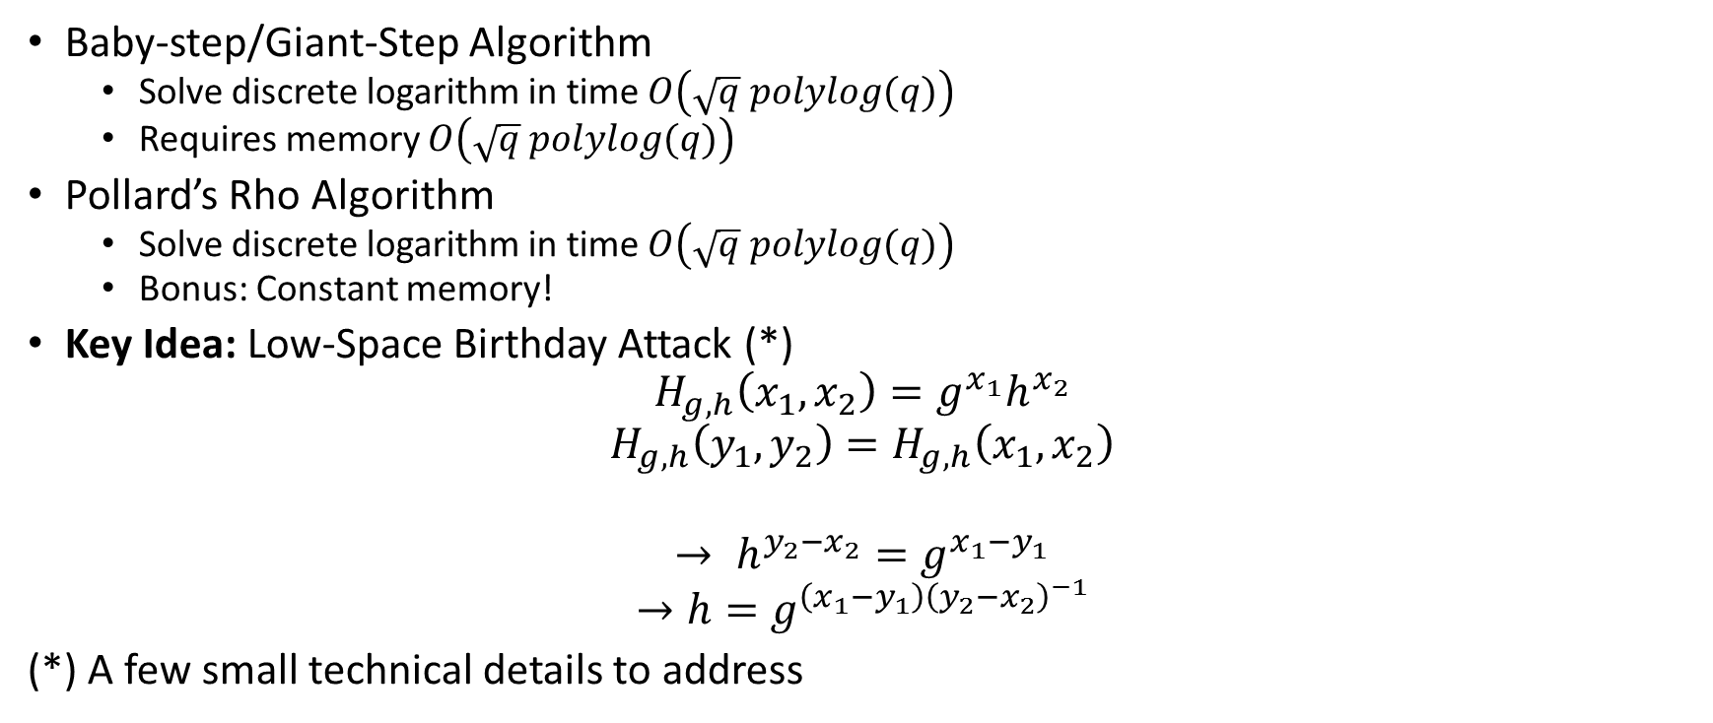
Discrete Log Attacks
Remark: We used discrete-log problem to construct collision resistant hash functions.
Security Reduction showed that attack on collision resistant hash function yields attack on discrete log.
→Generic attack on collision resistant hash functions (e.g., low space birthday attack) yields generic attack on discrete log.
Baby-step/Giant-Step Algorithm
  Solve discrete logarithm in time $O\left(\sqrt{q} polylog(q)\right)$
  Requires memory $O\left(\sqrt{q} polylog(q)\right)$
Pollard’s Rho Algorithm
  Solve discrete logarithm in time $O\left(\sqrt{q} polylog(q)\right)$
  Bonus: Constant memory!
Key Idea: Low-Space Birthday Attack (*)
$$H_{g,h}\left(x_{1},x_{2}\right)=g^{x_{1}}h^{x_{2}}$$
$$H_{g,h}\left(y_{1},y_{2}\right)=H_{g,h}\left(x_{1},x_{2}\right)$$
$$→ h^{y_{2}−x_{2}}=g^{x_{1}−y_{1}}$$
$$→h=g^{\left(x_{1}−y_{1}\right){\left(y_{2}−x_{2}\right)}^{−1}}$$
(*) A few small technical details to address

Slide 18
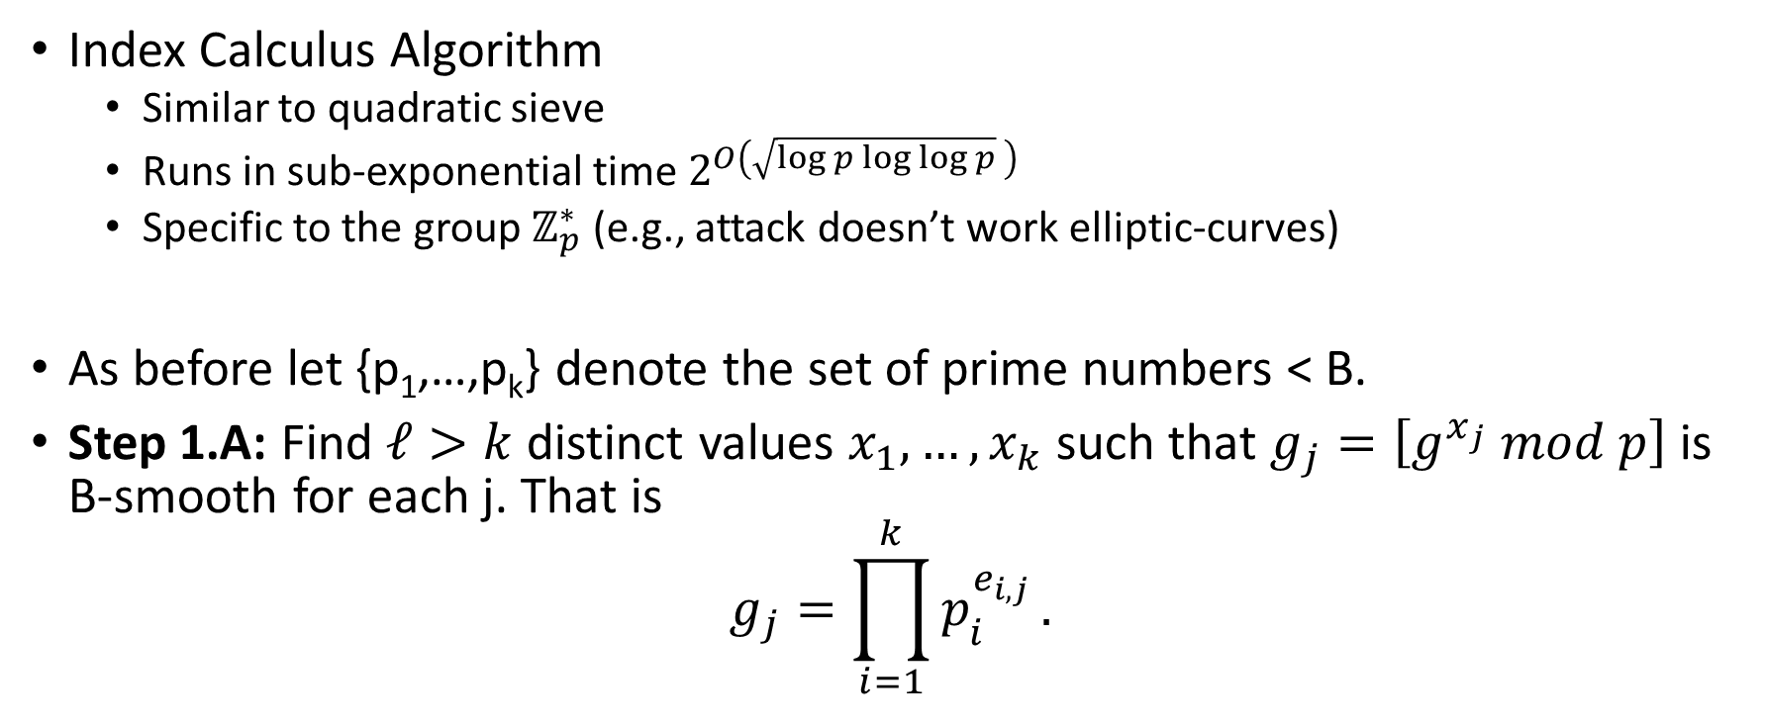
Discrete Log Attacks
Index Calculus Algorithm
  Similar to quadratic sieve
  Runs in sub-exponential time $2^{O\left(\sqrt{\log{p}\log{\log{p}}} \right)}$
  Specific to the group $ℤ_{p}^{∗}$ (e.g., attack doesn’t work elliptic-curves)
As before let {p₁,…,p_{k}} denote the set of prime numbers < B.
Step 1.A: Find $ℓ>k$ distinct values $x_{1},…,x_{k}$ such that $g_{j}=\left[g^{x_{j}} mod p\right]$ is B-smooth for each j. That is
$$g_{j}=\prod_{i=1}^{k}{p_{i}^{e_{i,j}}}.$$

Slide 19
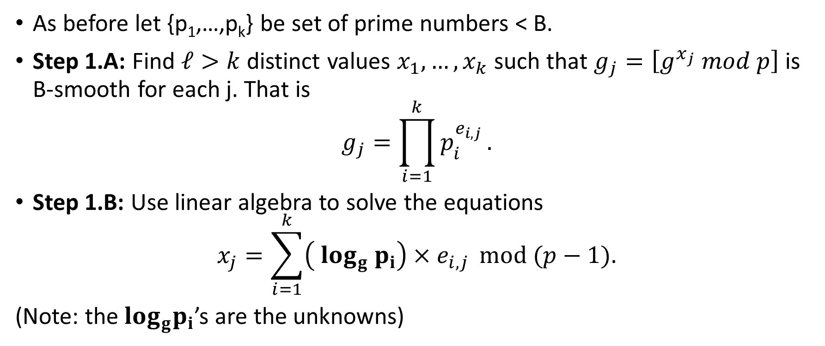
Discrete Log Attacks
As before let {p₁,…,p_{k}} be set of prime numbers < B.
Step 1.A: Find $ℓ>k$ distinct values $x_{1},…,x_{k}$ such that $g_{j}=\left[g^{x_{j}} mod p\right]$ is B-smooth for each j. That is
$$g_{j}=\prod_{i=1}^{k}{p_{i}^{e_{i,j}}}.$$
Step 1.B: Use linear algebra to solve the equations
$$x_{j}=\sum_{i=1}^{k}{\left(\log_{g}{ p}_{i}\right){×e}_{i,j}} mod (p−1).$$
(Note: the$\log_{g}p_{i}$’s are the unknowns)

Slide 20
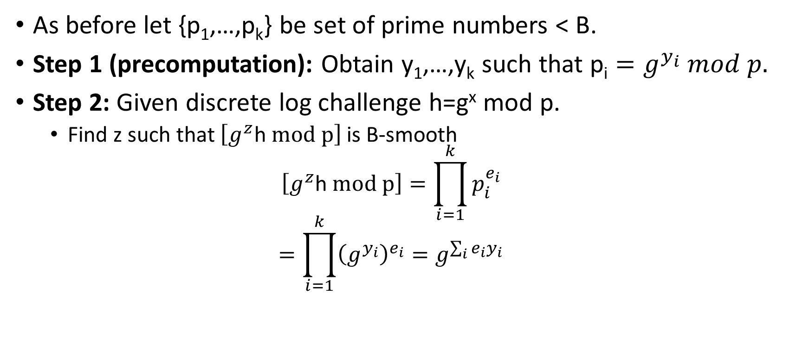
Discrete Log
As before let {p₁,…,p_{k}} be set of prime numbers < B.
Step 1 (precomputation): Obtain y₁,…,y_{k} such that $\text{p}\text{i}=g^{y_{i}} mod p.$
Step 2: Given discrete log challenge h=g^{x} mod p.
  Find z such that $\left[g^{z}\text{h} mod p\right]$ is B-smooth
  $$\left[g^{z}\text{h} mod p\right]=\prod_{i=1}^{k}{p_{i}^{e_{i}}}$$
  $$=\prod_{i=1}^{k}{{\left(g^{y_{i}}\right)}^{e_{i}}}=g^{\sum_{i}{{e_{i}y}_{i}}}$$

Slide 21
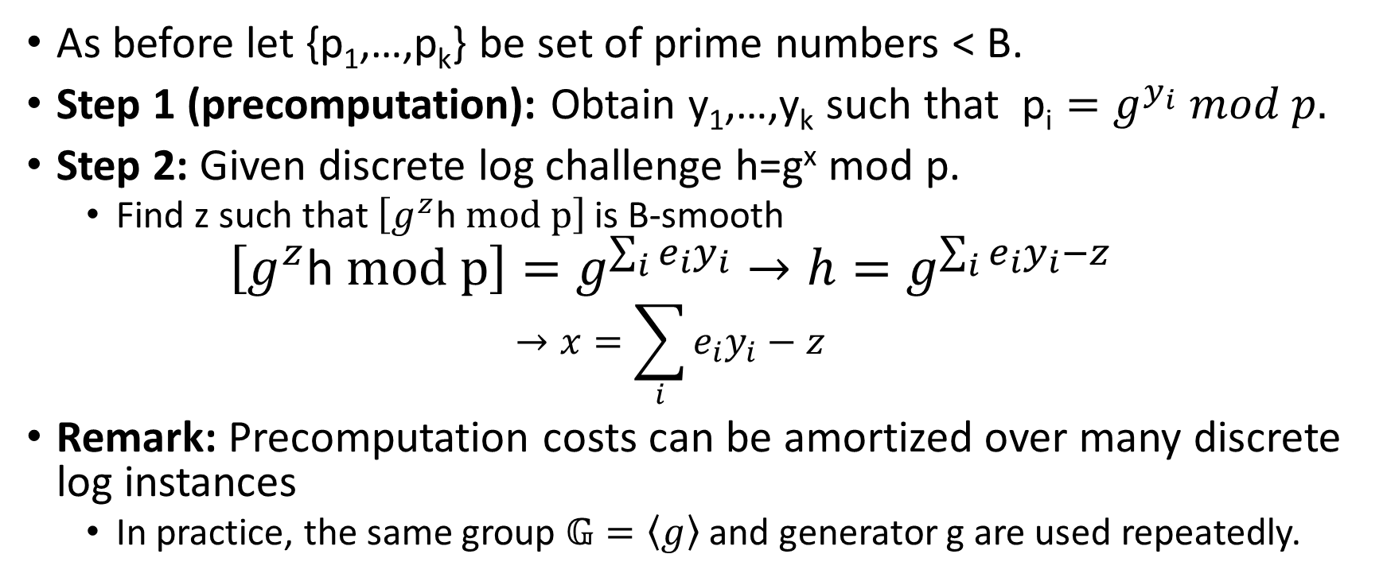
Discrete Log
As before let {p₁,…,p_{k}} be set of prime numbers < B.
Step 1 (precomputation): Obtain y₁,…,y_{k} such that $\text{p}\text{i}=g^{y_{i}} mod p.$
Step 2: Given discrete log challenge h=g^{x} mod p.
  Find z such that $\left[g^{z}\text{h} mod p\right]$ is B-smooth
  $$\left[g^{z}\text{h} mod p\right]=g^{\sum_{i}{{e_{i}y}_{i}}}→h=g^{\sum_{i}{{e_{i}y}_{i}}−z}$$
  $$→x=\sum_{i}{{e_{i}y}_{i}}−z$$
Remark: Precomputation costs can be amortized over many discrete log instances
  In practice, the same group $𝔾=\left\langle g\right\rangle$ and generator g are used repeatedly.
Reference: https://www.weakdh.org/

Slide 22
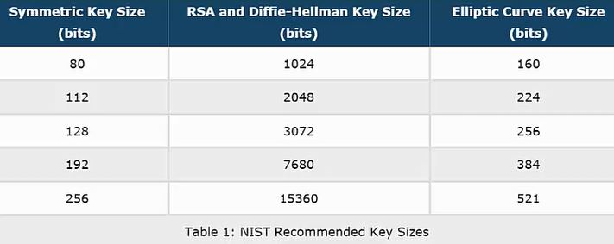
NIST Guidelines (Concrete Security)
Best known attack against 1024 bit RSA takes time (approximately) 2⁸⁰

Slide 23

NIST Guidelines (Concrete Security)
Diffie-Hellman uses subgroup of $ℤ_{p}^{∗}$ size q
q=224 bits
q=256 bits
q=384 bits
q=512 bits

Slide 24

NIST Guidelines (Concrete Security)
$112 bits=\frac{\log{2^{224}}}{2}=\log{\sqrt{2^{224}}}$bits (Pollard’s Rho)
q=224 bits
q=256 bits
q=384 bits
q=512 bits

Slide 25

NIST Guidelines (Concrete Security)
$112 bits≈\sqrt{2048\log{2048}}$ bits (Index Calculus)
q=224 bits
q=256 bits
q=384 bits
q=512 bits

Slide 26
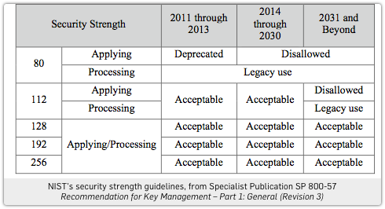

Slide 27
Week 12: Topic 1: Key Management

Slide 28


Key-Exchange Problem
Key-Exchange Problem:
  Obi-Wan and Yoda want to communicate securely
  Suppose that
    Obi-Wan and Yoda don’t have time to meet privately and generate one
    Obi-Wan and Yoda share a symmetric key with Anakin
    Suppose that they fully trust Anakin

Slide 29


Key-Distribution Center
(with Symmetric Key-Crypto)
Enc(K_{obiwan} ,”I would like to talk to Yoda”)
Ok, here is a fresh key that no sith lord has seen
c₁=Enc(K_{obiwan} ,ts, K_{new}),
c₂=Enc(K_{yoda} , ts, “Obiwan/Yoda”, K_{new})
K_{obiwan}: Shared key between Obiwan and Anakin
K_{yoda}: Shared key between yoda and Anakin

Slide 30
Key-Distribution Center
(with Symmetric Key-Crypto)
Enc(K_{obiwan} ,”I would like to talk to Yoda”)
Ok, here is a fresh key that no sith lord has seen
c₁=Enc(K_{obiwan} ,ts, K_{new}),
c₂=Enc(K_{yoda} , ts, “Obiwan/Yoda”, K_{new})
Enc(K_{new}, “Its me, Obiwan, let’s talk”)
c₂=Enc(K_{yoda} ,ts, “Obiwan/Yoda”, K_{new})

Slide 31

Key-Distribution Center (with Symmetric Key-Crypto)
Vulnerability: If Key-Distribution Center is compromised then all security guarantees are broken.
  KDC is a valuable target for attackers
  Possibility of insider attacks (e.g., employees)
Denial of Service (DOS) Attack: If KDC is down then secure communication is temporarily impossible.

Slide 32
Key-Distribution Center (with Symmetric Key-Crypto)
Benefit: Authenticated Encryption provides authentication as well
  Yoda can be sure he is talking to Obiwan (assuming he trusts the KDC)
Kerberos uses similar protocol
  Yoda’s key and Obiwan’s key are typically derived from a password that they know.
  Vulnerability: An eavesdropping attacker can mount a brute-force attack on the (low-entropy) passwords to recover K_{yoda} and K_{obiwan}.
Recommendation: Always use Public Key Initialization with Kerberos

Slide 33
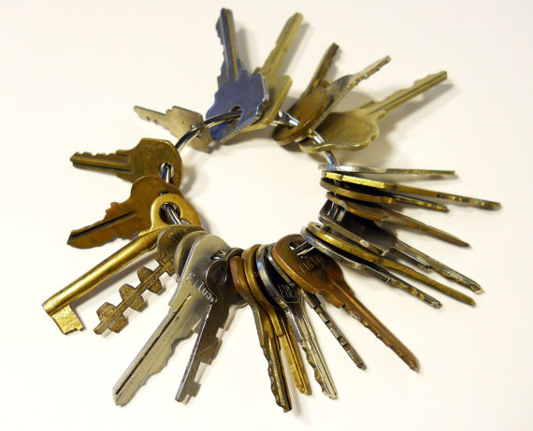
Key-Explosion Problem
To avoid use a trusted KDC we could have every pair of users exchange private keys
How many private keys per person?
  Answer: n-1
  Need to meet up with n-1 different users in person!
Key Explosion Problem
  n can get very big if you are Google or Amazon!

Slide 34

Diffie-Hellman Key Exchange
Alice picks $xA$ and sends ${ g}^{xA}$ to Bob
Bob picks $xB$ and sends ${ g}^{xB}$ to Alice
Alice and Bob can both compute ${K_{A,B}=g}^{xB xA}$

Slide 35
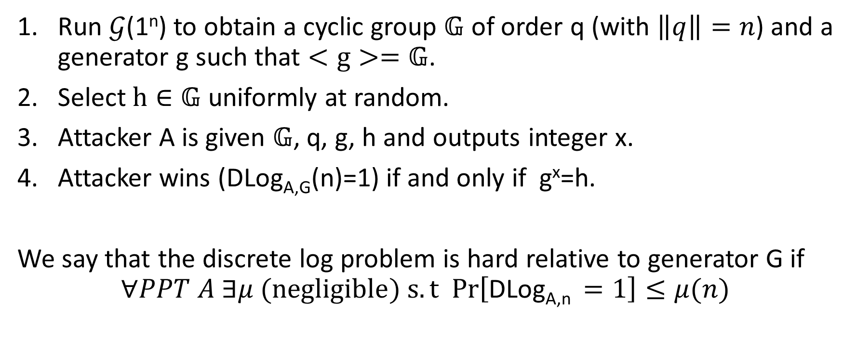
Discrete Log Experiment DLog_{A,G}(n)
Run $𝒢$(1^{n}) to obtain a cyclic group $𝔾$ of order q (with $\left\|q\right\|=n$) and a generator g such that $<g>=𝔾$.
Select$h∈𝔾$ uniformly at random.
Attacker A is given $𝔾$, q, g, h and outputs integer x.
Attacker wins (DLog_{A,G}(n)=1) if and only if g^{x}=h.
We say that the discrete log problem is hard relative to generator G if
$$∀PPT A ∃μ (negligible) s.t Pr\left[\text{DLog}\text{A}\text{,}\text{n} =1\right]≤μ(n)$$

Slide 36
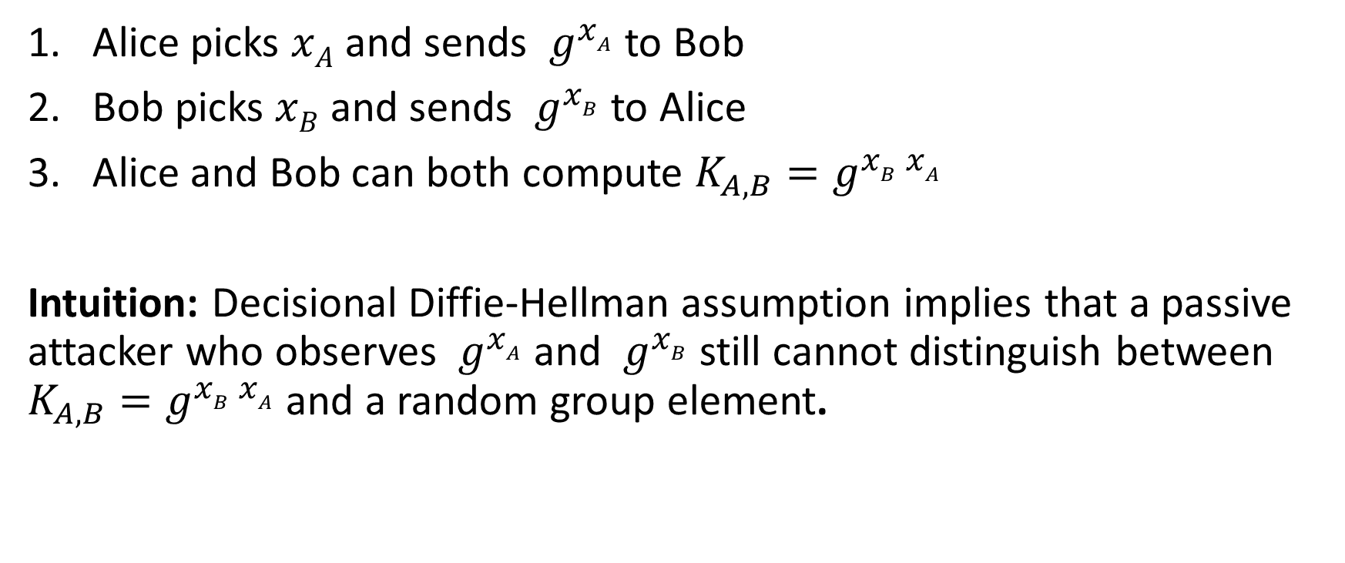
Diffie-Hellman Key Exchange
Alice picks $xA$ and sends ${ g}^{xA}$ to Bob
Bob picks $xB$ and sends ${ g}^{xB}$ to Alice
Alice and Bob can both compute ${K_{A,B}=g}^{xB xA}$
Intuition: Decisional Diffie-Hellman assumption implies that a passive attacker who observes ${ g}^{xA}$ and ${ g}^{xB}$ still cannot distinguish between ${K_{A,B}=g}^{xB xA}$ and a random group element.

Slide 37
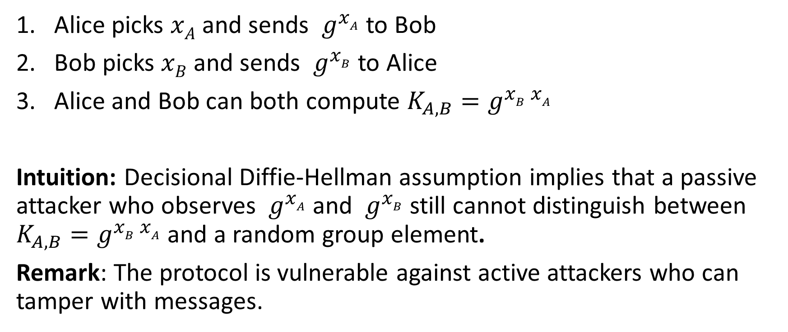
Diffie-Hellman Key Exchange
Alice picks $xA$ and sends ${ g}^{xA}$ to Bob
Bob picks $xB$ and sends ${ g}^{xB}$ to Alice
Alice and Bob can both compute ${K_{A,B}=g}^{xB xA}$
Intuition: Decisional Diffie-Hellman assumption implies that a passive attacker who observes ${ g}^{xA}$ and ${ g}^{xB}$ still cannot distinguish between ${K_{A,B}=g}^{xB xA}$ and a random group element.
Remark: The protocol is vulnerable against active attackers who can tamper with messages.

Slide 38
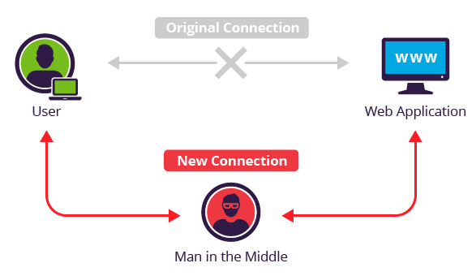
Man in the Middle Attack (MITM)

Slide 39
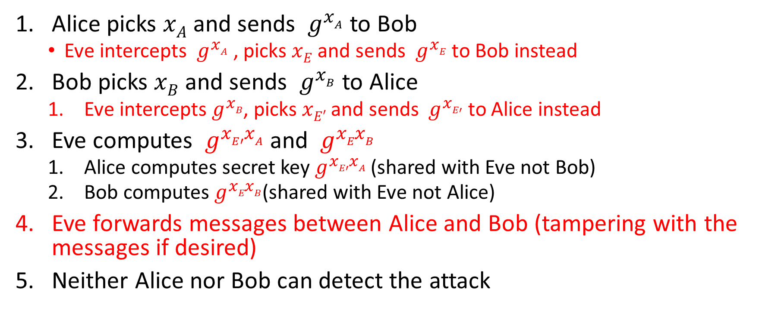
Man in the Middle Attack (MITM)
Alice picks $xA$ and sends ${ g}^{xA}$ to Bob
  Eve intercepts ${ g}^{xA}$ , picks $xE$ and sends ${ g}^{xE}$ to Bob instead
Bob picks $xB$ and sends ${ g}^{xB}$ to Alice
  Eve intercepts${ g}^{xB}$, picks $xE′$ and sends ${ g}^{xE′}$ to Alice instead
Eve computes ${ g}^{xE′xA}$ and ${ g}^{xExB}$
  Alice computes secret key${ g}^{xE′xA}$ (shared with Eve not Bob)
  Bob computes${ g}^{xExB}$(shared with Eve not Alice)
Eve forwards messages between Alice and Bob (tampering with the messages if desired)
Neither Alice nor Bob can detect the attack

Slide 40
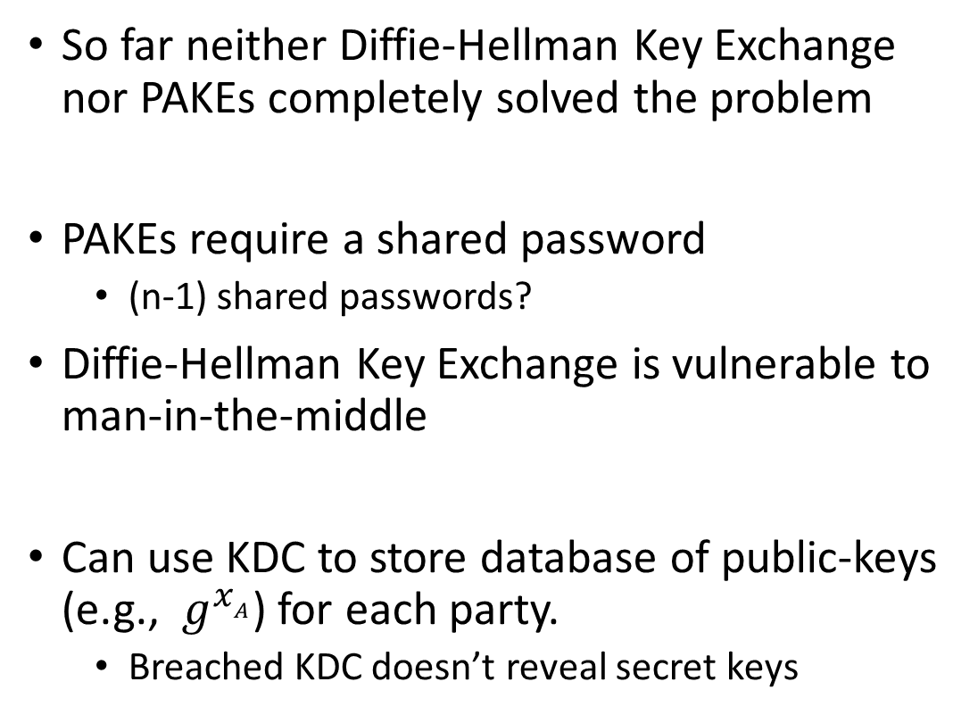
Key-Explosion Problem
So far neither Diffie-Hellman Key Exchange nor PAKEs completely solved the problem
PAKEs require a shared password
  (n-1) shared passwords?
Diffie-Hellman Key Exchange is vulnerable to man-in-the-middle
Can use KDC to store database of public-keys (e.g., ${ g}^{xA}$) for each party.
  Breached KDC doesn’t reveal secret keys

Slide 41
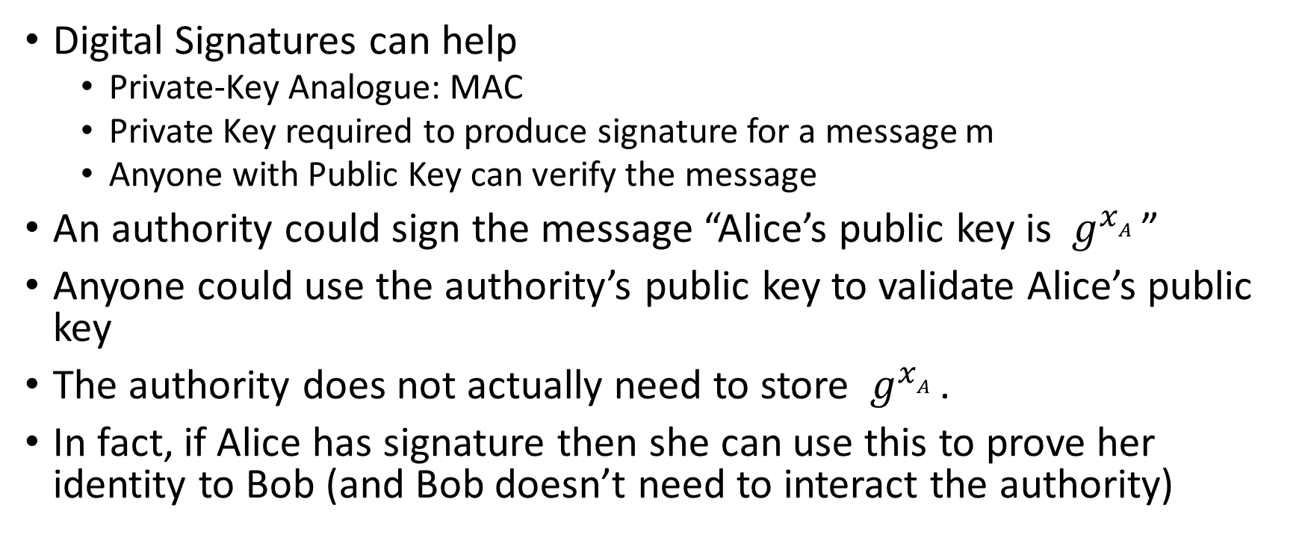
Public Key Revolution
Digital Signatures can help
  Private-Key Analogue: MAC
  Private Key required to produce signature for a message m
  Anyone with Public Key can verify the message
An authority could sign the message “Alice’s public key is ${ g}^{xA}$”
Anyone could use the authority’s public key to validate Alice’s public key
The authority does not actually need to store ${ g}^{xA}$.
In fact, if Alice has signature then she can use this to prove her identity to Bob (and Bob doesn’t need to interact the authority)

Slide 42
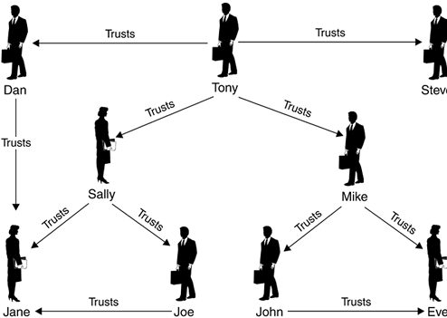
Distributed Web of Trust

Slide 43
Week 12 Topic 2: Formalizing Public Key Cryptography

Slide 44

Public Key Encryption: Basic Terminology
Plaintext/Plaintext Space
  A message $m∈ℳ$
Ciphertext $c∈𝒞$
Public/Private Key Pair $\left(pk,sk\right)∈𝓚$

Slide 45
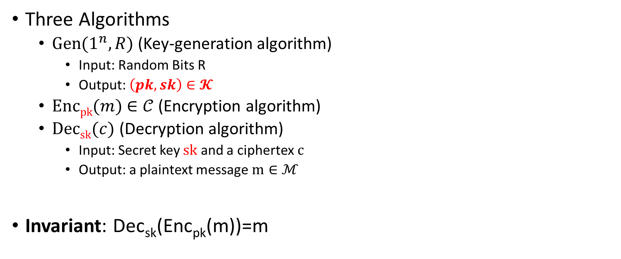
Public Key Encryption Syntax
Three Algorithms
  $\operatorname{Gen}{(1^{n},R)}$ (Key-generation algorithm)
    Input: Random Bits R
    Output: $\left(pk,sk\right)∈𝓚$
  $\operatorname{Encpk}{(m)}$ $∈𝒞$ (Encryption algorithm)
  $\operatorname{Decsk}{(c)}$ (Decryption algorithm)
    Input: Secret key $sk$ and a ciphertex$c$
    Output: a plaintext message $m∈ℳ$
Invariant: Dec_{sk}(Enc_{pk}(m))=m
    Alice must run key generation algorithm in advance an publishes the public key: pk
    Assumption: Adversary only gets to see pk (not sk)

Slide 46
Chosen-Plaintext Attacks
Model ability of adversary to control or influence what the honest parties encrypt.
Historical Example: Battle of Midway (WWII).
  US Navy cryptanalysts were able to break Japanese code by tricking Japanese navy into encrypting a particular message
Private Key Cryptography
Notes:
Batle of Midway. In May 1942, US Navy cryptanal

Slide 47
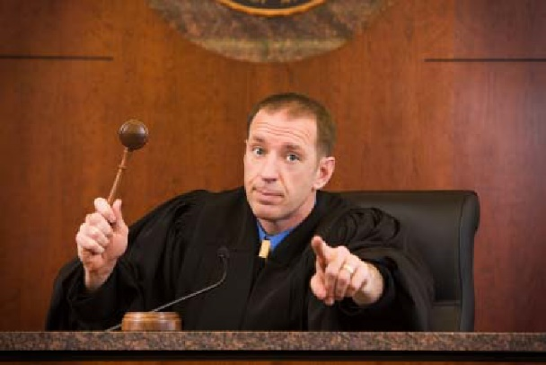

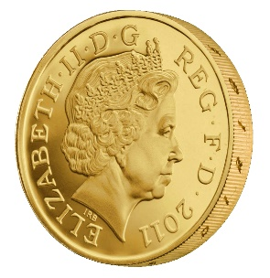

Recap CPA-Security (Symmetric Key Crypto)
m_{0,1},m_{1,1}
c₁ = Enc_{K}(m_{b,1})
m_{0,2},m_{1,2}
c₂ = Enc_{K}(m_{b,2})
m_{0,3},m_{1,3}
c₃ = Enc_{K}(m_{b,3})
…
$$∀PPT A ∃μ (negligible) s.t$$
$$Pr\left[A Guesses b^{′}=b\right]≤\frac{1}{2}+μ(n)$$
b’
Random bit b
K = Gen(.)

Slide 48
Chosen-Plaintext Attacks
Model ability of adversary to control or influence what the honest parties encrypt.
Private Key Crypto
  Attacker tricks victim into encrypting particular messages
Public Key Cryptography
  The attacker already has the public key pk
  Can encrypt any message s/he wants!
  CPA Security is critical!
Notes:
Batle of Midway. In May 1942, US Navy cryptanal

Slide 49






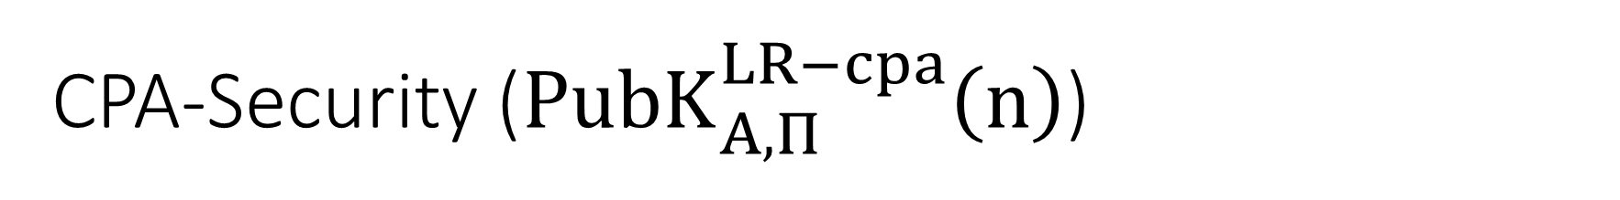

CPA-Security (${PubK}_{A,Π}^{LR−cpa}\left(n\right)$)
Public Key: pk
$$m_{0}^{1},m_{1}^{1}$$
$$c_{1}={Enc}_{pk}\left(m_{b}^{1}\right)$$
$$m_{0}^{2},m_{1}^{2}$$
$$c_{2}={Enc}_{pk}\left(m_{b}^{2}\right)$$
$$m_{0}^{3},m_{1}^{3}$$
$$c_{3}={Enc}_{pk}\left(m_{b}^{3}\right)$$
$$∀PPT A ∃μ (negligible) s.t$$
$$Pr\left[{PubK}_{A,Π}^{LR−cpa}\left(n\right)=1\right]≤\frac{1}{2}+μ(n)$$
…
b’
Random bit b
(pk,sk) = Gen(.)

Slide 50
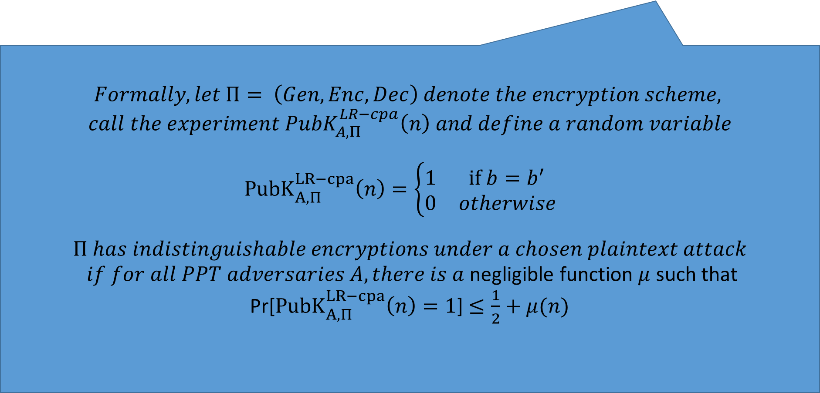
CPA-Security (Single Message)
m₀,m₁
$$Formally, let Π= \left(Gen,Enc,Dec\right) denote the encryption scheme,$$
$$call the experiment {PubK}_{A,Π}^{LR−cpa}\left(n\right) and define a random variable$$
$${PubK}_{A,Π}^{LR−cpa}\left(n\right)=\left\{\begin{matrix}1 & if b=b^{′} \\ 0 & otherwise\end{matrix}\begin{aligned} \\ \end{aligned}\right.$$
$$Π has indistinguishable encryptions under a chosen plaintext attack$$
$if for all PPT adversaries A, there is a$negligible function $μ$ such that
Pr[${PubK}_{A,Π}^{LR−cpa}\left(n\right)=1$] $≤\frac{1}{2}+μ(n)$
c = Enc_{K}(m_{b})
m₂
c₂ = Enc_{K}(m₂)
m₃
c₃ = Enc_{K}(m₃)
…
$$∀PPT A ∃μ (negligible) s.t$$
$$Pr\left[A Guesses b^{′}=b\right]≤\frac{1}{2}+μ(n)$$
b’
Random bit b
K = Gen(.)

Slide 51

Private Key Crypto
CPA Security was stronger than eavesdropping security
  $$EncK(m)=G(K)⨁m$$
Vs.
$$EncK(m)= \left\langle r,F_{k}\left(r\right)⨁m\right\rangle$$

Slide 52

Public Key Crypto
Fact 1: CPA Security and Eavesdropping Security are Equivalent
  Key Insight: The attacker has the public key so he doesn’t gain anything from being able to query the encryption oracle!
Fact 2: Any deterministic encryption scheme is not CPA-Secure
  Historically overlooked in many real world public key crypto systems
Fact 3: Plain RSA is not CPA-Secure
Fact 4: No Public Key Cryptosystem can achieve Perfect Secrecy!
  Exercise 11.1
  Hint: Unbounded attacker can keep encrypting the message m using the public key to recover all possible encryptions of m.

Slide 53

Encrypting Longer Messages
Claim 11.7: Let $Π= \left(Gen,Enc,Dec\right)$ denote a CPA-Secure public key encryption scheme and let $Π′= \left(Gen,Enc′,Dec′\right)$be defined such that
$${Enc}_{pk}^{′}\left(m_{1}∥m_{2}∥…∥m_{ℓ}\right)={Enc}_{pk}^{}\left(m_{1}\right)∥…∥{Enc}_{pk}^{}\left(m_{ℓ}\right)$$
Then $Π′$ is also CPA-Secure.

Slide 54
Chosen Ciphertext Attacks
Models ability of attacker to obtain (partial) decryption of selected ciphertexts
Attacker might intercept ciphertext c (sent from S to R) and send c’ instead.
  After that attacker can observe receiver’s behavior (abort, reply etc…)
Attacker might send a modified ciphertext c’ to receiver R in his own name.
  E-mail response: Receiver might decrypt c’ to obtain m’ and include m’ in the response to the attacker

Slide 55
Recap CCA-Security (Symmetric Key Crypto)
We could set m₀ = m₋₁ or m₁ = m₋₂
m₋₁
c₋₁ = Enc_{K}(m₋₁)
c₋₂
…
m₋₂ = Dec_{K}(c₋₂)
m₀,m₁
However, we could still flip 1 bit of c and ask challenger to decrypt
c = Enc_{K}(m_{b})
m₃
c₂ = Enc_{K}(m₂)
Random bit b
K = Gen(.)
c₃
m₃ = Dec_{K}(m₃)
c₄ =c
…
“No Way!”
b’

Slide 56

Recap CCA-Security $\left({PrivK}_{A,Π}^{cca}\left(n\right)\right)$
Challenger generates a secret key k and a bit b
Adversary (A) is given oracle access to Enc_{k} and Dec_{k}
Adversary outputs m₀,m₁
Challenger sends the adversary c=Enc_{k}(m_{b}).
Adversary maintains oracle access to Enc_{k} and Dec_{k} ,however the adversary is not allowed to query Dec_{k}(c).
Eventually, Adversary outputs b’.
$${PrivK}_{A,Π}^{cca}\left(n\right)=1 if b=b^{′};otherwise 0.$$
CCA-Security: For all PPT A exists a negligible function negl(n) s.t.
$$Pr\left[{PrivK}_{A,Π}^{cca}\left(n\right)=1\right]≤\frac{1}{2}+negl(n)$$

Slide 57






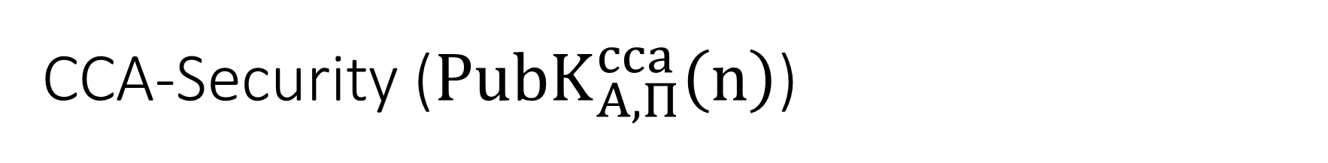

CCA-Security (${PubK}_{A,Π}^{cca}\left(n\right)$)
Public Key: pk
$$c_{−1}$$
$$m_{−1}={Dec}_{sk}\left(c_{−1}\right)$$
…
$$m_{0}^{},m_{1}^{}$$
$$c_{b}={Enc}_{pk}\left(m_{b}^{}\right)$$
$$c_{k}$$
$$∀PPT A ∃μ (negligible) s.t$$
$$Pr\left[{PubK}_{A,Π}^{cca}\left(n\right)=1\right]≤\frac{1}{2}+μ(n)$$
$$m_{k}={Dec}_{sk}\left(c_{k}\right)$$
b’
…
Random bit b
(pk,sk) = Gen(.)

Slide 58
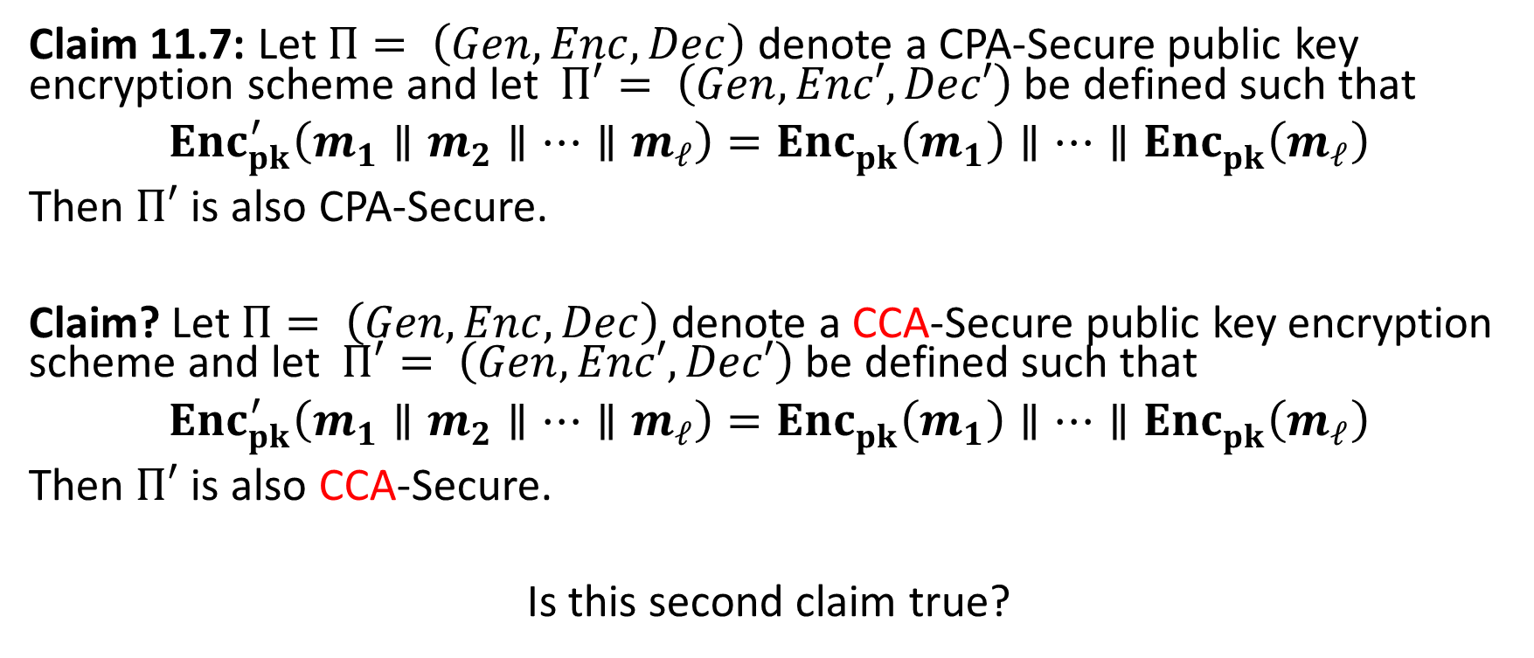
Encrypting Longer Messages
Claim 11.7: Let $Π= \left(Gen,Enc,Dec\right)$ denote a CPA-Secure public key encryption scheme and let $Π′= \left(Gen,Enc′,Dec′\right)$be defined such that
$${Enc}_{pk}^{′}\left(m_{1}∥m_{2}∥…∥m_{ℓ}\right)={Enc}_{pk}^{}\left(m_{1}\right)∥…∥{Enc}_{pk}^{}\left(m_{ℓ}\right)$$
Then $Π′$ is also CPA-Secure.
Claim? Let $Π= \left(Gen,Enc,Dec\right)$ denote a CCA-Secure public key encryption scheme and let $Π′= \left(Gen,Enc′,Dec′\right)$be defined such that
$${Enc}_{pk}^{′}\left(m_{1}∥m_{2}∥…∥m_{ℓ}\right)={Enc}_{pk}^{}\left(m_{1}\right)∥…∥{Enc}_{pk}^{}\left(m_{ℓ}\right)$$
Then $Π′$ is also CCA-Secure.
Is this second claim true?

Slide 59
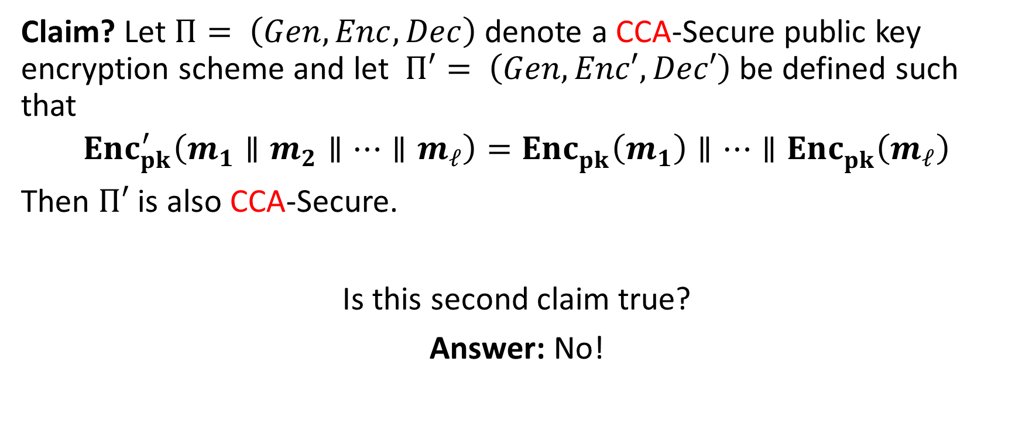
Encrypting Longer Messages
Claim? Let $Π= \left(Gen,Enc,Dec\right)$ denote a CCA-Secure public key encryption scheme and let $Π′= \left(Gen,Enc′,Dec′\right)$be defined such that
$${Enc}_{pk}^{′}\left(m_{1}∥m_{2}∥…∥m_{ℓ}\right)={Enc}_{pk}^{}\left(m_{1}\right)∥…∥{Enc}_{pk}^{}\left(m_{ℓ}\right)$$
Then $Π′$ is also CCA-Secure.
Is this second claim true?
Answer: No!

Slide 60

Encrypting Longer Messages
Fact: Let $Π= \left(Gen,Enc,Dec\right)$ denote a CCA-Secure public key encryption scheme and let $Π′= \left(Gen,Enc′,Dec′\right)$be defined such that
$${Enc}_{pk}^{′}\left(m_{1}∥m_{2}∥…∥m_{ℓ}\right)={Enc}_{pk}^{}\left(m_{1}\right)∥…∥{Enc}_{pk}^{}\left(m_{ℓ}\right)$$
Then $Π′$ is Provably Not CCA-Secure.
Attacker sets $m_{0}=0n∥1n$ $∥1n$ and $m_{1}=0n∥0n∥ 1n$ and gets $c_{b}={Enc}_{pk}^{′}\left(m_{b}\right)$ $=c_{b,1}∥c_{b,2}∥c_{b,3}$
Attacker sets $c′=c_{b,2}∥c_{b,3}∥c_{b,1}$ , queries the decryption oracle and gets
$${Dec}_{sk}^{′}\left(c′\right)=\left\{\begin{aligned} \\ 1n ∥1n∥0n \text{if} \text{b}\text{=}0 \\ 0n∥1n∥0n otherwise \end{aligned}\right.$$

Slide 61
Achieving CPA and CCA-Security
Plain RSA is not CPA Secure (therefore, not CCA-Secure)
El-Gamal (next class) is CPA-Secure, but not CCA-Secure
  Homework 4
Tools to obtain CCA-Security in Public Key Setting
  RSA-OAEP, Cramer-Shoup
  Key Encapsulation Mechanism

Slide 62

Key Encapsulation Mechanism (KEM)
Three Algorithms
  $\operatorname{Gen}{(1^{n},R)}$ (Key-generation algorithm)
    Input: Random Bits R
    Output: $\left(pk,sk\right)∈𝓚$
  $\operatorname{Encapspk}{(1^{n},R)}$
    Input: security parameter, random bits R
    Output: Symmetric key $k∈{\left\{0,1\right\}}^{ℓ\left(n\right)}$ and a ciphertext c
  $\operatorname{Decapssk}{(c)}$ (Deterministic algorithm)
    Input: Secret key $sk∈𝒦$ and a ciphertex$c$
    Output: a symmetric key${\left\{0,1\right\}}^{ℓ\left(n\right)}$ or $⊥$ (fail)
Invariant: $Decapssk$(c)=k whenever (c,k) = $Encapspk$($1^{n},R$)

Slide 63








KEM CCA-Security (${KEM}_{A,Π}^{cca}\left(n\right)$)
$$\left(pk,c,k_{b}\right)$$
…
$$c_{1}≠c$$
$${Decaps}_{sk}\left(c_{1}\right)$$
$$c_{2}≠c$$
$$∀PPT A ∃μ (negligible) s.t$$
$$Pr\left[{KEM}_{A,Π}^{cca}=1\right]≤\frac{1}{2}+μ(n)$$
$${Decaps}_{sk}\left(c_{2}\right)$$
b’
…
Random bit b
(pk,sk) = Gen(.)
$$\left(c,k0\right)={Encaps}_{pk}\left(.\right)$$
$$k1 ⟵{\left\{0,1\right\}}^{n}$$

Slide 64

CCA-Secure Encryption from CCA-Secure KEM
$${Enc}_{pk}^{}\left(m;R\right)=\left\langle c,{Enc}_{k}^{∗}\left(m\right)\right\rangle$$
Where
$\left(c,k\right)←{Encaps}_{pk}^{}\left(1^{n};R\right)$,
${Enc}_{k}^{∗}$ is a CCA-Secure symmetric key encryption algorithm, and
${Encaps}_{pk}^{}$ is a CCA-Secure KEM.
Theorem 11.14: ${Enc}_{pk}^{}$ is CCA-Secure public key encryption scheme.

Slide 65

CCA-Secure KEM in the Random Oracle Model
Let (N,e,d) be an RSA key (pk =(N,e), sk=(N,d)).
  $$\operatorname{Encapspk}\left(1^{n},R\right)=\left(r^{e} mod N, k=H\left(r\right)\right)$$
  Remark 1: k is completely random string unless the adversary can query random oracle H on input r.
Remark 2: If Plain-RSA is hard to invert for a random input then PPT attacker finds r with negligible probability.

Slide 66
Week 12 Topic 3: El-Gamal Encryption

Slide 67

A Quick Remark about Groups
Let $𝔾 be a group with order m=\left|𝔾\right|$with a binary operation $∘$ (over G) and let $g,h∈𝔾$ be given and consider sampling $k∈𝔾$ uniformly at random then we have
$${Pr}_{k←𝔾}\left[k=g\right]=\frac{1}{m}$$
Question: What is ${Pr}_{k←𝔾}\left[k∘h=g\right]=\frac{1}{m}?$
Answer:
$${Pr}_{k←𝔾}\left[k∘h=g\right]={Pr}_{k←𝔾}\left[k=g∘h^{−1}\right]=\frac{1}{m}$$

Slide 68

A Quick Remark about Groups
Lemma 11.15: Let $𝔾 be a group with order m=\left|𝔾\right|$with a binary operation $∘$ (over G) then for any pair $g,h∈𝔾$ we have
$${Pr}_{k←𝔾}\left[k∘h=g\right]=\frac{1}{m}$$
Remark: This lemma gives us a way to construct perfectly secret private-key crypto scheme. How?

Slide 69

El-Gamal Encryption
Key Generation (Gen($1^{n}$)):
  Run $𝒢\left(1^{n}\right)$ to obtain a cyclic group $𝔾$ of order q (with $\left\|q\right\|=n$) and a generator g such that $<g>=𝔾$.
  Choose a random $x∈ℤ_{q}$ and set $h=g^{x}$
  Public Key: $pk=\left\langle 𝔾,q,g,h\right\rangle$
  Private Key: $sk=\left\langle 𝔾,q,g,x\right\rangle$
$\operatorname{Encpk}{(m)}=\left\langle g^{y},m∙h^{y}\right\rangle$ for a random $y∈ℤ_{q}$
$\operatorname{Decsk}{(c=\left(c_{1},c_{2}\right))}=c_{2}c_{1}^{−x}$

Slide 70

El-Gamal Encryption
$\operatorname{Encpk}{(m)}=\left\langle g^{y},m∙h^{y}\right\rangle$ for a random $y∈ℤ_{q}$
$\operatorname{Decsk}{(c=\left(c_{1},c_{2}\right))}=c_{2}c_{1}^{−x}$
$$\operatorname{Decsk}{(g^{y},m∙h^{y})}=m∙h^{y}{\left(g^{y}\right)}^{−x}$$
$$=m∙h^{y}{\left(g^{y}\right)}^{−x}$$
$$=m∙{\left(g^{x}\right)}^{y}{\left(g^{y}\right)}^{−x}$$
$$=m∙g^{xy}g^{−xy}$$
$$=m$$

Slide 71


CPA-Security (${PubK}_{A,Π}^{LR−cpa}\left(n\right)$)
Public Key: pk
$$m_{0}^{1},m_{1}^{1}$$
$$c_{1}={Enc}_{pk}\left(m_{b}^{1}\right)$$
$$m_{0}^{2},m_{1}^{2}$$
$$c_{2}={Enc}_{pk}\left(m_{b}^{2}\right)$$
$$m_{0}^{3},m_{1}^{3}$$
$$c_{3}={Enc}_{pk}\left(m_{b}^{3}\right)$$
$$∀PPT A ∃μ (negligible) s.t$$
$$Pr\left[{PubK}_{A,Π}^{LR−cpa}\left(n\right)=1\right]≤\frac{1}{2}+μ(n)$$
…
b’
Random bit b
(pk,sk) = Gen(.)

Slide 72

El-Gamal Encryption
$\operatorname{Encpk}{(m)}=\left\langle g^{y},m∙h^{y}\right\rangle$ for a random $y∈ℤ_{q}$
$\operatorname{Decsk}{(c=\left(c_{1},c_{2}\right))}=c_{2}c_{1}^{−x}$
Theorem 11.18: Let $Π= \left(Gen,Enc,Dec\right)$ be the El-Gamal Encryption scheme (above) then if DDH is hard relative to $𝒢$then $Π$is CPA-Secure.
Proof: Recall that CPA-security and eavesdropping security are equivalent for public key crypto. It suffices to show that for all PPT A there is a negligible function negl such that
$$Pr\left[{PubK}_{A,Π}^{eav}\left(n\right)=1\right]≤\frac{1}{2}+\text{negl}\text{(}\text{n}\text{)}$$

Slide 73




Eavesdropping Security (${PubK}_{A,Π}^{eav}\left(n\right)$)
Public Key: pk
$$m_{0}^{},m_{1}^{}$$
$$c_{1}={Enc}_{pk}\left(m_{b}^{}\right)$$
b’
$$∀PPT A ∃μ (negligible) s.t$$
$$Pr\left[{PubK}_{A,Π}^{eav}\left(n\right)=1\right]≤\frac{1}{2}+μ(n)$$
Random bit b
(pk,sk) = Gen(.)

Slide 74

El-Gamal Encryption
Theorem 11.18: Let $Π= \left(Gen,Enc,Dec\right)$ be the El-Gamal Encryption scheme (above) then if DDH is hard relative to $𝒢$then $Π$is CPA-Secure.
Proof: First introduce an `encryption scheme’ $\tilde{Π}$ in which $\tilde{Encpk}\left(m\right)=\left\langle g^{y},m∙g^{z}\right\rangle$ for random $y,z∈ℤ_{q}$ (there is actually no way to do decryption, but the experiment ${PubK}_{A,\tilde{Π}}^{eav}\left(n\right)$ is still well defined). In fact, (using Lemma 11.15)
$$Pr\left[{PubK}_{A,\tilde{Π}}^{eav}\left(n\right)=1\right]=\frac{1}{2}Pr\left[{PubK}_{A,\tilde{Π}}^{eav}\left(n\right)=1\left|b=1\right.\right]+\frac{1}{2}\left(1−Pr\left[{PubK}_{A,\tilde{Π}}^{eav}\left(n\right)=1\left|b=0\right.\right]\right)$$
$$=\frac{1}{2}+\frac{1}{2}{Pr}_{y,z←ℤ_{q}}\left[A\left(\left\langle g^{y},m∙g^{z}\right\rangle \right)=1\right]−\frac{1}{2}{Pr}_{y,z←ℤ_{q}}\left[A\left(\left\langle g^{y}, g^{z}\right\rangle \right)=1\right]$$
$$=\frac{1}{2}$$

Slide 75

El-Gamal Encryption
Theorem 11.18: Let $Π= \left(Gen,Enc,Dec\right)$ be the El-Gamal Encryption scheme (above) then if DDH is hard relative to $𝒢$then $Π$is CPA-Secure.
Proof: We just showed that
$$Pr\left[{PubK}_{A,\tilde{Π}}^{eav}\left(n\right)=1\right]=\frac{1}{2}$$
Therefore, it suffices to show that
$$\left|Pr\left[{PubK}_{A,Π}^{eav}\left(n\right)=1\right]−Pr\left[{PubK}_{A,\tilde{Π}}^{eav}\left(n\right)=1\right]\right|≤negl(n)$$
This, will follow from DDH assumption.

Slide 76

El-Gamal Encryption
Theorem 11.18: Let $Π= \left(Gen,Enc,Dec\right)$ be the El-Gamal Encryption scheme (above) then if DDH is hard relative to $𝒢$then $Π$is CPA-Secure.
Proof: We can build $B\left(g^{x},g^{y},Z\right)$ to break DDH assumption if $Π$is not CPA-Secure. Simulate eavesdropping attacker A
Send attacker public key$pk=\left\langle 𝔾,q,g,h=g^{x}\right\rangle$
Receive m₀,m₁ from A.
Send A the ciphertext $\left\langle g^{y},m_{b}∙Z\right\rangle$.
Output 1 if and only if attacker outputs b’=b.
$$\left|Pr\left[B\left(g^{x},g^{y},Z\right)=1\left|Z=g^{xy}\right.\right]−Pr\left[B\left(g^{x},g^{y},Z\right)=1\left|Z=g^{z}\right.\right]\right|$$
$$=\left|Pr\left[{PubK}_{A,Π}^{eav}\left(n\right)=1\right]−Pr\left[{PubK}_{A,\tilde{Π}}^{eav}\left(n\right)=1\right]\right|$$
$$=\left|Pr\left[{PubK}_{A,Π}^{eav}\left(n\right)=1\right]−1/2\right|$$
Notes:
$$=\left|{Pr}_{y←ℤ_{q}}\left[A\left(g^{x},\left\langle g^{y},m_{b}∙g^{xy}\right\rangle \right)=1\right]−{Pr}_{y,z←ℤ_{q}}\left[A\left(g^{x},\left\langle g^{y},m_{b}∙g^{z}\right\rangle \right)=1\right]\right|$$
$$=\left|{Pr}_{y←ℤ_{q}}\left[A\left(h,\left\langle g^{y},m_{b}∙h^{z}\right\rangle \right)=1\right]−{Pr}_{y,z←ℤ_{q}}\left[A\left(h,\left\langle g^{y},m_{b}∙g^{z}\right\rangle \right)=1\right]\right|$$

Slide 77

El-Gamal Encryption
$\operatorname{Encpk}{(m)}=\left\langle g^{y},m∙h^{y}\right\rangle$ for a random $y∈ℤ_{q}$ and ${h=g}^{x},$
$\operatorname{Decsk}{(c=\left(c_{1},c_{2}\right))}=c_{2}c_{1}^{−x}$
Fact: El-Gamal Encryption is malleable.
$$c=Encpk{(m)}=\left\langle g^{y},m∙h^{y}\right\rangle$$
$$c′=Encpk{(m)}=\left\langle g^{y},2∙m∙h^{y}\right\rangle$$
$$\operatorname{Decsk}{(c′)}=2∙m∙h^{y}∙g^{−xy}=2m$$

Slide 78
Key Encapsulation Mechanism (KEM)
Three Algorithms
  $\operatorname{Gen}{(1^{n},R)}$ (Key-generation algorithm)
    Input: Random Bits R
    Output: $\left(pk,sk\right)∈𝓚$
  $\operatorname{Encapspk}{(1^{n},R)}$
    Input: security parameter, random bits R
    Output: Symmetric key $k∈{\left\{0,1\right\}}^{ℓ\left(n\right)}$ and a ciphertext c
  $\operatorname{Decapssk}{(c)}$ (Deterministic algorithm)
    Input: Secret key $sk∈𝒦$ and a ciphertex$c$
    Output: a symmetric key${\left\{0,1\right\}}^{ℓ\left(n\right)}$ or $⊥$ (fail)
Invariant: $Decapssk$(c)=k whenever (c,k) = $Encapspk$($1^{n},R$)

Slide 79


KEM CCA-Security (${KEM}_{A,Π}^{cca}\left(n\right)$)
$$\left(pk,c,kb\right)$$
…
$$c_{1}≠c$$
$${Decaps}_{sk}\left(c_{1}\right)$$
$$c_{2}≠c$$
$$∀PPT A ∃μ (negligible) s.t$$
$$Pr\left[{KEM}_{A,Π}^{cca}=1\right]≤\frac{1}{2}+μ(n)$$
$${Decaps}_{sk}\left(c_{2}\right)$$
b’
…
Random bit b
(pk,sk) = Gen(.)
$$\left(c,k0\right)={Encaps}_{pk}\left(.\right)$$
$$k1 ⟵{\left\{0,1\right\}}^{n}$$

Slide 80
Recall: Last Lecture
CCA-Secure KEM from RSA in Random Oracle Model
What if we want security proof in the standard model?
Answer: DDH yields a CPA-Secure KEM in standard model

Slide 81



KEM CPA-Security (${KEM}_{A,Π}^{cpa}\left(n\right)$)
$$\left(pk,c,kb\right)$$
b’
$$∀PPT A ∃μ (negligible) s.t$$
$$Pr\left[{KEM}_{A,Π}^{cpa}=1\right]≤\frac{1}{2}+μ(n)$$
Random bit b
(pk,sk) = Gen(.)
$$\left(c,k0\right)={Encaps}_{pk}\left(.\right)$$
$$k1 ⟵{\left\{0,1\right\}}^{n}$$

Slide 82

CCA-Secure Encryption from CPA-Secure KEM
$${Enc}_{pk}^{}\left(m;R\right)=\left\langle c,{Enc}_{k}^{∗}\left(m\right)\right\rangle$$
Where
$\left(c,k\right)←{Encaps}_{pk}^{}\left(1^{n};R\right)$,
${Enc}_{k}^{∗}$ is a eavesdropping-secure symmetric key encryption algorithm
${Encaps}_{pk}^{}$ is a CPA-Secure KEM.
Theorem 11.12: ${Enc}_{pk}^{}$ is CCA-Secure public key encryption scheme.

Slide 83

CPA-Secure KEM with El-Gamal
$\operatorname{Gen}{(1^{n},R)}$ (Key-generation algorithm)
  Run $𝒢\left(1^{n}\right)$ to obtain a cyclic group $𝔾$ of order q (with $\left\|q\right\|=2n$) and a generator g such that $<g>=𝔾$.
  Choose a random $x∈ℤ_{q}$ and set $h=g^{x}$
  Public Key: $pk=\left\langle 𝔾,q,g,h\right\rangle$
  Private Key: $sk=\left\langle 𝔾,q,g,x\right\rangle$
$\operatorname{Encapspk}{(1^{n},R)}$
  Pick random $y∈ℤ_{q}$
  Output: $\left\langle g^{y},k=LeastSigNBits\left(h^{y}\right)\right\rangle$
$\operatorname{Decapssk}{(c)}$ (Deterministic algorithm)
  Output: $k=LeastSigNBits\left(c^{x}\right)$

Slide 84

CPA-Secure KEM with El-Gamal
$\operatorname{Gen}{(1^{n},R)}$ (Key-generation algorithm)
  Run $𝒢\left(1^{n}\right)$ to obtain a cyclic group $𝔾$ of order q (with $\left\|q\right\|=2n$) and a generator g such that $<g>=𝔾$.
  Choose a random $x∈ℤ_{q}$ and set $h=g^{x}$
  Public Key: $pk=\left\langle 𝔾,q,g,h\right\rangle$
  Private Key: $sk=\left\langle 𝔾,q,g,x\right\rangle$
$\operatorname{Encapspk}{(1^{n},R)}$
  Pick random $y∈ℤ_{q}$
  Output: $\left\langle g^{y},k=LeastSigNBits\left(h^{y}\right)\right\rangle$
$\operatorname{Decapssk}{(c)}$ (Deterministic algorithm)
  Output: $k=LeastSigNBits\left(c^{x}\right)$
  $$\operatorname{Decapssk}\left(g^{y}\right)=LeastSigNBits\left(g^{xy}\right)=LeastSigNBits\left(h^{y}\right)=k$$

Slide 85

CPA-Secure KEM with El-Gamal
$\operatorname{Gen}{(1^{n},R)}$ (Key-generation algorithm)
  Run $𝒢\left(1^{n}\right)$ to obtain a cyclic group $𝔾$ of order q (with $\left\|q\right\|=2n$) and a generator g such that $<g>=𝔾$.
  Choose a random $x∈ℤ_{q}$ and set $h=g^{x}$
  Public Key: $pk=\left\langle 𝔾,q,g,h\right\rangle$
  Private Key: $sk=\left\langle 𝔾,q,g,x\right\rangle$
$\operatorname{Encapspk}{(1^{n},R)}$
  Pick random $y∈ℤ_{q}$
  Output: $\left\langle g^{y},k=LeastSigNBits\left(h^{y}\right)\right\rangle$
$\operatorname{Decapssk}{(c)}$ (Deterministic algorithm)
  Output: $k=LeastSigNBits\left(c^{x}\right)$
Theorem 11.20: If DDH is hard relative to $𝒢$ then (Gen,Encaps,Decaps) is a CPA-Secure KEM

Slide 86

CPA-Secure KEM with El-Gamal
$\operatorname{Gen}{(1^{n},R)}$ (Key-generation algorithm)
  Run $𝒢\left(1^{n}\right)$ to obtain a cyclic group $𝔾$ of order q (with $\left\|q\right\|=2n$) and a generator g such that $<g>=𝔾$.
  Choose a random $x∈ℤ_{q}$ and set $h=g^{x}$
  Public Key: $pk=\left\langle 𝔾,q,g,h\right\rangle$
  Private Key: $sk=\left\langle 𝔾,q,g,x\right\rangle$
$\operatorname{Encapspk}{(1^{n},R)}$
  Pick random $y∈ℤ_{q}$
  Output: $\left\langle g^{y},k=LeastSigNBits\left(h^{y}\right)\right\rangle$
$\operatorname{Decapssk}{(c)}$ (Deterministic algorithm)
  Output: $k=LeastSigNBits\left(c^{x}\right)$
Remark: If CDH is hard relative to $𝒢$ then (Gen,Encaps,Decaps) and we replace $LeastSigNBits$ with a random oracle H then this is a CPA-Secure KEM
(…also CCA-secure under a slightly stronger assumption called gap-CDH)

Slide 87

CCA-Secure Variant in Random Oracle Model
Key Generation (Gen($1^{n}$)):
  Run $𝒢\left(1^{n}\right)$ to obtain a cyclic group $𝔾$ of order q (with $\left\|q\right\|=n$) and a generator g such that $<g>=𝔾$.
  Choose a random $x∈ℤ_{q}$ and set $h=g^{x}$
  Public Key: $pk=\left\langle 𝔾,q,g,h\right\rangle$
  Private Key: $sk=\left\langle 𝔾,q,g,x\right\rangle$
$\operatorname{Encpk}{(m)}=\left\langle g^{y},c^{′}, {Mac}_{K_{M}}^{}\left(c′\right)\right\rangle$ for a random $y∈ℤ_{q}$ and $K_{E}\left\|K_{M}\right.=H\left(h^{y}\right)$ and $c^{′}{=Enc}_{K_{E}}^{′}\left(m\right)$
$\operatorname{Decsk}{(\left\langle c,c^{′},t\right\rangle )}$
$K_{E}\left\|K_{M}\right.=H\left(c^{x}\right)$
If ${Vrfy}_{K_{M}}\left(c^{′},t\right)≠1 \text{or} c∉𝔾 \text{output} ⊥$; otherwise output${Dec}_{K_{E}}^{′}\left(c^{′},t\right)$

Slide 88

CCA-Secure Variant in Random Oracle Model
Theorem: If ${Enc}_{K_{E}}^{′}$ is CPA-secure, ${Mac}_{K_{M}}^{}$ is a strong MAC and a problem called gap-CDH is hard then this a CCA-secure public key encryption scheme in the random oracle model.
$\operatorname{Encpk}{(m)}=\left\langle g^{y},c^{′}, {Mac}_{K_{M}}^{}\left(c′\right)\right\rangle$ for a random $y∈ℤ_{q}$ and $K_{E}\left\|K_{M}\right.=H\left(h^{y}\right)$ and $c^{′}{=Enc}_{K_{E}}^{′}\left(m\right)$
$\operatorname{Decsk}{(\left\langle c,c^{′},t\right\rangle )}$
$K_{E}\left\|K_{M}\right.=H\left(c^{x}\right)$
If ${Vrfy}_{K_{M}}\left(c^{′},t\right)≠1 or c∉𝔾$ output $⊥$; otherwise output${Dec}_{K_{E}}^{′}\left(c^{′},t\right)$

Slide 89

CCA-Secure Variant in Random Oracle Model
Remark: The CCA-Secure variant is used in practice in the ISO/IEC 18033-2 standard for public-key encryption.
Diffie-Hellman Integrated Encryption Scheme (DHIES)
Elliptic Curve Integrated Encryption Scheme (ECIES)
$\operatorname{Encpk}{(m)}=\left\langle g^{y},c^{′}, {Mac}_{K_{M}}^{}\left(c′\right)\right\rangle$ for a random $y∈ℤ_{q}$ and $K_{E}\left\|K_{M}\right.=H\left(h^{y}\right)$ and $c^{′}{=Enc}_{K_{E}}^{′}\left(m\right)$
$\operatorname{Decsk}{(\left\langle c,c^{′},t\right\rangle )}$
$K_{E}\left\|K_{M}\right.=H\left(c^{x}\right)$
If ${Vrfy}_{K_{M}}\left(c^{′},t\right)≠1$ or$c∉𝔾$ output $⊥$; otherwise output${Dec}_{K_{E}}^{′}\left(c^{′},t\right)$

