Slide 1
Recap
Plain RSA
Public Key (pk): N = pq, e such that $GCD\left(e,φ\left(N\right)\right)=1$
$φ\left(N\right)=\left(p−1\right)\left(q−1\right)$ for distinct primes p and q
Secret Key (sk): N, d such that ed=1 mod $φ\left(N\right)$
Encrypt(pk=(N,e),m) = $m^{e} mod N$
Decrypt(sk=(N,d),c) = $c^{d} mod N$
$Decryption Works because$
$$\left[c^{d}mod N\right]=\left[m^{ed}mod N\right]=\left[m^{[ed mod φ\left(N\right)]}mod N\right]=\left[m mod N\right]$$

Slide 2
RSA-Assumption
RSA-Experiment: ${\text{RSA}\text{−}\text{INV}}_{A,n}$
Run KeyGeneration(1^{n}) to obtain (N,e,d)
Pick uniform $y∈ ℤ_{N}^{∗}$
Attacker A is given N, e, y and outputs $x∈ ℤ_{N}^{∗}$
Attacker wins (RSA-INV_{A,n}=1) if $x^{e}=y mod N$
$$∀PPT A ∃μ (negligible) s.t Pr\left[{\text{RSA}\text{−}\text{INV}}_{A,n} =1\right]≤μ(n)$$

Slide 3
Plain RSA Weaknesses
Stateless + Deterministic ➔ Not CPA-secure
Vulnerable to brute force attacks (small message space)
Chosen Ciphertext Attack: c’ = c₁c₂ mod N is a valid encryption of m’=m₁m₂ mod N
(Partially Known Messages) If an attacker knows first 1-(1/e) bits of secret message $m=m_{1}\left\|??\right.$ then he can recover m given
$$Encrypt\left(pk,m\right)=m^{e} mod N$$
Theorem[Coppersmith]: If p(x) is a polynomial of degree e then in polynomial time (in log(N), 2e) we can find all m such that p(m) = 0 mod N and |m|<N^{(1/e)}
$$p\left(x\right)={\left(2^{k}m1+x\right)}^{e}−c$$

Slide 4
More Weaknesses: Plain RSA with small e
Theorem[Coppersmith]: Can also find small roots of bivariate polynomial $p\left(x_{1},x_{2}\right)$.
Similar Approach used to factor weak RSA secret keys N=q₁q₂
Weak PRG → Can guess many of the bits of prime factors
Obtain $\tilde{q_{1}}≈q_{1}$ and $\tilde{q_{2}}≈q_{2}$
Coppersmith Attack: Define polynomial p(.,.) as follows
$$p\left(x_{1},x_{2}\right)=\left(x_{1}+\tilde{q_{1}}\right)\left(x_{2}+\tilde{q_{2}}\right)−N$$
Small Roots of $p\left(x_{1},x_{2}\right)$: $x_{1}=q_{1}−\tilde{q_{1}}$ and $x_{2}=q_{2}−\tilde{q_{2}}$
D. Coppersmith (1996). "Finding a Small Root of a Bivariate Integer Equation; Factoring with high bits known"

Slide 5
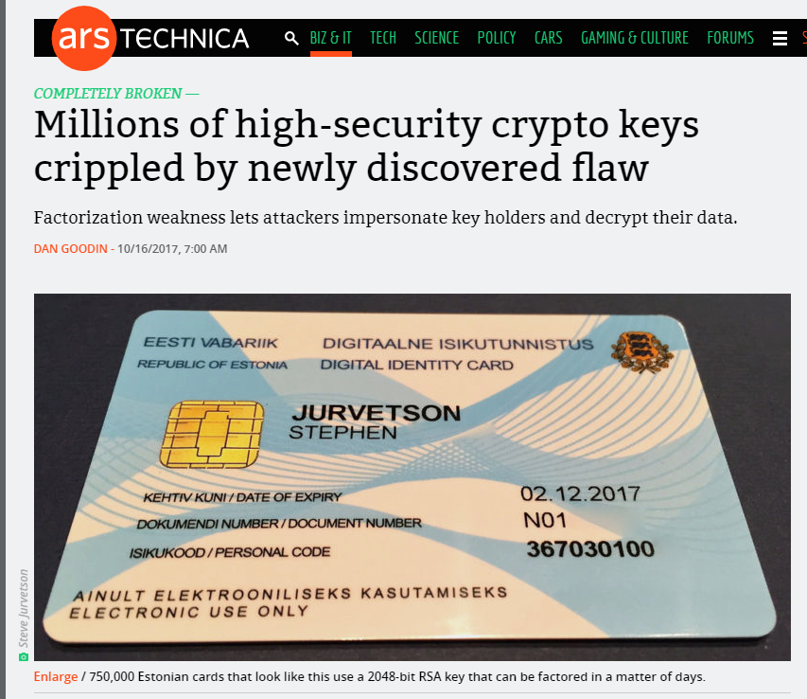
The Return of Coppersmith's Attack: Practical Factorization of Widely Used RSA Moduli (CCS 2017)

Slide 6
(Plain) RSA Discussion
However, notice that (Plain) RSA Encryption is stateless and deterministic.
→Plain RSA is not secure against chosen-plaintext attacks
In a public key setting the attacker does have access to an encryption oracle
Encrypted messages with low entropy are vulnerable to a brute-force attack.

Slide 7
Fixes for Plain RSA
Approach 1: RSA-OAEP
Incorporates random nonce r
CCA-Secure (in random oracle model)
Approach 2: Use RSA to exchange symmetric key for Authenticated Encryption scheme (e.g., AES)
Key Encapsulation Mechanism (KEM)
More details in future lectures…stay tuned!
For now we will focus on attacks on Plain RSA

Slide 8
Chinese Remainder Theorem
Theorem: Let N = pq (where gcd(p,q)=1) be given and let ${f:ℤ}_{N}^{}→ℤp×ℤq$ be defined as follows
$$f\left(x\right)=\left([x mod p],[x mod q]\right)$$
then
f is a bijective mapping (invertible)
f and its inverse$f^{−1}:ℤp×ℤq→ℤ_{N}^{}$ can be computed efficiently
$f\left(x+y\right)=f\left(x\right)+f(y)$
The restriction of f to $ℤ_{N}^{∗}$ yields a bijective mapping to $ℤ_{p}^{∗}×ℤ_{q}^{∗}$
For inputs ${x,y∈ℤ}_{N}^{∗}$ we have $f\left(x\right)f\left(y\right)=f\left(xy\right)$

Slide 9
Chinese Remainder Theorem
Application of CRT: Faster computation
Example: Compute [11⁵³ mod 15]
f(11)=([-1 mod 3],[1 mod 5])
f(11⁵³) =([(-1)⁵³ mod 3],[1⁵³ mod 5])= (-1,1)
$f^{−1}$(-1,1)=11
Thus, 11=[11⁵³ mod 15]

Slide 10
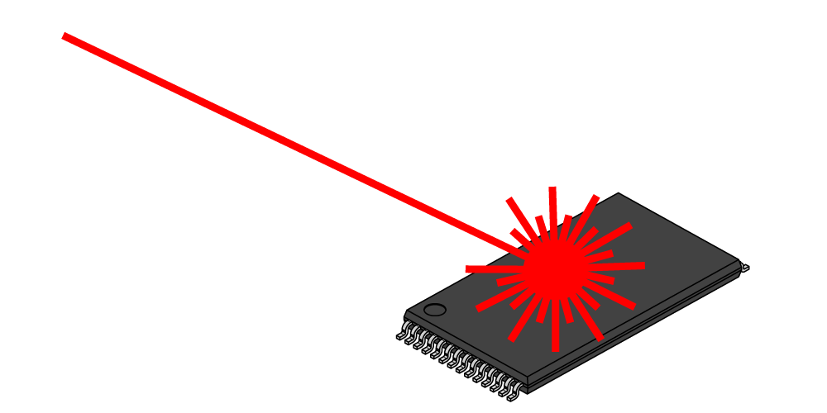
A Side Channel Attack on RSA with CRT
Suppose that decryption is done via Chinese Remainder Theorem for speed.
$${Dec}_{sk}^{}\left(c\right)=c^{d} mod N↔\left(c^{d} mod p,c^{d} mod q\right)$$
Attacker has physical access to smartcard
Have smartcard decrypt $c=m^{e} mod N$ for known message m
Can mess up computation of $c^{d} mod p$ (replaced with random r)
Response is $R↔\left(r,c^{d} mod q\right)$
$R−m↔\left(r−m mod p,0 mod q\right)$
GCD(R-m,N)=q

Slide 11
Recovering Encrypted Message faster than Brute-Force
Claim: Let m < 2^{n} be a secret message. For some constant $α=\frac{1}{2}+ε.$ We can recover m in in time ${T=2}^{αn}$ with high probability.
For r=1,…,T
let $xr=\left[cr^{−e}mod N\right]$, where $r^{−e}={\left(r^{−1}\right)}^{e}mod N$
Sort $L={\left\{\left(r,x_{r}\right)\right\}}_{r=1}^{T}$ (by the x_{r} values)
For s=1,…,T
if $\left[s^{e}mod N\right]=x_{r}$ for some r then
return $\left[rs mod N\right]$

Slide 12
Recovering Encrypted Message faster than Brute-Force
For r=1,…,T
let $xr=\left[cr^{−e}mod N\right]$, where $r^{−e}={\left(r^{−1}\right)}^{e}mod N$
Sort $L={\left\{\left(r,x_{r}\right)\right\}}_{r=1}^{T}$ (by the x_{r} values)
For s=1,…,T
if $\left[s^{e}mod N\right]=x_{r}$ for some r then
return $\left[rs mod N\right]$
Analysis: $\left[rs mod N\right]=\left[r\left(s^{e}\right)d mod N\right]=\left[r\left(xr\right)d mod N\right]$
$$=\left[r\left(cr^{−e}\right)d mod N\right]=\left[rr^{−ed}\left(c\right)d mod N\right]$$
$$=\left[rr^{−1}m mod N\right]=m$$

Slide 13
Recovering Encrypted Message faster than Brute-Force
For r=1,…,T
let $xr=\left[cr^{−e}mod N\right]$, where $r^{−e}={\left(r^{−1}\right)}^{e}mod N$
Sort $L={\left\{\left(r,x_{r}\right)\right\}}_{r=1}^{T}$ (by the x_{r} values)
For s=1,…,T
if $\left[s^{e}mod N\right]=x_{r}$ for some r then
return $\left[rs mod N\right]$
Fact: some constant $α=\frac{1}{2}+ε$ setting ${T=2}^{αn}$ with high probability we will find a pair s and x_{r} with $\left[s^{e}mod N\right]=xr$.

Slide 14
Recovering Encrypted Message faster than Brute-Force
Claim: Let m < 2^{n} be a secret message. For some constant $α=\frac{1}{2}+ε.$ We can recover m in in time ${T=2}^{αn}$ with high probability.
Roughly $\sqrt{B}$ steps to find a secret message m < B

Slide 15
CS 555: Week 10: Topic 3 Discrete Log + DDH Assumption

Slide 16
(Recap) Finite Groups
Definition: A (finite) group is a (finite) set $𝔾$with a binary operation $∘$ (over G) for which we have
(Closure:) For all $g,h∈𝔾$ we have $g∘h∈𝔾$
(Identity:) There is an element $e∈𝔾$ such that for all $g∈𝔾$ we have
$$g∘e=g=e∘g$$
(Inverses:) For each element $g∈𝔾$ we can find $h∈𝔾$ such that $g∘h=e$. We say that h is the inverse of g.
(Associativity: ) For all $g1,g2,g3∈𝔾$ we have
$$\left(g1∘g2\right)∘g3=g1∘\left(g2∘g3\right)$$
We say that the group is abelian if
(Commutativity:) For all $g,h∈𝔾$ we have $g∘h=$ $h∘g$

Slide 17
Finite Abelian Groups (Examples)
Example 1: $ℤ_{N}^{}$ when $∘$ denotes addition modulo N
Identity: 0, since 0 $∘$x =[0+x mod N] = [x mod N].
Inverse of x? Set x⁻¹=N-x so that [x⁻¹+x mod N] = [N-x+x mod N] = 0.
Example 2: $ℤ_{N}^{∗}$ when $∘$ denotes multiplication modulo N
Identity: 1, since 1$∘$x =[1(x) mod N] = [x mod N].
Inverse of x? Run extended GCD to obtain integers a and b such that
$$ax+bN=\gcd\left(x,N\right)=1$$
Observe that: x⁻¹ = a. Why?

Slide 18
Cyclic (Sub)Group
Let $𝔾$ be a group with order $m=\left|𝔾\right|$and a binary operation $∘$ (over G) and let $g∈𝔾$ be given consider the set
$$\left\langle g\right\rangle =\left\{g0,g1,g2,…\right\}$$
Fact: $\left\langle g\right\rangle$ defines a subgroup of $𝔾.$
Identity: $g0$
Closure: $gi∘gj=g^{i+j}∈\left\langle g\right\rangle$
g is called a “generator” of the subgroup.
Fact: Let $r=\left|\left\langle g\right\rangle \right|$ then $g^{i }=gj$ if and only if $i=j mod r$. Also m is divisible by r.

Slide 19
Finite Abelian Groups (Examples)
Fact: Let p be a prime then $ℤ_{p}^{∗}$ is a cyclic group of order p-1.
Note: Number of generators g s.t. of $\left\langle g\right\rangle =ℤ_{p}^{∗}$ is $φ\left(p−1\right)$
Example (non-generator): p=7, g=2
<2>={1,2,4}
Example (generator): p=7, g=5
<2>={1,5,4,6,2,3}

Slide 20
Discrete Log Experiment DLog_{A,G}(n)
Run G(1^{n}) to obtain a cyclic group $𝔾$ of order q (with $\left\|q\right\|=n$) and a generator g such that $<g>=𝔾$.
Select$h∈𝔾$ uniformly at random.
Attacker A is given $𝔾$, q, g, h and outputs integer x.
Attacker wins (DLog_{A,G}(n)=1) if and only if g^{x}=h.
We say that the discrete log problem is hard relative to generator G if
$$∀PPT A ∃μ (negligible) s.t Pr\left[\text{DLog}\text{A}\text{,}\text{n} =1\right]≤μ(n)$$

Slide 21
Diffie-Hellman Problems
Computational Diffie-Hellman Problem (CDH)
Attacker is given $h1=g^{x_{1}}∈𝔾$ and $h2=g^{x_{2}}∈𝔾.$
Attackers goal is to find${ g}^{x_{1}x_{2}}={\left(h1\right)}^{x_{2}}={\left(h2\right)}^{x_{1}}$
CDH Assumption: For all PPT A there is a negligible function negl upper bounding the probability that A succeeds with probability at most negl(n).
Decisional Diffie-Hellman Problem (DDH)
L$et z0={ g}^{x_{1}x_{2}}$ and let $z1={ g}^{r}$, where x₁,x₂ and r are random
Attacker is given $g^{x_{1}}$, $g^{x_{2}}$ and $zb$ (for a random bit b)
Attackers goal is to guess b
DDH Assumption: For all PPT A there is a negligible function negl such that A succeeds with probability at most ½ + negl(n).

Slide 22
Secure key-agreement with DDH
Alice publishes ${ g}^{xA}$ and Bob publishes ${ g}^{xB}$
Alice and Bob can both compute ${K_{A,B}=g}^{xB xA}$
Remark 1: Suppose that Alice publishes ${ g}^{xA}$ and Bob publishes ${ g}^{xB}$and then Alice agreed to use some independent key $K$ that they already agreed on instead of $K_{A,B}$.
DDH assumption → Eve can’t even tell the difference!
Remark 2: Protocol is vulnerable to Man-In-The-Middle Attacks if Bob cannot validate ${ g}^{xA}$.

Slide 23
Can we find a cyclic group where DDH holds?
Example 1: $ℤ_{p}^{∗}$ where p is a random n-bit prime.
CDH is believed to be hard
DDH is *not* hard (Exercise 13.15)
Theorem: $Let$p=rq+1 be a random n-bit prime where q is a large $λ$-bit prime then the set of r^{th} residues modulo p is a cyclic subgroup of order q. Then $𝔾_{r}=\left\{[h^{r}mod p] | {h∈ℤ}_{p}^{∗}\right\}$is a cyclic subgroup of $ℤ_{p}^{∗}$ of order q.
Remark 1: DDH is believed to hold for such a group
Remark 2: It is easy to generate uniformly random elements of $𝔾_{r}$
Remark 3: Any element (besides 1) is a generator of $𝔾_{r}$

Slide 24
Can we find a cyclic group where DDH holds?
Theorem: $Let$p=rq+1 be a random n-bit prime where q is a large $λ$-bit prime then the set of rth residues modulo p is a cyclic subgroup of order q. Then $𝔾_{r}=\left\{[h^{r}mod p] | {h∈ℤ}_{p}^{∗}\right\}$is a cyclic subgroup of $ℤ_{p}^{∗}$ of order q.
Closure: $hrgr={\left(hg\right)}^{r}$
Inverse of $hr$ is ${\left(h^{−1}\right)}^{r}∈𝔾_{r}$
Size ${\left(hr\right)}^{x}=h^{[rx mod rq]}={{\left(hr\right)}^{x}=h}^{r[x mod q]}={\left(hr\right)}^{[x mod q]}mod p$
Remark: Two known attacks on Discrete Log Problem for $𝔾_{r}$(Section 9.2).
First runs in time $O\left(\sqrt{q}\right)=O\left(2^{λ/2}\right)$
Second runs in time $2^{O\left(\sqrt[3]{n}{\left(\log{n}\right)}^{2/3}\right)}$

Slide 25
Can we find a cyclic group where DDH holds?
Remark: Two known attacks (Section 9.2).
First runs in time $O\left(\sqrt{q}\right)=O\left(2^{λ/2}\right)$
Second runs in time $2^{O\left(\sqrt[3]{n}{\left(\log{n}\right)}^{2/3}\right)},$where n is bit length of p
Goal: Set $λ$ and n to balance attacks
$$λ=O\left(\sqrt[3]{n}{\left(\log{n}\right)}^{2/3}\right)$$
How to sample p=rq+1?
First sample a random $λ$-bit prime q and
Repeatedly check if rq+1 is prime for a random n- $λ$ bit value r

Slide 26
Can we find a cyclic group where DDH holds?
Elliptic Curves Example: Let p be a prime (p > 3) and let A, B be constants. Consider the equation
$$y2=x3+Ax+B mod p$$
And let
$$E\left(ℤ_{p}^{}\right)=\left\{\left(x,y\right)∈ℤ_{p}^{2} | y2=x3+Ax+B mod p \right\}∪\left\{𝒪\right\}$$
Note: $𝒪$ is defined to be an additive identity $\left(x,y\right)+𝒪=\left(x,y\right)$
W$hat is \left(x1,y1\right)+\left(x2,y2\right)?$

Slide 27
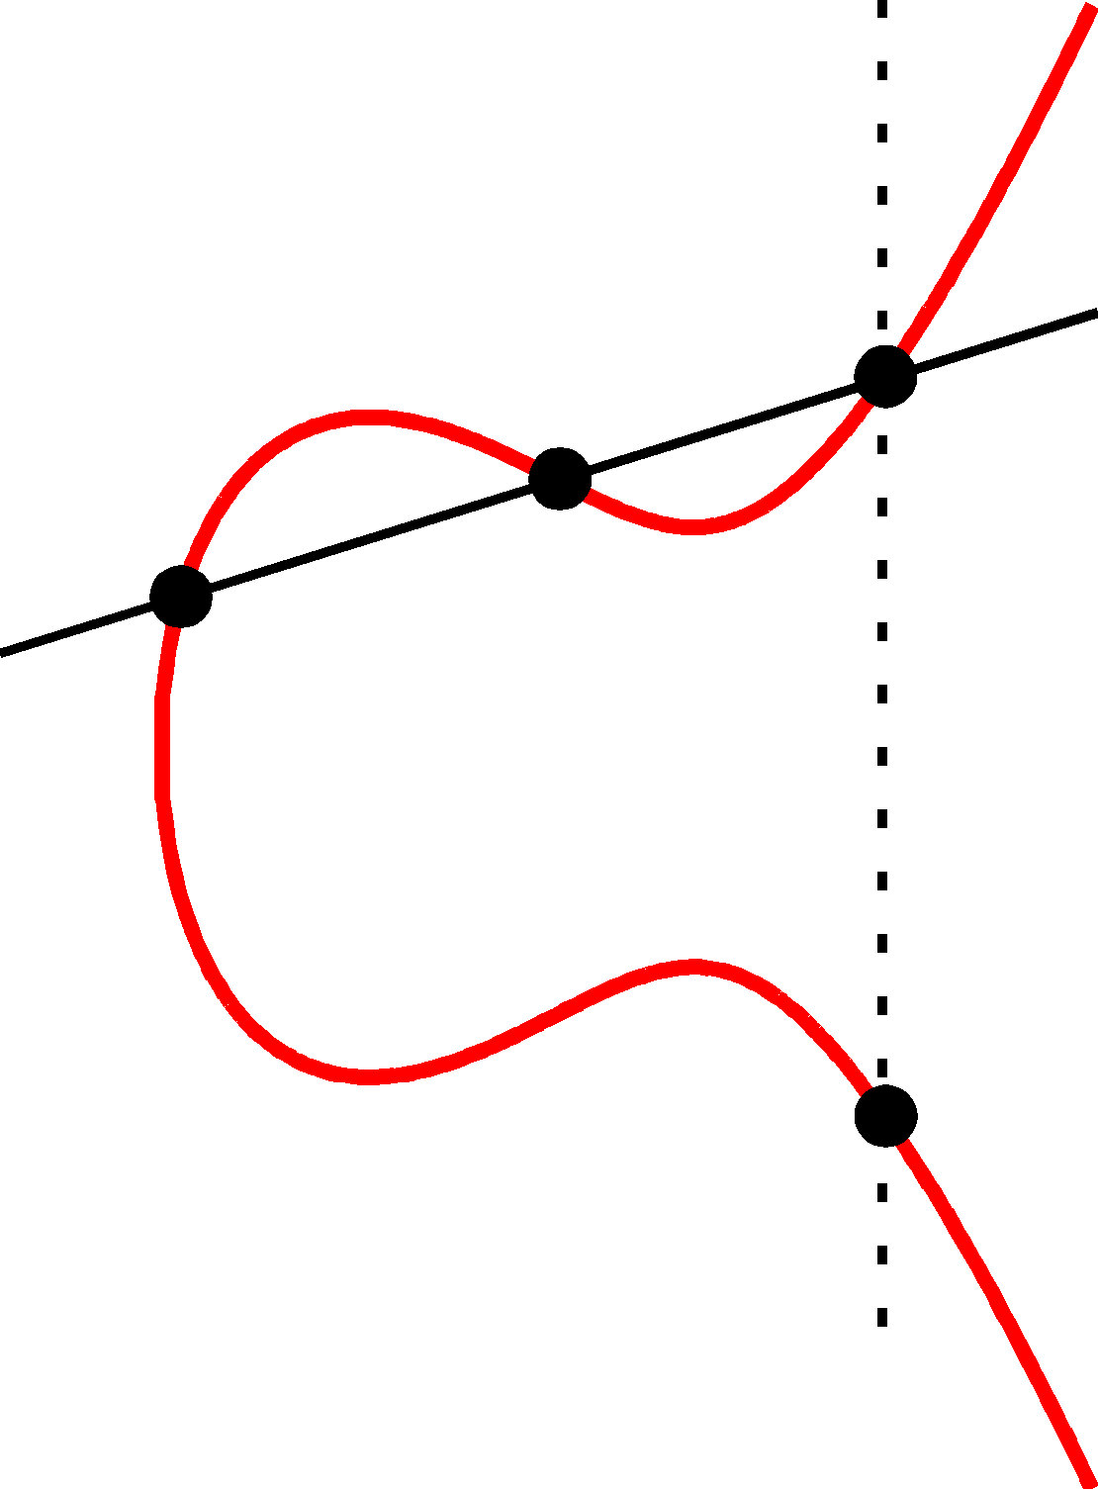
Elliptic Curve Example
$$\left(x2,y2\right)$$
(x₃,y₃)
The line passing through $\left(x1,y1\right)$ and $\left(x2,y2\right)$ has the equation
$$y=m\left(x−x1\right)+y1 mod P$$
Where the slope
$$m=\left[\frac{y1−y2}{x1−x2} mod p\right]$$
$$\left(x1,y1\right)$$
(x₃,-y₃)=$\left(x1,y1\right)+\left(x2,y2\right)$

Slide 28
Elliptic Curve Example
$$\left(x2,y2\right)$$
(x₃,y₃)
$$\left(x1,y1\right)$$
Formally, let
$$m=\left[\frac{y1−y2}{x1−x2} mod p\right]$$
Be the slope. Then the line passing through $\left(x1,y1\right)$ and $\left(x2,y2\right)$ has the equation
$$y=m\left(x−x1\right)+y1 mod P$$
$$\left(m\left(x−x1\right)+y1\right)2=x3+Ax+B mod p$$
(x₃,-y₃)=$\left(x1,y1\right)+\left(x2,y2\right)$
$$x3=[m2−x1−x2 mod p]$$
$$y3=[m\left(x3−x1\right)+y1 mod p]$$

Slide 29
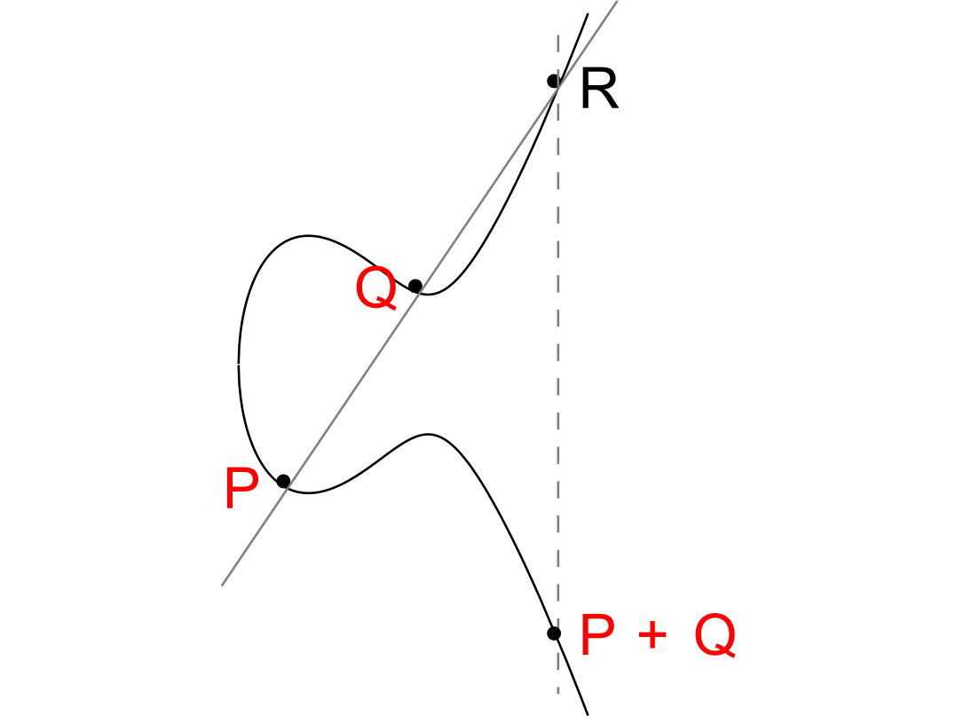

Slide 30
Elliptic Curve Special Cases
No third point R on the elliptic curve.
P+Q = 0
(Inverse)
Z+Z=0
Z

Slide 31
Elliptic Curve Special Cases
-R
Z
Z+Z=R
How to find R?
R

Slide 32
Can we find a cyclic group where DDH holds?
Elliptic Curves Example: Let p be a prime (p > 3) and let A, B be constants. Consider the equation
$$y2=x3+Ax+B mod p$$
And let
$$E\left(ℤ_{p}^{}\right)=\left\{\left(x,y\right)∈ℤ_{p}^{2} | y2=x3+Ax+B mod p \right\}∪\left\{𝒪\right\}$$
Fact: $E\left(ℤ_{p}^{}\right)$ defines an abelian group
For appropriate curves the DDH assumption is believed to hold
If you make up your own curve there is a good chance it is broken…
NIST has a list of recommendations
Bad Elliptic Curves:
Order is p, p+1, order divides $p^{k}−1$ for “small” k,…

Slide 33
Cryptography CS 555
Week 11:
Discrete Log/DDH
Applications of DDH
Factoring Algorithms, Discrete Log Attacks + NIST Recommendations for Concrete Security Parameters
Readings: Katz and Lindell Chapter 8.4 & Chapter 9
Fall 2017

Slide 34
Recap: Cyclic Group
$𝔾=\left\langle g\right\rangle =\left\{g0,g1,g2,…\right\}$ (g is generator)
If $m=\left|𝔾\right|$ then for each $h∈𝔾$ and each integer $x≥0$ we have
$$h^{x}=h^{x mod m}$$
Fact 1: Let p be a prime then $ℤ_{p}^{∗}$ is a cyclic group of order p-1.
Fact 2: Number of generators g s.t. of $\left\langle g\right\rangle =ℤ_{p}^{∗}$ is $φ\left(p−1\right)$
Example (generator): p=7, g=5
<2>={1,5,4,6,2,3}

Slide 35
Recap: Cyclic Group
$𝔾=\left\langle g\right\rangle =\left\{g0,g1,g2,…\right\}$ (g is generator)
If $m=\left|𝔾\right|$ then for each $h∈𝔾$ and each integer $x≥0$ we have
$$h^{x}=h^{x mod m}$$
Fact 1: Let p be a prime then $ℤ_{p}^{∗}$ is a cyclic group of order p-1.
Fact 2: Number of generators g s.t. of $\left\langle g\right\rangle =ℤ_{p}^{∗}$ is $φ\left(p−1\right)$
Proof: Suppose that $\left\langle g\right\rangle =ℤ_{p}^{∗}$ and let $h=gi$ then
$\left\langle h\right\rangle =\left\{g^{0},g^{i},g^{2i mod (p−1)},g^{3i mod (p−1)},…\right\}$
Recall: $\left\{ij mod \left(p−1\right):j ≥0\right\}=\{0,…,p−2\}$ if and only if gcd(i,p-1)=1.

Slide 36
Recap Diffie-Hellman Problems
Computational Diffie-Hellman Problem (CDH)
Attacker is given $h1=g^{x_{1}}∈𝔾$ and $h2=g^{x_{2}}∈𝔾.$
Attackers goal is to find${ g}^{x_{1}x_{2}}={\left(h1\right)}^{x_{2}}={\left(h2\right)}^{x_{1}}$
CDH Assumption: For all PPT A there is a negligible function negl such that A succeeds with probability at most negl(n).
Decisional Diffie-Hellman Problem (DDH)
L$et z0={ g}^{x_{1}x_{2}}$ and let $z1={ g}^{r}$, where x₁,x₂ and r are random
Attacker is given $g^{x_{1}}$, $g^{x_{2}}$ and $zb$ (for a random bit b)
Attackers goal is to guess b
DDH Assumption: For all PPT A there is a negligible function negl such that A succeeds with probability at most ½ + negl(n).

Slide 37
Can we find a cyclic group where DDH holds?
Theorem: $Let$p=rq+1 be a random n-bit prime where q is a large $λ$-bit prime then the set of rth residues modulo p is a cyclic subgroup of order q. Then $𝔾_{r}=\left\{[h^{r}mod p] | {h∈ℤ}_{p}^{∗}\right\}$is a cyclic subgroup of $ℤ_{p}^{∗}$ of order q.
Closure: $hrgr={\left(hg\right)}^{r}$
Inverse of $hr$ is ${\left(h^{−1}\right)}^{r}∈𝔾_{r}$
Size ${\left(hr\right)}^{x}=h^{[rx mod rq]}={{\left(hr\right)}^{x}=h}^{r[x mod q]}={\left(hr\right)}^{[x mod q]}mod p$
Remark: Two known attacks on Discrete Log Problem for $𝔾_{r}$(Section 9.2).
First runs in time $O\left(\sqrt{q}\right)=O\left(2^{λ/2}\right)$
Second runs in time $2^{O\left(\sqrt[3]{n}{\left(\log{n}\right)}^{2/3}\right)}$

Slide 38
Can we find a cyclic group where DDH holds?
Remark: Two known attacks (Section 9.2).
First runs in time $O\left(\sqrt{q}\right)=O\left(2^{λ/2}\right)$
Second runs in time $2^{O\left(\sqrt[3]{n}{\left(\log{n}\right)}^{2/3}\right)},$where n is bit length of p
Goal: Set $λ$ and n to balance attacks
$$λ=O\left(\sqrt[3]{n}{\left(\log{n}\right)}^{2/3}\right)$$
How to sample prime $p=rq+1$?
First sample a random $λ$-bit prime q and
Repeatedly check if $rq+1$ is prime for a random $\left(n−λ\right)$ bit value(s) r

Slide 39
More groups where DDH holds?
Elliptic Curves Example: Let p be a prime (p > 3) and let A, B be constants. Consider the equation
$$y2=x3+Ax+B mod p$$
And let
$$E\left(ℤ_{p}^{}\right)=\left\{\left(x,y\right)∈ℤ_{p}^{2} | y2=x3+Ax+B mod p \right\}∪\left\{𝒪\right\}$$
Note: $𝒪$ is defined to be an additive identity $\left(x,y\right)+𝒪=\left(x,y\right)$
W$hat is \left(x1,y1\right)+\left(x2,y2\right)?$

Slide 40
Elliptic Curve Example
$$\left(x2,y2\right)$$
(x₃,y₃)
The line passing through $\left(x1,y1\right)$ and $\left(x2,y2\right)$ has the equation
$$y=m\left(x−x1\right)+y1 mod P$$
Where the slope
$$m=\left[\frac{y1−y2}{x1−x2} mod p\right]$$
$$\left(x1,y1\right)$$
(x₃,-y₃)=$\left(x1,y1\right)+\left(x2,y2\right)$

Slide 41
Elliptic Curve Example
$$\left(x2,y2\right)$$
(x₃,y₃)
$$\left(x1,y1\right)$$
Formally, let
$$m=\left[\frac{y1−y2}{x1−x2} mod p\right]$$
Be the slope. Then the line passing through $\left(x1,y1\right)$ and $\left(x2,y2\right)$ has the equation
$$y=m\left(x−x1\right)+y1 mod P$$
$$\left(m\left(x−x1\right)+y1\right)2=x3+Ax+B mod p$$
(x₃,-y₃)=$\left(x1,y1\right)+\left(x2,y2\right)$
$$x3=[m2−x1−x2 mod p]$$
$$y3=[m\left(x3−x1\right)+y1 mod p]$$

Slide 43
Elliptic Curve Example
No third point R on the line intersects our elliptic curve.
Thus,
$$P+Q=𝒪$$

Slide 44
Summary: Elliptic Curves
Elliptic Curves Example: Let p be a prime (p > 3) and let A, B be constants. Consider the equation
$$y2=x3+Ax+B mod p$$
And let
$$E\left(ℤ_{p}^{}\right)=\left\{\left(x,y\right)∈ℤ_{p}^{2} | y2=x3+Ax+B mod p \right\}∪\left\{𝒪\right\}$$
Fact: $E\left(ℤ_{p}^{}\right)$ defines an abelian group
For appropriate curves the DDH assumption is believed to hold
If you make up your own curve there is a good chance it is broken…
NIST has a list of recommendations

Slide 45
Week 11: Topic 1: Discrete Logarithm Applications
Diffie-Hellman Key Exchange
Collision Resistant Hash Functions
Password Authenticated Key Exchange

Slide 46
Diffie-Hellman Key Exchange
Alice picks $xA$ and sends ${ g}^{xA}$ to Bob
Bob picks $xB$ and sends ${ g}^{xB}$ to Alice
Alice and Bob can both compute ${K_{A,B}=g}^{xB xA}$

Slide 47
Key-Exchange Experiment ${KE}_{A,Π}^{eav}\left(n\right)$:
Two parties run $Π$ to exchange secret messages (with security parameter 1^{n}).
Let trans be a transcript which contains all messages sent and let k be the secret key output by each party.
Let b be a random bit and let k_{b} = k if b=0; otherwise k_{b} is sampled uniformly at random.
Attacker A is given trans and k_{b} (passive attacker).
Attacker outputs b’ (${KE}_{A,Π}^{eav}\left(n\right)$=1 if and only if b=b’)
Security of $Π$ against an eavesdropping attacker: For all PPT A there is a negligible function negl such that
$$Pr\left[{KE}_{A,Π}^{eav}\left(n\right)\right]\text{=}\text{½}+negl\left(n\right).$$

Slide 48
Diffie-Hellman Key-Exchange is Secure
Theorem: If the decisional Diffie-Hellman problem is hard relative to group generator $𝒢$ then the Diffie-Hellman key-exchange protocol $Π$is secure in the presence of a (passive) eavesdropper (*).
(*) Assuming keys are chosen uniformly at random from the cyclic group $𝔾$
Protocol $Π$
Alice picks $xA$ and sends ${ g}^{xA}$ to Bob
Bob picks $xB$ and sends ${ g}^{xB}$ to Alice
Alice and Bob can both compute ${K_{A,B}=g}^{xB xA}$

Slide 49
Diffie-Hellman Assumptions
Computational Diffie-Hellman Problem (CDH)
Attacker is given $h1=g^{x_{1}}∈𝔾$ and $h2=g^{x_{2}}∈𝔾.$
Attackers goal is to find${ g}^{x_{1}x_{2}}={\left(h1\right)}^{x_{2}}={\left(h2\right)}^{x_{1}}$
CDH Assumption: For all PPT A there is a negligible function negl upper bounding the probability that A succeeds
Decisional Diffie-Hellman Problem (DDH)
L$et z0={ g}^{x_{1}x_{2}}$ and let $z1={ g}^{r}$, where x₁,x₂ and r are random
Attacker is given $g^{x_{1}}$, $g^{x_{2}}$ and $zb$ (for a random bit b)
Attackers goal is to guess b
DDH Assumption: For all PPT A there is a negligible function negl such that A succeeds with probability at most ½ + negl(n).

Slide 50
Diffie-Hellman Key Exchange
Alice picks $xA$ and sends ${ g}^{xA}$ to Bob
Bob picks $xB$ and sends ${ g}^{xB}$ to Alice
Alice and Bob can both compute ${K_{A,B}=g}^{xB xA}$
Intuition: Decisional Diffie-Hellman assumption implies that a passive attacker who observes ${ g}^{xA}$ and ${ g}^{xB}$ still cannot distinguish between ${K_{A,B}=g}^{xB xA}$ and a random group element.
Remark: Modified protocol sets$K_{A,B}=H\left(g^{xB xA}\right)$. You will prove that this protocol is secure under the weaker CDH assumption in homework 4.

Slide 51
Diffie-Hellman Key-Exchange is Secure
Theorem: If the decisional Diffie-Hellman problem is hard relative to group generator $𝒢$ then the Diffie-Hellman key-exchange protocol $Π$is secure in the presence of an eavesdropper (*).
Proof:
$$Pr\left[{KE}_{A,Π}^{eav}\left(n\right)=1\right]$$
$$\text{=}\text{½}Pr\left[{KE}_{A,Π}^{eav}\left(n\right)=1|b=1\right]+\text{½}Pr\left[{KE}_{A,Π}^{eav}\left(n\right)=1|b=0\right]$$
$$\text{=}\text{½}Pr\left[A\left(𝔾 ,g,q,g^{x},g^{y},g^{xy}\right)=1\right]+\text{½}Pr\left[A\left(𝔾 ,g,q,g^{x},g^{y},g^{z}\right)=0\right]$$
$$\text{=}\text{½}\text{+}\text{½}\left(Pr\left[A\left(𝔾 ,g,q,g^{x},g^{y},g^{xy}\right)=1\right]−Pr\left[A\left(𝔾 ,g,q,g^{x},g^{y},g^{z}\right)=1\right]\right).$$
$$≤\text{½}\text{ + }\text{½}\text{negl}\text{(}\text{n}\text{) (}\text{by} \text{DDH}\text{)}$$
(*) Assuming keys are chosen uniformly at random from the cyclic group $𝔾$

Slide 52
Diffie-Hellman Key Exchange
Alice picks $xA$ and sends ${ g}^{xA}$ to Bob
Bob picks $xB$ and sends ${ g}^{xB}$ to Alice
Alice and Bob can both compute $K_{A,B}=g^{xB xA}$
Intuition: Decisional Diffie-Hellman assumption implies that a passive attacker who observes ${ g}^{xA}$ and ${ g}^{xB}$ still cannot distinguish between ${K_{A,B}=g}^{xB xA}$ and a random group element.
Remark: The protocol is vulnerable against active attackers who can tamper with messages.

Slide 53
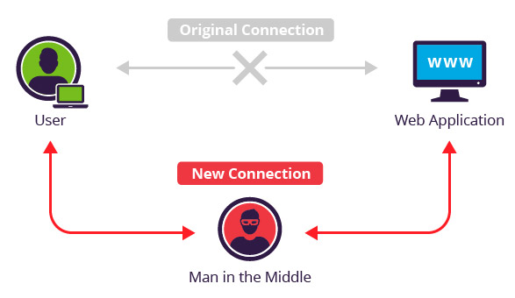
Man in the Middle Attack (MITM)

Slide 54
Man in the Middle Attack (MITM)
Alice picks $xA$ and sends ${ g}^{xA}$ to Bob
Mallory intercepts ${ g}^{xA}$ , picks $xE$ and sends ${ g}^{xE}$ to Bob instead
Bob picks $xB$ and sends ${ g}^{xB}$ to Alice
Mallory intercepts${ g}^{xB}$, picks $xE′$ and sends ${ g}^{xE′}$ to Alice instead
Eve computes ${ g}^{xE′xA}$ and ${ g}^{xExB}$
Alice computes secret key${ g}^{xE′xA}$ (shared with Eve not Bob)
Bob computes${ g}^{xExB}$(shared with Eve not Alice)
Mallory forwards messages between Alice and Bob (tampering with the messages if desired)
Neither Alice nor Bob can detect the attack

Slide 55
Discrete Log Experiment DLog_{A,G}(n)
Run $𝒢\left(1^{n}\right)$ to obtain a cyclic group $𝔾$ of order q (with $\left\|q\right\|=n$) and a generator g such that $<g>=𝔾$.
Select$h∈𝔾$ uniformly at random.
Attacker A is given $𝔾$, q, g, h and outputs integer x.
Attacker wins (DLog_{A,G}(n)=1) if and only if g^{x}=h.
We say that the discrete log problem is hard relative to generator $𝒢$ if
$$∀PPT A ∃μ (negligible) s.t Pr\left[\text{DLog}\text{A}\text{,}\text{n} =1\right]≤μ(n)$$

Slide 56
Collision Resistant Hash Functions (CRHFs)
Recall: not known how to build CRHFs from OWFs
Can build collision resistant hash functions from Discrete Logarithm Assumption
Let $𝒢\left(1^{n}\right)$ output $\left(𝔾,q,g\right)$ where $𝔾$ is a cyclic group of order $q$ and g is a generator of the group.
Suppose that discrete log problem is hard relative to generator $𝒢.$
$$∀PPT A ∃μ (negligible) s.t Pr\left[\text{DLog}\text{A}\text{,}\text{n} =1\right]≤μ(n)$$

Slide 57
Collision Resistant Hash Functions
Let $𝒢\left(1^{n}\right)$ output $\left(𝔾,q,g\right)$ where $𝔾$ is a cyclic group of prime order $q$ and g is a generator of the group.
Collision Resistant Hash Function (Gen,H):
$Gen\left(1^{n}\right)$
$\left(𝔾,q,g\right) ←𝒢\left(1^{n}\right)$
Select random $h← 𝔾$
Output $s=\left(𝔾,q,g,h\right)$
$H^{s}\left(x_{1},x_{2}\right)=g^{x_{1}}h^{x_{2}}$ (where, $x_{1},x_{2}{∈ℤ}_{q}^{}$)
Claim: (Gen,H) is collision resistant if the discrete log assumption holds for $𝒢$

Slide 58
Collision Resistant Hash Functions
$H^{s}\left(x_{1},x_{2}\right)=g^{x_{1}}h^{x_{2}}$ (where, $x_{1},x_{2}{∈ℤ}_{q}^{}$)
Claim: (Gen,H) is collision resistant
Proof (sketch): Suppose we find a collision $H^{s}\left(x_{1},x_{2}\right)=H^{s}\left(y_{1},y_{2}\right)$ then we have $g^{x_{1}}h^{x_{2}}=g^{y_{1}}h^{y_{2}}$ which implies
$$h^{x_{2}−y_{2}}=g^{y_{1}−x_{1}}$$
Use extended GCD to find ${\left(x_{2}−y_{2}\right)}^{−1} mod q$ then
$${h=h}^{\left(x_{2}−y_{2}\right){\left(x_{2}−y_{2}\right)}^{−1}}=g^{\left(y_{1}−x_{1}\right){\left(x_{2}−y_{2}\right)}^{−1} }$$
Which means that $\left(y_{1}−x_{1}\right){\left(x_{2}−y_{2}\right)}^{−1} mod q$ is the discrete log of h.

Slide 59
Password Authenticated Key-Exchange
Suppose Alice and Bob share a low-entropy password pwd and wish to communicate securely
(without using any trusted party)
Assuming an active attacker may try to mount a man-in-the-middle attack
Can they do it?
Tempting Approach:
Alice and Bob both compute K= KDF(pwd)=$H^{n}$(pwd) and communicate with using an authenticated encryption scheme.
Midterm Exam: Secure in random oracle model if attacker cannot query random oracle H(.) too many times.

Slide 60
Password Authenticated Key-Exchange
Tempting Approach:
Alice and Bob both compute K= KDF(pwd)=H^{n}(pwd) and communicate with using an authenticated encryption scheme.
Midterm Exam: Secure in random oracle model if attacker cannot query random oracle too many time.
Problems:
In practice the attacker can (and will) query the random oracle many times.
In practice people tend to pick very weak passwords
Brute-force attack: Attacker enumerates over a dictionary of passwords and attempts to decrypt messages with K_{pwd’}=KDF(pwd’) (only succeeds if K_{pwd’}=K).
An offline attack (brute-force) will almost always succeed

Slide 61
Attempt 2
Alice picks $xA$ and sends ${ g}^{H\left(pwd\right)+x_{A}}$ to Bob
Bob picks $xB$ and sends ${ g}^{H\left(pwd\right)+xB}$ to Alice
Alice and Bob can both compute $K_{A,B}=H\left(g^{xBx_{A}}\right)$
Alice picks random nonce $r_{A}$ and sends ${Enc}_{K_{A,B}}\left(r_{A}\right)$ to Bob
Enc is an authentication encryption scheme
Bob decrypts and sends $r_{A}$ to Alice
Advantage: MITM Attacker cannot establish connection without password
Disadvantage: Mallory could mount a brute-force attack after attempted MITM attack

Slide 62
Attempt 2: MITM Attack
Alice picks $xA$ and sends ${ g}^{H\left(pwd\right)+x_{A}}$ to Bob
Bob picks $xB$ and sends ${ g}^{H\left(pwd\right)+xB}$ to Alice
Mallory intercepts${ g}^{H\left(pwd\right)+x_{B}}$, picks $xE$ and sends ${ g}^{xE}$ to Alice instead
Bob can both compute $K_{A,B}=H\left(g^{xB xA}\right)$
Allice computes${ K}_{A,B}′=H\left(g^{\left(xE−H\left(pwd\right)\right) xA}\right)$ instead
Alice picks random nonce $r_{A}$ and sends $c={Enc}_{{ K}_{A,B}′}\left(r_{A}\right)$ to Bob
Mallory intercepts ${Enc}_{{ K}_{A,B}′}\left(r_{A}\right)$ and proceeds to mount brute-force attack on password
For each password guess y
let ${ K}_{y}=H\left(g^{\left(xE−H\left(y\right)\right) xA}\right)$ and
if ${Dec}_{{ K}_{y}}\left(c\right)≠⊥$then output y
Advantage: MITM Attacker cannot establish connection without password
Disadvantage: Mallory could mount a brute-force attack on password after attempted MITM attack

Slide 63
Password Authenticated Key-Exchange (PAKE)
Better Approach (PAKE):
Alice and Bob both compute $W=g^{pwd}$
Alice picks $xA$ and sends “$\text{Alice}\text{"}\text{,} {X=g}^{xA}$ to Bob
Bob picks $xB$ computes $r=H\left(1, Alice, Bob,X\right) and Y={\left(X×{\left(W\right)}^{r}\right)}^{xB}$and sends Alice the following message:$"Bob," Y$
Alice computes $K=Y^{Z}{=g}^{xB}$ where $Z=1/{\left(\left(pwd×r\right)+xA\right)} mod p$. Alice sends the message V_{A}= H(2,Alice,Bob,X,Y,K) to Bob.
Bob verifies that V_{A}== H(2,Alice,Bob,X,Y,K) where K = ${ g}^{xB}$. Bob generates V_{B}= H(3,Alice,Bob,X,Y,K) and sends V_{B} to Alice.
Alice verifies that V_{B}==H(3,Alice,Bob,X,Y, $Y^{Z}$ ) where $Z=1/{\left(\left(pwd×r\right)+xA\right)}$.
If Alice and Bob don’t terminate the session key is H(4,Alice,Bob,X,Y, $K$)
Security:
No offline attack (brute-force) is possible. Attacker get’s one password guess per instantiation of the protocol.
If attacker is incorrect and he tampers with messages then he will cause the Alice & Bob to quit.
If Alice and Bob accept the secret key K and the attacker did not know/guess the password then K is “just as good” as a truly random secret key.
See RFC 6628

Slide 64
Week 11: Topic 2: Factoring Algorithms, Discrete Log Attacks + NIST Recommendations for Concrete Security Parameters

Slide 65
Pollard’s p-1 Algorithm (Factoring)
Let $N=pq$ where (p-1) has only “small” prime factors.
Pollard’s p-1 algorithm can factor N.
Remark 1: This happens with very small probability if p is a random n bit prime.
Remark 2: One convenient/fast way to generate big primes it to multiply many small primes, add 1 and test for primality.
Example: $2×3×5×7+1=211$ is prime
Claim: Suppose we are given an integer B such that (p-1) divides B but (q-1) does not divide B then we can factor N.

Slide 66
Pollard’s p-1 Algorithm (Factoring)
Claim: Suppose we are given an integer B such that (p-1) divides B but (q-1) does not divide B then we can factor N.
Proof: Suppose B=c(p-1) for some integer c and let
$$y=\left[x^{B}−1 mod N\right]$$
Applying the Chinese Remainder Theorem we have
$$y↔\left(x^{B}−1 mod p,x^{B}−1 mod q\right)$$
$$=\left(0, x^{B mod (q−1)}−1 mod q\right)$$
This means that p divides y, but q does not divide y (unless $x^{B}=1 mod q$, which is unlikely when $x$ is random since $0≠B mod (q−1)$).
Thus, GCD(y,N) = p

Slide 67
Pollard’s p-1 Algorithm (Factoring)
Let $N=pq$ where (p-1) has only “small” prime factors.
Pollard’s p-1 algorithm can factor N.
Claim: Suppose we are given an integer B such that (p-1) divides B but (q-1) does not divide B then we can factor N.
Goal: Find B such that (p-1) divides B but (q-1) does not divide B.
Remark: This is difficult if (p-1) has a large prime factor.
$$B=\prod_{i=1}^{k}{p_{i}^{\left[n/\log{pi}\right]}}$$

Slide 68
Pollard’s p-1 Algorithm (Factoring)
Goal: Find B such that (p-1) divides B but (q-1) does not divide B.
Remark: This is difficult if (p-1) has a large prime factor.
$$B=\prod_{i=1}^{k}{p_{i}^{\left[n/\log{pi}\right]}}$$
Here p₁=2,p₂=3,…p_{k} are the first k prime numbers.
Fact: If (q-1) has prime factor larger than p_{k} then (q-1) does not divide B.
Fact: If (p-1) does not have prime factor larger than p_{k} then (p-1) does divide B.

Slide 69
Pollard’s p-1 Algorithm (Factoring)
Option 1: To defeat this attack we can choose strong primes p and q
A prime p is strong if (p-1) has a large prime factor
Drawback: It takes more time to generate (provably) strong primes
Option 2: A random prime is strong with high probability
Current Consensus: Just pick a random prime

Slide 70
Pollard’s Rho Algorithm
General Purpose Factoring Algorithm
Doesn’t assume (p-1) has no large prime factor
Goal: factor N=pq (product of two n-bit primes)
Running time: $O\left(\sqrt[4]{N} polylog(N)\right)$
Contrast: Naïve Algorithm takes time $O\left(\sqrt{N} polylog(N)\right)$ to factor
Core idea: find distinct $x,x′∈ℤ_{N}^{∗}$ such that $x=x^{′}mod p$
Implies that x-x’ is a multiple of p and, thus, GCD(x-x’,N)=p (whp)

Slide 71
Pollard’s Rho Algorithm
General Purpose Factoring Algorithm
Doesn’t assume (p-1) has no large prime factor
Running time: $O\left(\sqrt[4]{N} polylog(N)\right)$
Core idea: find distinct $x,x′∈ℤ_{N}^{∗}$ such that $x=x^{′}mod p$ (but $x≠x^{′}mod q$ )
Implies that x-x’ is a multiple of p and, thus, GCD(x-x’,N)=p
Question: If we pick $k=O\left(\sqrt{p}\right)$ random $x^{(1)},…,x^{(k)}∈ℤ_{N}^{∗}$ then what is the probability that we can find distinct $i and j$such that
$$x^{(i)}=x^{(j)}mod p?$$

Slide 72
Pollard’s Rho Algorithm
Question: If we pick $k=O\left(\sqrt{p}\right)$ random $x^{(1)},…,x^{(k)}∈ℤ_{N}^{∗}$ then what is the probability that we can find distinct $i and j$such that$x^{(i)}=x^{(j)}mod p$?
Answer: $≥1/2$
Proof (sketch): Use the Chinese Remainder Theorem + Birthday Bound
$$x^{(i)}=\left(x^{(i)} mod p,x^{(i)} mod q\right)$$
Note: We will also have $x^{(i)}≠x^{\left(j\right)} mod q$ (whp)

Slide 73
Pollard’s Rho Algorithm
Question: If we pick $k=O\left(\sqrt{p}\right)$ random $x^{(1)},…,x^{(k)}∈ℤ_{N}^{∗}$ then what is the probability that we can find distinct $i and j$such that$x^{(i)}=x^{(j)}mod p$?
Answer: $≥1/2$
Challenge: We do not know p or q so we cannot sort the $x^{(i)}$’s using the Chinese Remainder Theorem Representation
$$x^{(i)}=\left(x^{(i)} mod p,x^{(i)} mod q\right)$$
Problem: How can we identify the pair $i and j$such that$x^{(i)}=x^{(j)}mod p$?

Slide 74
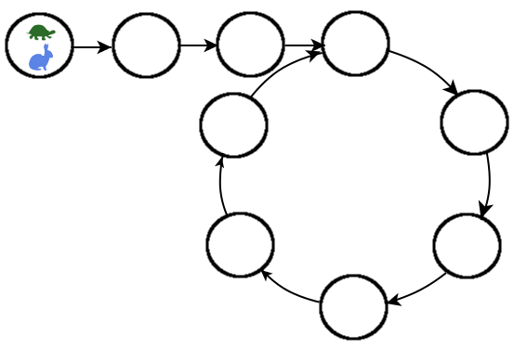
Pollard’s Rho Algorithm
Pollard’s Rho Algorithm is similar the low-space version of the birthday attack
Input: N (product of two n bit primes)
$x^{(0)}←ℤ_{N}^{∗}$, $x=x^{′}=x^{(0)}$
For i=1 to $2^{n/2}$
$x←F(x)$
$x^{′}←F\left(F\left(x′\right)\right)$
p = GCD(x-x’,N)
if 1< p < N return p
$$F\left(x^{(i−1)}\right)=x^{(i)}↔\left(x^{(i)}mod p ,x^{(i)}mod q\right)$$
Expected Cycle Length: $O\left(\sqrt{N}\right)$ too high!

Slide 75
Pollard’s Rho Algorithm
Pollard’s Rho Algorithm is similar the low-space version of the birthday attack
Input: N (product of two n bit primes)
$x^{(0)}←ℤ_{N}^{∗}$, $x=x^{′}=x^{(0)}$
For i=1 to $2^{n/2}$
$x←F(x)$
$x^{′}←F\left(F\left(x′\right)\right)$
p = GCD(x-x’,N)
if 1< p < N return p
Remark 1: F should have the property that $F\left(x\right)=F\left(x mod p\right) mod p$ i.e.,
$$F\left(x\right)↔\left(F\left(x mod p\right) mod p,F_{2}\left(x\right) mod q\right)$$
$$x^{(i)}mod p$$
$$\left(x^{(i)}mod p ,x^{(i)}mod q\right)$$

Slide 76
Pollard’s Rho Algorithm
Pollard’s Rho Algorithm is similar the low-space version of the birthday attack
Input: N (product of two n bit primes)
$x^{(0)}←ℤ_{N}^{∗}$, $x=x^{′}=x^{(0)}$
For i=1 to $2^{n/2}$
$x←F(x)$
$x^{′}←F\left(F\left(x′\right)\right)$
p = GCD(x-x’,N)
if 1< p < N return p
Remark 1: F should have the property that $F\left(x\right)=F\left(x mod p\right) mod p$ i.e.,
$$F\left(x\right)↔\left(F\left(x mod p\right) mod p,F_{2}\left(x\right) mod q\right)$$
Remark 2: $F\left(x\right)=\left[x^{2}+1 mod N\right]$ will work since
$$F\left(x\right)=\left[x^{2}+1 mod N\right]↔\left(x^{2}+1 mod p,x^{2}+1 mod q\right)$$
$$↔\left(F\left(\left[x mod p\right] \right) mod p,F\left(\left[x mod q\right] \right)mod q\right)$$

Slide 77
Pollard’s Rho Algorithm
Pollard’s Rho Algorithm is similar the low-space version of the birthday attack
Input: N (product of two n bit primes)
$x^{(0)}←ℤ_{N}^{∗}$, $x=x^{′}=x^{(0)}$
For i=1 to $2^{n/2}$
$x←F\left(x\right)$
$x^{′}←F\left(F\left(x′\right)\right)$
p = GCD(x-x’,N)
if 1< p < N return p
Claim: Let $x^{(i+1)}=F\left(x^{(i)}\right)$ and suppose that for some distinct $i,j<2^{n/2}$ we have $x^{(i)}=x^{(j)} mod p$ but $x^{(i)}≠x^{(j)}$. Then the algorithm will find p.
$x^{(3)}$ mod p
$x^{(j)}≡x^{(i)}$ mod p
Expected Cycle Length: $O\left(\sqrt{p}\right)$
Notes:
Proof: First part of claim states that there is a cycle. If there is such a cycle we will detect it

Slide 78
Pollard’s Rho Algorithm (Summary)
General Purpose Factoring Algorithm
Doesn’t assume (p-1) has no large prime factor
Expected Running Time: $O\left(\sqrt[4]{N} polylog(N)\right)$
(Birthday Bound)
(still exponential in number of bits $\sim 2^{n/4}$)
Required Space: $O\left(log(N)\right)$

Slide 79
Quadratic Sieve Algorithm
Runs in sub-exponential time $2^{O\left(\sqrt{\log{N} \log{\log{N}}}\right)}=2^{O\left(\sqrt{n\log{n}}\right)}$
Still not polynomial time but $2^{\sqrt{n\log{n}}}$ is sub-exponential and grows much slower than $2^{n/4}$.
Core Idea: Find $x,y∈ℤ_{N}^{∗}$ such that
$$x^{2}=y^{2} mod N$$
and
$$x≠±y mod N$$

Slide 80
Quadratic Sieve Algorithm
Core Idea: Find $x,y∈ℤ_{N}^{∗}$ such that
$$x^{2}=y^{2} mod N (1)$$
and
$$x≠±y mod N \left(2\right)$$
Claim: gcd(x-y,N)$∈\left\{p,q\right\}$
N=pq divides $x^{2}−y^{2}=\left(x−y\right)\left(x+y\right).$ (by (1)).
$\left(x−y\right)\left(x+y\right)≠0$ (by (2)).
N does not divide $\left(x−y\right)$(by (2)).
N does not divide $\left(x+y\right).$ (by (2)).
p is a factor of exactly one of the terms $\left(x−y\right)$ and $\left(x+y\right).$
(q is a factor of the other term)

Slide 81
Quadratic Sieve Algorithm
Core Idea: Find $x,y∈ℤ_{N}^{∗}$ such that
$$x^{2}=y^{2} mod N$$
and
$$x≠±y mod N$$
Key Question: How to find such an $x,y∈ℤ_{N}^{∗}$?
Step 1: (Initialize j=0 );
For $x=\sqrt{N}+1,\sqrt{N}+2,…,\sqrt{N}+i$,…
$$q←\left[{\left(\sqrt{N}+i\right)}^{2} mod N\right]=\left[2i\sqrt{N}+i2 mod N\right]$$
Check if q is B-smooth (all prime factors of q are in {p₁,…,p_{k}} where p_{k} < B).
If q is B smooth then factor q, increment j and define
$$qj←q=\prod_{i=1}^{k}{p_{i}^{e_{j,i}}}, and xj←x$$

Slide 82
Quadratic Sieve Algorithm
Core Idea: Find $x,y∈ℤ_{N}^{∗}$ such that
$$x^{2}=y^{2} mod N$$
and
$$x≠±y mod N$$
Key Question: How to find such an $x,y∈ℤ_{N}^{∗}$?
Step 2: Once we have $ℓ>k$ equations of the form
$$qj←q=\prod_{i=1}^{k}{p_{i}^{e_{j,i}}},$$
We can use linear algebra to find subset S such that for each $i≤k$ we have
$$\sum_{j∈S}{e_{j,i}}=0 mod 2.$$

Slide 83
Quadratic Sieve Algorithm
Key Question: How to find $x,y∈ℤ_{N}^{∗}$ such that $x^{2}=y^{2} mod N$ and $x≠±y mod N$?
Step 2: Once we have $ℓ>k$ equations of the form
$$qj←q=\prod_{i=1}^{k}{p_{i}^{e_{j,i}}},$$
We can use linear algebra to find a subset S such that for each $i≤k$ we have
$$\sum_{j∈S}{e_{j,i}}=0 mod 2.$$
Thus,
$$\prod_{j∈S}{qj}=\prod_{i=1}^{k}{p_{i}^{\sum_{j∈S}{e_{j,i}}}}={\left(\prod_{i=1}^{k}{p_{i}^{\frac{1}{2}\sum_{j∈S}{e_{j,i}}}}\right)}^{2}=y2$$

Slide 84
Quadratic Sieve Algorithm
Key Question: How to find $x,y∈ℤ_{N}^{∗}$ such that $x^{2}=y^{2} mod N$ and $x≠±y mod N$?
Thus,
$$\prod_{j∈S}{qj}=\prod_{i=1}^{k}{p_{i}^{\sum_{j∈S}{e_{j,i}}}}={\left(\prod_{i=1}^{k}{p_{i}^{\frac{1}{2}\sum_{j∈S}{e_{j,i}}}}\right)}^{2}=y2$$
But we also have
$$\prod_{j∈S}{qj}=\prod_{j∈S}{\left(xj2 \right)}={\left(\prod_{j∈S}{xj}\right)}^{2}=x2 mod N$$

Slide 85
Quadratic Sieve Algorithm (Summary)
Appropriate parameter tuning yields sub-exponential time algorithm $2^{O\left(\sqrt{\log{N} \log{\log{N}}}\right)}=2^{O\left(\sqrt{n\log{n}}\right)}$
Still not polynomial time but $2^{\sqrt{n\log{n}}}$ grows much slower than $2^{n/4}$.

Slide 86
Discrete Log Attacks
Pohlig-Hellman Algorithm
Given a cyclic group $𝔾$ of non-prime order q=| $𝔾$|=rp
Reduce discrete log problem to discrete problem(s) for subgroup(s) of order p (or smaller).
Preference for prime order subgroups in cryptography
Baby-step/Giant-Step Algorithm
Solve discrete logarithm in time $O\left(\sqrt{q} polylog(q)\right)$
Pollard’s Rho Algorithm
Solve discrete logarithm in time $O\left(\sqrt{q} polylog(q)\right)$
Bonus: Constant memory!
Index Calculus Algorithm
Similar to quadratic sieve
Runs in sub-exponential time $2^{O\left(\sqrt{\log{q}\log{\log{q}}} \right)}$
Specific to the group $ℤ_{p}^{∗}$ (e.g., attack doesn’t work elliptic-curves)

Slide 87
Discrete Log Attacks
Pohlig-Hellman Algorithm
Given a cyclic group $𝔾$ of non-prime order q=| $𝔾$|=rp
Reduce discrete log problem to discrete problem(s) for subgroup(s) of order p (or smaller).
Preference for prime order subgroups in cryptography
Let $𝔾=\left\langle g\right\rangle$ and$h=g^{x}∈𝔾$ be given. For simplicity assume that r is prime and r < p.
Observe that $\left\langle gr\right\rangle$ generates a subgroup of size p and that $hr∈\left\langle gr\right\rangle$.
Solve discrete log problem in subgroup $\left\langle gr\right\rangle$ with input $hr$.
Find z such that $hrz=grz$.
Observe that $\left\langle gp\right\rangle$ generates a subgroup of size r and that $hp∈\left\langle gp\right\rangle$.
Solve discrete log problem in subgroup $\left\langle gp\right\rangle$ with input $hp$.
Find y such that $hyp=gyp$.
Chinese Remainder Theorem $h=g^{x}$ where $x↔\left(\left[z mod p\right], [y mod r]\right)$

Slide 88
Baby-step/Giant-Step Algorithm
Input: $𝔾=\left\langle g\right\rangle$ of order q, generator g and $h=g^{x}∈𝔾$
Set $t=\left\lfloor \sqrt{q}\right\rfloor$
For i =0 to $\left\lfloor \frac{q}{t}\right\rfloor$
$$g_{i}←g^{it}$$
Sort the pairs (i,g_{i}) by their second component
For i =0 to $t$
$h_{i}←hg^{i}$
if $h_{i}=g_{k}∈\left\{g_{0},…,g_{t}\right\}$ then
return [kt-i mod q]
$h_{i}=hg^{i}$ $=g^{kt}$
$$→h=g^{kt−i}$$

Slide 89
Discrete Log Attacks
Baby-step/Giant-Step Algorithm
Solve discrete logarithm in time $O\left(\sqrt{q} polylog(q)\right)$
Requires memory $O\left(\sqrt{q} polylog(q)\right)$
Pollard’s Rho Algorithm
Solve discrete logarithm in time $O\left(\sqrt{q} polylog(q)\right)$
Bonus: Constant memory!
Key Idea: Low-Space Birthday Attack (*) using our collision resistant hash function
$$H_{g,h}\left(x_{1},x_{2}\right)=g^{x_{1}}h^{x_{2}}$$
$$H_{g,h}\left(y_{1},y_{2}\right)=H_{g,h}\left(x_{1},x_{2}\right)→ h^{y_{2}−x_{2}}=g^{x_{1}−y_{1}}$$
$$→h=g^{\left(x_{1}−y_{1}\right){\left(y_{2}−x_{2}\right)}^{−1}}$$
(*) A few small technical details to address

Slide 90
Discrete Log Attacks
Remark: We used discrete-log problem to construct collision resistant hash functions.
Security Reduction showed that attack on collision resistant hash function yields attack on discrete log.
→Generic attack on collision resistant hash functions (e.g., low space birthday attack) yields generic attack on discrete log.
Baby-step/Giant-Step Algorithm
Solve discrete logarithm in time $O\left(\sqrt{q} polylog(q)\right)$
Requires memory $O\left(\sqrt{q} polylog(q)\right)$
Pollard’s Rho Algorithm
Solve discrete logarithm in time $O\left(\sqrt{q} polylog(q)\right)$
Bonus: Constant memory!
Key Idea: Low-Space Birthday Attack (*)
$$H_{g,h}\left(x_{1},x_{2}\right)=g^{x_{1}}h^{x_{2}}$$
$$H_{g,h}\left(y_{1},y_{2}\right)=H_{g,h}\left(x_{1},x_{2}\right)$$
$$→ h^{y_{2}−x_{2}}=g^{x_{1}−y_{1}}$$
$$→h=g^{\left(x_{1}−y_{1}\right){\left(y_{2}−x_{2}\right)}^{−1}}$$
(*) A few small technical details to address

Slide 91
Discrete Log Attacks
Index Calculus Algorithm
Similar to quadratic sieve
Runs in sub-exponential time $2^{O\left(\sqrt{\log{q}\log{\log{q}}} \right)}$
Specific to the group $ℤ_{p}^{∗}$ (e.g., attack doesn’t work elliptic-curves)
As before let {p₁,…,p_{k}} be set of prime numbers < B.
Step 1.A: Find $ℓ>k$ distinct values $x_{1},…,x_{k}$ such that $g_{j}=\left[g^{x_{j}} mod p\right]$ is B-smooth for each j. That is
$$g_{j}=\prod_{i=1}^{k}{p_{i}^{e_{i,j}}}.$$

Slide 92
Discrete Log Attacks
As before let {p₁,…,p_{k}} be set of prime numbers < B.
Step 1.A: Find $ℓ>k$ distinct values $x_{1},…,x_{k}$ such that $g_{j}=\left[g^{x_{j}} mod p\right]$ is B-smooth for each j. That is
$$g_{j}=\prod_{i=1}^{k}{p_{i}^{e_{i,j}}}.$$
Step 1.B: Use linear algebra to solve the equations
$$x_{j}=\sum_{i=1}^{k}{\left(\log_{g}{ p}_{i}\right){×e}_{i,j}} mod (p−1).$$
(Note: the$\log_{g}p_{i}$’s are the unknowns)

Slide 93
Discrete Log
As before let {p₁,…,p_{k}} be set of prime numbers < B.
Step 1 (precomputation): Obtain y₁,…,y_{k} such that $\text{p}\text{i}=g^{y_{i}} mod p.$
Step 2: Given discrete log challenge h=g^{x} mod p.
Find y such that $\left[g^{y}\text{h} mod p\right]$ is B-smooth
$$\left[g^{y}\text{h} mod p\right]=\prod_{i=1}^{k}{p_{i}^{e_{i}}}$$
$$=\prod_{i=1}^{k}{{\left(g^{y_{i}}\right)}^{e_{i}}}=g^{\sum_{i}{{e_{i}y}_{i}}}$$

Slide 94
Discrete Log
As before let {p₁,…,p_{k}} be set of prime numbers < B.
Step 1 (precomputation): Obtain y₁,…,y_{k} such that $\text{p}\text{i}=g^{y_{i}} mod p.$
Step 2: Given discrete log challenge h=g^{x} mod p.
Find z such that $\left[g^{z}\text{h} mod p\right]$ is B-smooth
$$\left[g^{z}\text{h} mod p\right]=g^{\sum_{i}{{e_{i}y}_{i}}}→h=g^{\sum_{i}{{e_{i}y}_{i}}−z}$$
$$→x=\sum_{i}{{e_{i}y}_{i}}−z$$
Remark: Precomputation costs can be amortized over many discrete log instances
In practice, the same group $𝔾=\left\langle g\right\rangle$ and generator g are used repeatedly.
Reference: https://www.weakdh.org/

Slide 95
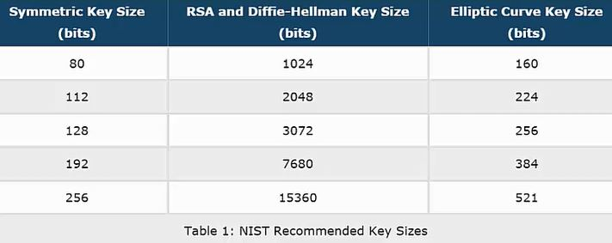
NIST Guidelines (Concrete Security)
Best known attack against 1024 bit RSA takes time (approximately) 2⁸⁰

Slide 96
NIST Guidelines (Concrete Security)
Diffie-Hellman uses subgroup of $ℤ_{p}^{∗}$ size q
q=224 bits
q=256 bits
q=384 bits
q=512 bits

Slide 97
