Slide 1
Midterm Statistics
Minimum Value | 56.1
Maximum Value | 93.8
Range | 37.7
Average | 78.72
Median | 79.15
Standard Deviation | 9.51

Slide 2
Final Exam
Time: Tuesday, December 12th at 1PM (Tentative Subject to Change)
Location: LWSN 1106

Slide 3
Cryptography
CS 555
Week 8:
DES, 3DES, AES
One Way Functions
Readings: Katz and Lindell Chapter 7
Fall 2017

Slide 4
Feistel Networks and Substitution Permutation Networks
Used to construct block-ciphers
DES: Feistel Network
AES: Substitution Permutation Network

Slide 5
CS 555: Week 8: Topic 1:
DES, 3DES, AES

Slide 6
Data Encryption Standard
Developed in 1970s by IBM (with help from NSA)
Adopted in 1977 as Federal Information Processing Standard (US)
Data Encryption Standard (DES): 16-round Feistel Network.
Key Length: 56 bits
  Vulnerable to brute-force attacks in modern times
  1.5 hours at 14 trillion keys/second (e.g., Antminer S9)

Slide 7
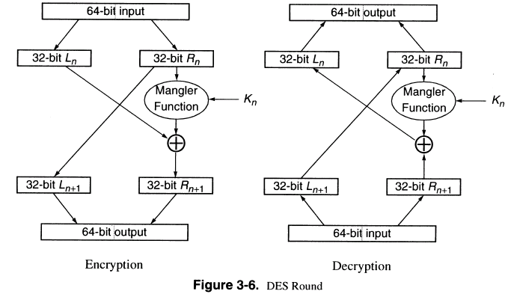
DES Round

Slide 8
DES Security
Best Known attack is brute-force 2⁵⁶
  Except under unrealistic conditions (e.g., 2⁴³ known plaintexts)
Brute force is not too difficult on modern hardware
Attack can be accelerated further after precomputation
  Output is a few terabytes
  Subsequently keys are cracked in 2³⁸ DES evaluations (minutes)
Precomputation costs amortize over number of DES keys cracked
Even in 1970 there were objections to the short key length for DES

Slide 9
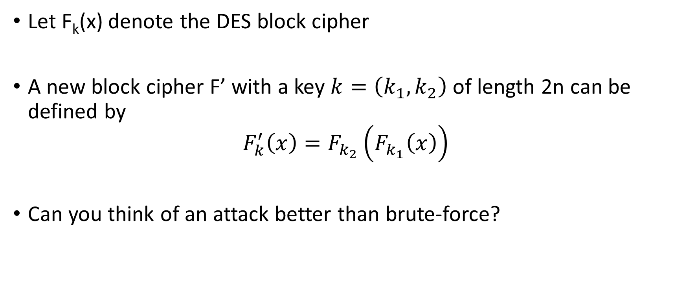
Double DES
Let F_{k}(x) denote the DES block cipher
A new block cipher F’ with a key $k=\left(k_{1},k_{2}\right)$ of length 2n can be defined by
$$F_{k}^{′}\left(x\right)=F_{k_{2}}\left(F_{k_{1}}\left(x\right)\right)$$
Can you think of an attack better than brute-force?

Slide 10
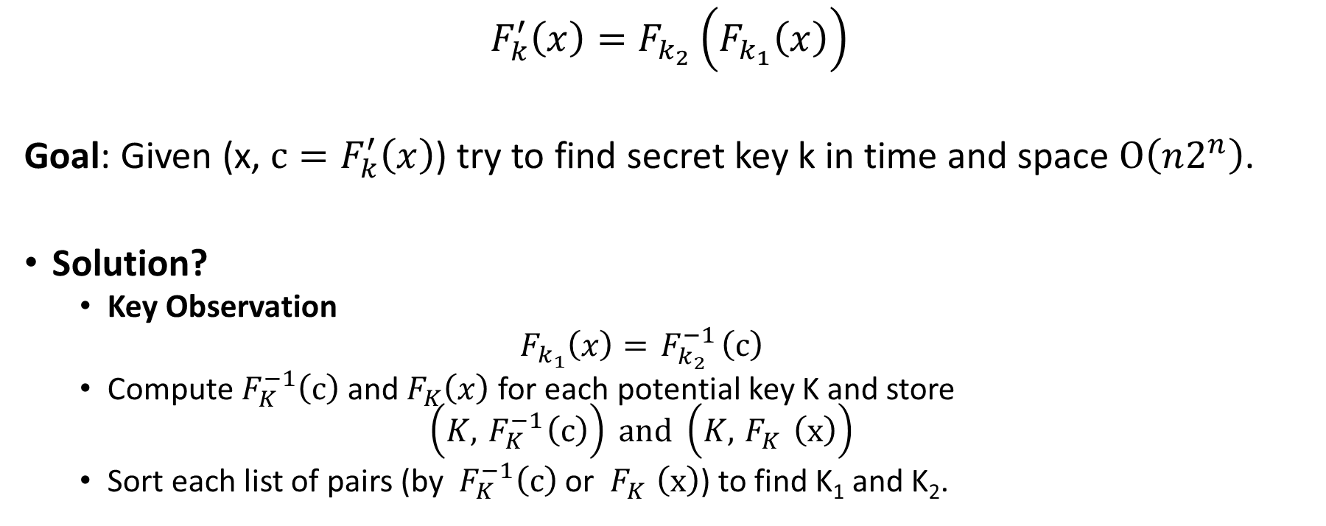
Meet in the Middle Attack
$$F_{k}^{′}\left(x\right)=F_{k_{2}}\left(F_{k_{1}}\left(x\right)\right)$$
Goal: Given (x, $c=F_{k}^{′}\left(x\right)$) try to find secret key k in time and space $O\left(n2^{n}\right)$.
Solution?
  Key Observation
  $$F_{k_{1}}\left(x\right)={ F}_{k_{2}}^{−1}\left(c\right)$$
  Compute${ F}_{K}^{−1}\left(c\right)$ and${ F}_{K}\left(x\right)$ for each potential key K and store
  $$\left(K,{ F}_{K}^{−1}\left(c\right)\right) and \left(K,{ F}_{K}^{}\left(x\right)\right)$$
  Sort each list of pairs (by ${ F}_{K}^{−1}\left(c\right)$ or ${ F}_{K}^{}\left(x\right)$) to find K₁ and K₂.

Slide 11
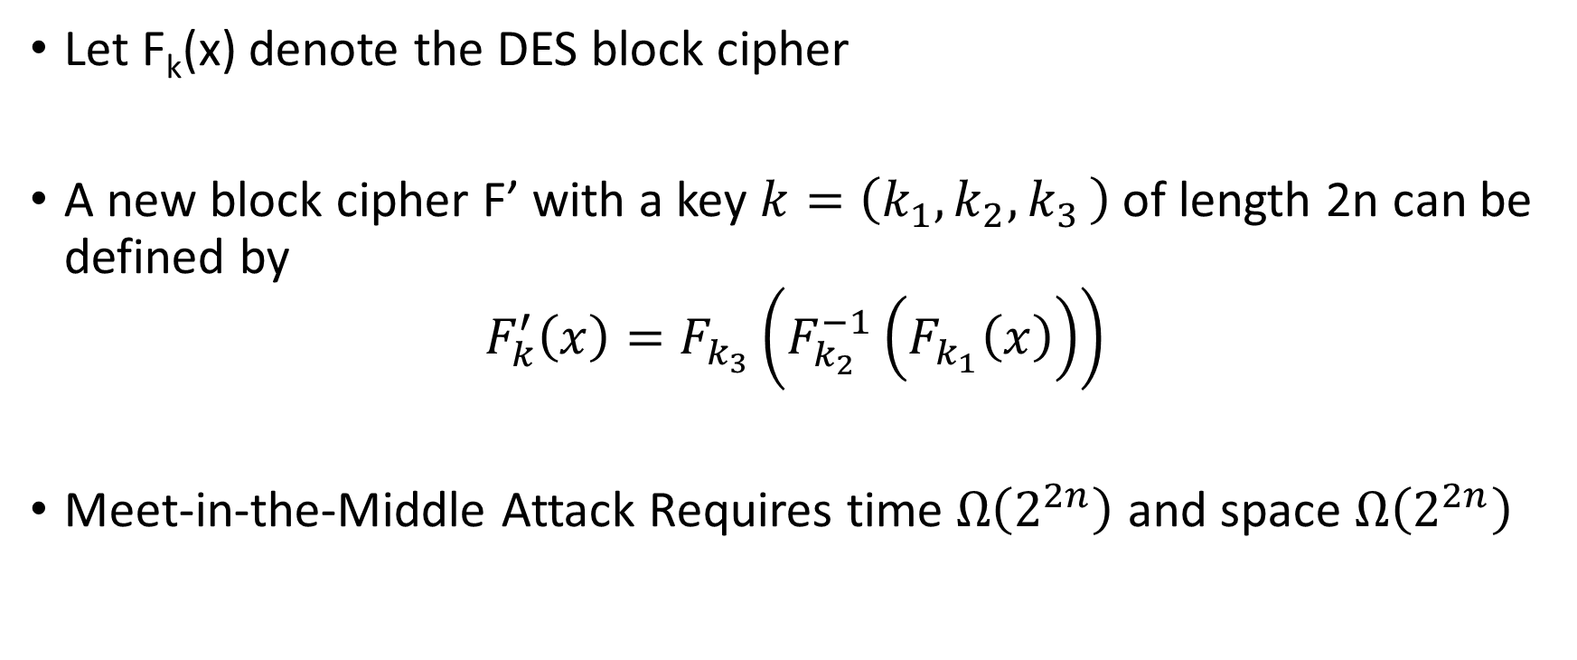
Triple DES Variant 1
Let F_{k}(x) denote the DES block cipher
A new block cipher F’ with a key $k=\left(k_{1},k_{2}{,k}_{3}\right)$ of length 2n can be defined by
$$F_{k}^{′}\left(x\right)=F_{k_{3}}\left(F_{k_{2}}^{−1}\left(F_{k_{1}}\left(x\right)\right)\right)$$
Meet-in-the-Middle Attack Requires time $Ω\left(2^{2n}\right)$ and space $Ω\left(2^{2n}\right)$

Slide 12
Triple DES
Allows backward compatibility with DES by setting k₁=k₂=k₃
Let F_{k}(x) denote the DES block cipher
A new block cipher F’ with a key $k=\left(k_{1},k_{2}{,k}_{3}\right)$ of length 2n can be defined by
$$F_{k}^{′}\left(x\right)=F_{k_{3}}\left(F_{k_{2}}^{−1}\left(F_{k_{1}}\left(x\right)\right)\right)$$
Meet-in-the-Middle Attack Requires time $Ω\left(2^{2n}\right)$ and space $Ω\left(2^{2n}\right)$

Slide 13
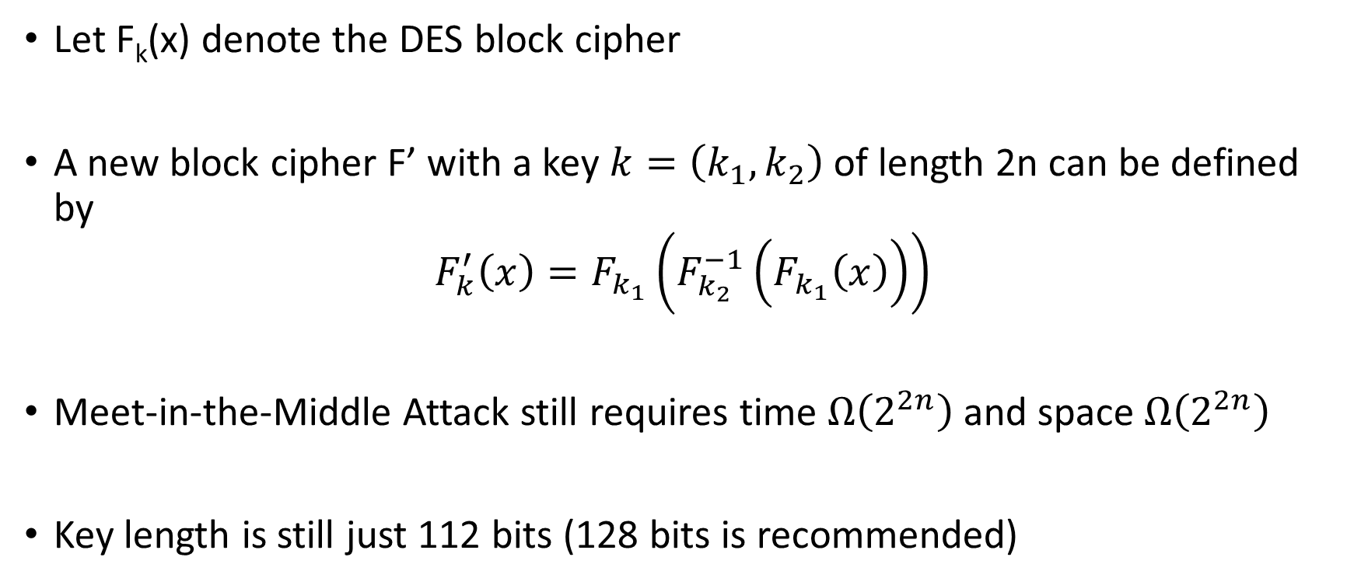
Triple DES Variant 2
Just two keys!
Let F_{k}(x) denote the DES block cipher
A new block cipher F’ with a key $k=\left(k_{1},k_{2}\right)$ of length 2n can be defined by
$$F_{k}^{′}\left(x\right)=F_{k_{1}}\left(F_{k_{2}}^{−1}\left(F_{k_{1}}\left(x\right)\right)\right)$$
Meet-in-the-Middle Attack still requires time $Ω\left(2^{2n}\right)$ and space $Ω\left(2^{2n}\right)$
Key length is still just 112 bits (128 bits is recommended)

Slide 14
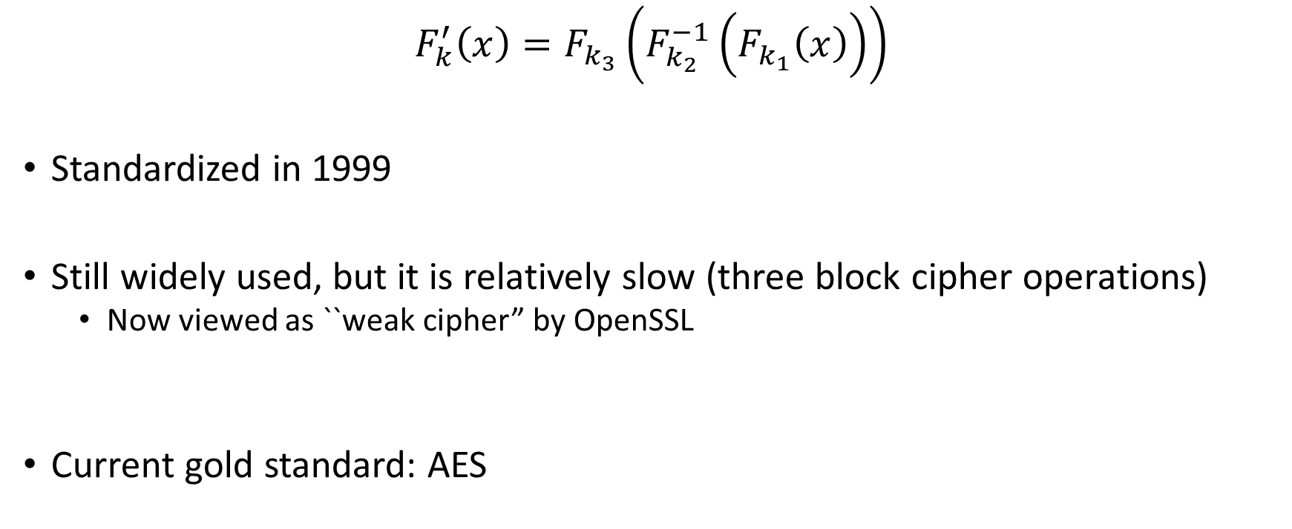
Triple DES
$$F_{k}^{′}\left(x\right)=F_{k_{3}}\left(F_{k_{2}}^{−1}\left(F_{k_{1}}\left(x\right)\right)\right)$$
Standardized in 1999
Still widely used, but it is relatively slow (three block cipher operations)
  Now viewed as ``weak cipher” by OpenSSL
Current gold standard: AES

Slide 15
Advanced Encryption Standard (AES)
(1997) US National Institute of Standards and Technology (NIST) announces competition for new block cipher to replace DES
Fifteen algorithms were submitted from all over the world
  Analyzed by NIST
Contestants given a chance to break competitors schemes
October, 2000 NIST announces a winner Rijndael
  Vincent Rijmen and Joan Daemen
  No serious vulnerabilities found in four other finalists
  Rijndael was selected for efficiency, hardware performance, flexibility etc…

Slide 16
Advanced Encryption Standard
Block Size: 128 bits (viewed as 4x4 byte array)
Key Size: 128, 192 or 256
First public cipher approved by NSA for Top Secret information
(2009) Attack on 11 round version of AES
  recovers 256-bit key in time 2⁷⁰
  But AES is 14 round (with 256 bit key) so the attack doesn’t apply in practice
(2009) Attack on 192-bit and 256 bit version of AES
  recovers 256-bit key in time 2^{99.5}.

Slide 17
AES Attacks?
Side channel attacks affect a few specific implementations
  But, this is not a weakness of AES itself
  Timing attack on OpenSSL’s implementation AES encryption (2005, Bernstein)
Notes:
In April 2005, D.J. Bernstein announced a cache-timing attack that he used to break a custom server that used OpenSSL's AES encryption.^{[20]} The custom server was designed to give out as much timing information as possible (the server reports back the number of machine cycles taken by the encryption operation), and the attack required over 200 million chosen plaintexts.^{[21]}

Slide 18
CS 555: Week 8: Topic 1:
One Way Functions
What are the minimal assumptions necessary for symmetric key-cryptography?

Slide 19
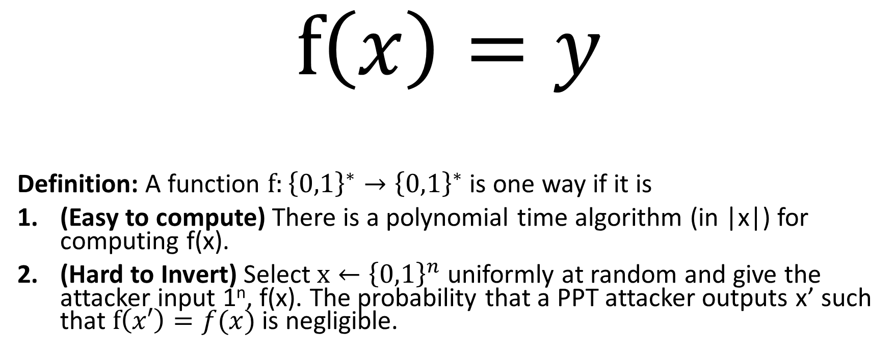
One-Way Functions (OWFs)
$$f\left(x\right)=y$$
Definition: A function $f:{\left\{0,1\right\}}^{∗}→{\left\{0,1\right\}}^{∗}$ is one way if it is
(Easy to compute) There is a polynomial time algorithm (in |x|) for computing f(x).
(Hard to Invert) Select $x←{\left\{0,1\right\}}^{n}$ uniformly at random and give the attacker input 1^{n}, f(x). The probability that a PPT attacker outputs x’ such that $f\left(x′\right)=f(x)$ is negligible.

Slide 20
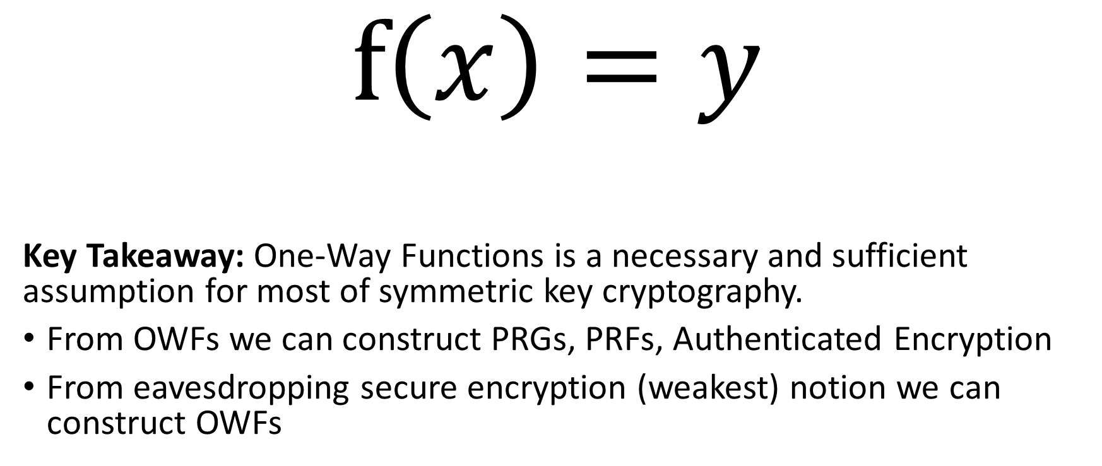
One-Way Functions (OWFs)
$$f\left(x\right)=y$$
Key Takeaway: One-Way Functions is a necessary and sufficient assumption for most of symmetric key cryptography.
From OWFs we can construct PRGs, PRFs, Authenticated Encryption
From eavesdropping secure encryption (weakest) notion we can construct OWFs

Slide 21
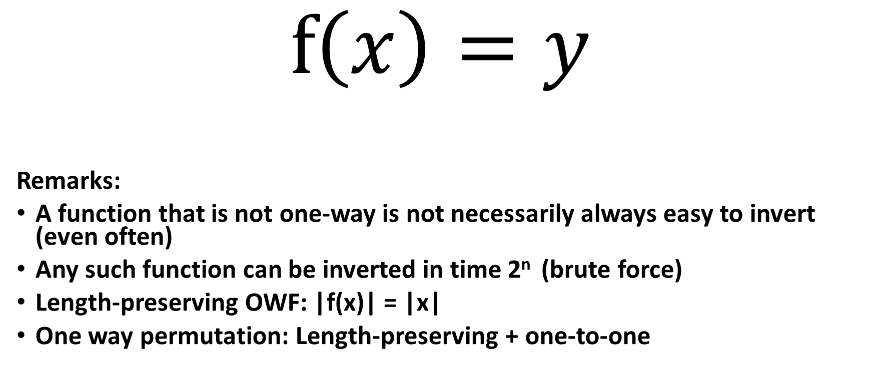
One-Way Functions (OWFs)
$$f\left(x\right)=y$$
Remarks:
A function that is not one-way is not necessarily always easy to invert (even often)
Any such function can be inverted in time 2^{n} (brute force)
Length-preserving OWF: |f(x)| = |x|
One way permutation: Length-preserving + one-to-one

Slide 22
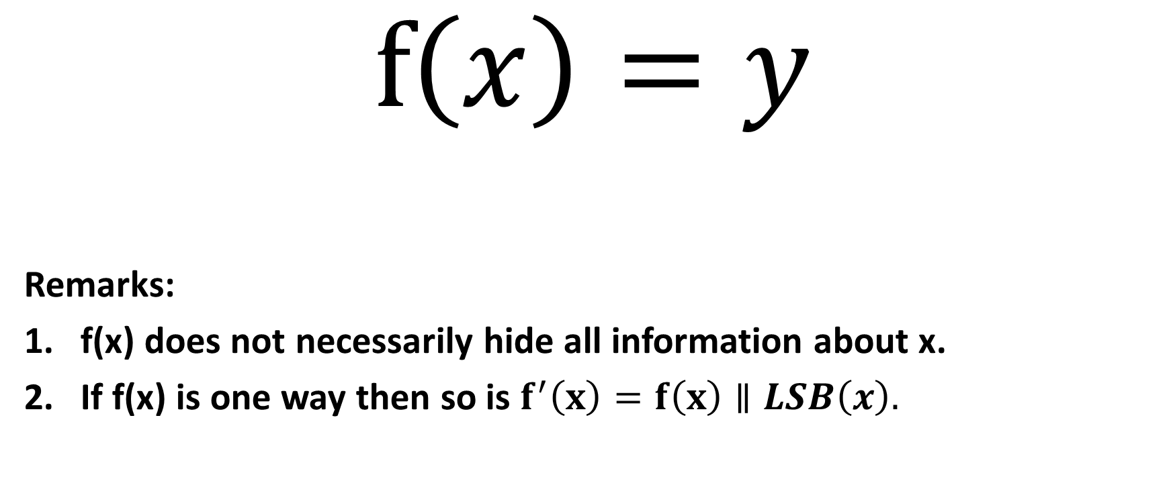
One-Way Functions (OWFs)
$$f\left(x\right)=y$$
Remarks:
f(x) does not necessarily hide all information about x.
If f(x) is one way then so is $f^{′}\left(x\right)=f\left(x\right)∥LSB\left(x\right).$

Slide 23
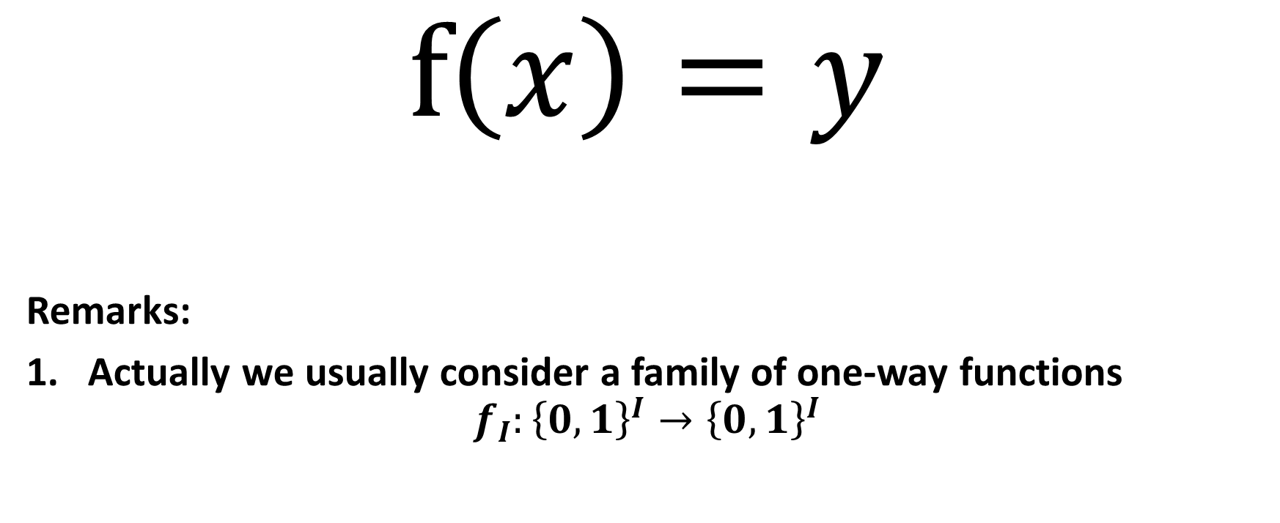
One-Way Functions (OWFs)
$$f\left(x\right)=y$$
Remarks:
Actually we usually consider a family of one-way functions
$$f_{I}:{\left\{0,1\right\}}^{I}→{\left\{0,1\right\}}^{I}$$

Slide 24
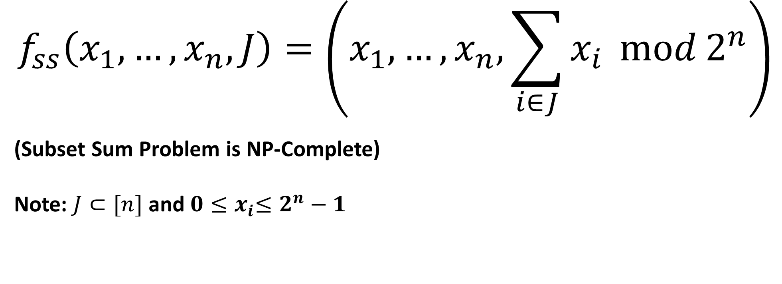
Candidate One-Way Functions
$$f_{ss}\left(x_{1},…,x_{n},J\right)=\left(x_{1},…,x_{n},\sum_{i∈J}{x_{i}}\operatorname{mod}{2^{n}}\right)$$
(Subset Sum Problem is NP-Complete)
Note: $J⊂[n]$ and $0{≤x}_{i}≤2^{n}−1$

Slide 25
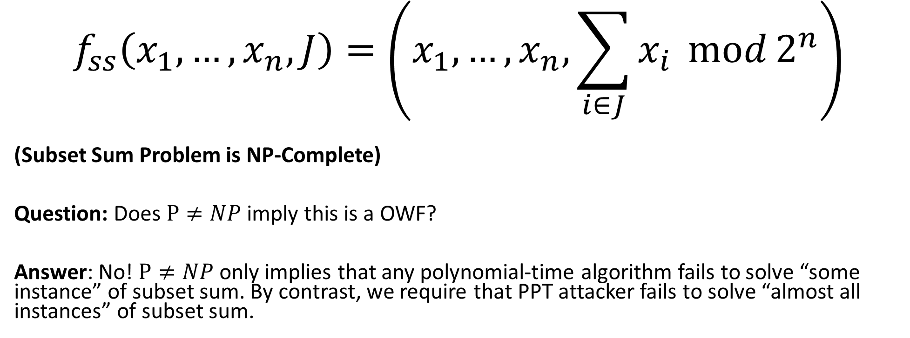
Candidate One-Way Functions
$$f_{ss}\left(x_{1},…,x_{n},J\right)=\left(x_{1},…,x_{n},\sum_{i∈J}{x_{i}}\operatorname{mod}{2^{n}}\right)$$
(Subset Sum Problem is NP-Complete)
Question: Does $P≠NP$ imply this is a OWF?
Answer: No! $P≠NP$ only implies that any polynomial-time algorithm fails to solve “some instance” of subset sum. By contrast, we require that PPT attacker fails to solve “almost all instances” of subset sum.

Slide 26
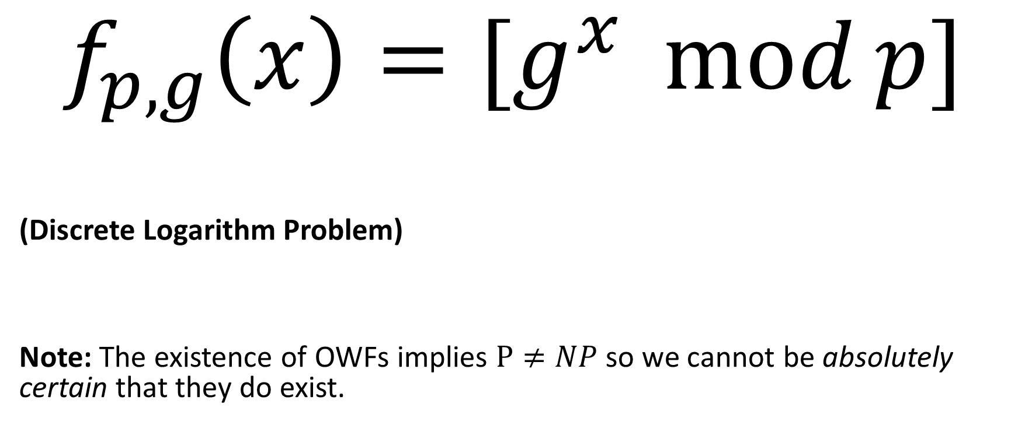
Candidate One-Way Functions (OWFs)
$$f_{p,g}\left(x\right)=[g^{x}\operatorname{mod}{p}]$$
(Discrete Logarithm Problem)
Note: The existence of OWFs implies $P≠NP$ so we cannot be absolutely certain that they do exist.

Slide 27
Hard Core Predicates
Recall that a one-way function f may potentially reveal lots of information about input
Example: f(x₁,x₂)=(x₁,g(x₂)), where g is a one-way function.
Claim: f is one-way (even if f(x₁,x₂) reveals half of the input bits!)

Slide 28
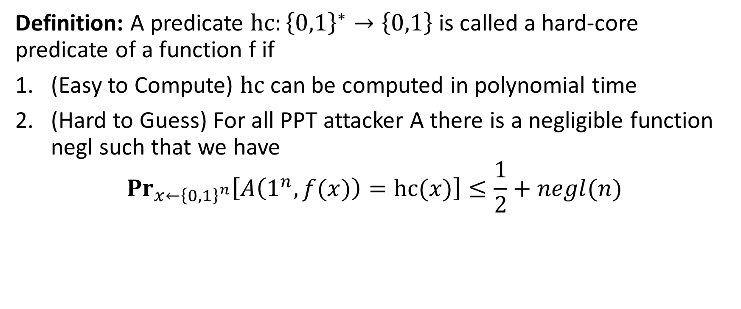
Hard Core Predicates
Definition: A predicate $hc:{\left\{0,1\right\}}^{∗}→\left\{0,1\right\}$ is called a hard-core predicate of a function f if
(Easy to Compute) $hc$ can be computed in polynomial time
(Hard to Guess) For all PPT attacker A there is a negligible function negl such that we have
$${Pr}_{x←{\left\{0,1\right\}}^{n}}\left[A\left(1^{n},f(x)\right)=hc(x)\right]≤\frac{1}{2}+negl(n)$$

Slide 29
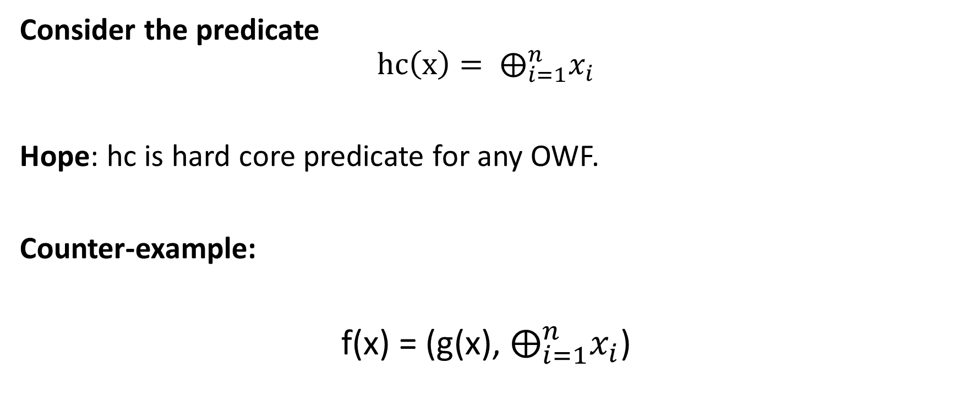
Attempt 1: Hard-Core Predicate
Consider the predicate
$$hc\left(x\right)= ⨁_{i=1}^{n}x_{i}$$
Hope: hc is hard core predicate for any OWF.
Counter-example:
f(x) = (g(x), $⨁_{i=1}^{n}x_{i}$)

Slide 30
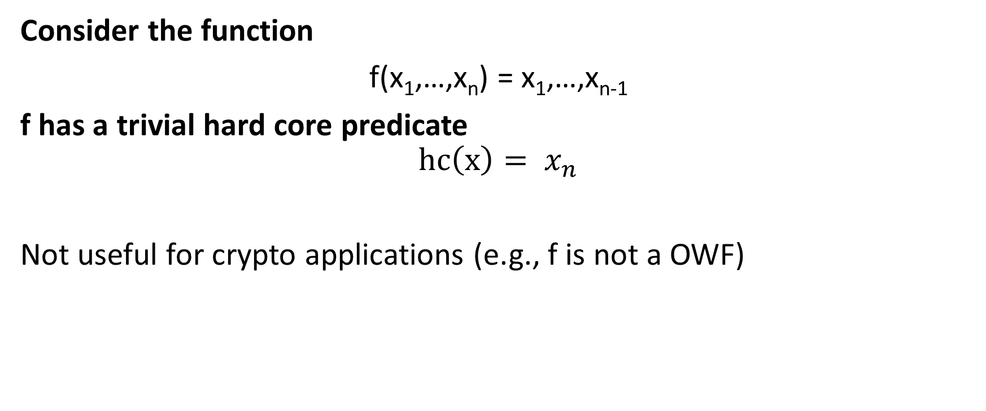
Trivial Hard-Core Predicate
Consider the function
f(x₁,…,x_{n}) = x₁,…,x_{n-1}
f has a trivial hard core predicate
$$hc\left(x\right)= x_{n}$$
Not useful for crypto applications (e.g., f is not a OWF)

Slide 31
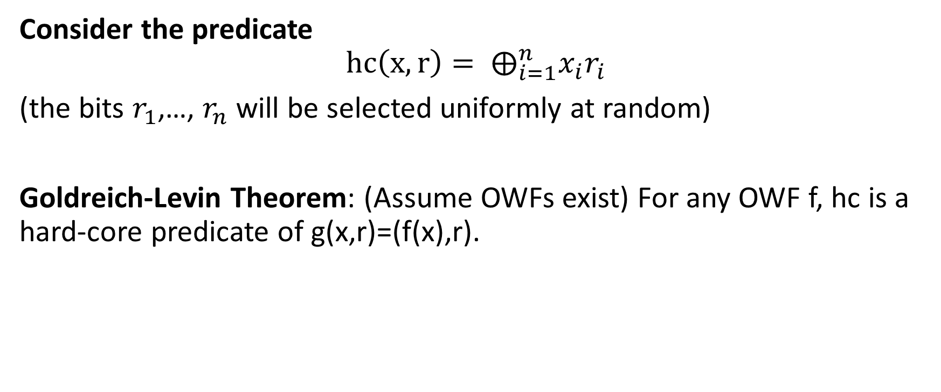
Attempt 3: Hard-Core Predicate
Consider the predicate
$$hc\left(x,r\right)= ⨁_{i=1}^{n}x_{i}r_{i}$$
(the bits $r_{1}$,…, $r_{n}$ will be selected uniformly at random)
Goldreich-Levin Theorem: (Assume OWFs exist) For any OWF f, hc is a hard-core predicate of g(x,r)=(f(x),r).

Slide 32
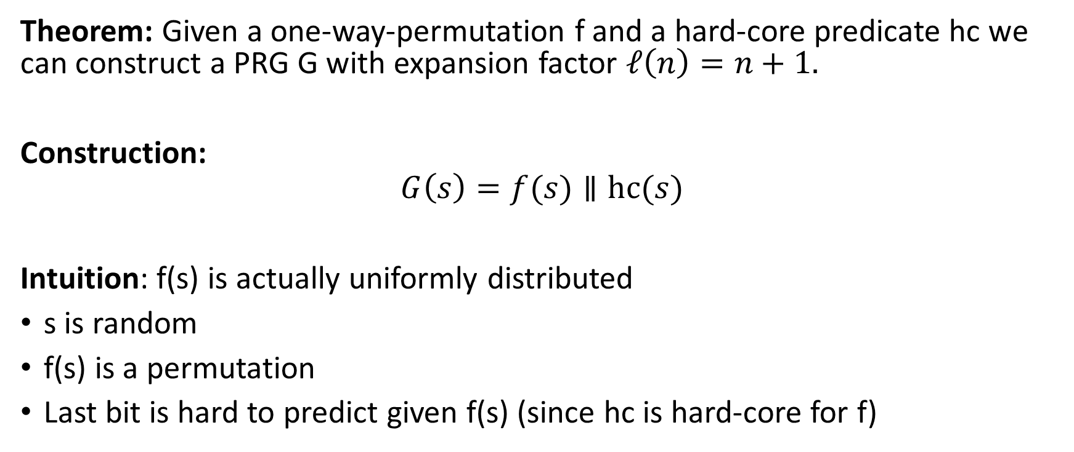
Using Hard-Core Predicates
Theorem: Given a one-way-permutation f and a hard-core predicate hc we can construct a PRG G with expansion factor $ℓ\left(n\right)=n+1.$
Construction:
$$G\left(s\right)=f(s)∥hc(s)$$
Intuition: f(s) is actually uniformly distributed
s is random
f(s) is a permutation
Last bit is hard to predict given f(s) (since hc is hard-core for f)

Slide 33
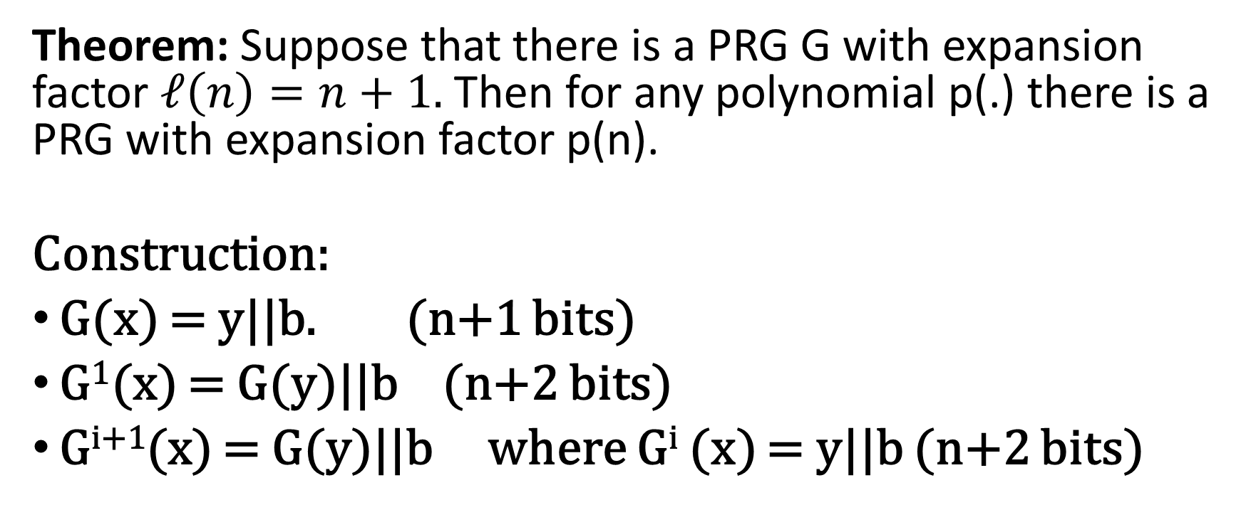
Arbitrary Expansion
Theorem: Suppose that there is a PRG G with expansion factor $ℓ\left(n\right)=n+1.$ Then for any polynomial p(.) there is a PRG with expansion factor p(n).
Construction:
G(x) = y||b. (n+1 bits)
G¹(x) = G(y)||b (n+2 bits)
G^{i+1}(x) = G(y)||b where G^{i} (x) = y||b (n+2 bits)

Slide 34
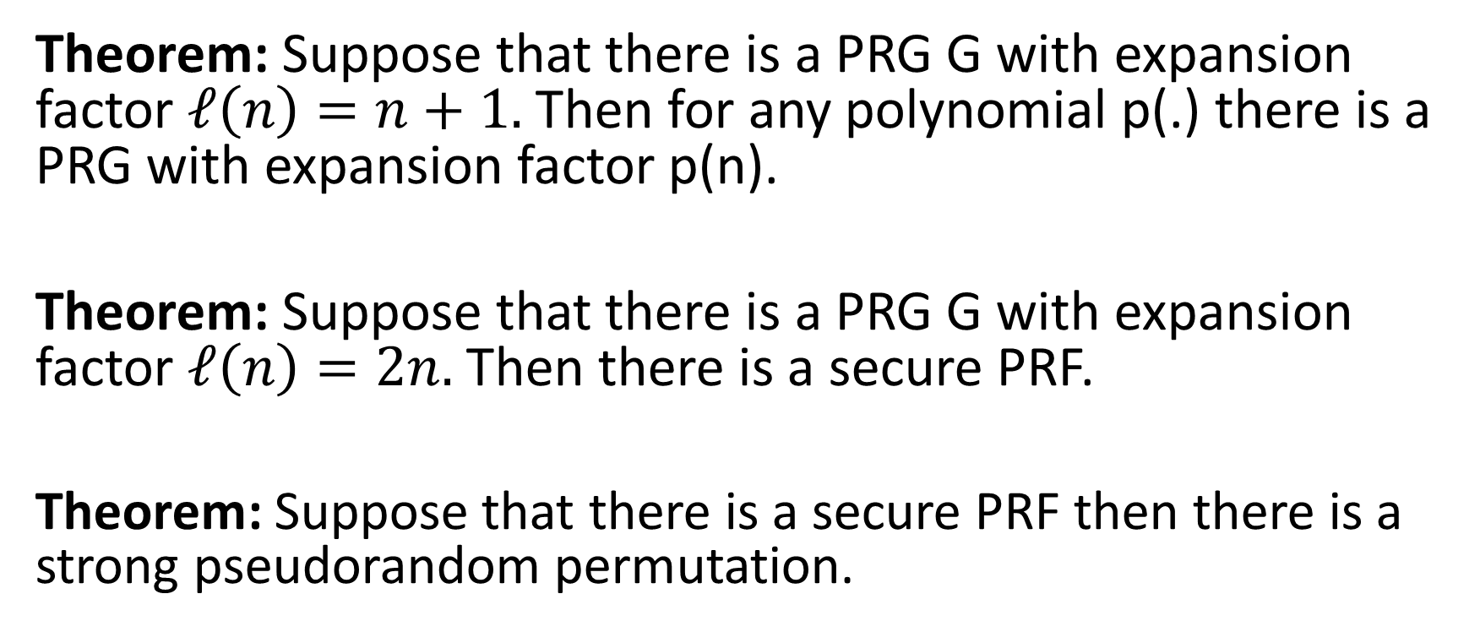
Any Beyond
Theorem: Suppose that there is a PRG G with expansion factor $ℓ\left(n\right)=n+1.$ Then for any polynomial p(.) there is a PRG with expansion factor p(n).
Theorem: Suppose that there is a PRG G with expansion factor $ℓ\left(n\right)=2n.$ Then there is a secure PRF.
Theorem: Suppose that there is a secure PRF then there is a strong pseudorandom permutation.

Slide 35
Any Beyond
Corollary: If one-way functions exist then PRGs, PRFs and strong PRPs all exist.
Corollary: If one-way functions exist then there exist CCA-secure encryption schemes and secure MACs.

Slide 36
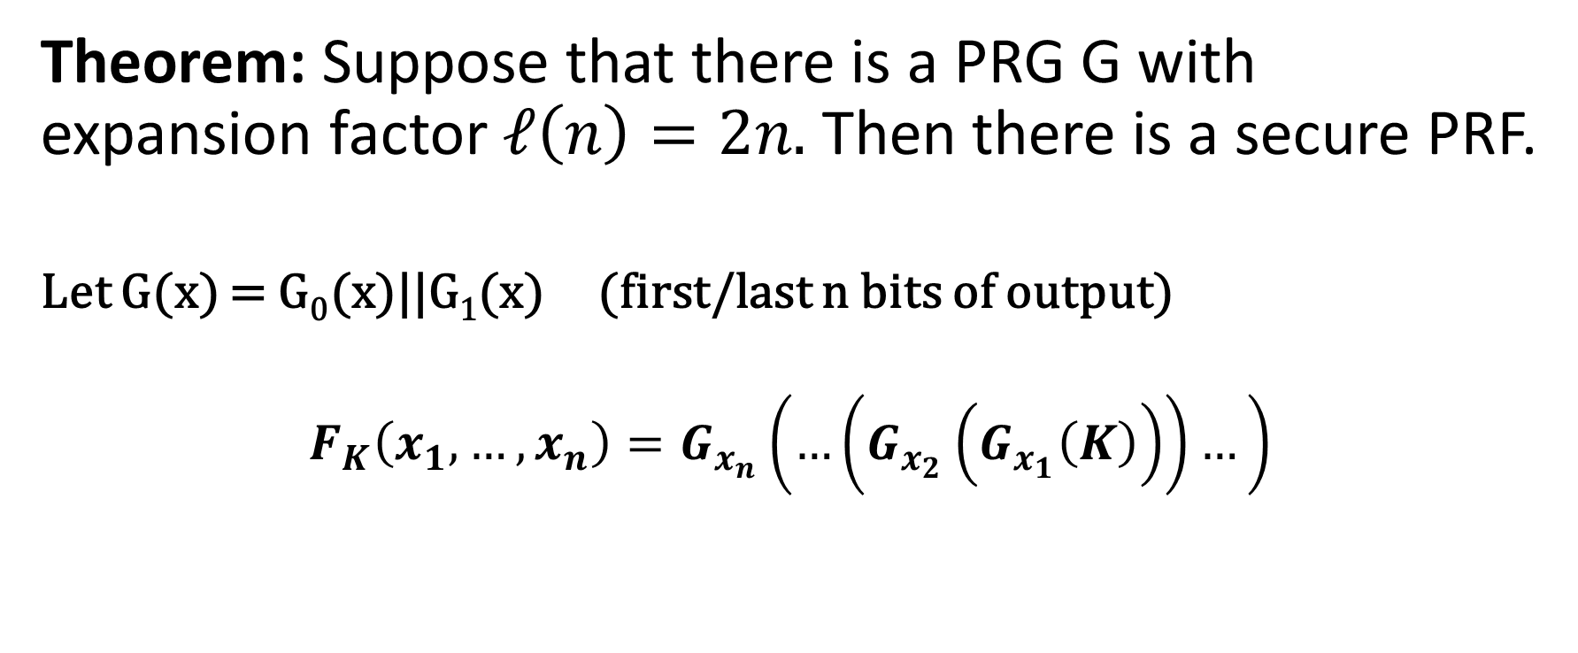
PRFs from PRGs
Theorem: Suppose that there is a PRG G with expansion factor $ℓ\left(n\right)=2n.$ Then there is a secure PRF.
Let G(x) = G₀(x)||G₁(x) (first/last n bits of output)
$$F_{K}\left(x_{1},…,x_{n}\right)=G_{x_{n}}\left(…\left(G_{x_{2}}\left(G_{x_{1}}\left(K\right)\right)\right)…\right)$$

Slide 37

PRFs from PRGs
Theorem: Suppose that there is a PRG G with expansion factor $ℓ\left(n\right)=2n.$ Then there is a secure PRF.
k
1
0
F_{k}(011)=G₁(G₁(G₀(k)))
G₀(k)
G₁(k)
0
1
1
0
G₀(G₀(k))
G₁(G₀(k))
G₀(G₁(k))
G₁(G₁(k))
1
…
…
0
1
0
1
…
0
1
…
0
…
…
…
…

Slide 38
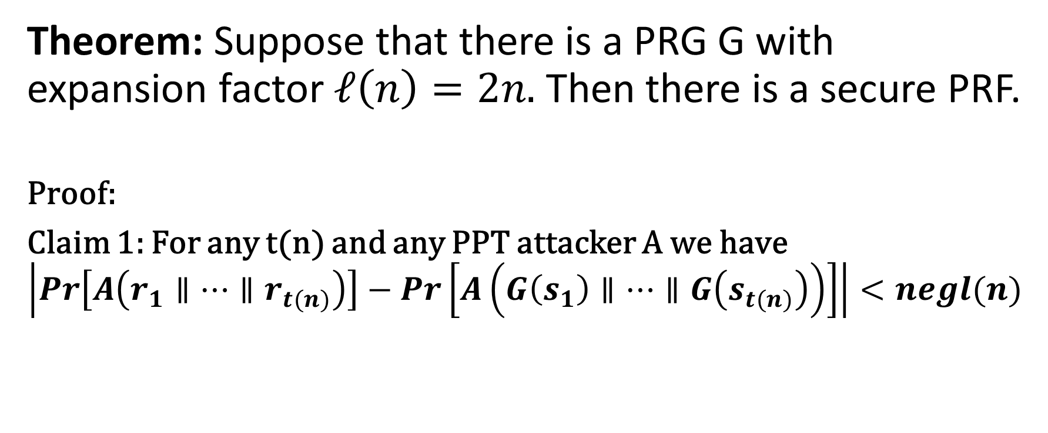
PRFs from PRGs
Theorem: Suppose that there is a PRG G with expansion factor $ℓ\left(n\right)=2n.$ Then there is a secure PRF.
Proof:
Claim 1: For any t(n) and any PPT attacker A we have
$$\left|Pr\left[A\left(r_{1}∥…∥r_{t(n)}\right)\right]−Pr\left[A\left(G\left(s_{1}\right)∥…∥G\left(s_{t(n)}\right)\right)\right]\right|<negl(n)$$

Slide 39
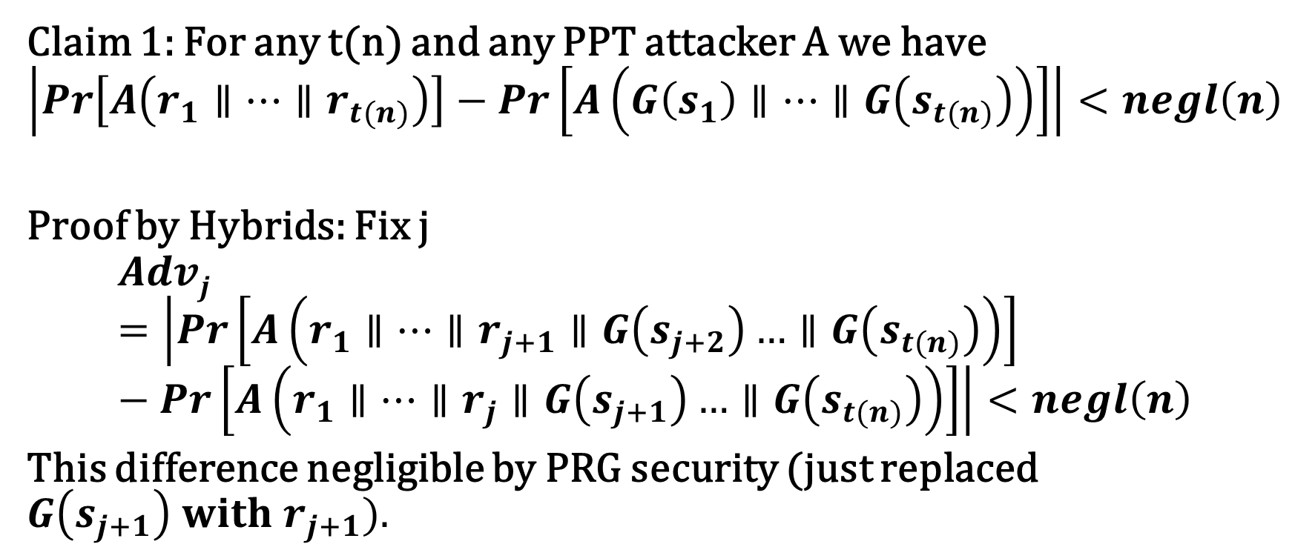
PRFs from PRGs
Claim 1: For any t(n) and any PPT attacker A we have
$$\left|Pr\left[A\left(r_{1}∥…∥r_{t(n)}\right)\right]−Pr\left[A\left(G\left(s_{1}\right)∥…∥G\left(s_{t(n)}\right)\right)\right]\right|<negl\left(n\right)$$
Proof by Hybrids: Fix j
$$Advj=\left|Pr\left[A\left(r_{1}∥…∥r_{j+1}∥G\left(s_{j+2}\right)…∥G\left(s_{t(n)}\right)\right)\right]−Pr\left[A\left(r_{1}∥…∥r_{j}∥G\left(s_{j+1}\right)…∥G\left(s_{t(n)}\right)\right)\right]\right|<negl\left(n\right)$$
This difference negligible by PRG security (just replaced $G\left(s_{j+1}\right) with r_{j+1}).$

Slide 40
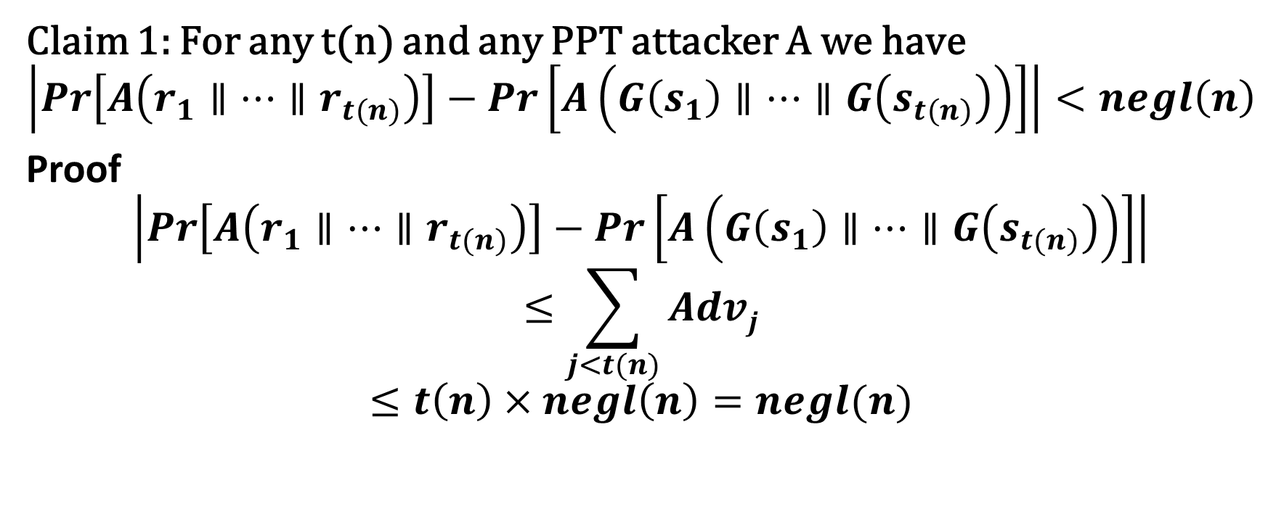
PRFs from PRGs
Claim 1: For any t(n) and any PPT attacker A we have
$$\left|Pr\left[A\left(r_{1}∥…∥r_{t(n)}\right)\right]−Pr\left[A\left(G\left(s_{1}\right)∥…∥G\left(s_{t(n)}\right)\right)\right]\right|<negl\left(n\right)$$
Proof
$$\left|Pr\left[A\left(r_{1}∥…∥r_{t(n)}\right)\right]−Pr\left[A\left(G\left(s_{1}\right)∥…∥G\left(s_{t(n)}\right)\right)\right]\right|$$
$$≤\sum_{j<t(n)}{Advj}$$
$$≤t\left(n\right)×negl\left(n\right)=negl(n)$$

Slide 41
PRFs from PRGs
Claim 1: For any t(n) and any PPT attacker A we have
$$\left|Pr\left[A\left(r_{1}∥…∥r_{t(n)}\right)\right]−Pr\left[A\left(G\left(s_{1}\right)∥…∥G\left(s_{t(n)}\right)\right)\right]\right|<negl\left(n\right)$$
Proof
$$\left|Pr\left[A\left(r_{1}∥…∥r_{t(n)}\right)\right]−Pr\left[A\left(G\left(s_{1}\right)∥…∥G\left(s_{t(n)}\right)\right)\right]\right|$$
$$≤\sum_{j<t(n)}{Advj}$$
$$≤t\left(n\right)×negl\left(n\right)=negl(n)$$

Slide 42
Hybrid H₁
r
1
0
r₀
r₁
0
1
1
0
G₀(r0)
G₁(r0)
G₀(r₁)
G₁(r₁)
1
…
…
0
1
0
1
…
0
1
…
0
…
…
…
…
42

Slide 43
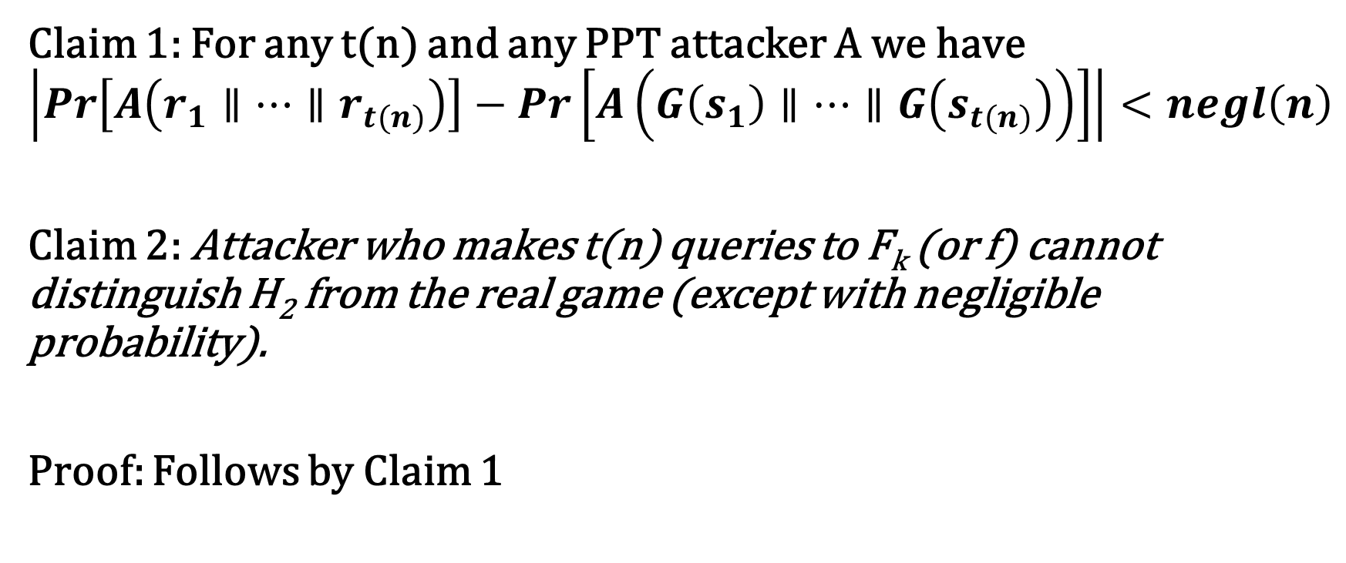
Hybrid H₁ vs H₂
Claim 1: For any t(n) and any PPT attacker A we have
$$\left|Pr\left[A\left(r_{1}∥…∥r_{t(n)}\right)\right]−Pr\left[A\left(G\left(s_{1}\right)∥…∥G\left(s_{t(n)}\right)\right)\right]\right|<negl\left(n\right)$$
Claim 2: Attacker who makes t(n) queries to F_{k} (or f) cannot distinguish H₂ from the real game (except with negligible probability).
Proof: Follows by Claim 1

Slide 44
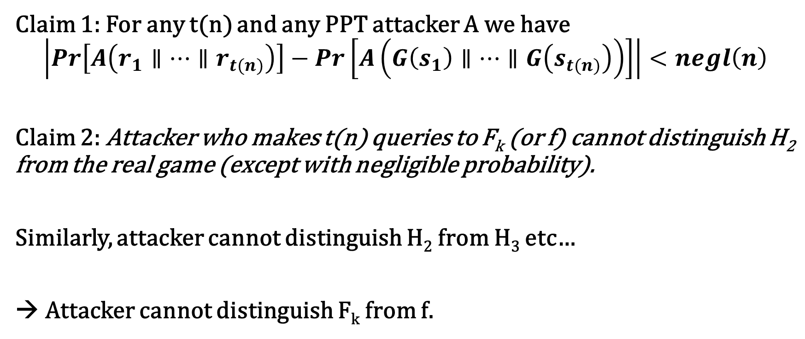
Hybrid H₂
Claim 1: For any t(n) and any PPT attacker A we have
$$\left|Pr\left[A\left(r_{1}∥…∥r_{t(n)}\right)\right]−Pr\left[A\left(G\left(s_{1}\right)∥…∥G\left(s_{t(n)}\right)\right)\right]\right|<negl\left(n\right)$$
Claim 2: Attacker who makes t(n) queries to F_{k} (or f) cannot distinguish H₂ from the real game (except with negligible probability).
Similarly, attacker cannot distinguish H₂ from H₃ etc…
→ Attacker cannot distinguish F_{k} from f.

Slide 45
From OWFs (Recap)
Theorem: Suppose that there is a PRG G with expansion factor $ℓ\left(n\right)=n+1.$ Then for any polynomial p(.) there is a PRG with expansion factor p(n).
Theorem: Suppose that there is a PRG G with expansion factor $ℓ\left(n\right)=2n.$ Then there is a secure PRF.
Theorem: Suppose that there is a secure PRF then there is a strong pseudorandom permutation.

Slide 46
From OWFs (Recap)
Corollary: If one-way functions exist then PRGs, PRFs and strong PRPs all exist.
Corollary: If one-way functions exist then there exist CCA-secure encryption schemes and secure MACs.

Slide 47
Are OWFs Necessary for Private Key Crypto
Previous results show that OWFs are sufficient.
Can we build Private Key Crypto from weaker assumptions?
Short Answer: No, OWFs are also necessary for most private-key crypto primitives

Slide 48
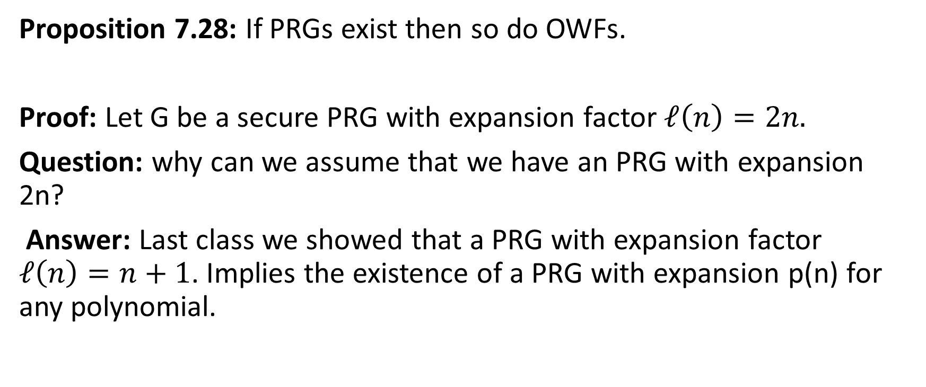
PRGs → OWFs
Proposition 7.28: If PRGs exist then so do OWFs.
Proof: Let G be a secure PRG with expansion factor $ℓ\left(n\right)=2n.$
Question: why can we assume that we have an PRG with expansion 2n?
Answer: Last class we showed that a PRG with expansion factor $ℓ\left(n\right)=n+1$. Implies the existence of a PRG with expansion p(n) for any polynomial.

Slide 49
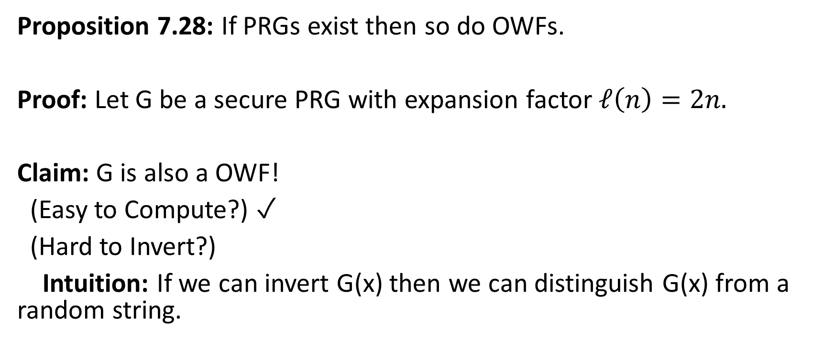
PRGs → OWFs
Proposition 7.28: If PRGs exist then so do OWFs.
Proof: Let G be a secure PRG with expansion factor $ℓ\left(n\right)=2n.$
Claim: G is also a OWF!
(Easy to Compute?) ✓
(Hard to Invert?)
Intuition: If we can invert G(x) then we can distinguish G(x) from a random string.

Slide 50
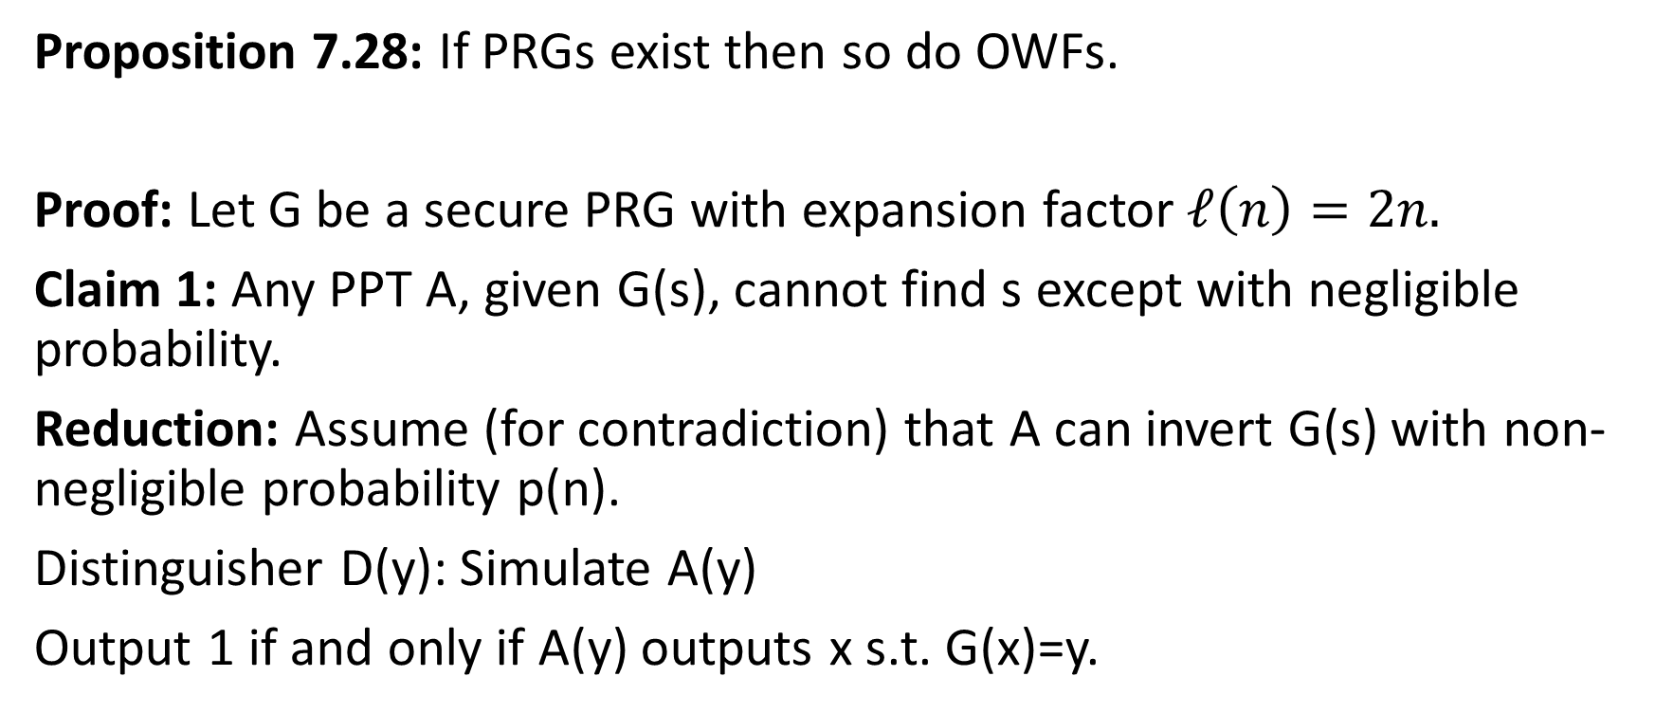
PRGs → OWFs
Proposition 7.28: If PRGs exist then so do OWFs.
Proof: Let G be a secure PRG with expansion factor $ℓ\left(n\right)=2n.$
Claim 1: Any PPT A, given G(s), cannot find s except with negligible probability.
Reduction: Assume (for contradiction) that A can invert G(s) with non-negligible probability p(n).
Distinguisher D(y): Simulate A(y)
Output 1 if and only if A(y) outputs x s.t. G(x)=y.

Slide 51
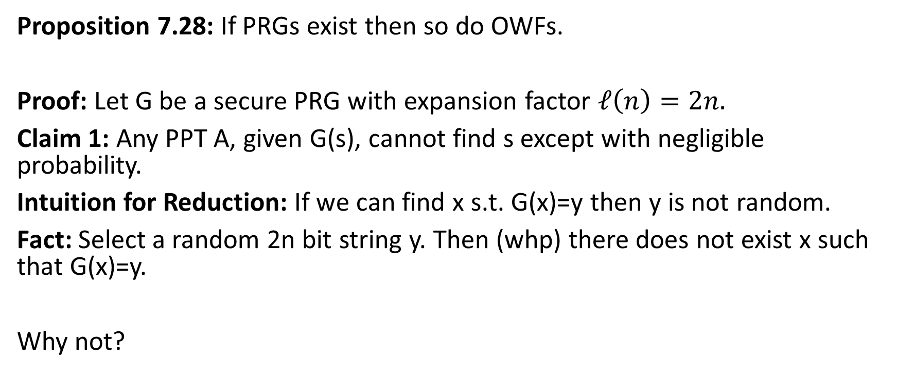
PRGs → OWFs
Proposition 7.28: If PRGs exist then so do OWFs.
Proof: Let G be a secure PRG with expansion factor $ℓ\left(n\right)=2n.$
Claim 1: Any PPT A, given G(s), cannot find s except with negligible probability.
Intuition for Reduction: If we can find x s.t. G(x)=y then y is not random.
Fact: Select a random 2n bit string y. Then (whp) there does not exist x such that G(x)=y.
Why not?

Slide 52
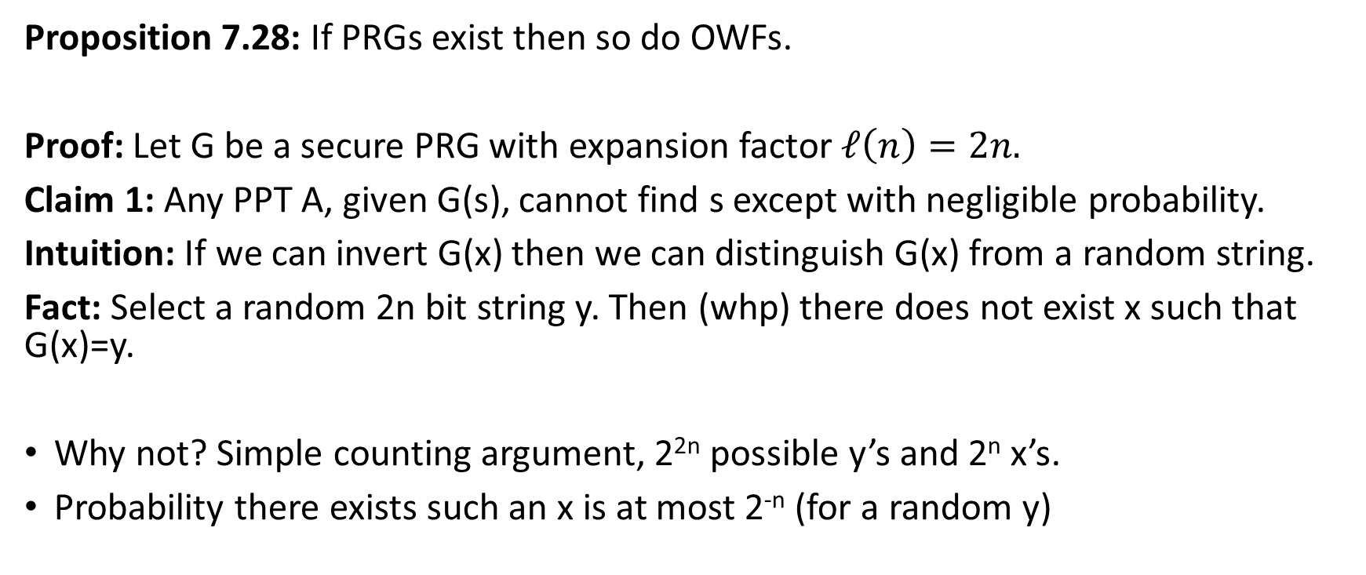
PRGs → OWFs
Proposition 7.28: If PRGs exist then so do OWFs.
Proof: Let G be a secure PRG with expansion factor $ℓ\left(n\right)=2n.$
Claim 1: Any PPT A, given G(s), cannot find s except with negligible probability.
Intuition: If we can invert G(x) then we can distinguish G(x) from a random string.
Fact: Select a random 2n bit string y. Then (whp) there does not exist x such that G(x)=y.
Why not? Simple counting argument, 2^{2n} possible y’s and 2^{n} x’s.
Probability there exists such an x is at most 2^{-n} (for a random y)

Slide 53
What other assumptions imply OWFs?
PRGs → OWFs
(Easy Extension) PRFs → PRGs → OWFs
Does secure crypto scheme imply OWFs?
  CCA-secure? (Strongest)
  CPA-Secure? (Weaker)
  EAV-secure? (Weakest)
    As long as the plaintext is longer than the secret key
  Perfect Secrecy? X (Guarantee is information theoretic)

Slide 54
EAV-Secure Crypto → OWFs
Proposition 7.29: If there exists a EAV-secure private-key encryption scheme that encrypts messages twice as long as its key, then a one-way function exists.
Recap: EAV-secure.
Attacker picks two plaintexts m₀,m₁ and is given c=Enc_{K}(m_{b}) for random bit b.
Attacker attempts to guess b.
No ability to request additional encryptions (chosen-plaintext attacks)
In fact, no ability to observe any additional encryptions

Slide 55
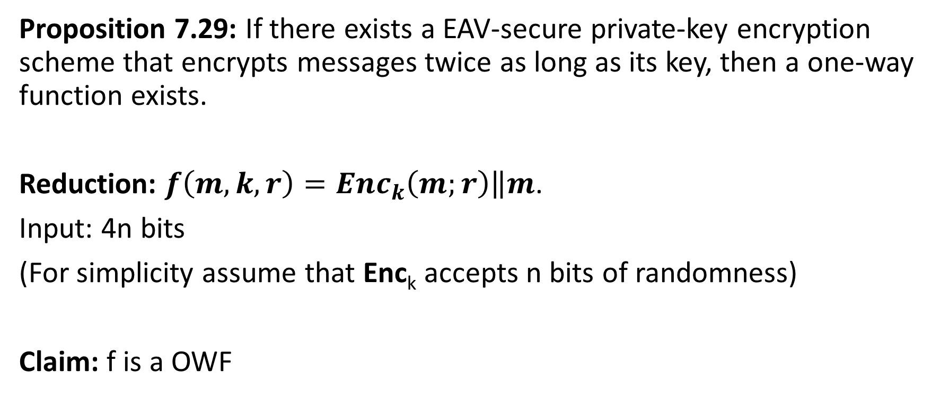
EAV-Secure Crypto → OWFs
Proposition 7.29: If there exists a EAV-secure private-key encryption scheme that encrypts messages twice as long as its key, then a one-way function exists.
Reduction: $f\left(m,k,r\right)={Enc}_{k}\left(m;r\right)\left\|m\right.$.
Input: 4n bits
(For simplicity assume that Enc_{k} accepts n bits of randomness)
Claim: f is a OWF

Slide 56
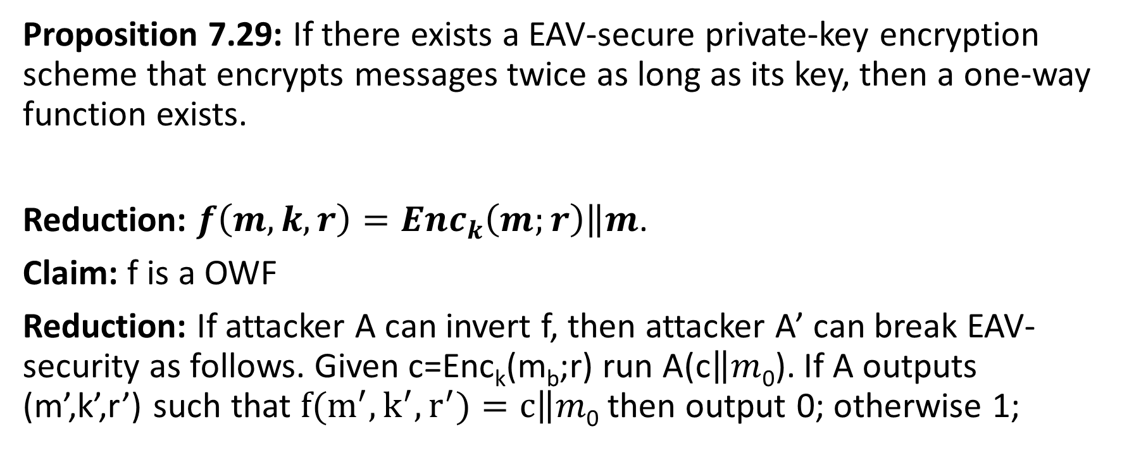
EAV-Secure Crypto → OWFs
Proposition 7.29: If there exists a EAV-secure private-key encryption scheme that encrypts messages twice as long as its key, then a one-way function exists.
Reduction: $f\left(m,k,r\right)={Enc}_{k}\left(m;r\right)\left\|m\right.$.
Claim: f is a OWF
Reduction: If attacker A can invert f, then attacker A’ can break EAV-security as follows. Given c=Enc_{k}(m_{b};r) run A(c$\left\|m\right.$₀). If A outputs (m’,k’,r’) such that $f(m^{′},k^{′},r^{′})=c\left\|m\right.$₀ then output 0; otherwise 1;

Slide 57
MACs→ OWFs
In particular, given a MAC that satisfies MAC security (Definition 4.2) against an attacker who sees an arbitrary (polynomial) number of message/tag pairs.
Conclusions: OWFs are necessary and sufficient for all (non-trivial) private key cryptography.
→OWFs are a minimal assumption for private-key crypto.
Public Key Crypto/Hashing?
OWFs are known to be necessary
Not known (or believed) to be sufficient.

Slide 58
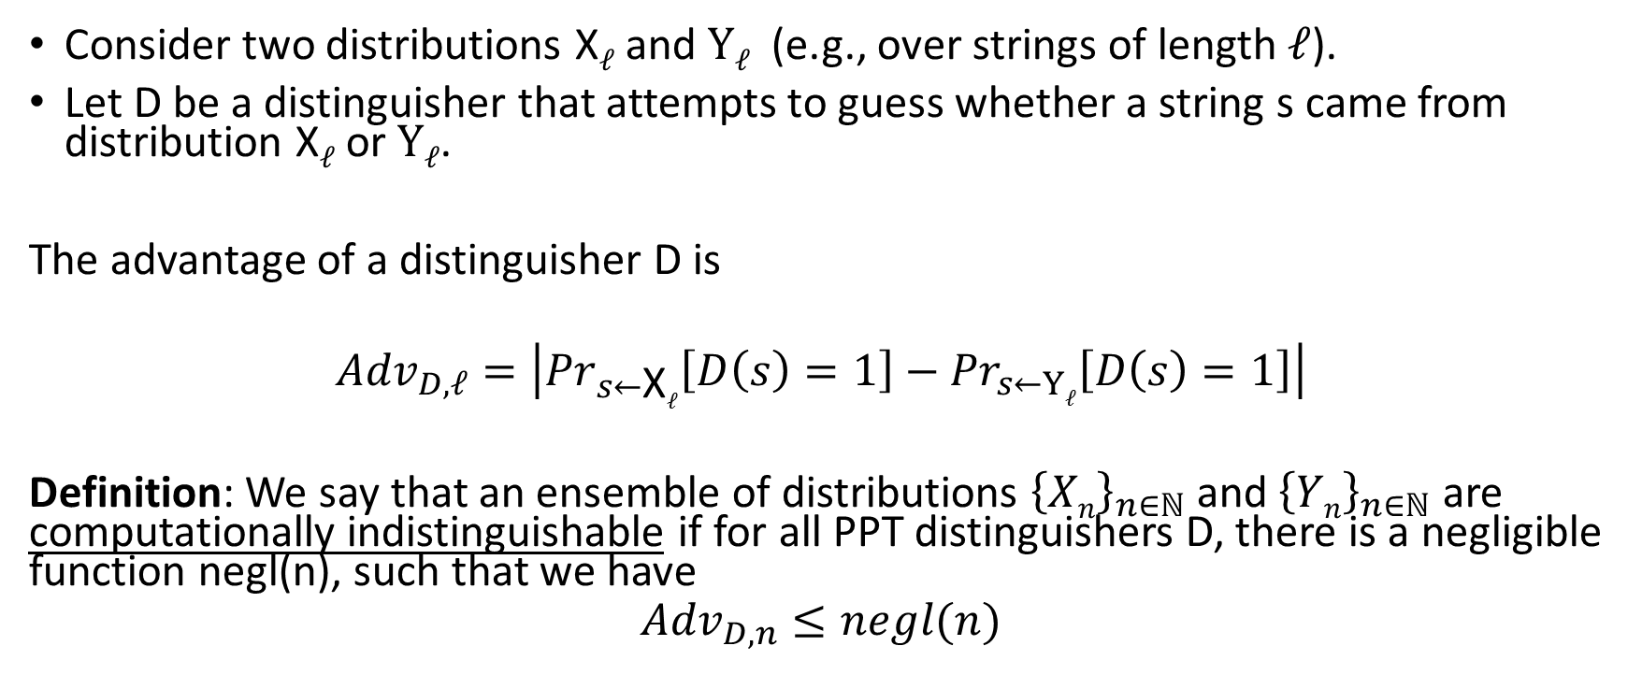
Computational Indistinguishability
Consider two distributions X$ℓ$ and $Yℓ$ (e.g., over strings of length $ℓ$).
Let D be a distinguisher that attempts to guess whether a string s came from distribution X$ℓ$ or $Yℓ$.
The advantage of a distinguisher D is
$${Adv}_{D,ℓ}=\left|{Pr}_{s←\text{X}ℓ}\left[D\left(s\right)=1\right]−{Pr}_{s←Yℓ}\left[D\left(s\right)=1\right]\right|$$
Definition: We say that an ensemble of distributions ${\left\{Xn\right\}}_{n∈ℕ}$ and ${\left\{Yn\right\}}_{n∈ℕ}$ are computationally indistinguishable if for all PPT distinguishers D, there is a negligible function negl(n), such that we have
$${Adv}_{D,n}≤negl(n)$$

Slide 59
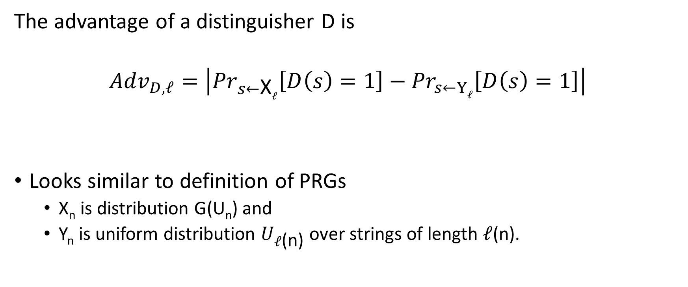
Computational Indistinguishability
The advantage of a distinguisher D is
$${Adv}_{D,ℓ}=\left|{Pr}_{s←\text{X}ℓ}\left[D\left(s\right)=1\right]−{Pr}_{s←Yℓ}\left[D\left(s\right)=1\right]\right|$$
Looks similar to definition of PRGs
  X_{n} is distribution G(U_{n}) and
  Y_{n} is uniform distribution $U_{ℓ\text{(}\text{n}\text{)}}$ over strings of length $ℓ$(n).

Slide 60
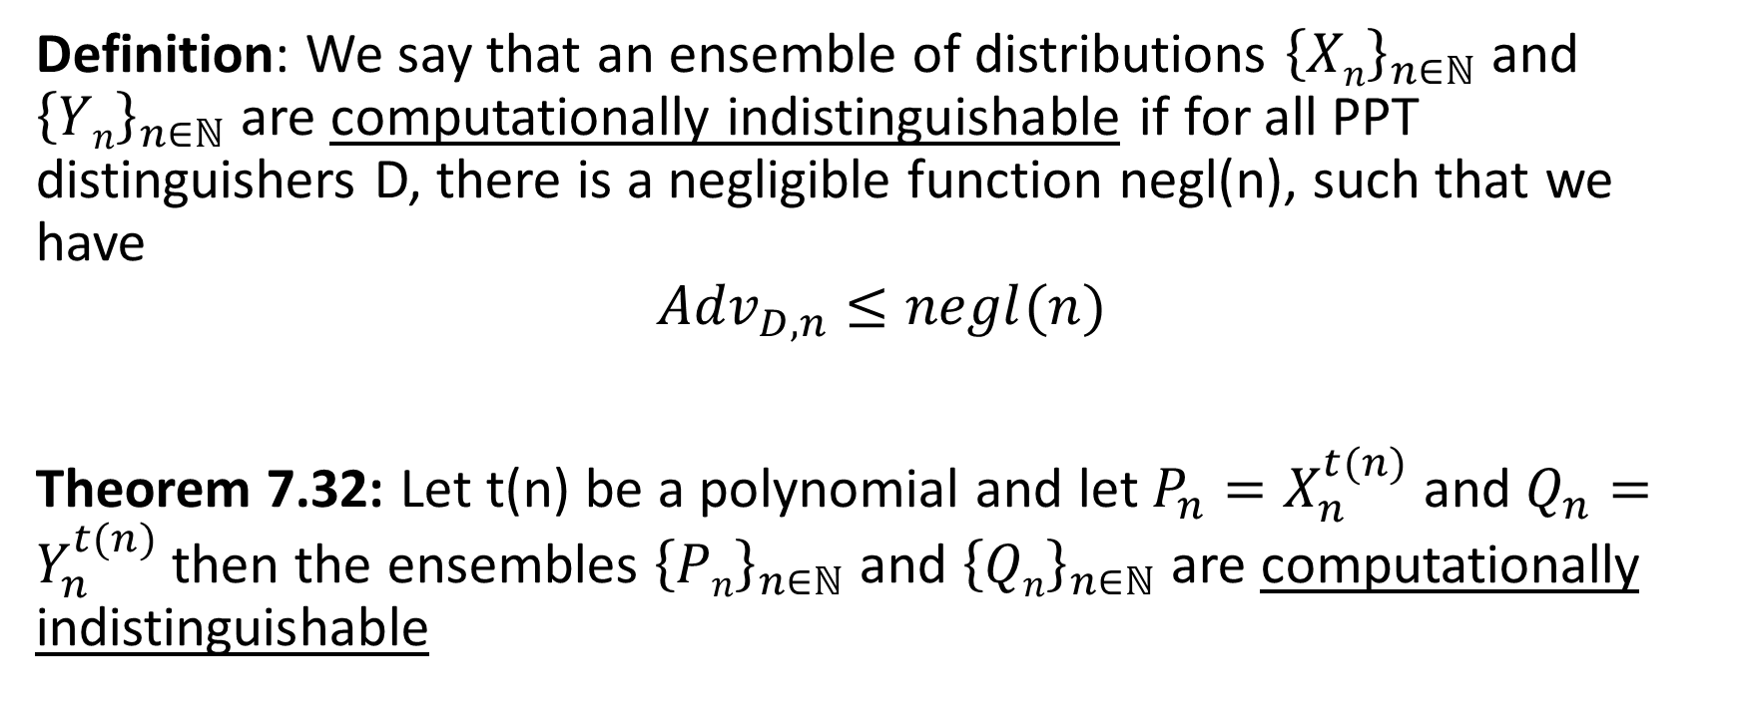
Computational Indistinguishability
Definition: We say that an ensemble of distributions ${\left\{Xn\right\}}_{n∈ℕ}$ and ${\left\{Yn\right\}}_{n∈ℕ}$ are computationally indistinguishable if for all PPT distinguishers D, there is a negligible function negl(n), such that we have
$${Adv}_{D,n}≤negl(n)$$
Theorem 7.32: Let t(n) be a polynomial and let $P_{n}=X_{n}^{t(n)}$ and $Q_{n}=Y_{n}^{t(n)}$then the ensembles ${\left\{Pn\right\}}_{n∈ℕ}$ and ${\left\{Qn\right\}}_{n∈ℕ}$ are computationally indistinguishable

Slide 61
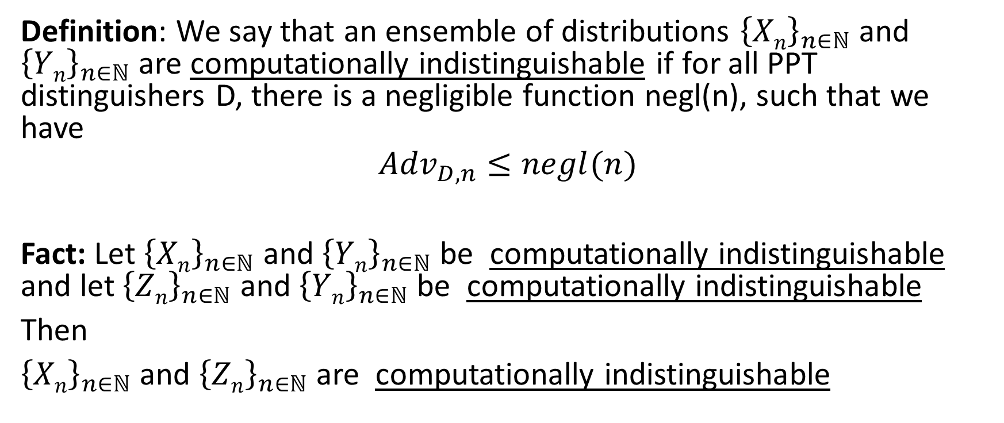
Computational Indistinguishability
Definition: We say that an ensemble of distributions ${\left\{Xn\right\}}_{n∈ℕ}$ and ${\left\{Yn\right\}}_{n∈ℕ}$ are computationally indistinguishable if for all PPT distinguishers D, there is a negligible function negl(n), such that we have
$${Adv}_{D,n}≤negl(n)$$
Fact: Let ${\left\{Xn\right\}}_{n∈ℕ}$ and ${\left\{Yn\right\}}_{n∈ℕ}$ be computationally indistinguishable and let ${\left\{Zn\right\}}_{n∈ℕ}$ and ${\left\{Yn\right\}}_{n∈ℕ}$ be computationally indistinguishable
Then
${\left\{Xn\right\}}_{n∈ℕ}$ and ${\left\{Zn\right\}}_{n∈ℕ}$ are computationally indistinguishable

