Slide 1


Homework 2 Statistics
Minimum Value | 40.00
Maximum Value | 100.00
Range | 60.00
Average | 83.79
Median | 85.00
Standard Deviation | 15.93
Harry
Hagrid

Slide 2
Midterm Exam
Thursday, October 5th at 9 AM (in class)
  Multiple Choice, True/False, Fill-in-the-Blank
  75 minutes
You may bring one (double sided) index card with notes
No electronic devices/calculators
May Incorporate Content from Today’s Lecture or Katz and Lindell Chapters 1--6

Slide 3
Final Exam
Time: Tuesday, December 12th at 1PM (Tentative Subject to Change)
Location: LWSN 1106

Slide 4
Recap
Random Oracle Model
  Pros (Easier Proofs/More Efficient Protocols/Solid Evidence for Security in Practice)
  Cons (Strong Assumption)
Hashing Applications
Building Stream Ciphers
  Linear Feedback Shift Registers (+ Attacks)
  RC4 (+ Attacks)
  Trivium
Block Ciphers

Slide 5
Cryptography
CS 555
Week 7:
Block Ciphers
Feistel Networks
DES, 3DES, AES
Readings: Katz and Lindell Chapter 6
Fall 2017

Slide 6
CS 555: Week 7: Topic 1
Block Ciphers (Continued)

Slide 7

Review Pseudorandom Permutation
A keyed function $F:{\left\{0,1\right\}}^{n}×{\left\{0,1\right\}}^{n}→{\left\{0,1\right\}}^{n}$, which is invertible and “looks random” without the secret key k.
Similar to a PRF, but
Computing F_{k}(x) and $F_{k}^{−1}\left(x\right)$ is efficient (polynomial-time)
Definition 3.28: A keyed function $F:{\left\{0,1\right\}}^{n}×{\left\{0,1\right\}}^{n}→{\left\{0,1\right\}}^{n}$ is a strong pseudorandom permutation if for all PPT distinguishers D there is a negligible function $μ$ s.t.
$$\left|Pr\left[D^{F_{k}\left(.\right),F_{k}^{−1}\left(.\right)}\left(1^{n}\right)\right]−Pr\left[D^{f\left(.\right),f^{−1}\left(.\right)}\left(1^{n}\right)\right]\right|≤μ\left(n\right)$$

Slide 8
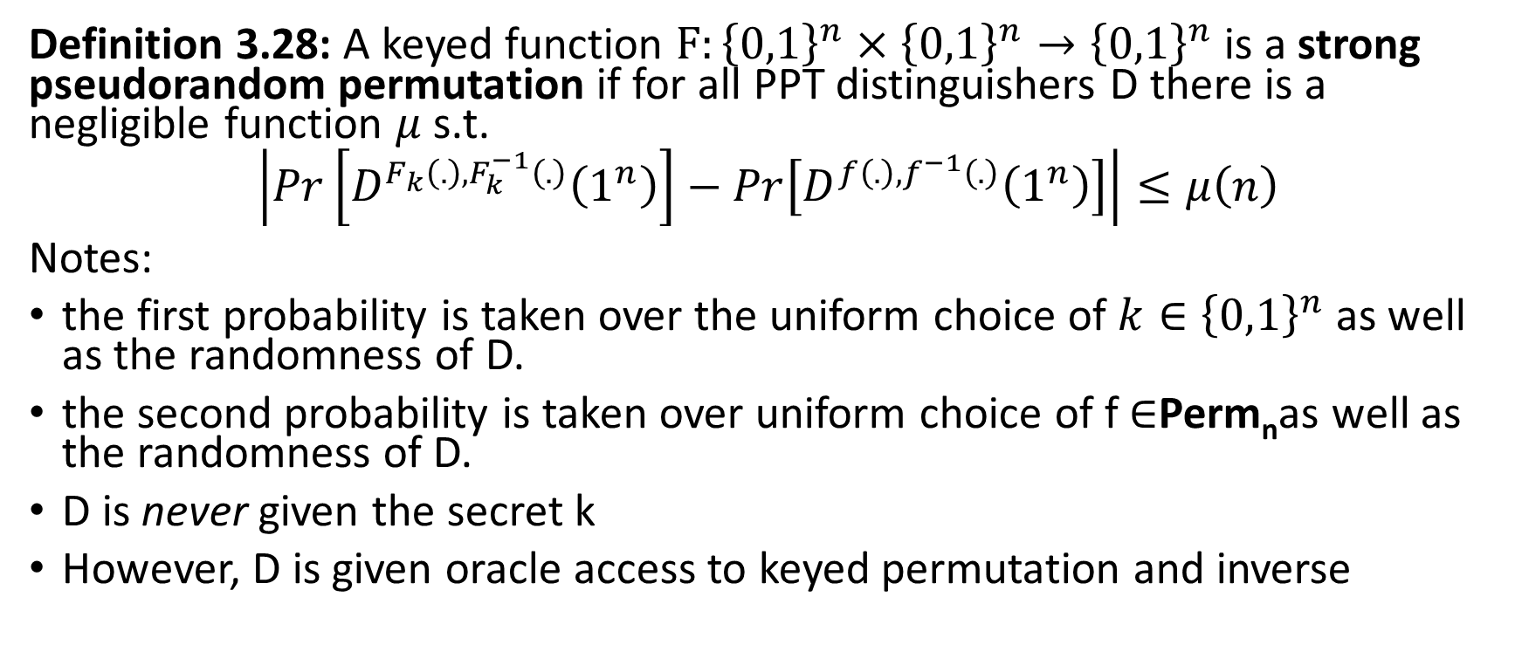
Pseudorandom Permutation
Definition 3.28: A keyed function $F:{\left\{0,1\right\}}^{n}×{\left\{0,1\right\}}^{n}→{\left\{0,1\right\}}^{n}$ is a strong pseudorandom permutation if for all PPT distinguishers D there is a negligible function $μ$ s.t.
$$\left|Pr\left[D^{F_{k}\left(.\right),F_{k}^{−1}\left(.\right)}\left(1^{n}\right)\right]−Pr\left[D^{f\left(.\right),f^{−1}\left(.\right)}\left(1^{n}\right)\right]\right|≤μ\left(n\right)$$
Notes:
the first probability is taken over the uniform choice of ${k∈\left\{0,1\right\}}^{n}$ as well as the randomness of D.
the second probability is taken over uniform choice of f $∈$Perm_{n}as well as the randomness of D.
D is never given the secret k
However, D is given oracle access to keyed permutation and inverse

Slide 9

How many permutations?
|Perm_{n}|=?
Answer: 2^{n}!
How many bits to store f $∈$Perm_{n}?
Answer:
$$\log\left(\text{2}\text{n}\text{!}\right)=\sum_{i=1}^{\text{2}\text{n}}{\log\left(\text{i}\right)}$$
$$≥\sum_{i=2^{n−1}}^{2^{n}}{n−1}≥(n−1)×2^{n−1}$$

Slide 10
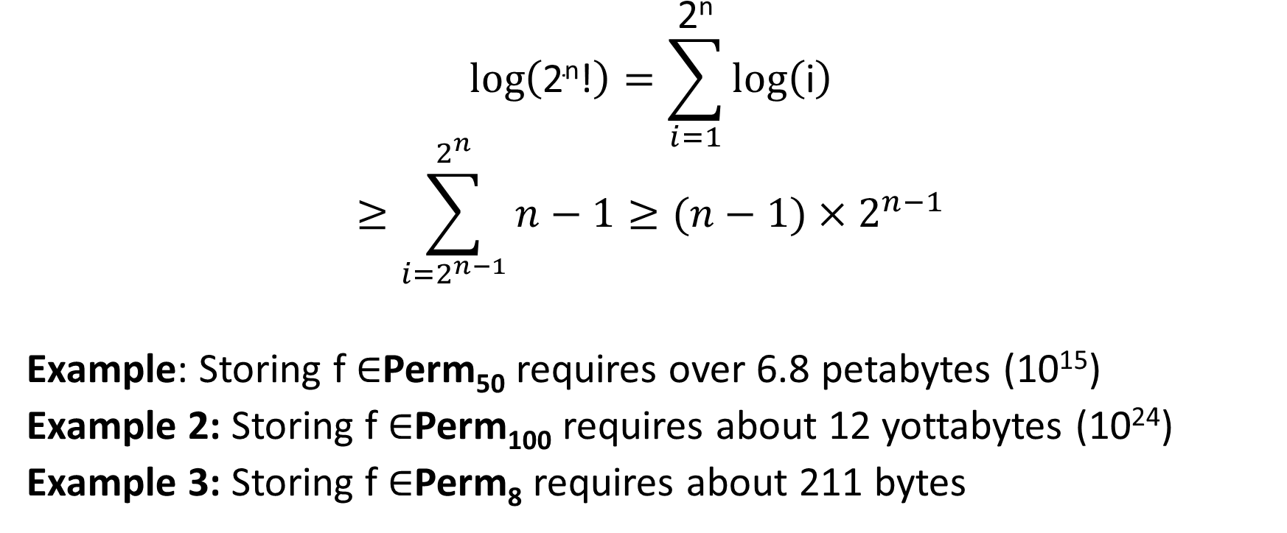
How many bits to store permutations?
$$\log\left(\text{2}\text{n}\text{!}\right)=\sum_{i=1}^{\text{2}\text{n}}{\log\left(\text{i}\right)}$$
$$≥\sum_{i=2^{n−1}}^{2^{n}}{n−1}≥(n−1)×2^{n−1}$$
Example: Storing f $∈$Perm₅₀ requires over 6.8 petabytes (10¹⁵)
Example 2: Storing f $∈$Perm₁₀₀ requires about 12 yottabytes (10²⁴)
Example 3: Storing f $∈$Perm₈ requires about 211 bytes

Slide 11
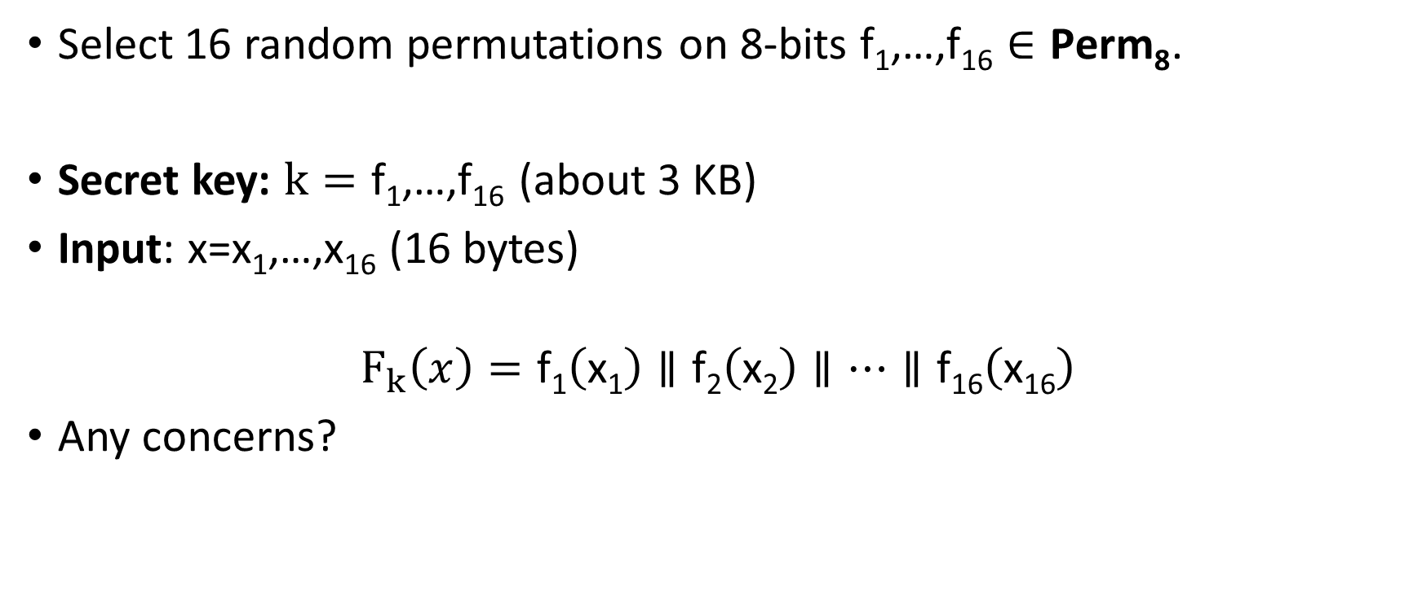
Attempt 1: Pseudorandom Permutation
Select 16 random permutations on 8-bits $\text{f}\text{1}\text{,…,}\text{f}\text{16}∈\text{Perm}\text{8}$.
Secret key: $k=\text{f}\text{1}\text{,…,}\text{f}\text{16}$(about 3 KB)
Input: x=x₁,…,x₁₆ (16 bytes)
$$F_{k}\left(x\right)=\text{f}\text{1}\left(\text{x}\text{1}\right)∥\text{f}\text{2}\left(\text{x}\text{2}\right)∥…∥\text{f}\text{16}\left(\text{x}\text{16}\right)$$
Any concerns?

Slide 12
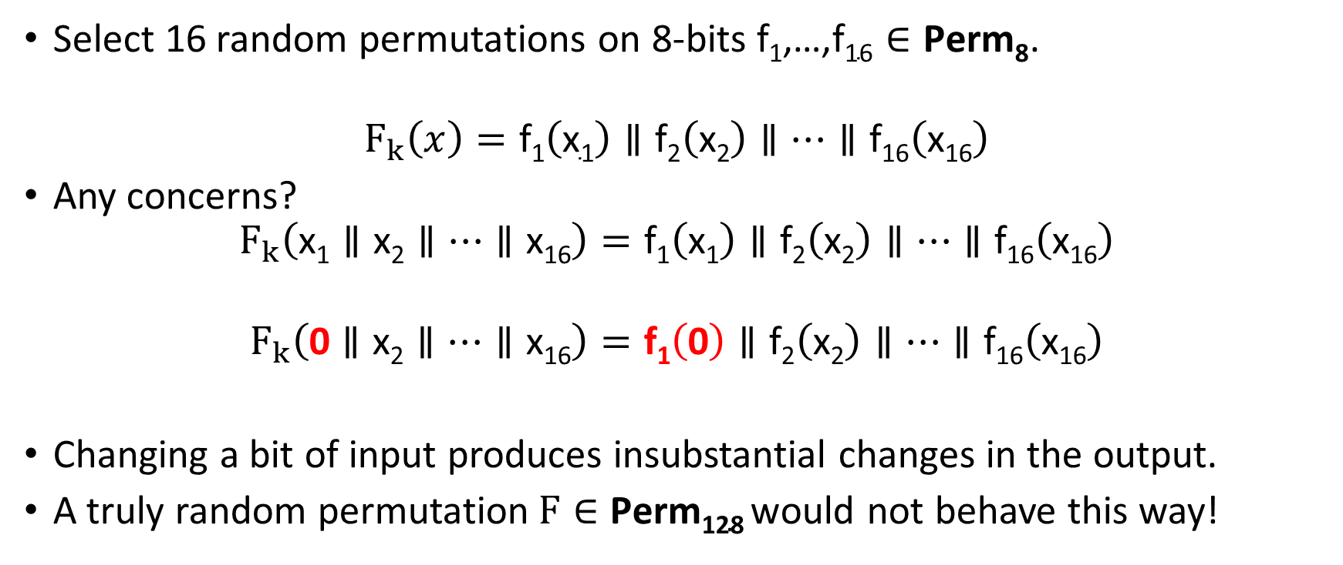
Attempt 1: Pseudorandom Permutation
Select 16 random permutations on 8-bits $\text{f}\text{1}\text{,…,}\text{f}\text{16}∈\text{Perm}\text{8}$.
$$F_{k}\left(x\right)=\text{f}\text{1}\left(\text{x}\text{1}\right)∥\text{f}\text{2}\left(\text{x}\text{2}\right)∥…∥\text{f}\text{16}\left(\text{x}\text{16}\right)$$
Any concerns?
$$F_{k}\left(\text{x}\text{1}∥\text{x}\text{2}∥…∥\text{x}\text{16}\right)=\text{f}\text{1}\left(\text{x}\text{1}\right)∥\text{f}\text{2}\left(\text{x}\text{2}\right)∥…∥\text{f}\text{16}\left(\text{x}\text{16}\right)$$
$$F_{k}\left(\text{0}∥\text{x}\text{2}∥…∥\text{x}\text{16}\right)=\text{f}\text{1}\left(\text{0}\right)∥\text{f}\text{2}\left(\text{x}\text{2}\right)∥…∥\text{f}\text{16}\left(\text{x}\text{16}\right)$$
Changing a bit of input produces insubstantial changes in the output.
A truly random permutation$F∈\text{Perm}\text{128}$would not behave this way!

Slide 13
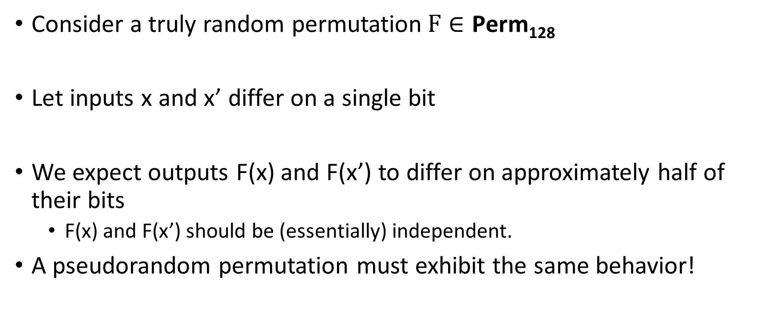
Pseudorandom Permutation Requirements
Consider a truly random permutation$F∈\text{Perm}\text{128}$
Let inputs x and x’ differ on a single bit
We expect outputs F(x) and F(x’) to differ on approximately half of their bits
  F(x) and F(x’) should be (essentially) independent.
A pseudorandom permutation must exhibit the same behavior!

Slide 14
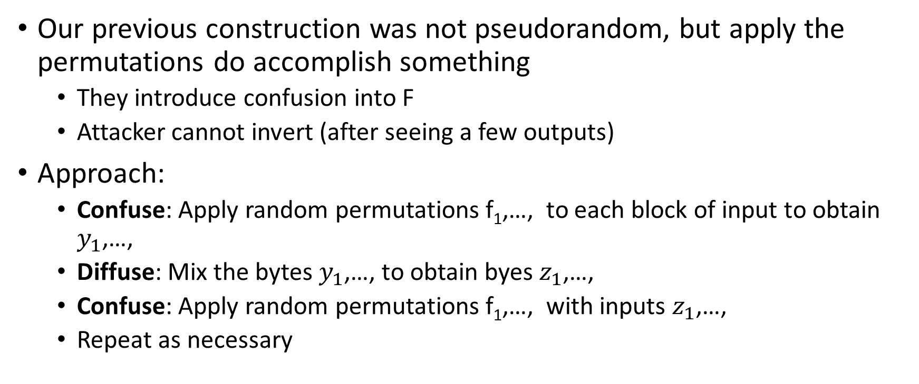
Confusion-Diffusion Paradigm
Our previous construction was not pseudorandom, but apply the permutations do accomplish something
  They introduce confusion into F
  Attacker cannot invert (after seeing a few outputs)
Approach:
  Confuse: Apply random permutations $\text{f}\text{1}\text{,…,}$ to each block of input to obtain $y_{1}$,…,
  Diffuse: Mix the bytes $y_{1}$,…, to obtain byes $z_{1}$,…,
  Confuse: Apply random permutations $\text{f}\text{1}\text{,…,}$ with inputs $z_{1}$,…,
  Repeat as necessary

Slide 15
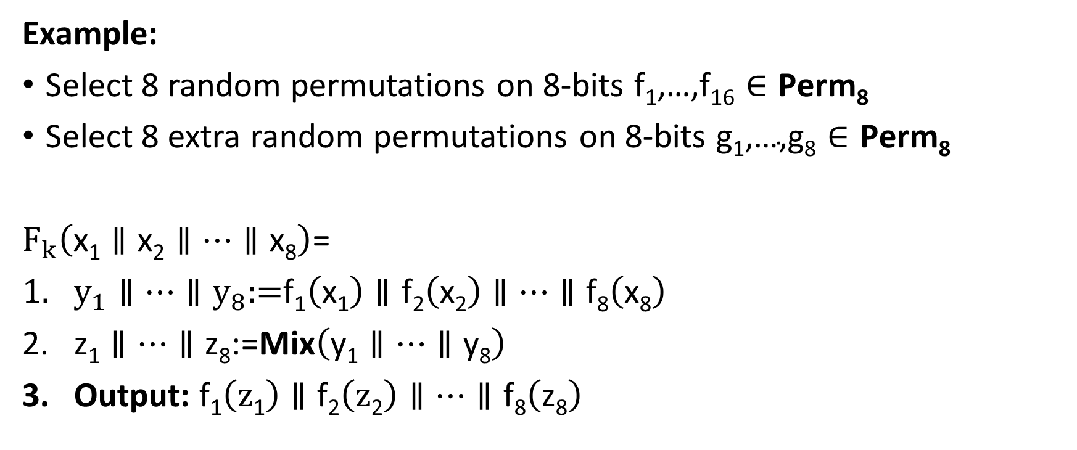
Confusion-Diffusion Paradigm
Example:
Select 8 random permutations on 8-bits $\text{f}\text{1}\text{,…,}\text{f}\text{16}∈\text{Perm}\text{8}$
Select 8 extra random permutations on 8-bits $\text{g}\text{1}\text{,…,}\text{g}\text{8}∈\text{Perm}\text{8}$
$F_{k}\left(\text{x}\text{1}∥\text{x}\text{2}∥…∥\text{x}\text{8}\right)$=
$y_{1}∥…∥y_{8}\text{:=}\text{f}\text{1}\left(\text{x}\text{1}\right)∥\text{f}\text{2}\left(\text{x}\text{2}\right)∥…∥\text{f}\text{8}\left(\text{x}\text{8}\right)$
$\text{z}\text{1}∥…∥\text{z}\text{8}\text{:=}\text{Mix}\left(\text{y}\text{1}∥…∥\text{y}\text{8}\right)$
Output: $\text{f}\text{1}\left(\text{z}\text{1}\right)∥\text{f}\text{2}\left(\text{z}\text{2}\right)∥…∥\text{f}\text{8}\left(\text{z}\text{8}\right)$

Slide 16
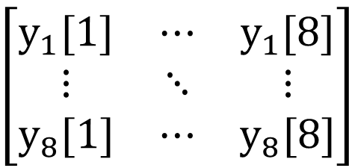





Example Mixing Function
$\text{Mix}\left(\text{y}\text{1}∥…∥\text{y}\text{8}\right)$=
For i=1 to 8
$\text{z}\text{i}\text{:=}\text{y}\text{1}\text{[}\text{i}\text{]}∥…∥\text{y}\text{8}\text{[}\text{i}\text{]}$
End For
Output: $\text{g}\text{1}\left(\text{z}\text{1}\right)∥\text{g}\text{2}\left(\text{z}\text{2}\right)∥…∥\text{g}\text{8}\left(\text{z}8\right)$
$$\text{z}\text{1}$$
$$\text{z}\text{8}$$
$$y_{1}=$$
$$\left[\begin{matrix}y_{1}[1] & ⋯ & y_{1}[8] \\ ⋮ & ⋱ & ⋮ \\ y_{8}[1] & ⋯ & y_{8}[8]\end{matrix}\right]$$
$$y_{8}=$$

Slide 17
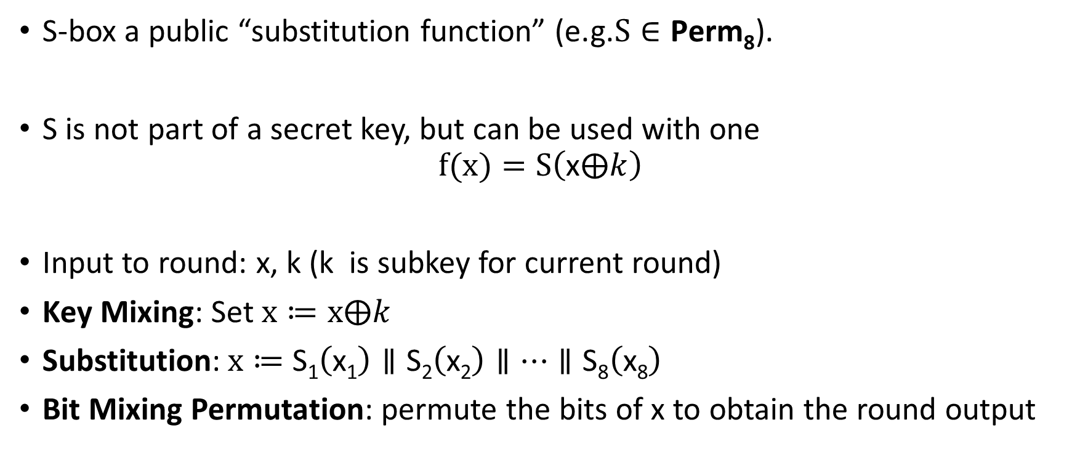
Substitution Permutation Networks
S-box a public “substitution function” (e.g.$S∈\text{Perm}\text{8}$).
S is not part of a secret key, but can be used with one
$$f(x)=S\left(\text{x}⨁k\right)$$
Input to round: x, k (k is subkey for current round)
Key Mixing: Set $x≔x⨁k$
Substitution:$x≔$ $\text{S}\text{1}\left(\text{x}\text{1}\right)∥\text{S}\text{2}\left(\text{x}\text{2}\right)∥…∥\text{S}\text{8}\left(\text{x}\text{8}\right)$
Bit Mixing Permutation: permute the bits of x to obtain the round output
Note: there are only n! possible bit mixing permutations of [n] as opposed to 2^{n}! Permutations of {0,1}^{n}

Slide 18
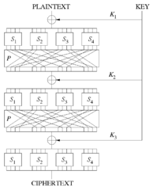
Substitution Permutation Networks
Proposition 6.3: Let F be a keyed function defined by a Substitution Permutation Network. Then for any keys/number of rounds F_{k} is a permutation.
Why? Composing permutations f,g results in another permutation h(x)=g(f(x)).

Slide 19
Remarks
Want to achieve “avalanche effect” (one bit change should “affect” every output bit)
Should a S-box be a random byte permutation?
Better to ensure that S(x) differs from x on at least 2-bits (for all x)
  Helps to maximize “avalanche effect”
Mixing Permutation should ensure that output bits of any given S-box are used as input to multiple S-boxes in the next round

Slide 20
Remarks
How many rounds?
Informal Argument: If we ensure that S(x) differs from S(x’) on at least 2-bits (for all x,x’ differing on at least 1 bit) then every input bit affects
  2 bits of round 1 output
  4 bits of round 2 output
  8 bits of round 3 output
  ….
  128 bits of round 4 output
Need at least 7 rounds (minimum) to ensure that every input bit affects every output bit

Slide 21
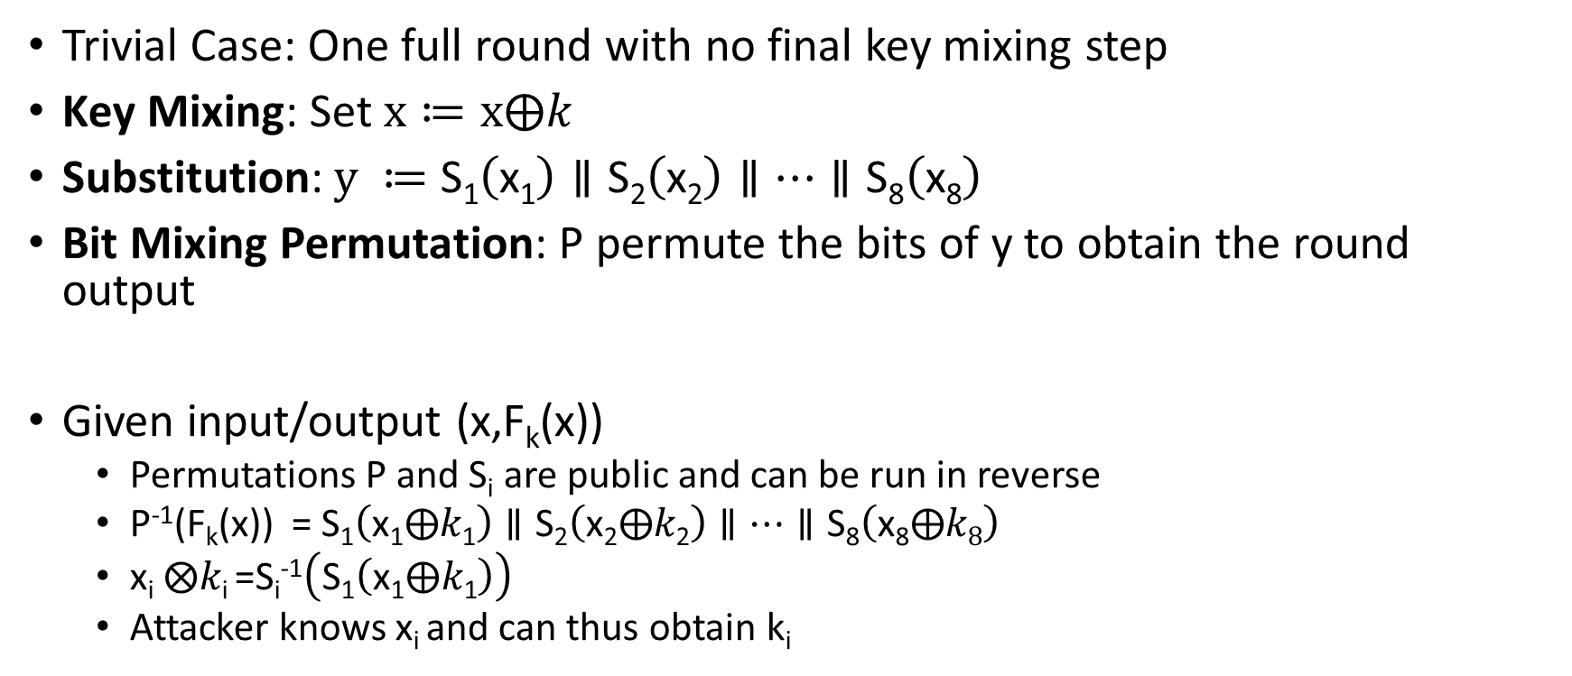
Attacking Lower Round SPNs
Trivial Case: One full round with no final key mixing step
Key Mixing: Set $x≔x⨁k$
Substitution:$y ≔$ $\text{S}\text{1}\left(\text{x}\text{1}\right)∥\text{S}\text{2}\left(\text{x}\text{2}\right)∥…∥\text{S}\text{8}\left(\text{x}\text{8}\right)$
Bit Mixing Permutation: P permute the bits of y to obtain the round output
Given input/output (x,F_{k}(x))
  Permutations P and S_{i} are public and can be run in reverse
  P⁻¹(F_{k}(x)) = $\text{S}\text{1}\left(\text{x}\text{1}⨁k\text{1}\right)∥\text{S}\text{2}\left(\text{x}\text{2}⨁k\text{2}\right)∥…∥\text{S}\text{8}\left(\text{x}\text{8}⨁k8\right)$
  $\text{x}\text{i} ⨂k\text{i}$=S_{i}⁻¹$\left(\text{S}\text{1}\left(\text{x}\text{1}⨁k\text{1}\right)\right)$
  Attacker knows x_{i} and can thus obtain k_{i}

Slide 22
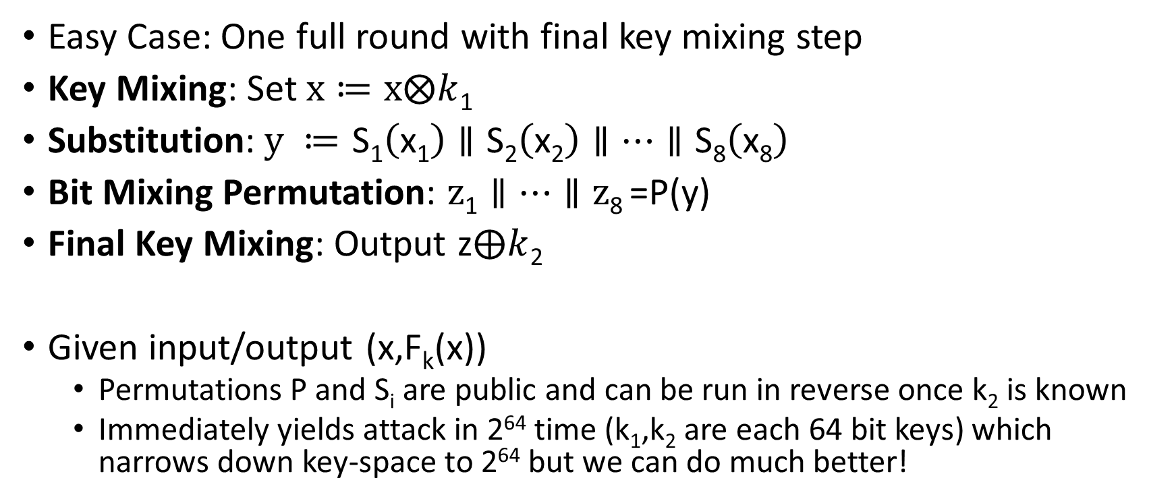
Attacking Lower Round SPNs
Easy Case: One full round with final key mixing step
Key Mixing: Set $x≔x⨂k$₁
Substitution:$y ≔$ $\text{S}\text{1}\left(\text{x}\text{1}\right)∥\text{S}\text{2}\left(\text{x}\text{2}\right)∥…∥\text{S}\text{8}\left(\text{x}\text{8}\right)$
Bit Mixing Permutation: $z\text{1}∥…∥\text{z}\text{8}$=P(y)
Final Key Mixing: Output z$⨁k$₂
Given input/output (x,F_{k}(x))
  Permutations P and S_{i} are public and can be run in reverse once k₂ is known
  Immediately yields attack in 2⁶⁴ time (k₁,k₂ are each 64 bit keys) which narrows down key-space to 2⁶⁴ but we can do much better!

Slide 23
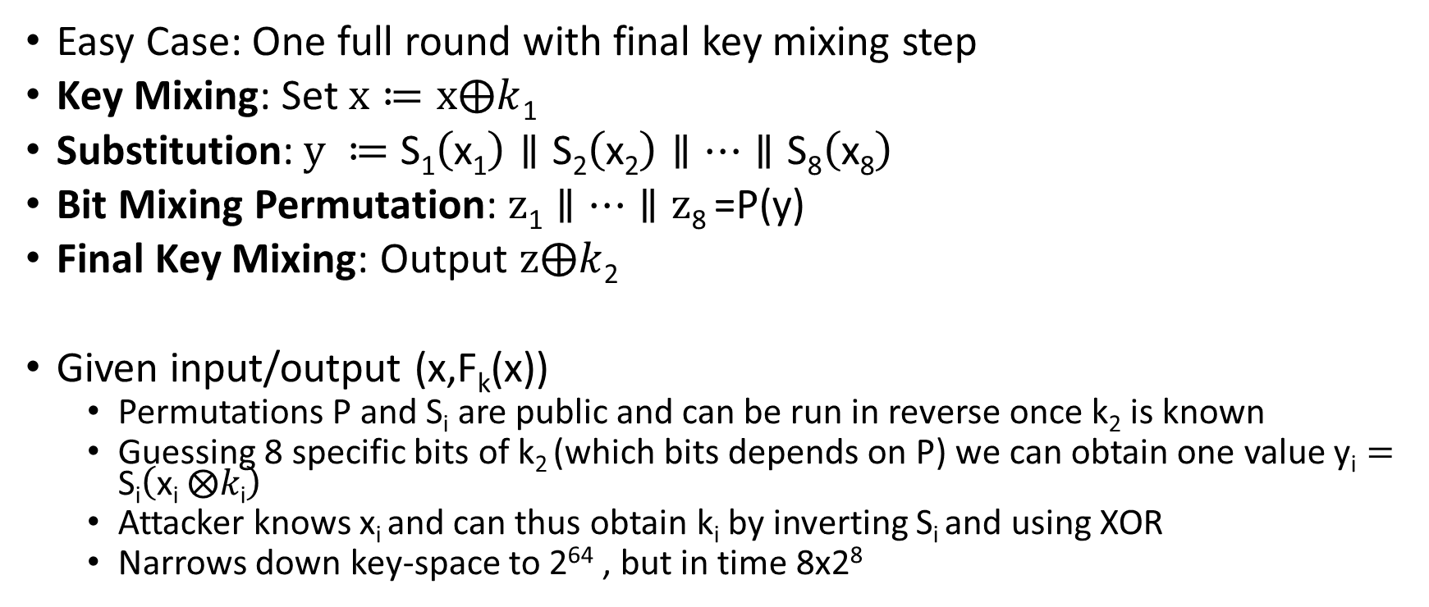
Attacking Lower Round SPNs
Easy Case: One full round with final key mixing step
Key Mixing: Set $x≔x⨁k$₁
Substitution:$y ≔$ $\text{S}\text{1}\left(\text{x}\text{1}\right)∥\text{S}\text{2}\left(\text{x}\text{2}\right)∥…∥\text{S}\text{8}\left(\text{x}\text{8}\right)$
Bit Mixing Permutation: $z\text{1}∥…∥\text{z}\text{8}$=P(y)
Final Key Mixing: Output $z⨁k$₂
Given input/output (x,F_{k}(x))
  Permutations P and S_{i} are public and can be run in reverse once k₂ is known
  Guessing 8 specific bits of k₂ (which bits depends on P) we can obtain one value $\text{y}\text{i}=\text{S}\text{i}\left(\text{x}\text{i} ⨂k\text{i}\right)$
  Attacker knows x_{i} and can thus obtain k_{i} by inverting S_{i} and using XOR
  Narrows down key-space to 2⁶⁴ , but in time 8x2⁸

Slide 24
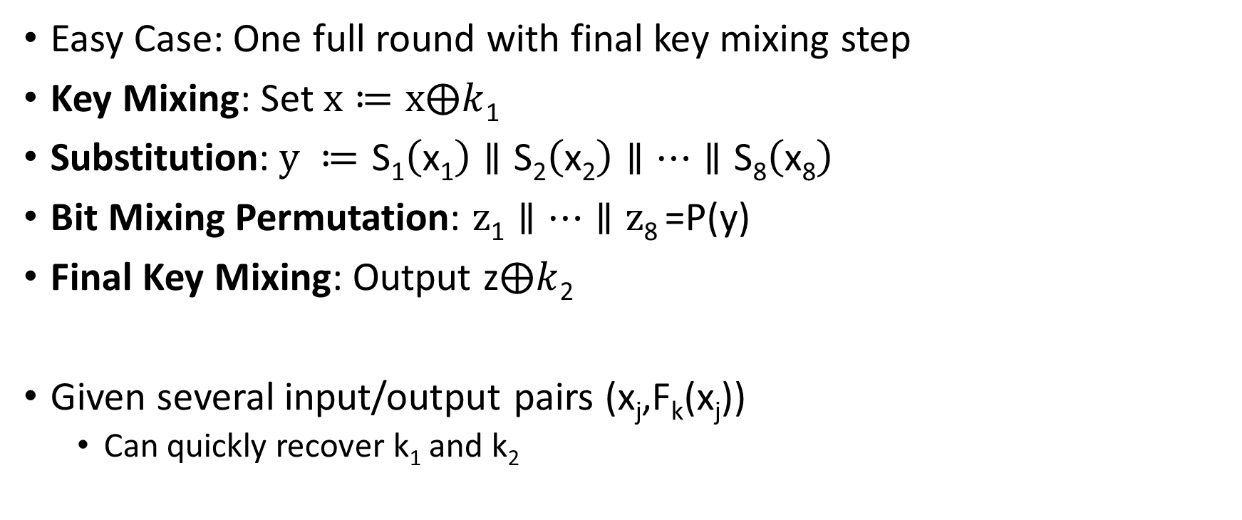
Attacking Lower Round SPNs
Easy Case: One full round with final key mixing step
Key Mixing: Set $x≔x⨁k$₁
Substitution:$y ≔$ $\text{S}\text{1}\left(\text{x}\text{1}\right)∥\text{S}\text{2}\left(\text{x}\text{2}\right)∥…∥\text{S}\text{8}\left(\text{x}\text{8}\right)$
Bit Mixing Permutation: $z\text{1}∥…∥\text{z}\text{8}$=P(y)
Final Key Mixing: Output z$⨁k$₂
Given several input/output pairs (x_{j},F_{k}(x_{j}))
  Can quickly recover k₁ and k₂

Slide 25
Attacking Lower Round SPNs
Harder Case: Two round SPN
Exercise ☺

Slide 26
Feistel Networks
Alternative to Substitution Permutation Networks
Advantage: underlying functions need not be invertible, but the result is still a permutation

Slide 27
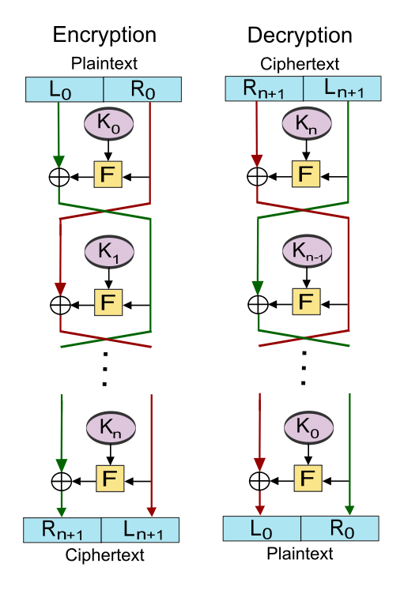
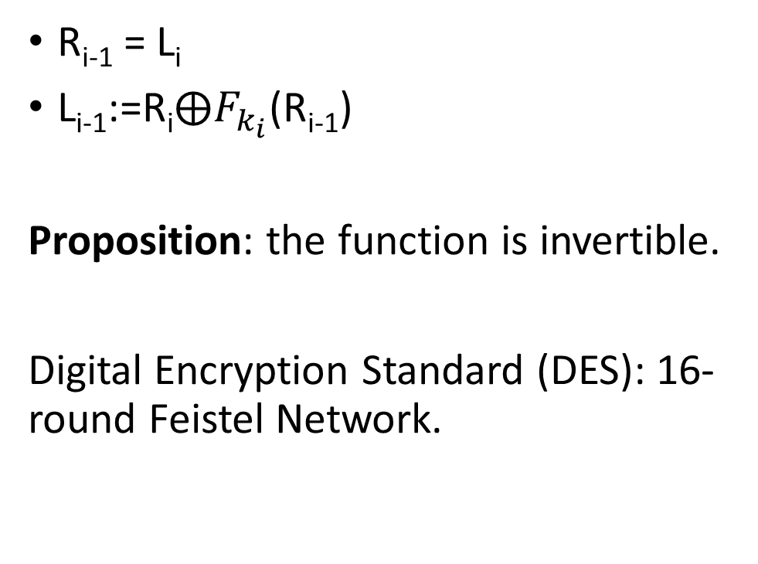
R_{i-1} = L_{i}
L_{i-1}:=$\text{R}\text{i}⨁F_{k_{i}}$(R_{i-1})
Proposition: the function is invertible.
Digital Encryption Standard (DES): 16-round Feistel Network.

Slide 28
CS 555: Week 7: Topic 2
DES, 3DES, AES

Slide 29
Feistel Networks
Alternative to Substitution Permutation Networks
Advantage: underlying functions need not be invertible, but the result is still a permutation

Slide 30

L_{i+1} = R_{i}
R_{i+1}≔L$\text{i}⨁F_{k_{i}}$(R_{i})
Proposition: the function is invertible.

Slide 31
Data Encryption Standard
Developed in 1970s by IBM (with help from NSA)
Adopted in 1977 as Federal Information Processing Standard (US)
Data Encryption Standard (DES): 16-round Feistel Network.
Key Length: 56 bits
  Vulnerable to brute-force attacks in modern times
  1.5 hours at 14 trillion keys/second (e.g., Antminer S9)

Slide 32
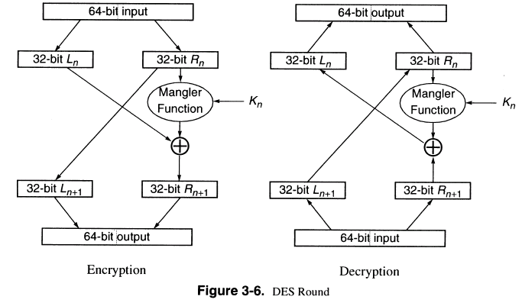
DES Round

Slide 33
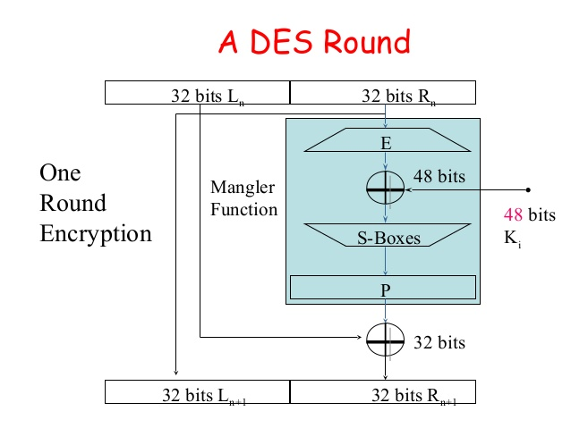
DES Mangle Function
Expand E: 32-bit input → 48-bit output (duplicates 16 bits)
S-boxes: S₁,…,S₈
  Input: 6-bits
  Output: 4 bits
  Not a permutation!
4-to-1 function
  Exactly four inputs mapped to each possible output

Slide 34
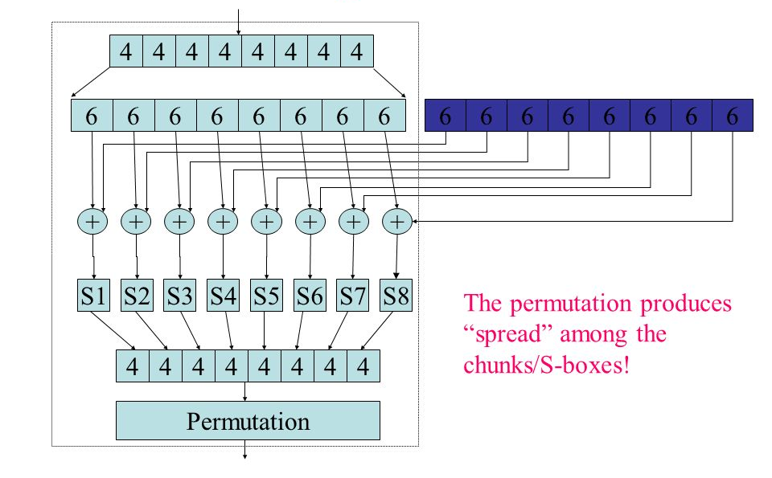
Mangle Function
32 bit input
48 bit output of expand
48-bit sub key
XOR block before
Applying S-Boxes
Each S-box outputs 4 bits

Slide 35
S-Box Representation as Table
4 columns (2 bits)
 | 00 | 01 | 10 | 11
0000
0001
0010
0011
0100
0101
0110 |  |  |  | S(x)=1101
…. | …. | …. | …. | ….
1111
16 columns (4 bits)
x =101101
S(x) = Table[0110,11]

Slide 36
S-Box Representation
Each column is permutation
4 columns (2 bits)
 | 00 | 01 | 10 | 11
0000
0001
0010
0011
0100
0101
0110 |  |  |  | S(x)=1101
…. | …. | …. | …. | ….
1111
16 columns (4 bits)
S(x) = T[0110,11]
x =101101

Slide 37
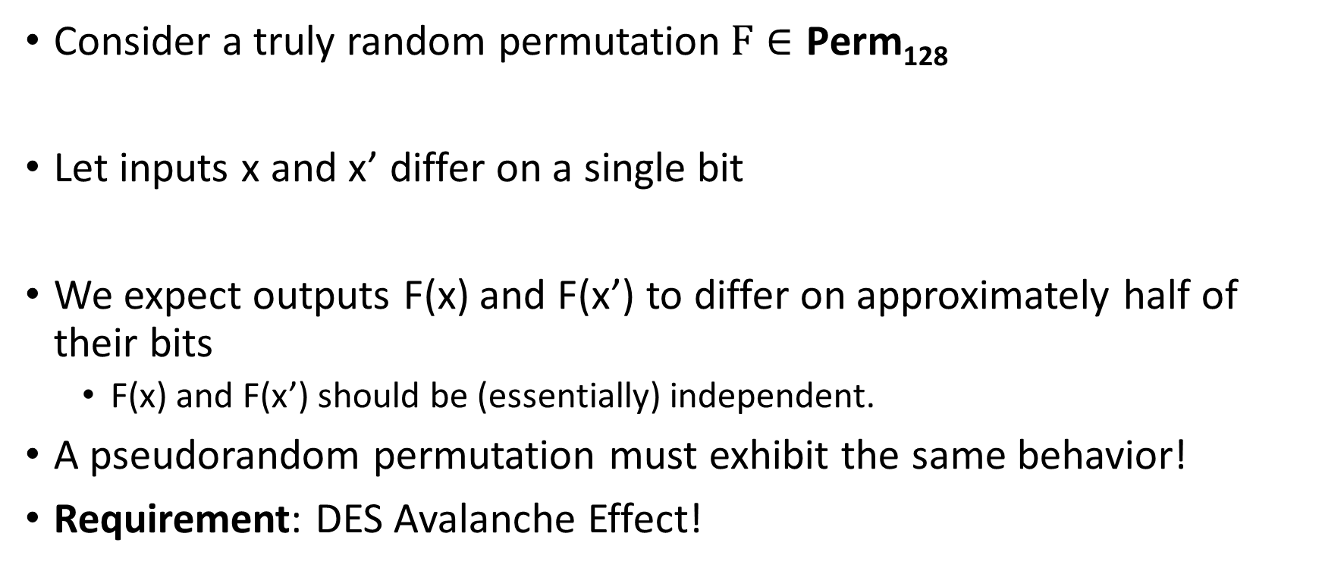
Pseudorandom Permutation Requirements
Consider a truly random permutation$F∈\text{Perm}\text{128}$
Let inputs x and x’ differ on a single bit
We expect outputs F(x) and F(x’) to differ on approximately half of their bits
  F(x) and F(x’) should be (essentially) independent.
A pseudorandom permutation must exhibit the same behavior!
Requirement: DES Avalanche Effect!

Slide 38
DES Avalanche Effect
Permutation the end of the mangle function helps to mix bits
Special S-box property #1
Let x and x’ differ on one bit then S_{i}(x) differs from S_{i}(x’) on two bits.

Slide 39
Avalanche Effect Example
Consider two 64 bit inputs
  (L_{n},R_{n}) and (L_{n}’,R’_{n}=R_{n})
  L_{n} and L_{n}’ differ on one bit
This is worst case example
  L_{n+1} = L_{n+1}’=R_{n}
  But now R’_{n+1} and R_{n+1} differ on one bit
Even if we are unlucky E(R’_{n+1}) and E(R_{n+1}) differ on 1 bit
→ R_{n+2} and R’_{n+2} differ on two bits
→ L_{n+2} = R’_{n+1} and L_{n+2}’ = R’_{n+1} differ in one bit

Slide 40
Avalanche Effect Example
R_{n+2} and R’_{n+2} differ on two bits
L_{n+2} = R_{n+1} and L_{n+2}’ = R’_{n+1} differ in one bit
→R_{n+3} and R’_{n+3} differ on four bits since we have different inputs to two of the S-boxes
L_{n+3} = R’_{n+2} and L_{n+2}’ = R’_{n+2} now differ on two bits
Seven rounds we expect all 32 bits in right half to be “affected” by input change
…
DES has sixteen rounds

Slide 41
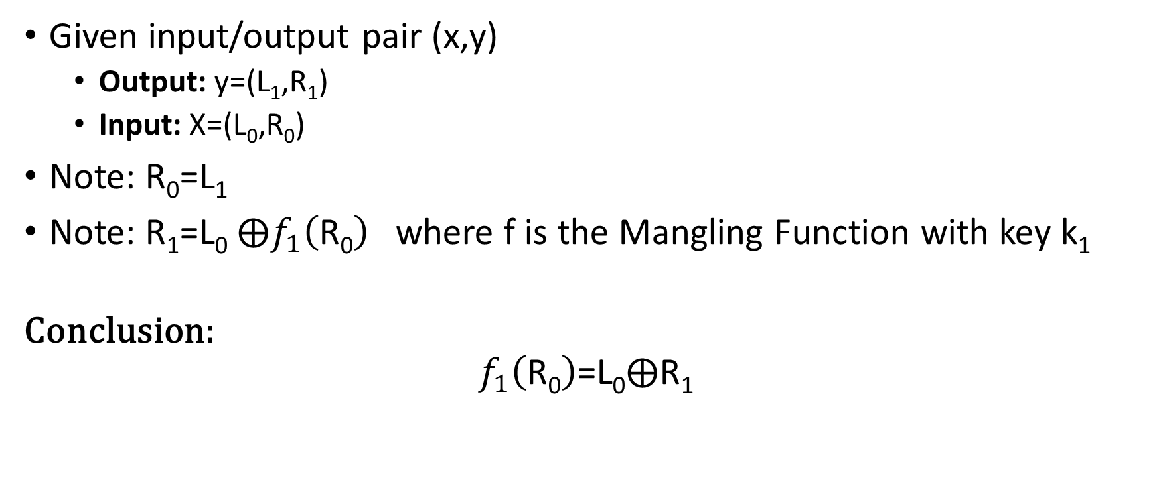
Attack on One-Round DES
Given input/output pair (x,y)
  Output: y=(L₁,R₁)
  Input: X=(L₀,R₀)
Note: R₀=L₁
Note: R₁=L₀ $⨁f_{1}\left(\text{R}\text{0}\right)$ where f is the Mangling Function with key k₁
Conclusion:
$$f_{1}\left(\text{R}\text{0}\right)\text{=}\text{L}\text{0}⨁\text{R}\text{1}$$

Slide 42


Attack on One-Round DES
$$\text{R}\text{0}$$
Four possible inputs
Trivial to Recover
$$\text{L}\text{0}⨁\text{R}\text{1}$$

Slide 43
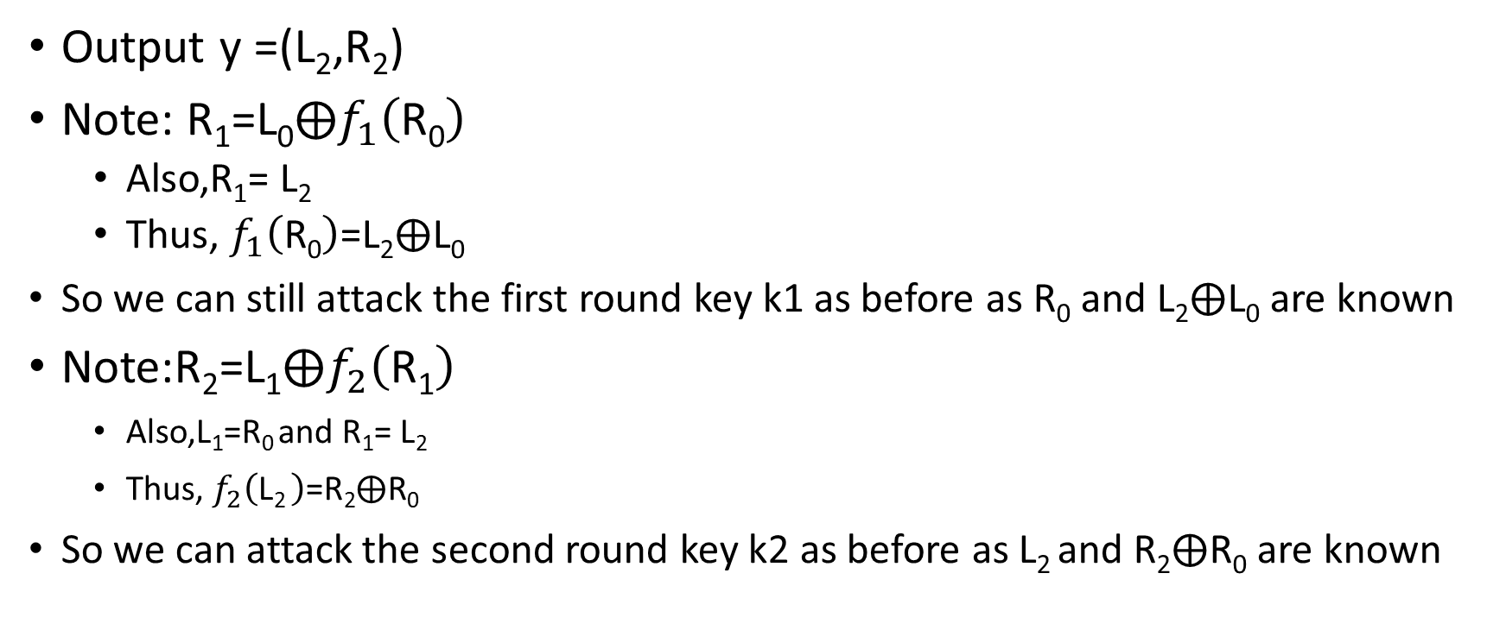
Attack on Two-Round DES
Output y =(L₂,R₂)
Note: $\text{R}\text{1}\text{=}\text{L}\text{0}⨁f_{1}\left(\text{R}\text{0}\right)$
  Also,$\text{R}\text{1}\text{=}$ $\text{L}\text{2}$
  Thus, $f_{1}\left(\text{R}\text{0}\right)\text{=}\text{L}\text{2}⨁\text{L}\text{0}$
  So we can still attack the first round key k1 as before as $\text{R}\text{0}$ and $\text{L}\text{2}⨁\text{L}\text{0}$ are known
Note:$\text{R}\text{2}\text{=}\text{L}\text{1}⨁f_{2}\left(\text{R}\text{1}\right)$
    Also,$\text{L}\text{1}\text{=}\text{R}\text{0 }$and $\text{R}\text{1}\text{=}$ $\text{L}\text{2}$
    Thus, $f_{2}\left(\text{L}\text{2 }\right)\text{=}\text{R}\text{2}⨁\text{R}\text{0}$
  So we can attack the second round key k2 as before as $\text{L}\text{2}$and $\text{R}\text{2}⨁\text{R}\text{0}$ are known

Slide 44
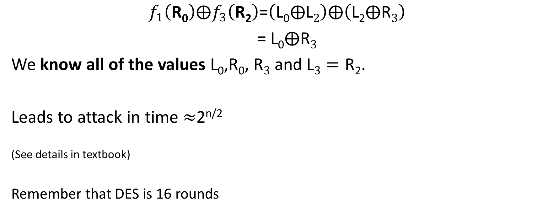
Attack on Three-Round DES
$$f_{1}\left(\text{R}\text{0}\right)⨁f_{3}\left(\text{R}\text{2}\right)\text{=}\left(\text{L}\text{0}⨁\text{L}2\right)⨁\left(\text{L}\text{2}⨁\text{R}3\right)$$
$\text{=}$ $\text{L}\text{0}⨁\text{R}3$
We know all of the values $\text{L}\text{0}\text{,}\text{R}\text{0}$, $\text{R}3$ and $\text{L}3=\text{R}\text{2}$.
Leads to attack in time $≈$2^{n/2}
^{(See details in textbook)}
^{Remember that DES is 16 rounds}

Slide 45
DES Security
Best Known attack is brute-force 2⁵⁶
  Except under unrealistic conditions (e.g., 2⁴³ known plaintexts)
Brute force is not too difficult on modern hardware
Attack can be accelerated further after precomputation
  Output is a few terabytes
  Subsequently keys are cracked in 2³⁸ DES evaluations (minutes)
Precomputation costs amortize over number of DES keys cracked
Even in 1970 there were objections to the short key length for DES

Slide 46
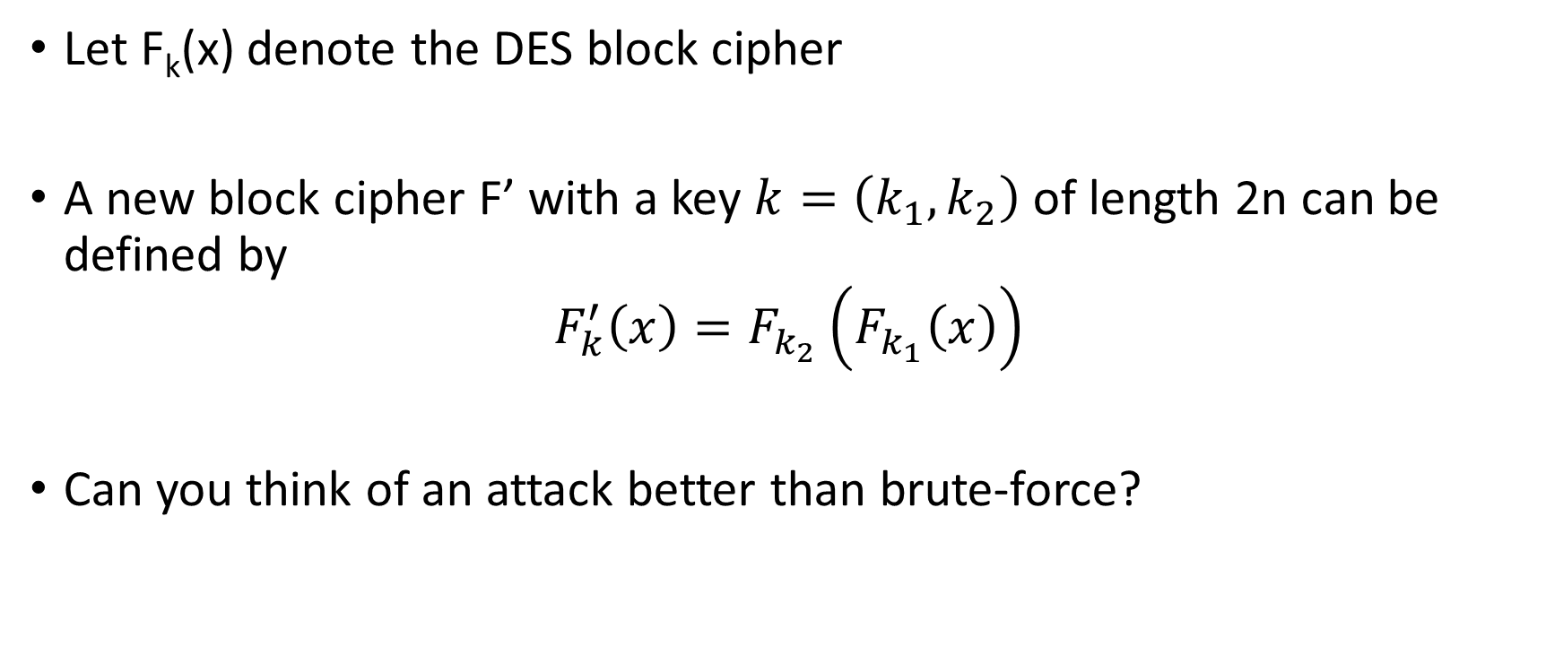
Double DES
Let F_{k}(x) denote the DES block cipher
A new block cipher F’ with a key $k=\left(k_{1},k_{2}\right)$ of length 2n can be defined by
$$F_{k}^{′}\left(x\right)=F_{k_{2}}\left(F_{k_{1}}\left(x\right)\right)$$
Can you think of an attack better than brute-force?

Slide 47
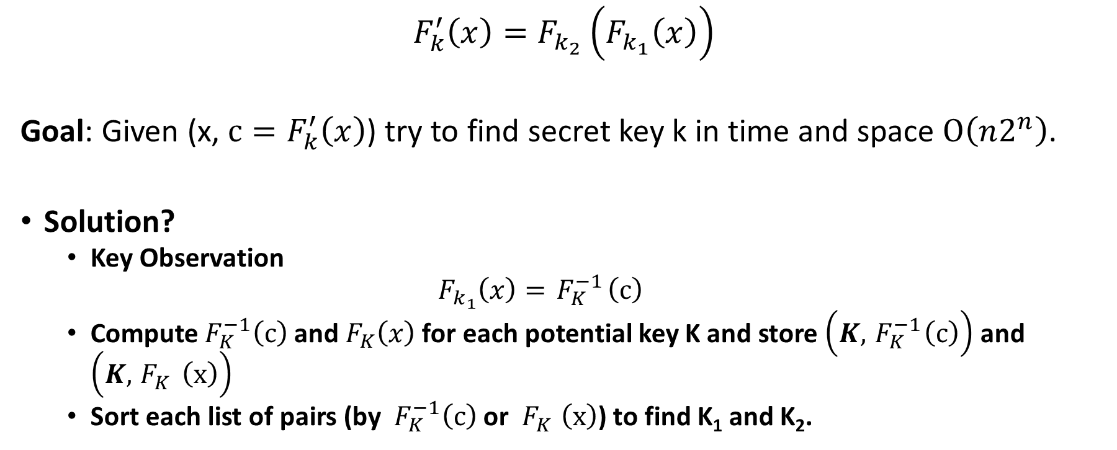
Meet in the Middle Attack
$$F_{k}^{′}\left(x\right)=F_{k_{2}}\left(F_{k_{1}}\left(x\right)\right)$$
Goal: Given (x, $c=F_{k}^{′}\left(x\right)$) try to find secret key k in time and space $O\left(n2^{n}\right)$.
Solution?
  Key Observation
  $$F_{k_{1}}\left(x\right)={ F}_{K}^{−1}\left(c\right)$$
  Compute${ F}_{K}^{−1}\left(c\right)$ and${ F}_{K}\left(x\right)$ for each potential key K and store $\left(K,{ F}_{K}^{−1}\left(c\right)\right)$ and $\left(K,{ F}_{K}^{}\left(x\right)\right)$
  Sort each list of pairs (by ${ F}_{K}^{−1}\left(c\right)$ or ${ F}_{K}^{}\left(x\right)$) to find K₁ and K₂.

Slide 48
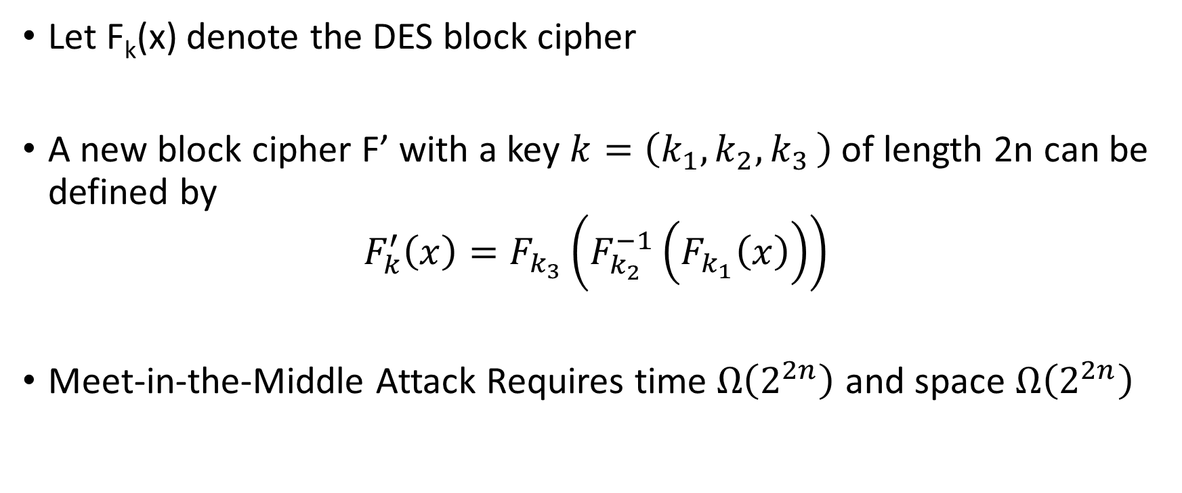
Triple DES Variant 1
Let F_{k}(x) denote the DES block cipher
A new block cipher F’ with a key $k=\left(k_{1},k_{2}{,k}_{3}\right)$ of length 2n can be defined by
$$F_{k}^{′}\left(x\right)=F_{k_{3}}\left(F_{k_{2}}^{−1}\left(F_{k_{1}}\left(x\right)\right)\right)$$
Meet-in-the-Middle Attack Requires time $Ω\left(2^{2n}\right)$ and space $Ω\left(2^{2n}\right)$

Slide 49
Triple DES Variant 1
Allows backward compatibility with DES by setting k₁=k₂=k₃
Let F_{k}(x) denote the DES block cipher
A new block cipher F’ with a key $k=\left(k_{1},k_{2}{,k}_{3}\right)$ of length 2n can be defined by
$$F_{k}^{′}\left(x\right)=F_{k_{3}}\left(F_{k_{2}}^{−1}\left(F_{k_{1}}\left(x\right)\right)\right)$$
Meet-in-the-Middle Attack Requires time $Ω\left(2^{2n}\right)$ and space $Ω\left(2^{2n}\right)$

Slide 50
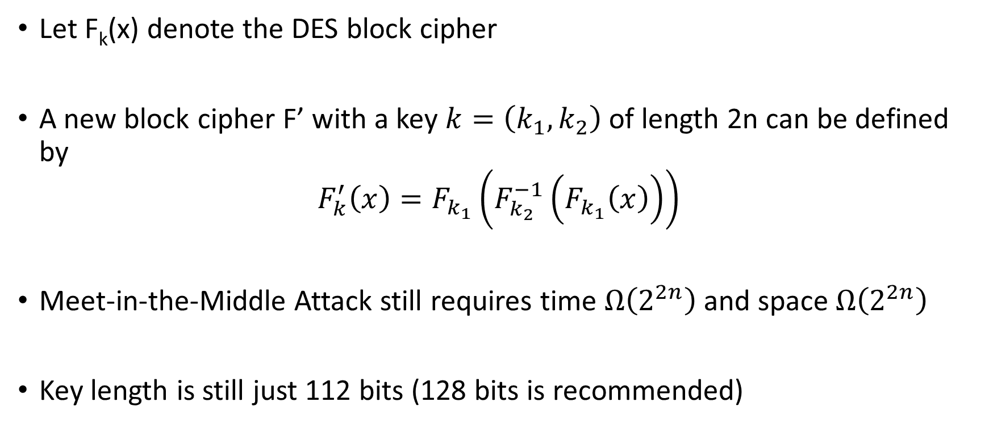
Triple DES Variant 2
Just two keys!
Let F_{k}(x) denote the DES block cipher
A new block cipher F’ with a key $k=\left(k_{1},k_{2}\right)$ of length 2n can be defined by
$$F_{k}^{′}\left(x\right)=F_{k_{1}}\left(F_{k_{2}}^{−1}\left(F_{k_{1}}\left(x\right)\right)\right)$$
Meet-in-the-Middle Attack still requires time $Ω\left(2^{2n}\right)$ and space $Ω\left(2^{2n}\right)$
Key length is still just 112 bits (128 bits is recommended)

Slide 51
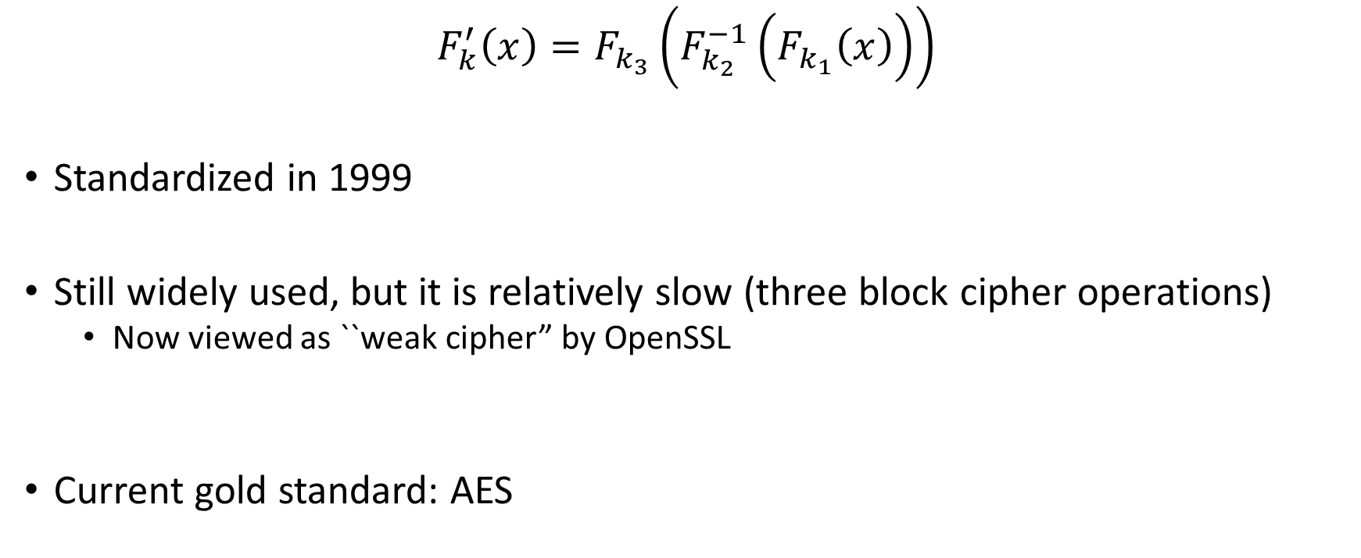
Triple DES Variant 1
$$F_{k}^{′}\left(x\right)=F_{k_{3}}\left(F_{k_{2}}^{−1}\left(F_{k_{1}}\left(x\right)\right)\right)$$
Standardized in 1999
Still widely used, but it is relatively slow (three block cipher operations)
  Now viewed as ``weak cipher” by OpenSSL
Current gold standard: AES

Slide 52
Advanced Encryption Standard (AES)
(1997) US National Institute of Standards and Technology (NIST) announces competition for new block cipher to replace DES
Fifteen algorithms were submitted from all over the world
  Analyzed by NIST
Contestants given a chance to break competitors schemes
October, 2000 NIST announces a winner Rijndael
  Vincent Rijmen and Joan Daemen
  No serious vulnerabilities found in four other finalists
  Rijndael was selected for efficiency, hardware performance, flexibility etc…

Slide 53
Advanced Encryption Standard
Block Size: 128 bits (viewed as 4x4 byte array)
Key Size: 128, 192 or 256
Essentially a Substitution Permutation Network
  AddRoundKey: Generate 128-bit sub-key from master key XOR with current state
  SubBytes: Each byte of state array (16 bytes) is replaced by another byte according a a single S-box (lookup table)
  ShiftRows – shift ith row by i bytes
  MixColumns – permute the bits in each column

Slide 54
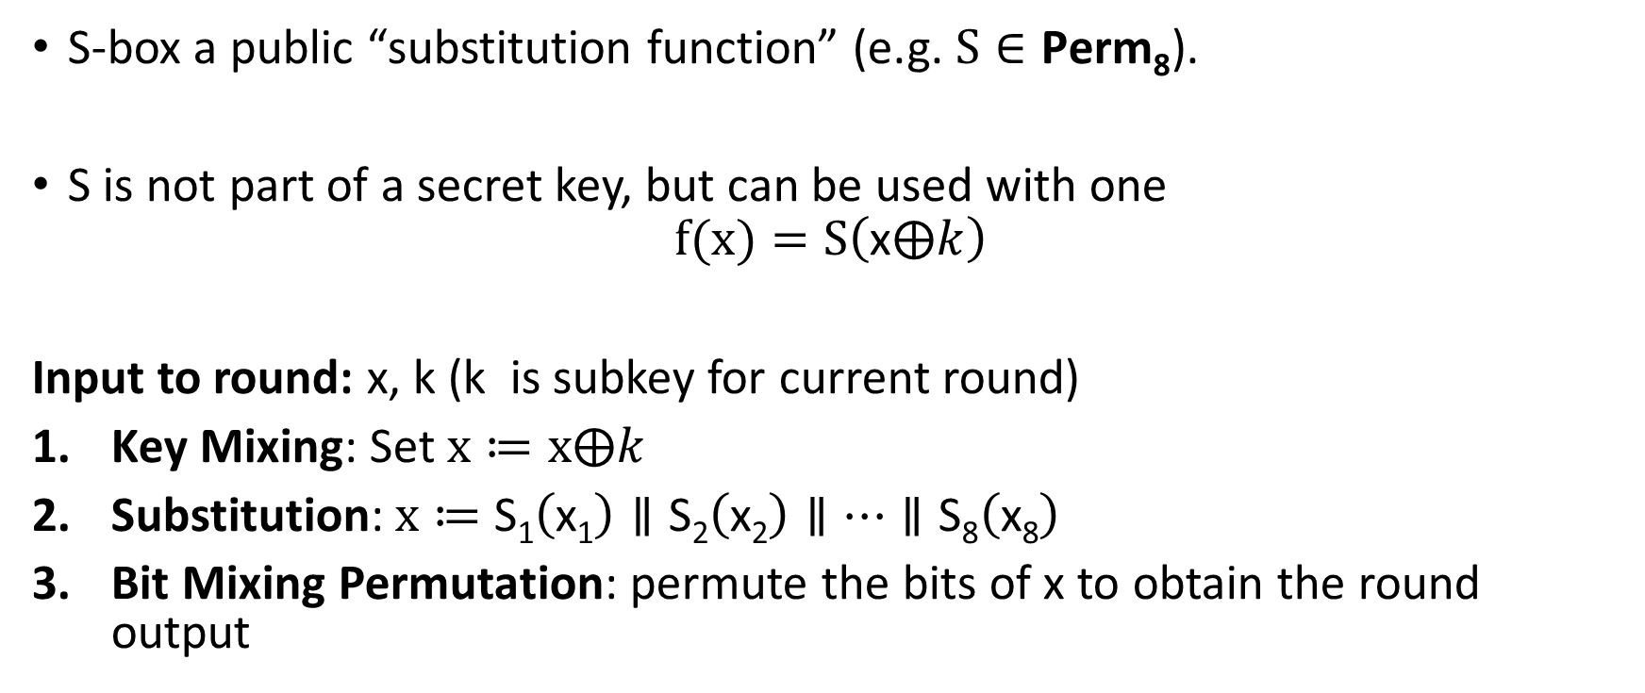
Substitution Permutation Networks
S-box a public “substitution function” (e.g.$S∈\text{Perm}\text{8}$).
S is not part of a secret key, but can be used with one
$$f(x)=S\left(\text{x}⨁k\right)$$
Input to round: x, k (k is subkey for current round)
Key Mixing: Set $x≔x⨁k$
Substitution:$x≔$ $\text{S}\text{1}\left(\text{x}\text{1}\right)∥\text{S}\text{2}\left(\text{x}\text{2}\right)∥…∥\text{S}\text{8}\left(\text{x}\text{8}\right)$
Bit Mixing Permutation: permute the bits of x to obtain the round output
Note: there are only n! possible bit mixing permutations of [n] as opposed to 2^{n}! Permutations of {0,1}^{n}

Slide 55
Substitution Permutation Networks
Proposition 6.3: Let F be a keyed function defined by a Substitution Permutation Network. Then for any keys/number of rounds F_{k} is a permutation.
Why? Composing permutations f,g results in another permutation h(x)=g(f(x)).

Slide 56
Advanced Encryption Standard
Key Mixing
Block Size: 128 bits
Key Size: 128, 192 or 256
Essentially a Substitution Permutation Network
  AddRoundKey: Generate 128-bit sub-key from master key, XOR with current state array
  SubBytes: Each byte of state array (16 bytes) is replaced by another byte according a single S-box (lookup table)
  ShiftRows
  MixColumns
Permutation
Substitution

Slide 57


AddRoundKey:
Round Key (16 Bytes)
00001111
10100011 | …
11001100 |  | …
01111111 |  |  | …
$$⨁$$
State
11110000
01100010 | …
00110000 |  | …
11111111 |  |  | …
$$=$$
11111111
11000001 | …
11111100 |  | …
10000000 |  |  | …

Slide 58
AddRoundKey:
Round Key (16 Bytes)
10100011 | …
 |  | …
 |  |  | …
State
11111111
11000001 | …
11111100 |  | …
10000000 |  |  | …
SubBytes (Apply S-box)
S(11111111)
S(11000001) | S(…)
S(11111100) |  | S(…)
S(10000000) |  |  | S(…)

Slide 59
AddRoundKey:
Round Key (16 Bytes)
10100011 | …
 |  | …
 |  |  | …
State
S(11111111)
S(11000001) | S(…)
S(11111100) |  | S(…)
S(10000000) |  |  | S(…)
Shift Rows
S(11111111)
 | S(11000001) | S(…)
S(…) |  | S(11111100)
 |  | S(…) | S(10000000)

Slide 60
AddRoundKey:
Round Key (16 Bytes)
10100011 | …
 |  | …
 |  |  | …
State
S(11111111)
 | S(11000001) | S(…)
S(…) |  | S(11111100)
 |  | S(…) | S(10000000)
Mix Columns
Invertible (linear) transformation.
Key property: if inputs differ in b>0 bytes then output differs in 5-b bytes (minimum)

Slide 61
AES
We just described one round of the SPN
AES uses
  10 rounds (with 128 bit key)
  12 rounds (with 192 bit key)
  14 rounds (with 256 bit key)

Slide 62
AES Attacks?
Side channel attacks affect a few specific implementations
  But, this is not a weakness of AES itself
  Timing attack on OpenSSL’s implementation AES encryption (2005, Bernstein)
(2009) Attack on 11 round version of AES
  recovers 256-bit key in time 2⁷⁰
  But AES is 14 round (with 256 bit key) so the attack doesn’t apply in practice
(2009) Attack on 192-bit and 256 bit version of AES
  recovers 256-bit key in time 2^{99.5}.
First public cipher approved by NSA for Top Secret information
Notes:
In April 2005, D.J. Bernstein announced a cache-timing attack that he used to break a custom server that used OpenSSL's AES encryption.^{[20]} The custom server was designed to give out as much timing information as possible (the server reports back the number of machine cycles taken by the encryption operation), and the attack required over 200 million chosen plaintexts.^{[21]}

