Slide 1
Homework 1 Statistics
Minimum Value | 30.00
Maximum Value | 100.00
Range | 70.00
Average | 79.18
Median | 84.50
Standard Deviation | 21.08

Slide 2
Homework 2 Released
Due: Thursday, September 28th at 9 AM (beginning of class)
Please Typeset Your Solutions (LaTeX, Word etc…)
You may collaborate, but must write up your own solutions in your own words

Slide 3
Cryptography CS 555
Week 5:
Loose Ends
Cryptographic Hash Functions
HMACs
Generic Attacks
Random Oracle Model
Applications of Hashing
Readings: Katz and Lindell Chapter 5, Appendix A.4
Fall 2017

Slide 4
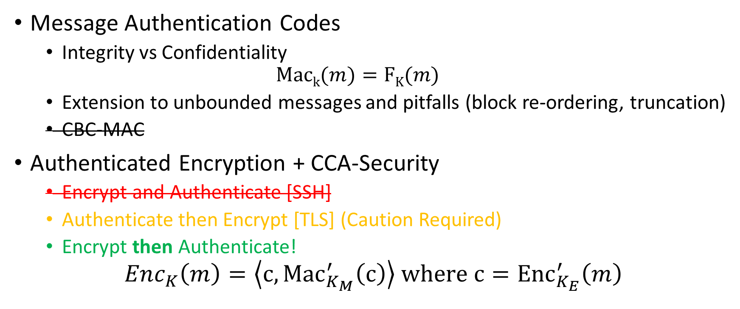
Recap
Message Authentication Codes
Integrity vs Confidentiality
$$\operatorname{Mack}{(m)}=FK(m)$$
Extension to unbounded messages and pitfalls (block re-ordering, truncation)
CBC-MAC
Authenticated Encryption + CCA-Security
Encrypt and Authenticate [SSH]
Authenticate then Encrypt [TLS] (Caution Required)
Encrypt then Authenticate!
$${Enc}_{K}\left(m\right)=\left\langle c,{Mac}_{K_{M}}^{′}\left(c\right)\right\rangle where{ c=Enc}_{K_{E}}^{′}\left(m\right)$$

Slide 5
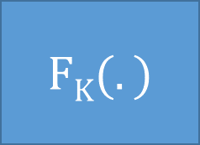
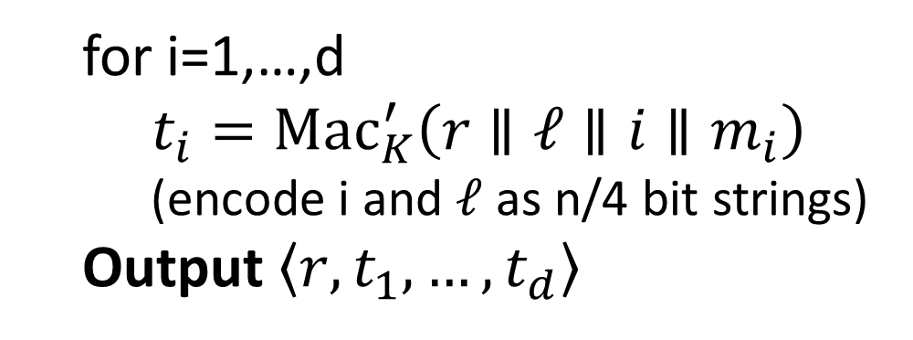


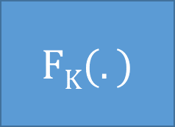








CBC-MAC
Caveat: Tricky Padding Issues arise if |m| is not a multiple of the block-length. See textbook.
We will see a simpler MAC construction using hash functions soon.
$$m_{1}$$
$$m_{2}$$
$$m_{3}$$
$${\left|m\right|}_{}$$
$$⨁$$
$$⨁$$
$$⨁$$
$$FK(.)$$
$$FK(.)$$
$$FK(.)$$
$$FK(.)$$
$$τ={Mac}_{K}\left(m\right)$$
Advantages over Previous Solution
Both MACs are secure
Works for unbounded length messages
Canonical Verification
Short Authentication tag
Parallelizable
for i=1,…,d
$t_{i}={Mac}_{K}^{′}\left(r∥ℓ∥i{∥m}_{i}\right)$
(encode i and $ℓ$ as n/4 bit strings)
Output $\left\langle r,t_{1},…,t_{d}\right\rangle$

Slide 6
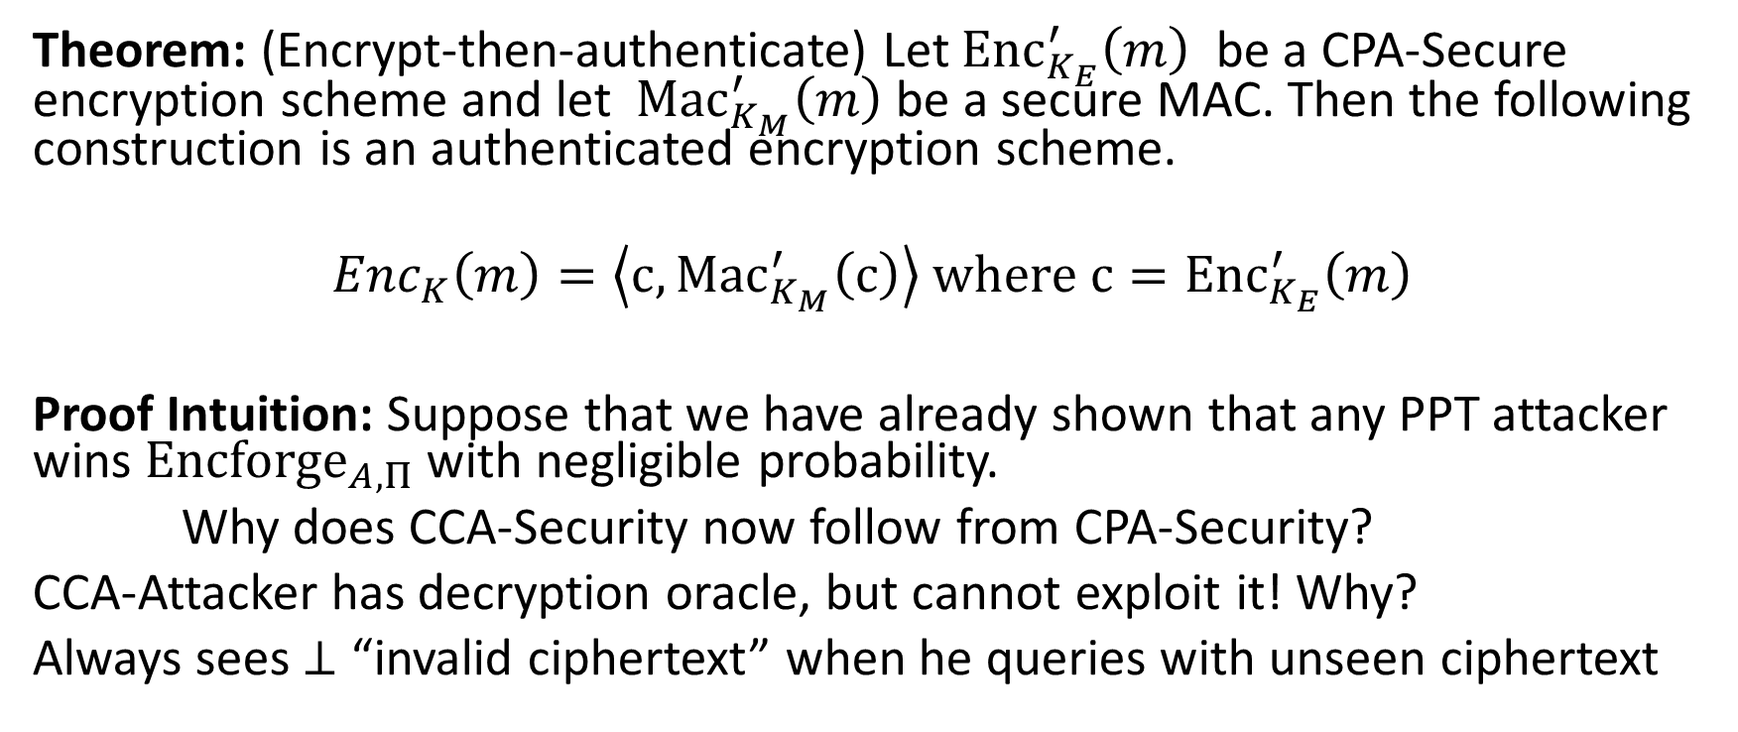
Building Authenticated Encryption
Theorem: (Encrypt-then-authenticate) Let ${Enc}_{K_{E}}^{′}\left(m\right)$ be a CPA-Secure encryption scheme and let ${Mac}_{K_{M}}^{′}\left(m\right)$ be a secure MAC. Then the following construction is an authenticated encryption scheme.
$${Enc}_{K}\left(m\right)=\left\langle c,{Mac}_{K_{M}}^{′}\left(c\right)\right\rangle where{ c=Enc}_{K_{E}}^{′}\left(m\right)$$
Proof Intuition: Suppose that we have already shown that any PPT attacker wins ${Encforge}_{A,Π}$ with negligible probability.
Why does CCA-Security now follow from CPA-Security?
CCA-Attacker has decryption oracle, but cannot exploit it! Why?
Always sees $⊥$ “invalid ciphertext” when he queries with unseen ciphertext

Slide 7
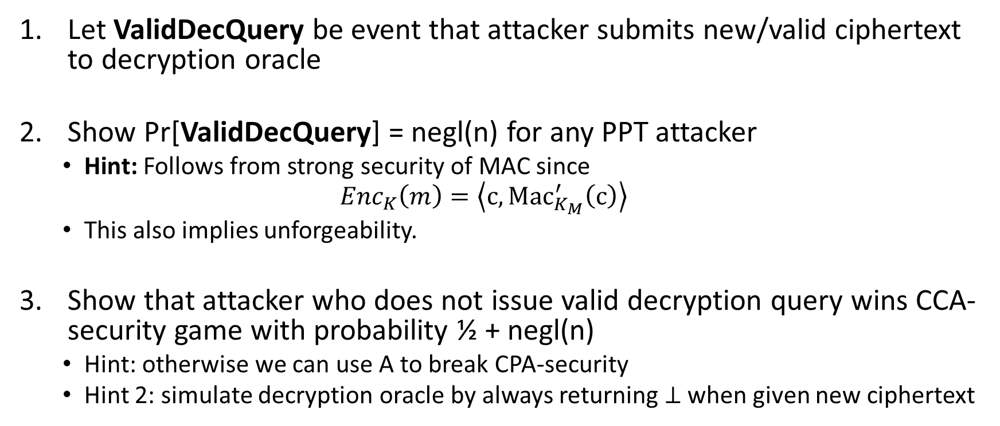
Proof Sketch
Let ValidDecQuery be event that attacker submits new/valid ciphertext to decryption oracle
Show Pr[ValidDecQuery] = negl(n) for any PPT attacker
Hint: Follows from strong security of MAC since
$${Enc}_{K}\left(m\right)=\left\langle c,{Mac}_{K_{M}}^{′}\left(c\right)\right\rangle$$
This also implies unforgeability.
Show that attacker who does not issue valid decryption query wins CCA-security game with probability ½ + negl(n)
Hint: otherwise we can use A to break CPA-security
Hint 2: simulate decryption oracle by always returning $⊥$ when given new ciphertext

Slide 8
Secure Communication Session
Solution? Alice transmits c₁ = Enc_{K}(m₁) to Bob, who decrypts and sends Alice c₂ = Enc_{K}(m₂) etc…
Authenticated Encryption scheme is
Stateless
For fixed length-messages
We still need to worry about
Re-ordering attacks
Alice sends 2n-bit message to Bob as c₁ = Enc_{K}(m₁), c₂ = Enc_{K}(m₂)
Replay Attacks
Attacker who intercepts message c₁ = Enc_{K}(m₁) can replay this message later in the conversation
Reflection Attack
Attacker intercepts message c₁ = Enc_{K}(m₁) sent from Alice to Bob and replays to c₁ Alice only

Slide 9
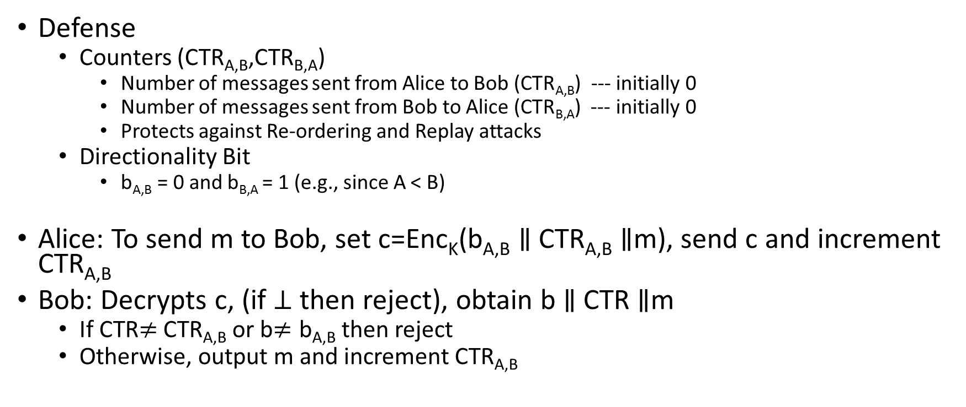
Secure Communication Session
Defense
Counters (CTR_{A,B},CTR_{B,A})
Number of messages sent from Alice to Bob (CTR_{A,B}) --- initially 0
Number of messages sent from Bob to Alice (CTR_{B,A}) --- initially 0
Protects against Re-ordering and Replay attacks
Directionality Bit
b_{A,B} = 0 and b_{B,A} = 1 (e.g., since A < B)
Alice: To send m to Bob, set c=Enc_{K}(b_{A,B} $∥$ CTR_{A,B} $∥$m), send c and increment CTR_{A,B}
Bob: Decrypts c, (if $⊥$ then reject), obtain b $∥$ CTR $∥$m
If CTR$≠$CTR_{A,B} or b$≠\text{b}\text{A}\text{,}\text{B}$ then reject
Otherwise, output m and increment CTR_{A,B}

Slide 10
Authenticated Security vs CCA-Security
Authenticated Encryption → CCA-Security (by definition)
CCA-Security does not necessarily imply Authenticate Encryption
But most natural CCA-Secure constructions are also Authenticated Encryption Schemes
Some constructions are CCA-Secure, but do not provide Authenticated Encryptions, but they are less efficient.
Conceptual Distinction
CCA-Security the goal is secrecy (hide message from active adversary)
Authenticated Encryption: the goal is integrity + secrecy

Slide 11
Week 5: Topic 1: Cryptographic Hash Functions

Slide 12
Hash Functions
H(x)=y
Long Input: x
Short Output: y

Slide 13
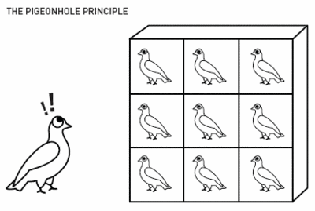
Pigeonhole Principle
“You cannot fit 10 pigeons into 9 pigeonholes”

Slide 14
Hash Collisions
By Pigeonhole Principle there must exist x and y s.t.
H(x) = H(y)

Slide 15
Classical Hash Function Applications
Hash Tables
O(1) lookup*
“Good hash function” should yield “few collisions”
* Certain terms and conditions apply

Slide 16
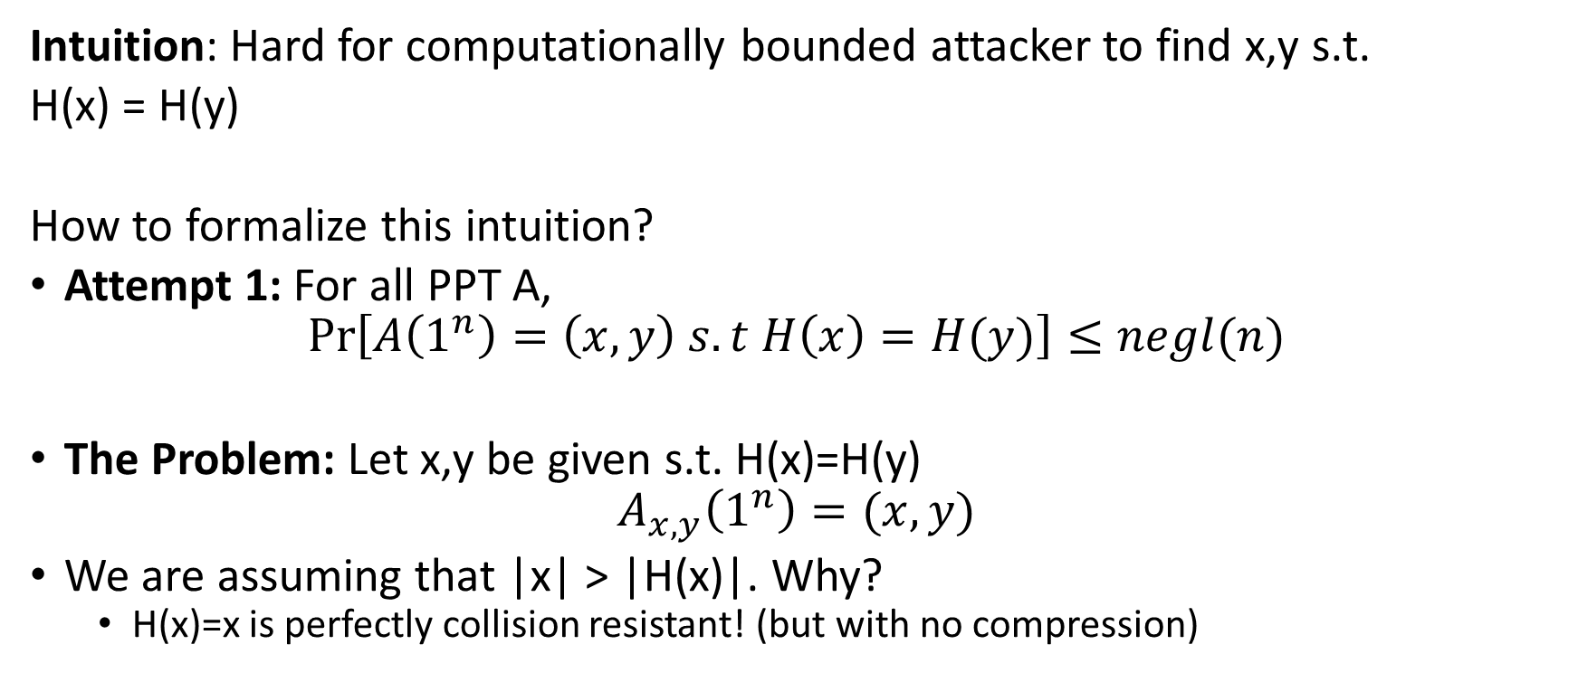
Collision-Resistant Hash Function
Intuition: Hard for computationally bounded attacker to find x,y s.t.
H(x) = H(y)
How to formalize this intuition?
Attempt 1: For all PPT A,
$$Pr\left[A\left(1^{n}\right)=\left(x,y\right) s.t H\left(x\right)=H(y)\right]≤negl(n)$$
The Problem: Let x,y be given s.t. H(x)=H(y)
$$A_{x,y}\left(1^{n}\right)=(x,y)$$
We are assuming that |x| > |H(x)|. Why?
H(x)=x is perfectly collision resistant! (but with no compression)

Slide 17
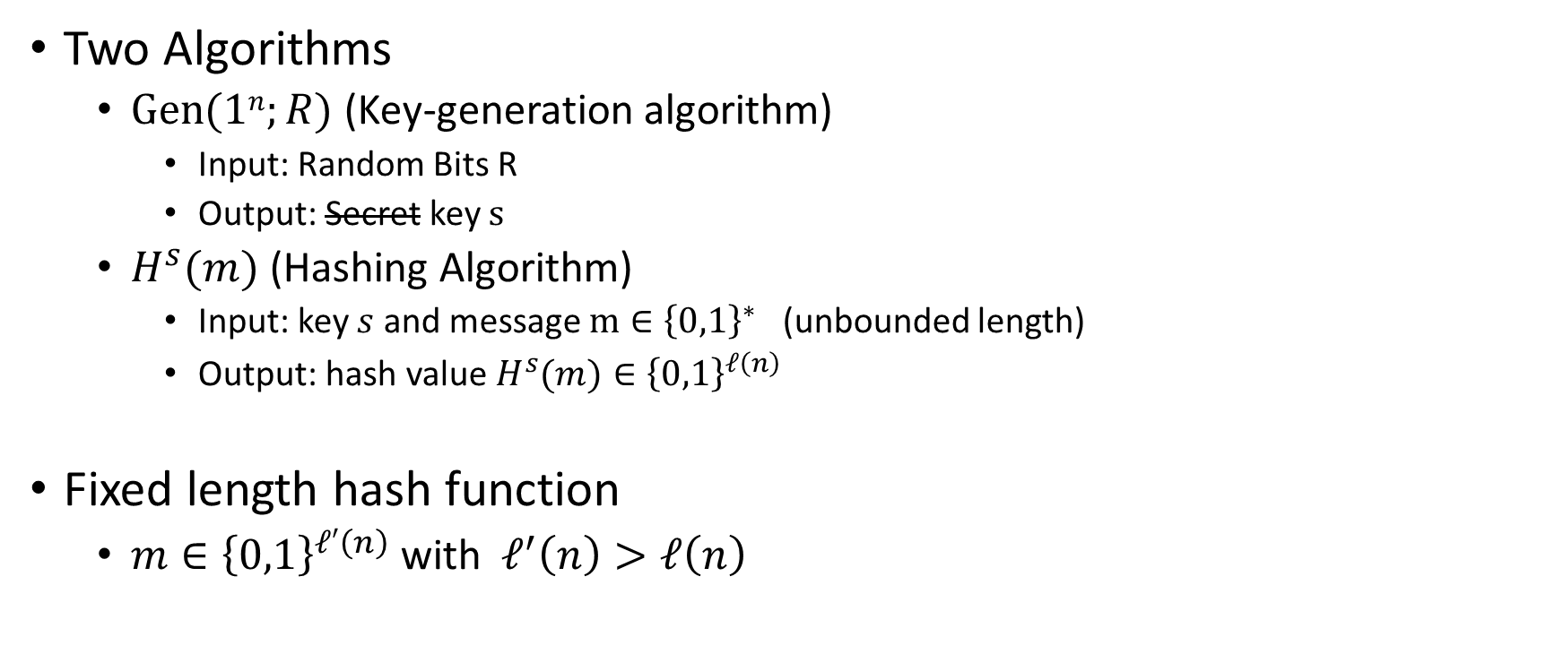
Keyed Hash Function Syntax
Two Algorithms
$\operatorname{Gen}{(1n;R)}$ (Key-generation algorithm)
Input: Random Bits R
Output: Secret key $s$
$H^{s}{(m)}$ (Hashing Algorithm)
Input: key $s$ and message $m∈{\left\{0,1\right\}}^{∗}$ (unbounded length)
Output: hash value${ H}^{s}{(m)}∈{\left\{0,1\right\}}^{ℓ\left(n\right)}$
Fixed length hash function
$m∈{\left\{0,1\right\}}^{ℓ′\left(n\right)}$ with$ℓ^{′}\left(n\right)>ℓ\left(n\right)$

Slide 18


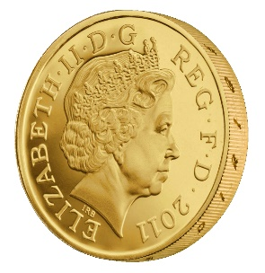



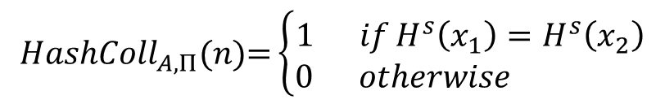
Collision Experiment (${HashColl}_{A,Π}(n)$)
s
x₁,x₂
$${HashColl}_{A,Π}(n)\text{=}\left\{\begin{aligned}1 ifH^{s}\left(x_{1}\right)=H^{s}\left(x_{2}\right) \\ 0 otherwise \end{aligned}\right.$$
$$s=Gen{(1n;R)}$$
Definition: (Gen,H) is a collision resistant hash function if
$$∀PPT A ∃μ (negligible) s.t$$
$$Pr\left[{HashColl}_{A,Π}(n)\text{=}1\right]≤μ(n)$$

Slide 19
Collision Experiment (${HashColl}_{A,Π}(n)$)
For simplicity we will sometimes just say that H (or H^{s}) is a collision resistant hash function
s
Key is not key secret (just random)
x₁,x₂
$${HashColl}_{A,Π}(n)\text{=}\left\{\begin{aligned}1 ifH^{s}\left(x_{1}\right)=H^{s}\left(x_{2}\right) \\ 0 otherwise \end{aligned}\right.$$
$$s=Gen{(1n;R)}$$
Definition: (Gen,H) is a collision resistant hash function if
$$∀PPT A ∃μ (negligible) s.t$$
$$Pr\left[{HashColl}_{A,Π}(n)\text{=}1\right]≤μ(n)$$

Slide 20
Theory vs Practice
Most cryptographic hash functions used in practice are un-keyed
Examples: MD5, SHA1, SHA2, SHA3
Tricky to formally define collision resistance for keyless hash function
There is a PPT algorithm to find collisions
We just usually can’t find this algorithm ☺

Slide 21
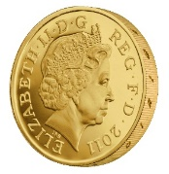
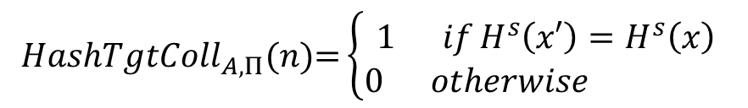

Weaker Requirements for Cryptographic Hash
Target-Collision Resistance
s,x
x’
$${HashTgtColl}_{A,Π}(n)\text{=}\left\{\begin{aligned}1 ifH^{s}\left(x′\right)=H^{s}\left(x\right) \\ 0 otherwise \end{aligned}\right.$$
$$s=Gen{(1n;R)}$$
$${x∈\left\{0,1\right\}}^{n}$$
Question: Why is collision resistance stronger?

Slide 22
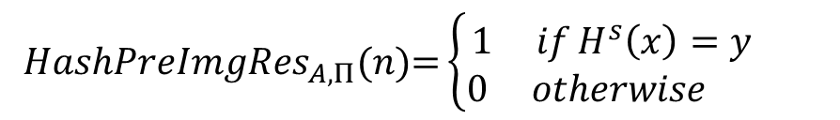

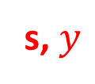

Weaker Requirements for Cryptographic Hash
Preimage Resistance (One-Wayness)
s, $y$
$$\text{x}$$
$${HashPreImgRes}_{A,Π}(n)\text{=}\left\{\begin{aligned}1 ifH^{s}\left(x\right)=y \\ 0 otherwise \end{aligned}\right.$$
$$s=Gen{(1n;R)}$$
$${y∈\left\{0,1\right\}}^{ℓ(n)}$$
Question: Why is collision resistance stronger?

Slide 23
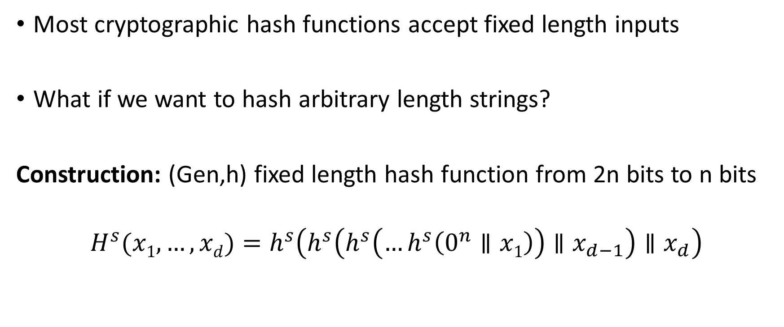
Merkle-Damgård Transform
Most cryptographic hash functions accept fixed length inputs
What if we want to hash arbitrary length strings?
Construction: (Gen,h) fixed length hash function from 2n bits to n bits
$$H^{s}{(x1,…,xd)}=h^{s}\left(h^{s}\left(h^{s}\left(…h^{s}\left(0^{n}∥x1\right)\right)∥x_{d−1}\right)∥x_{d}\right)$$

Slide 24
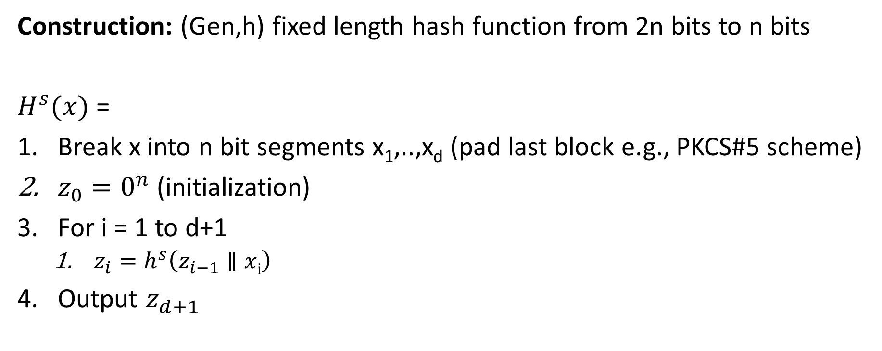
Merkle-Damgård Transform
Construction: (Gen,h) fixed length hash function from 2n bits to n bits
$H^{s}{(x)}$ =
Break x into n bit segments x₁,..,x_{d} (pad last block e.g., PKCS#5 scheme)
$z_{0}=0^{n}$ (initialization)
For i = 1 to d+1
$z_{i}=h^{s}\left(z_{i−1}∥xi\right)$
Output $z_{d+1}$

Slide 25
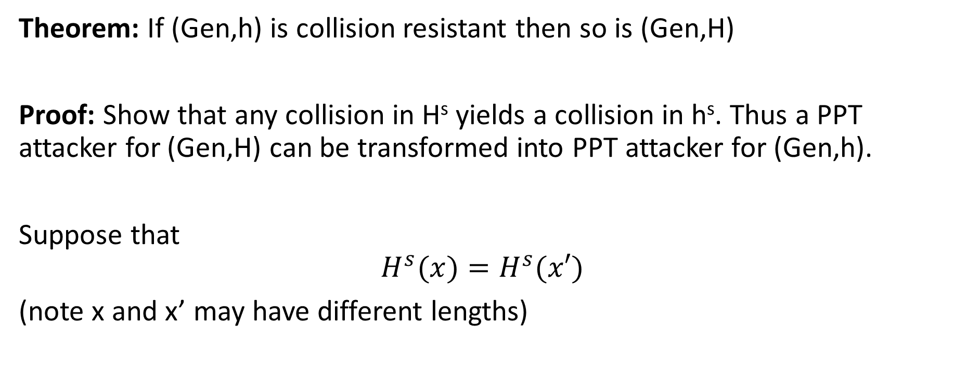
Merkle-Damgård Transform
Theorem: If (Gen,h) is collision resistant then so is (Gen,H)
Proof: Show that any collision in H^{s} yields a collision in h^{s}. Thus a PPT attacker for (Gen,H) can be transformed into PPT attacker for (Gen,h).
Suppose that
$$H^{s}{(x)}=H^{s}{(x′)}$$
(note x and x’ may have different lengths)

Slide 26

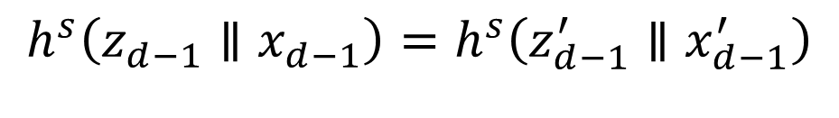
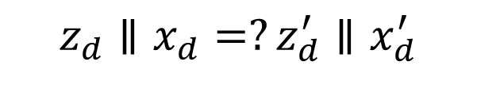
Merkle-Damgård Transform
Theorem: If (Gen,h) is collision resistant then so is (Gen,H)
Proof: Suppose that
$$H^{s}{(x)}=H^{s}{(x′)}$$
Case 1: |x|=|x’| (proof for case two is similar)
$${H^{s}{(x)}=z}_{d+1}=h^{s}\left(z_{d}∥x_{d}\right){=H}^{s}{(x′)}=z_{d+1}^{′}=h^{s}\left(z_{d}^{′}∥x_{d}^{′}\right)$$
$$z_{d}∥x_{d}=?z_{d}^{′}∥x_{d}^{′}$$
No → Found collision
Yes?
$$h^{s}\left(z_{d−1}∥x_{d−1}\right)=h^{s}\left(z_{d−1}^{′}∥x_{d−1}^{′}\right)$$

Slide 27
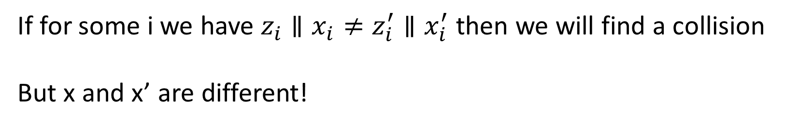

Merkle-Damgård Transform
Theorem: If (Gen,h) is collision resistant then so is (Gen,H)
Proof: Suppose that
$$H^{s}{(x)}=H^{s}{(x′)}$$
Case 1: |x|=|x’| (proof for case two is similar)
If for some i we have $z_{i}∥x_{i}≠z_{i}^{′}∥x_{i}^{′}$ then we will find a collision
But x and x’ are different!

Slide 28
Week 5: Topic 2: HMACs and Generic Attacks

Slide 29
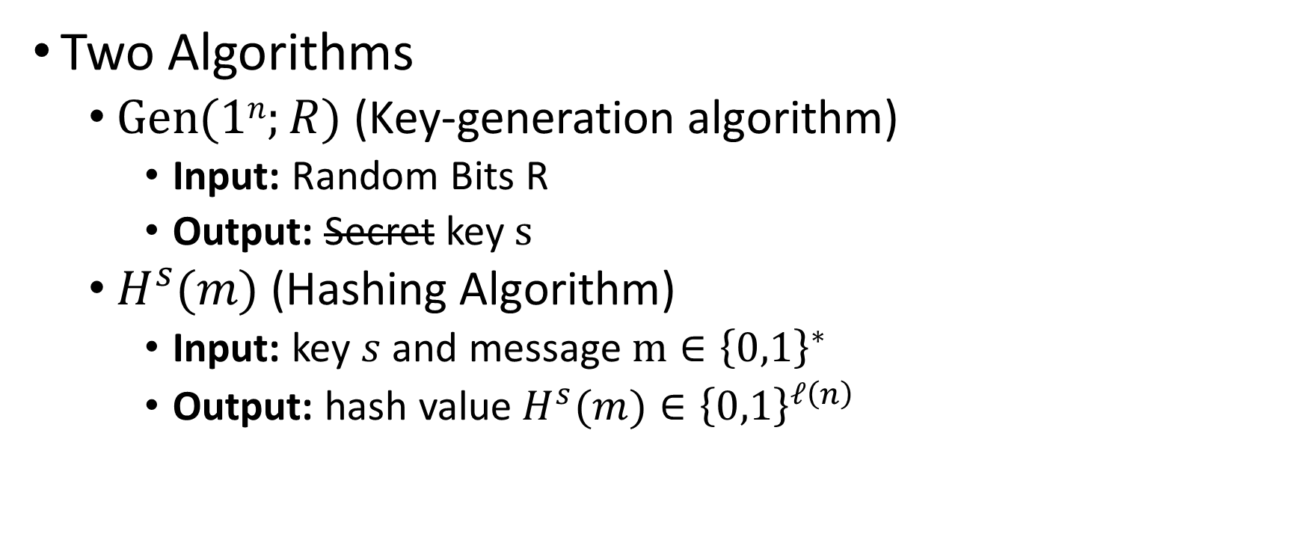
Keyed Hash Function Syntax
Two Algorithms
$\operatorname{Gen}{(1n;R)}$ (Key-generation algorithm)
Input: Random Bits R
Output: Secret key $s$
$H^{s}{(m)}$ (Hashing Algorithm)
Input: key $s$ and message $m∈{\left\{0,1\right\}}^{∗}$
Output: hash value${ H}^{s}{(m)}∈{\left\{0,1\right\}}^{ℓ\left(n\right)}$

Slide 30
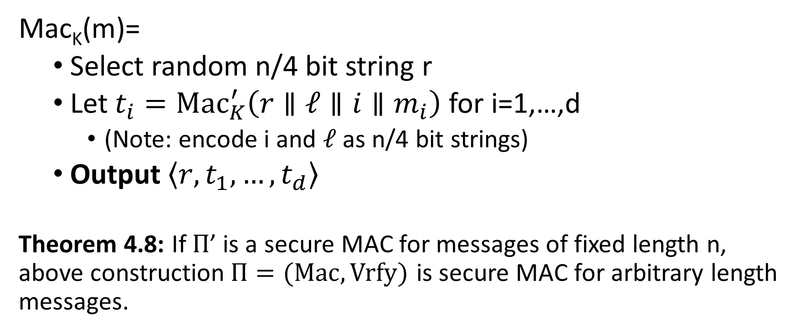
MACs for Arbitrary Length Messages
Mac_{K}(m)=
Select random n/4 bit string r
Let $t_{i}={Mac}_{K}^{′}\left(r∥ℓ∥i{∥m}_{i}\right)$ for i=1,…,d
(Note: encode i and $ℓ$ as n/4 bit strings)
Output $\left\langle r,t_{1},…,t_{d}\right\rangle$
Theorem 4.8: If $Π$’ is a secure MAC for messages of fixed length n, above construction$Π=(Mac,Vrfy)$ is secure MAC for arbitrary length messages.
Notes:
Disadvage for not using randomized construction.
1. This may not be a Strong-MAC.

Slide 31
MACs for Arbitrary Length Messages
Disadvantages: Lose Strong-MAC Guarantee
(Multiple valid MACs of same message)
Disadvantage 1: Long output
Mac_{K}(m)=
Select random n/4 bit string r
Let $t_{i}={Mac}_{K}^{′}\left(r∥ℓ∥i{∥m}_{i}\right)$ for i=1,…,d
(Note: encode i and $ℓ$ as n/4 bit strings)
Output $\left\langle r,t_{1},…,t_{d}\right\rangle$
Theorem 4.8: If $Π$’ is a secure MAC for messages of fixed length n, above construction$Π=(Mac,Vrfy)$ is secure MAC for arbitrary length messages.
Randomized Construction (no canonical verification). Disadvantage?
Notes:
Disadvage for not using randomized construction.
1. This may not be a Strong-MAC.

Slide 32
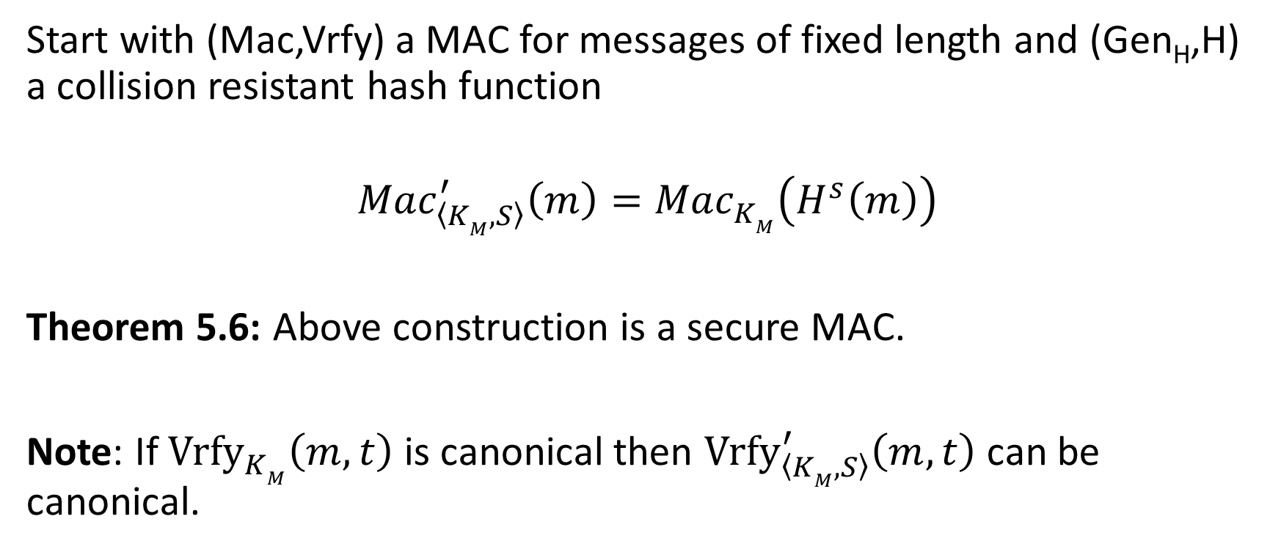
Hash and MAC Construction
Start with (Mac,Vrfy) a MAC for messages of fixed length and (Gen_{H},H) a collision resistant hash function
$${Mac}_{\left\langle KM,S\right\rangle }^{′}\left(m\right)={Mac}_{KM}^{}\left(H^{s}\left(m\right)\right)$$
Theorem 5.6: Above construction is a secure MAC.
Note: If ${Vrfy}_{KM}^{}\left(m,t\right)$ is canonical then ${Vrfy}_{\left\langle KM,S\right\rangle }^{′}\left(m,t\right)$ can be canonical.

Slide 33
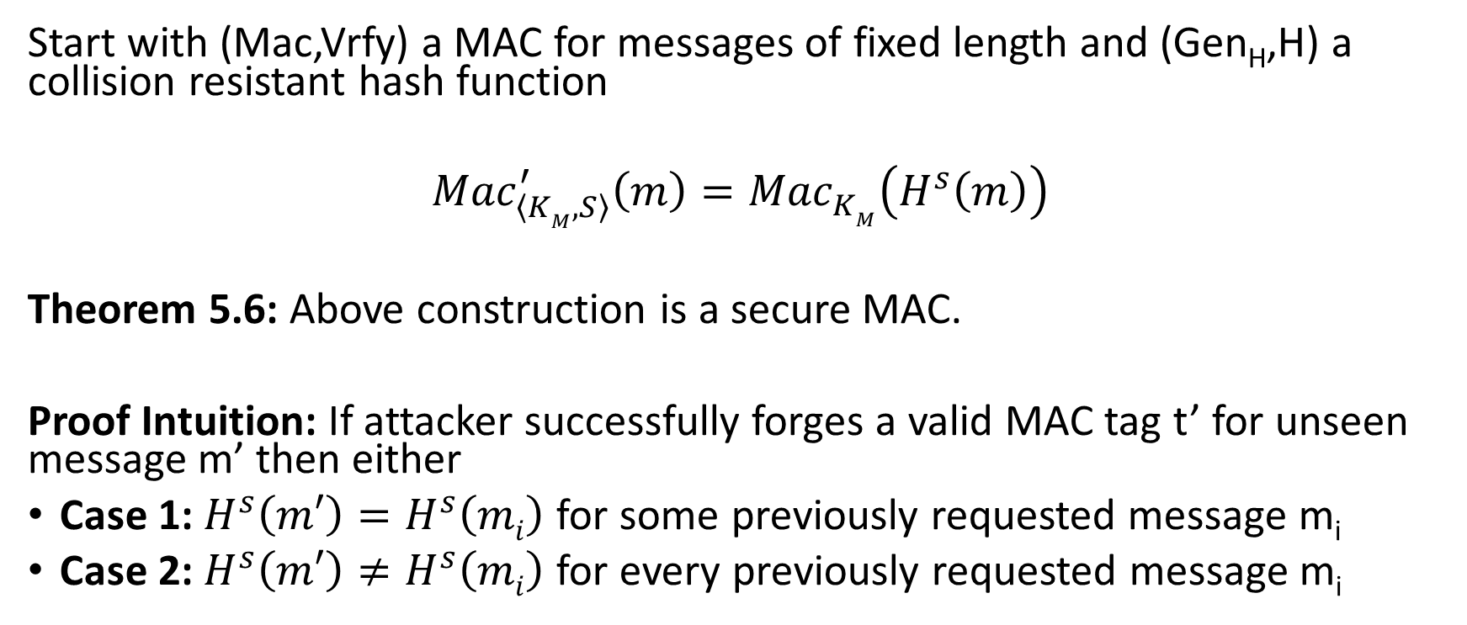
Hash and MAC Construction
Start with (Mac,Vrfy) a MAC for messages of fixed length and (Gen_{H},H) a collision resistant hash function
$${Mac}_{\left\langle KM,S\right\rangle }^{′}\left(m\right)={Mac}_{KM}^{}\left(H^{s}\left(m\right)\right)$$
Theorem 5.6: Above construction is a secure MAC.
Proof Intuition: If attacker successfully forges a valid MAC tag t’ for unseen message m’ then either
Case 1: $H^{s}\left(m′\right)=H^{s}\left(mi\right)$ for some previously requested message m_{i}
Case 2: $H^{s}\left(m′\right)≠H^{s}\left(mi\right)$ for every previously requested message m_{i}

Slide 34
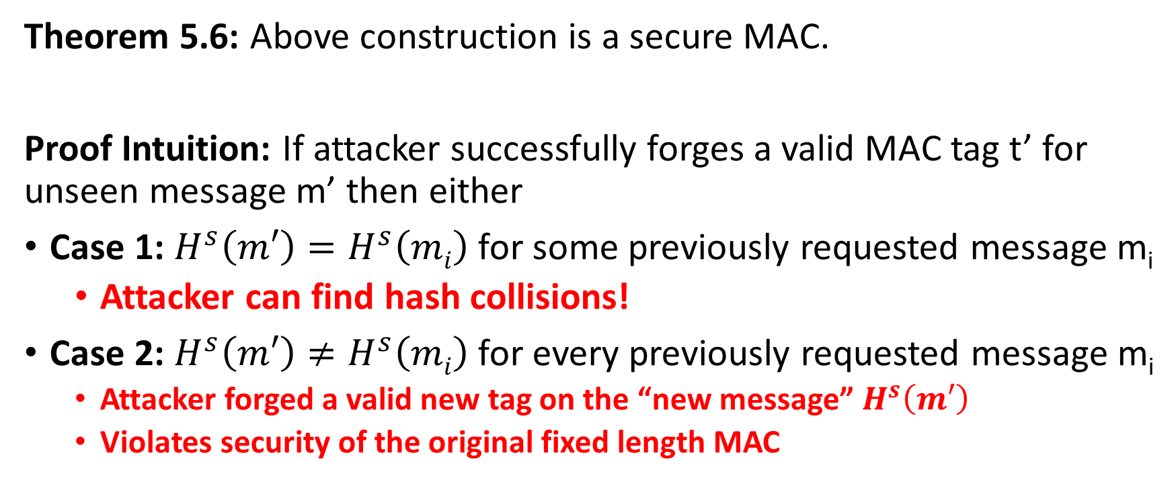
Hash and MAC Construction
Theorem 5.6: Above construction is a secure MAC.
Proof Intuition: If attacker successfully forges a valid MAC tag t’ for unseen message m’ then either
Case 1: $H^{s}\left(m′\right)=H^{s}\left(mi\right)$ for some previously requested message m_{i}
Attacker can find hash collisions!
Case 2: $H^{s}\left(m′\right)≠H^{s}\left(mi\right)$ for every previously requested message m_{i}
Attacker forged a valid new tag on the “new message” $H^{s}\left(m′\right)$
Violates security of the original fixed length MAC

Slide 35
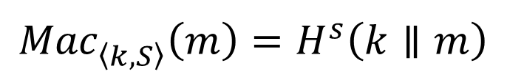
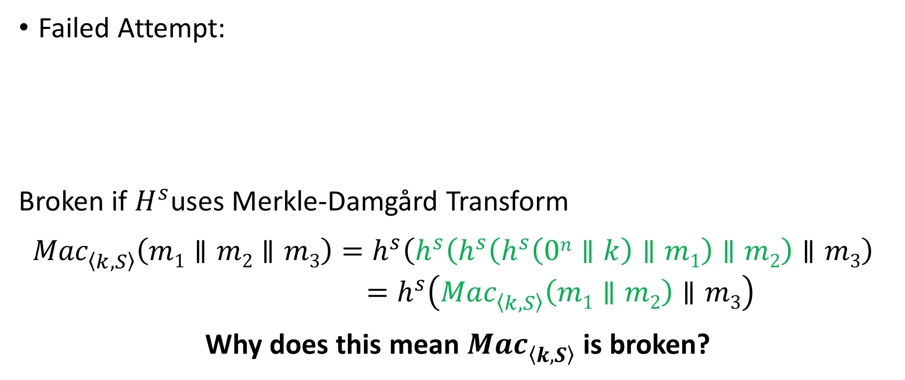
MAC from Collision Resistant Hash
Failed Attempt:
Broken if $H^{s}$uses Merkle-Damgård Transform
${Mac}_{\left\langle k,S\right\rangle }^{}\left(m1∥m2∥m3\right)=h^{s}\left(h^{s}\left(h^{s}\left(h^{s}\left(0n∥k\right)∥m1\right)∥m2\right)∥m3\right)$
$$=h^{s}\left({Mac}_{\left\langle k,S\right\rangle }^{}\left(m1∥m2\right)∥m3\right)$$
Why does this mean ${Mac}_{\left\langle k,S\right\rangle }^{}$ is broken?
$${Mac}_{\left\langle k,S\right\rangle }^{}\left(m\right)=H^{s}\left(k∥m\right)$$

Slide 36


HMAC
$${Mac}_{\left\langle k,S\right\rangle }^{}\left(m\right)=H^{s}\left(\left(k⨁opad\right)∥H^{s}\left(\left(k⨁ipad\right)∥m\right)\right)$$
$$ipad?$$
Notes:
Bad joke, I know…

Slide 37
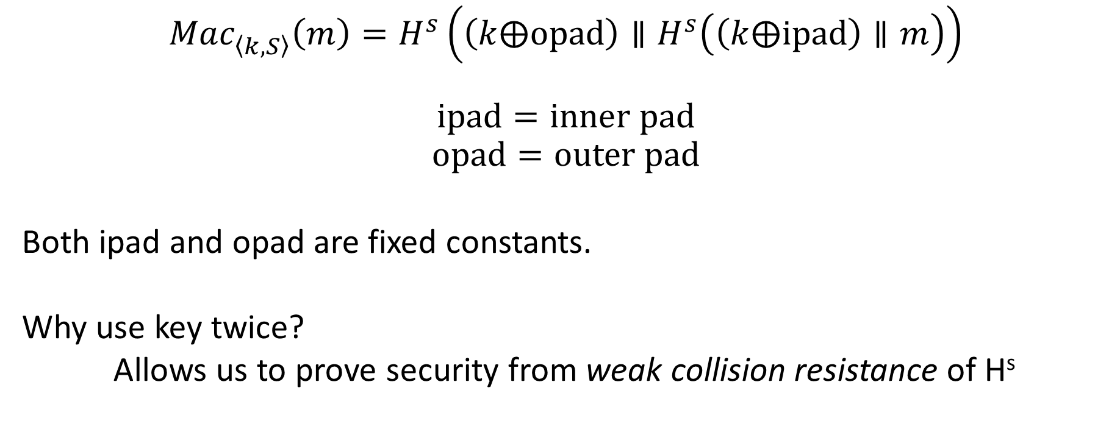
HMAC
$${Mac}_{\left\langle k,S\right\rangle }^{}\left(m\right)=H^{s}\left(\left(k⨁opad\right)∥H^{s}\left(\left(k⨁ipad\right)∥m\right)\right)$$
$$ipad=inner pad$$
$$opad=outer pad$$
Both ipad and opad are fixed constants.
Why use key twice?
Allows us to prove security from weak collision resistance of H^{s}
Notes:
Bad joke, I know…

Slide 38
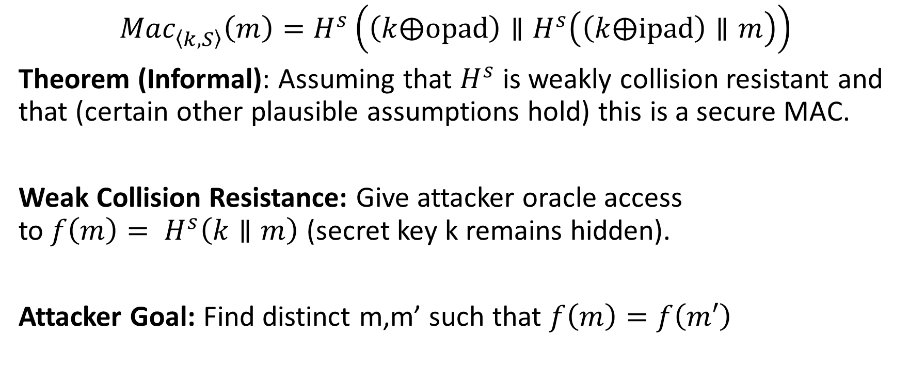
HMAC Security
$${Mac}_{\left\langle k,S\right\rangle }^{}\left(m\right)=H^{s}\left(\left(k⨁opad\right)∥H^{s}\left(\left(k⨁ipad\right)∥m\right)\right)$$
Theorem (Informal): Assuming that $H^{s}$ is weakly collision resistant and that (certain other plausible assumptions hold) this is a secure MAC.
Weak Collision Resistance: Give attacker oracle access to${ f\left(m\right)= H}^{s}\left(k∥m\right)$ (secret key k remains hidden).
Attacker Goal: Find distinct m,m’ such that $f\left(m\right)=f\left(m′\right)$

Slide 39
HMAC in Practice
MD5 can no longer be viewed as collision resistant
However, HMAC-MD5 remained unbroken after MD5 was broken
Gave developers time to replace HMAC-MD5
Nevertheless, don’t use HMAC-MD5!
HMAC-SHA1 still seems to be okay (temporarily), despite collision
HMAC is efficient and unbroken
CBC-MAC was not widely deployed because it as “too slow”
Instead practitioners often used heuristic constructions (which were breakable)

Slide 40

Finding Collisions
Can we do better?
Ideal Hashing Algorithm
Random function H from {0,1}* to {0,1}$ℓ$
Suppose attacker has oracle access to H(.)
Attack 1: Evaluate H(.) on 2$ℓ$+1 distinct inputs.

Slide 41
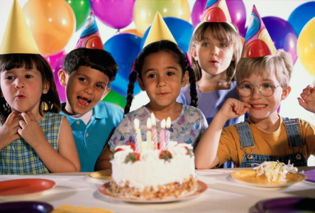
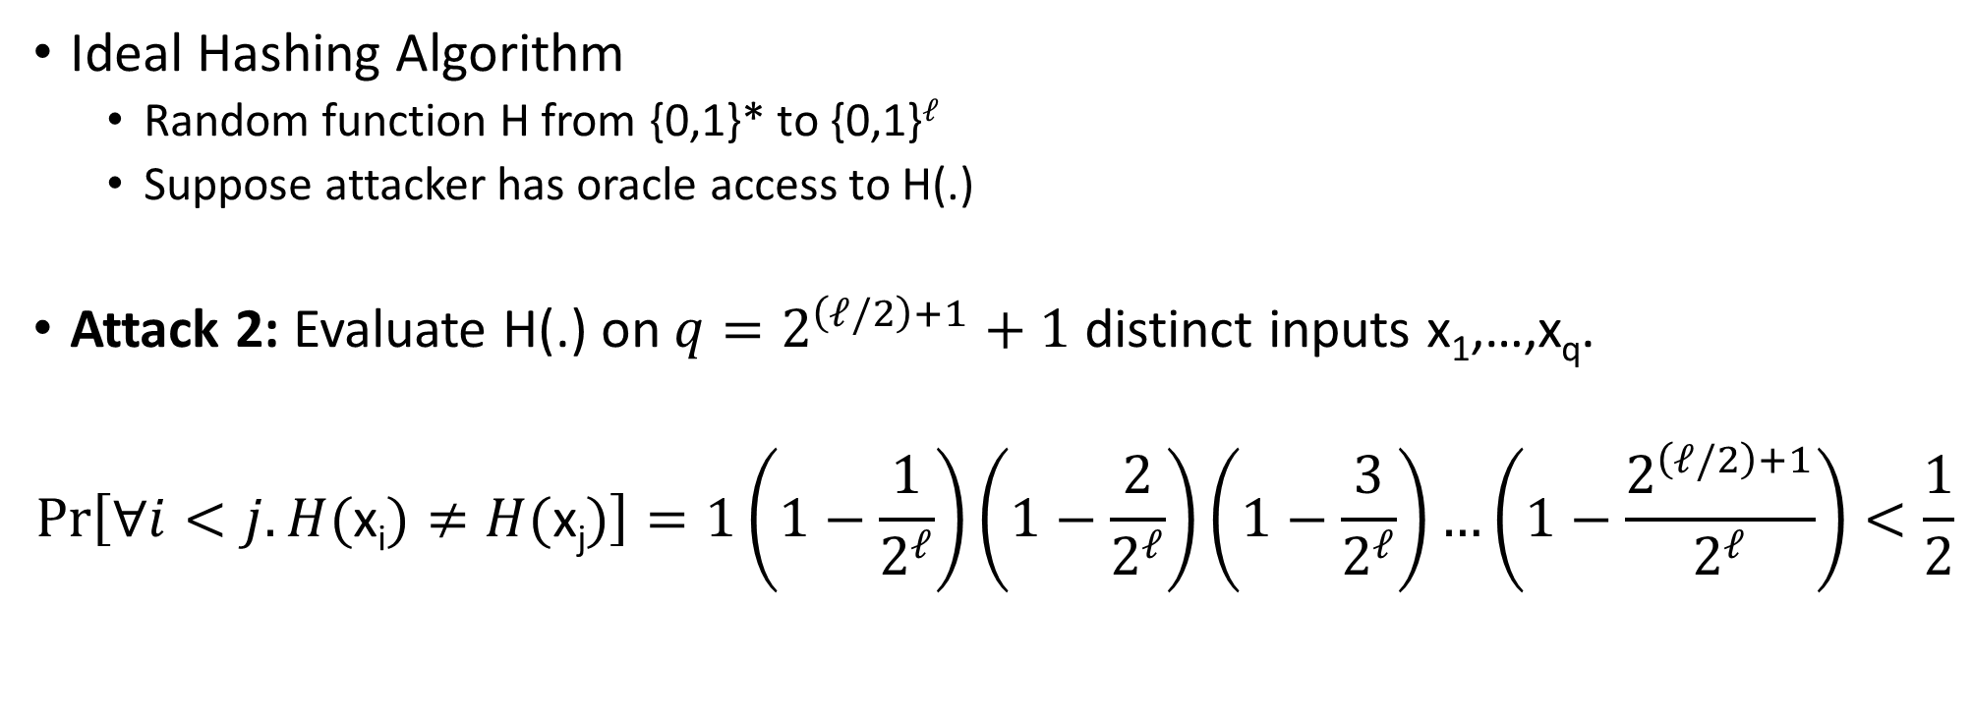
Birthday Attack for Finding Collisions
Ideal Hashing Algorithm
Random function H from {0,1}* to {0,1}$ℓ$
Suppose attacker has oracle access to H(.)
Attack 2: Evaluate H(.) on ${q=2}^{\left(ℓ/2\right)+1}+1$ distinct inputs x₁,…,x_{q}.
$$Pr\left[∀i<j. H(\text{x}\text{i})≠H(\text{x}\text{j})\right]=1\left(1−\frac{1}{2^{ℓ}}\right)\left(1−\frac{2}{2^{ℓ}}\right)\left(1−\frac{3}{2^{ℓ}}\right)…\left(1−\frac{2^{\left(ℓ/2\right)+1}}{2^{ℓ}}\right)<\frac{1}{2}$$

Slide 42
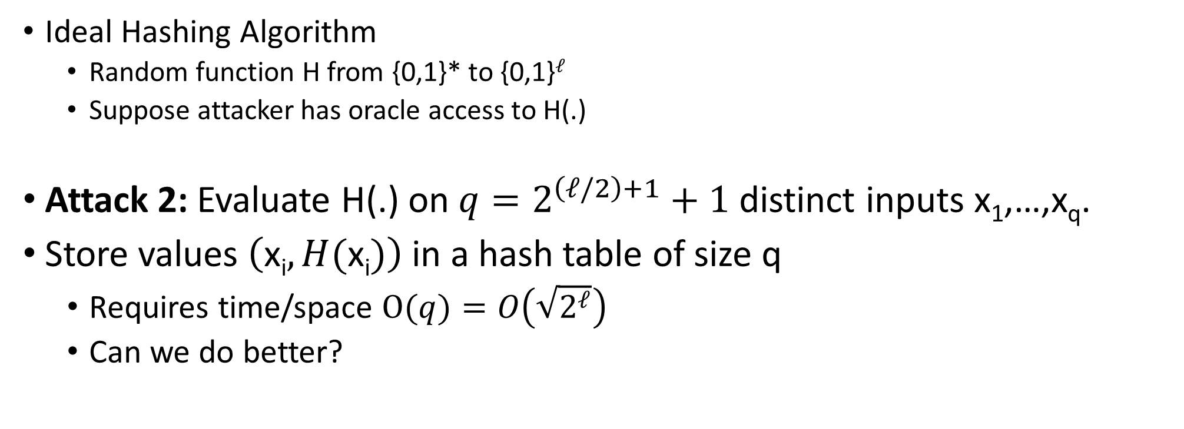
Birthday Attack for Finding Collisions
Ideal Hashing Algorithm
Random function H from {0,1}* to {0,1}$ℓ$
Suppose attacker has oracle access to H(.)
Attack 2: Evaluate H(.) on ${q=2}^{\left(ℓ/2\right)+1}+1$ distinct inputs x₁,…,x_{q}.
Store values $\left(\text{x}\text{i},H(\text{x}\text{i})\right)$ in a hash table of size q
Requires time/space $\text{O}(q)=O\left(\sqrt{2^{ℓ}}\right)$
Can we do better?

Slide 43
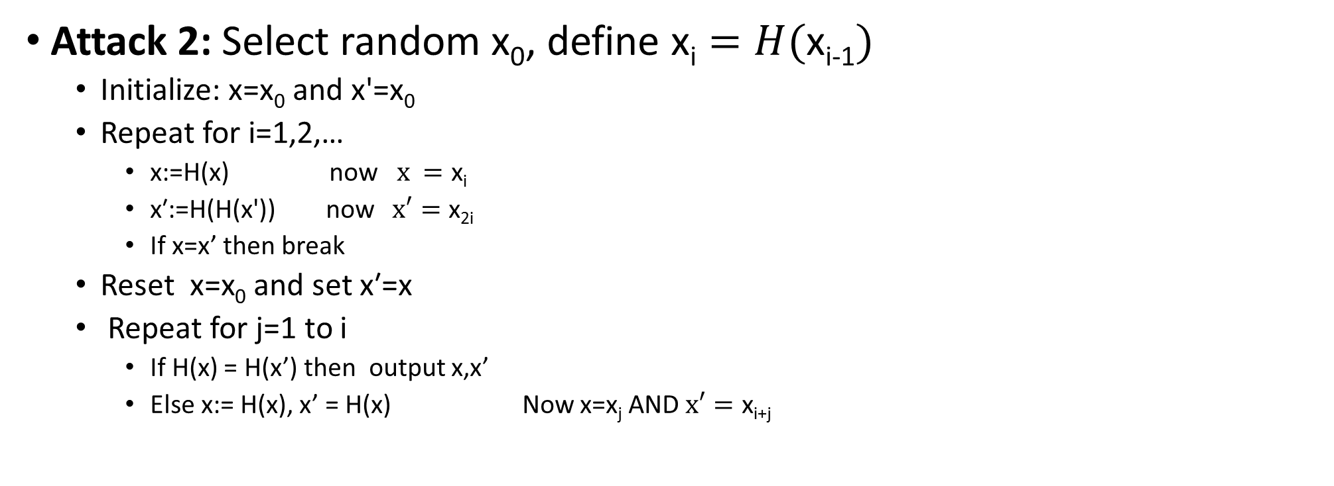
Small Space Birthday Attack
Attack 2: Select random $\text{x}\text{0}$, define $\text{x}\text{i}=H(\text{x}\text{i}\text{−1})$
$\text{Initialize}\text{: }\text{x}\text{=}\text{x}\text{0}$ and $\text{x}\text{′}\text{=}\text{x}\text{0}$
Repeat for i=1,2,…
$\text{x}\text{:}\text{=}\text{H}\text{(}\text{x}\text{) }\text{now} x =\text{x}\text{i}$
$\text{x}\text{′:=}\text{H}\text{(}\text{H}\text{(}\text{x}\text{′))}$ now $x′=\text{x}\text{2}\text{i}$
If x=x’ then break
$\text{Reset} \text{x}\text{=}\text{x}\text{0}$ and set $\text{x}\text{′=}\text{x}$
Repeat for j=1 to i
If H(x) = H(x’) then output x,x’
Else x:= H(x), x’ = H(x) Now x=$\text{x}\text{j}$ AND $x′=\text{x}\text{i}\text{+}\text{j}$

Slide 44
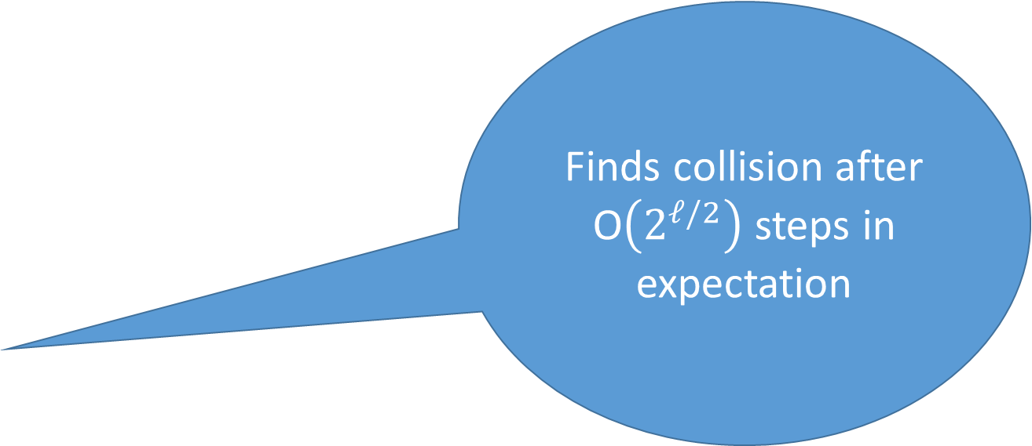
Small Space Birthday Attack
Finds collision after O$\left(2^{ℓ/2}\right)$steps in expectation
Attack 2: Select random $\text{x}\text{0}$, define $\text{x}\text{i}=H(\text{x}\text{i}\text{−1})$
$\text{Initialize}\text{: }\text{x}\text{=}\text{x}\text{0}$ and $\text{x}\text{′}\text{=}\text{x}\text{0}$
Repeat for i=1,2,…
$\text{x}\text{:}\text{=}\text{H}\text{(}\text{x}\text{) }\text{now} x =\text{x}\text{i}$
$\text{x}\text{′:=}\text{H}\text{(}\text{H}\text{(}\text{x}\text{′))}$ now $x′=\text{x}\text{2}\text{i}$
If x=x’ then break
$\text{Reset} \text{x}\text{=}\text{x}\text{0}$ and set $\text{x}\text{′=}\text{x}$
Repeat for j=1 to i
If H(x) = H(x’) then output x,x’
Else x:= H(x), x’ = H(x) Now x=$\text{x}\text{j}$ AND $x′=\text{x}\text{i}\text{+}\text{j}$
Notes:
Let j denote the length of the chain before the cycle starts (3) in the example and let c denote the length of the cycle
Let c denote length of cycle and suppose that x_{2i} = x_i then we have 2i-j=i-j mod c. Implies that 2i=c+i.
We have h(x_{j-1}) = h(x_{j+c-1}),
X reaches x_{j-1} in j-1 steps and x’ reaches x_{j+c-1}=x_{j+2c-1} in j-1 – steps (since we start at j)

Slide 45
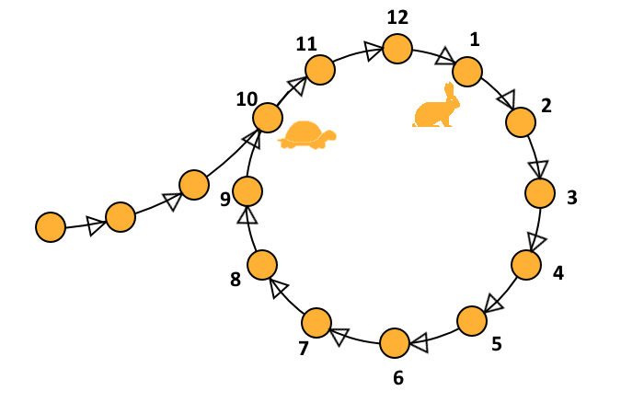
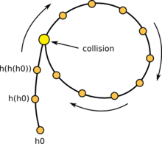
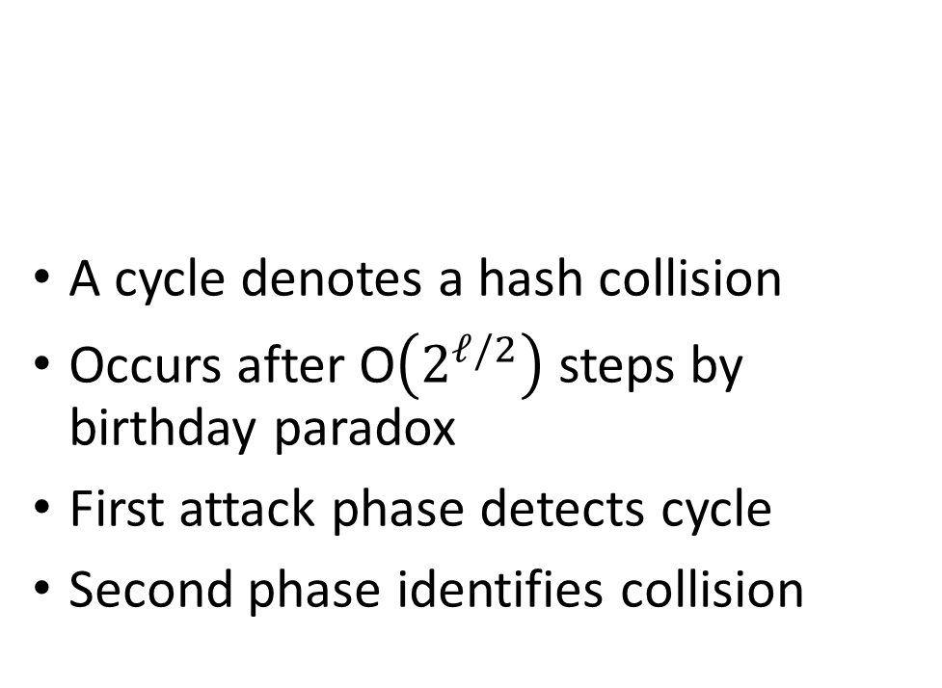
Floyd’s Cycle Finding Algorithm
A cycle denotes a hash collision
Occurs after O$\left(2^{ℓ/2}\right)$ steps by birthday paradox
First attack phase detects cycle
Second phase identifies collision
Analogy: Cycle detection in linked list
Can traverse “linked list” by computing H
Notes:
Let j denote the length of the chain before the cycle starts (3) in the example and let c denote the length of the cycle
Let c denote length of cycle and suppose that x_{2i} = x_i then we have 2i-j=i-j mod c. Implies that 2i=c+i.
We have h(x_{j-1}) = h(x_{j+c-1}),
X reaches x_{j-1} in j-1 steps and x’ reaches x_{j+c-1}=x_{j+2c-1} in j-1 – steps (since we start at j)

Slide 46
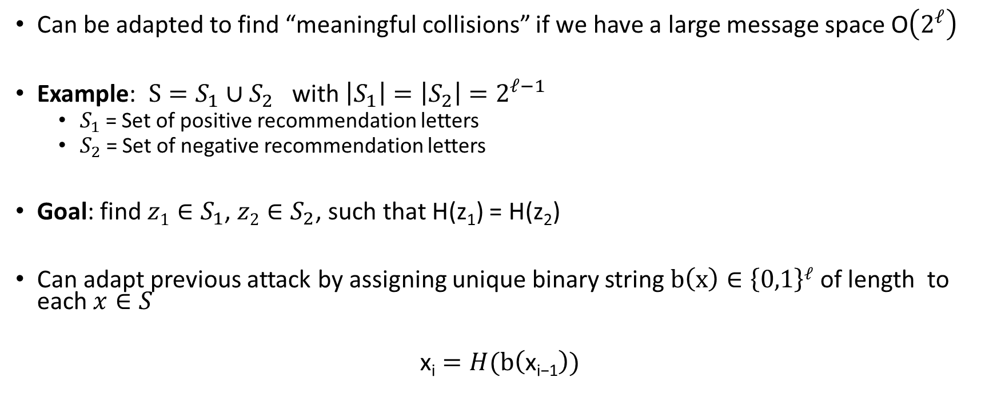
Small Space Birthday Attack
Can be adapted to find “meaningful collisions” if we have a large message space O$\left(2^{ℓ}\right)$
Example: $S=S_{1}∪S_{2}$ with $\left|S_{1}\right|=\left|S_{2}\right|=2^{ℓ−1}$
$S_{1}$ = Set of positive recommendation letters
$S_{2}$ = Set of negative recommendation letters
Goal: find ${z1∈S}_{1}$, ${z2∈S}_{2}$, such that H(z₁) = H(z₂)
Can adapt previous attack by assigning unique binary string $b\left(x\right)∈\left\{0,1\right\}ℓ$ of length to each $x∈S$
$$\text{x}\text{i}=H(\text{b}\left(\text{x}\text{i}\text{−1}\right))$$

Slide 47
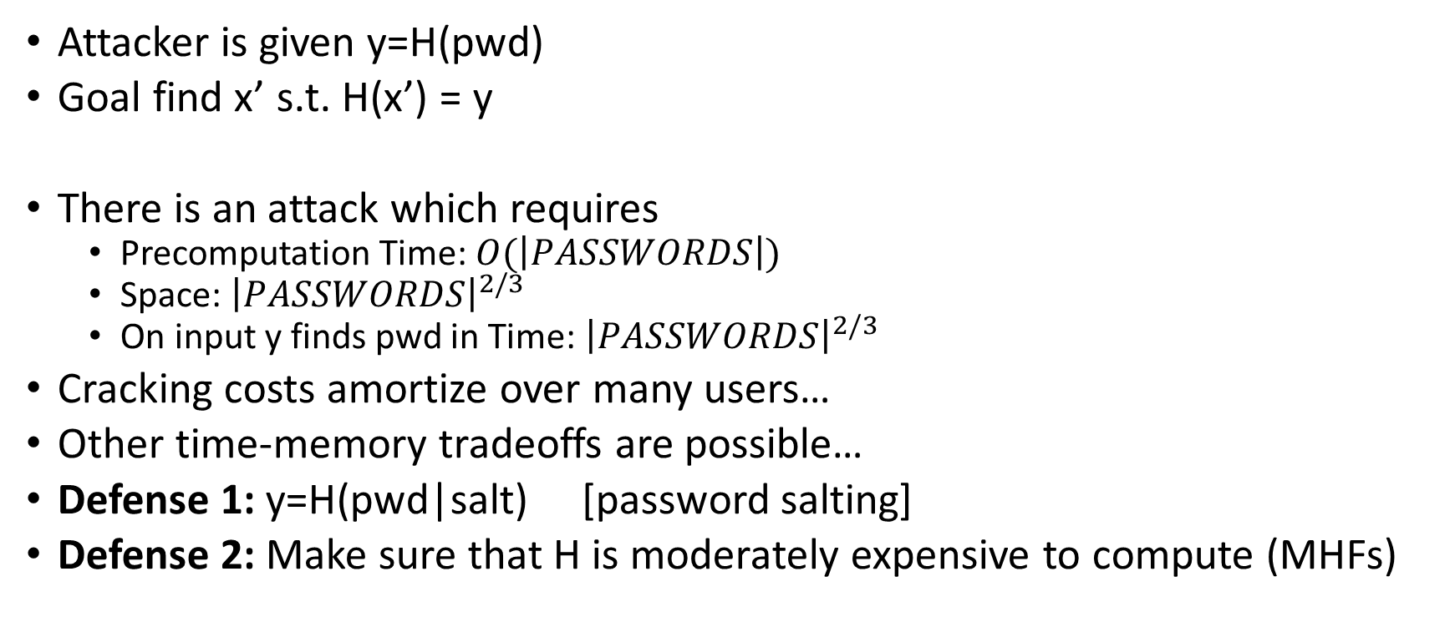
Targeted Collision (e.g., Password Cracking)
Attacker is given y=H(pwd)
Goal find x’ s.t. H(x’) = y
There is an attack which requires
Precomputation Time: $O(\left|PASSWORDS\right|)$
Space: ${\left|PASSWORDS\right|}^{2/3}$
On input y finds pwd in Time:${ \left|PASSWORDS\right|}^{2/3}$
Cracking costs amortize over many users…
Other time-memory tradeoffs are possible…
Defense 1: y=H(pwd|salt) [password salting]
Defense 2: Make sure that H is moderately expensive to compute (MHFs)
Notes:
Expected number of j’s such that EP_{j}=y_{i} is s/2$ℓ$

Slide 48


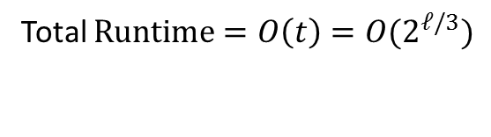


Targeted Collision (e.g., Password Cracking)
Attacker is given y=H(x)
Goal find x’ s.t. H(x’) = y
Precomputation (sketch)
Store $s=2^{ℓ/3}$ pairs $\left(\text{S}\text{P}\text{i}\text{,}\text{E}\text{P}\text{i}\right)$ where$\text{EP}\text{i}=H^{t}\left(\text{SP}\text{i}\right)$ and t = $2^{ℓ/3}$
Let y=y₀
For i=1,2…., $2^{ℓ/3}$
$\text{y}\text{i}=H(\text{y}\text{i}\text{−1})$
For each j s.t EP_{j}=y_{i}
Check if y is in the hash chain $\left(\text{SP}\text{i}\text{,}\text{EP}\text{i}\right)$
Yes → Found desired x’
Space: $2^{ℓ/3}$
Precomputation Time: $2^{2ℓ/3}$
Total $\#j^{′}s=\frac{st2}{2^{ℓ }}<O(1)$
Total $Runtime=O\left(t\right)=O(2^{ℓ/3})$
S$uccess Rate≈\frac{1}{4t}$
Notes:
Expected number of j’s such that EP_{j}=y_{i} is s/2$ℓ$

Slide 49




Targeted Collision (e.g., Password Cracking)
Attacker is given y=H(x)
Goal find x’ s.t. H(x’) = y
Precomputation (sketch)
Store $4st={4×2}^{2ℓ/3}$ pairs $\left({SP}_{i}^{j}\text{,}{EP}_{i}^{j}\right)$ where${ EP}_{i}^{j}=H^{t}\left(cj⨁\text{SP}\text{i}\right)$ and t = $2^{ℓ/3}$
Let y=y₀
For i=1,2…., $2^{ℓ/3}$
${ y}_{i}^{j}=H(cj⨁\text{y}\text{i}\text{−1})$
Foreach j s.t ${ EP}_{i}^{j}={ y}_{i}^{j}$
Check if y is in the hash chain $\left(\text{SP}\text{i}\text{,}\text{EPi}\right)$
Yes → Found desired x’
Space: $2^{2ℓ/3}$
Precomputation Time: $2^{ℓ}$=$2^{2ℓ/3}2^{ℓ/3}$
Repeat for each j < t
Total $Runtime=O\left(t×t\right)=O(2^{2ℓ/3})$
S$uccess Rate>0.63$
Notes:
Expected number of j’s such that EP_{j}=y_{i} is s/2$ℓ$

Slide 50

Targeted Collisions (Other Applications)
Define H(K) = F_{k}(x)
Suppose attacker obtains a pair x,F_{k}(x) (chosen plaintext attack)
There is a key recovery attack with
Precomputation Time: $\left|𝒦\right|$
Space: ${ \left|𝒦\right|}^{2/3}$
Cracking Time: ${ \left|𝒦\right|}^{2/3}$
Precomputation costs amortize if we are attacking multiple different keys
As long as we have x,F_{k’}(x) we don’t need to repeat precomputation phase

Slide 51
Week 5: Topic 3: Random Oracle Model + Hashing Applications

Slide 52

(Recap) Collision-Resistant Hash Function
Intuition: Hard for computationally bounded attacker to find x,y s.t.
H(x) = H(y)
How to formalize this intuition?
Attempt 1: For all PPT A,
$$Pr\left[A_{x,y}\left(1^{n}\right)=\left(x,y\right) s.t H\left(x\right)=H(y)\right]≤negl(n)$$
The Problem: Let x,y be given s.t. H(x)=H(y)
$$A_{x,y}\left(1^{n}\right)=(x,y)$$
We are assuming that |x| > |H(x)|. Why?
H(x)=x is perfectly collision resistant! (but with no compression)

Slide 53
(Recap) Keyed Hash Function Syntax
Two Algorithms
$\operatorname{Gen}{(1n;R)}$ (Key-generation algorithm)
Input: Random Bits R
Output: Secret key $s$
$H^{s}{(m)}$ (Hashing Algorithm)
Input: key $s$ and message $m∈{\left\{0,1\right\}}^{∗}$ (unbounded length)
Output: hash value${ H}^{s}{(m)}∈{\left\{0,1\right\}}^{ℓ\left(n\right)}$
Fixed length hash function
$m∈{\left\{0,1\right\}}^{ℓ′\left(n\right)}$ with$ℓ^{′}\left(n\right)>ℓ\left(n\right)$

Slide 54


When Collision Resistance Isn’t Enough
Example: Message Commitment
Alice sends Bob: $Hs\left(r∥m\right)$ (e.g., predicted winner of NCAA Tournament)
Alice can later reveal message (e.g., after the tournament is over)
Just send r and m (note: r has fixed length)
Why can Alice not change her message?
In the meantime Bob shouldn’t learn anything about m
Problem: Let (Gen,H’) be collision resistant then so is (Gen,H)
$$H^{s}\left(x1,…,xd\right)=H^{′s}\left(x1,…,xd\right)∥xd$$
Notes:
Why include r in the hash? Brute-force attack if message space is small…attacker can quickly learn message is not _____

Slide 55

When Collision Resistance Isn’t Enough
Problem: Let (Gen,H’) be collision resistant then so is (Gen,H)
$$H^{s}\left(x1,…,xd \right)=H^{′s}\left(x1,…,xd \right)∥xd$$
(Gen,H) definitely does not hide all information about input ($x1,…,xd$)
Conclusion: Collision resistance is not sufficient for message commitment

Slide 56

The Tension
Example: Message Commitment
Alice sends Bob: $Hs\left(r∥m\right)$ (e.g., predicted winners of NCAA Final Four)
Alice can later reveal message (e.g., after the Final Four is decided)
In the meantime Bob shouldn’t learn anything about m
This is still a reasonable approach in practice!
No attacks when instantiated with any reasonable candidate (e.g., SHA3)
Cryptographic hash functions seem to provide “something” beyond collision resistance, but how do we model this capability?

Slide 57
Random Oracle Model
Model hash function H as a truly random function
Algorithms can only interact with H as an oracle
Query: x
Response: H(x)
If we submit the same query you see the same response
If x has not been queried, then the value of H(x) is uniform
Real World: H instantiated as cryptographic hash function (e.g., SHA3) of fixed length (no Merkle-Damgård)

Slide 58

Back to Message Commitment
Example: Message Commitment
Alice sends Bob: $H\left(r∥m\right)$ (e.g., predicted winners of NCAA Final Four)
Alice can later reveal message (e.g., after the Final Four is decided)
Just send r and m (note: r has fixed length)
Why can Alice not change her message?
In the meantime Bob shouldn’t learn anything about m
Random Oracle Model: Above message commitment scheme is secure (Alice cannot change m + Bob learns nothing about m)
Information Theoretic Guarantee against any attacker with q queries to H
Notes:
Suppose when attacker submits query H(r’|m’) we tell him that r’ is correct/incorrect. As long as r’ is incorrect the attacker learns nothing in an information theoretic sense. The probability of submitting r’=r is at most (1/2^|r|)

Slide 59
Random Oracle Model: Pros
It is easier to prove security in Random Oracle Model
Suppose we are simulating attacker A in a reduction
Extractability: When A queries H at x we see this query and learn x (and can easily find H(x))
Programmability: We can set the value of H(x) to a value of our choice
As long as the value is correctly distribute i.e., close to uniform
Both Extractability and Programmability are useful tools for a security reduction!

Slide 60
Random Oracle Model: Pros
It is easier to prove security in Random Oracle Model
Provably secure constructions in random oracle model are often much more efficient (compared to provably secure construction is “standard model”
Sometimes we only know how to design provably secure protocol in random oracle model

Slide 61
Random Oracle Model: Cons
Lack of formal justification
Why should security guarantees translate when we instantiate random oracle with a real cryptographic hash function?
We can construct (contrived) examples of protocols which are
Secure in random oracle model…
But broken in the real world

Slide 62
Random Oracle Model: Justification
“A proof of security in the random-oracle model is significantly better than no proof at all.”
Evidence of sound design (any weakness involves the hash function used to instantiate the random oracle)
Empirical Evidence for Security
“there have been no successful real-world attacks on
schemes proven secure in the random oracle model”

Slide 63
Hash Function Application: Fingerprinting
The hash h(x) of a file x is a unique identifier for the file
Collision Resistance → No need to worry about another file y with H(y)=H(y)
Application 1: Virus Fingerprinting
Application 2: P2P File Sharing
Application 3: Data deduplication

Slide 64




Tamper Resistant Storage
m₁
H(m₁)
m₁’

Slide 65
Tamper Resistant Storage
File Index | Hash
1 | H(m₁)
2 | H(m₂)
3 | H(m₃)
Disadvantage: Too many hashes to store
m₁,m₂,m₃
Send file 1
m₁’

Slide 66
Tamper Resistant Storage
Disadvantage: Need all files to compute hash m₁,m₂,m₃
H(m₁,m₂,m₃)
m₁,m₂,m₃
Send file 1
m₁’

Slide 67


Merkle Trees
Proof of Correctness for data block 2
Verify that root matches
Proof consists of just log(n) hashes
Verifier only needs to permanently store
only one hash value

Slide 68
Merkle Trees
Theorem: Let (Gen, h^{s}) be a collision resistant hash function and let H^{s}(m)
return the root hash in a Merkle Tree. Then H^{s} is collision resistant.

Slide 69
Tamper Resistant Storage
Root: H₁₋₄
m₁,m₂,m₃,m₄
Send file 2
m₂’,h₁,h₃₋₄

Slide 70
Commitment Schemes
Alice wants to commit a message m to Bob
And possibly reveal it later at a time of her choosing
Properties
Hiding: commitment reveals nothing about m to Bob
Binding: it is infeasible for Alice to alter message

Slide 71



Commitment Hiding (${Hiding}_{A,Com}(n)$)
m₀,m₁
commit(r,m_{b})
b’
$${Hiding}_{A,Com}(n)\text{=}\left\{\begin{aligned}1 if b=b^{′} \\ 0 otherwise \end{aligned}\right.$$
r = Gen(.)
Bit b
$$∀PPT A ∃μ (negligible) s.t$$
$$Pr\left[{Hiding}_{A,Com}\left(n\right)=1\right]≤\frac{1}{2}+μ(n)$$

Slide 72


Commitment Binding (${Binding}_{A,Com}(n)$)
r₀,r₁,m₀,m₁
$${Binding}_{A,Com}(n)\text{=}\left\{\begin{aligned}1 if \text{commit}\text{(}\text{r}\text{0}\text{,}\text{m}\text{0}\text{)= }\text{commit}\text{(}\text{r}\text{1}\text{,}\text{m}\text{1}\text{) } \\ 0 otherwise \end{aligned}\right.$$
$$∀PPT A ∃μ (negligible) s.t$$
$$Pr\left[{Binding}_{A,Com}\left(n\right)=1\right]≤μ(n)$$

Slide 73

Secure Commitment Scheme
Definition: A secure commitment scheme is hiding and binding
Hiding
Binding
$$∀PPT A ∃μ (negligible) s.t$$
$$Pr\left[{Hiding}_{A,Com}\left(n\right)=1\right]≤\frac{1}{2}+μ(n)$$
$$∀PPT A ∃μ (negligible) s.t$$
$$Pr\left[{Binding}_{A,Com}\left(n\right)=1\right]≤μ(n)$$

Slide 74
Commitment Scheme in Random Oracle Model
Commit(r,m):=H(m|r)
Reveal(c):= (m,r)
Theorem: In the random oracle model this is a secure commitment scheme.

Slide 75


Commitment Hiding (${Hiding}_{A,Com}(n)$)
m₀,m₁
H(r,m_{b})
b’
$${Hiding}_{A,Com}(n)\text{=}\left\{\begin{aligned}1 ifb=b^{′} \\ 0 otherwise \end{aligned}\right.$$
r = Gen(.)
Bit b
$$∀PPT A making q\left(n\right) queries s.t$$
$$Pr\left[{Hiding}_{A,Com}\left(n\right)=1\right]≤\frac{1}{2}+\frac{q(n)}{2^{\left|r\right|}}$$
Notes:
Proof: Suppose we gave attacker extra information for every query. Tell him if r matches. Now unless he sends

Slide 76
Other Applications
Password Hashing
Key Derivation

Slide 77
Next Week
Stream Ciphers
Block Ciphers
Feistel Networks
DES, 3DES
Read Katz and Lindell 6.1-6.2

Slide 78

Revisit: Building Authenticated Encryption
Attempt 3: (Authenticate-then-encrypt) Let ${Enc}_{K_{E}}^{′}\left(m\right)$ be a CPA-Secure encryption scheme and let ${Mac}_{K_{M}}^{′}\left(m\right)$ be a secure MAC. Let $K=\left(K_{E},K_{M}\right)$ then
$${Enc}_{K}\left(m\right)=\left\langle {Enc}_{K_{E}}^{′}\left(m∥t\right)\right\rangle where{ t=Mac}_{K_{M}}^{′}\left(m\right)$$
Doesn’t necessarily work
Approach is still used in TLS
Some practitioners still advocate for this methodology

Slide 79

Building Authenticated Encryption
Attempt 3: (Authenticate-then-encrypt) Let ${Enc}_{K_{E}}^{′}\left(m\right)$ be a CPA-Secure encryption scheme and let ${Mac}_{K_{M}}^{′}\left(m\right)$ be a secure MAC. Let $K=\left(K_{E},K_{M}\right)$ then
$${Enc}_{K}\left(m\right)=\left\langle {Enc}_{K_{E}}^{′}\left(m∥t\right)\right\rangle where{ t=Mac}_{K_{M}}^{′}\left(m\right)$$
A Bad Example:
$${Enc}_{K}\left(m\right)=\left\langle r,F_{K_{E}}^{}\left(r\right)⨁\left(ECC(m)∥t\right)\right\rangle$$
$$ECC\left(m\right)=w \left(codeword for error correction\right)$$
$$Decode\left(w′\right)=m if w^{′}and w are `mostly the same′$$
Source: The Order of Encryption and Authentication for protecting communication by Hugo Krawczyk
https://eprint.iacr.org/2001/045

Slide 80

Building Authenticated Encryption
$${Enc}_{K}\left(m\right)=\left\langle r,F_{K_{E}}^{}\left(r\right)⨁\left(ECC(m)∥t\right)\right\rangle where{ t=Mac}_{K_{M}}^{′}\left(m\right)$$
$w=ECC\left(m\right)$
${Dec}_{K}\left(\left\langle r,s\right\rangle \right)$
$w∥t←F_{K_{E}}^{}\left(r\right)⨁s$
$m←Decode\left(w\right)$
$output=\left\{\begin{aligned}m if{ t=Mac}_{K_{M}}^{′}\left(m\right) \\ ⊥ otherwise\end{aligned}\right.$
Source: The Order of Encryption and Authentication for protecting communication by Hugo Krawczyk
https://eprint.iacr.org/2001/045

Slide 81

Building Authenticated Encryption
$${Enc}_{K}\left(m\right)=\left\langle r,F_{K_{E}}^{}\left(r\right)⨁\left(ECC(m)∥t\right)\right\rangle where{ t=Mac}_{K_{M}}^{′}\left(m\right)$$
$w=ECC\left(m\right)$
${Dec}_{K}\left(\left\langle r,s\right\rangle \right)$
$w∥t←F_{K_{E}}^{}\left(r\right)⨁s$
$m←Decode\left(w\right)$
$output=\left\{\begin{aligned}m if{ t=Mac}_{K_{M}}^{′}\left(m\right) \\ ⊥ otherwise\end{aligned}\right.$
Key Point: Error Correcting Code allows attacker to flip a few bits of s without altering message m.
$$\left\langle r,s⨁{10}^{n−1}\right\rangle =\left\langle r,F_{K_{E}}^{}\left(r\right)⨁\left(w′∥t\right)\right\rangle$$
Source: The Order of Encryption and Authentication for protecting communication by Hugo Krawczyk
https://eprint.iacr.org/2001/045

Slide 82
Building Authenticated Encryption
$${Enc}_{K}\left(m\right)=\left\langle r,F_{K_{E}}^{}\left(r\right)⨁\left(ECC(m)∥t\right)\right\rangle where{ t=Mac}_{K_{M}}^{′}\left(m\right)$$
$w=ECC\left(m\right)$
${Dec}_{K}\left(\left\langle r,s\right\rangle \right)$
$w∥t←F_{K_{E}}^{}\left(r\right)⨁s$
$m←Decode\left(w\right)$
$output=\left\{\begin{aligned}m if{ t=Mac}_{K_{M}}^{′}\left(m\right) \\ ⊥ otherwise\end{aligned}\right.$
Key Point: Error Correcting Code allows attacker to flip a few bits of s without altering message m.
$$\left\langle r,s⨁{10}^{n−1}\right\rangle =\left\langle r,F_{K_{E}}^{}\left(r\right)⨁\left(w′∥t\right)\right\rangle$$
Worst Case: Chosen ciphertext attack allows attacker to completely recover plaintext.
Source: The Order of Encryption and Authentication for protecting communication by Hugo Krawczyk
https://eprint.iacr.org/2001/045

