Slide 1
Updated Office Hours
Tuesday: 10:30 AM-11:30 AM
Thursday: 10:30 AM-11:30 AM
Friday: 10:30 AM-11:30 AM
Office: Lawson 1165
Plain RSA Public Key: (N=1165,e=11) ☺
Challenge: Decrypt the ciphertext c=610

Slide 2
Cryptography CS 555
Week 3:
Building CPA-Secure Encryption Schemes
Pseudorandom Functions/Permutations
Block Ciphers + Modes of Operation
CCA-Security (definition)
Message Authentication Codes [time permitting]
Readings: Katz and Lindell Chapter 3.5-3.7
Fall 2017

Slide 3
Recap CPA-Security
Defend against attacker’s ability to influence messages that honest party encrypts
Practical Importance: Battle of Midway
CPA-Security Equivalence
Multiple vs Single Encryption Game
Limitations
Passive vs Active Attacker
What if attacker can get honest party to (partially) decrypt some messages?

Slide 4
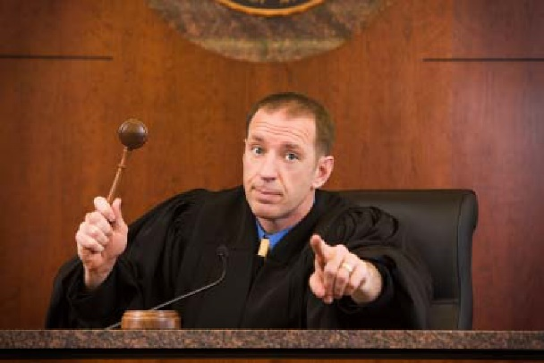
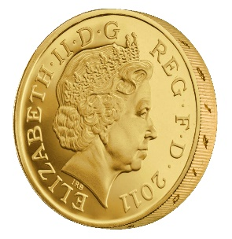
CPA-Security (Multiple Messages)
m_{0,1},m_{1,1}
c₁ = Enc_{K}(m_{b,1})
m_{0,2},m_{1,2}
c₂ = Enc_{K}(m_{b,2})
m_{0,3},m_{1,3}
c₃ = Enc_{K}(m_{b,3})
…
$$∀PPT A ∃μ (negligible) s.t$$
$$Pr\left[{PrivK}_{A,Π }^{cpa}\right]≤\frac{1}{2}+μ(n)$$
b’
Random bit b
$K←Gen\left(1^{n}\right)$

Slide 5
CPA-Security and Message Length
Observation: Given a CPA-secure encryption scheme $Π= \left(Gen,Enc,Dec\right)$ that supports messages of a single bit ($ℳ=\left\{0,1\right\}$) it is easy to build a CPA-secure scheme $Π′= \left(Gen′,Enc′,Dec′\right)$ that supports messages m = m₁,…,m_{n}$∈\left\{0,1\right\}n$ of length n.
$${Enc}_{k}^{′}\left(m\right)=\left\langle {Enc}_{k}^{}\left(m1\right),…,{Enc}_{k}^{}\left(mn\right)\right\rangle$$
Exercise: How would you prove $Π$’ is CPA-secure?

Slide 6
Security Reduction
Step 1: Assume for contraction that we have a PPT attacker A that breaks CPA-Security.
Step 2: Construct a PPT distinguisher D which breaks PRF security.

Slide 7
The Reduction
Random bit b
$$\text{K}←\text{Gen}\left(1^{n}\right)$$
Multiple Message CPA-Game
m₀[0], m₁[0]
m₀, m₁
Enc_{K}(m_{b}[0])
$$c′={Enc′}_{K}\left(m_{b′}\right)$$
$Π$’ Encryption Attacker
…
…
g=b’
b’
$Π$ Encryption Attacker
$${Enc}_{k}^{′}\left(m\right)=\left\langle {Enc}_{k}^{}\left(m1\right),…,{Enc}_{k}^{}\left(mn\right)\right\rangle$$

Slide 8
Week 3: Topic 1: Pseudorandom Functions and CPA-Security

Slide 9
Pseudorandom Function (PRF)
A keyed function $F:{\left\{0,1\right\}}^{ℓ_{key}\left(n\right)}×{\left\{0,1\right\}}^{ℓ_{in}\left(n\right)}→{\left\{0,1\right\}}^{ℓ_{out}\left(n\right)}$, which “looks random” without the secret key k.
$ℓ_{key}\left(n\right)$ - length of secret key k
$ℓ_{in}\left(n\right)$ - length of input
$ℓ_{out}\left(n\right)$ - length of output
Typically, $ℓ_{key}\left(n\right)$=$ℓ_{in}\left(n\right)$=$ℓ_{out}\left(n\right)$ =n (unless otherwise specified)
Computing F_{K}(x) is efficient (polynomial-time)

Slide 10
PRF vs. PRG
Pseudorandom Generator G is not a keyed function
PRG Security Model: Attacker sees only output G(r)
Attacker who sees r can easily distinguish G(r) from random
PRF Security Model: Attacker sees both inputs and outputs (r_{i},F_{k}(r_{i}))
In fact, attacker can select inputs r_{i}
Attacker Goal: distinguish F from a truly random function

Slide 11
Truly Random Function
Let Func_{n} denote the set of all functions ${f:\left\{0,1\right\}}^{n}→{\left\{0,1\right\}}^{n}$.
Question: How big is the set Func_{n}?
Hint: Consider the lookup table.
2^{n} entries in lookup table
n bits per entry
n2^{n} bits to encode f$∈$Func_{n}
Answer: $\left|\text{Func}\text{n} \right|=2^{n2^{n}}$ (by comparison only 2^{n} n-bit keys)

Slide 12
Truly Random Function
Let Func_{n} denote the set of all functions ${f:\left\{0,1\right\}}^{n}→{\left\{0,1\right\}}^{n}$.
Can view entries in lookup table as populated in advance (uniformly)
Space: n2^{n} bits to encode f$∈$Func_{n}
Alternatively, can view entries as populated uniformly “on-the-fly”
Space: 2n$×$q(n) bits after q(n) queries
To store past responses

Slide 13
Oracle Notation
We use A^{f(.)} to denote an algorithm A with oracle access to a function f.
A may adaptively query f(.) on multiple different inputs x₁,x₂,… and A receives the answers f(x₁),f(x₂),…
However, A can only use f(.) as a blackbox (no peaking at the source code in the box)

Slide 14
PRF Security
Definition 3.25: A keyed function $F:{\left\{0,1\right\}}^{n}×{\left\{0,1\right\}}^{n}→{\left\{0,1\right\}}^{n}$ is a pseudorandom function if for all PPT distinguishers D there is a negligible function $μ$ s.t.
$$\left|Pr\left[D^{F_{k}(.)}\left(1^{n}\right)\right]−Pr\left[D^{f(.)}\left(1^{n}\right)\right]\right|≤μ\left(n\right)$$
Notes:
the first probability is taken over the uniform choice of ${k∈\left\{0,1\right\}}^{n}$ as well as the randomness of D.
the second probability is taken over uniform choice of f $∈$Func_{n}as well as the randomness of D.
D is not given the secret k in the first probability (otherwise easy to distinguish…how?)

Slide 15
PRF-Security as a Game
m₁
r₁
m₂
r₂
m₃
r₃
…
$$∀PPT A ∃μ (negligible) s.t$$
$$Pr\left[A Guesses b^{′}=b\right]≤\frac{1}{2}+μ(n)$$
b’
Random bit b
$K←Gen\left(1^{n}\right)$
Truly random func R
r_{i} = F_{K}(m_{i}) if b=1
R(m_{i}) o.w

Slide 16
Reminder: CPA-Security (Single Message)
m₀,m₁
c = Enc_{K}(m_{b})
m₂
c₂ = Enc_{K}(m₂)
m₃
c₃ = Enc_{K}(m₃)
…
$$∀PPT A ∃μ (negligible) s.t$$
$$Pr\left[A Guesses b^{′}=b\right]≤\frac{1}{2}+μ(n)$$
b’
Random bit b
$K←Gen\left(1^{n}\right)$

Slide 17
CPA-Secure Encryption
Gen: on input 1^{n} pick uniform ${k∈\left\{0,1\right\}}^{n}$
Enc: Input ${k∈\left\{0,1\right\}}^{n}$ and ${m∈\left\{0,1\right\}}^{n}$
Output $c=\left\langle r,F_{k}\left(r\right)⨁m\right\rangle$ for uniform ${r∈\left\{0,1\right\}}^{n}$
Dec: Input ${k∈\left\{0,1\right\}}^{n}$ and$c=\left\langle r,s\right\rangle$
Output $m=F_{k}\left(r\right)⨁s$
Theorem: If F is a pseudorandom function, then (Gen,Enc,Dec) is a CPA-secure encryption scheme for messages of length n.
How to begin proof?

Slide 18
Breaking CPA-Security (Single Message)
m₀,m₁
$$\left\langle r,F_{k}\left(r\right)⨁m_{b}\right\rangle$$
m₂
$$\left\langle r,F_{k}\left(r\right)⨁m_{2}\right\rangle$$
m₃
$$\left\langle r,F_{k}\left(r\right)⨁m_{3}\right\rangle$$
…
Assumption: $∃$PPT $A, P (non−negligible) s.t$
$$Pr\left[A Guesses b^{′}=b\right]≥\frac{1}{2}+P(n)$$
b’
Random bit b
$$K←Gen\left(1^{n}\right)$$

Slide 19
Security Reduction
Step 1: Assume for contraction that we have a PPT attacker A that breaks CPA-Security.
Step 2: Construct a PPT distinguisher D which breaks PRF security.
Distinguisher D^{O} (oracle O --- either f or F_{k})
Simulate A
Whenever A queries its encryption oracle on a message m
Select random r
Return $c=\left\langle r,O\left(r\right)⨁m\right\rangle$
Whenever A outputs messages m₀,m₁
Select random r and bit b
Return $c=\left\langle r,O\left(r\right)⨁m_{b}\right\rangle$
Whenever A outputs b’
Output 1 if b=b’
Output 0 otherwise
Analysis: Suppose that O = f then
$\text{Pr}\left[{\text{D}}^{F_{k}}=1\right]\text{=} \text{Pr}\left[{PrivK}_{A,Π }^{cpa}=1\right]$
Suppose that O = f then
$$\text{Pr}\left[{\text{D}}^{f}=\text{1}\right]\text{=}\text{Pr}\left[{PrivK}_{A,\tilde{Π} }^{cpa}=1\right]$$
where $\tilde{Π}$ denotes the encryption scheme in which F_{k} is replaced by truly random f.

Slide 20
Security Reduction
Step 1: Assume for contraction that we have a PPT attacker A that breaks CPA-Security.
Step 2: Construct a PPT distinguisher D which breaks PRF security.
Distinguisher D^{O} (oracle O --- either f or F_{k})
Simulate A
Whenever A queries its encryption oracle on a message m
Select random r
Return $c=\left\langle r,O\left(r\right)⨁m\right\rangle$
Whenever A outputs messages m₀,m₁
Select random r and bit b
Return $c=\left\langle r,O\left(r\right)⨁m_{b}\right\rangle$
Whenever A outputs b’
Output 1 if b=b’
Output 0 otherwise
Analysis: Suppose that O = F_{k} then by PRF security, for some negligible function $μ,$ we have
$$\left|\text{Pr}\left[{PrivK}_{A,Π }^{cpa}=1\right]−\text{Pr}\left[{PrivK}_{A,\tilde{Π} }^{cpa}=1\right]\right|=\left|\text{Pr}\text{[}{\text{D}}^{F_{k}}=1\text{]}−\text{Pr}\text{[}{\text{D}}^{f}=1\text{]}\right|≤μ(n)$$
Implies: $\text{Pr}\left[{PrivK}_{A,\tilde{Π} }^{cpa}=1\right]≥\text{Pr}\left[{PrivK}_{A,Π }^{cpa}=1\right]$-$μ(n)$

Slide 21
Security Reduction
Fact: $\text{Pr}\left[{PrivK}_{A,\tilde{Π} }^{cpa}=1\right]≥\text{Pr}\left[{PrivK}_{A,Π }^{cpa}=1\right]$-$μ(n)$
Claim: For any attacker A making at most q(n) queries we have
$$\text{Pr}\left[{PrivK}_{A,\tilde{Π} }^{cpa}=1\right]≤\frac{1}{2}+\frac{q(n)}{2^{n}}$$
Conclusion: For any attacker A making at most q(n) queries we have
$$\text{Pr}\left[{PrivK}_{A,Π }^{cpa}=1\right]≤\frac{1}{2}+\frac{q\left(n\right)}{2^{n}}+μ\left(n\right)$$
where $\frac{q\left(n\right)}{2^{n}}+μ\left(n\right)$ is negligible.

Slide 22
Finishing Up
Claim: For any attacker A making at most q(n) queries we have
$$\text{Pr}\left[{PrivK}_{A,\tilde{Π} }^{cpa}=1\right]≤\frac{1}{2}+\frac{q(n)}{2^{n}}$$
Proof: Let m₀,m₁ denote the challenge messages and let r* denote the random string used to produce the challenge ciphertext
$$c=\left\langle r^{∗},f\left(r^{∗}\right)⨁m_{b}\right\rangle$$
And let $r_{1}\text{,…,}r_{q}$ denote the random strings used to produce the other ciphertexts $ci=\left\langle r_{i},f\left(r_{i}\right)⨁m_{i}\right\rangle$.
If $r^{∗}≠r_{1}\text{,…,}r_{q}$then then c leaks no information about b (information theoretically).

Slide 23
Finishing Up
Claim: For any attacker A making at most q(n) queries we have
$$\text{Pr}\left[{PrivK}_{A,\tilde{Π} }^{cpa}=1\right]≤\frac{1}{2}+\frac{q(n)}{2^{n}}$$
Proof: If $r^{∗}≠r_{1}\text{,…,}r_{q}$ then then c leaks no information about b (information theoretically). We have
$$\text{Pr}\left[{PrivK}_{A,\tilde{Π} }^{cpa}=1\right]≤\text{Pr}\left[{PrivK}_{A,\tilde{Π} }^{cpa}=1\left|r^{∗}≠r_{1}\text{,…,}r_{q}\right.\right]+\text{Pr}\left[\text{r}\text{∗}∈\left\{r_{1}\text{,…,}r_{q}\right\} \right]$$
$$≤\frac{1}{2}+\frac{q(n)}{2^{n}}$$

Slide 24
Conclusion
$$\text{Enc}\text{k}\text{(}\text{m}\text{)}=\left\langle r,F_{k}\left(r\right)⨁m\right\rangle$$
$$\text{Dec}\text{k}\text{(}\left\langle r,s\right\rangle \text{)}=F_{k}\left(r\right)⨁s$$
For any attacker A making at most q(n) queries we have
$$\text{Pr}\left[{PrivK}_{A,Π }^{cpa}=1\right]≤\frac{1}{2}+\frac{q\left(n\right)}{2^{n}}+μ\left(n\right)$$
PRF Security

Slide 25
Are PRFs or PRGs more Powerful?
Easy to construct a secure PRG from a PRF
G(s) = F_{s}(1)|…|F_{s}($ℓ$)
Construct a PRF from a PRG?
Tricky, but possible… (Katz and Lindell Section 7.5)

Slide 26
Construct PRF from PRG
Define: G(s)= G₀(s)| G₁(s)
PRF: $F_{k}\left(x\right)=G_{x_{1}}\left({…G}_{x_{n−1}}\left(G_{x_{n}}\left(k\right)\right)\right)$
Recursive Definition: $F_{k}\left(x\right)=\text{H}\text{k}\text{(}\text{x}\text{)}$ where
H_{k}(1)$:=$ G₁(k)
H_{k}(0)$:=$ G₀(k)
H_{k}(1|x)$:=$G₁(H_{k}(x))
H_{k}(0|x)$:=$ G₀(H_{k}(x))
Theorem: If G is a PRG then F_{k} is a PRF

Slide 27
Candidate PRG
Notation: Given string $x∈{\left\{0,1\right\}}^{n}$ and a subset $S⊂\left\{1,…,n\right\}$ let x_{S} $∈{\left\{0,1\right\}}^{|S|}$ denote the substring formed by concatenating bits at the positions in S.
Example: x=10110 and S = {1,4,5} x_{S}=110
$$P\left(x1,x2,x3,x4,x5\right)=x1+x2+x3+x4x5 mod{2}$$
Select random subsets $𝕊=$S₁,…,$S_{ℓ\left(n\right)}⊂\left\{1,…,n\right\}$ of size |S_{i}|=5 and with $ℓ\left(n\right)=n^{1.4}$
$$G𝕊\left(x\right)=\left.P\left(x_{S_{1}}\right)\right|…\left|P\left(x_{S_{ℓ\left(n\right)}}\right)\right.$$

Slide 28
Stream Cipher vs PRG
PRG pseudorandom bits output all at once
Stream Cipher
Pseudorandom bits can be output as a stream
RC4, RC5 (Ron’s Code)
st₀ := Init(s)
For i=1 to $ℓ$:
(y_{i},st_{i}):=GetBits(st_{i-1})
Output: y₁,…,y$ℓ$

Slide 29
The RC4 Stream Cipher
A proprietary cipher owned by RSA, designed by Ron Rivest in 1987.
Became public in 1994.
Simple and effective design.
Variable key size (typical 40 to 256 bits),
Output unbounded number of bytes.
Widely used (web SSL/TLS, wireless WEP).
Extensively studied, not a completely secure PRNG, when used correctly, no known attacks exist
Newer Versions: RC5 and RC6
Rijndael selected by NIST as AES in 2000

Slide 30
The RC4 Cipher
The cipher internal state consists of
a 256-byte array S, which contains a permutation of 0 to 255
total number of possible states is 256! ≈ 2¹⁷⁰⁰
two indexes: i, j
i = j = 0
Loop
i = (i + 1) (mod 256)
j = (j + S[i]) (mod 256)
swap(S[i], S[j])
output S[S[i] + S[j]] (mod 256)
End Loop

Slide 31
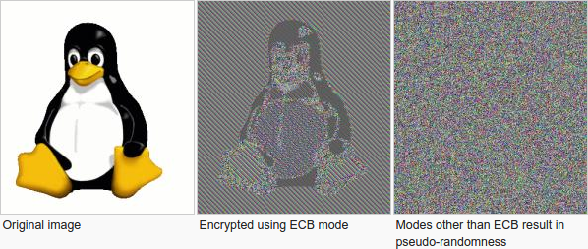
Week 3: Topic 2: Modes of Encryption, The Penguin and CCA security

Slide 32
Pseudorandom Permutation
A keyed function $F:{\left\{0,1\right\}}^{n}×{\left\{0,1\right\}}^{n}→{\left\{0,1\right\}}^{n}$, which is invertible and “looks random” without the secret key k.
Similar to a PRF, but
Computing F_{k}(x) and $F_{k}^{−1}\left(x\right)$ is efficient (polynomial-time)
Definition 3.28: A keyed function $F:{\left\{0,1\right\}}^{n}×{\left\{0,1\right\}}^{n}→{\left\{0,1\right\}}^{n}$ is a strong pseudorandom permutation if for all PPT distinguishers D there is a negligible function $μ$ s.t.
$$\left|Pr\left[D^{F_{k}\left(.\right),F_{k}^{−1}\left(.\right)}\left(1^{n}\right)\right]−Pr\left[D^{f\left(.\right),f^{−1}\left(.\right)}\left(1^{n}\right)\right]\right|≤μ\left(n\right)$$

Slide 33
Pseudorandom Permutation
Definition 3.28: A keyed function $F:{\left\{0,1\right\}}^{n}×{\left\{0,1\right\}}^{n}→{\left\{0,1\right\}}^{n}$ is a strong pseudorandom permutation if for all PPT distinguishers D there is a negligible function $μ$ s.t.
$$\left|Pr\left[D^{F_{k}\left(.\right),F_{k}^{−1}\left(.\right)}\left(1^{n}\right)\right]−Pr\left[D^{f\left(.\right),f^{−1}\left(.\right)}\left(1^{n}\right)\right]\right|≤μ\left(n\right)$$
Notes:
the first probability is taken over the uniform choice of ${k∈\left\{0,1\right\}}^{n}$ as well as the randomness of D.
the second probability is taken over uniform choice of f $∈$Perm_{n}as well as the randomness of D.
D is never given the secret k
However, D is given oracle access to (keyed) permutation and inverse

Slide 34
Electronic Code Book (ECB) Mode
Uses strong PRP F_{k}(x) and $F_{k}^{−1}\left(x\right)$
Enc_{k}
Input: m₁,…,m$ℓ$
Output: $\left\langle \text{F}\text{k}\text{(}\text{m}\text{1}\text{)},…,\text{F}\text{k}\text{(}\text{m}ℓ \text{)}\right\rangle$
How to decrypt?
Is this secure?
Hint: Encryption is deterministic.
Implication: Not CPA-Secure
But, it gets even worse

Slide 35
ECB Mode (A Failed Approach)

Slide 36
The Penguin Principle
If you can still see the penguin after “encrypting” the image something is very very wrong with the encryption scheme.

Slide 37
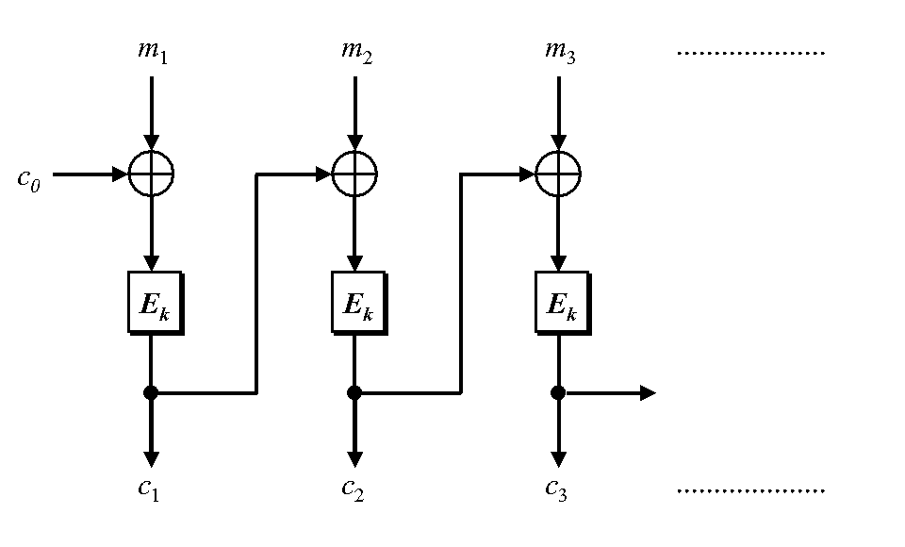
Cipher Block Chaining
CBC-Mode (below) is CPA-secure if E_{k} is a PRP
Reduces bandwidth!
Message: 3n bits
Ciphertext: 4n bits
IV
IV

Slide 38
Chained CBC-Mode
m₄
m₅
m₆
IV
c₃
IV
c₄
c₅
c₆
First glance: seems similar to CBC-Mode and reduces bandwidth
Vulnerable to CPA-Attack! (Set $m4=IV⨁c3⨁m_{1}^{′}$ and c₄=c₁ iff m₁=m₁’)
Moral: Be careful when tweaking encryption scheme!

Slide 39
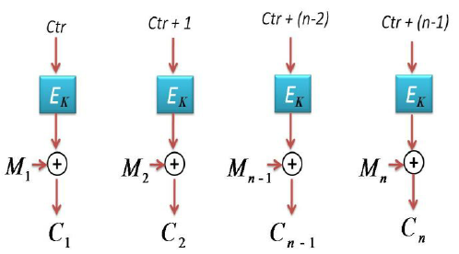
Counter Mode
Input: m₁,…,m_{n}
Output: c = (ctr, c₁,c₂,…,c_{n}) where ctr is chosen uniformly at random
Theorem: If E_{k} is PRF then counter mode is CPA-Secure
Advantages: Parallelizable encryption/decryption

Slide 40
Recap
Pseudorandom Functions
CPA-Security
Today’s Goals:
Evaluate several modes of operation for stream-ciphers + block-ciphers
Introduce Chosen Ciphertext Attacks/CCA-Security
Construct encryption scheme with CCA-Security

Slide 41
Week 3: Topic 3: CCA-Security

Slide 42
Chosen Ciphertext Attacks
Sometimes an attacker has ability to obtain (partial) decryptions of ciphertexts of its choice.
CPA-Security does not model this ability.
Examples:
An attacker may learn that a ciphertext corresponds to an ill-formed plaintext based on the reaction (e.g., server replies with “invalid message”).
Monitor enemy behavior after receiving and encrypted message.
Authentication Protocol: Send Enc_{k}(r) to recipient who authenticates by responding with r.

Slide 43
CCA-Security (Ind-CCA2)
We could set m₀ = m₋₁ or m₁ = m₋₂
m₋₁
c₋₁ = Enc_{K}(m₋₁)
c₋₂
…
m₋₂ = Dec_{K}(c₋₂)
m₀,m₁
However, we could still flip 1 bit of c and ask challenger to decrypt
c = Enc_{K}(m_{b})
m₃
c₂ = Enc_{K}(m₂)
Random bit b
K = Gen(.)
c₃
m₃ = Dec_{K}(m₃)
c₄ =c
…
“No Way!”
b’

Slide 44
CCA-Security $\left({PrivK}_{A,Π}^{cca}\left(n\right)\right)$
Challenger generates a secret key k and a bit b
Adversary (A) is given oracle access to Enc_{k} and Dec_{k}
Adversary outputs m₀,m₁
Challenger sends the adversary c=Enc_{k}(m_{b}).
Adversary maintains oracle access to Enc_{k} and Dec_{k} ,however the adversary is not allowed to query Dec_{k}(c).
Eventually, Adversary outputs b’.
$${PrivK}_{A,Π}^{cca}\left(n\right)=1 if b=b^{′};otherwise 0.$$
CCA-Security: For all PPT A exists a negligible function negl(n) s.t.
$$Pr\left[{PrivK}_{A,Π}^{cca}\left(n\right)=1\right]≤\frac{1}{2}+negl(n)$$

Slide 45
CCA-Security
Definition 3.33: An encryption scheme $Π$ is CCA-secure if for all PPT A there is a negligible function negl(n) such that
$$Pr\left[{PrivK}_{A,Π}^{cca}\left(n\right)=1\right]≤\frac{1}{2}+negl(n)$$

Slide 46
CPA-Security doesn’t imply CCA-Security
$$\text{Enc}\text{k}\text{(}\text{m}\text{)}=\left\langle r,F_{k}\left(r\right)⨁m\right\rangle$$
Attacker: Selects m₀ = 0^{n} and m₁ = 1^{n}
Attacker Receives: $c=\left\langle r, s\right\rangle$ ${\text{where} s=F}_{k}\left(r\right)⨁m_{b}$
Attacker Queries: Dec_{k}(c’) for
$$c′=\left\langle r,s⨁{10}^{n−1}\right\rangle$$
Attacker Receives: ${10}^{n−1}$ (if b=0) or ${01}^{n−1}$ (if b=1)
Example Shows: CPA-Security doesn’t imply CCA Security (Why?)

Slide 47
Attacks in the Wild
Padding Oracle Attack
Length of plaintext message must be multiple of block length
Popular fix PKCS #5 padding
4 bytes of padding (0x04040404)
3 bytes of padding (0x030303)
“Bad Padding Error”
Adversary submits ciphertext(s) and waits to if this error is produced
Attacker can repeatedly modify ciphertext to reveal original plaintext piece by piece!

Slide 48
Example
M=“hello…please keep this message secret”+0x030303
$$C=\left\langle r,s=F_{k}\left(r\right)⨁m\right\rangle$$
$C^{′}=\left\langle r,F_{k}\left(r\right)⨁m⨁\text{0}\text{x}\text{0000}….\text{30}\text{000} \right\rangle$
Ask to decrypt C’
If we added < 3 bits of padding C’ can be decrypted.
Otherwise, we will get a decryption error.
Once we know we have three bits of padding we can set
$$C^{′′}=\left\langle r,s=F_{k}\left(r\right)⨁\text{0}\text{x}\text{0000}….\text{30}\text{3}\text{0}\text{3}⨁\text{0}\text{x}\text{0}…gg0\text{4}\text{0}\text{4}\text{0}\text{4}\right\rangle$$
If C’’ decrypts then we can infer the last byte “t” from $gg⨁0x04$.

Slide 49
CCA-Security
Gold Standard: CCA-Security is strictly stronger than CPA-Security
If a scheme has indistinguishable encryptions under one chosen-ciphertext attack then it has indistinguishable multiple encryptions under chosen-ciphertext attacks.
None of the encryption schemes we have considered so far are CCA-Secure ☹
CCA-Security implies non-malleability (message integrity)
An attacker who modifies a ciphertext c produces c’ which is either
Invalid, or
Decrypted message is unrelated to original message

Slide 50
Back to CPA-Security
We will build a CCA-Secure Encryption scheme later in the course
We will need to introduce additional tools (Message Authentication Codes)
Remaining Lecture: Modes of Operation for Stream-Ciphers and Block-Ciphers

Slide 51
CPA-Secure Encryption
$$\text{Enc}\text{k}\text{(}\text{m}\text{)}=\left\langle r,F_{k}\left(r\right)⨁m\right\rangle$$
$$\text{Dec}\text{k}\text{(}\left\langle r,s\right\rangle \text{)}=F_{k}\left(r\right)⨁s$$
Drawbacks:
Encryption is for fixed length messages only
Length of ciphertext is twice as long as message
Attacker can still tamper with ciphertexts to flip bits of plaintext
Stream Ciphers/Block Ciphers
CCA Security

Slide 52
Stream Ciphers Modes
What if we don’t know the length of the message to be encrypted a priori?
Stream Cipher: $G_{∞}\left(s,1^{n}\right)$ outputs n pseudorandom bits as follows
Initial State: st₀ = Initialize(s)
Repeat
(y_{i},st_{i})=GetBits(st_{i-1})
Output y_{i}
Synchronized Mode
Message sequence: m₁,m₂,…
Ciphertext sequence: c_{i} = m_{i} $⨁$y_{i} (same length as ciphertext!)
“CPA-like” security follows from cipher security (must stop after n-bits)
Deterministic encryption, what gives???
Requires both parties to maintain state (not good for sporadic communication)

Slide 53
Stream Ciphers Modes
What if we don’t want to keep state?
Unsynchronized Mode
Message sequence: m₁,m₂,…
Ciphertext sequence: $ci=\left\langle \text{IV}\text{, }m_{i}⨁ G_{∞}\left(s,IV,1^{\left|m_{i}\right|}\right)\right\rangle$
CPA-Secure if F_{k}(IV) $=G_{∞}\left(k,IV,1^{n}\right)$ is a (weak) PRF.
No shared state, but longer ciphertexts….

Slide 54
CPA-Secure Encryption: Drawbacks
$$\text{Enc}\text{k}\text{(}\text{m}\text{)}=\left\langle r,F_{k}\left(r\right)⨁m\right\rangle$$
Ciphertext is twice as long as the message |c|=2|m|
Is this always necessary?
What if we know we are going to transmit several messages m₁,m₂,…

Slide 55
Next Class
Read Katz and Lindell 4.1-4.2
Message Authentication Codes (MACs) Part 1

Slide 56
Week 3: Topic 4: Message Authentication Codes (Part 1)

Slide 57
Recap
CPA-Security vs. CCA-Security
PRFs
Today’s Goals:
Introduce Message Authentication Codes (MACs)
Key tool in Construction of CCA-Secure Encryption Schemes
Build Secure MACs

Slide 58
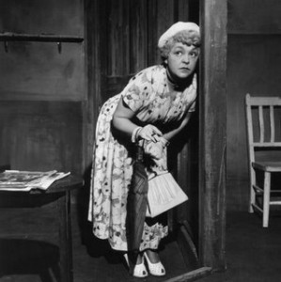
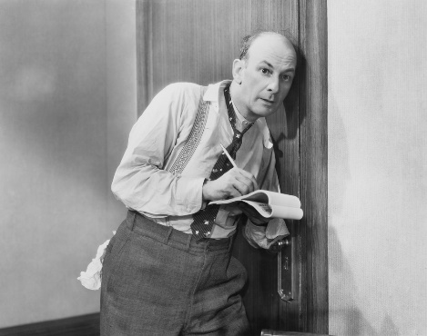
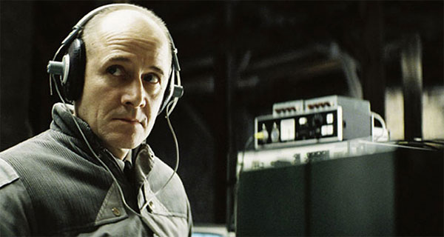
What Does It Mean to “Secure Information”
Confidentiality (Security/Privacy)
Only intended recipient can see the communication

Slide 59
What Does It Mean to “Secure Information”
Confidentiality (Security/Privacy)
Only intended recipient can see the communication
Integrity (Authenticity)
The message was actually sent by the alleged sender
I love you Alice… - Bob
We need to break up -Bob
Alice
Bob

Slide 60
Message Authentication Codes
CPA-Secure Encryption: Focus on Secrecy
But does not promise integrity
Message Authentication Codes: Focus on Integrity
But does not promise secrecy
CCA-Secure Encryption: Requires Integrity and Secrecy

Slide 61
What Does It Mean to “Secure Information”
Integrity (Authenticity)
The message was actually sent by the alleged sender
And the received message matches the original
Pay robot devil $50
Pay robot devil $5,000
Alice
Bob
Notes:
Example: HTTP is stateless. Cookies can be stored on the client, but can the server trust the client not to modify the cookie?

Slide 62
Error Correcting Codes?
Tool to detect/correct a small number of random errors in transmission
Examples: Parity Check, Reed-Solomon Codes, LDPC, Hamming Codes …
Provides no protection against a malicious adversary who can introduce an arbitrary number of errors
Still useful when implementing crypto in the real world (Why?)

Slide 63
Modifying Ciphertexts
$$\text{Enc}\text{k}\text{(}\text{m}\text{)}=c=\left\langle r,F_{k}\left(r\right)⨁m\right\rangle$$
$$c^{′}=\left\langle r,F_{k}\left(r\right)⨁m⨁y\right\rangle$$
$$\text{Dec}\text{k} {(c}^{′})=F_{k}\left(r\right)⨁F_{k}\left(r\right)⨁m⨁y=m⨁y$$
If attacker knows original message he can forge c’ to decrypt to any message he wants.
Even if attacker doesn’t know message he may find it advantageous to flip certain bits (e.g., decimal places)

Slide 64
Message Authentication Code Syntax
Definition 4.1: A message authentication code (MAC) consists of three algorithms
$\operatorname{Gen}{(1^{n};R)}$ (Key-generation algorithm)
Input: security parameter 1^{n} (unary) and random bits R
Output: Secret key $k∈𝒦$
$\operatorname{Mack}{(m;R)}$ (Tag Generation algorithm)
Input: Secret key $k∈𝒦$ and message $m∈ℳ$ and random bits R
Output: a tag t
$\operatorname{Vrfyk}{(m,t)}$ (Verification algorithm)
Input: Secret key $k∈𝒦,$ a message m and a tag t
Output: a bit b (b=1 means “valid” and b=0 means “invalid”)
Invariant?

Slide 65
Message Authentication Code Syntax
Definition 4.1: A message authentication code (MAC) consists of three algorithms
$\operatorname{Gen}{(1^{n};R)}$ (Key-generation algorithm)
Input: security parameter 1^{n} (unary) and random bits R
Output: Secret key $k∈𝒦$
$\operatorname{Mack}{(m;R)}$ (Tag Generation algorithm)
Input: Secret key $k∈𝒦$ and message $m∈ℳ$ and random bits R
Output: a tag t
$\operatorname{Vrfyk}{(m,t)}$ (Verification algorithm)
Input: Secret key $k∈𝒦,$ a message m and a tag t
Output: a bit b (b=1 means “valid” and b=0 means “invalid”)
Invariant?

Slide 66
Message Authentication Code Syntax
Definition 4.1: A message authentication code (MAC) consists of three algorithms $Π=\left(Gen, Mac, Vrfy\right)$
$\operatorname{Gen}{(1^{n};R)}$ (Key-generation algorithm)
Input: security parameter 1^{n} (unary) and random bits R
Output: Secret key $k∈𝒦$
$\operatorname{Mack}{(m;R)}$ (Tag Generation algorithm)
Input: Secret key $k∈𝒦$ and message $m∈ℳ$ and random bits R
Output: a tag t
$\operatorname{Vrfyk}{(m,t)}$ (Verification algorithm)
Input: Secret key $k∈𝒦,$ a message m and a tag t
Output: a bit b (b=1 means “valid” and b=0 means “invalid”)
$$\operatorname{Vrfyk}{(m,\operatorname{Mack}{(m;R)})}=1$$

Slide 67
General vs Fixed Length MAC
$$ℳ={\left\{0,1\right\}}^{∗}$$
versus
$$ℳ={\left\{0,1\right\}}^{ℓ(n)}$$

Slide 68
Deterministic MACs
Canonical Verification Algorithm
$$\operatorname{Vrfyk}{(m,t)}=\left\{\begin{aligned}\begin{matrix}1 & if t=Mack(m)\end{matrix} \\ \begin{matrix}0 & otherwise\end{matrix}\end{aligned}\right.{}$$
“All real-world MACs use canonical verification” – page 115

Slide 69
MAC Authentication Game (${Macforge}_{A,Π}(n)$)
m₁
t₁ = Mac_{K}(m₁)
m₂
…
t₂ = Mac_{K} (m₂)
m_{q}
t_{q} = Mac_{K}(m_{q})
$\left(m,t\right)$ s.t $m∉\left\{m1,…,m_{q}\right\}$
$${Macforge}_{A,Π}(n)=Vrfyk{(m,t)}$$
K = Gen(.)
$$∀PPT A ∃μ (negligible) s.t$$
$$Pr\left[{Macforge}_{A,Π}\left(n\right)=1\right]≤μ(n)$$

Slide 70
Discussion
Is the definition too strong?
Attacker wins if he can forge any message
Does not necessarily attacker can forge a “meaningful message”
“Meaningful Message” is context dependent
Conservative Approach: Prove Security against more powerful attacker
Conservative security definition can be applied broadly
Replay Attacks?
t=Mac_{K}(“Pay Bob $1,000 from Alice’s bank account”)
Alice cannot modify message to say $10,000, but…
She may try to replay it 10 times

Slide 71
Replay Attacks
MACs alone do not protect against replay attacks (they are stateless)
Common Defenses:
Include Sequence Numbers in Messages (requires synchronized state)
Can be tricky over a lossy channel
Timestamp Messages
Double check timestamp before taking action

Slide 72
Strong MACs
Previous game ensures attacker cannot generate a valid tag for a new message.
However, attacker may be able to generate a second valid tag t’ for a message m after observing (m,t)
Strong MAC: attacker cannot generate second valid tag, even for a known message

Slide 73
Strong MAC Authentication (${Macsforge}_{A,Π}(n)$)
m₁
t₁ = Mac_{K}(m₁)
m₂
…
t₂ = Mac_{K} (m₂)
m_{q}
t_{q} = Mac_{K}(m_{q})
$\left(m,t\right)$ s.t $\left(m,t\right)∉\left\{(m1,t1),…,(mq,tq)\right\}$
$${Macsforge}_{A,Π}(n)=Vrfyk{(m,t)}$$
K = Gen(.)
$$∀PPT A ∃μ (negligible) s.t$$
$$Pr\left[{Macsforge}_{A,Π}\left(n\right)=1\right]≤μ(n)$$

Slide 74
Strong MAC vs Regular MAC
Proposition 4.4: Let $Π=\left(Gen, Mac, Vrfy\right)$ be a secure MAC that uses canonical verification. Then $Π$ is a strong MAC.
“All real-world MACs use canonical verification” – page 115
Should attacker have access to Vrfy_{K}(.) oracle in games?
(e.g., CPA vs CCA security for encryption)
Irrelevant if the MAC uses canonical verification!

Slide 75
Timing Attacks (Side Channel)
Naïve Canonical Verification Algorithm
Input: m,t’
t=Mac_{K}(m)
for i=1 to tag-length
if t[i] != t’[i] then
return 0
return 1
Example
t= 1 0 1 0 1 1 1 0
t’= 1 0 1 0 1 0 1 1
Returns 0 after 8 steps

Slide 76
Timing Attacks (Side Channel)
Naïve Canonical Verification Algorithm
Input: m,t’
t=Mac_{K}(m)
for i=1 to tag-length
if t[i] != t’[i] then
return 0
return 1
Example
t= 1 0 1 0 1 1 1 0
t’= 0 0 1 0 1 0 1 0
Returns 0 after 1 step

Slide 77
Timing Attack
MACs used to verify code updates for Xbox 360
Implementation allowed different rejection times (side-channel)
Attacks exploited vulnerability to load pirated games onto hardware
Moral: Ensure verification is time-independent

Slide 78
Improved Canonical Verification Algorithm
Input: m,t’
B=1
t=Mac_{K}(m)
for i=1 to tag-length
if t[i] != t’[i] then
B=0
else (dummy op)
return B
Example
t= 1 0 1 0 1 1 1 0
t’= 0 0 1 0 1 0 1 0
Returns 0 after 8 steps

Slide 79
Side-Channel Attacks
Cryptographic Definition
Attacker only observes outputs of oracles (Enc, Dec, Mac) and nothing else
When attacker gains additional information like timing (not captured by model) we call it a side channel attack.
Other Examples
Differential Power Analysis
Cache Timing Attack
Power Monitoring
Acoustic Cryptanalysis
…many others

Slide 80
Next Class
Read Katz and Lindell 4.3
Message Authentication Codes (MACs) Part 2
Constructing Secure MACs

